Slide 1

Radiative sensitivity from isotropic model
→ Isotropic model matches kernel calculations
Satellite observations provide an estimate of Radiative sensitivity
→The model average radiative sensitivity is close to the observational estimate

Slide 2

Simplified (isotropic) shortwave radiation model
Atmospheric
Contribution
To planetary
Albedo
Surface
Contribution
To planetary
Albedo
S = incident
R = cloud
reflection
A = absorption
α = surface
albedo
(UNKNOWNS)

Slide 3



Climatological
planetary albedo
Surface reflection
Surface contribution:
= α(1-A)(1-R)²
(1-αR)
Atmospheric reflection
Radiative Sensitivity
Atmosphere

Slide 4
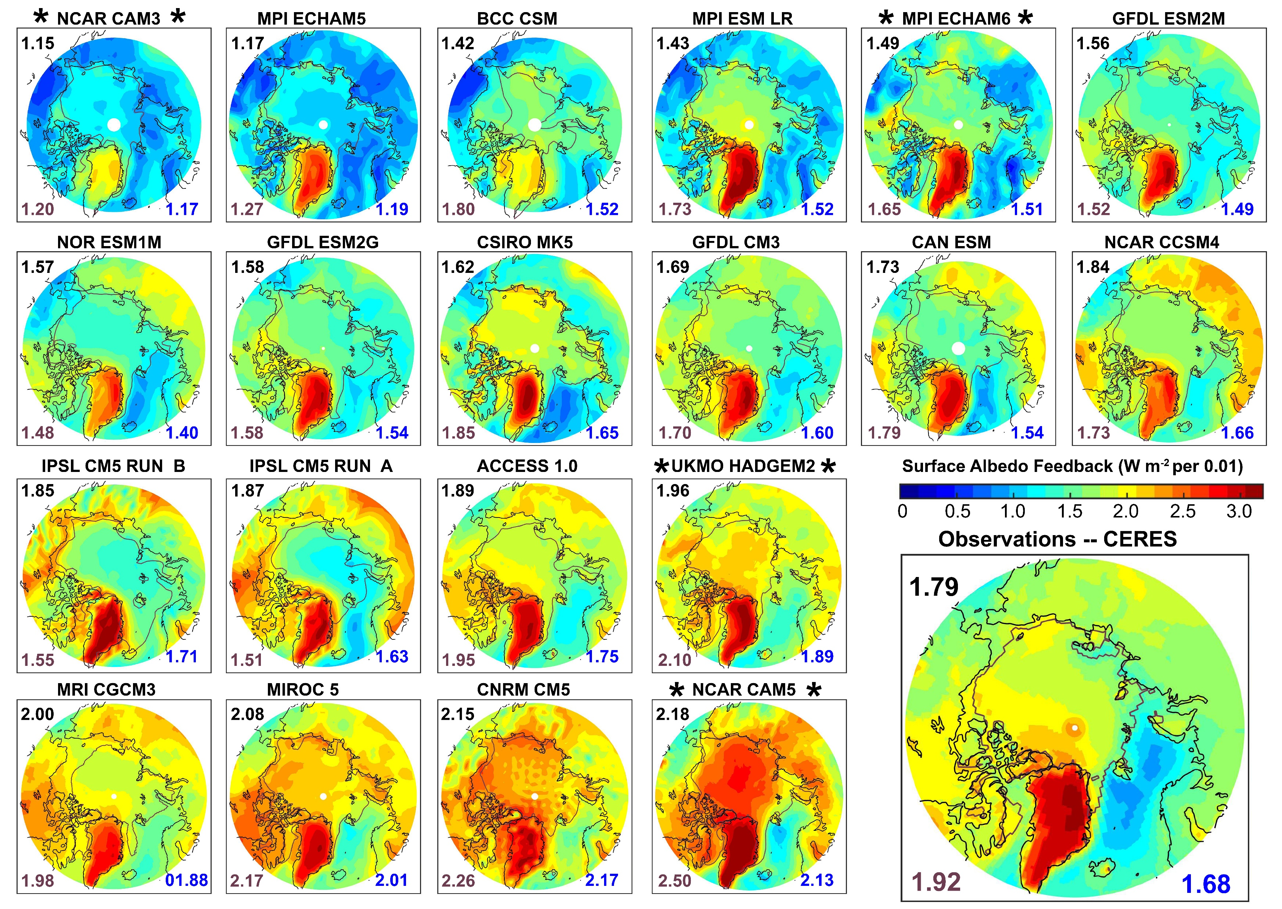

Slide 5
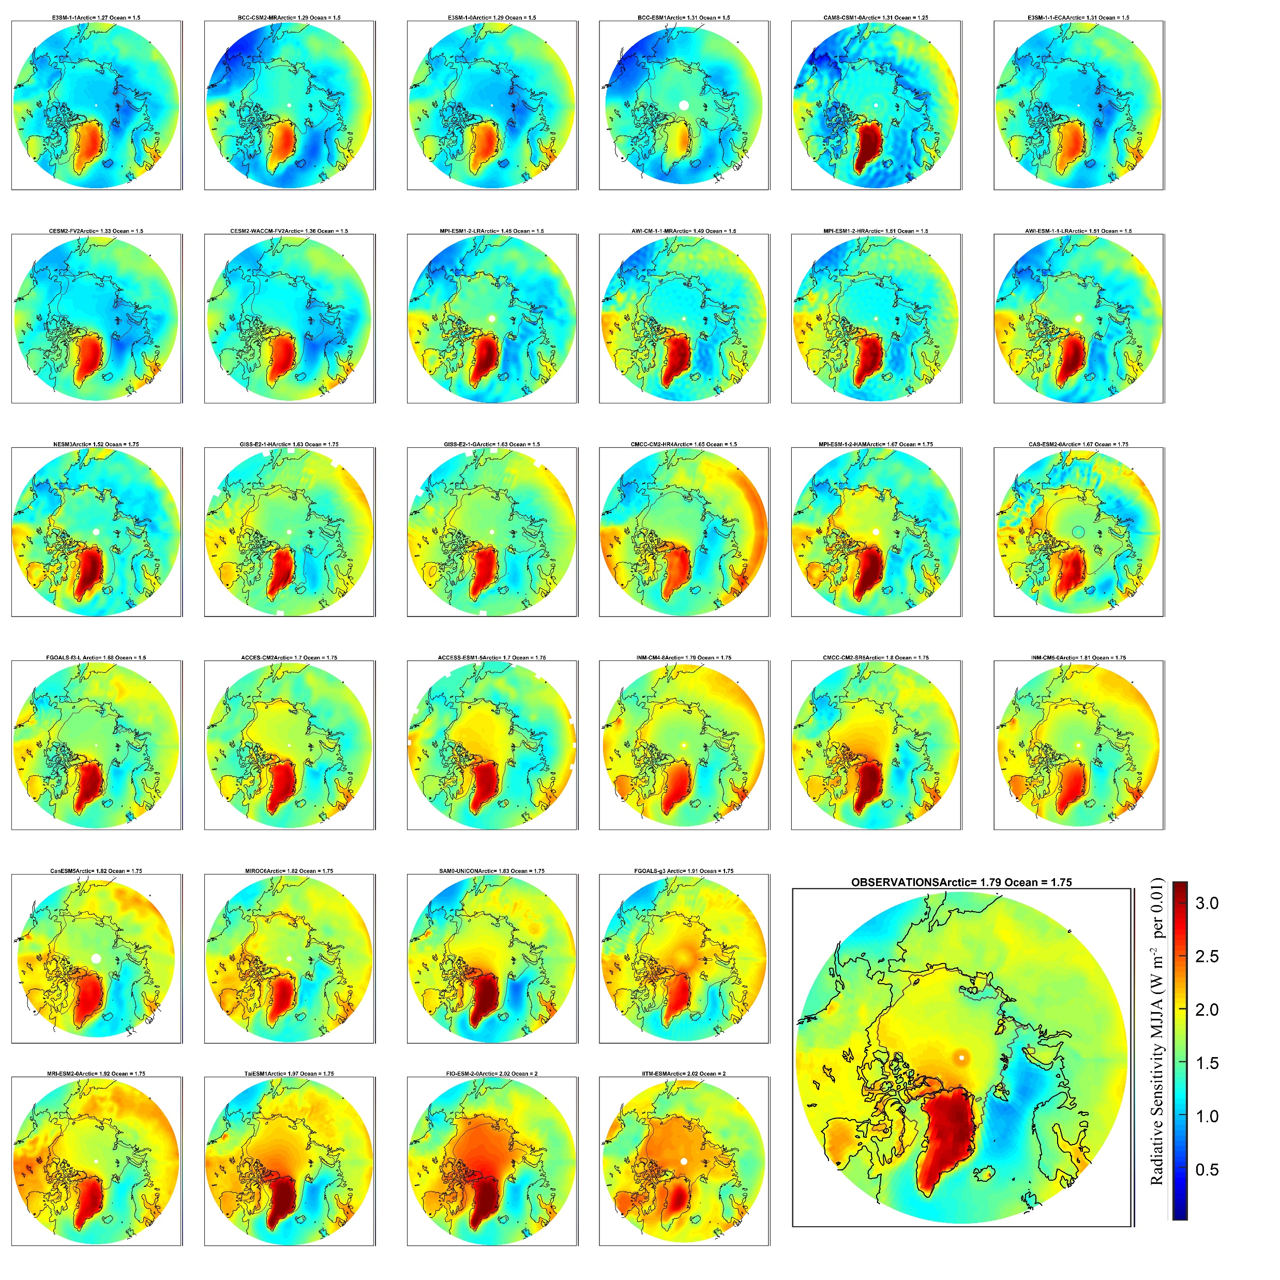
CMIP 6 Radiative
Sensitivity

Slide 6
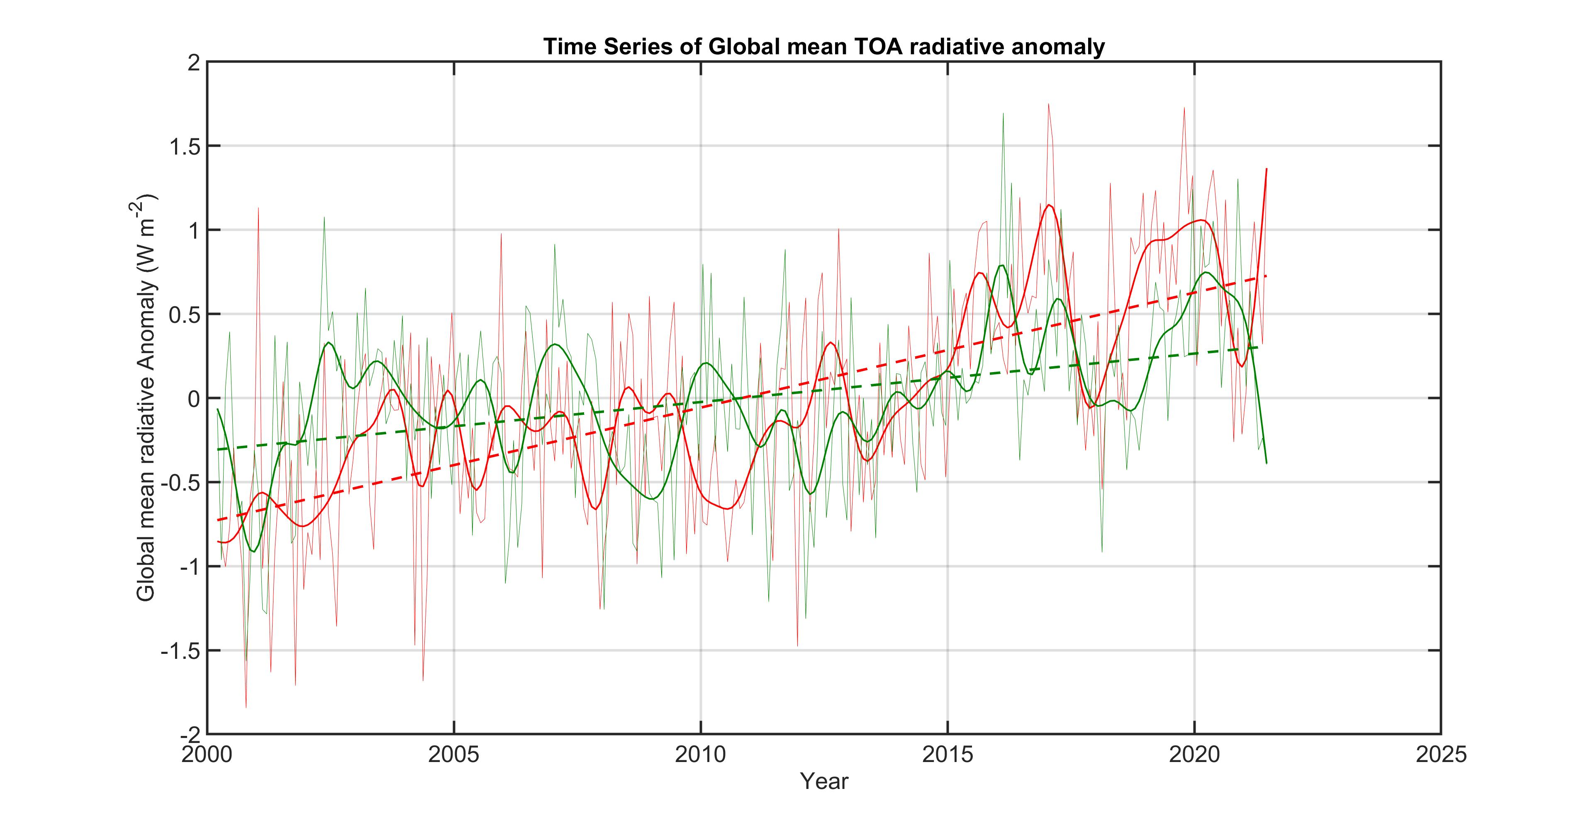
Absorbed Solar
Outgoing longwave

Slide 8
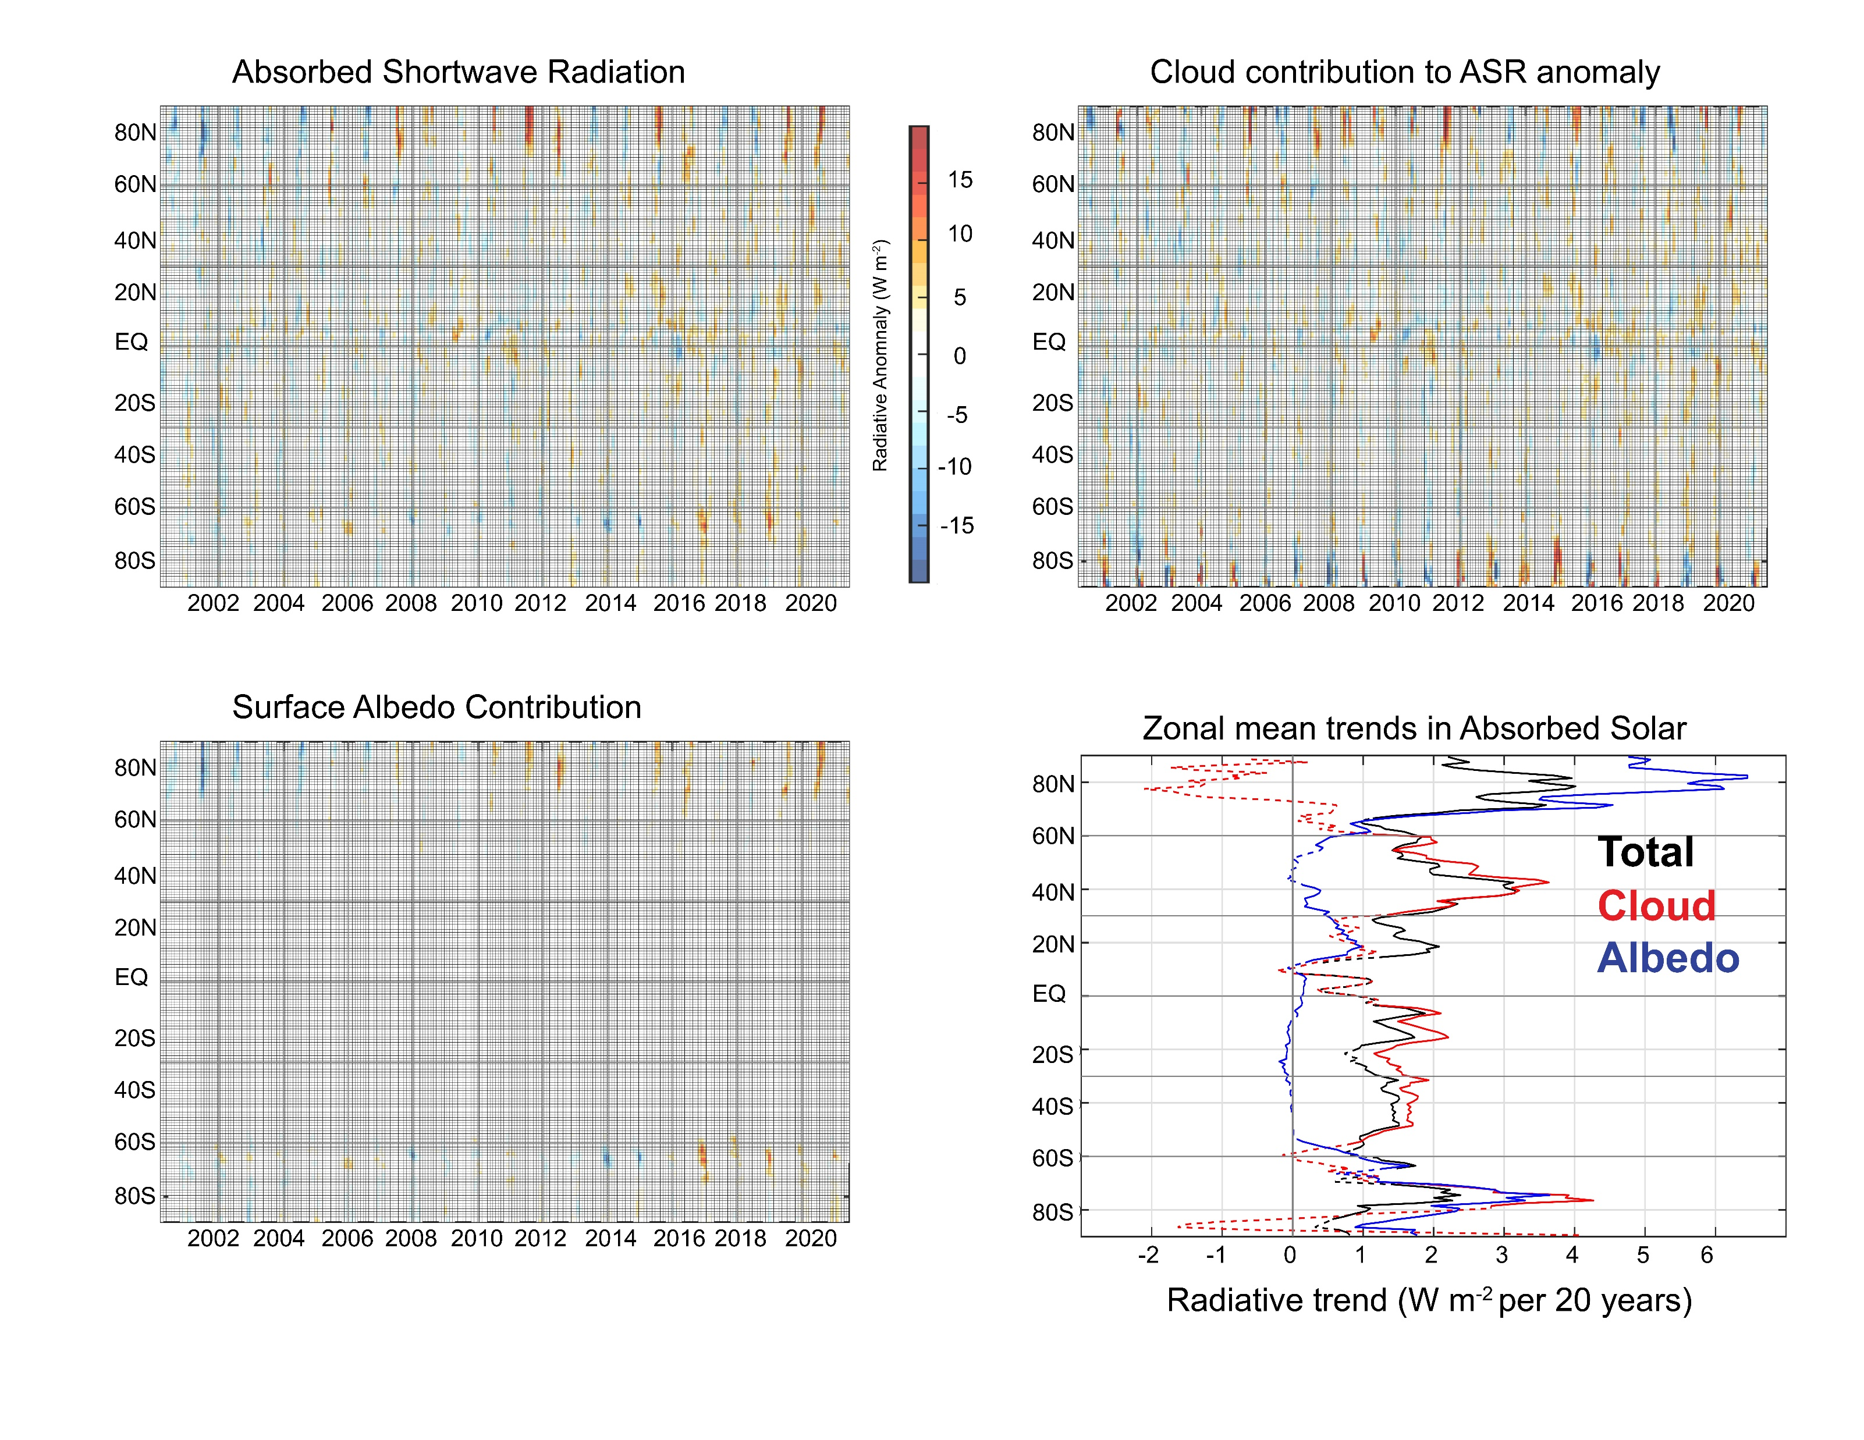

Slide 9
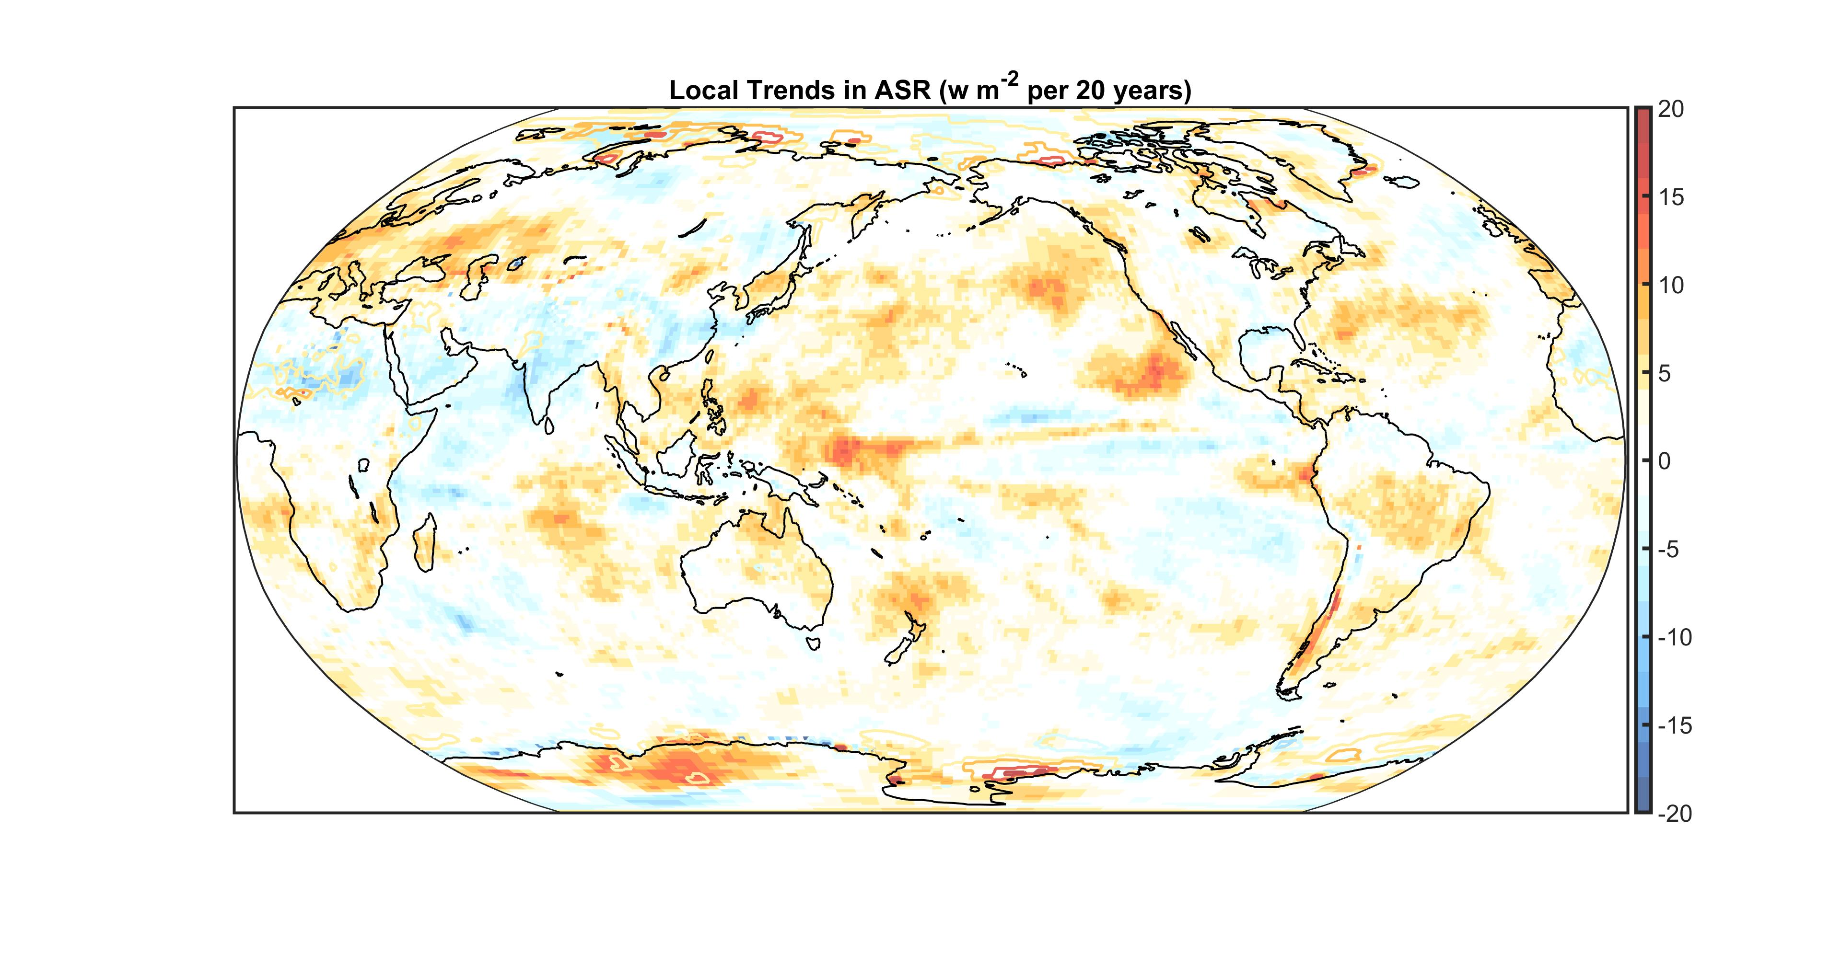
Colors = Cloud contribution
Contours = albedo contribution

Slide 10
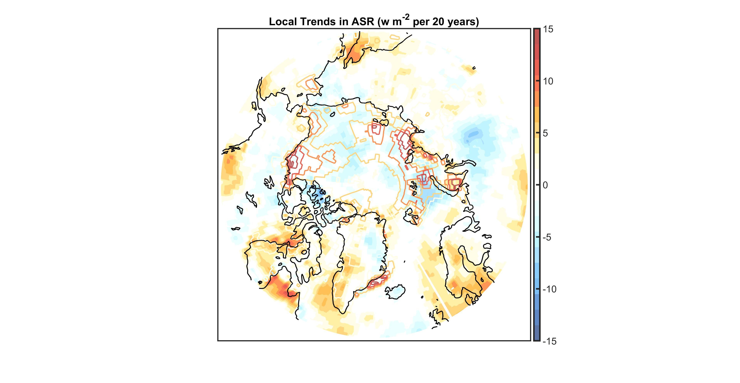
Colors = Cloud contribution
Contours = albedo contribution

Slide 11
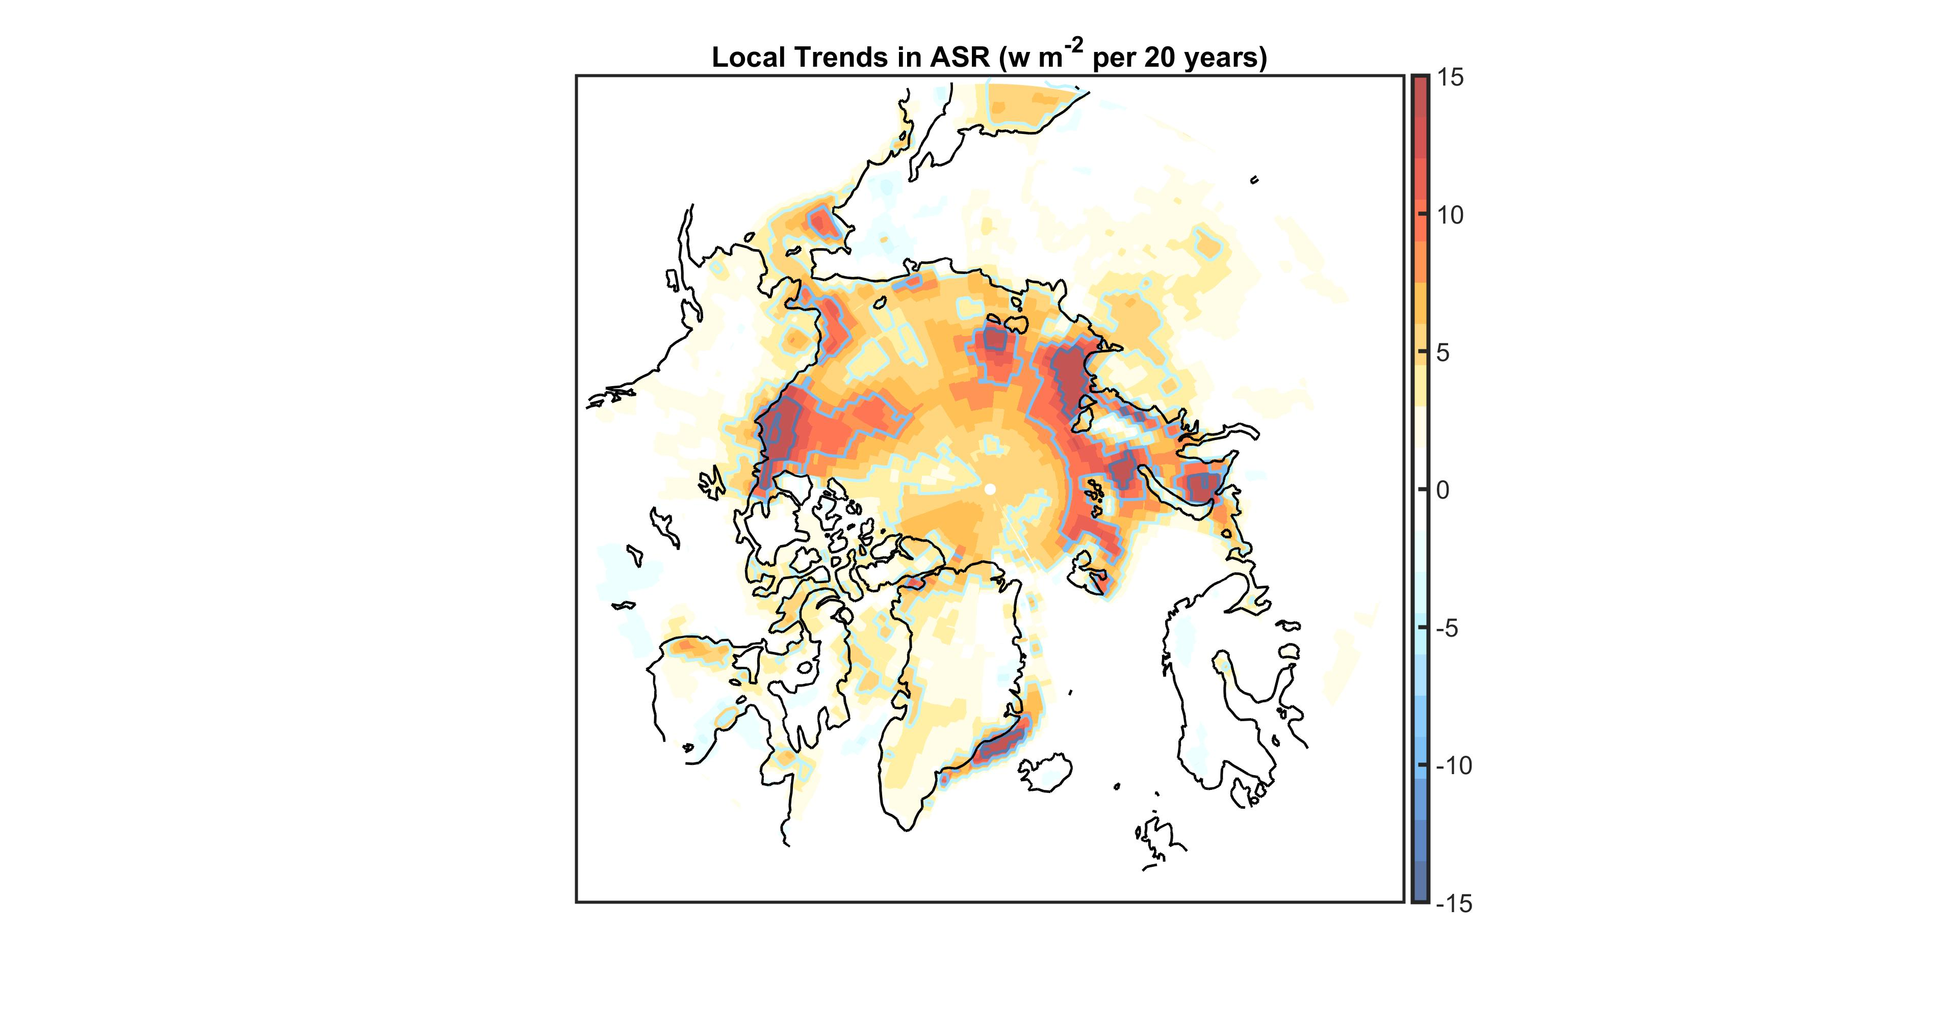
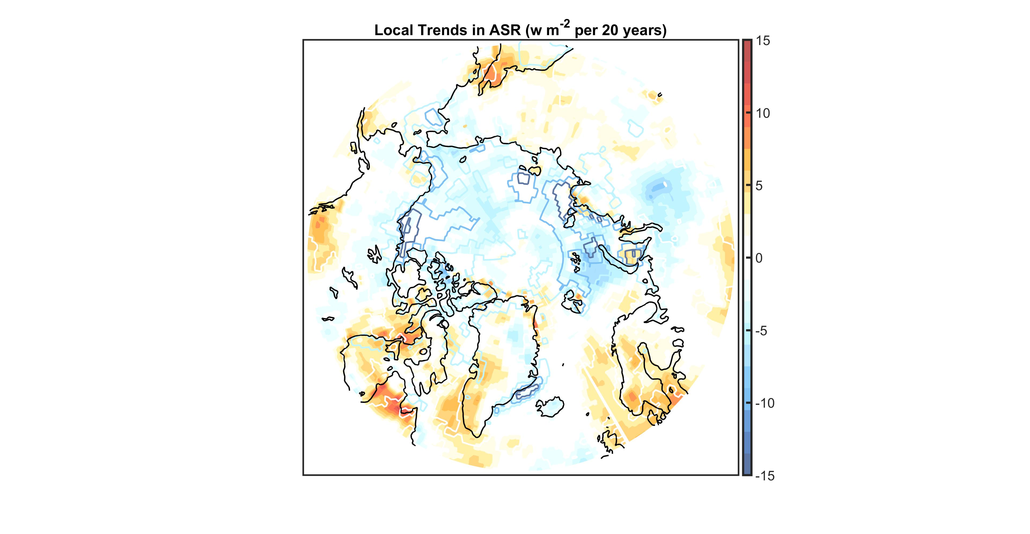
Colors = Albedo Contribution
Contours = surface albedo trend
(0.2 per 20 year interval)
Colors = Cloud Contribution
Contours = surface albedo trend
(0.2 per 20 year interval)

Slide 12
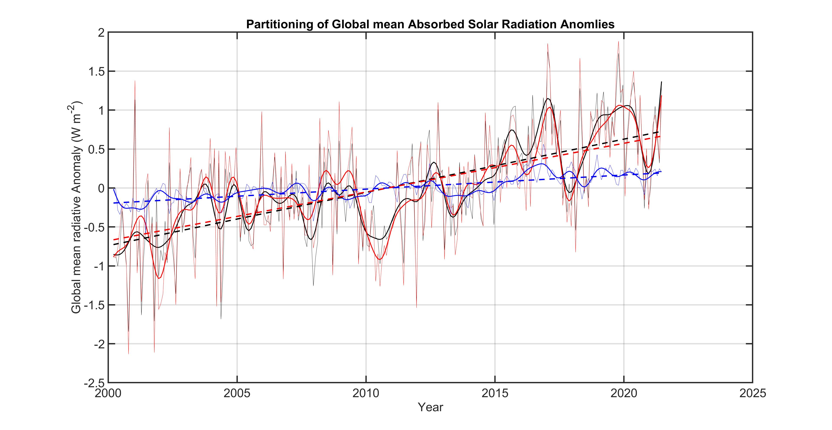
Total ASR = 1.4 W m-2
Cloud Contribution = 1.2 W m-2
Surface Albedo Contribution = 0.4 W m-2

Slide 13
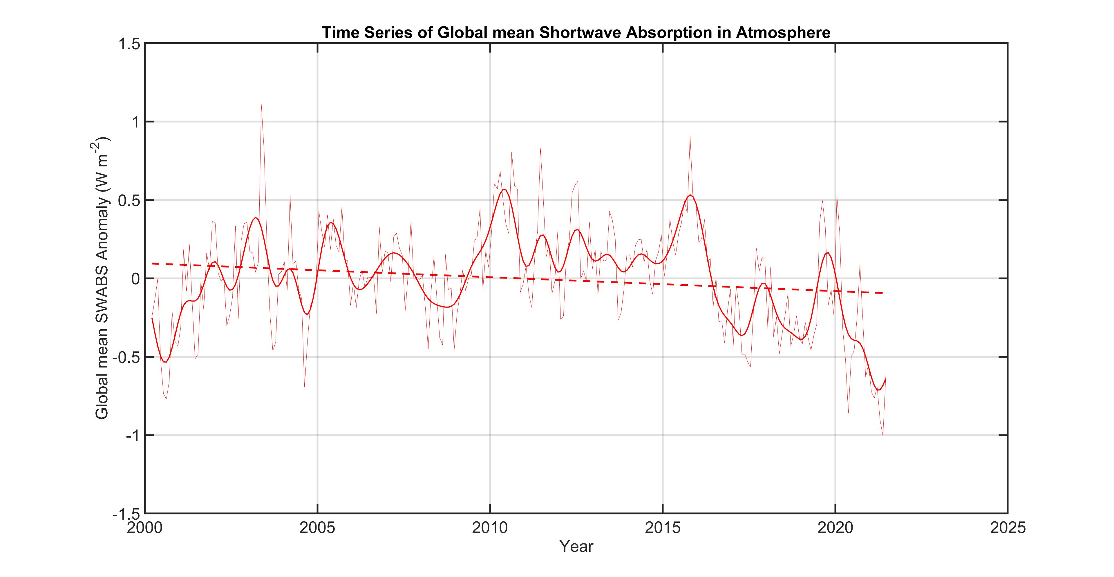

Slide 14
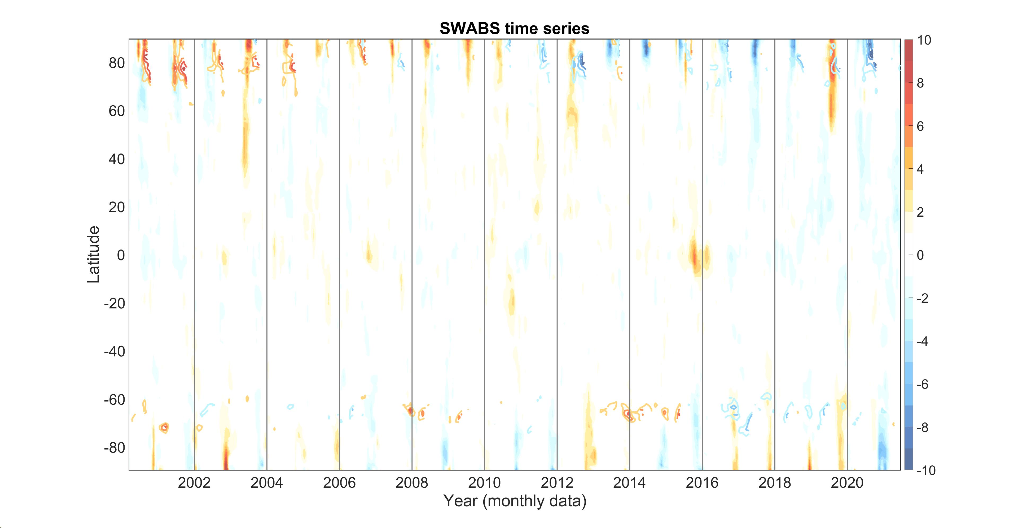
Contours are surface albedo anomalies with interval of 0.04

Slide 16
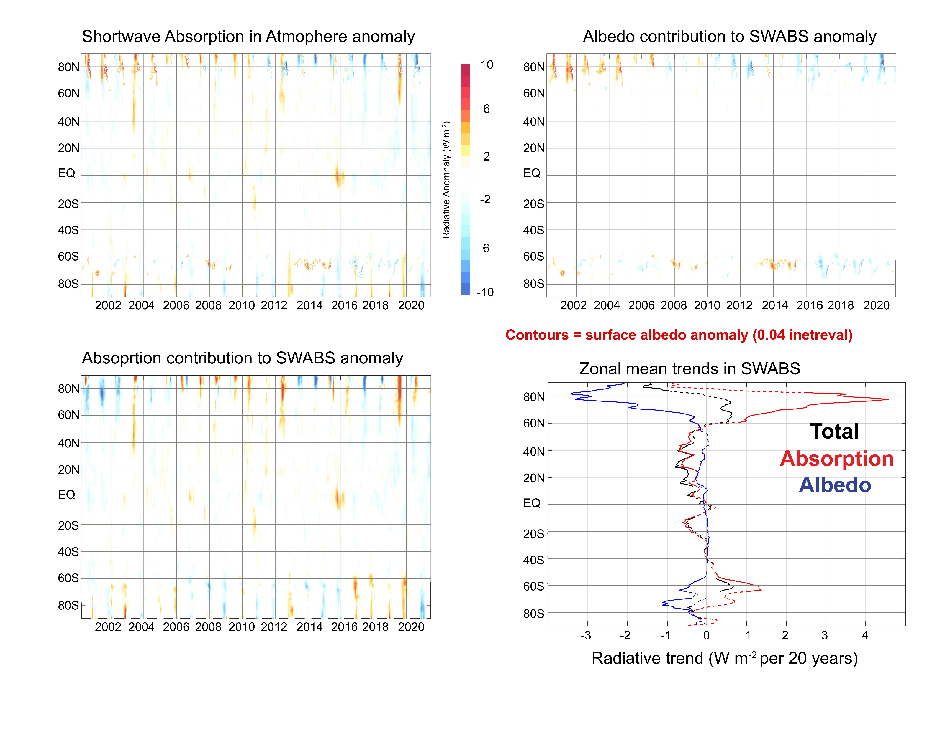

Slide 17
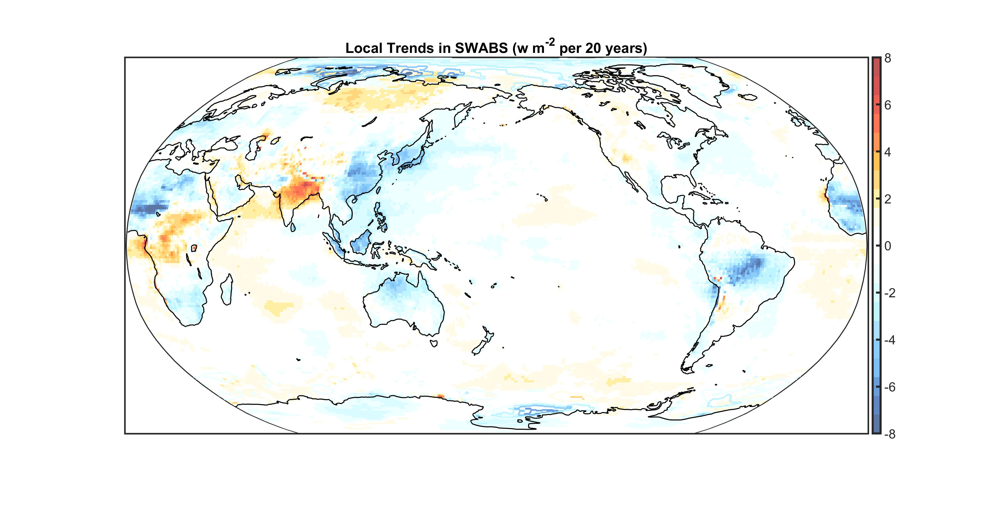
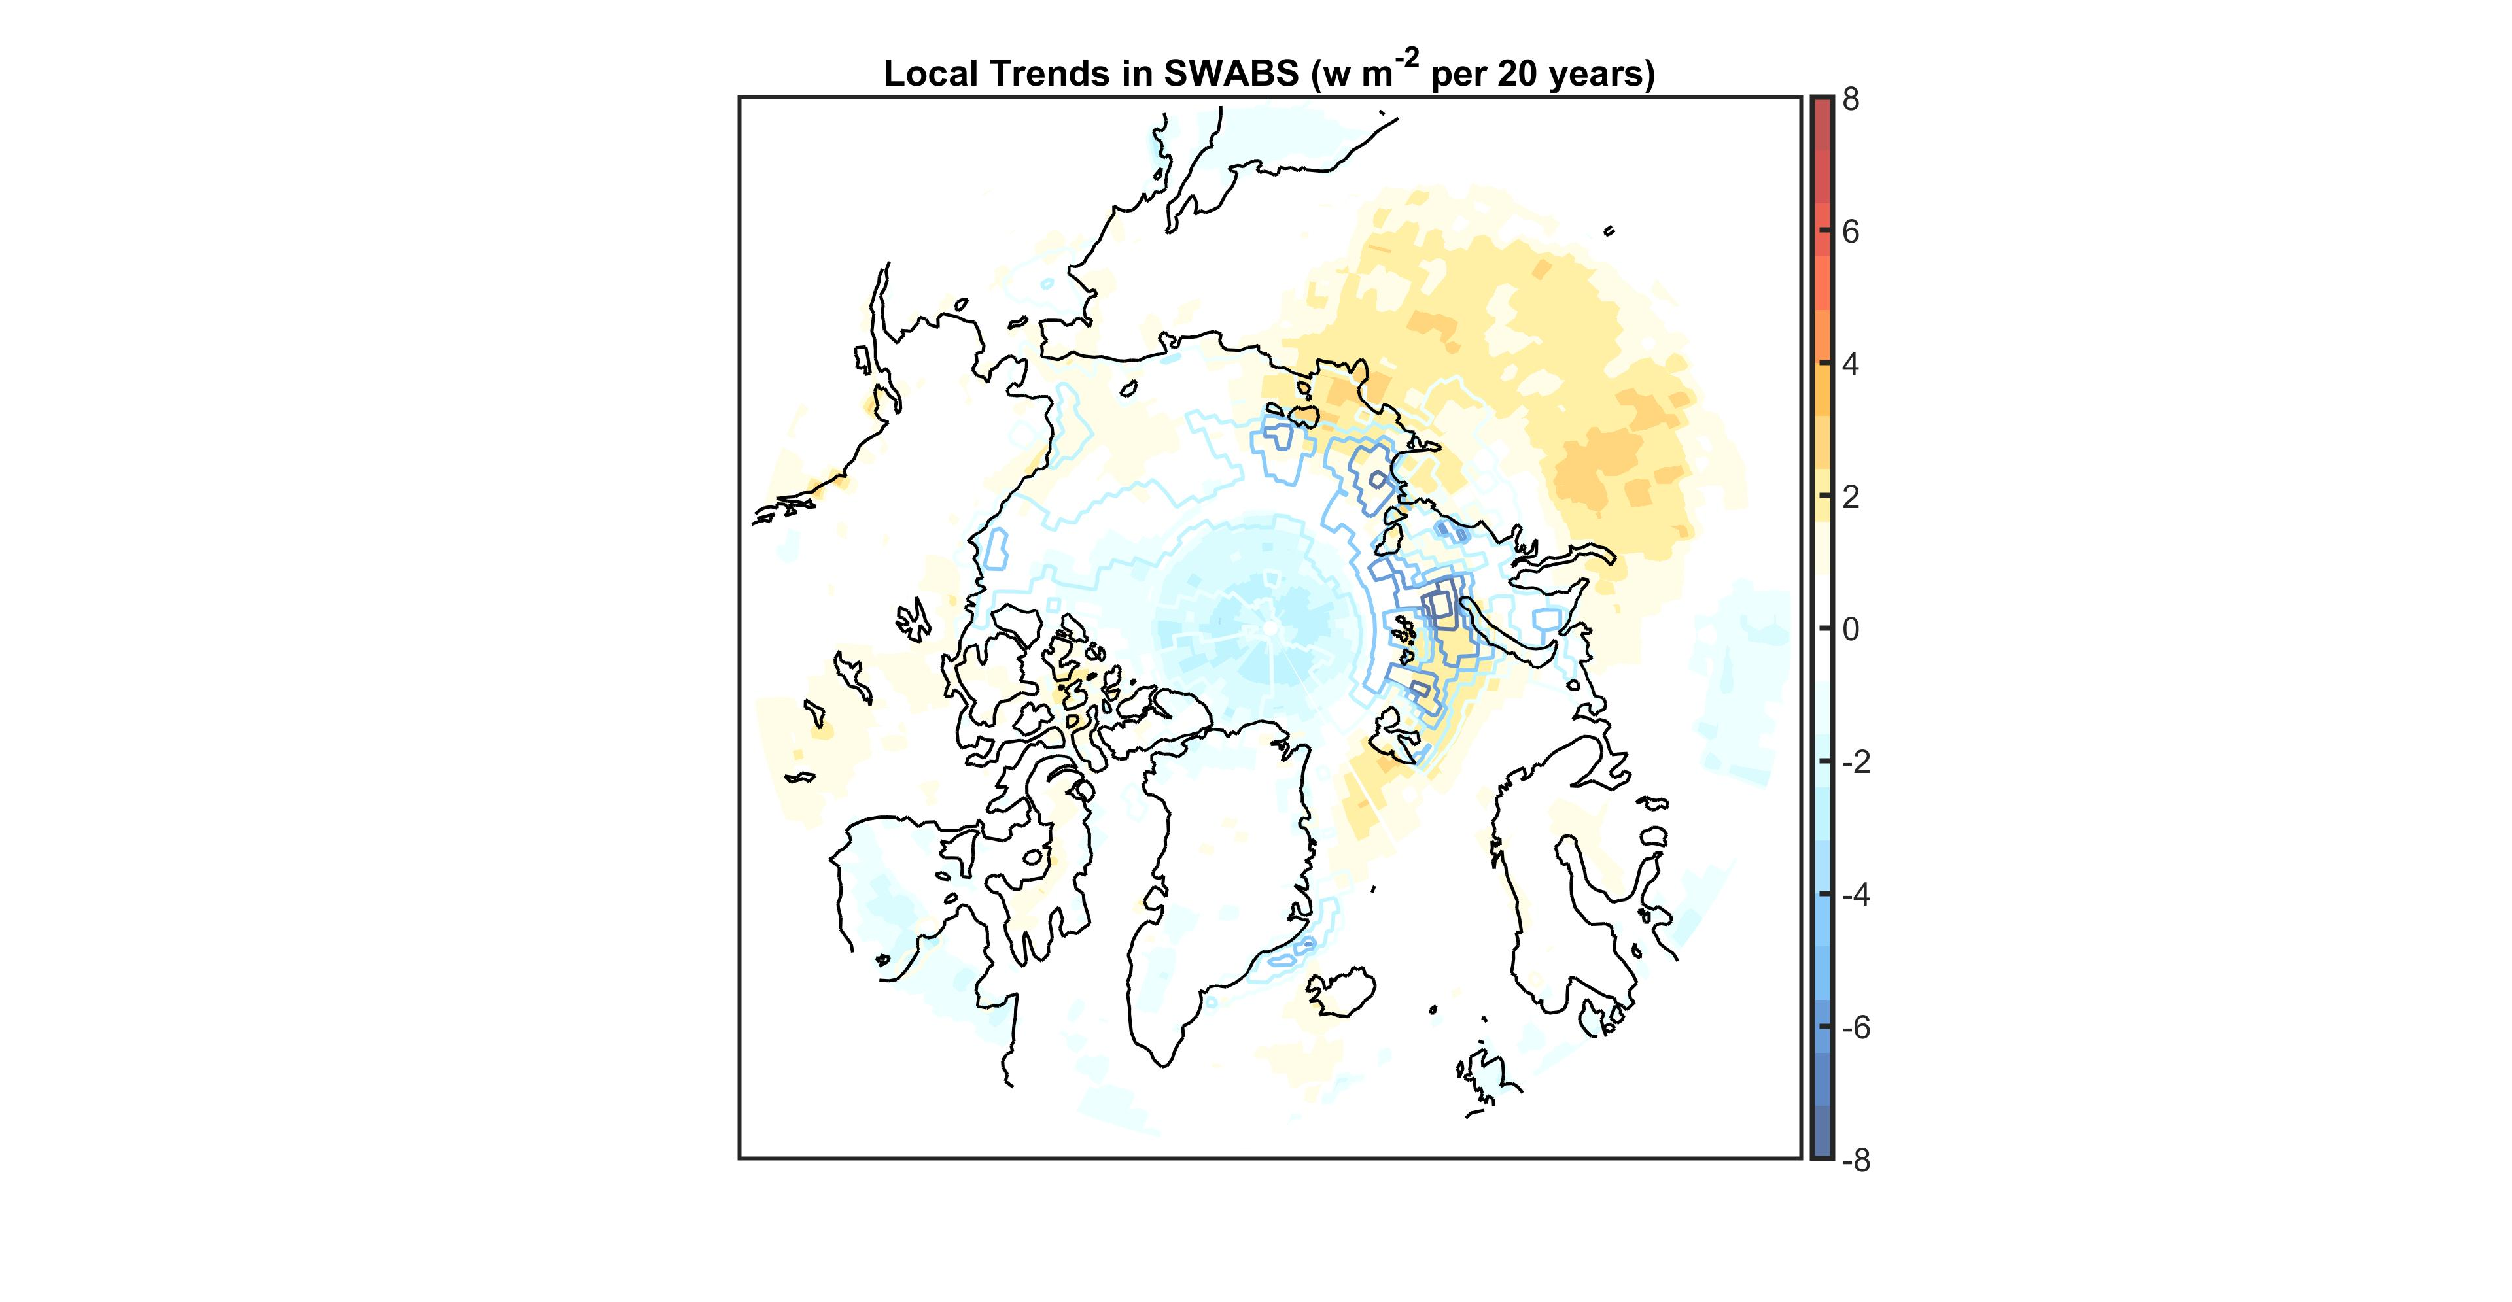

Slide 18
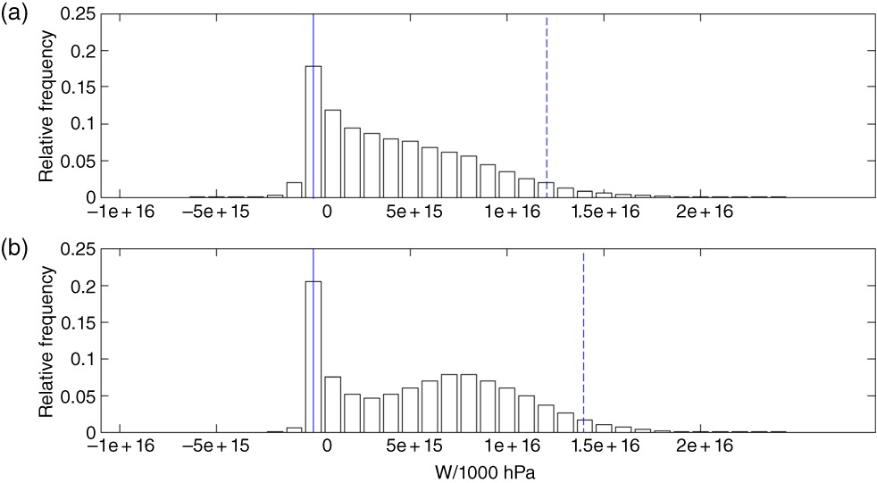
On local and zonal pulses of atmospheric heat transport in reanalysis data
The PDFs of zonally integrated atmospheric heat transport due to transient eddies for (a) Northern Hemisphere DJFs and (b) Southern Hemisphere JJAs. Both PDFs are plotted over the same bins. The data cover the 850 mb fields from June 1989 to February 2011. All latitude circles between 30°N and 89°N and S are taken into account. The skewnesses of the PDFs are (a) 0.83 and (b) 0.34. The corresponding most likely values are (a) 0 W/1000 hPa and (b) 0 W/1000 hPa. The continuous vertical lines show the bins corresponding to the most likely values. The dashed vertical lines show the bins corresponding to the 95th percentiles.
Quarterly Journal of the Royal Meteorological Society, Volume: 141, Issue: 691, Pages: 2376-2389, First published: 09 February 2015, DOI: (10.1002/qj.2529)
Notes:
The PDFs of zonally integrated atmospheric heat transport due to transient eddies for (a) Northern Hemisphere DJFs and (b) Southern Hemisphere JJAs. Both PDFs are plotted over the same bins. The data cover the 850 mb fields from June 1989 to February 2011. All latitude circles between 30°N and 89°N and S are taken into account. The skewnesses of the PDFs are (a) 0.83 and (b) 0.34. The corresponding most likely values are (a) 0 W/1000 hPa and (b) 0 W/1000 hPa. The continuous vertical lines show the bins corresponding to the most likely values. The dashed vertical lines show the bins corresponding to the 95th percentiles.
IF THIS IMAGE HAS BEEN PROVIDED BY OR IS OWNED BY A THIRD PARTY, AS INDICATED IN THE CAPTION LINE, THEN FURTHER PERMISSION MAY BE NEEDED BEFORE ANY FURTHER USE. PLEASE CONTACT WILEY'S PERMISSIONS DEPARTMENT ON PERMISSIONS@WILEY.COM OR USE THE RIGHTSLINK SERVICE BY CLICKING ON THE 'REQUEST PERMISSIONS' LINK ACCOMPANYING THIS ARTICLE. WILEY OR AUTHOR OWNED IMAGES MAY BE USED FOR NON-COMMERCIAL PURPOSES, SUBJECT TO PROPER CITATION OF THE ARTICLE, AUTHOR, AND PUBLISHER.

Slide 19
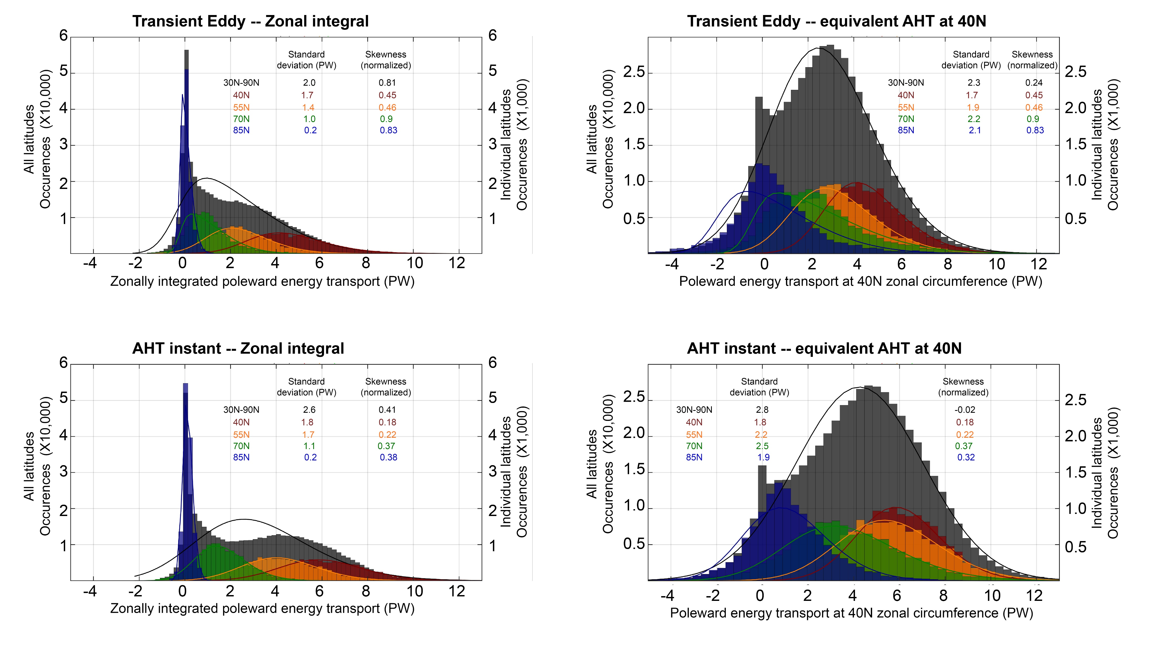

Slide 20
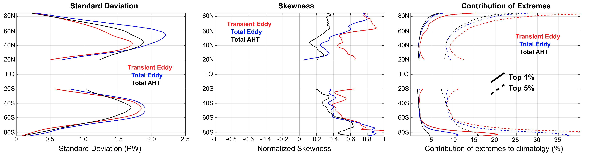

Slide 21
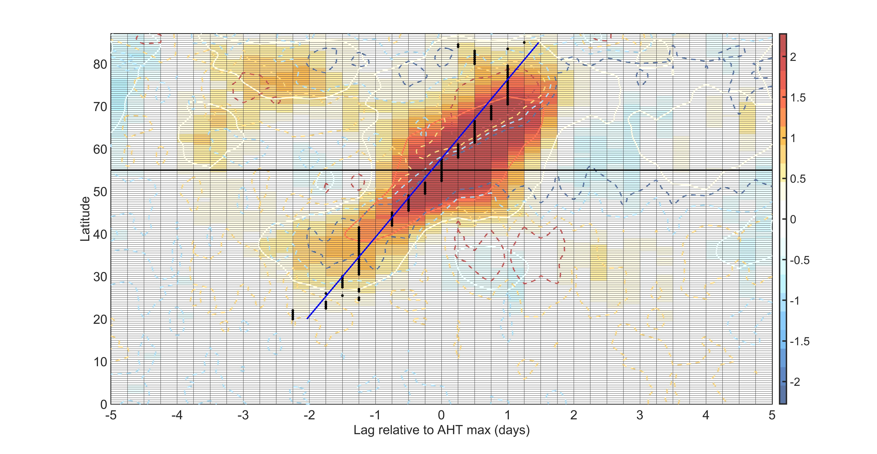
Colors are atmospheric energy transport in PW
Solid contours are eddy component
Dashed contours are atmospheric energy transport by overturning circulation

Slide 22
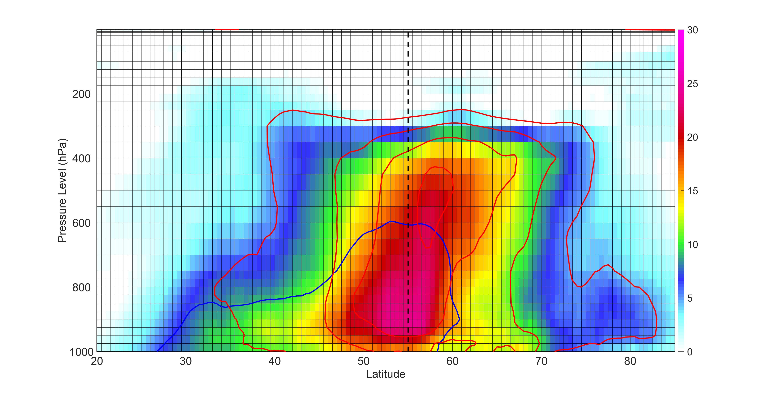
Vertical structure of AHT composite anomaly along the axis of the AHT maximum
Colors are AHT in PW per 1000 hPa
Red is sensible, blue is latent with the same contour interval

