Slide 1
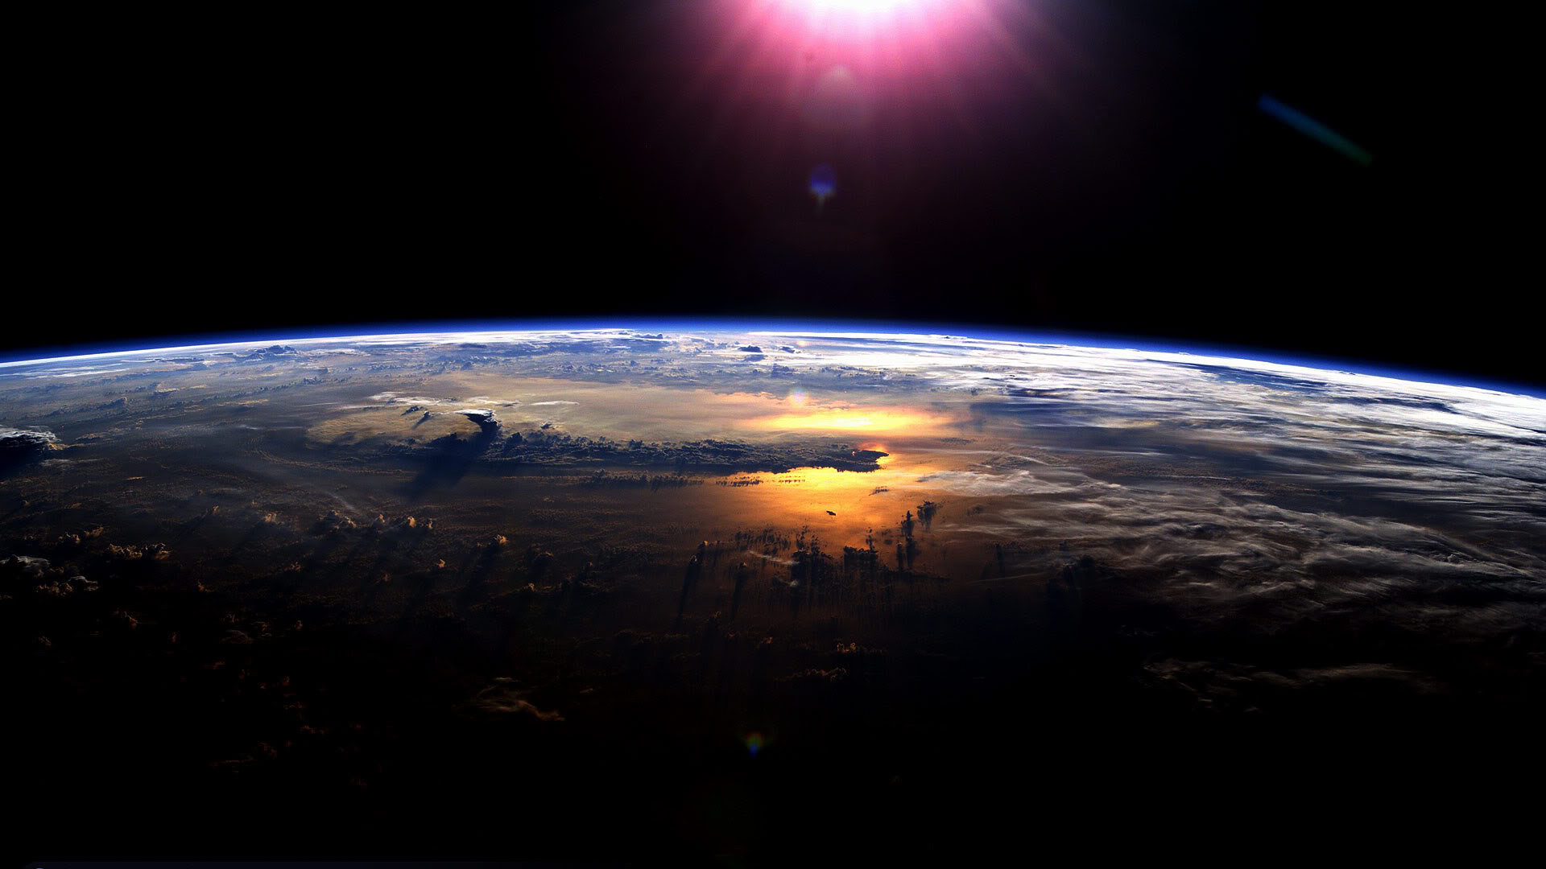
The Interannual variability of the Arctic energy budget
Aaron Donohoe, Axel Schweiger
Polar Science Center --APL, U. Washington
Sea Ice mini workshop, UW
July 12, 2017

Slide 2
Arctic energy (poleward of 70N) from Serreze et al. 2007)
Radiative loss = Energy Import
- (Incident – Reflected) + Emitted = Ocean flux + atmospheric flux
110 W m⁻² = 111 W m⁻²
Incident
Solar
184 W m⁻²
Reflected SW
98 W m⁻²
Emitted LW
196 W m⁻²
atmospheric flux
FWALL
100 W m⁻²
Arctic
oceanic flux (surface flux)
11 W m⁻²

Slide 3
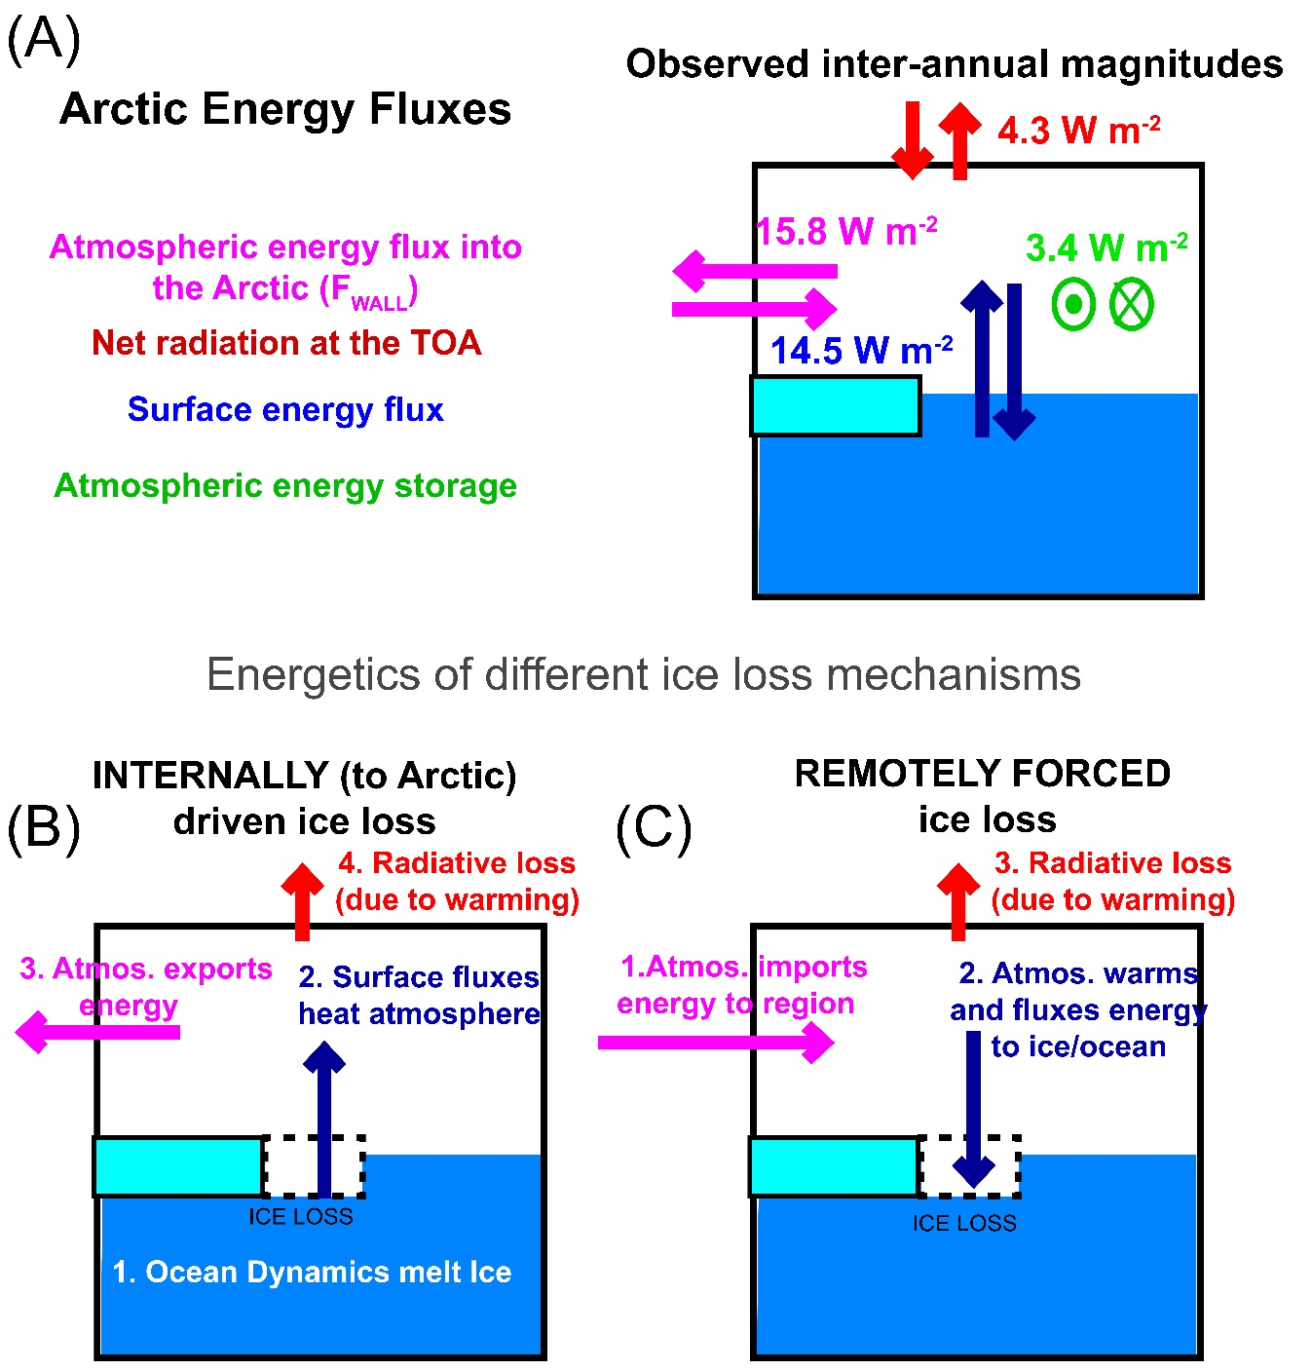
Interannual variability of Arctic Energy Budget
Shown is the magnitude of month-to-month variability of energy fluxes into the Arctic (poleward of 60N) over the 2000-2017 period from the following sources:
F_{WALL} is from NCEP and ERA reanalysis (V, T, Q and Z)
TOA radiation from CERES EBAF
Atmospheric energy storage from NCEP and ERA reanalysis
Surface fluxes from the RESIDUAL of the atmospheric energy budget
Possible mechanisms of sea ice loss and their expression on the (anomalous) energy budget

Slide 4
What determines the Earth’s planetary albedo? (solar radiation reflected at top of atmosphere)
Reflected by Atmosphere
Solar Incident
Reflected by Surface
Atmosphere
Earth’s Surface

Slide 5
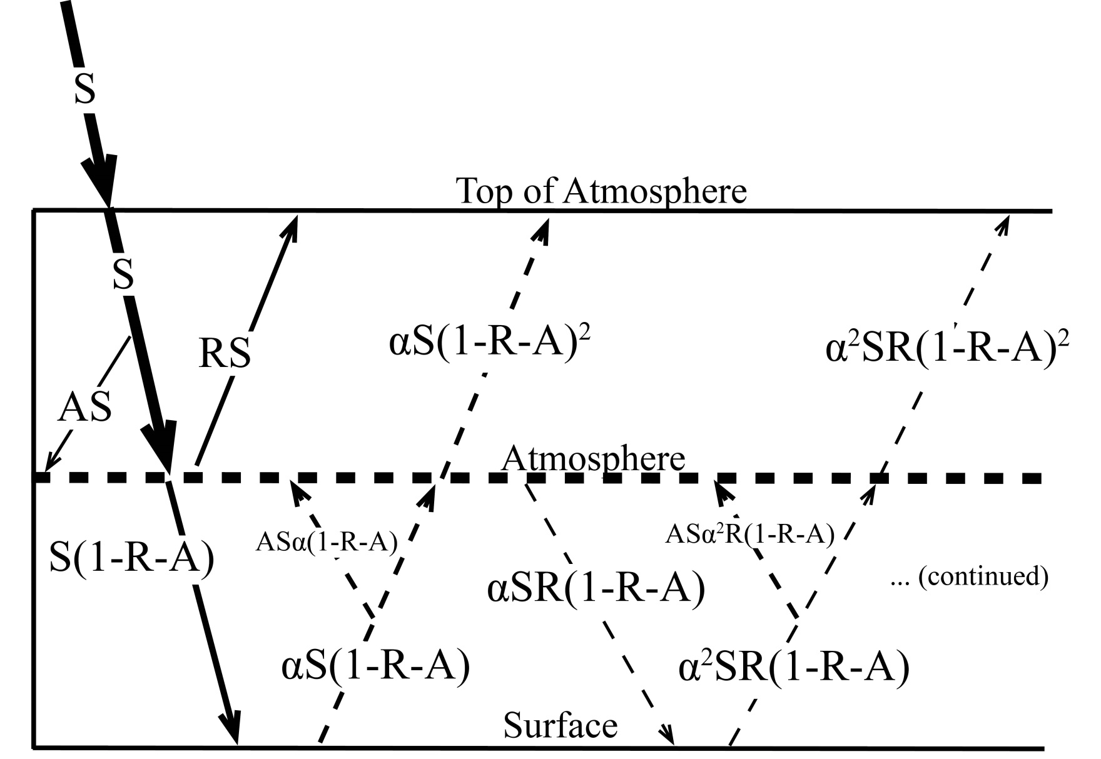
Simplified (isotropic) shortwave radiation model
Atmospheric
Contribution
To planetary
Albedo
Surface
Contribution
To planetary
Albedo
S = incident
R = cloud
reflection
A = absorption
α = surface
albedo
(UNKNOWNS)

Slide 6
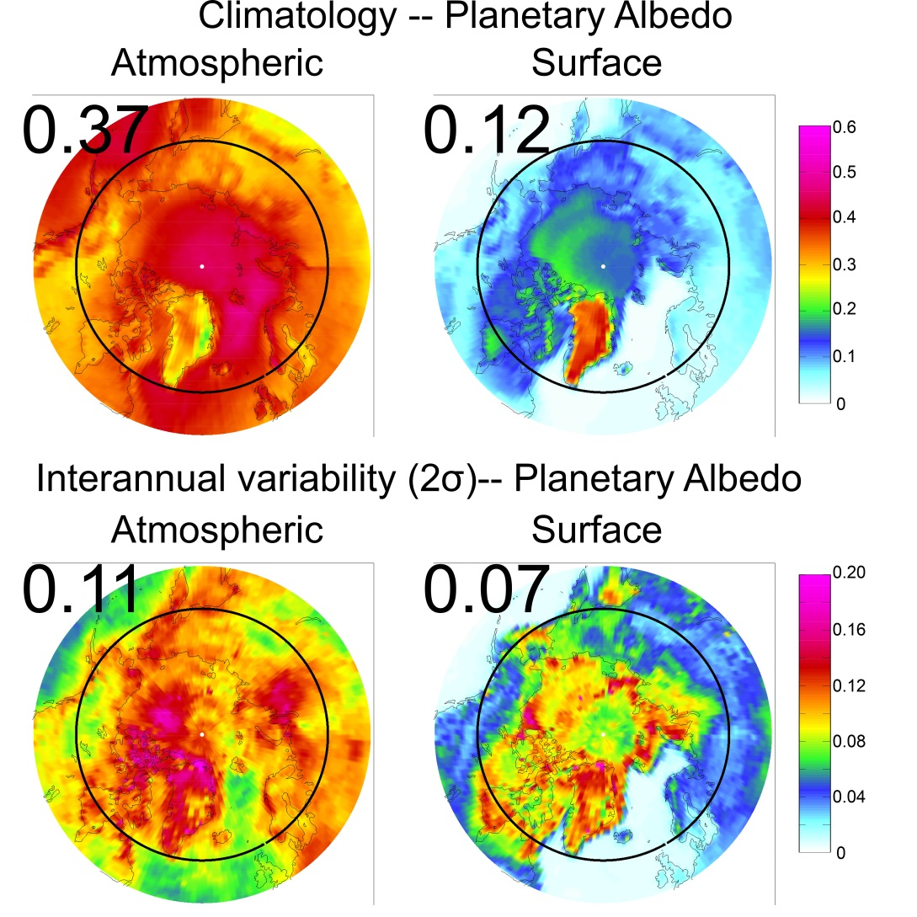
Arctic Planetary Albedo
→Atmosphere contributes more to climatology
Greenland is the exception
→ Bright and not much atmosphere (clouds) above

Slide 7
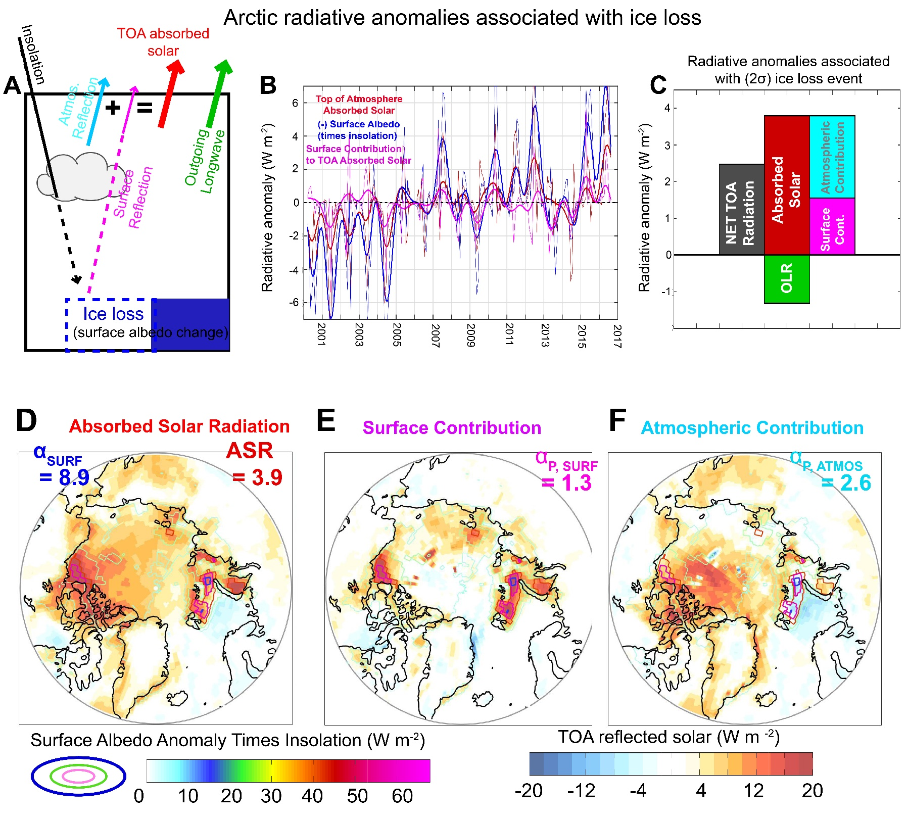

Slide 8
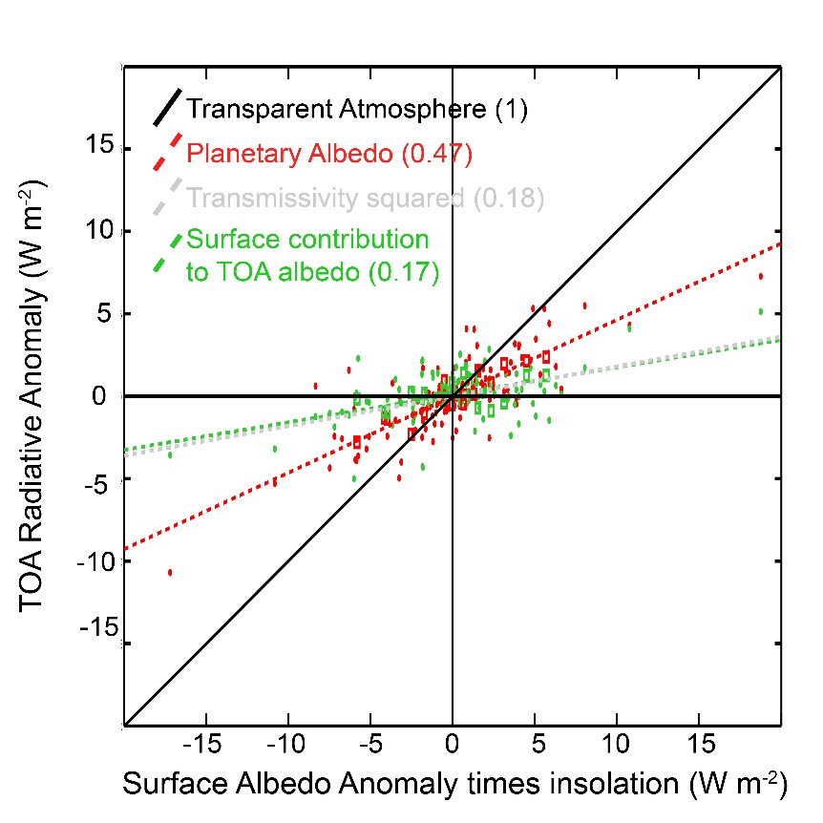
Pistone et al. (2014) used the regression of sea ice onto CERES all-sky planetary albedo to conclude that the ice albedo feedback increased the absorbed solar radiation in the Arctic by 6.4 W m⁻² since 1979
Our results suggest the impact is approximately 1/3 the size and that much of the planetary albedo anomalies during sea ice loss events is not directly due to the surface darkening:
A one unit surface albedo anomaly in the Arctic is accompanied by 0.5 units planetary albedo
Only 0.18 units of the planetary albedo anomaly is due to the surface albedo

Slide 9
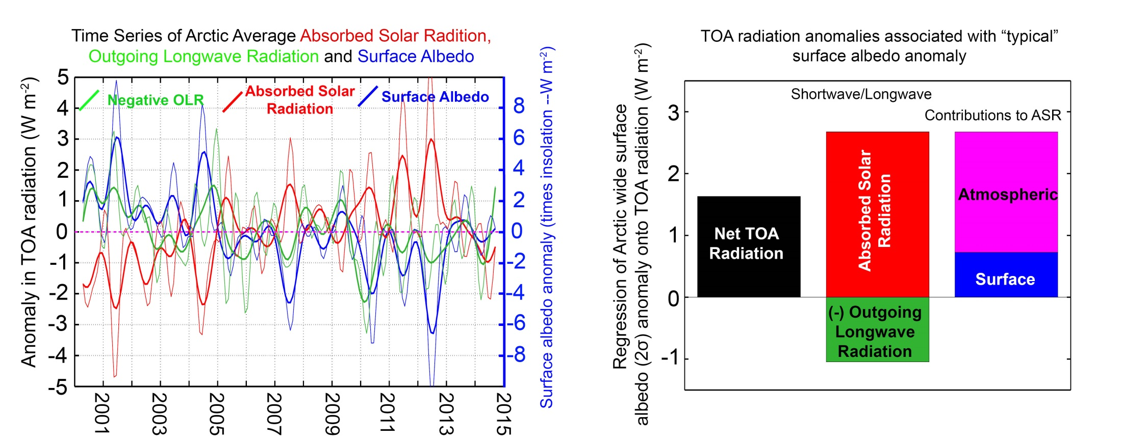
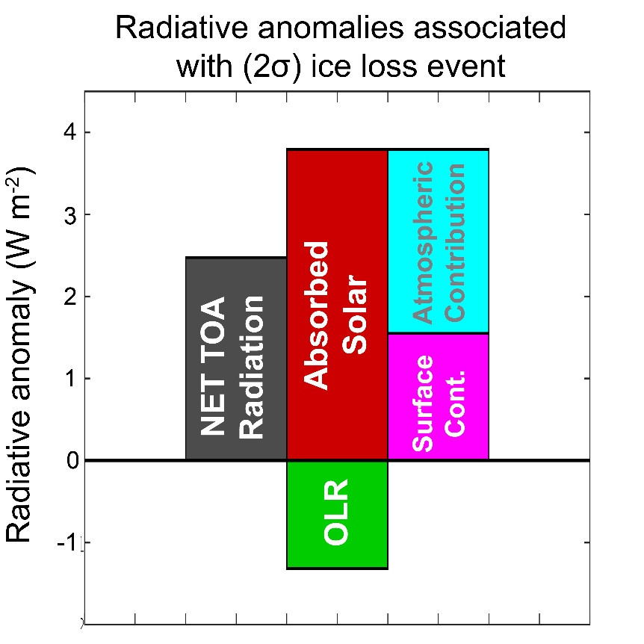
Radiative anomalies associated with Arctic sea ice loss
Arctic gains about 2 W m⁻² during a “typical” (2 σ) sea ice retreat
Absorbs more shortwave (3 W m⁻²)
→ 1/3 due to surface albedo and 2/3 due to clouds
Emits more longwave radiation ( 1 W m⁻² loss)

Slide 10
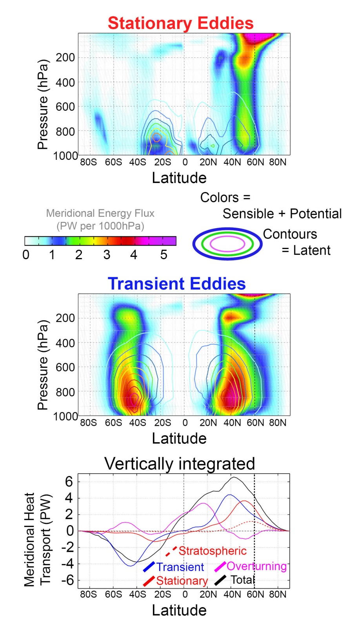
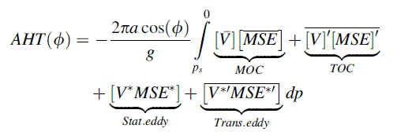
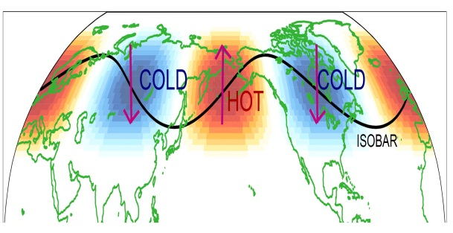
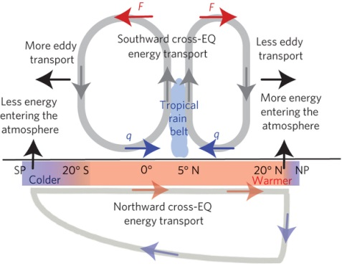
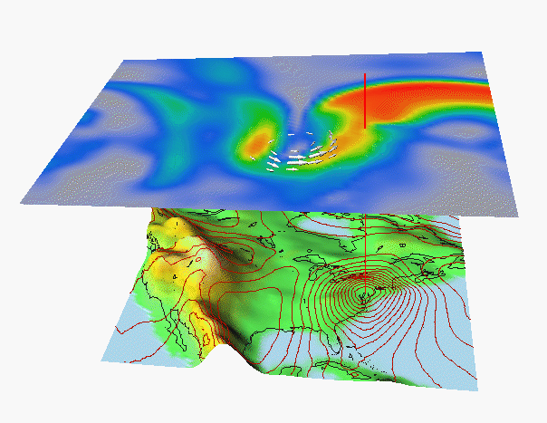
F _{WALL} DJF
* = Departure from zonal mean -- [ ]
' = Departure from time mean -- ¯
MSE = moist static energy
= CpT + LQ +gZ
Stationary
MOC
Overturning
Transient

Slide 11
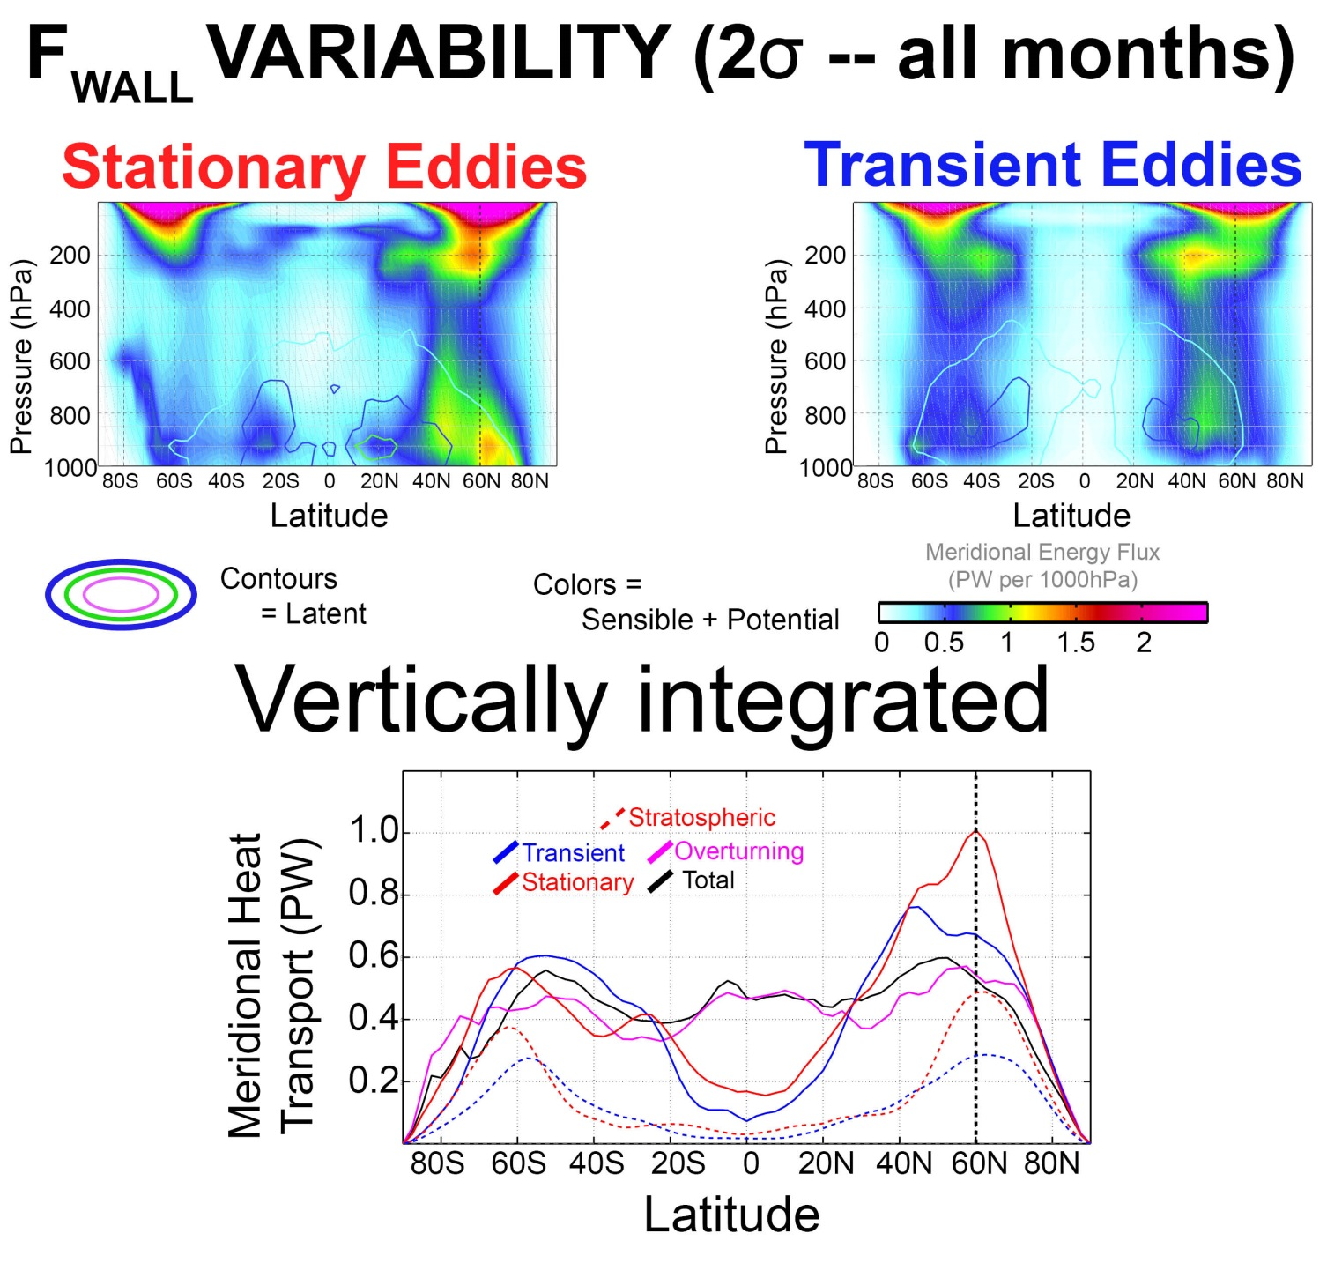
→Variability of energy transport is primarily due to stationary eddies and is very large at high latitudes
→Substantial signal in the upper atmosphere

Slide 12
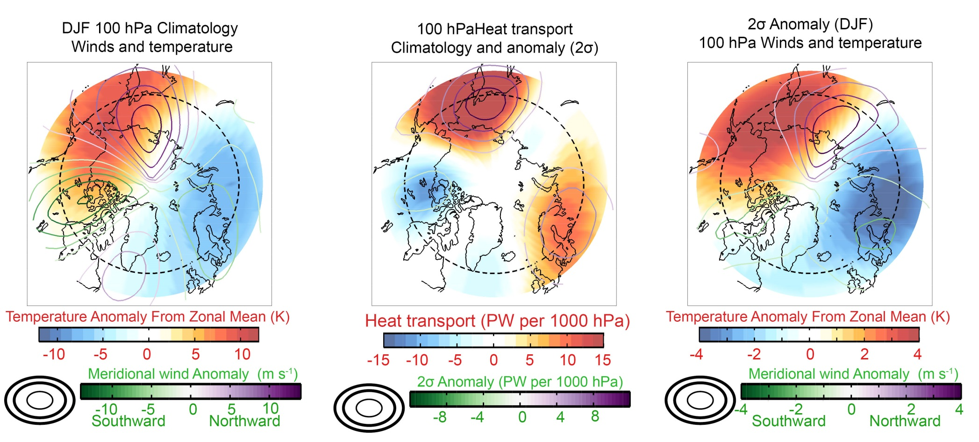
Variability of stratospheric stationary eddy heat transport—
Amplification of climatological eddy

Slide 13
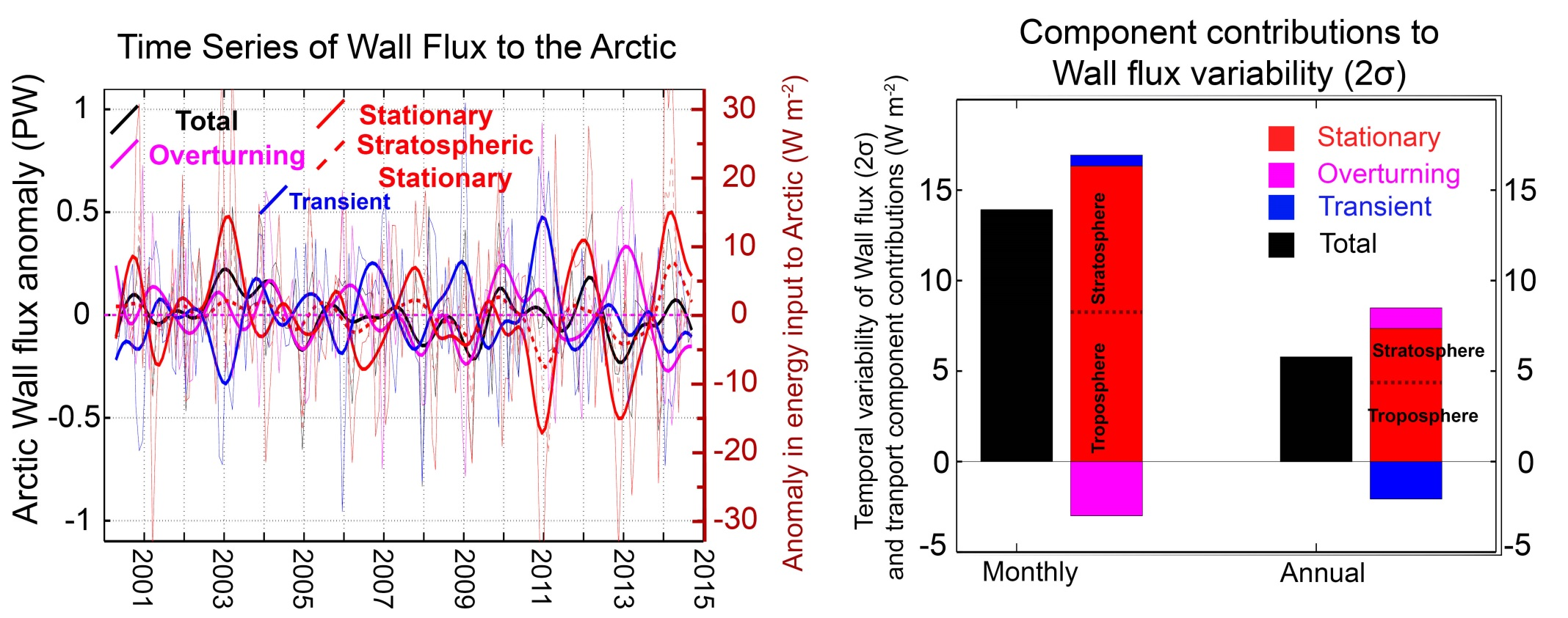
Variability of Atmospheric energy flux into the Arctic is large
    6 W m⁻² at the annual time scale, 12 W m⁻² at the monthly time scale
Primarily due to stationary waves and compensated by overturning (short timescale) and transient eddies (annual timescale)
    Nearly equal contributions from the stratosphere and troposphere

Slide 14
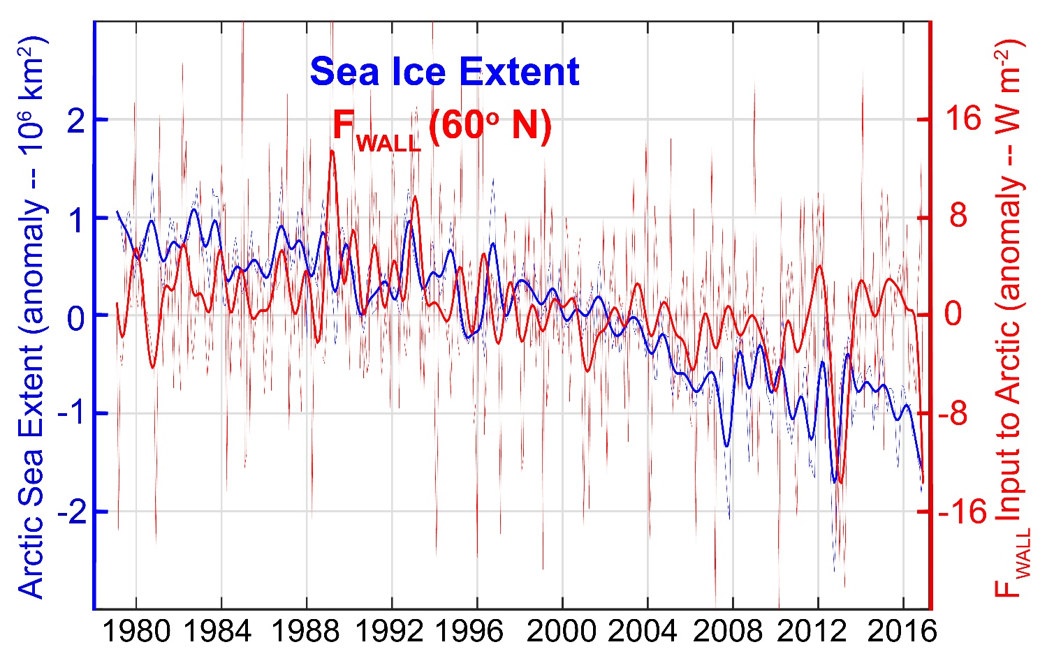
F_{WALL} and sea ice extent
F_{WALL} does not show a consistent relationship with sea ice extent
Shown here is tropospheric only contribution
Answer with full atmosphere is qualitatively different
How to interpret?
Speculation: FWALL is impacted both by surface heat fluxes in the Arctic (due to ice loss) and tropical variability with comparable magnitude influences

Slide 15
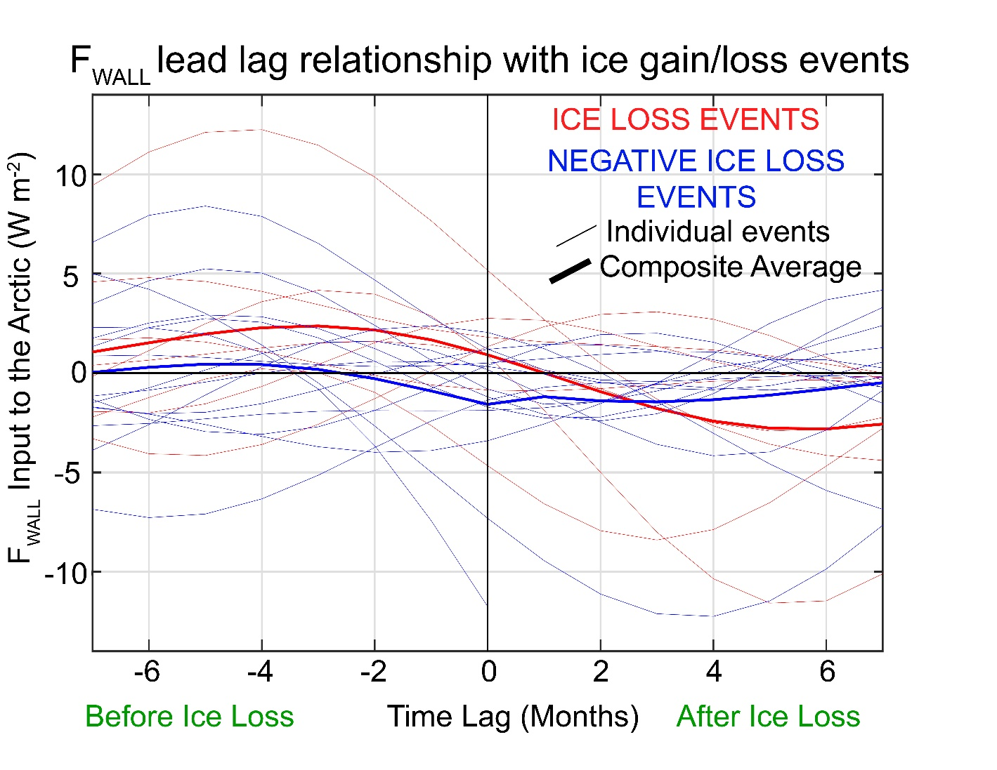
Lagged relationship between ice extent and F_{WALL}
Compositing the energetics of a typical ice loss event doesn’t make sense.

Slide 16
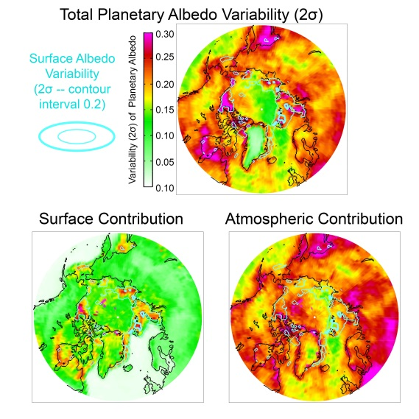
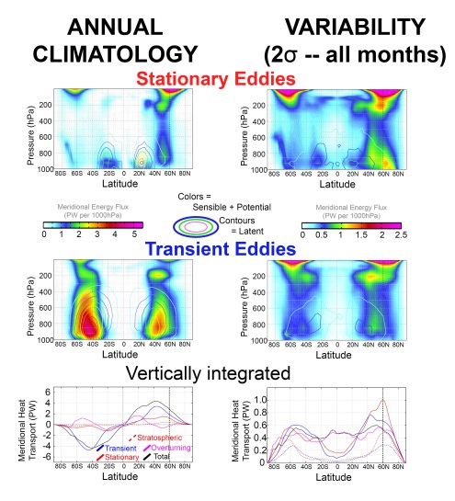
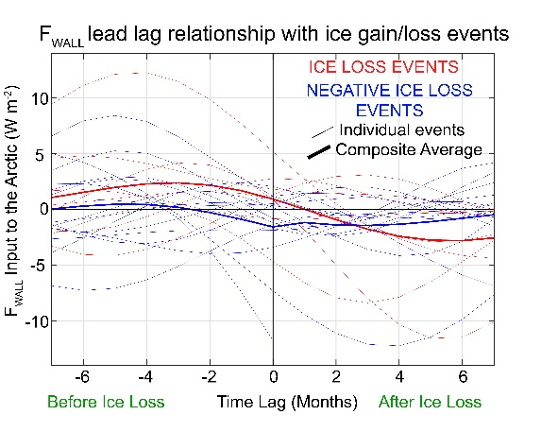
Conclusions
Arctic Planetary Albedo and its variability is dominated by atmospheric processes
Prior association of surface albedo anomalies with TOA radiative anomalies may have included non-casual co-variance
Radiative variability is fairly modest (2 W m⁻²)
Atmospheric energy fluxes to the Arctic (FWALL) :
Are highly variable (12 W m⁻²)
Dominated by the stationary waves – a substantial part is in the stratosphere
There is no clear relationship between FWALL and sea ice extent
Paths forward: relationship in long control simulations in coupled climate models, isolating seasons, removing ENSO variability

Slide 17
Extras

Slide 18
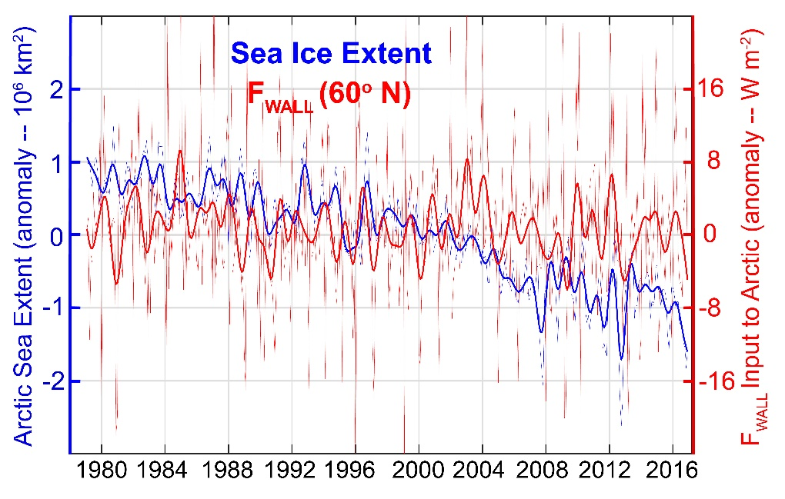
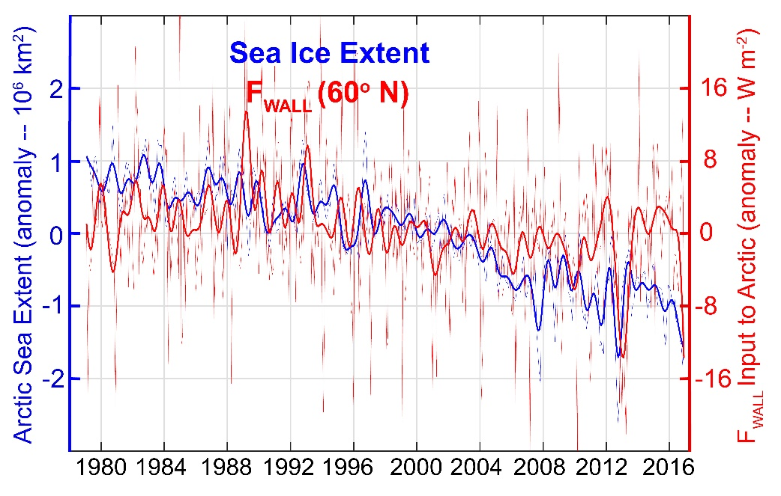
F_{WALL} and sea ice extent
Full atmosphere
Troposphere only

Slide 19
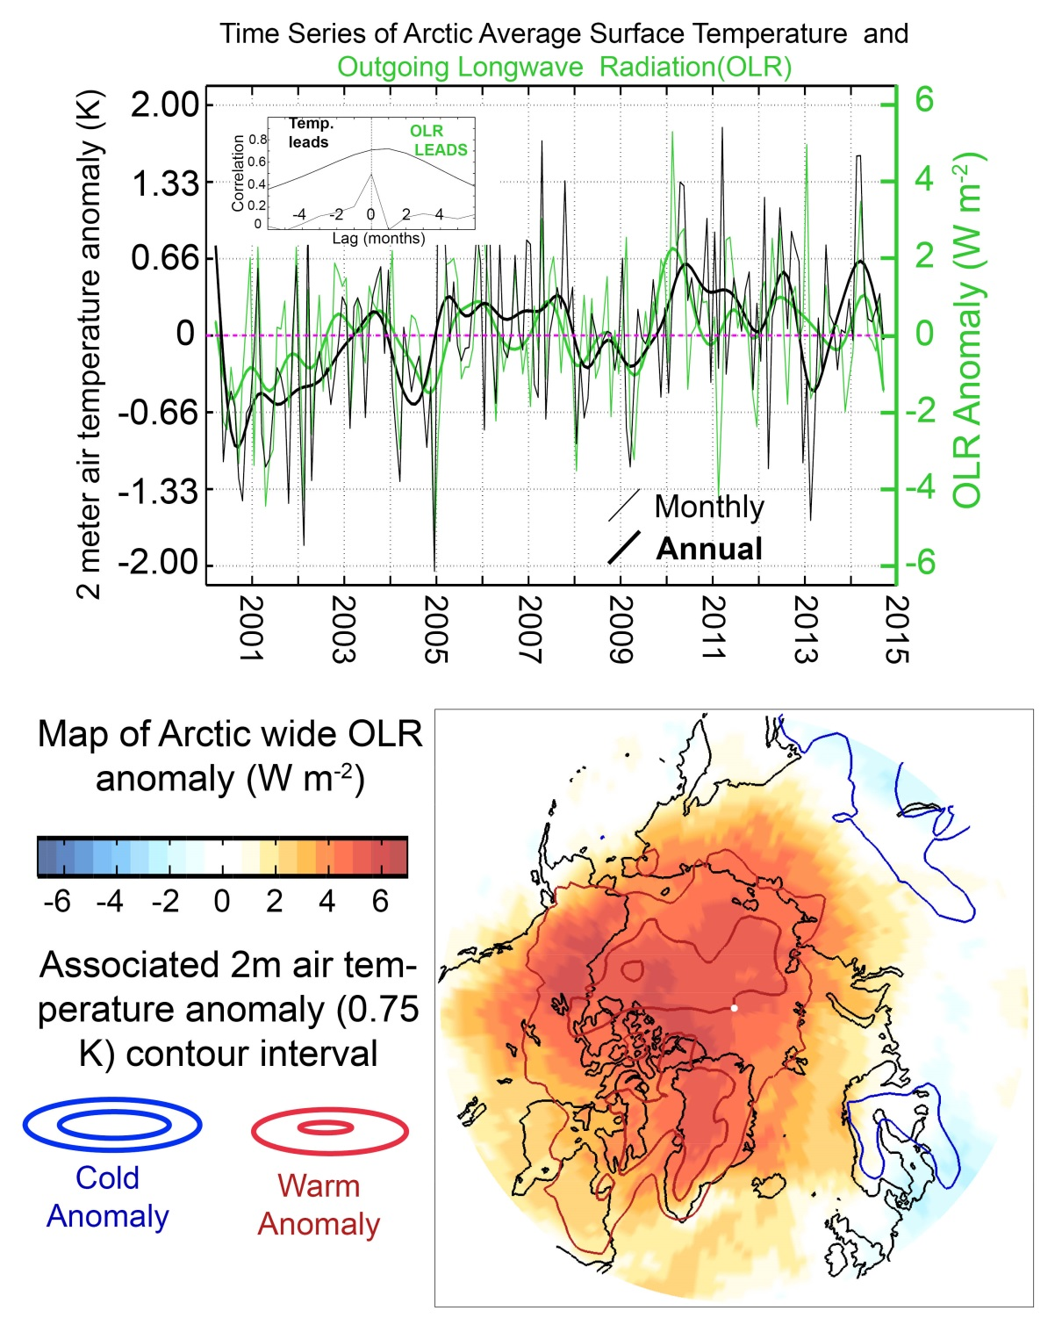
Arctic emits more OLR to space when the surface warms – basin wide
Consistent with a climate feedback parameter of 1.5 W m⁻² K⁻¹

Slide 20
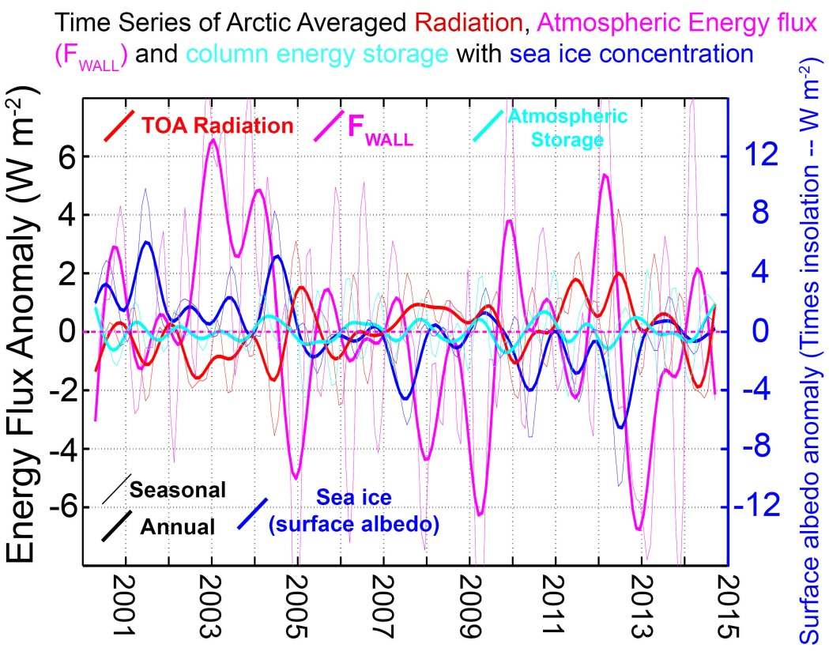
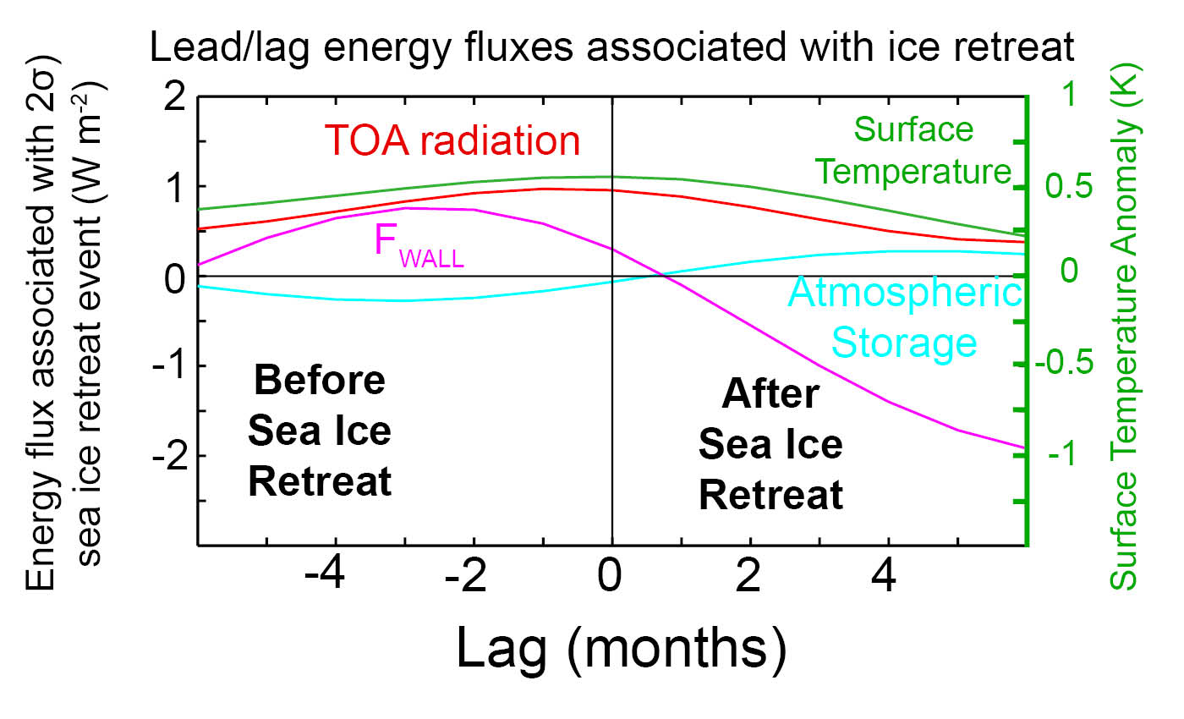
Putting the pieces together
Relative variances of terms in W m⁻² per 2σ– annual (seasonal)
FWALL 5.7 (8.5)
RADIATION 1.8 (2.7)
TENDENCY 0.7 (1.8)
Hint that enhanced F_{WALL} precedes sea ice anomaly and decreases afterward
Radiative
Heating
Atmosphere Heats up
Upward
Surface
Heat flux
F_{WALL}
increases
F_{WALL}
decreases
ICE
Melts
ICE

