Slide 2
1 : What determines the Earth’s planetary albedo? (solar radiation reflected at top of atmosphere)
Reflected by Atmosphere
Solar Incident
Reflected by Surface
Atmosphere
Earth’s Surface

Slide 3
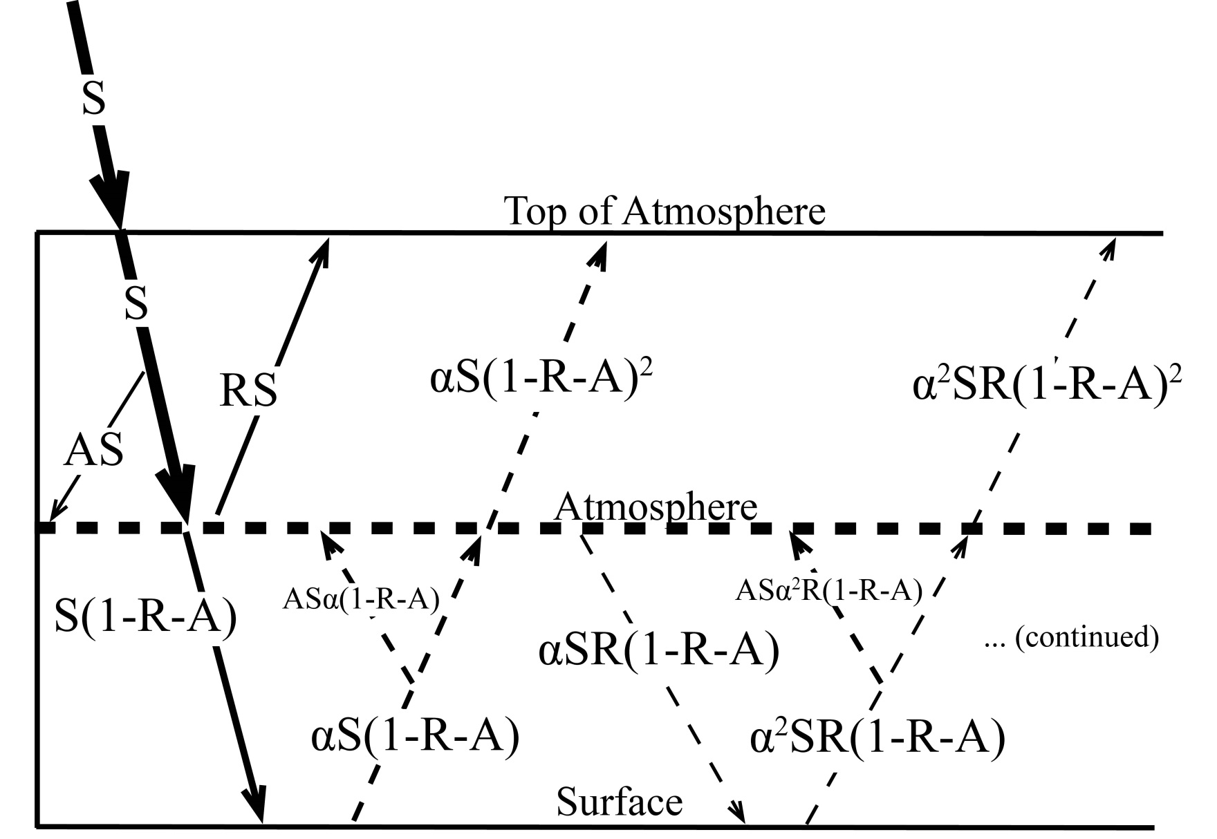
Simplified (isotropic) shortwave radiation model
Atmospheric
Contribution
To planetary
Albedo
Surface
Contribution
To planetary
Albedo
S = incident
R = cloud
reflection
A = absorption
α = surface
albedo
(UNKNOWNS)

Slide 4
Partitioning of planetary albedo into atmospheric and surface components
Reflected by Atmosphere
α_{P} = α_{P,ATMOS} + α_{P,SURF}
Reflected by Surface
α_{P,ATMOS} = R
Solar Incident
α_{P,SURF} = α(1-R-A)²
(1-αR)
Atmosphere
Earth’s Surface

Slide 5
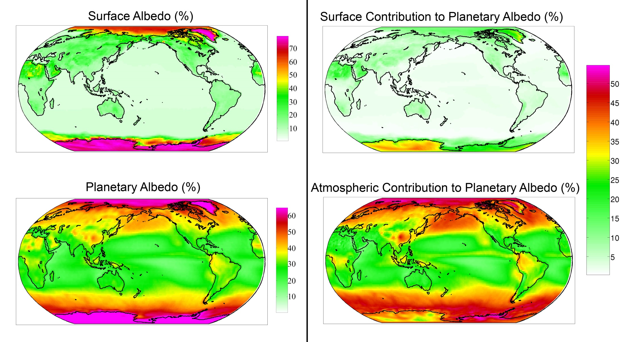
Observed (CERES) surface and atmospheric contribution to planetary albedo

Slide 6
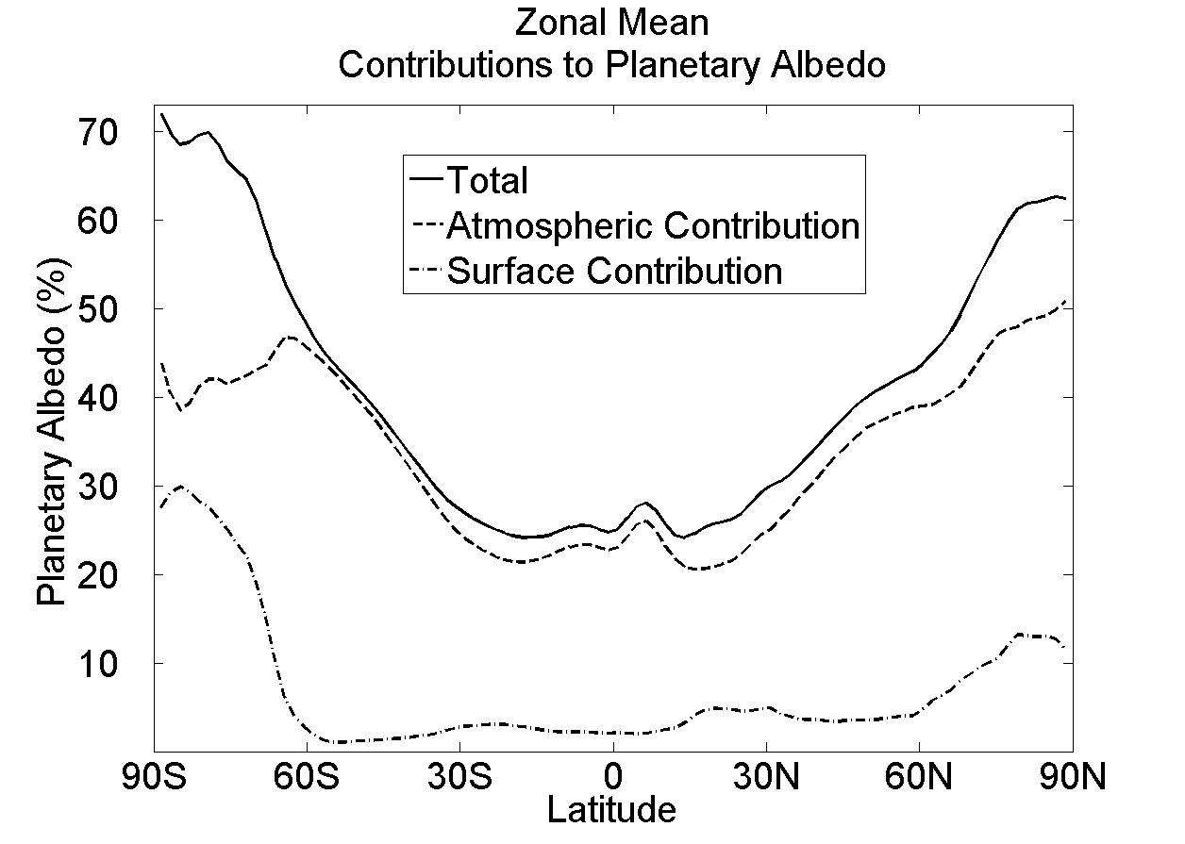
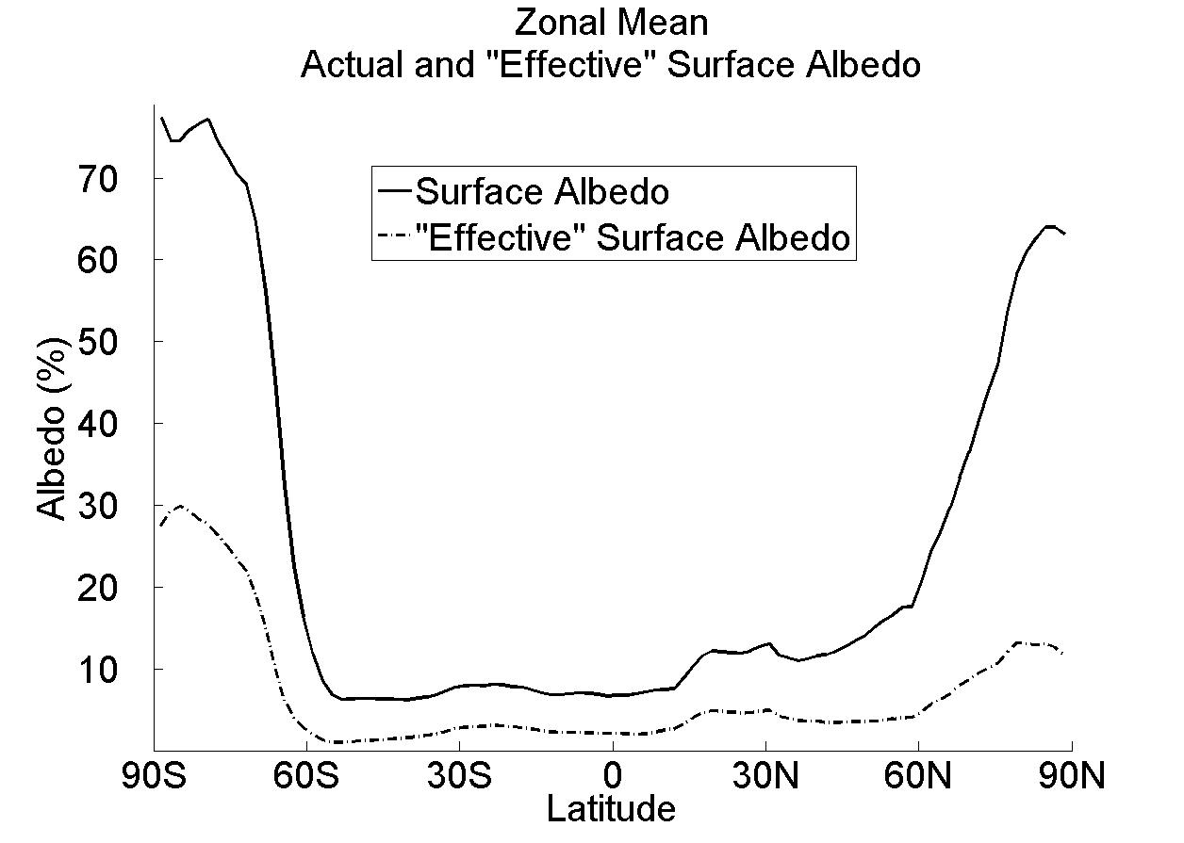
Observed Surface and atmospheric contribution to planetary albedo
Surface albedo and surface contribution to planetary albedo (α and α_{P,SURF})
α (surface albedo)
α_{P,SURF} = α(1-R-A)²
α_{P,SURF}
(1-αR)

Slide 7
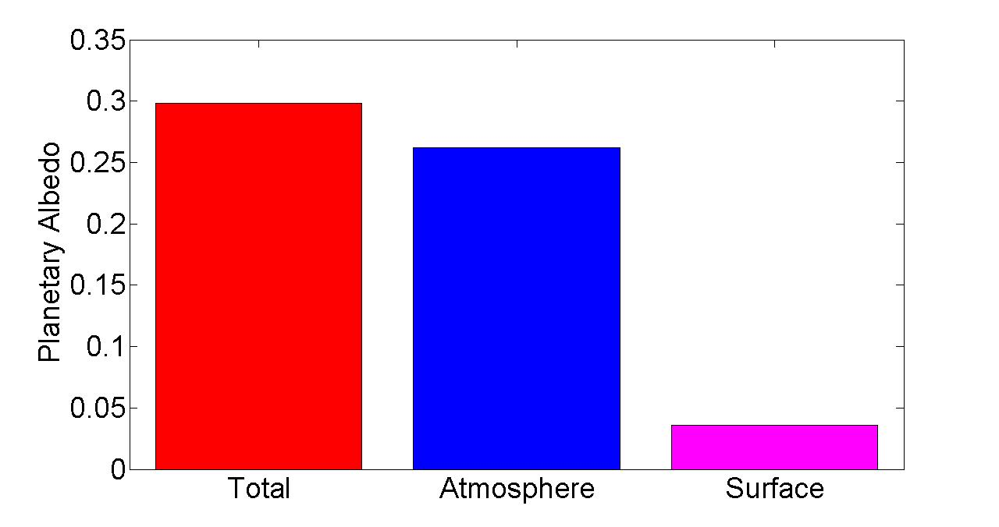
Observed Global Mean Planetary Albedo and it atmospheric/surface Partitioning
Notes:
0.298 = 0.262 + 0.036
100% = 88% + 12%

Slide 8
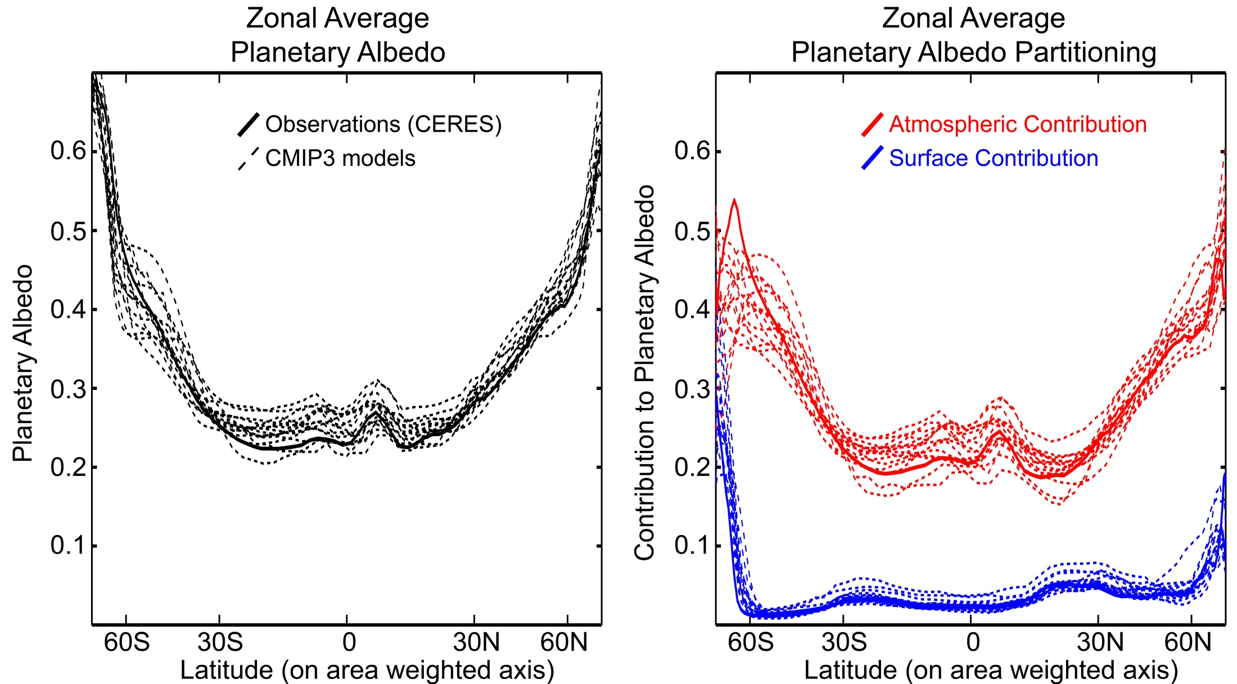
Planetary Albedo Partitioning:
Comparison of models (CMIP3 pre-industrial) and observations (CERES)

Slide 9
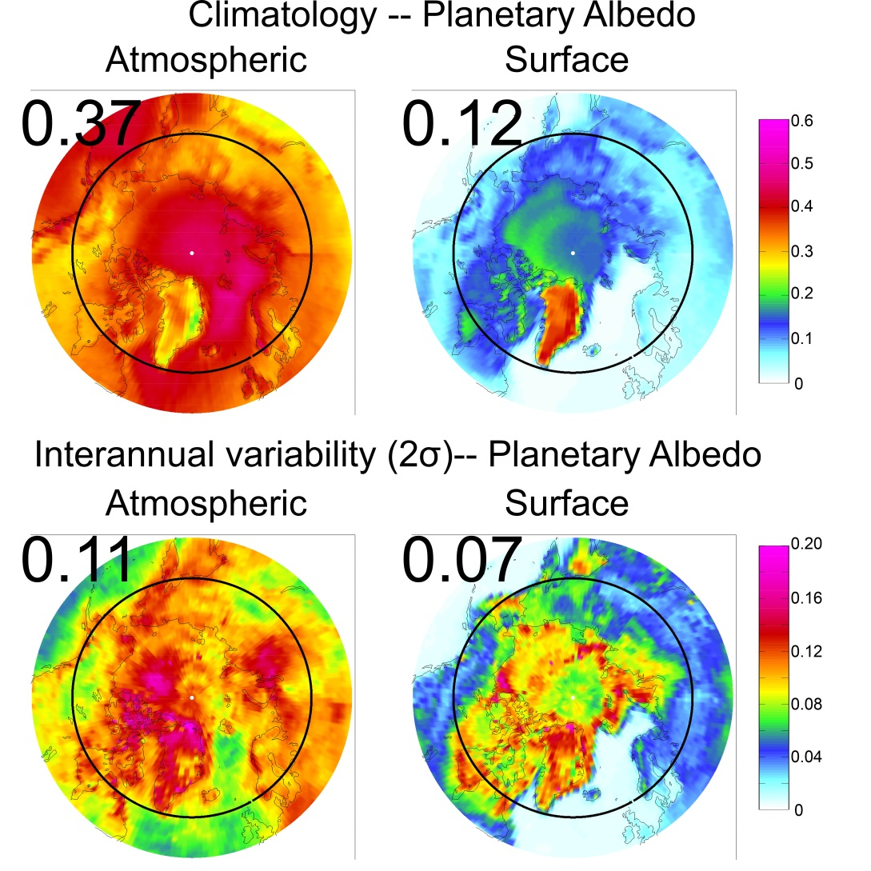
Arctic Planetary Albedo
→Atmosphere contributes more to climatology
Greenland is the exception
→ Bright and not much atmosphere (clouds) above

Slide 10
