Slide 1


Earth’s Energy Imbalance (EEI) from satellites, surface heat fluxes and ocean heat content
Aaron Donohoe
Why care about EEI?
– Starting from Master equation:
EEI =F - λT
At equilibrium, EEI → 0; the temperature response to 2XCO2 Forcing(F_{2XCO2})– the equilibrium climate sensitivity (ECS) :
ECS = F_{2XCO2}/λ
Two main approaches to estimating ECS from observational record
(2): Estimating fraction of ECS realized
(1): Variation of radiation with Temperature
ECS=T ( ) ( )
1 F_{2XCO2}
EEI = RAD_{TOA} = F – λT + noise
1-EEI/F F
Fraction of equilibrium realized

Slide 2
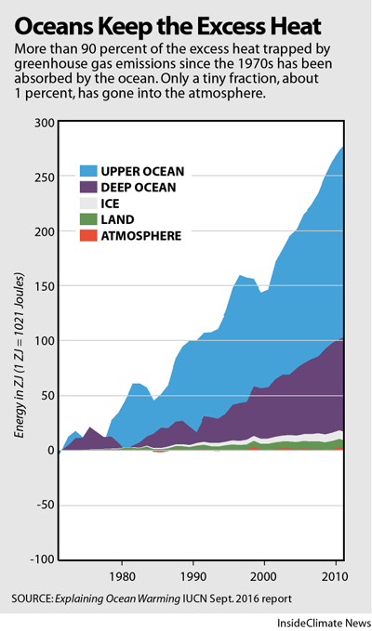
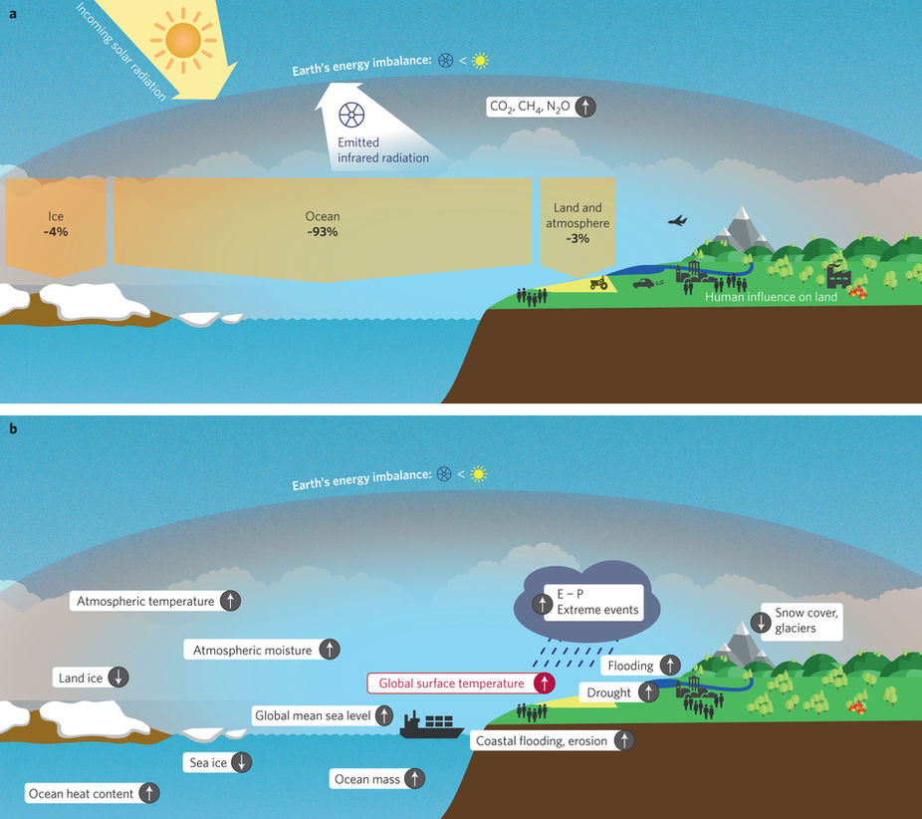
Earth’s Energy Imbalance (EEI)
EEI = RAD_{TOA}= d/dt ( Ocean energy + Atmos. energy + L_{F} *(Ice Volume) + Land )
Changes in Earth Energy Content
von Schuckmann et. al , 2016

Slide 3
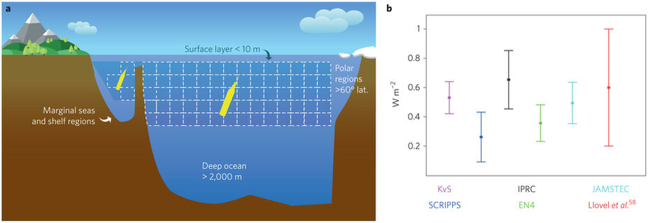
Three estimates of Earth’s Energy Imbalance (EEI)
EEI = RAD_{TOA} ≈ d/dt ( Ocean energy) = Surface energy flux
Comparing three estimates of EEI
RAD_{TOA}: Constrains EEI to the Range -2.1 to 6.7 W m⁻²
RAD_{TOA}
RAD_{TOA}
Loeb et al. (2008)
d/dt ( Ocean energy) : 0.54±0.38 W m⁻²
Atmosphere
Atmosphere
Lyman and Johnson (2008)
+Purkey and Johnson (2010)
Surface energy flux
Surface energy flux
Storage
Surface energy flux :
??? ± 10s of W m⁻²
Storage
Ocean
Ocean

Slide 4
EEI from satellite radiation – CERES and ERBE
Satellite derived EEI is unreasonably large (given ocean heat content changes) and has not improved from ERBE to CERES
Loeb et al. (2012)
The majority of uncertainty is from absolute calibration errors that are constant in time
→ Month-to-month anomalies have uncertainity of 0.2 W m⁻²

Slide 5
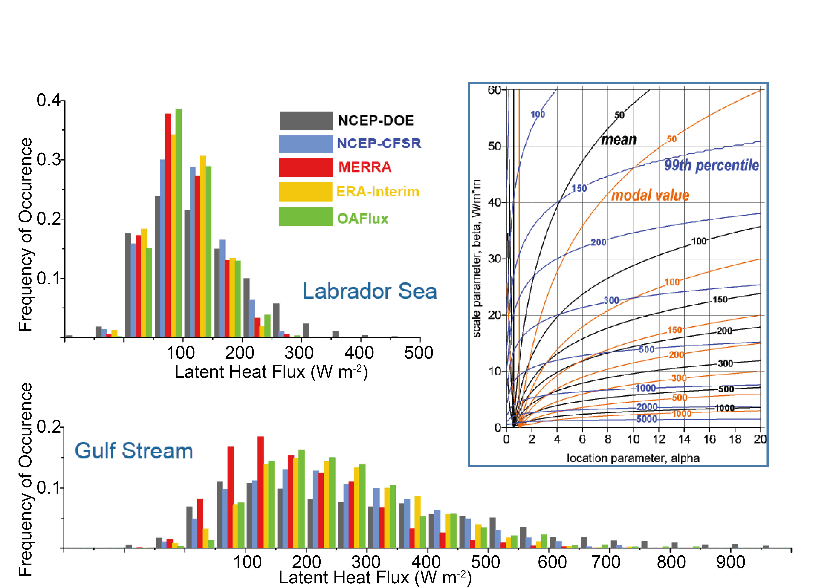
EEI from surface heat fluxes
Probability distribution functions of latent heat fluxes over Labrador sea and Gulf stream show:
Extreme events contribute fundamentally (100s of W m⁻²) to mean values
Reanalyses differ in the how frequent extreme events are
→ Lead to large global uncertainties in global surface heat fluxes
Gulev, CLIVAR Concept heat meeting, EXETER, UK

Slide 6
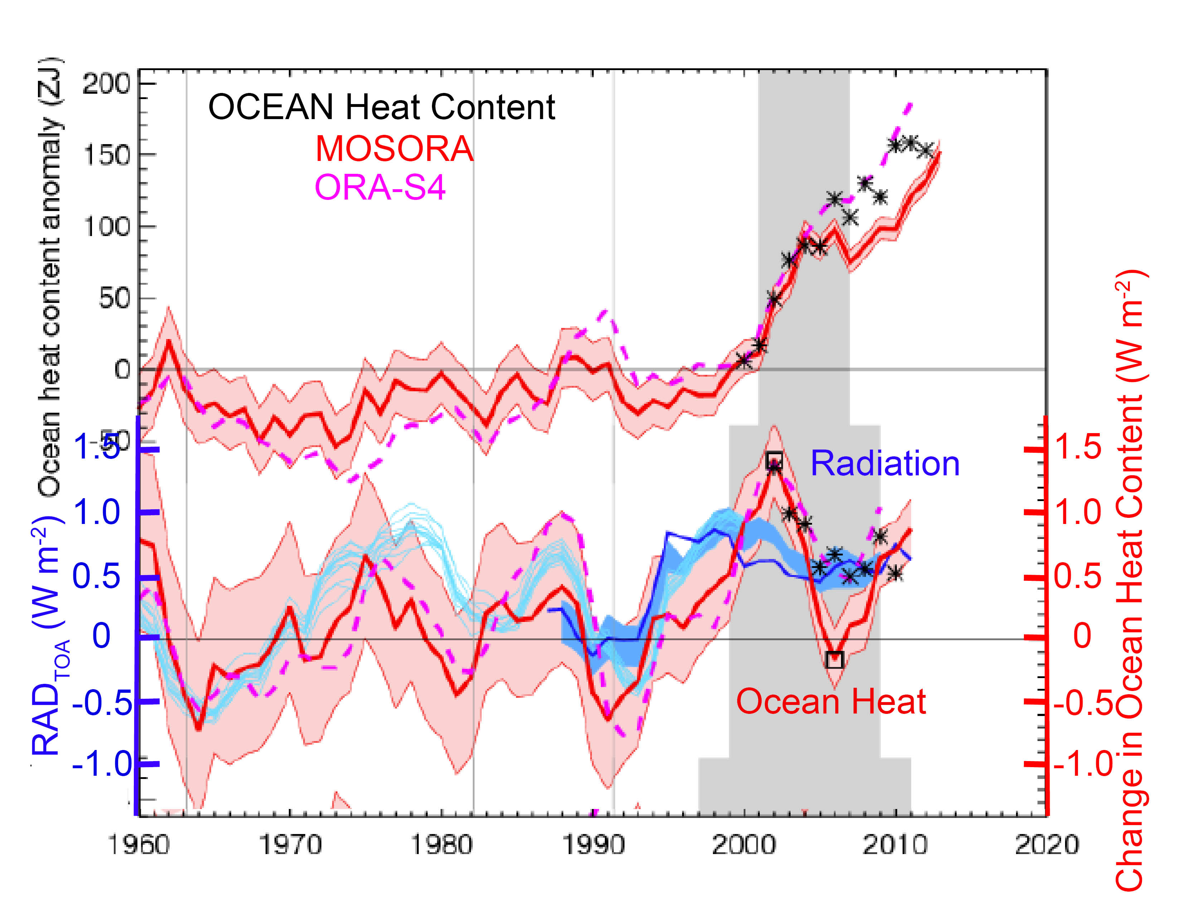
Radiation is a merged product of ERBE (1985-1989), ERBE WFOV (1985-1997) and CERES (2000-present – most reliable and self consistent data is since 2000
TOA Radiation has little year-to-year variability (1σ = 0.5 W m⁻²) and low uncertainty
Ocean heat content changes imply EEI of order 2 W m⁻²
The mismatch is outside of the uncertainty
Adapted from Smith et al. (2015)

Slide 7
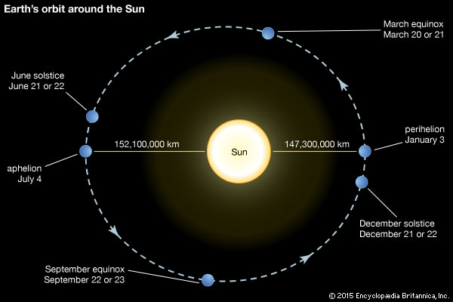
An idea to test the consistency of EEI from satellite radiation and ocean heat content –
The seasonal cycle of global mean heat content
Back of envelope– How much does global mean insolation vary by over the annual cycle?
Earth-sun distance varies by 5 million km
--- 3% of the mean distance (ΔR/R_{mean} = 5/150)
Insolation scales as 1/R² so fractional change in insolation is ≈ 2ΔR/R_{mean} = 6%
6% of S_{O}/4 is = 0.06 * (341 W m⁻²) =
20.5 W m ⁻² (30 times EEI)

Slide 8
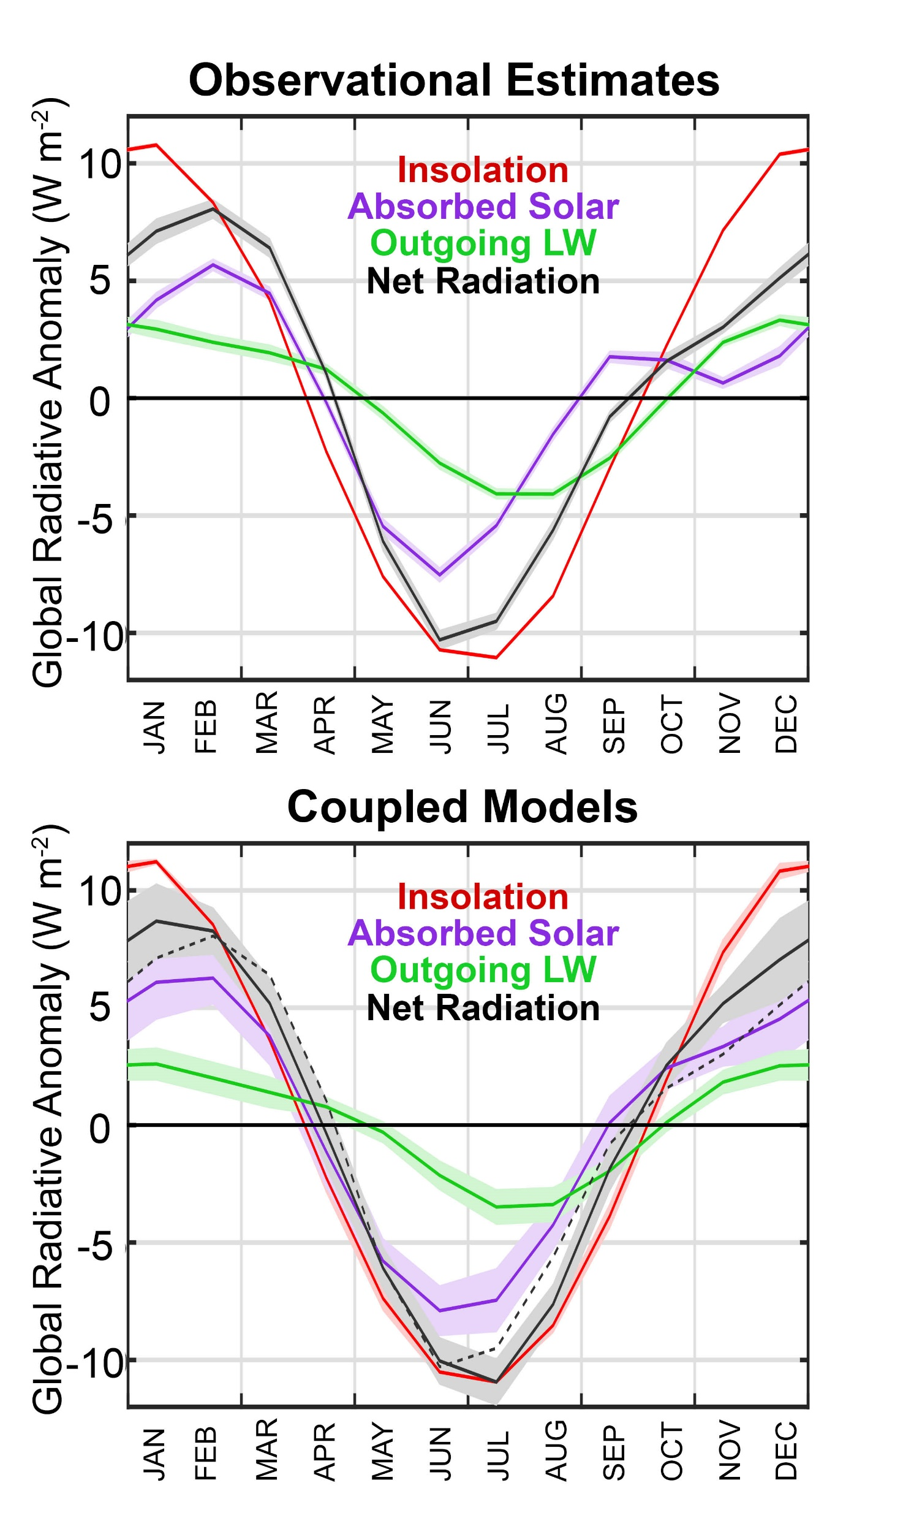
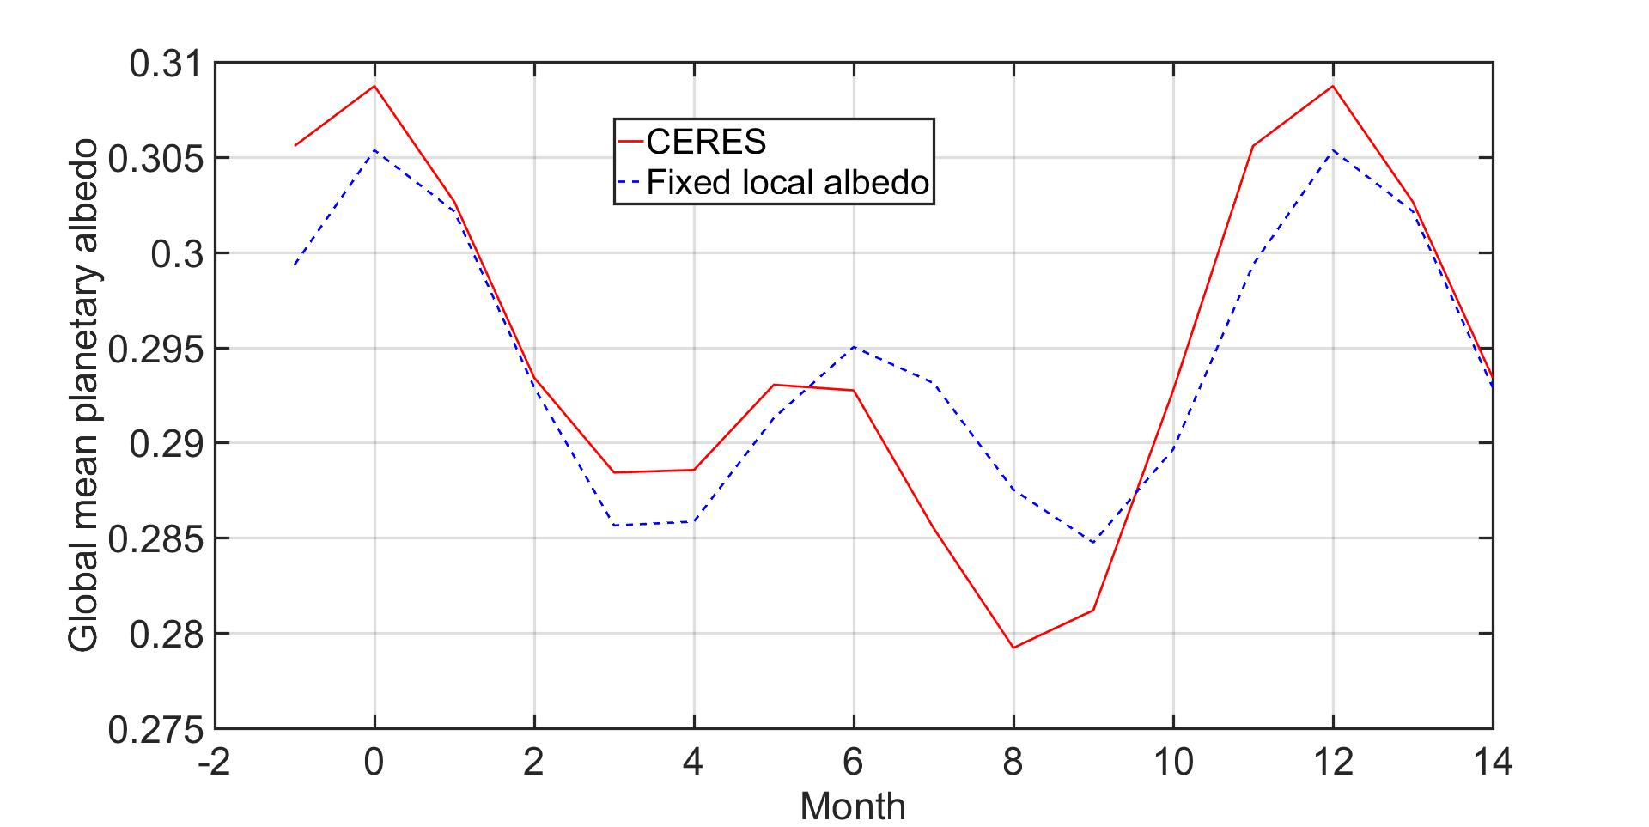
Global Insolation varies by 20 W m ⁻²
--Global Planetary albedo variations damp amplitude of insolation and add some texture to the time series
(-)
OLR follows global mean surface temperature peaking during Boreal summer
→ (-) OLR is in phase with insolation and amplifies seasonal cycle of net radiation
The climate system has to deal with 15 W m⁻² seasonal cycle of global EEI and this number is highly certain
The latter is consistent with solar reweighting of high versus low latitude →semi annual time series

Slide 9
(-)
(-)
The latter is consistent with solar reweighting of high versus low latitude →semi annual time series
The climate system has to deal with 15 W m⁻² seasonal cycle of global EEI and this number is highly certain
Climate models generally agree on amplitude and phase of seasonal cycle in EEI

Slide 10
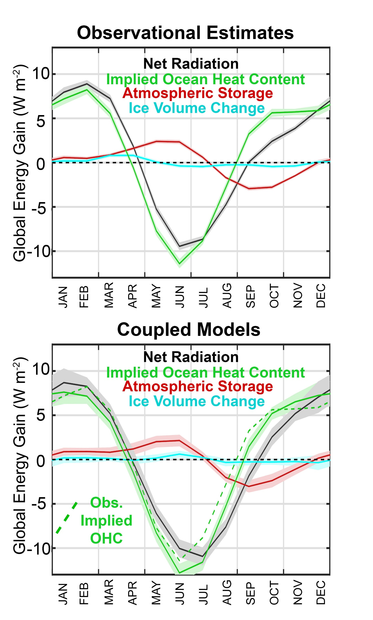
In addition to TOA radiation from CERES, we calculate the required seasonal ocean heat content change from:
Atmospheric heat content change from ERA reanalysis
Ice Volume change from Gravity Recovery and Climate Experiment (GRACE)

Slide 11
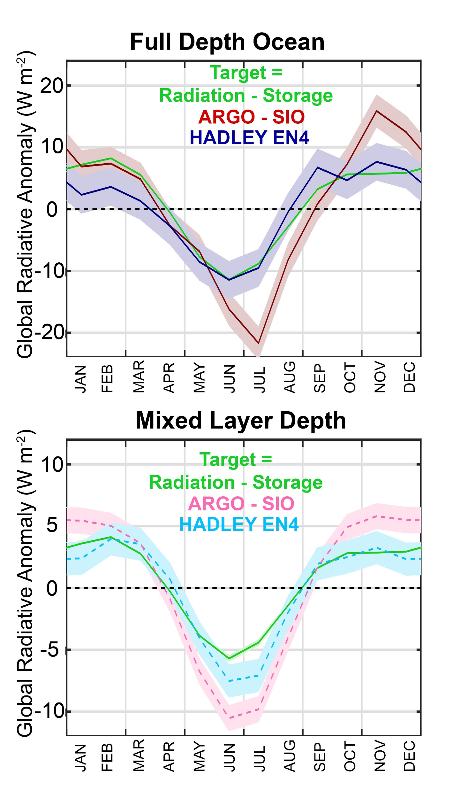
How well does the oceanographic data match the target from TOA minus atmospheric and ice changes?
Two oceanographic data sets are compared
Scripps (SIO) objectively analyzed ARGO measurement (Roemmich and Gilson, 2009)
UK Met Office EN4 ( Good et al. 2013)
EEI from HAD EN4 agrees with those from satellite radiation within the error bounds whereas the ARGO SIO product does not
Differences between the two data sets seems to be in the mixed layer

Slide 12
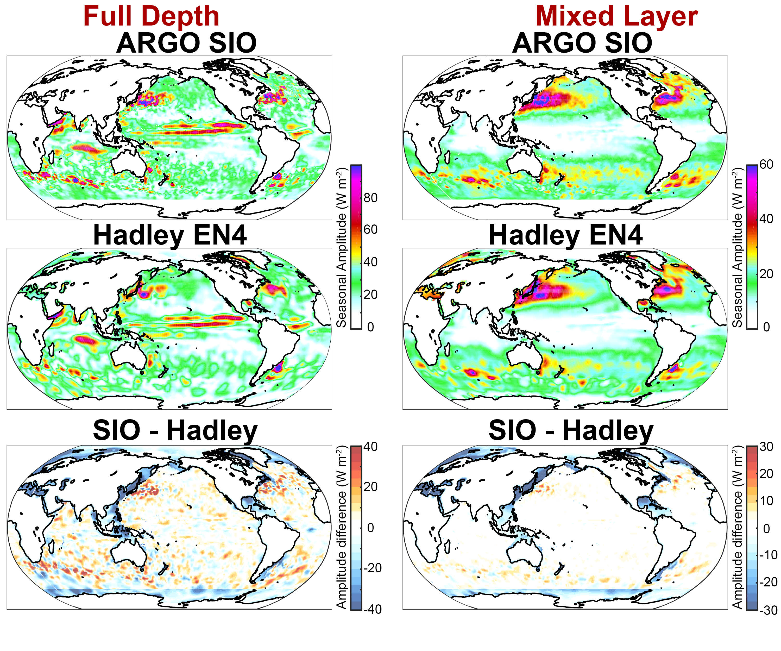
Major difference between the HAD EN4 and ARGO/SIO products:
SIO doe not include data from continental shelves and marginal seas
The latter has a large impact on global seasonal since the discluded region are predominantly in the Northern Hemisphere

Slide 13

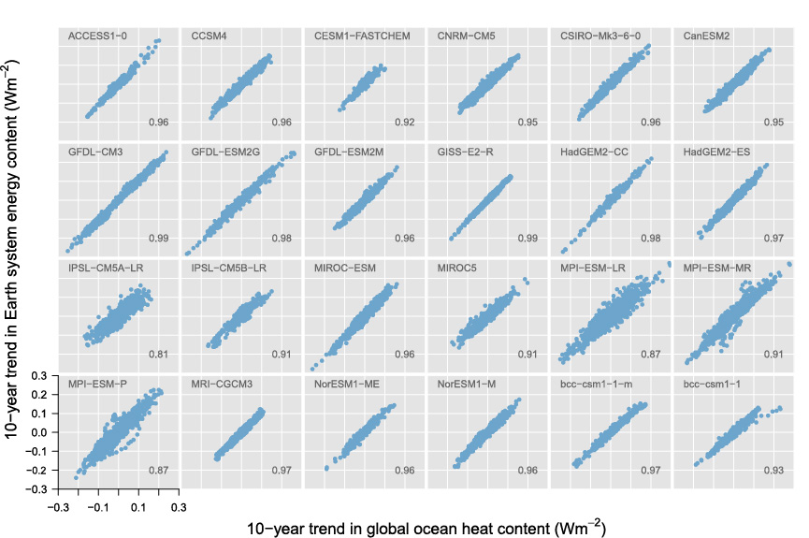
If we can trust Earth’s Energy Imbalance (EEI) from oceanographic and radiative data, what can we say about climate sensitivity from interannual variability?
Foundational equation
Internal Variability of EEI in climate models
=
d/dt(Ocean Energy)
RAD_{TOA}
X
X
C dT/dt =F - λT
RAD_{TOA} (W m⁻²)
d/dt(Ocean Energy) -- W m⁻²
Palmer and McNeall 2014

Slide 14
If we can trust Earth’s Energy Imbalance (EEI) from oceanographic and radiative data, what can we say about climate sensitivity from interannual variability?
Foundational equation
Internal Variability Temperature trend and EEI in climate models
=
d/dt(Ocean Energy)
RAD_{TOA}
X
X
C dT/dt =F - λT
d/dt(Ocean Energy) – W m⁻²
d/dt(T)-- K per decade
Palmer and McNeall 2014

Slide 15
If we can trust Earth’s Energy Imbalance (EEI) from oceanographic and radiative data, what can we say about climate sensitivity from interannual variability?
Foundational equation
=
d/dt(Ocean Energy)
RAD_{TOA}
X
X
C dT/dt =F - λT
Forster 2016

Slide 16
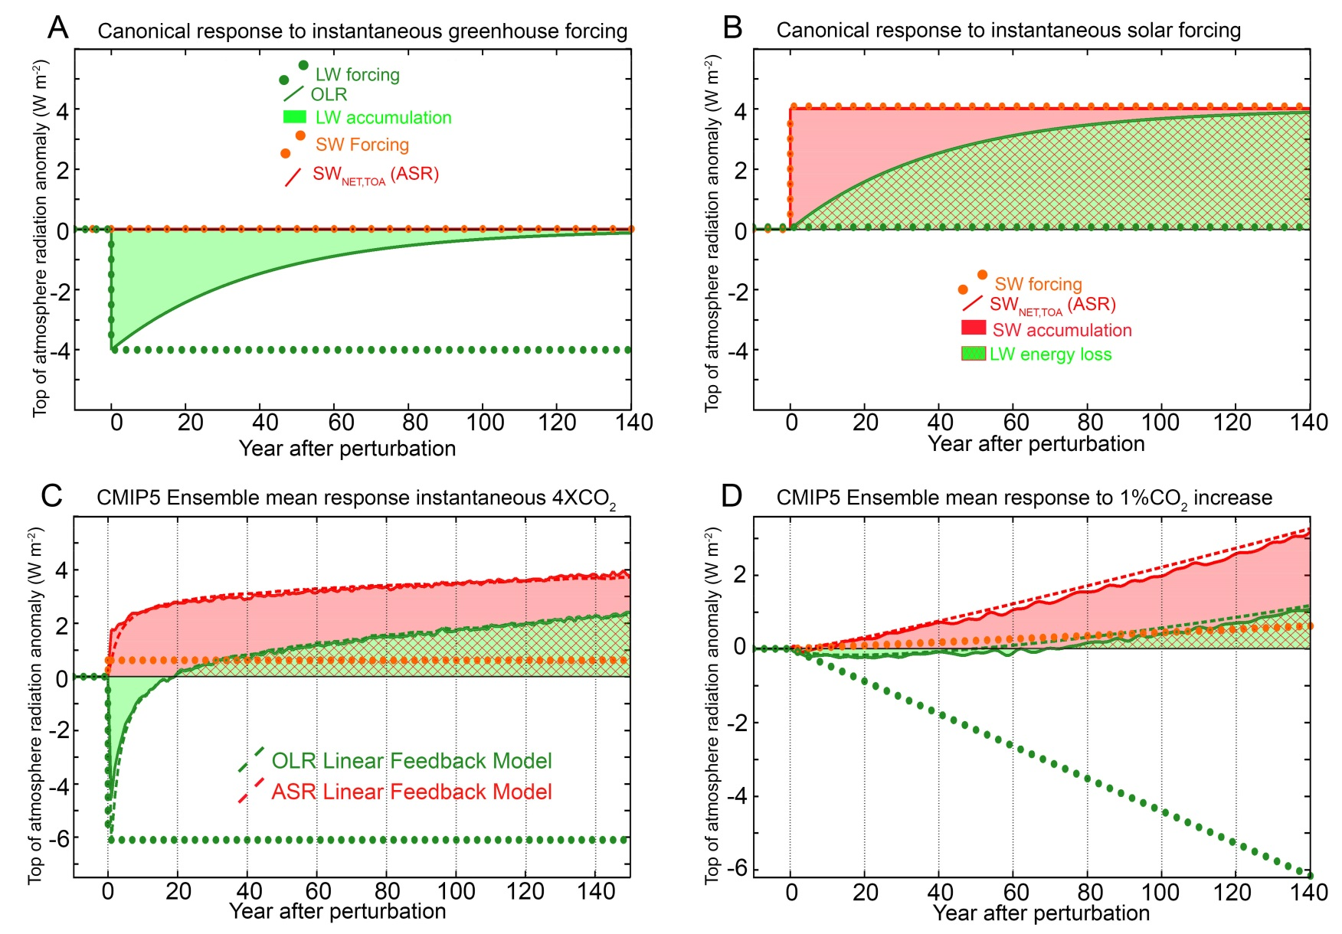
How would we “detect” global warming (EEI) from satellite radiation trends?
In the canonical response to greenhouse forcing, EEI results from reduction in OLR
In climate models forced (abruptly) with CO2, EEI results from an enhancement of absorbed solar radiation

Slide 17
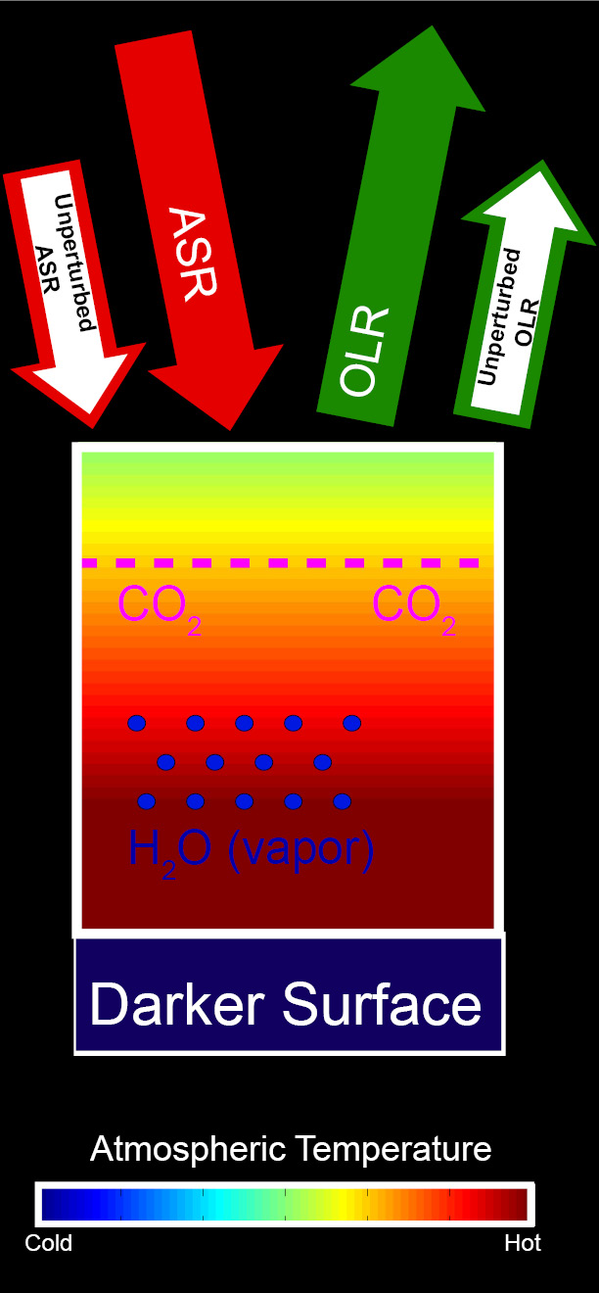
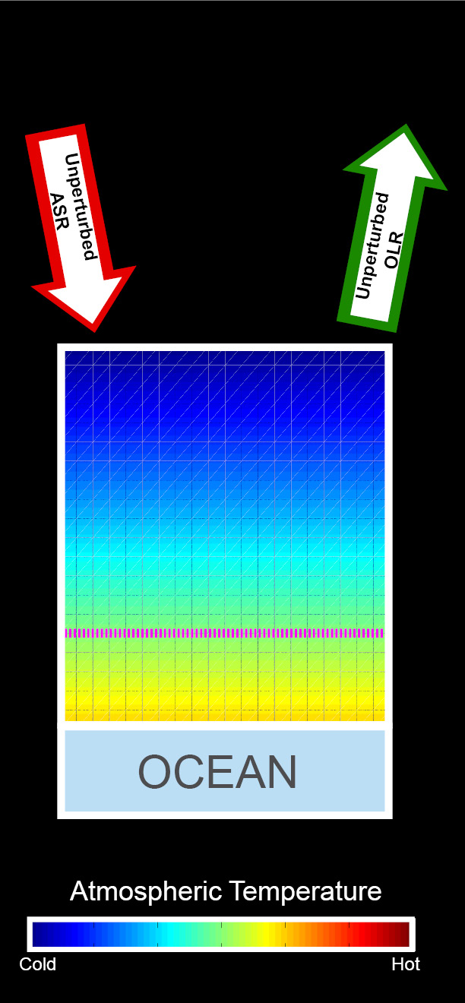
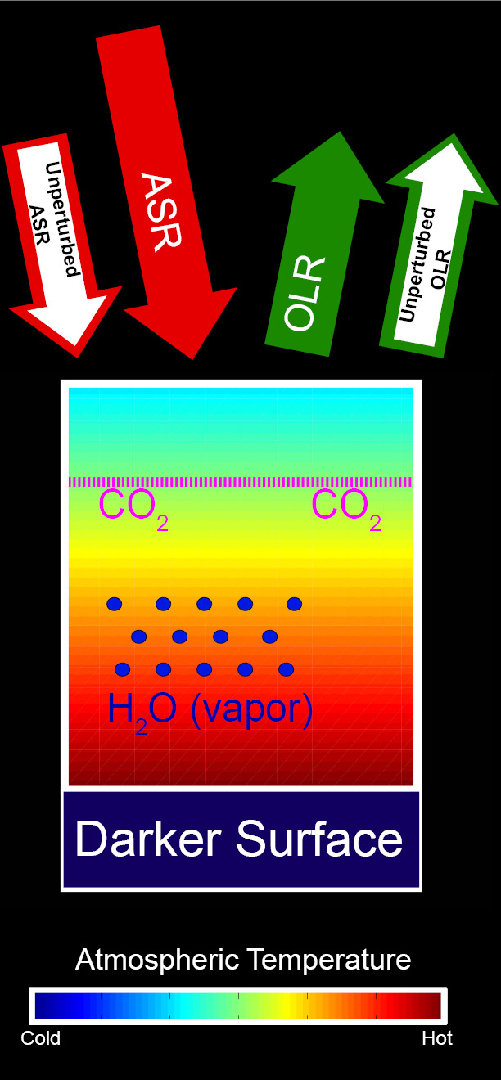
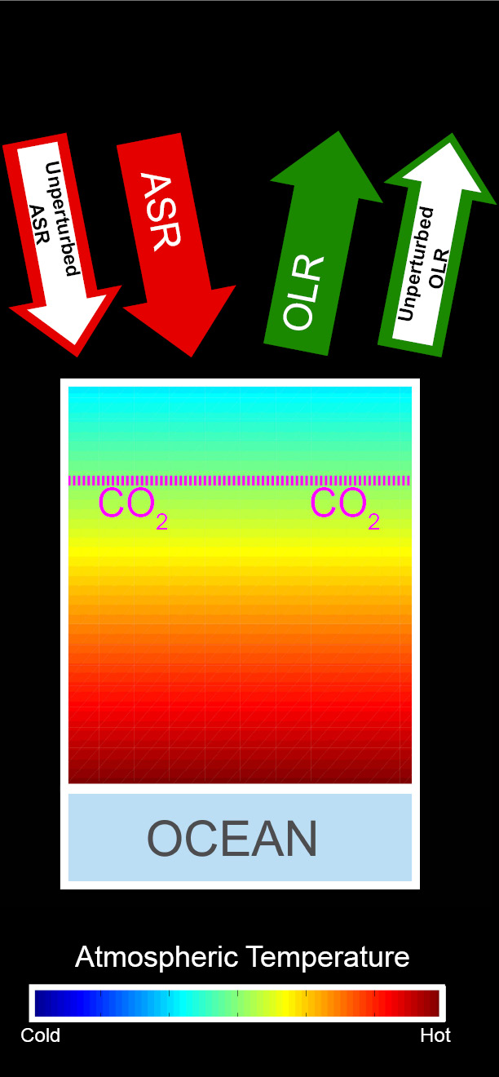
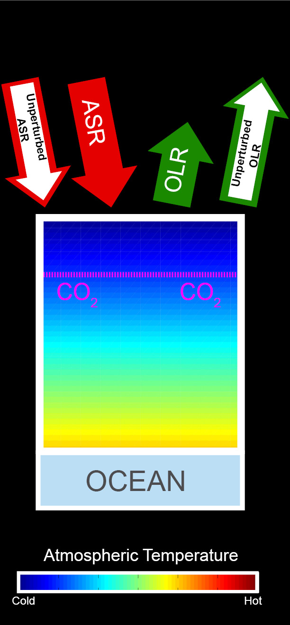
Energetic response to increased CO₂
Increased ASR
Unperturbed
Balanced Initial System
CO₂ added
Warming
CO₂ reduces OLR → energy imbalance
Warming →
OLR increases
Moistening and darkening → ASR increases
Additional warming
→ OLR balances increased ASR

Slide 18
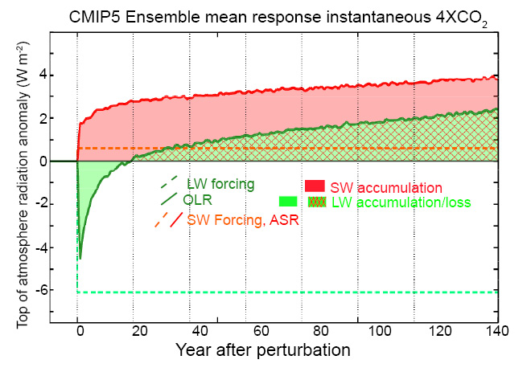
Response of absorbed solar radiation and outgoing longwave radiation to carbon dioxide
Donohoe et. al (2014):Shortwave and longwave contributions to global warming under increasing CO2. Proceedings of the National Academy of Sciences.

Slide 19
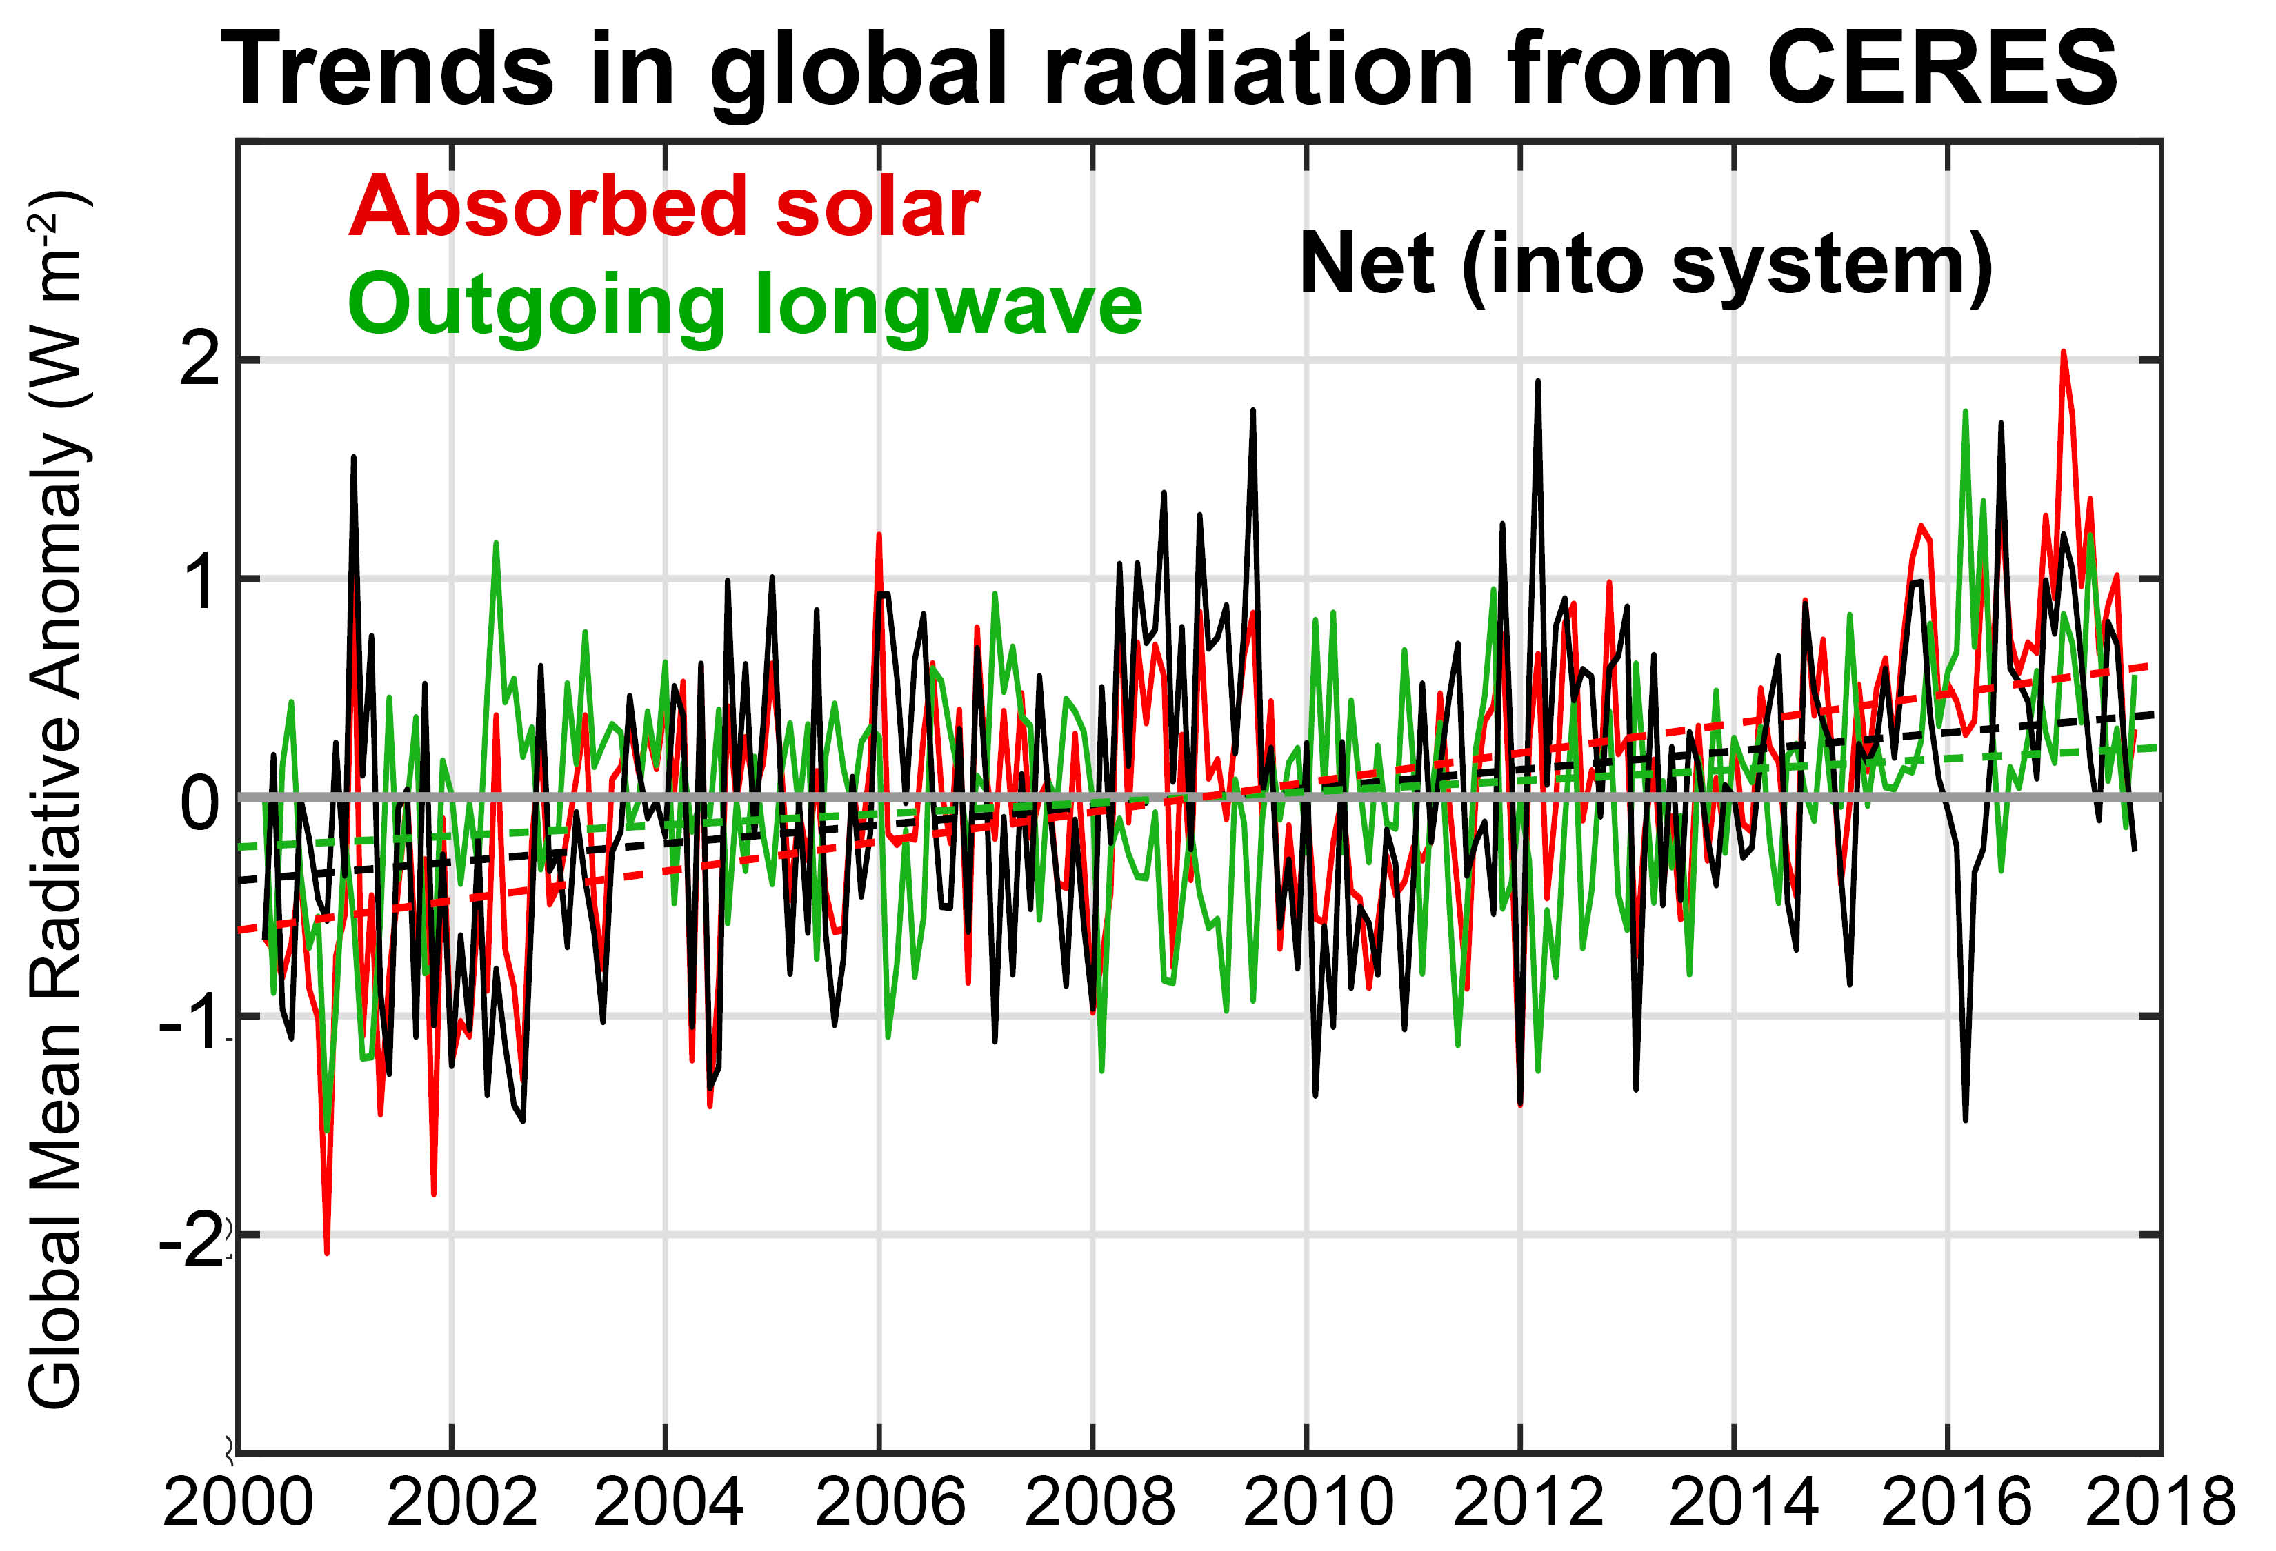
Trends in satellite radiation (CERES)
No significant trend prior to 2015
Full time period shows increase in net radiation due to an increase in absorbed solar radiation that exceeds the modest increase in outgoing longwave radiation
Consistent with CMIP5 response to increasing greenhouse gases?

Slide 20
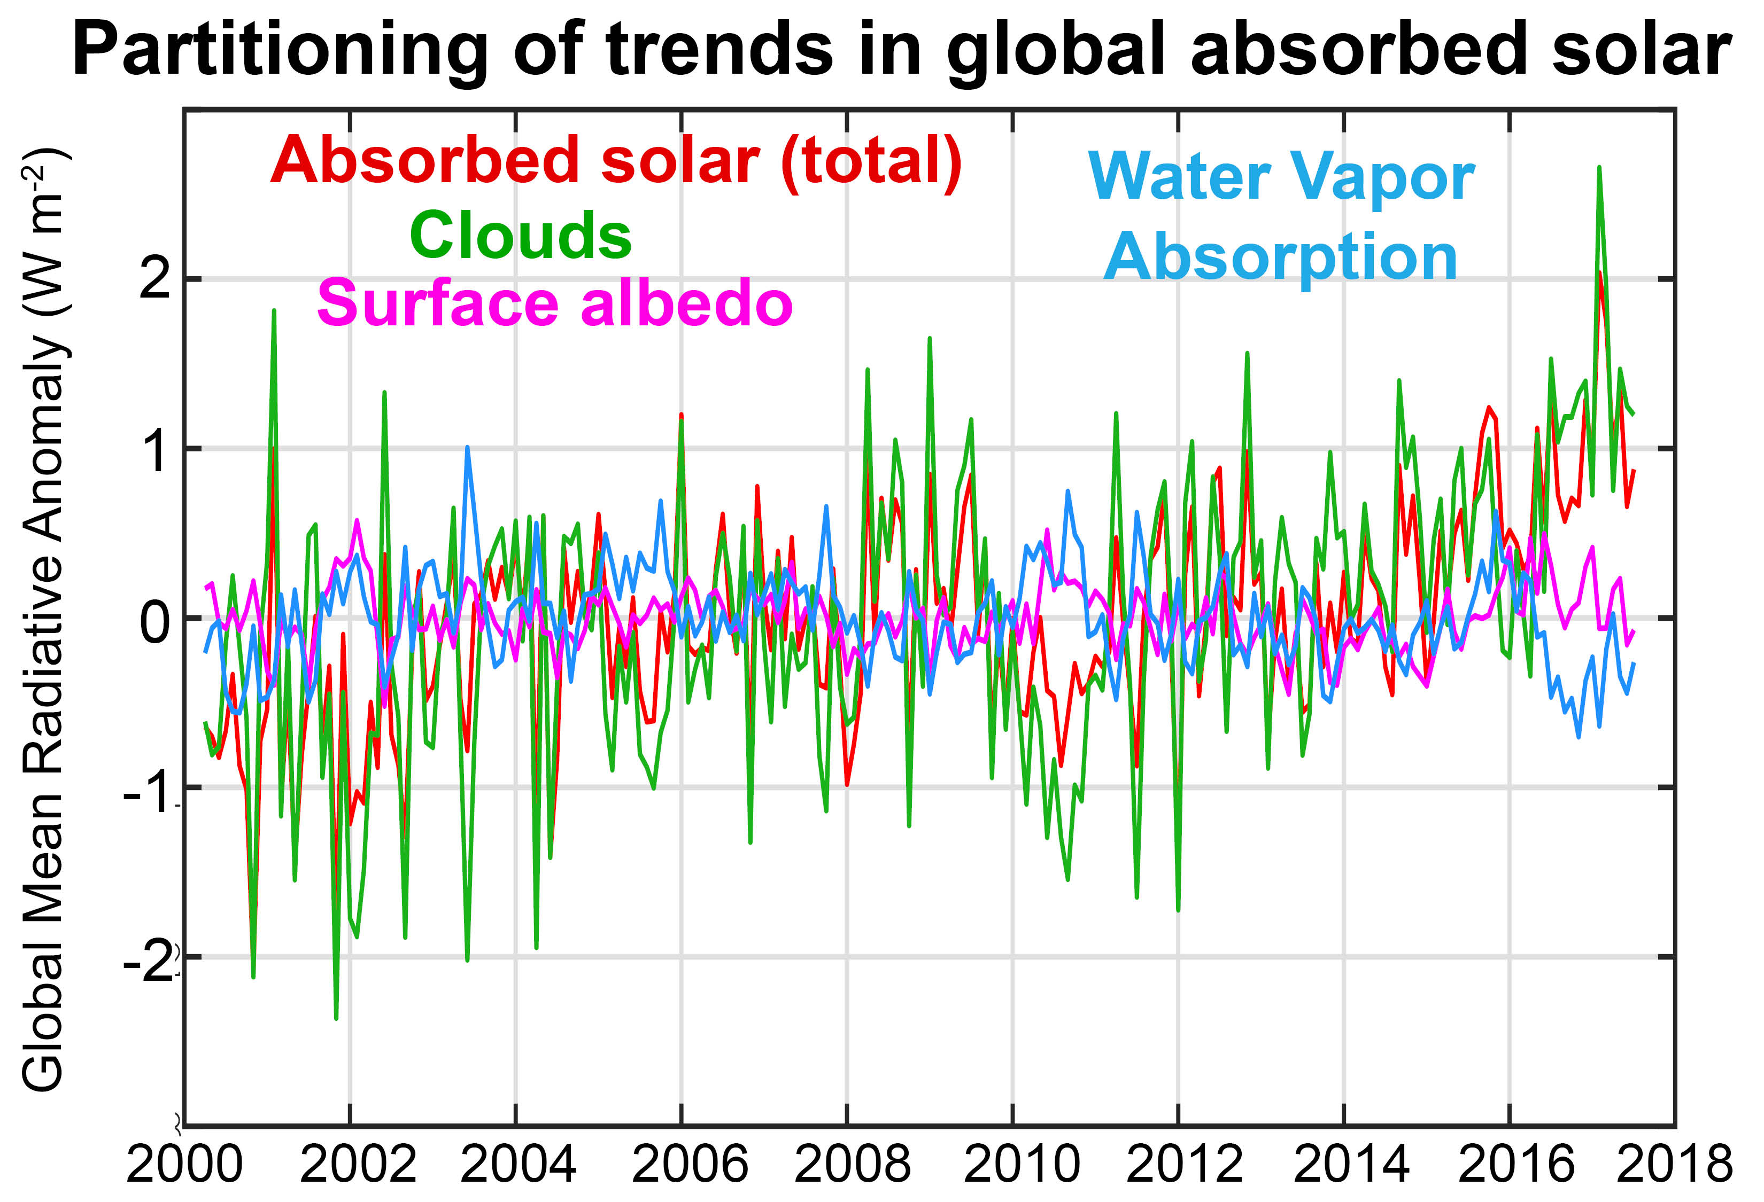

Trends in satellite radiation (CERES)
Full time period shows increase in net radiation due to an increase in absorbed solar radiation that exceeds the modest increase in outgoing longwave radiation
Consistent with CMIP5 response to increasing greenhouse gases?
Cause of increase absorbed solar radiation
Reflected
cloud
absorbed
?
H₂0
(vapor)
transmitted
ice

Slide 21

This is what I’ve been talking about
RADTOA
Observational estimates of the absolute magnitude of Earth Energy imbalance (EEI) is only known from ocean heat content changes
Surface energy flux
Ocean Storage
EEI from TOA radiation and ocean heat content seem self consistent over: (1) seasonal cycle and (2) inter-annual variability
→ Unclear how to use this information to figure out climate sensitivity
Atmosphere
We expect trends in EEI measured from TOA radiation to result from increases in absorbed solar radiation

Slide 22
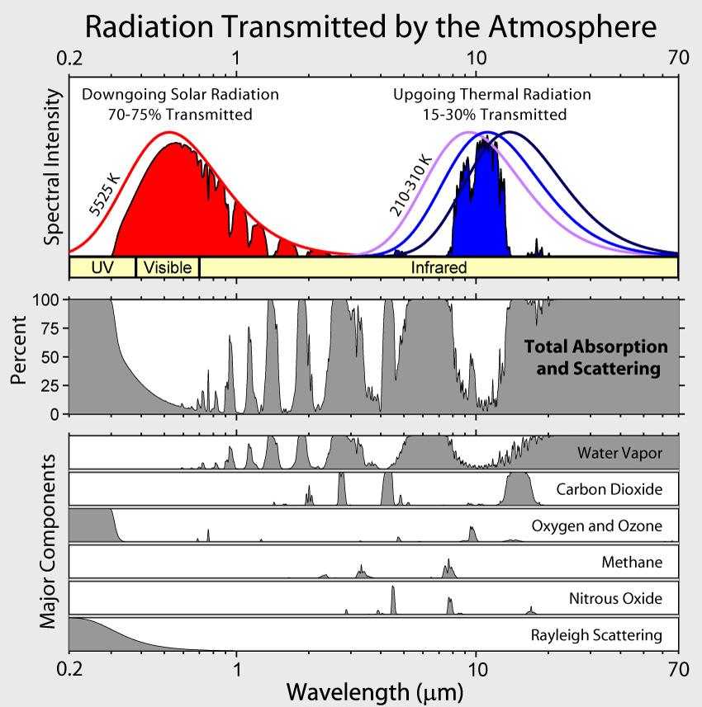
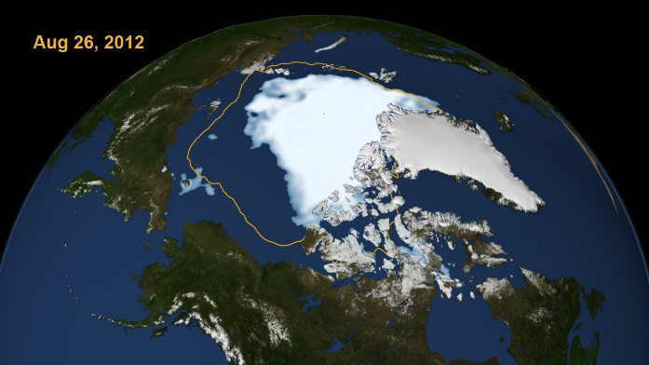
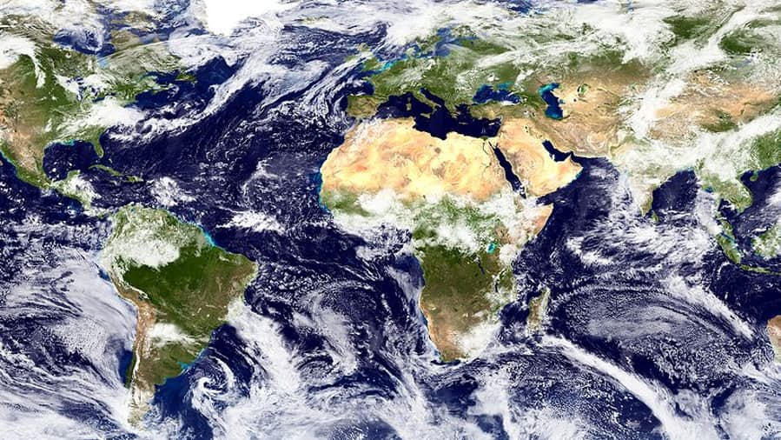
Mechanisms leading to changes in absorbed solar radiation with global warming
1
Moistening of the atmosphere
Enhanced atmospheric solar absorption (water vapor)
Sea ice (and snow) loss
More solar radiation absorbed by surface
2
Cloud Changes
Highly Uncertain
3

Slide 23
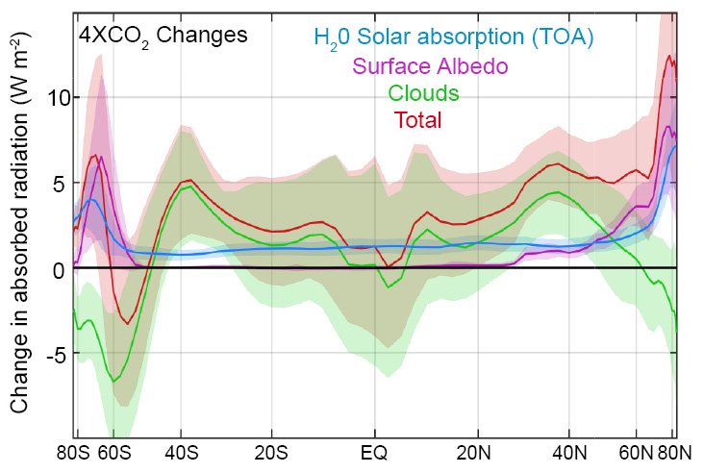
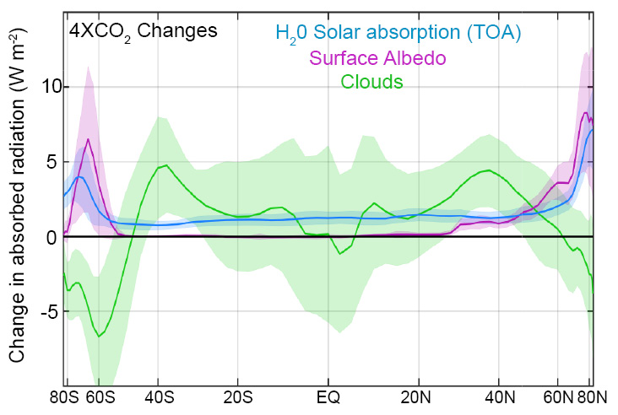
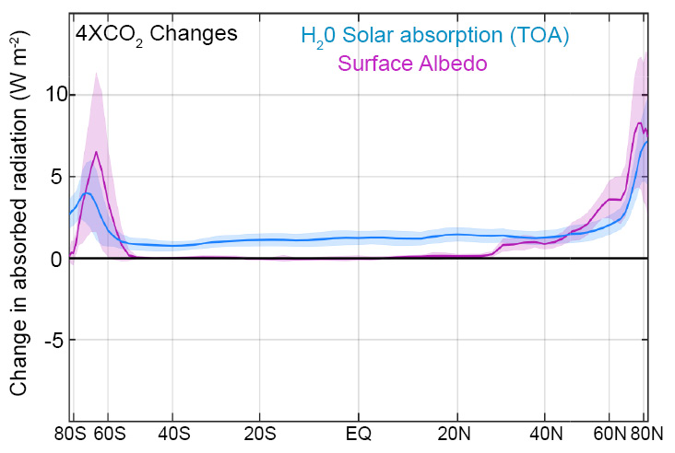
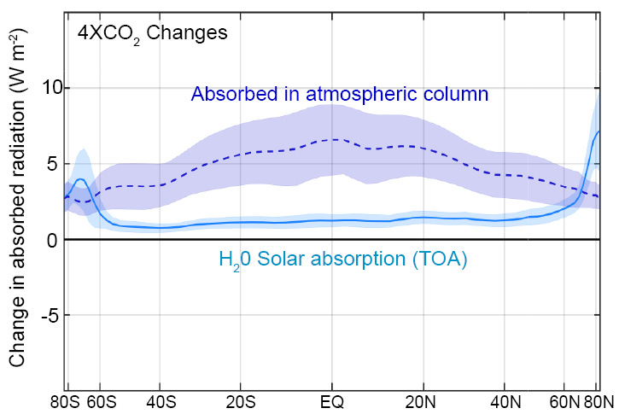
Changes in absorbed solar radiation with global warming
incident
Reflected
cloud
absorbed
?
H₂0
(vapor)
Reflected
surface
transmitted
ice
ocean

Slide 24
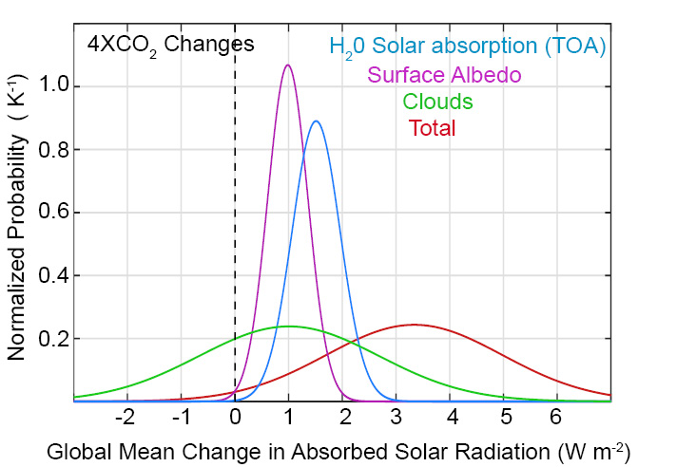
Changes in global mean absorbed solar radiation with increased CO₂
Despite uncertainties in clouds, it is highly likely that the climate system will absorb more solar radiation as it warms due to two robust processes:
Moistening of the atmosphere
Melting of sea ice and snow

