Slide 1


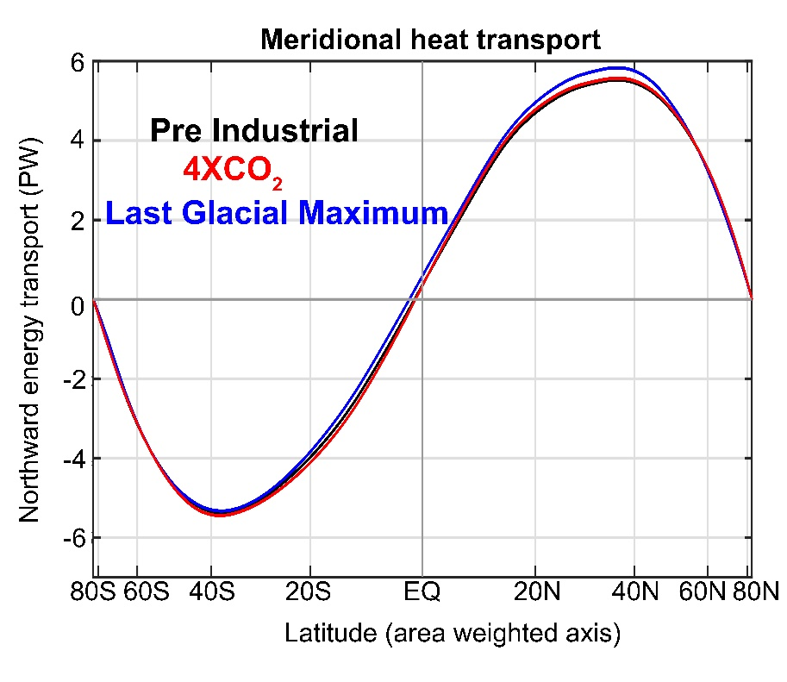






The partitioning of poleward energy transport in the climate system; model biases and the near invariances of total energy transport under climate forcing
Aaron Donohoe – Polar Science Center, APL, UW
Tyler Cox -- UW atmospheric sciences
Robert Fajber – UW atmospheric science
Kyle Armour – UW Oceanography
David Battisti– UW atmospheric sciences
Gerard Roe – UW Earth and Space Sciences
Lily Hahn– UW atmospheric sciences

Slide 2


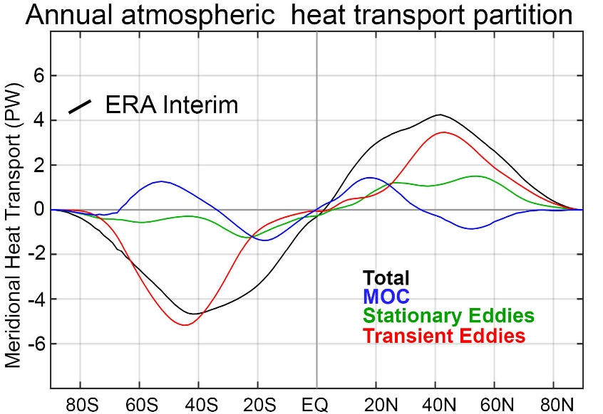
Dynamics perspective
Radiative perspective
meridional energy transport
5.8 PW
=
Net radiative
Deficit of extratropics
Absorbed Solar
Emitted
(Outgoing Longwave)
Net
Tropics
Extratropics
Notes:
NH = 8.2 - 2.4 = 5.8
SH = 9.0 – 3.2 = 5.8

Slide 3



Radiative perspective of energy transport
5.8 PW
ASR*
OLR*
8.2 PW
2.4 PW
-
Heat
Transport
=
Notes:
NH = 8.2 - 2.4 = 5.8
SH = 9.0 – 3.2 = 5.8

Slide 4
ASR*, OLR*, MHT, and the tropical/extratropical energy budget
OLR*
ASR*
2.4 PW
8.2 PW
MHT =
ASR* - OLR*
MHT
Tropics
5.8 PW
To extratropics
All arrows are relative to the global average

Slide 5
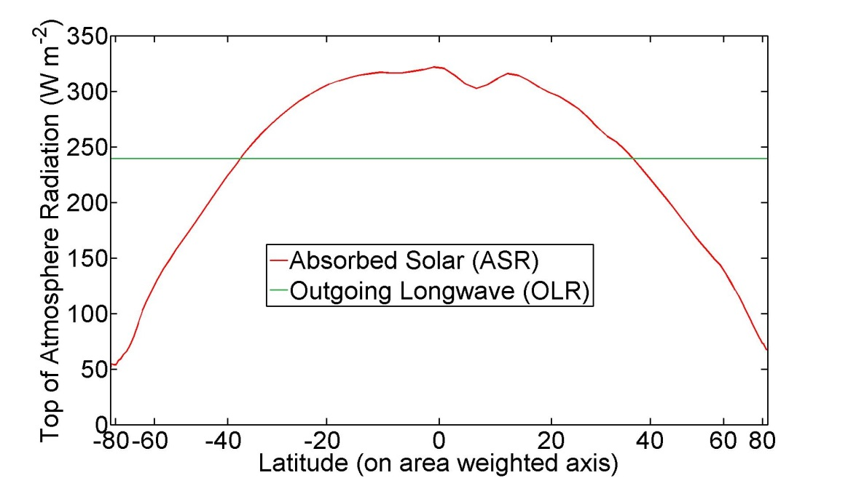

ASR*, OLR*, MHT
Dynamic Limit
MHT = ASR*
OLR* = 0
ASR*
9.0 PW
8.2 PW
8.2 PW
MHT
Tropics
8.2 PW
To extratropics
All arrows are relative to the global average

Slide 6
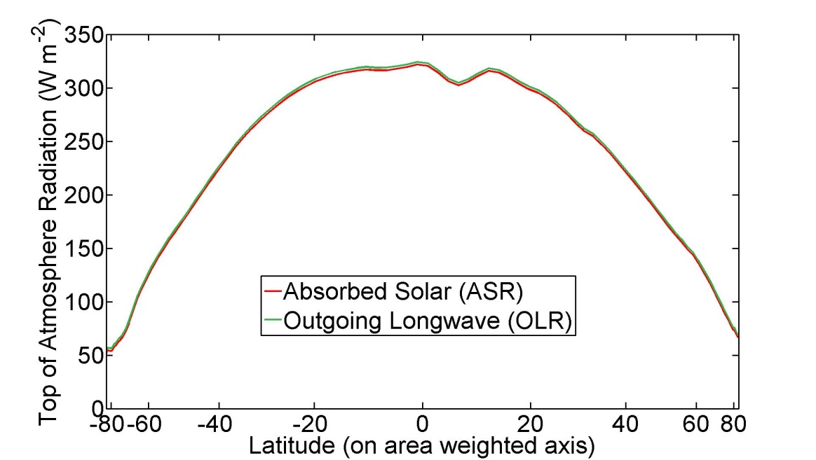
ASR*, OLR*, MHT
Radiative Limit
MHT = 0 ,
ASR* = OLR*
ASR*
8.2 PW
OLR*
8.2 PW
MHT
Tropics
0 PW
To extratropics
All arrows are relative to the global average

Slide 7
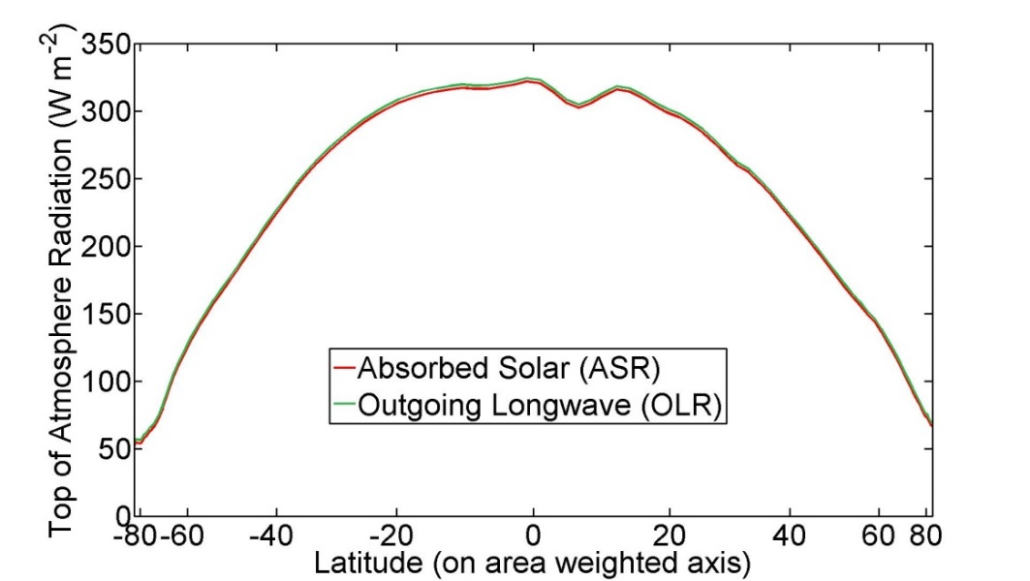
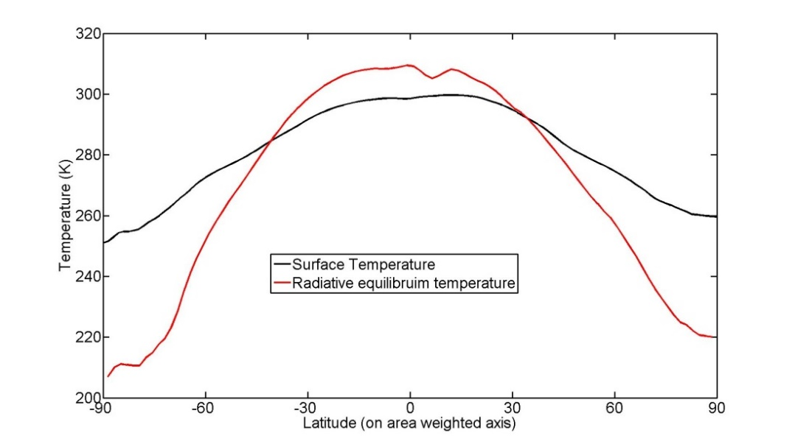
The equator-to-pole temperature gradient in the radiative limit
Equator-to-pole temperature gradient of 100K needed for OLR to balance ASR are each latitude
→Poleward heat transport is responsible for Earth being habitable

Slide 8
In the observed climate system, dynamics are more efficient than radiation at moderating the equator-to-pole temperature gradient
ASR*
OLR*
8.2 PW
2.4 PW
MHT
5.8 PW
To extratropics
Tropics

Slide 9
Radiative perspective
Absorbed Solar
Emitted
(Outgoing Longwave)
Net
Tropics
Extratropics
Dynamics perspective
Notes:
NH = 8.2 - 2.4 = 5.8
SH = 9.0 – 3.2 = 5.8

Slide 10



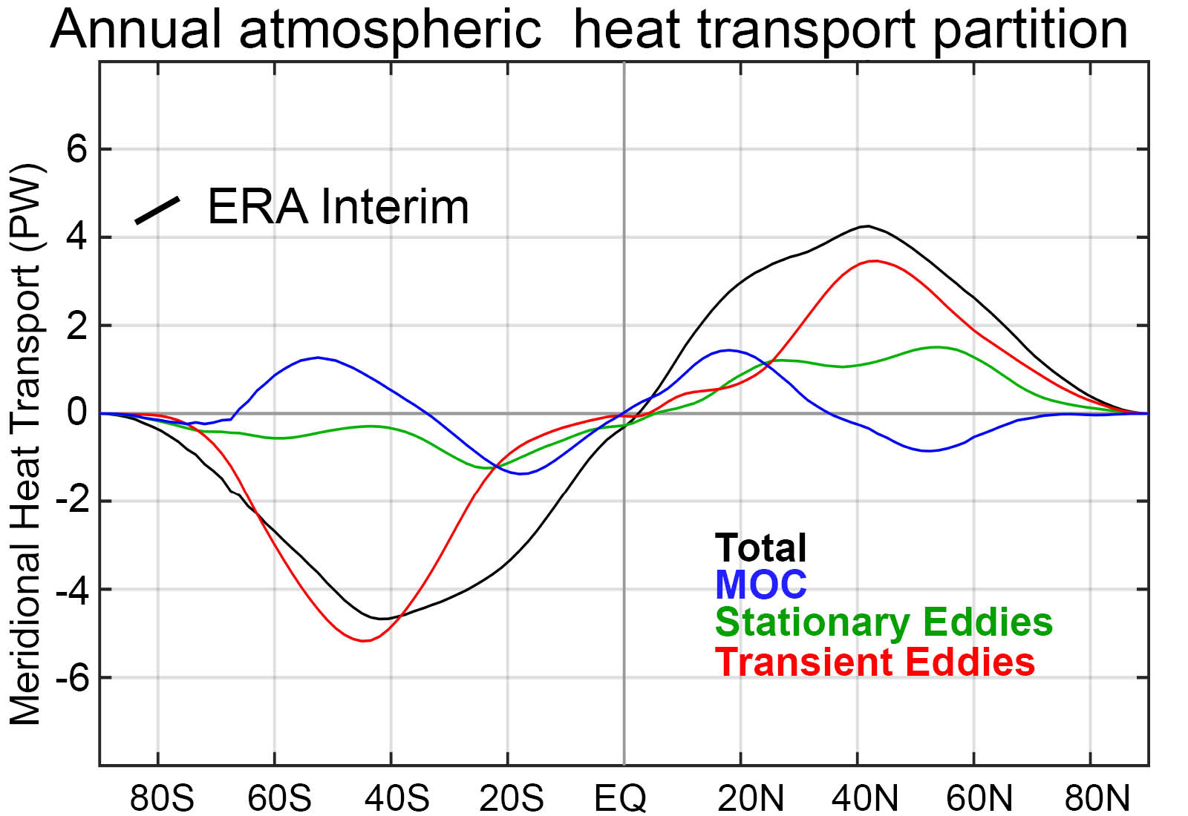
Stationary
Partitioning of atmospheric energy by circulation type
MOC
Overturning
Transient
* = Departure from zonal mean -- [ ]
' = Departure from time mean -- ¯
MSE = moist static energy
= CpT + LQ +gZ
MOC dominates in the deep tropics – Hadley cell
Stationary eddies stronger in NH
Transient eddies dominate the mid-latitudes

Slide 11
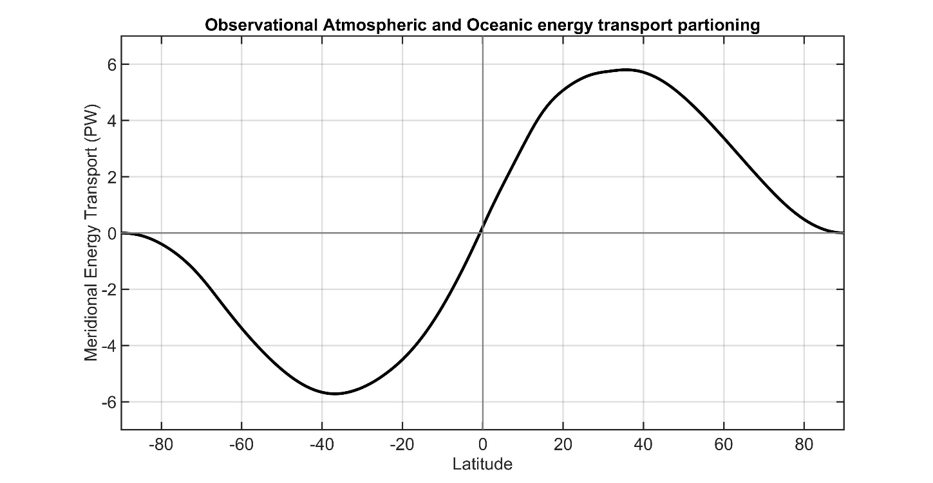
Total (atmosphere plus ocean) energy transport from TOA radiation (CERES satellite).
Tropics
Extratropics
Total
Notes:
NH = 8.2 - 2.4 = 5.8
SH = 9.0 – 3.2 = 5.8

Slide 12
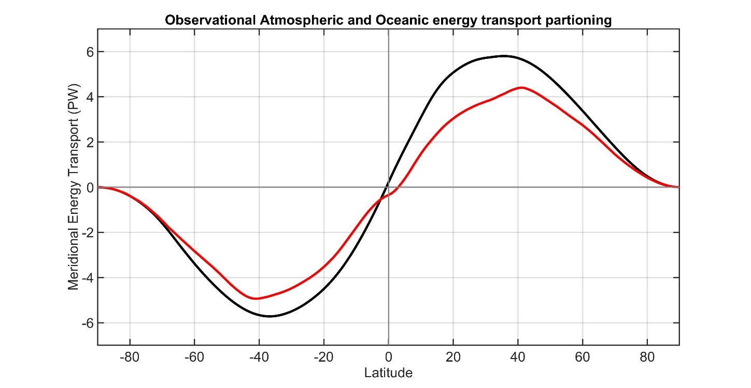
Total (atmosphere plus ocean) energy transport from TOA radiation (CERES satellite).
Atmospheric energy transport from 6 hourly ERA5 reanalysis dynamics calculation
Tropics
Extratropics
Total
Atmosphere
Notes:
NH = 8.2 - 2.4 = 5.8
SH = 9.0 – 3.2 = 5.8

Slide 13
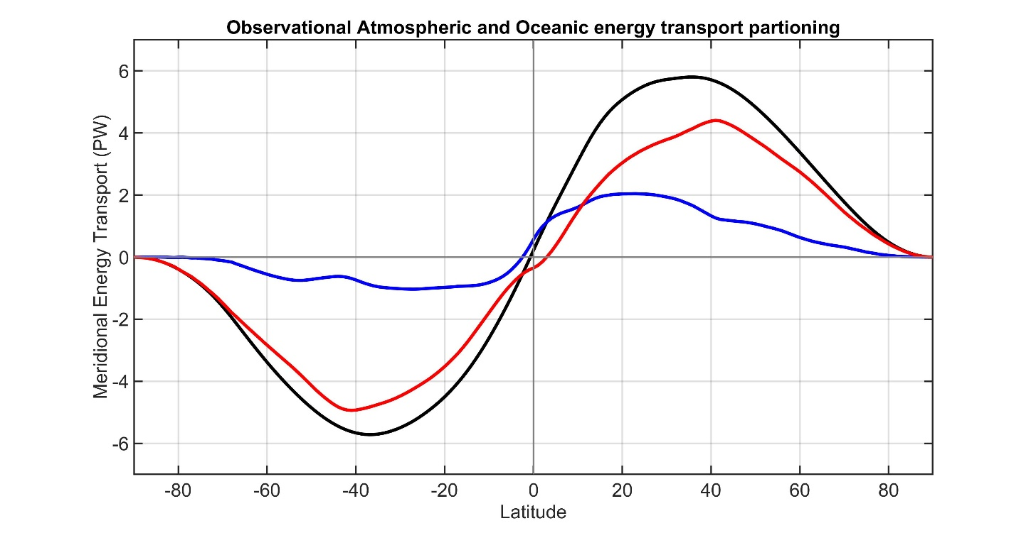
Total (atmosphere plus ocean) energy transport from TOA radiation (CERES satellite).
Atmospheric energy transport from 6 hourly ERA5 reanalysis dynamics calculation
Tropics
Extratropics
Ocean heat transport as the residual = Total - atmos
Total
Atmosphere
Ocean
Notes:
NH = 8.2 - 2.4 = 5.8
SH = 9.0 – 3.2 = 5.8

Slide 14
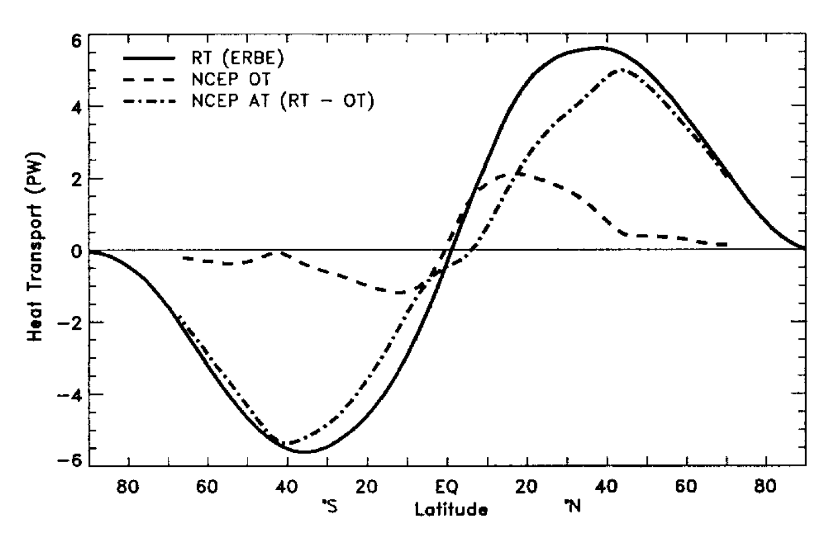
This strategy was pioneered by Trenberth and Caron (2001)
Total
Atmosphere
Ocean
Notes:
NH = 8.2 - 2.4 = 5.8
SH = 9.0 – 3.2 = 5.8

Slide 15
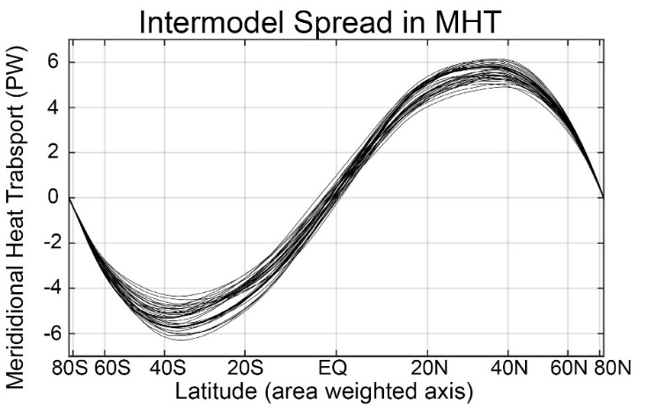

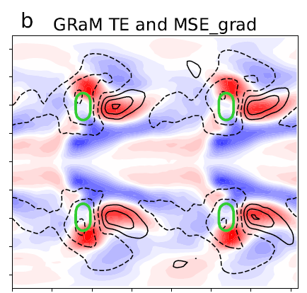
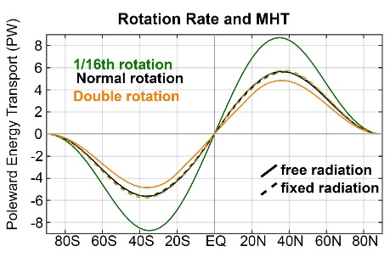
Overview of talk.
Radiative and dynamic perspectives will be used to understand why meridional heat transport (MHT):
1. Varies (20%) between different climate models and is biased relative to observations (in it’s partitioning)
2. Is nearly invariant under past/future forcing
Topography Rotation rate
3. Use of idealized simulation to probe mechanisms of compensation leading to MHT invariance

Slide 16
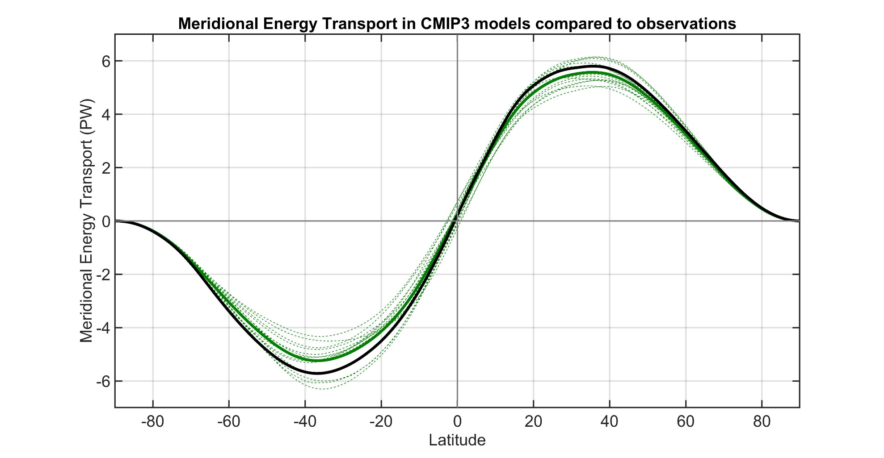
Observations
Individual models
Model Mean
Total (atmosphere plus ocean) meridional heat transport varies by about 20% between models.
→ Also biased low relative to observations especially in the SH
Donohoe and Battisti (2012). What determined meridional heat transport in climate models. J. Climate.

Slide 17
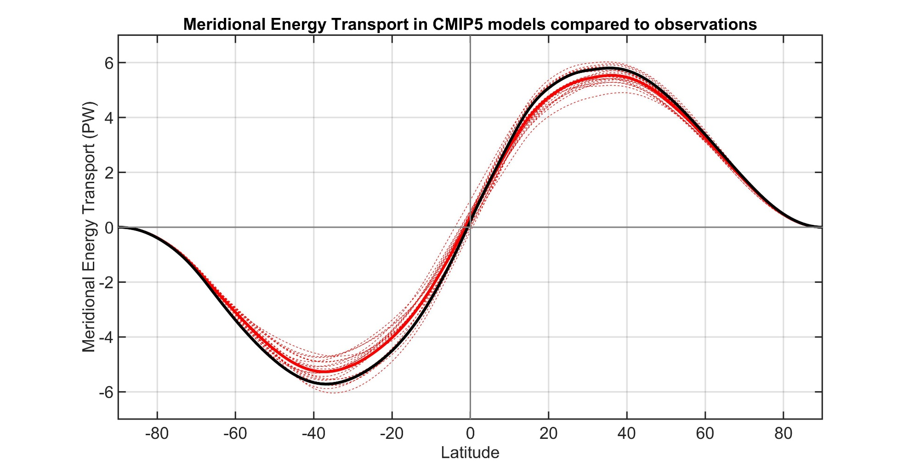
Observations
Individual models
Model Mean

Slide 18
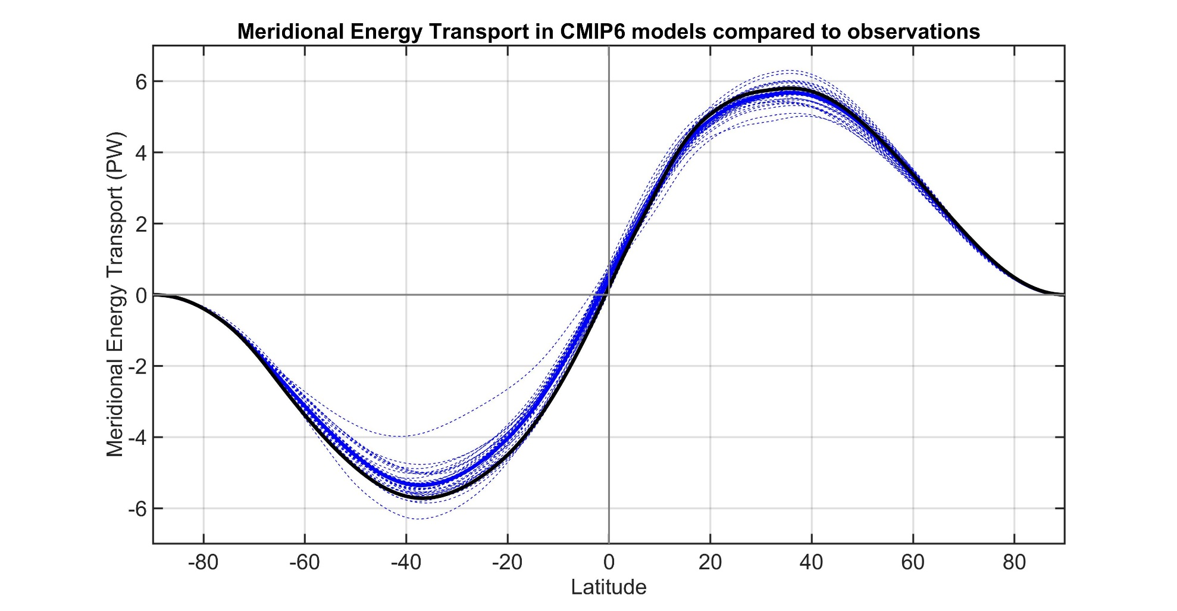
Observations
Individual models
Model Mean

Slide 19
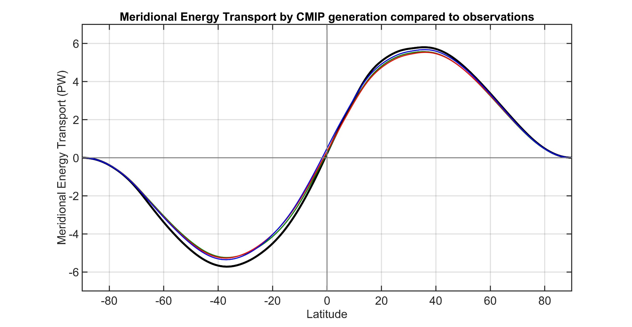
Observations
CMIP3 Mean
CMIP5 Mean
CMIP6 Mean
Inter-model spread and bias in MHT is persistent across generations of CMIP models

Slide 20
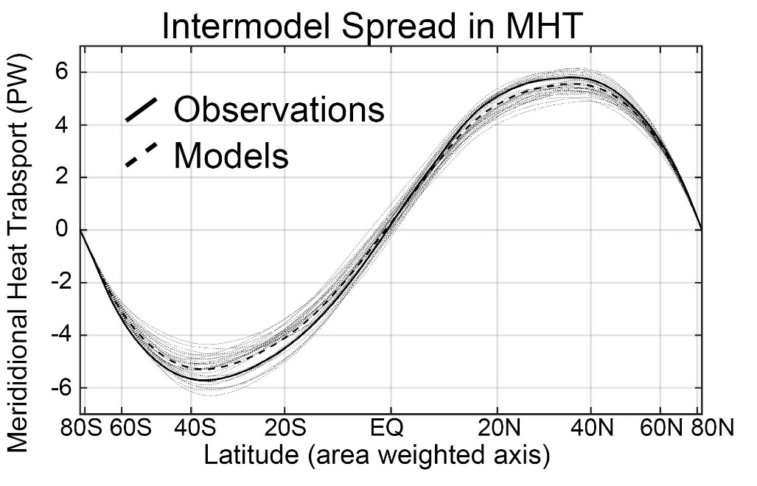
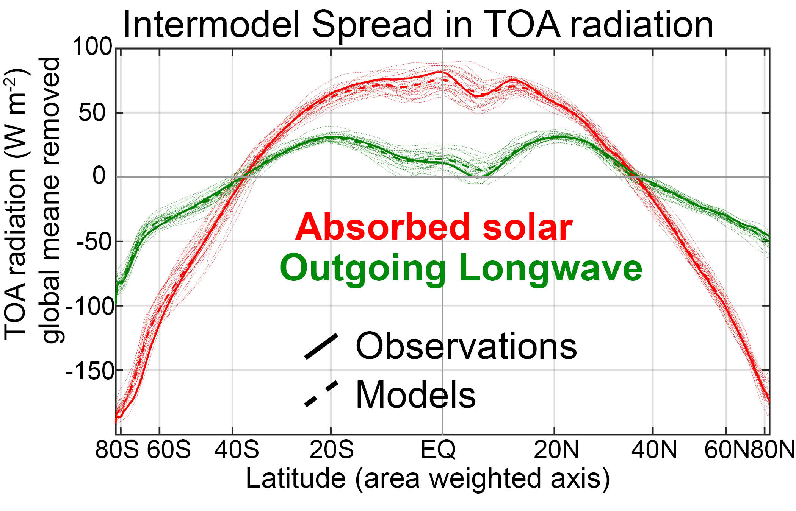

Slide 21

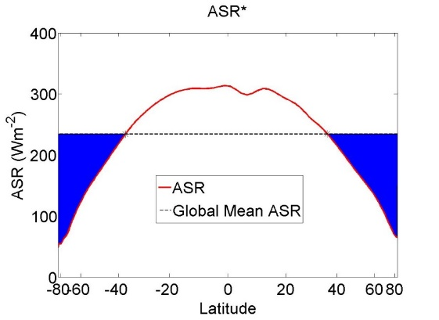
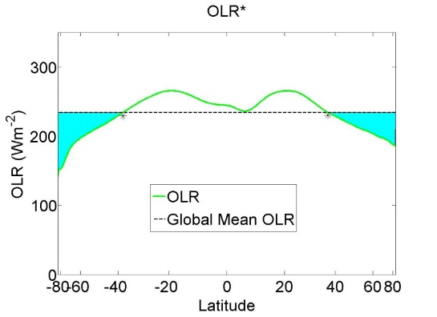

MHT maximum (PW)
MHT = ASR* - OLR*

Slide 22
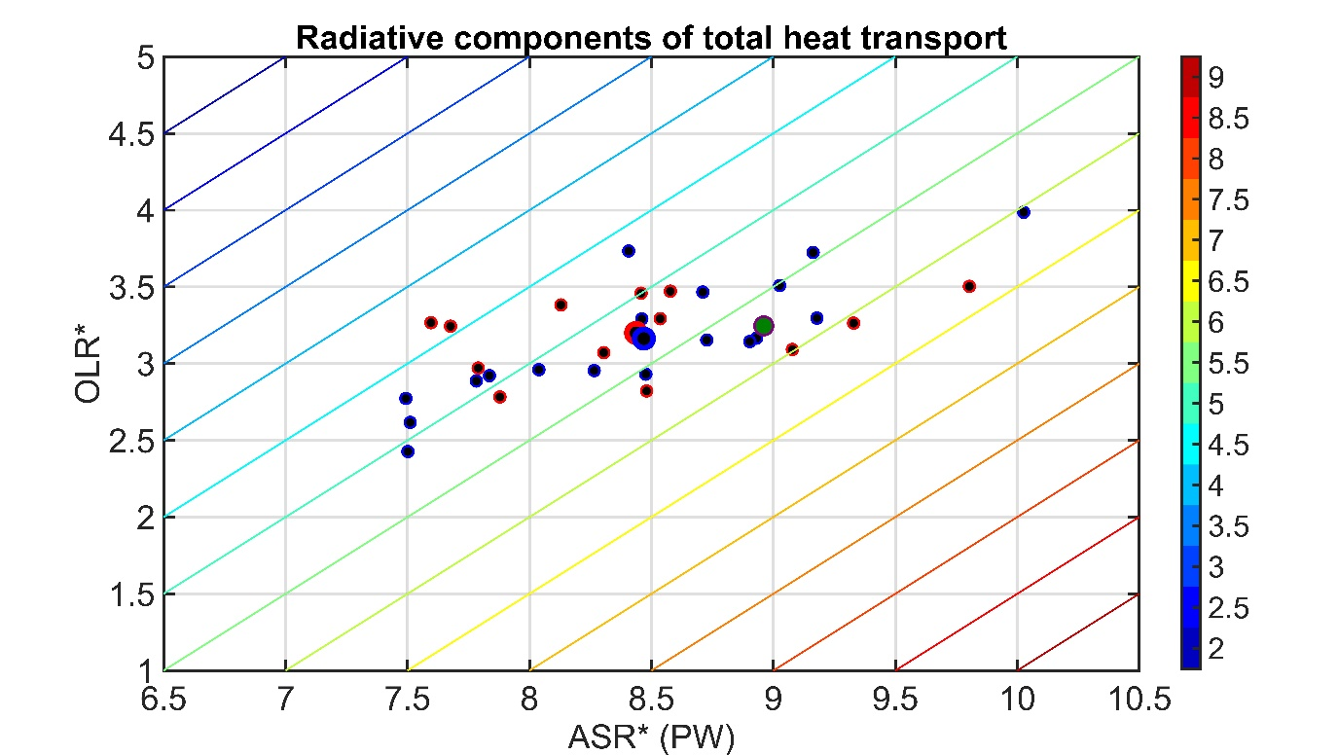
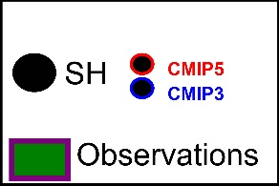
MHT maximum (PW)
MHT = ASR* - OLR*
Southern Hemisphere
Mean state inter-model spread in MHT:
Spread in ASR* exceeds that in OLR
→No compensation between ASR* and OLR*
→ Model mean bias due ASR* -- low planetary albedo of Southern Ocean

Slide 23
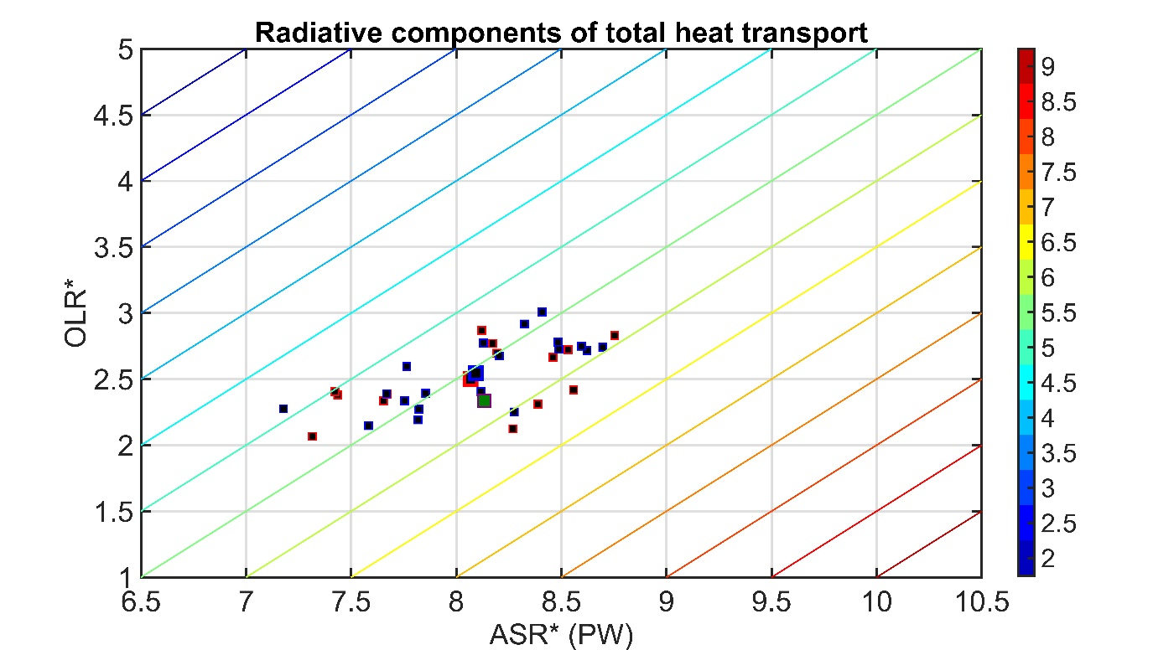
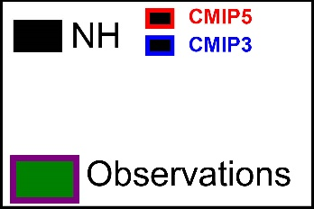
MHT = ASR* - OLR*
MHT maximum (PW)
Northern Hemisphere
Mean state inter-model spread in MHT:
Spread in ASR* exceeds that in OLR
→No compensation between ASR* and OLR*
→ Model mean bias do to too much tropical OLR

Slide 24
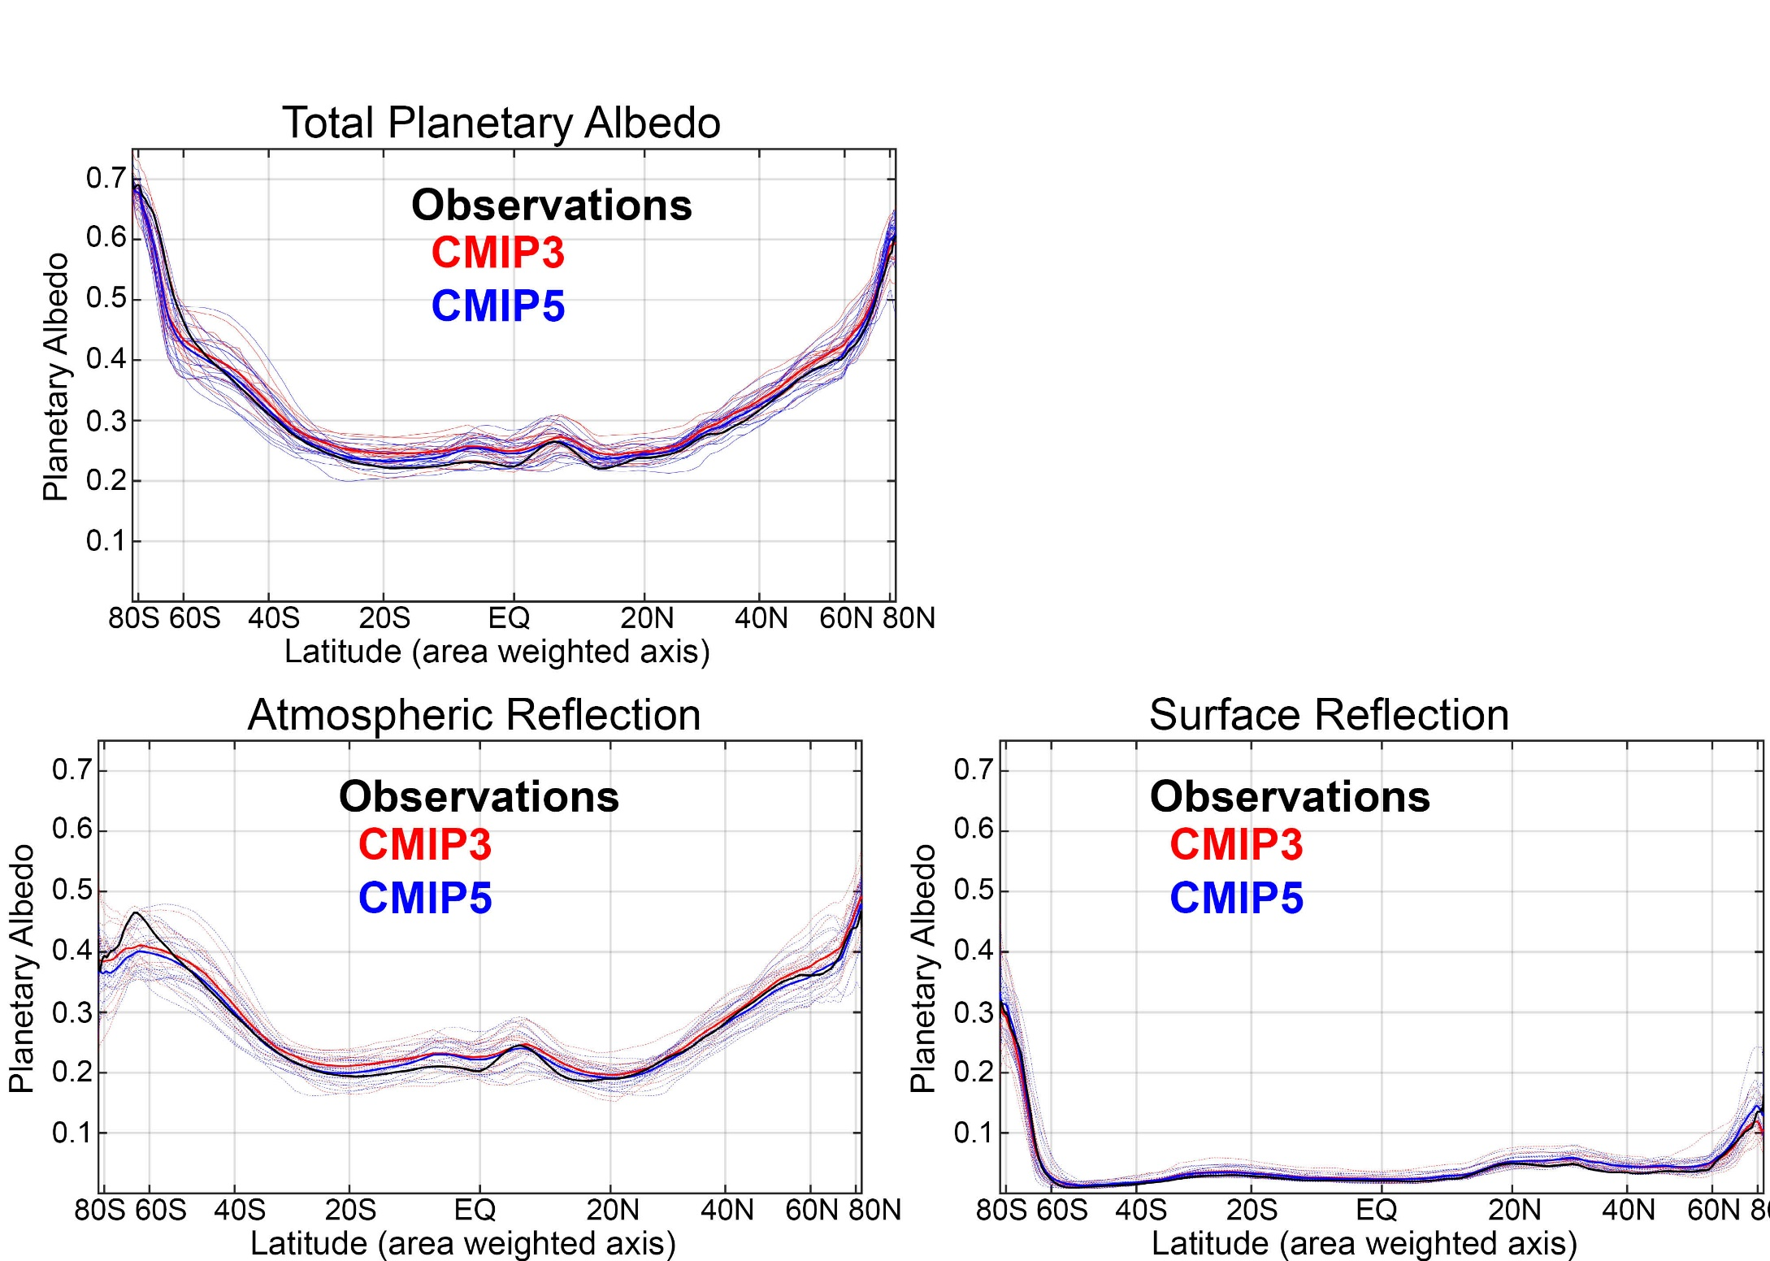
Fraction of solar radiation reflected at TOA (planetary albedo) differs between climate models and is responsible for MHT differences
Due to cloud differences Surface albedo contributes very little to planetary albedo
Donohoe and Battisti (2012). Atmospheric and surface contributions
to planetary albedo J. Climate.

Slide 25
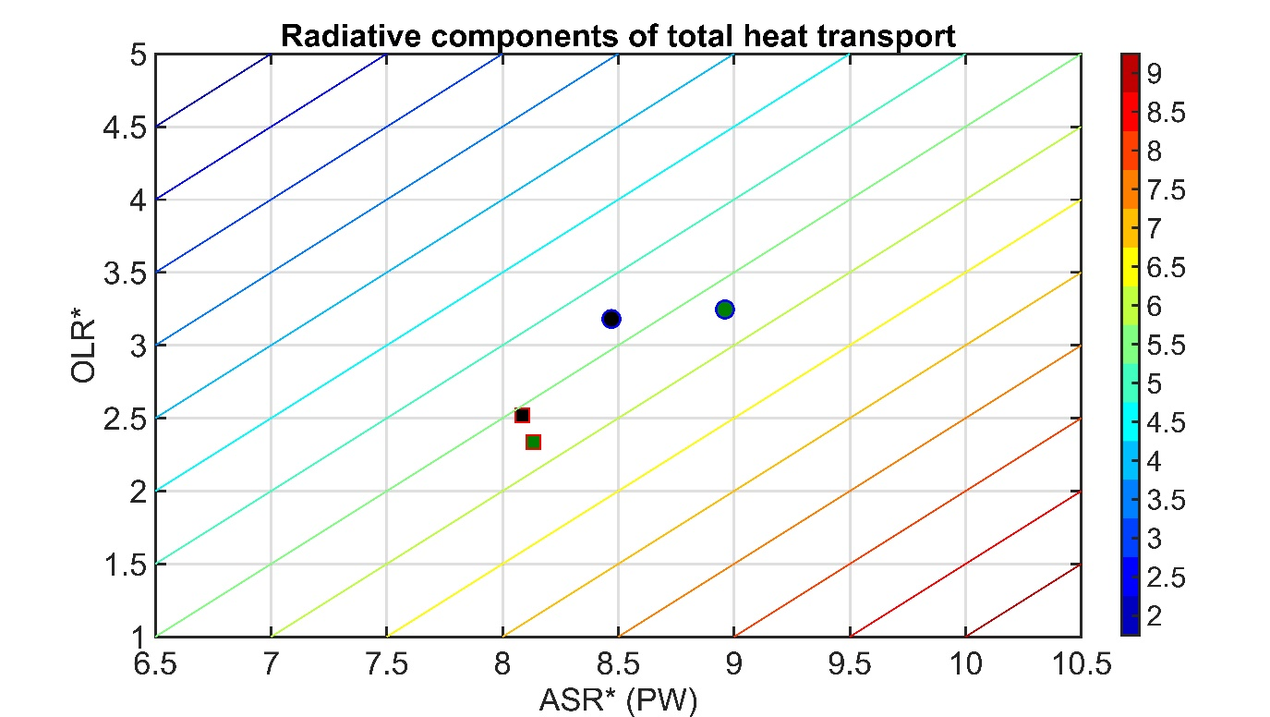
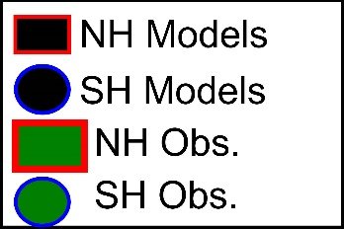
MHT = ASR* - OLR*
MHT maximum (PW)
Northern Hemisphere
Mean state inter-model spread in MHT:
Spread in ASR* exceeds that in OLR
→No compensation between ASR* and OLR*
→ Model mean bias do to too much tropical OLR

Slide 26
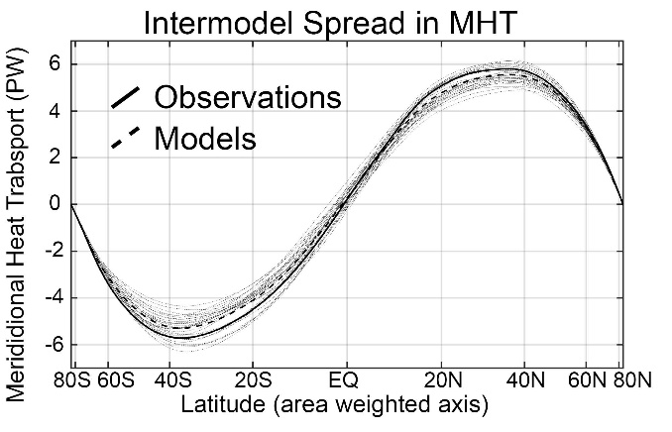
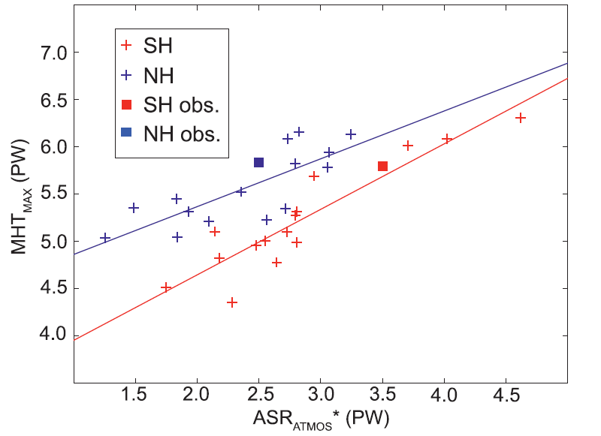
What determines the inter-model spread in MHT?
Cloud Reflection
Equator to pole contrast of absorbed shortwave
Poleward Energy Transport
Poleward Energy Transport
Equator to pole contrast in clouds
Notes:
R^2 NH \\\ 0.63 SH \\\\ 0.84

Slide 27
Total (atmosphere plus ocean) energy transport from TOA radiation (CERES satellite).
Atmospheric energy transport from 6 hourly ERA5 reanalysis dynamics calculation
Tropics
Extratropics
Ocean heat transport as the residual = Total - atmos
Total
Atmosphere
Ocean
Notes:
NH = 8.2 - 2.4 = 5.8
SH = 9.0 – 3.2 = 5.8

Slide 28
Partitioning of MHT in atmospheric (AHT) and ocean (OHT) contributions
MHT from Radiation
Model approach
Net radiative
Deficit of extratropics
5.8 PW
MHT= Integral (TOA)
OHT = Integral (SHF)
AHT = MHT – OHT
= Integral (TOA – SHF)
Tropics
Extratropics
Notes:
NH = 8.2 - 2.4 = 5.8
SH = 9.0 – 3.2 = 5.8

Slide 29
Observational/model comparison
Observational approach
Model approach
MHT= Integral (TOA)
MHT= Integral (TOA)
AHT from dynamics
OHT = Integral (SHF)
OHT = MHT - AHT
AHT = MHT - OHT
Tropics
Extratropics
Notes:
NH = 8.2 - 2.4 = 5.8
SH = 9.0 – 3.2 = 5.8

Slide 30
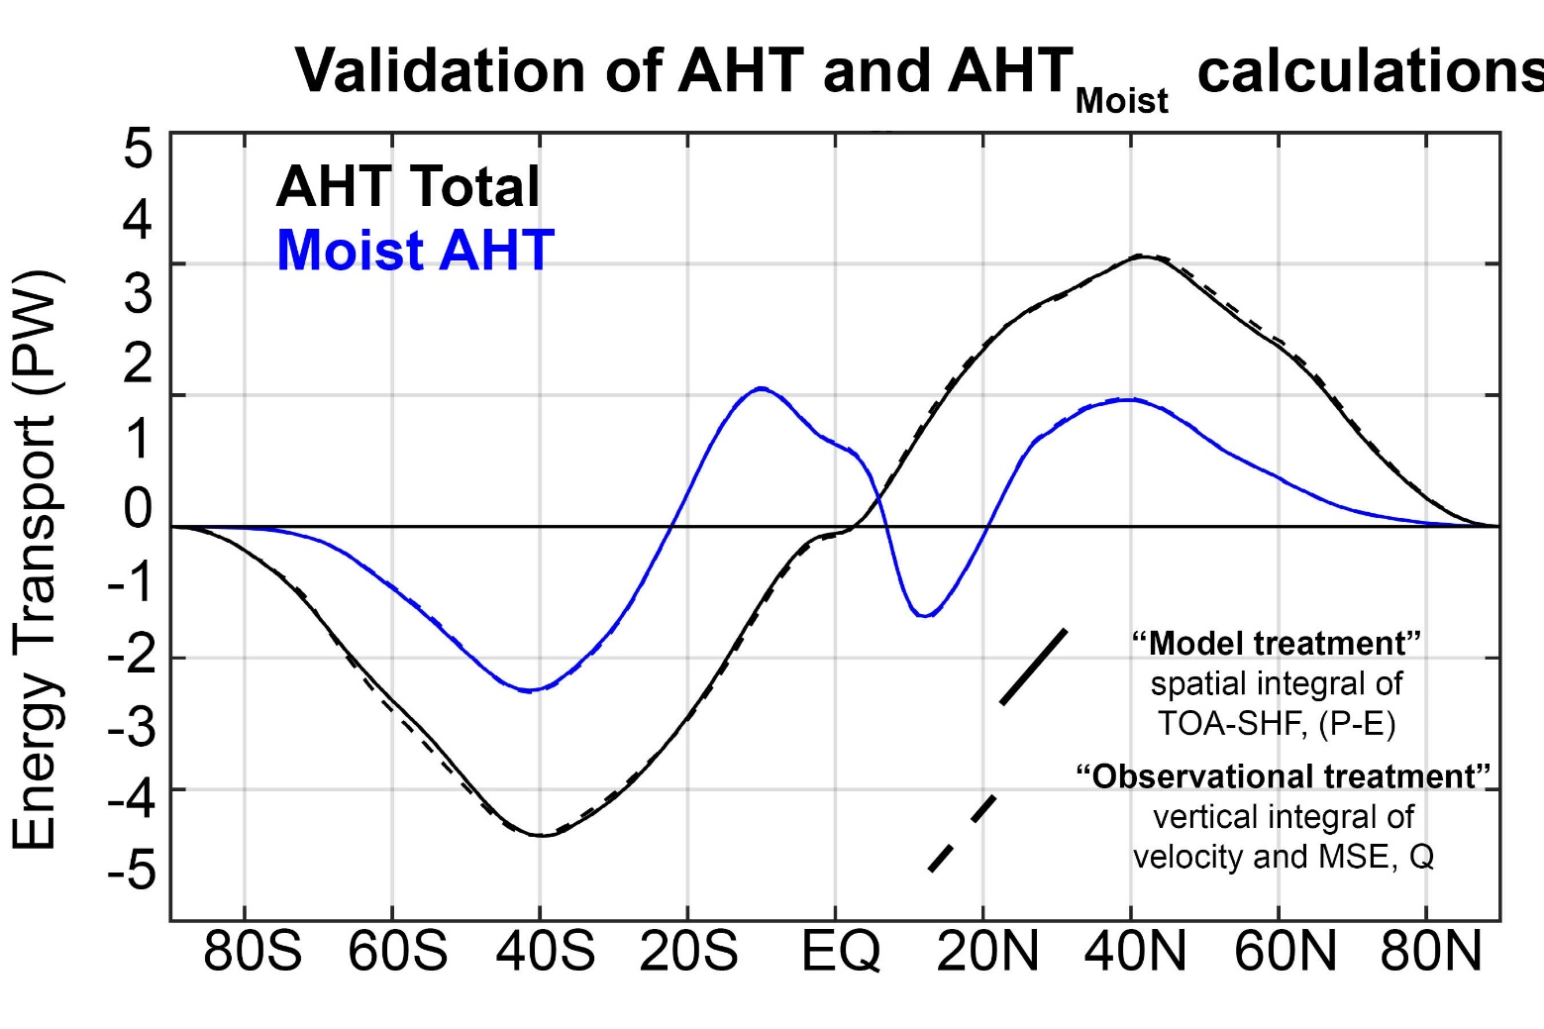
Consistency of “observational” and “model” based MHT calculation in a model simulation

Slide 31

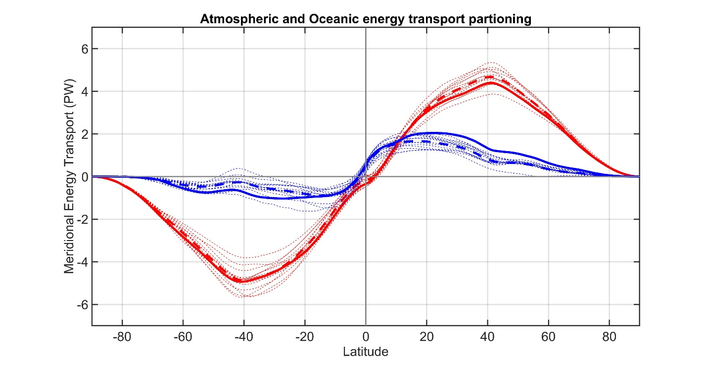
CMIP3 -- Partitioning of MHT 3
Observations
Total energy
transport
Individual models
Model Mean
ATMOSPHERE
Atmosphere ocean partitioning
OCEAN
Observations
Individual models
Model Mean

Slide 32

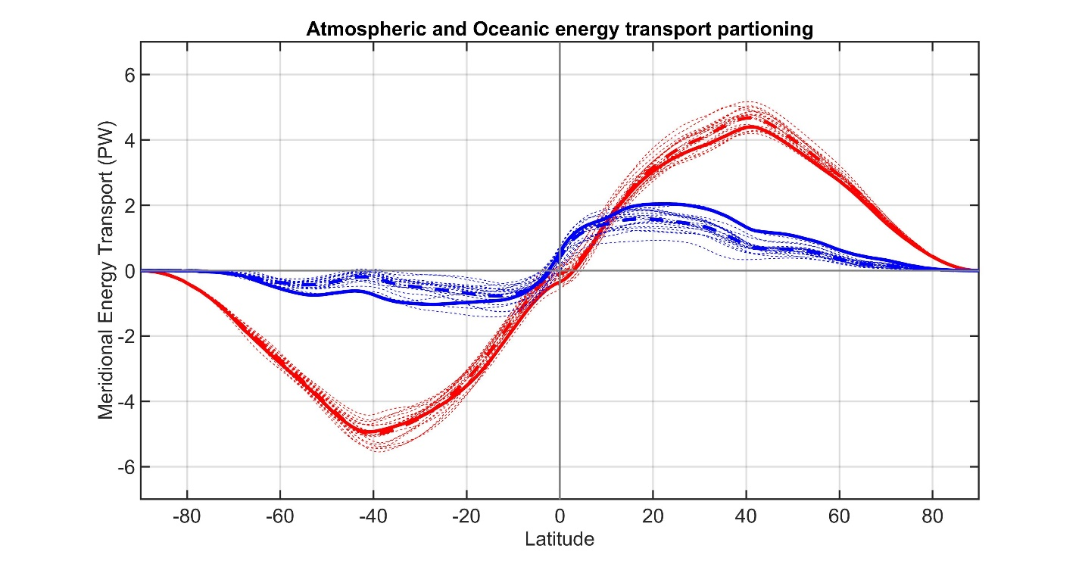
CMIP53
Observations
Total energy
transport
Individual models
Model Mean
ATMOSPHERE
Atmosphere ocean partitioning
OCEAN
Observations
Individual models
Model Mean

Slide 33
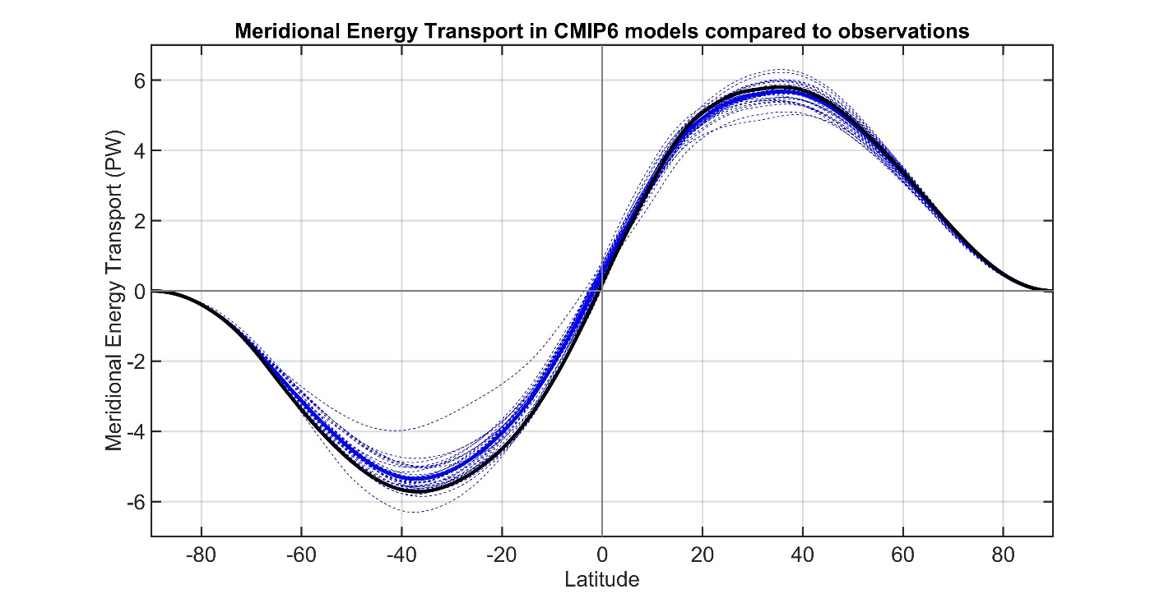
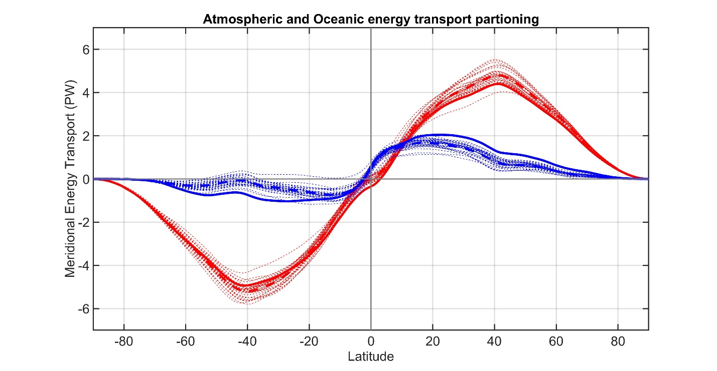
CMIP63
Observations
Total energy
transport
Individual models
Model Mean
ATMOSPHERE
Atmosphere ocean partitioning
OCEAN
Observations
Individual models
Model Mean

Slide 34

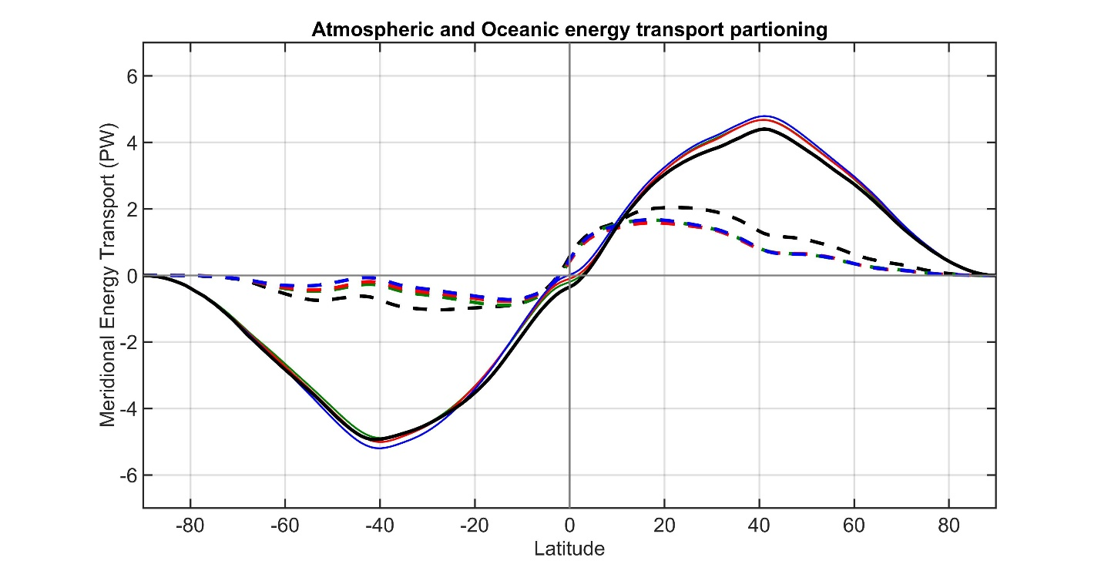
CMIP3 to 6 against observations
Observations
Total energy
transport
CMIP3 Mean
CMIP5 Mean
CMIP6 Mean
ATMOSPHERE
Atmosphere ocean partitioning
OCEAN
Observations
CMIP3 Mean
CMIP5 Mean
CMIP6 Mean

Slide 35
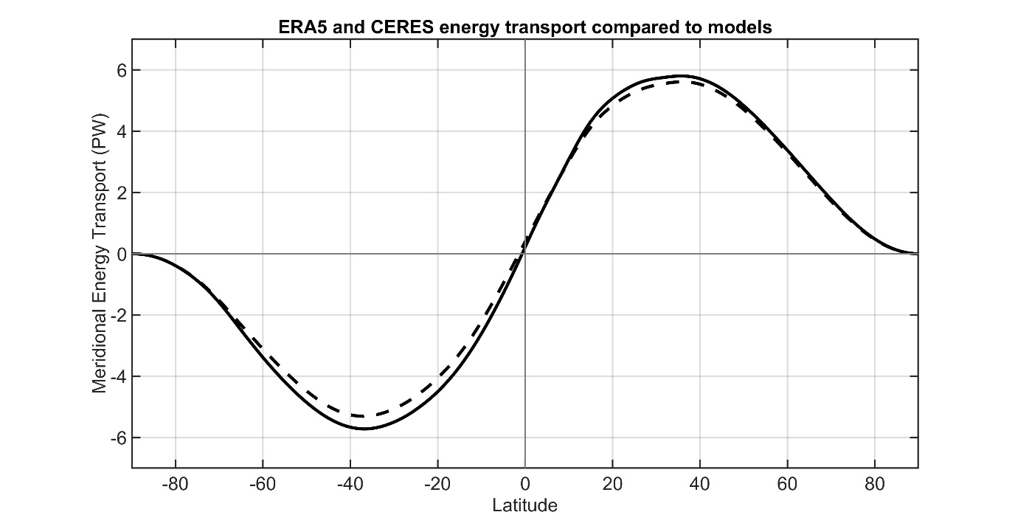
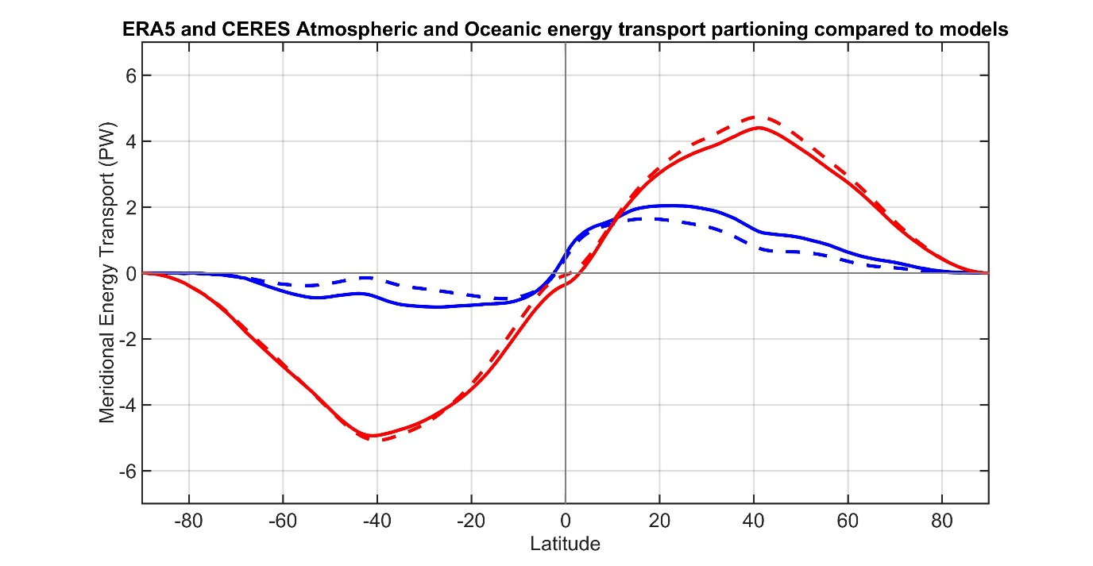
OBSERVATIONS FROM ERA5 and CERES
Observations
CMIP Mean
Total energy
transport
ATMOSPHERE
OCEAN
Observations
Atmosphere ocean partitioning
CMIP Mean

Slide 36
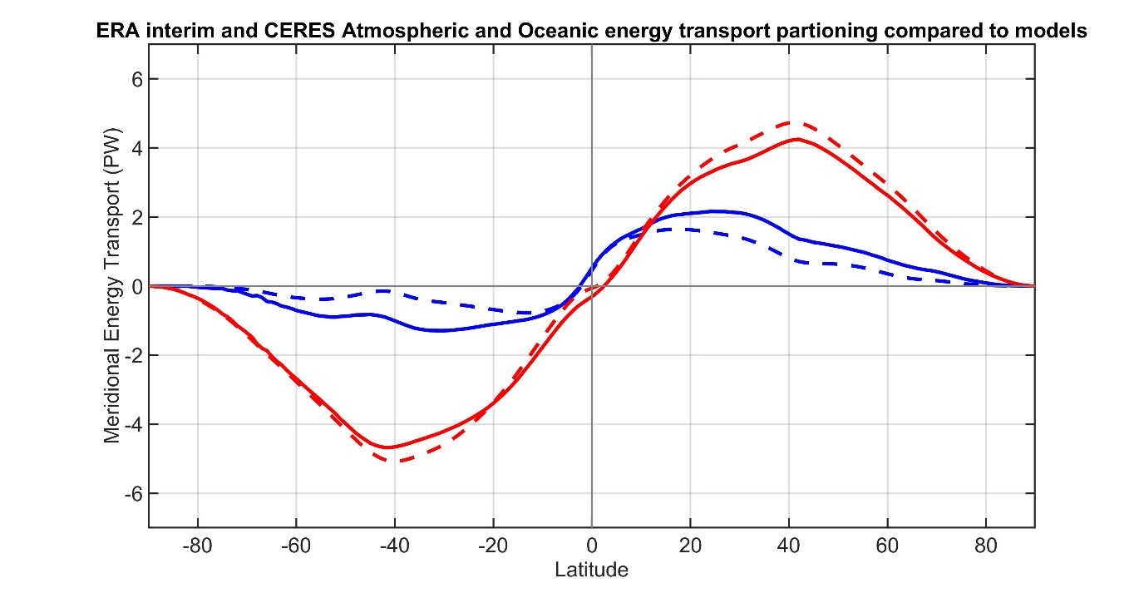
OBSERVATIONS FROM ERA INTERIM and CERES
Observations
CMIP Mean
Total energy
transport
ATMOSPHERE
OCEAN
Observations
Atmosphere ocean partitioning
CMIP Mean

Slide 37
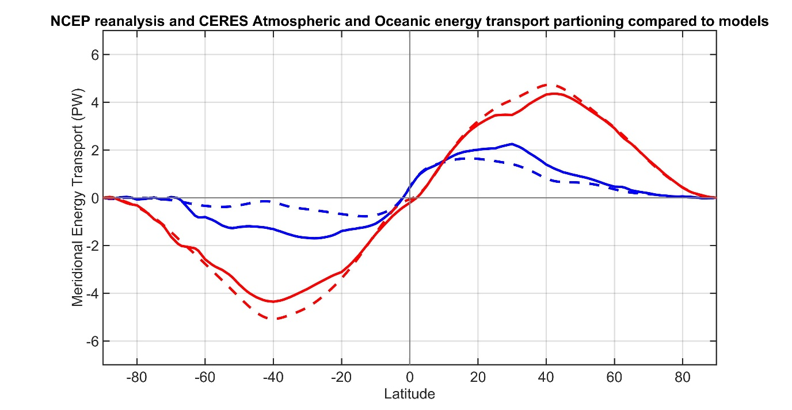
OBSERVATIONS FROM NCEP reanalysis and CERES
Observations
CMIP Mean
Total energy
transport
ATMOSPHERE
OCEAN
Observations
Atmosphere ocean partitioning
CMIP Mean

Slide 38
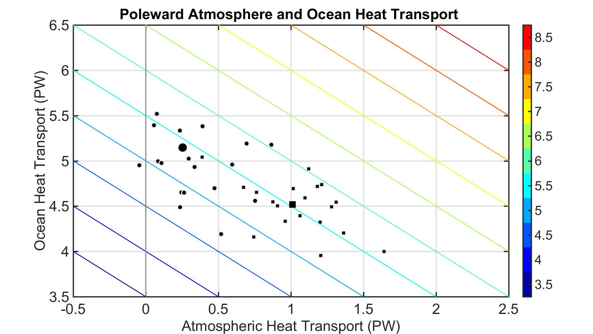
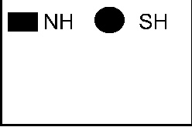
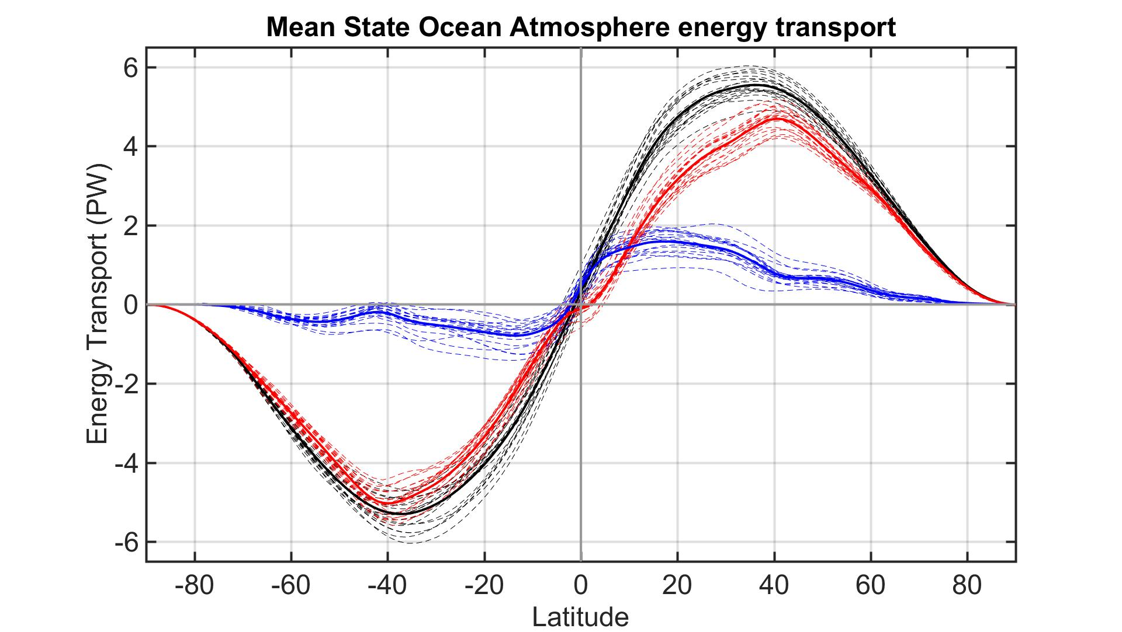
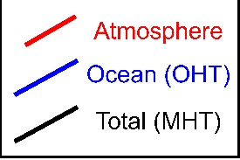
Ocean/Atmosphere heat transport
AHT and OHT differences between models not correlated → no compensation
AHT contributes more to inter-model spread than OHT (but comparable)
MHT maximum (PW)
Atmospheric Heat Transport (PW)
Ocean Heat Transport (PW)

Slide 39
Partitioning of atmospheric energy by circulation type
Stationary
MOC
Overturning
Transient
* = Departure from zonal mean -- [ ]
' = Departure from time mean -- ¯
MSE = moist static energy
= CpT + LQ +gZ
MOC dominates in the deep tropics – Hadley cell
Stationary eddies stronger in NH
Transient eddies dominate the mid-latitudes

Slide 40
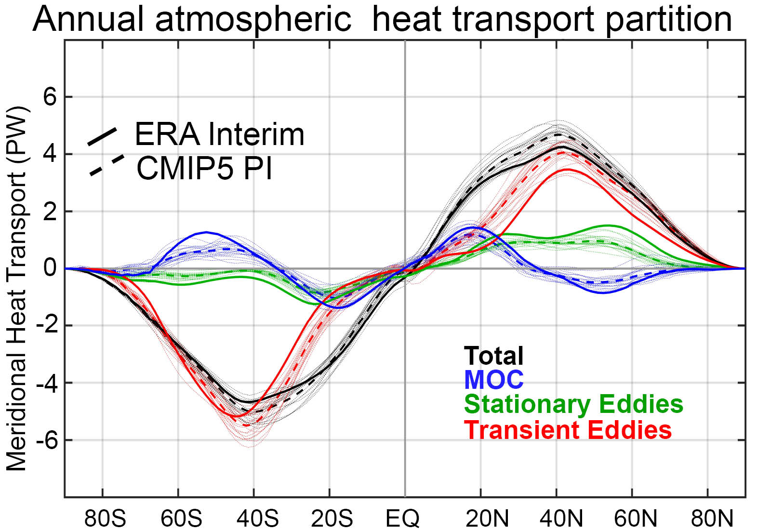
Observation vs. model AHT partitioning

Slide 41

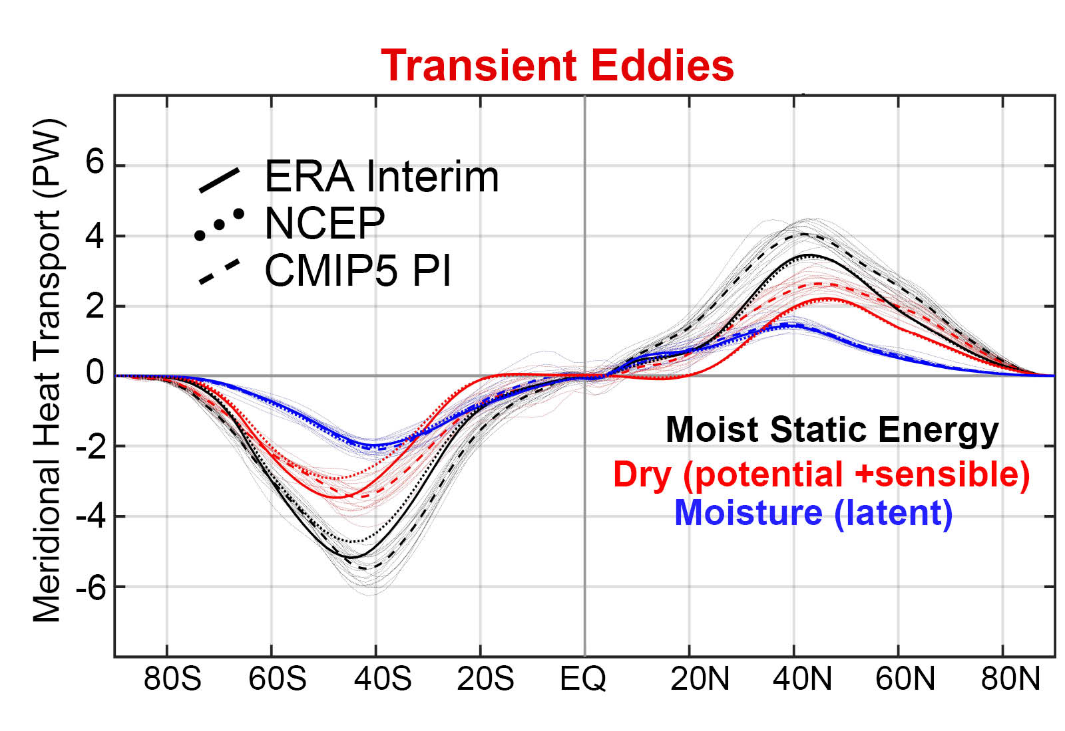
Model bias of enhanced transient eddy heat transport is due to sensible heat transport

Slide 42
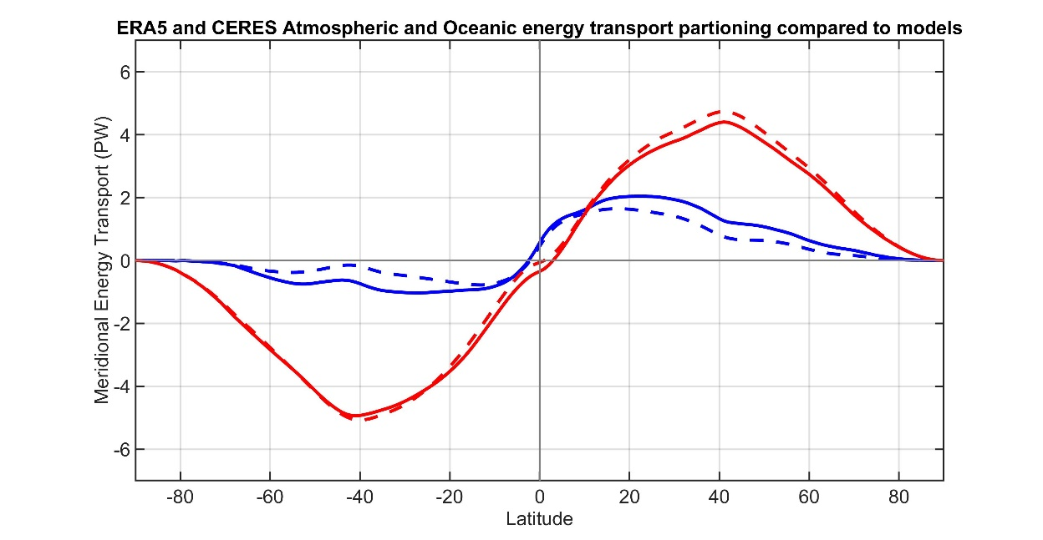

Summary:
Relative to observations, models:
OCEAN
Are biased in the atmosphere/ocean portioning of energy transport
Too weak ocean heat transport
Too strong atmospheric heat transport
ATMOSPHERE
Observations
CMIP Mean
Are biased in the atmospheric circulations that move energy
Too weak stationary eddies
Too strong transient eddy heat transport

Slide 43
II: The near invariance of meridional heat transport from the last glacial maximum to CO₂ quadrupling

Slide 44
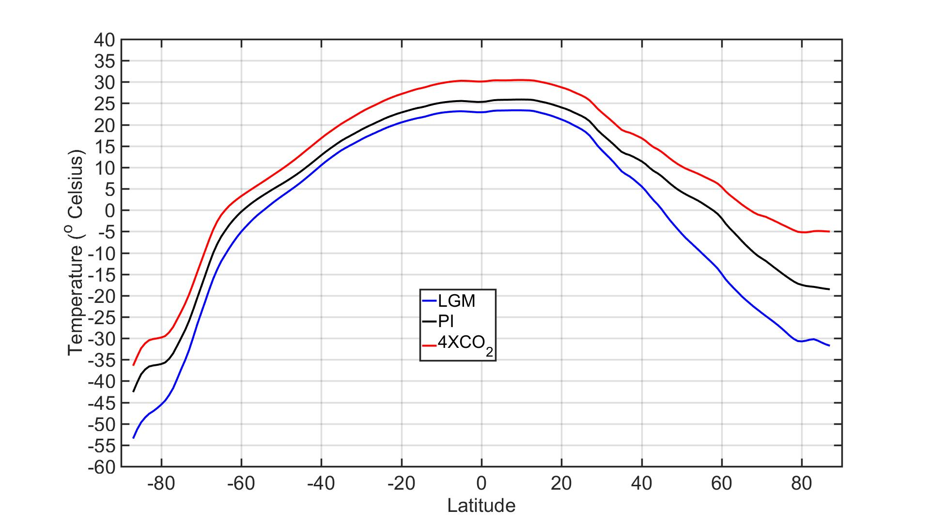
Annual and Zonal mean temperature
LGM to 4XCO₂ : very different climate states
Global mean temperature ranges from 9⁰C to 19⁰C
Equator to pole temperature gradient ranges from 55⁰C to 35⁰C
Laurentide Ice Sheet
4 km of ice over North America
Orbital Parameters
Impact of obliquity on MHT is small but non- trivial
(≈ 0.1 PW increase in LGM MHT )
Li and Battisti (2007)

Slide 45
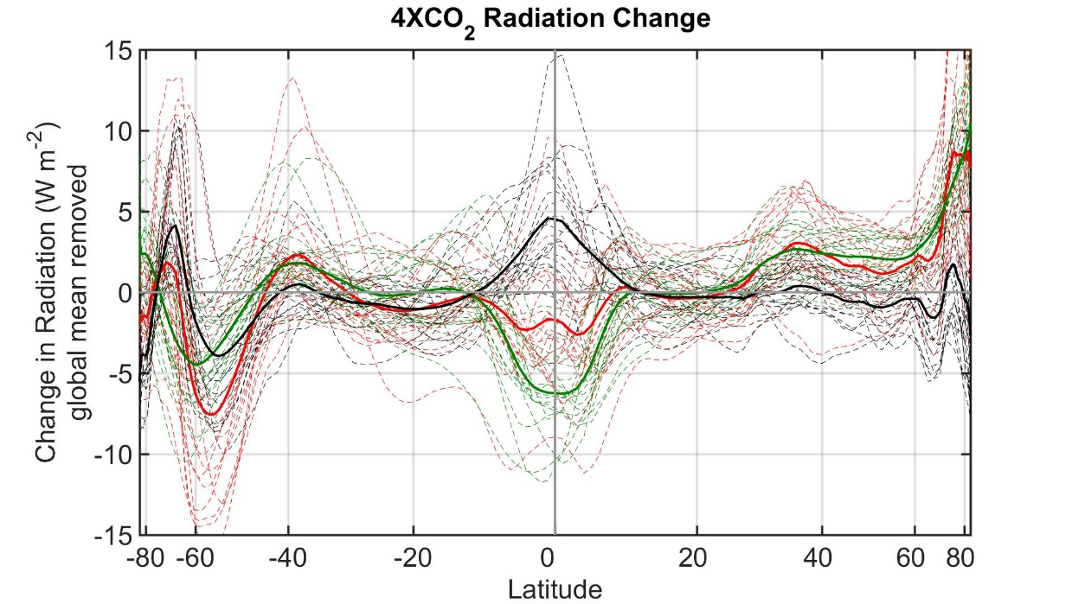
4XCO₂ MHT invariance from radiation
MHT maximum (PW)
MHT = ASR* - OLR*
ASR
OLR
NET

Slide 46



4XCO₂ Northern Hemisphere
MHT maximum (PW)
ASR
OLR
NET
MHT = ASR* - OLR*
4XCO₂ change in MHT :
ASR* and OLR* changes in compensate to conserve MHT

Slide 47


4XCO₂ Southern Hemisphere
MHT maximum (PW)
MHT = ASR* - OLR*
ASR
OLR
NET
4XCO₂ change in MHT :
ASR* and OLR* changes compensate to
conserve MHT

Slide 48



Last Glacial Maximum Northern Hemisphere
MHT maximum (PW)
MHT = ASR* - OLR*
LGM change in MHT :
ASR* and OLR* changes imperfect compensation
In NH → increased MHT
NET
ASR
OLR

Slide 49


Last Glacial Maximum Southern Hemisphere
MHT maximum (PW)
MHT = ASR* - OLR*
LGM change in MHT :
ASR* and OLR* changes imperfect compensation
In NH → increased MHT
→Very small changes in SH
NET
ASR
OLR

Slide 50

Mean state inter-model spread in MHT:
Spread in ASR* exceeds that in OLR*
→No compensation between ASR* and OLR*
Radiative perspective on forced MHT invariance
MHT maximum (PW)
4XCO₂ change in MHT :
ASR* and OLR* changes compensate to
conserve MHT
LGM change in MHT :
ASR* and OLR* changes imperfect compensation
In NH → increased MHT

Slide 51


Atmosphere/Ocean partitioning of heat transport under 4XCO₂
ATMOSPHERE
MHT maximum (PW)
OCEAN
Mean state spread dominated by atmospheric contribution
Observations
Individual models
Model Mean
4XCO₂ change in
AHT/OHT :
High latitude ocean heat uptake (reduced implied OHT) compensated by increased AHT

Slide 52



AHT/OHT changes under 4XCO2 – Northern Hemisphere
MHT maximum (PW)
Atmospheric Heat Transport (PW)
4XCO₂ change in
AHT/OHT :
High latitude ocean heat uptake (reduced implied OHT) compensated by increased AHT
Ocean Heat Transport (PW)

Slide 53


AHT/OHT changes under 4XCO2 – Southern Hemisphere
MHT maximum (PW)
Atmospheric Heat Transport (PW)
4XCO₂ change in
AHT/OHT :
High latitude ocean heat uptake (reduced implied OHT) compensated by increased AHT
Ocean Heat Transport (PW)

Slide 54



AHT/OHT changes during LGM – Northern Hemisphere
MHT maximum (PW)
Atmospheric Heat Transport (PW)
LGM change in ocean and atmosphere heat
transport :
Small changes in the ocean heat transport
Ocean Heat Transport (PW)

Slide 55

AHT/OHT changes during LGM – Southern Hemisphere
MHT maximum (PW)
Atmospheric Heat Transport (PW)
LGM change in ocean and atmosphere heat
transport :
Small changes in the ocean heat transport
Ocean Heat Transport (PW)

Slide 56


Summary: Forced changes in atmosphere/ocean heat transport partitioning
4XCO₂ change in
AHT/OHT :
High latitude ocean heat uptake (reduced implied OHT) compensated by increased AHT
MHT maximum (PW)
LGM change in ocean and atmosphere heat
transport :
Small changes in the ocean heat transport

Slide 57

Partitioning of atmospheric energy by circulation type
Stationary
MOC
Overturning
Transient
* = Departure from zonal mean -- [ ]
' = Departure from time mean -- ¯
MSE = moist static energy
= CpT + LQ +gZ
MOC dominates in the deep tropics – Hadley cell
Stationary eddies stronger in NH
Transient eddies dominate the mid-latitudes

Slide 58

Climatological partitioning of atmospheric heat transport:
→ Spatial structure of heat transport by mean overturning circulation and eddies sums to meridional smooth MHT mandated by radiative constraints
4XCO₂ changes in the partitioning of atmospheric heat transport:
→ Complicated spatial structure of changes in overturning, stationary eddies and transient eddies sum to spatially smooth AHT demanded by high latitude ocean heat uptake

Slide 59

Changes in the partitioning of poleward energy transport under 4XCO2
Moisture transport intensifies in the sense of their climatological direction
→ Compensating decreases in sensible energy transport
Robust increase in stationary eddy moisture transport by monsoons in the subtropics
NH mid-latitude stationary sensible energy transport changes are variable
Transient eddy moisture transport increase, sensible decreases, total increases slightly

Slide 60

LGM changes in the partitioning of atmospheric heat transport:
→Increased stationary eddy heat transport induced by Laurentide ice sheet is nearly compensated by decreased transient eddy heat transport

Slide 61

Changes in the partitioning of poleward energy transport during the Last Glacial Maximum
Large increase in NH mid-latitude stationary eddy energy transport associated with Laurentide ice sheet
In some models (PMIP2) there is a compensating decrease in transient eddy energy transport
Zonal Velocity
Transient eddy heat flux
Donohoe et al. 2009

Slide 62
Aquaplanet rotation rate experiments
Gray radiation model
MHT increases as rotation rate decreases
Cox, Armour, Roe, Donohoe, Frierson (2021)
Radiative and dynamic controls of AHT over different planetary rotation rates

Slide 63





AHT partitioning with rotation rate
Overturning dominated
Eddy Dominated

Slide 64
Aquaplanet rotation rate experiments
With fixed radiation
Run an additional suite of simulation with radiation (vertical profile in atmosphere and at surface) fixed to regular rotation rate control experiment
→Temperature and circulation can change
(but radiation doesn’t know about it)
MHT can’t change
How does circulation adjust in radiative feedback enabled versus disabled runs to maintain MHT invariance?

Slide 65



Freely evolving radiation
Fixed radiation = fixed MHT
Overturning dominated
MHT invariance is achieved by changes in the dominate mode of MHT
Radiative feedback on overturning for slow rotation
Radiative feedbacks on eddies for fast rotation
Eddy Dominated

Slide 66
MHT invariance under idealized topography
Adding idealized topography (gaussian water mountains) results in near perfect compensation between stationary eddy and transient eddy energy transport
Cox, Roe, Donohoe, Armour, Frierson (2021)
Near Invariance of MHT in response to mid-latitude orography

Slide 67
MHT invariance under idealized topography
Colors – transient eddy heat flux (anomalies)
Contours = Moist static energy gradient (zonal anomaly)

Slide 68
MHT invariance under idealized topography
Colors – transient eddy heat flux (anomalies)
Contours = Moist static energy gradient (zonal anomaly)
Mountains make stationary waves
Stationary wave AHT reduced meridional gradient in temperature (MSE)
Transient eddies respond to MSE gradient change
AHT is invariant if eddy heat transport is more sensitive to MSE gradients than radiation

Slide 69
Atmospheric overturning circulation
→Meridional extent of Hadley cell controlled by rotation rate
→Strength of circulation differs by two with and without radiative feedbacks
→ AHT scales as mass circulation (fixed gross moist stability)

Slide 70
→Strength of circulation differs by two with and without radiative feedbacks
Radiative cooling associated with poleward transport in the upper branch results in enhanced subsidence
Suggests Hadley cell strength is radiatively driven and provides a possible connection between radiation and circulation
Radiative heating anomaly

Slide 71
2x rotation eddy regime
Increased rotation rate
Decreased eddy length scale
Reduced eddy diffusivity
Poles initially cool
No radiative
Feedback
With radiative
Feedback
Poles cool
until MHT is restored with enhanced equator-to-pole temperature contrast
Reduced OLR (radiative gain) allows MHT to decrease
Less severe change in equator-to-pole temperature contrast

Slide 72



Conclusions
Total MHT and its partitioning differs between models and observations
Role of clouds in radiation (ASR*)
Dynamics?
MHT invariant from LGM to 4XCO₂
→Radiative compensation between
ASR* and OLR*
Dynamic compensation between
Everything (eddies, MOC, moist, dry)
How are radiative constraints communicated to the atmosphere?

Slide 74

Partitioning of atmospheric heat transport from monthly mean data
AHT from TOA radiation and surface fluxes
MOC, SE from atmospheric data, transients as a residual (ongoing effort that seems to be working)
Transient eddies as residual
Excellent agreement with direct calculation of transient eddy heat transport

Slide 75


Model biases in MHT/AHT/OHT

Slide 76




Poleward energy transport
All Models
Meridional energy transport differs substantially (≈1 PW) between models
→ Mean state bias
But seems relatively invariant to climate state within a given model

Slide 77
1 : What determines the Earth’s planetary albedo? (solar radiation reflected at top of atmosphere)
Reflected by Atmosphere
Solar Incident
Reflected by Surface
Atmosphere
Earth’s Surface

Slide 78

Simplified (isotropic) shortwave radiation model
Atmospheric
Contribution
To planetary
Albedo
Surface
Contribution
To planetary
Albedo
S = incident
R = cloud
reflection
A = absorption
α = surface
albedo
(UNKNOWNS)

Slide 79
Partitioning of planetary albedo into atmospheric and surface components
Reflected by Atmosphere
α_{P} = α_{P,ATMOS} + α_{P,SURF}
Reflected by Surface
α_{P,ATMOS} = R
Solar Incident
α_{P,SURF} = α(1-R-A)²
(1-αR)
Atmosphere
Earth’s Surface

