Slide 1
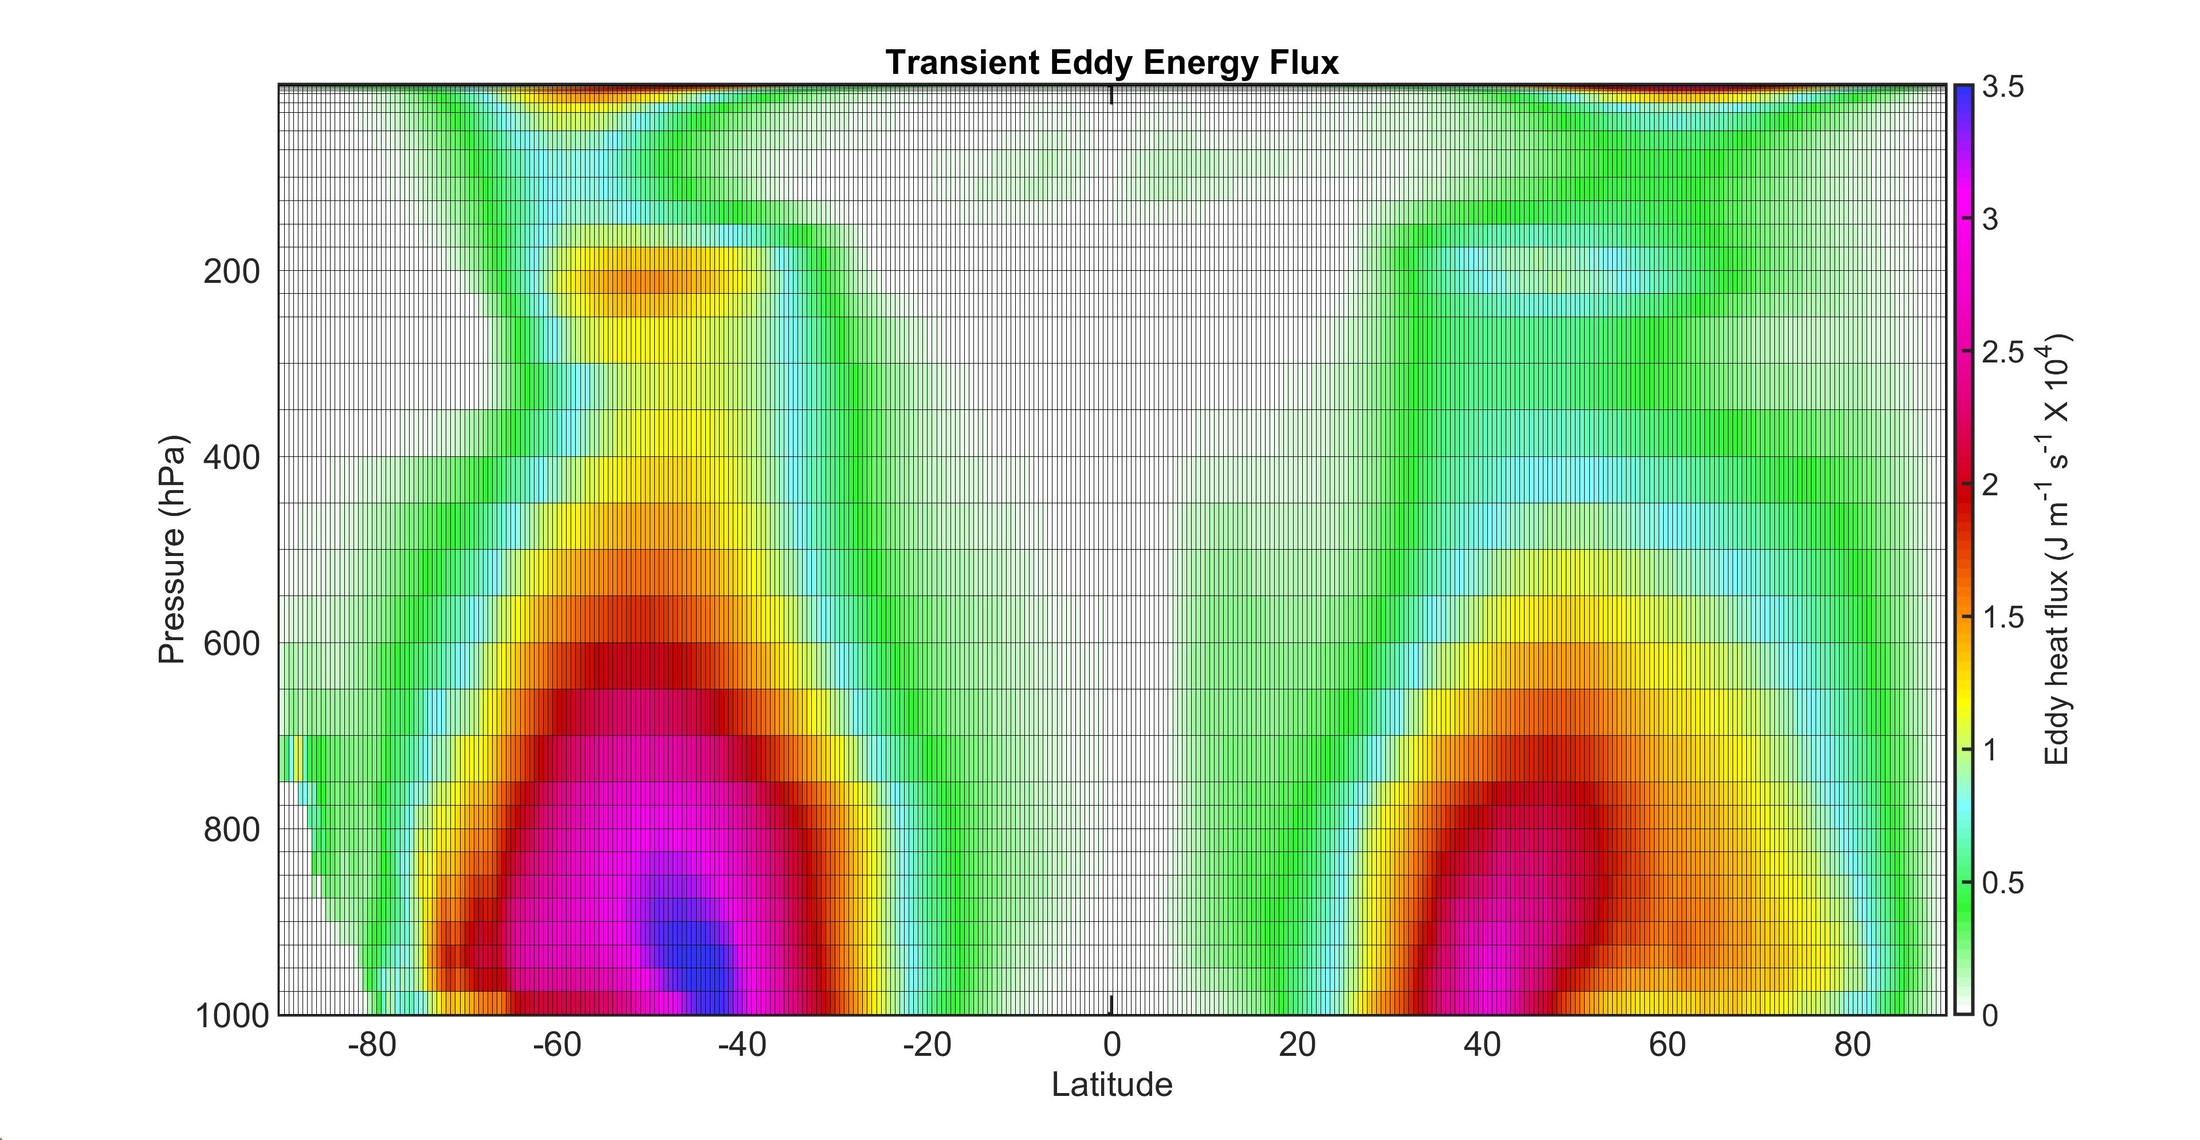
Why is the Southern Hemisphere stormier than the Northern Hemisphere?

Slide 2
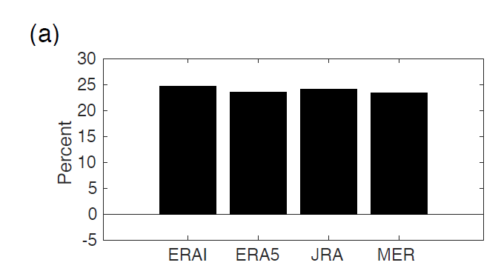
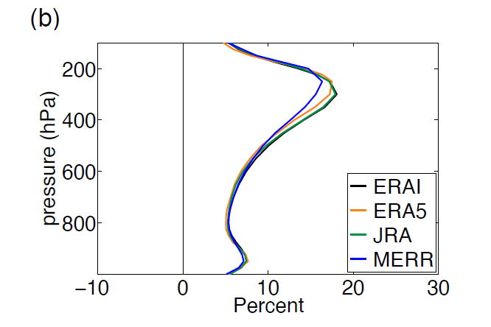
Hemispheric difference in eddy kinetic energy
SH-NH as a % of NH climatology
Averaged between 20 and 90
20 to 90 and vertical integral eddy kinetic energy
Difference between SH and NH in 4 sets of reanalysis

Slide 3
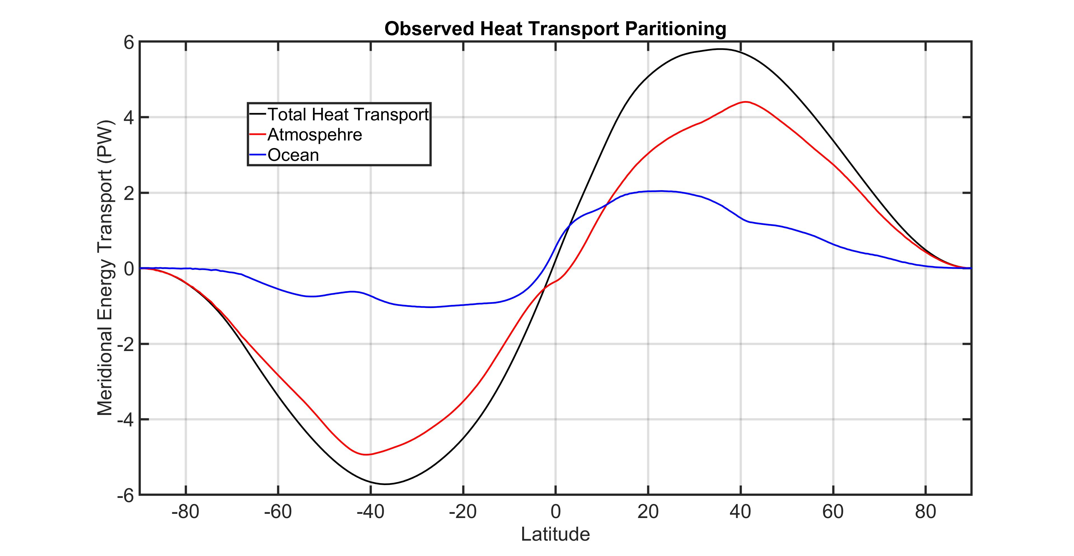
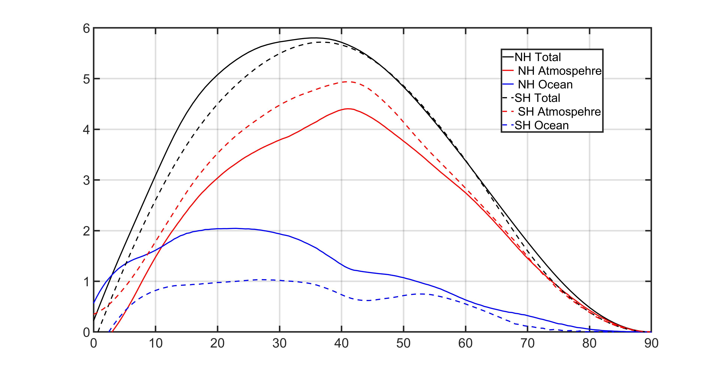
Total (ocean plus atmosphere) poleward energy transport is nearly symmetric between the hemispheres (radiative constraint)
Poleward ocean heat transport is greater in the Northern Hemisphere (AMOC)
Therefore, atmosphere must move more energy poleward in the Southern Hemisphere
Ocean Heat Transport contributes to the hemispheric asymmetry of storminess

Slide 4
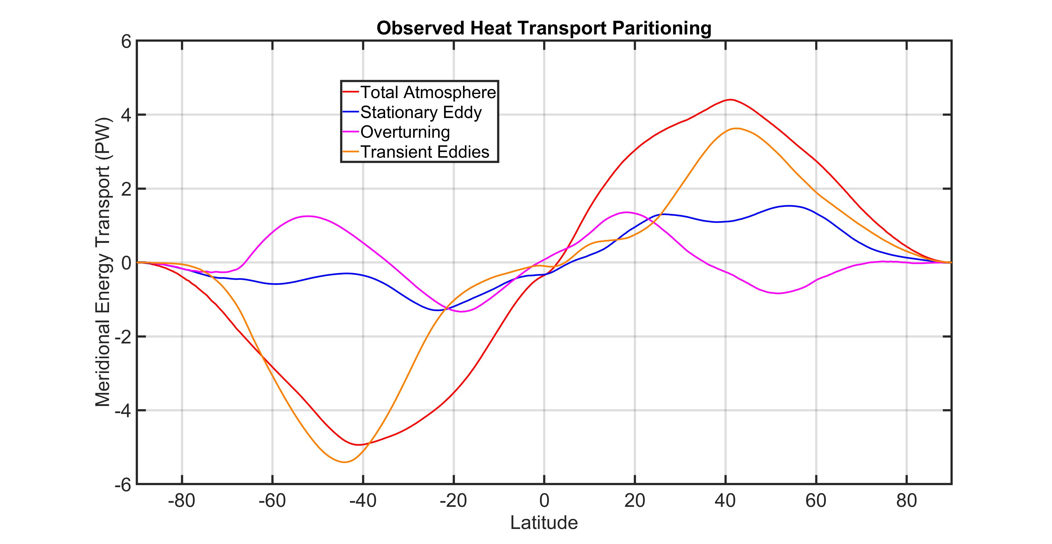
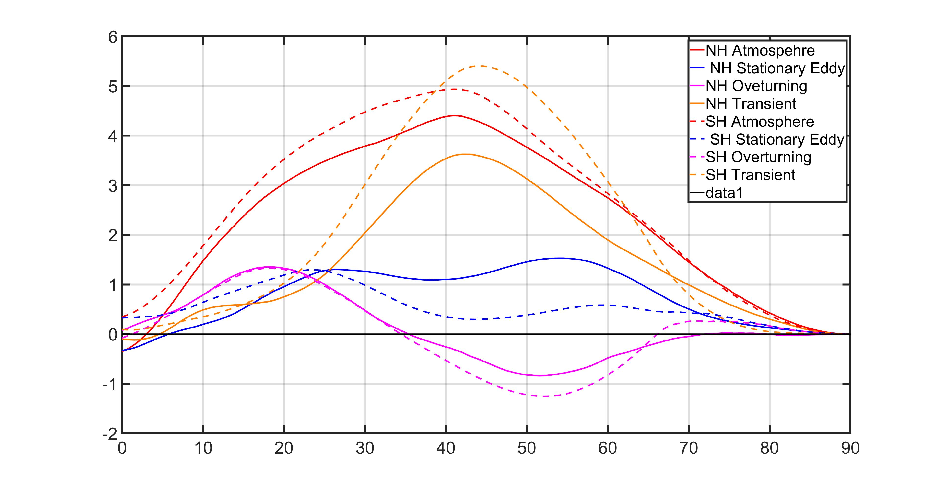
Hemispheric Asymmetry of atmospheric heat transport partitioning
Stationary eddies transport energy poleward in the NH (mid-latitude planetary wave forced by topography and land ocean heating contrast)
No stationary eddies in SH
So transient eddies have to do more work → SH is stormier
Ferrel cell damps hemispherif asymtery of storminess → expected as Ferrel cell is driven by transient eddies

Slide 5
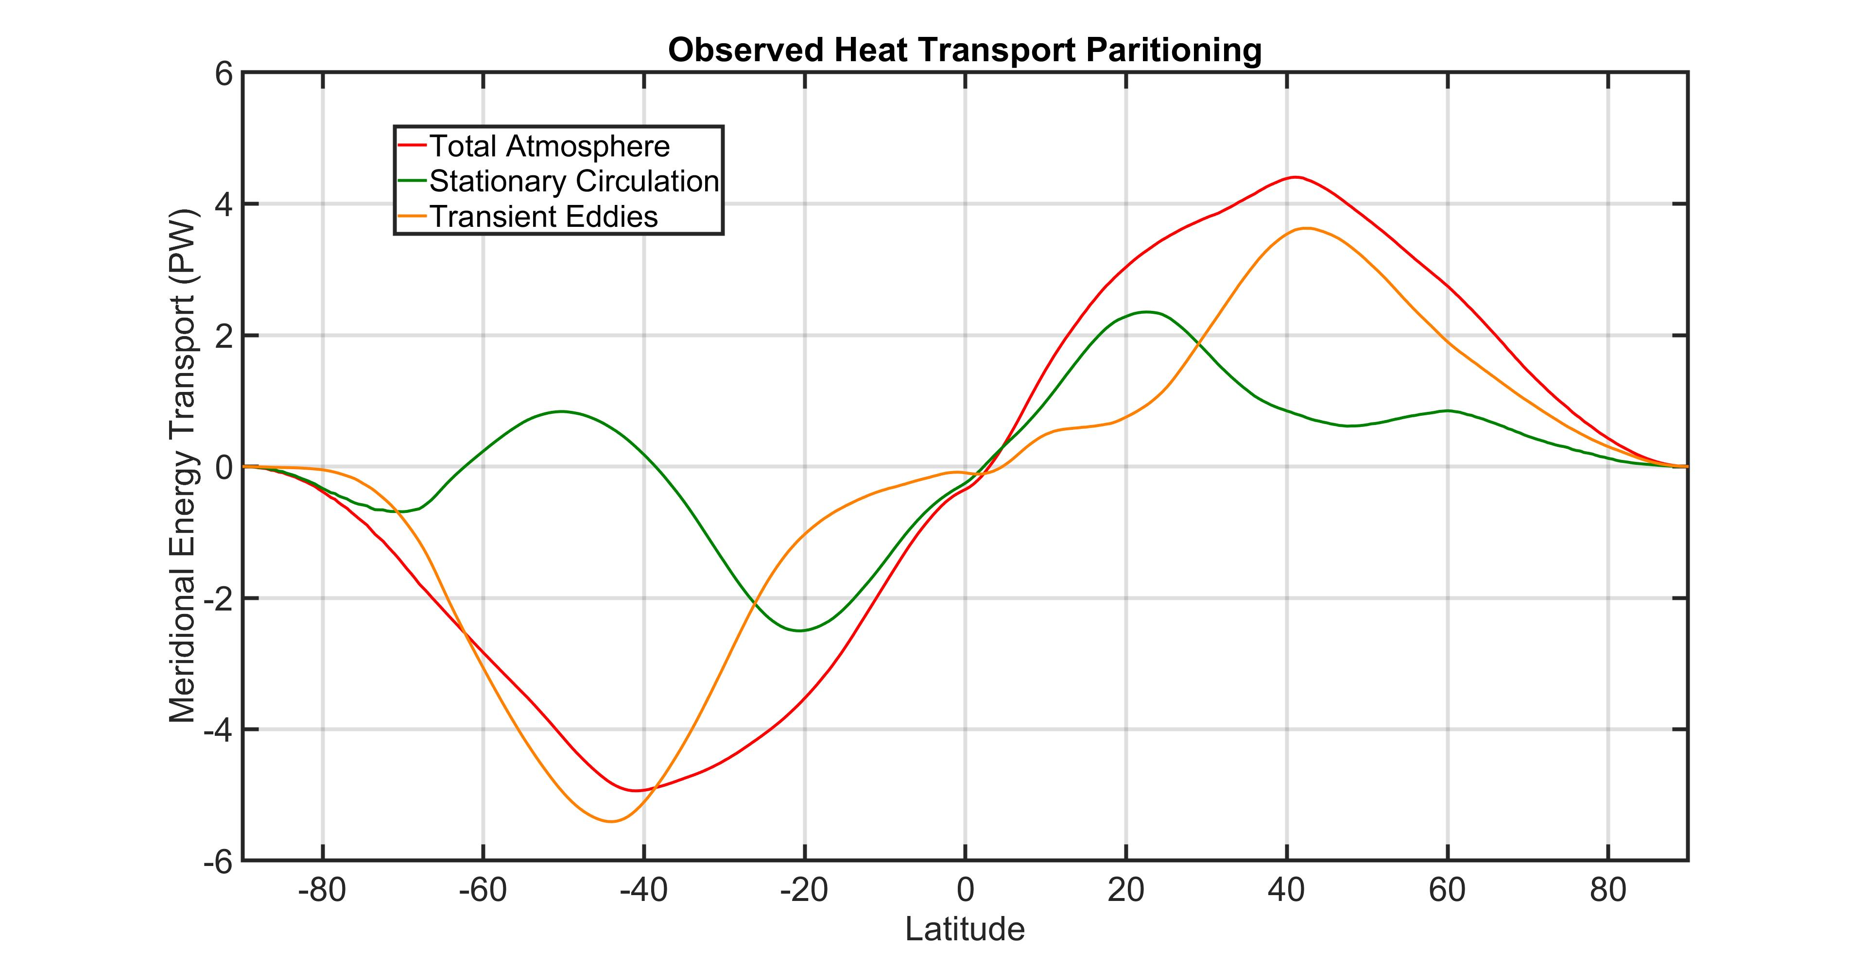
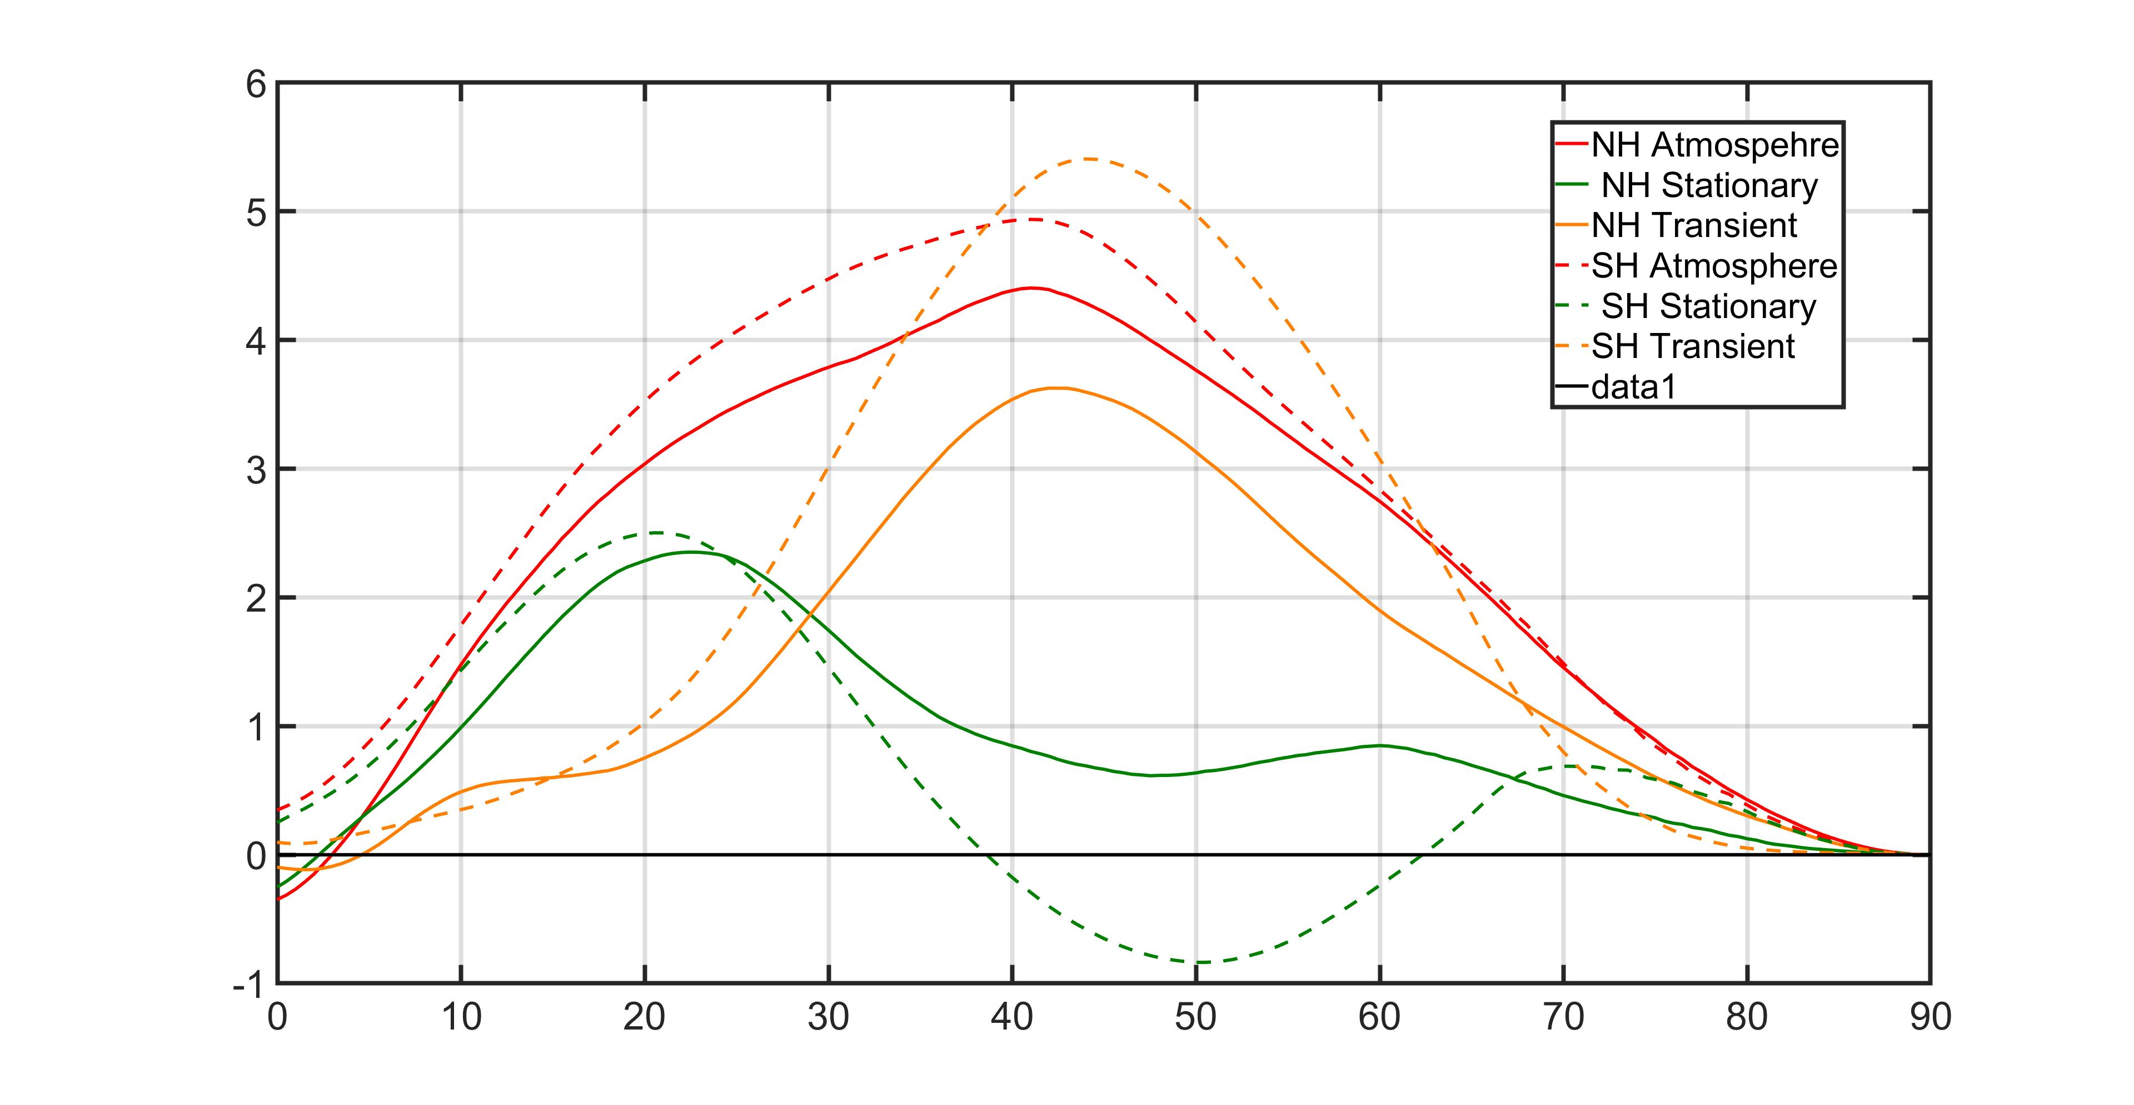
Hemispheric Asymmetry of atmospheric heat transport partitioning
Combine the stationary eddies and overturning circulation to define a “stationary circulation” heat transport to make things simplier

Slide 6
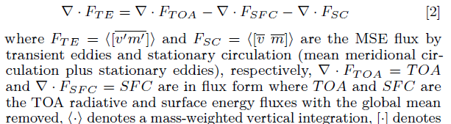


How much do ocean heat transport and stationary circulation contribute to hemispheric asymmetry of storminess?
Hemispheric Asymmetry of Ocean and Atmosphere heat transport
Total Heat
Transport
Ocean
Transport
Stationary
Atmospheric
Circulation
Hemispheric Asymmetry of Atmosphere heat transport partition
Transient
eddy

Slide 7
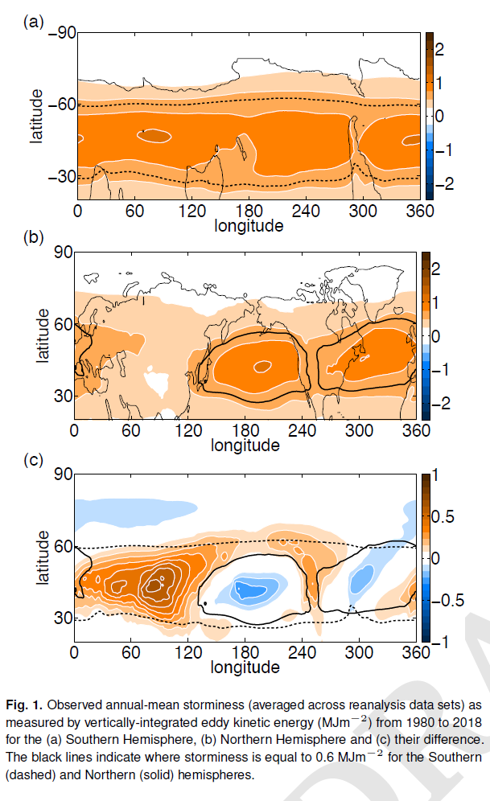

Slide 8
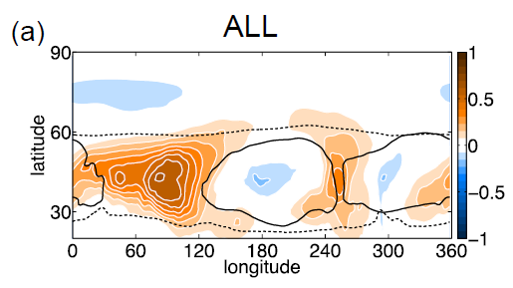
We can replicate the observed hemispheric asymmetry of storminess in a (ECHAM6 slab ocean) climate model with:
1.) Topography (and land masses)
2.) Prescribed ocean heat transport (Q fluxes to match observations)

Slide 9
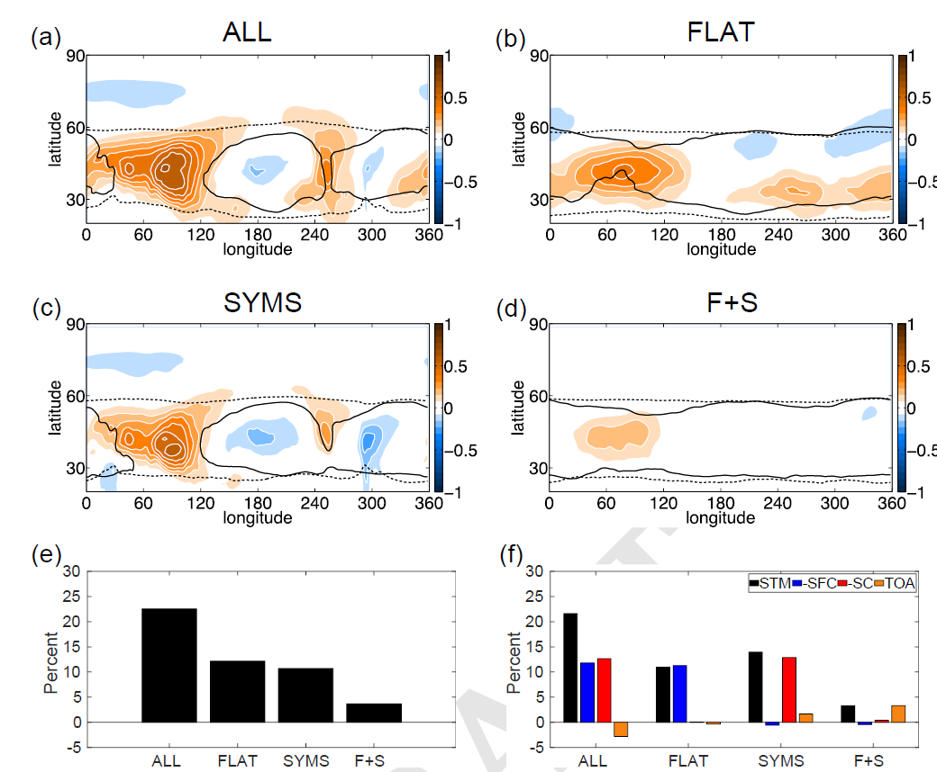
How much do ocean heat transport and stationary circulation contribute to hemispheric asymmetry of storminess?
Answer by:
→ Remove topography
Isolates role of ocean
Symmetrize the ocean heat transport
Isolates role of stationary circulation (sort of)
Role of Ocean
Role of Stationary Circulation
No ocean
No stationary waves

Slide 10
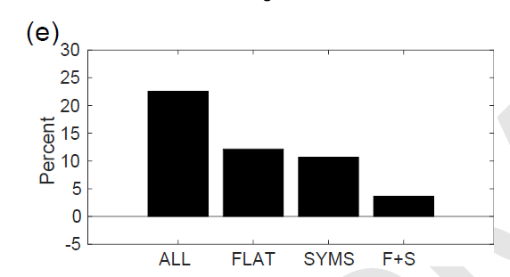
How much do ocean heat transport and stationary circulation contribute to hemispheric asymmetry of storminess?
Diagnosed from climate model experiments
Diagnosed from observational energetics
Storminess Asymmetry (Transient eddy)
Role of Stationary Atmospheric Circulation
Role of Ocean Transport
Other Things

Slide 11
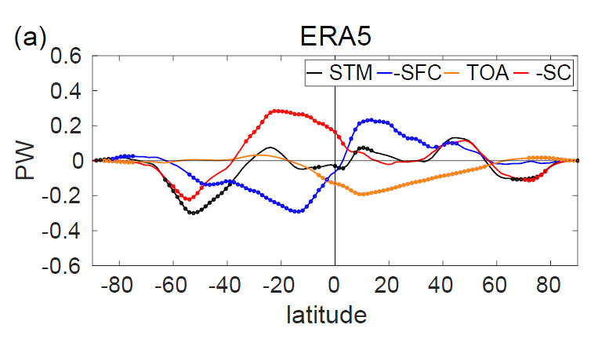
From 1980 to 2018 the Southern Hemisphere got more stormy whereas the NH did not. Why?

Slide 12
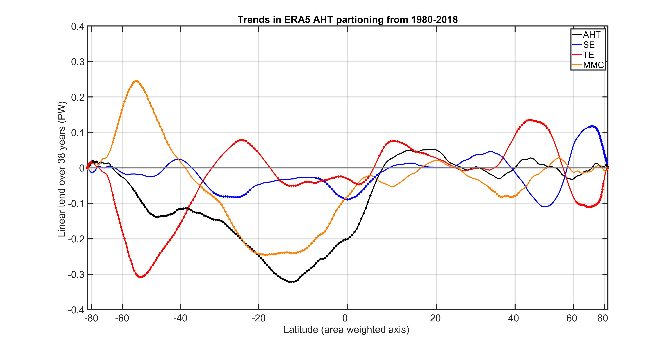

Slide 13
