Slide 1
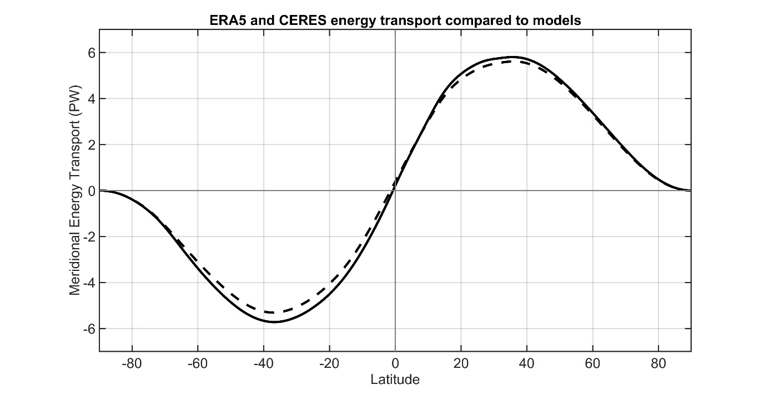
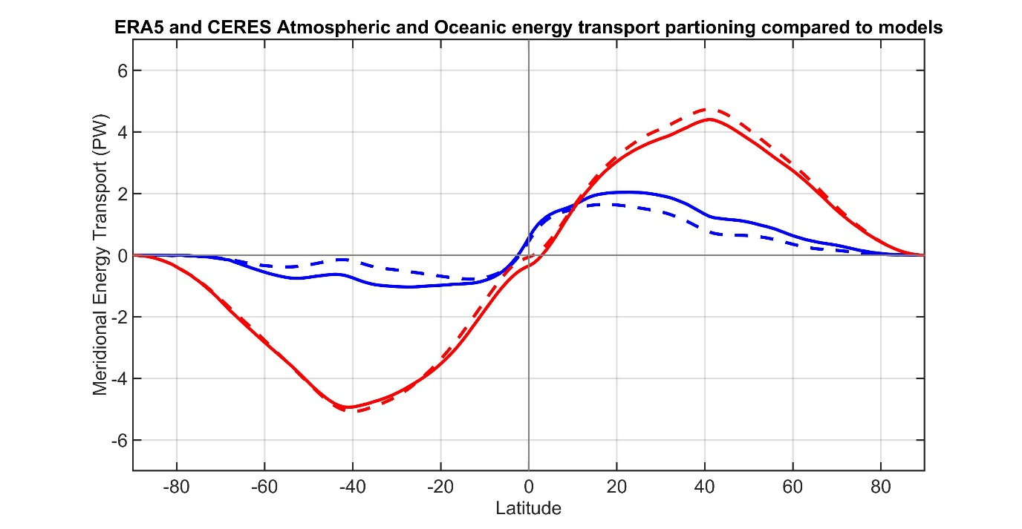
Poleward energy tranbsport:
OBSERVATIONS FROM ERA5 and CERES
Observations
CMIP Mean
Total energy
transport
ATMOSPHERE
OCEAN
Observations
Atmosphere ocean partitioning
CMIP Mean

Slide 2




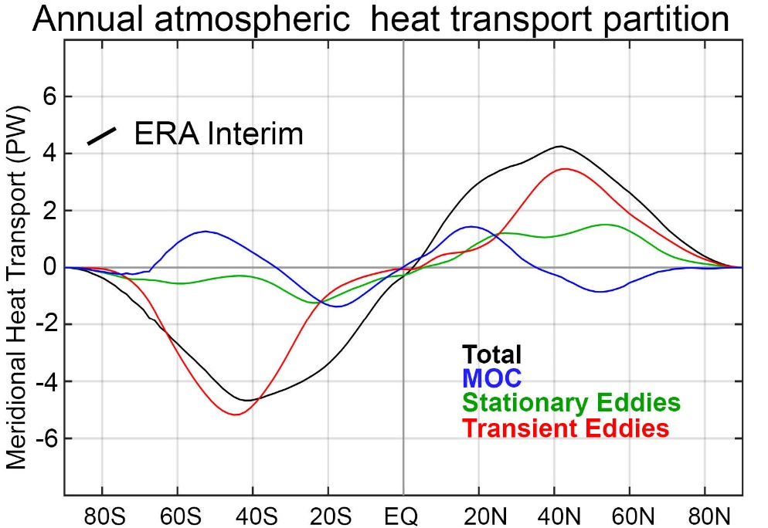
Partitioning of atmospheric energy by circulation type
Stationary
MOC
Overturning
Transient
* = Departure from zonal mean -- [ ]
' = Departure from time mean -- ¯
MSE = moist static energy
= CpT + LQ +gZ
MOC dominates in the deep tropics – Hadley cell
Stationary eddies stronger in NH
Transient eddies dominate the mid-latitudes

Slide 3
Motivating question: How is poleward atmospheric energy transport distributed in time
Is poleward energy transport steady in time (consequence of “average” storminess) or sporadic in nature
How doe the temporal variability of energy transport relate to atmospheric/surface heating (temperature variability)

Slide 4
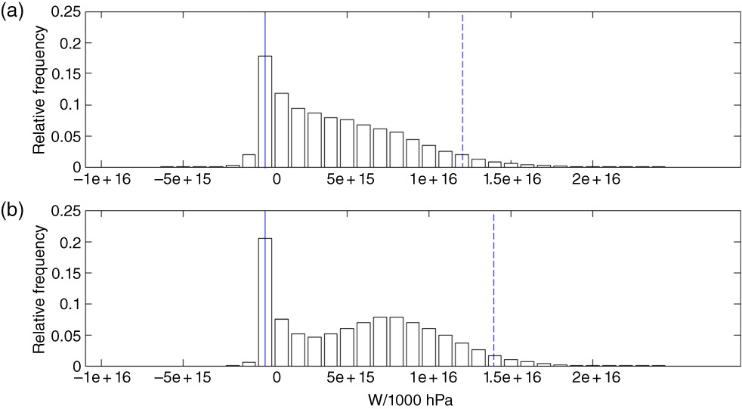
Motivating question: How is poleward atmospheric energy transport distributed in time
Is poleward energy transport steady in time (consequence of “average” storminess) or sporadic in nature
How doe the temporal variability of energy transport relate to atmospheric/surface heating (temperature variability)
Histogram of zonally integrated AHT
All latitudes from 20N-90N

Slide 5
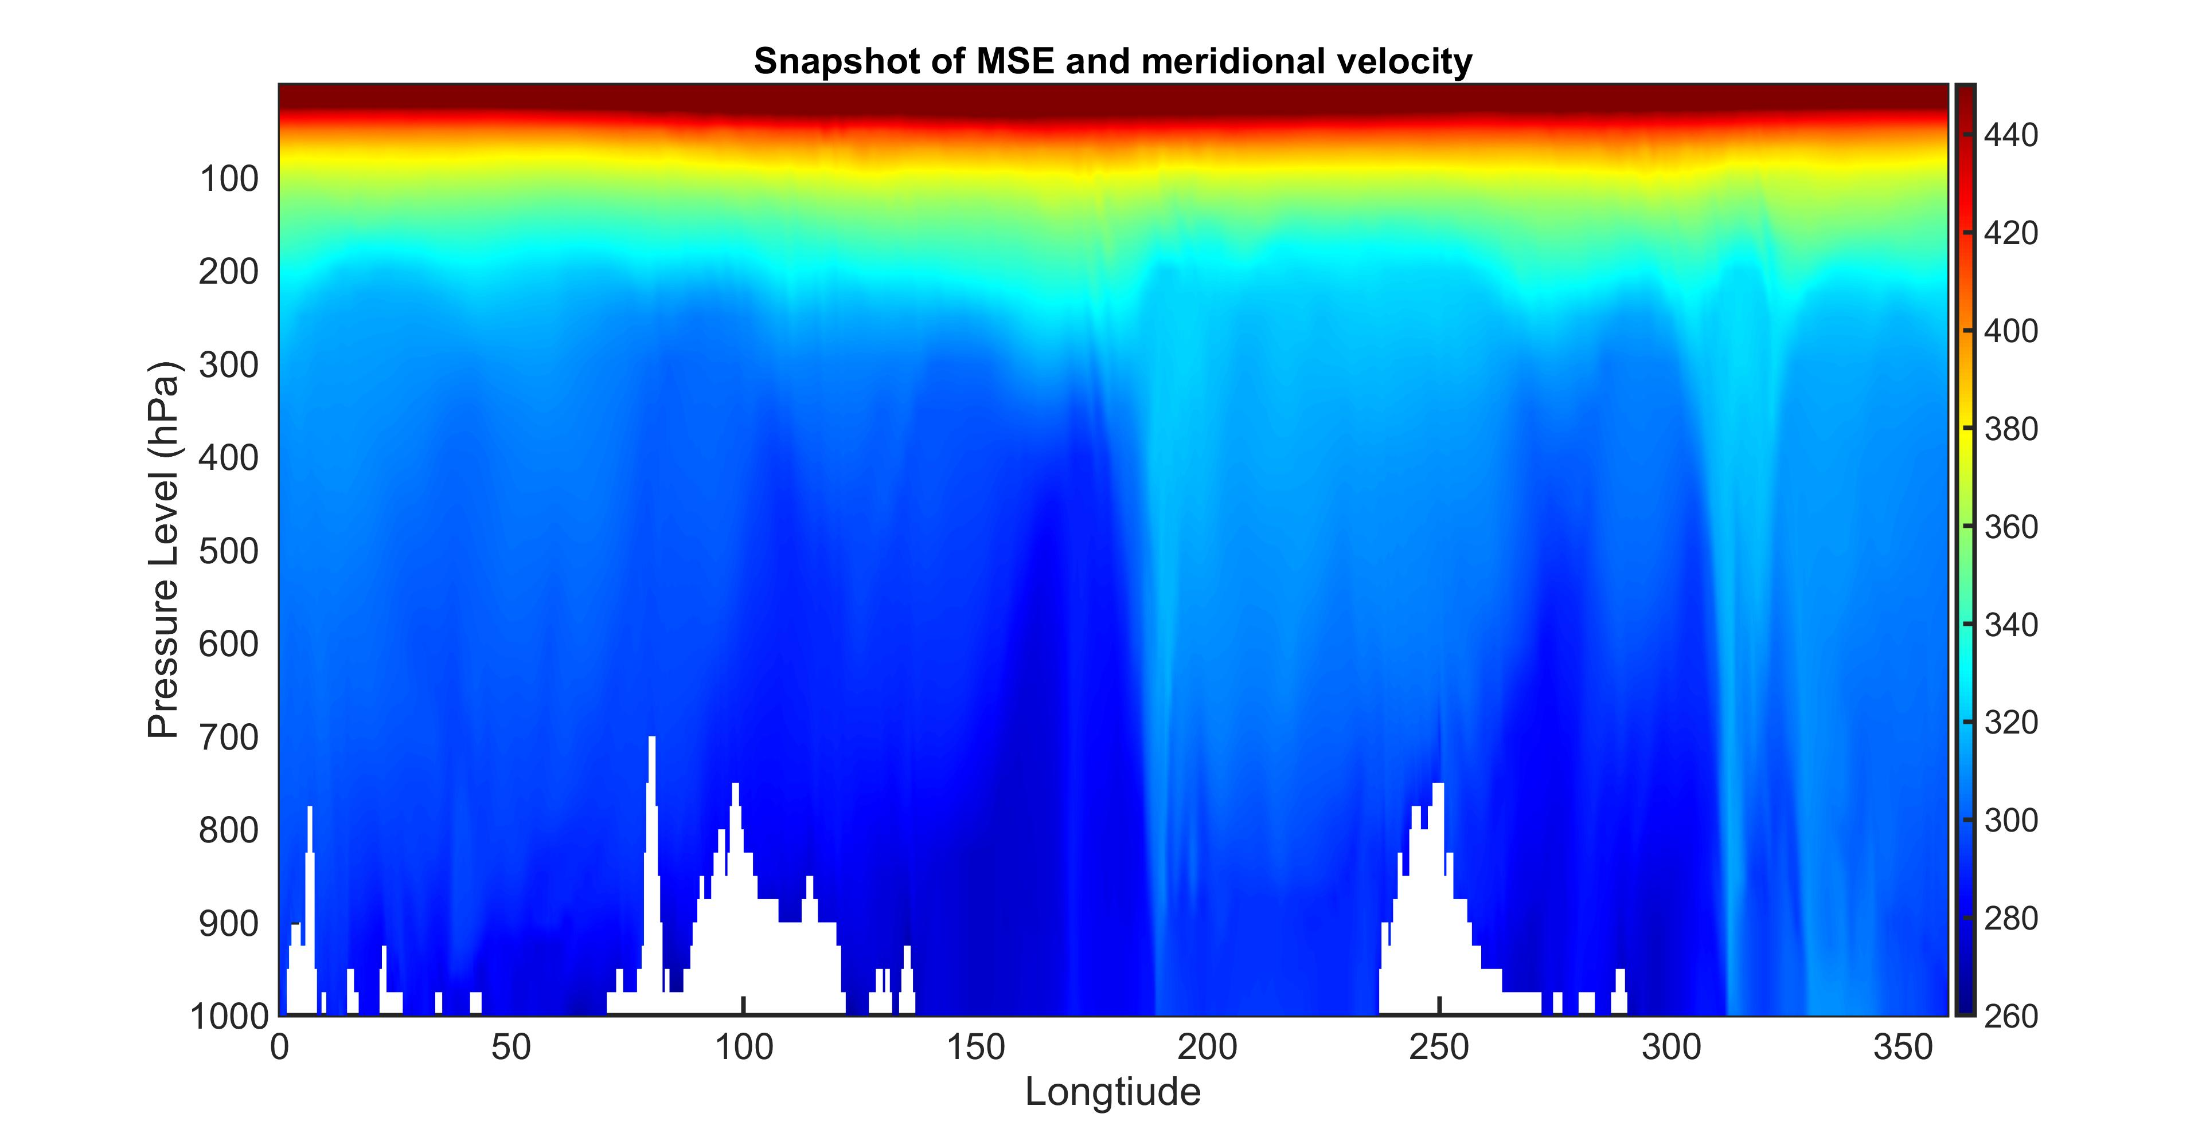

In principle, $AHT=2πcosϴ\left[\frac{1}{g}\int_{0}^{PS}{V∗MSE dp}\right]$

Slide 6
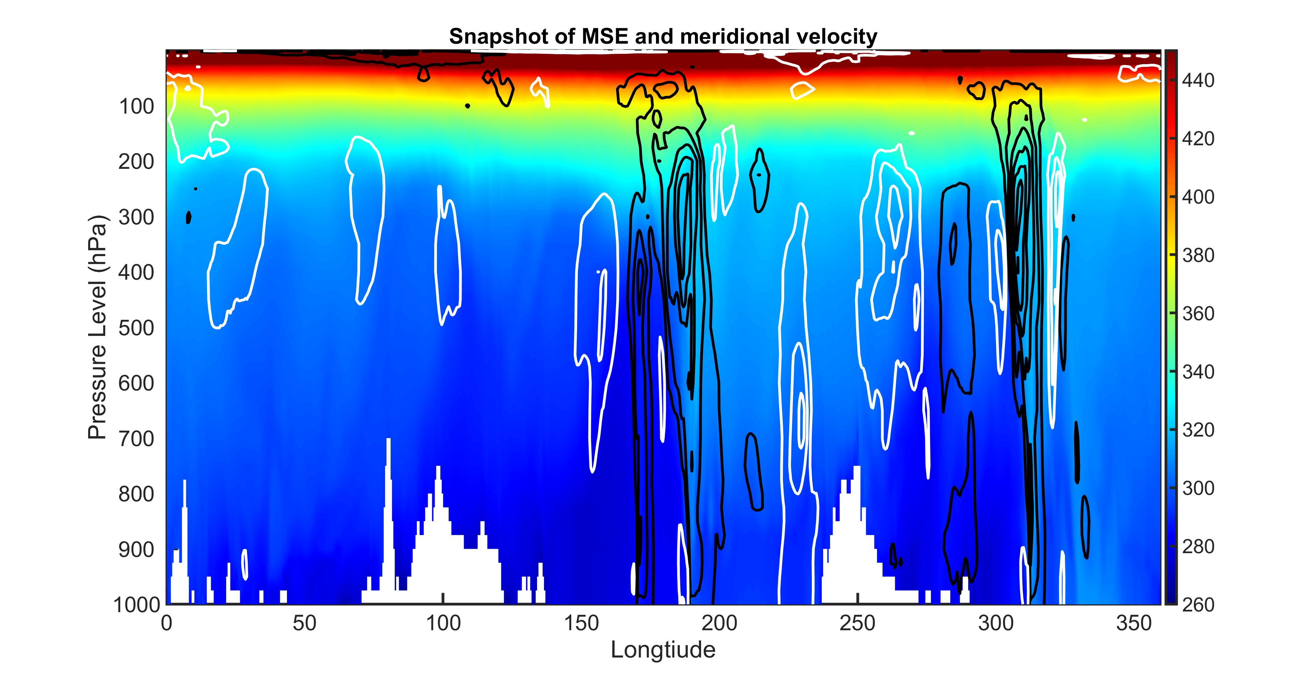
In principle, $AHT=2πcosϴ\left[\frac{1}{g}\int_{0}^{PS}{V∗MSE dp}\right]$

Slide 7
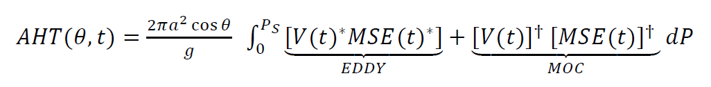
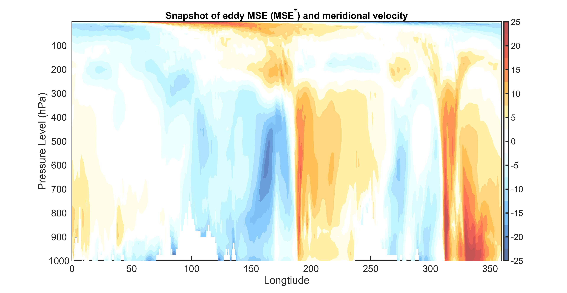
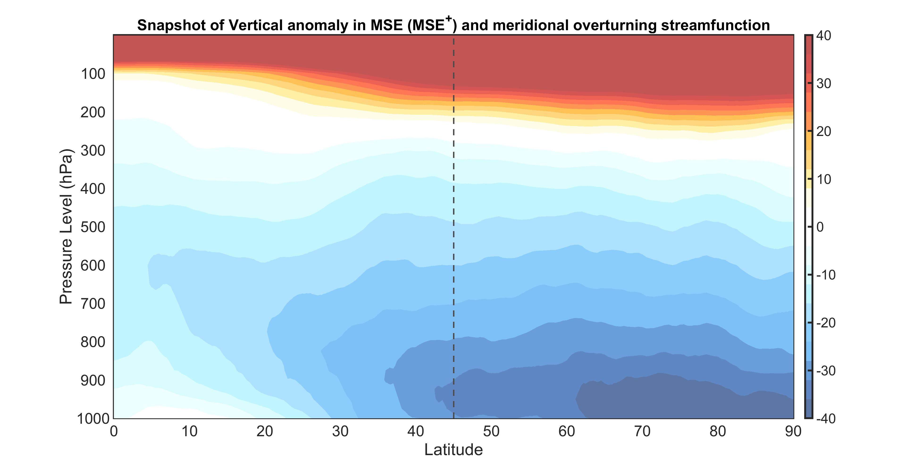
How we do the calculation
MSE*
MSE*/Cp (K)
Instantaneous MSE at 45N
Equivalent potential temp. (K)
MSE^{Ϯ}
MSE^{Ϯ}/Cp (K)

Slide 8
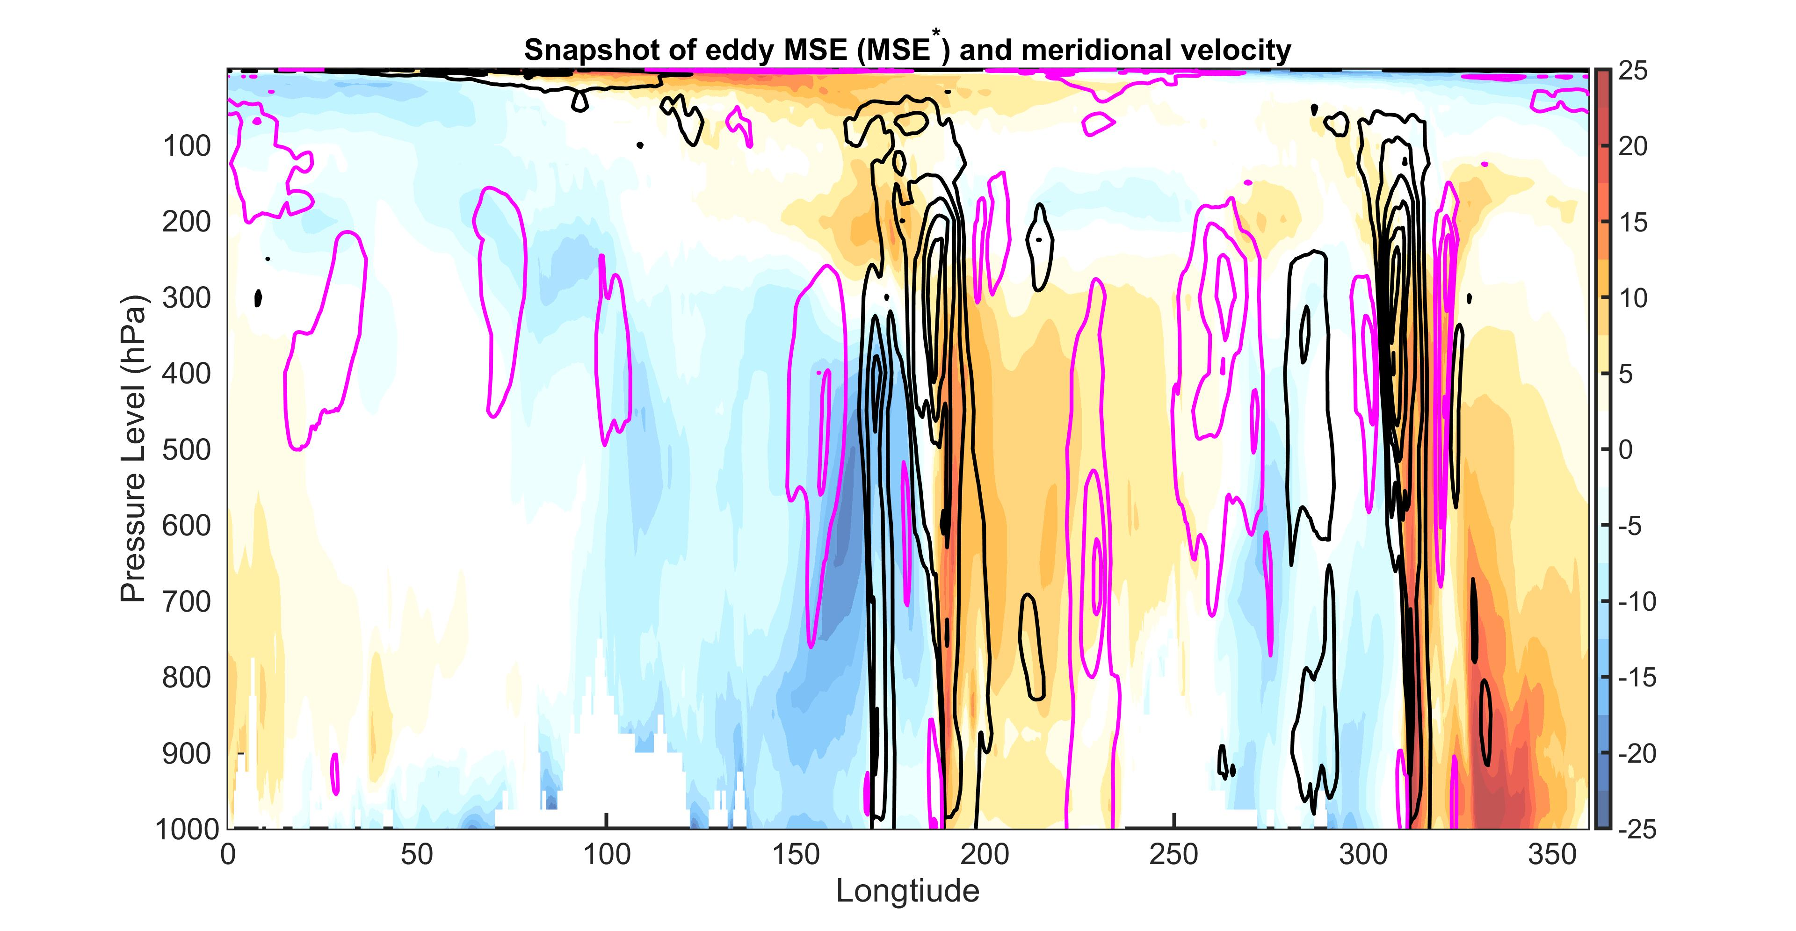
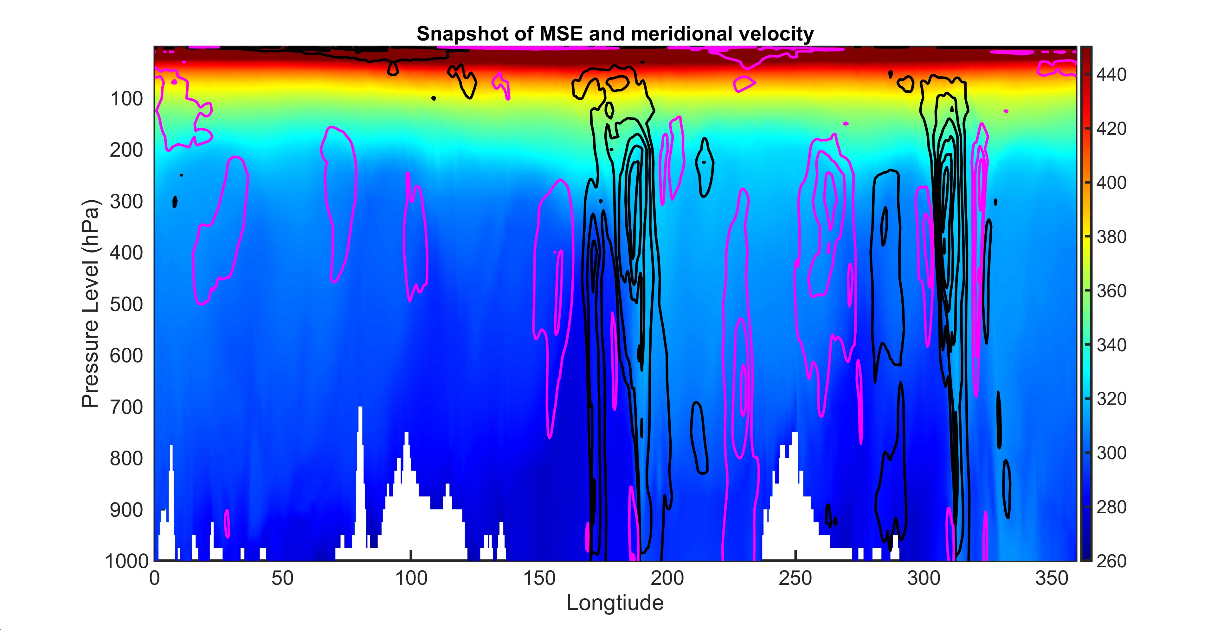
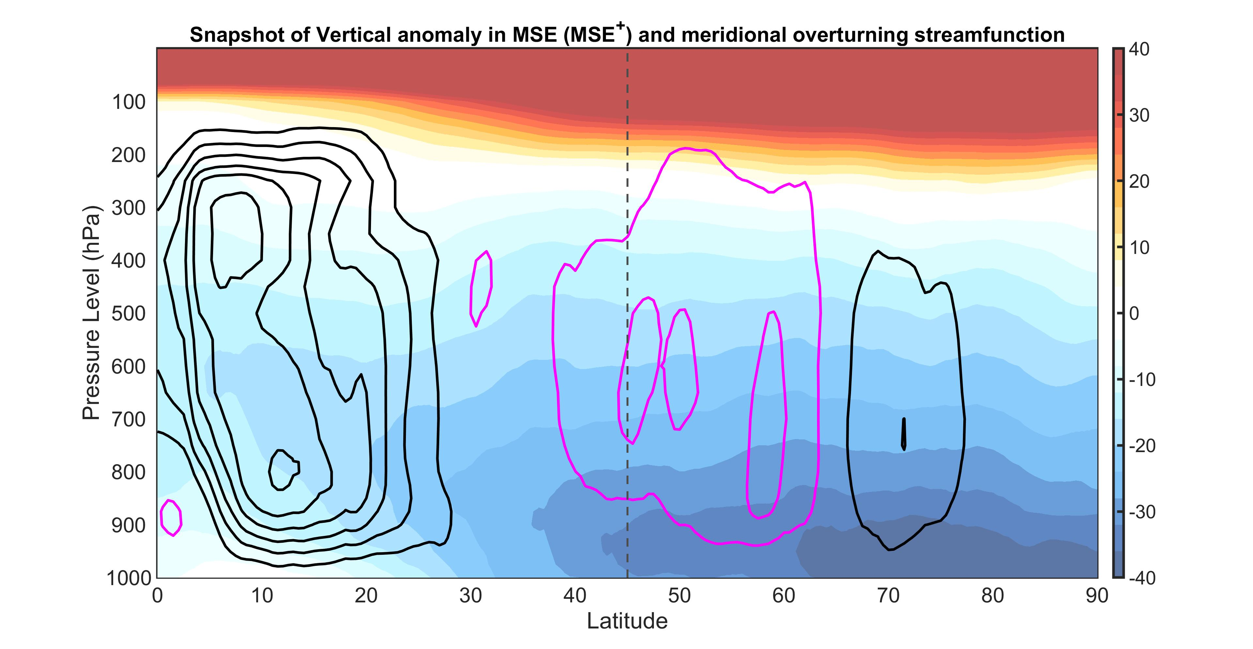
How we do the calculation:
EDDY
Poleward winds
Equatorward winds
Contour interval 10 m/s
MSE*/Cp (K)
MOC
Clockwise cell
Counter-clockwise
Contour interval 30 Sv
MSE^{Ϯ}/Cp (K)

Slide 9
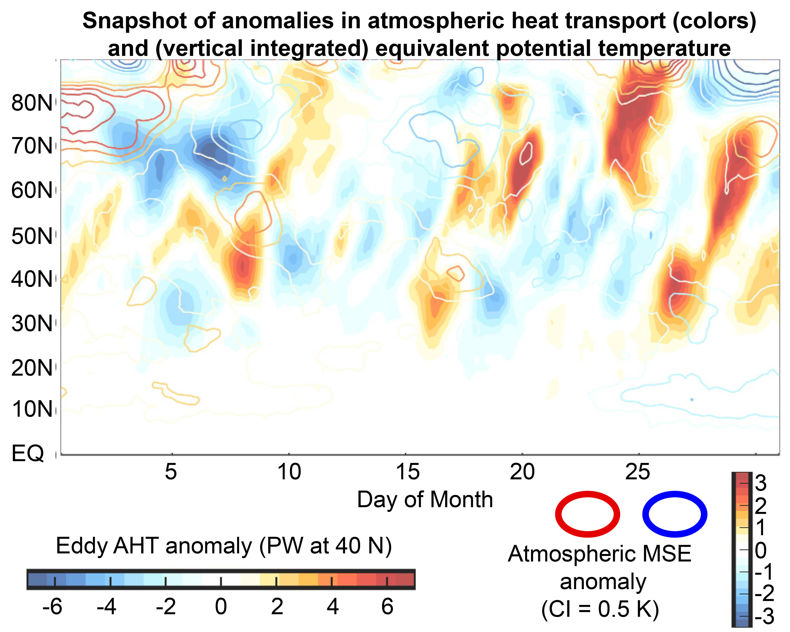
Snapshot of instantaneous (6 hourly)
AHT (Jan 2006)

Slide 10
Histograms of zonally integrated DJF AHT is nearly gaussian at each latitude:
But, combining latitudes into a single histogram gives a distribution with a mode near zero
→ Reflects small zonal circumference at high latitudes
Our distribution of AHT is mostly consistent with Messori and Czaja 2015

Slide 11
Snapshot of instantaneous
AHT (Jan 2006)
How is AHT related to atmospheric heating?

Slide 12
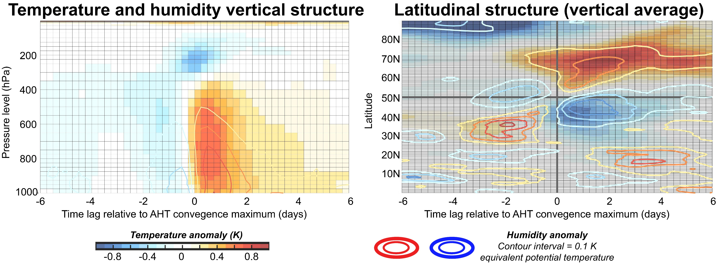
Lead/lag composite of temperature anomalies associated with AHT anomaly at 50N (DJF)

Slide 13
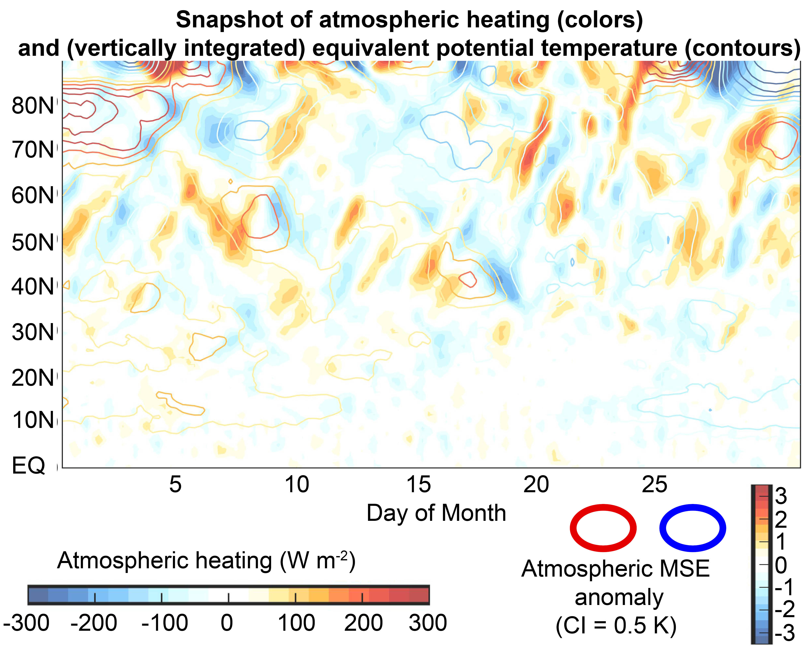
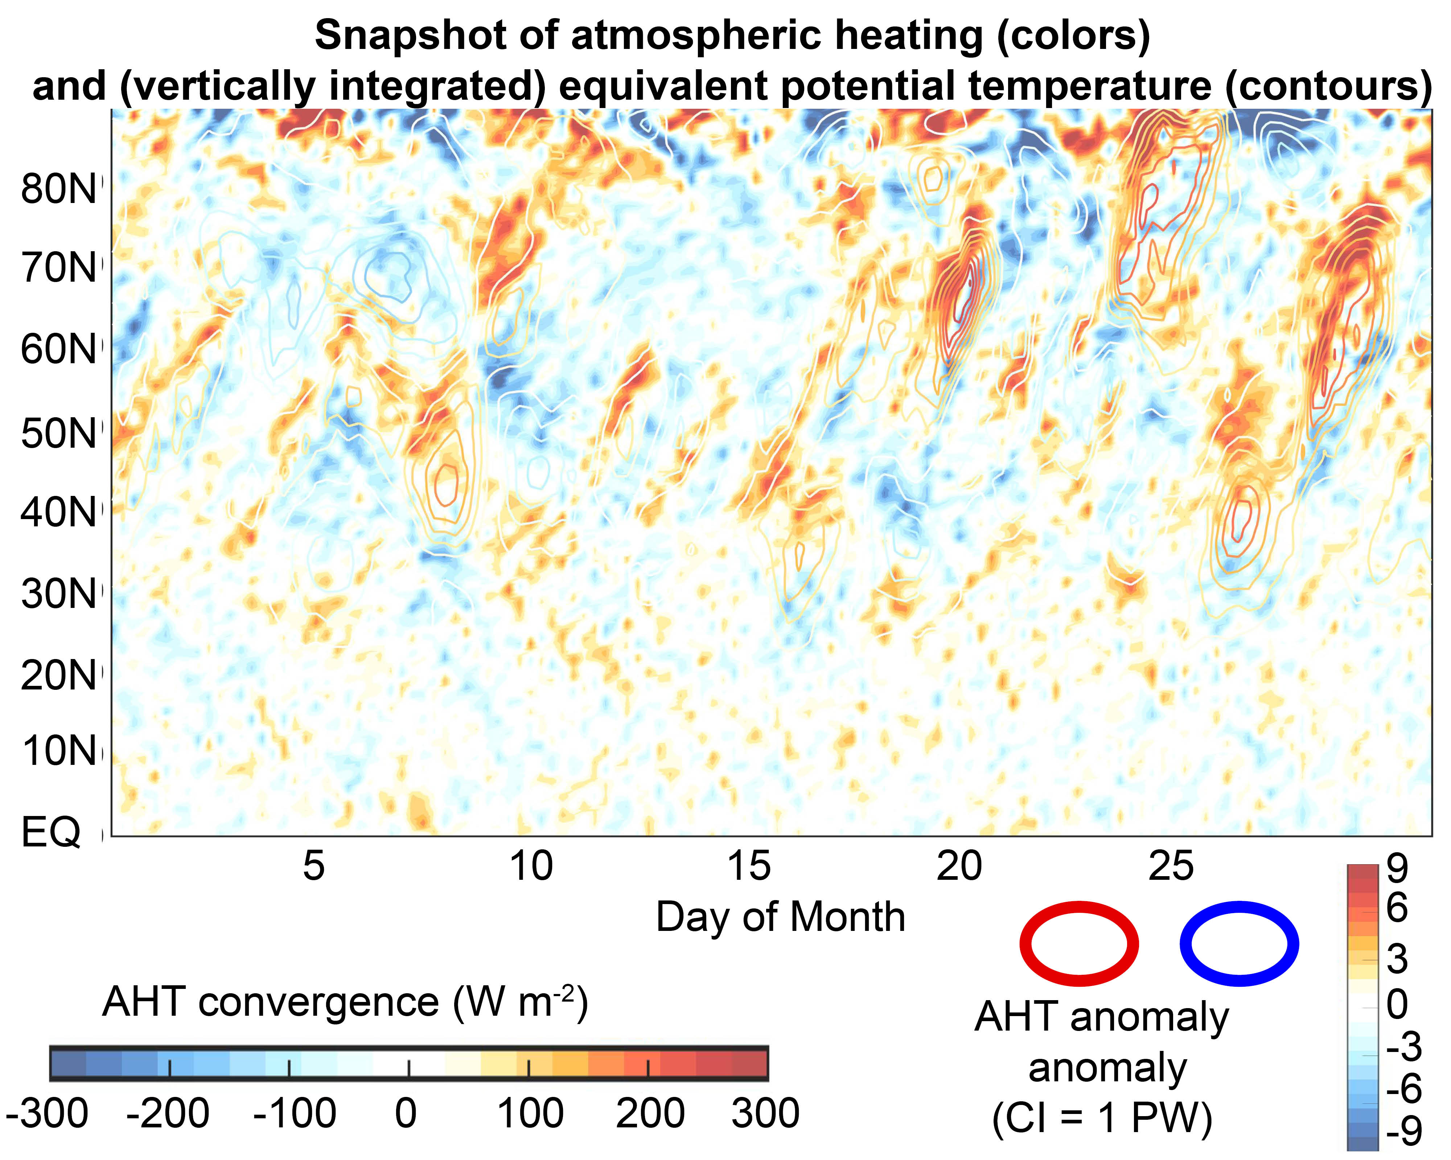


$$\frac{d\frac{1}{g}\int_{P_{S}}^{0}{MSE dP}}{dt}=− ∇∙AHT+diabatic$$
$$\frac{d\frac{1}{g}\int_{P_{S}}^{0}{MSE dP}}{dt}$$
$$−∇∙AHT$$

Slide 14
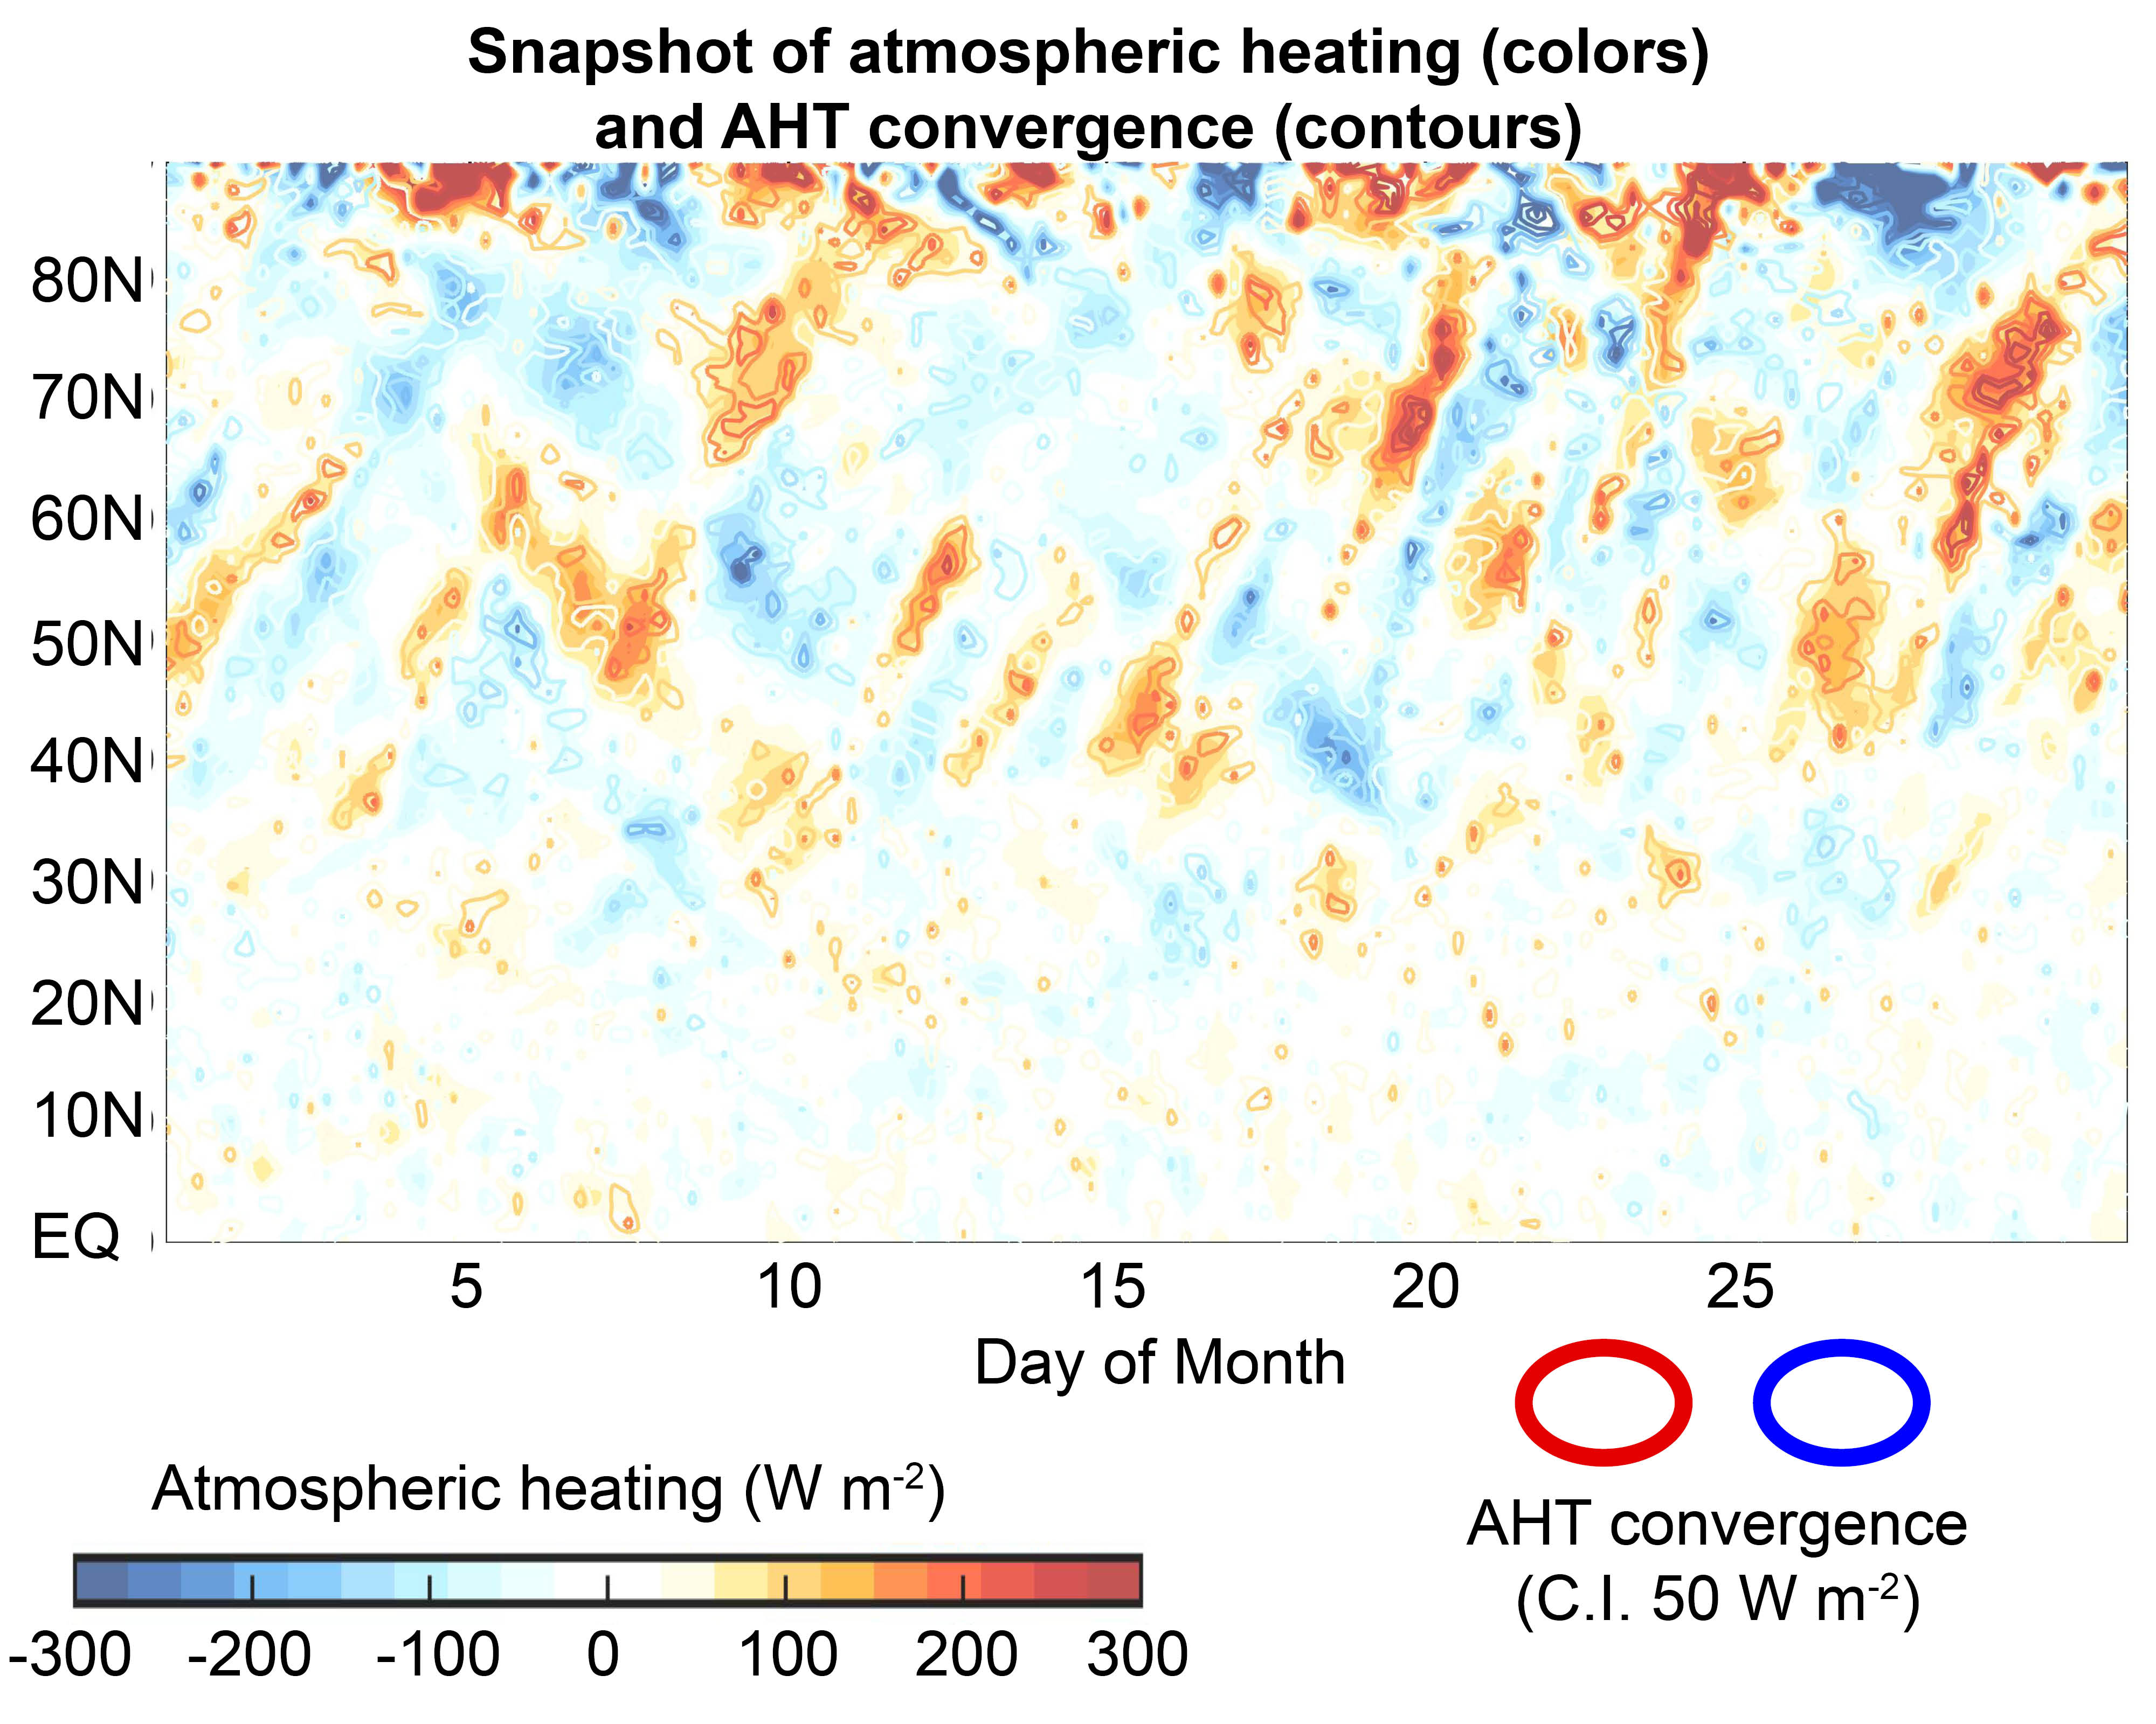

$$\frac{d\frac{1}{g}\int_{P_{S}}^{0}{MSE dP}}{dt} vs.− ∇∙AHT$$
$$\frac{d\frac{1}{g}\int_{P_{S}}^{0}{MSE dP}}{dt}$$
$$−∇∙AHT$$

Slide 15
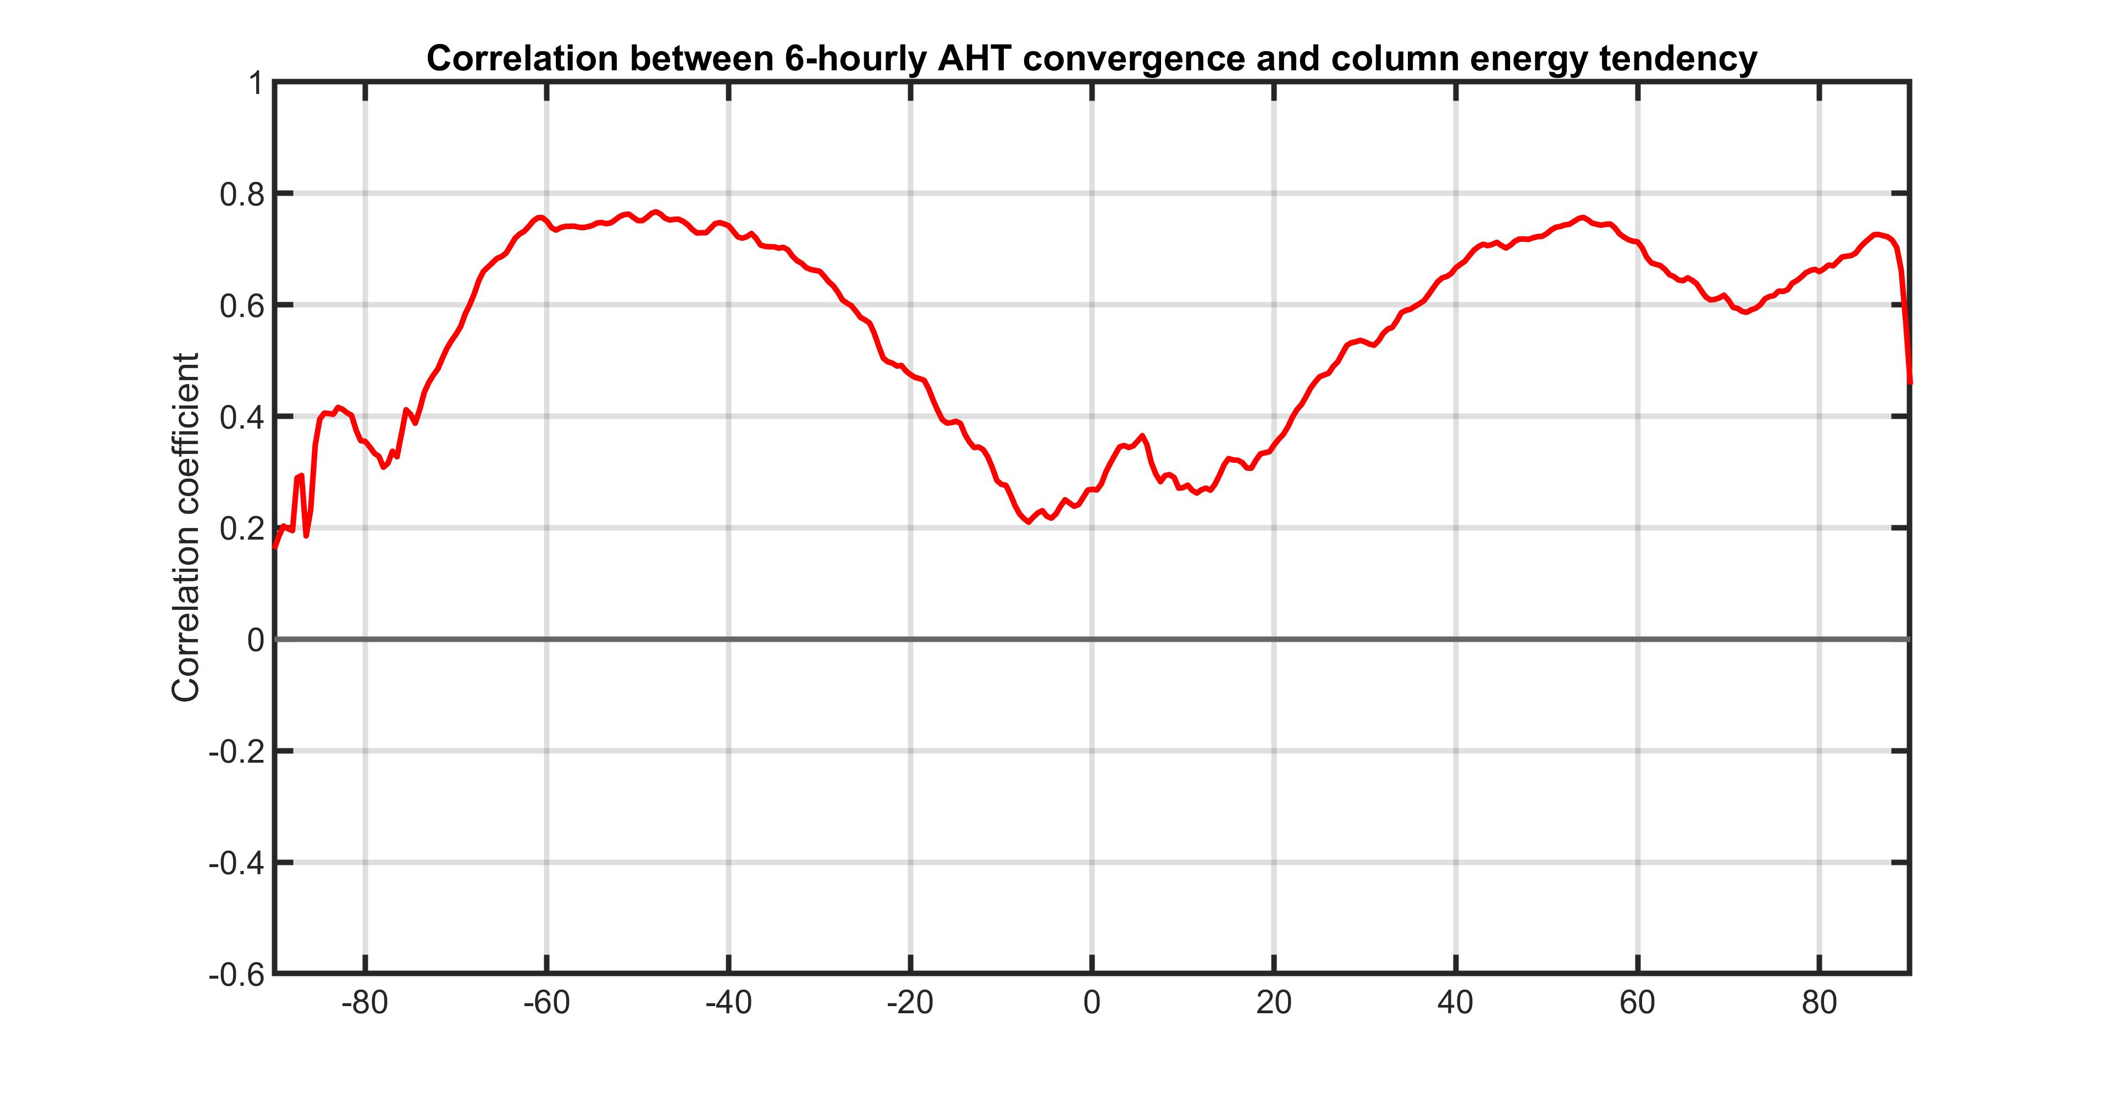

We quantify the consistency of: with a temporal correlation at each latitude
$$\frac{d\frac{1}{g}\int_{P_{S}}^{0}{MSE dP}}{dt} \sim − ∇∙AHT$$
~

Slide 16
Tight correlation between AHT and atmospheric heating – with a near 1:1 ratio –
At synoptic timescales suggest that dominant balance is between AHT and atmospheric storage.
Little role for radiative feedbacks and surface exchange
Atmospheric heating events are limited by AHT (and the fixed heat capacity of the atmosphere)
If we understand variability of AHT, we understand variability of atmospheric temperature

Slide 17
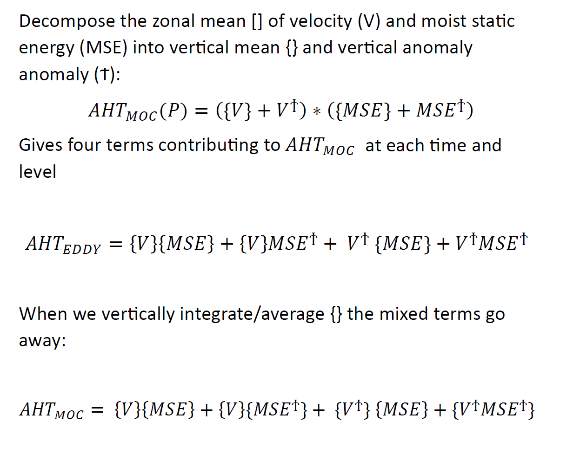
Mass flux independence
Mass Flux AHT
MOC

Slide 18
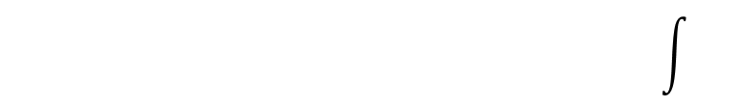
Mass flux independence
Reanalysis generally don’t conserve mass.
There can be non-zero zonal mean mass fluxes in the climate system that:
Increase the mass (surface pressure) of the atmosphere poleward of that latitude
Remove water from the atmosphere
$$\left\{V(ϴ)\right\}=\int_{sin⁡(ϴ)}^{sin⁡(90)}{\frac{1}{g}\frac{dP_{s}}{dt}}+\left(P−E\right)dsin(ϴ)\int{}$$
Multiply above by {MSE} to get Mass flux AHT
Mass Flux AHT
MOC

Slide 19
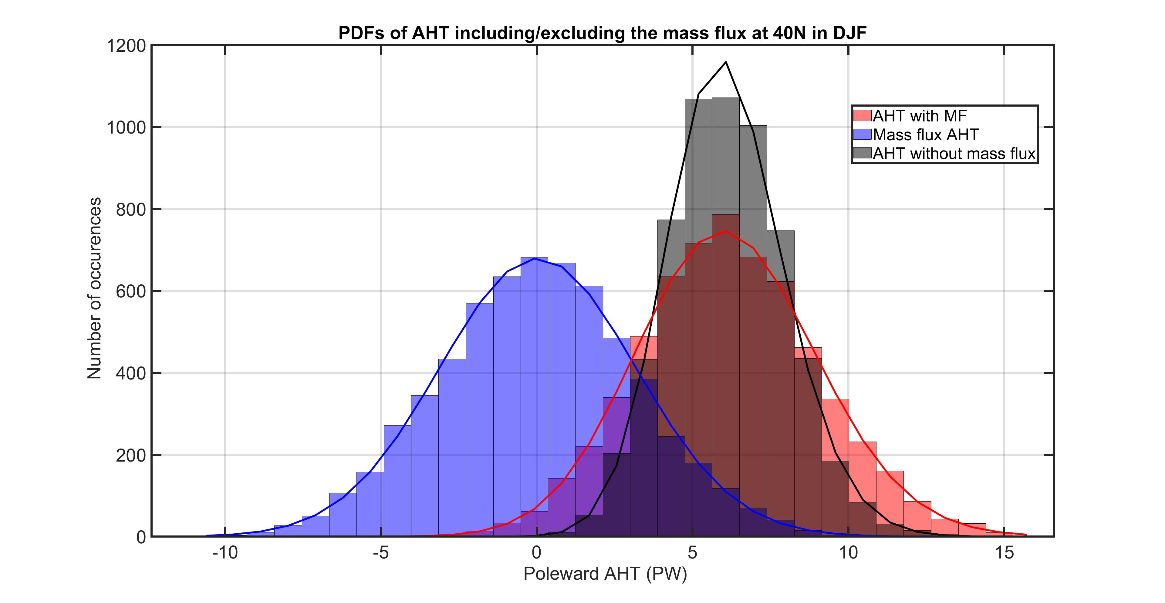

Slide 20
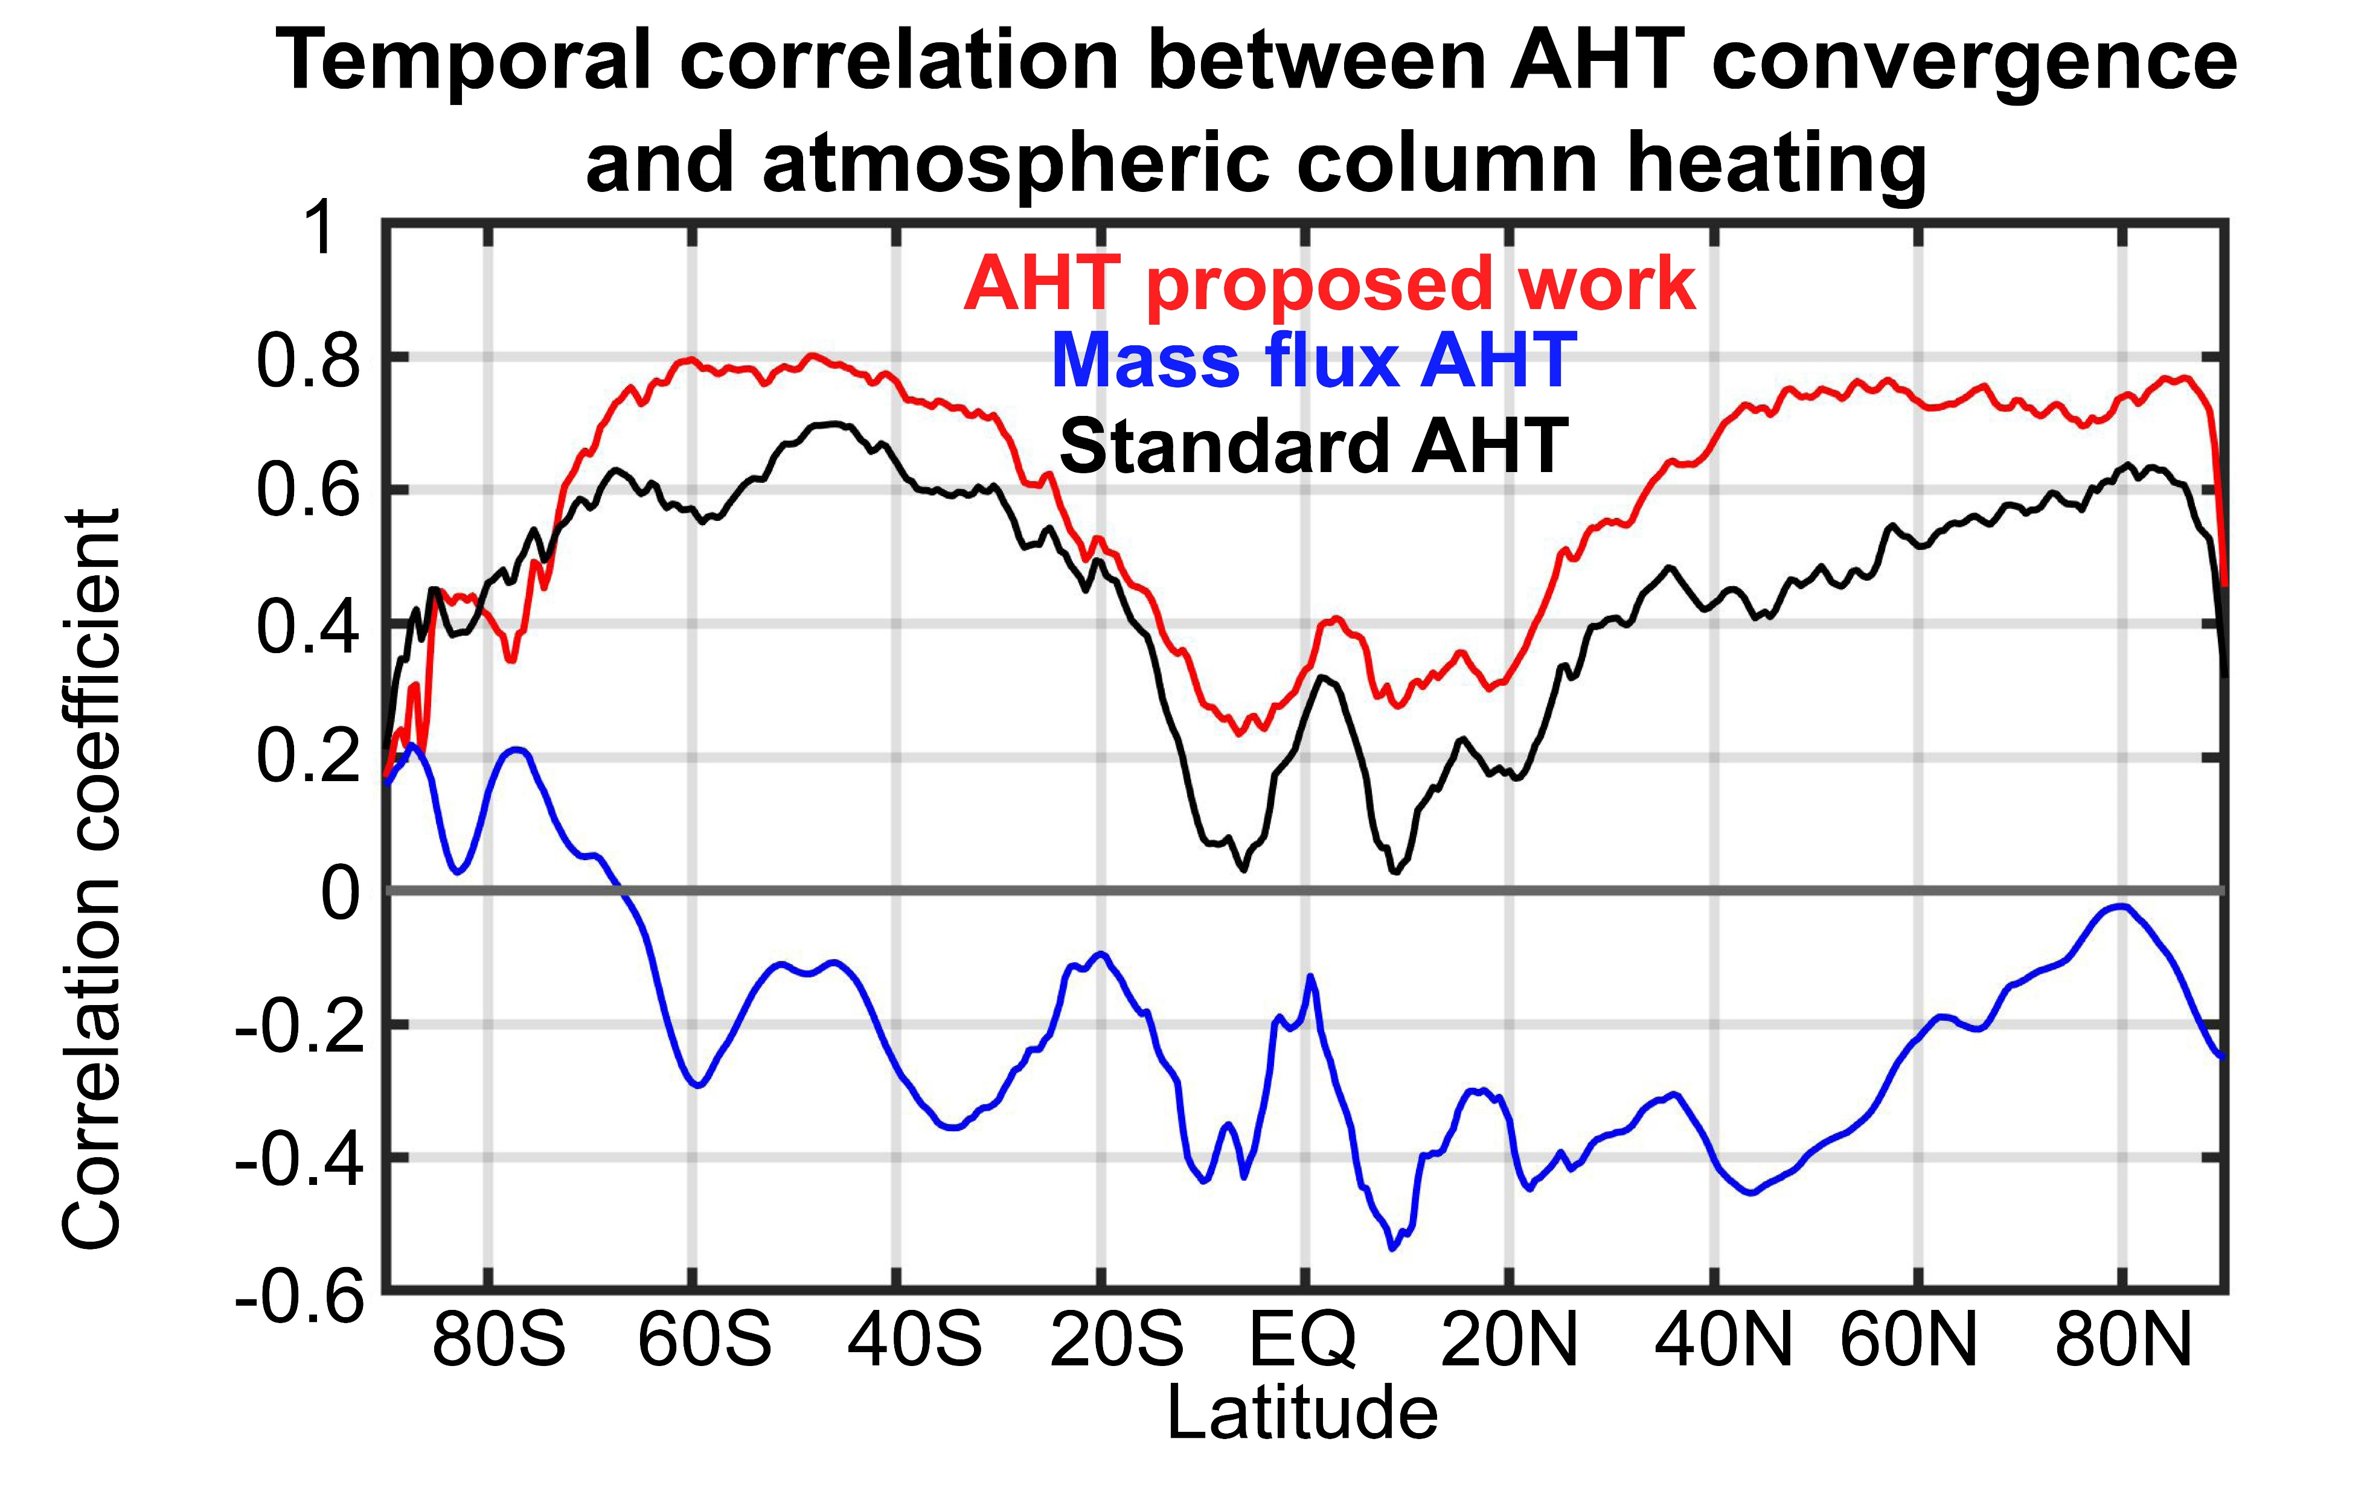

Slide 21
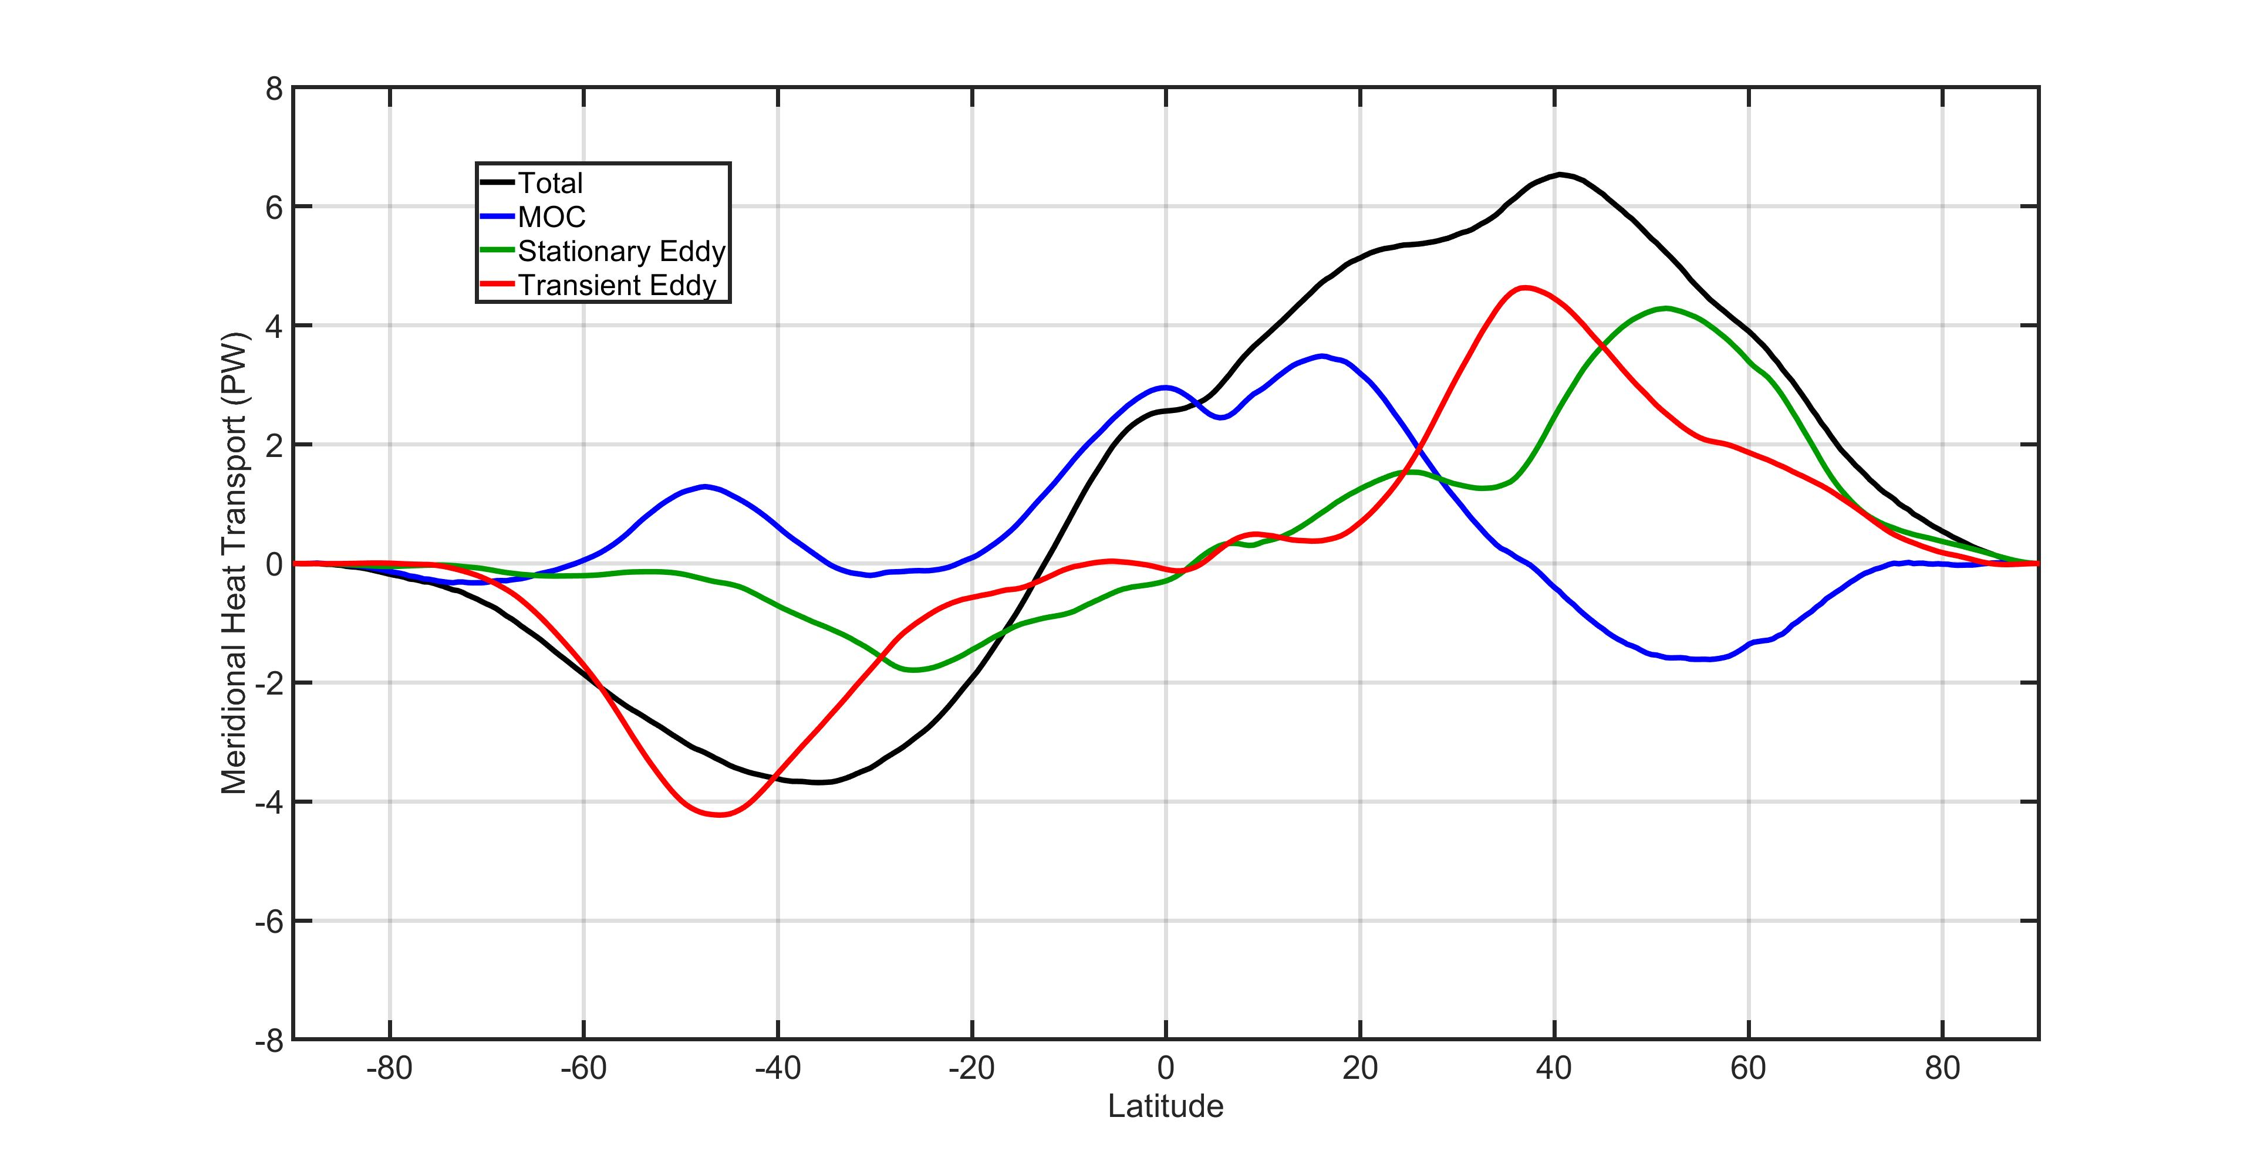
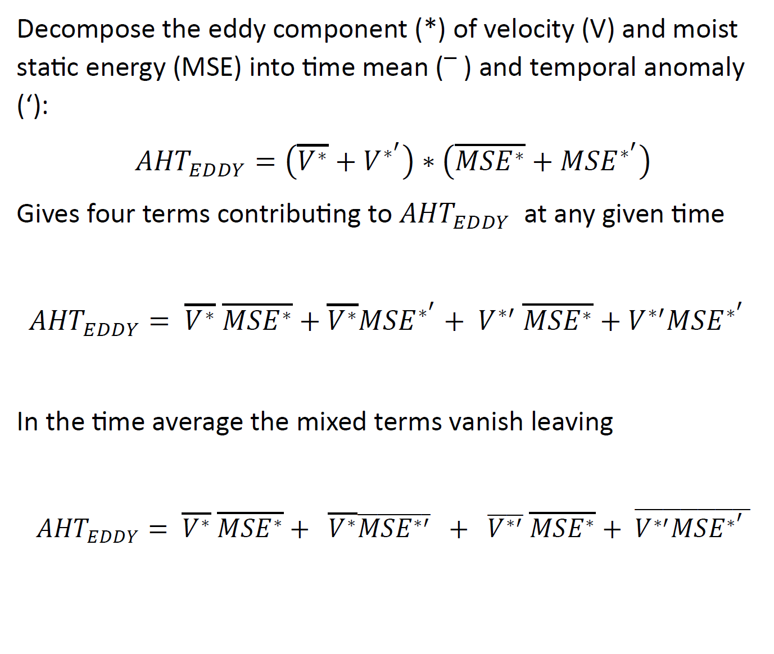
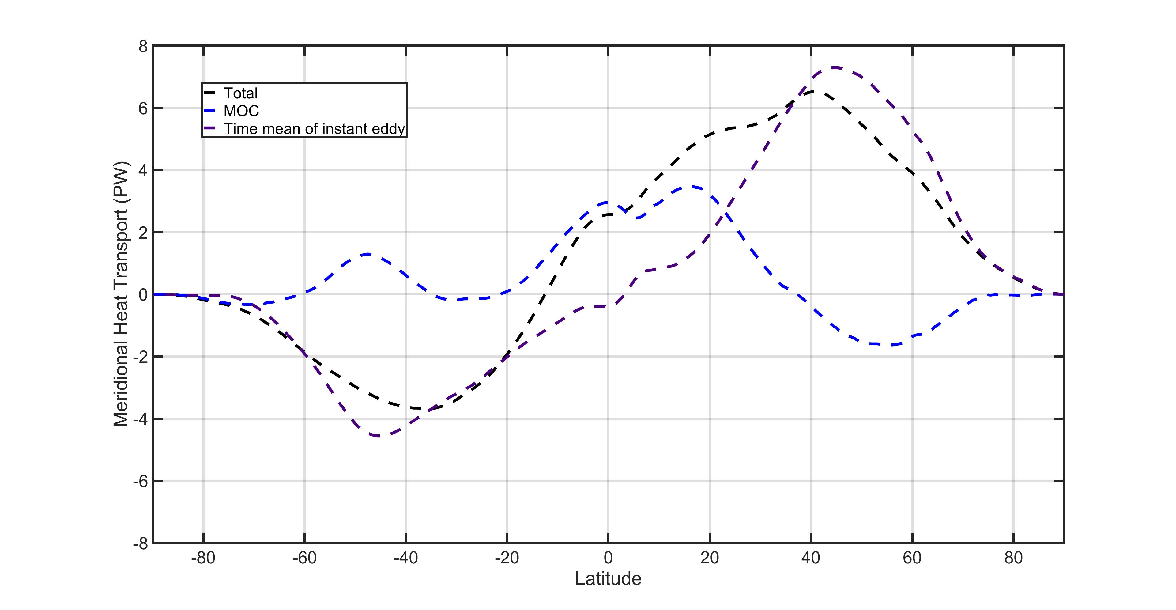
Time mean of instant calculations
(January 2001)
Traditional Monthly calculation
Time mean of our instant calculation
Stationary Eddy
Transient Eddy

Slide 22
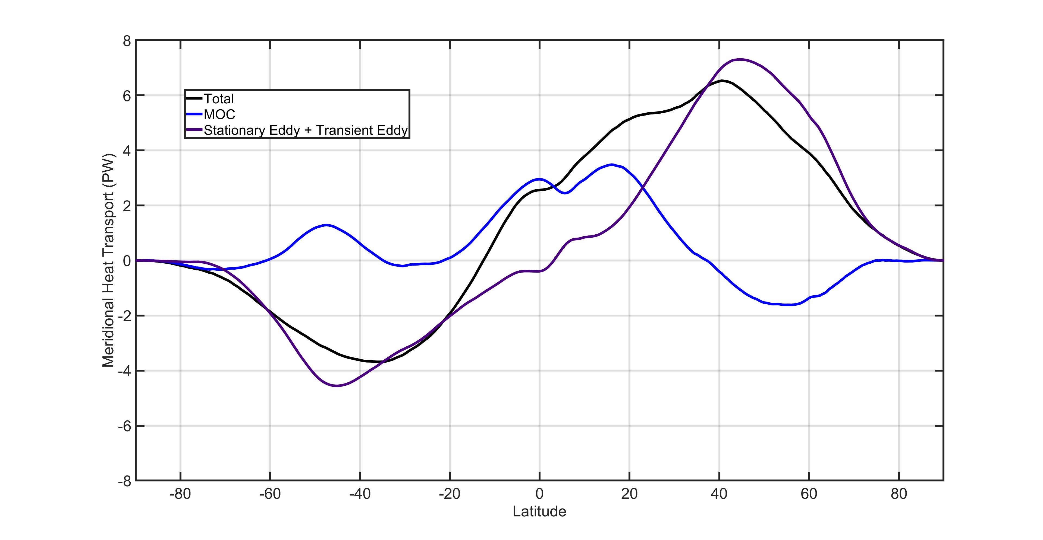
Time mean of instant calculations
(January 2001)
Traditional Monthly calculation
Time mean of our instant calculation
Stationary Eddy
Transient Eddy

Slide 23
Time mean of instant calculations
(January 2001)
We retain the monthly mean AHT calculation using only instantaneous data
→ While allowing time mean and temporal anomalies to interact
Comparison of monthly and
Time mean of our instant calculation
Stationary Eddy
Transient Eddy

Slide 24
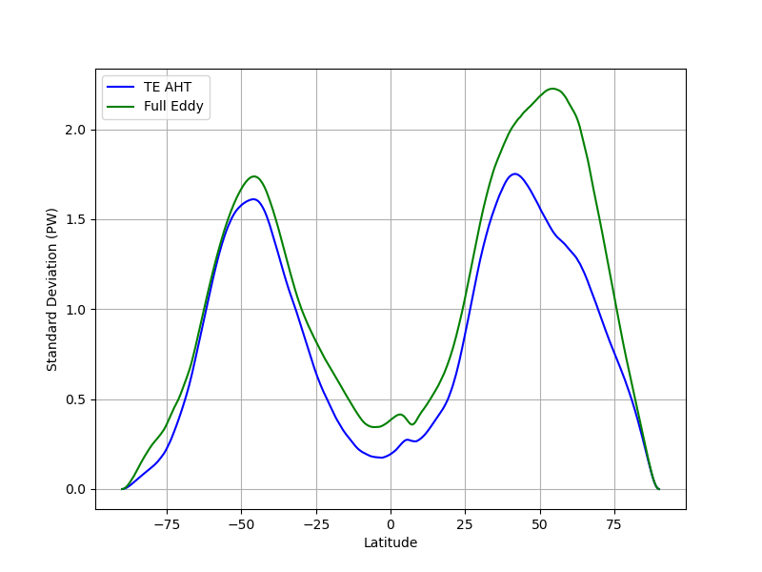
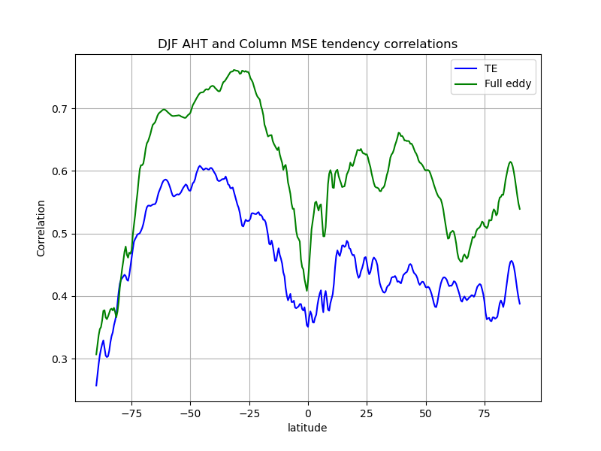
Anomalies in AHT are not just from transient eddies
Full Eddy
Stationary
(time invariant)
Mixed terms
(zero time mean)
Transient eddy
The mixed terms have zero time mean but enhance the temporal variance of full eddy AHT relative to that of the transient eddies alone
The resultant AHT is more strongly tied to atmospheric heating than the transient eddy alone

Slide 25
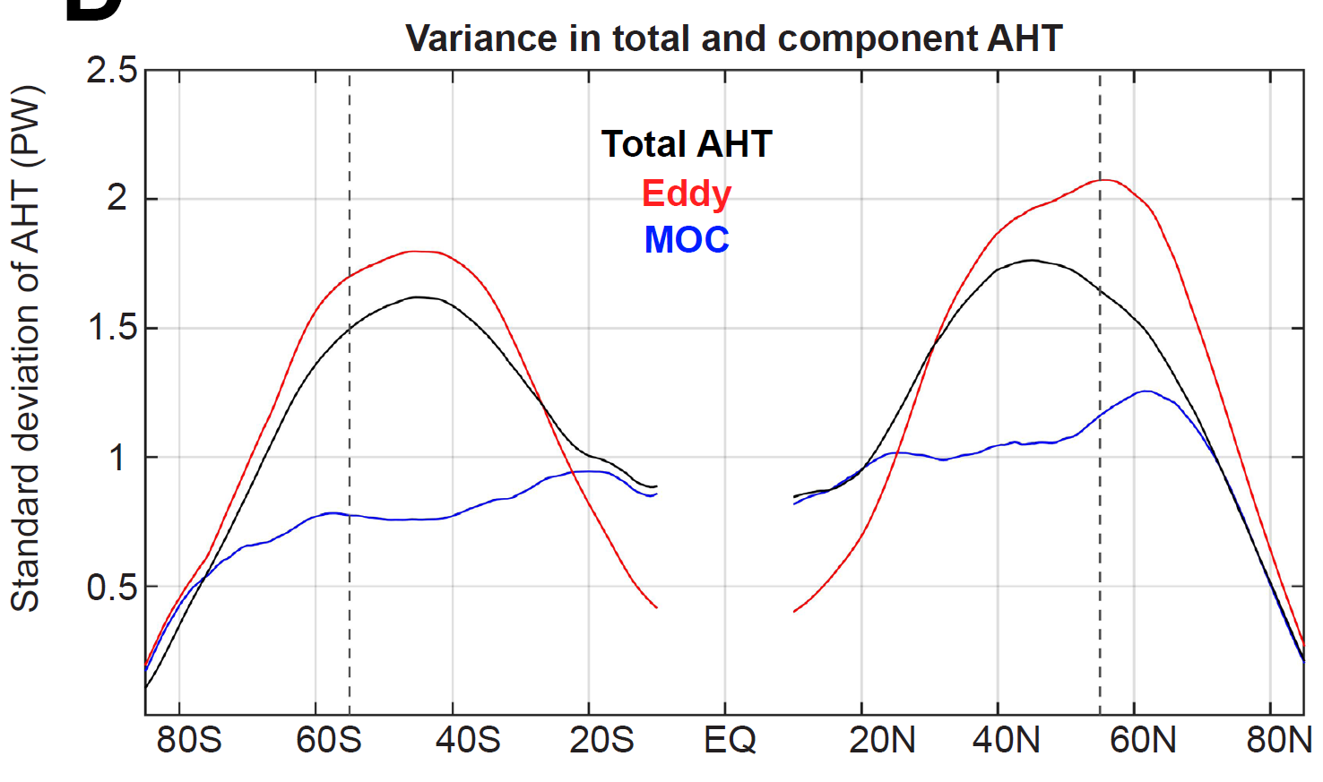
Relationship between Eddy and MOC AHT
Full Eddy
MOC
Eddy and MOC AHT are anti-correlated in time
Consistent with eddy driven Ferrel cell
This reduces the variance in AHT relative to eddy AHT alone

Slide 26
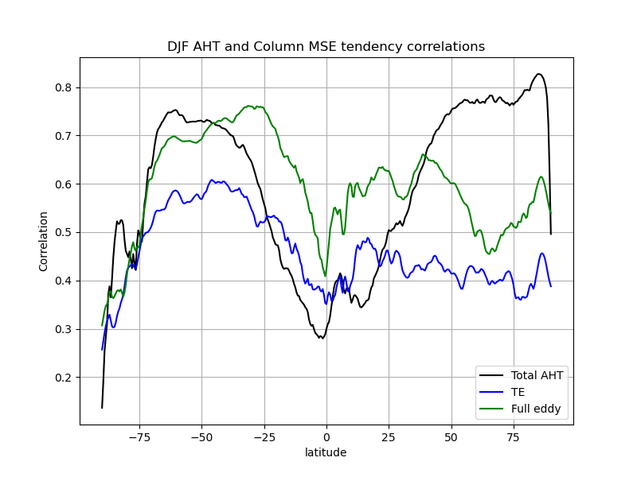
Accounting for MOC AHT general improve correlations with atmospheric heating

Slide 27
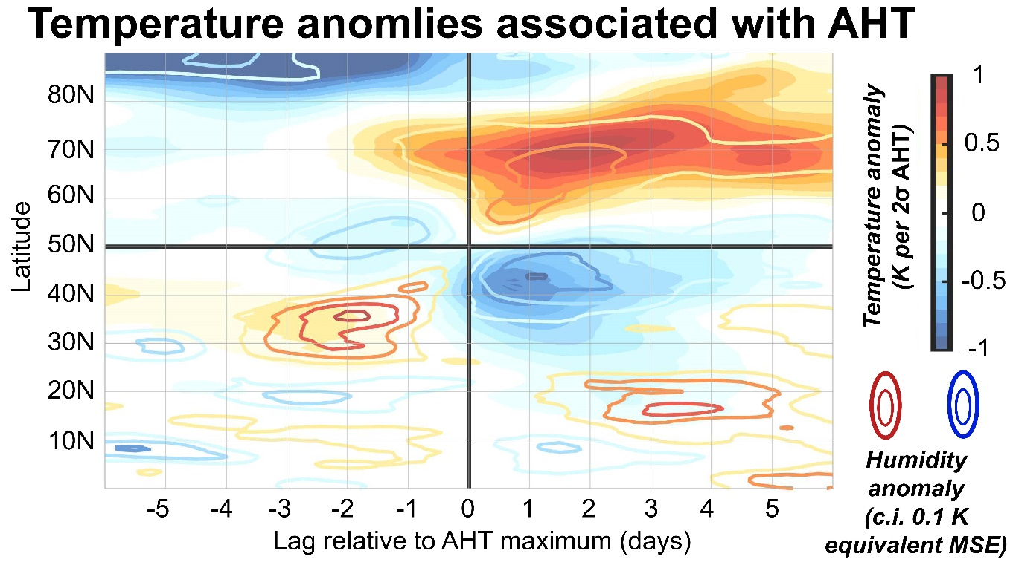
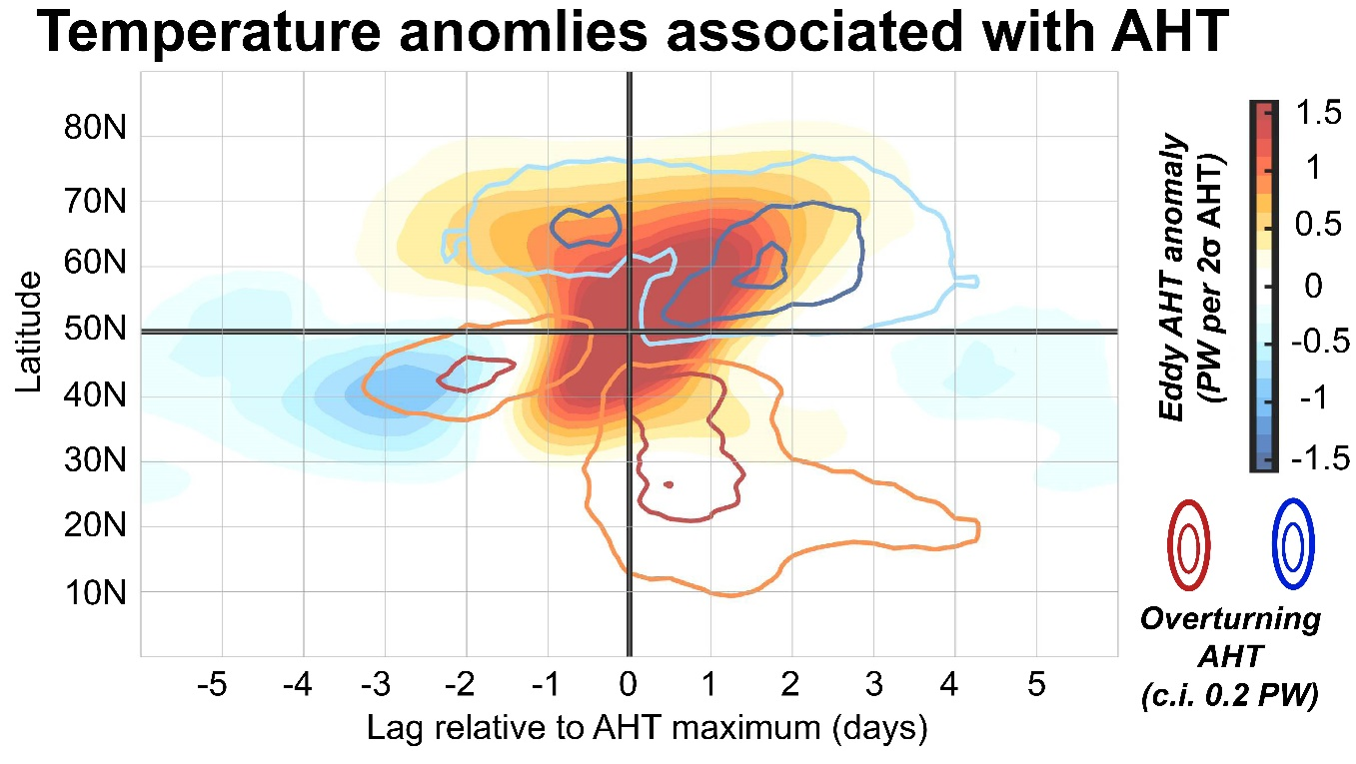
Composites of AHT anomaly at 50N (Wintertime DJF
Atmospheric heat transport is responsible for the majority (80%) of atmospheric heating
MOC AHT associated with eddy AHT anomaly
Ferrel cell response is nearly synchronous and damps heating by 20%

Slide 28
Switching gears: can we do this as a function of latitude and longitude?
$$∇∙AHT\left(lat,lon\right)=\frac{1}{g}\int_{0}^{P_{S}}{\left(U,V\right)∗∇MSE +{MSE}^{Ϯ}∇∙(U,V)}dp$$
Horizontal advection
Vertical motion

Slide 29
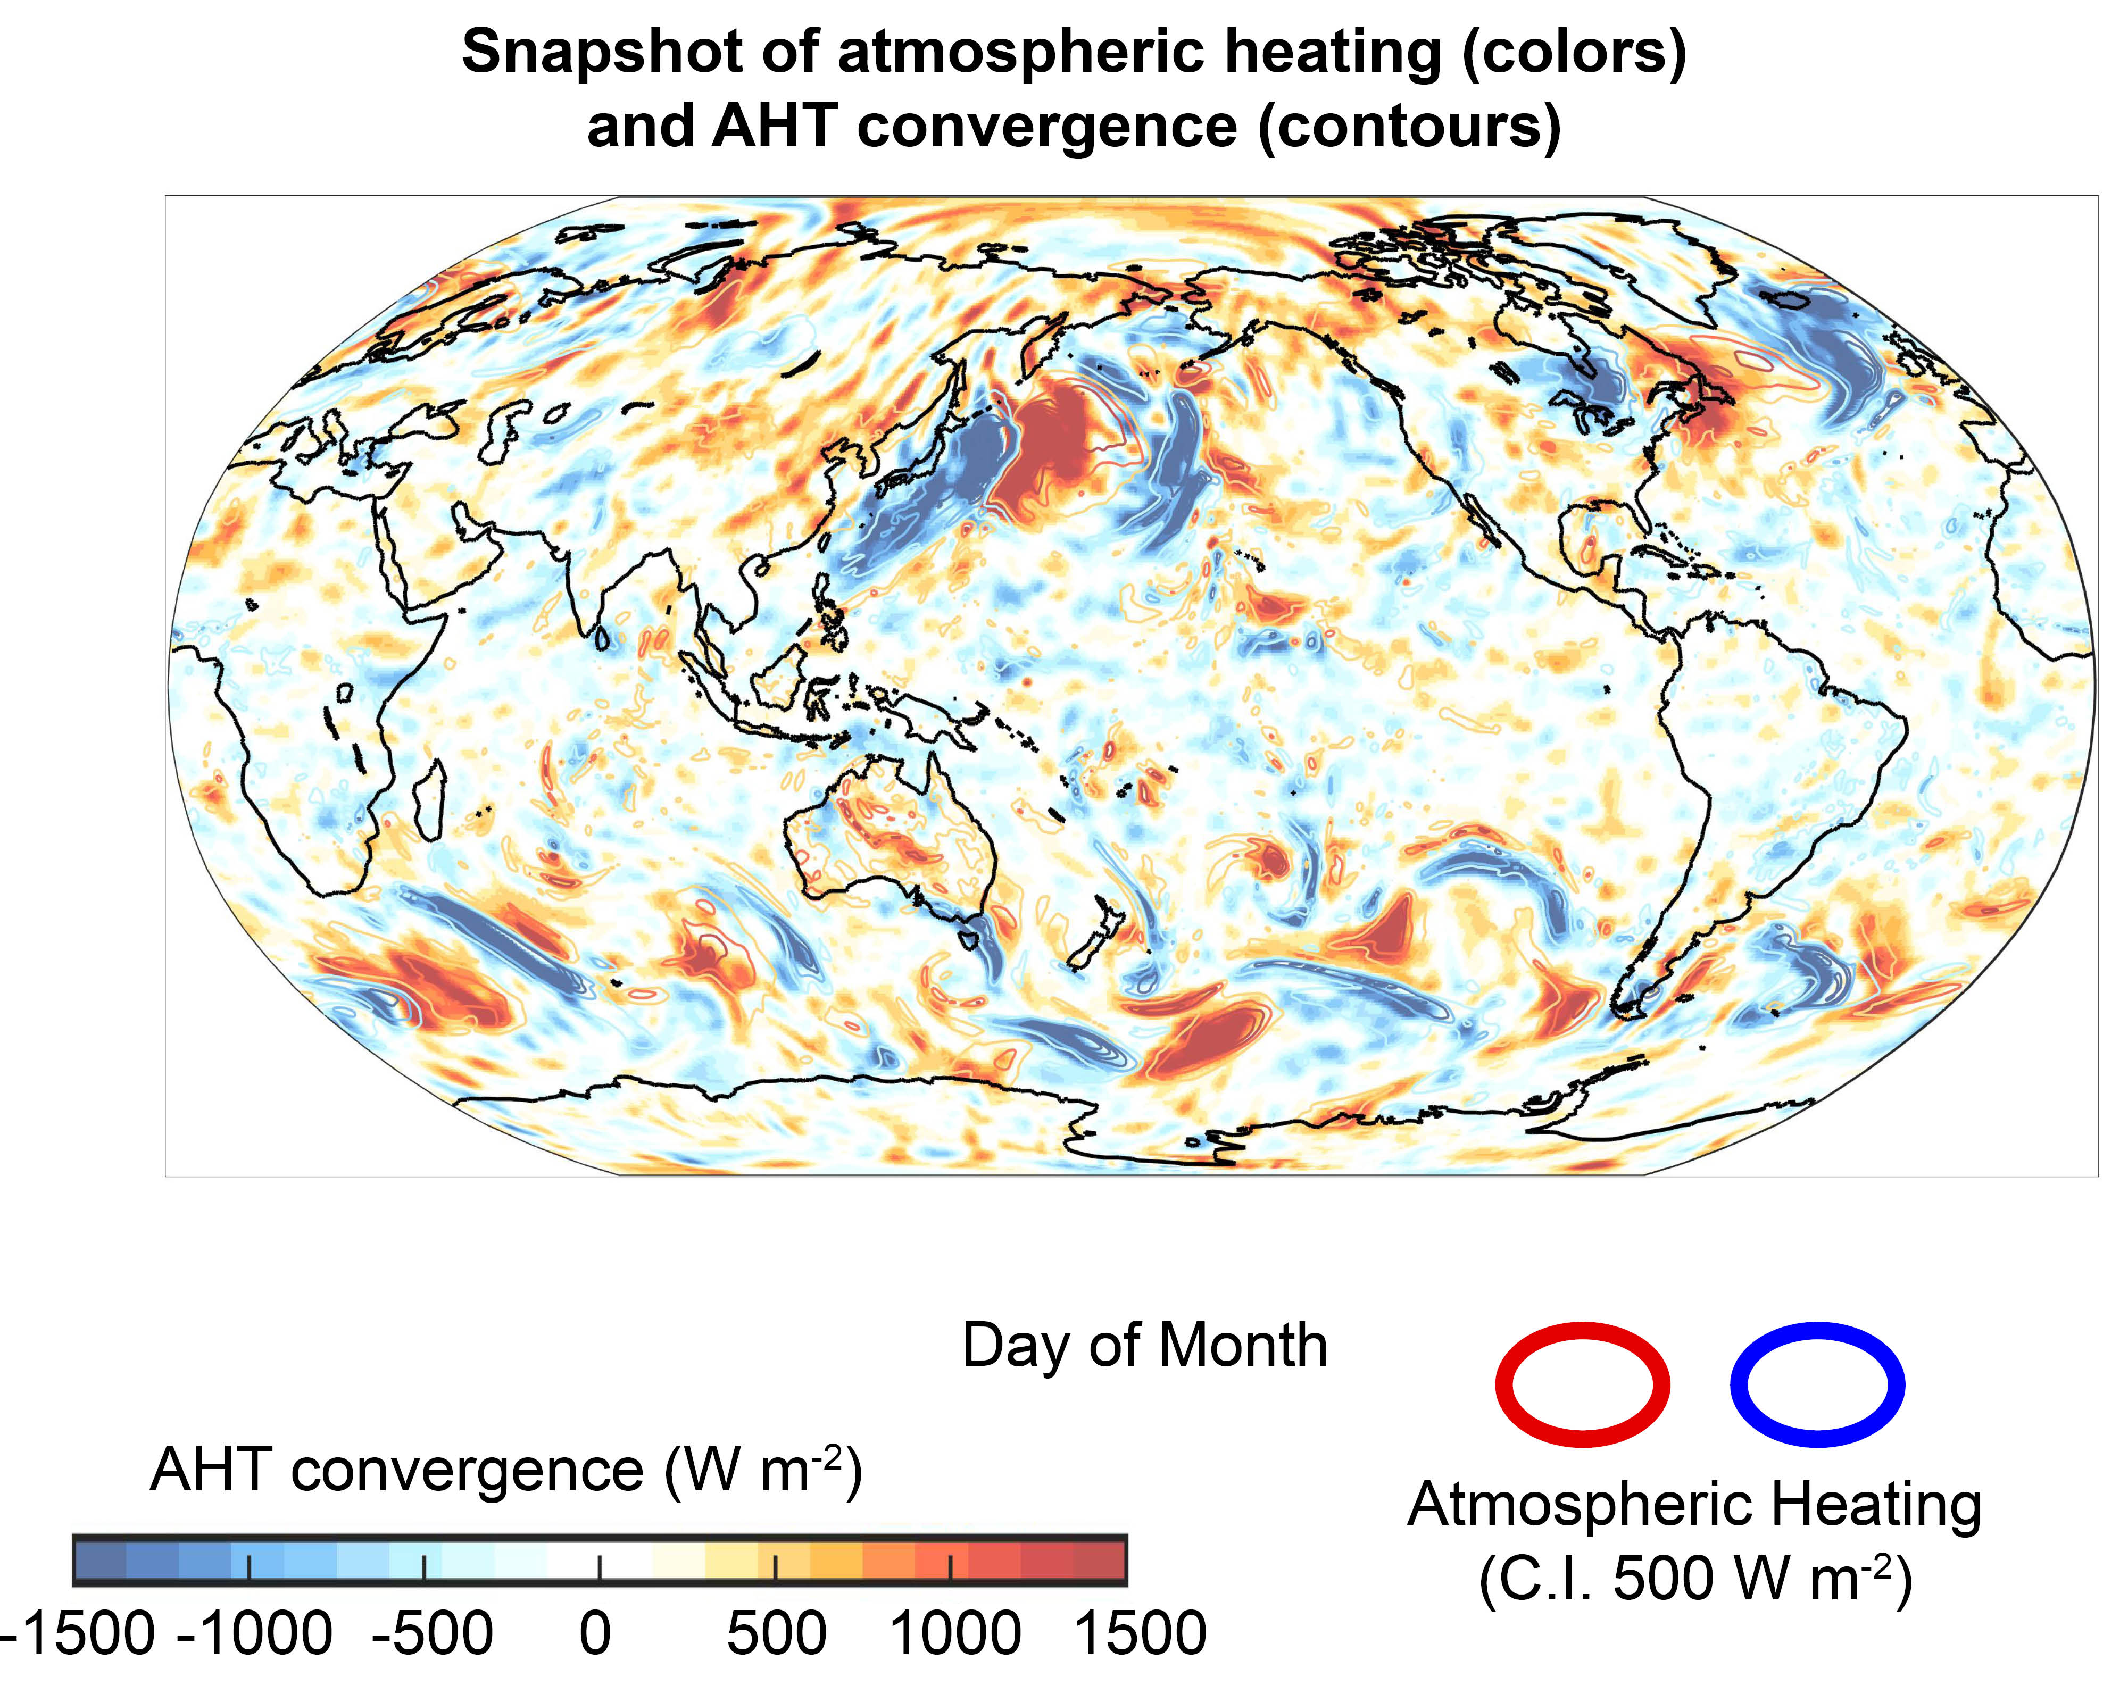
Instantaneous snapshot of AHT convergence (colors)
and
column heating (contours)
1500 W m⁻² !!!
Heating and AHT convergence are right on top of each other

Slide 30
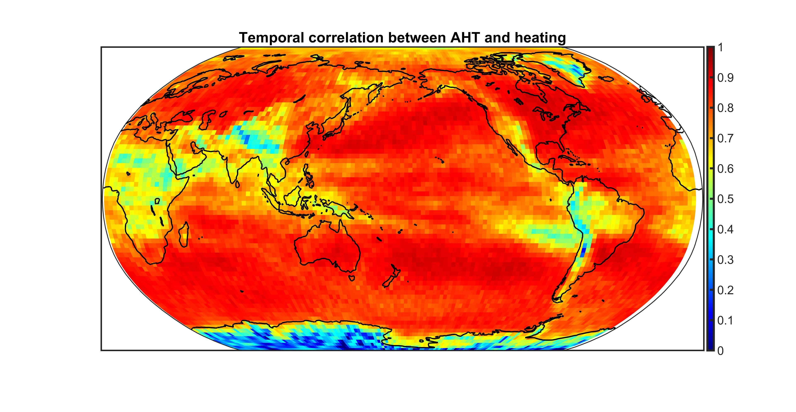

Slide 31
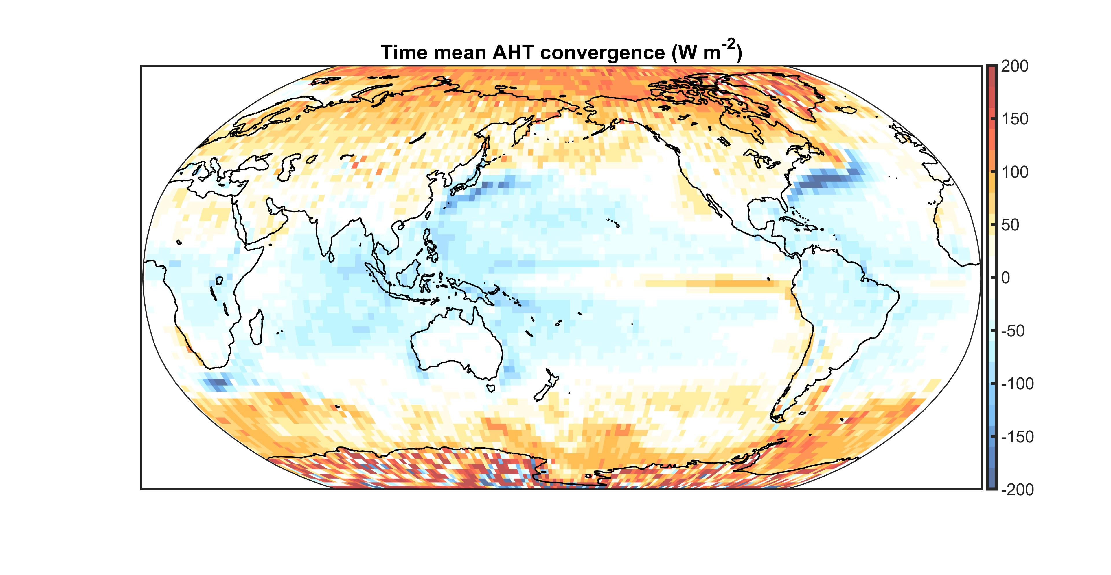

Slide 32
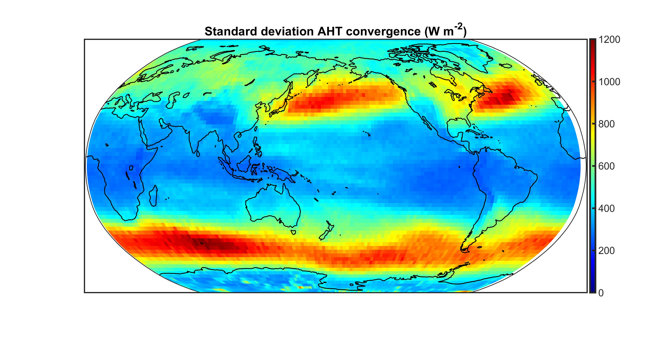
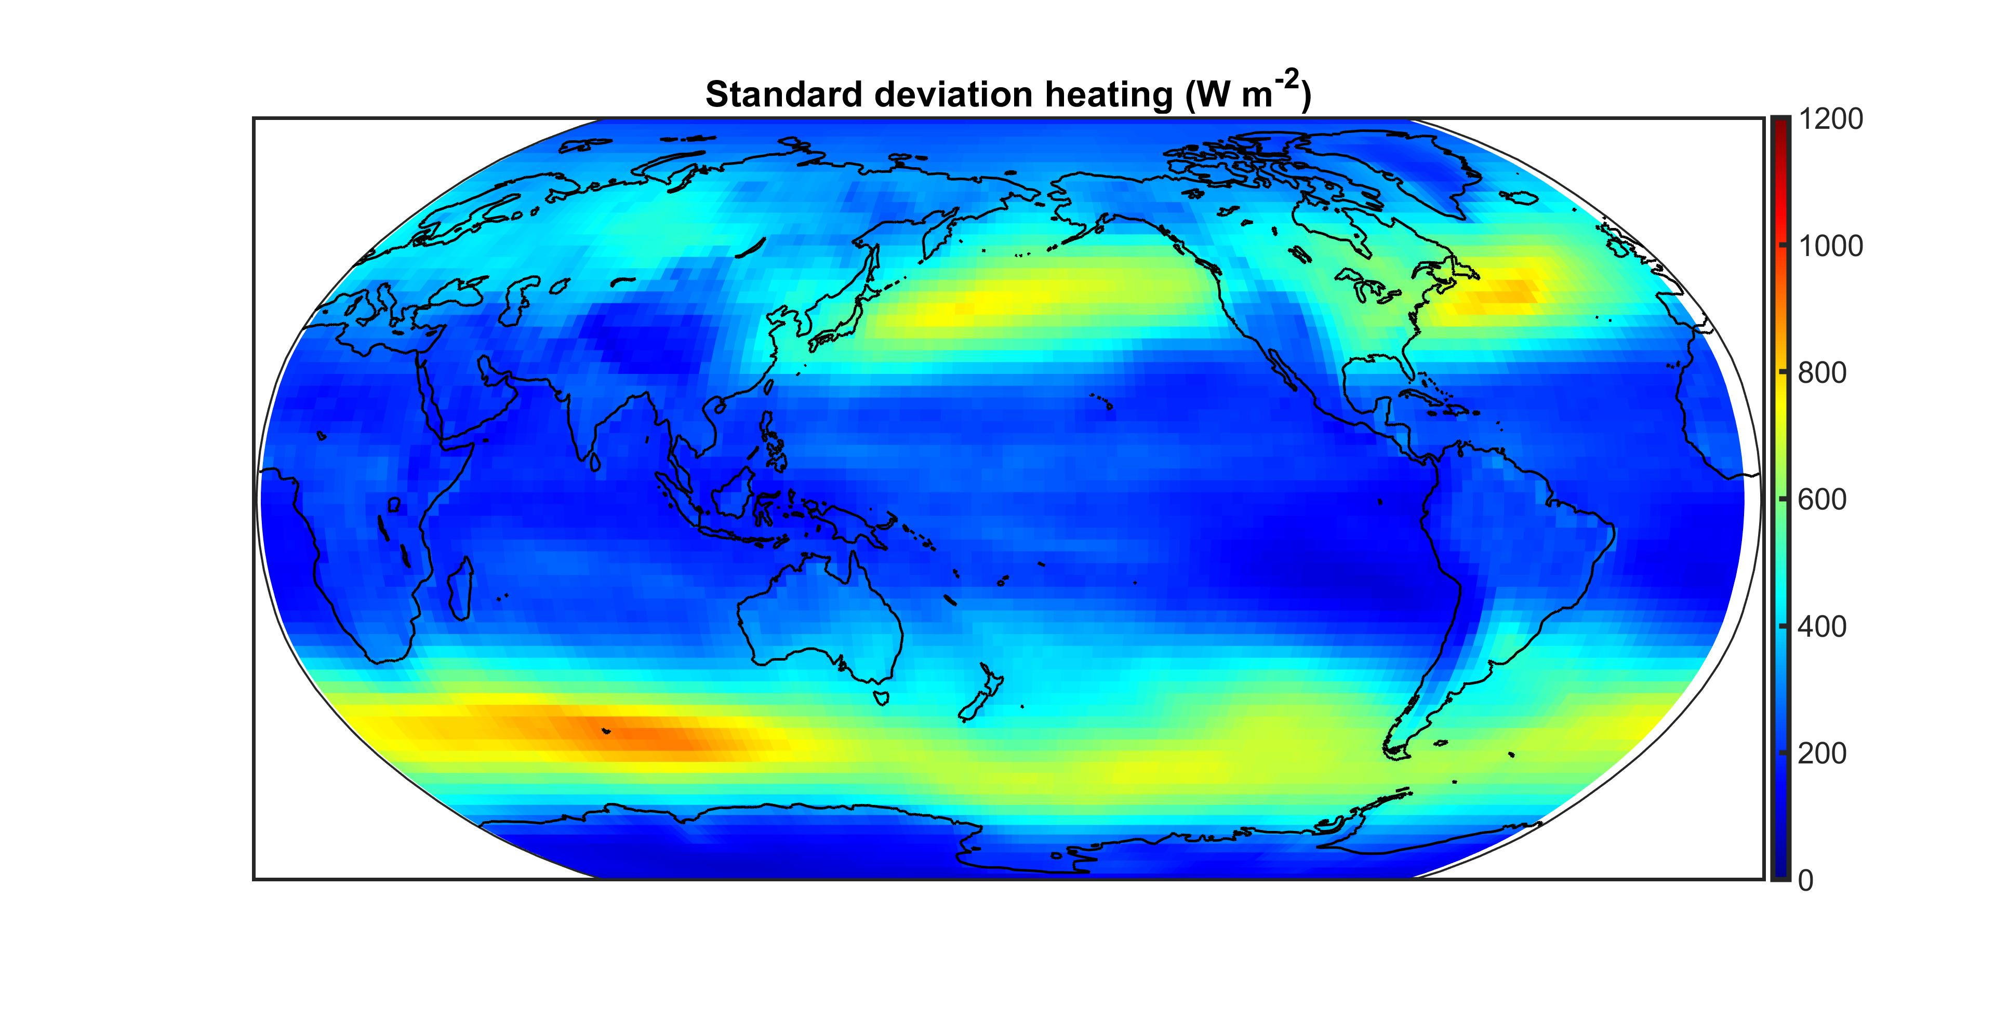

Slide 33
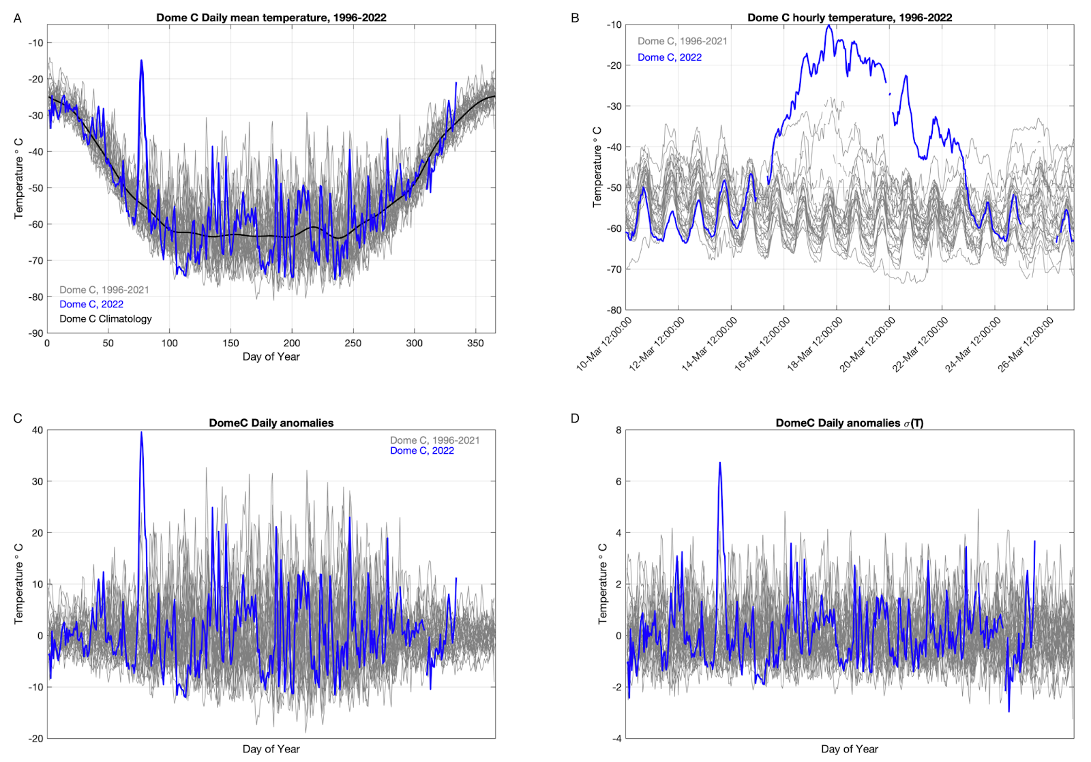
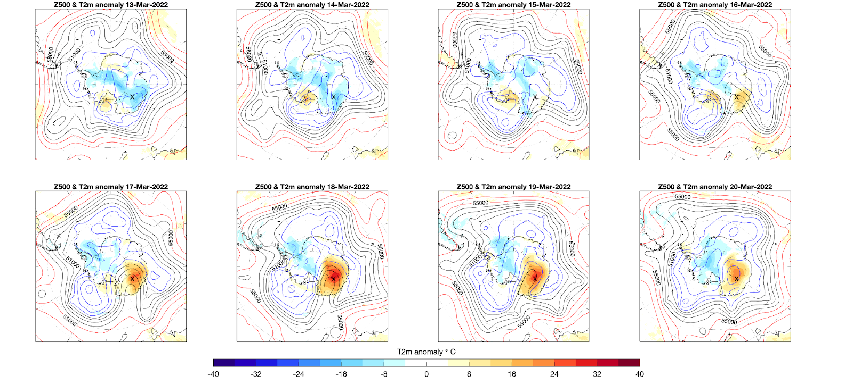
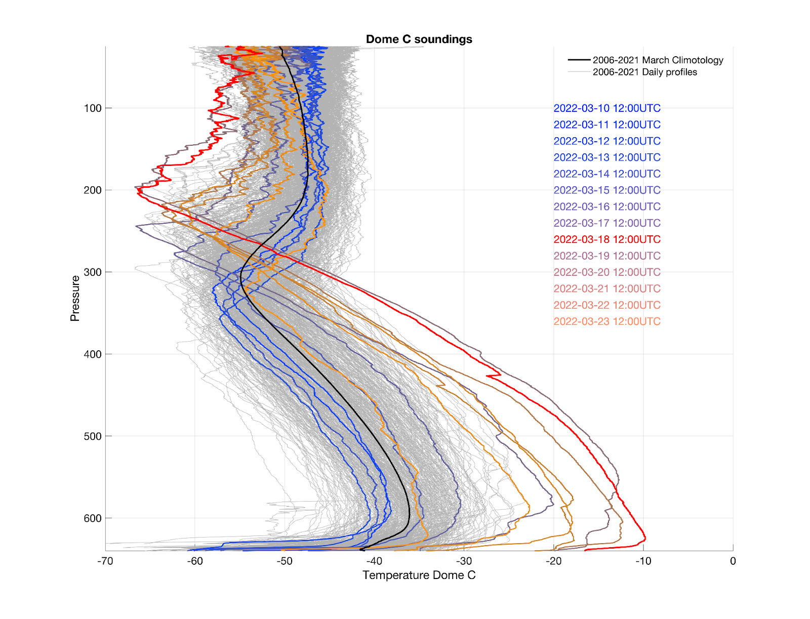
Dome C Heat wave
of March 2022
38 K temperature anomaly
Was laterally extensive
Significant warming of whole troposphere
Should be seen in AHT convergence

Slide 34
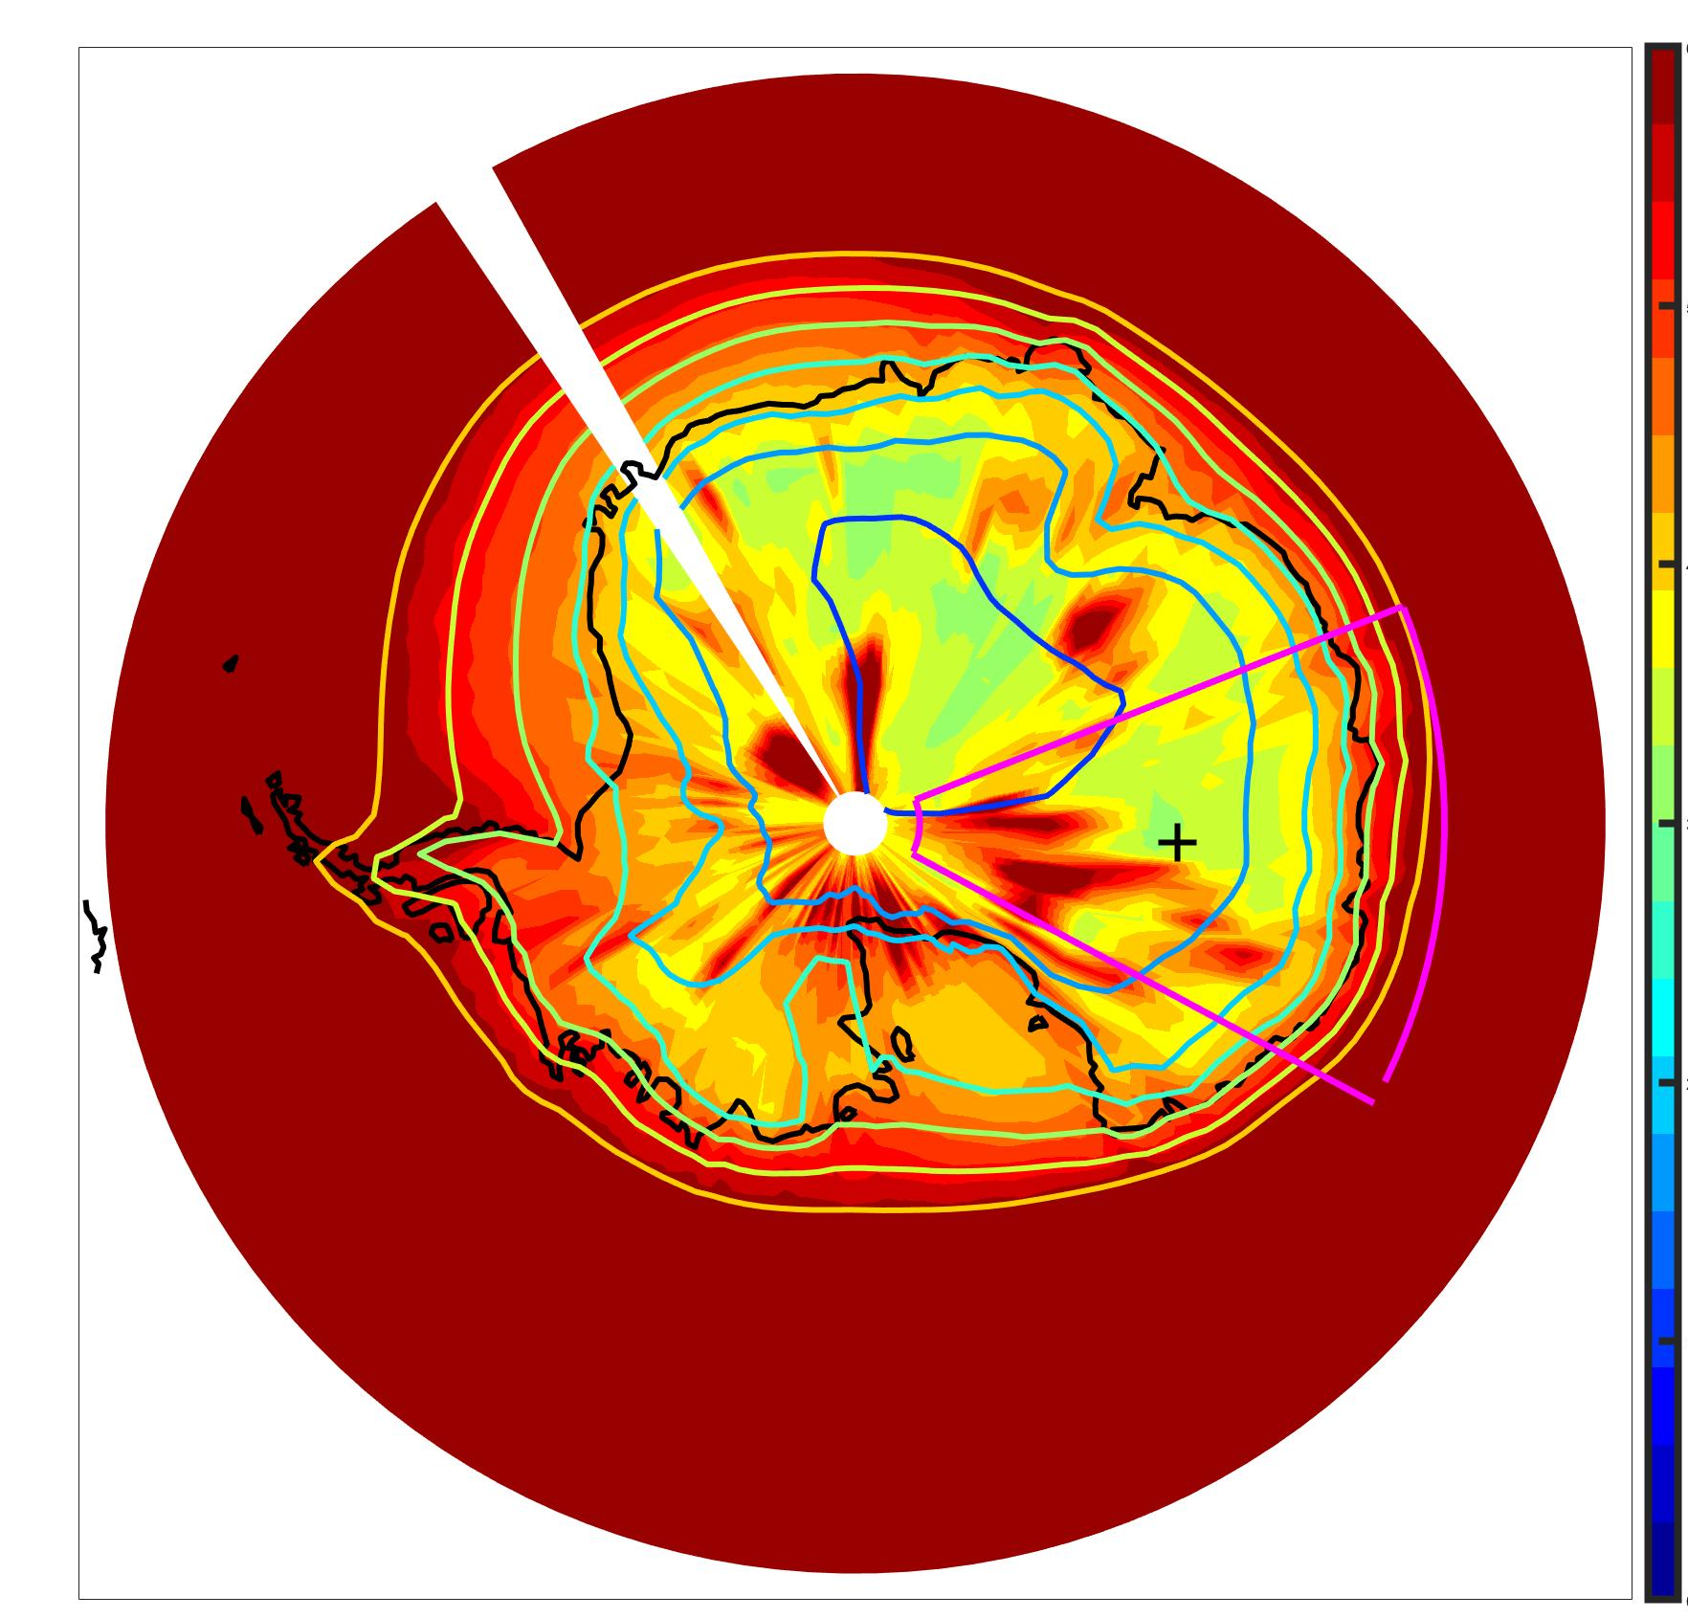
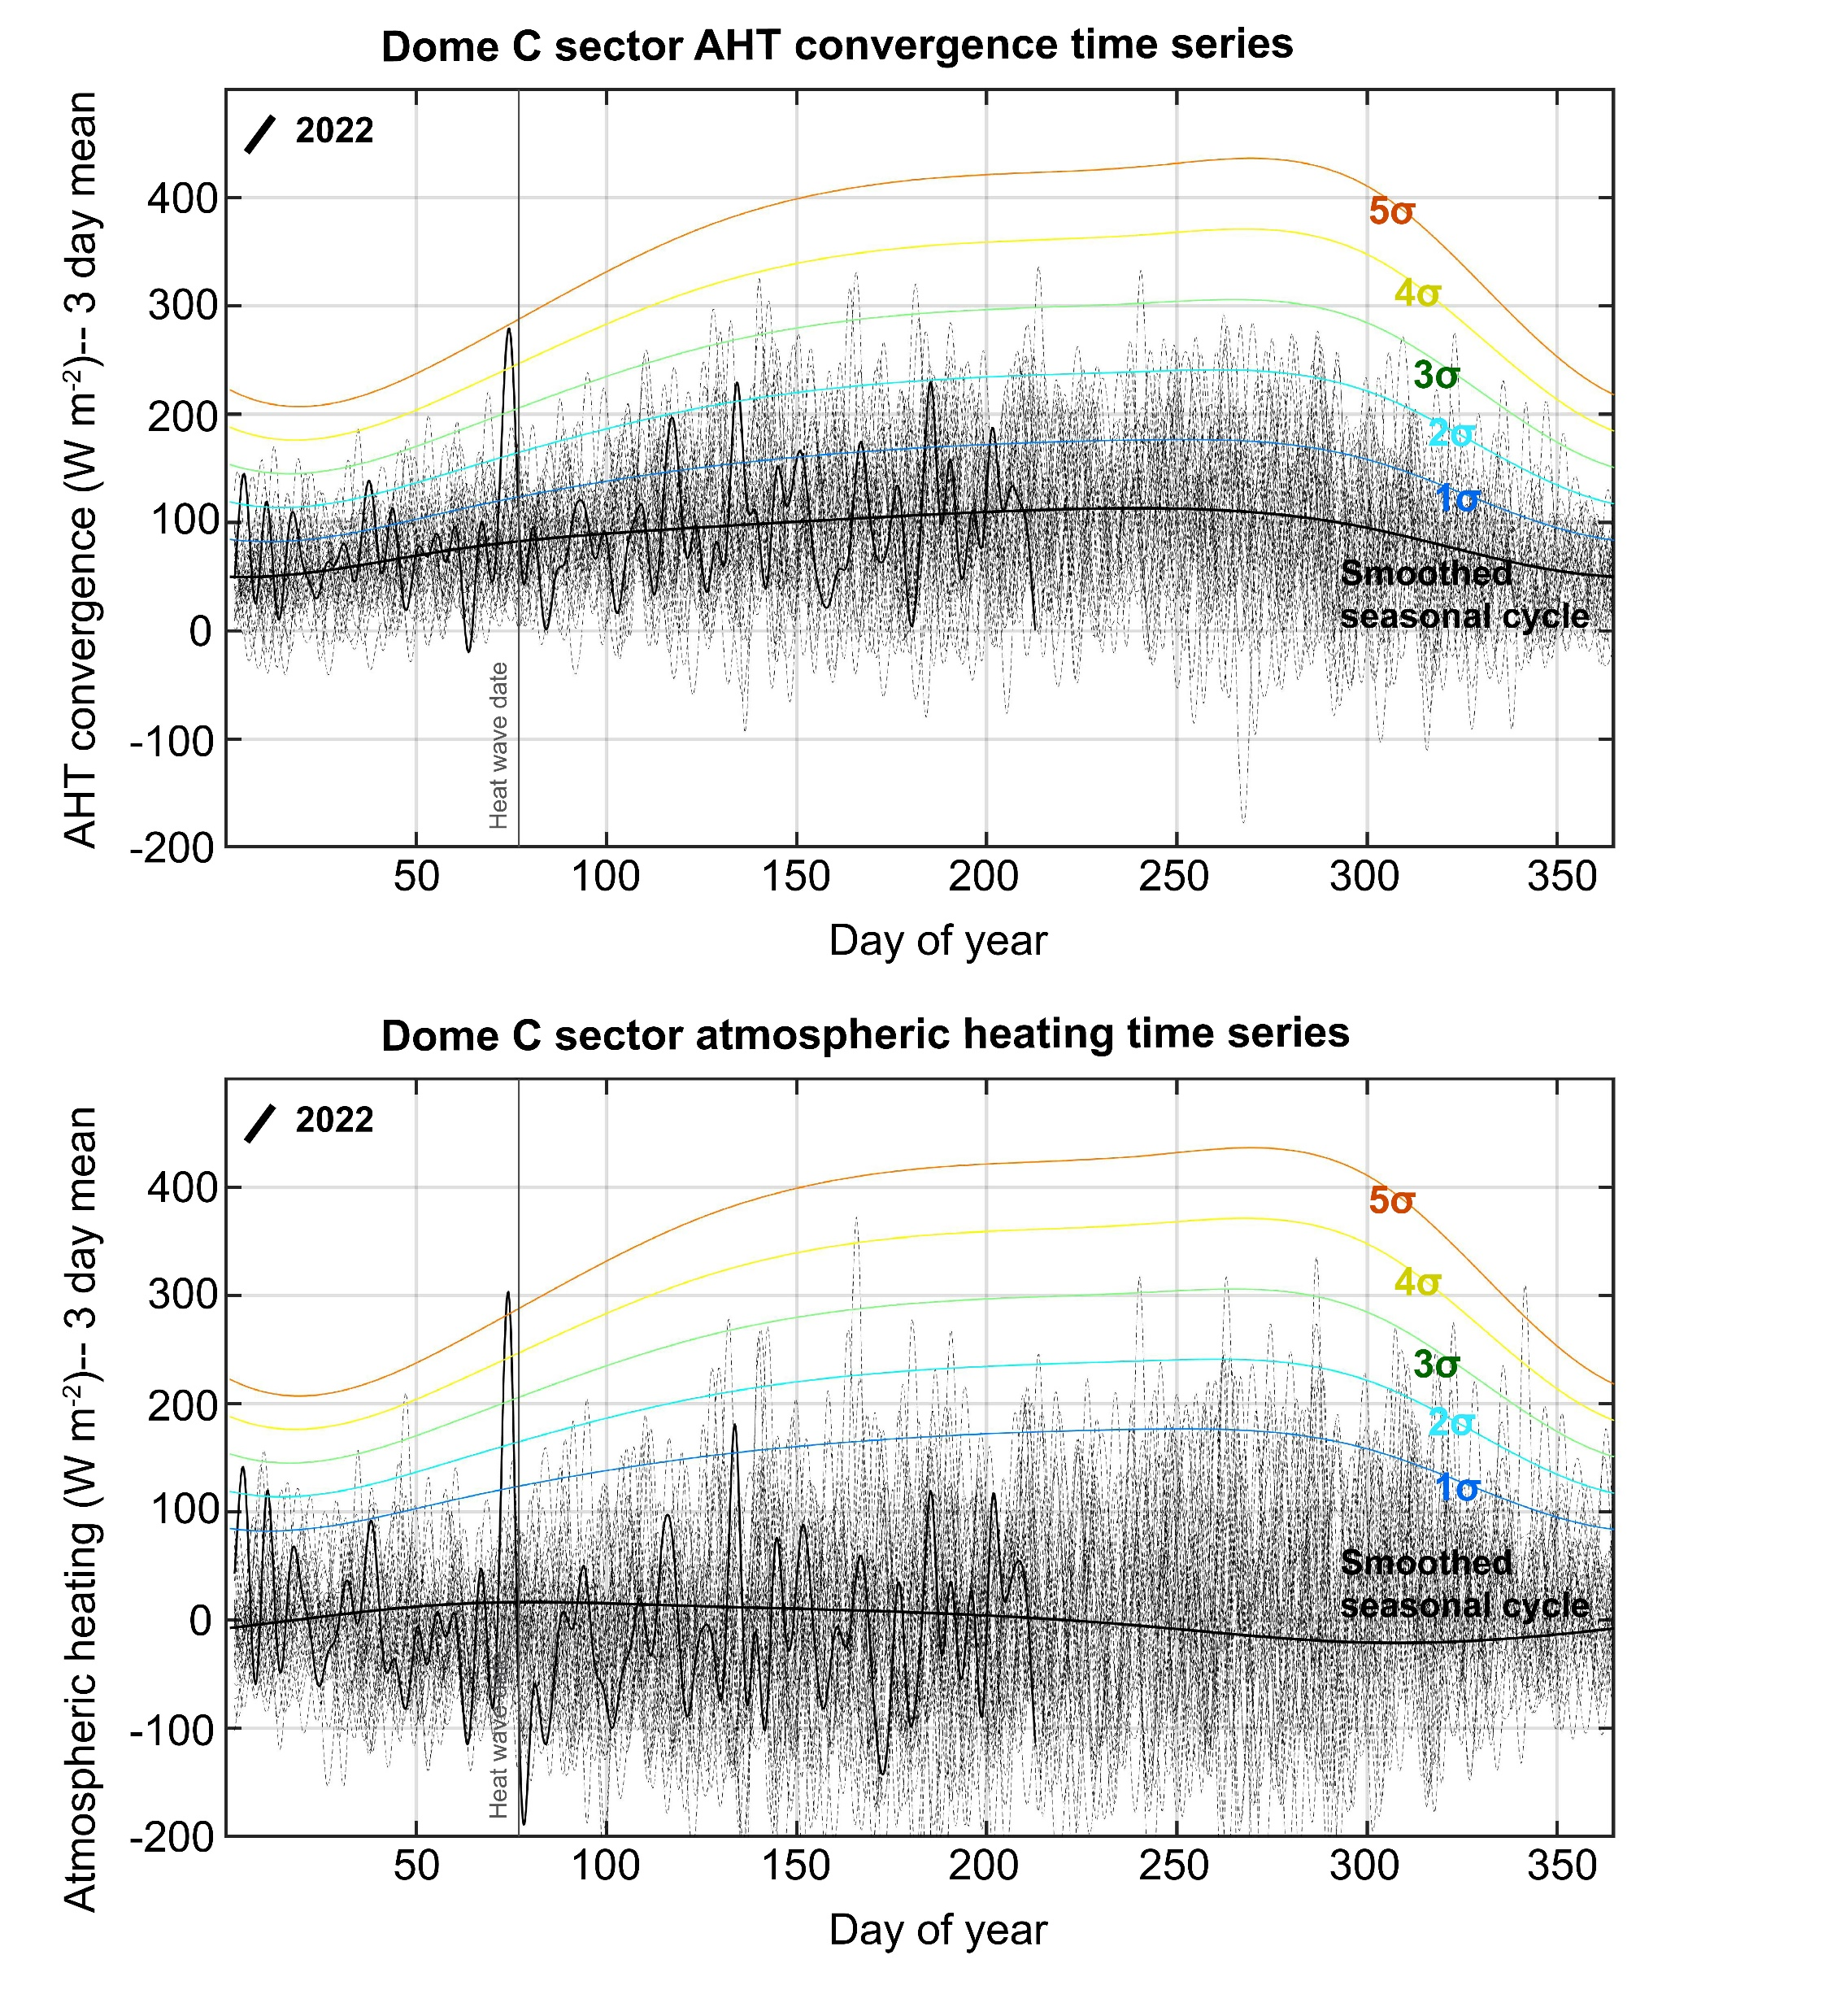

600
400
$∇∙$AHT standard deviation (W m⁻²)
200
Dome C sector
Dome C heat wave of March 2022 was associated with 5 standard deviation anomalies in both AHT convergence and column heating – for a 3 day average
The amount of heating is consistent (1:1 ish) with the AHT convergence
There are bigger (absolute in W m-2) anomalies at other times of the year; why aren’t these associated with larger magnitude heat waves

Slide 35
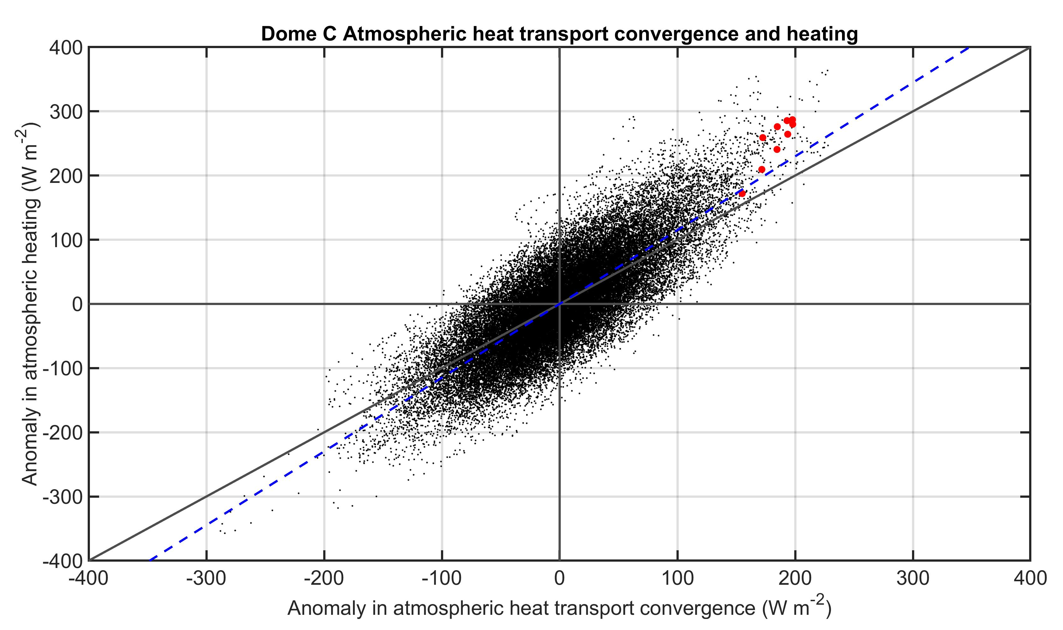
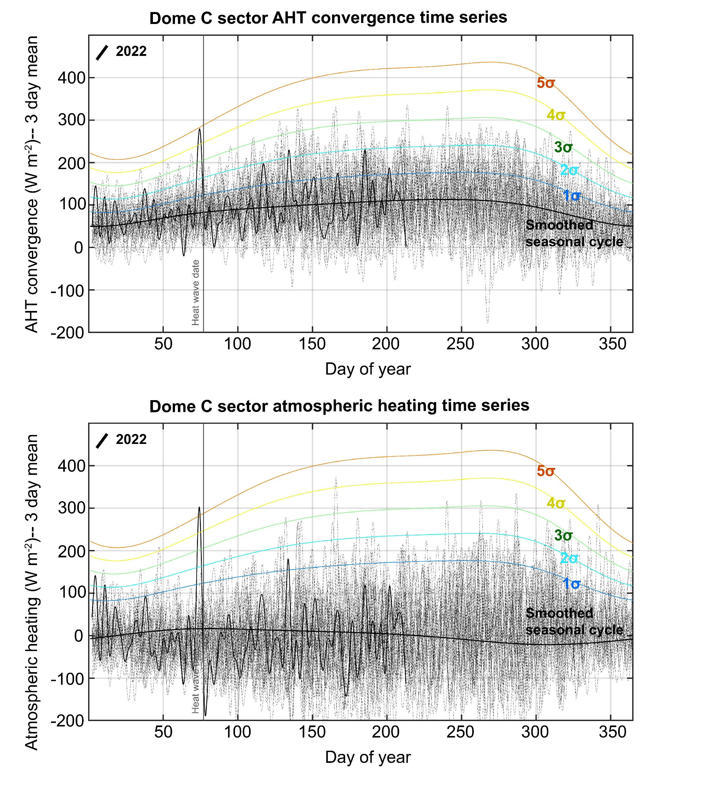
March 15-17, 2022
Time series of Dome C sector averages of AHT convergence and heating are strongly correlated (R=0.80) suggesting that the dominant energy balance is between AHT and heating
→ March 2022 are amongst the most extreme 3 day average anomalies but not the largest evert seen
→ I expected the regression slope to be less than 1:1

Slide 36
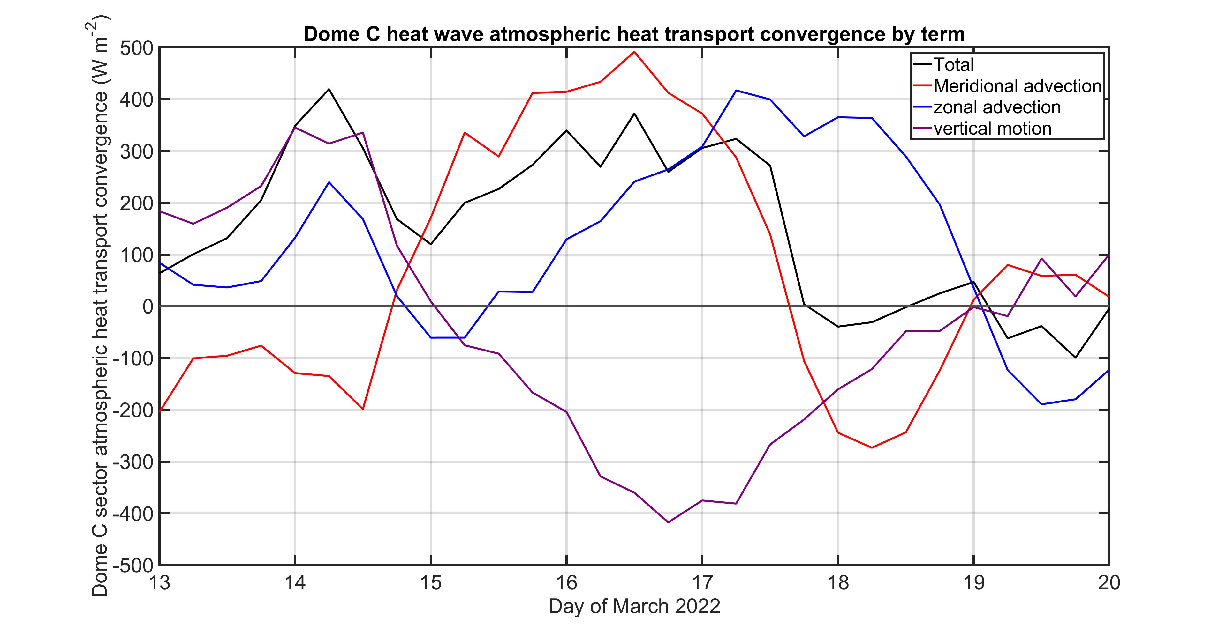


Evolution of Dome C AHT convergence
$∇∙AHT\left(lat,lon\right)=\frac{1}{g}\int_{0}^{P_{S}}{\left(U,V\right)∗∇MSE +{MSE}^{Ϯ}∇∙(U,V)}dp$
Horizontal advection
Vertical motion
$$\left(V\right)∗\frac{dMSE}{dy}$$
$$\left(U\right)∗\frac{dMSE}{dx}$$
Meridional advection
Zonal advection

Slide 37
EXTRAS

Slide 38
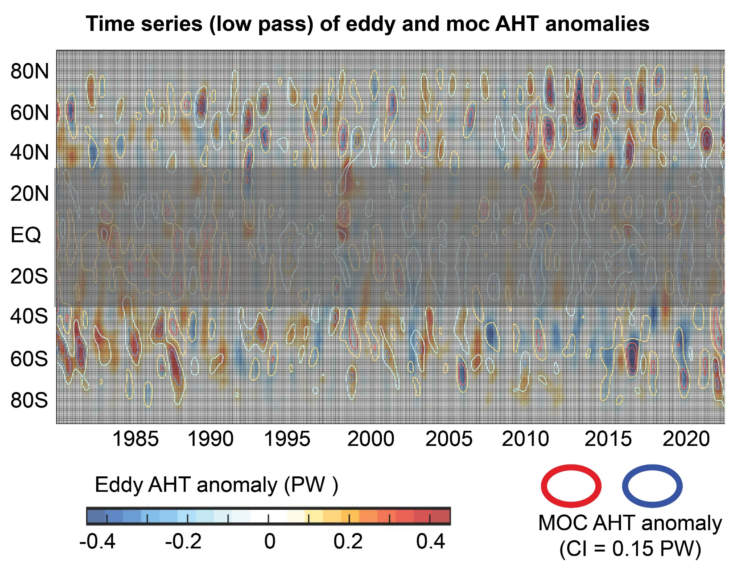

Slide 39
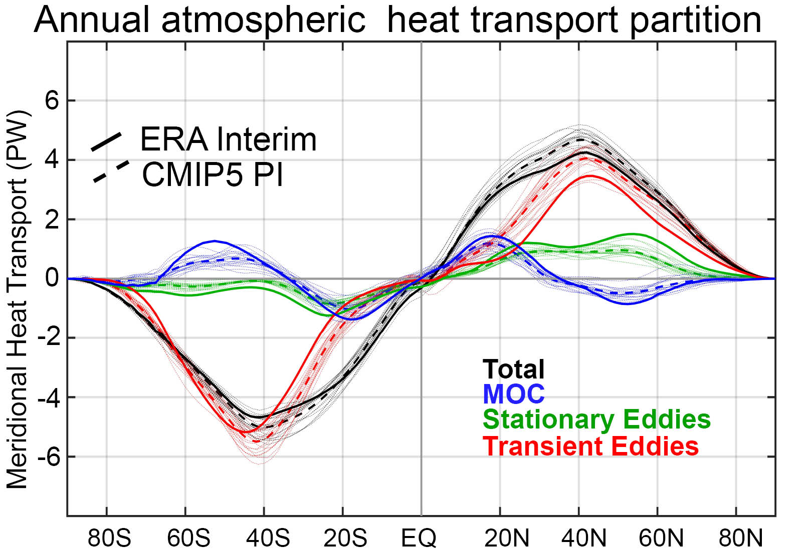
Observation vs. model AHT partitioning

