Slide 1

Model-Observation Comparison of Global Scale Energy Flows
Aaron Donohoe
Gordon Research Conference – Climate and Radiation
Help from many but especially Tyler Cox and Robert Fajber

Slide 2
Global mean energy balance
Incident
Solar
340.0 W m⁻²
Reflected solar 99.1 W m⁻²
OLR 240.1 W m⁻²
Net Energy Imbalance
=340.0 – 99.1 -240.1
= +0.8 W m-2
Into the climate system
(Loeb et al. 2018 – CERES EBAF)
Earth

Slide 3
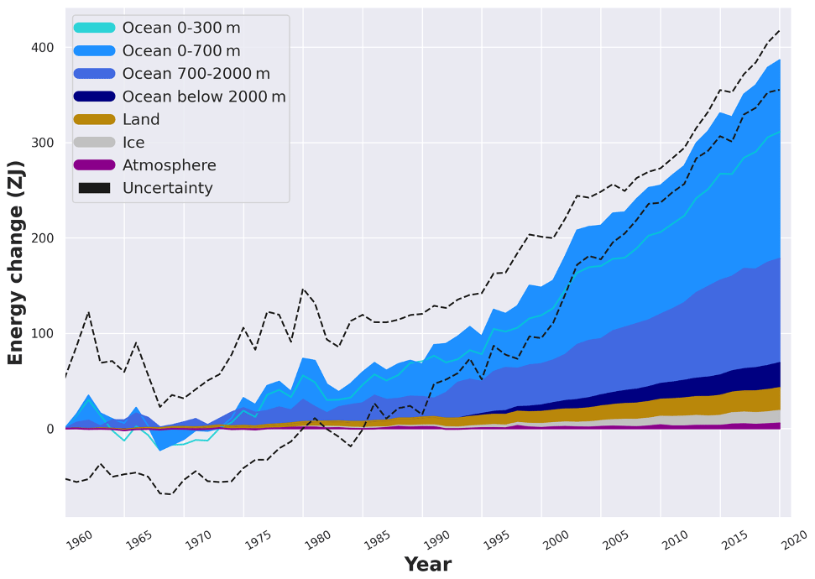
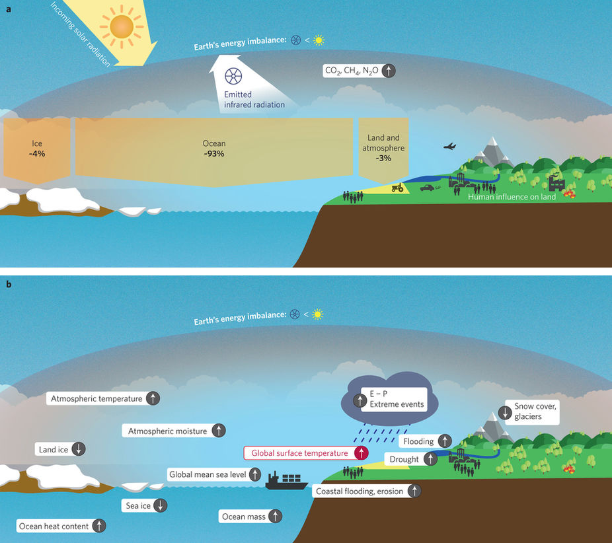
Where does the energy imbalance go?
Changes in Earth
Energy Content
von Schuckmann et. al , 2020

Slide 4
Three estimates of Earth’s energy imbalance
If we assume that all the energy imbalance goes into the ocean, we should have 3 independent estimates of Earth’s energy imbalance
1) Net radiation at the top of atmosphere (satellites)
2) Net energy flux into the surface (surface radiation + turbulent fluxes)
Ocean
3) Energy accumulation in the ocean
d(ocean heat content)/dt

Slide 5
Unadjusted satellite radiation
Incident
Solar
340.0 W m⁻²
^{(+/- 0.2)}
Reflected solar 97.1 W m^{-2 (+/-3.0)}
OLR 238.6 W m^{-2 (+/- 5.5)}
Net Energy Imbalance
=340.0 – 97.1 -238.6
= +4.3 (+/-5.5) W m ⁻²
Into the climate system
(Loeb et al. 2012 – CERES EBAF)
Earth

Slide 6
Where does the energy imbalance go?
Changes in Earth
Energy Content
von Schuckmann et. al , 2020
Reconciling units: 0.8 W m⁻² integrated over Earth’s surface area (5*10¹⁴ m²)
and over a decade (3*10⁸s)
= 120 ZJ per decade

Slide 7
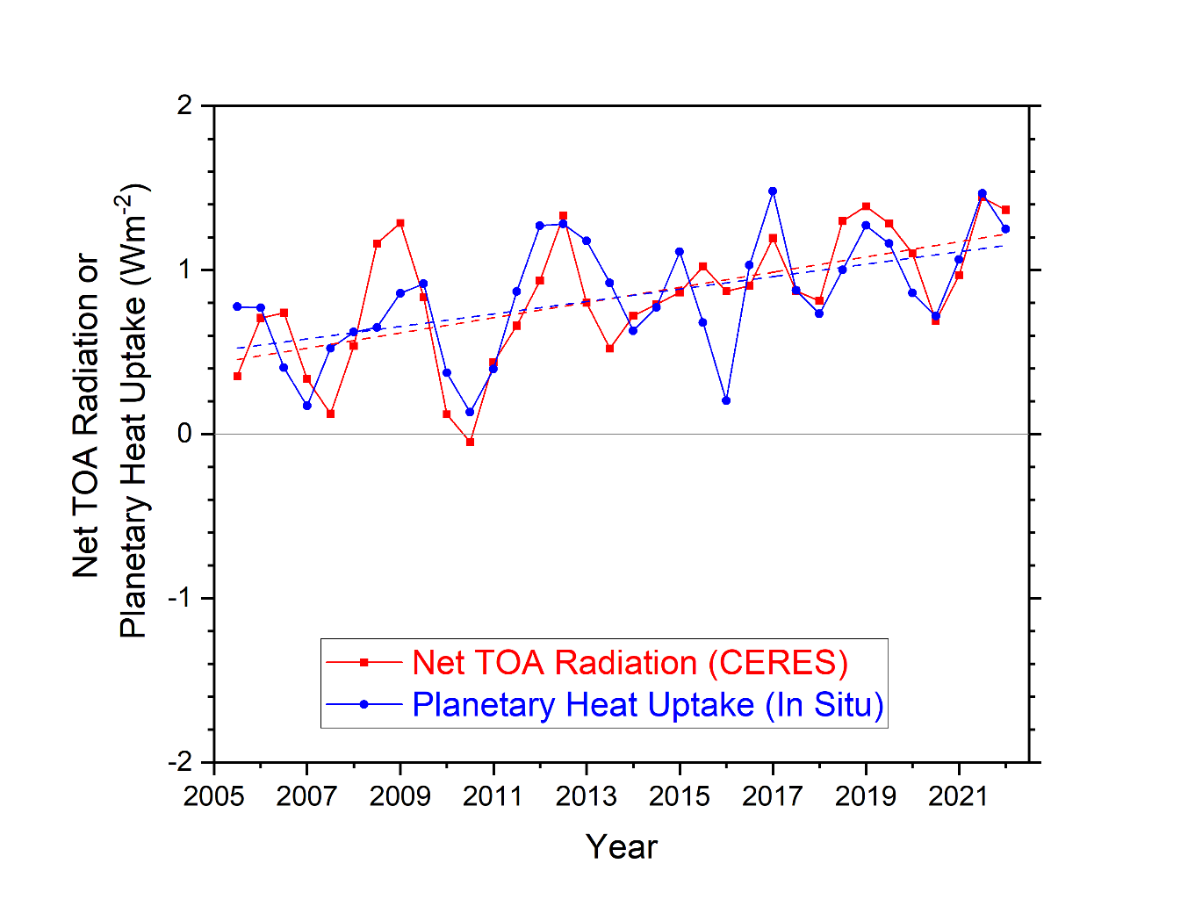
→ Satellite observations have low precision but high year-to-year accuracy
→ Trends in ocean heat content have low accuracy for shorter time periods
How can we test the consistency of the two?
Year-to-year variability of ocean heat content change and satellite derived top of atmosphere radiation are consistent within uncertainity
d(ocean heat content)/dt
Loeb et al. 2020

Slide 8
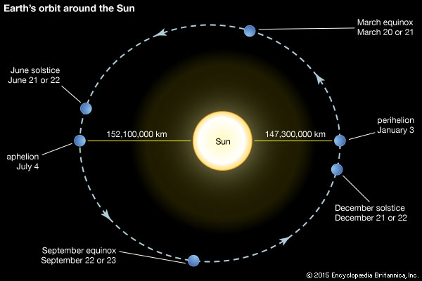
An idea to test the consistency of energy imbalance from satellite radiation and ocean heat content –
The seasonal cycle of global mean heat content
Back of envelope– How much does global mean insolation vary by over the annual cycle?
Earth-sun distance varies by 5 million km
--- 3% of the mean distance (ΔR/R_{mean} = 5/150)
Insolation scales as 1/R² so fractional change in insolation is ≈ 2ΔR/R_{mean} = 6%
6% of S_{O}/4 is = 0.06 * (341 W m⁻²) =
20 W m ⁻²
(30 times time mean energy imbalance)

Slide 9
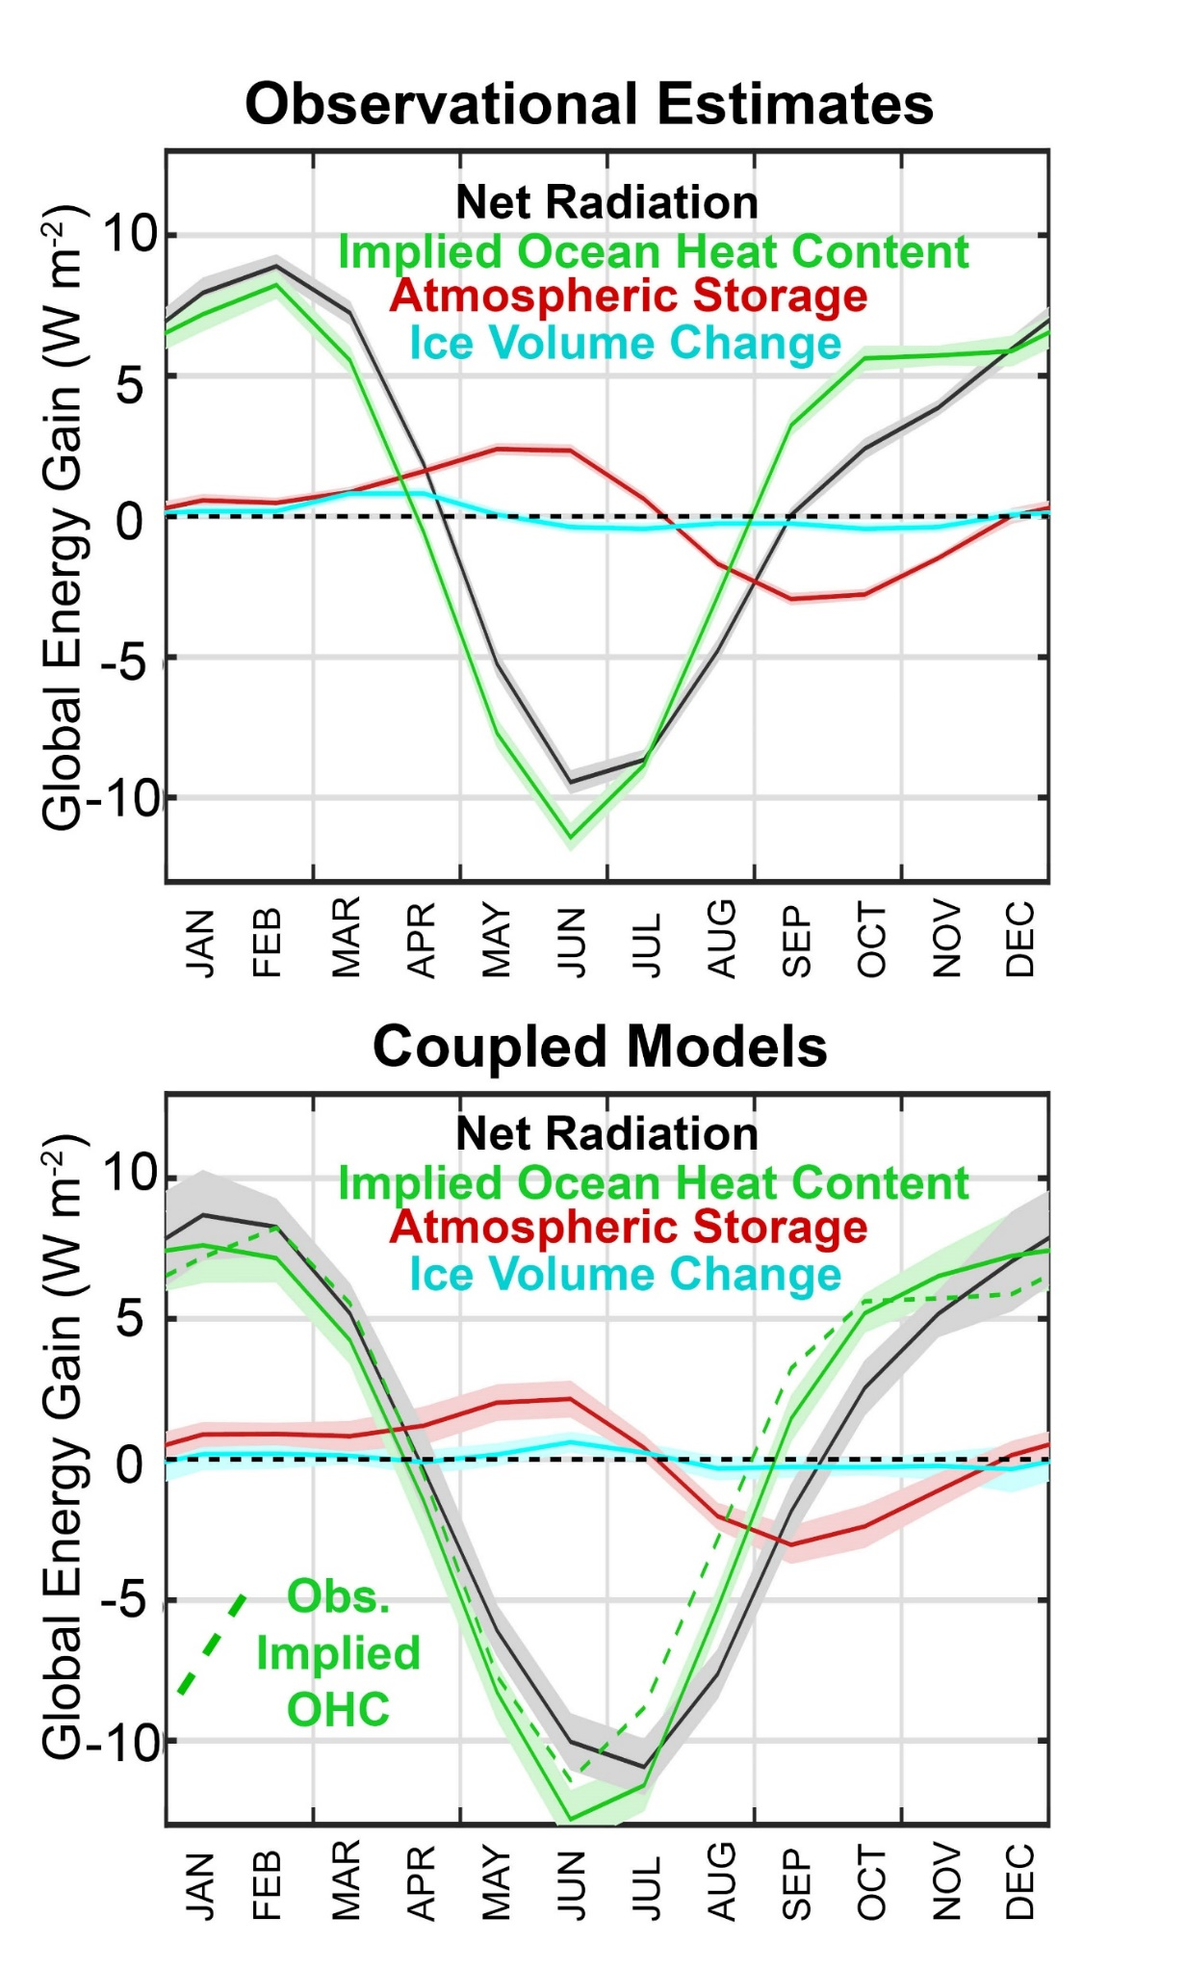
In addition to TOA radiation from CERES, we calculate the required seasonal ocean heat content change from:
Atmospheric heat content change from ERA reanalysis
Ice Volume change from Gravity Recovery and Climate Experiment (GRACE)
Donohoe, 2016

Slide 10
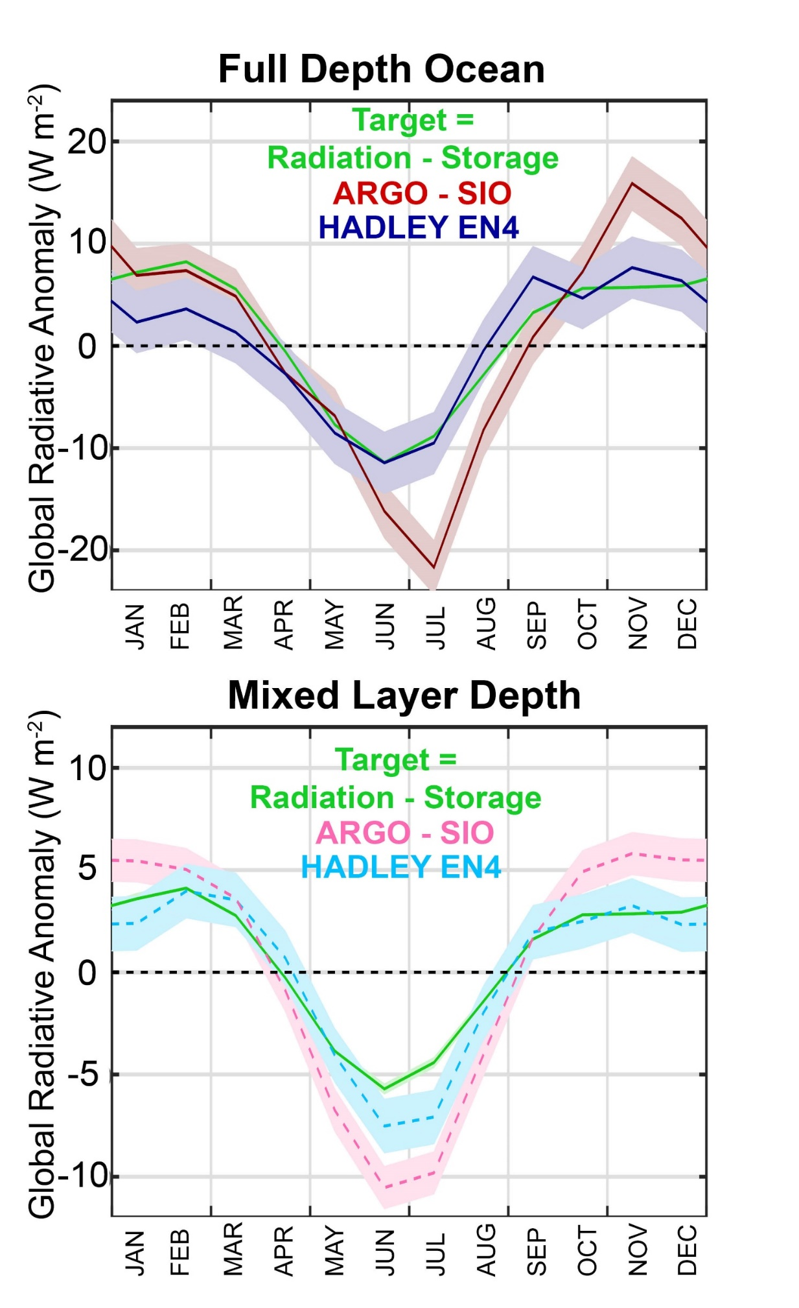
Two different estimates of Earth’s global mean seasonal cycle of energy content are consistent:
→ Satellite derived top of atmosphere radiation
and
Ocean heat content changes (in the Hadley EN4 data set)
Donohoe, 2016

Slide 11
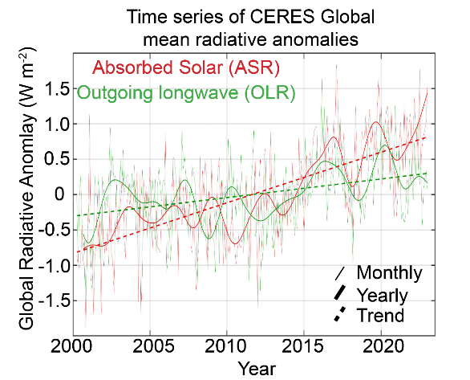
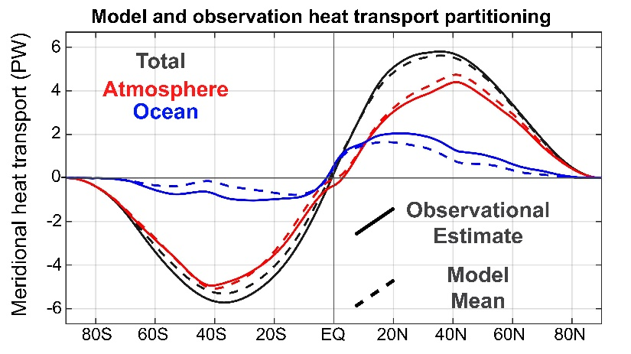
Overview: How can we use observationally available information to understand (potential) model biases in global scale energy flows?
→ Lack of closure of surface energy budget
→ Weak absolute calibration of TOA radiation
1. Trends in global mean radiation(shortwave and longwave)
2. The partitioning of meridional heat transport between the ocean and atmosphere
Loeb et al. 2020

Slide 12
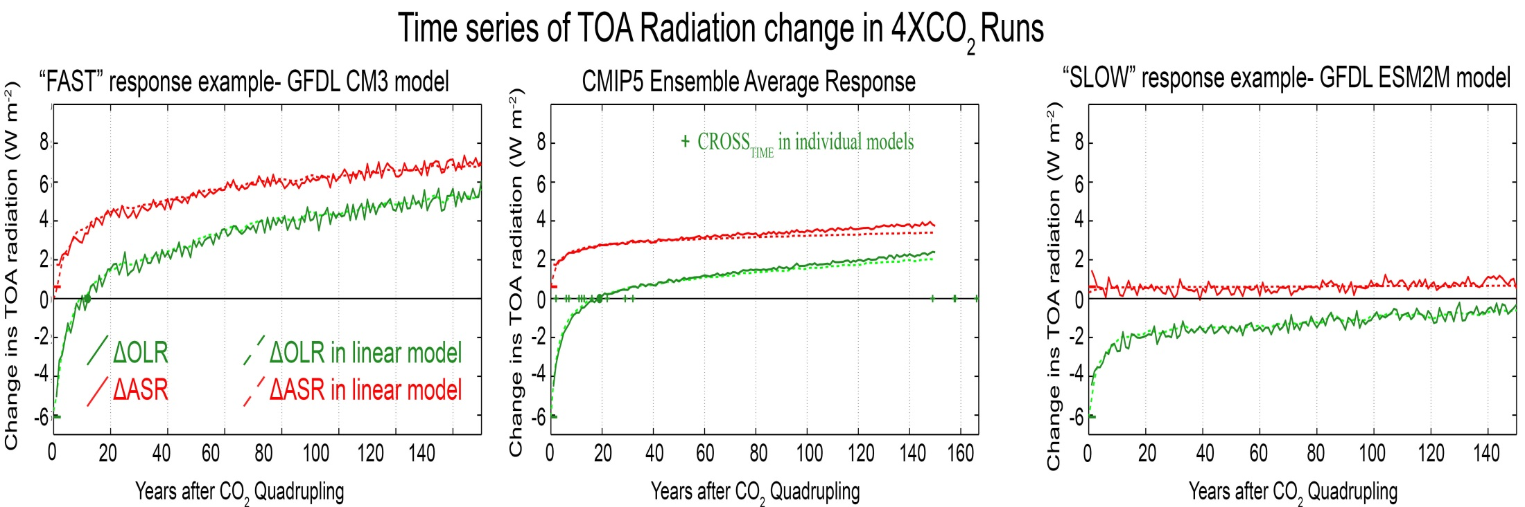
Model global mean TOA response to instantaneous CO₂ quadrupling
Absorbed Solar (ASR)
Outgoing Longwave (OLR)
Radiative anomaly (W m⁻²)
Year after CO2 quadrupling
OLR returns to unperturbed value in 20 years

Slide 13
Model global mean TOA response to instantaneous CO₂ quadrupling
Model A: Quick OLR Recovery
Radiative anomaly (W m⁻²)
Absorbed Solar (ASR)
Outgoing Longwave (OLR)
Ensemble Mean
Year after CO2 quadrupling
Absorbed Solar (ASR)
Model B: Long OLR Recovery
Outgoing Longwave (OLR)
Absorbed Solar (ASR)
Radiative anomaly (W m⁻²)
Outgoing Longwave (OLR)
Radiative anomaly (W m⁻²)
Year after CO2 quadrupling
Year after CO2 quadrupling

Slide 14

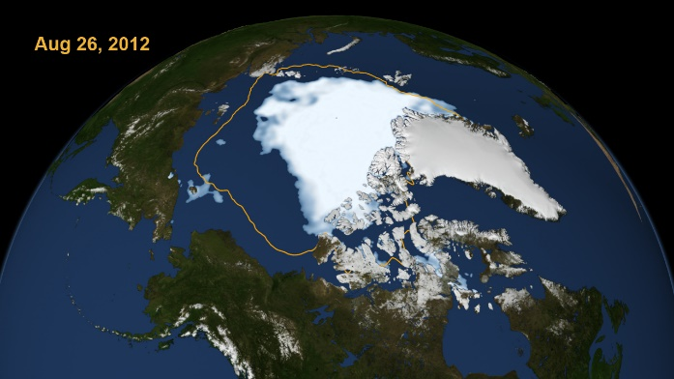
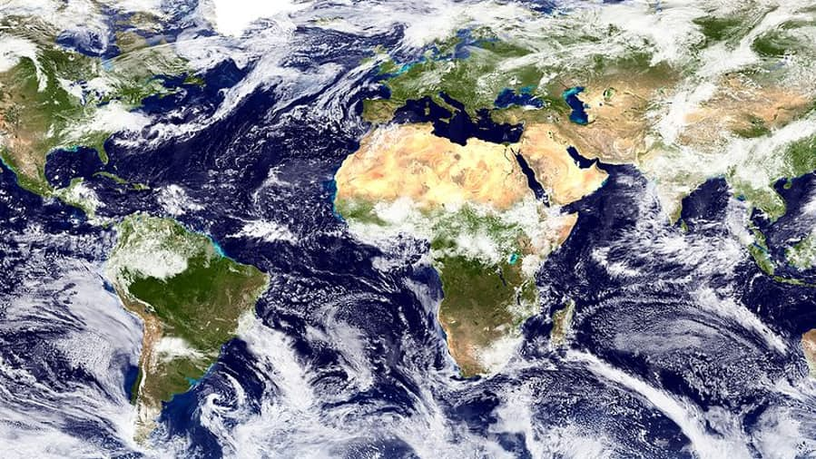
Mechanisms leading to changes in absorbed solar radiation with global warming (in models)
1
Moistening of the atmosphere
Enhanced atmospheric solar absorption (water vapor)
Sea ice (and snow) loss
More solar radiation absorbed by surface
2
Cloud Changes
Highly Uncertain
3

Slide 15
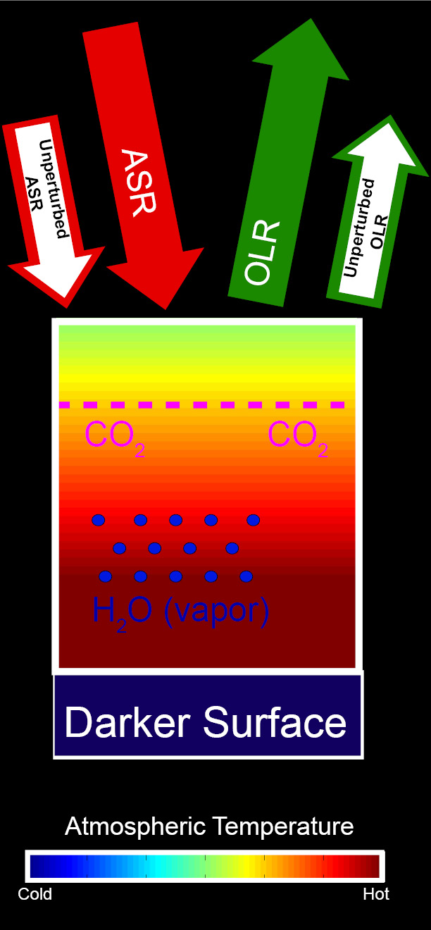
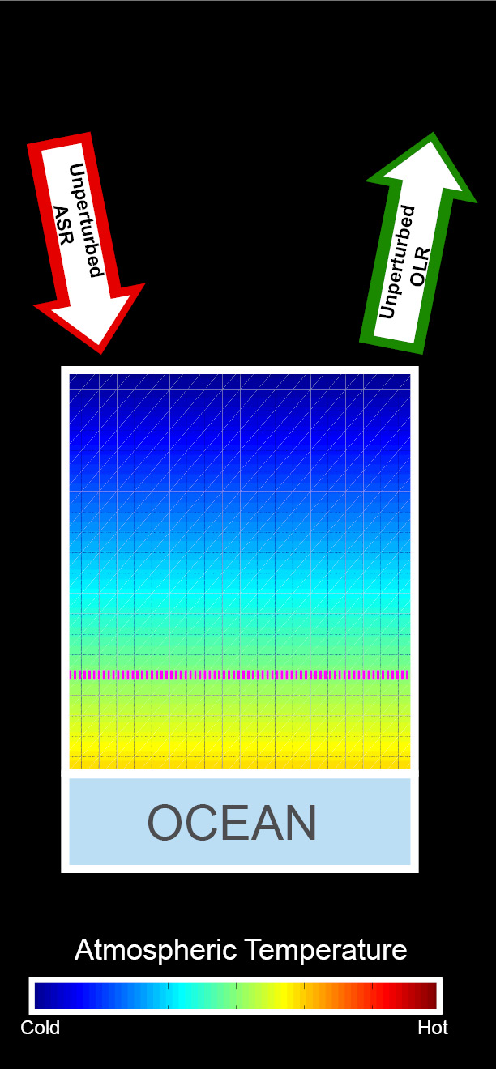
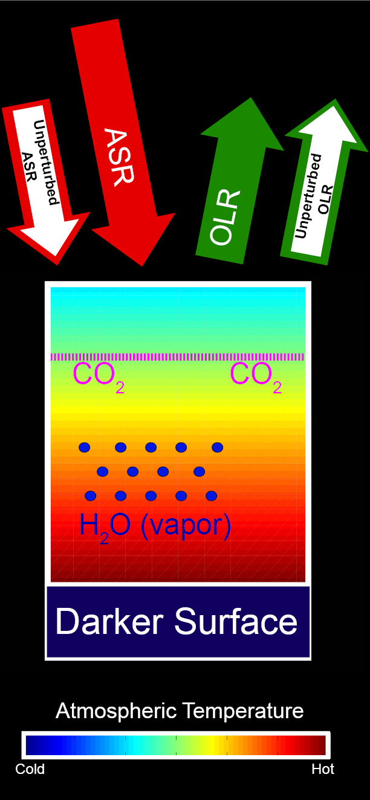
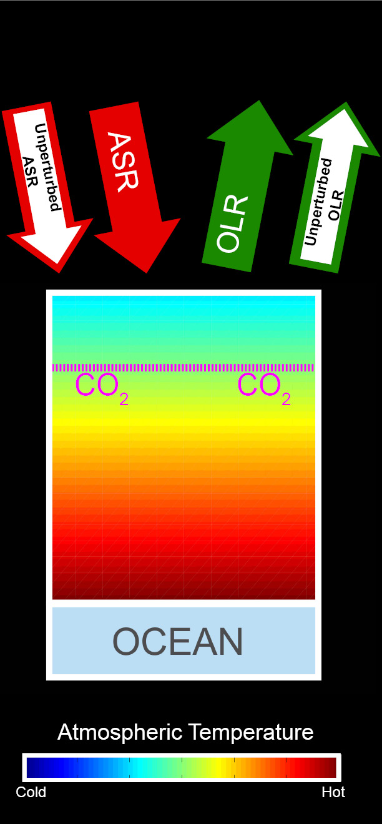
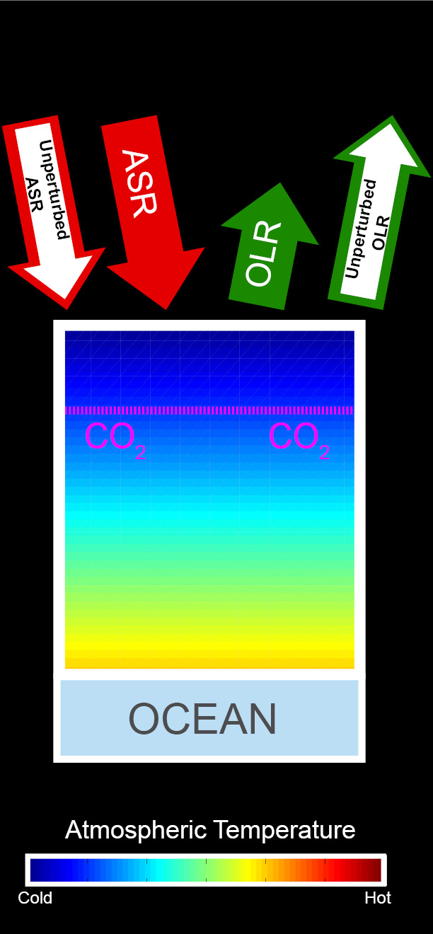
Energetic response to increased CO₂
Increased ASR
Unperturbed
Balanced Initial System
CO₂ added
Warming
CO₂ reduces OLR → energy imbalance
Warming →
OLR increases
Moistening and darkening → ASR increases
Additional warming
→ OLR balances increased ASR

Slide 16

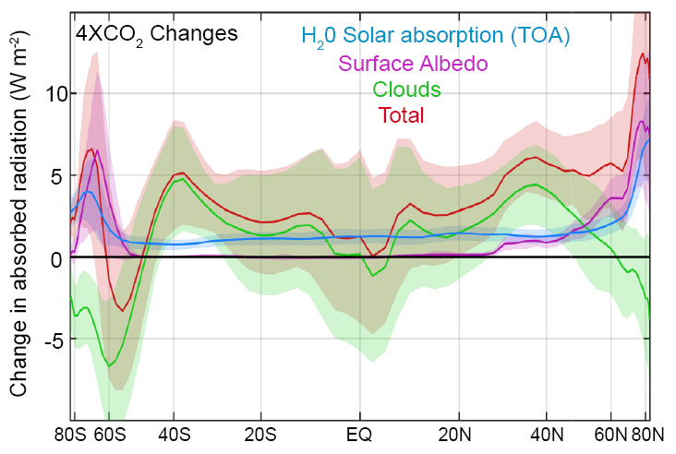
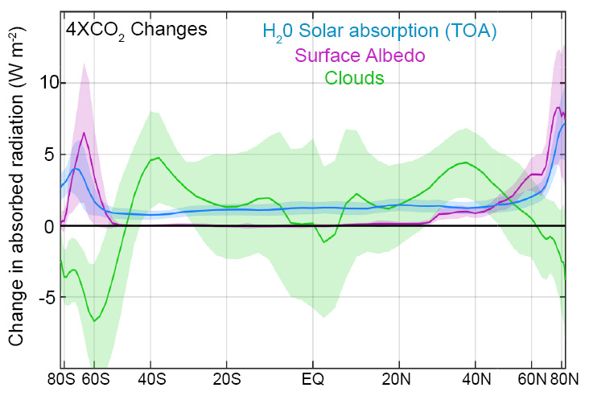
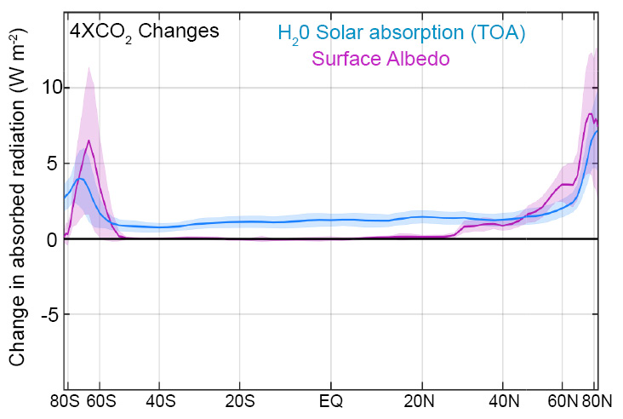
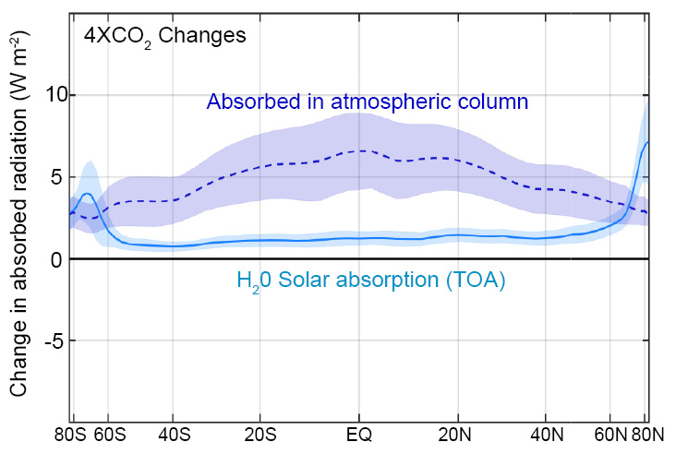
Changes in absorbed solar radiation with global warming
incident
Reflected
cloud
absorbed
?
H₂0
(vapor)
Reflected
surface
transmitted
ice
ocean

Slide 17
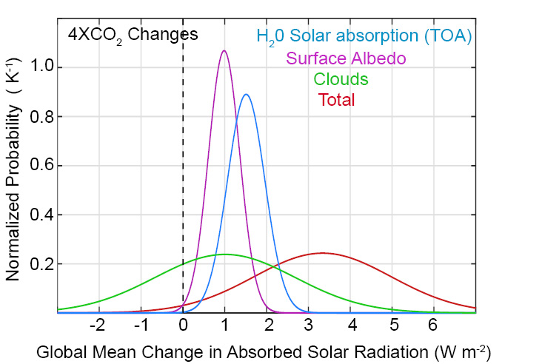
Changes in global mean absorbed solar radiation with increased CO₂
Despite uncertainties in clouds, it is highly likely that the climate system will absorb more solar radiation as it warms due to two robust processes:
Moistening of the atmosphere
Melting of sea ice and snow

Slide 18
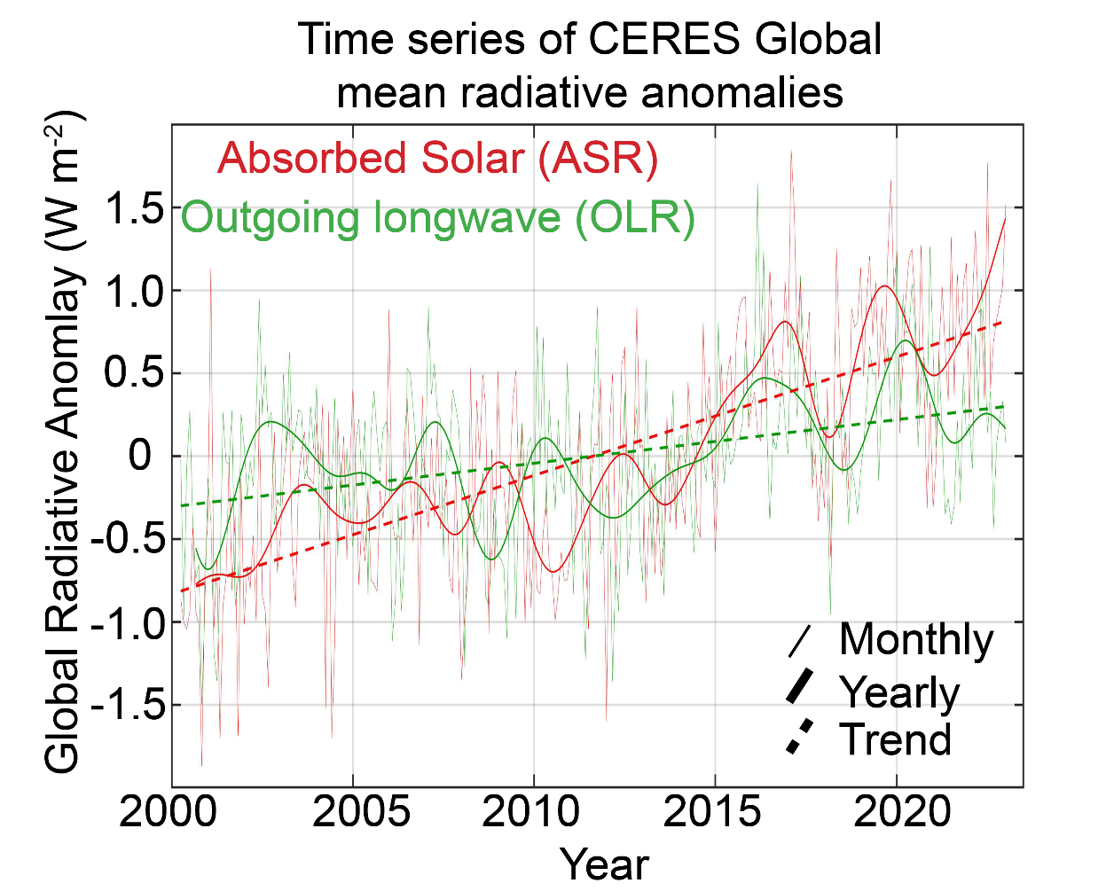
Observed (CERES) 23 year trends in TOA radiation:
+1.6 W m⁻² ASR
+0.6 W m⁻² OLR
Task: understanding the reasons absorbed solar has increased

Slide 19

Simplified shortwave radiation model (APRP, Taylor 2007)
S = incident
R = cloud
reflection
A = absorption
α = surface
albedo
(UNKNOWNS)
v
v
v

Slide 20
Simplified shortwave radiation model (APRP, Taylor 2007)
S = incident
R = cloud
reflection
A = absorption
α = surface
albedo
(UNKNOWNS)
v
v

Slide 21
Simplified shortwave radiation model (APRP, Taylor 2007)
S = incident
R = cloud
reflection
A = absorption
α = surface
albedo
(UNKNOWNS)

Slide 22
Simplified shortwave radiation model (APRP, Taylor 2007)
S = incident
R = cloud
reflection
A = absorption
α = surface
albedo
(UNKNOWNS)

Slide 23
Simplified shortwave radiation model (APRP, Taylor 2007)
S = incident
R = cloud
reflection
A = absorption
α = surface
albedo
(UNKNOWNS)

Slide 24
Simplified (isotropic) shortwave radiation model
Surface
Contribution
To planetary
Albedo
Atmospheric
Contribution
To planetary
Albedo
S = incident
R = cloud
reflection
A = absorption
α = surface
albedo
(UNKNOWNS)

Slide 25
Simplified (isotropic) shortwave radiation model
Atmospheric
Contribution
To planetary
Albedo
Surface
Contribution
To planetary
Albedo
S = incident
R = cloud
reflection
A = absorption
α = surface
albedo
(UNKNOWNS)

Slide 26



Climatological
planetary albedo
Surface reflection
Surface contribution:
= α(1-A)(1-R)²
(1-αR)
Atmospheric reflection
Impact of surface changes
on ASR
Atmosphere

Slide 27

Radiative sensitivity from isotropic model
→ Isotropic model matches kernel calculations
Satellite observations provide an estimate of Radiative sensitivity
→The model average radiative sensitivity is close to the observational estimate

Slide 28
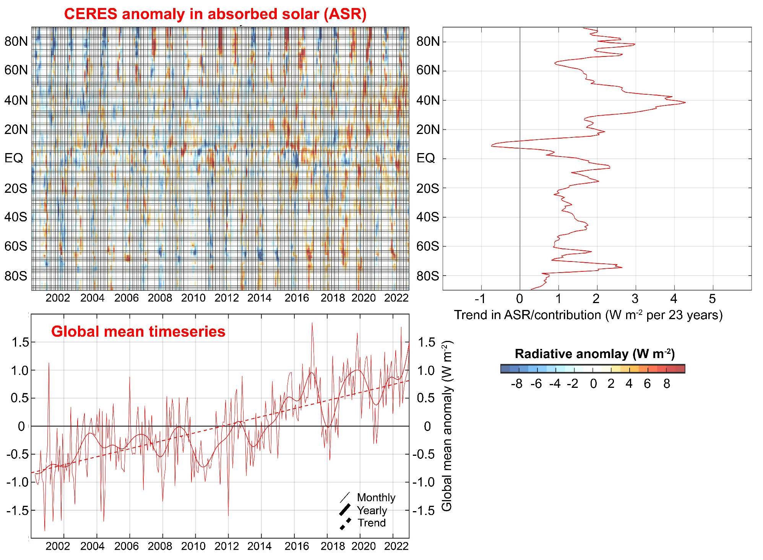

Slide 29
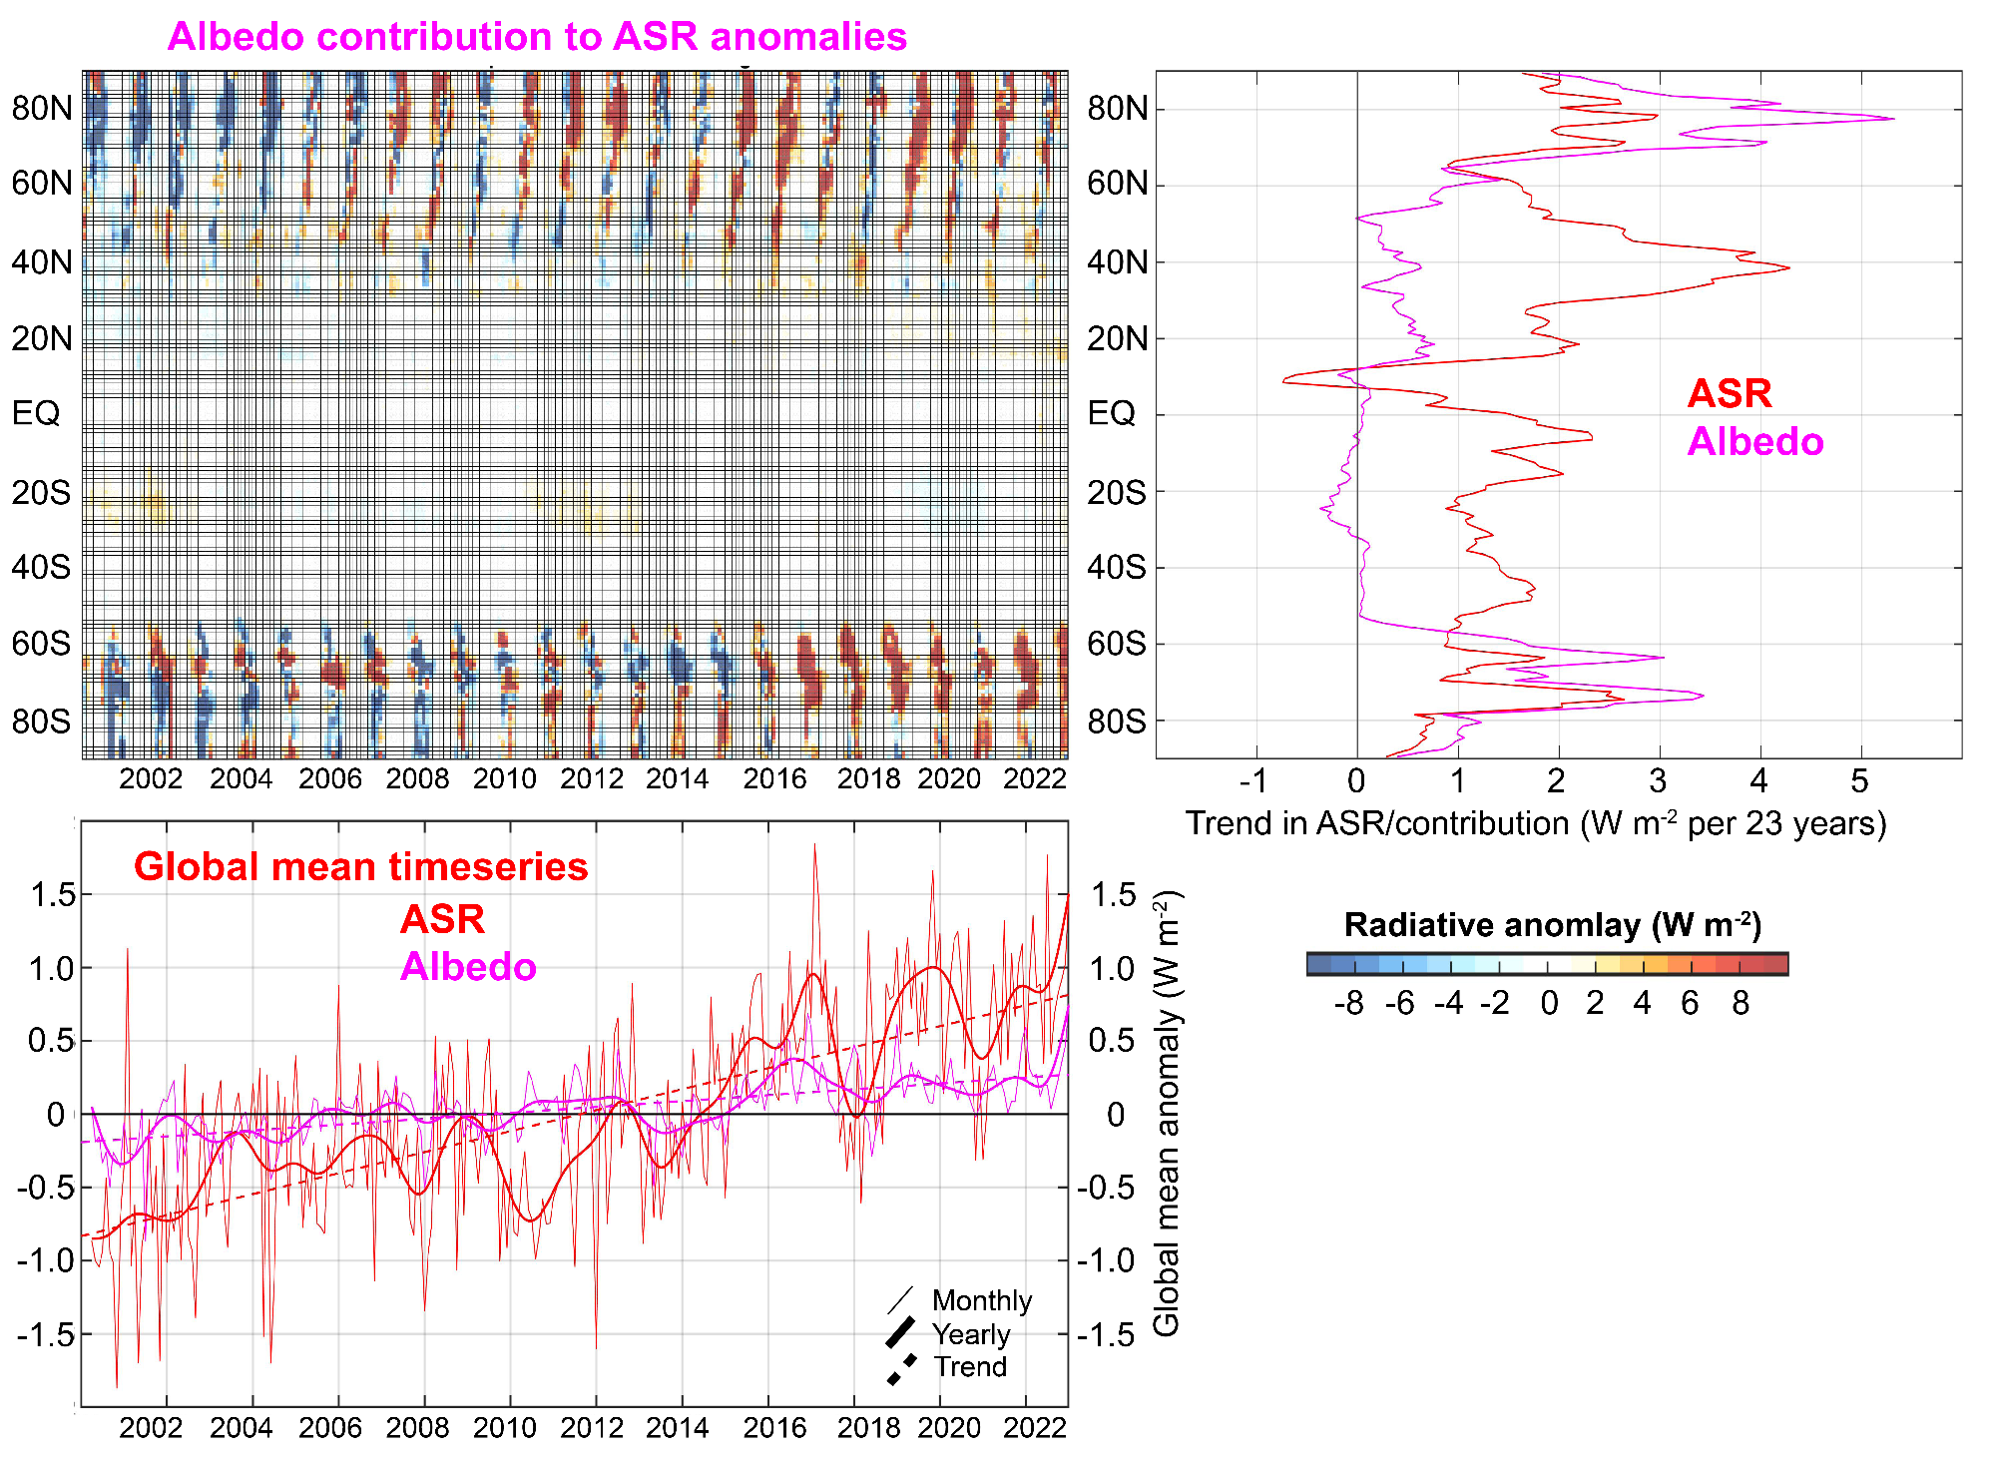
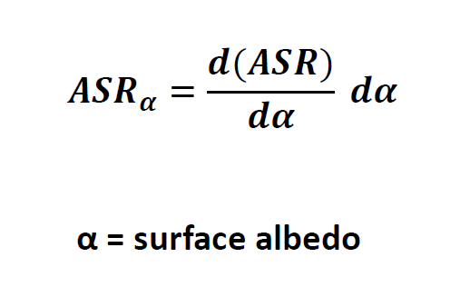

Slide 30
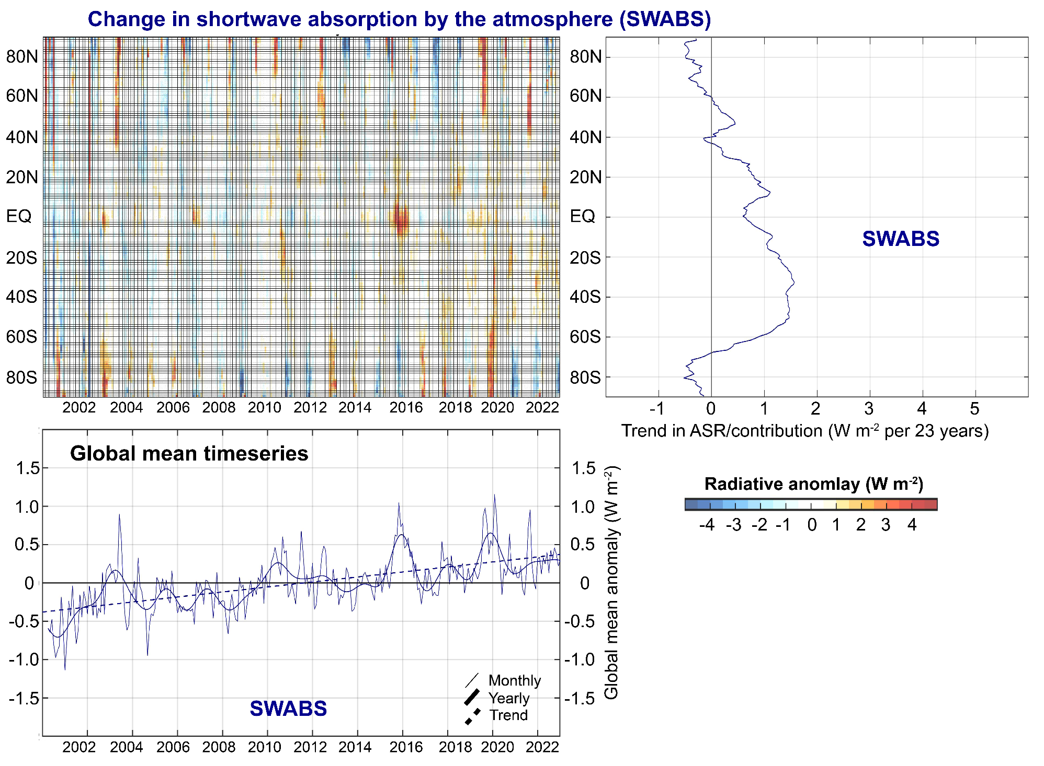

Slide 31
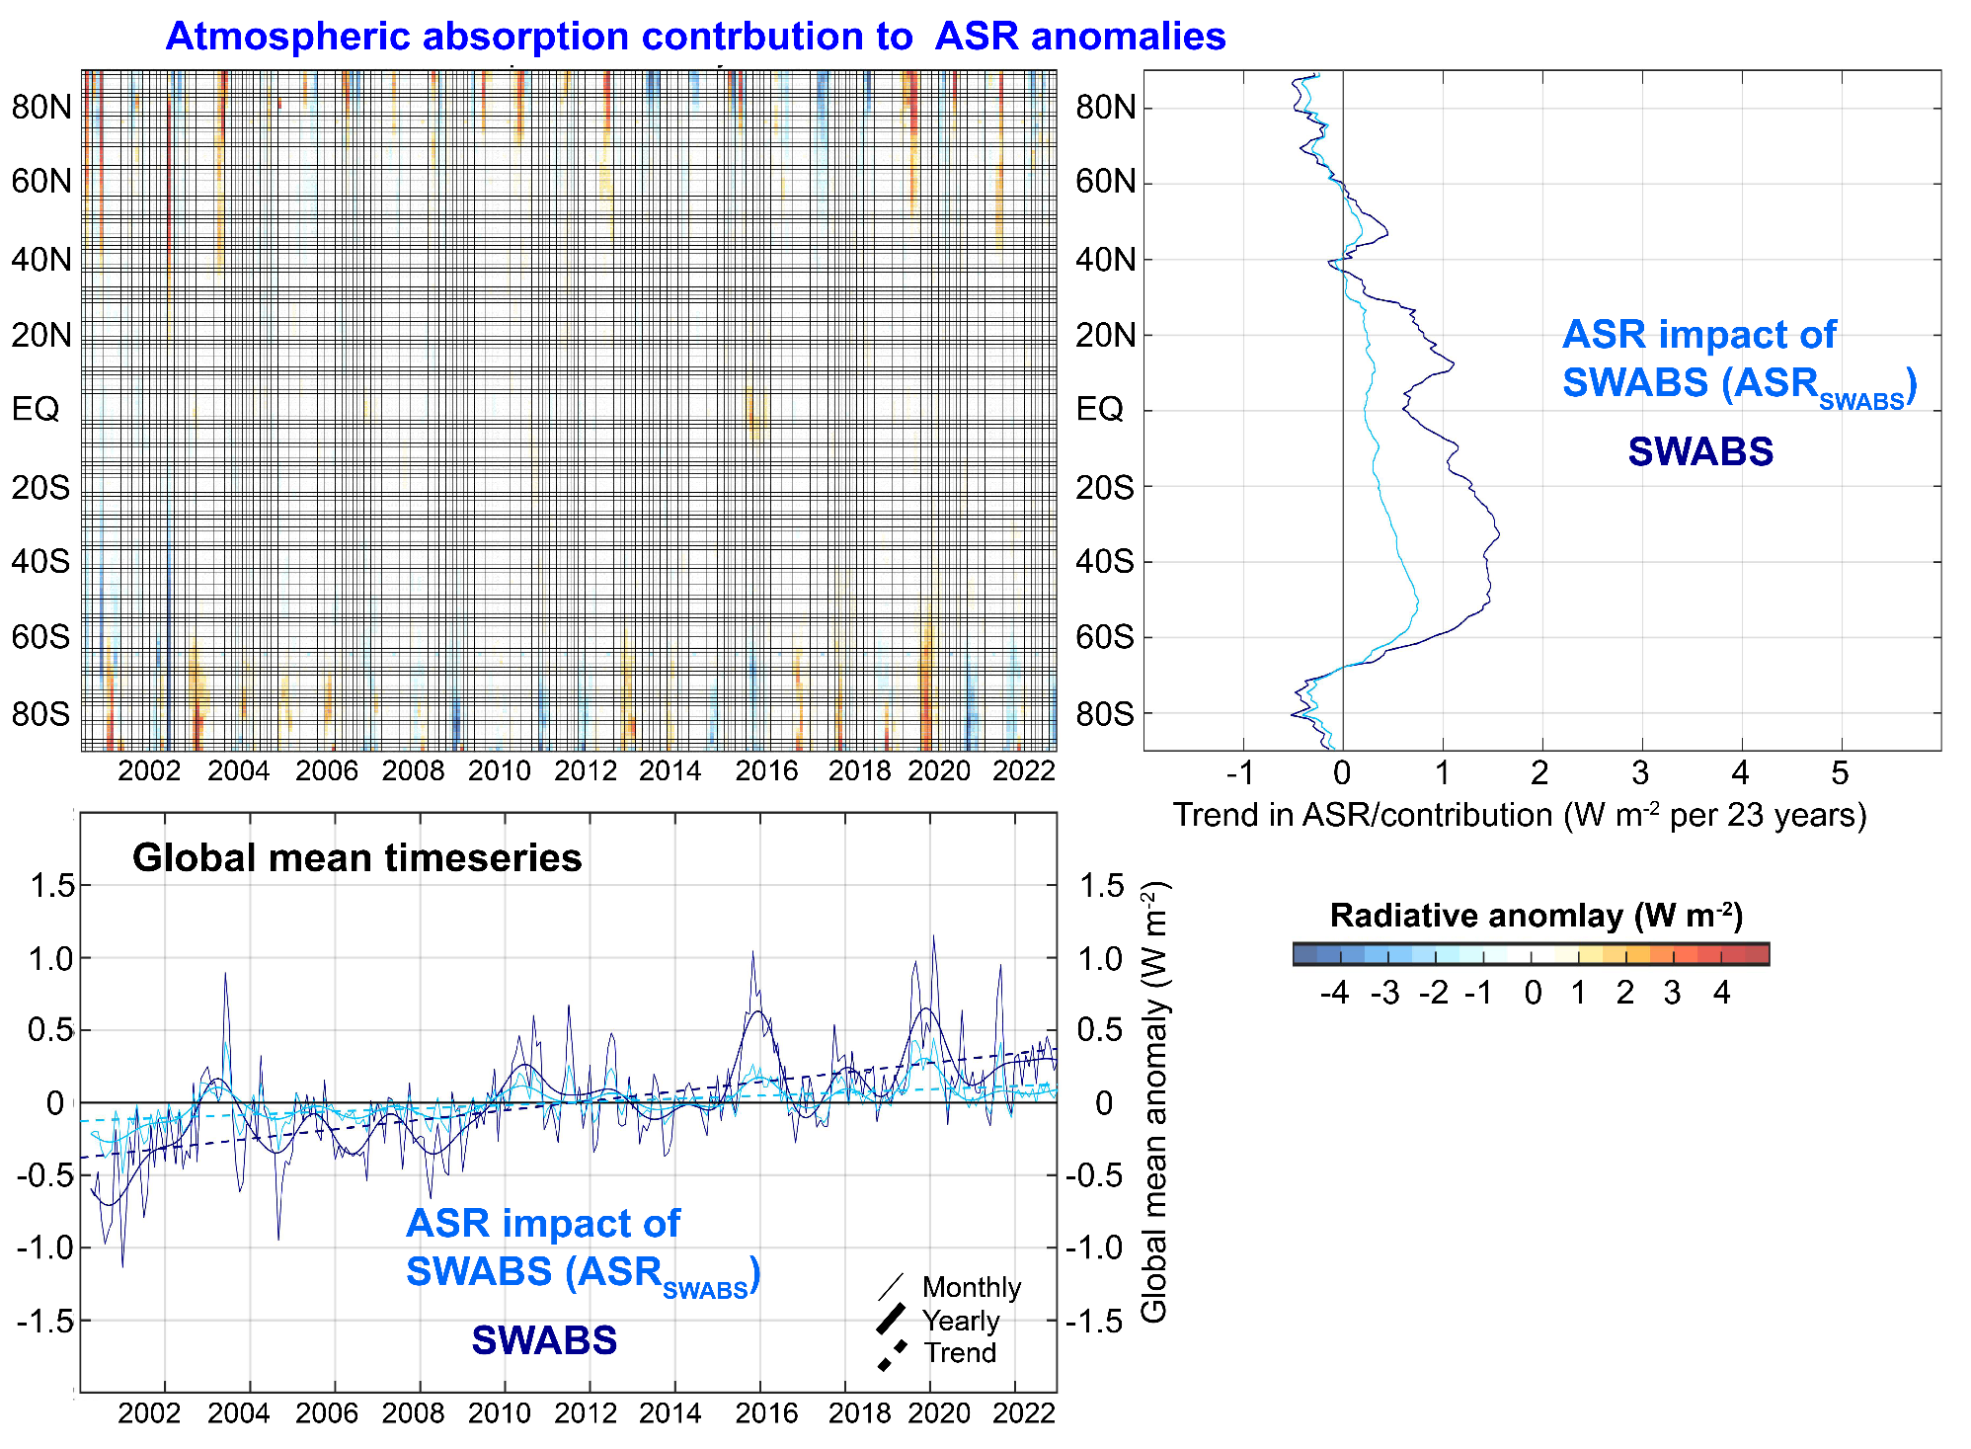

Slide 32
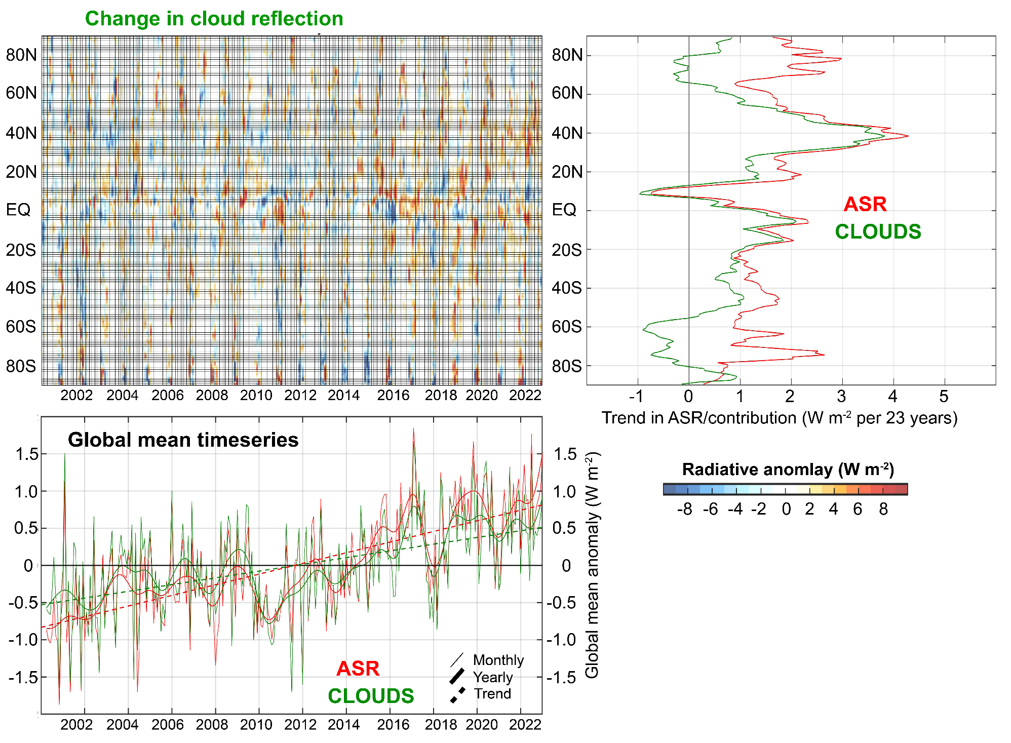

Slide 33
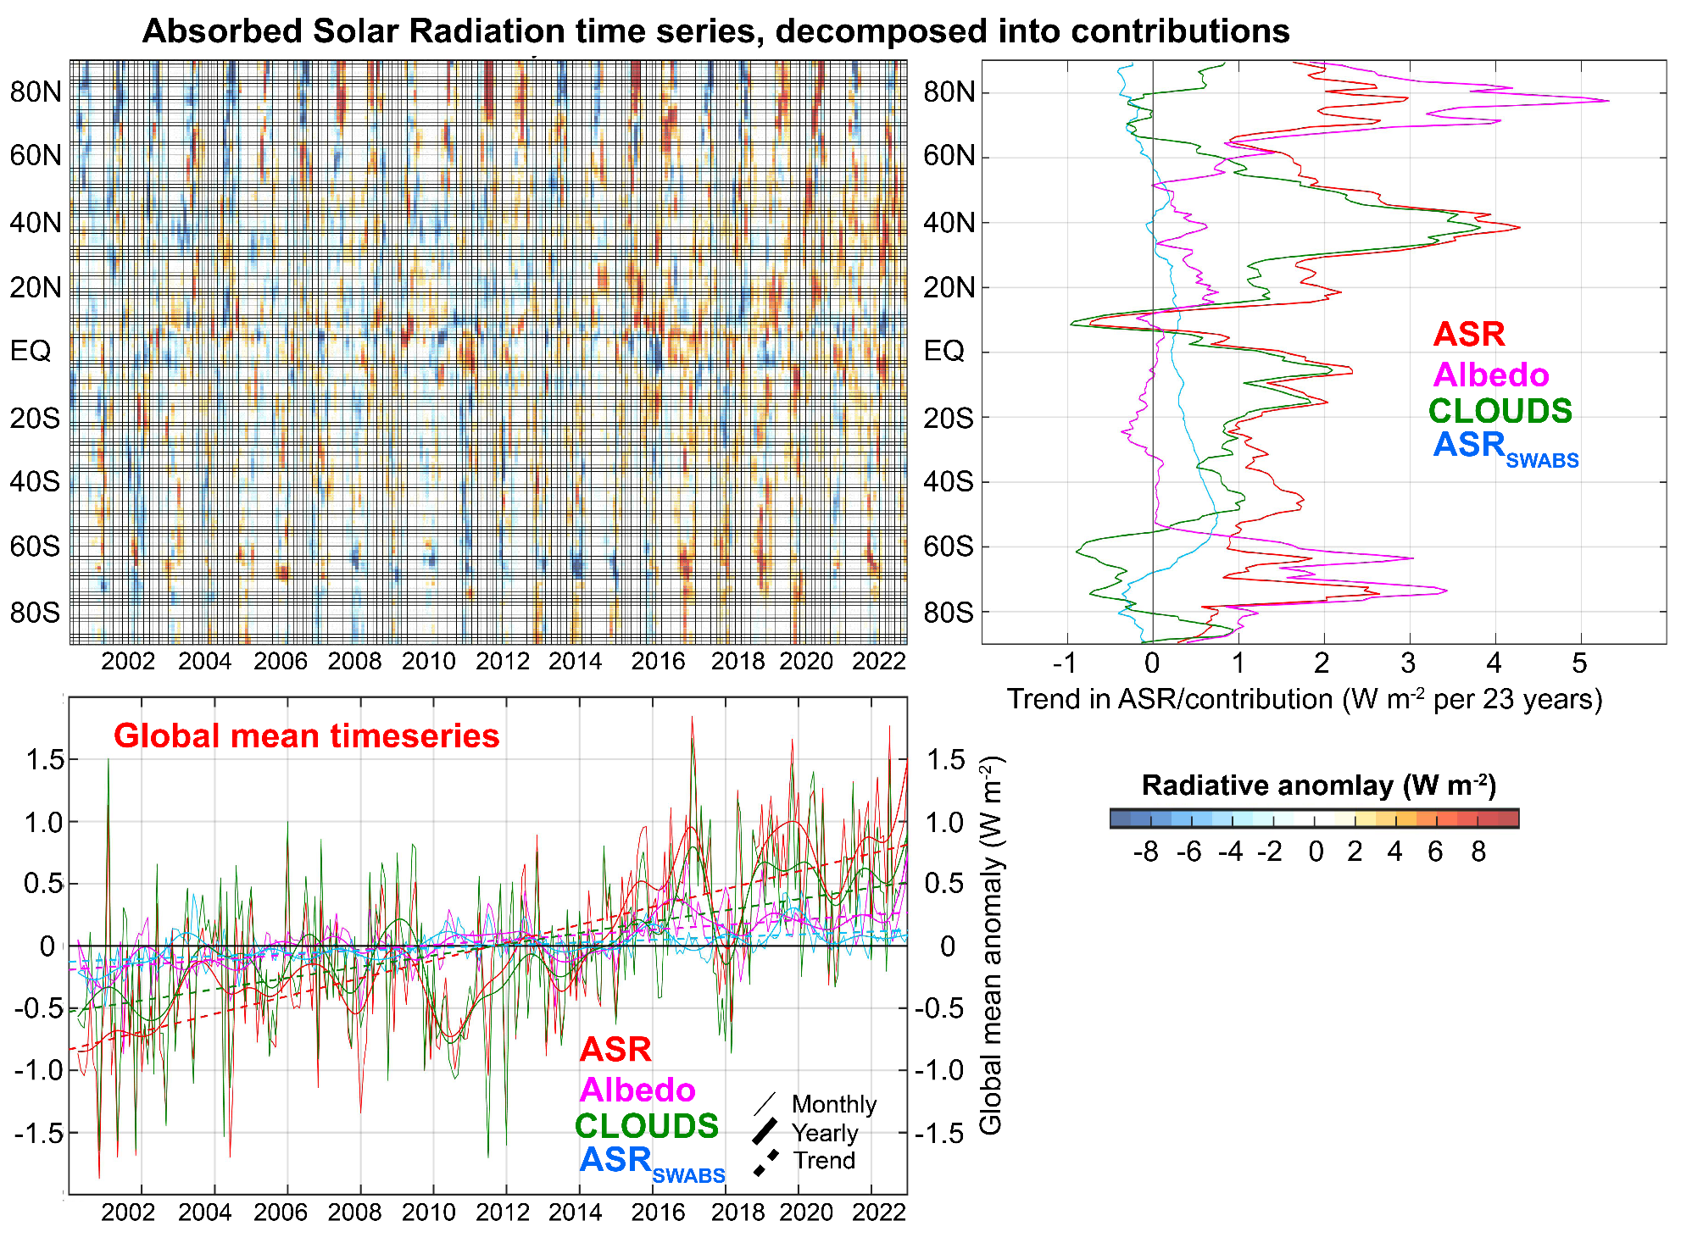
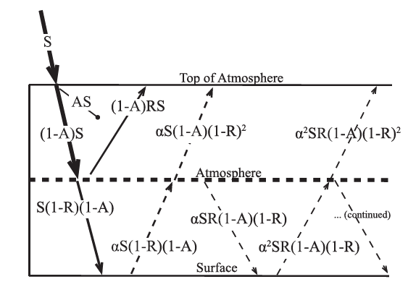

Slide 34
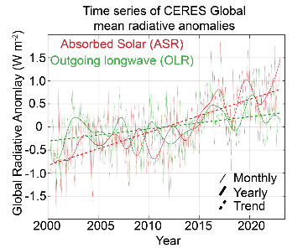
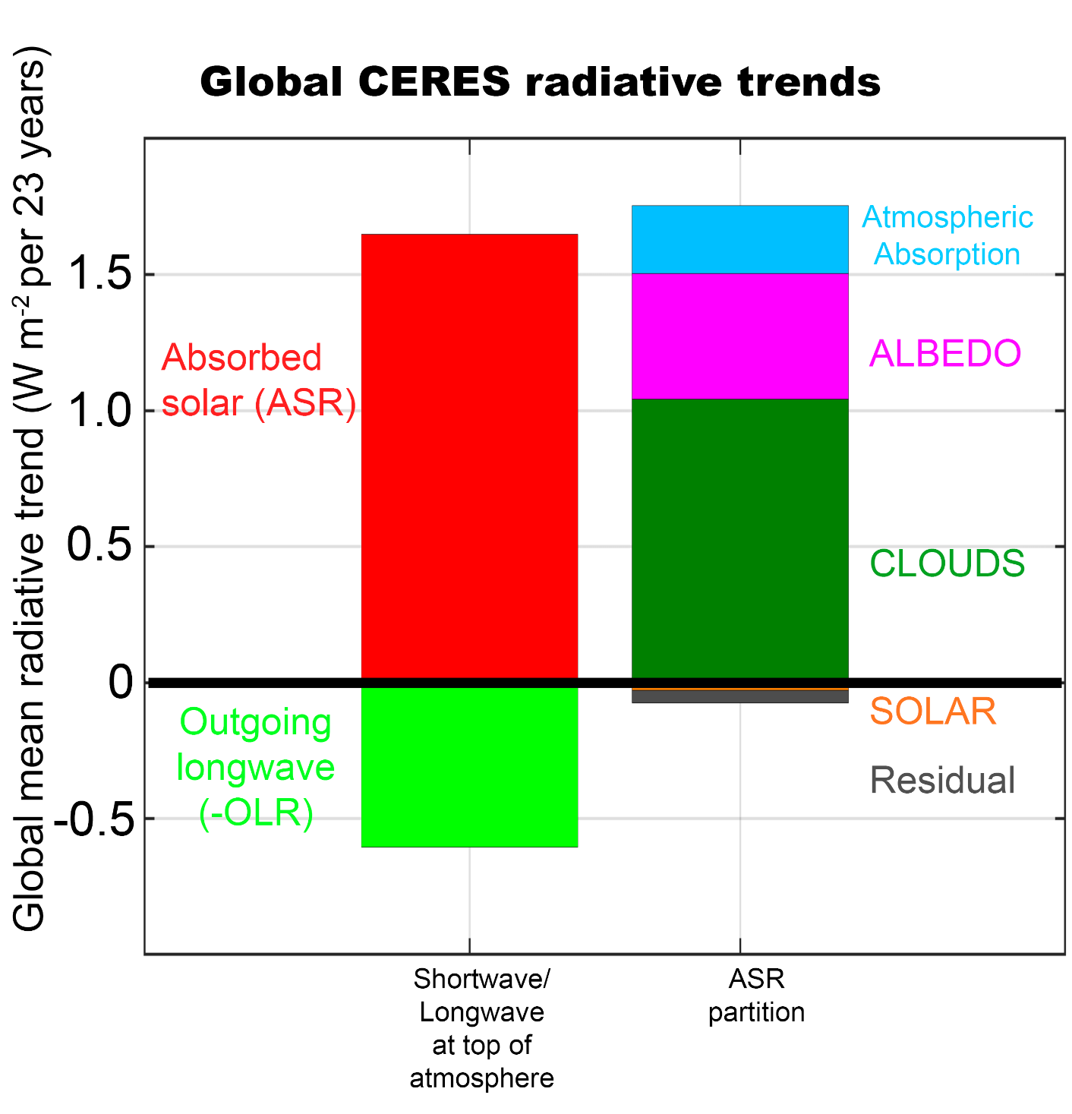
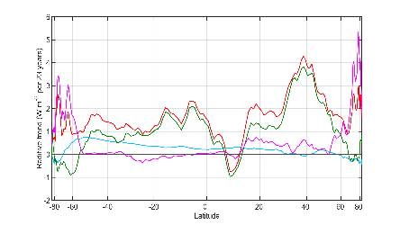


Slide 35
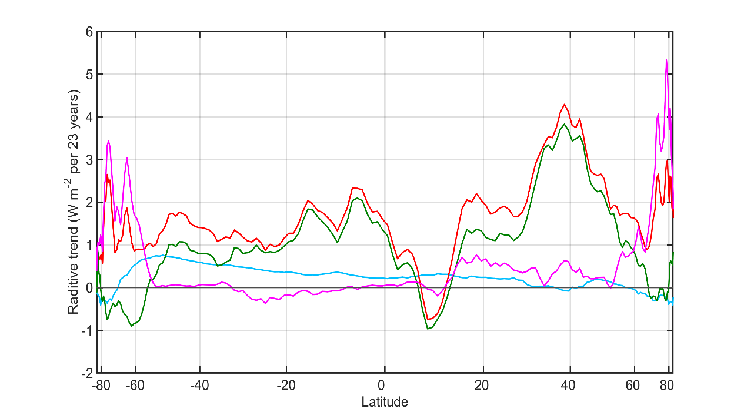

Observational trends in Absorbed Solar from CERES (2000-2023)
Model (ensemble mean) change in absorbed solar from radiative kernels

Slide 36


Radiative constraints on poleward energy transport
5.8 PW
Notes:
NH = 8.2 - 2.4 = 5.8
SH = 9.0 – 3.2 = 5.8

Slide 37
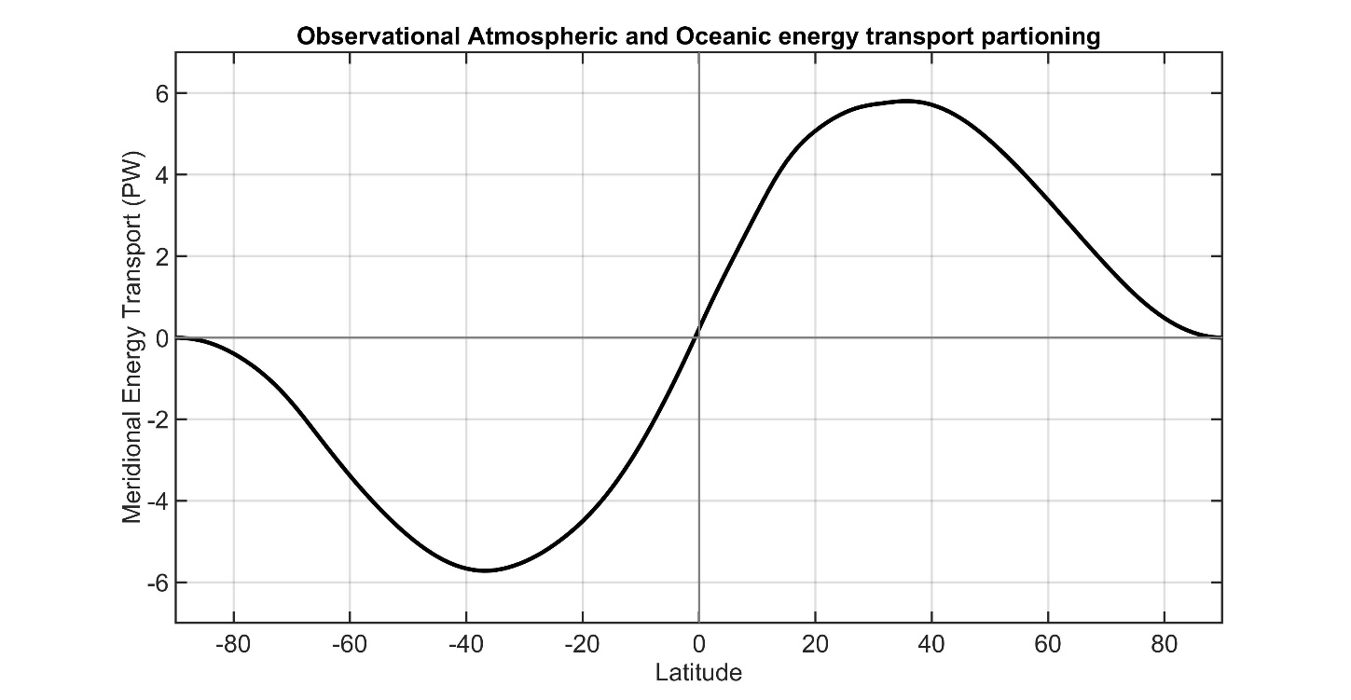
Total (atmosphere plus ocean) energy transport from satellite top of atmosphere (TOA) radiation (CERES EBAF ).
5.8 PW
5.8 PW
Total
Notes:
NH = 8.2 - 2.4 = 5.8
SH = 9.0 – 3.2 = 5.8

Slide 38
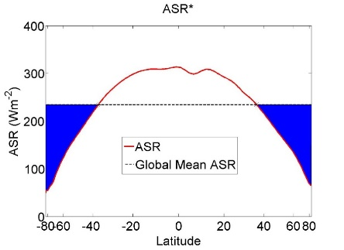

Radiative constraints on poleward heat transport
ASR*
OLR*
5.8 PW
8.2 PW
2.4 PW
2.4 PW
Net radiative
Deficit of extratropics
=
-
OLR*
ASR*
2.4 PW
8.2 PW
5.8 PW
Absorbed Solar
Emitted
(Outgoing Longwave)
Net
Tropics
Extratropics
MHT
Notes:
NH = 8.2 - 2.4 = 5.8
SH = 9.0 – 3.2 = 5.8

Slide 39
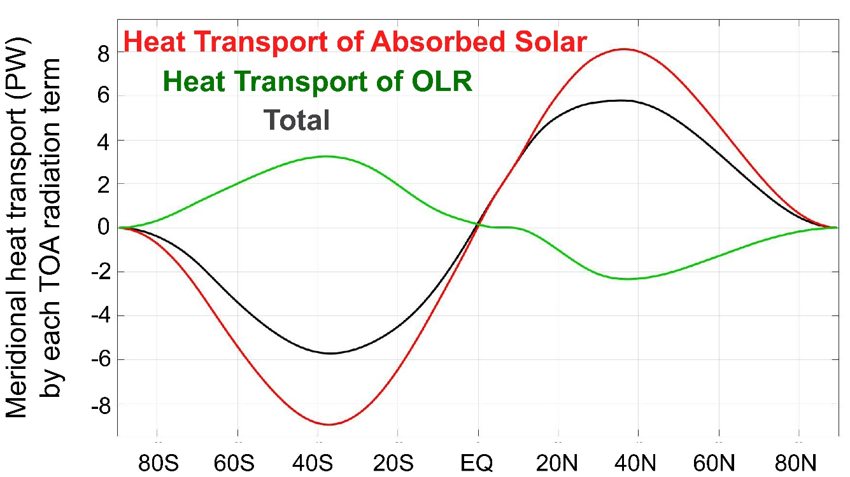
Radiative constraints on poleward heat transport
ASR*
OLR*
5.8 PW
8.2 PW
2.4 PW
2.4 PW
Net radiative
Deficit of extratropics
=
-
Remove global mean and spatially integrate each term
Notes:
NH = 8.2 - 2.4 = 5.8
SH = 9.0 – 3.2 = 5.8

Slide 40
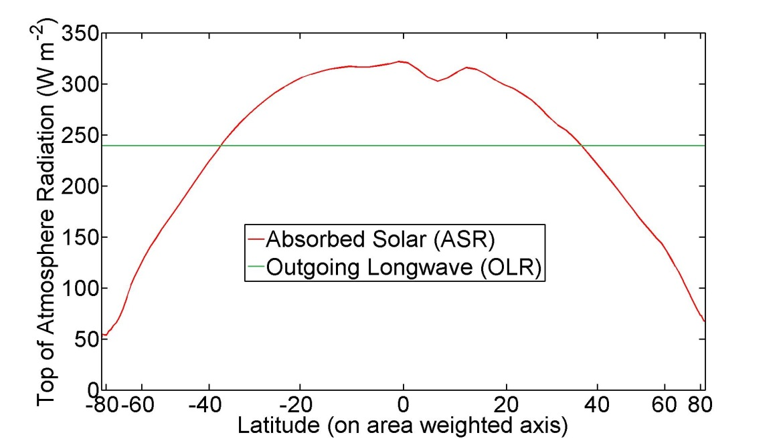

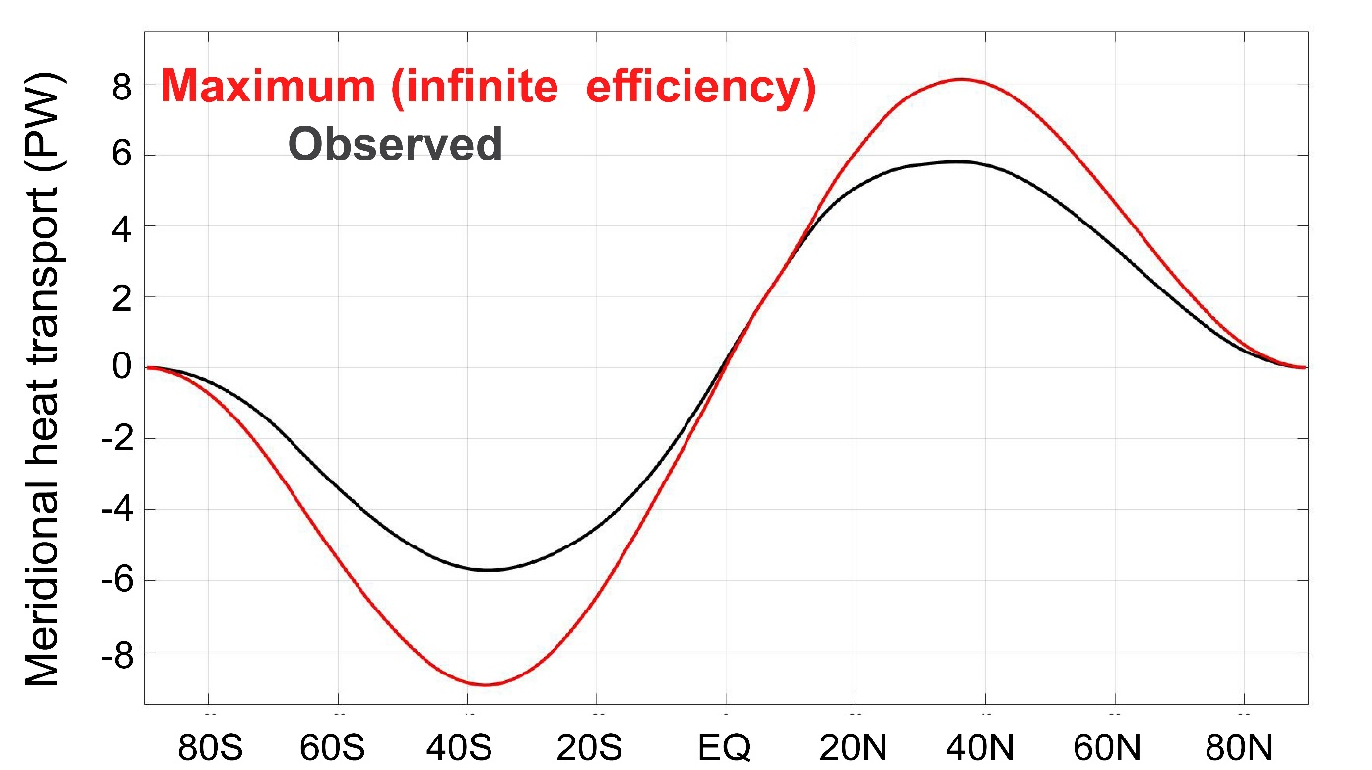
9.0 PW
8.2 PW
Limits on meridional heat transport:
Infinite heat transport efficiency
Notes:
NH = 8.2 - 2.4 = 5.8
SH = 9.0 – 3.2 = 5.8

Slide 41
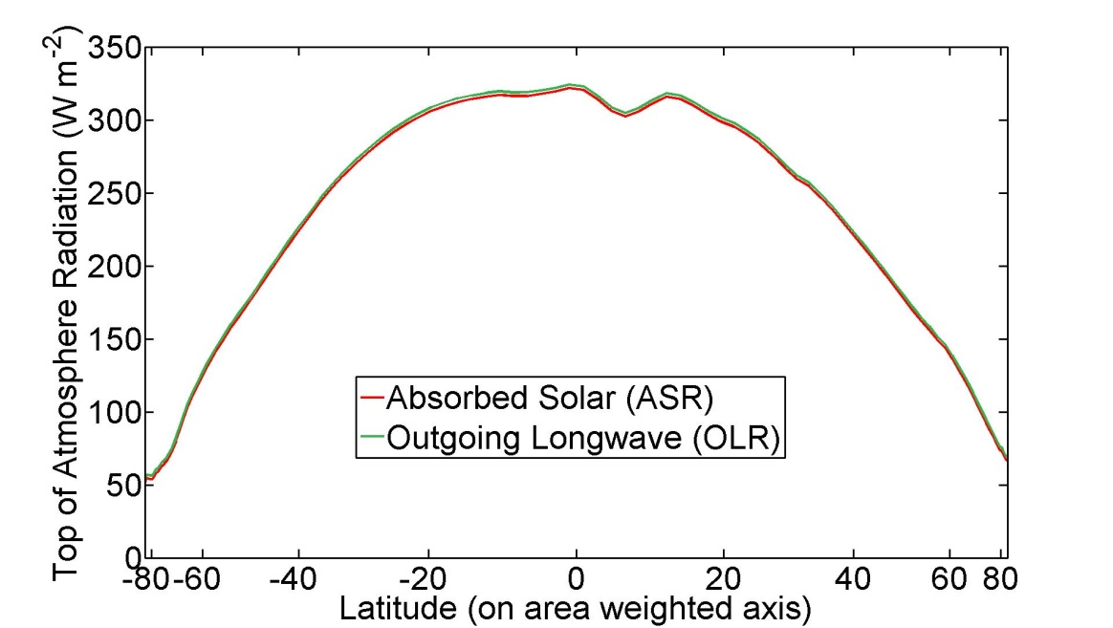
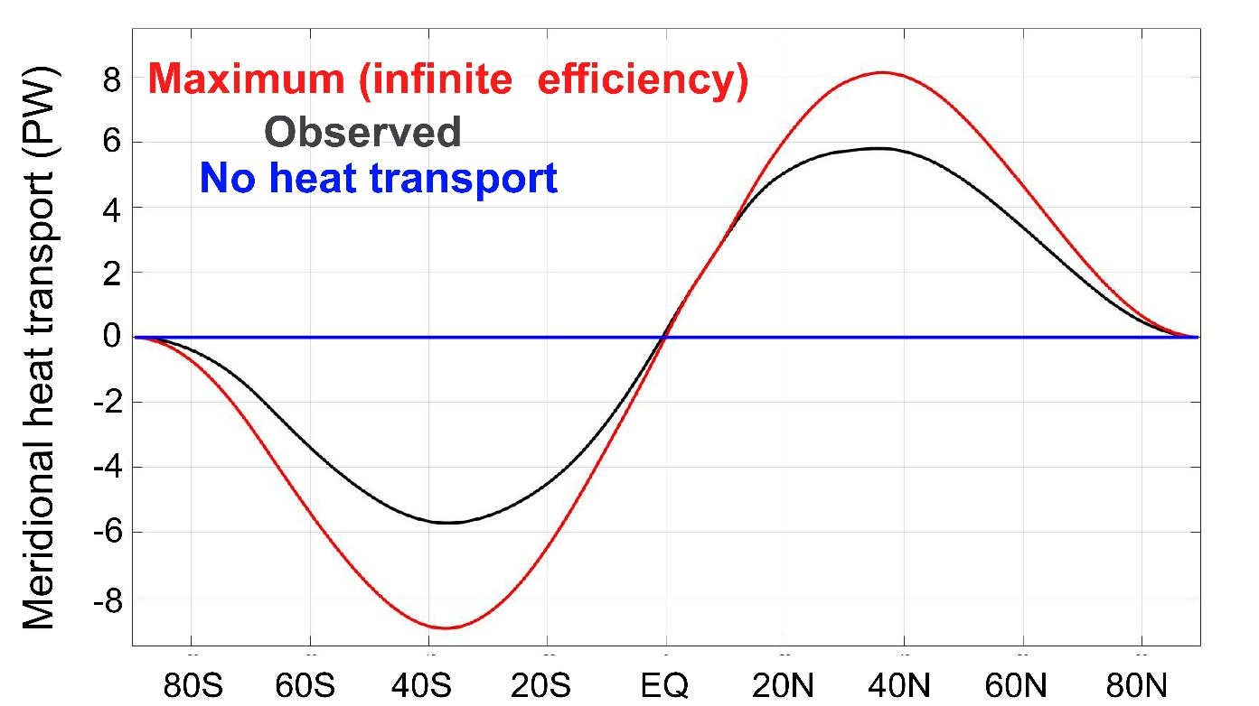
Limits on meridional heat transport:
No heat transport
→ Local Radiative equilibruim
Notes:
NH = 8.2 - 2.4 = 5.8
SH = 9.0 – 3.2 = 5.8

Slide 42
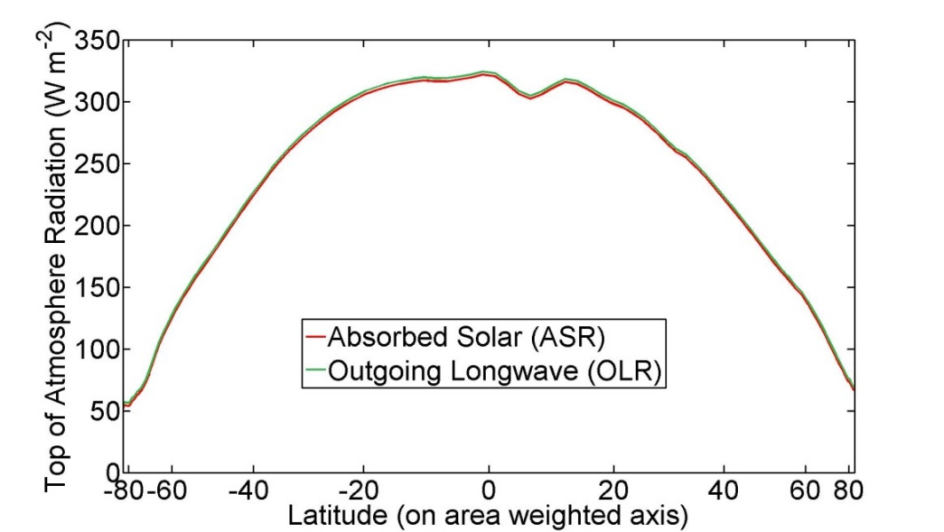
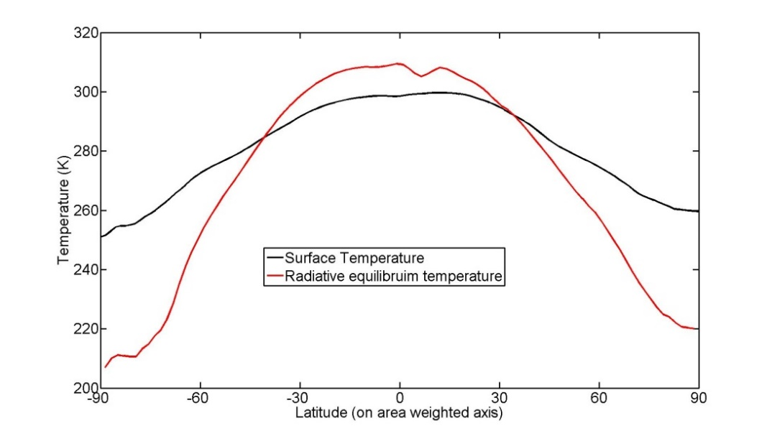
The equator-to-pole temperature gradient in the absence of poleward energy transport
Equator-to-pole temperature gradient of 100K needed for OLR to balance ASR are each latitude
→Poleward heat transport is responsible for Earth being habitable

Slide 43
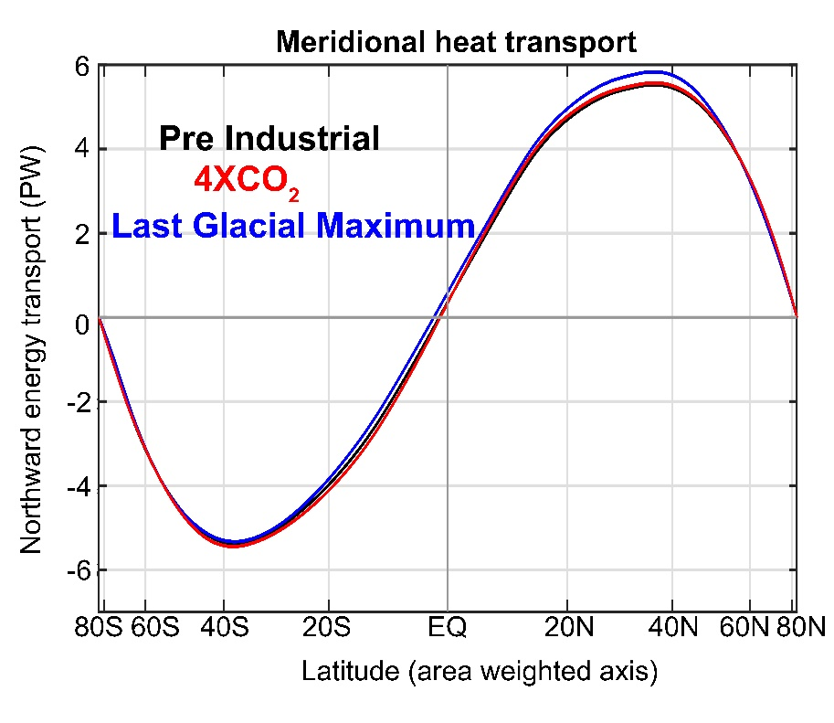
Poleward Energy Transport is unchanged with climate state in models

Slide 44
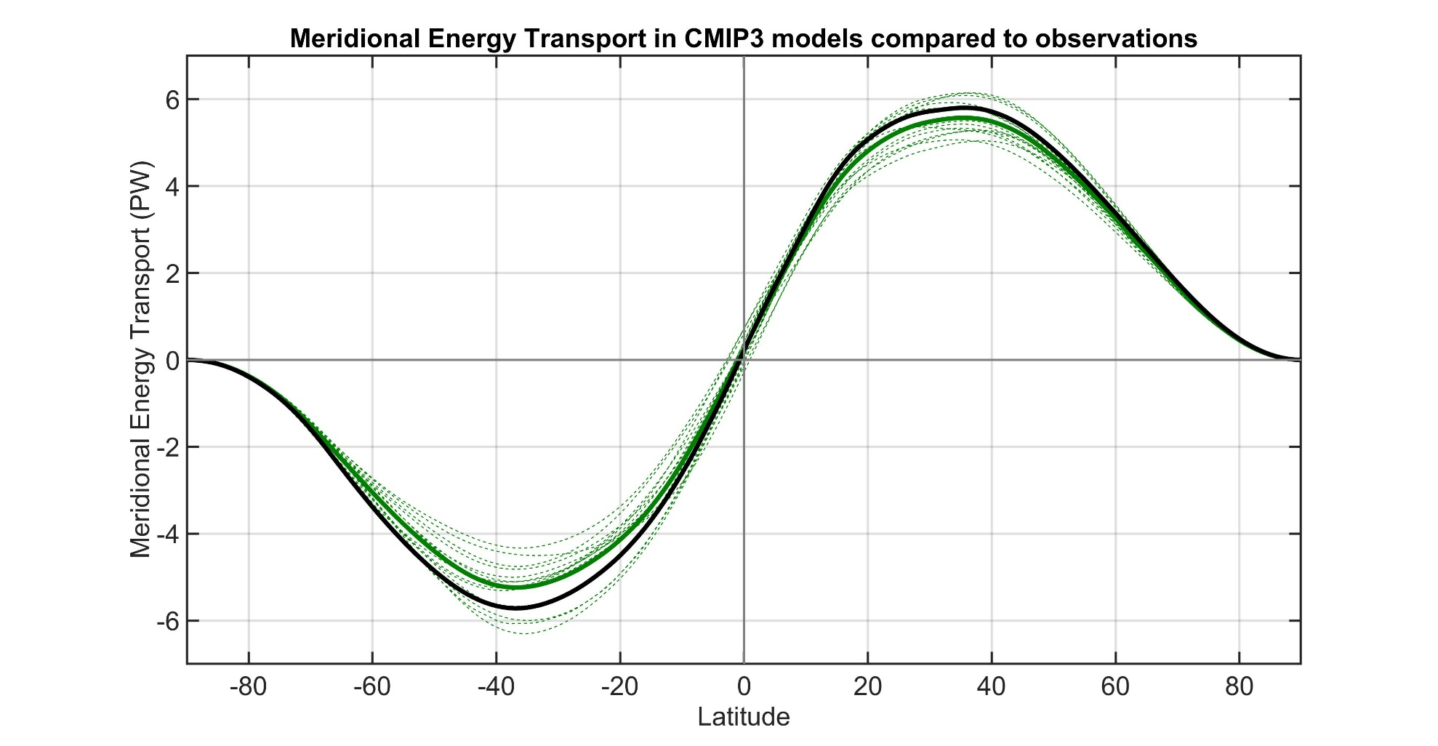
Observations
Individual models
Model Mean
Total (atmosphere plus ocean) meridional heat transport varies by about 20% between models.
→ Also biased low relative to observations especially in the SH
Donohoe and Battisti (2012). What determined meridional heat transport in climate models. J. Climate.

Slide 45
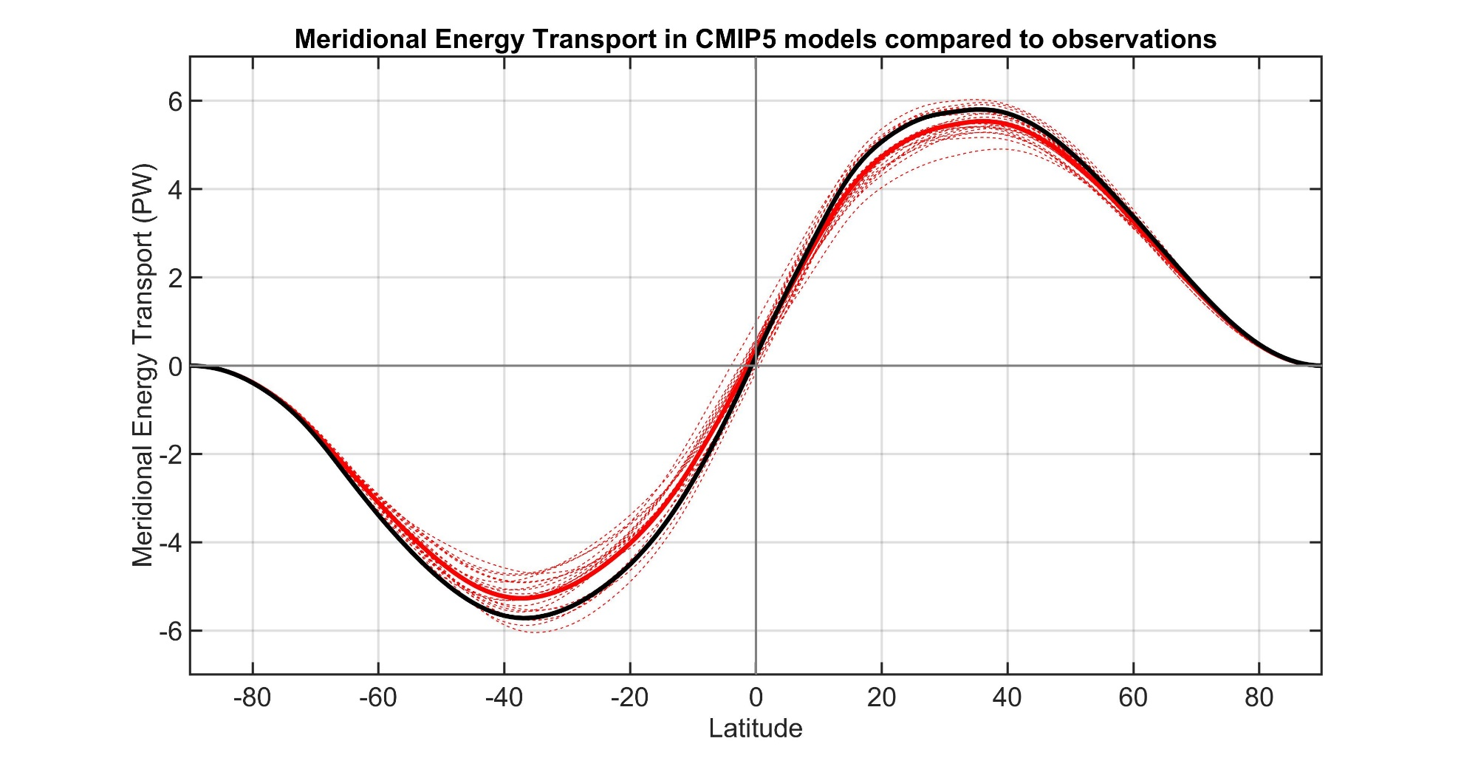
Observations
Individual models
Model Mean

Slide 46
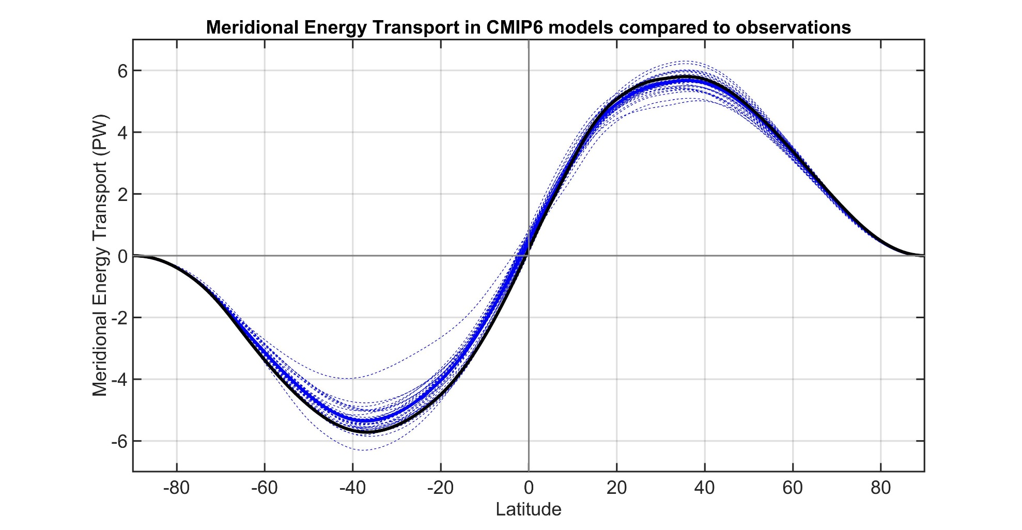
Observations
Individual models
Model Mean

Slide 47
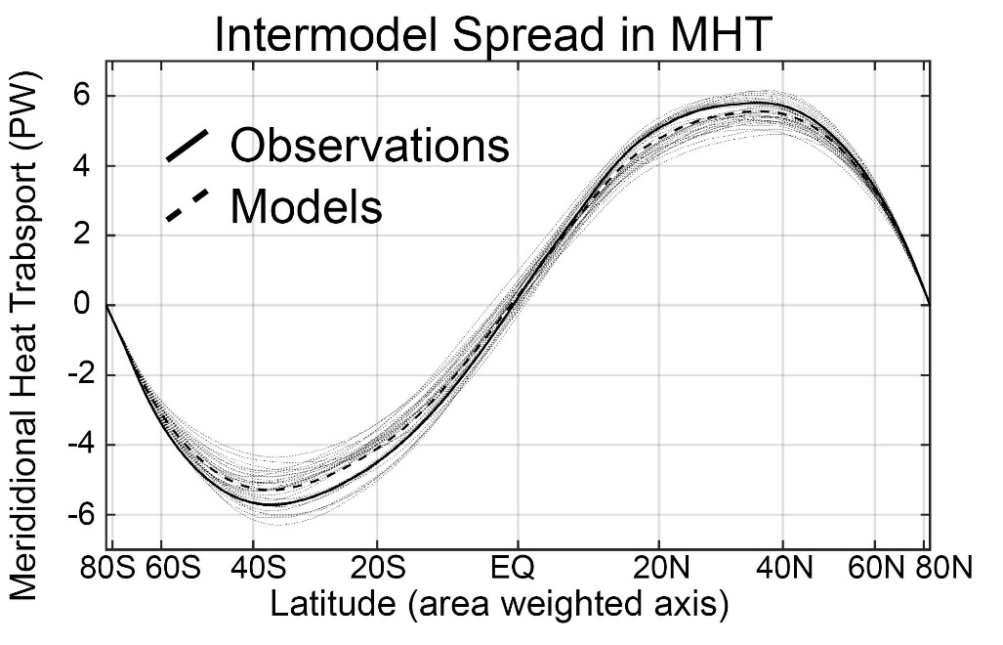
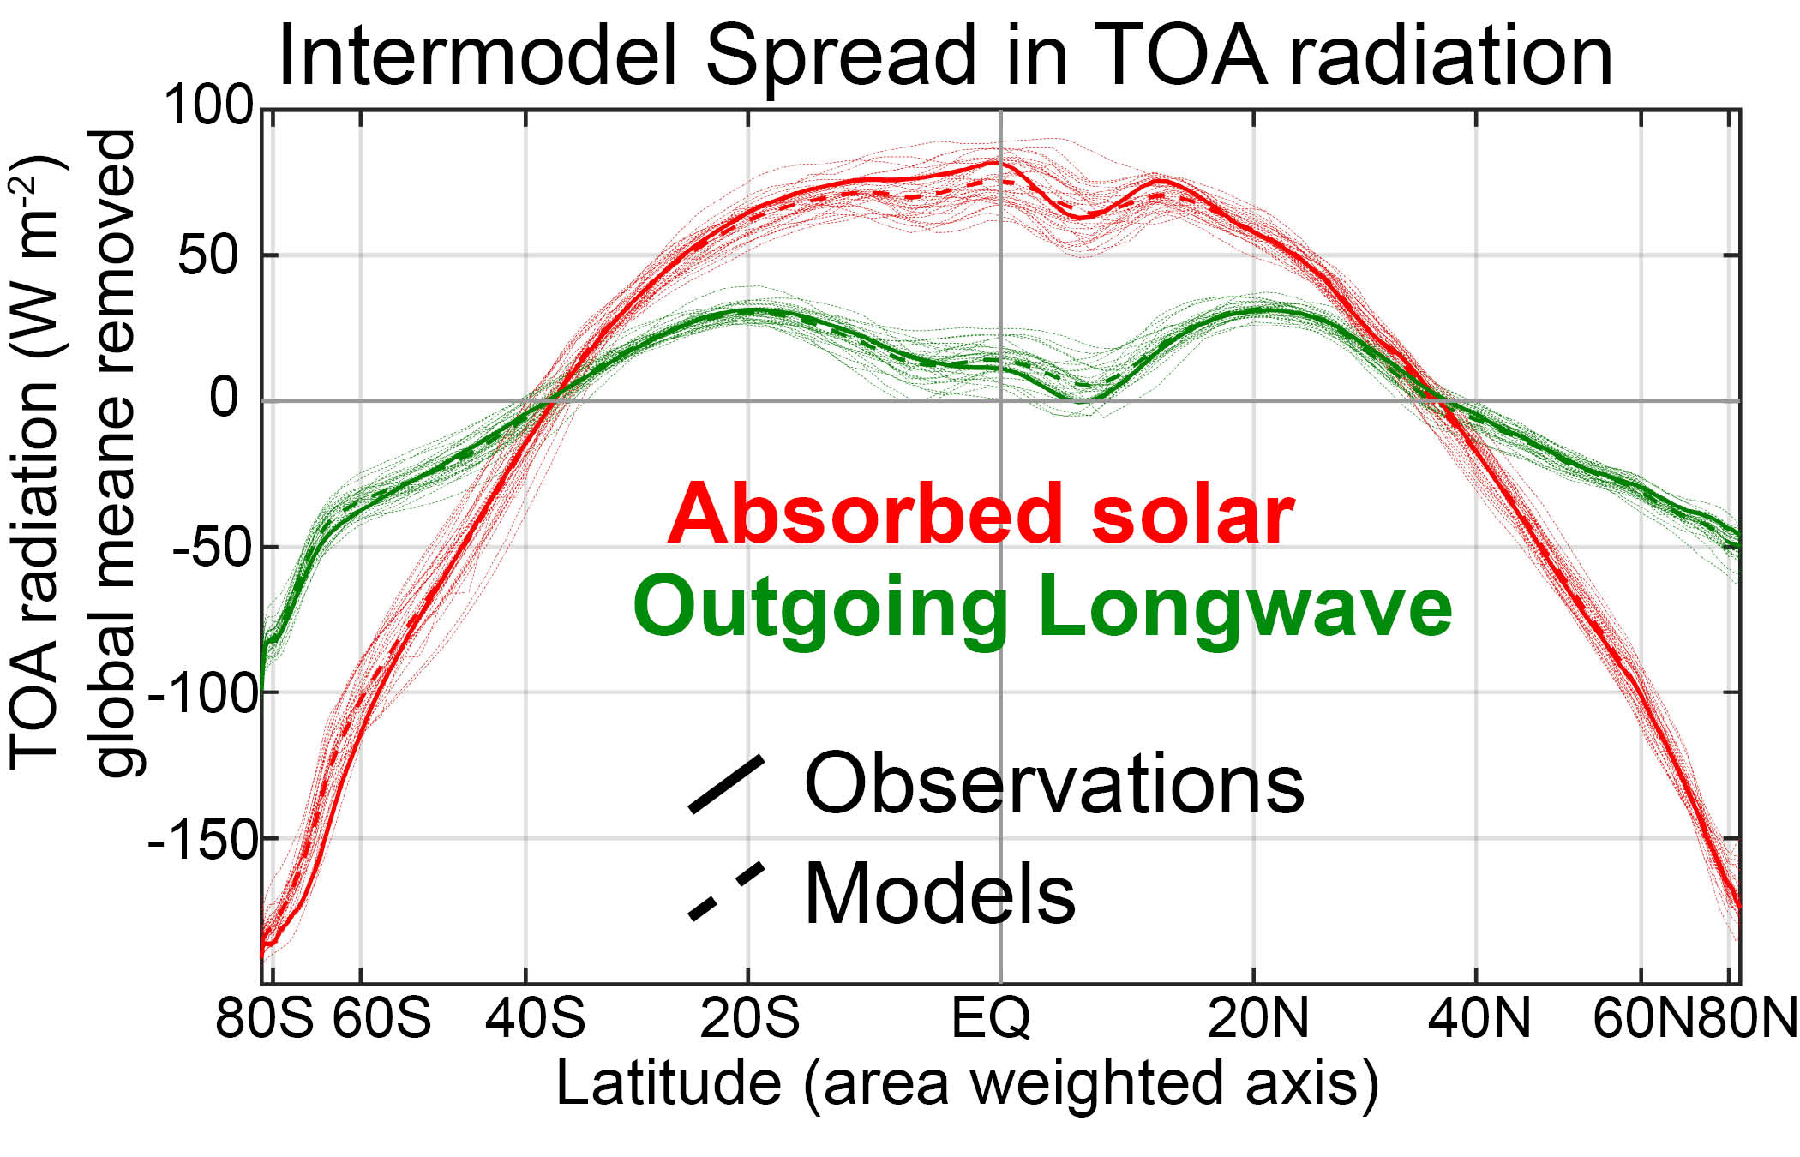

Slide 48
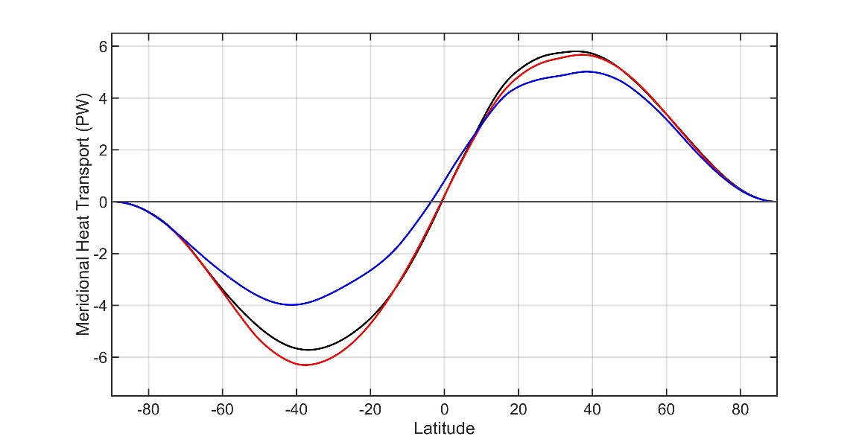

Radiative constraints on inter-model spread in poleward heat transport
Compare model with:
The least MHT in the SH
and
The most MHT in the SH
Model with most MHT
Model with least MHT
Observations
TOA radiation (w m-2)
Global mean removed
Absorbed
Solar
Outgoing
Longwave

Slide 49
Radiative constraints on inter-model spread in poleward heat transport
Compare model with:
Least MHT
Model with most MHT
ASR*
OLR*
Model with least MHT
6.7 PW
2.7 PW
Observations
4.0 PW
To extratropics
Tropics
MOST MHT
ASR*
OLR*
3.0 PW
9.3 PW
TOA radiation (w m-2)
Global mean removed
Absorbed
Solar
6.3 PW
Outgoing
Longwave
Tropics
To extratropics

Slide 50
Atmosphere and Ocean Heat Transport
Method for model partitioning
5.8 PW
Total heat
transport (MHT)
Integral of
TOA radiation
=
Integral of
Surface heat
Flux (SHF)
Ocean heat
Transport (OHT)
=
Atmospheric heat transport (AHT)
AHT = MHT – OHT
= Integral (TOA – SHF)
Tropics
Extratropics
Notes:
NH = 8.2 - 2.4 = 5.8
SH = 9.0 – 3.2 = 5.8

Slide 51


Atmosphere and Ocean Heat Transport
Method for model partitioning
TOA
Atmosphere
Ocean
Total heat
transport (MHT)
Integral of
TOA radiation
=
Integral of
Surface heat
Flux (SHF)
Ocean heat
Transport (OHT)
=
Atmospheric heat transport (AHT)
AHT = MHT – OHT
= Integral (TOA – SHF)
Notes:
NH = 8.2 - 2.4 = 5.8
SH = 9.0 – 3.2 = 5.8

Slide 52


ASR
Total (atmosphere plus ocean) energy transport from TOA radiation (CERES satellite).
NET
OLR
AHT
Atmospheric energy transport from 6 hourly ERA5 reanalysis dynamics calculation
Tropics
Extratropics
Total
Atmosphere
Notes:
NH = 8.2 - 2.4 = 5.8
SH = 9.0 – 3.2 = 5.8

Slide 53

ASR
Total (atmosphere plus ocean) energy transport from TOA radiation (CERES satellite).
NET
OLR
AHT
Atmospheric energy transport from 6 hourly ERA5 reanalysis dynamics calculation
Tropics
Extratropics
Ocean heat transport as the residual = Total - atmos
Total
Atmosphere
Ocean
Notes:
NH = 8.2 - 2.4 = 5.8
SH = 9.0 – 3.2 = 5.8

Slide 54

This strategy was pioneered by Trenberth and Caron (2001)
ERBE and NCEP
Total
Atmosphere
Ocean
Our result
CERES and ERA5
Notes:
NH = 8.2 - 2.4 = 5.8
SH = 9.0 – 3.2 = 5.8

Slide 55


Slide 56


CMIP3 -- Partitioning of MHT 3
Observations
Total energy
transport
Individual models
Model Mean
ATMOSPHERE
Atmosphere ocean partitioning
OCEAN
Observations
Individual models
Model Mean

Slide 57


CMIP53
Observations
Total energy
transport
Individual models
Model Mean
ATMOSPHERE
Atmosphere ocean partitioning
OCEAN
Observations
Individual models
Model Mean

Slide 58


CMIP63
Observations
Total energy
transport
Individual models
Model Mean
ATMOSPHERE
Atmosphere ocean partitioning
OCEAN
Observations
Individual models
Model Mean

Slide 59


CMIP3 to 6 against observations
Observations
Total energy
transport
CMIP3 Mean
CMIP5 Mean
CMIP6 Mean
ATMOSPHERE
Atmosphere ocean partitioning
OCEAN
Observations
CMIP3 Mean
CMIP5 Mean
CMIP6 Mean

Slide 60


OBSERVATIONS FROM ERA5 and CERES
Observations
CMIP Mean
Total energy
transport
ATMOSPHERE
OCEAN
Observations
Atmosphere ocean partitioning
CMIP Mean

Slide 61

Sensitivity to reanalysis
ERA INTERIM and CERES
Observations
CMIP Mean
Total energy
transport
ATMOSPHERE
OCEAN
Observations
Atmosphere ocean partitioning
CMIP Mean

Slide 62

Sensitivity to reanalysis
NCEP reanalysis and CERES
Observations
CMIP Mean
Total energy
transport
ATMOSPHERE
OCEAN
Observations
Atmosphere ocean partitioning
CMIP Mean

Slide 63
Sensitivity to observational radiation
CERES EBAF (energy balanced and filled)
Observations
CMIP Mean
Total energy
transport
ATMOSPHERE
OCEAN
Observations
Atmosphere ocean partitioning
CMIP Mean

Slide 64


Sensitivity to observational radiation unadjusted CERES (single scanner)
Observations
CMIP Mean
Total energy
transport
ATMOSPHERE
OCEAN
Observations
Atmosphere ocean partitioning
CMIP Mean

Slide 65


Sensitivity to observational radiation
ERBE (1984-1990)
Observations
CMIP Mean
Total energy
transport
ATMOSPHERE
OCEAN
Observations
Atmosphere ocean partitioning
CMIP Mean

Slide 66

Accounting for ocean heat content changes
Total energy
transport
Observations
CMIP Mean
ATMOSPHERE
Correcting for ocean heat content changes -------------------------
From EN4 ocean reanalysis temperature trends
OCEAN
Observations
CMIP Mean

Slide 67
What determines the partitioning of heat transport between the atmosphere and ocean (Robert Fajber)
Energy input to the atmosphere
Globally, evaporation adds energy to the atmosphere and
atmospheric radiation removes energy
Local energy imbalances drive atmospheric heat transport
Source of atmospheric energy input (W m⁻² )
Notes:
Left figure shows the sources of energy input to the atmosphere in observations (ERA reanalysis) with the global mean removed. Energy enters the atmosphere in the low latitudes and leaves the atmosphere in the high latitudes (black line). The energy input to the atmosphere is decomposed into three terms; the sensible hear flux from the surface to the atmosphere (orange), the evaporation (green), and the radiative heating of the atmosphere (note this differs from the top of atmosphere radiation and the surface radiation). The evaporation has more spatial structure than the other terms contributing energy into the atmosphere.
The right panel shows the atmospheric heat transport due to each process. This shows that nearly all the poleward heat transport in the atmosphere is derived from evaporation. This result has been confirmed with idealized model studying in which we (Robert Fajber) traces the heating and transport that results from each process by tagging and tracing air parcels (much like one would do with passive tracer transport).
There is one subtlety here. The evaporations drives both the flux of temperature and humidity (dry and moist energy transports in the atmosphere. The evaporation in the tropics can either be balanced by a moisture transport in the atmosphere, or be precipitated out which condesationally heats the atmospheric column to drive the dry atmospheric heat transport.

Slide 68
What determines the partitioning of heat transport between the atmosphere and ocean (Robert Fajber)
150
6
Total
Total
Radiation (atmos)
Radiation (atmos)
100
Sensible heat
4
Sensible heat
Evaporation
Evaporation
50
50
2
Source of atmospheric energy input (W m⁻² )
Global mean removed
Atmospheric heat transport generated
By each source term (PW)
0
0
-50
-2
-100
-4
-150
30N
60N
90N
-6
30N
60N
90N
90S
60S
30S
EQ
90S
60S
30S
EQ
Notes:
Left figure shows the sources of energy input to the atmosphere in observations (ERA reanalysis) with the global mean removed. Energy enters the atmosphere in the low latitudes and leaves the atmosphere in the high latitudes (black line). The energy input to the atmosphere is decomposed into three terms; the sensible hear flux from the surface to the atmosphere (orange), the evaporation (green), and the radiative heating of the atmosphere (note this differs from the top of atmosphere radiation and the surface radiation). The evaporation has more spatial structure than the other terms contributing energy into the atmosphere.
The right panel shows the atmospheric heat transport due to each process. This shows that nearly all the poleward heat transport in the atmosphere is derived from evaporation. This result has been confirmed with idealized model studying in which we (Robert Fajber) traces the heating and transport that results from each process by tagging and tracing air parcels (much like one would do with passive tracer transport).
There is one subtlety here. The evaporations drives both the flux of temperature and humidity (dry and moist energy transports in the atmosphere. The evaporation in the tropics can either be balanced by a moisture transport in the atmosphere, or be precipitated out which condesationally heats the atmospheric column to drive the dry atmospheric heat transport.

Slide 69
Atmospheric heat transport is traditionally subdivided into processes that add moisture versus heat to the atmosphere
Source of atmospheric energy input (W m⁻² )
Global mean removed
Moisture input = evaporation - precipitation
Atmospheric heating = precipitation + stuff
Notes:
Left figure shows the sources of energy input to the atmosphere in observations (ERA reanalysis) with the global mean removed. Energy enters the atmosphere in the low latitudes and leaves the atmosphere in the high latitudes (black line). The energy input to the atmosphere is decomposed into three terms; the sensible hear flux from the surface to the atmosphere (orange), the evaporation (green), and the radiative heating of the atmosphere (note this differs from the top of atmosphere radiation and the surface radiation). The evaporation has more spatial structure than the other terms contributing energy into the atmosphere.
The right panel shows the atmospheric heat transport due to each process. This shows that nearly all the poleward heat transport in the atmosphere is derived from evaporation. This result has been confirmed with idealized model studying in which we (Robert Fajber) traces the heating and transport that results from each process by tagging and tracing air parcels (much like one would do with passive tracer transport).
There is one subtlety here. The evaporations drives both the flux of temperature and humidity (dry and moist energy transports in the atmosphere. The evaporation in the tropics can either be balanced by a moisture transport in the atmosphere, or be precipitated out which condesationally heats the atmospheric column to drive the dry atmospheric heat transport.

Slide 70
Sptail pattern of atmospheric heating (dry static energy input) is dominated by precipitation
Source of atmospheric heating
Precipitation
Radiation
Sensible
Source of atmospheric heating input (W m⁻² )
Global mean removed
Atmospheric heating = precipitation + radiation + sensible
Notes:
Left figure shows the sources of energy input to the atmosphere in observations (ERA reanalysis) with the global mean removed. Energy enters the atmosphere in the low latitudes and leaves the atmosphere in the high latitudes (black line). The energy input to the atmosphere is decomposed into three terms; the sensible hear flux from the surface to the atmosphere (orange), the evaporation (green), and the radiative heating of the atmosphere (note this differs from the top of atmosphere radiation and the surface radiation). The evaporation has more spatial structure than the other terms contributing energy into the atmosphere.
The right panel shows the atmospheric heat transport due to each process. This shows that nearly all the poleward heat transport in the atmosphere is derived from evaporation. This result has been confirmed with idealized model studying in which we (Robert Fajber) traces the heating and transport that results from each process by tagging and tracing air parcels (much like one would do with passive tracer transport).
There is one subtlety here. The evaporations drives both the flux of temperature and humidity (dry and moist energy transports in the atmosphere. The evaporation in the tropics can either be balanced by a moisture transport in the atmosphere, or be precipitated out which condesationally heats the atmospheric column to drive the dry atmospheric heat transport.

Slide 71

Evaporation drives total atmospheric heat transport
Moist/dry partitioning
Dry AHT
Total AHT
Atmospheric energy input = moisture input + heating
evaporation – precipitation + precipitation
evaporation

Slide 72
If AHT is governed by evaporation
Prediction: Reduced evaporation → reduced AHT
Control
Snowball
In Snowball Earth simulation
Evaporation becomes negligible
AHT reduced by 90%
Evaporation
Sensible
Radiation
Model simulation from:
J Horner, A Voigt, C Braun, Snowball earth initiation and the thermodynamics of sea ice. J. Adv. Model. Earth Syst. 14, e2021MS002734 (2022).
Control
½ evap
Simulation with evaporation
Coefficient is cut in half
Evaporation reduced by %20
AHT reduced by similar amount
Change ih AHT (PW)

Slide 73


Why are models biased high in AHT
ATMOSPHERE
OCEAN
Observations
Model Mean
Hypothesis: model’s have too much AHT because they have too much evaporation
CMIP Mean
Evaporation
Observations
CMIP Mean
Observations are WHOI OA flux
Both plots are ocean domain only

Slide 74


Evaporation biases:
→Result in AHT/OHT tradeoff
→ Are right magnitude to explain AHT/OHT bias

Slide 75


Evaporation biases:
→Result in AHT/OHT tradeoff
→ Are right magnitude to explain AHT/OHT bias

Slide 76

Evaporation biases:
→Result in AHT/OHT tradeoff
→ Are right magnitude to explain AHT/OHT bias

Slide 77

Trends in Atmospheric Heat transport (1980-2020) – Tyler Cox
Reanalysis
Coupled Models
AMIP – prescribed SST
AHT Trend (PW per 40 years)
90S
60S
30S
EQ
30N
60N
90N

Slide 78




Partitioning of atmospheric energy by circulation type
Stationary
MOC
Overturning
Transient
* = Departure from zonal mean -- [ ]
' = Departure from time mean -- ¯
MSE = moist static energy
= CpT + LQ +gZ
MOC dominates in the deep tropics – Hadley cell
Stationary eddies stronger in NH
Transient eddies dominate the mid-latitudes

Slide 79


Trends in Atmospheric heat transport
Model simulation with historical forcing and prescribed observed SST show compensating trends in eddy and overturning AHT in the SH
→ Historical trends are smaller than observed
→ Prescribed SST are close to observed trends

Slide 80


Conclusions
Trends in global mean radiation are characterized by increase in both absorbed solar radiation and outgoing longwave radiation consistent with positive shortwave feedback by surface albedo, atmospheric absorption and clouds
The atmosphere moves the majority of energy poleward in the climate system, but the ocean moves more energy in climate models than in couple climate models

