Slide 1

Global mean temperature and energy content
In observations

Slide 2
Global mean energy balance
Incident
Solar
340.0 W m⁻²
Reflected solar 99.1 W m⁻²
OLR 240.1 W m⁻²
Net Energy Imbalance
=340.0 – 99.1 -240.1
= +0.8 W m-2
Into the climate system
(Loeb et al. 2018 – CERES EBAF)
Earth

Slide 3
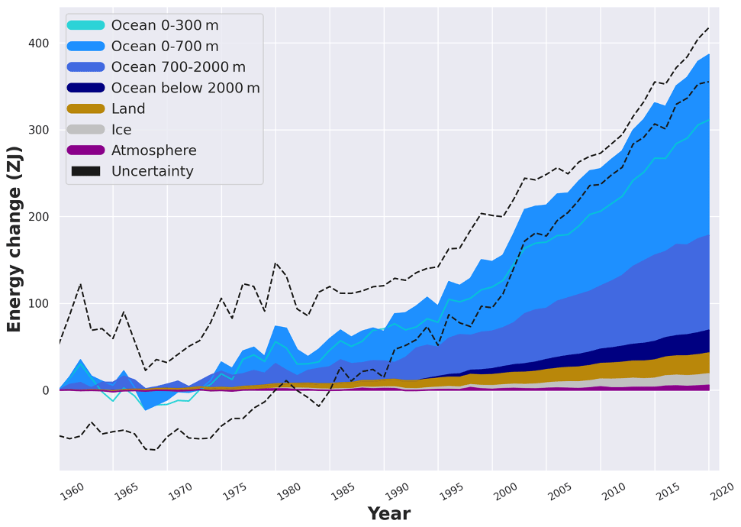
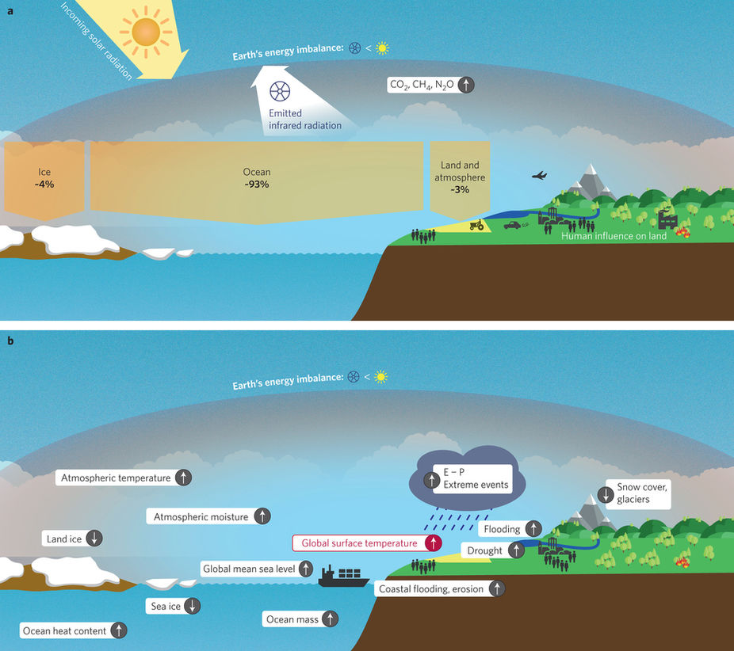
Where does the energy imbalance go?
Changes in Earth
Energy Content
von Schuckmann et. al , 2020

Slide 4
Three estimates of Earth’s energy imbalance
If we assume that all the energy imbalance goes into the ocean, we should have 3 independent estimates of Earth’s energy imbalance
1) Net radiation at the top of atmosphere (satellites)
2) Net energy flux into the surface (surface radiation + turbulent fluxes)
Ocean
3) Energy accumulation in the ocean
d(ocean heat content)/dt

Slide 5
Unadjusted satellite radiation
Incident
Solar
340.0 W m⁻²
^{(+/- 0.2)}
Reflected solar 97.1 W m^{-2 (+/-3.0)}
OLR 238.6 W m^{-2 (+/- 5.5)}
Net Energy Imbalance
=340.0 – 97.1 -238.6
= +4.3 (+/-5.5) W m ⁻²
Into the climate system
(Loeb et al. 2012 – CERES EBAF)
Earth

Slide 6
Where does the energy imbalance go?
Changes in Earth
Energy Content
von Schuckmann et. al , 2020
Reconciling units: 0.8 W m⁻² integrated over Earth’s surface area (5*10¹⁴ m²)
and over a decade (3*10⁸s)
= 120 ZJ per decade

Slide 7
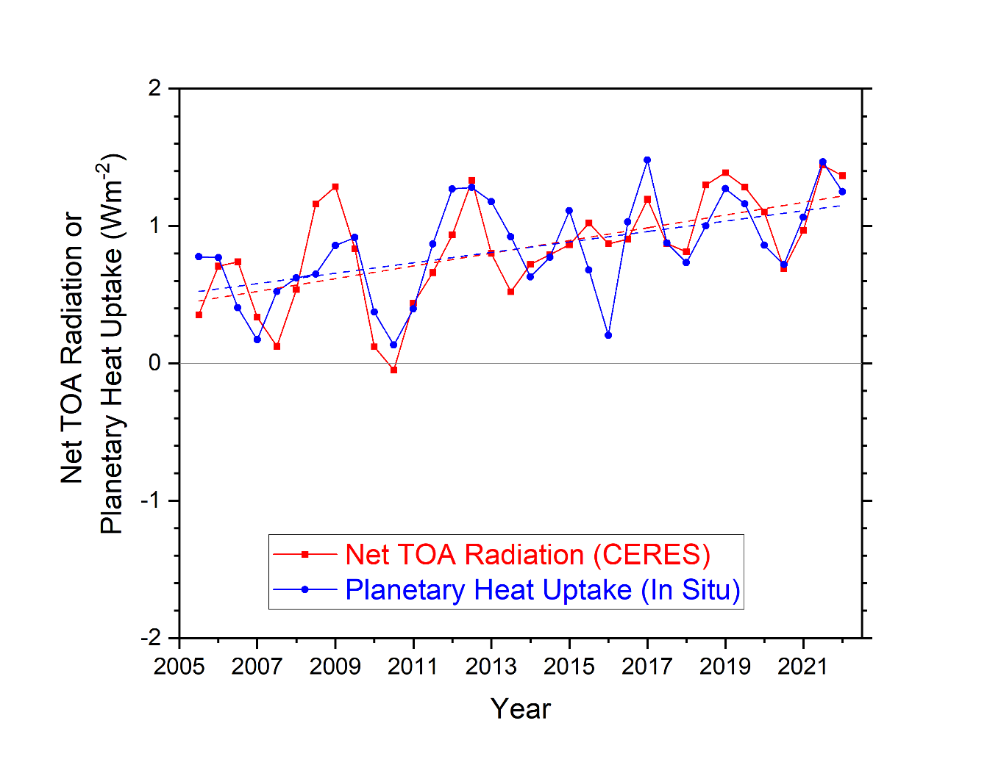
→ Satellite observations have low precision but high year-to-year accuracy
→ Trends in ocean heat content have low accuracy for shorter time periods
How can we test the consistency of the two?
Year-to-year variability of ocean heat content change and satellite derived top of atmosphere radiation are consistent within uncertainity
d(ocean heat content)/dt
Loeb et al. 2020

Slide 8
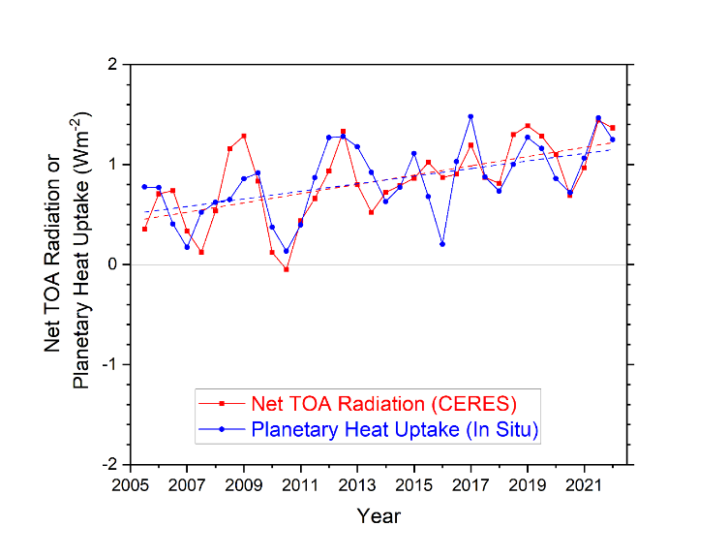
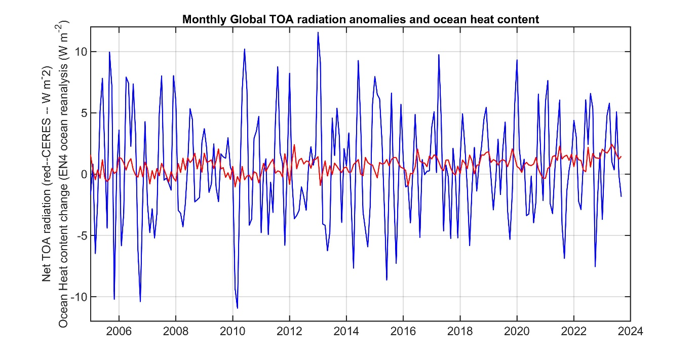
Year-to-year variability of ocean heat content change and satellite derived top of atmosphere radiation are consistent within uncertainity
Observed month to variability of ocean heat content change has huge uncertainty which leads to an order of magnitude more variability than satellite derived top of atmosphere radiation
Loeb et al. 2020

Slide 9
Year-to-year variability of ocean heat content change and satellite derived top of atmosphere radiation are consistent within uncertainity
In climate models, decade long trends in ocean heat content and accumulation of energy in the climate system are very highly correlated
(Palmer et al. 2011)
Loeb et al. 2020

Slide 10
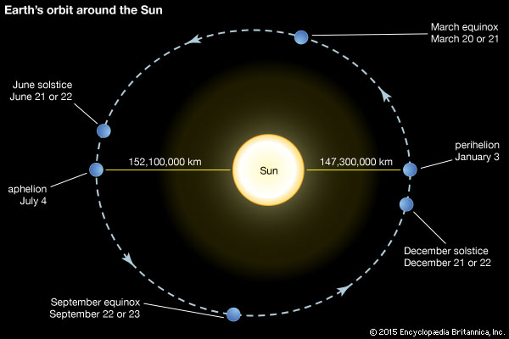
An idea to test the consistency of energy imbalance from satellite radiation and ocean heat content –
The seasonal cycle of global mean heat content
Back of envelope– How much does global mean insolation vary by over the annual cycle?
Earth-sun distance varies by 5 million km
--- 3% of the mean distance (ΔR/R_{mean} = 5/150)
Insolation scales as 1/R² so fractional change in insolation is ≈ 2ΔR/R_{mean} = 6%
6% of S_{O}/4 is = 0.06 * (341 W m⁻²) =
20 W m ⁻²
(30 times time mean energy imbalance)

Slide 11
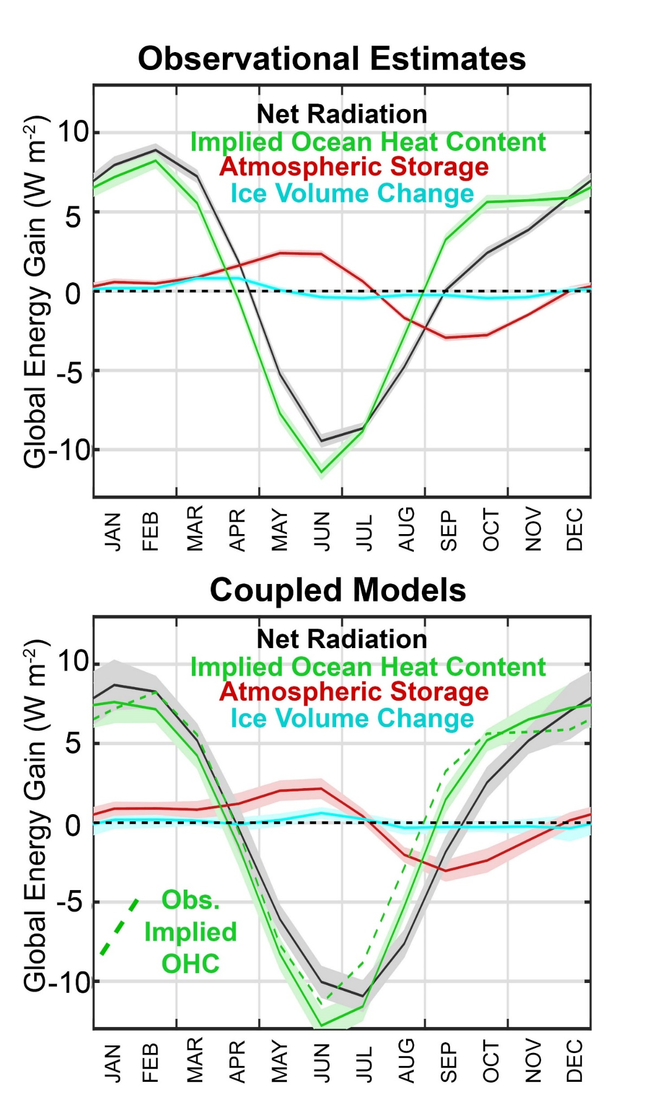
In addition to TOA radiation from CERES, we calculate the required seasonal ocean heat content change from:
Atmospheric heat content change from ERA reanalysis
Ice Volume change from Gravity Recovery and Climate Experiment (GRACE)
Donohoe, 2016

Slide 12
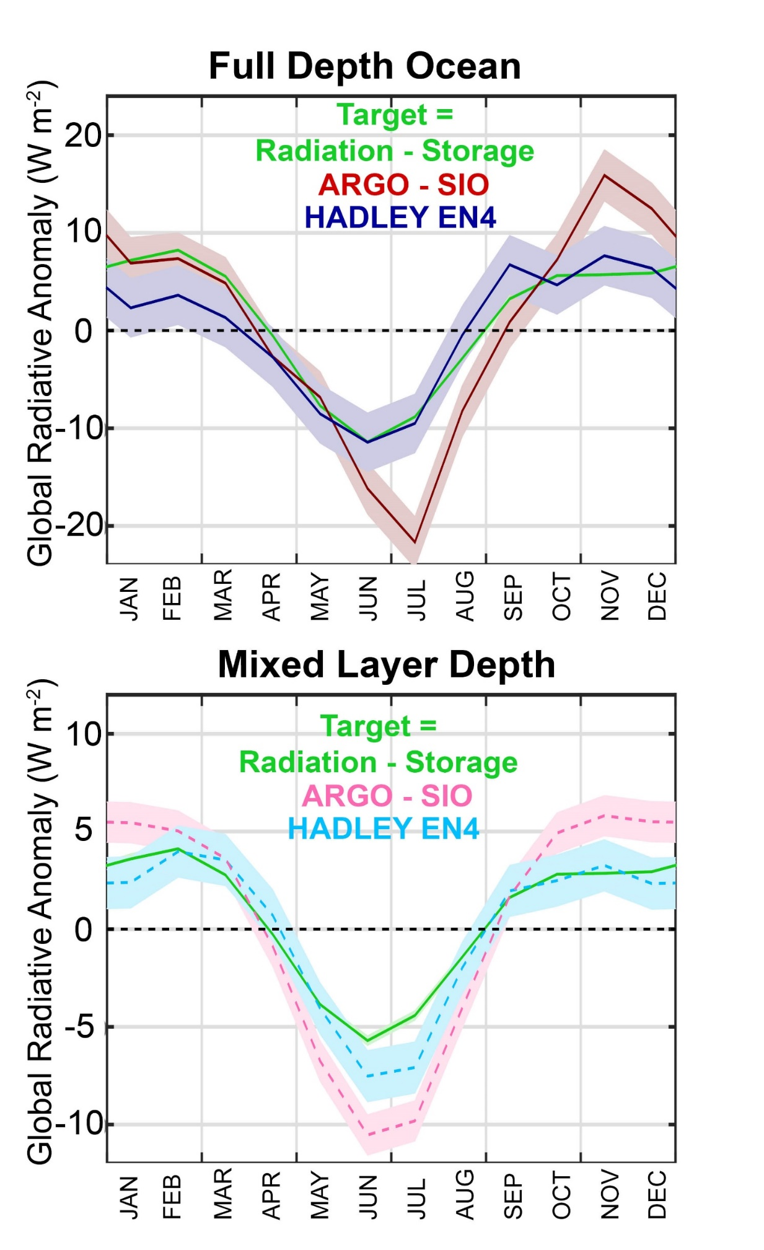
Two different estimates of Earth’s global mean seasonal cycle of energy content are consistent:
→ Satellite derived top of atmosphere radiation
and
Ocean heat content changes (in the Hadley EN4 data set)
Donohoe, 2016

Slide 13
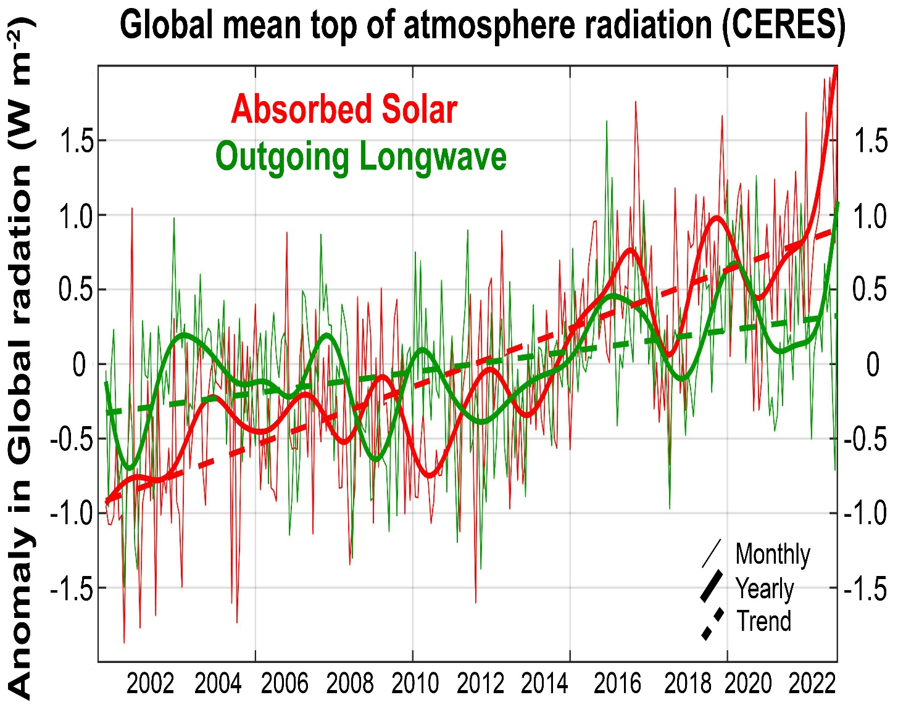
Observed (CERES) 23 year trends in TOA radiation:
+1.8 W m⁻² ASR
+0.65 W m⁻² OLR
Task: understanding the reasons absorbed solar has increased

Slide 14
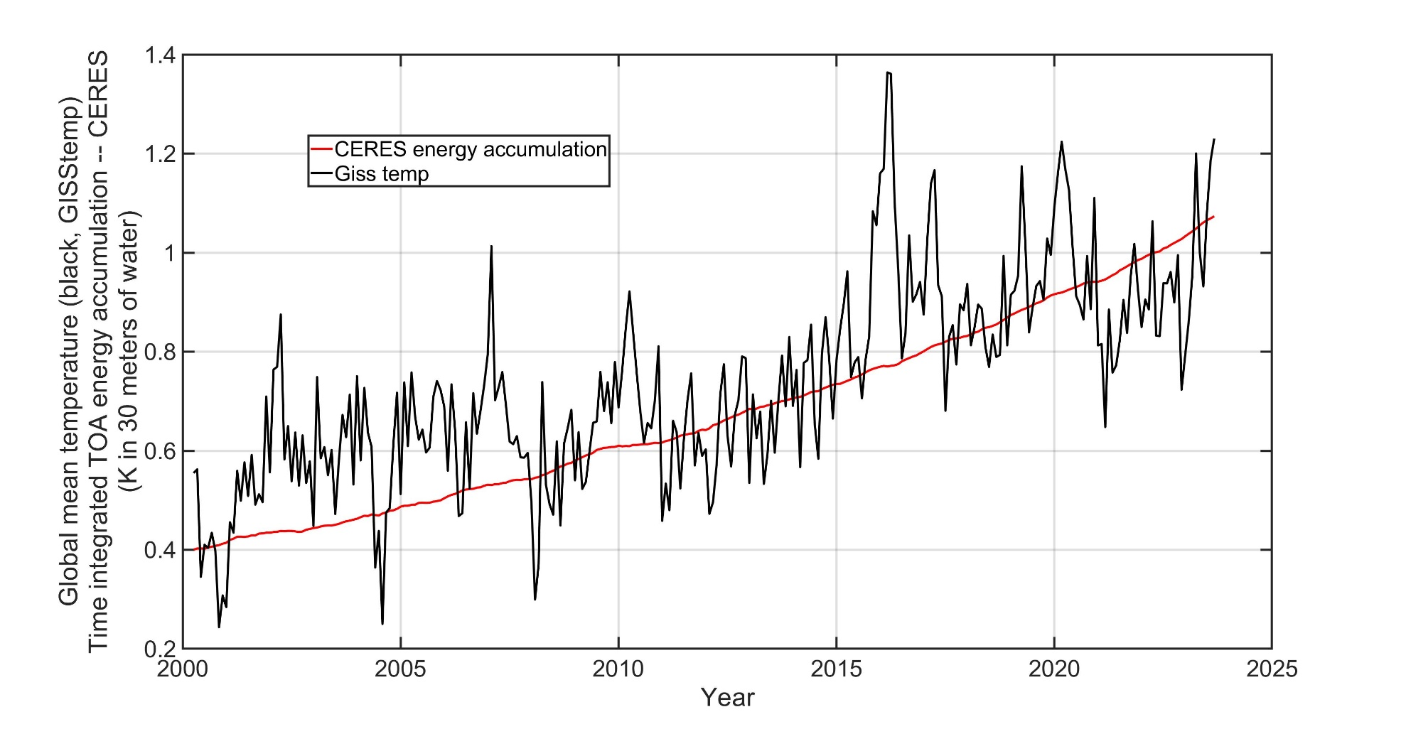
Global mean temperature variability is uncorrelated with global energy content on timescales less than 5 years

Slide 15
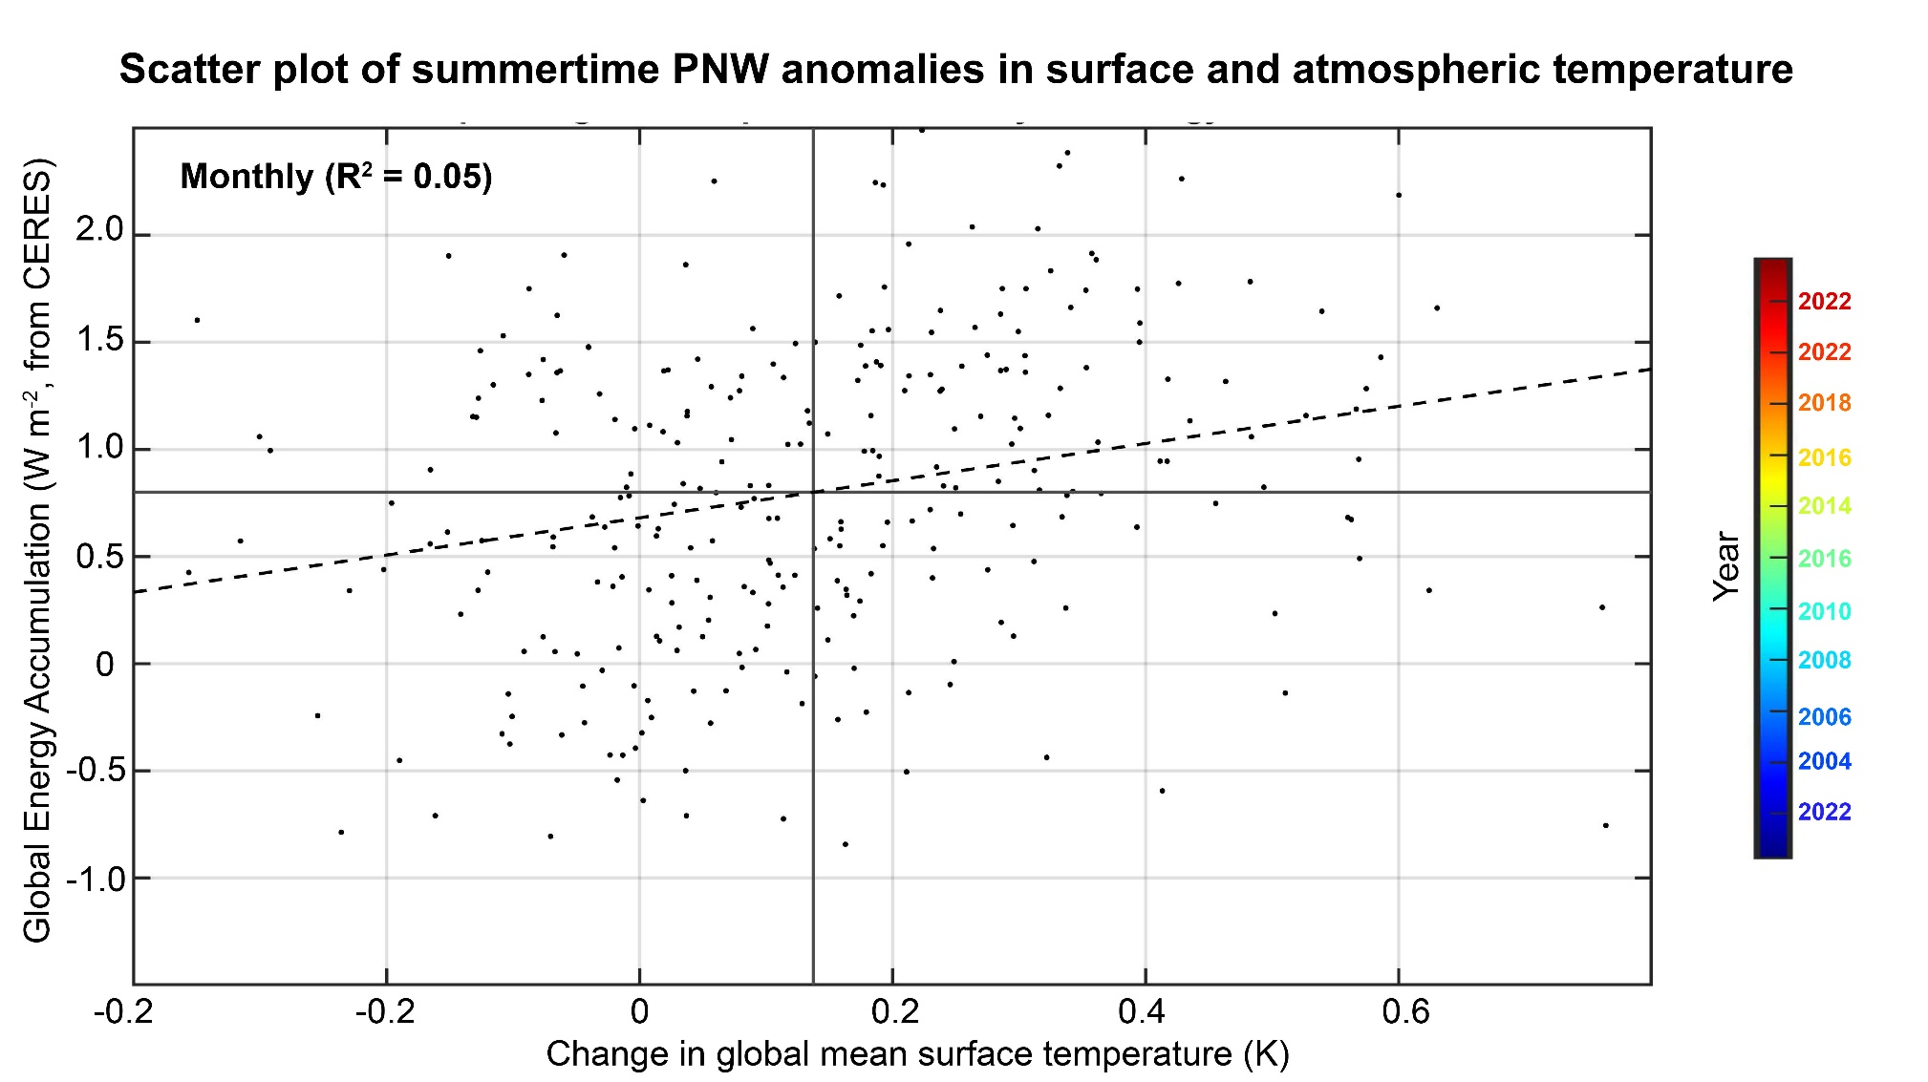
To belabor the point; changes in global mean temp are not related to energy accumulation

Slide 16
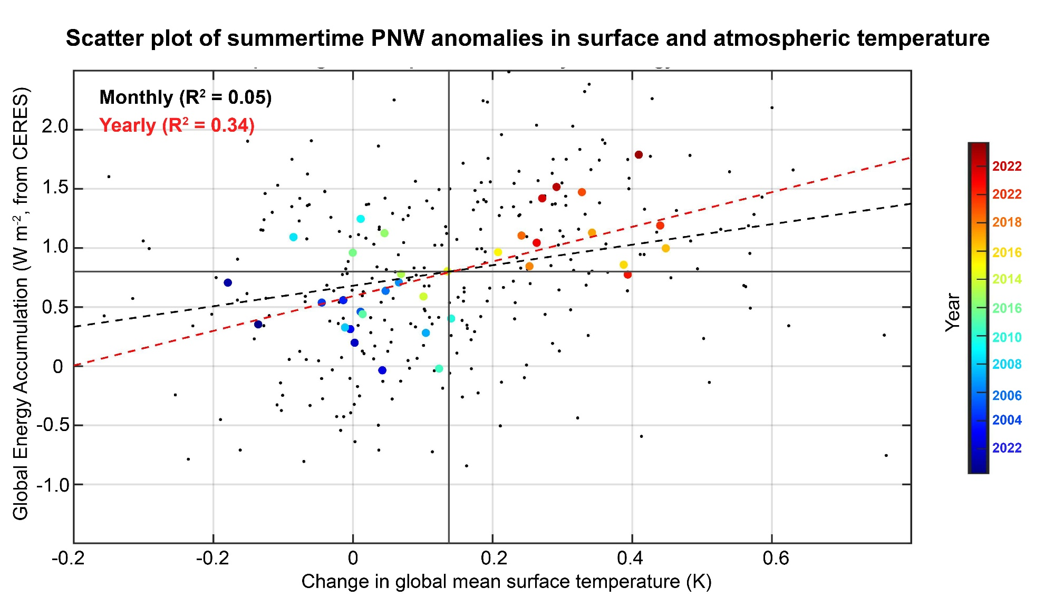
But if we low pass filter to annual resolution, temperature change (year-to-year) and radiation are weakly correlated

Slide 17
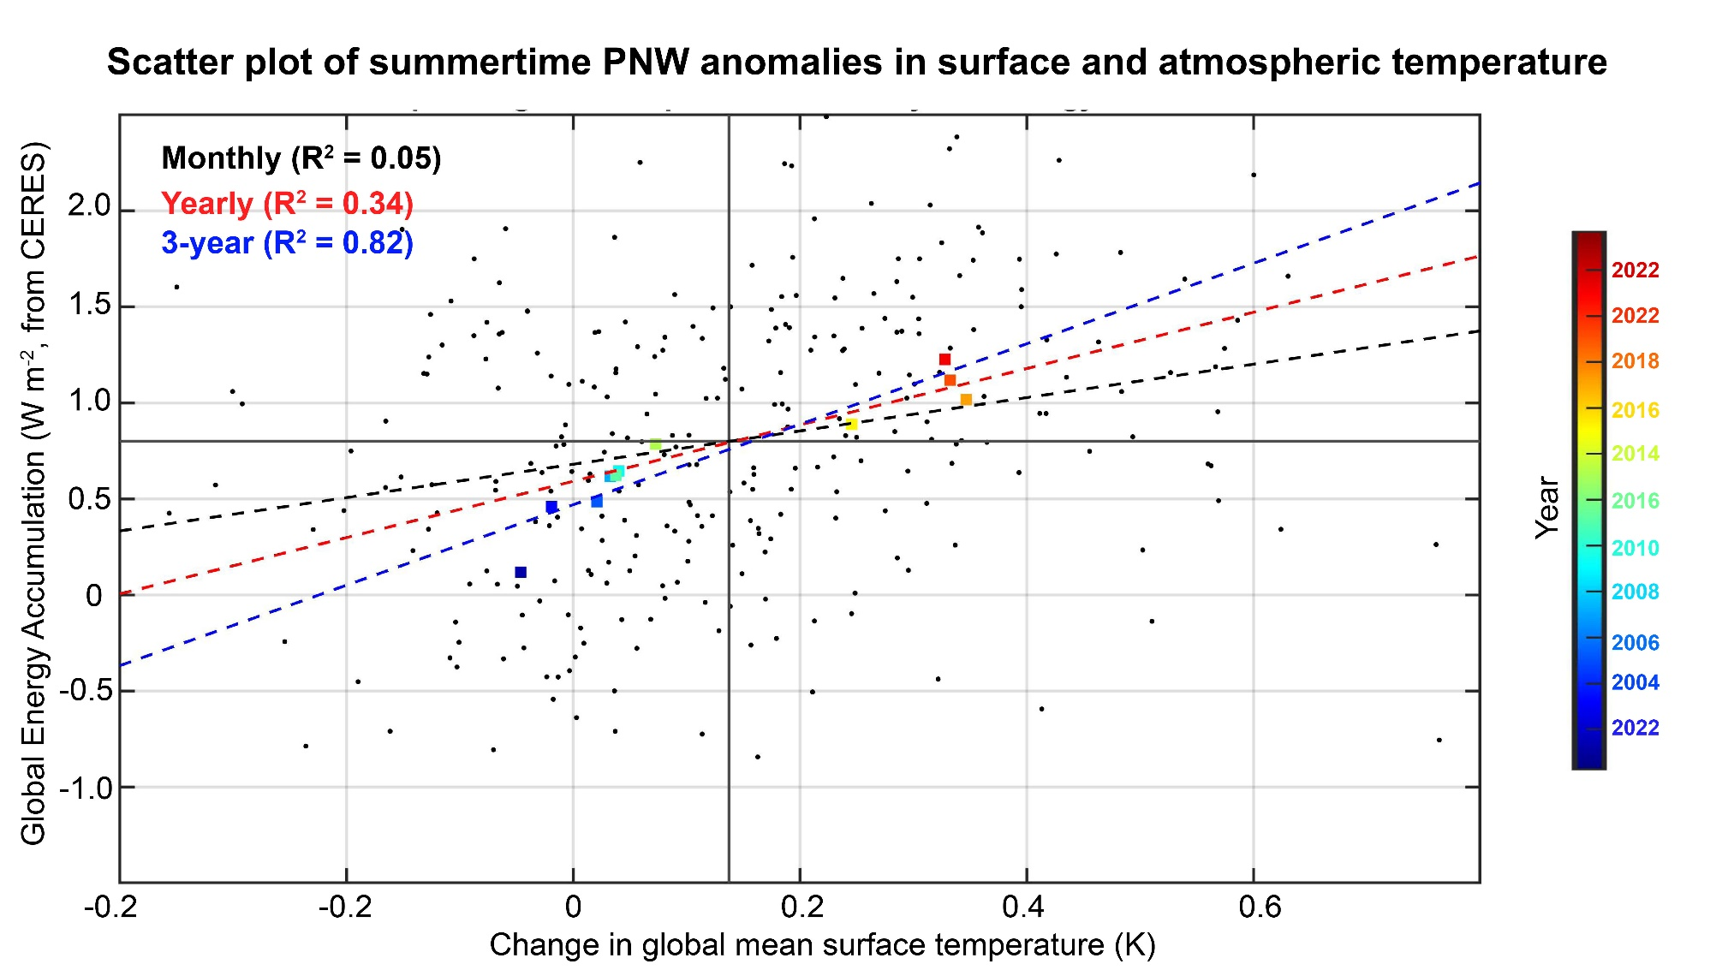
Correlation get stronger going to 3-year time scales

Slide 18
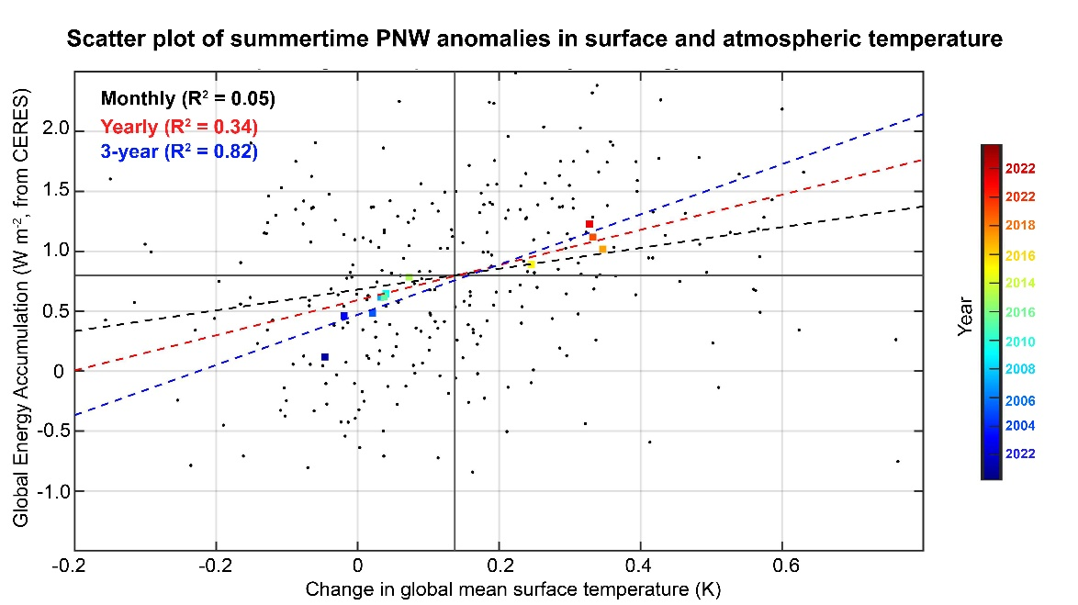
In 20 years of observations energy accumulation (radiation) is correlated with to surface temperature trends on time scales > 3 years
Trends in TOA radiation → acceleration of global warming
In pre-industrial climate models, decade long trends in energy accumulation (radiation) are unrelated to surface temperature trends
(Palmer et al. 2011)

Slide 19
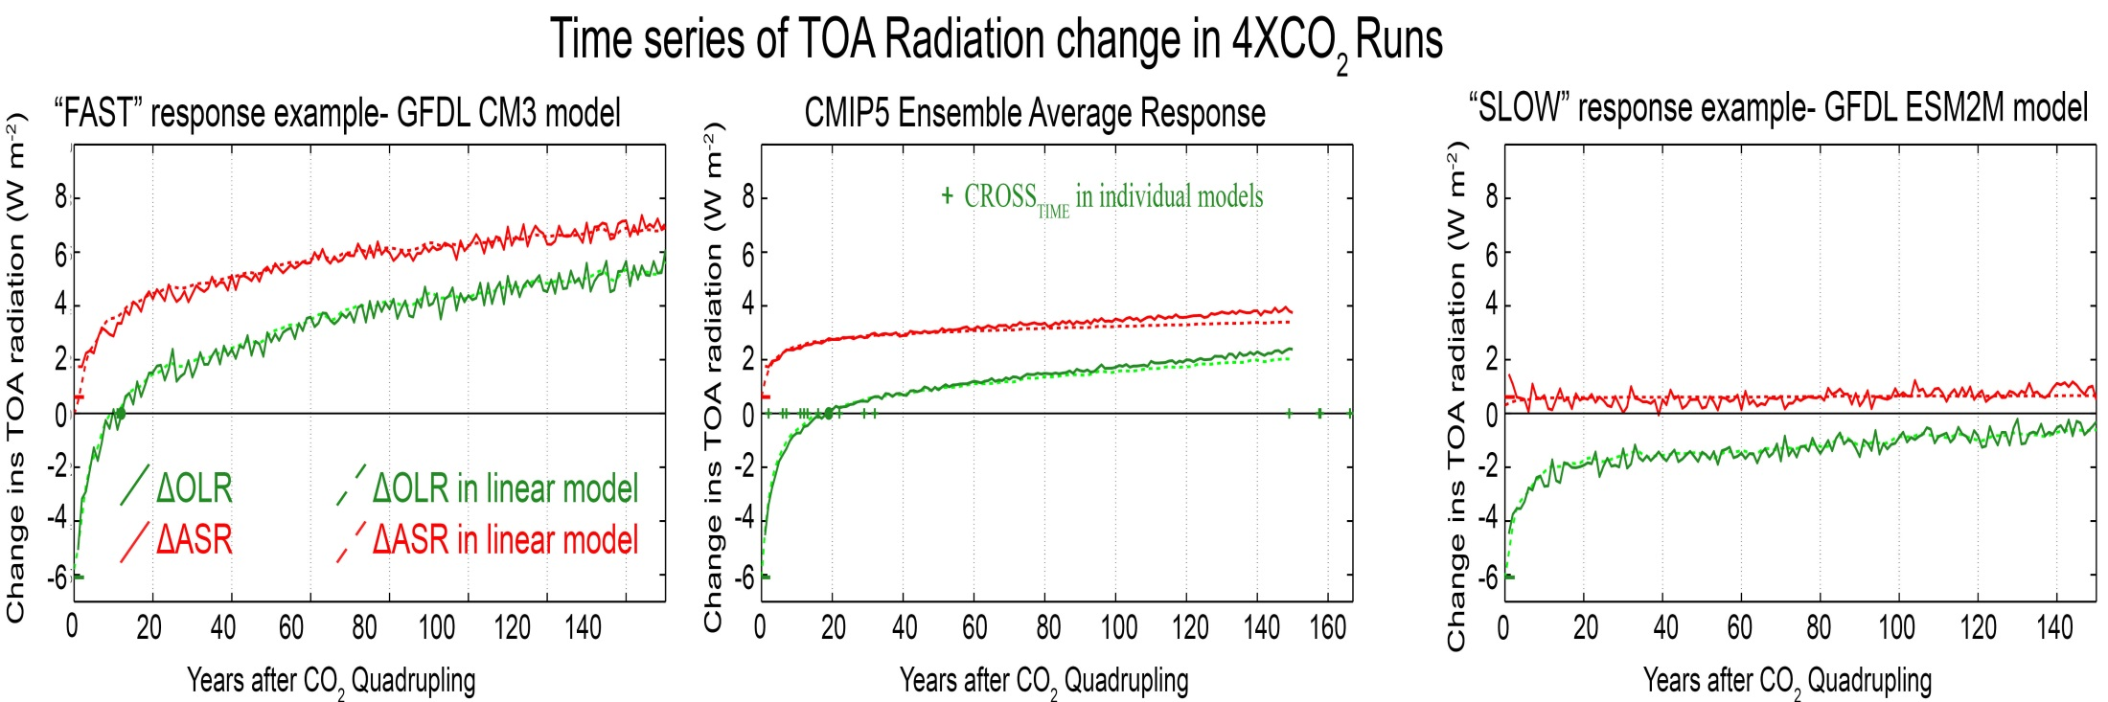
Model global mean TOA response to instantaneous CO₂ quadrupling
Absorbed Solar (ASR)
Outgoing Longwave (OLR)
Radiative anomaly (W m⁻²)
Year after CO2 quadrupling
OLR returns to unperturbed value in 20 years

Slide 20
Model global mean TOA response to instantaneous CO₂ quadrupling
Model A: Quick OLR Recovery
Radiative anomaly (W m⁻²)
Absorbed Solar (ASR)
Outgoing Longwave (OLR)
Ensemble Mean
Year after CO2 quadrupling
Absorbed Solar (ASR)
Model B: Long OLR Recovery
Outgoing Longwave (OLR)
Absorbed Solar (ASR)
Radiative anomaly (W m⁻²)
Outgoing Longwave (OLR)
Radiative anomaly (W m⁻²)
Year after CO2 quadrupling
Year after CO2 quadrupling

Slide 21

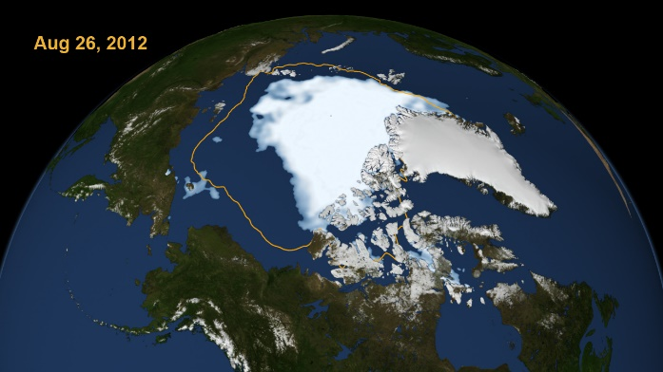
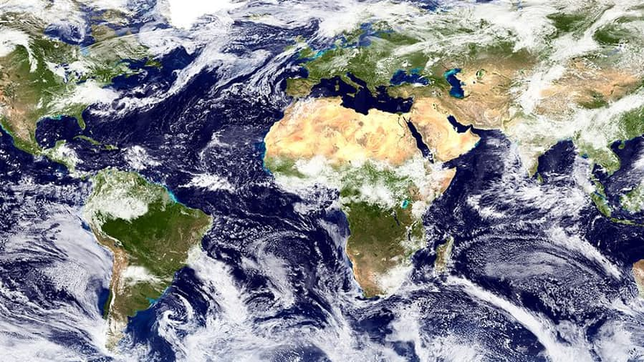
Mechanisms leading to changes in absorbed solar radiation with global warming (in models)
1
Moistening of the atmosphere
Enhanced atmospheric solar absorption (water vapor)
Sea ice (and snow) loss
More solar radiation absorbed by surface
2
Cloud Changes
Highly Uncertain
3

Slide 22
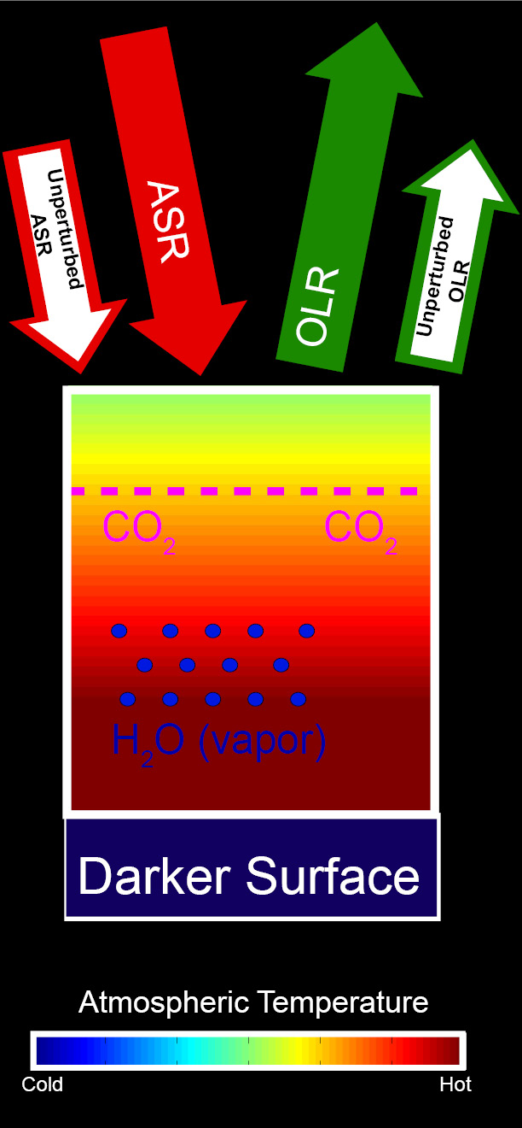
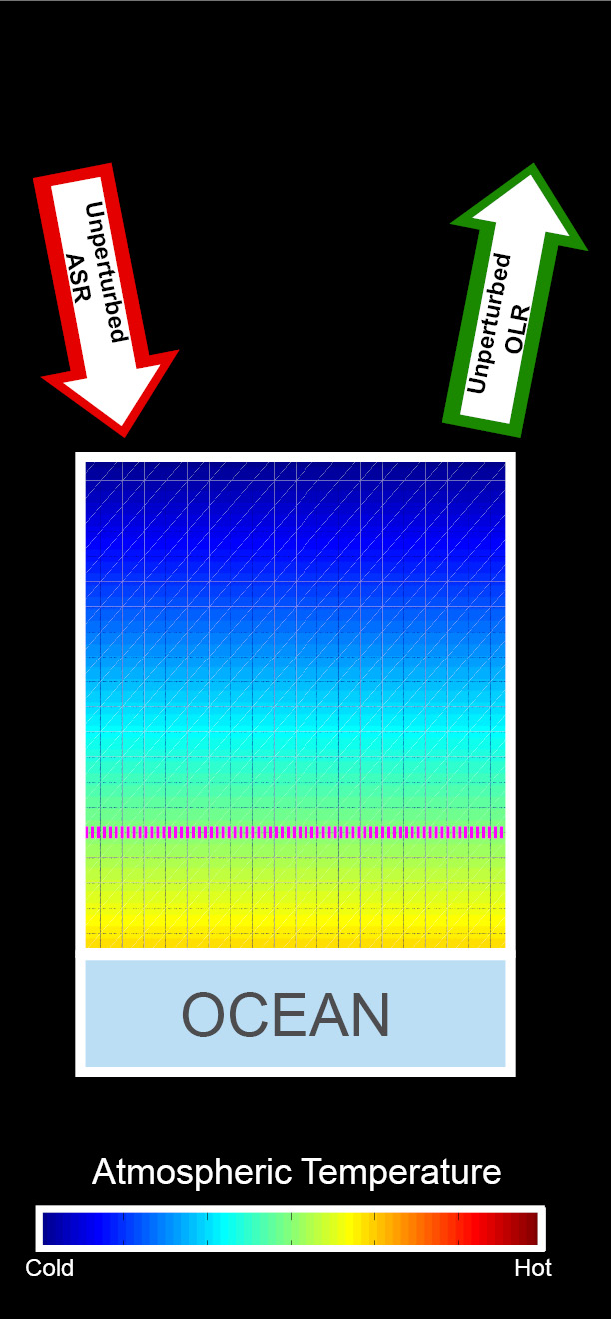
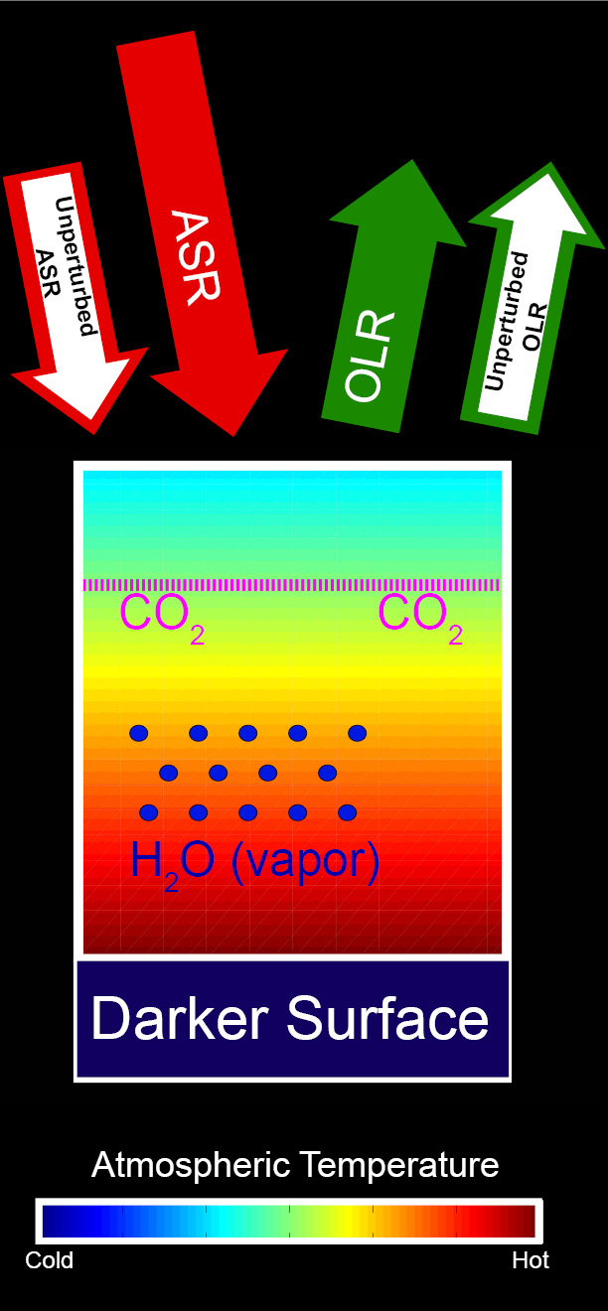
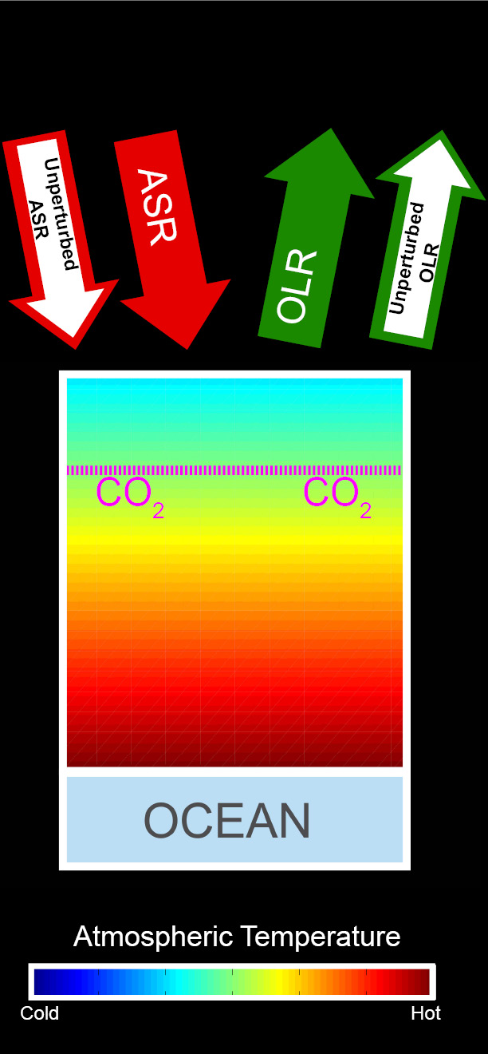
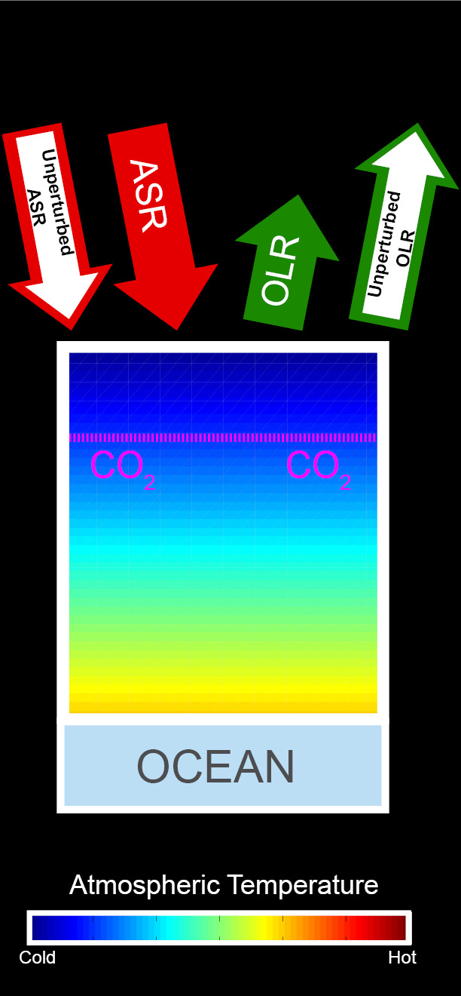
Energetic response to increased CO₂
Increased ASR
Unperturbed
Balanced Initial System
CO₂ added
Warming
CO₂ reduces OLR → energy imbalance
Warming →
OLR increases
Moistening and darkening → ASR increases
Additional warming
→ OLR balances increased ASR

Slide 23

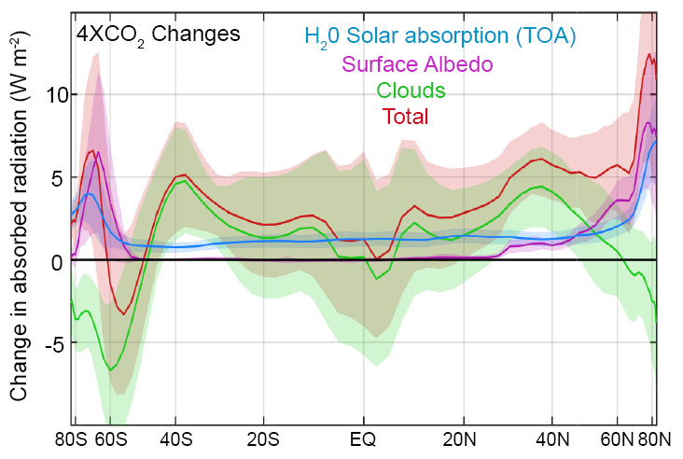
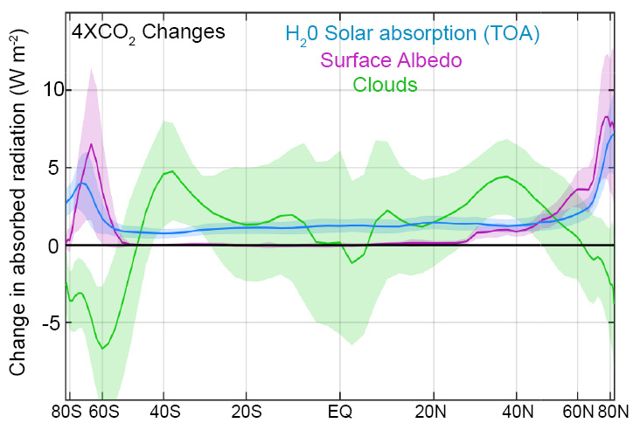
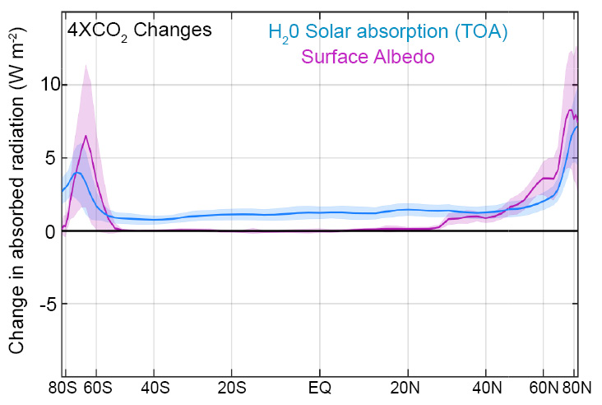
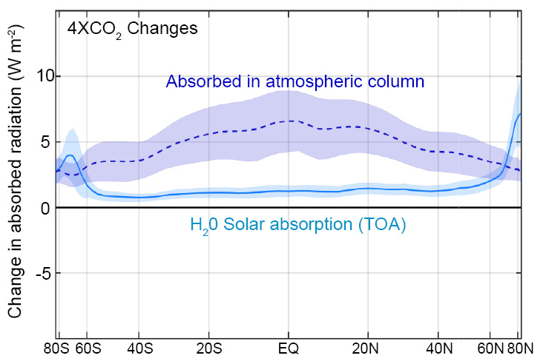
Changes in absorbed solar radiation with global warming
incident
Reflected
cloud
absorbed
?
H₂0
(vapor)
Reflected
surface
transmitted
ice
ocean

Slide 24
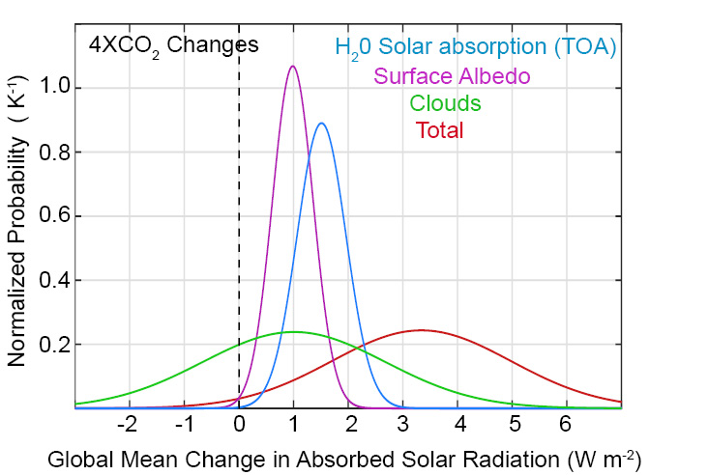
Changes in global mean absorbed solar radiation with increased CO₂
Despite uncertainties in clouds, it is highly likely that the climate system will absorb more solar radiation as it warms due to two robust processes:
Moistening of the atmosphere
Melting of sea ice and snow

Slide 25

Simplified shortwave radiation model (APRP, Taylor 2007)
S = incident
R = cloud
reflection
A = absorption
α = surface
albedo
(UNKNOWNS)
v
v
v

Slide 26
Simplified shortwave radiation model (APRP, Taylor 2007)
S = incident
R = cloud
reflection
A = absorption
α = surface
albedo
(UNKNOWNS)
v
v

Slide 27
Simplified shortwave radiation model (APRP, Taylor 2007)
S = incident
R = cloud
reflection
A = absorption
α = surface
albedo
(UNKNOWNS)

Slide 28
Simplified shortwave radiation model (APRP, Taylor 2007)
S = incident
R = cloud
reflection
A = absorption
α = surface
albedo
(UNKNOWNS)

Slide 29
Simplified shortwave radiation model (APRP, Taylor 2007)
S = incident
R = cloud
reflection
A = absorption
α = surface
albedo
(UNKNOWNS)

Slide 30
Simplified (isotropic) shortwave radiation model
Surface
Contribution
To planetary
Albedo
Atmospheric
Contribution
To planetary
Albedo
S = incident
R = cloud
reflection
A = absorption
α = surface
albedo
(UNKNOWNS)

Slide 31
Simplified (isotropic) shortwave radiation model
Atmospheric
Contribution
To planetary
Albedo
Surface
Contribution
To planetary
Albedo
S = incident
R = cloud
reflection
A = absorption
α = surface
albedo
(UNKNOWNS)

Slide 32



Climatological
planetary albedo
Surface reflection
Surface contribution:
= α(1-A)(1-R)²
(1-αR)
Atmospheric reflection
Impact of surface changes
on ASR
Atmosphere

Slide 33

Radiative sensitivity from isotropic model
→ Isotropic model matches kernel calculations
Satellite observations provide an estimate of Radiative sensitivity
→The model average radiative sensitivity is close to the observational estimate

Slide 34
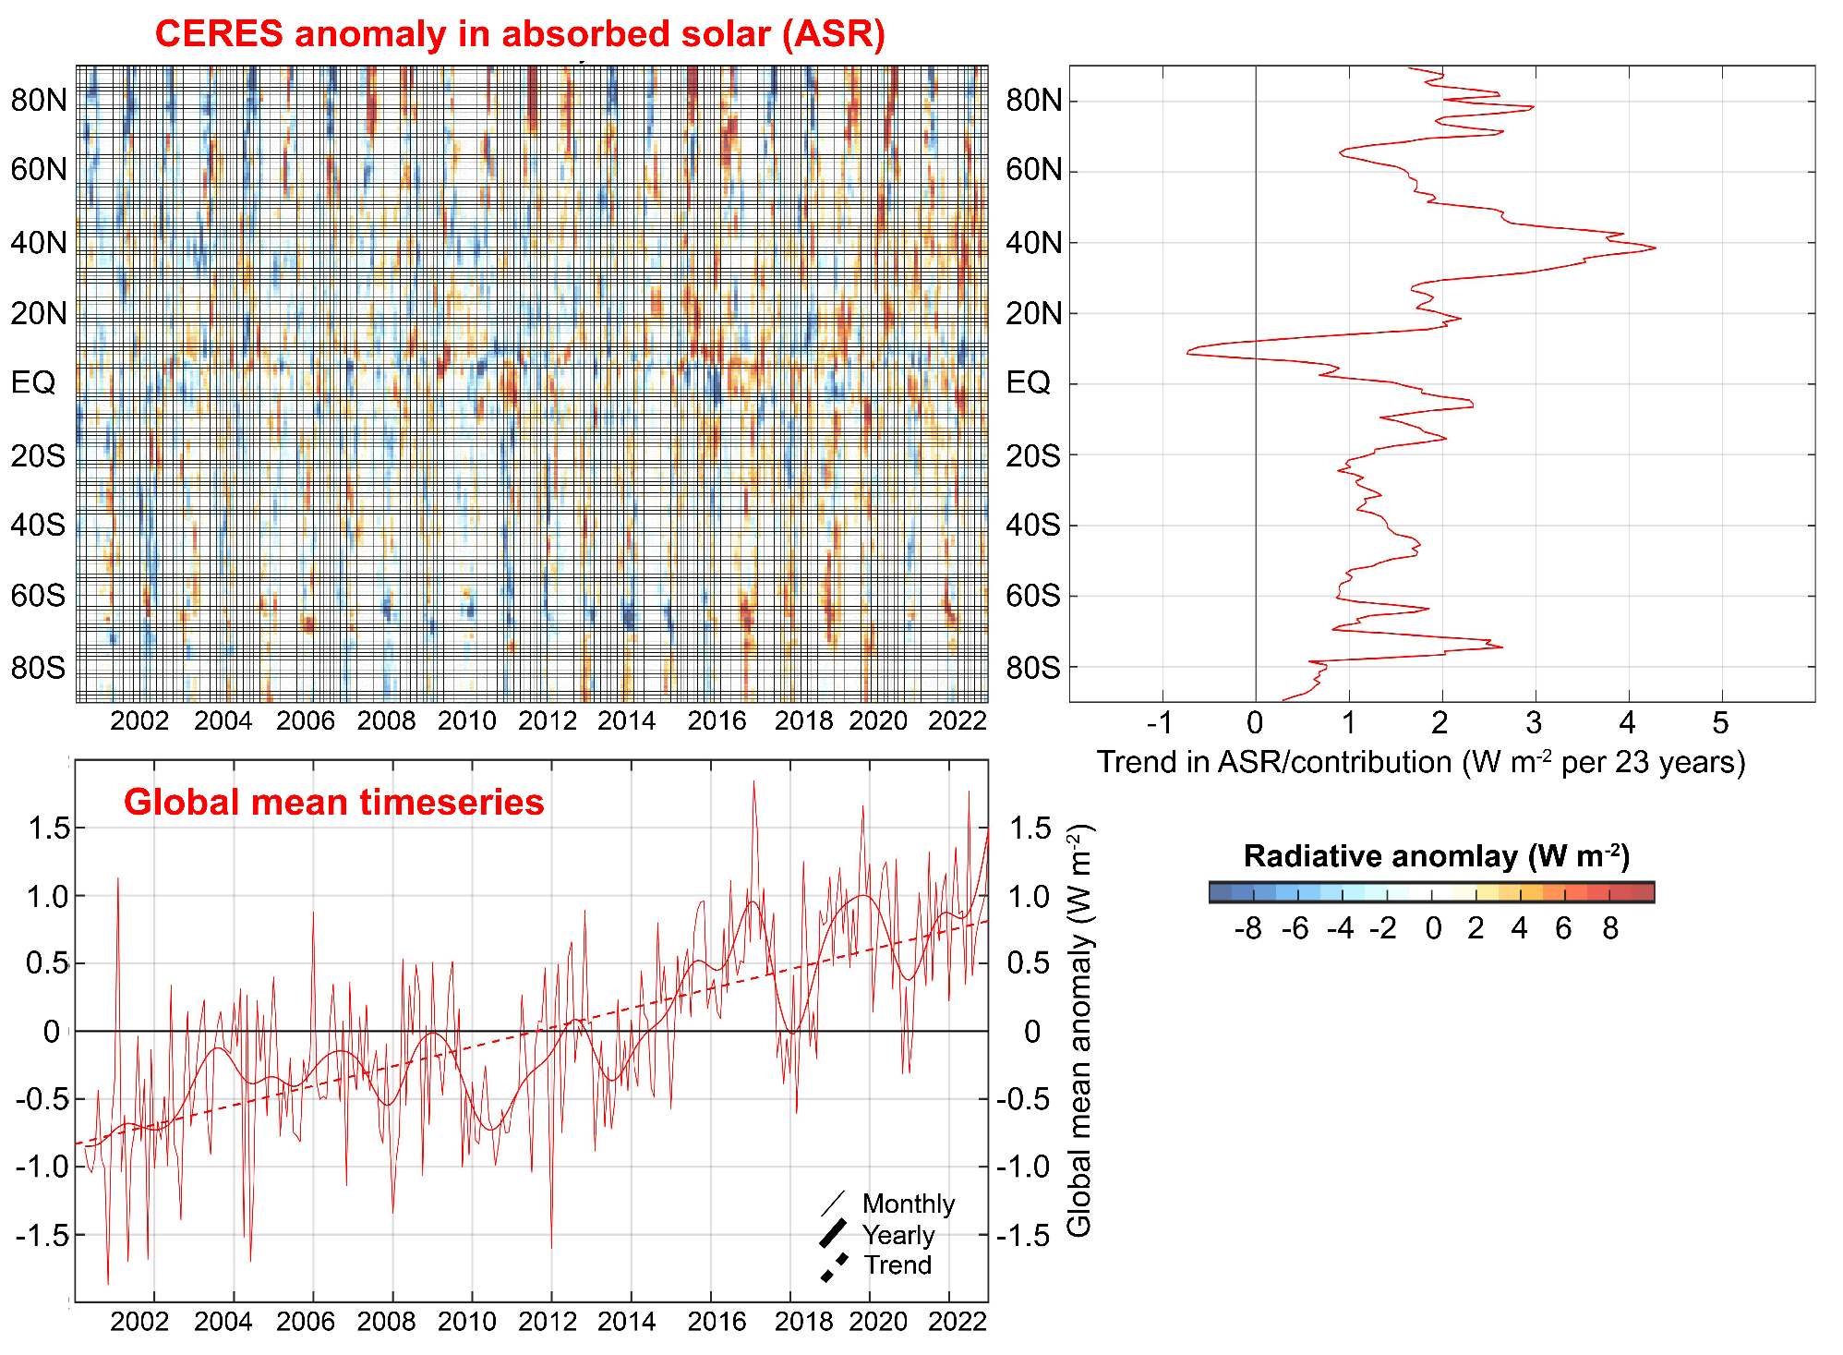

Slide 35
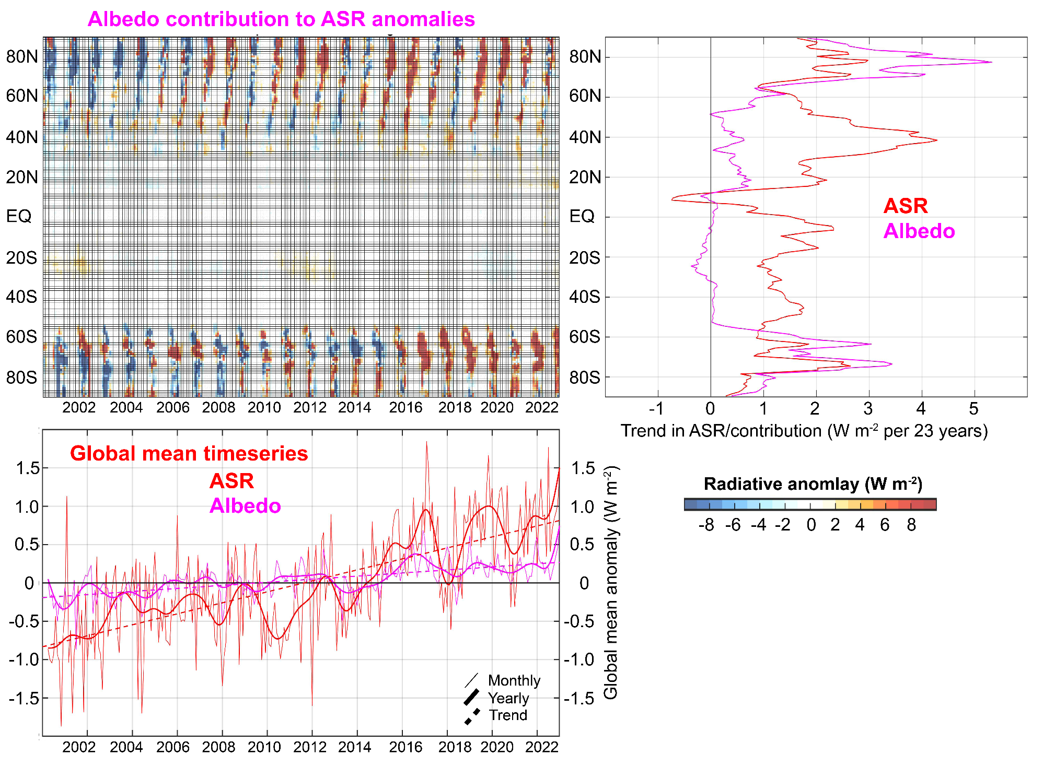
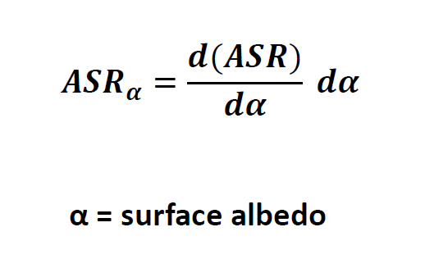

Slide 36
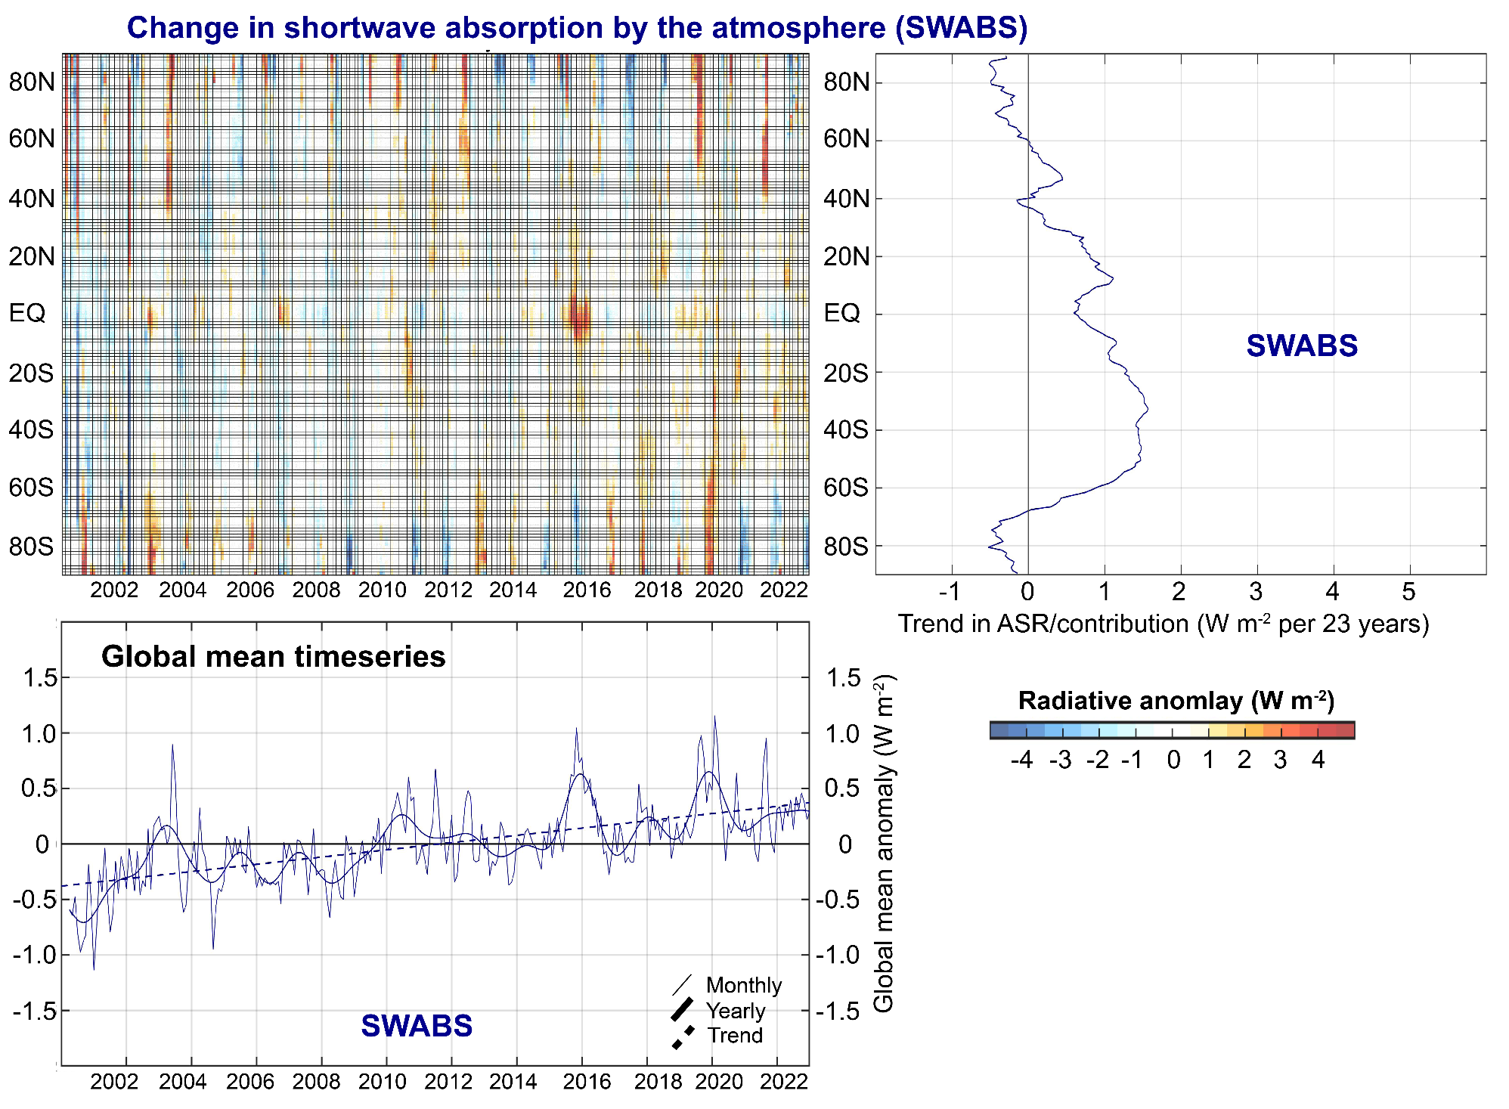

Slide 37
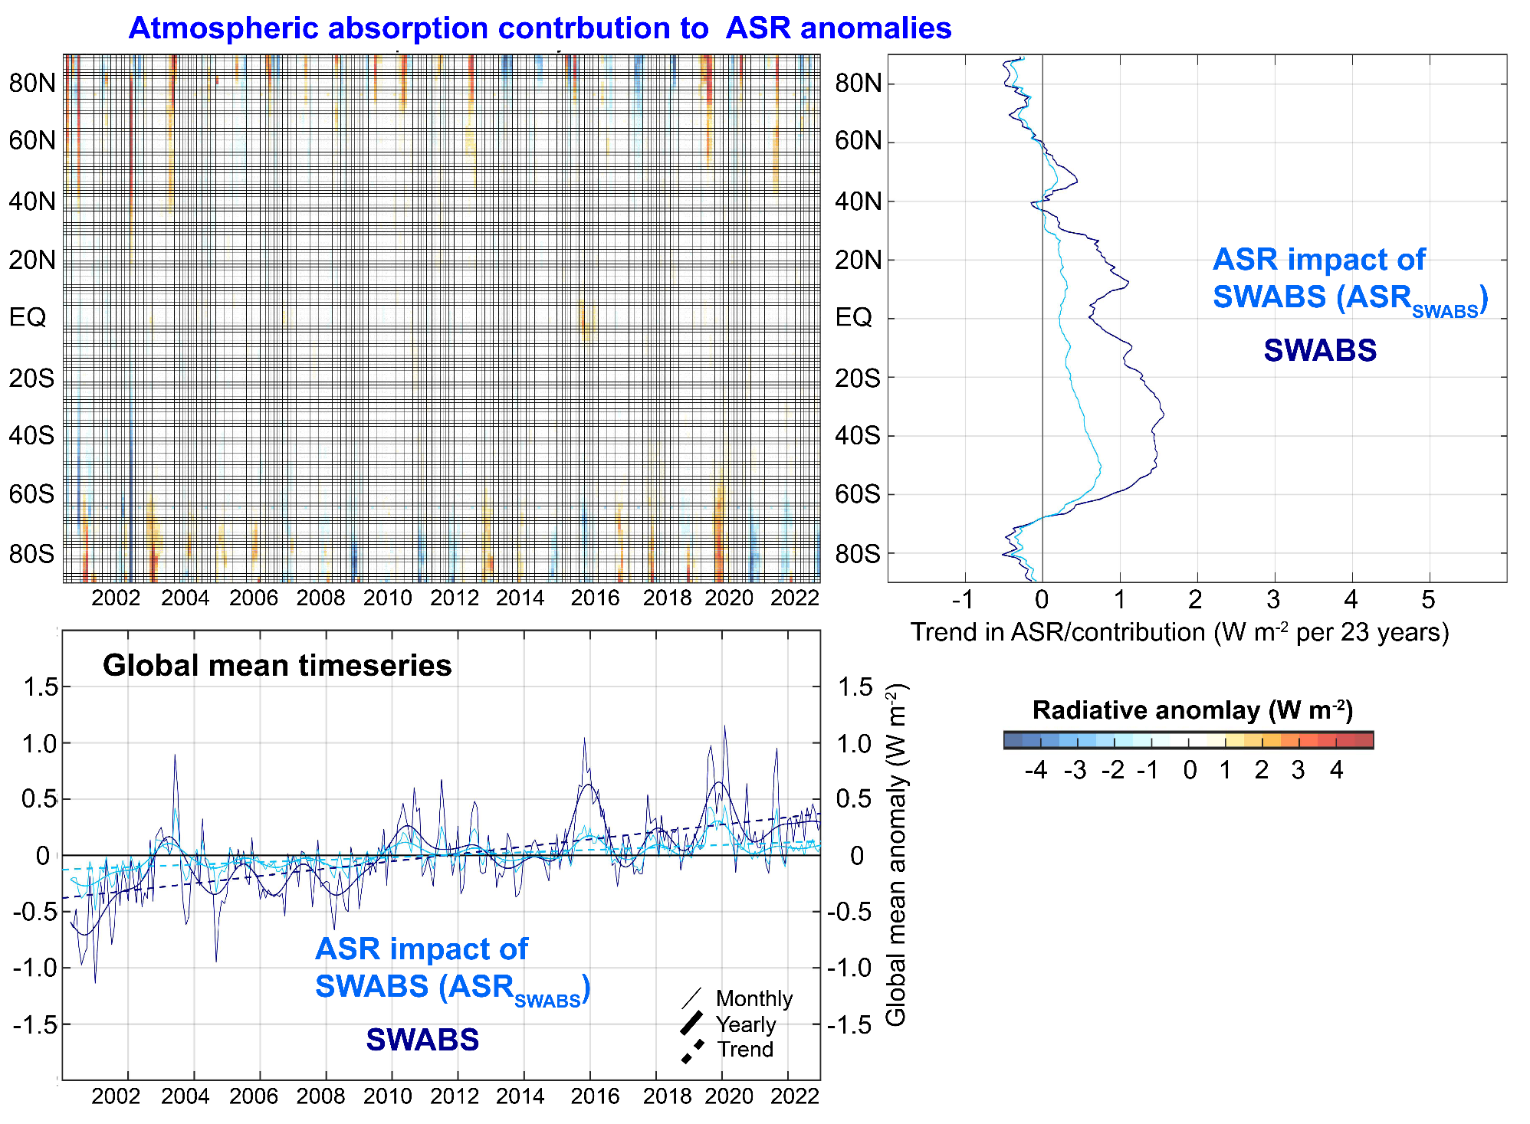

Slide 38
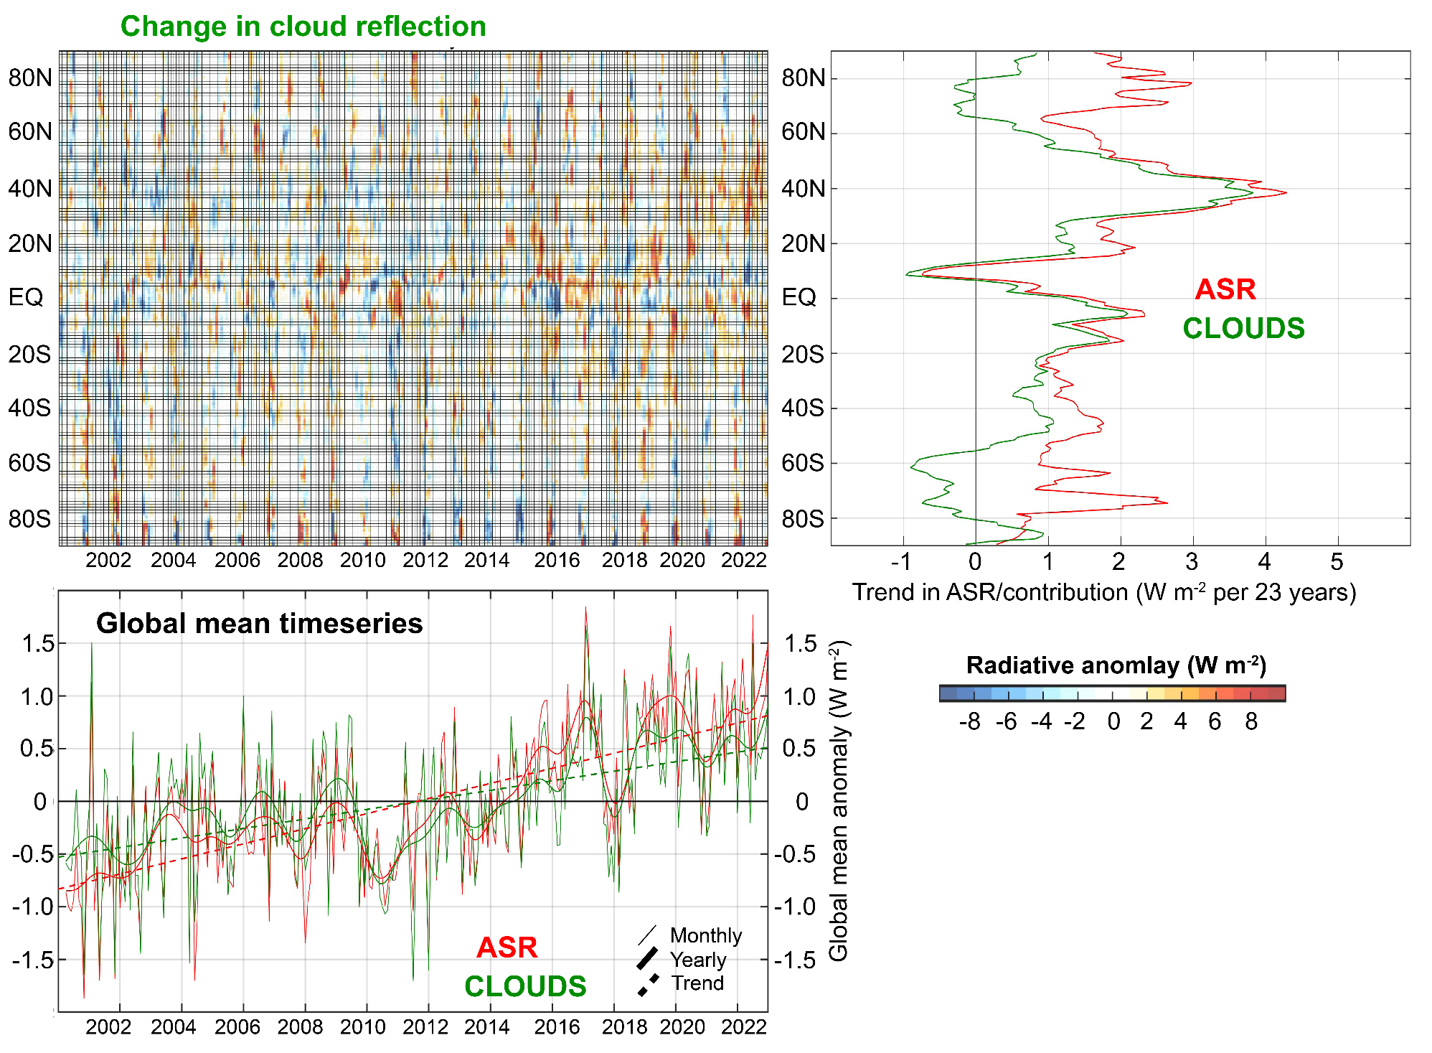

Slide 39
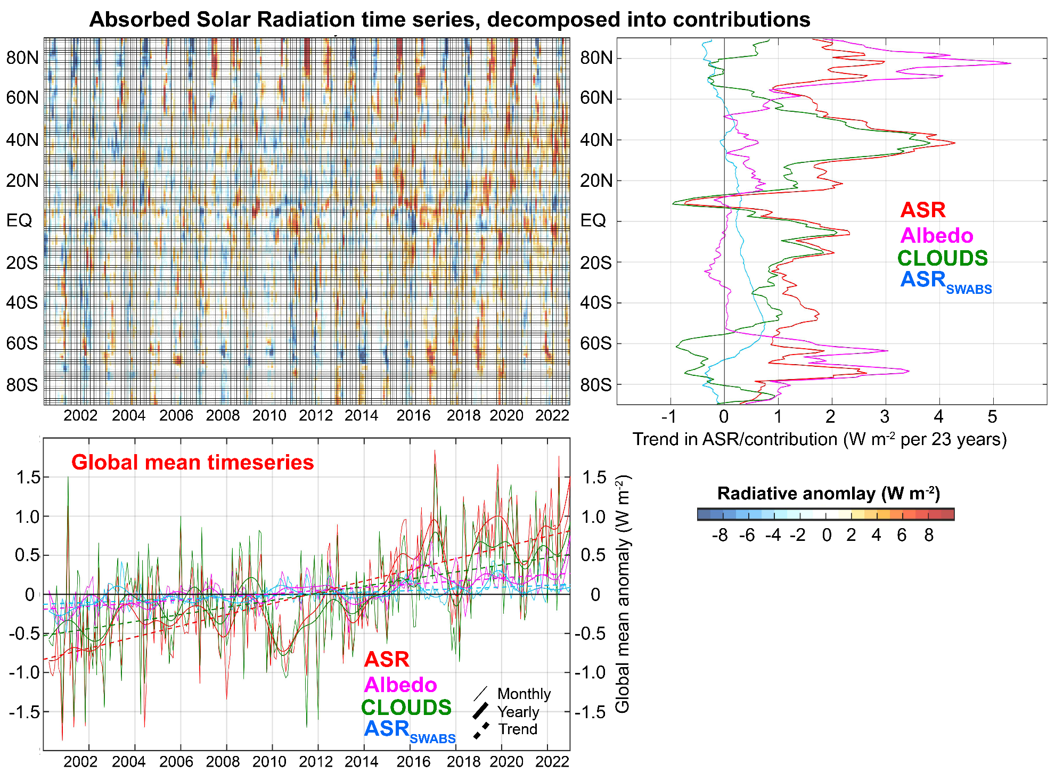
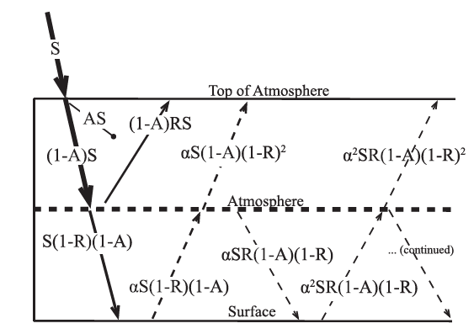

Slide 40
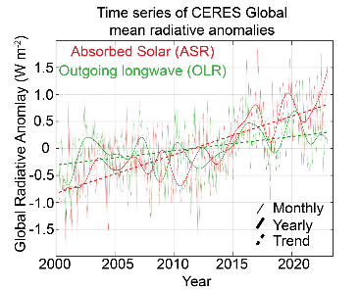
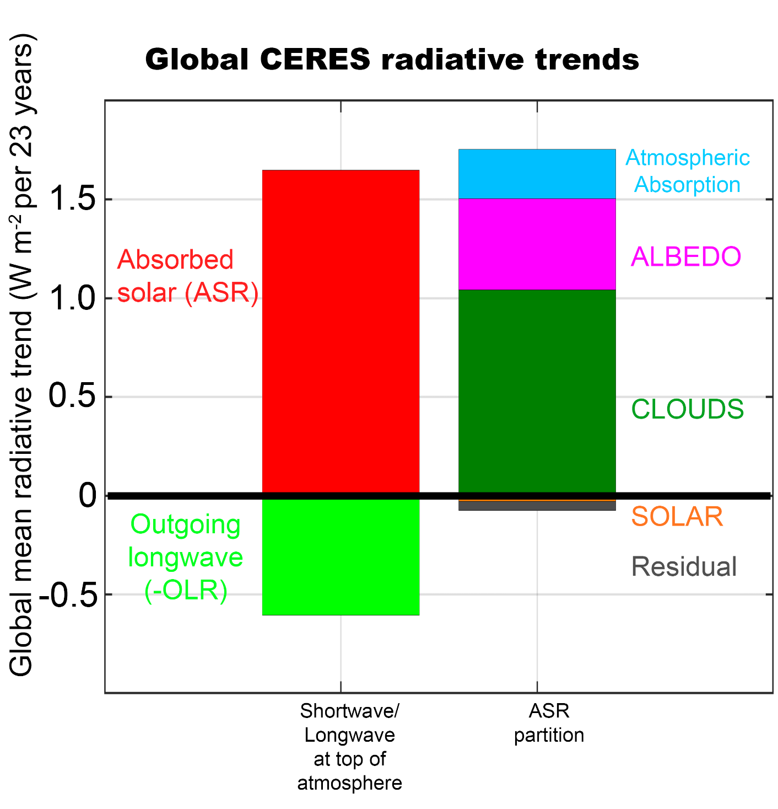
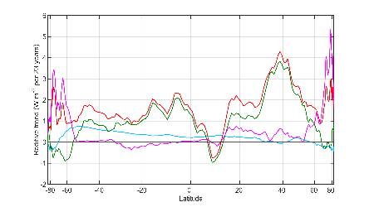


Slide 41
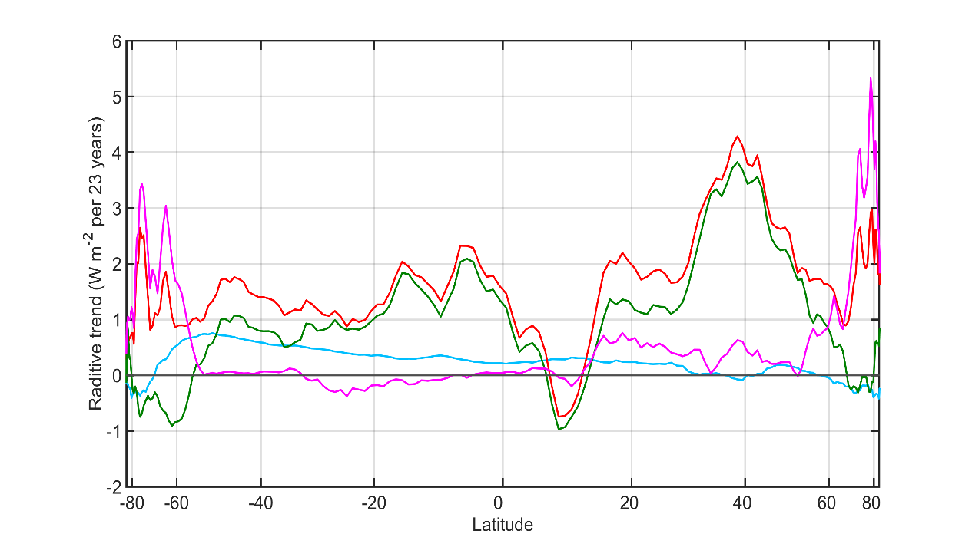

Observational trends in Absorbed Solar from CERES (2000-2023)
Model (ensemble mean) change in absorbed solar from radiative kernels

