Slide 1






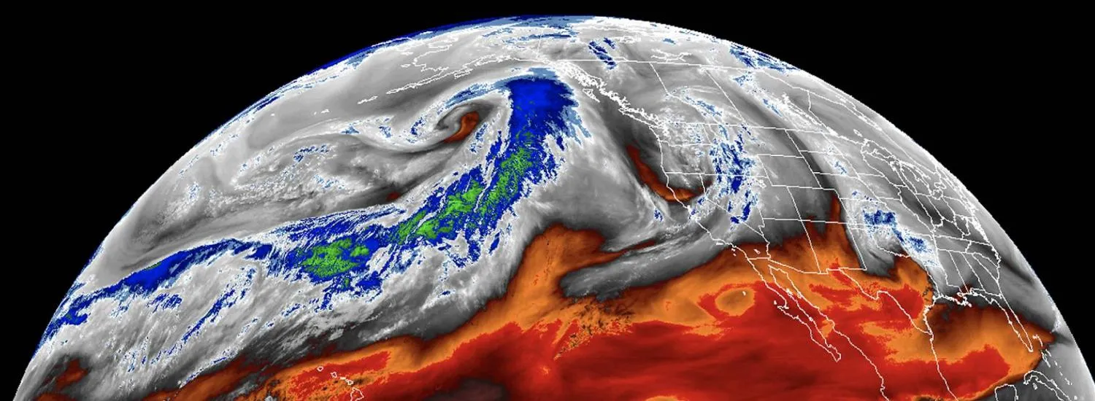
The physics of mid-latitude heatwaves
CO2 Foundation
Aaron Donohoe, Polar Science Center, UW
Ed Blanchard, Dept. Atmospheric and Climate Science, UW
Nicole Feldl, U. California Santa Cruz
Tyler Cox, Inigo Insurance, London
NSF Climate and
Large Scale Dynamics
CRESST Program
Photo: Water vapor image
From CIRES

Slide 2
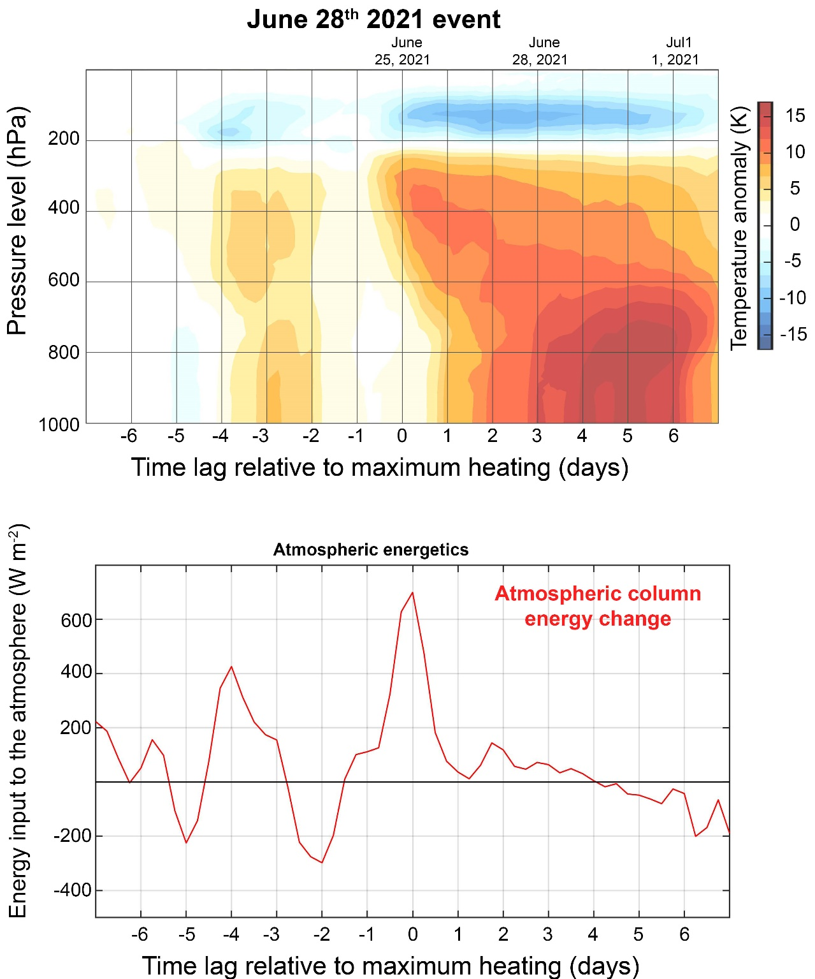
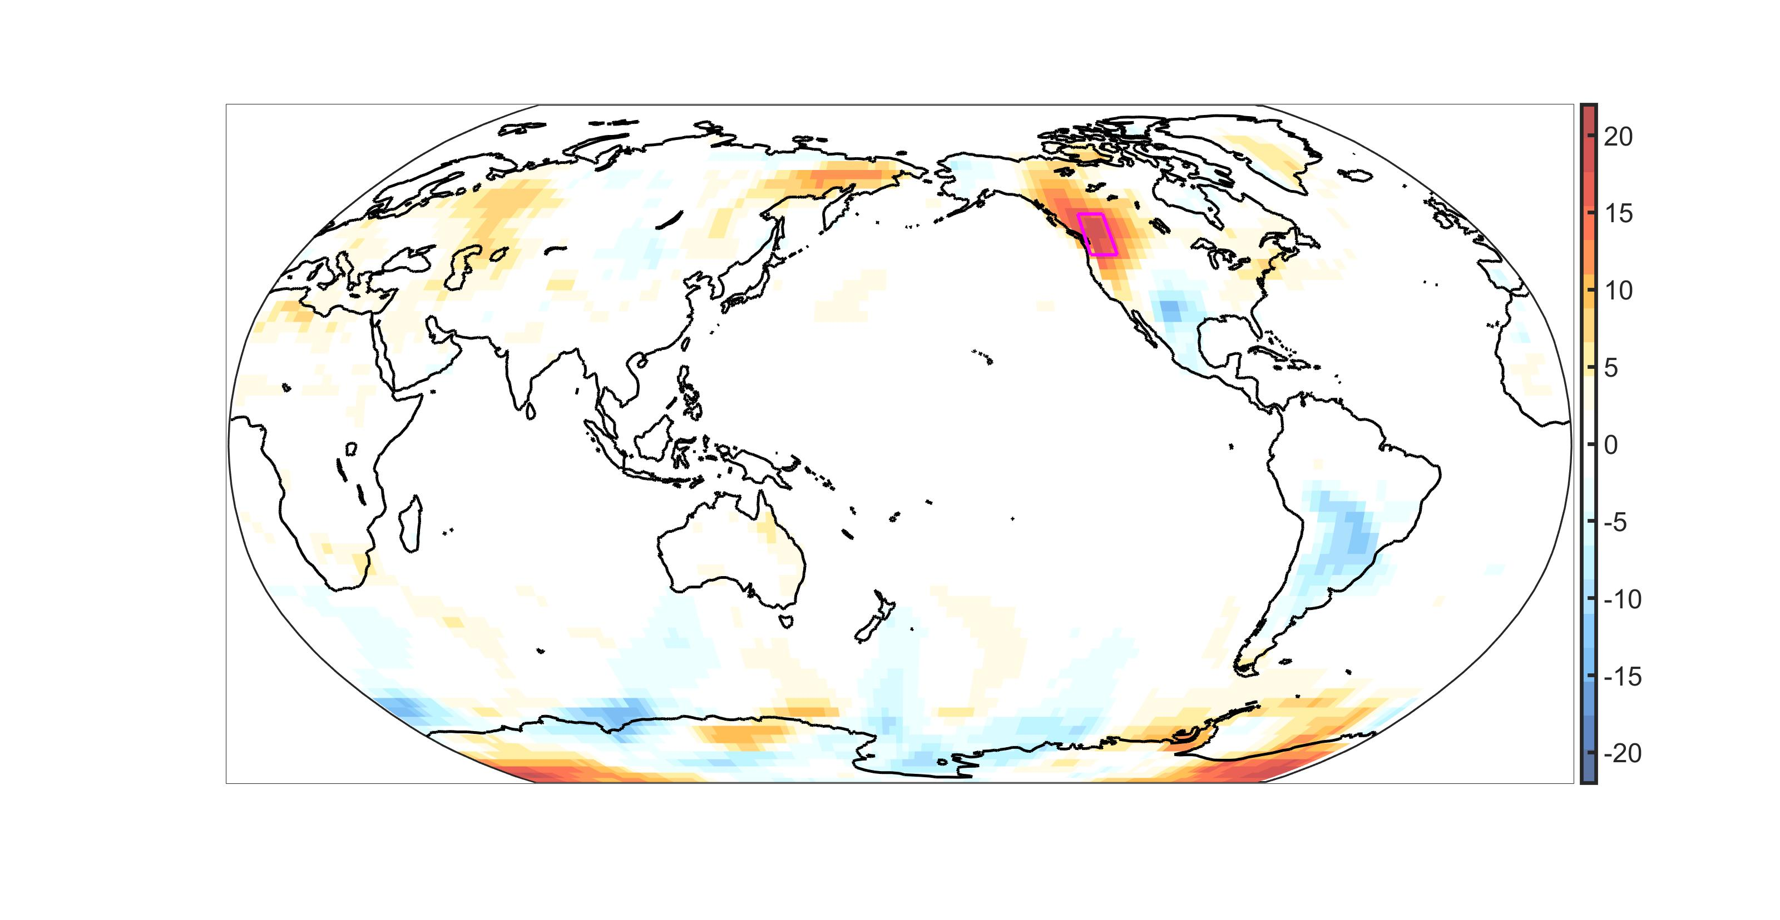
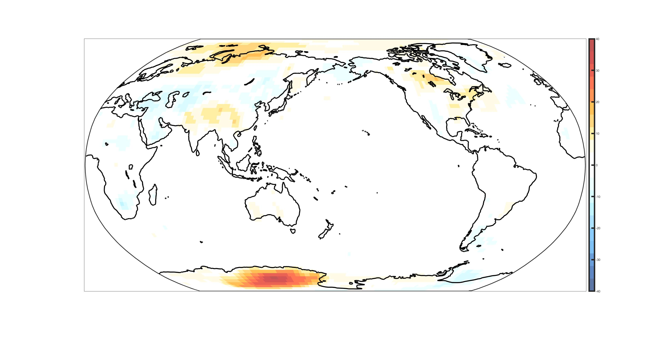
The Pacific Northwest Heat wave of 2021
Regionally expansive
Characterized by heating of the entire troposphere
Surface temperature anomaly
20 C
15 C
Definition of region
10 C
5 C
Surface temperature anomaly (C)
-5 C
-10 C
-15 C
-20 C

Slide 3


Energetic perspective:
How much energy was needed to heat the atmospheric column?
The time rate of change of the vertically integrated atmospheric energy content (about 40% is moisture)
More energy than the local sun just to warm the atmosphere
$$\frac{d\frac{1}{g}\int_{0}^{P_{s}}{C_{P}T+LQ dP}}{dt}$$
20 C
15 C
10 C
5 C
-5 C
-10 C
-15 C

Slide 4
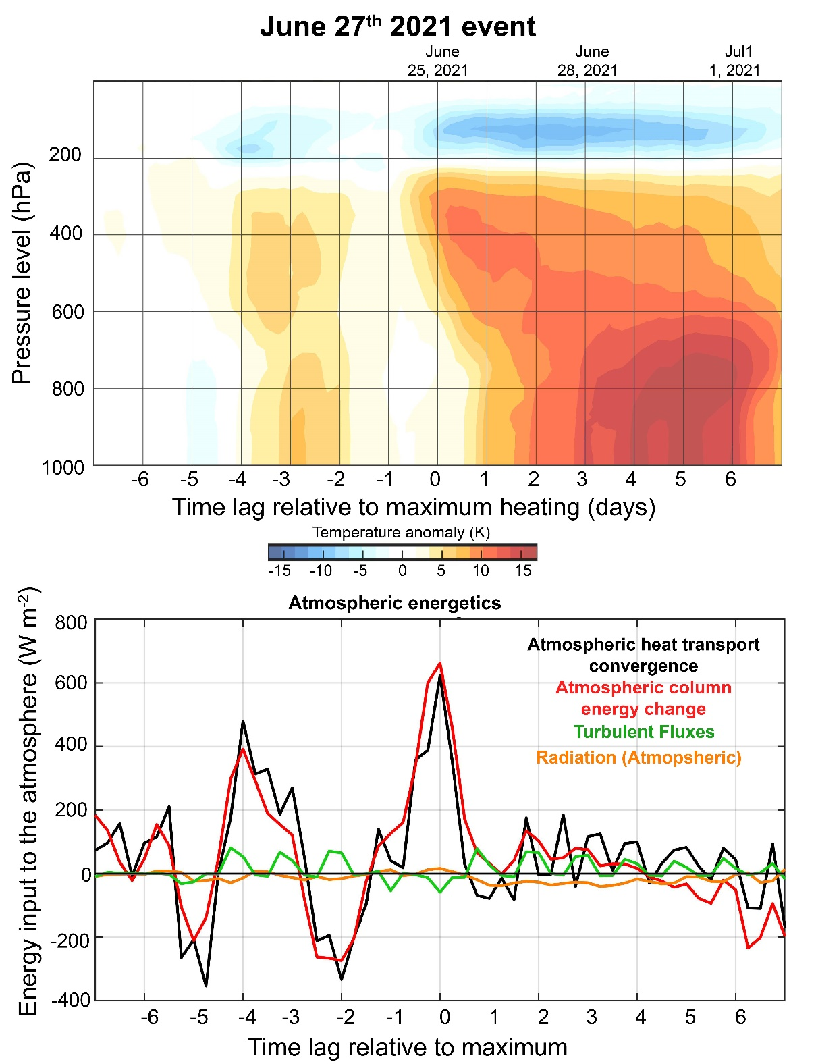
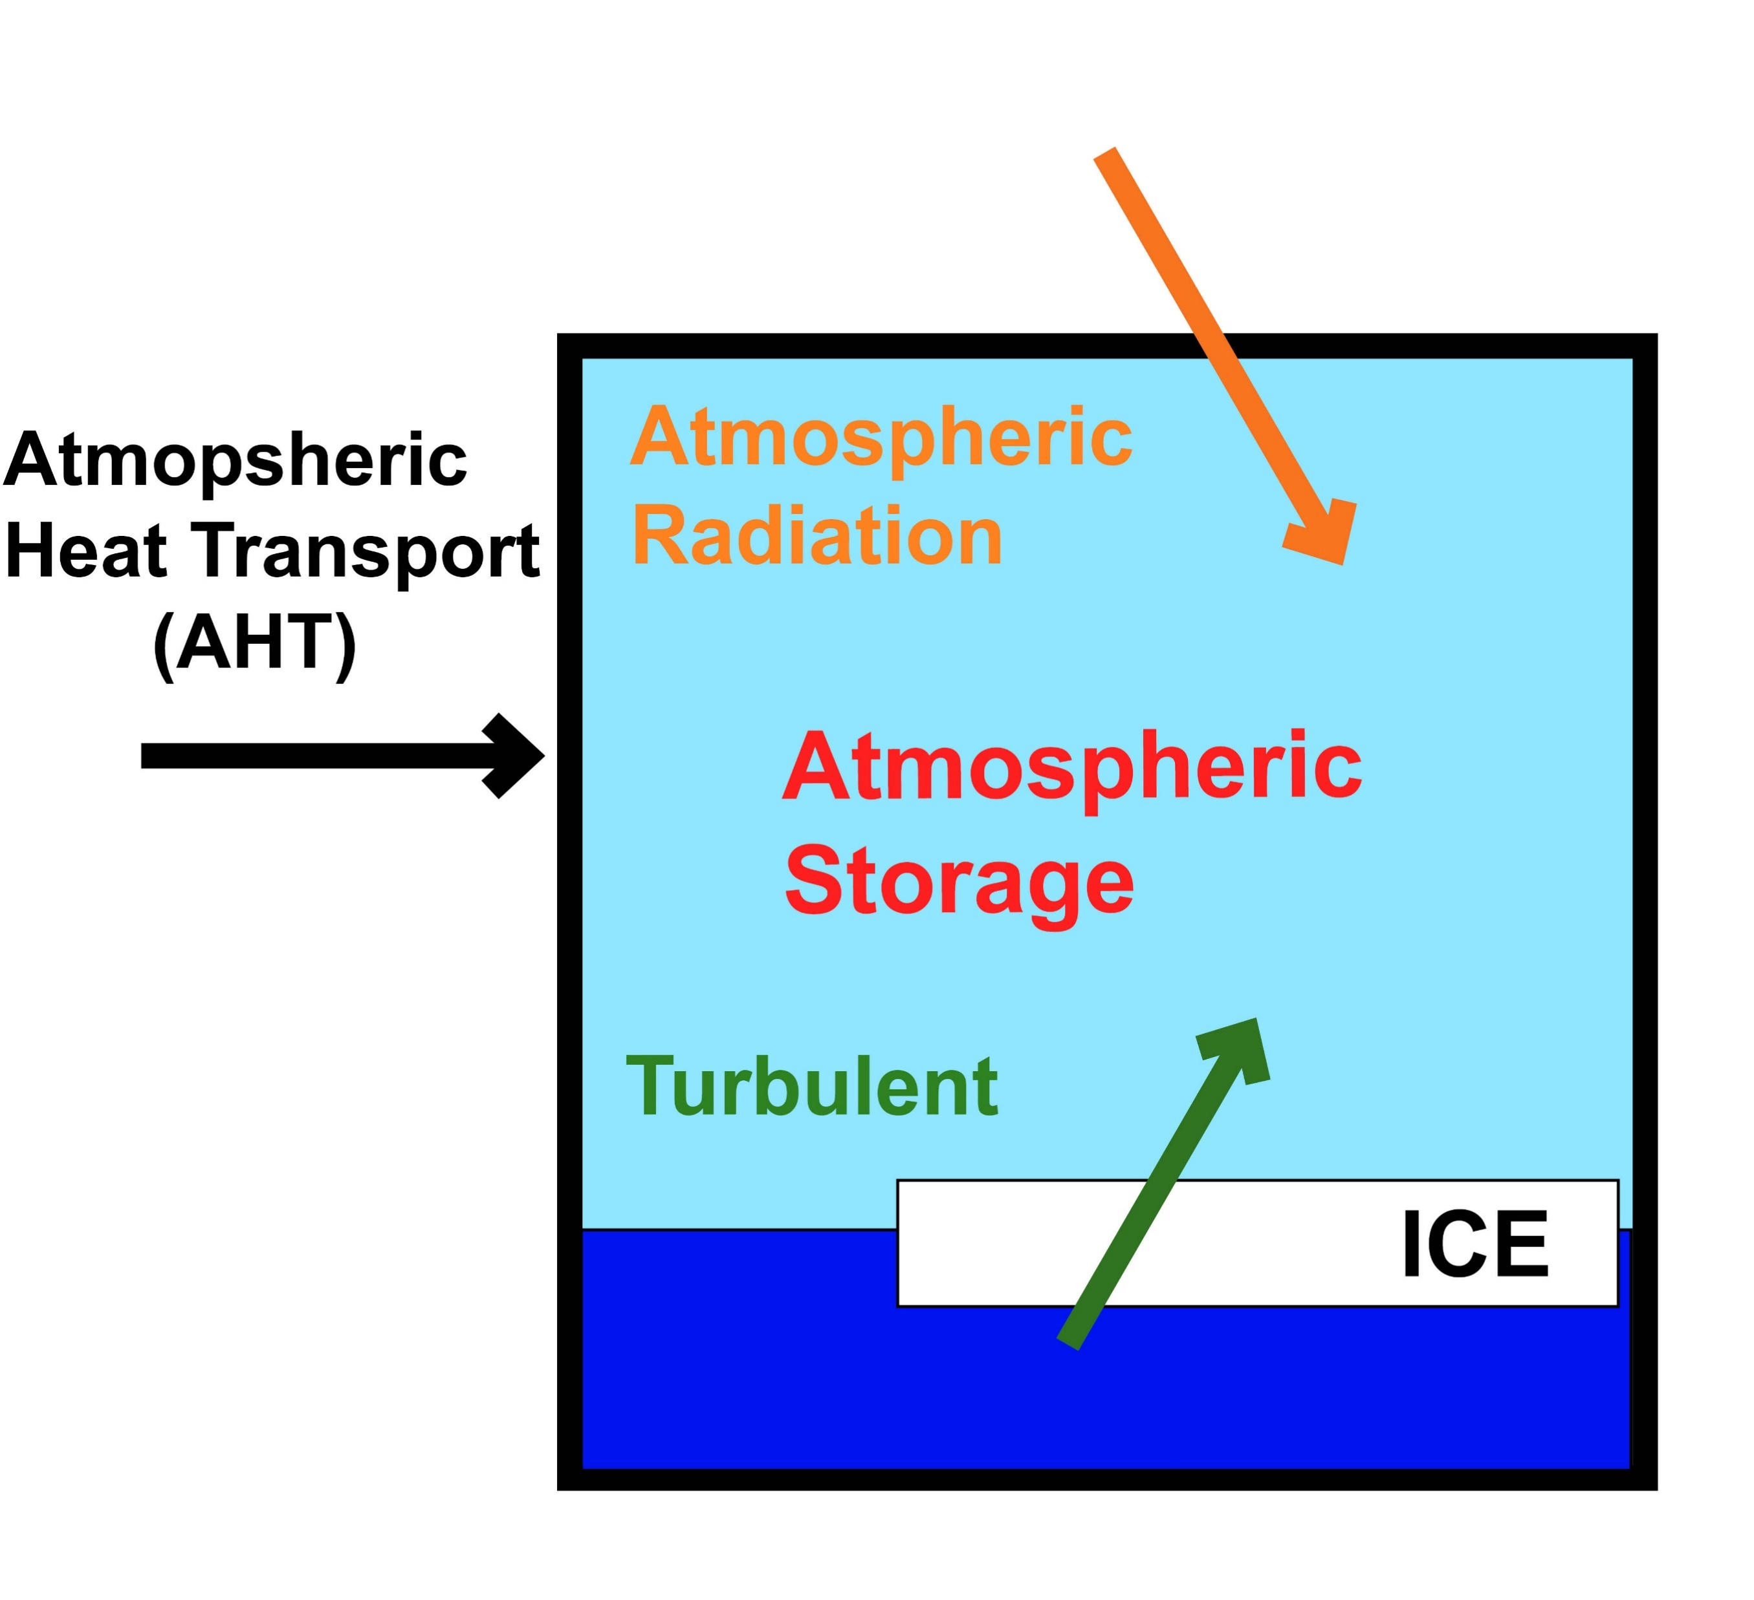
What accounts for the heating of the atmospheric column in this event
→ The atmospheric heat transport convergence matched the heating of the atmosphere
20 C
15 C
10 C
5 C
-5 C
-10 C
-15 C

Slide 5
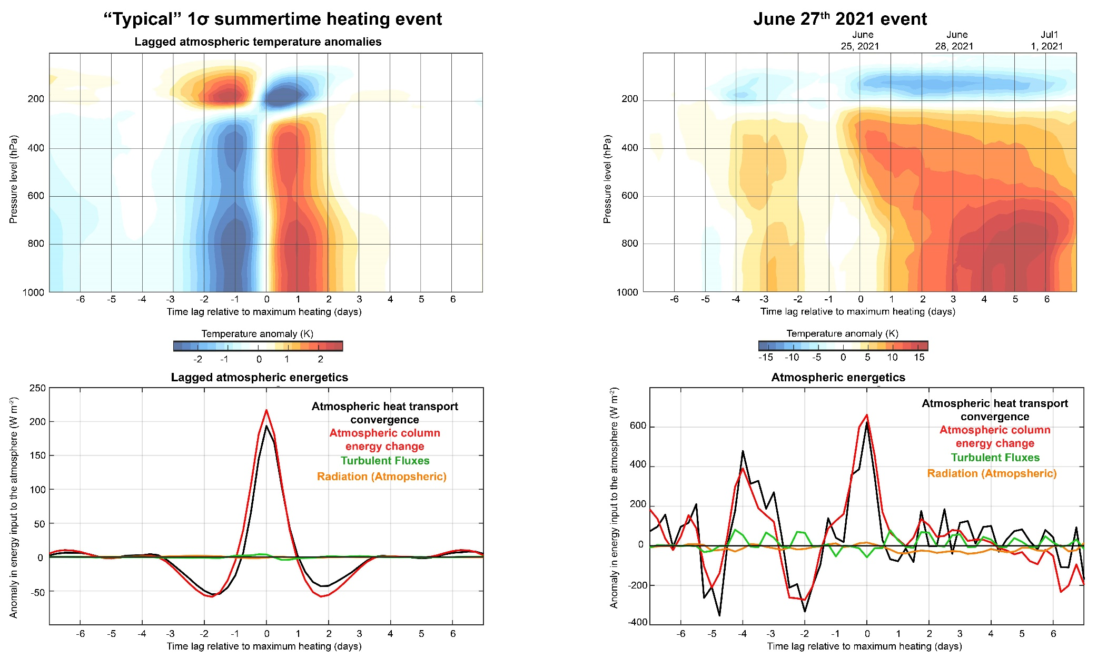
The physics of the PNW heatwave are consistent with a “typical” heating event of the region
→ Atmospheric energy balance between energy transport and heating
→ The magnitude and duration of the transport and heating were extreme

Slide 6
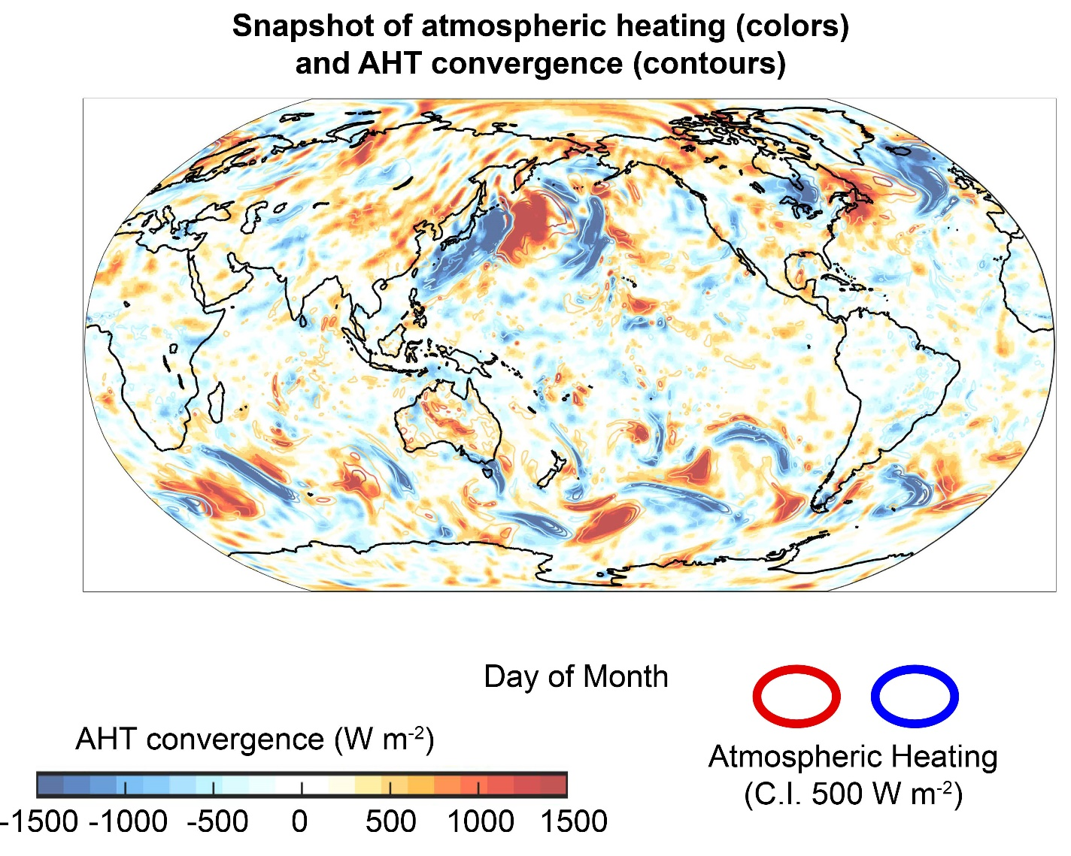

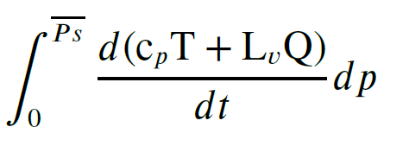
Instantaneous snapshot of AHT convergence (colors)
and column heating (contours)
1500 W m⁻² !!!
Heating and AHT convergence are right on top of each other
MSE^{Ϯ} is the vertical anomaly in moist static energy
→ Energy budget with respect to a fixed mass of atmosphere

Slide 7
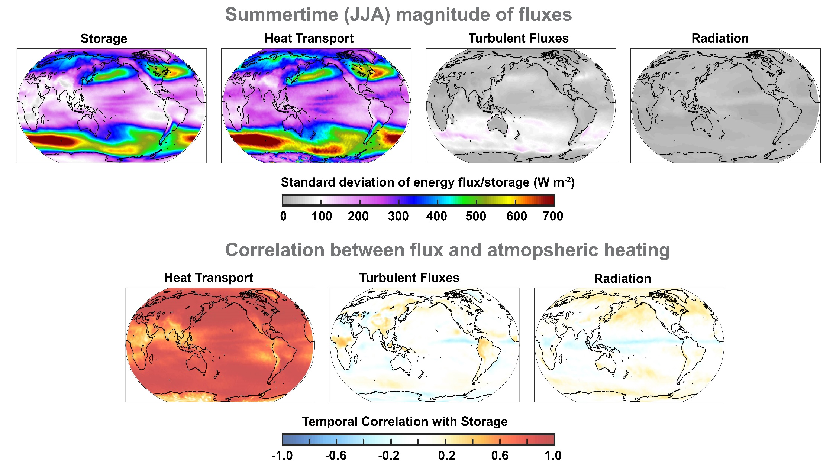

Energy budget of atmospheric heating events
.
$$\frac{d\frac{1}{g}\int_{0}^{P_{s}}{C_{P}T+LQ dP}}{dt}$$
Δ
= -
AHT + TURB + RAD_{ATMOS}

Slide 8

Energy budget of atmospheric heating events

Slide 9
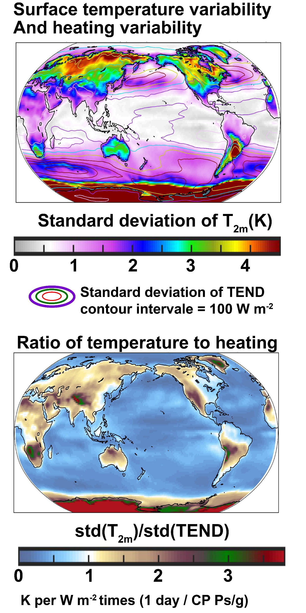
Atmospheric heating is dominated by heat transport everywhere
However, the amount of surface temperature that results from a given amount of heating is higher over land and lower over ocean

Slide 10
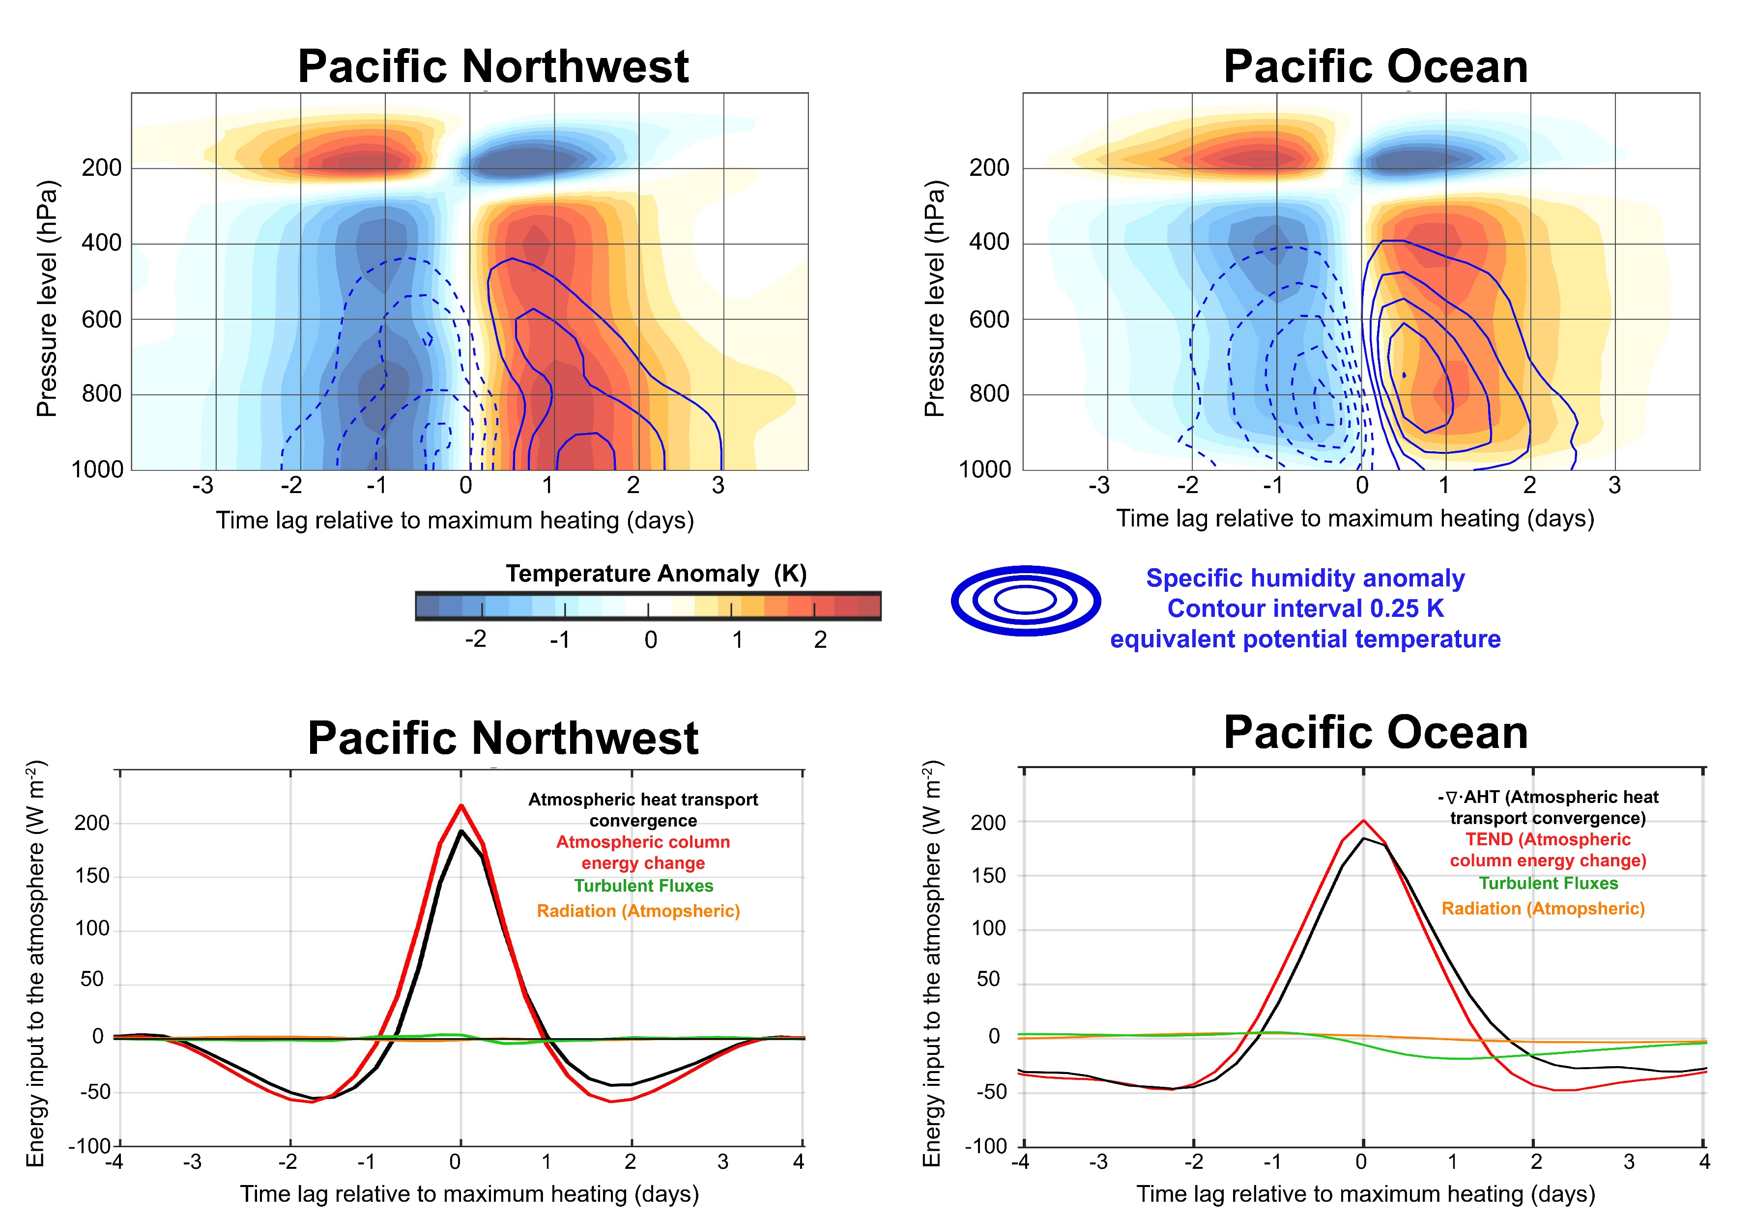

Slide 11
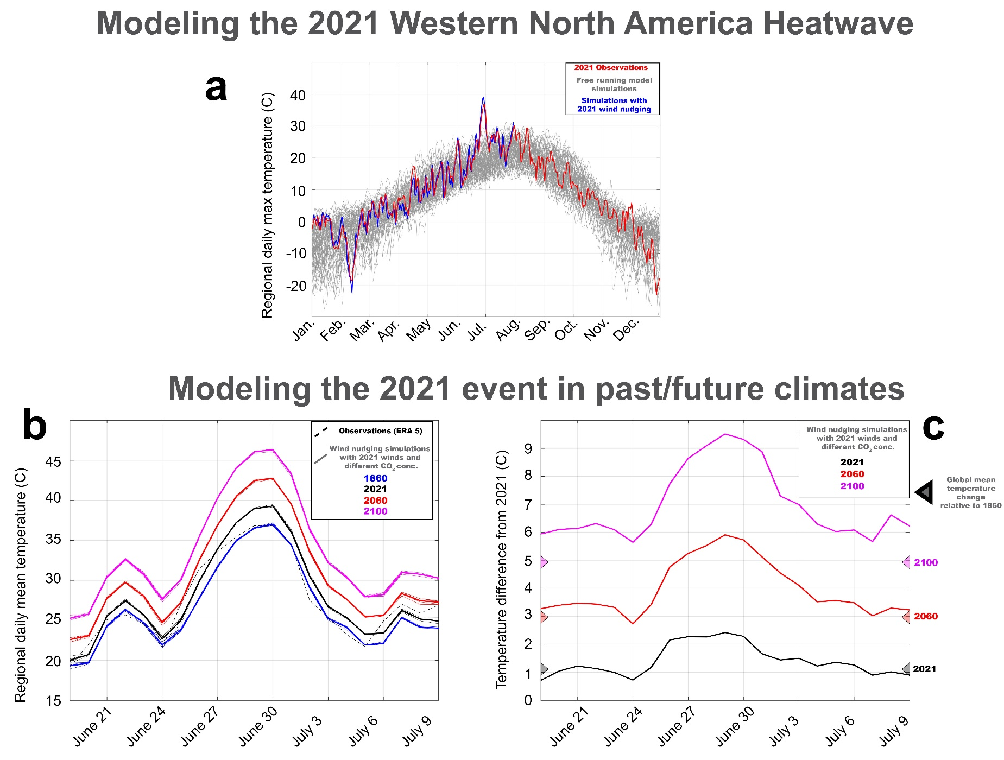
Observations
Free running models
Models with wind nudging
Free running climate models can not simulate a heatwave as large as the observed heatwave , but if we nudge the model winds to match observations, the models replicate the heatwave
Ed Blanchard

Slide 12
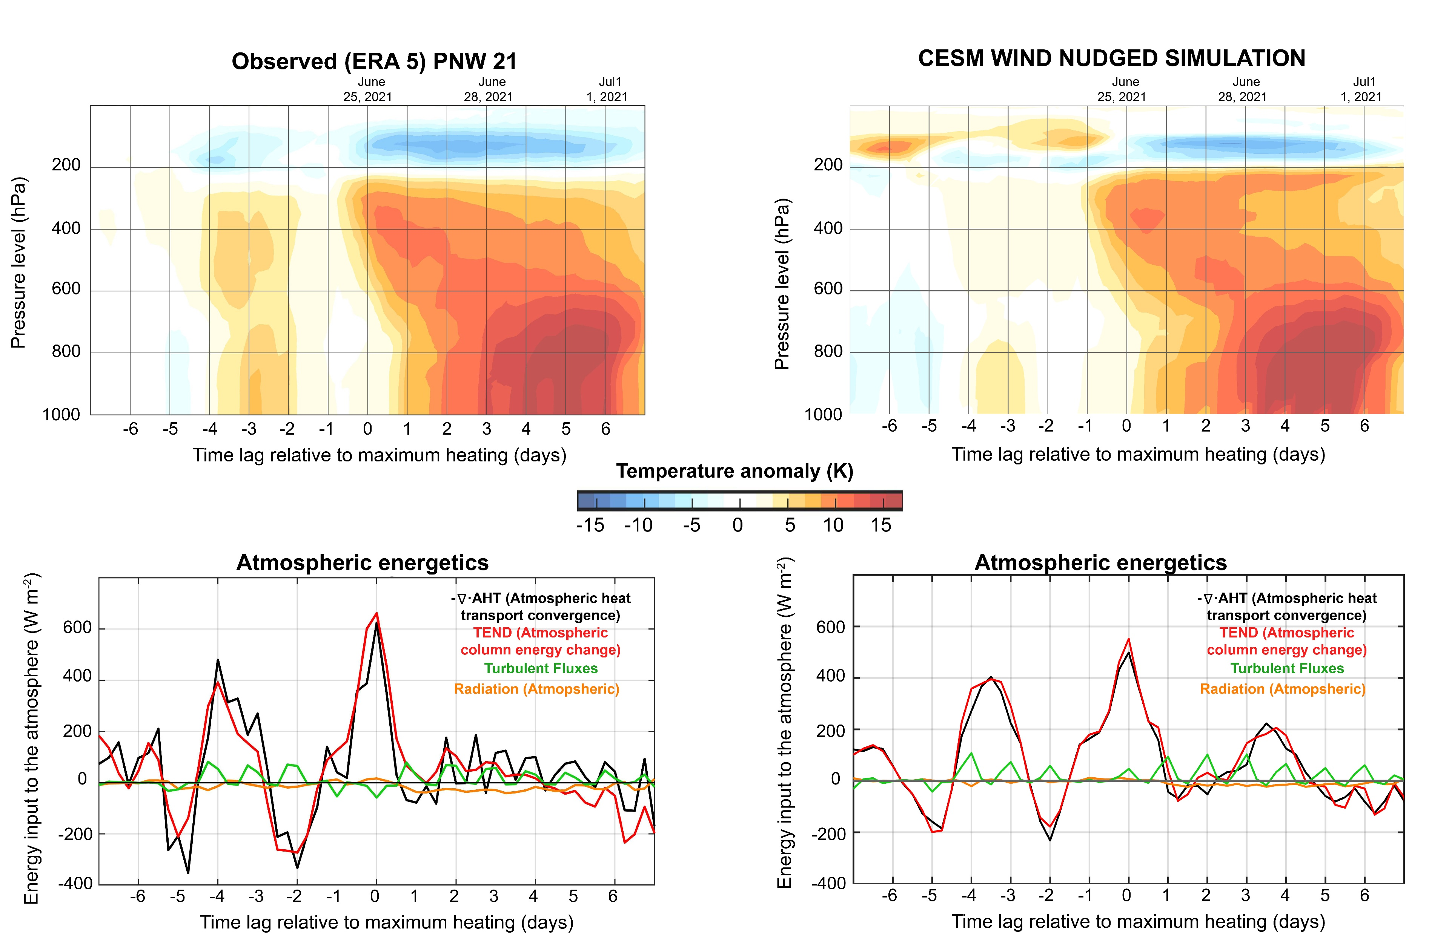
Wind nudging broadly constrains atmospheric energetics

Slide 13
Observations
Free running models
Models with wind nudging
Ed Blanchard

Slide 14
