Slide 1

Energy constraints on Global Climate
Aaron Donohoe
Georgia Tech Seminar
Feb. 14 2017

Slide 2
Global mean energy balance
The Earth receives energy from the sun (and reflects back some portion of it)
To come into energy balance (equilibrium) the Earth must emit the same amount of energy it receives
Reflected
Emitted
Incident
Solar
Incident – Reflected = Emitted
Earth
S(1-α_{P}) = σT_{e}⁴

Slide 3
Equator-to-pole contrast
The tropics receive more solar radiation than the high latitudes (extratropics)
To come to equilibrium, the tropics must either emit excess radiation or transport energy to the extratropics
Incident
Reflected
Emitted
Net
Tropics
Extratropics

Slide 4
Seasonal Cycle
Seasonal variations in solar insolation are of order 1 in the extratropics
How much energy goes into the atmosphere versus the ocean to drive seasonal variations in temperature?
Summer
Heating
Solar
Atmos.-Ocean
Exchange
Absorbed
Transmitted
Energy gain

Slide 5
Outline
What determines how much solar radiation gets absorbed in the climate system? Changes under global warming.
Earth
2. What determines the amount of energy transported in the climate system?
i) from equator to pole
ii) between the two hemispheres (link to location of tropical precipitation)
Tropics
Extratropics
3. How do seasonal variations in solar insolation lead to atmospheric heating?
Changes under global warming

Slide 6
1 : What determines the Earth’s planetary albedo? (solar radiation reflected at top of atmosphere)
Reflected by Atmosphere
Solar Incident
Reflected by Surface
Atmosphere
Earth’s Surface

Slide 7
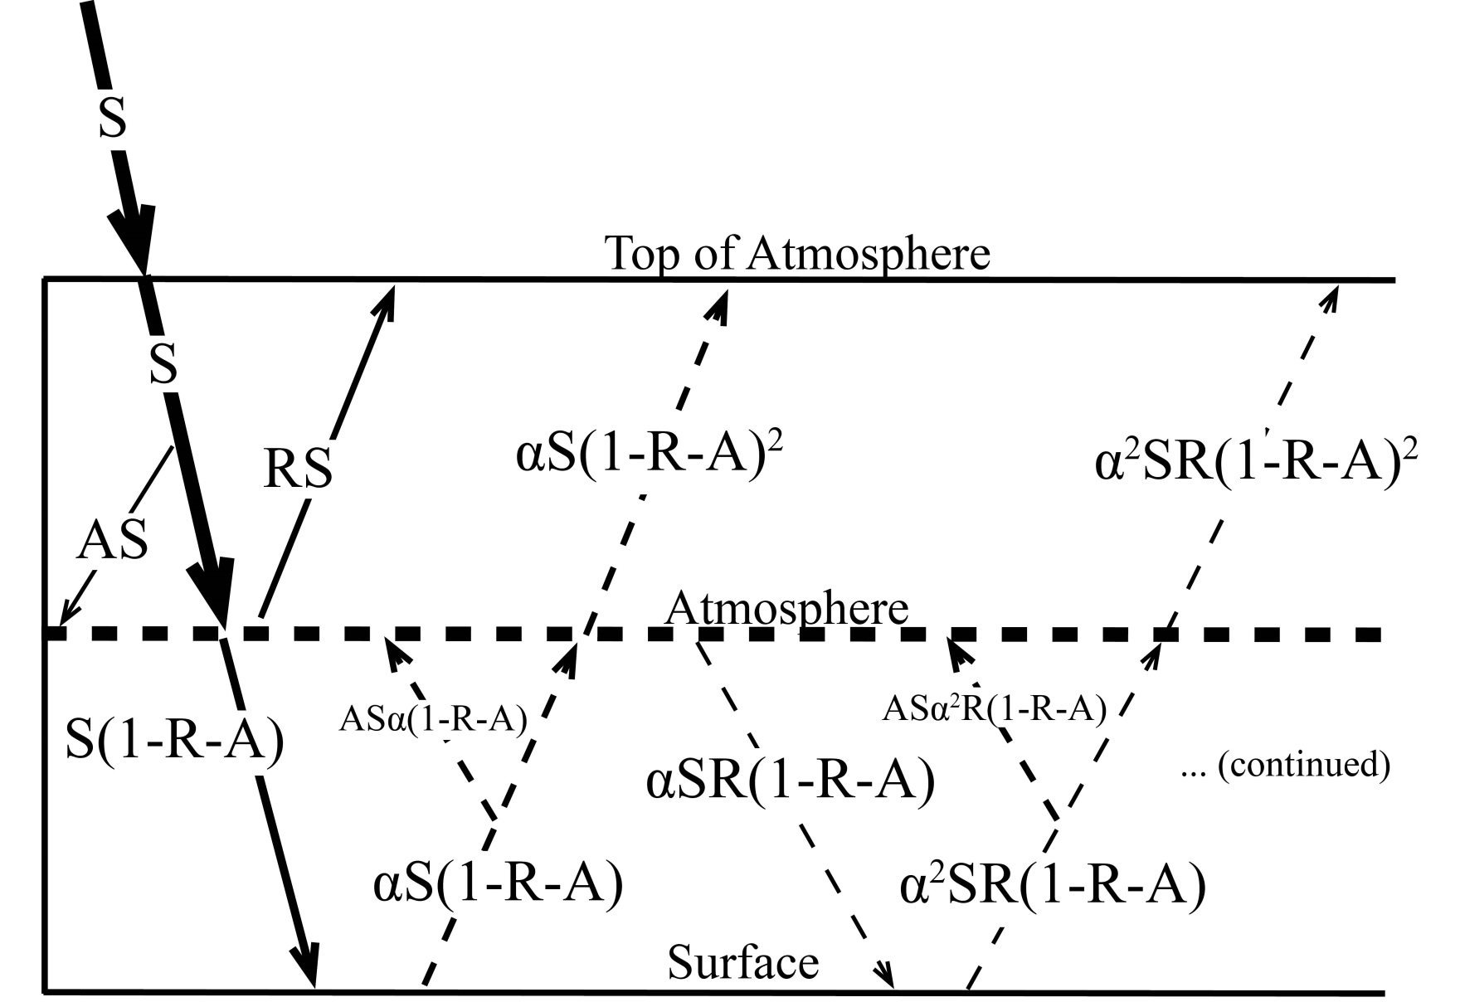
Simplified (isotropic) shortwave radiation model
Atmospheric
Contribution
To planetary
Albedo
Surface
Contribution
To planetary
Albedo
S = incident
R = cloud
reflection
A = absorption
α = surface
albedo
(UNKNOWNS)

Slide 8
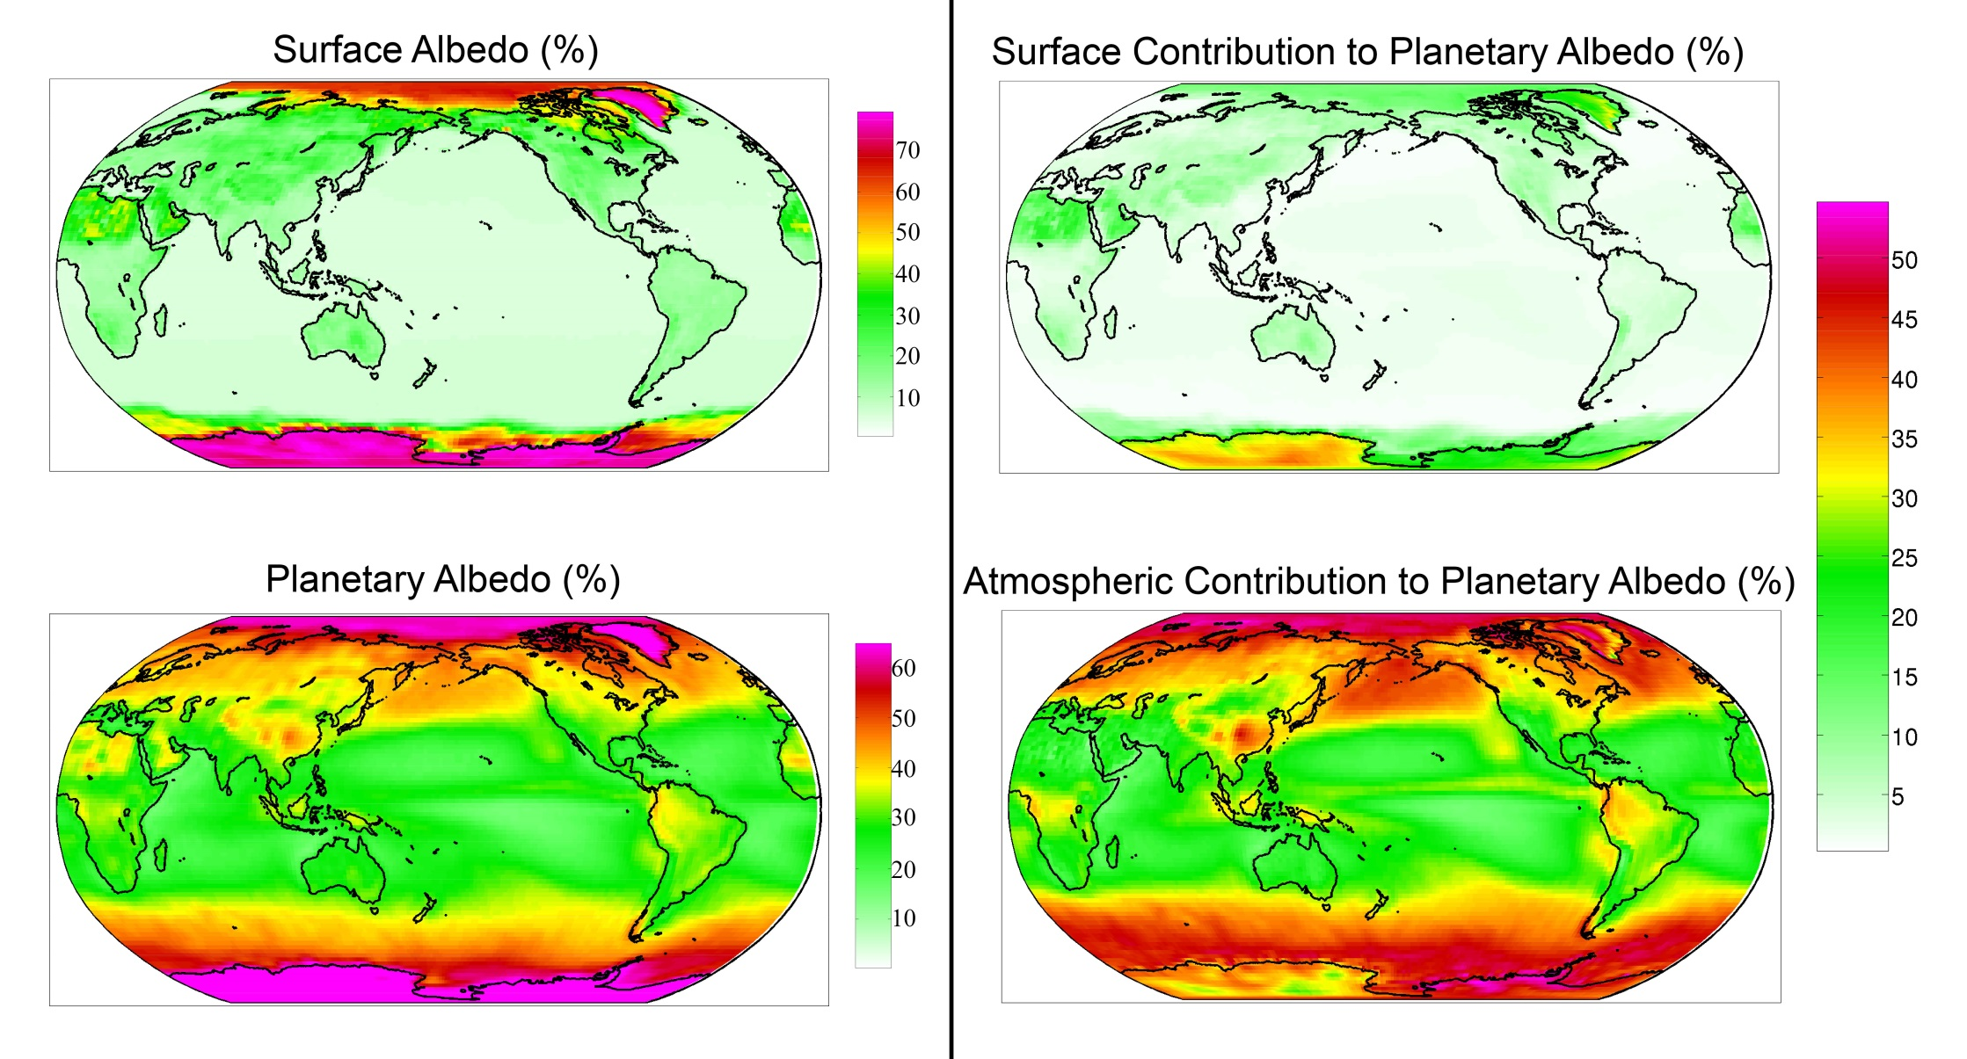
Observed (CERES) surface and atmospheric contribution to planetary albedo

Slide 9
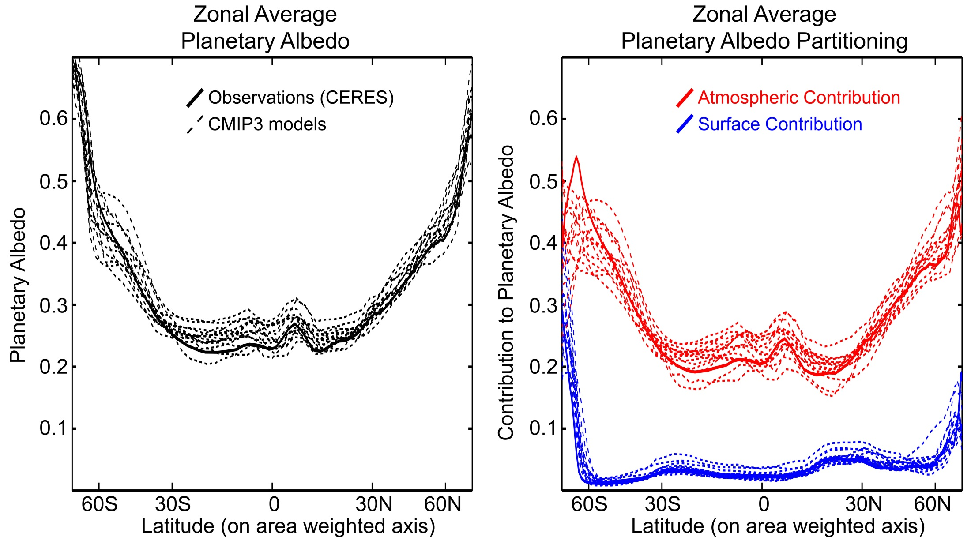
Planetary Albedo Partitioning:
Comparison of models (CMIP3 pre-industrial) and observations (CERES)

Slide 10
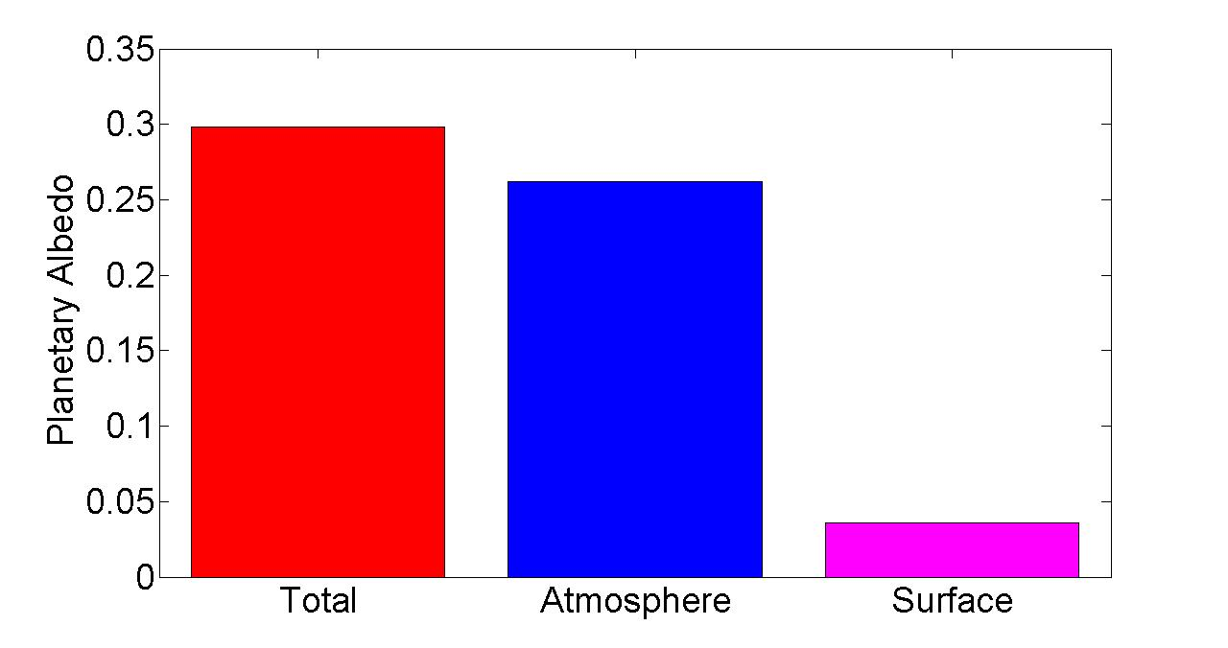
Observed Global Mean Planetary Albedo and it atmospheric/surface Partitioning
Notes:
0.298 = 0.262 + 0.036
100% = 88% + 12%

Slide 11

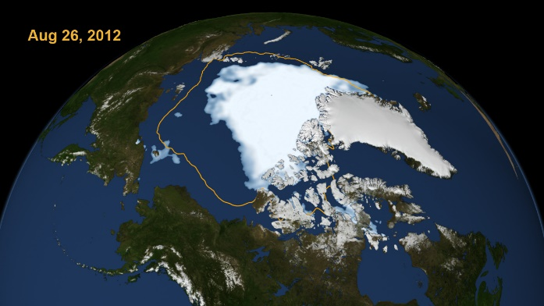
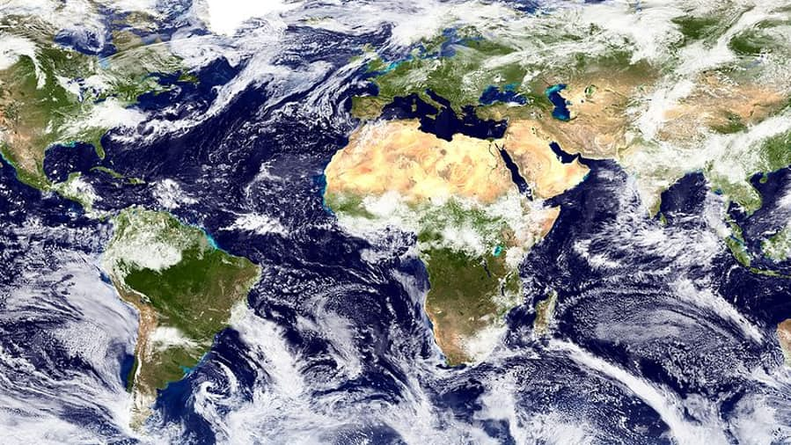
Mechanisms leading to changes in absorbed solar radiation with global warming
1
Moistening of the atmosphere
Enhanced atmospheric solar absorption (water vapor)
Sea ice (and snow) loss
More solar radiation absorbed by surface
2
Cloud Changes
Highly Uncertain
3

Slide 12

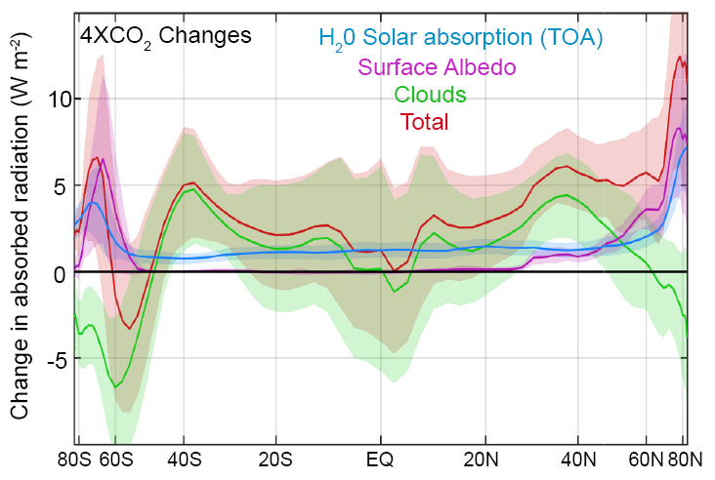
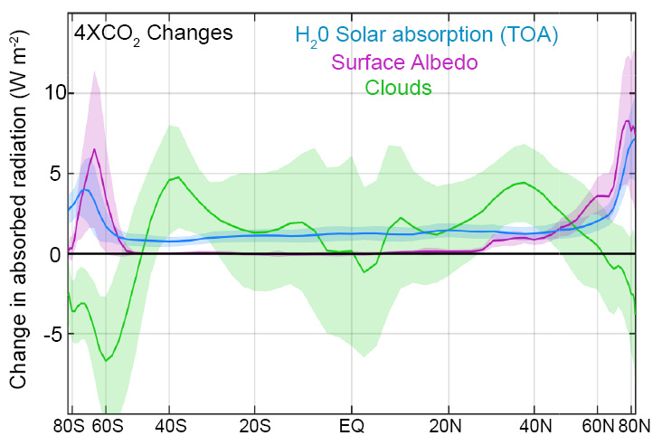
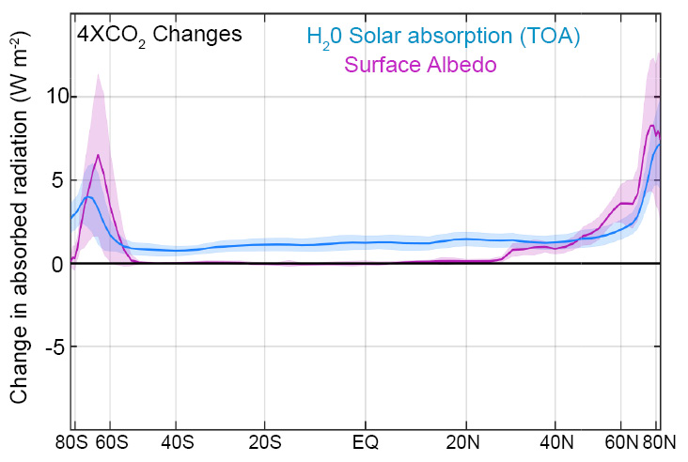
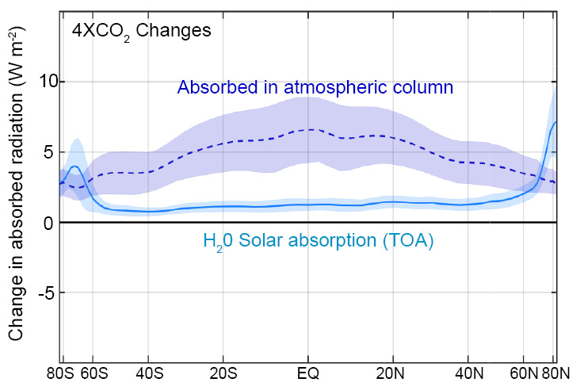
Changes in absorbed solar radiation with global warming
incident
Reflected
cloud
absorbed
?
H₂0
(vapor)
Reflected
surface
transmitted
ice
ocean

Slide 13
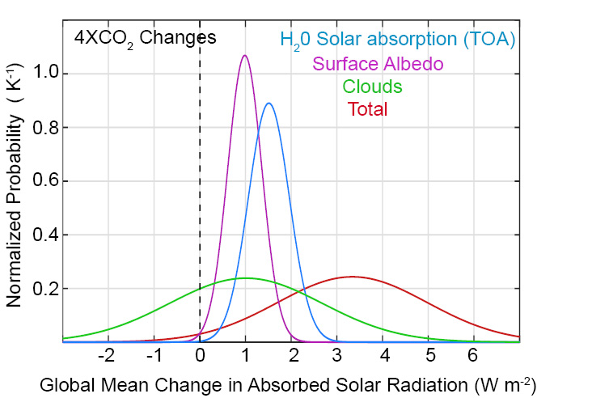
Changes in global mean absorbed solar radiation with increased CO₂
Despite uncertainties in clouds, it is highly likely that the climate system will absorb more solar radiation as it warms due to two robust processes:
Moistening of the atmosphere
Melting of sea ice and snow

Slide 14
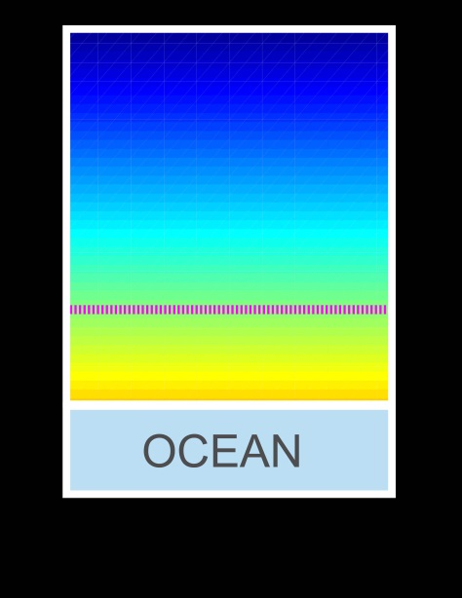
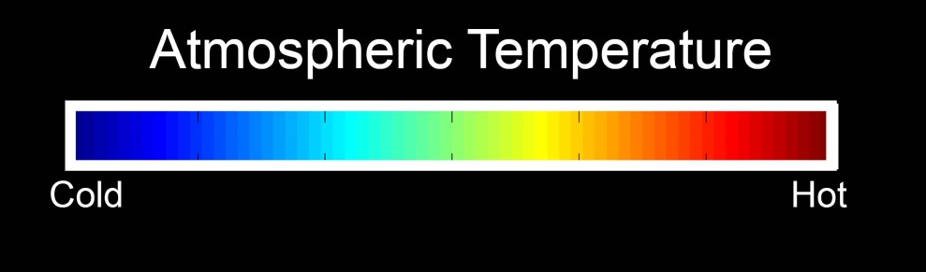
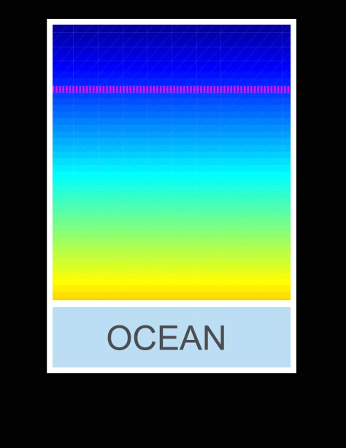
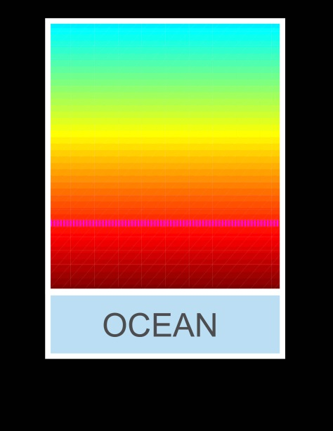

Energy imbalance and Global Warming
Unperturbed
Absorbed solar = Emitted Radiation
ASR = OLR
Atmospheric Emission Level
Solar Perturbation
Greenhouse Perturbation
ASR = OLR
ASR > OLR
CO₂
CO₂
ASR = OLR
ASR > OLR

Slide 15
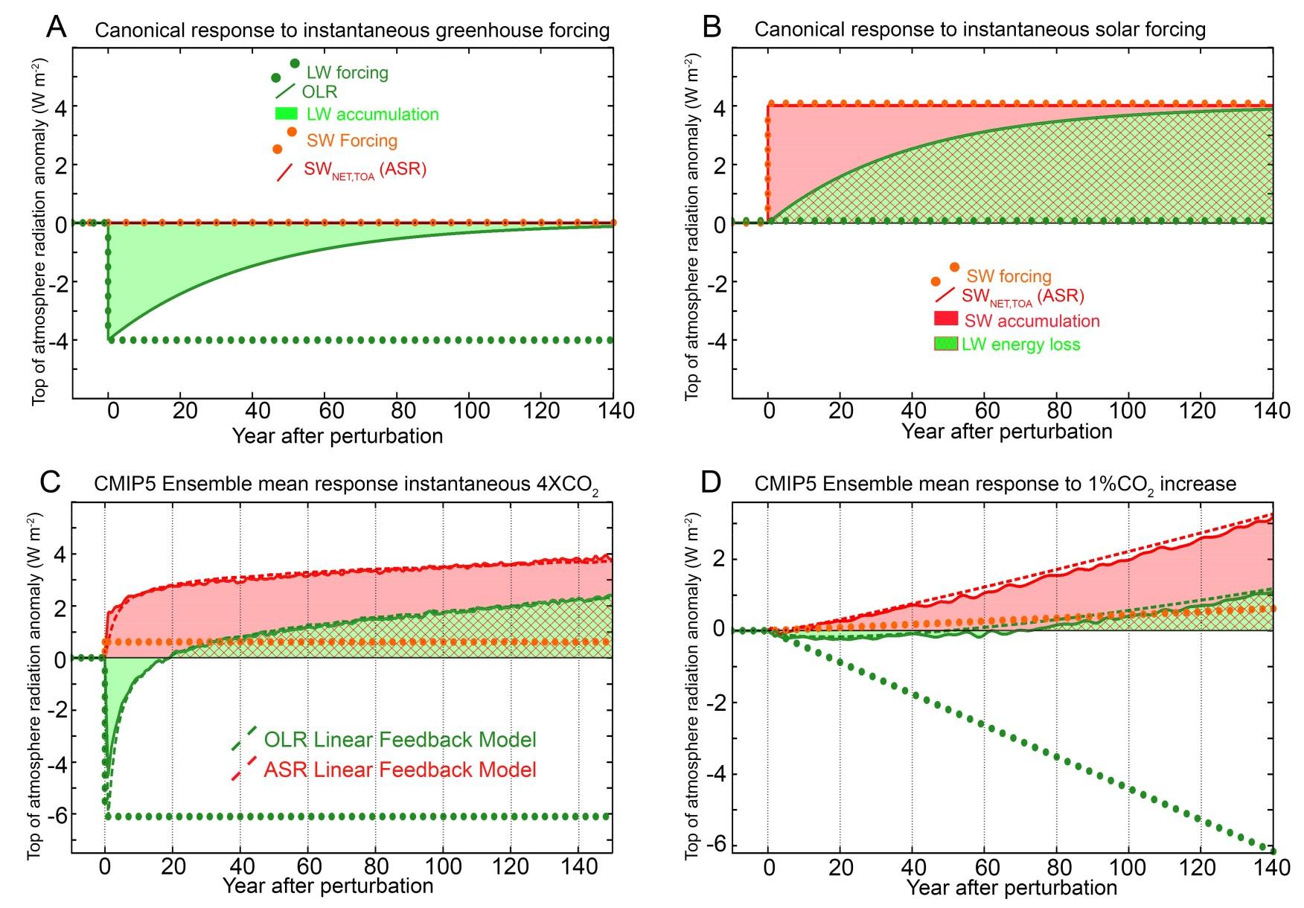
Top of Atmosphere Radiative response to greenhouse and shortwave forcing
OLR returns to unperturbed value in 20 years

Slide 16
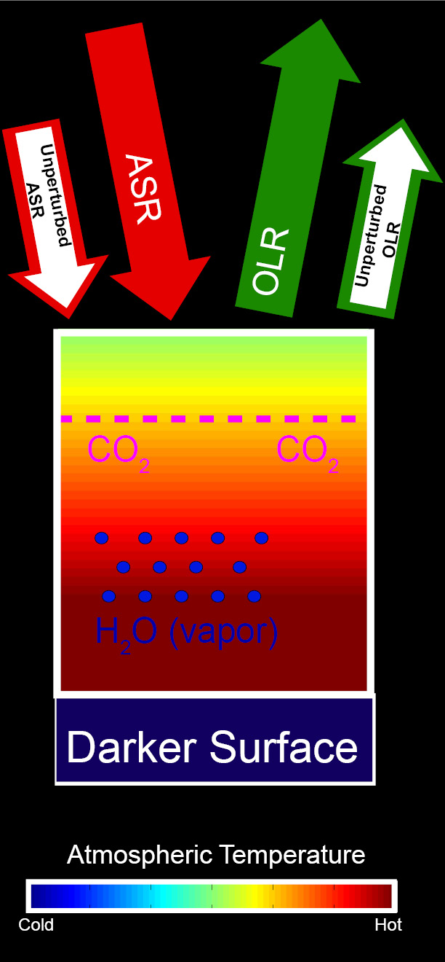
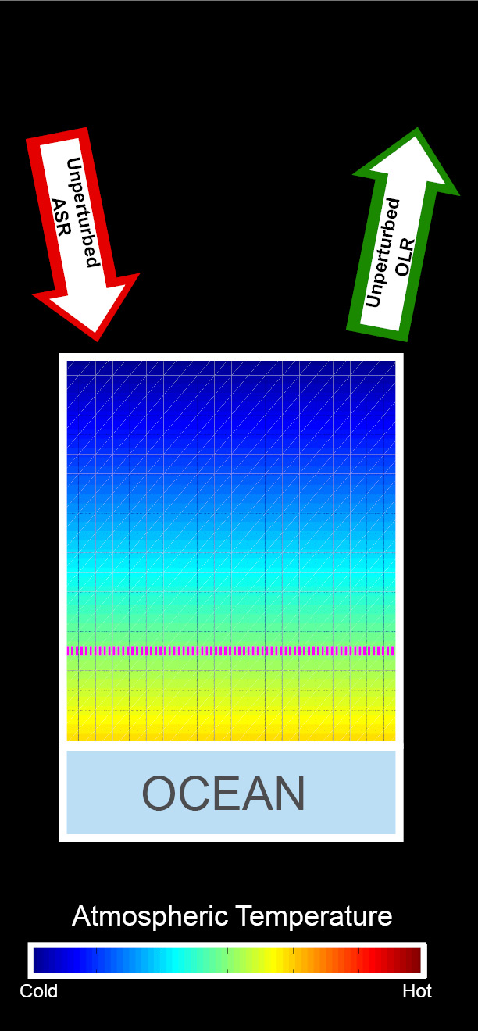
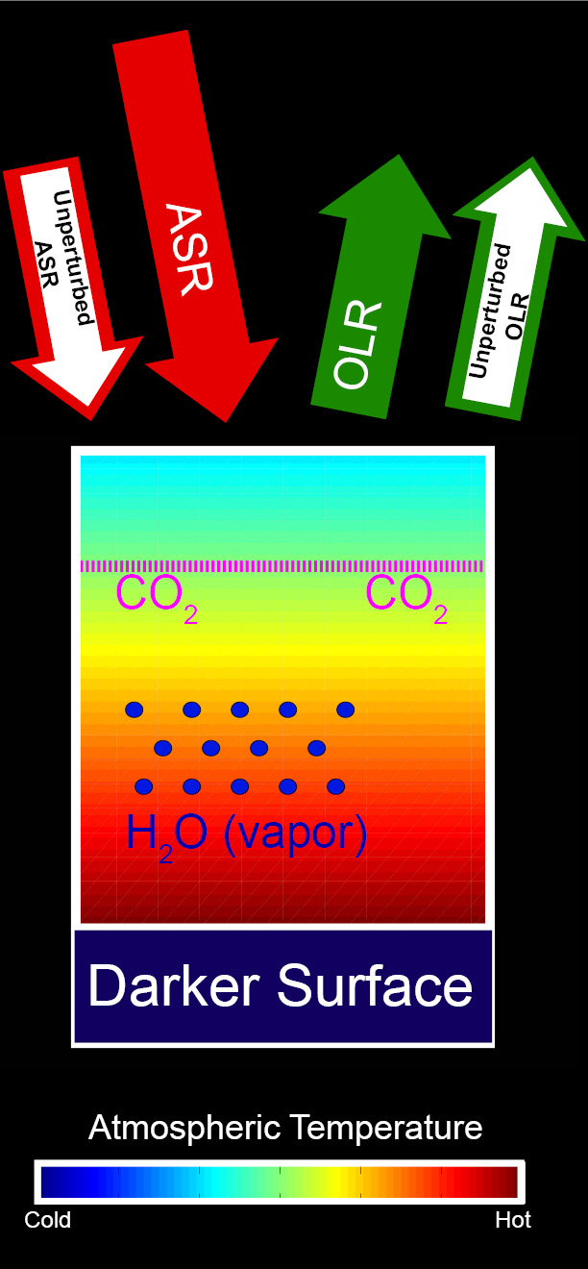
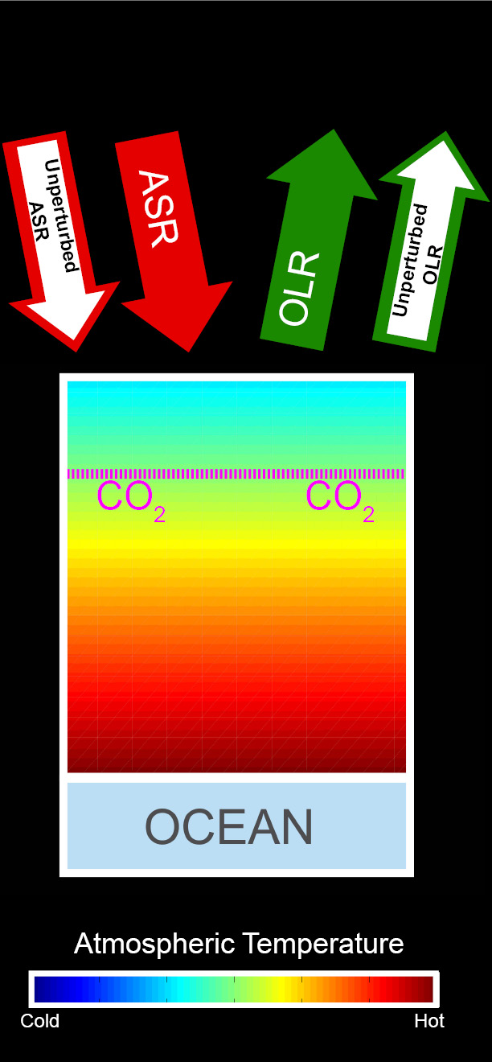
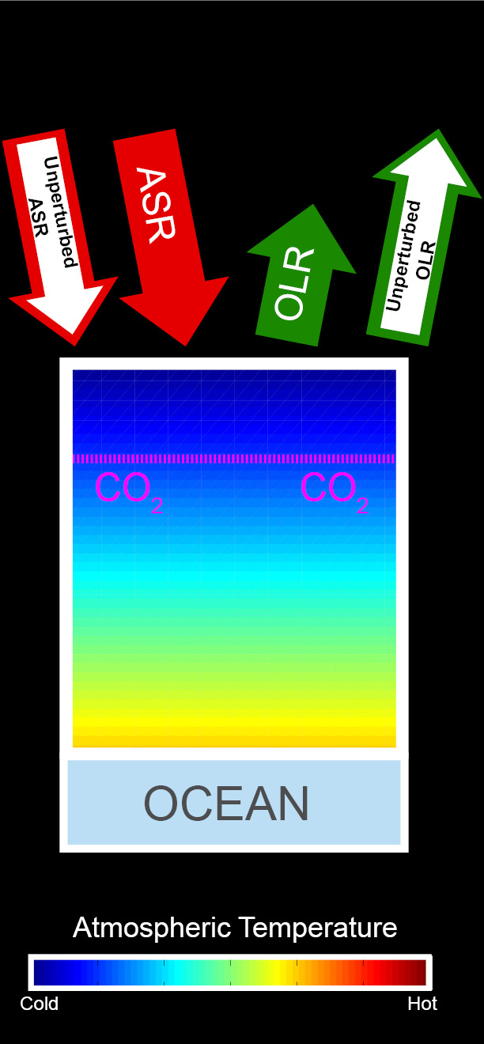
Energetic response to increased CO₂
Increased ASR
Unperturbed
Balanced Initial System
CO₂ added
Warming
CO₂ reduces OLR → energy imbalance
Warming →
OLR increases
Moistening and darkening → ASR increases
Additional warming
→ OLR balances increased ASR

Slide 17
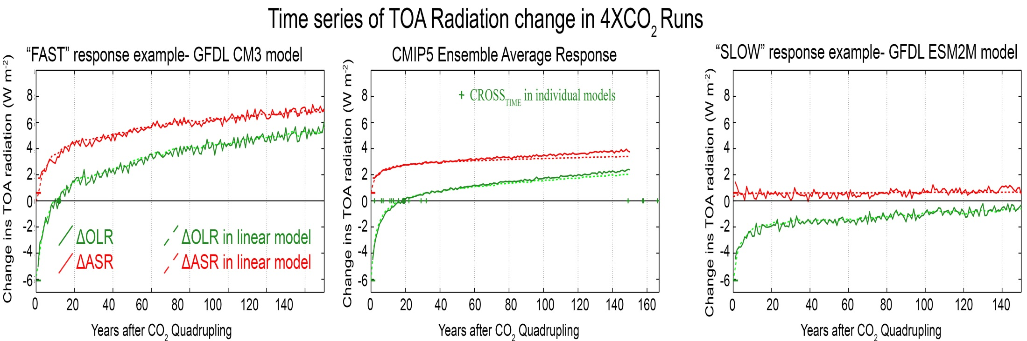
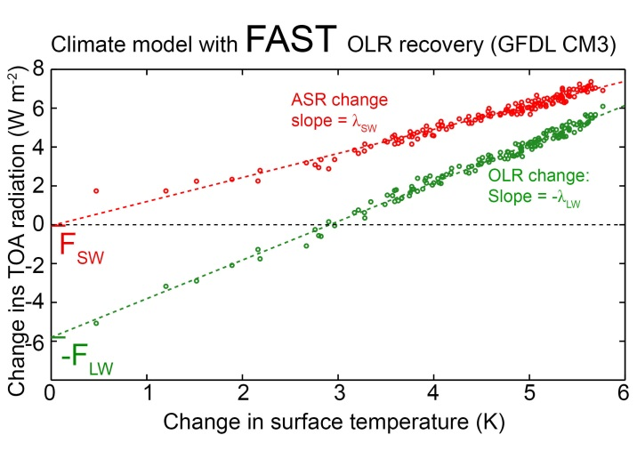
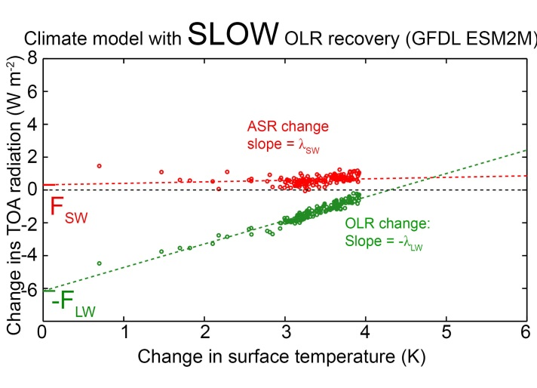
Climate model differences in OLR response time
CNRM model
ASR INCREASES
with Warming
ASR UNCHANGED with Warming

Slide 18
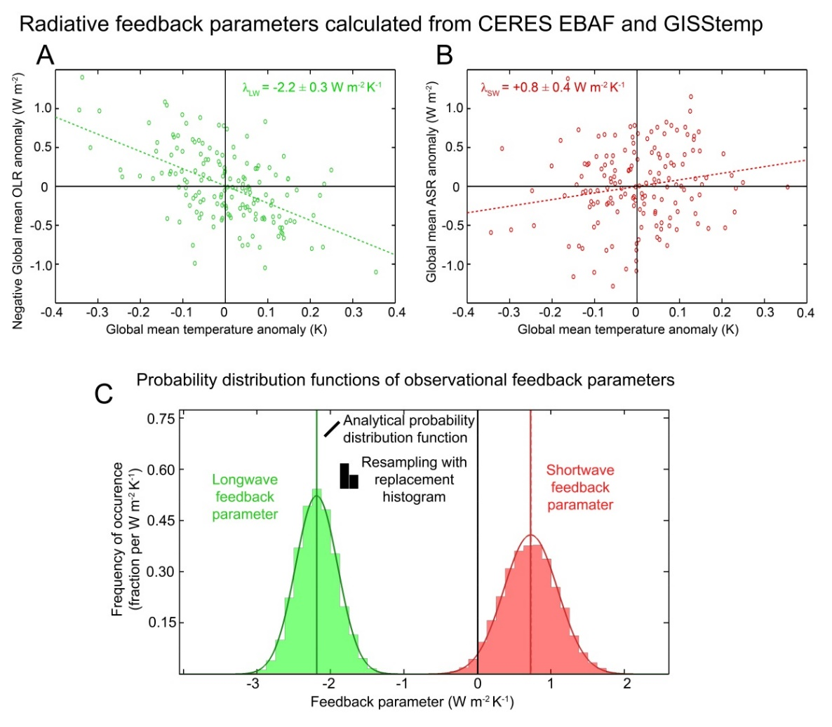
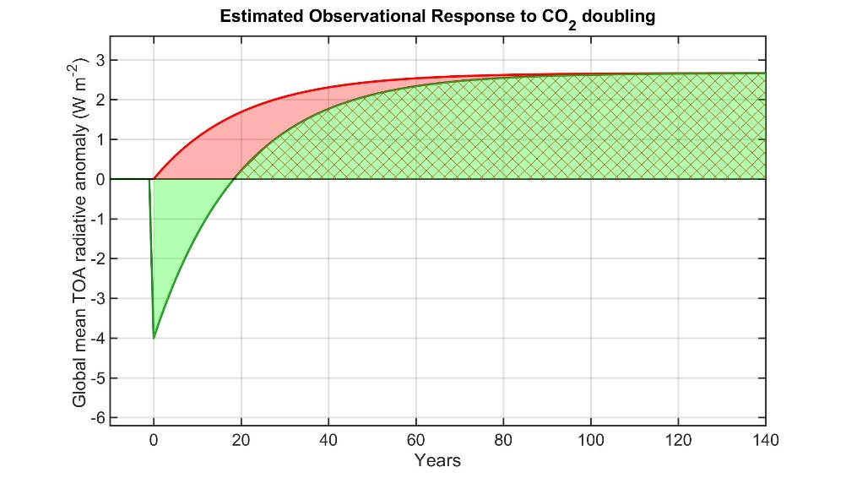
Observations suggest Absorbed solar radiation will increase with surface warming
The reduction in OLR due to greenhouse forcing will be balanced by the climate response in about 20 years
→ Detection of global energy imbalance will be in the solar not in the longwave

Slide 19
2 : What determines meridional heat transport?
Incident
Reflected
Emitted
Net
Tropics
Extratropics

Slide 20




Understanding heat transport
5.8 PW
ASR*
OLR*
8.2 PW
2.4 PW
-
Heat
Transport
=
Notes:
NH = 8.2 - 2.4 = 5.8
SH = 9.0 – 3.2 = 5.8

Slide 21
ASR*, OLR*, MHT, and the tropical/extratropical energy budget
OLR*
ASR*
2.4 PW
8.2 PW
MHT =
ASR* - OLR*
MHT
Tropics
5.8 PW
To extratropics
All arrows are relative to the global average

Slide 22
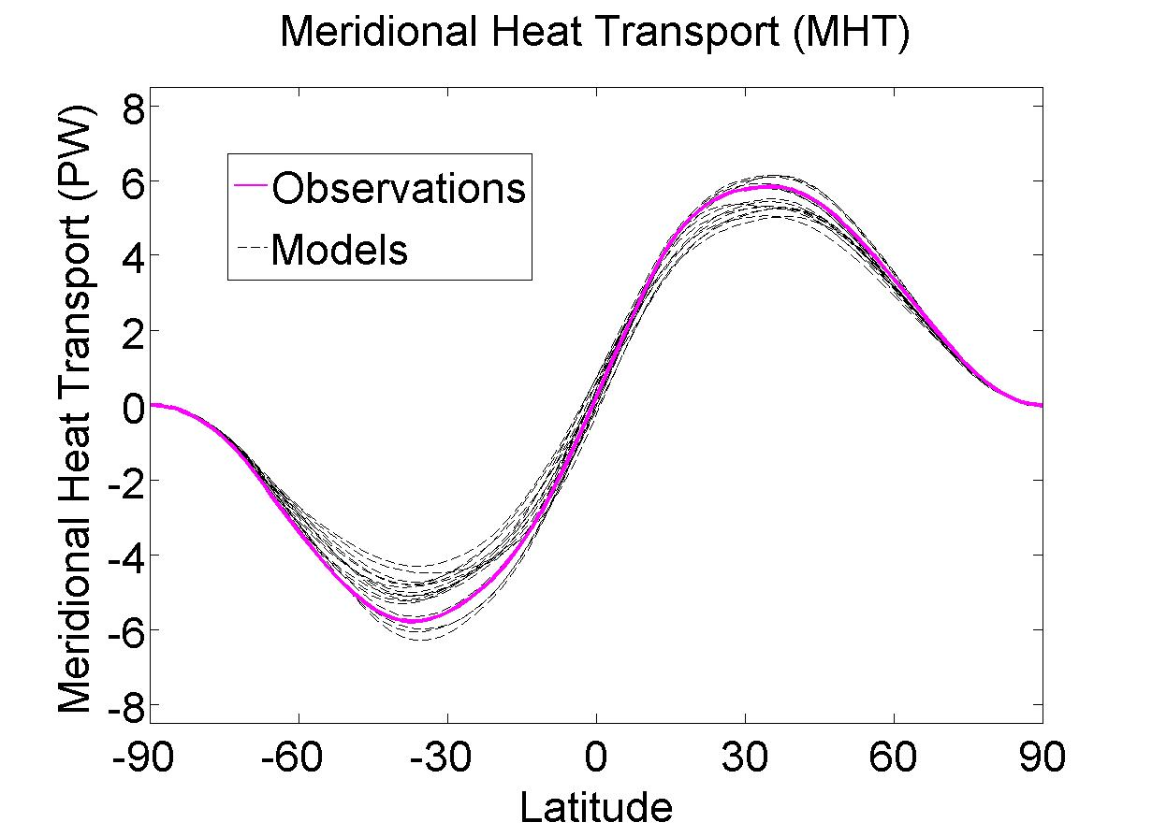
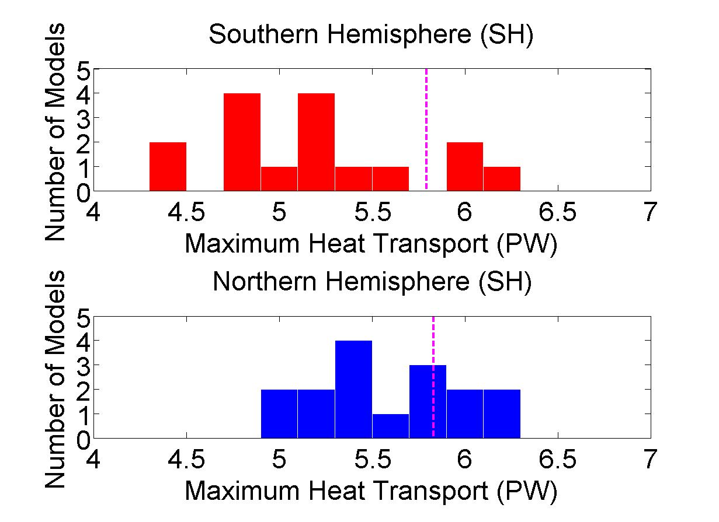
Heat Transport In Climate Models
(CMIP3)
Peak Heat Transport Histograms
Observations
Notes:
Spread – 2 sigma SH = 1.1 PW NH = 0.8 PW

Slide 23


Conceptual model for heat transport
ASR*
OLR*
How to increase MHT
Option I: Increase D
8.2 PW
λ ΔT_{S}
λ ΔT_{S}
MHT
2.4 PW
0 PW
ΔT_{S}
D ΔT_{S}
ΔT_{S}
D ΔT_{S}
ΔT_{S}
5.8 PW
Tropics
8.2 PW
Tropics
ΔT_{S} is the equator-to-pole temperature contrast
Let OLR* = λ ΔT_{S}
Where λ is climate feedback parameter (W m⁻² K⁻¹)
And let MHT = D ΔT_{S}
Where D represents atmospheric diffusion (W m⁻² K⁻¹)
9.0 PW
8.2 PW
5.8 PW

Slide 24

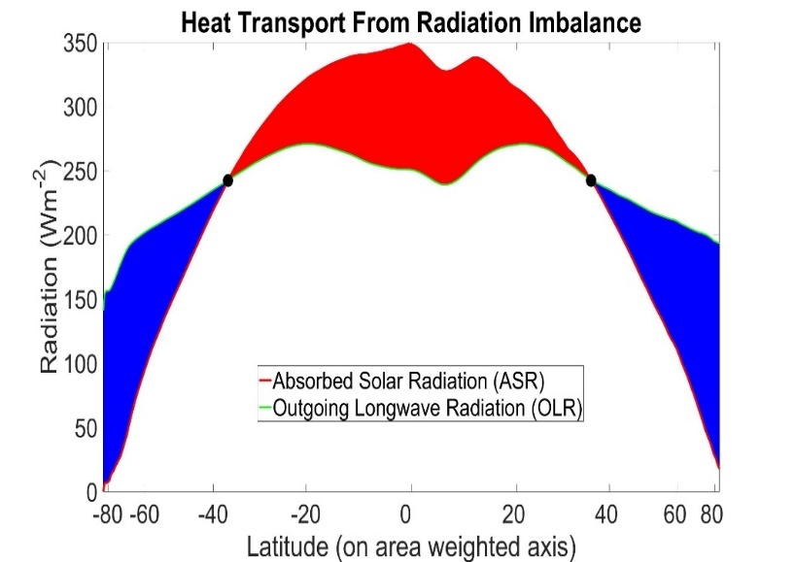
How to increase MHT
Option I: Increase D
Option II: Change ASR*
8.2 PW
8.2 PW
λ ΔT_{S}
10.5 PW
0 PW
D ΔT_{S}
D ΔT_{S}
ΔT_{S}
ΔT_{S}
D ΔT_{S}
ΔT_{S}
8.2 PW
7.5 PW
Tropics
9.0 PW
8.2 PW
8.4 PW
7.5 PW
MHT increases because OLR* decreases
MHT increases because ASR* increases

Slide 25
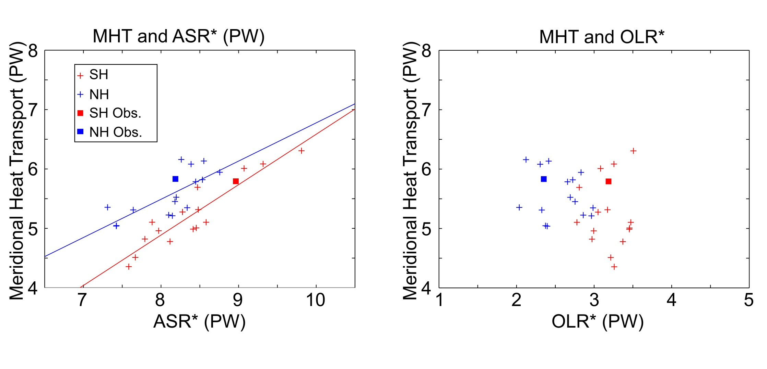
Model heat transport spread in terms of OLR* and ASR*
Notes:
ASR and MHT R^2 (slope) /// NH = 0.57 (0.64) , SH = 0.85 (0.85)
OLR* is insignificant

Slide 26
Planetary Albedo Partitioning

Slide 27
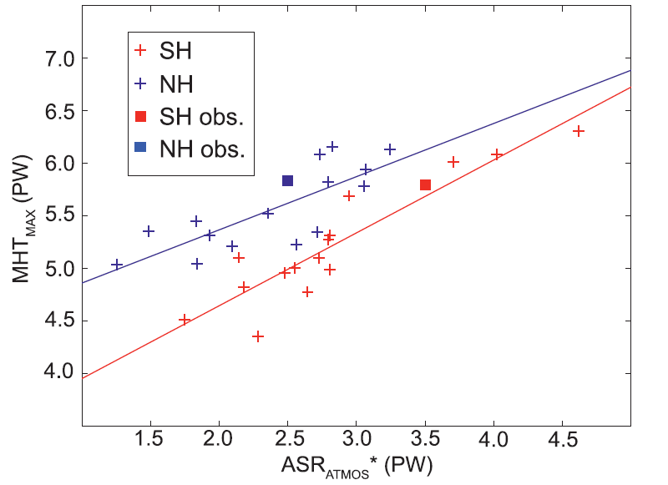
Atmospheric and Surface reflection contribution to ASR*
Cloud Reflection
Equator to pole contrast of absorbed shortwave
Poleward Energy Transport
Poleward Energy Transport
MHT spread
Equator to pole contrast in clouds
Notes:
R^2 NH \\\ 0.63 SH \\\\ 0.84

Slide 28

2B: Inter-hemispheric energy transport and tropical precipitation
Northern Hemisphere Summer
Solar
Emitted
Surface/ Ocean
Heat Transport
Net Heating
(Atmospheric heat transport)
Southern Hemisphere
Northern Hemisphere

Slide 29
2B: Inter-hemispheric energy transport and tropical precipitation
Southern Hemisphere Summer
Solar
Emitted
Surface/ Ocean
Heat Transport
Net Heating
(Atmospheric heat transport)
Southern Hemisphere
Northern Hemisphere

Slide 30
2B: Inter-hemispheric energy transport and tropical precipitation
Annual Mean
Atmosphere moves energy North to south across the equator to counter ocean heat transport
Solar
Emitted
Surface/ Ocean
Heat Transport
Net Heating
(Atmospheric heat transport)
Southern Hemisphere
Northern Hemisphere

Slide 31
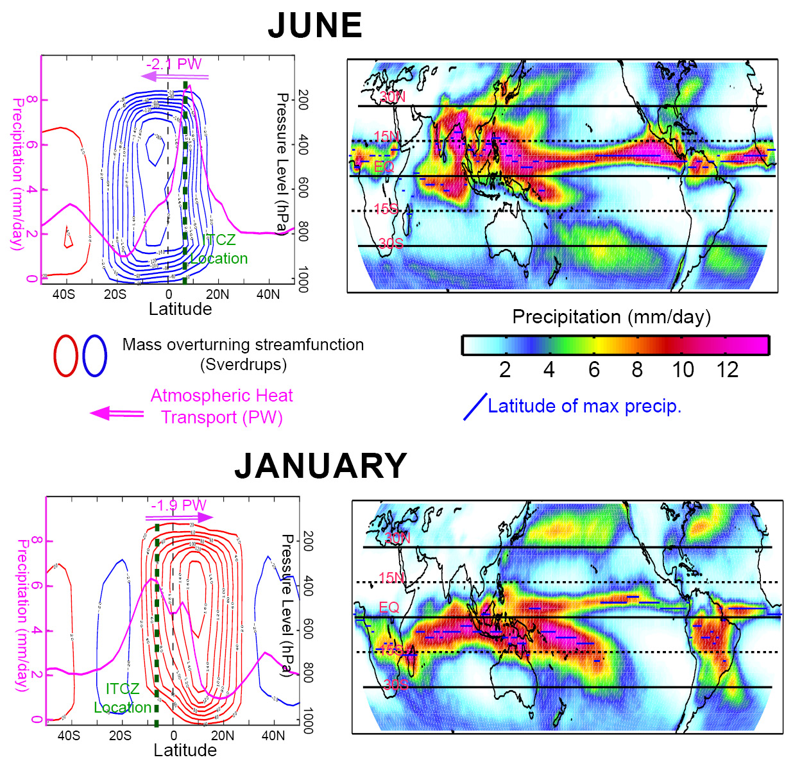
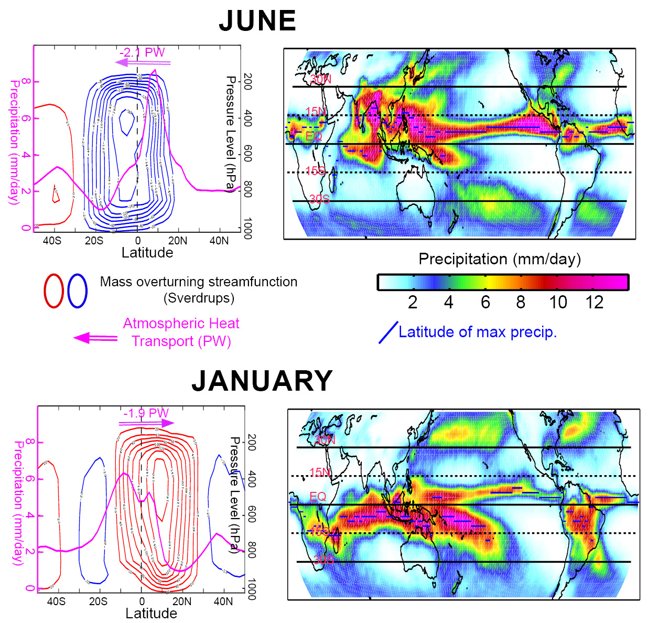
Hemispheric Heating
June
310
245
2.1 PW
+8
57
SH
NH
January
160
227
1.9 PW
-7
60
SH
NH
Solar Emitted (OLR) Surface Heat Flux Net Heating

Slide 32
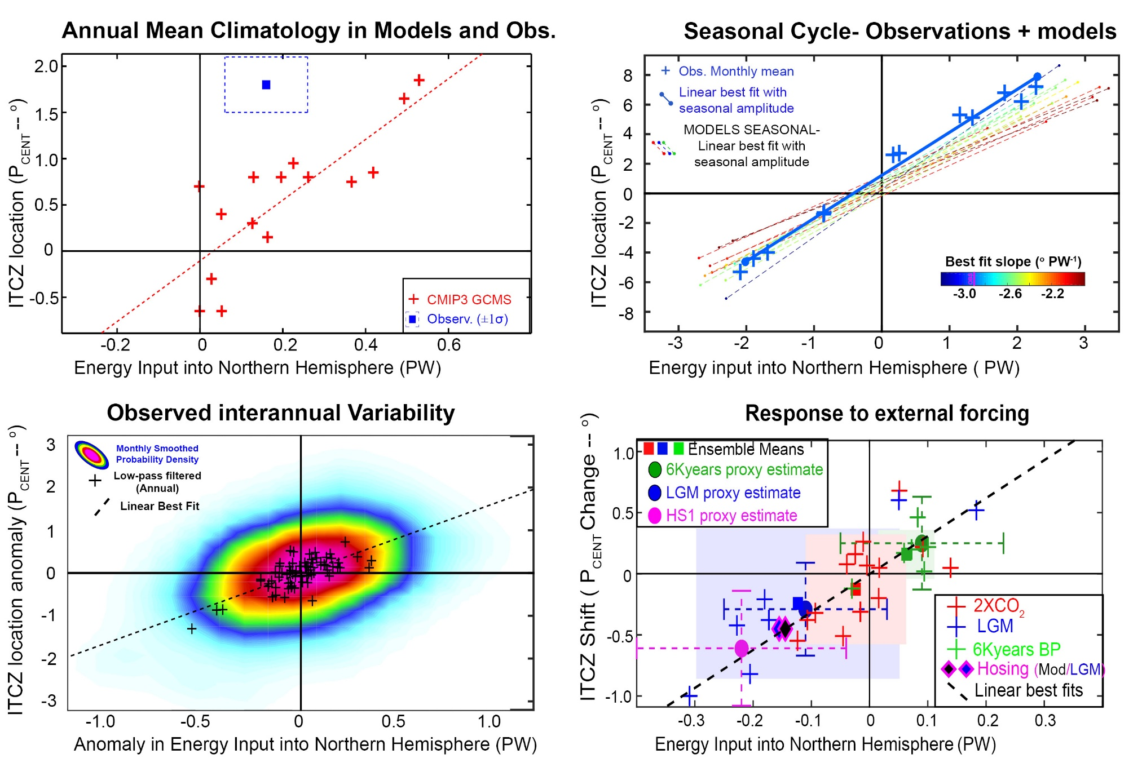

Location of tropical precipitation and inter-hemispheric heating contrast

Slide 33
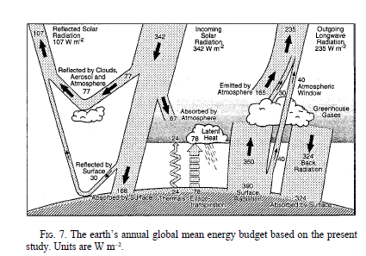
How is the atmosphere heated in the annual average?
3. The seasonal cycle of atmospheric heating and temperature
30% reflected
20% absorbed atmosphere
50% transmitted
To surface
50% net flux
From surface
To atmosphere
Kiehl and Trenberth 1997

Slide 34
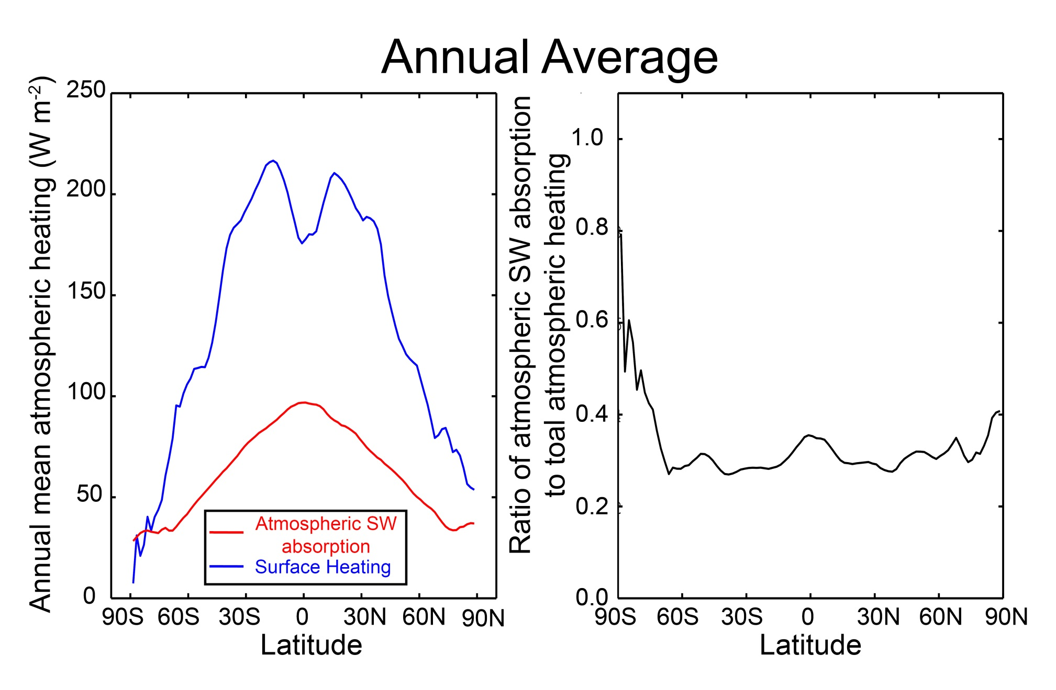
Spatial structure of atmospheric heating
Spatial structure of atmospheric heating
Annual Average

Slide 35
Limiting models of seasonal atmospheric heating
SW flux
Turbulent + LW
Surface flux
Heated from above
Heated from below
SW absorbing
atmosphere
SW transparent
atmosphere
DEEP
OCEAN
Shallow ocean

Slide 36
Atmospheric energy budget
Conventional
This study
Net SW
TOA
OLR
Atmospheric SW absorption (SWABS)
OLR
Net energy flux
Through surface
SW transparent
atmosphere
Surface heat
Flux (SHF)
Surface
Surface
Net energy flux through surface =
Solar + turbulent + LW
SHF = turbulent + LW
=> Energy exchange between surface and atmosphere

Slide 37
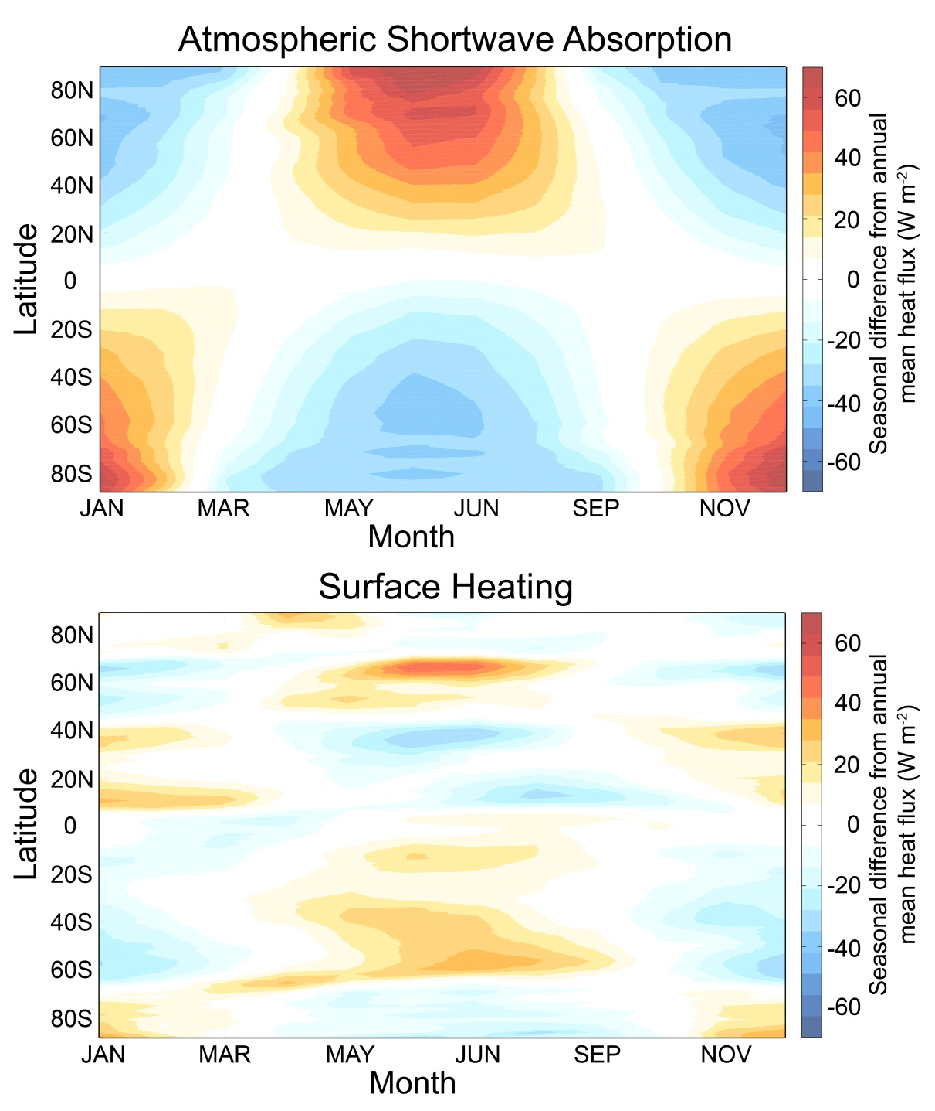
Seasonal Atmospheric Heating
ANNUAL MEAN IS
REMOVED

Slide 38
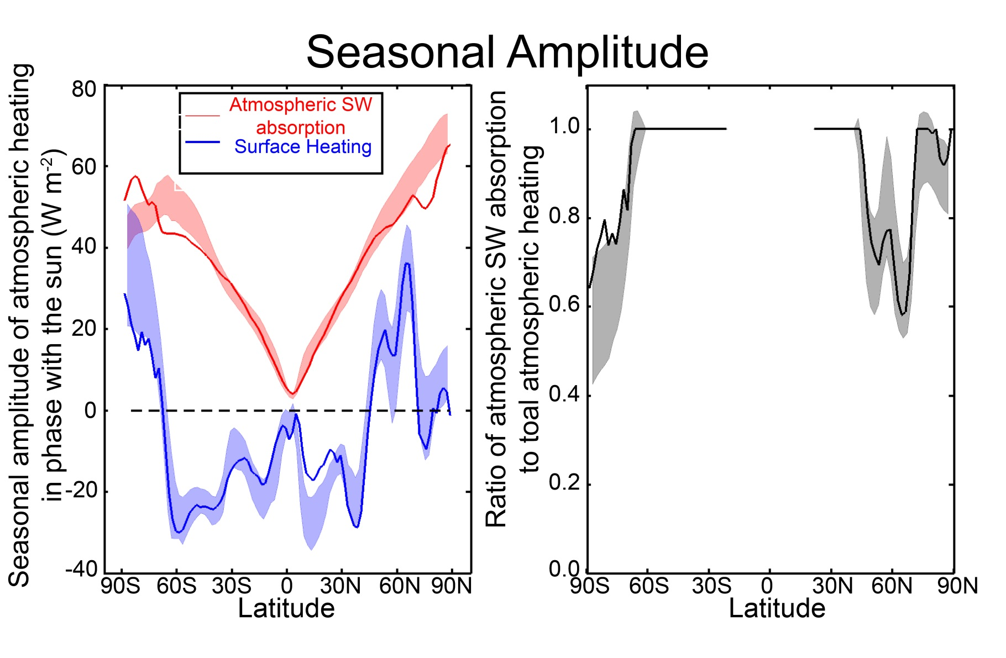
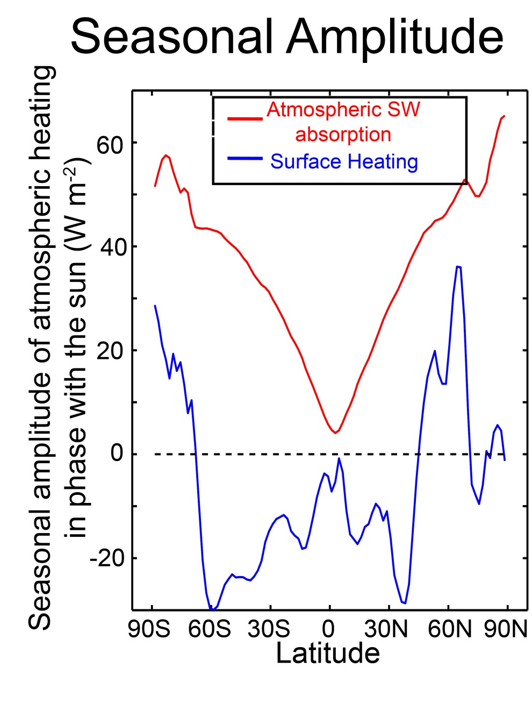
Seasonal Amplitude of heating
Seasonal Amplitude
Annual Mean
Define seasonal amplitude as:
Amplitude of annual harmonic
In phase with the insolation
Takes into account magnitude
and phase
Positive amplifies seasonal cycle
Negative reduces seasonal cycle

Slide 39
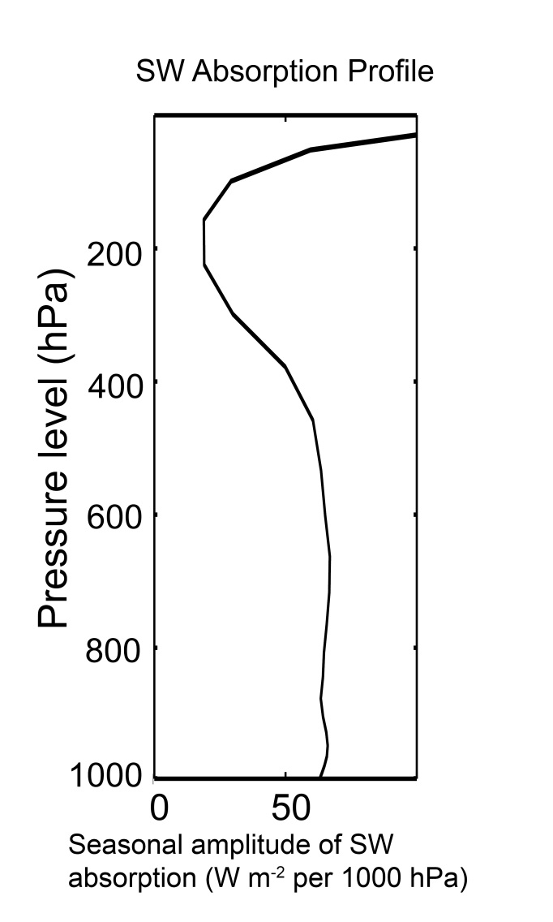
Define a seasonal amplitude
Vertical structure of SW absorption
GFDL Model
Seasonal amplitude
In the extratropics
Ozone
Water
Vapor

Slide 40
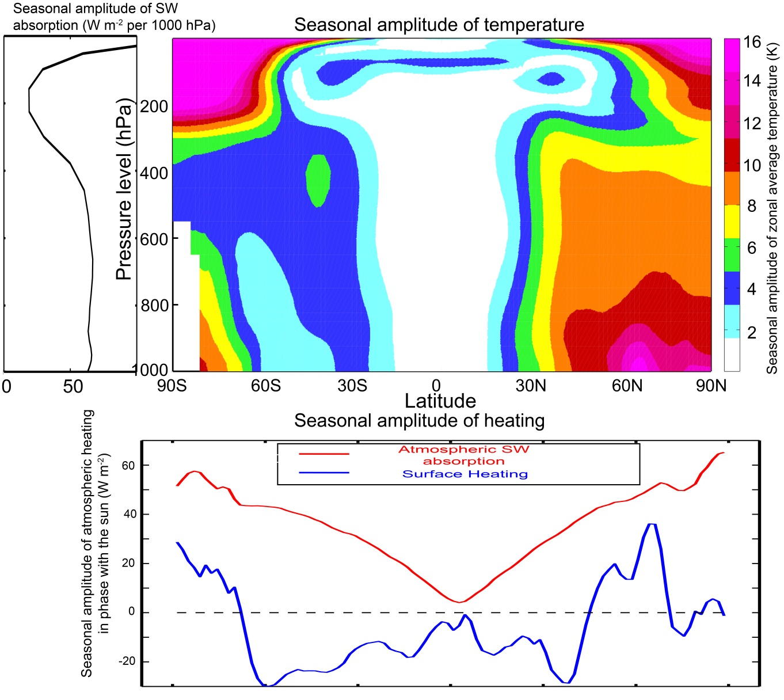
Structure of seasonal amplitude in temperature
Seasonal cycle is surface amplified where the surface heat fluxes contribute to seasonal heating (over land)

Slide 41
CO₂ doubling expectations
Summer schematic
Surface flux
SWABS
Moistening and melting
Mores seasonal energy input directly into the atmosphere (SWABS)
Less seasonal energy input at the surface (SHF)
Sea ice
Open ocean

Slide 42
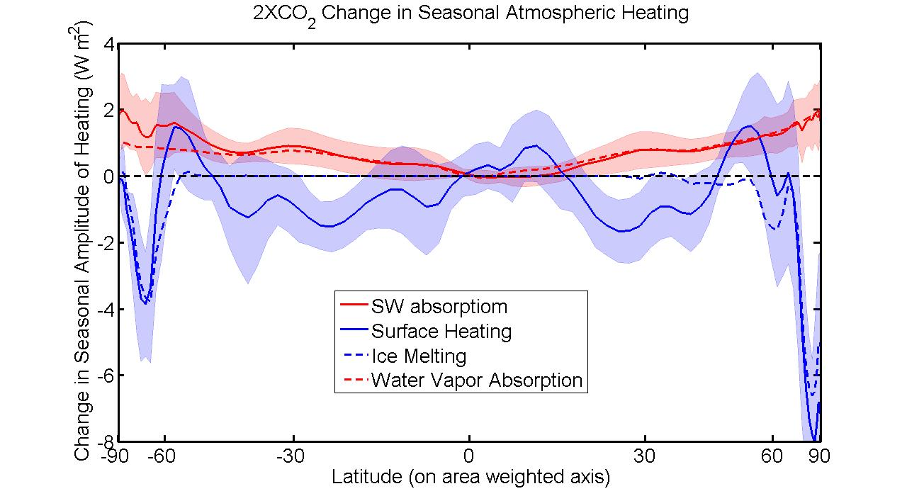

Slide 43
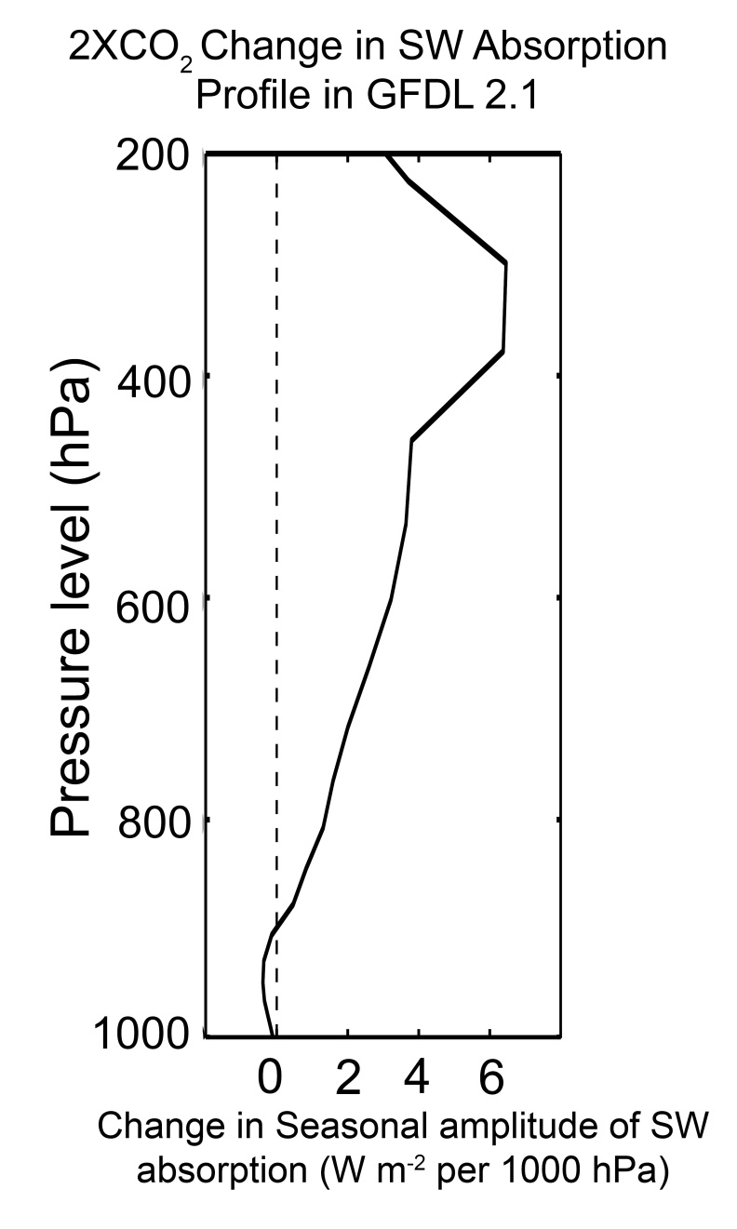
Water Vapor as a SW Absorber
(Figure: Robert Rhode
Global Warming Art Project)

Slide 44
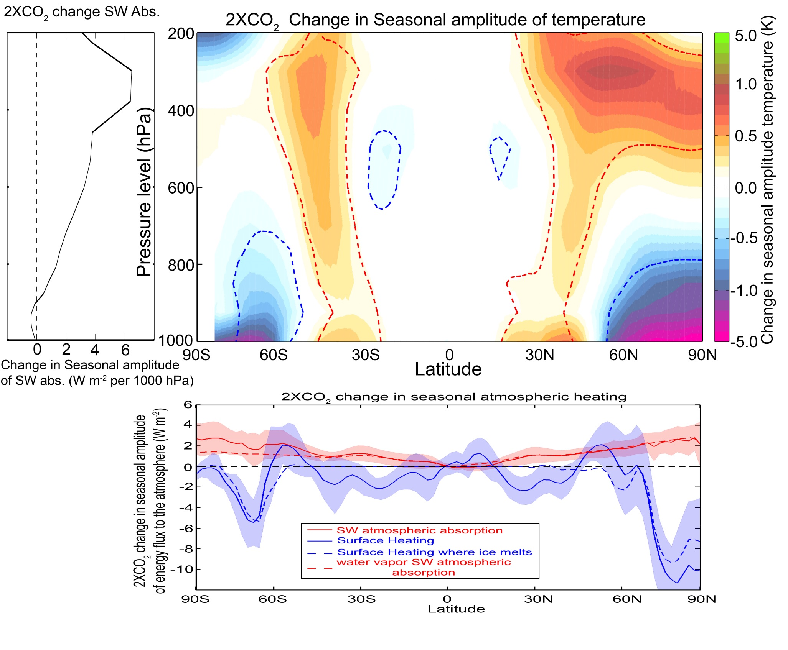
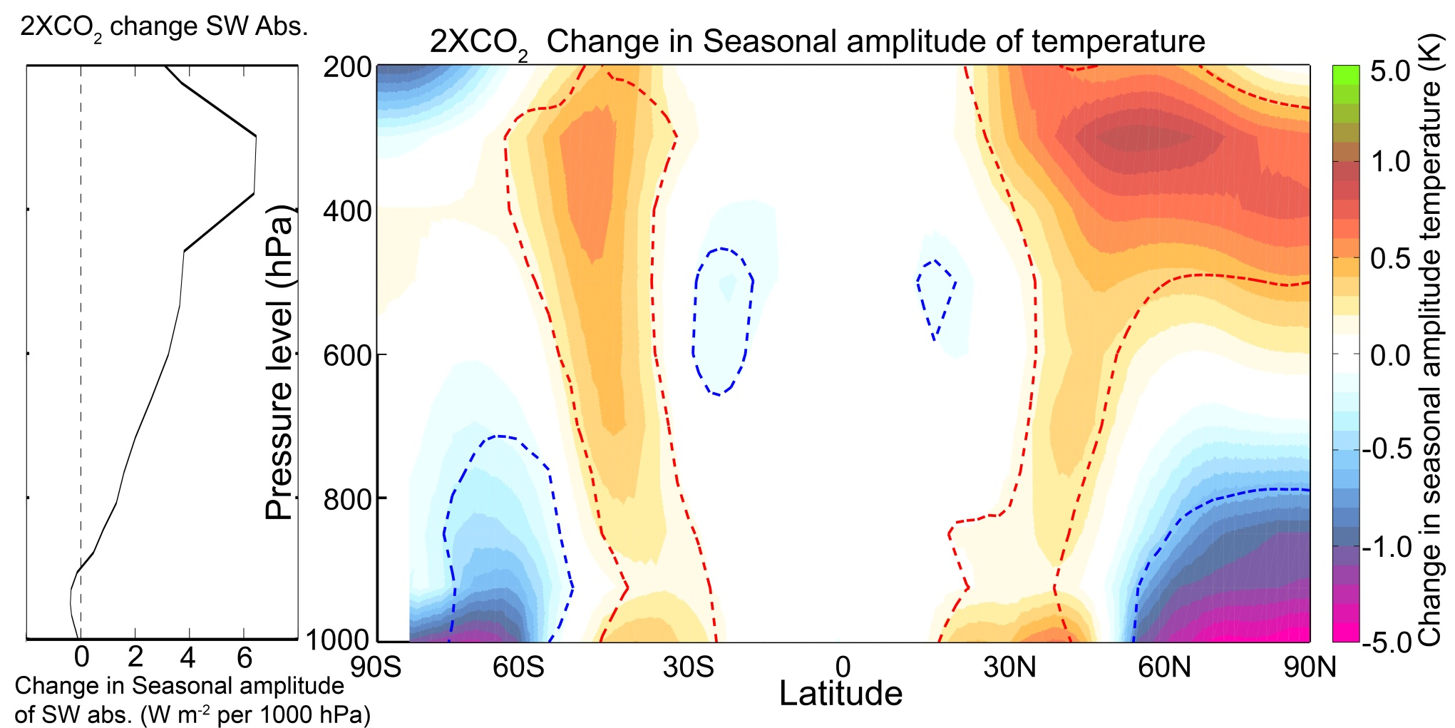
Reflects the combined contributions of:
Melting sea ice
=> reduced seasonal cycle of temperature at the surface
2. Increased SWABS due to atmospheric moistening
=> enhanced seasonal cycle of temperature aloft

Slide 45
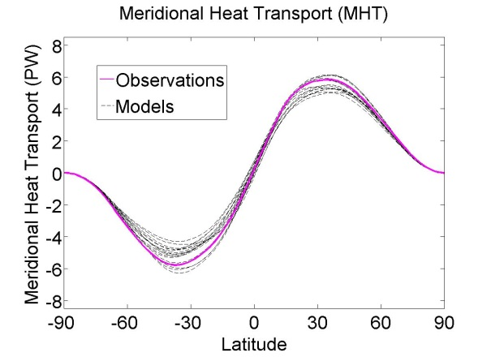

Conclusions
Reflected by Atmosphere
The amount of solar radiation absorbed by the climate system is primarily (88%) controlled by clouds
Solar Incident
Reflected by Surface
→ As the planet warms, more solar radiation will be absorbed due to atmospheric moistening and surface darkening
Atmosphere
The spatial pattern of absorbed solar radiation sets the atmospheric circulation
→ Strength of poleward energy transport
→ Location of tropical precipitation (Hadley Cell)
3. The seasonal heating of the atmosphere is due to shortwave heating of the atmosphere and is opposed by surface fluxes
→ Atmospheric moistening will amplify the seasonal cycle aloft and ice melt reduces the seasonal cycle at the surface

Slide 46
Extras

Slide 47
Partitioning of planetary albedo into atmospheric and surface components
Reflected by Atmosphere
α_{P} = α_{P,ATMOS} + α_{P,SURF}
Reflected by Surface
α_{P,ATMOS} = R
Solar Incident
α_{P,SURF} = α(1-R-A)²
(1-αR)
Atmosphere
Earth’s Surface

Slide 48
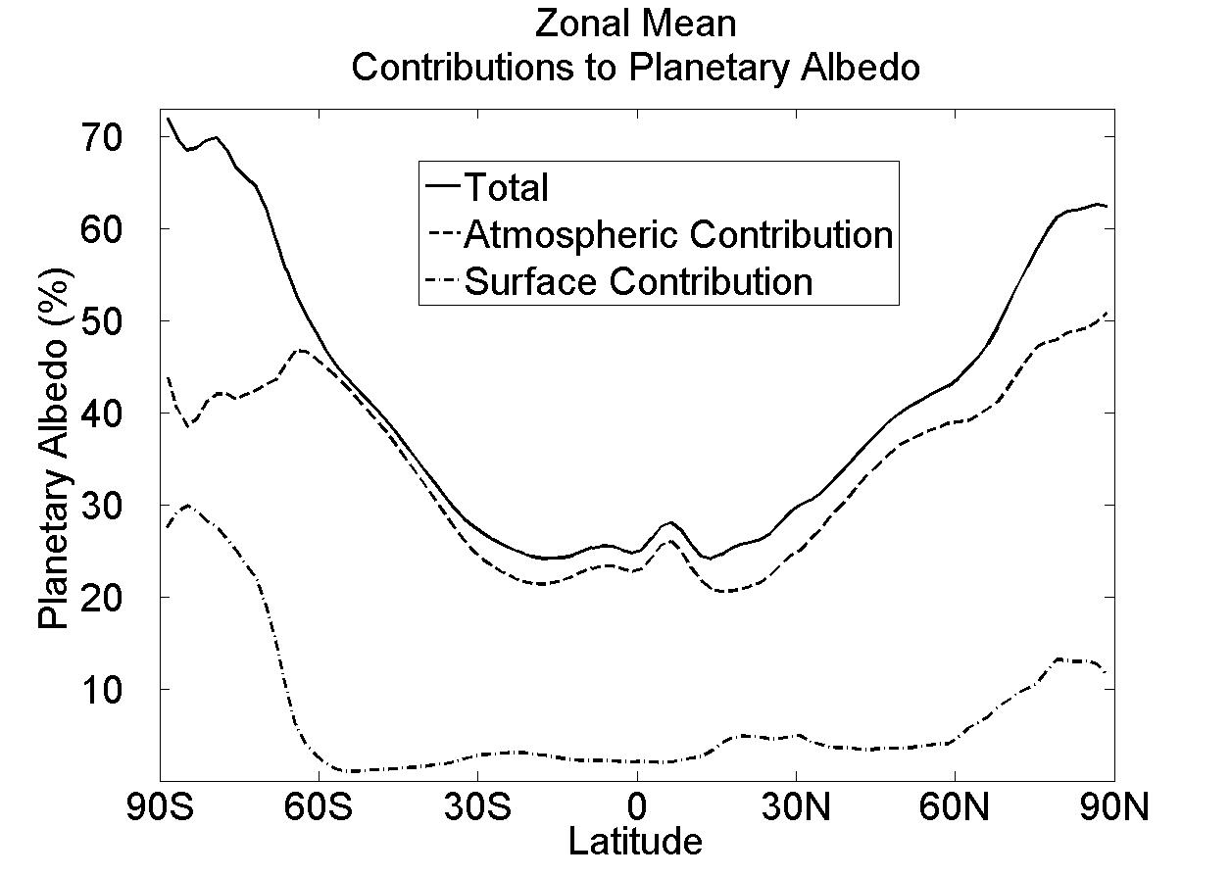
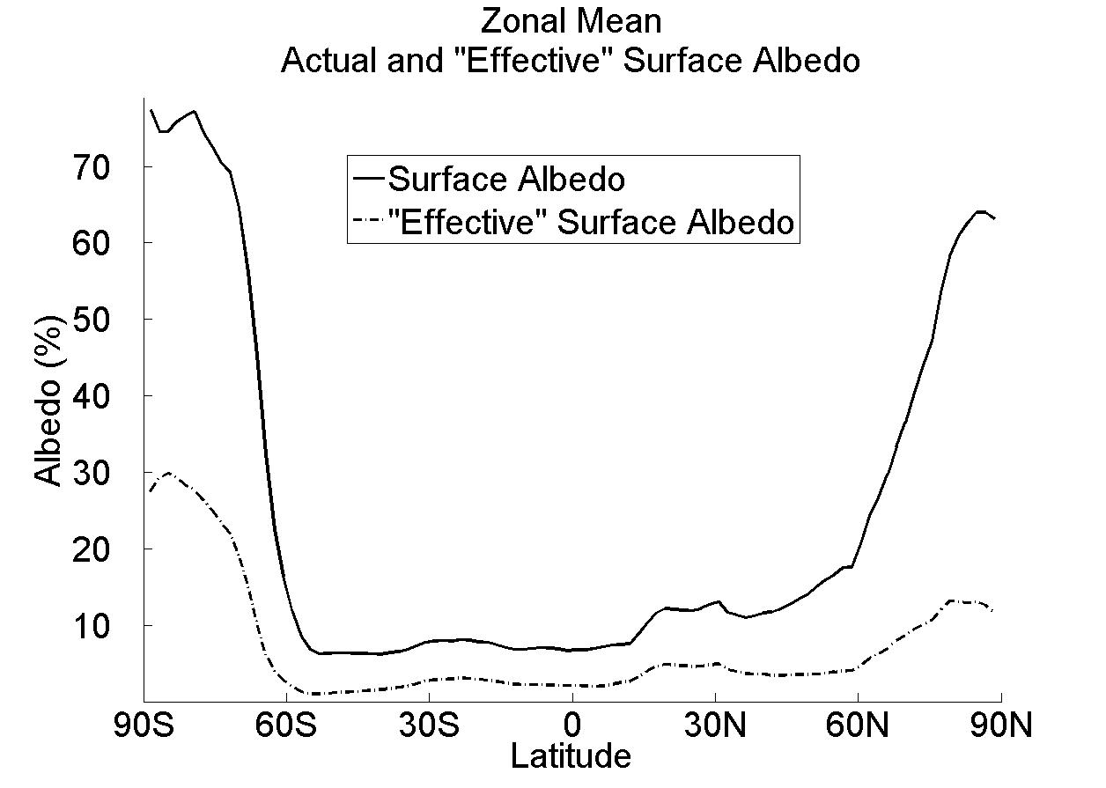
Observed Surface and atmospheric contribution to planetary albedo
Surface albedo and surface contribution to planetary albedo (α and α_{P,SURF})
α (surface albedo)
α_{P,SURF} = α(1-R-A)²
α_{P,SURF}
(1-αR)

Slide 49
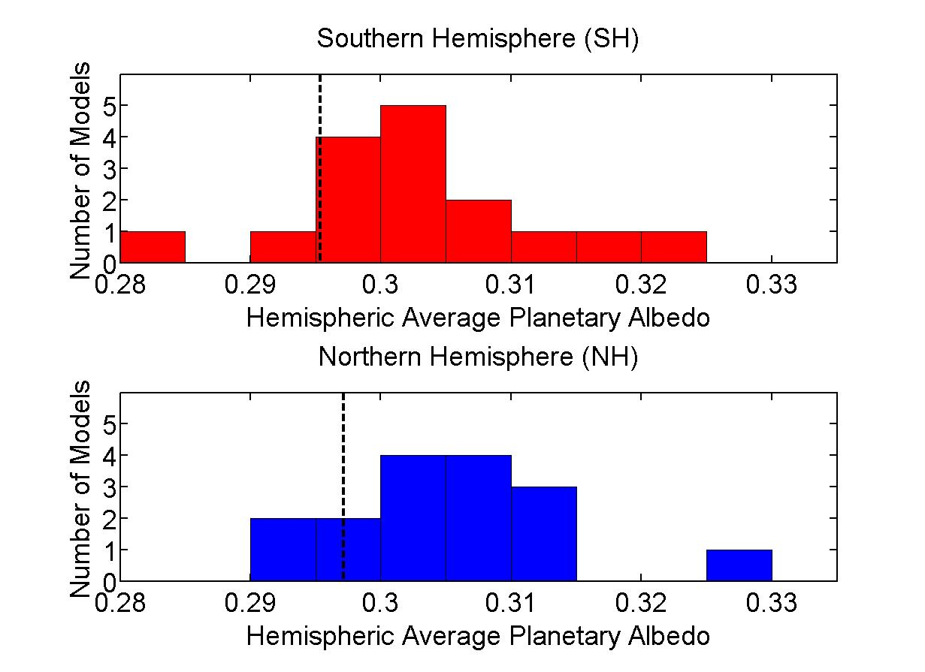
Histogram of hemispheric average planetary albedo
10 W m⁻²
Observations
(CERES)
Notes:
2 sigma = 0.016

Slide 50
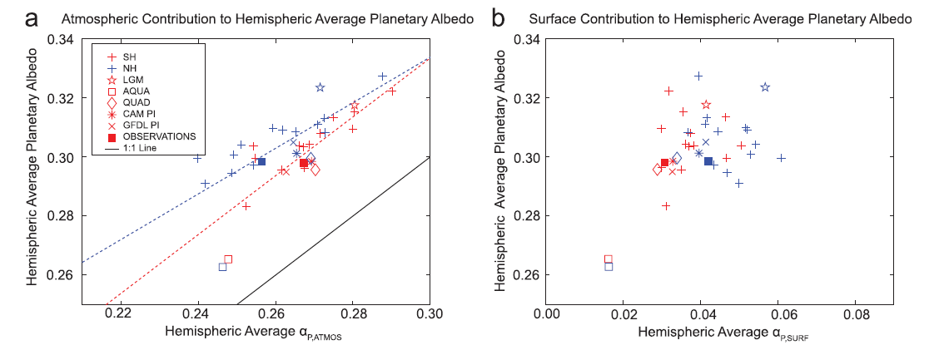
Hemispheric average planetary albedo partitioning in climate models
Inter-model spread in Hemispheric average planetary albedo is a consequence of differences in cloud reflection
Surface albedo makes a much smaller contribution to basic state albedo, model bias and inter-model spread

Slide 51
Observed Surface and atmospheric contribution to planetary albedo
Surface albedo and surface contribution to planetary albedo (α and α_{P,SURF})
α (surface albedo)
α_{P,SURF} = α(1-R-A)²
α_{P,SURF}
(1-αR)

Slide 52
Histogram of hemispheric average planetary albedo
10 W m⁻²
Observations
(CERES)
Notes:
2 sigma = 0.016

Slide 53
Hemispheric average planetary albedo partitioning in climate models
Inter-model spread in Hemispheric average planetary albedo is a consequence of differences in cloud reflection
Surface albedo makes a much smaller contribution to basic state albedo, model bias and inter-model spread

Slide 54


Cause of SW positive feedbacks:
incident
Reflected
cloud
absorbed
H₂0
(vapor)
Reflected
surface
transmitted
ice
ocean
Surface albedo feedback =
+0.26 ±0.08 W m⁻²K⁻¹
Bony et al. (2006)
SW Water vapor feedback
= +0.3±0.1 W m⁻²K⁻¹

Slide 55


Inter-hemispheric energy transport and the location of tropical precipitation
ITCZ location and atmospheric heat transport across the equator (AHT_{EQ})are both a consequence of the Hadley cell location
-> The atmosphere moves energy away from the ITCZ
The inter-model spread in
AHT_{EQ} and ITCZ location are strongly correlated

Slide 56

Conceptual model for heat transport
ASR*
OLR*
How to increase MHT
Option II: Increase ASR*
λ ΔT_{S}
8.2 PW
λ ΔT_{S}
10.5 PW
MHT
3.0 PW
2.4 PW
ΔT_{S}
D ΔT_{S}
ΔT_{S}
D ΔT_{S}
ΔT_{S}
5.8 PW
Tropics
7.5 PW
Tropics
ΔT_{S} is the equator-to-pole temperature contrast
Let OLR* = λ ΔT_{S}
Where λ is climate feedback parameter (W m⁻² K⁻¹)
And let MHT = D ΔT_{S}
Where D represents atmospheric diffusion (W m⁻² K⁻¹)
8.4 PW
7.5 PW
5.8 PW

Slide 57


Hemispheric contrast of radiation and ITCZ location
ITCZ lives in the hemisphere where the atmosphere is heated more strongly
-> In observations, the radiative input to each hemisphere is nearly equal and ITCZ is North of the equator because of Northward ocean heat transport
Model biases is planetary albedo lead to ITCZ biases
-> SH absorbs too much shortwave and ITCZ is too far south
Heating of SH

Slide 58

Changes in absorbed solar radiation with global warming
Surface flux
SWABS
Moistening and melting
Mores seasonal energy input directly into the atmosphere (SWABS)
Less seasonal energy input at the surface (SHF)
Sea ice
Open ocean

Slide 59

Meridional structure of atmospheric attenuation

Slide 60

Planetary Albedo and Surface Albedo

Slide 61

Meridional profile of albedo in all simiulations

Slide 62

Inter-model spread in albedo by region

Slide 63

2XCO₂ Planetary Albedo

Slide 64

2XCO₂ Planetary Albedo

Slide 65

Carl’s Question: Planetary Albedo Partitioning Error Bars

Slide 66

Planetary Albedo Partition: Sensitivity to shortwave absorption assumptions

Slide 67
What determines OLR*?
Why don’t differences in ASR* and OLR* compensate for each other?
Longwave Cloud Forcing
LWCF = OLR_{CLEAR} - OLR
(Kiehl, 1994)

Slide 68


Contributions to ASR* spread

Slide 69

Hemispheric Contrast Of TOA Radiation
NH reflects more SW radiation in the subtropical deserts. SH reflects more SW in the extratropics due to clouds in the Southern Ocean
The NH is warmer (more OLR), especially in the polar latitudes
Planetary albedo is partitioned into cloud and surface contributions via the method of Donohoe and Battisti (2011)

Slide 70
Define a seasonal amplitude
Vertical structure of SW absorption
GFDL Model
Seasonal amplitude
In the extratropics
Chou Lee (1996)
Water vapor absorption
In the summer
50
100
150
Heating Rate (W m⁻² )

Slide 71
Annual mean heating summary
30% reflected
20% absorbed atmosphere
atmosphere
50% transmitted
To surface
50% net flux from surface
to atmosphere
surface
Surface energy balance (absorbed solar flux = upward flux to the atmosphere) requires that the ratio of heating from direct absorption to surface energy fluxes is
approximately:
atmospheric absorption (SW) /atmospheric transmissivity(SW)
=> direct absorption accounts for 30% of atmospheric heating

