Slide 1
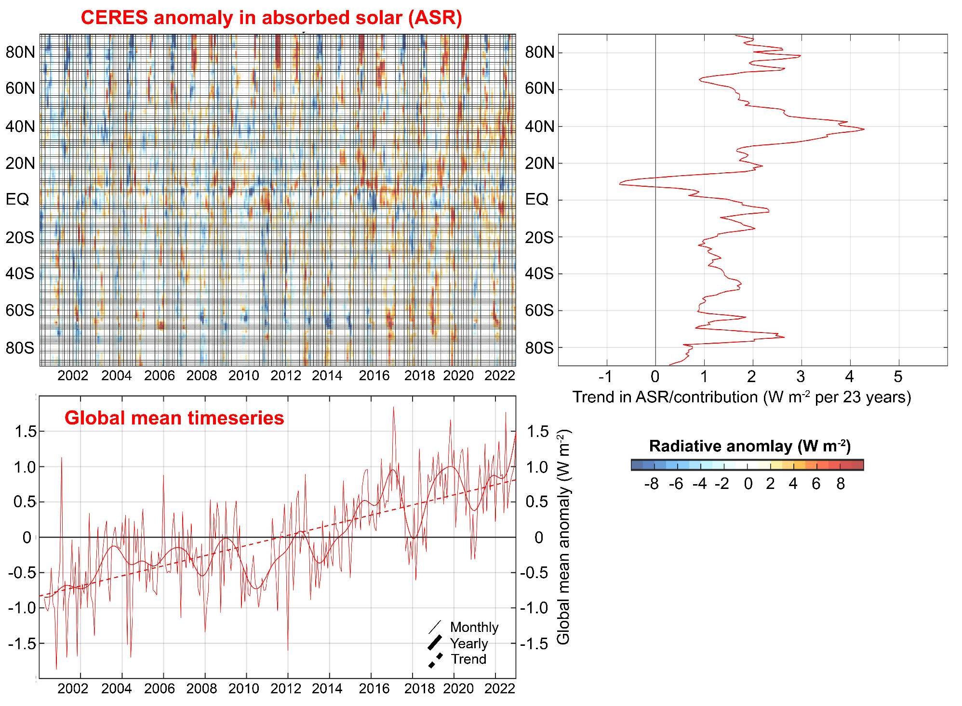

Slide 2

Attributing observed ASR changes to processes
Atmospheric
Contribution
To planetary
Albedo
Surface
Contribution
To planetary
Albedo
S = incident
R = cloud
reflection
A = absorption
α = surface
albedo
(UNKNOWNS)

Slide 3



Climatological
planetary albedo
Surface reflection
Surface contribution:
= α(1-A)(1-R)²
(1-αR)
Atmospheric reflection
Impact of surface changes
on ASR
Atmosphere

Slide 4

Radiative sensitivity from isotropic model
→ Isotropic model matches kernel calculations
Satellite observations provide an estimate of Radiative sensitivity
→The model average radiative sensitivity is close to the observational estimate

Slide 6
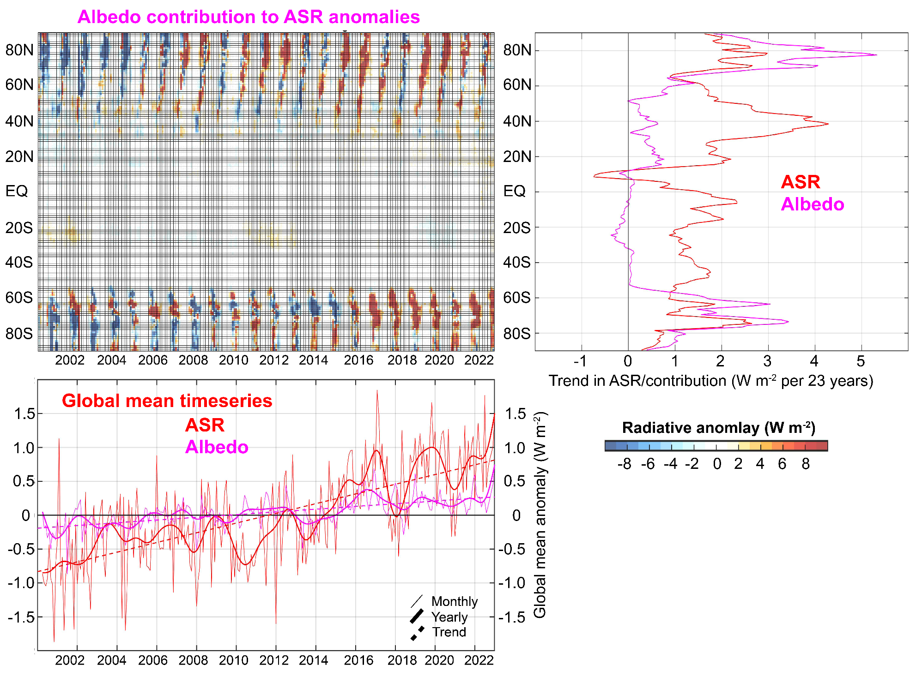
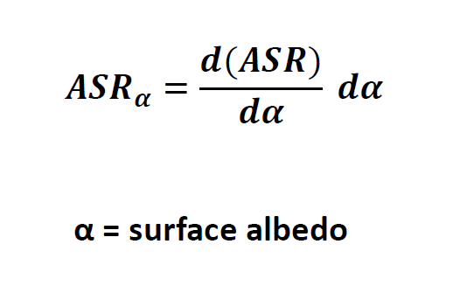

Slide 7
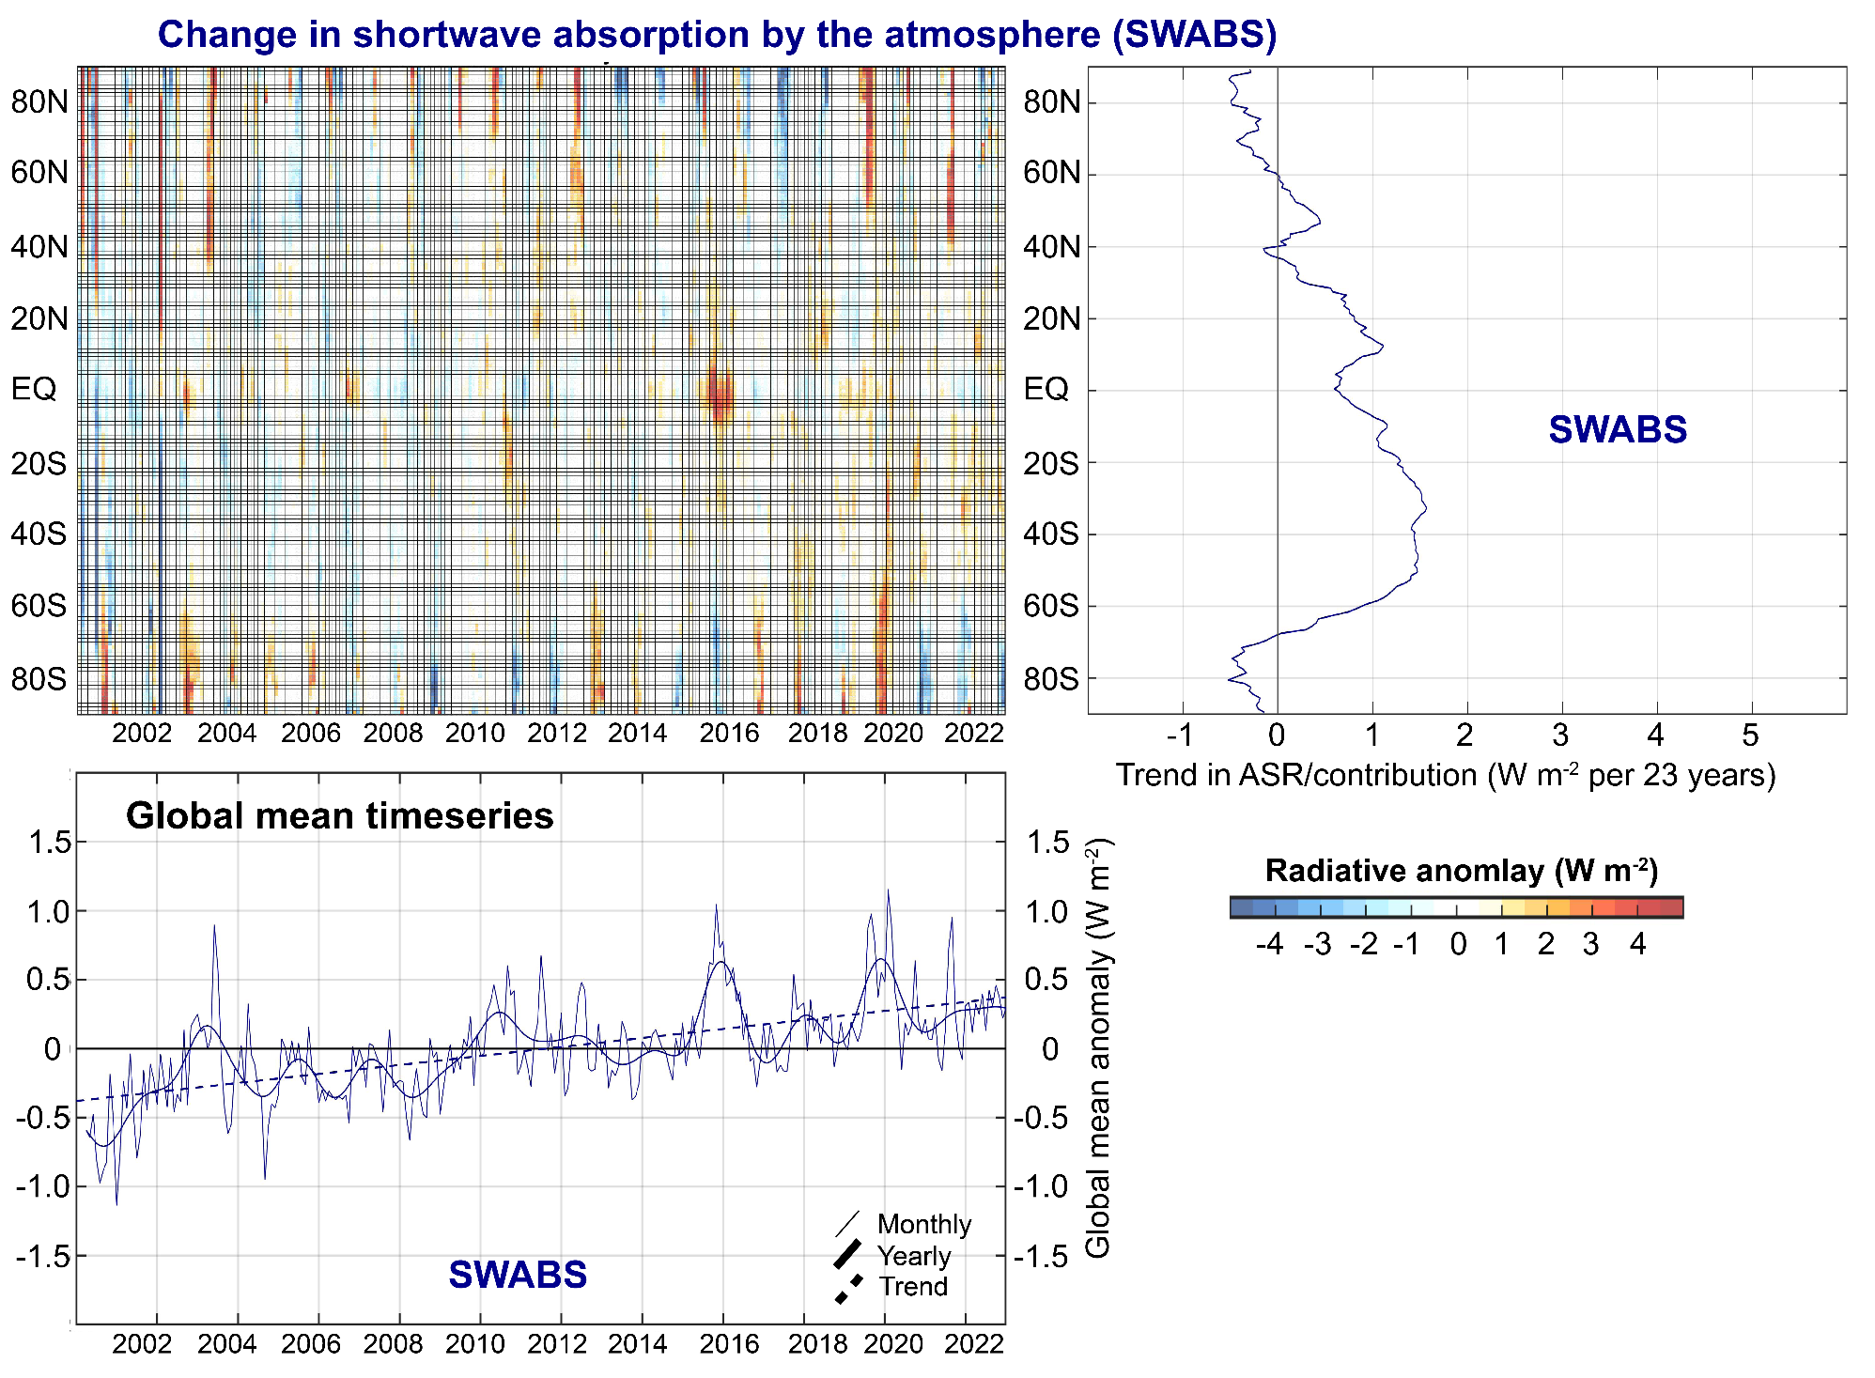

Slide 8
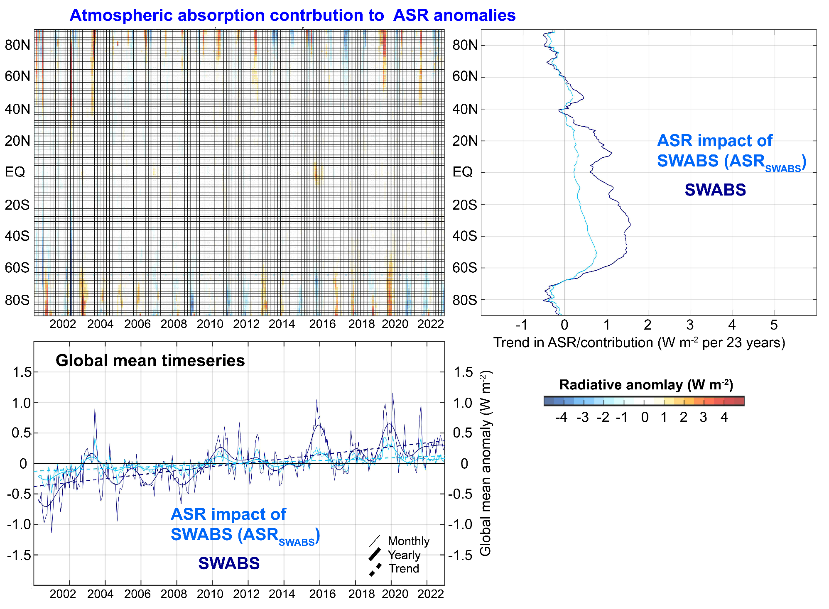
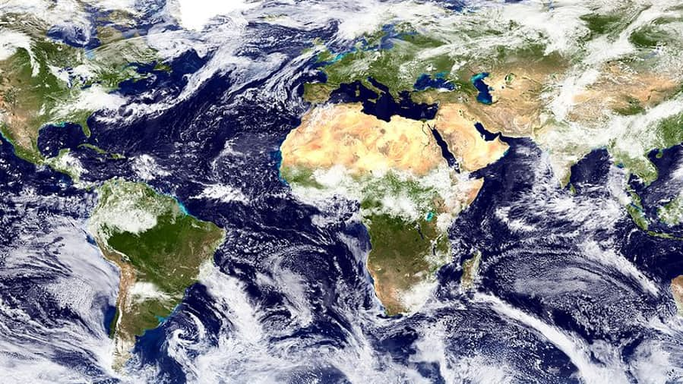

Slide 9
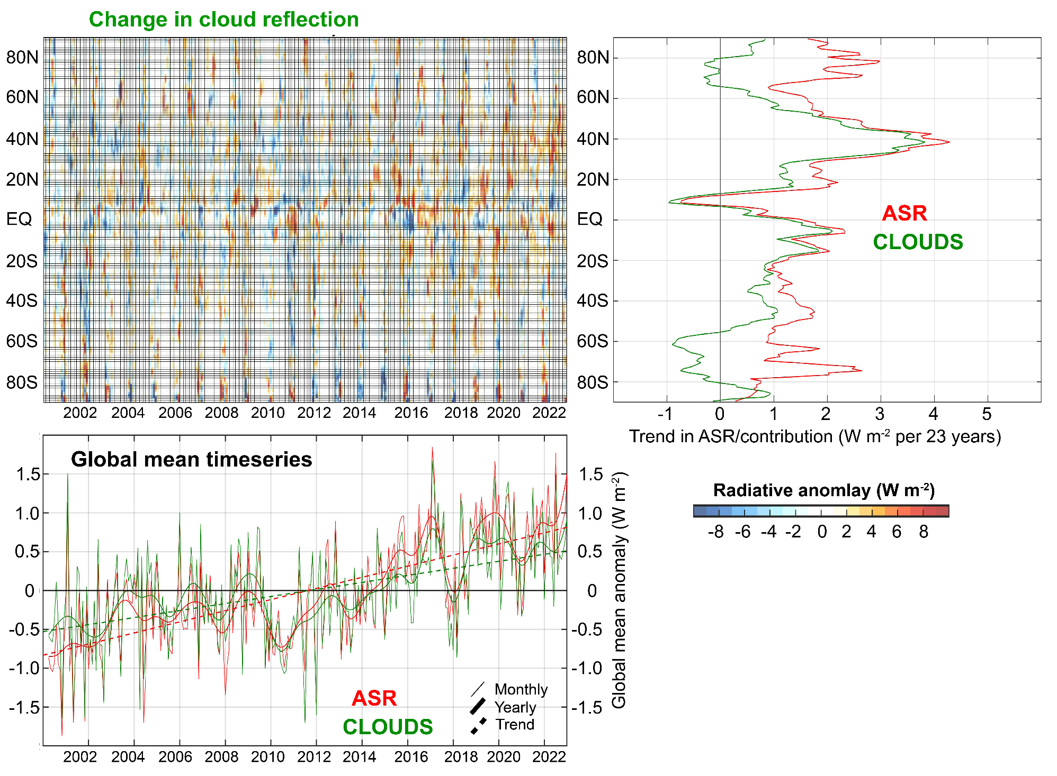

Slide 10
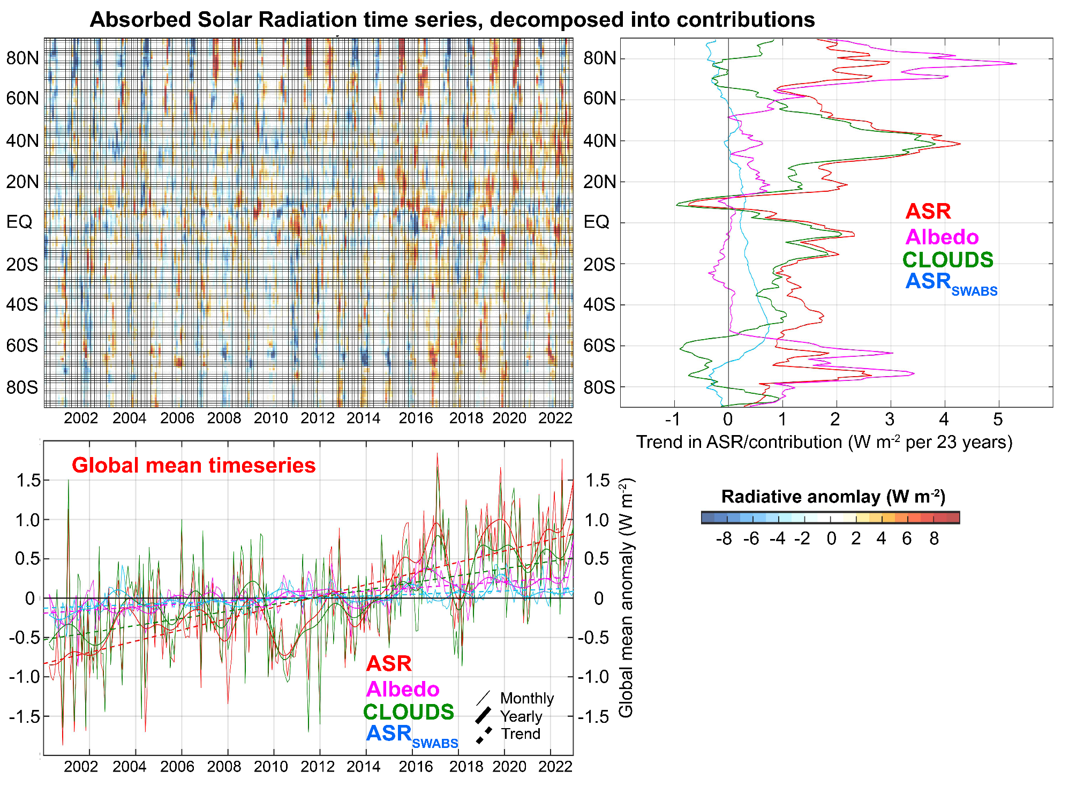
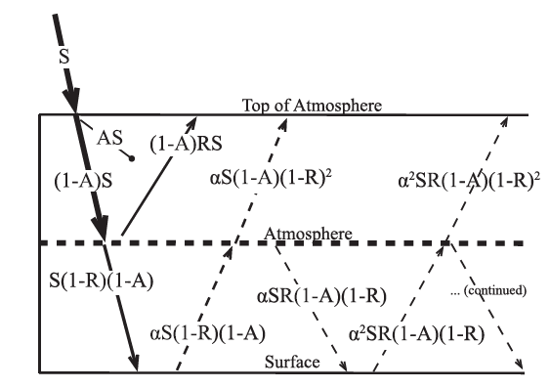

Slide 11
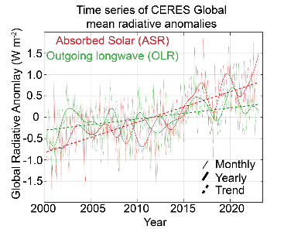
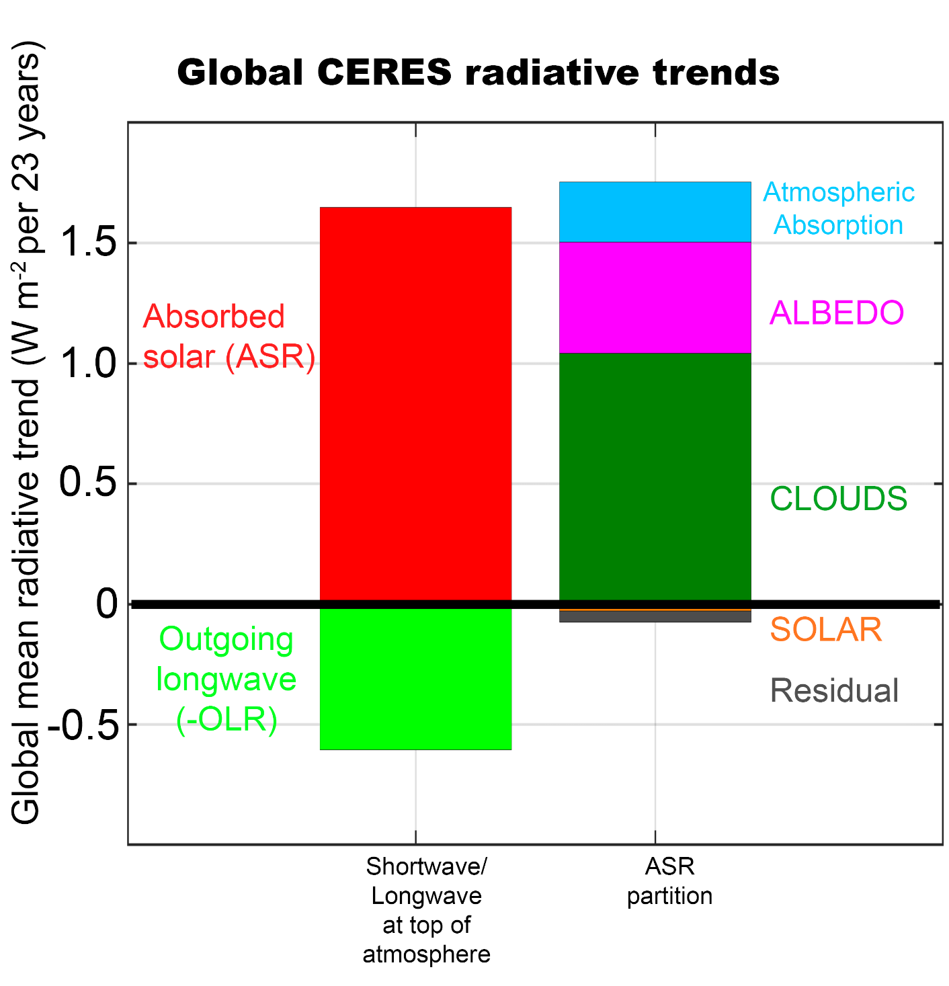
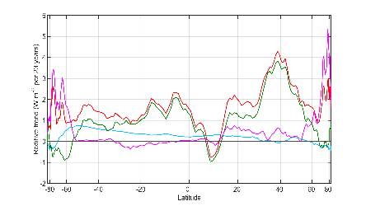


Slide 12
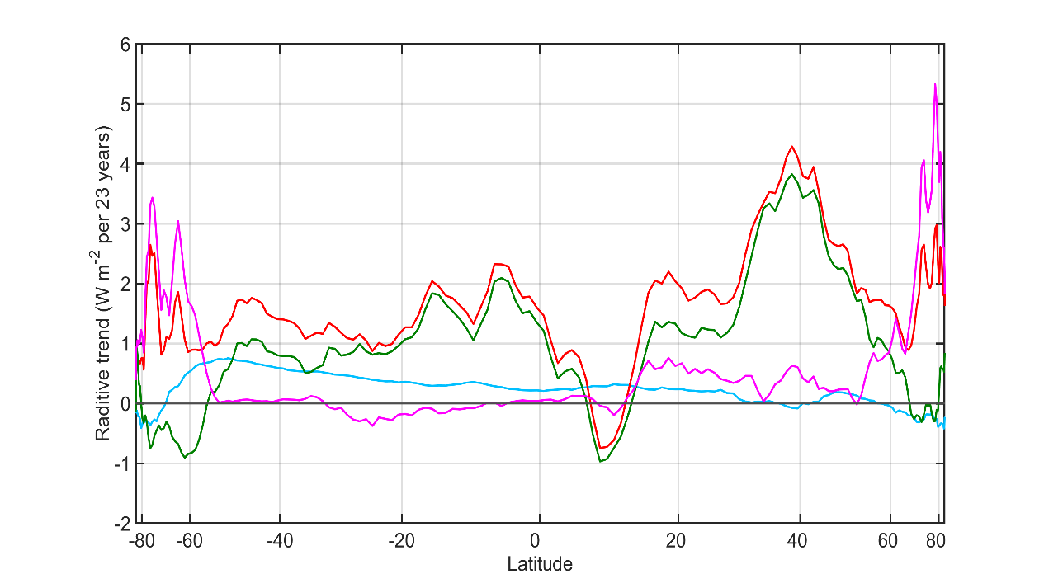

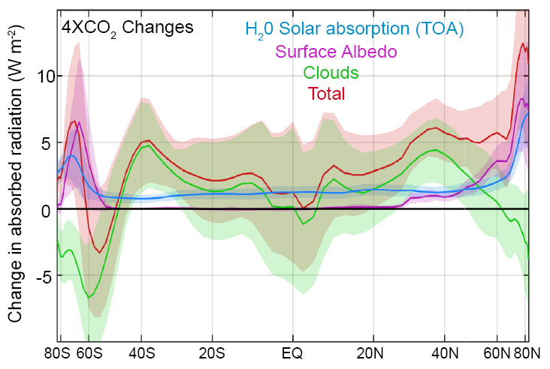
Observational trends in Absorbed Solar from CERES (2000-2023)
Model (ensemble mean) change in absorbed solar from radiative kernels

