Slide 1
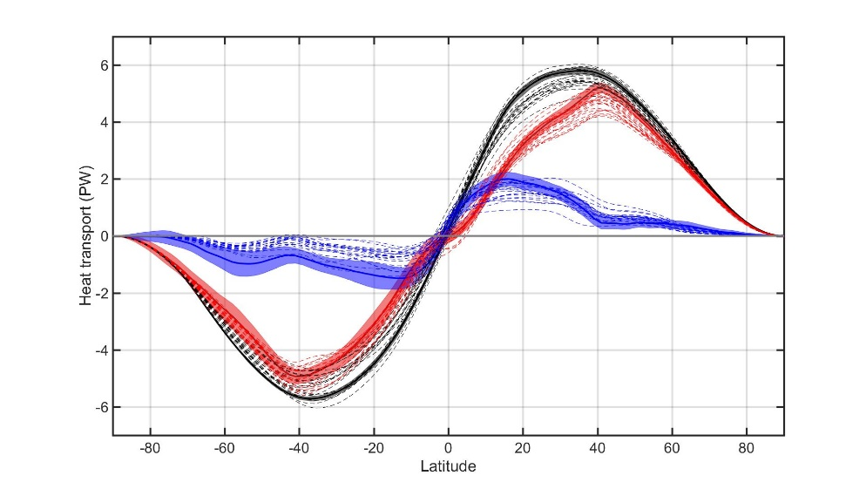










Observational-model comparison of:
Surface albedo feedback
Poleward energy transport
Total
Atmosphere
Ocean
Aaron Donohoe
Ed Blanchard-Wrigglesworth IV – UW Atmos. Sciences
Axel Schweiger – Polar Science Center, APL, UW
Phil Rasch – Pacific Northwest National Lab
Kyle Armour – UW Oceanography
David Battisti– UW atmospheric sciences
Gerard Roe – UW Earth and Space Sciences

Slide 2
=
Ice Albedo
Feedback
Ice sensitivity
Radiative Sensitivity
Global Radiative Feedbacks
IPCC AR5 estimate
albedo feedback
IPCC AR5, Soden and Held 2006

Slide 3
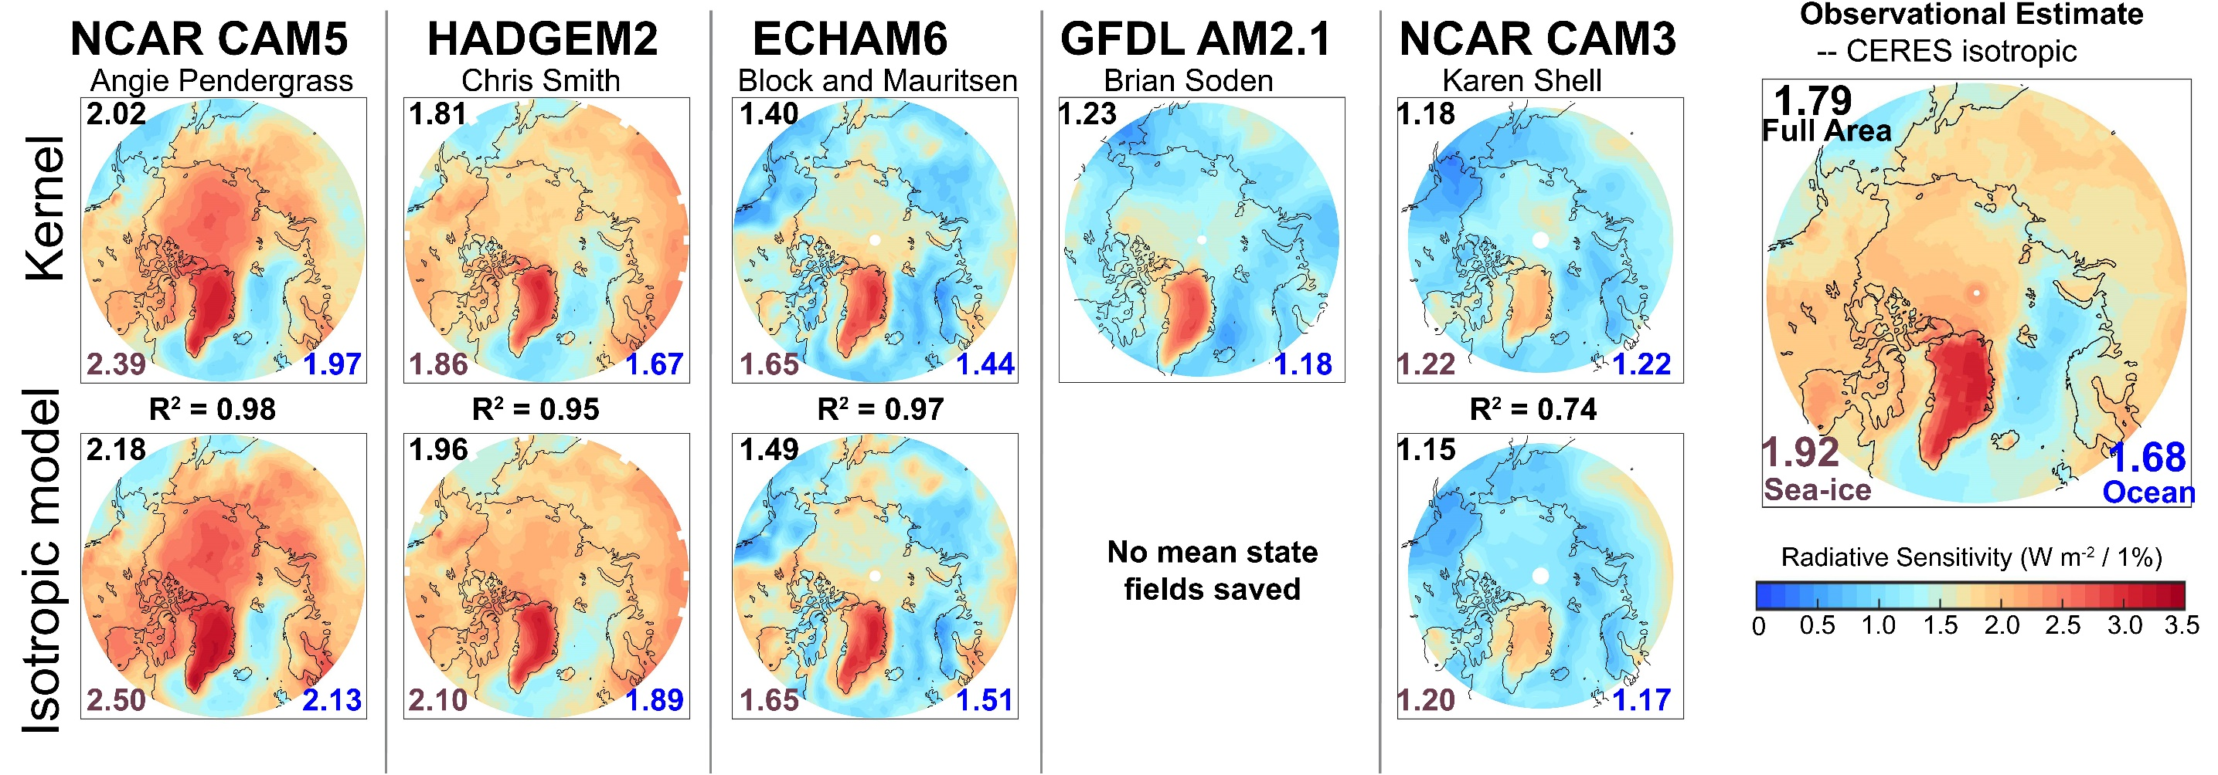
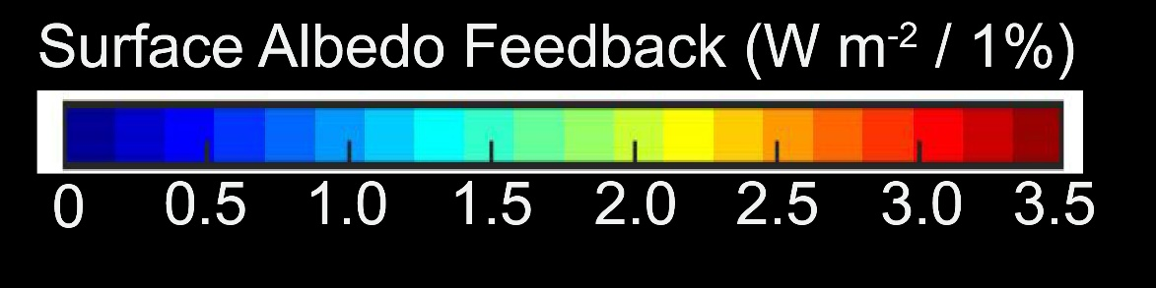
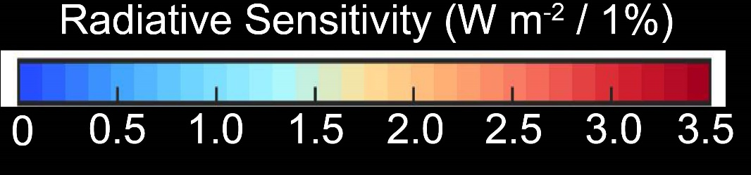
How much additional solar radiation is absorbed in the Arctic as sea ice melts? -- Radiative sensitivity
Averaged over May, June, July and August
Calculated from Radiative kernels – by perturbing surface albedo in each model’s radiative code
Large inter-model differences due to mean state cloudiness
Summer insolation averages 420 W m⁻² → transparent atmosphere expected to have values of 4.2 W m⁻² %⁻¹

Slide 4

Simplified shortwave radiation model (APRP, Taylor 2007)
S = incident
R = cloud
reflection
A = absorption
α = surface
albedo
(UNKNOWNS)
v
v
v

Slide 5
Simplified shortwave radiation model (APRP, Taylor 2007)
S = incident
R = cloud
reflection
A = absorption
α = surface
albedo
(UNKNOWNS)
v
v

Slide 6
Simplified shortwave radiation model (APRP, Taylor 2007)
S = incident
R = cloud
reflection
A = absorption
α = surface
albedo
(UNKNOWNS)

Slide 7
Simplified shortwave radiation model (APRP, Taylor 2007)
S = incident
R = cloud
reflection
A = absorption
α = surface
albedo
(UNKNOWNS)

Slide 8
Simplified shortwave radiation model (APRP, Taylor 2007)
S = incident
R = cloud
reflection
A = absorption
α = surface
albedo
(UNKNOWNS)

Slide 9
Simplified (isotropic) shortwave radiation model
Surface
Contribution
To planetary
Albedo
Atmospheric
Contribution
To planetary
Albedo
S = incident
R = cloud
reflection
A = absorption
α = surface
albedo
(UNKNOWNS)

Slide 10
Simplified (isotropic) shortwave radiation model
Atmospheric
Contribution
To planetary
Albedo
Surface
Contribution
To planetary
Albedo
S = incident
R = cloud
reflection
A = absorption
α = surface
albedo
(UNKNOWNS)

Slide 11



Climatological
planetary albedo
Surface reflection
Surface contribution:
= α(1-A)(1-R)²
(1-αR)
Atmospheric reflection
Radiative Sensitivity
Atmosphere

Slide 12

Radiative sensitivity from isotropic model
→ Isotropic model matches kernel calculations
Satellite observations provide an estimate of Radiative sensitivity
→The model average radiative sensitivity is close to the observational estimate

Slide 13
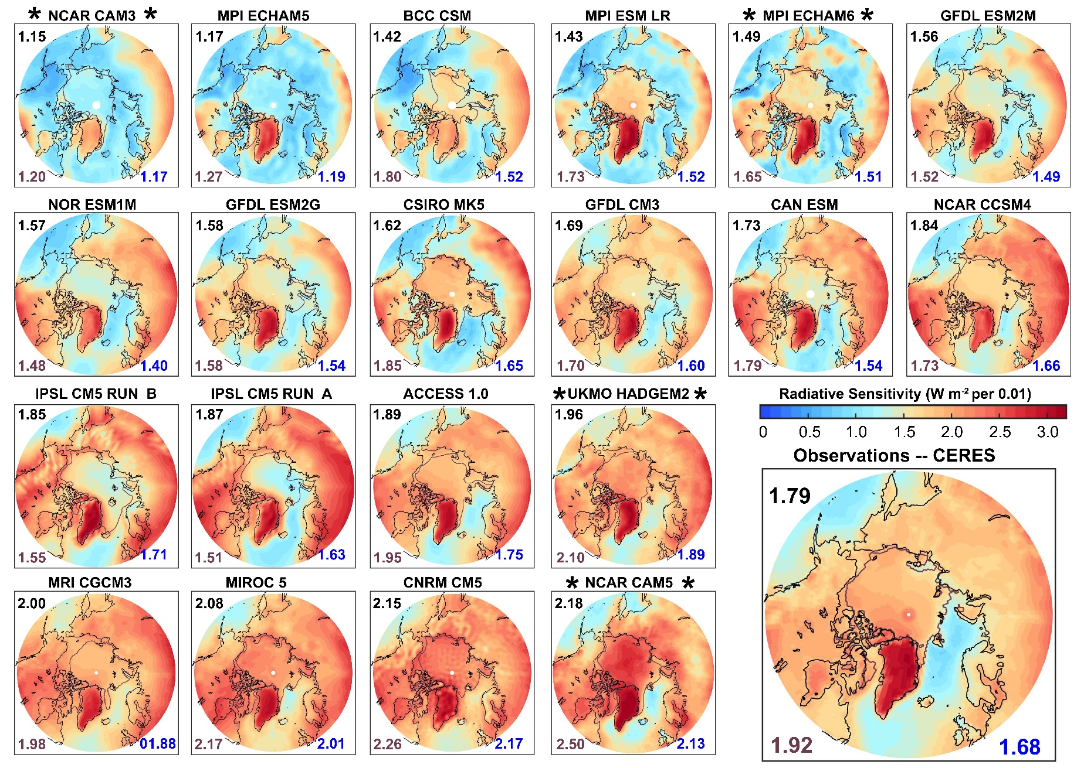
Radiative sensitivity all models
Domain Average
Ice edge
Arctic Ocean Average
Average over sea ice

Slide 14
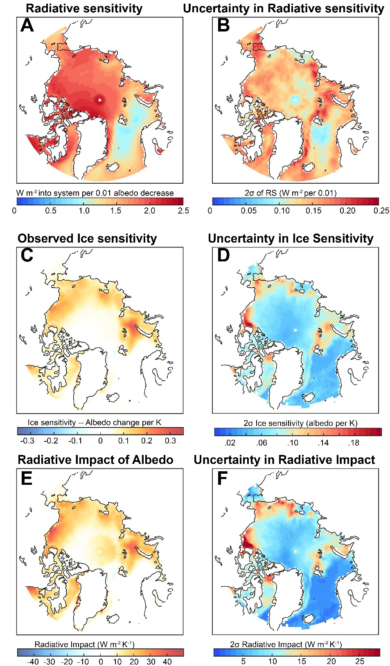
Observational Ice Albedo Feedback (IAF)
Ice Albedo
Feedback
=
Ice sensitivity
Radiative Sensitivity
Surface albedo changes between 1982 and 2017 from 2 sources
NSIDC sea ice change times Δα of 0.54
Polar Pathfinder (APP-X) surface albedo change
Thanks to Xuanji Wang and Jeff Key
Global mean surface temperature change = 0.7 +/- .1 K from 3 sources
HADCRUT (Cowtan and Way)
GISTEMP
NCEP surface temp
Radiative sensitivity from CERES
Global Impact of IAF
= 0.16 ± 0.04 W m⁻² K⁻¹

Slide 15
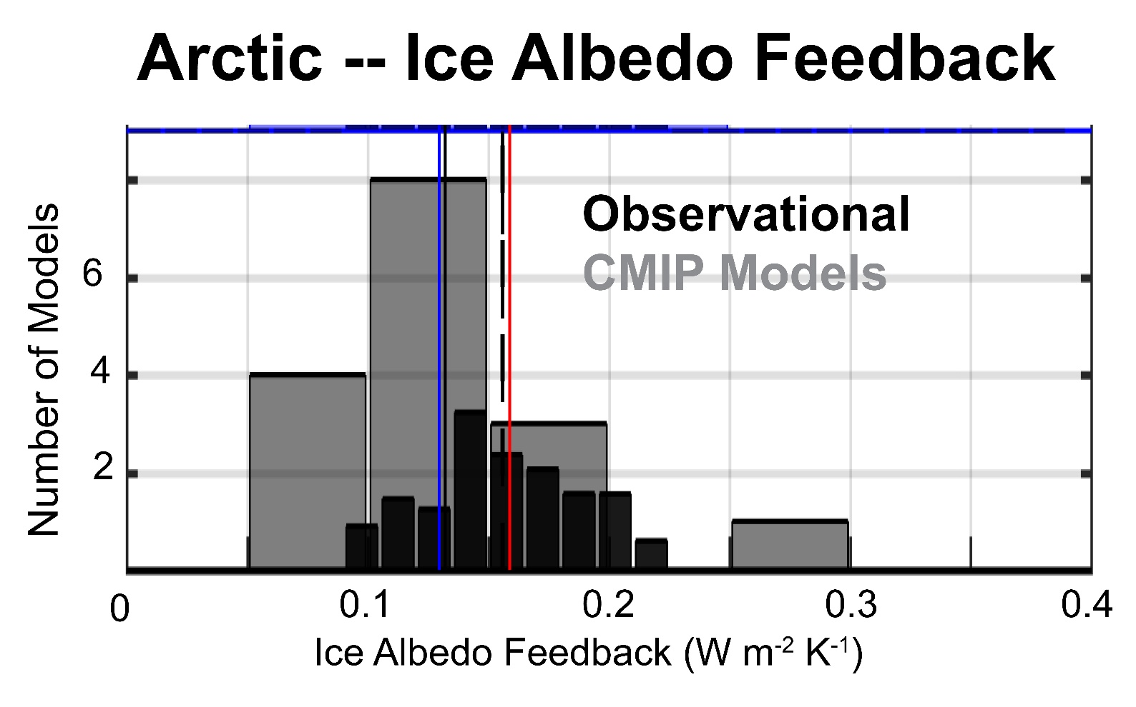
Model Observation comparison of ice albedo feedback
Observed IAF = 0.16 ± 0.04 W m⁻² K⁻¹
CMIP5 historical simulation IAF = 0.12 ± 0.13 W m⁻² K⁻¹
CMIP5 4XCO2 IAF = 0.13 ± 0.09 W m⁻² K⁻¹
CMIP5 4XCO2 IAF with observational Radiative Sensitivity = 0.13 ± 0.08 W m⁻² K⁻¹
CMIP5 4XCO2 IAF with observational Ice Sensitivity = 0.16 ± 0.04 W m⁻² K⁻¹

Slide 16

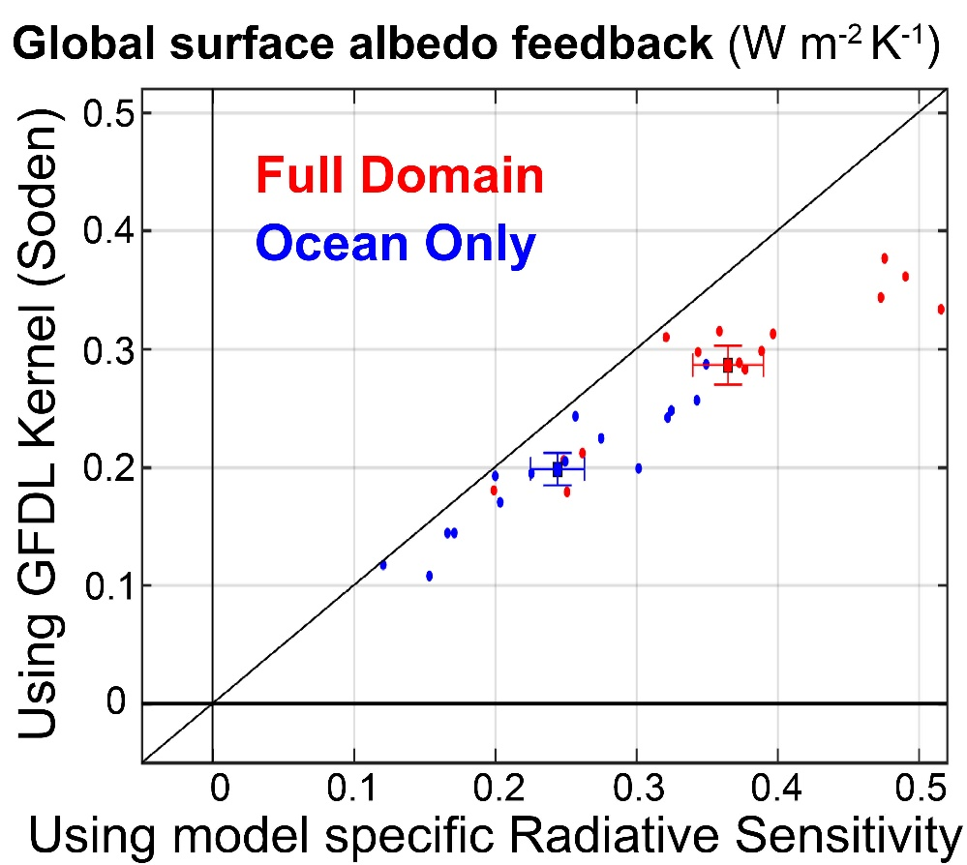
IPCC value of surface albedo feedback in models
Using GFDL surface albedo kernel applied to all models (Soden , 2008) gives ensemble average of:
0.26 W m⁻² K⁻¹
Replace GFDL kernel with model specific radiative sensitivity
Surface albedo feedback --This Study
0.37 W m⁻² K⁻¹
Our value is 40% larger than the IPCC estimate:
30% from using a radiative sensitivity that is biased low
10% from larger ice sensitivity in CMIP5 compared to CMIP3

Slide 17
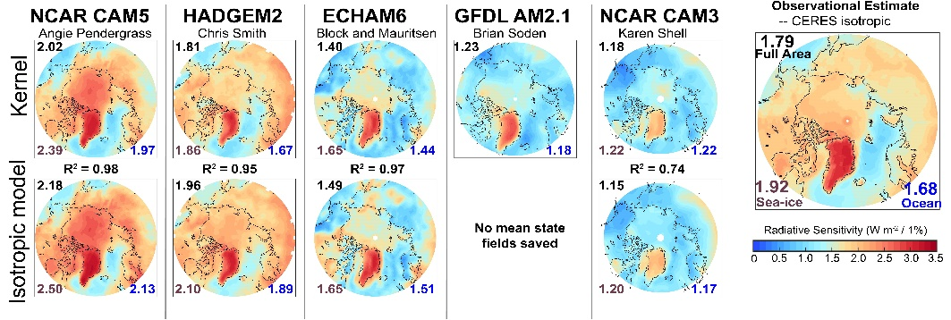

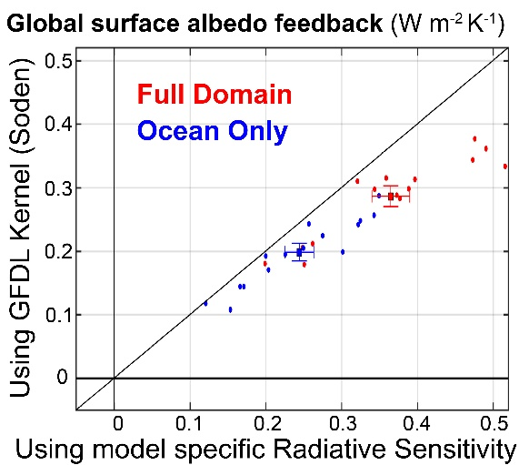
Surface albedo Conclusions
Radiative sensitivity of sea ice loss differs by factor of 2 between models
Replicated by simple radiation model
Observational estimate is near model mean
Observational ice albedo feedback estimate = 0.16 ± 0.04 W m⁻² K⁻¹
Models biased slightly low due to low ice sensitivity
Global surface albedo feedback in climate models
= 0.37 ± 0.19 W m⁻² K⁻¹
40% greater than IPCC estimate

Slide 18

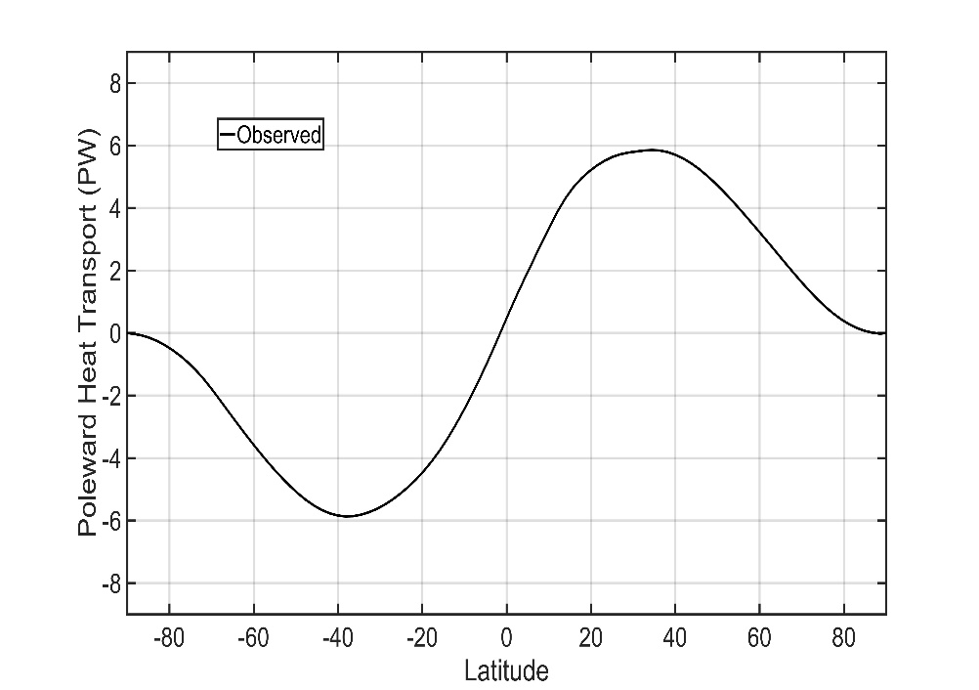

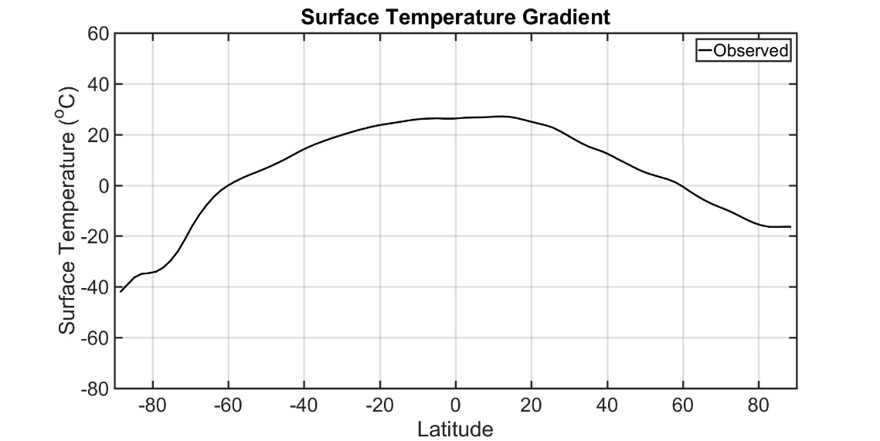
Poleward energy transport: motivation
5.8 PW
5.8 PW

Slide 19
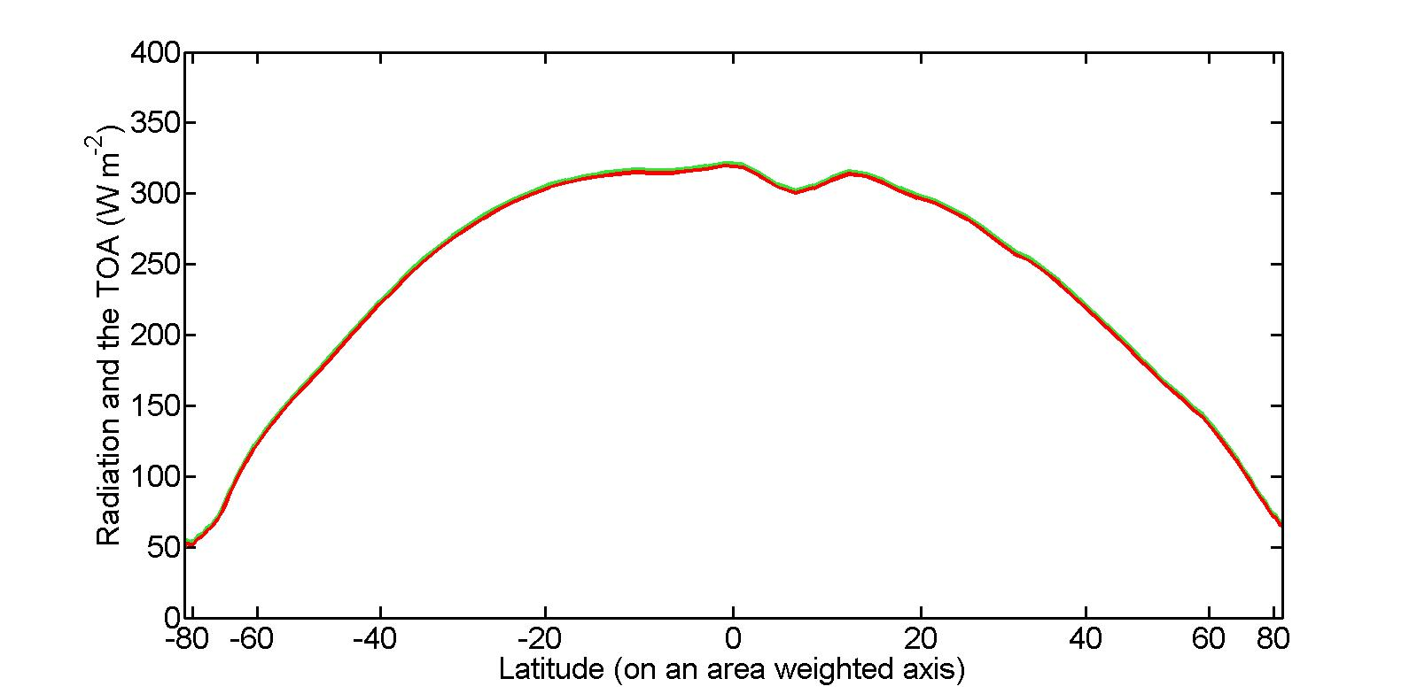
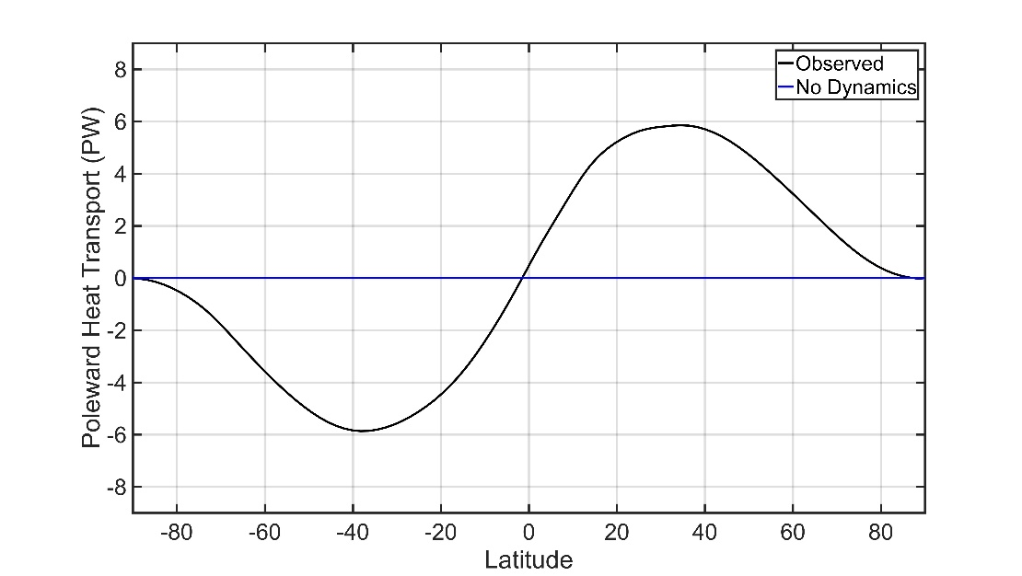

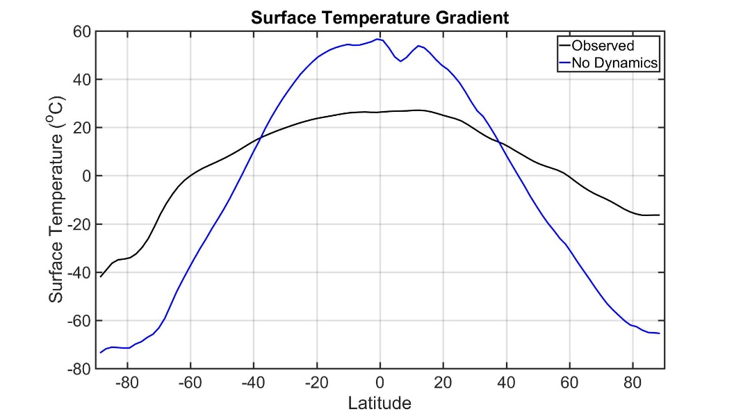
Poleward energy transport: motivation
Limit of no dynamics: local radiative equilibrium
0 PW
0 PW

Slide 20
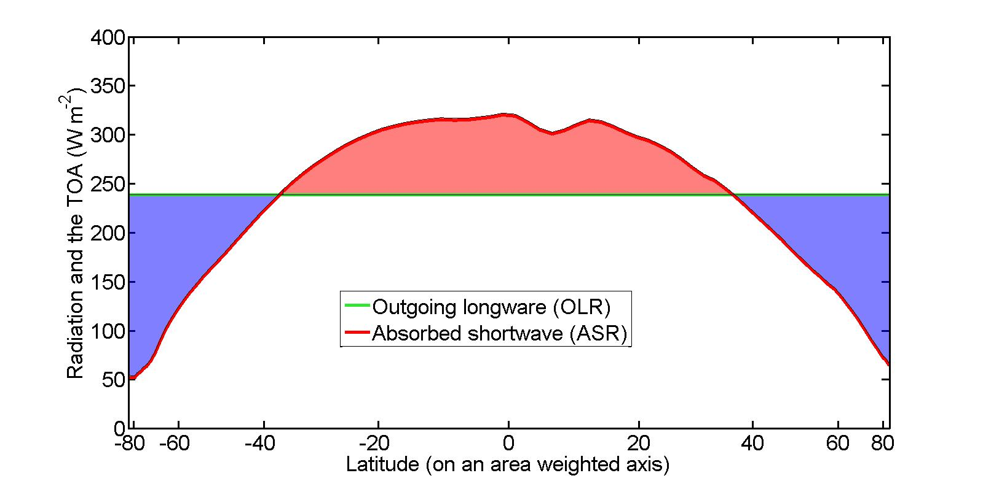
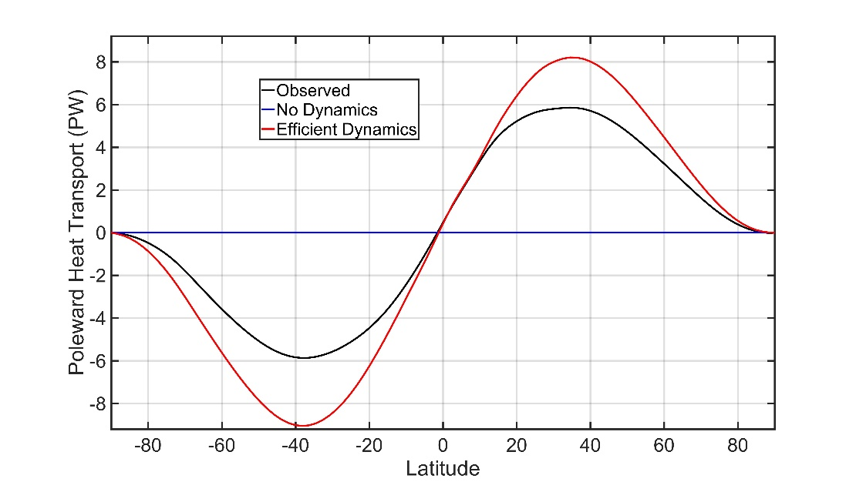
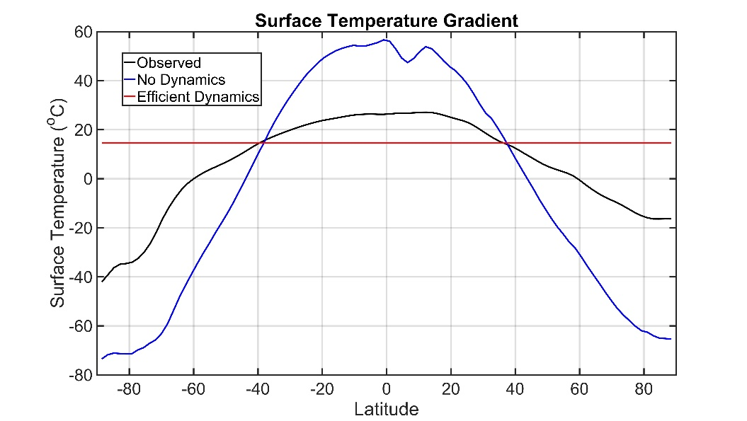
Poleward energy transport: motivation
Limit (infinitely) efficient dynamics : heat transport = insolation gradient
9.0 PW
8.2 PW
Poleward energy transport = local radiative disequilibrium of extratropics
Intricately rekated to equator to pole temperature gradient
Theoretically, can vary between 0 and 9 PWs

Slide 21
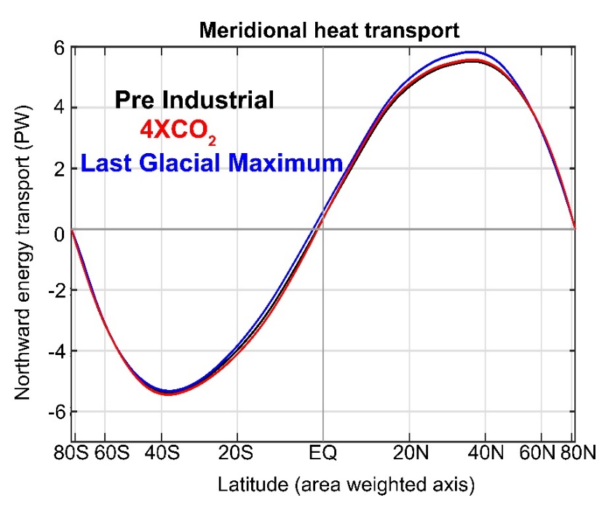
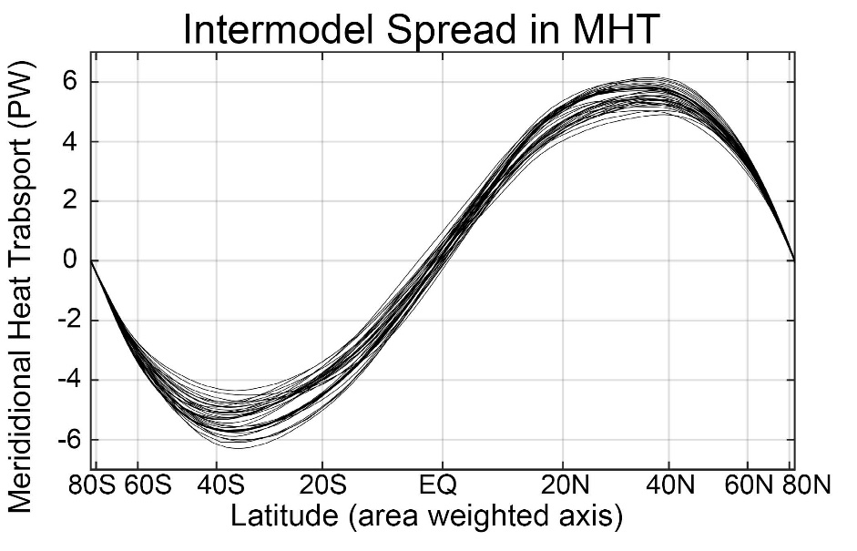
In climate models, Coupled (atmosphere plus ocean) Meridional Heat Transport (MHT):
Is nearly invariant under past/future forcing, but
Varies (20%) between different climate models (and observations)

Slide 22


Understanding heat transport
5.8 PW
ASR*
OLR*
9.0 PW
8.2 PW
2.4 PW
-
Heat
Transport
=
Notes:
NH = 8.2 - 2.4 = 5.8
SH = 9.0 – 3.2 = 5.8

Slide 23
ASR*, OLR*, MHT, and the tropical/extratropical energy budget
OLR*
ASR*
2.4 PW
8.2 PW
MHT =
ASR* - OLR*
MHT
Tropics
5.8 PW
To extratropics
All arrows are relative to the global average

Slide 24
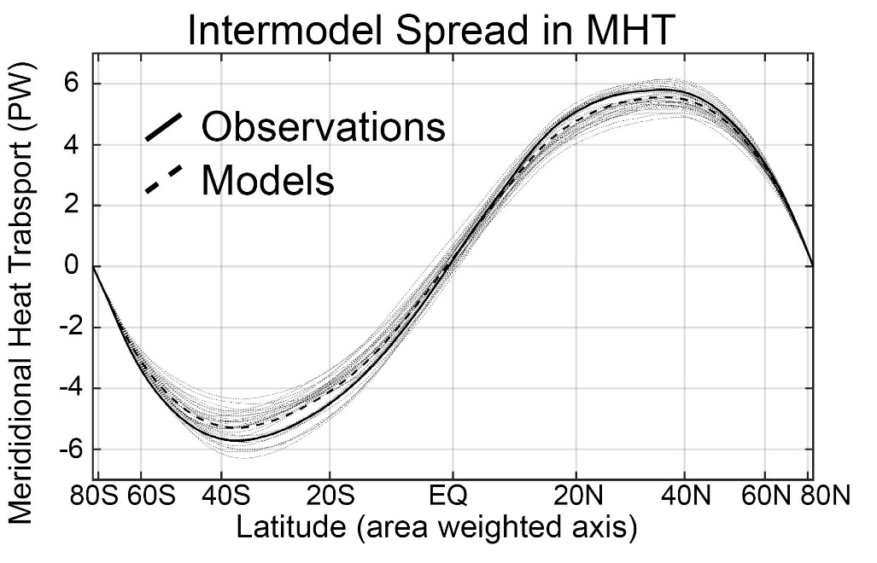
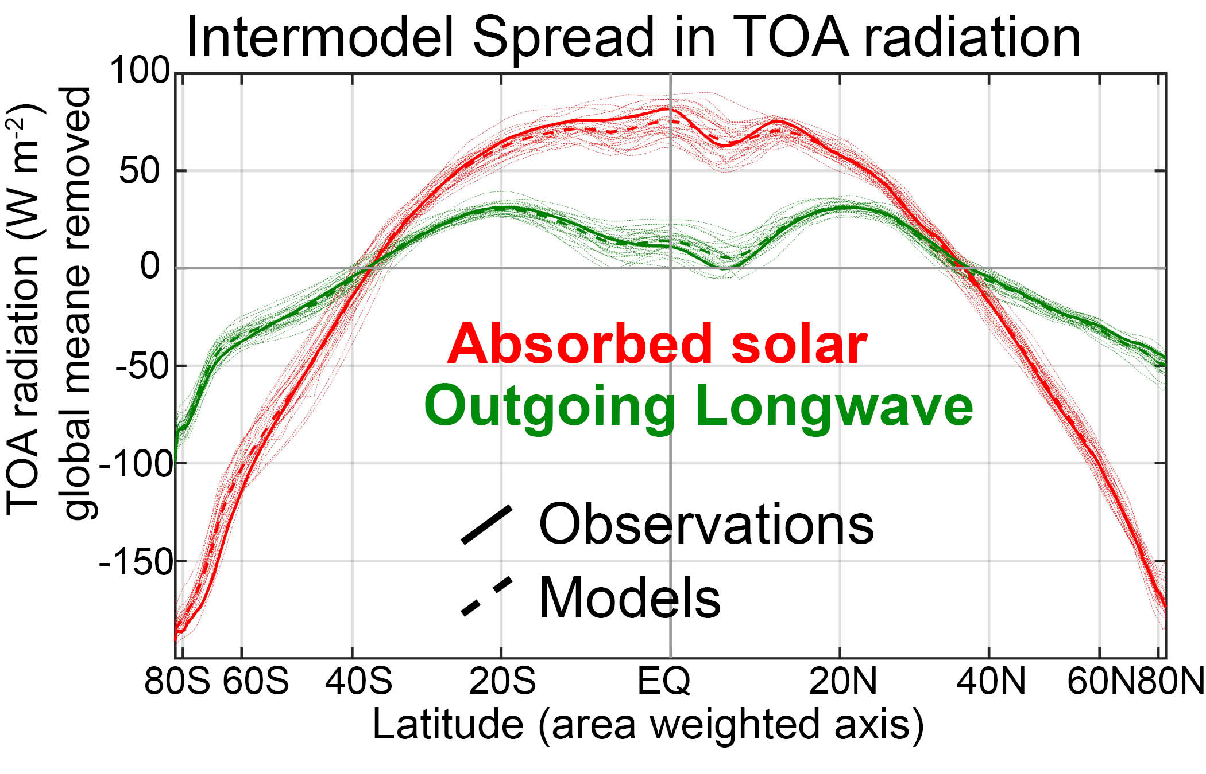

Slide 25
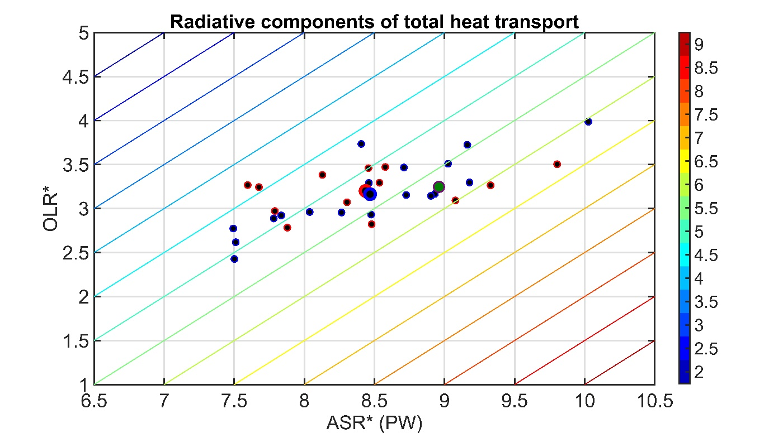

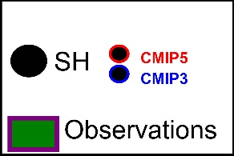

MHT =
ASR* - OLR*
MHT maximum (PW)
Southern Hemisphere
Mean state inter-model spread in MHT:
Spread in ASR* exceeds that in OLR
→No compensation between ASR* and OLR*
→ Model mean bias due ASR* -- low planetary albedo of Southern Ocean

Slide 26
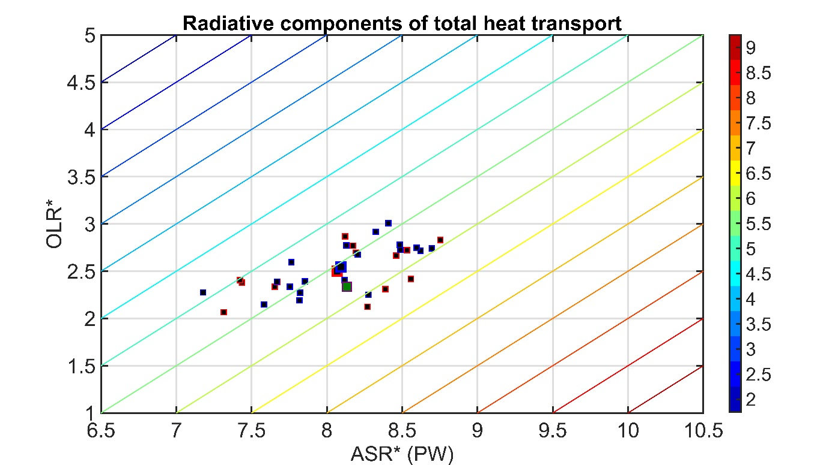
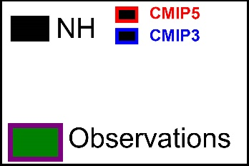
MHT = ASR* - OLR*
MHT maximum (PW)
Northern Hemisphere
Mean state inter-model spread in MHT:
Spread in ASR* exceeds that in OLR*
→No compensation between ASR* and OLR*
→ Model mean bias do to too much tropical OLR

Slide 27
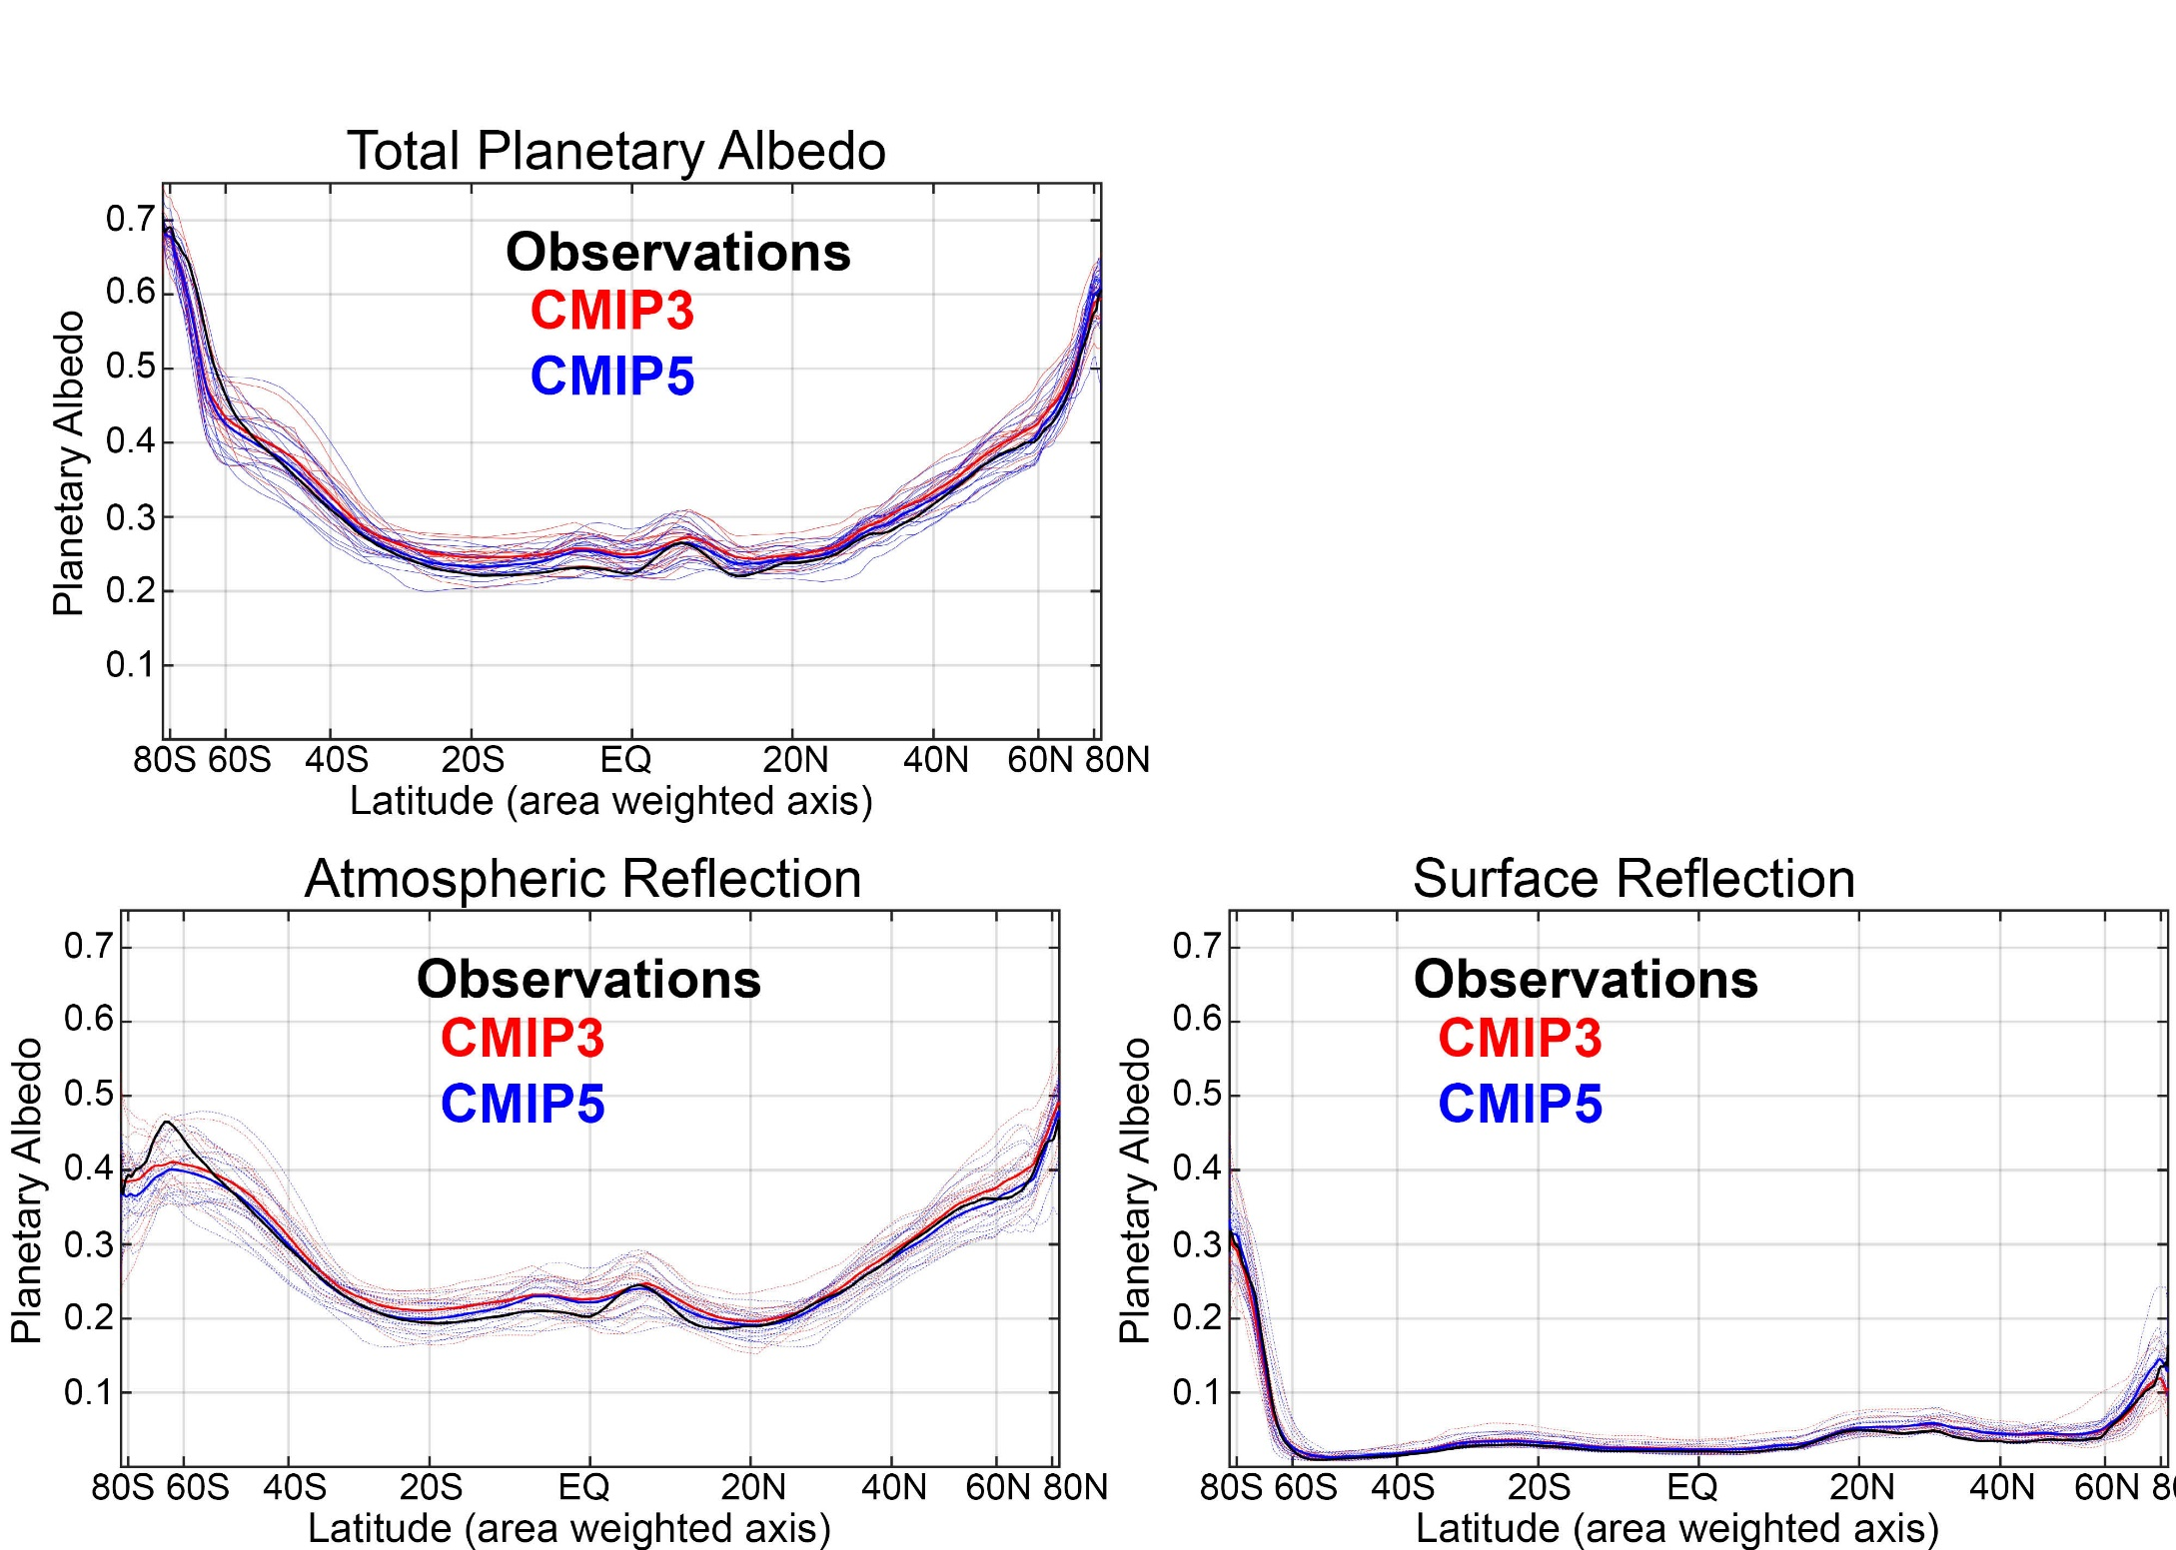
Fraction of solar radiation reflected at TOA (planetary albedo) differs between climate models and is responsible for MHT differences
Due to cloud differences (Donohoe and Battisti, 2012)
Surface albedo contributes very little to planetary albedo

Slide 28

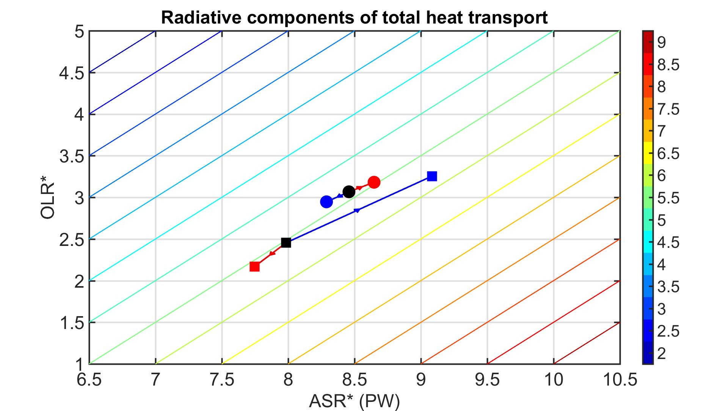
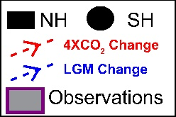
Why is poleward heat transport nearly unchanged from the Last Glacial Maximum (LGM) to 4XCO₂ ?
LGM and 4XCO₂ change in radiative contribution to MHT :
ASR* and OLR* changes nearly compensate to
conserve MHT
MHT maximum (PW)

Slide 29
Partitioning of MHT in atmospheric (AHT) and ocean (OHT) contributions
MHT from Radiation
Net radiative
Deficit of extratropics
Model approach
5.8 PW
MHT= Integral (TOA)
OHT = Integral (SHF)
AHT = MHT – OHT
= Integral (TOA – SHF)
Tropics
Extratropics
Notes:
NH = 8.2 - 2.4 = 5.8
SH = 9.0 – 3.2 = 5.8

Slide 30
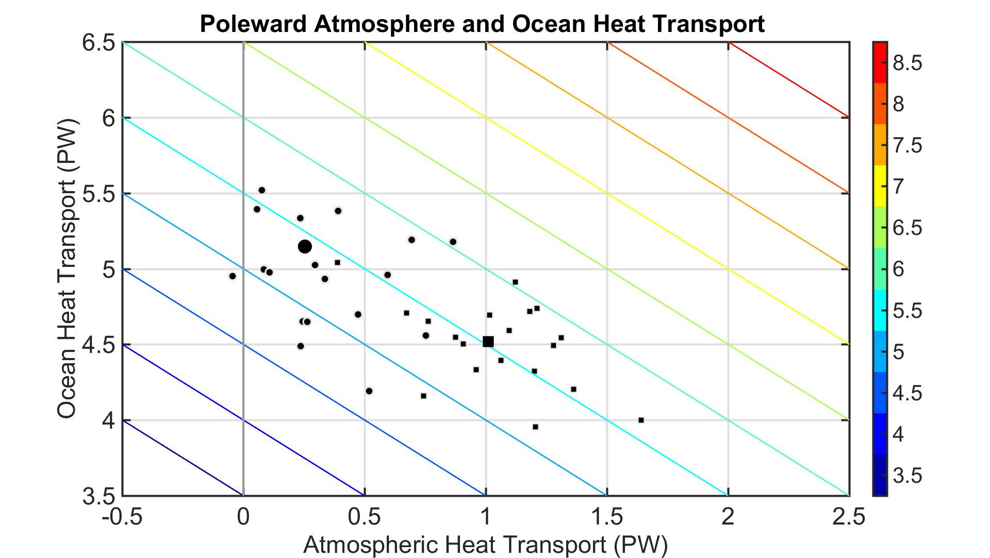
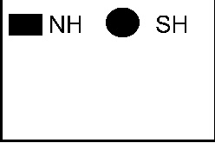
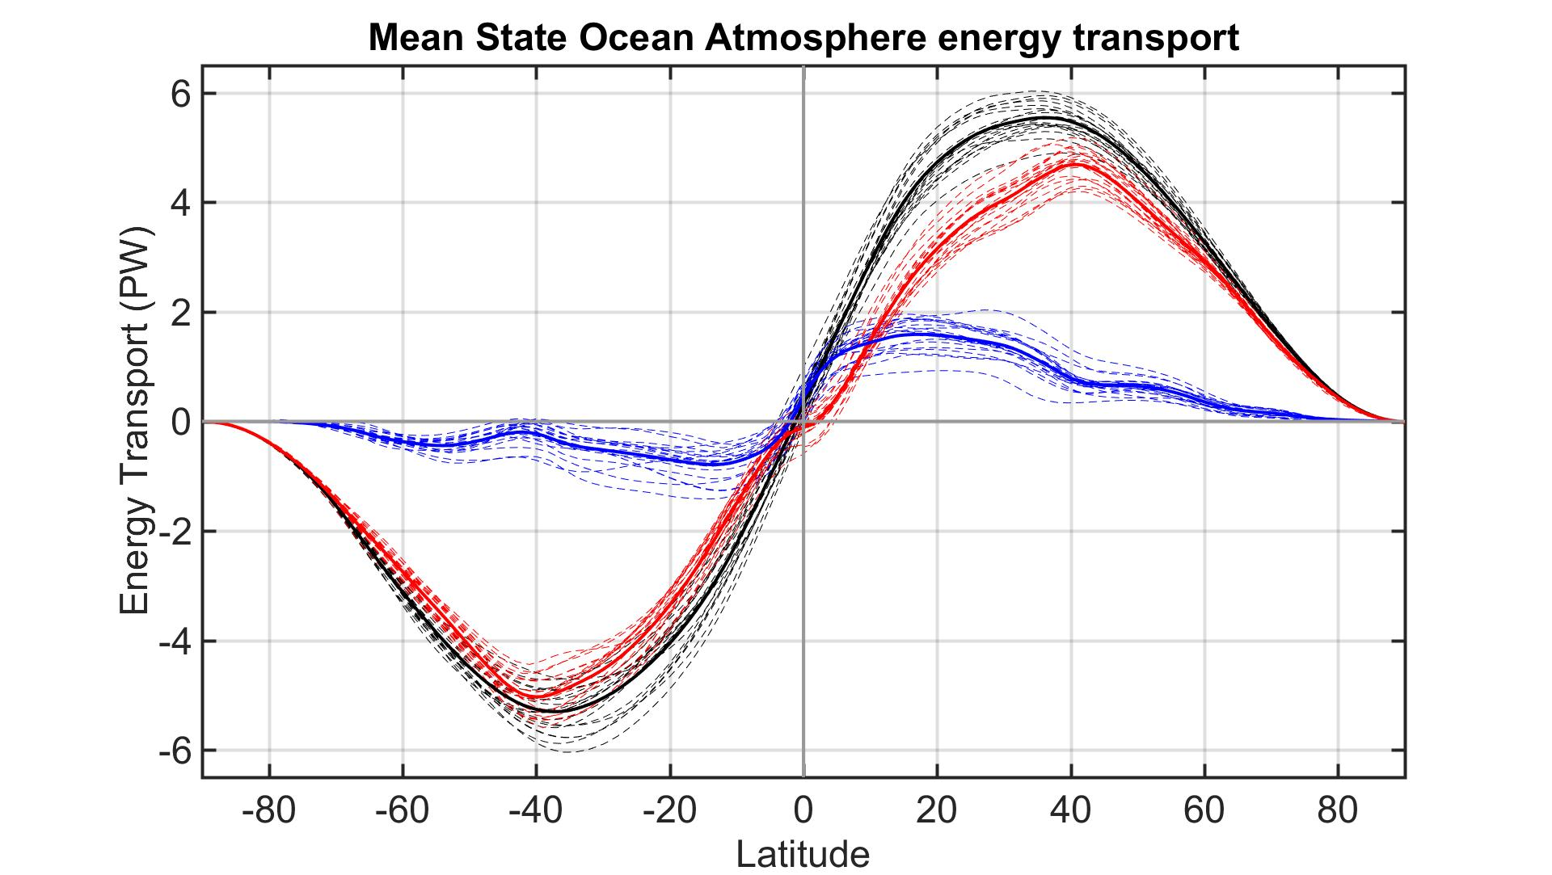
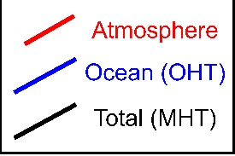
Ocean/Atmosphere heat transport
AHT and OHT differences between models not correlated → no compensation
AHT contributes more to inter-model spread than OHT (but comparable)
MHT maximum (PW)
Atmospheric Heat Transport (PW)
Ocean Heat Transport (PW)

Slide 31

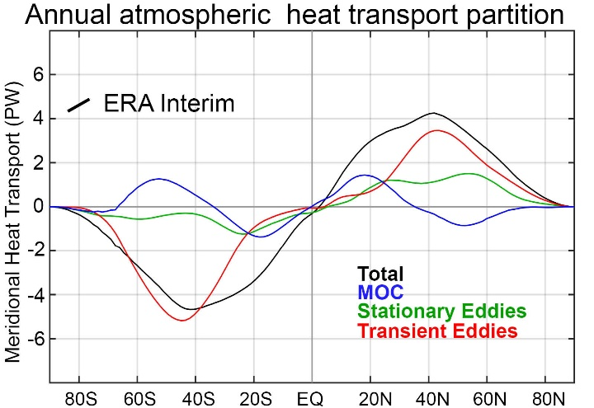
Observational estimate of MHT/AHT/OHT
AHT from reanalysis
MHT from Radiation
Net radiative
Deficit of extratropics
5.8 PW
Observational approach
Tropics
Extratropics
MHT= Integral (TOA)
AHT from dynamics
OHT = MHT - AHT
Trenberth and Caron (2001)
Notes:
NH = 8.2 - 2.4 = 5.8
SH = 9.0 – 3.2 = 5.8

Slide 32
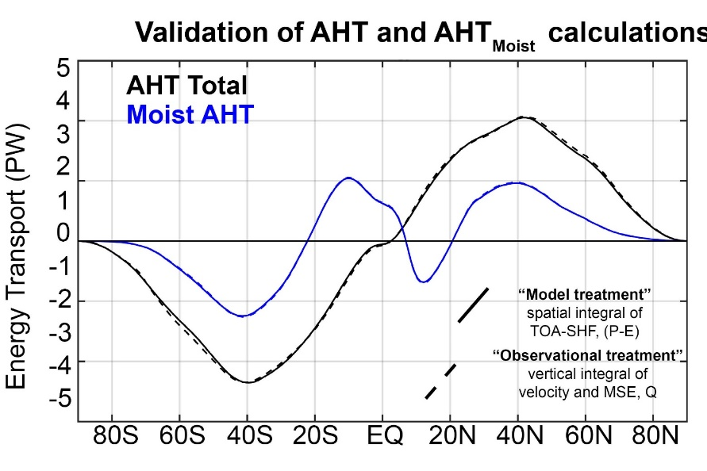
Observational/model comparison
Observational approach
Model approach
MHT= Integral (TOA)
MHT= Integral (TOA)
AHT from dynamics
OHT = Integral (SHF)
OHT = MHT - AHT
AHT = MHT - OHT
Tropics
Extratropics
Notes:
NH = 8.2 - 2.4 = 5.8
SH = 9.0 – 3.2 = 5.8

Slide 33

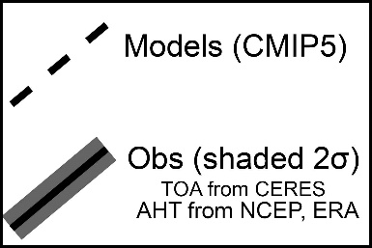
Model biases in MHT/AHT/OHT

Slide 34



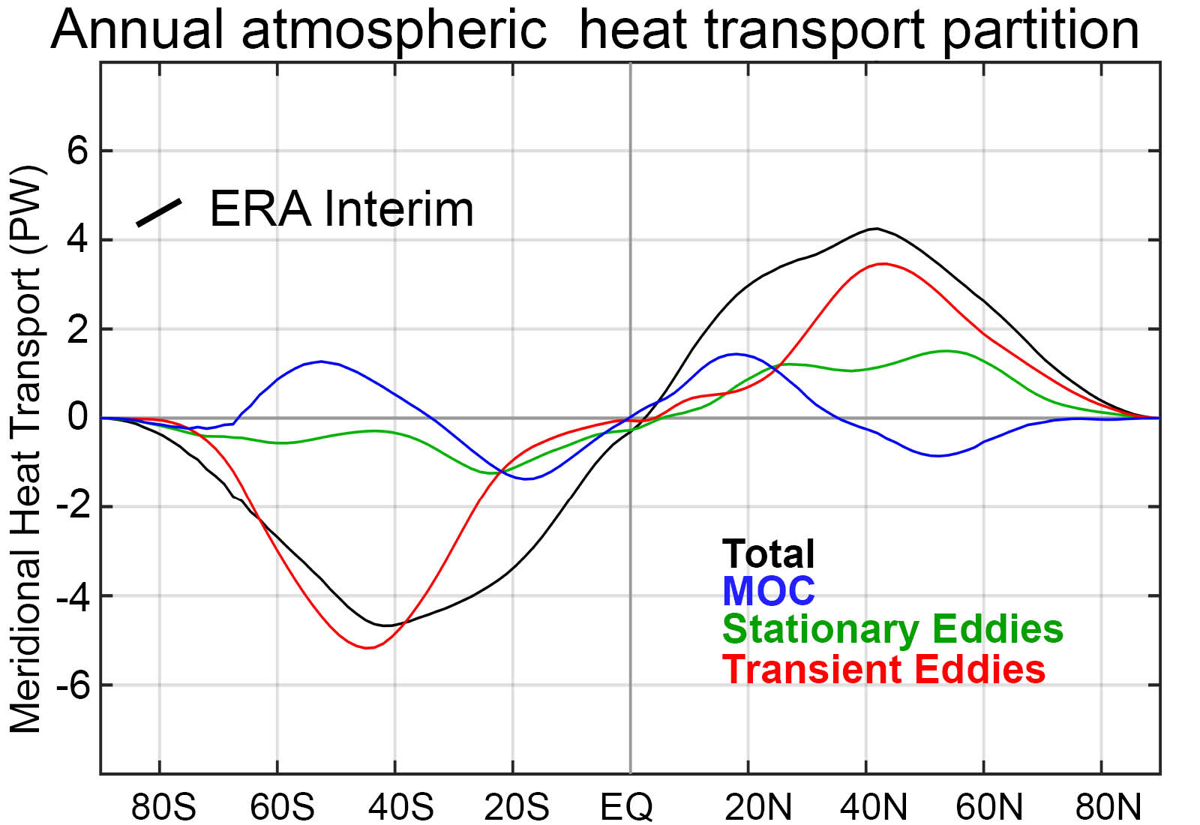
Partitioning of atmospheric energy by circulation type
Stationary
MOC
Overturning
Transient
* = Departure from zonal mean -- [ ]
' = Departure from time mean -- ¯
MSE = moist static energy
= CpT + LQ +gZ
MOC dominates in the deep tropics – Hadley cell
Stationary eddies stronger in NH
Transient eddies dominate the mid-latitudes

Slide 35
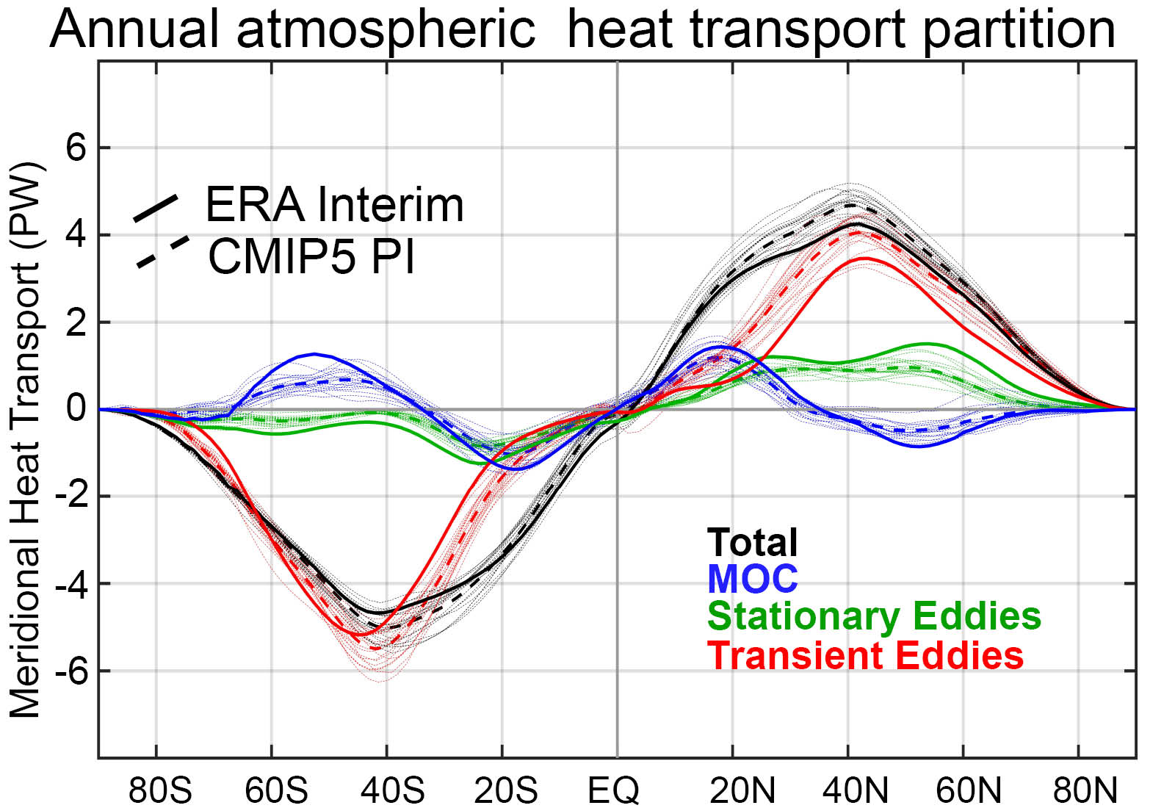
Observation vs. model AHT partitioning

Slide 36
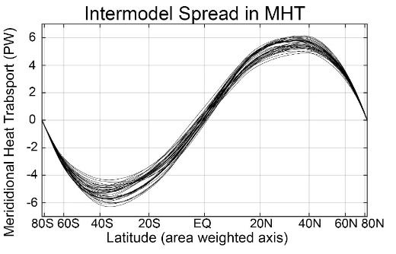

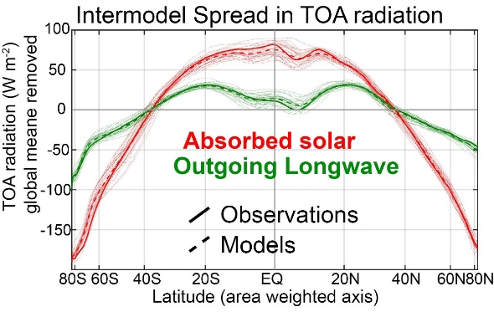

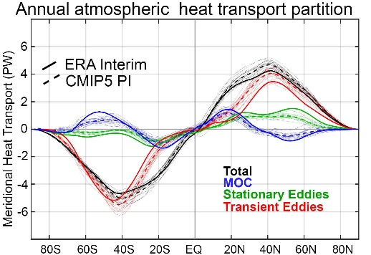
Conclusions– Poleward heat transport
Inter-model spread in mean state poleward heat transport is large (20%) compared to forced changes
Heat transport spread (and bias) due to simulated clouds impact on planetary albedo
Ocean
Atmosphere
The partitioning of poleward heat transport differs substantially between models and is biased relative to observations
Too weak ocean heat transport in Southern Hemisphere
Weaker stationary eddy heat transport and more (dry) transient eddy energy transport

Slide 37
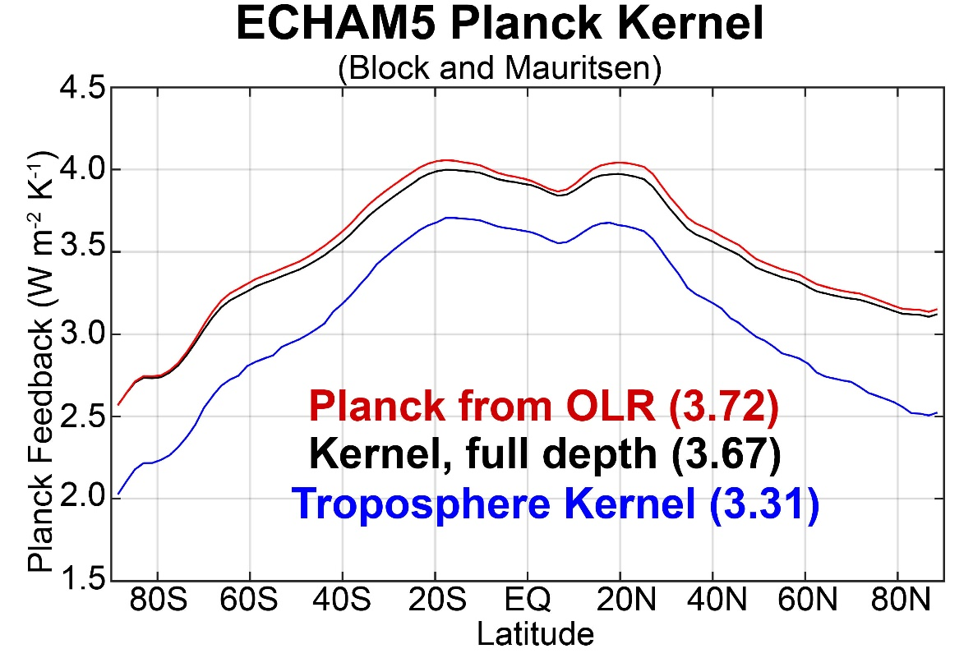
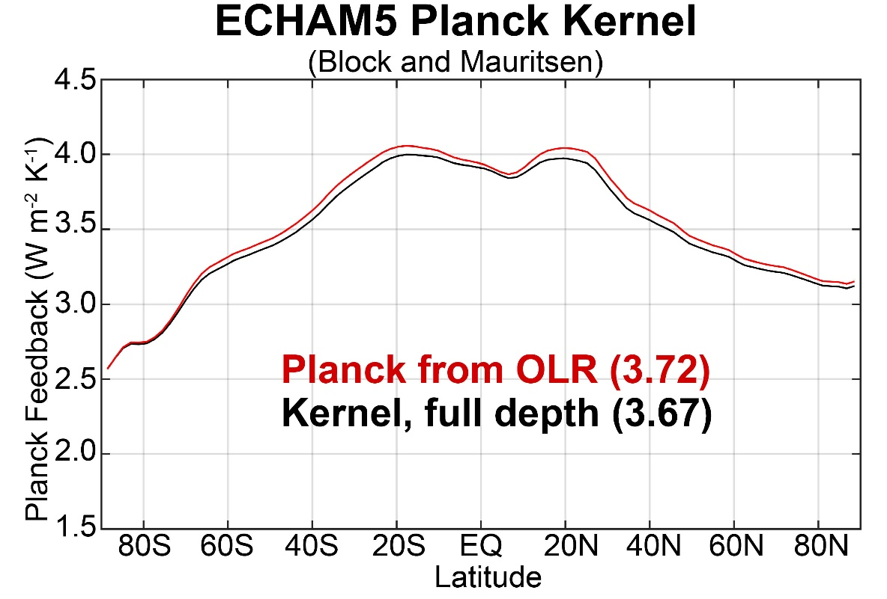
Can CERES data be used to constrain other climate feedbacks?
Assume: OLR = σT_{Emission}⁴
Planck = d(OLR)/d(T_{S})
=d(OLR)/d(T_{Emission})
For uniform warming
Planck = 4σT_{Emission}³
= 4σ^{1/4} OLR^{3/4}
Planck feedback implied by climatological OLR compares very well with radiative kernel calculation
→ If the radiative kernel is integrated over the full depth of atmosphere

Slide 38

Reasons this shouldn’t work
Estimates of non-linear effects and spectral covariance in line by line calculation
(Tim Cronin)

Slide 39
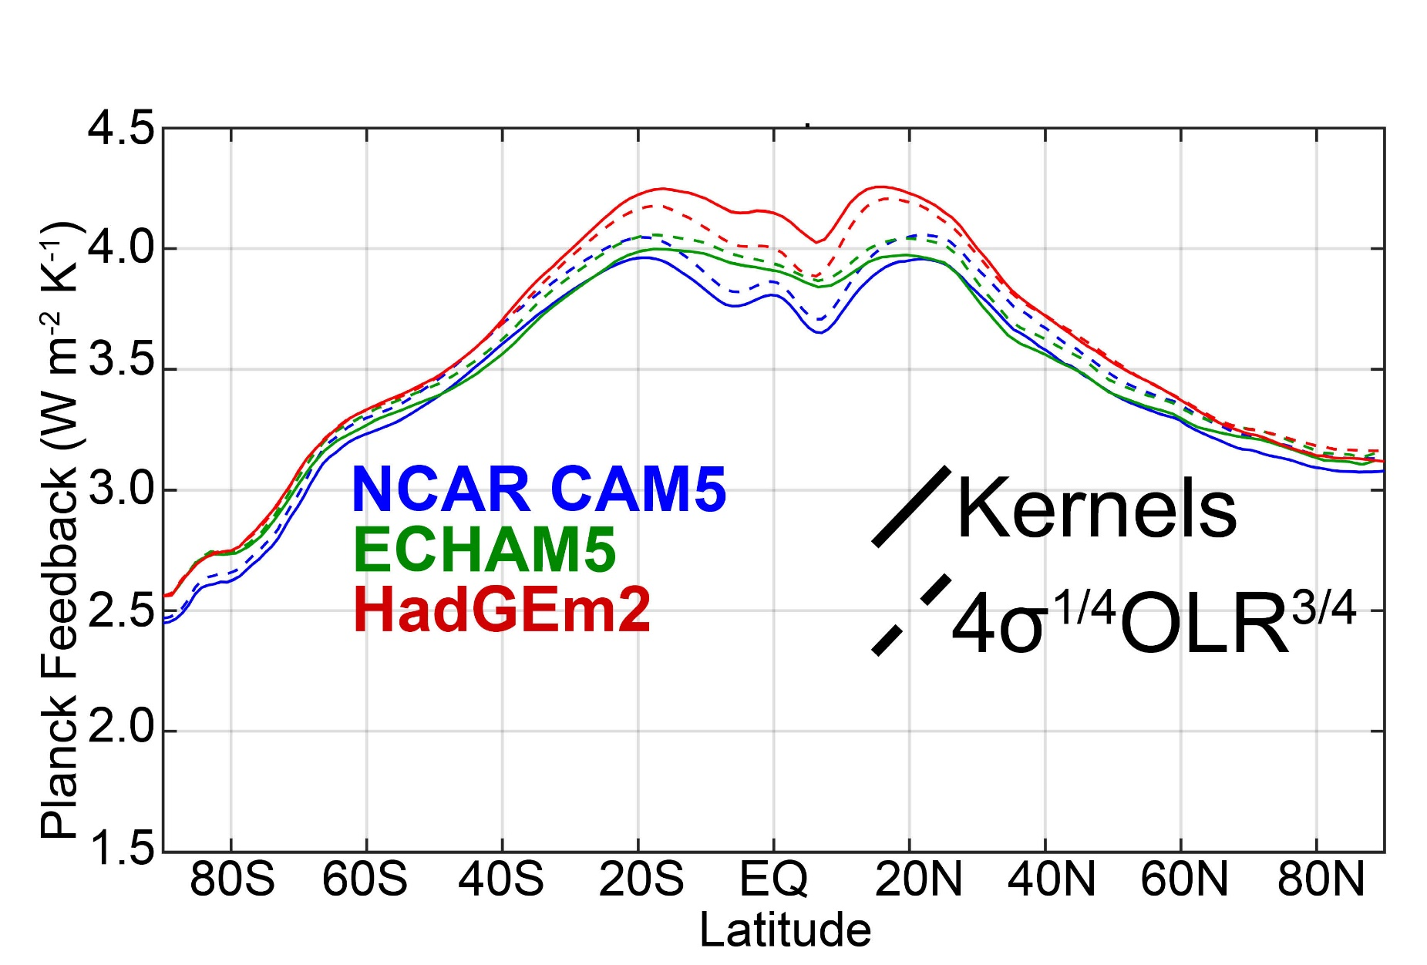
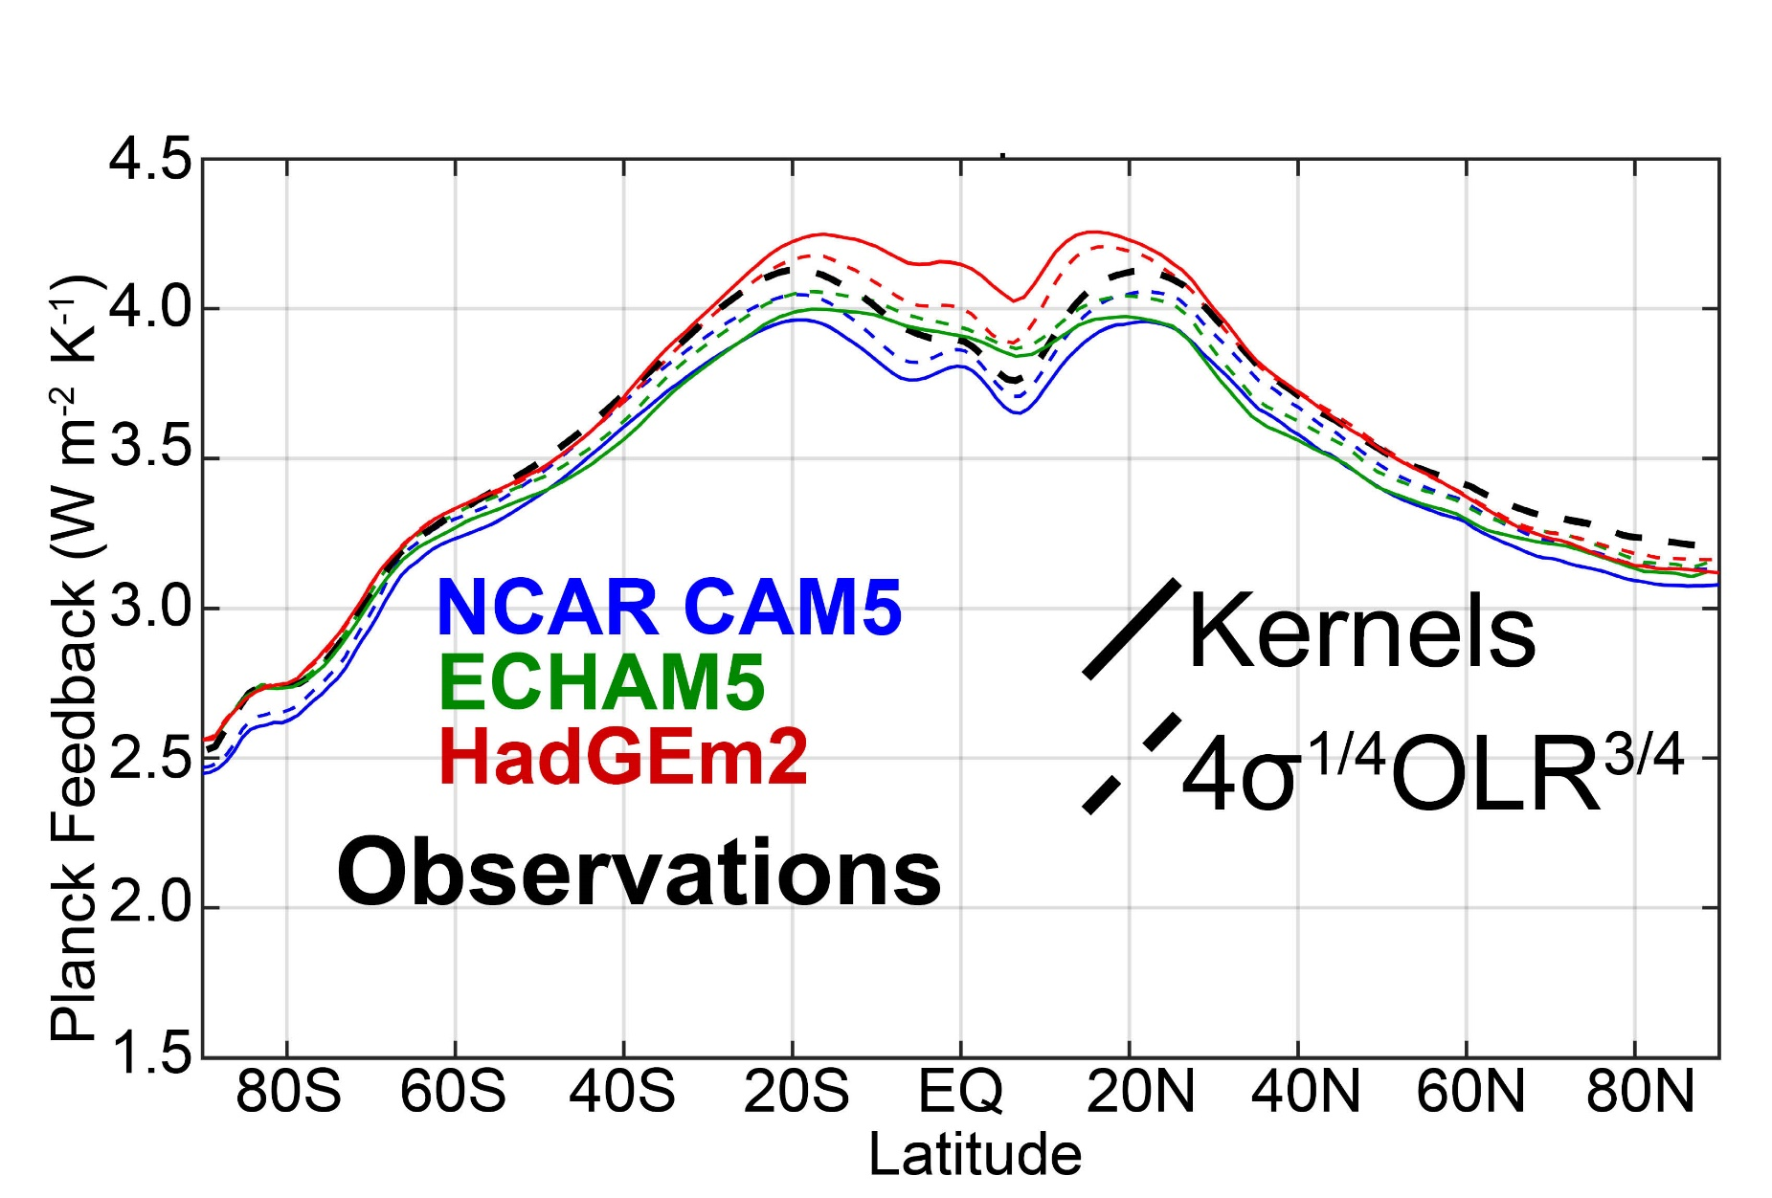
Planck feedback from OLR compares well with kernels
→ Spatial structure and inter-model spread
→ Provides estimate of Planck feedback from CERES data

Slide 40
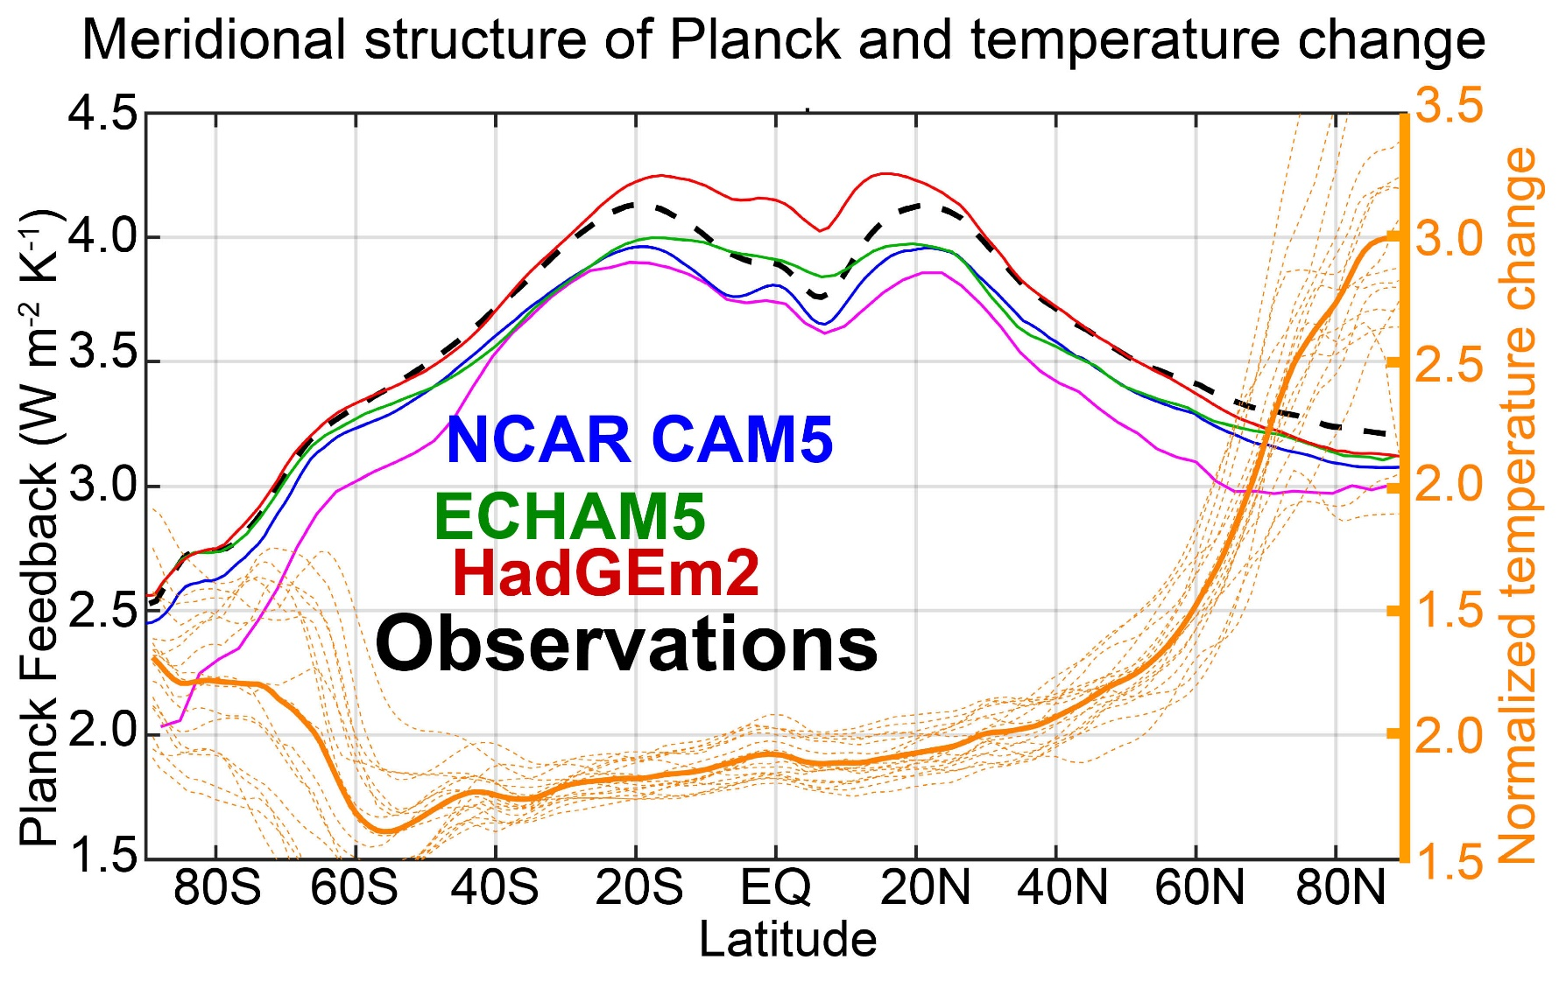
Global Planck feedback is the temperature change weighted spatial average of Planck
→ Polar amplified warming where the Planck feedback is weak results in smaller global Planck feedback (through meridional covariance of order 0.1 W m⁻² K⁻¹)

Slide 41
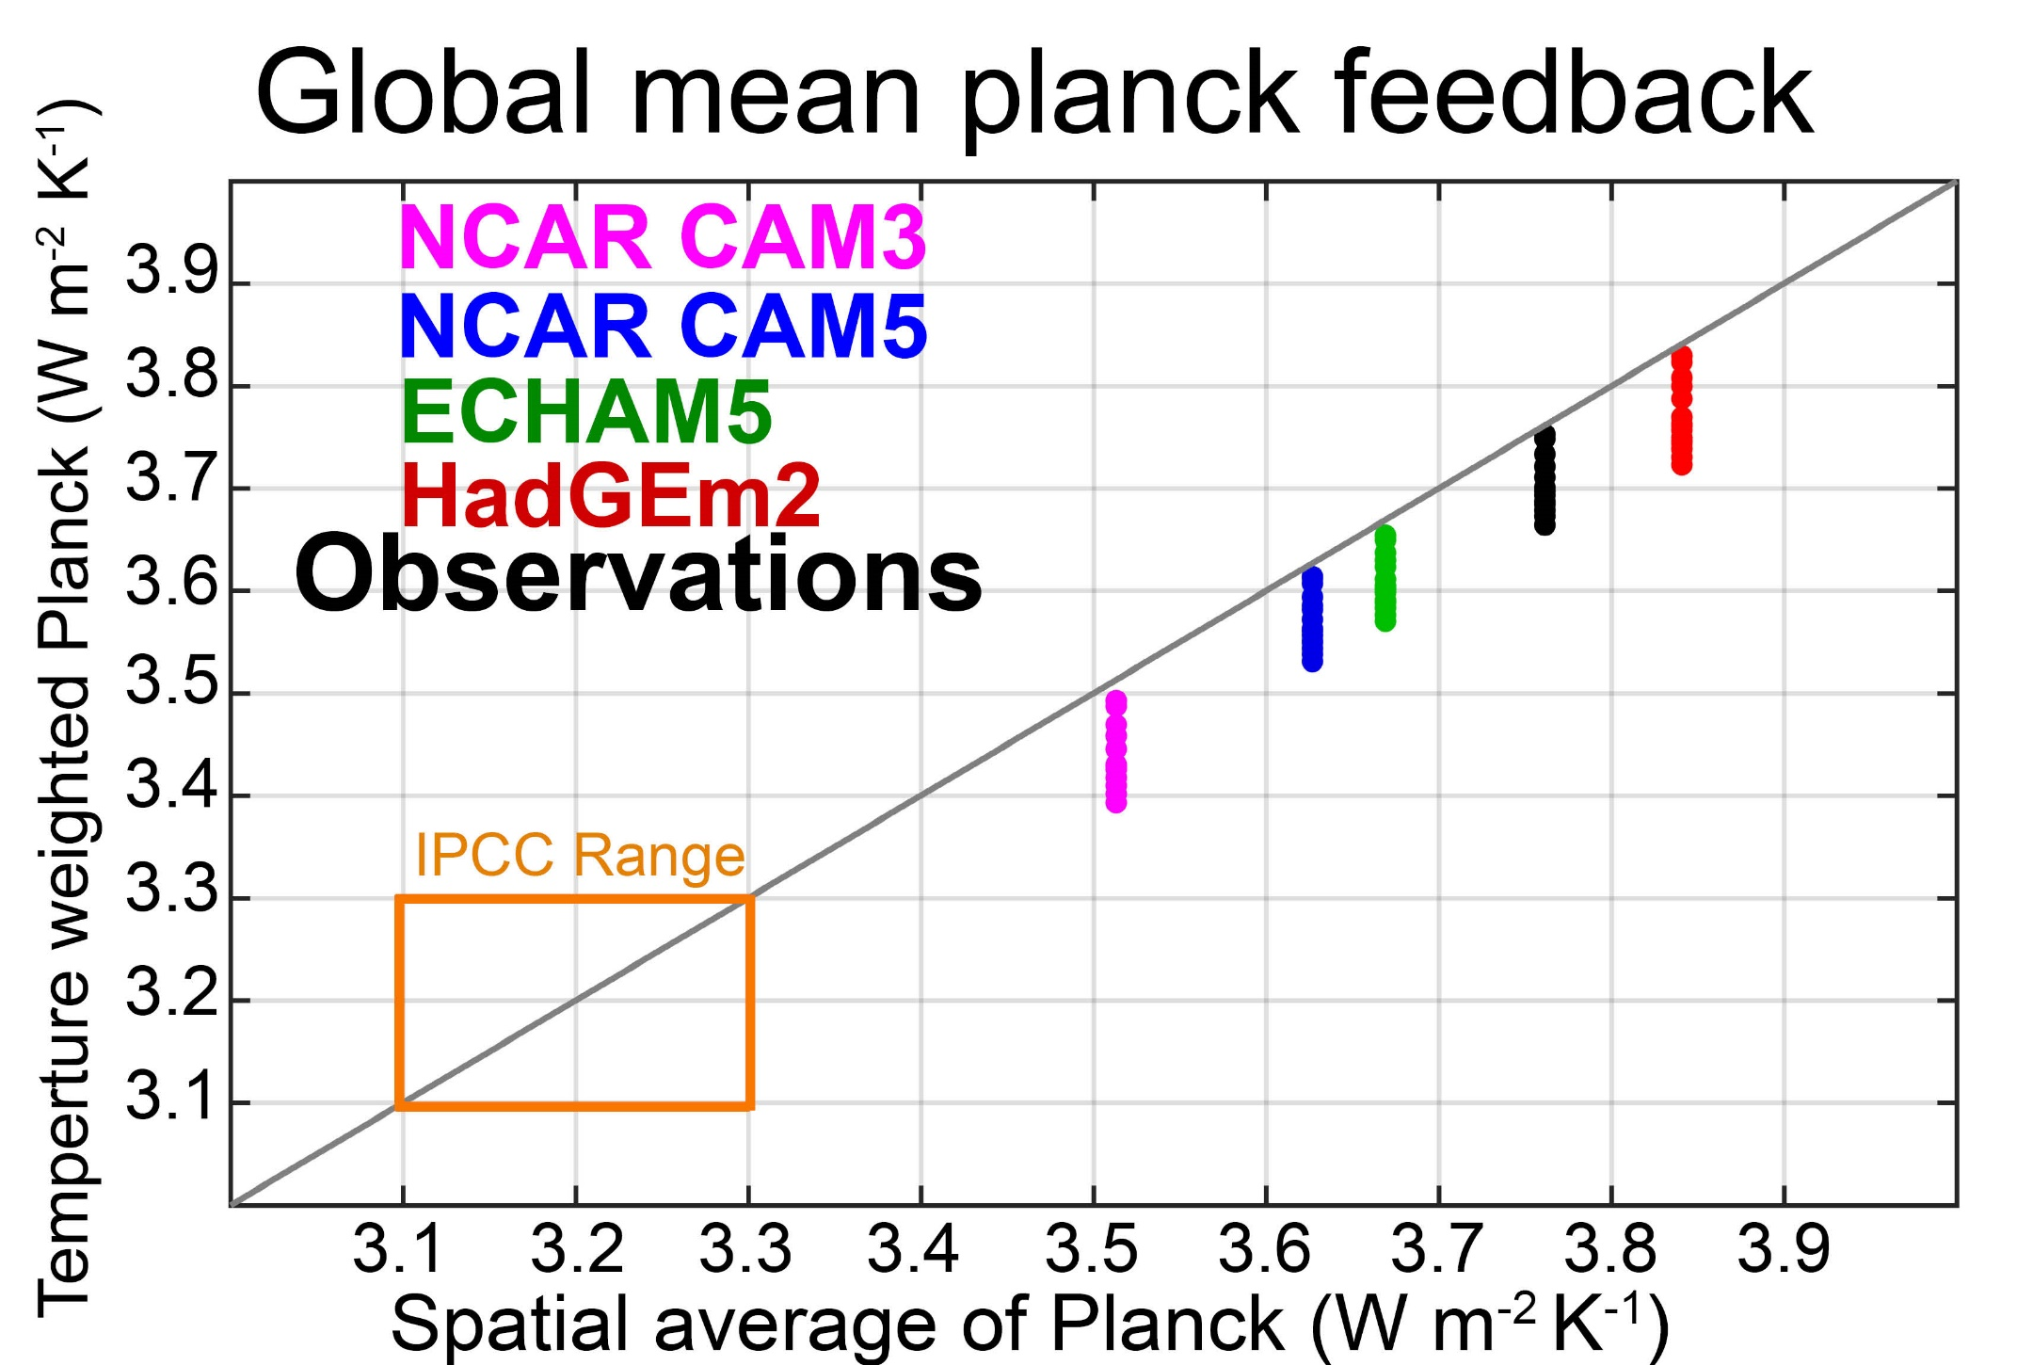

Slide 42
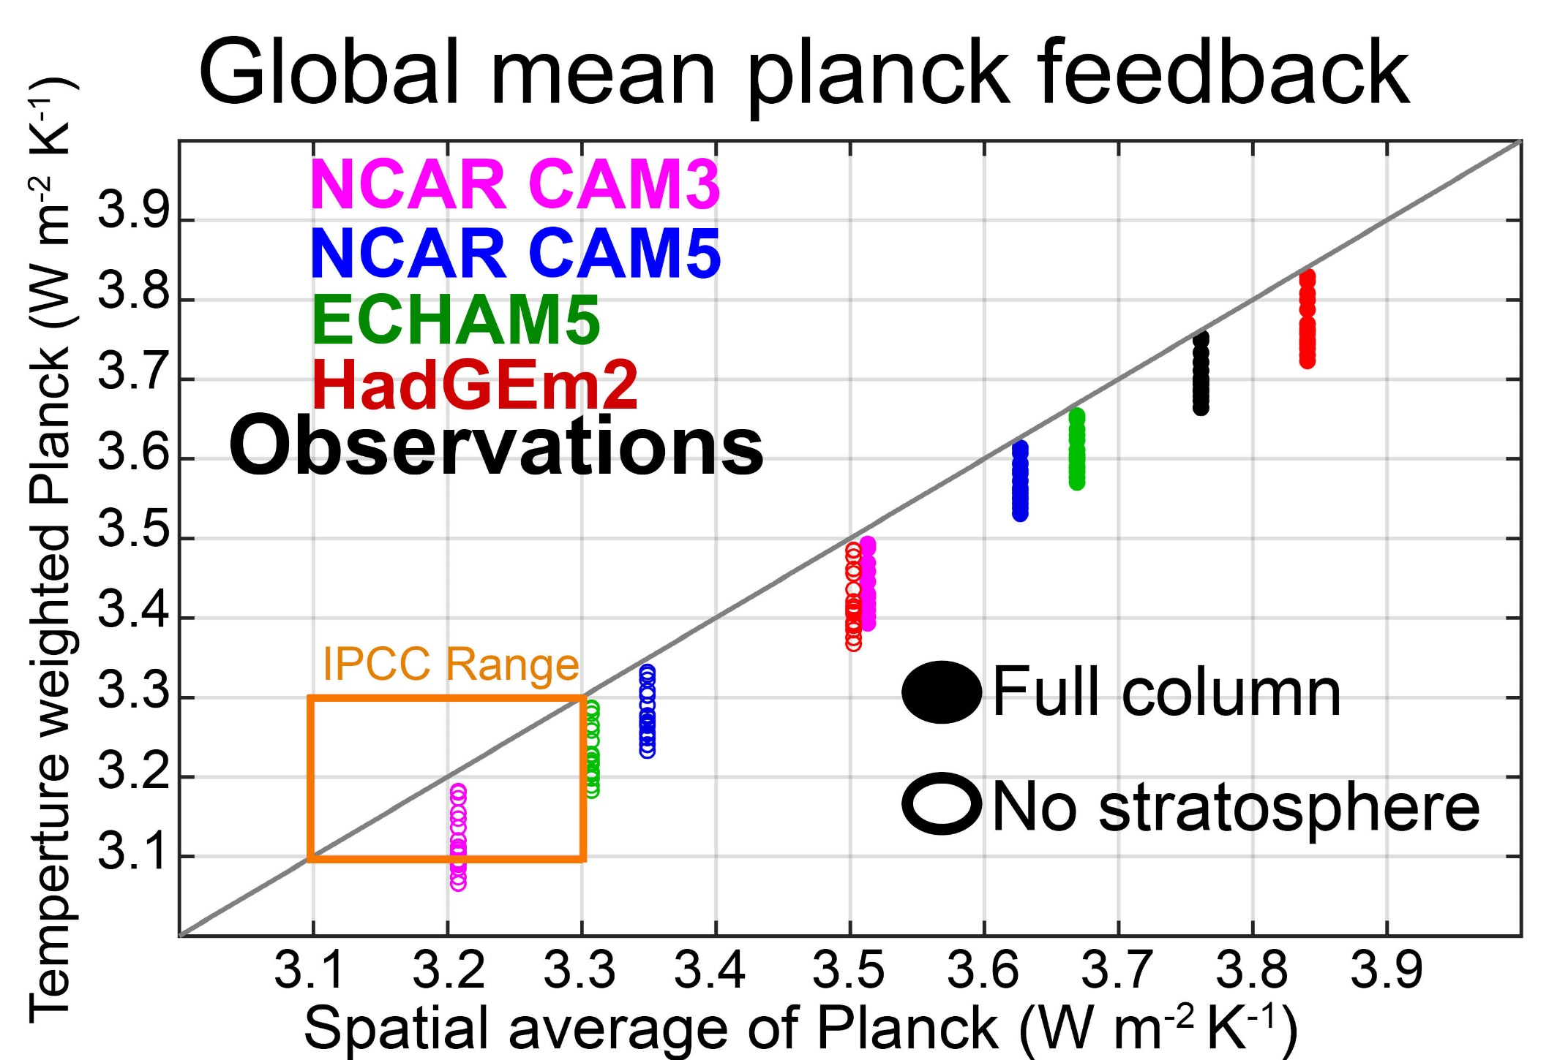

Slide 43
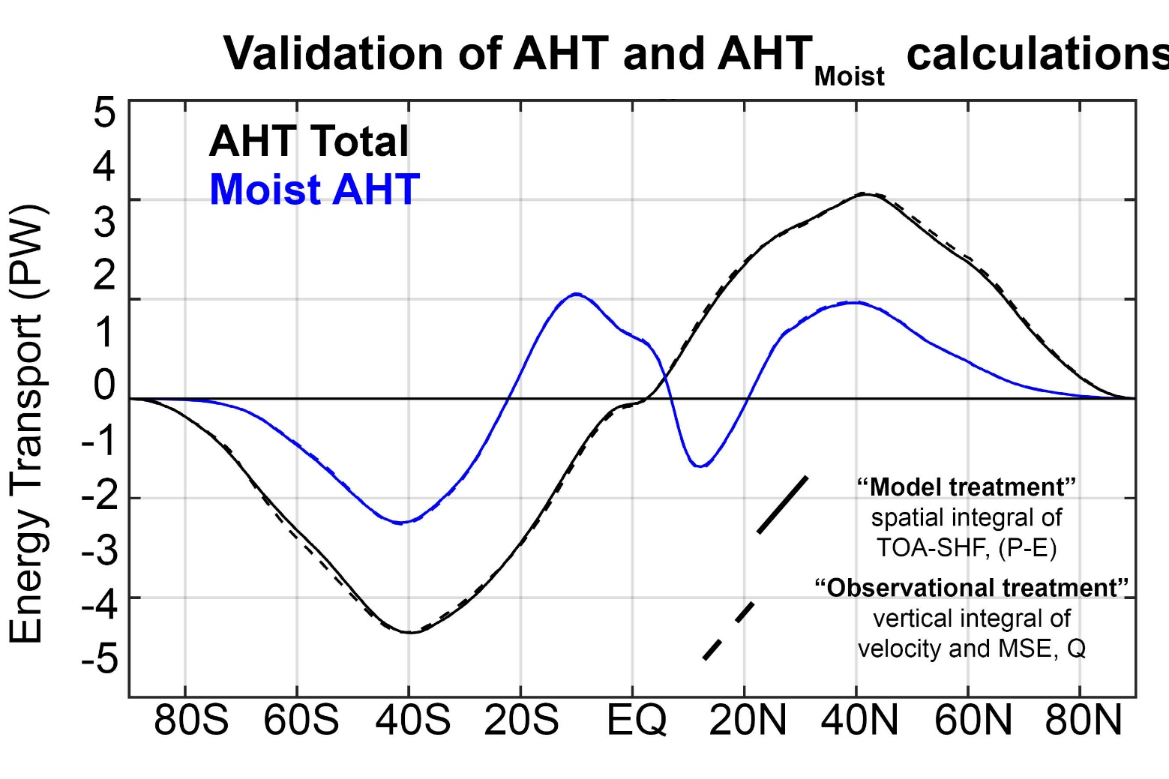
Consistency of “observational” and “model” based MHT calculation in a model simulation

Slide 44
Ocean/Atmosphere heat transport
AHT and OHT differences between models not correlated → no compensation
AHT contributes more to inter-model spread than OHT (but comparable)
MHT maximum (PW)
Atmospheric Heat Transport (PW)
Ocean Heat Transport (PW)

Slide 45

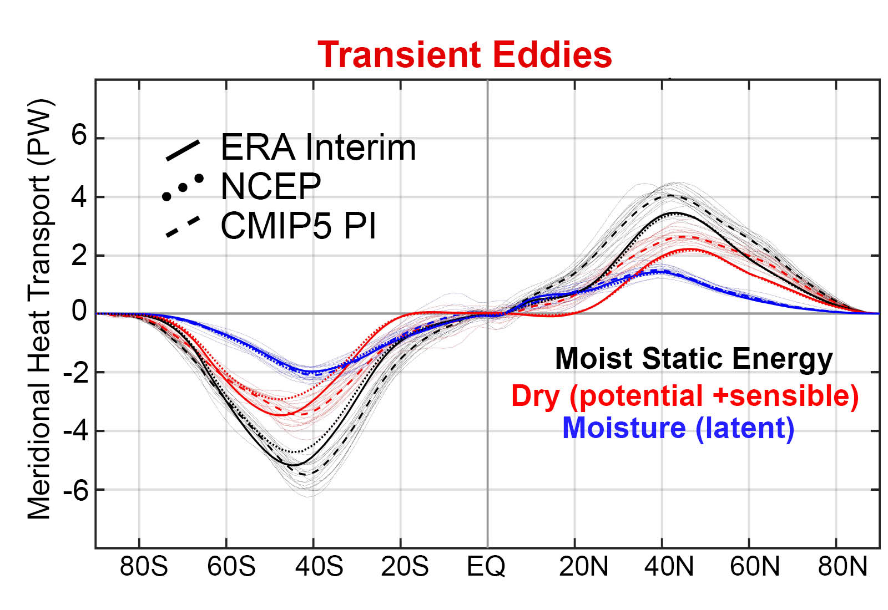
Model bias of enhanced transient eddy heat transport is due to sensible heat transport

Slide 46

Changes in the partitioning of poleward energy transport under 4XCO2
Moisture transport intensifies in the sense of their climatological direction
→ Compensating decreases in sensible energy transport
Robust increase in stationary eddy moisture transport by monsoons in the subtropics
NH mid-latitude stationary sensible energy transport changes are variable
Transient eddy moisture transport increase, sensible decreases, total increases slightly

Slide 47

Changes in the partitioning of poleward energy transport during the Last Glacial Maximum
Large increase in NH mid-latitude stationary eddy energy transport associated with Laurentide ice sheet
In some models (PMIP2) there is a compensating decrease in transient eddy energy transport
Zonal Velocity
Transient eddy heat flux
Donohoe et al. 2009

Slide 48





MHT maximum (PW)
Atmospheric Heat Transport (PW)
Ocean/Atmosphere heat transport
Mean state spread dominated by atmospheric contribution
Ocean Heat Transport (PW)
4XCO₂ change in
AHT/OHT :
High latitude ocean heat uptake (reduced implied OHT) compensated by increased AHT

Slide 49

MHT maximum (PW)
Atmospheric Heat Transport (PW)
Mean state inter-model spread in MHT:
Spread in ASR* exceeds that in OLR
→No compensation between ASR* and OLR*
Ocean Heat Transport (PW)
4XCO₂ change in
AHT/OHT :
ASR* and OLR* changes compensate to
conserve MHT

Slide 50



Mean state inter-model spread in MHT:
Spread in ASR* exceeds that in OLR
MHT maximum (PW)
Atmospheric Heat Transport (PW)
4XCO₂ change in
AHT/OHT :
ASR* and OLR* changes compensate to
conserve MHT
Ocean Heat Transport (PW)
LGM change in MHT :
ASR* and OLR* changes imperfect compensation
In NH → increased MHT

Slide 51

Mean state inter-model spread in MHT:
Spread in ASR* exceeds that in OLR
MHT maximum (PW)
Atmospheric Heat Transport (PW)
4XCO₂ change in
AHT/OHT :
ASR* and OLR* changes compensate to
conserve MHT
Ocean Heat Transport (PW)
LGM change in MHT :
ASR* and OLR* changes imperfect compensation
In NH → increased MHT

Slide 52

Mean state inter-model spread in MHT:
Spread in ASR* exceeds that in OLR
→No compensation between ASR* and OLR*
MHT maximum (PW)
4XCO₂ change in
AHT/OHT :
ASR* and OLR* changes compensate to
conserve MHT

