Slide 1

Tracking the flow of energy through Earth’s climate system
Aaron Donohoe
APL Seminar
May 11 2023

Slide 2
Global mean energy balance
The Earth receives energy from the sun (and reflects back some portion of it)
To come into energy balance (equilibrium) the Earth must emit the same amount of energy it receives
Emitted (outgoing longwave radiation – OLR)
Reflected solar
Incident
Solar
Earth

Slide 3
Global mean energy balance
Incident
Solar
340.0 W m⁻²
Reflected solar 99.1 W m⁻²
OLR 240.1 W m⁻²
Net Energy Imbalance
=340.0 – 99.1 -240.1
= +0.8 W m-2
Into the climate system
(Loeb et al. 2018 – CERES EBAF)
Earth

Slide 4
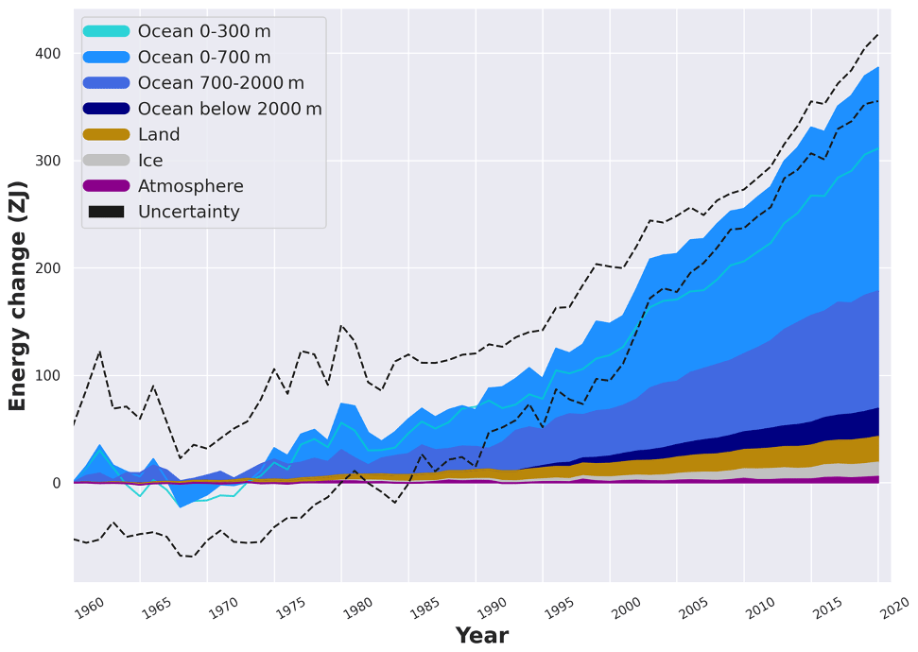
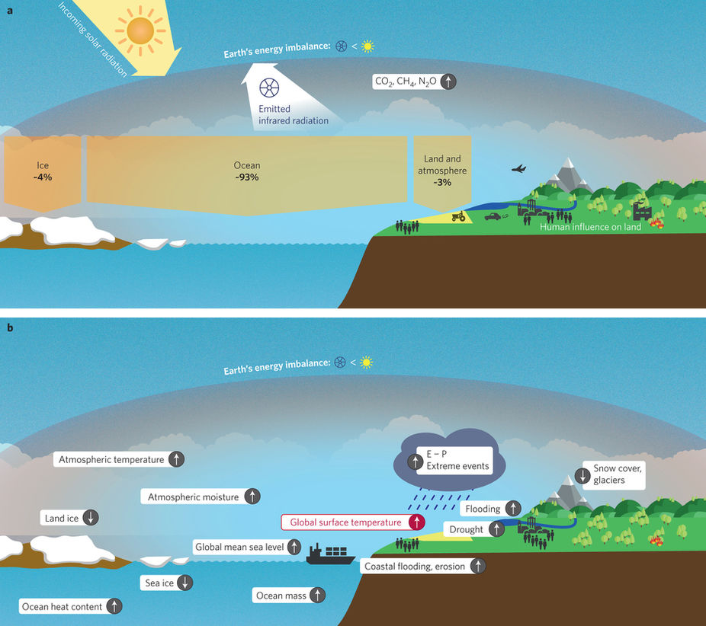
Where does the energy imbalance go?
Changes in Earth
Energy Content
von Schuckmann et. al , 2020

Slide 5
Three estimates of Earth’s energy imbalance
If we assume that all the energy imbalance goes into the ocean, we should have 3 independent estimates of Earth’s energy imbalance
1) Net radiation at the top of atmosphere (satellites)
2) Net energy flux into the surface (surface radiation + turbulent fluxes)
Ocean
3) Energy accumulation in the ocean
d(ocean heat content)/dt

Slide 6
Unadjusted satellite radiation
Incident
Solar
340.0 W m⁻²
^{(+/- 0.2)}
Reflected solar 97.1 W m^{-2 (+/-3.0)}
OLR 238.6 W m^{-2 (+/- 5.5)}
Net Energy Imbalance
=340.0 – 97.1 -238.6
= +4.3 (+/-5.5) W m ⁻²
Into the climate system
(Loeb et al. 2012 – CERES EBAF)
Earth

Slide 7
Unadjusted satellite radiation
Satellite radiation measurements aren’t precise enough to tell us global energy imbalance!
Net Energy Imbalance
=340.0 – 97.1 -238.6
= +4.3 (+/-5.5) W m ⁻²
Into the climate system
(Loeb et al. 2012 – CERES EBAF)
Earth

Slide 8
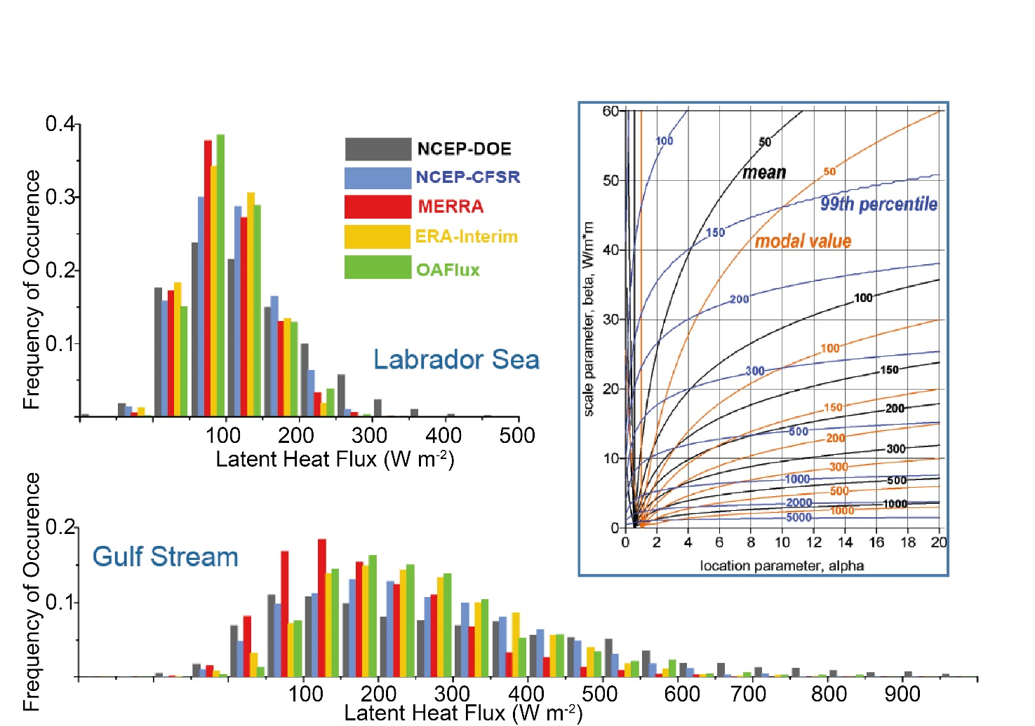
Energy imbalance from surface heat fluxes
Probability distribution functions of latent heat fluxes over Labrador sea and Gulf stream show:
Extreme events contribute fundamentally (100s of W m⁻²) to mean values
→ Lead to large global uncertainties in global surface heat fluxes
Gulev, CLIVAR Concept heat meeting, EXETER, UK

Slide 9
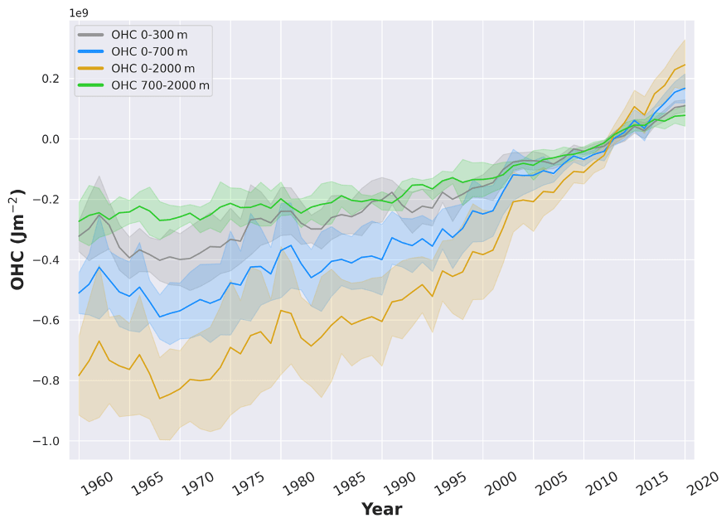
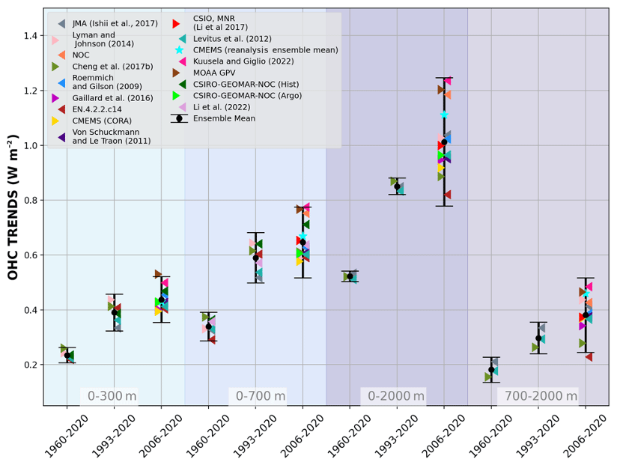
Energy imbalance from ocean heat content trends
Trends in global energy content have more uncertainty for shorter time periods
Average over satellite time period (2000-2020) of:
+0.8 (=/-0.2) W m⁻²
von Schuckmann et. al , 2020

Slide 10
Where does the energy imbalance go?
Changes in Earth
Energy Content
von Schuckmann et. al , 2020
Reconciling units: 0.8 W m⁻² integrated over Earth’s surface area (5*10¹⁴ m²)
and over a decade (3*10⁸s)
= 120 ZJ per decade

Slide 11
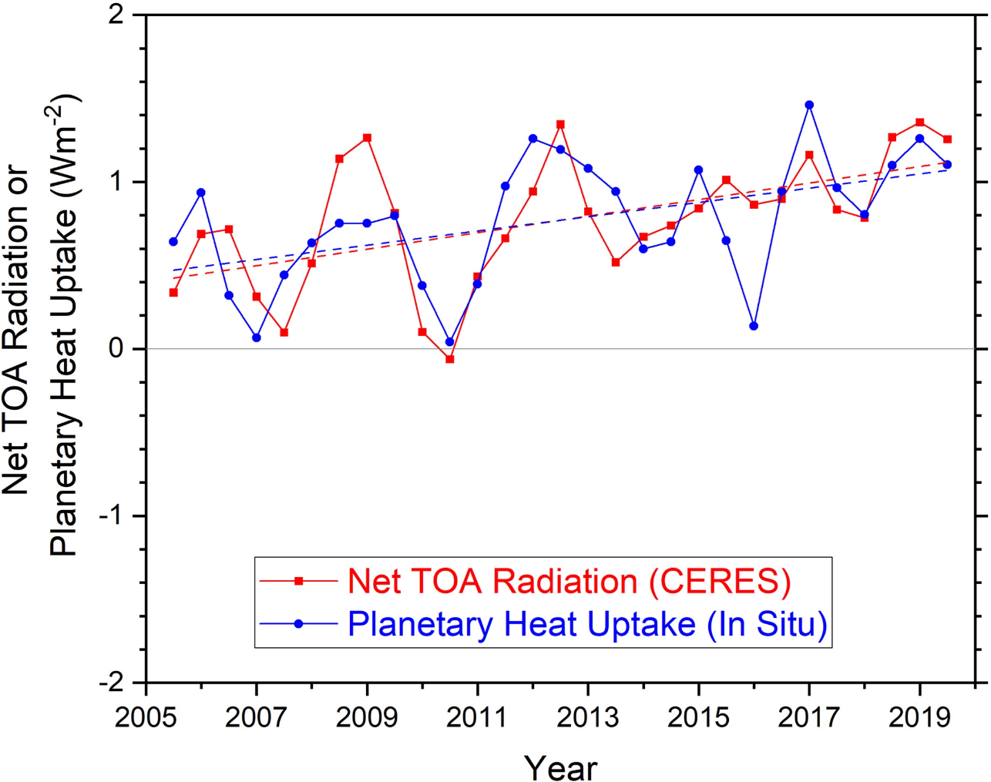
→ Satellite observations have low precision but high year-to-year accuracy
→ Trends in ocean heat content have low accuracy for shorter time periods
How can we test the consistency of the two?
Year-to-year variability of ocean heat content change and satellite derived top of atmosphere radiation are consistent within uncertainity
d(ocean heat content)/dt
Loeb et al. 2020

Slide 12
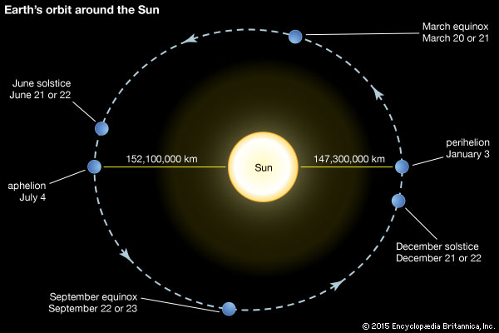
An idea to test the consistency of energy imbalance from satellite radiation and ocean heat content –
The seasonal cycle of global mean heat content
Back of envelope– How much does global mean insolation vary by over the annual cycle?
Earth-sun distance varies by 5 million km
--- 3% of the mean distance (ΔR/R_{mean} = 5/150)
Insolation scales as 1/R² so fractional change in insolation is ≈ 2ΔR/R_{mean} = 6%
6% of S_{O}/4 is = 0.06 * (341 W m⁻²) =
20 W m ⁻²
(30 times time mean energy imbalance)

Slide 13
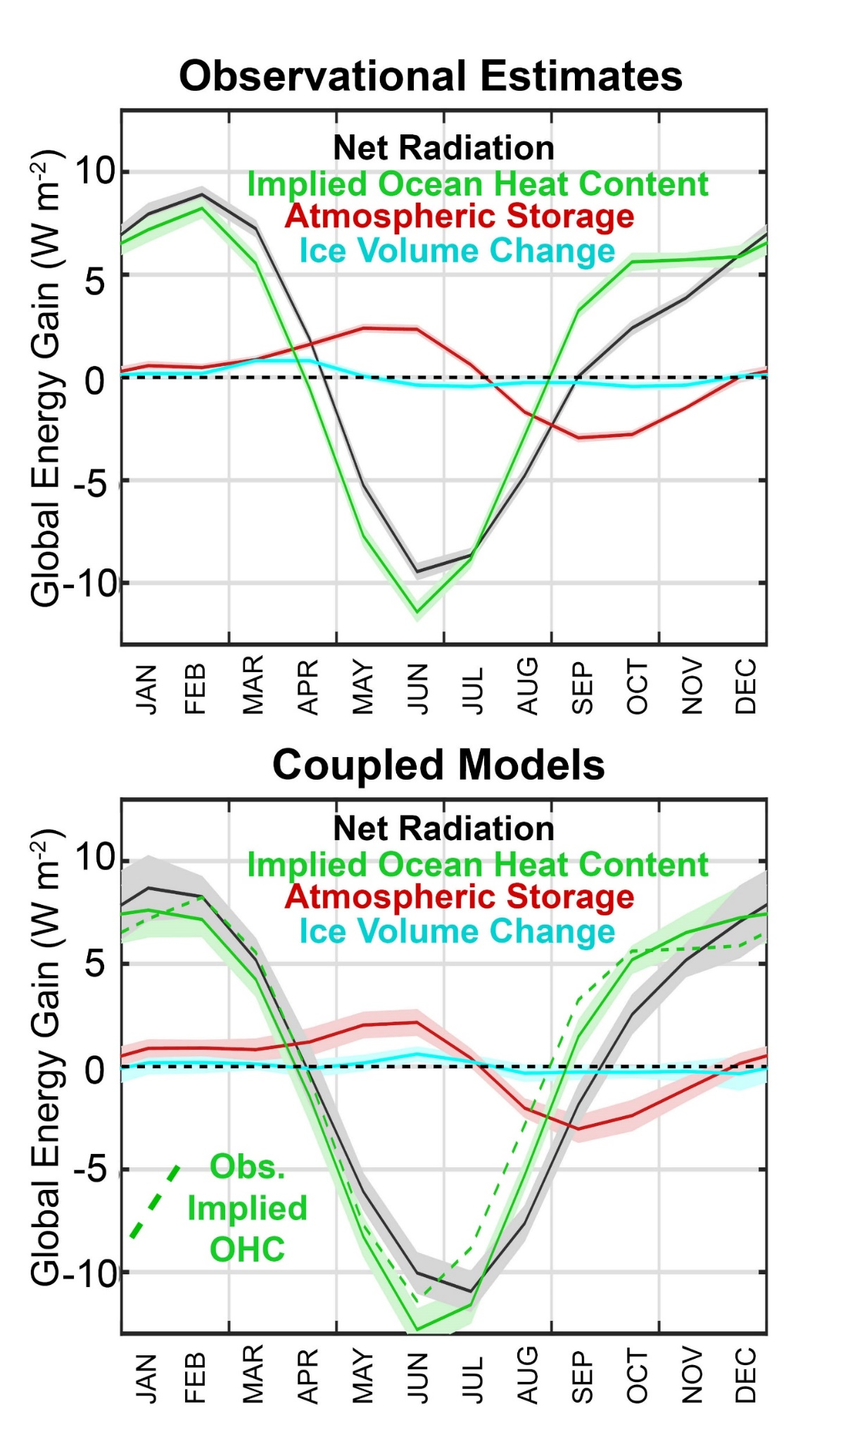
In addition to TOA radiation from CERES, we calculate the required seasonal ocean heat content change from:
Atmospheric heat content change from ERA reanalysis
Ice Volume change from Gravity Recovery and Climate Experiment (GRACE)
Donohoe, 2016

Slide 14
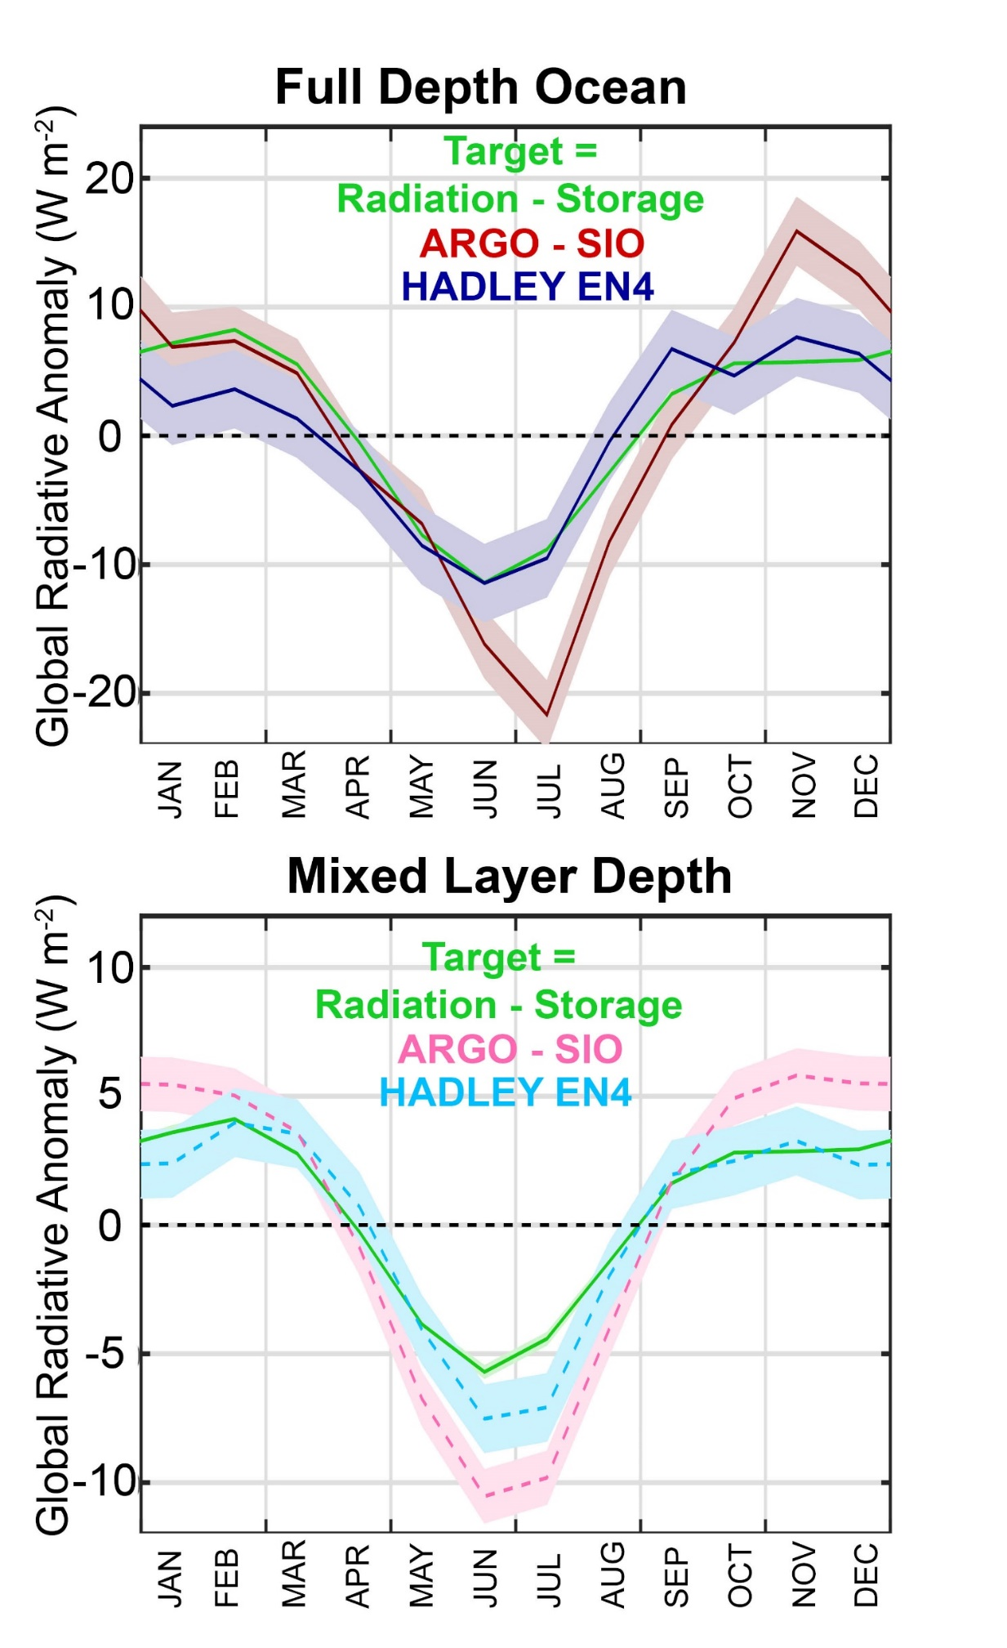
Two different estimates of Earth’s global mean seasonal cycle of energy content are consistent:
→ Satellite derived top of atmosphere radiation
and
Ocean heat content changes (in the Hadley EN4 data set)
Donohoe, 2016

Slide 15
Understanding Earth’s radiative budget and how it has changed over the last 20 years
Incident
Solar
340.0 W m⁻²
Reflected solar 99.1 W m⁻²
OLR 240.1 W m⁻²
Earth

Slide 16
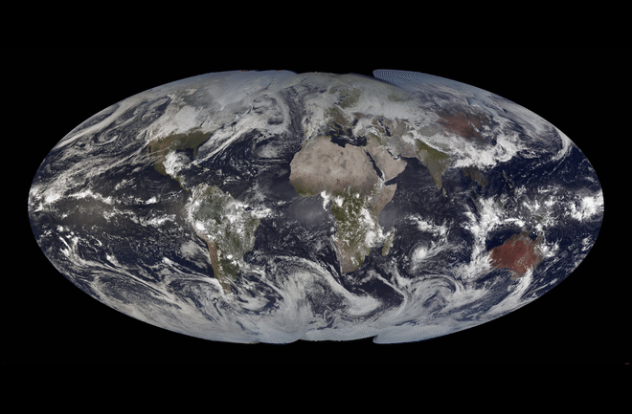
What determines the amount of solar radiation reflected by Earth?
Credit: Cooperative Institute for Meteorological Satellite Studies

Slide 17
What determines the Earth’s planetary albedo? (solar radiation reflected at top of atmosphere)
Reflected by Atmosphere
Solar Incident
Reflected by Surface
Atmosphere
Earth’s Surface

Slide 18

Simplified shortwave radiation model (APRP, Taylor 2007)
S = incident
R = cloud
reflection
A = absorption
α = surface
albedo
(UNKNOWNS)
v
v
v

Slide 19
Simplified shortwave radiation model (APRP, Taylor 2007)
S = incident
R = cloud
reflection
A = absorption
α = surface
albedo
(UNKNOWNS)
v
v

Slide 20
Simplified shortwave radiation model (APRP, Taylor 2007)
S = incident
R = cloud
reflection
A = absorption
α = surface
albedo
(UNKNOWNS)

Slide 21
Simplified shortwave radiation model (APRP, Taylor 2007)
S = incident
R = cloud
reflection
A = absorption
α = surface
albedo
(UNKNOWNS)

Slide 22
Simplified shortwave radiation model (APRP, Taylor 2007)
S = incident
R = cloud
reflection
A = absorption
α = surface
albedo
(UNKNOWNS)

Slide 23
Simplified (isotropic) shortwave radiation model
Surface
Contribution
To planetary
Albedo
Atmospheric
Contribution
To planetary
Albedo
S = incident
R = cloud
reflection
A = absorption
α = surface
albedo
(UNKNOWNS)

Slide 24
Simplified (isotropic) shortwave radiation model
Atmospheric
Contribution
To planetary
Albedo
Surface
Contribution
To planetary
Albedo
S = incident
R = cloud
reflection
A = absorption
α = surface
albedo
(UNKNOWNS)

Slide 25
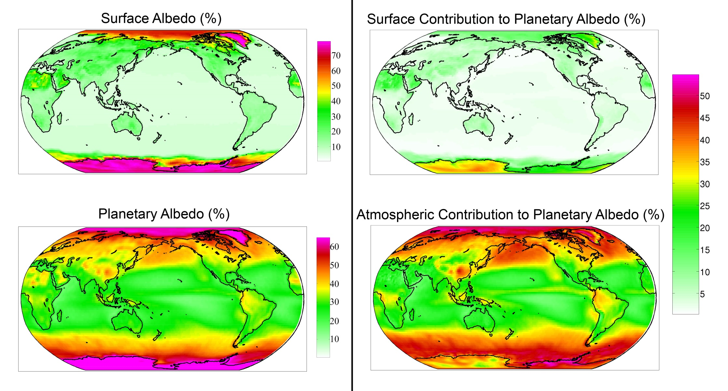
Observed (CERES) surface and atmospheric contribution to planetary albedo

Slide 26
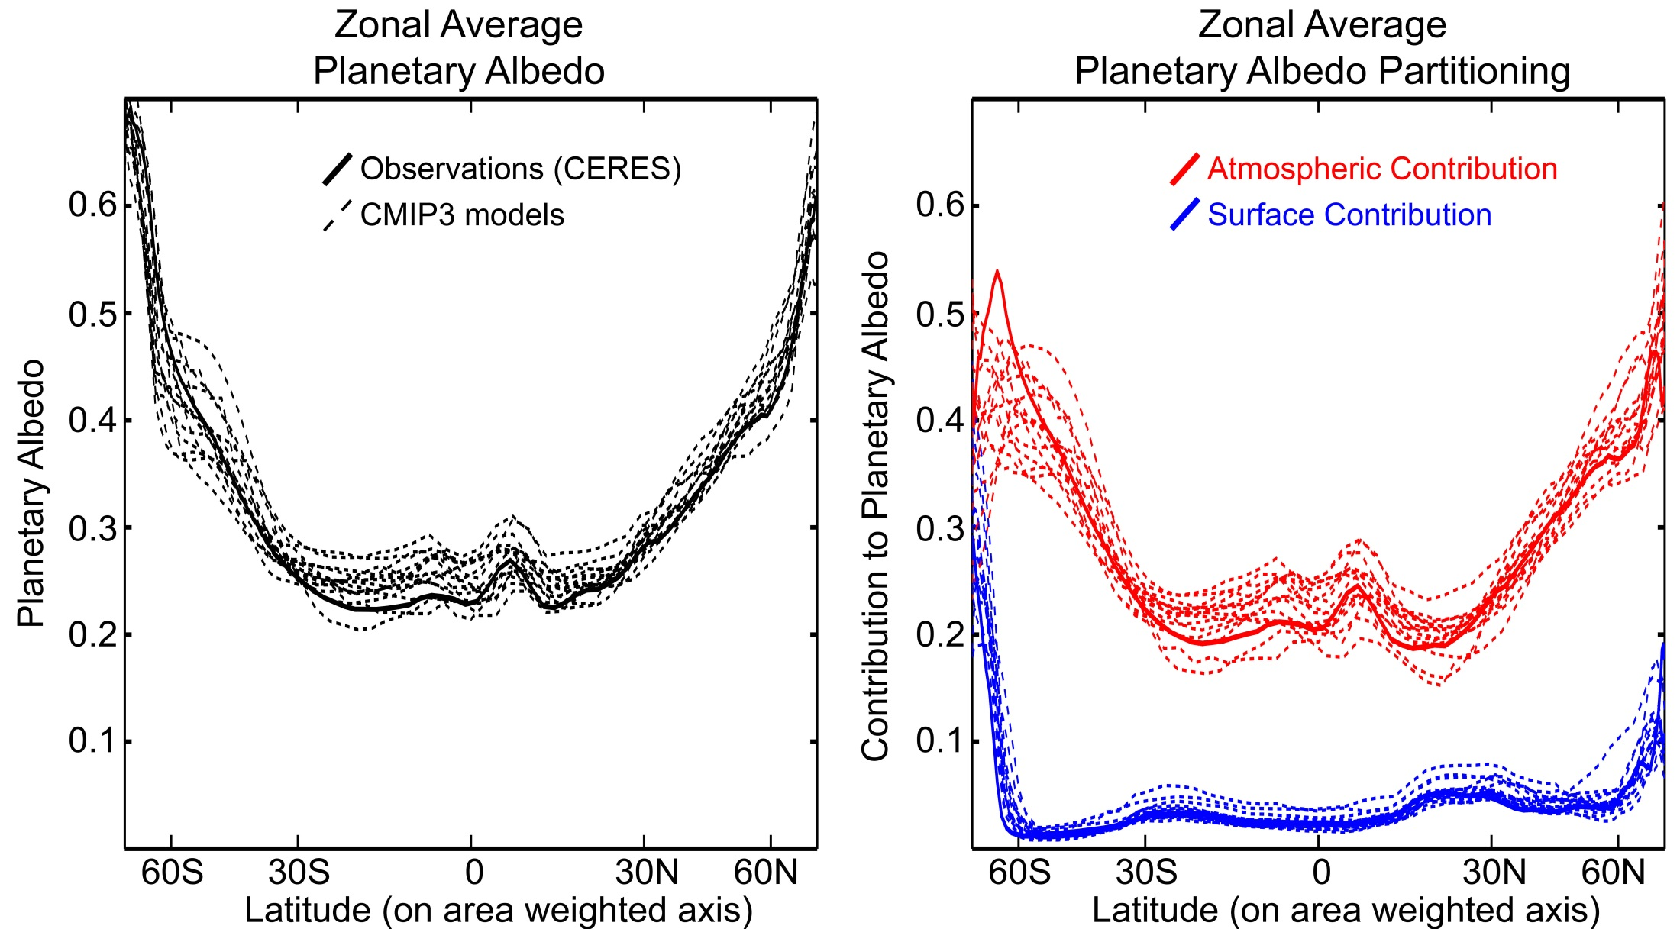
Planetary Albedo Partitioning:
Comparison of models (CMIP3 pre-industrial) and observations (CERES)

Slide 27
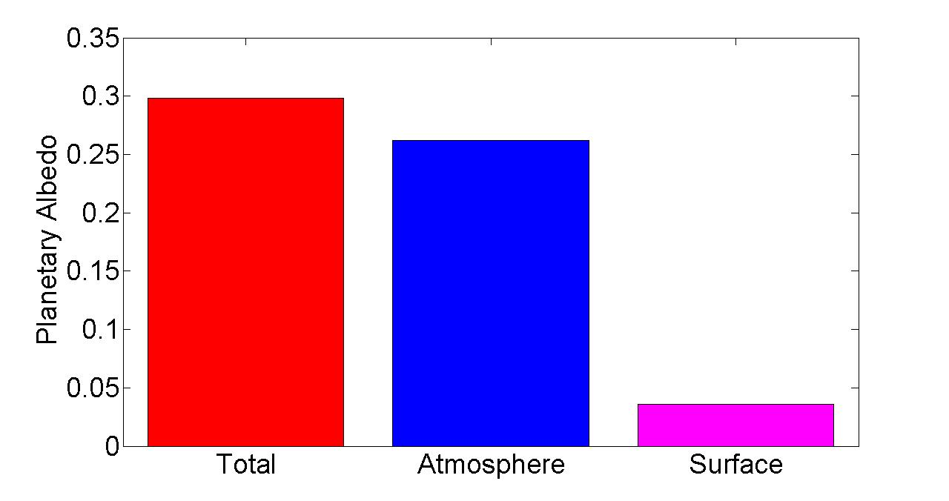
Observed Global Mean Planetary Albedo and it atmospheric/surface Partitioning
Notes:
0.298 = 0.262 + 0.036
100% = 88% + 12%

Slide 28
Global average energy balance and outgoing longwave radiation
Reflected
Emitted
Incident
Solar
Incident – Reflected = Emitted
S(1-α_{P}) = σT_{e}⁴
Earth
S(1-α_{P}) = T_{e}
(
)
0.25
σ
α_{P} = 0.3
T_{e}=255 K
Compare to T_{S}=287 K
σ = 5.67*10⁻⁸ W m ⁻² K⁻⁴
S =340 W m⁻²

Slide 29
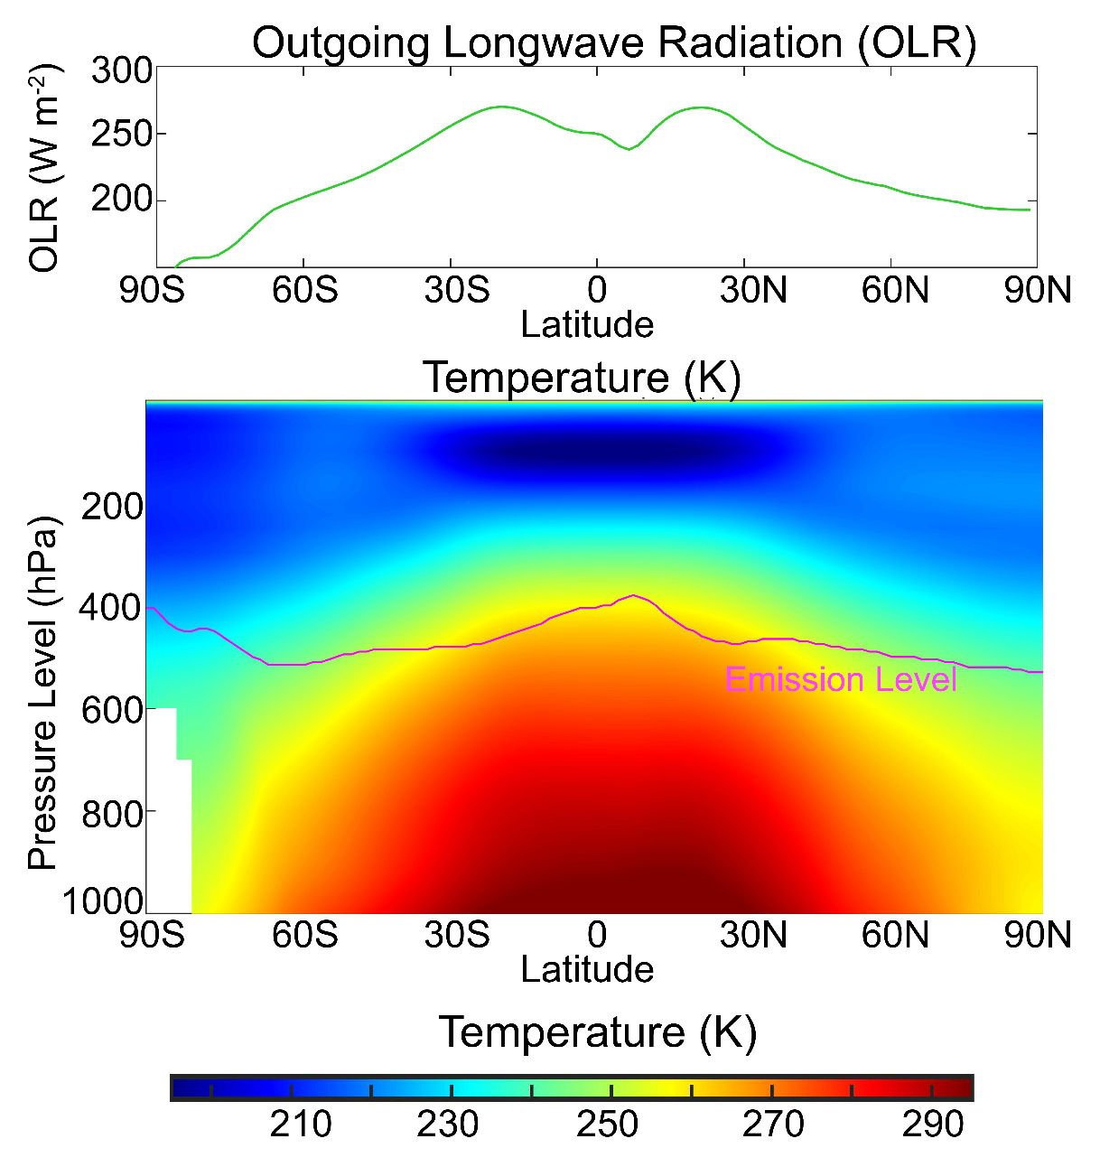
Emission Temperature (T_{E}) Vs. Surface Temperature (T_{S})
Radiation is emitted from the upper troposphere where it is colder

Slide 30

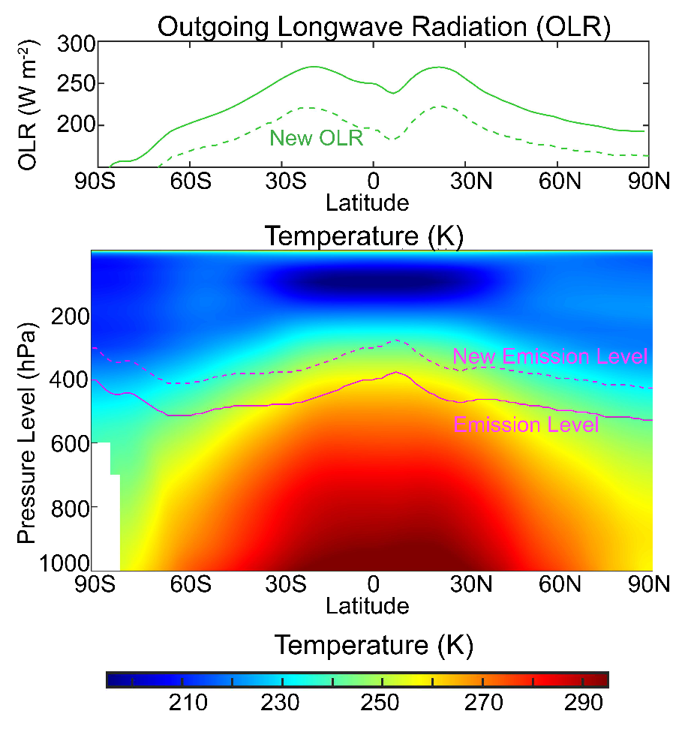
Equilibrium (pre-industrial)
Add CO₂ instantaneously (X2¹⁰)
ASR 241 W m⁻²
OLR 241 W m⁻²
ASR 241 W m⁻²
OLR 191 W m⁻²
ASR
Absorbed Solar Radiation (net solar at top of atmosphere)
+40 W m⁻²
Into the Earth

Slide 31


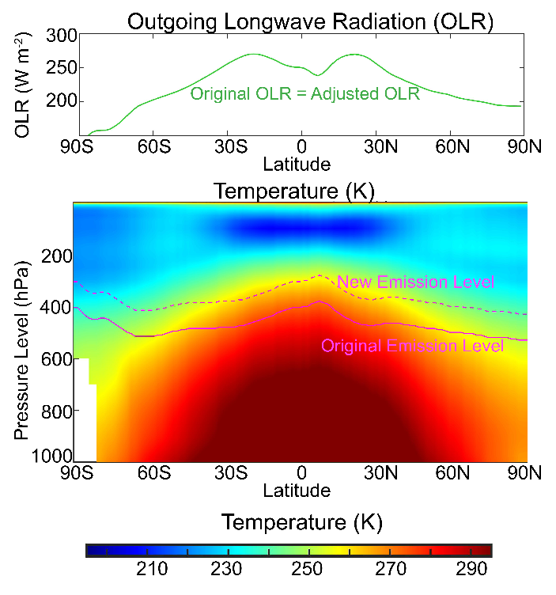
Equilibrium (pre-industrial)
Add CO₂ instantaneously
Temperature adjusts
ASR 241 W m⁻²
OLR 241 W m⁻²
ASR 241 W m⁻²
OLR 221 W m⁻²
ASR 241 W m⁻²
OLR 241 W m⁻²
+40 W m⁻²
Into the Earth
New Balance

Slide 32
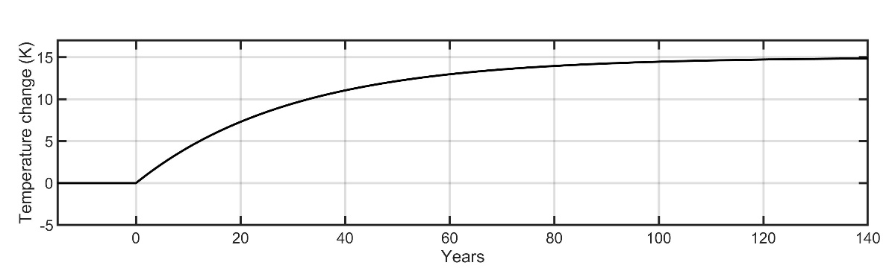
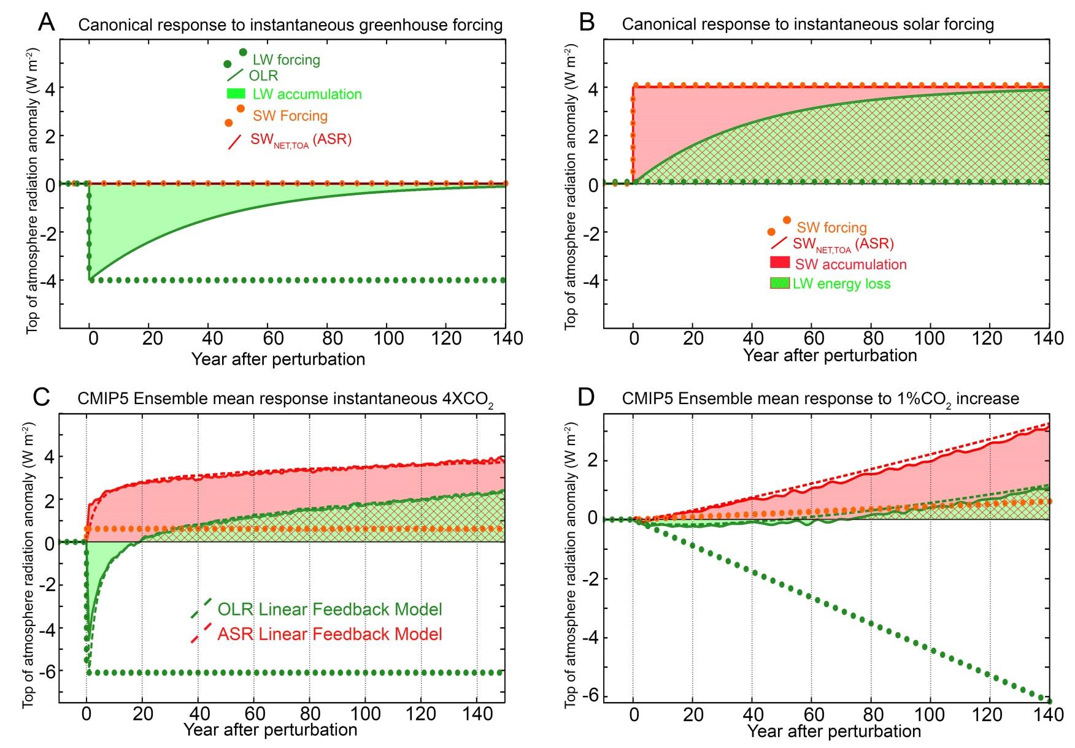
Idealized response to instantaneous CO₂ addition
40
20
Radiative anomaly (W m⁻²)
0
-20
-40
Equilibrium (pre-industrial)
Add CO₂ instantaneously
Temperature adjusts
ASR 241 W m⁻²
OLR 241 W m⁻²
ASR 241 W m⁻²
OLR 241 W m⁻²
OLR 201 W m⁻²
ASR 241 W m⁻²
+40 W m⁻²
Into the Earth
New Balance

Slide 33


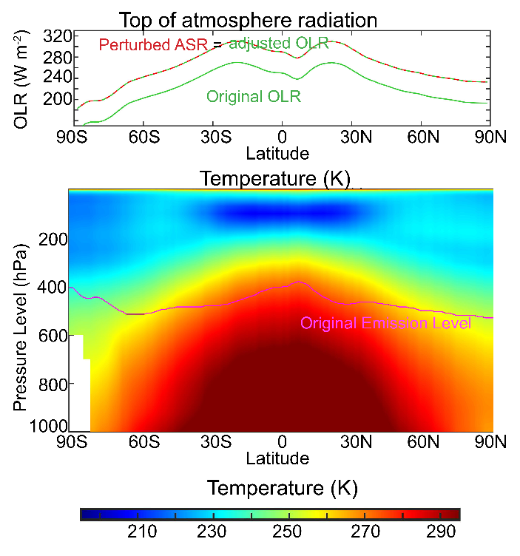
Increase insolation Instantaneously
Equilibrium (pre-industrial)
Temperature adjusts
ASR 241 W m⁻²
OLR 241 W m⁻²
ASR 281 W m⁻²
OLR 241 W m⁻²
ASR 281 W m⁻²
OLR 281 W m⁻²
+40 W m⁻²
Into the Earth
New Balance

Slide 34
Idealized response to instantaneous increase in strength of the sun
40
20
Radiative anomaly (W m⁻²)
0
-20
-40
Equilibrium (pre-industrial)
Increase insolation (ASR)
Temperature adjusts
ASR 241 W m⁻²
OLR 241 W m⁻²
ASR 281 W m⁻²
OLR 281 W m⁻²
OLR 241 W m⁻²
ASR 281 W m⁻²
+40 W m⁻²
Into the Earth
New Balance

Slide 35
pre-industrial
Adding CO₂
Temperature adjusts
ASR 241
OLR 241
OLR 241
ASR 241
40
Radiative anomaly (W m⁻²)
New Balance
20
0
-20
-40
Increased Insolation
40
20
Temperature adjusts
Radiative anomaly (W m⁻²)
ASR 241
OLR 241
0
ASR 281
OLR 281
-20
-40
New Balance

Slide 36
Top of Atmosphere Radiative response to greenhouse and shortwave forcing
OLR returns to unperturbed value in 20 years

Slide 37

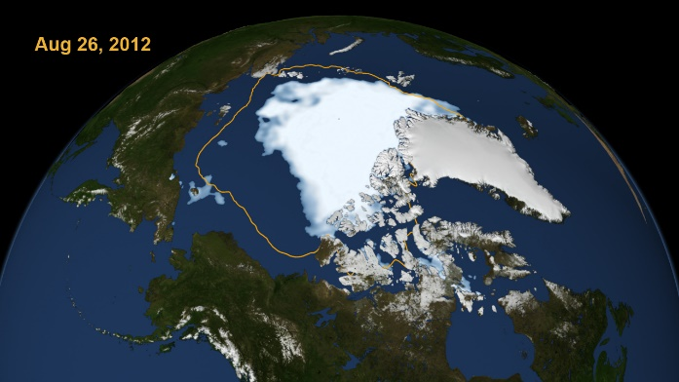
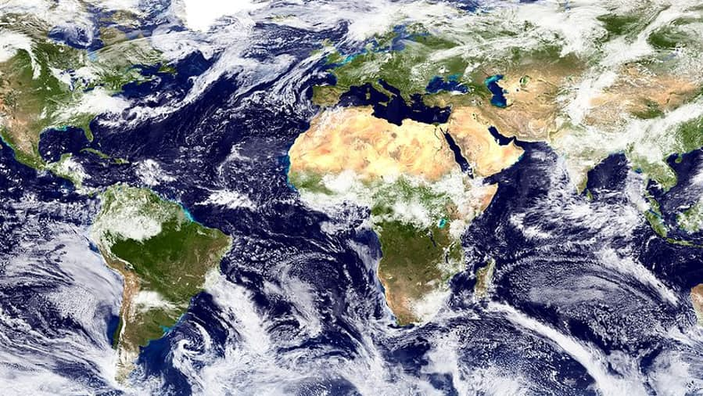
Mechanisms leading to changes in absorbed solar radiation with global warming (in models)
1
Moistening of the atmosphere
Enhanced atmospheric solar absorption (water vapor)
Sea ice (and snow) loss
More solar radiation absorbed by surface
2
Cloud Changes
Highly Uncertain
3

Slide 38

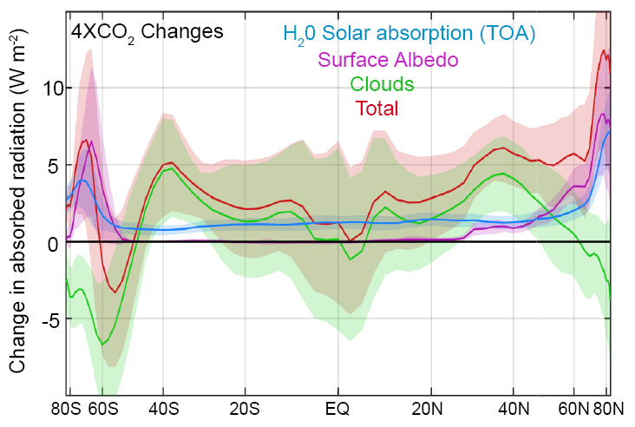
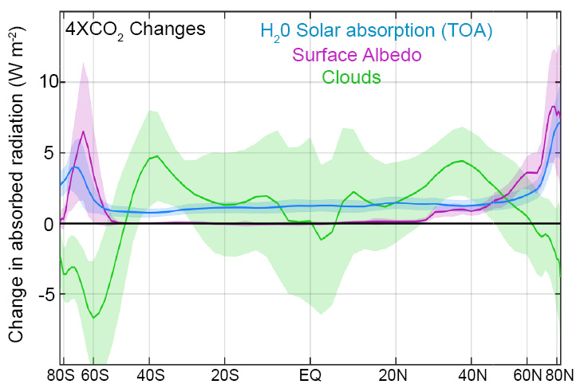
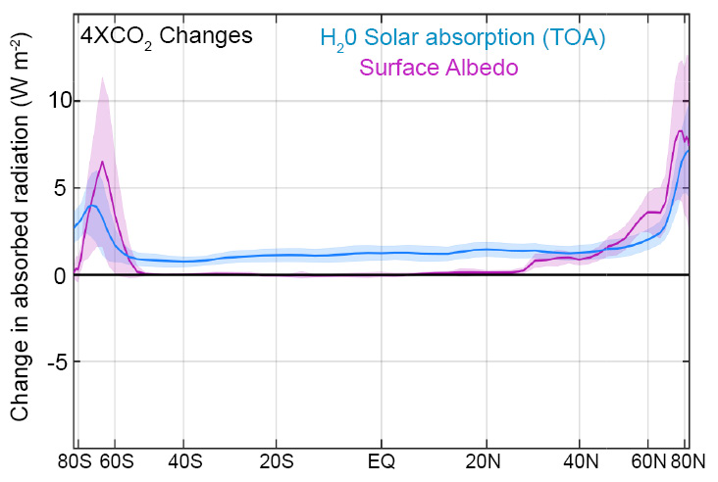
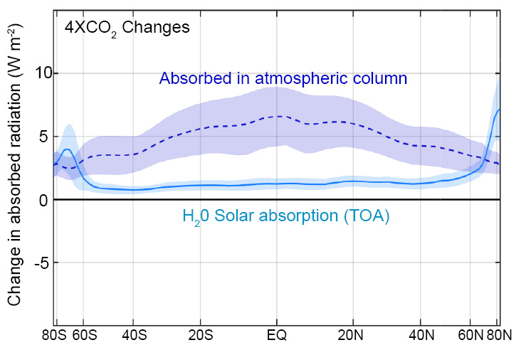
Changes in absorbed solar radiation with global warming
incident
Reflected
cloud
absorbed
?
H₂0
(vapor)
Reflected
surface
transmitted
ice
ocean

Slide 39
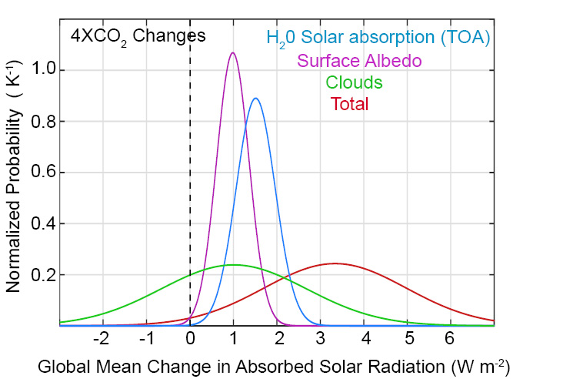
Changes in global mean absorbed solar radiation with increased CO₂
Despite uncertainties in clouds, it is highly likely that the climate system will absorb more solar radiation as it warms due to two robust processes:
Moistening of the atmosphere
Melting of sea ice and snow

Slide 40
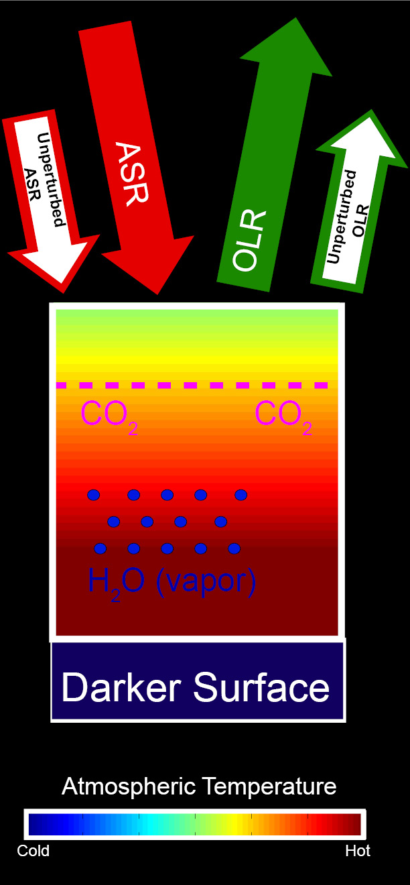
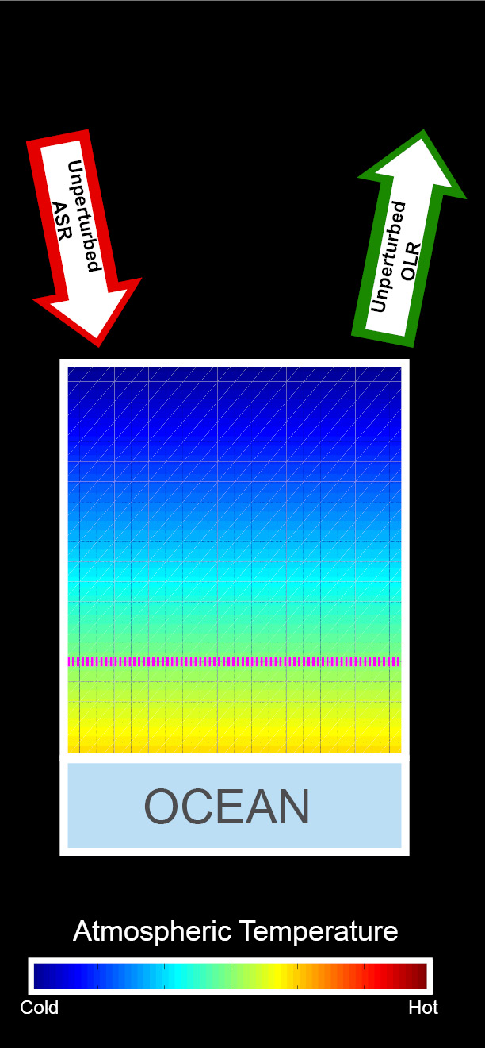
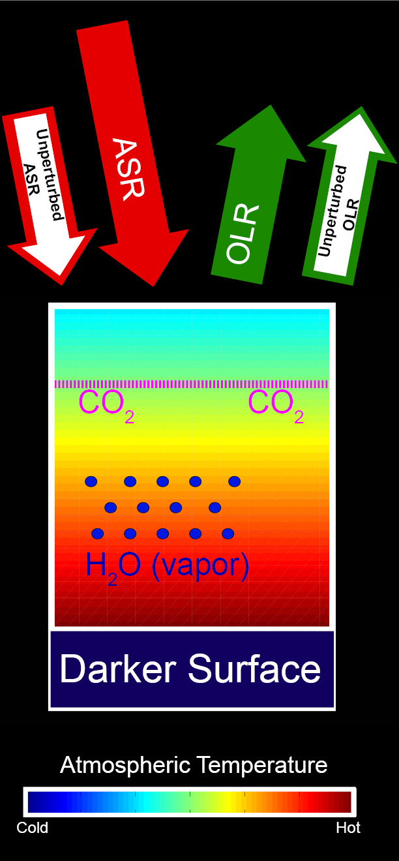
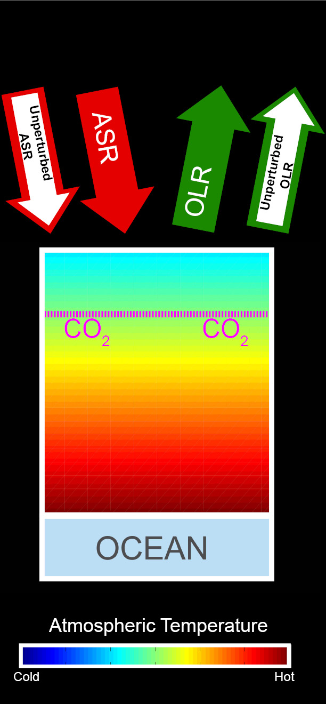
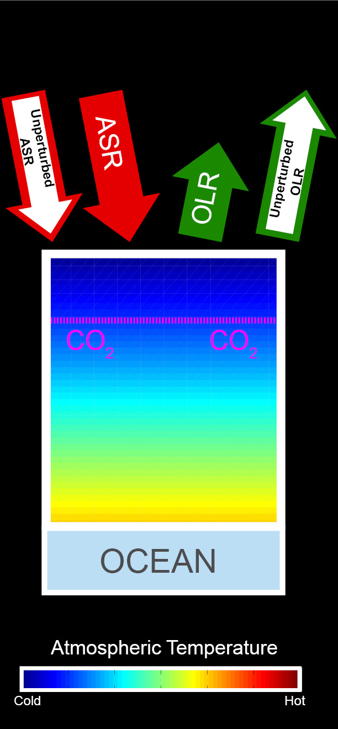
Energetic response to increased CO₂
Increased ASR
Unperturbed
Balanced Initial System
CO₂ added
Warming
CO₂ reduces OLR → energy imbalance
Warming →
OLR increases
Moistening and darkening → ASR increases
Additional warming
→ OLR balances increased ASR

Slide 41
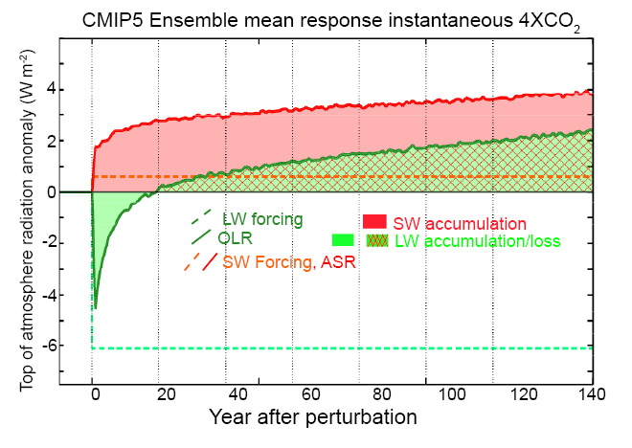
In models, long-term trends in radiation show increases in ASR and OLR in response to CO2
OLR returns to unperturbed value in 20 years

Slide 42
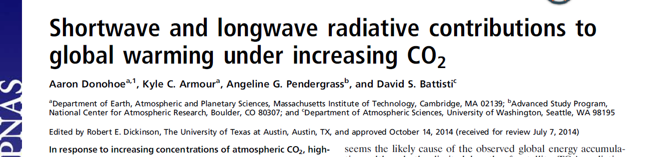
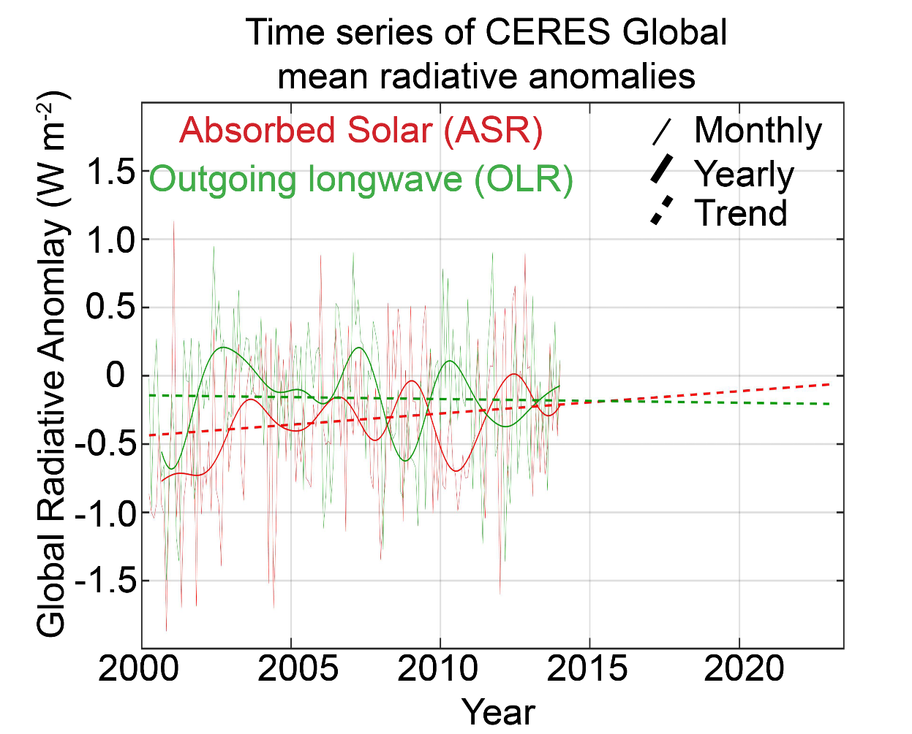
“Observational constraints of radiative feedbacks suggest a transition to a regime of global energy accumulation dominated by enhanced ASR could occur with only 0.5 K
global warming above present—by the middle of the 21st century
if warming trends continue as projected”.

Slide 43
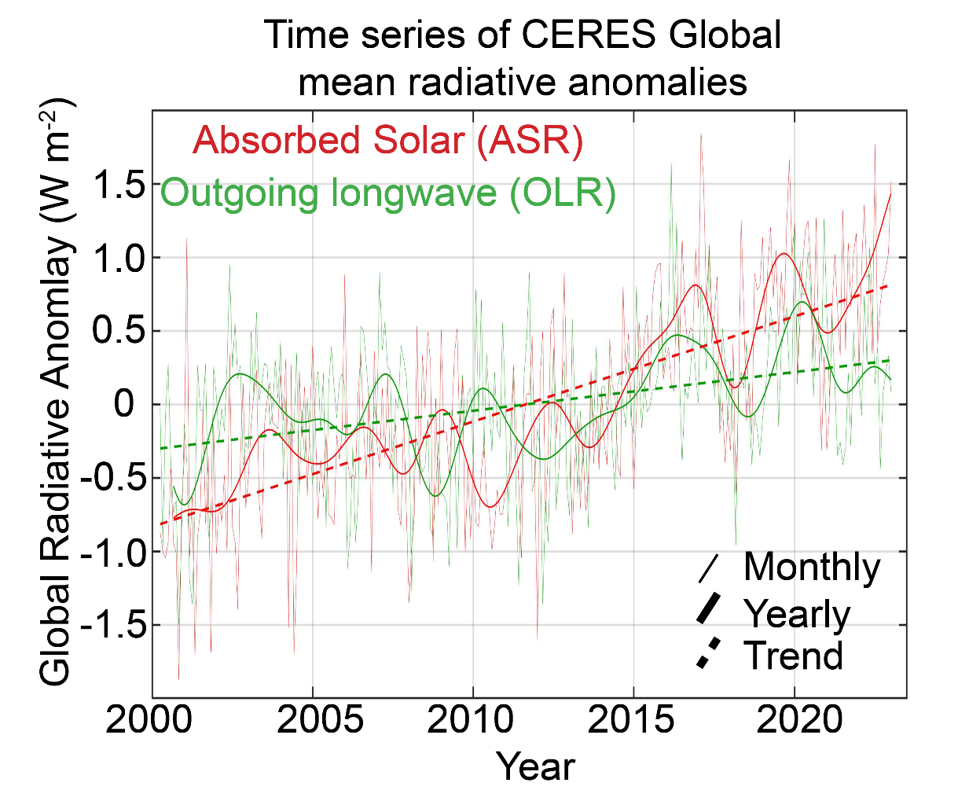
“Observational constraints of radiative feedbacks suggest a transition to a regime of global energy accumulation dominated by enhanced ASR could occur with only 0.5 K
global warming above present—by the middle of the 21st century
if warming trends continue as projected”.

Slide 44
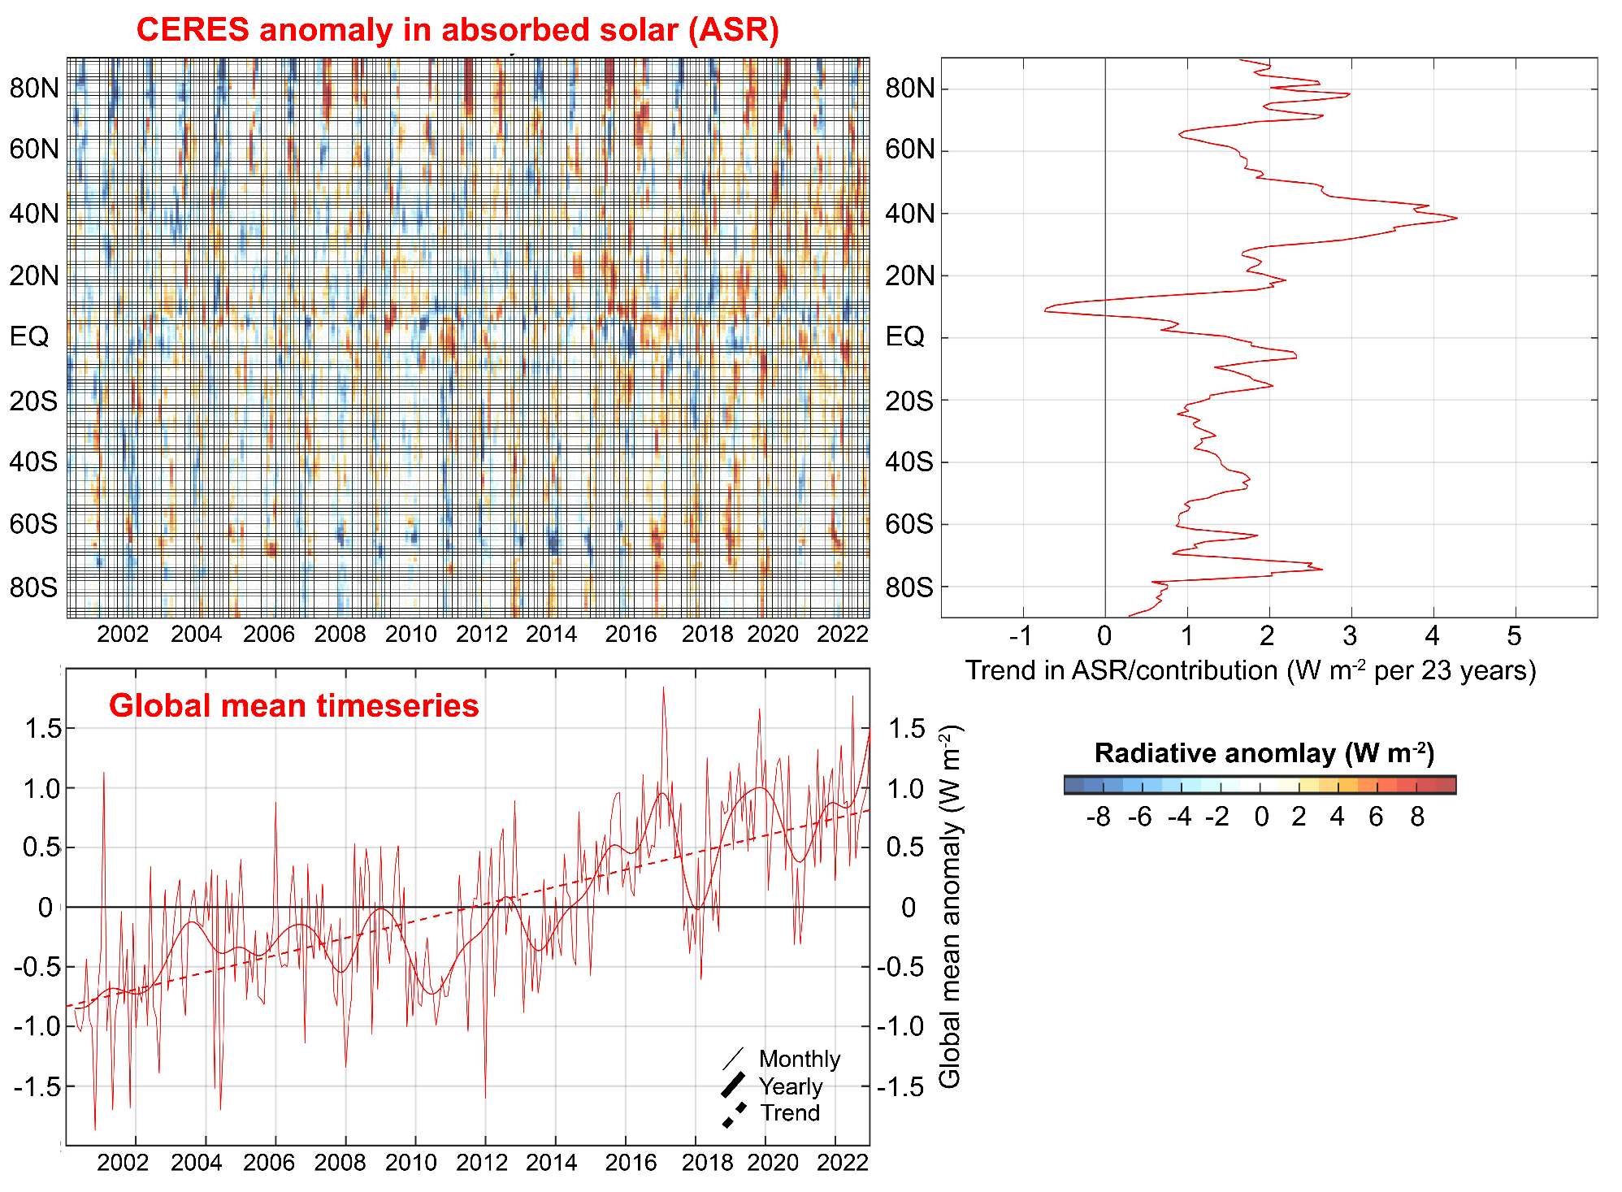

Slide 45
Attributing observed ASR changes to processes
Atmospheric
Contribution
To planetary
Albedo
Surface
Contribution
To planetary
Albedo
S = incident
R = cloud
reflection
A = absorption
α = surface
albedo
(UNKNOWNS)

Slide 46



Climatological
planetary albedo
Surface reflection
Surface contribution:
= α(1-A)(1-R)²
(1-αR)
Atmospheric reflection
Impact of surface changes
on ASR
Atmosphere

Slide 47

Radiative sensitivity from isotropic model
→ Isotropic model matches kernel calculations
Satellite observations provide an estimate of Radiative sensitivity
→The model average radiative sensitivity is close to the observational estimate

Slide 49
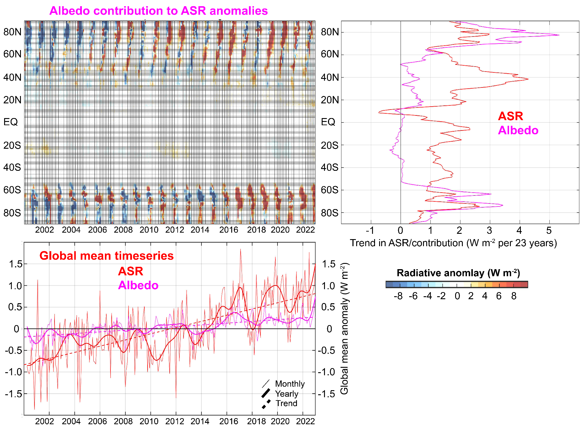
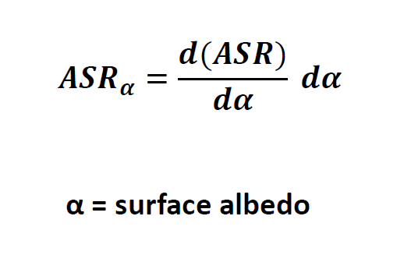

Slide 50
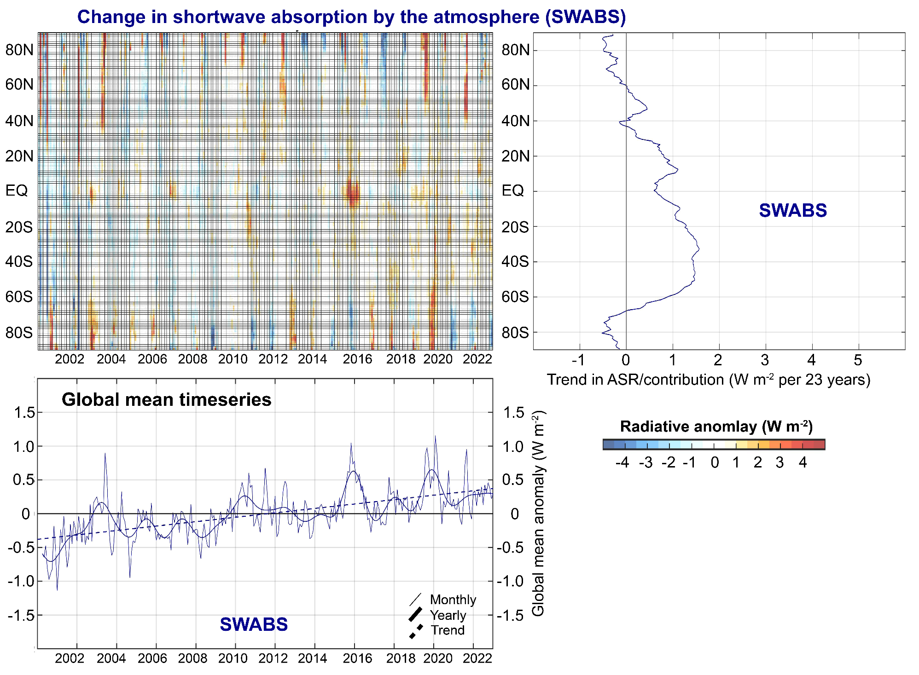

Slide 51
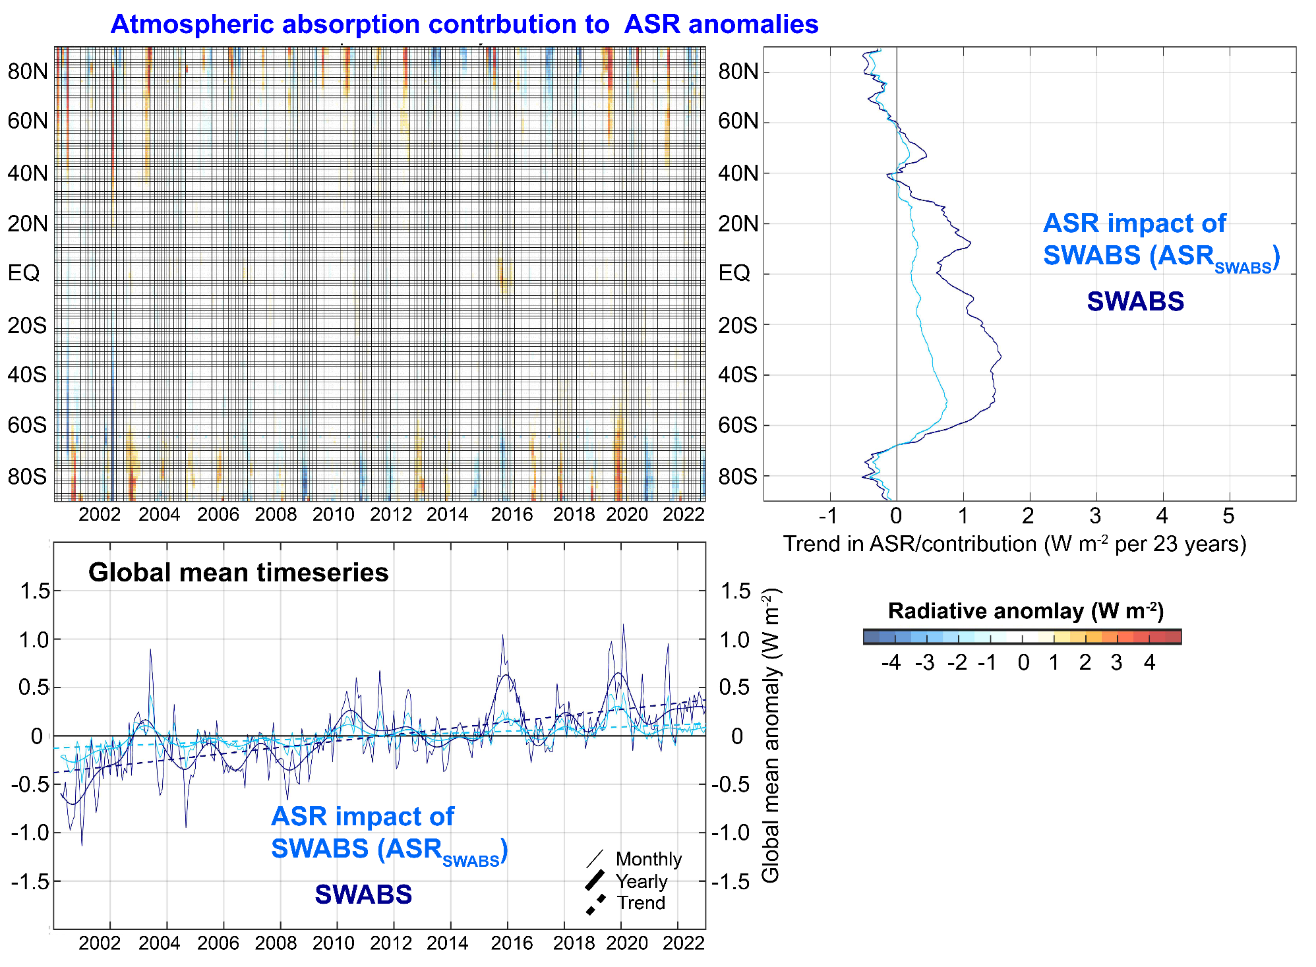

Slide 52
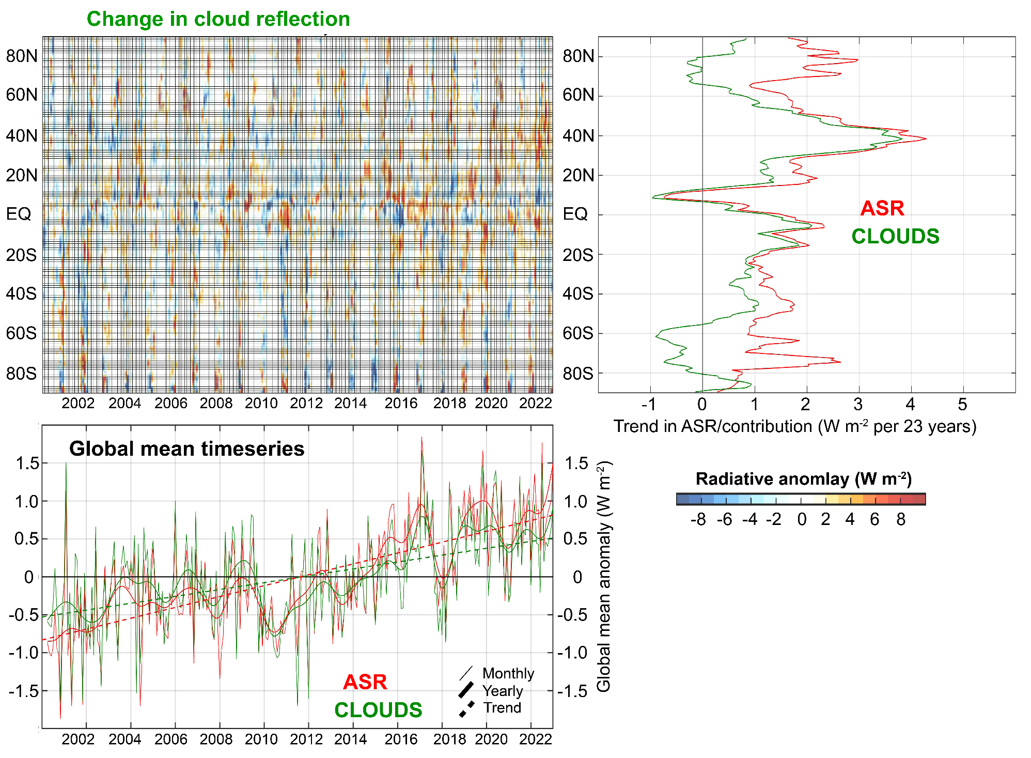

Slide 53
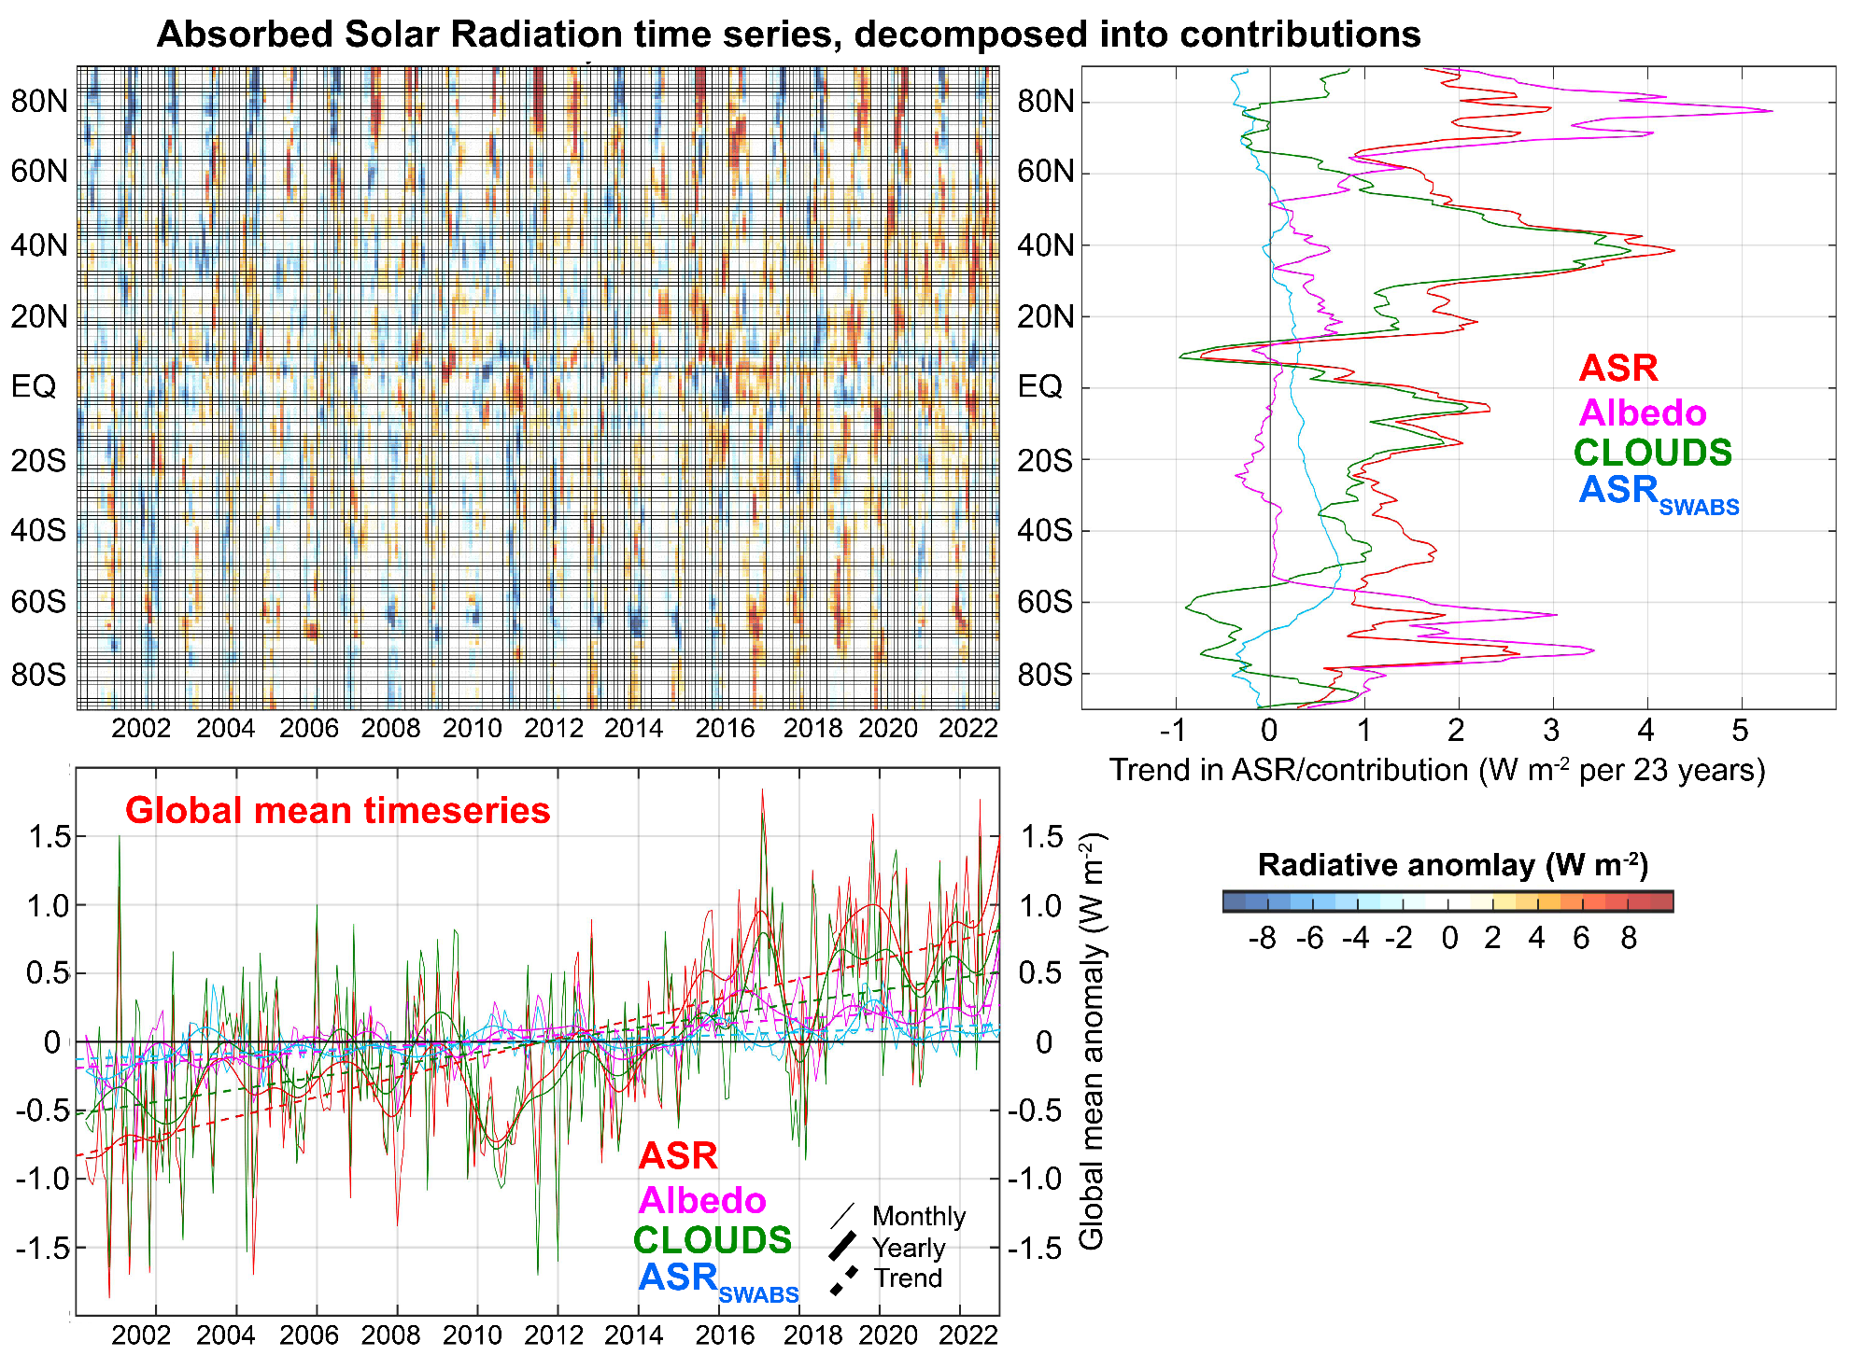
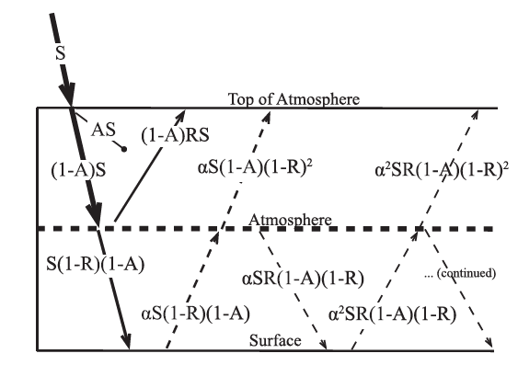

Slide 54
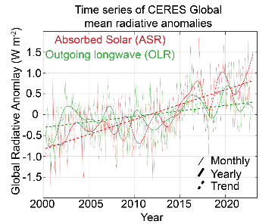
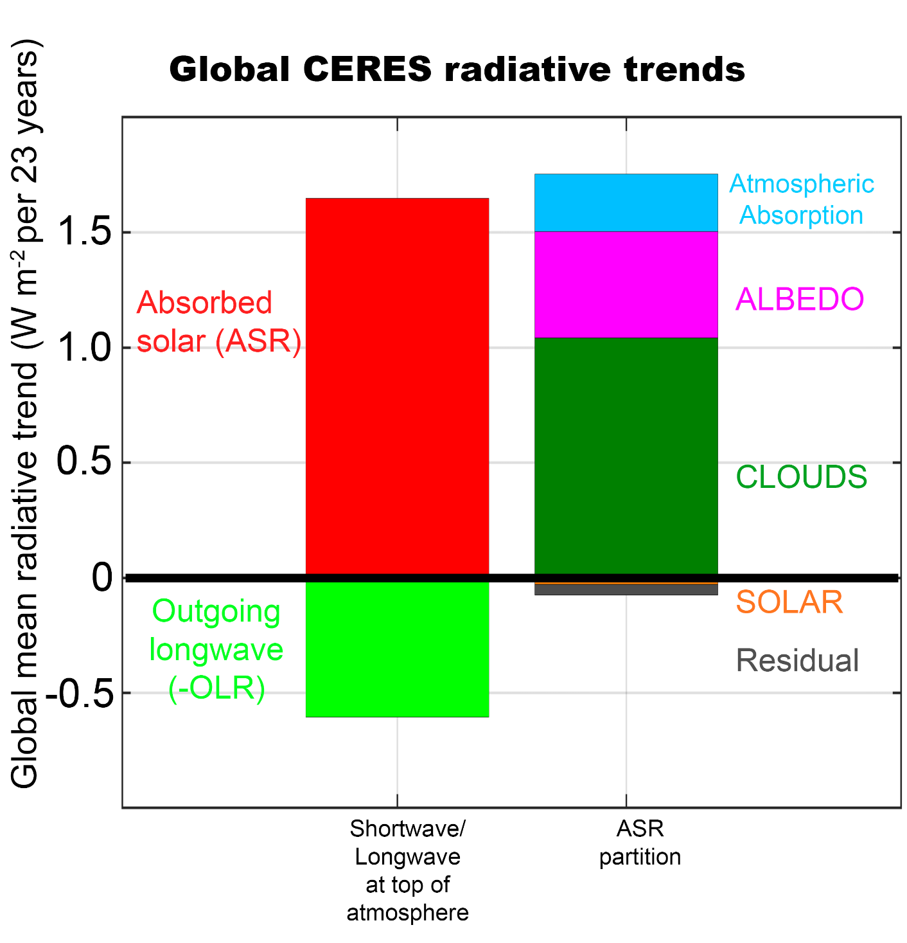
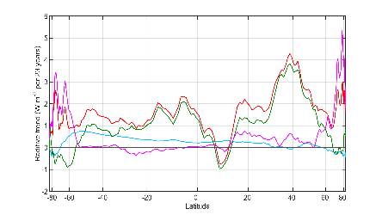


Slide 55
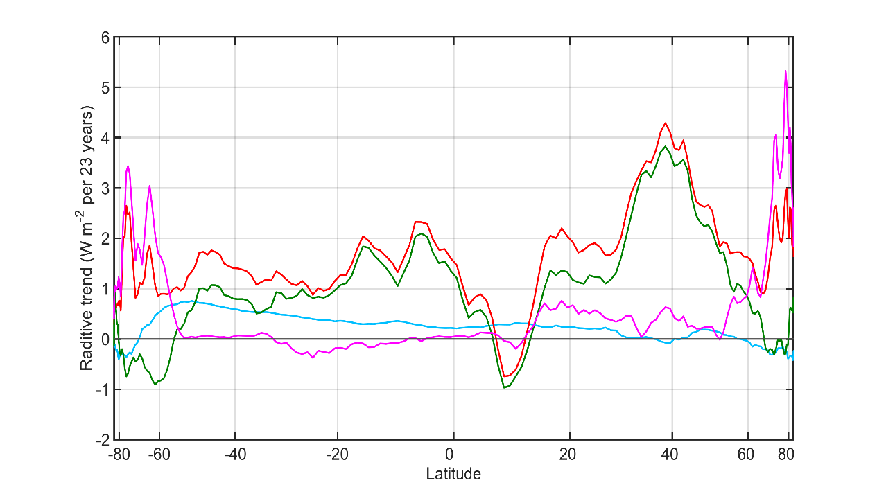

Observational trends in Absorbed Solar from CERES (2000-2023)
Model (ensemble mean) change in absorbed solar from radiative kernels

Slide 56
Poleward energy transport in the climate system
Incident
Reflected
Emitted
Net
Tropics
Extratropics

Slide 57


Radiative constraints on poleward energy transport
5.8 PW
Notes:
NH = 8.2 - 2.4 = 5.8
SH = 9.0 – 3.2 = 5.8

Slide 58
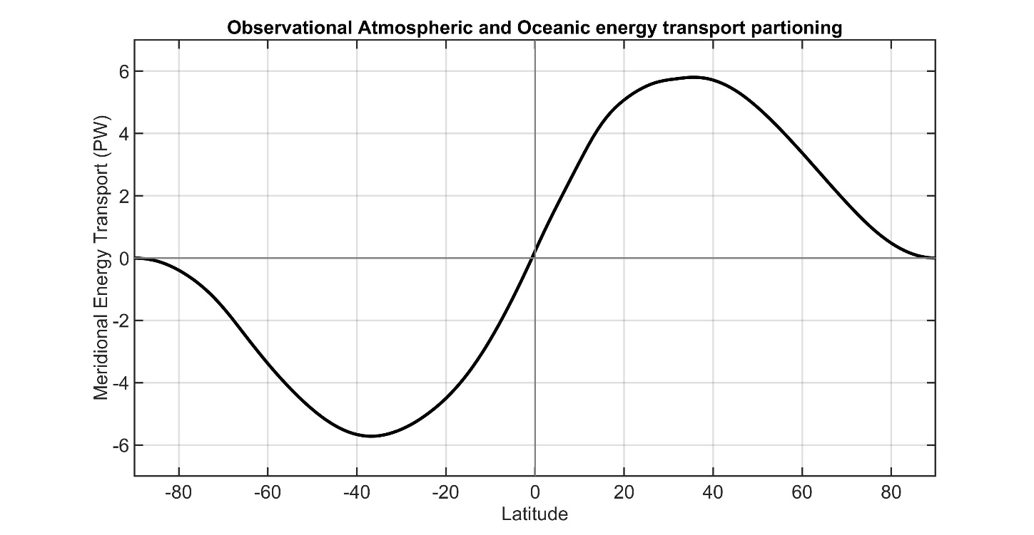
Total (atmosphere plus ocean) energy transport from satellite top of atmosphere (TOA) radiation (CERES EBAF ).
5.8 PW
5.8 PW
Total
Notes:
NH = 8.2 - 2.4 = 5.8
SH = 9.0 – 3.2 = 5.8

Slide 59
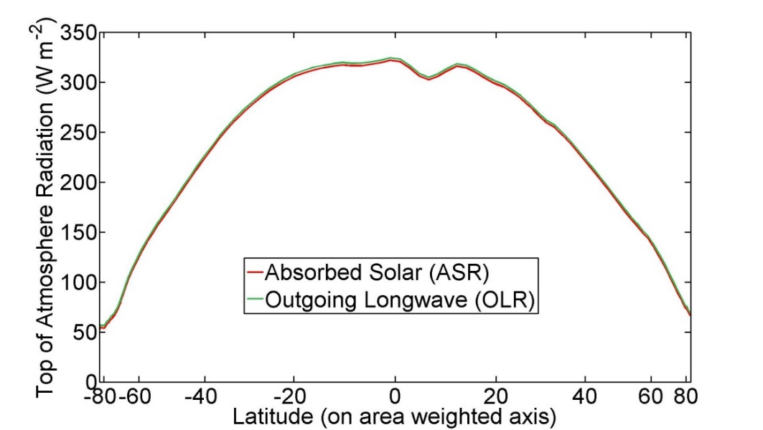
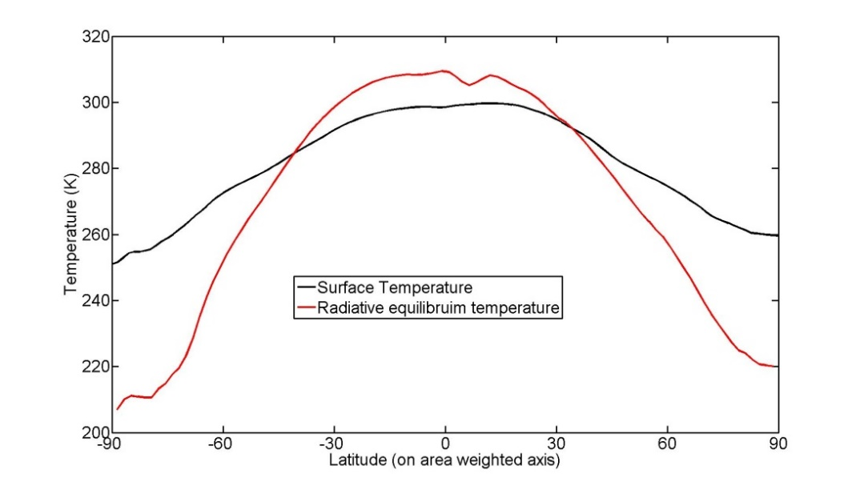
The equator-to-pole temperature gradient in the absence of poleward energy transport
Equator-to-pole temperature gradient of 100K needed for OLR to balance ASR are each latitude
→Poleward heat transport is responsible for Earth being habitable

Slide 60

Poleward Energy Transport is unchanged with climate state in models

Slide 61

Observations
Individual models
Model Mean
Total (atmosphere plus ocean) meridional heat transport varies by about 20% between models.
→ Also biased low relative to observations especially in the SH
Donohoe and Battisti (2012). What determined meridional heat transport in climate models. J. Climate.

Slide 62

Observations
Individual models
Model Mean

Slide 63

Observations
Individual models
Model Mean

Slide 64

Observations
CMIP3 Mean
CMIP5 Mean
CMIP6 Mean
Inter-model spread and bias in MHT is persistent across generations of CMIP models

Slide 65



Slide 66


Radiative constraints on inter-model spread in poleward heat transport
Compare model with:
The least MHT in the SH
and
The most MHT in the SH
Model with most MHT
Model with least MHT
Observations
TOA radiation (w m-2)
Global mean removed
Absorbed
Solar
Outgoing
Longwave

Slide 67
Radiative constraints on inter-model spread in poleward heat transport
Compare model with:
Least MHT
Model with most MHT
ASR*
OLR*
Model with least MHT
6.7 PW
2.7 PW
Observations
4.0 PW
To extratropics
Tropics
MOST MHT
ASR*
OLR*
3.0 PW
9.3 PW
TOA radiation (w m-2)
Global mean removed
Absorbed
Solar
6.3 PW
Outgoing
Longwave
Tropics
To extratropics

Slide 68


ASR
Total (atmosphere plus ocean) energy transport from TOA radiation (CERES satellite).
NET
OLR
AHT
Atmospheric energy transport from 6 hourly ERA5 reanalysis dynamics calculation
Tropics
Extratropics
Total
Atmosphere
Notes:
NH = 8.2 - 2.4 = 5.8
SH = 9.0 – 3.2 = 5.8

Slide 69

ASR
Total (atmosphere plus ocean) energy transport from TOA radiation (CERES satellite).
NET
OLR
AHT
Atmospheric energy transport from 6 hourly ERA5 reanalysis dynamics calculation
Tropics
Extratropics
Ocean heat transport as the residual = Total - atmos
Total
Atmosphere
Ocean
Notes:
NH = 8.2 - 2.4 = 5.8
SH = 9.0 – 3.2 = 5.8

Slide 70

This strategy was pioneered by Trenberth and Caron (2001)
ERBE and NCEP
Total
Atmosphere
Ocean
Our result
CERES and ERA5
Notes:
NH = 8.2 - 2.4 = 5.8
SH = 9.0 – 3.2 = 5.8

Slide 71
Model partitioning of AHT/OHT
MHT from Radiation
Total heat
transport (MHT)
Integral of
TOA radiation
=
Net radiative
Deficit of extratropics
5.8 PW
Integral of
Surface heat
Flux (SHF)
Ocean heat
Transport (OHT)
=
Atmospheric heat transport (AHT)
AHT = MHT – OHT
= Integral (TOA – SHF)
Tropics
Extratropics
Notes:
NH = 8.2 - 2.4 = 5.8
SH = 9.0 – 3.2 = 5.8

Slide 72


Slide 73


CMIP3 -- Partitioning of MHT 3
Observations
Total energy
transport
Individual models
Model Mean
ATMOSPHERE
Atmosphere ocean partitioning
OCEAN
Observations
Individual models
Model Mean

Slide 74


CMIP53
Observations
Total energy
transport
Individual models
Model Mean
ATMOSPHERE
Atmosphere ocean partitioning
OCEAN
Observations
Individual models
Model Mean

Slide 75


CMIP63
Observations
Total energy
transport
Individual models
Model Mean
ATMOSPHERE
Atmosphere ocean partitioning
OCEAN
Observations
Individual models
Model Mean

Slide 76


CMIP3 to 6 against observations
Observations
Total energy
transport
CMIP3 Mean
CMIP5 Mean
CMIP6 Mean
ATMOSPHERE
Atmosphere ocean partitioning
OCEAN
Observations
CMIP3 Mean
CMIP5 Mean
CMIP6 Mean

Slide 77


OBSERVATIONS FROM ERA5 and CERES
Observations
CMIP Mean
Total energy
transport
ATMOSPHERE
OCEAN
Observations
Atmosphere ocean partitioning
CMIP Mean

Slide 78

Sensitivity to reanalysis
ERA INTERIM and CERES
Observations
CMIP Mean
Total energy
transport
ATMOSPHERE
OCEAN
Observations
Atmosphere ocean partitioning
CMIP Mean

Slide 79

Sensitivity to reanalysis
NCEP reanalysis and CERES
Observations
CMIP Mean
Total energy
transport
ATMOSPHERE
OCEAN
Observations
Atmosphere ocean partitioning
CMIP Mean

Slide 80
Sensitivity to observational radiation
CERES EBAF (energy balanced and filled)
Observations
CMIP Mean
Total energy
transport
ATMOSPHERE
OCEAN
Observations
Atmosphere ocean partitioning
CMIP Mean

Slide 81


Sensitivity to observational radiation unadjusted CERES (single scanner)
Observations
CMIP Mean
Total energy
transport
ATMOSPHERE
OCEAN
Observations
Atmosphere ocean partitioning
CMIP Mean

Slide 82


Sensitivity to observational radiation
ERBE (1984-1990)
Observations
CMIP Mean
Total energy
transport
ATMOSPHERE
OCEAN
Observations
Atmosphere ocean partitioning
CMIP Mean

Slide 83

Accounting for ocean heat content changes
Total energy
transport
Observations
CMIP Mean
ATMOSPHERE
Correcting for ocean heat content changes -------------------------
From EN4 ocean reanalysis temperature trends
OCEAN
Observations
CMIP Mean

Slide 84
What determines the partitioning of heat transport between the atmosphere and ocean (Robert Fajber)
Energy input to the atmosphere
Globally, evaporation adds energy to the atmosphere and
atmospheric radiation removes energy
Local energy imbalances drive atmospheric heat transport
Source of atmospheric energy input (W m⁻² )
Notes:
Left figure shows the sources of energy input to the atmosphere in observations (ERA reanalysis) with the global mean removed. Energy enters the atmosphere in the low latitudes and leaves the atmosphere in the high latitudes (black line). The energy input to the atmosphere is decomposed into three terms; the sensible hear flux from the surface to the atmosphere (orange), the evaporation (green), and the radiative heating of the atmosphere (note this differs from the top of atmosphere radiation and the surface radiation). The evaporation has more spatial structure than the other terms contributing energy into the atmosphere.
The right panel shows the atmospheric heat transport due to each process. This shows that nearly all the poleward heat transport in the atmosphere is derived from evaporation. This result has been confirmed with idealized model studying in which we (Robert Fajber) traces the heating and transport that results from each process by tagging and tracing air parcels (much like one would do with passive tracer transport).
There is one subtlety here. The evaporations drives both the flux of temperature and humidity (dry and moist energy transports in the atmosphere. The evaporation in the tropics can either be balanced by a moisture transport in the atmosphere, or be precipitated out which condesationally heats the atmospheric column to drive the dry atmospheric heat transport.

Slide 85
What determines the partitioning of heat transport between the atmosphere and ocean (Robert Fajber)
150
6
Total
Total
Radiation (atmos)
Radiation (atmos)
100
Sensible heat
4
Sensible heat
Evaporation
Evaporation
50
50
2
Source of atmospheric energy input (W m⁻² )
Global mean removed
Atmospheric heat transport generated
By each source term (PW)
0
0
-50
-2
-100
-4
-150
30N
60N
90N
-6
30N
60N
90N
90S
60S
30S
EQ
90S
60S
30S
EQ
Notes:
Left figure shows the sources of energy input to the atmosphere in observations (ERA reanalysis) with the global mean removed. Energy enters the atmosphere in the low latitudes and leaves the atmosphere in the high latitudes (black line). The energy input to the atmosphere is decomposed into three terms; the sensible hear flux from the surface to the atmosphere (orange), the evaporation (green), and the radiative heating of the atmosphere (note this differs from the top of atmosphere radiation and the surface radiation). The evaporation has more spatial structure than the other terms contributing energy into the atmosphere.
The right panel shows the atmospheric heat transport due to each process. This shows that nearly all the poleward heat transport in the atmosphere is derived from evaporation. This result has been confirmed with idealized model studying in which we (Robert Fajber) traces the heating and transport that results from each process by tagging and tracing air parcels (much like one would do with passive tracer transport).
There is one subtlety here. The evaporations drives both the flux of temperature and humidity (dry and moist energy transports in the atmosphere. The evaporation in the tropics can either be balanced by a moisture transport in the atmosphere, or be precipitated out which condesationally heats the atmospheric column to drive the dry atmospheric heat transport.

Slide 86
If AHT is governed by evaporation
Prediction: Reduced evaporation → reduced AHT
Control
Snowball
In Snowball Earth simulation
Evaporation becomes negligible
AHT reduced by 90%
Evaporation
Sensible
Radiation
Model simulation from:
J Horner, A Voigt, C Braun, Snowball earth initiation and the thermodynamics of sea ice. J. Adv. Model. Earth Syst. 14, e2021MS002734 (2022).
Control
½ evap
Simulation with evaporation
Coefficient is cut in half
Evaporation reduced by %20
AHT reduced by similar amount
Change ih AHT (PW)

Slide 87


Why are models biased high in AHT
ATMOSPHERE
OCEAN
Observations
Model Mean
Hypothesis: model’s have too much AHT because they have too much evaporation
Evaporation
Observations
CMIP Mean
Observations are WHOI OA flux
Both plots are ocean domain only

Slide 88


Conclusions
Trends in global mean radiation are characterized by increase in both absorbed solar radiation and outgoing longwave radiation consistent with positive shortwave feedback by surface albedo, atmospheric absorption and clouds
The atmosphere moves the majority of energy poleward in the climate system, but the ocean moves more energy in climate models than in couple climate models
Other things I like to think about
Trends in poleward atmospheric heat transport
The relationship between heat waves and atmospheric heat transport
The season cycle of temperature and how it will change
Hemispheric asymmetries in climate and the impact on tropical precipitation

