Slide 1


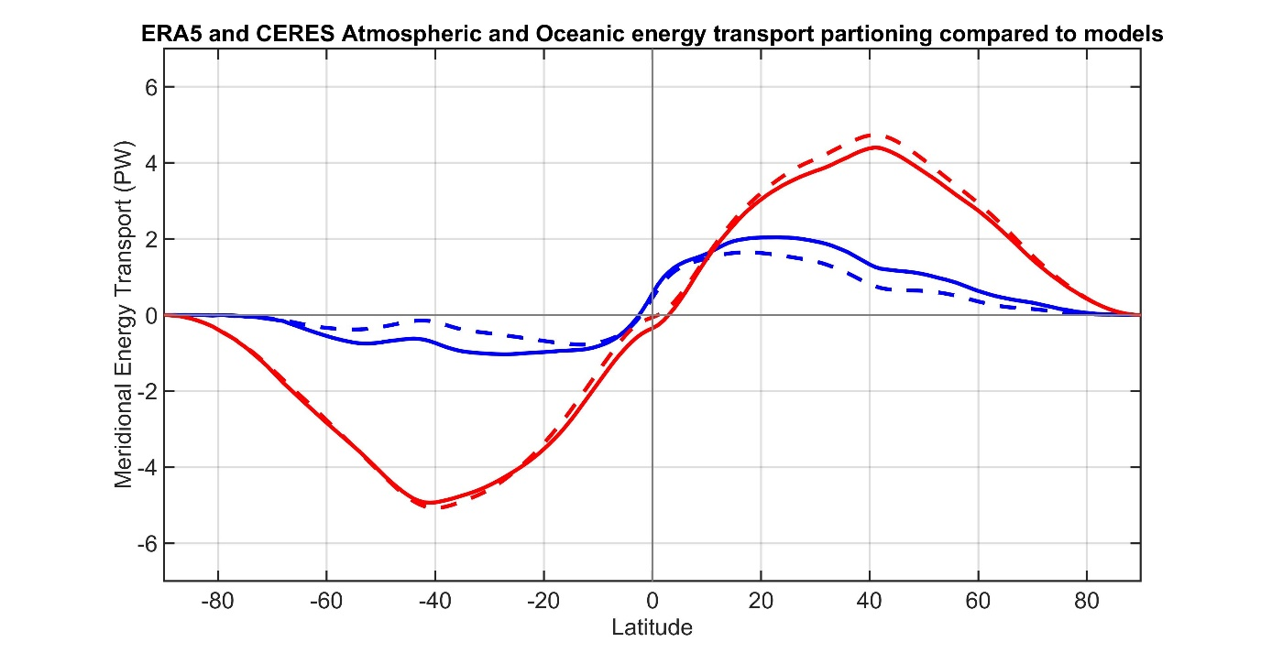






Are climate models biased in the atmosphere-ocean partitioning of poleward energy transport?
ATMOSPHERE
OCEAN
Observations
Model Mean
Aaron Donohoe – Polar Science Center,
Applied Physics Lab., U. Washington
Robert Fajber –UW Dept. of atmospheric science
Kyle Armour – UW Oceanography
Sarah Ragen – UW Oceanography

Slide 2
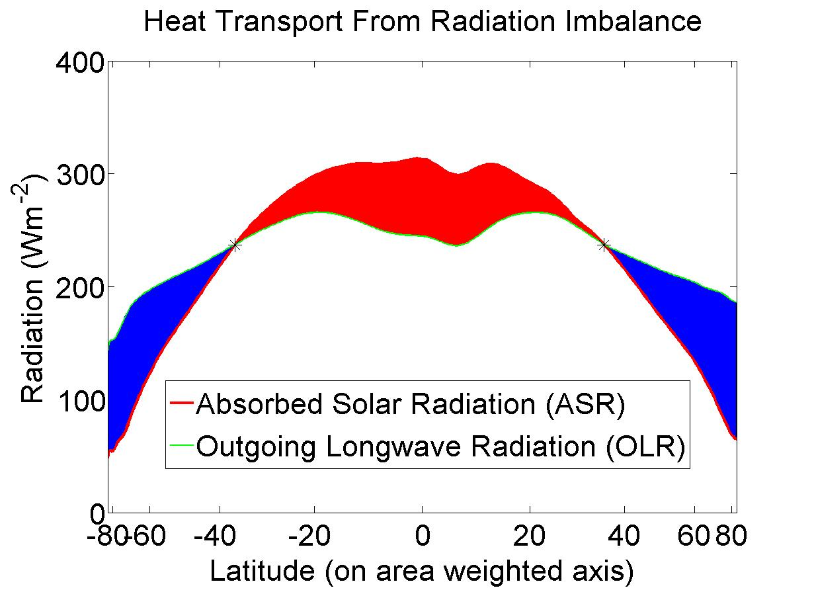
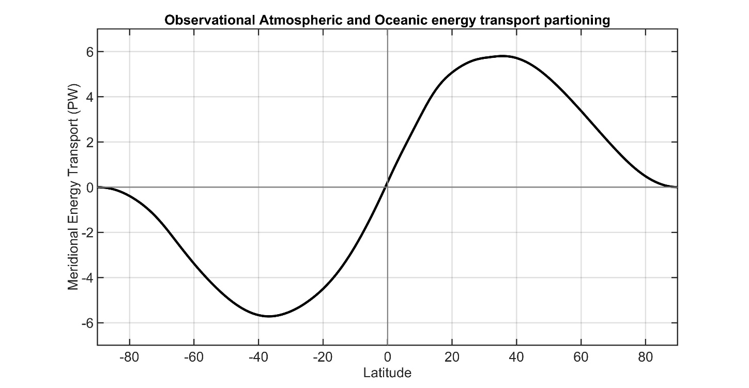
Total (atmosphere plus ocean) energy transport from satellite top of atmosphere (TOA) radiation (CERES EBAF ).
5.8 PW
5.8 PW
Total
Notes:
NH = 8.2 - 2.4 = 5.8
SH = 9.0 – 3.2 = 5.8

Slide 3
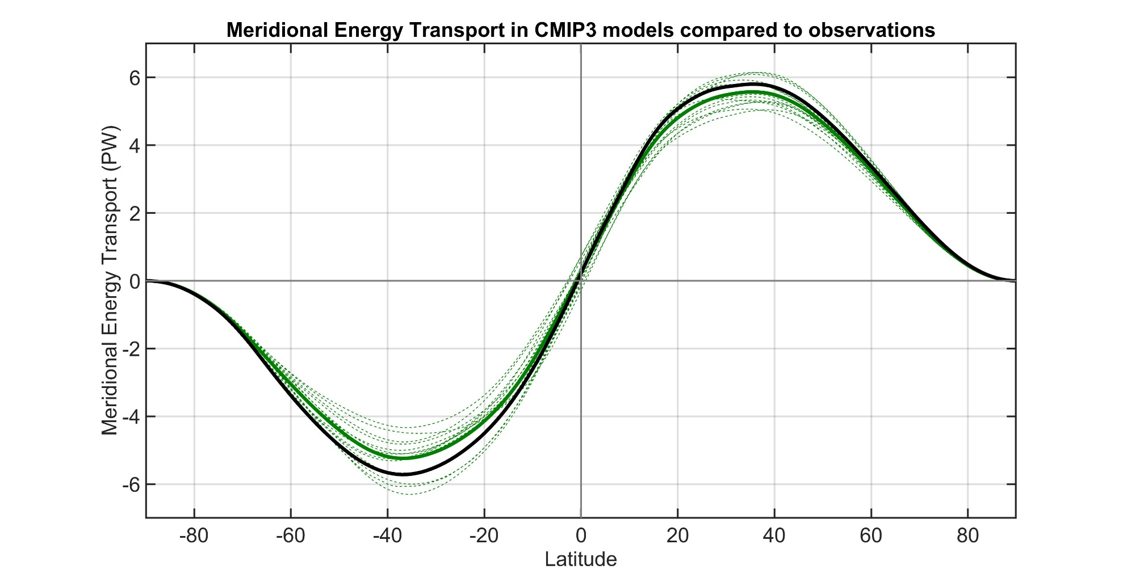
Observations
Individual models
Model Mean
Total (atmosphere plus ocean) meridional heat transport varies by about 20% between models.
→ Also biased low relative to observations especially in the SH
Donohoe and Battisti (2012). What determined meridional heat transport in climate models. J. Climate.

Slide 4
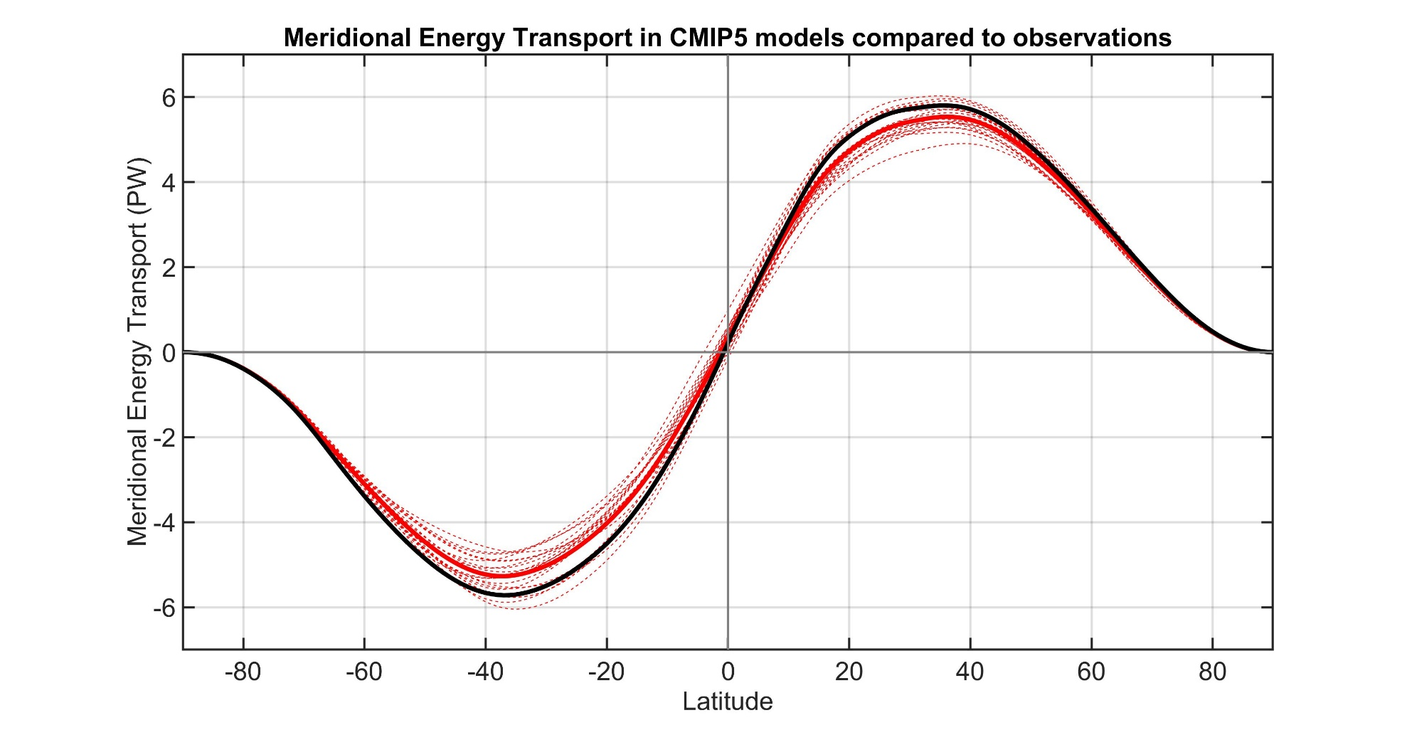
Observations
Individual models
Model Mean

Slide 5
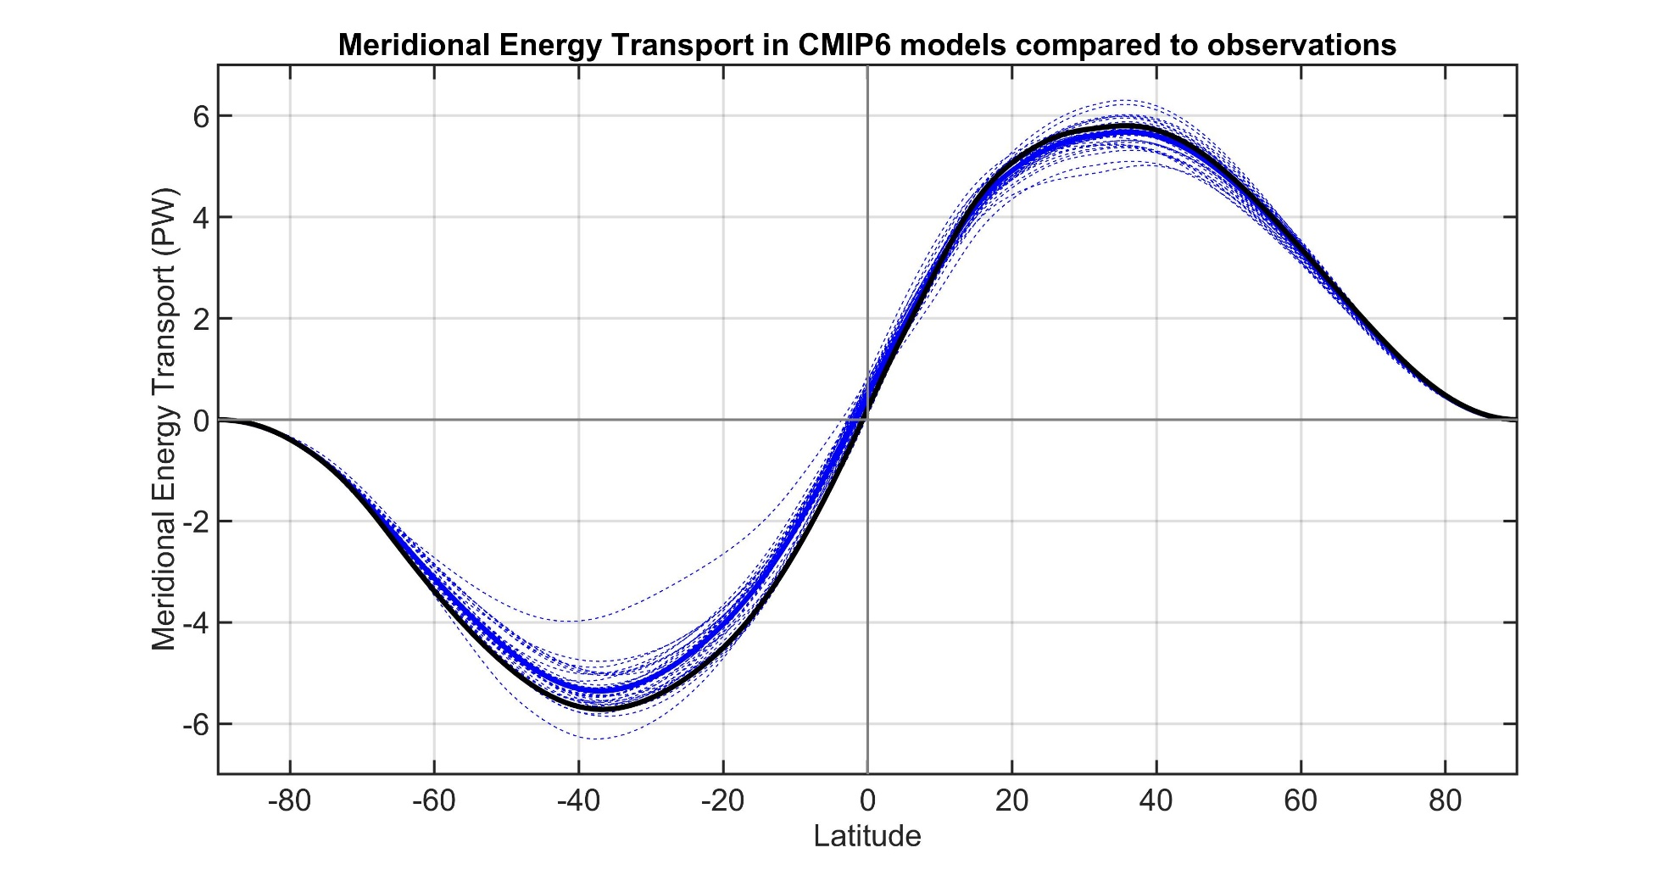
Observations
Individual models
Model Mean

Slide 6
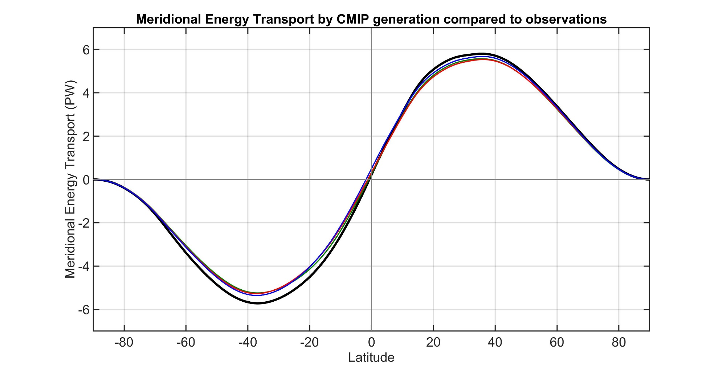
Observations
CMIP3 Mean
CMIP5 Mean
CMIP6 Mean
Inter-model spread and bias in MHT is persistent across generations of CMIP models

Slide 7
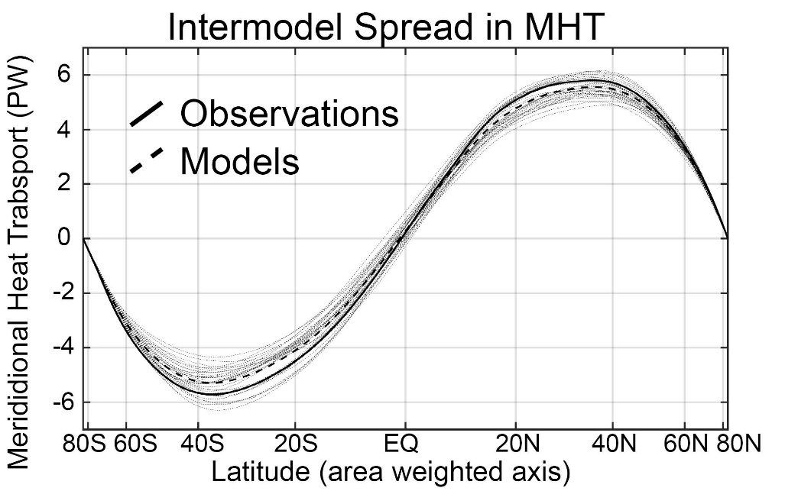
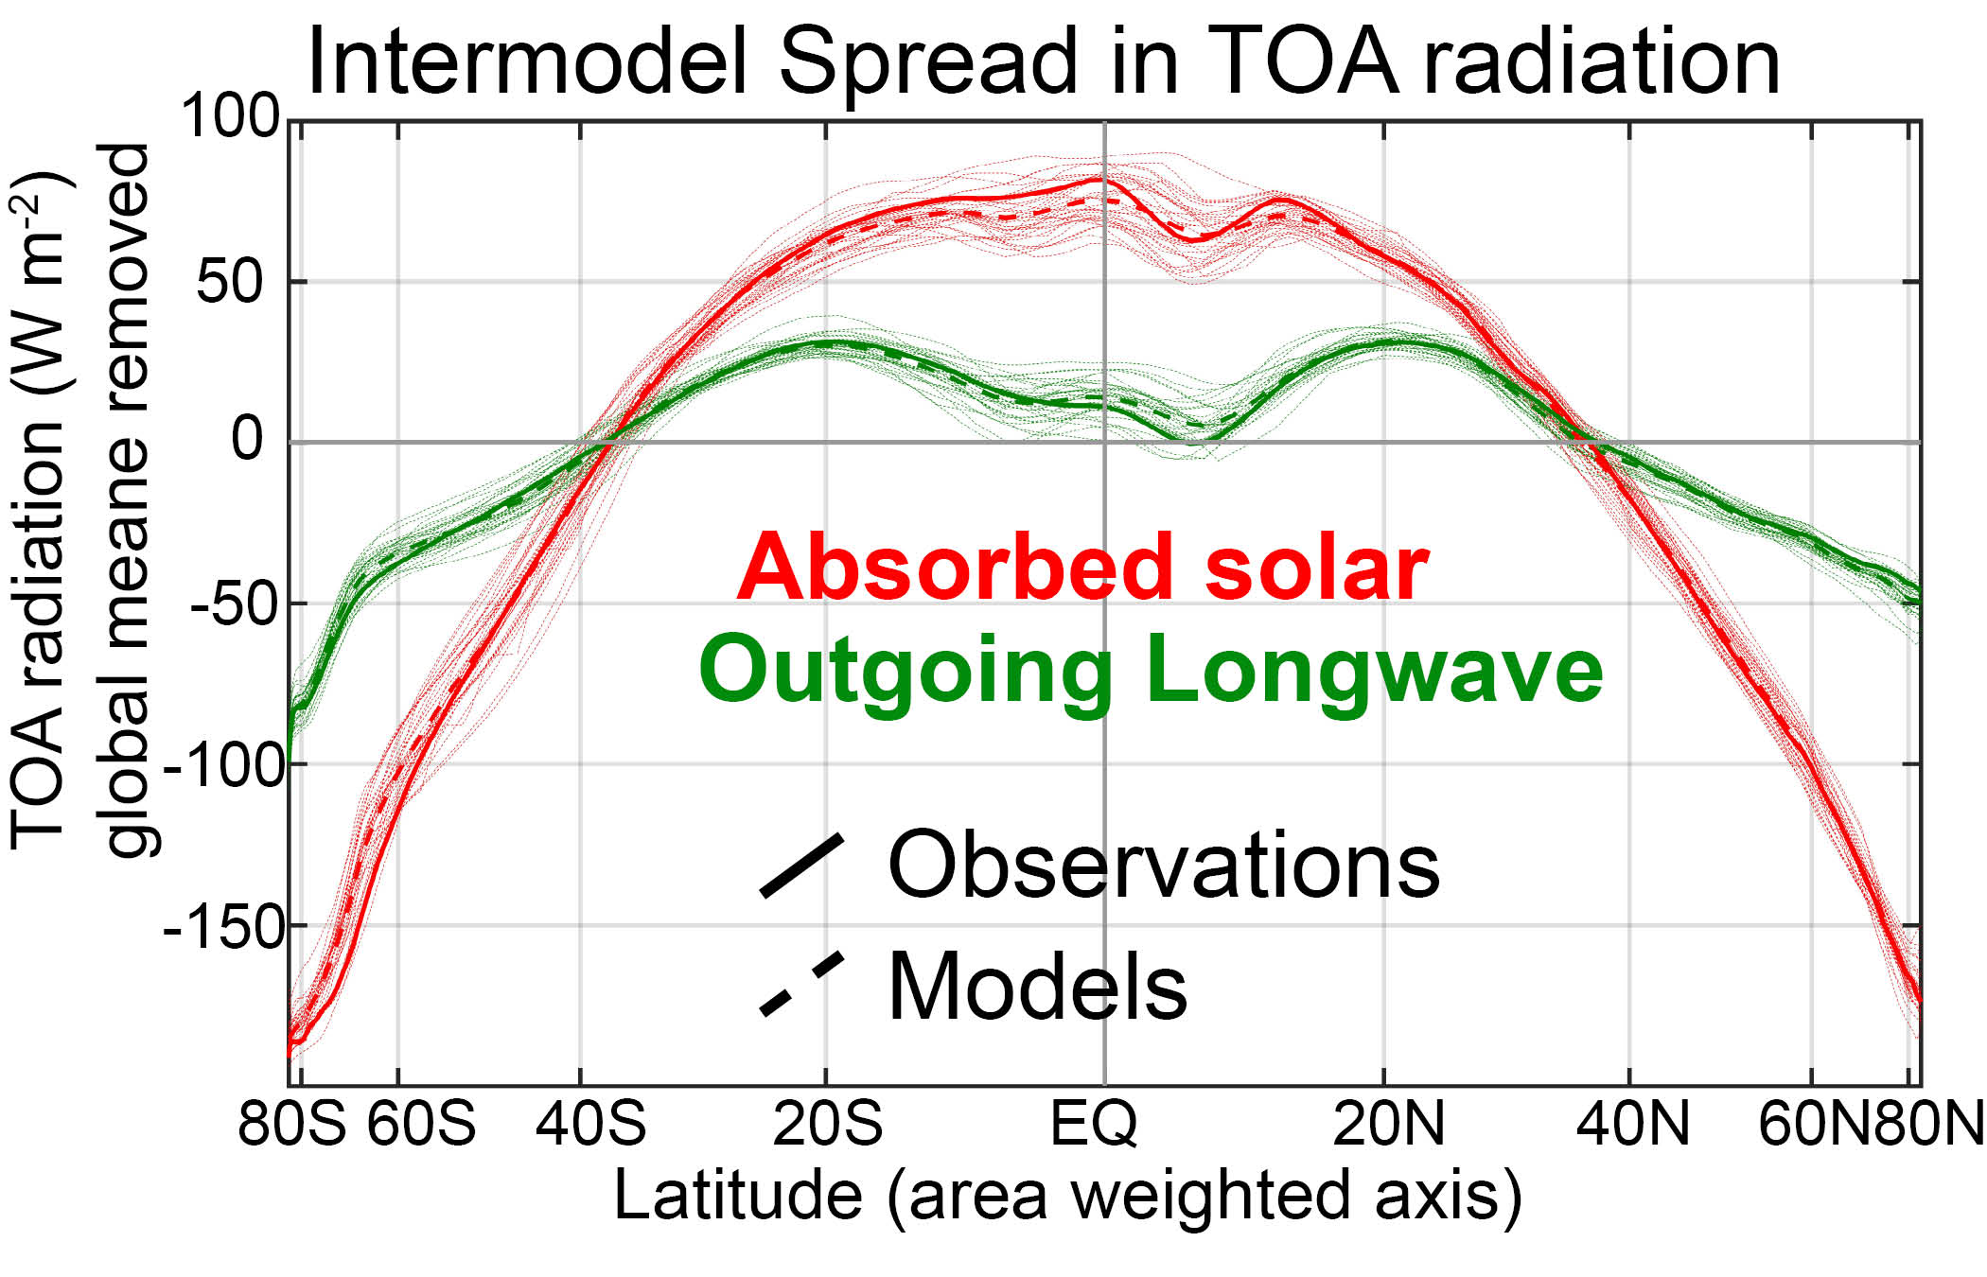

Slide 8
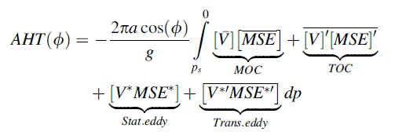
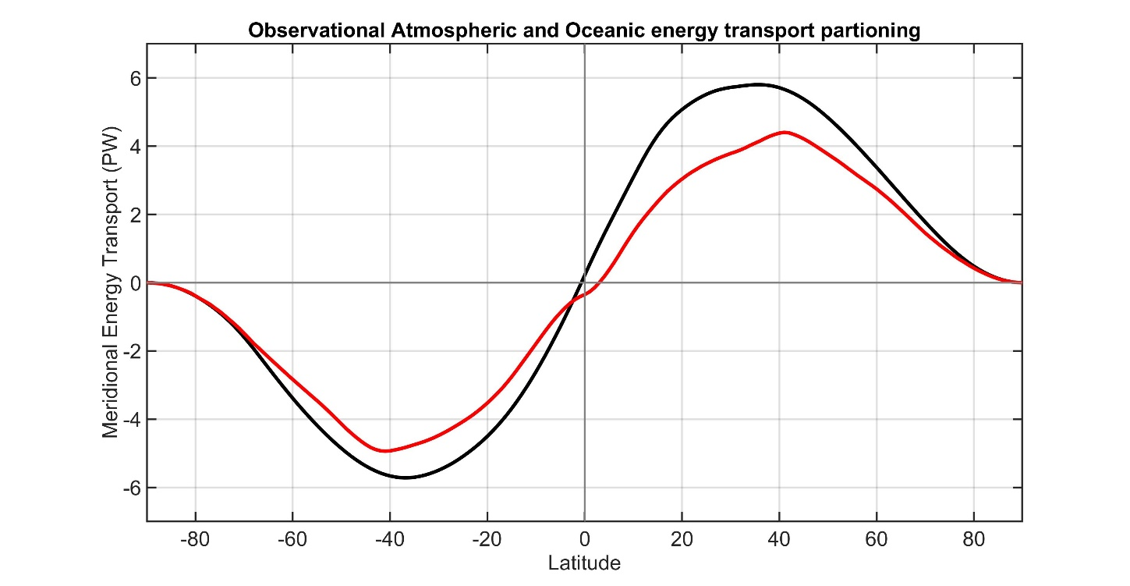
ASR
Total (atmosphere plus ocean) energy transport from TOA radiation (CERES satellite).
NET
OLR
AHT
Atmospheric energy transport from 6 hourly ERA5 reanalysis dynamics calculation
Tropics
Extratropics
Total
Atmosphere
Notes:
NH = 8.2 - 2.4 = 5.8
SH = 9.0 – 3.2 = 5.8

Slide 9
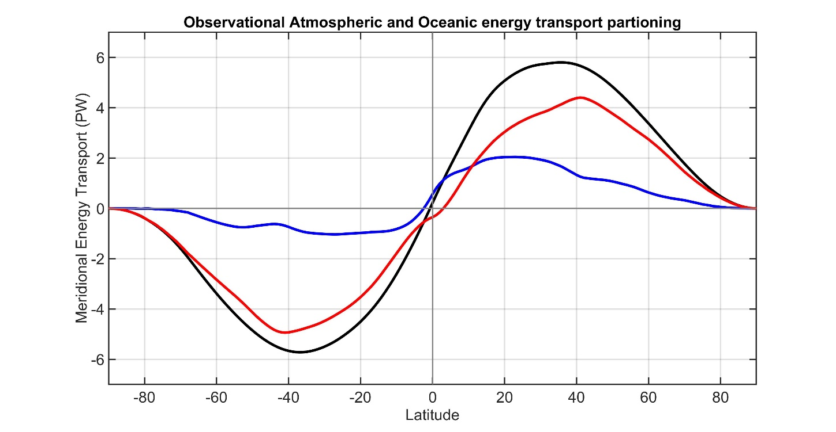
ASR
Total (atmosphere plus ocean) energy transport from TOA radiation (CERES satellite).
NET
OLR
AHT
Atmospheric energy transport from 6 hourly ERA5 reanalysis dynamics calculation
Tropics
Extratropics
Ocean heat transport as the residual = Total - atmos
Total
Atmosphere
Ocean
Notes:
NH = 8.2 - 2.4 = 5.8
SH = 9.0 – 3.2 = 5.8

Slide 10
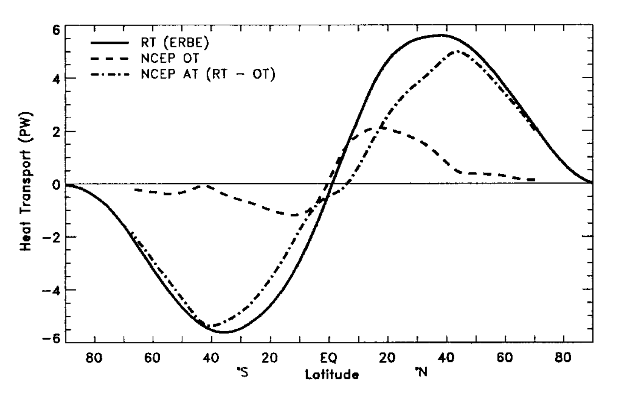
This strategy was pioneered by Trenberth and Caron (2001)
ERBE and NCEP
Total
Atmosphere
Ocean
Our result
CERES and ERA5
Notes:
NH = 8.2 - 2.4 = 5.8
SH = 9.0 – 3.2 = 5.8

Slide 11
Model partitioning of AHT/OHT
MHT from Radiation
Total heat
transport (MHT)
Integral of
TOA radiation
=
Net radiative
Deficit of extratropics
5.8 PW
Integral of
Surface heat
Flux (SHF)
Ocean heat
Transport (OHT)
=
Atmospheric heat transport (AHT)
AHT = MHT – OHT
= Integral (TOA – SHF)
Tropics
Extratropics
Notes:
NH = 8.2 - 2.4 = 5.8
SH = 9.0 – 3.2 = 5.8

Slide 12
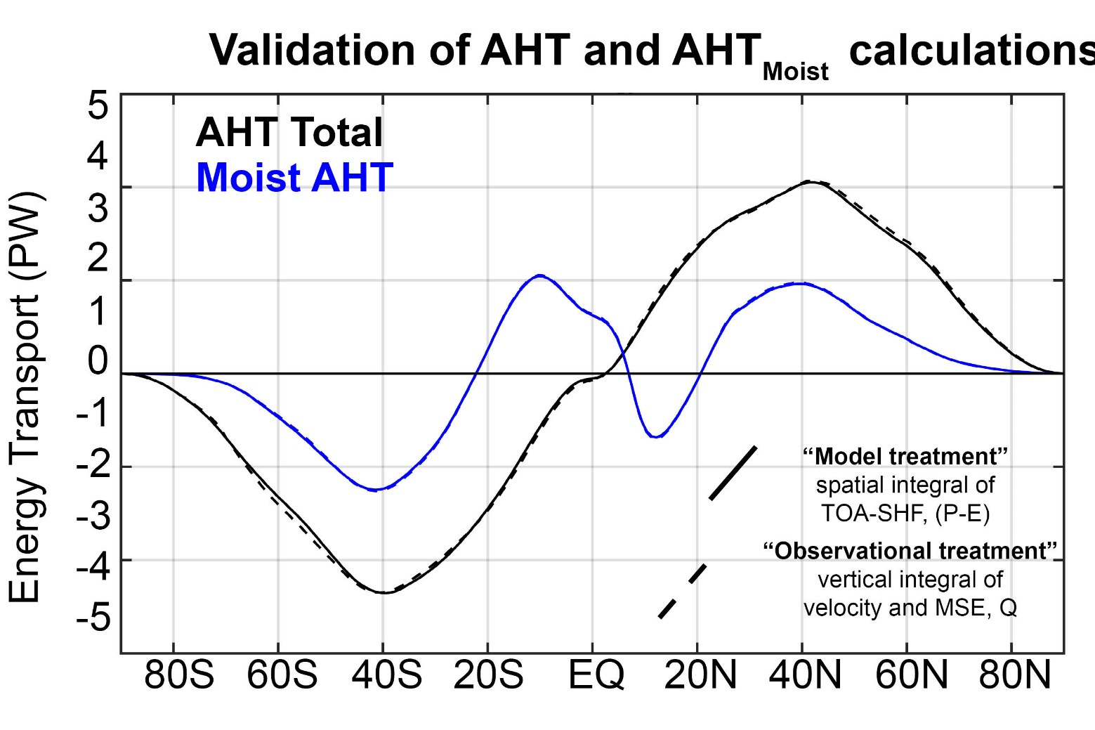
Consistency of “observational” and “model” based MHT calculation in a model simulation (NCEP CESM)

Slide 13

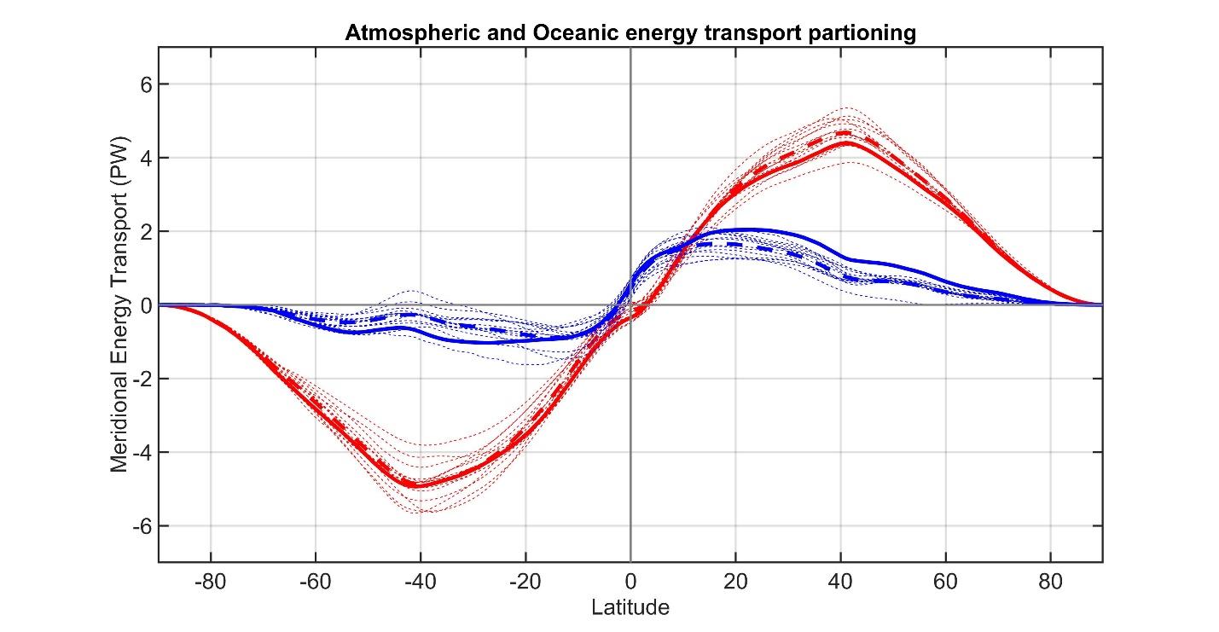
CMIP3 -- Partitioning of MHT 3
Observations
Total energy
transport
Individual models
Model Mean
ATMOSPHERE
Atmosphere ocean partitioning
OCEAN
Observations
Individual models
Model Mean

Slide 14

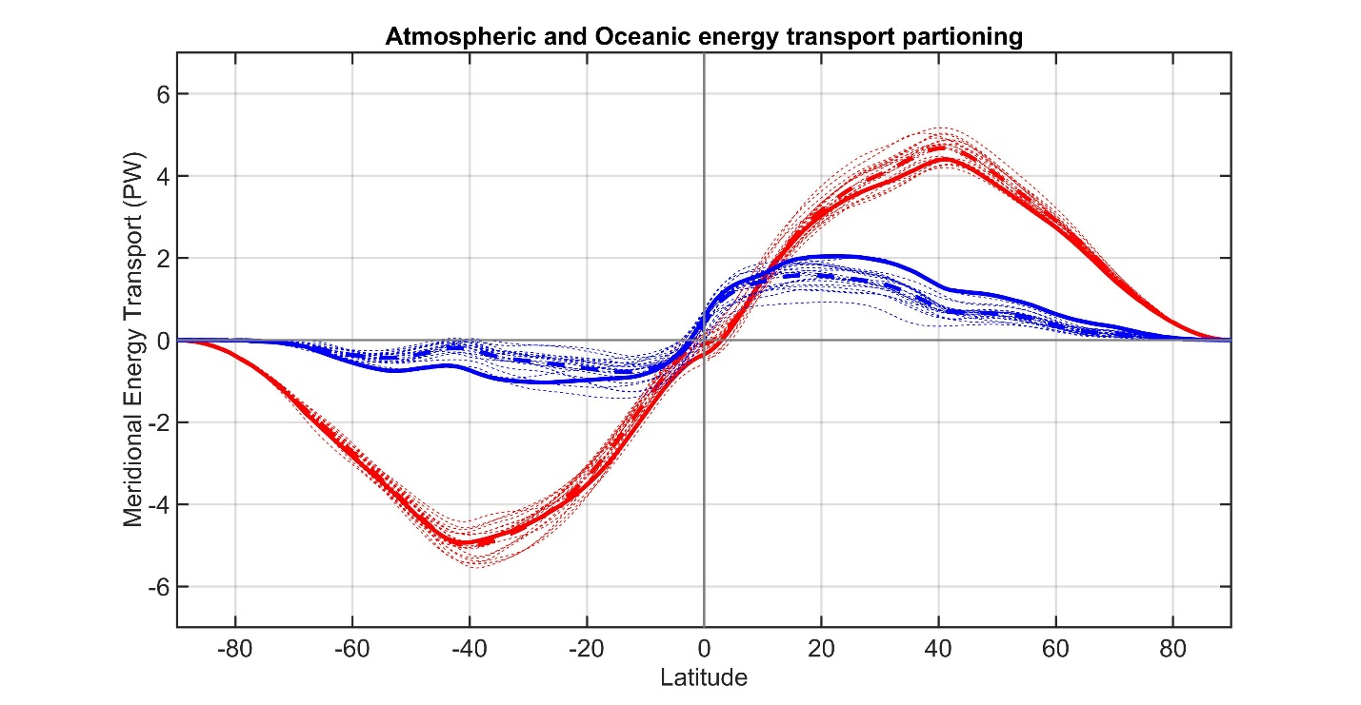
CMIP53
Observations
Total energy
transport
Individual models
Model Mean
ATMOSPHERE
Atmosphere ocean partitioning
OCEAN
Observations
Individual models
Model Mean

Slide 15
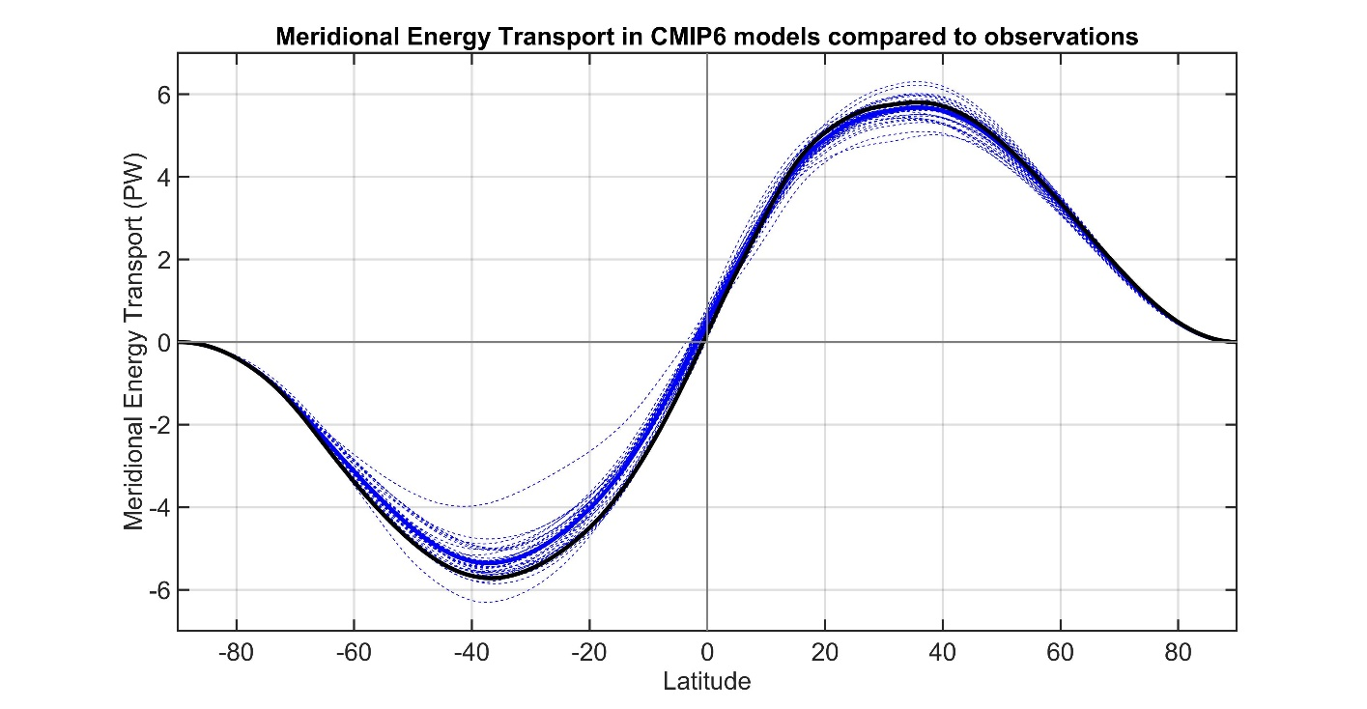
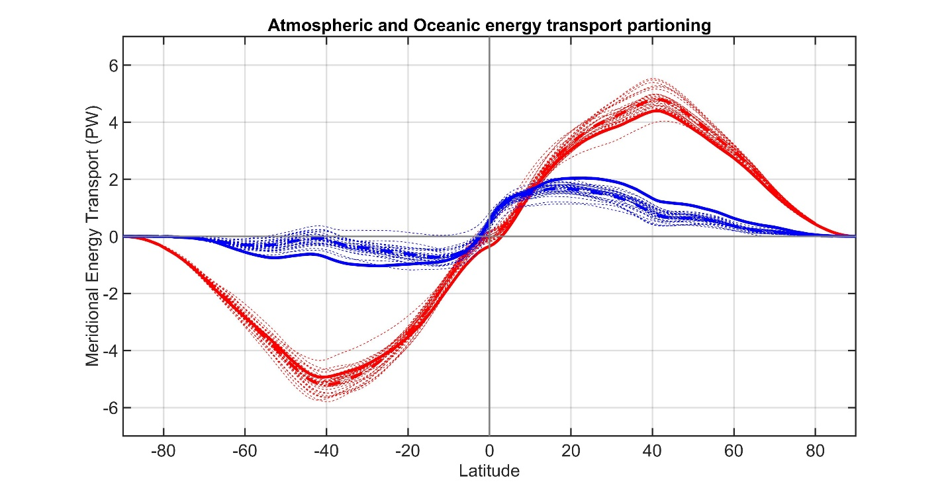
CMIP63
Observations
Total energy
transport
Individual models
Model Mean
ATMOSPHERE
Atmosphere ocean partitioning
OCEAN
Observations
Individual models
Model Mean

Slide 16

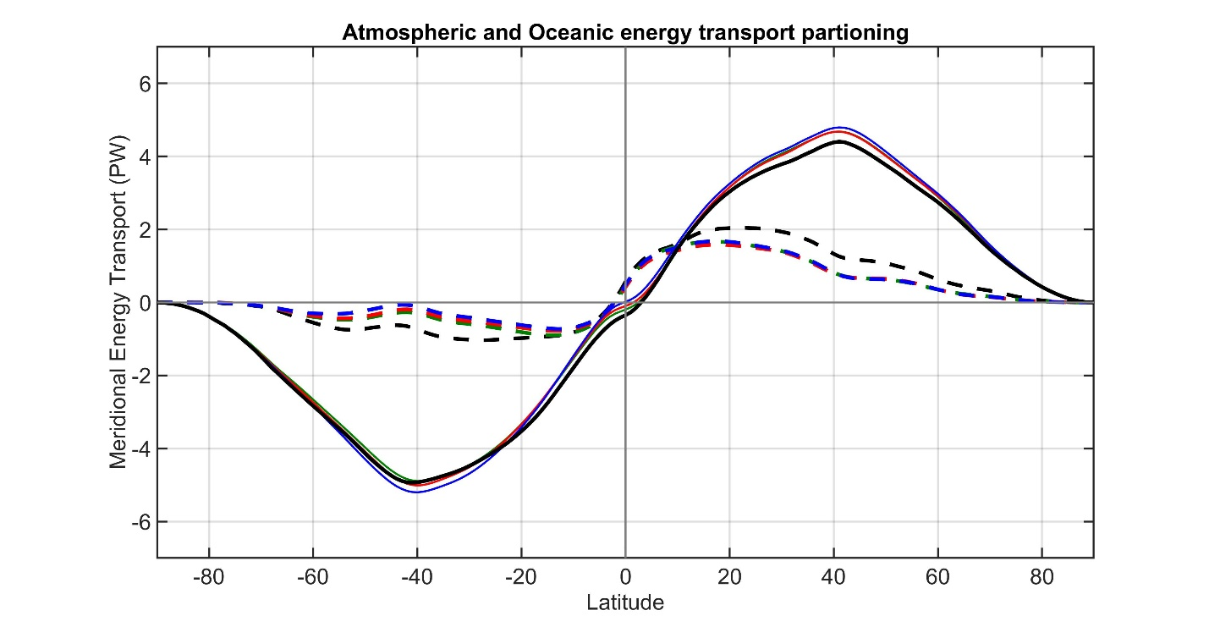
CMIP3 to 6 against observations
Observations
Total energy
transport
CMIP3 Mean
CMIP5 Mean
CMIP6 Mean
ATMOSPHERE
Atmosphere ocean partitioning
OCEAN
Observations
CMIP3 Mean
CMIP5 Mean
CMIP6 Mean

Slide 17
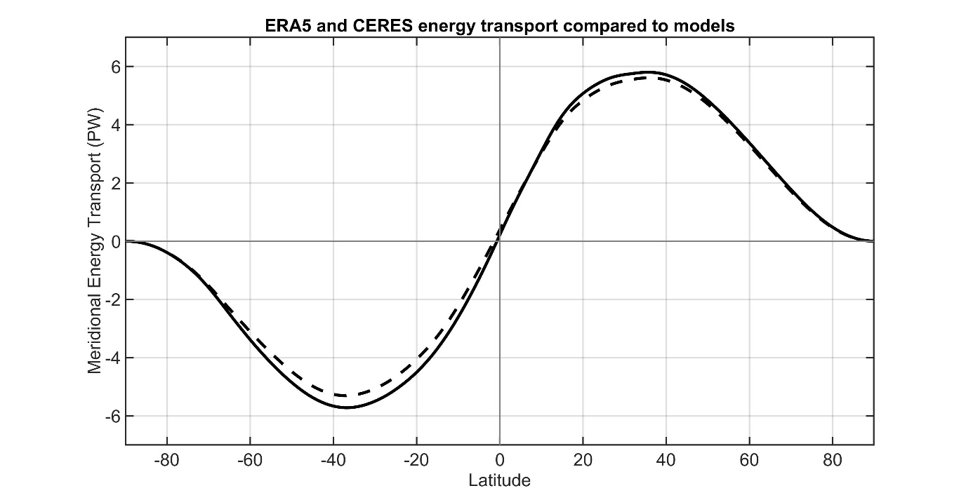
OBSERVATIONS FROM ERA5 and CERES
Observations
CMIP Mean
Total energy
transport
ATMOSPHERE
OCEAN
Observations
Atmosphere ocean partitioning
CMIP Mean

Slide 18
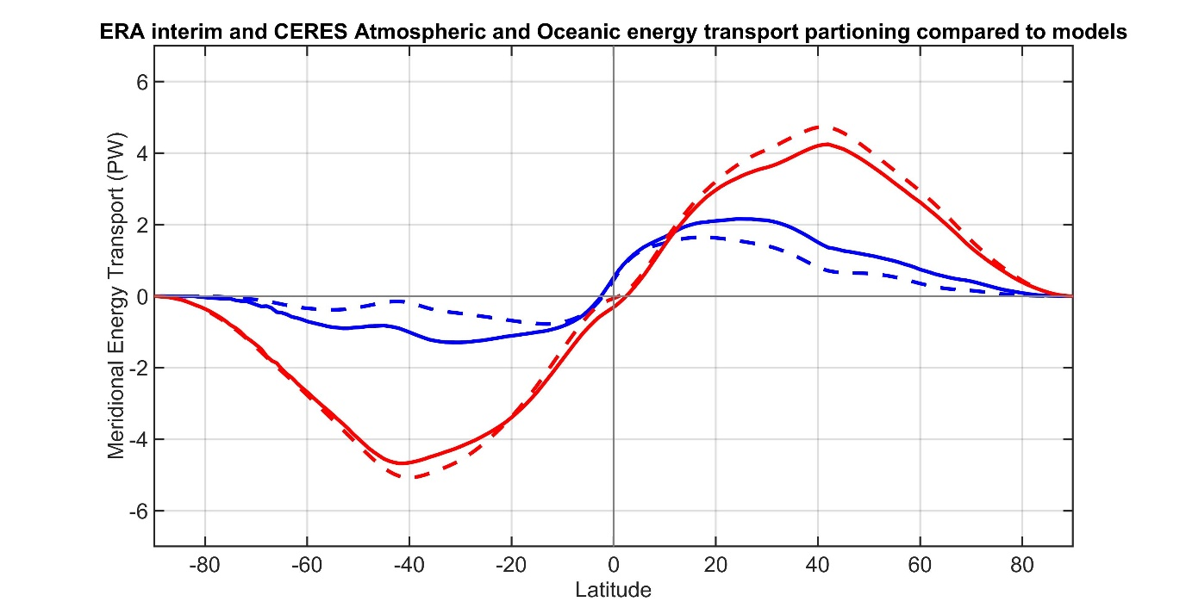
Sensitivity to reanalysis
ERA INTERIM and CERES
Observations
CMIP Mean
Total energy
transport
ATMOSPHERE
OCEAN
Observations
Atmosphere ocean partitioning
CMIP Mean

Slide 19
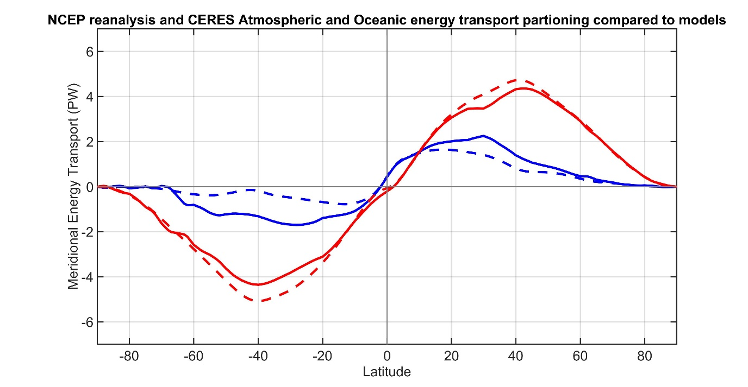
Sensitivity to reanalysis
NCEP reanalysis and CERES
Observations
CMIP Mean
Total energy
transport
ATMOSPHERE
OCEAN
Observations
Atmosphere ocean partitioning
CMIP Mean

Slide 20
Sensitivity to observational radiation
CERES EBAF (energy balanced and filled)
Observations
CMIP Mean
Total energy
transport
ATMOSPHERE
OCEAN
Observations
Atmosphere ocean partitioning
CMIP Mean

Slide 21
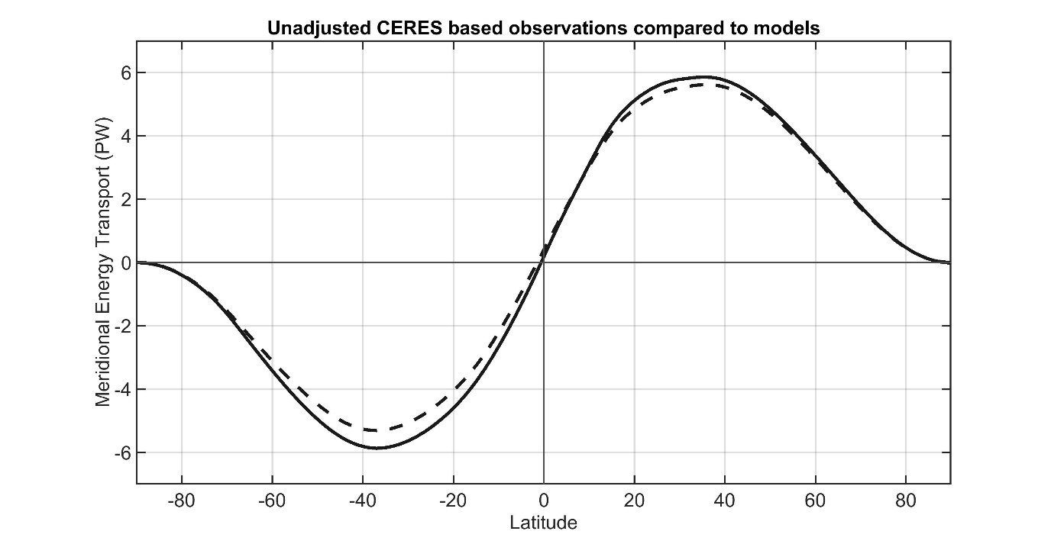
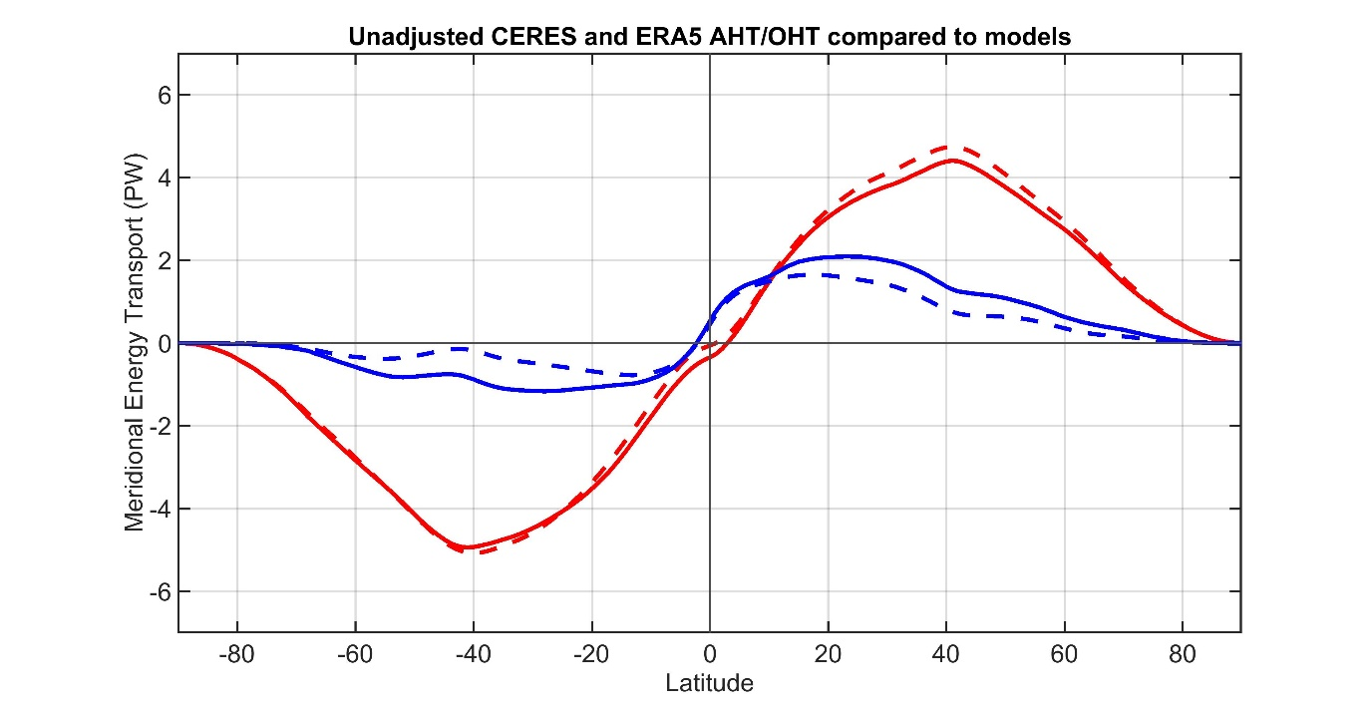
Sensitivity to observational radiation unadjusted CERES (single scanner)
Observations
CMIP Mean
Total energy
transport
ATMOSPHERE
OCEAN
Observations
Atmosphere ocean partitioning
CMIP Mean

Slide 22
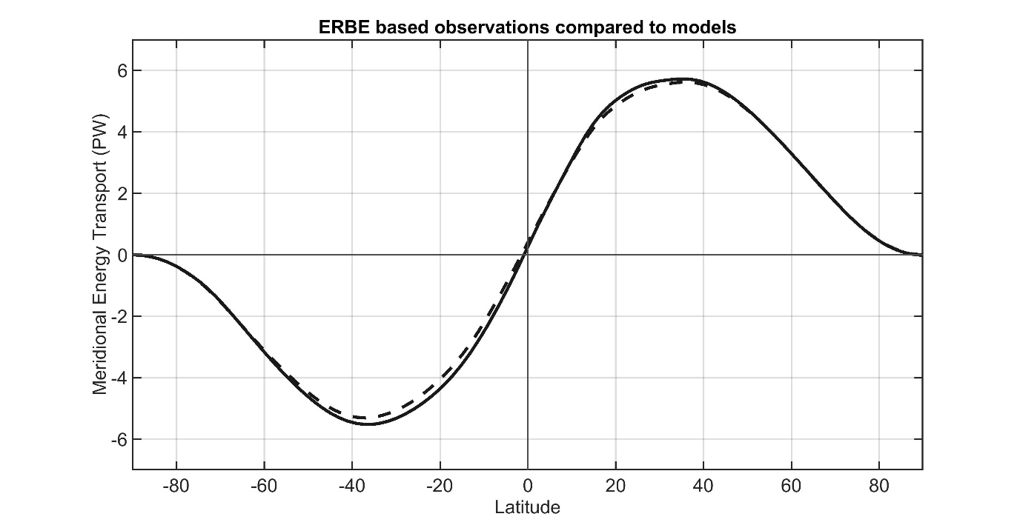
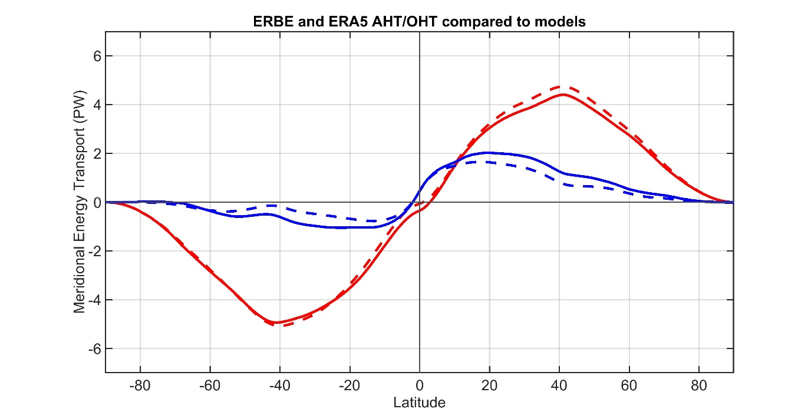
Sensitivity to observational radiation
ERBE (1984-1990)
Observations
CMIP Mean
Total energy
transport
ATMOSPHERE
OCEAN
Observations
Atmosphere ocean partitioning
CMIP Mean

Slide 23
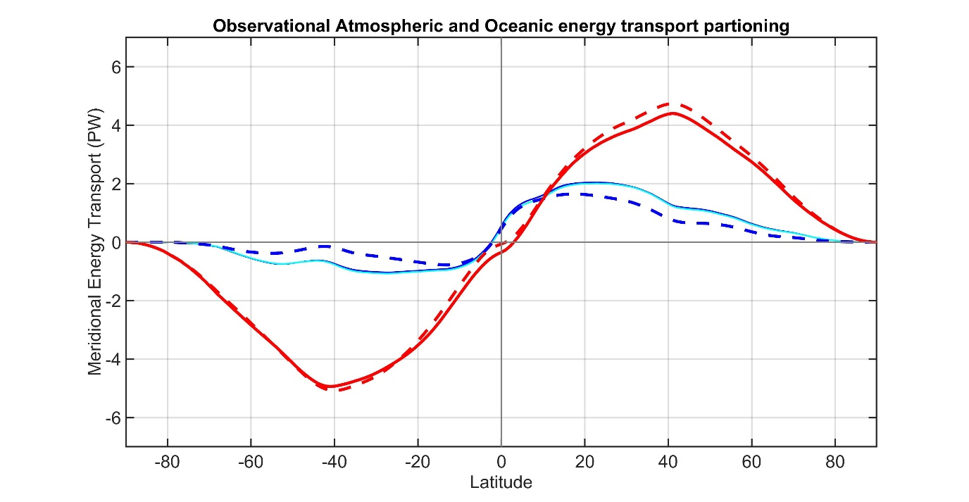
Accounting for ocean heat content changes
Total energy
transport
Observations
CMIP Mean
ATMOSPHERE
Correcting for ocean heat content changes -------------------------
From EN4 ocean reanalysis temperature trends
OCEAN
Observations
CMIP Mean

Slide 24
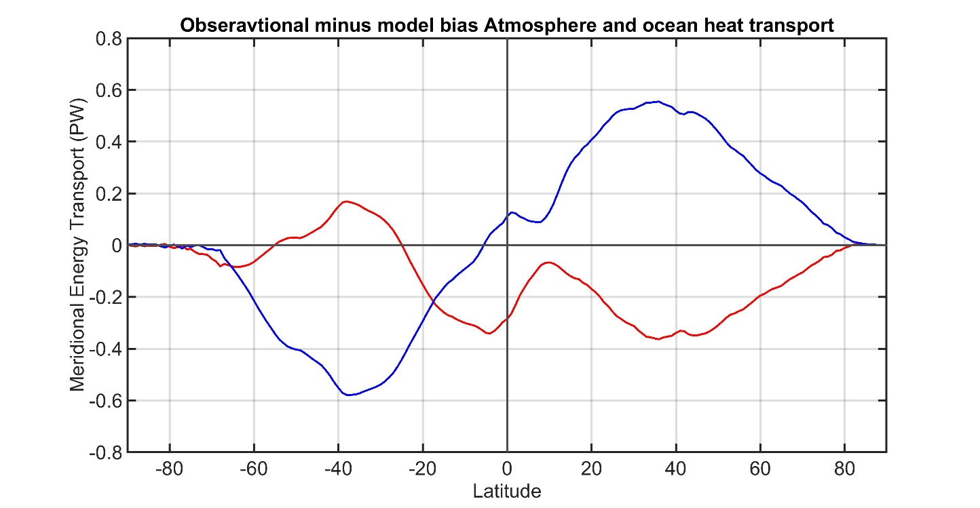
Main conclusion: Models move too much energy through the atmosphere and too little through the ocean
ATMOSPHERE
OCEAN
Observations
CMIP Mean
ATMOSPHERE
OCEAN

Slide 25
From Robert’s talk 39 minutes ago:
Evaporation drives atmospheric heat transport because it dominates spatial structure of energy input to atmosphere
150
6
Total
Total
Radiation (atmos)
Radiation (atmos)
100
Sensible heat
4
Sensible heat
Evaporation
Evaporation
50
50
2
Source of atmospheric energy input (W m⁻² )
Global mean removed
Atmospheric heat transport generated
By each source term (PW)
0
0
-50
-2
-100
-4
-150
30N
60N
90N
-6
30N
60N
90N
90S
60S
30S
EQ
90S
60S
30S
EQ
Notes:
Left figure shows the sources of energy input to the atmosphere in observations (ERA reanalysis) with the global mean removed. Energy enters the atmosphere in the low latitudes and leaves the atmosphere in the high latitudes (black line). The energy input to the atmosphere is decomposed into three terms; the sensible hear flux from the surface to the atmosphere (orange), the evaporation (green), and the radiative heating of the atmosphere (note this differs from the top of atmosphere radiation and the surface radiation). The evaporation has more spatial structure than the other terms contributing energy into the atmosphere.
The right panel shows the atmospheric heat transport due to each process. This shows that nearly all the poleward heat transport in the atmosphere is derived from evaporation. This result has been confirmed with idealized model studying in which we (Robert Fajber) traces the heating and transport that results from each process by tagging and tracing air parcels (much like one would do with passive tracer transport).
There is one subtlety here. The evaporations drives both the flux of temperature and humidity (dry and moist energy transports in the atmosphere. The evaporation in the tropics can either be balanced by a moisture transport in the atmosphere, or be precipitated out which condesationally heats the atmospheric column to drive the dry atmospheric heat transport.

Slide 26
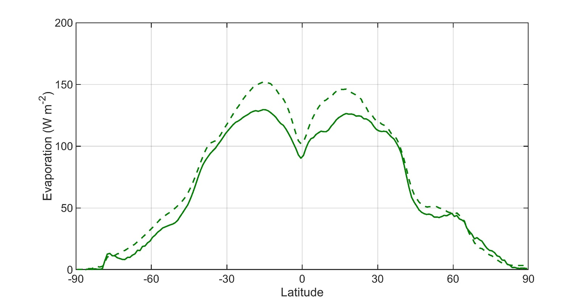
Hypothesis: models are biased toward too much evaporation
→ Enhances Atmospheric heat transport
→ Reduces Ocean heat transport
Evaporation
Observations
CMIP Mean
Observations are WHOI OA flux
Both plots are ocean domain only

Slide 27
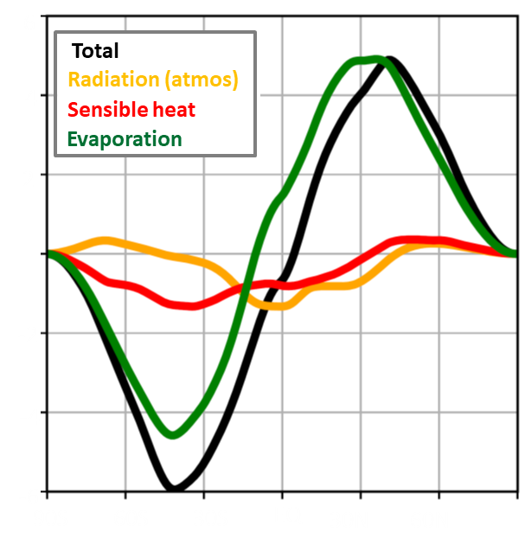
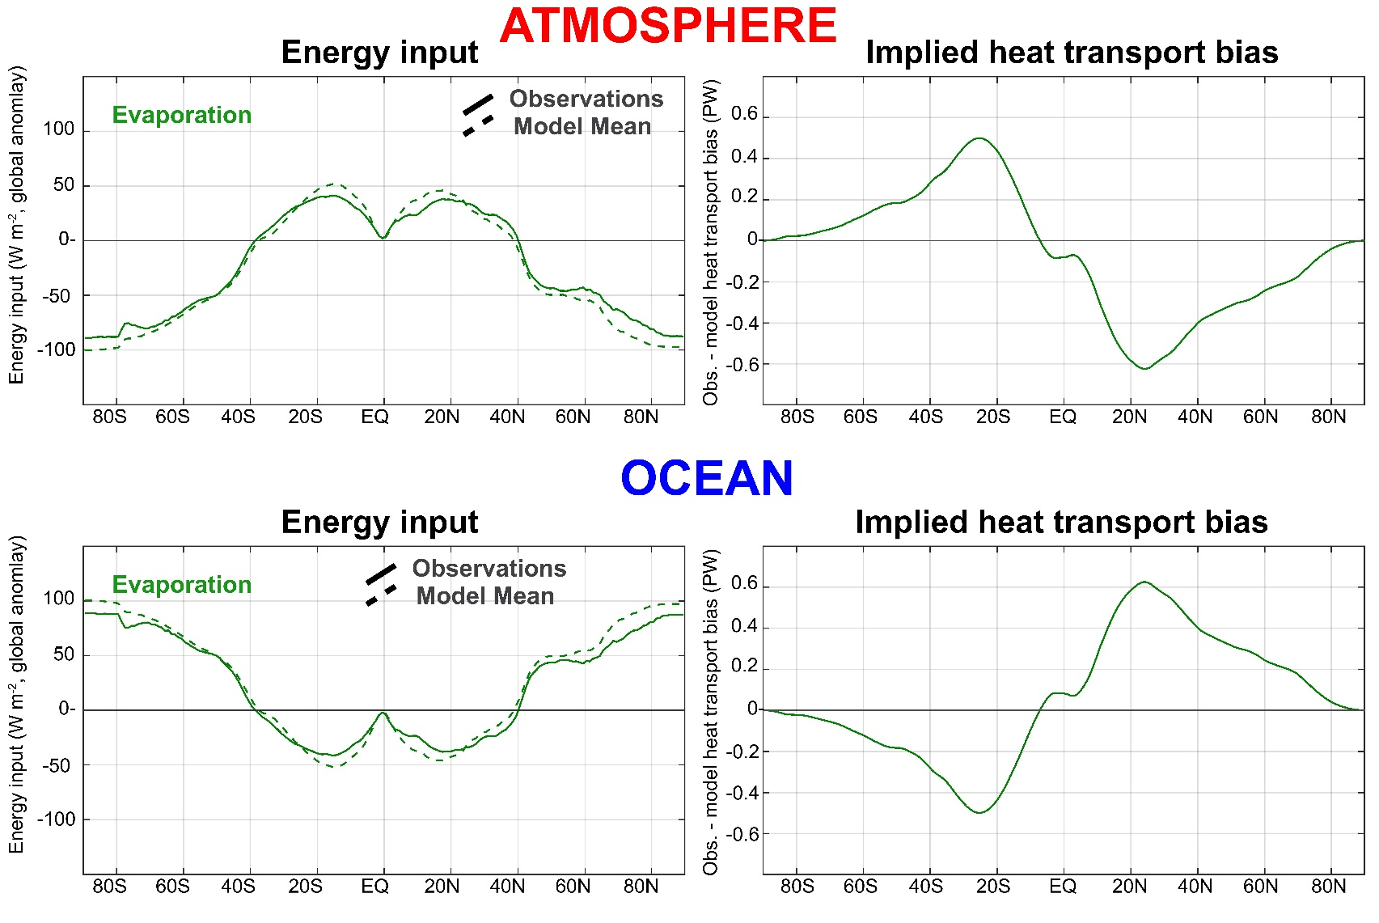
Evaporation biases:
→Result in AHT/OHT tradeoff
→ Are right magnitude to explain AHT/OHT bias

Slide 28
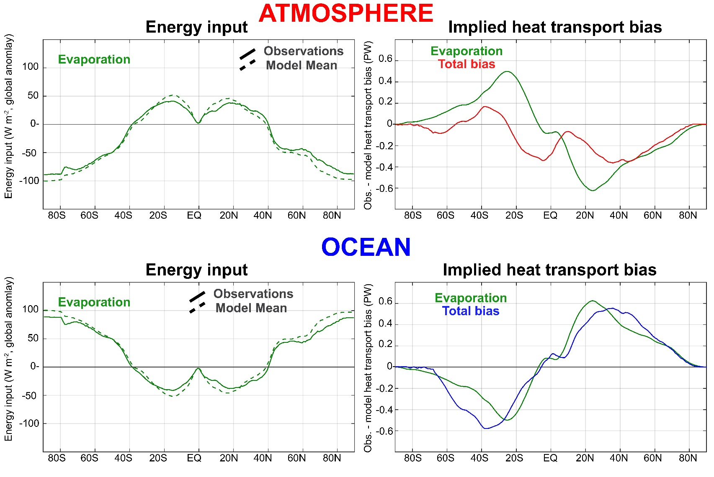
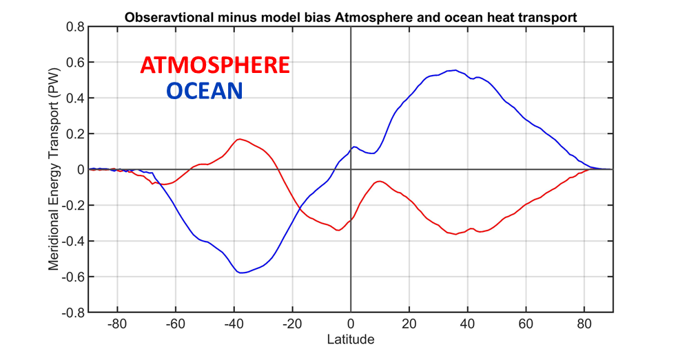
Evaporation biases:
→Result in AHT/OHT tradeoff
→ Are right magnitude to explain AHT/OHT bias

Slide 29
EXTRAS

Slide 30
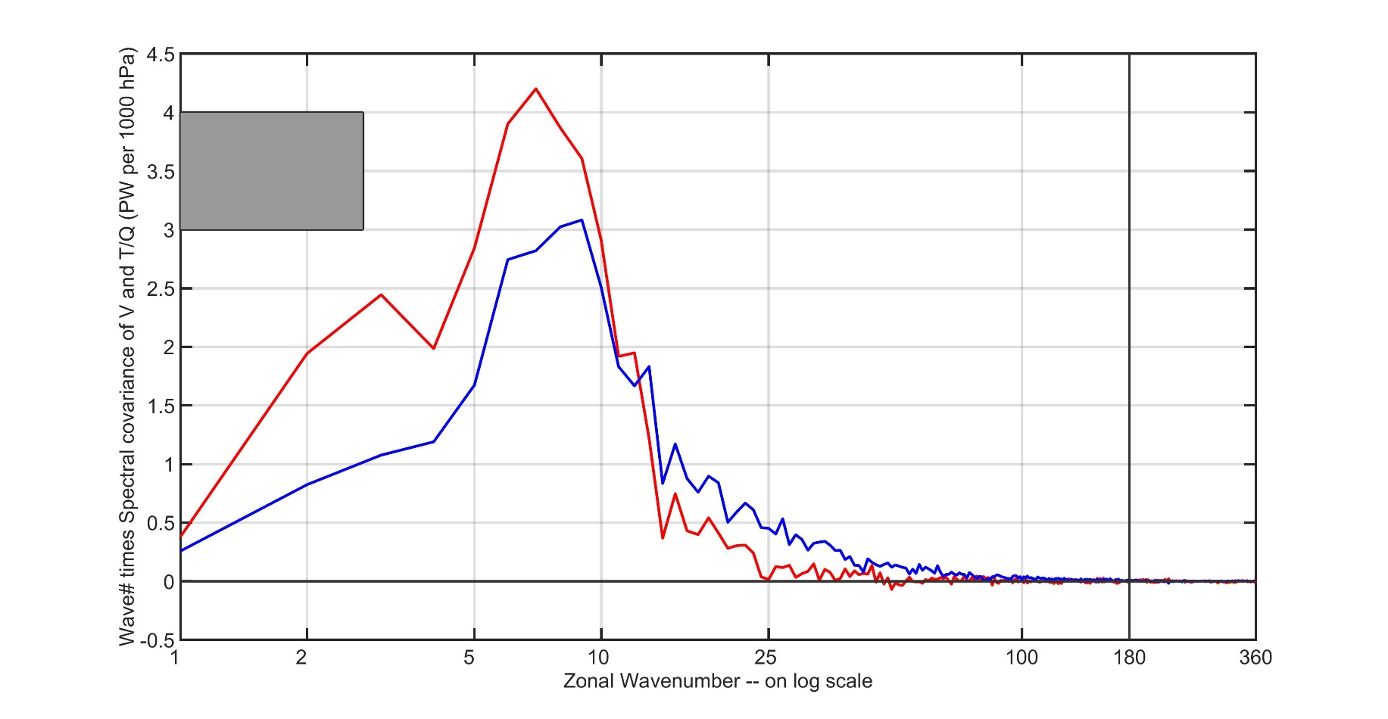
Does spatial resolution of atmospheric reanalysis miss heat transport at small scales? (NO!)
Heat transport spectra for 40N at 700 hPa DJF
Dry energy transport
1 PW
Moist energy transport
Truncation at 2º resolution results in
0.009% and 0.021% loss of dry/moist heat transport

Slide 31
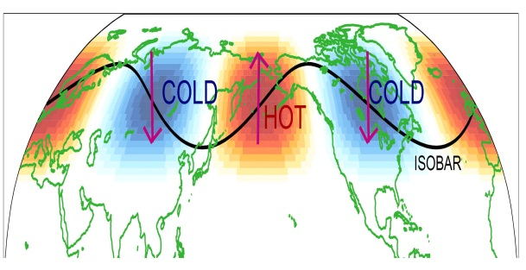
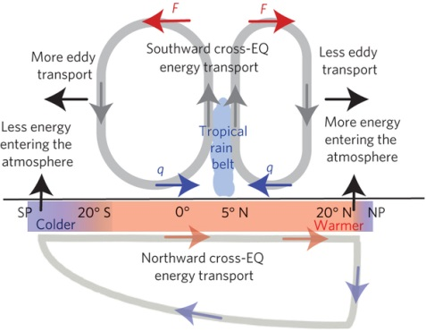
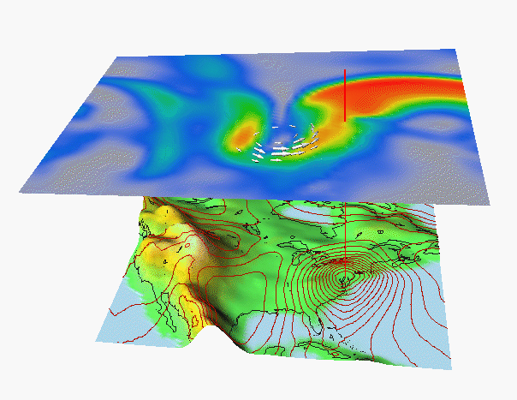
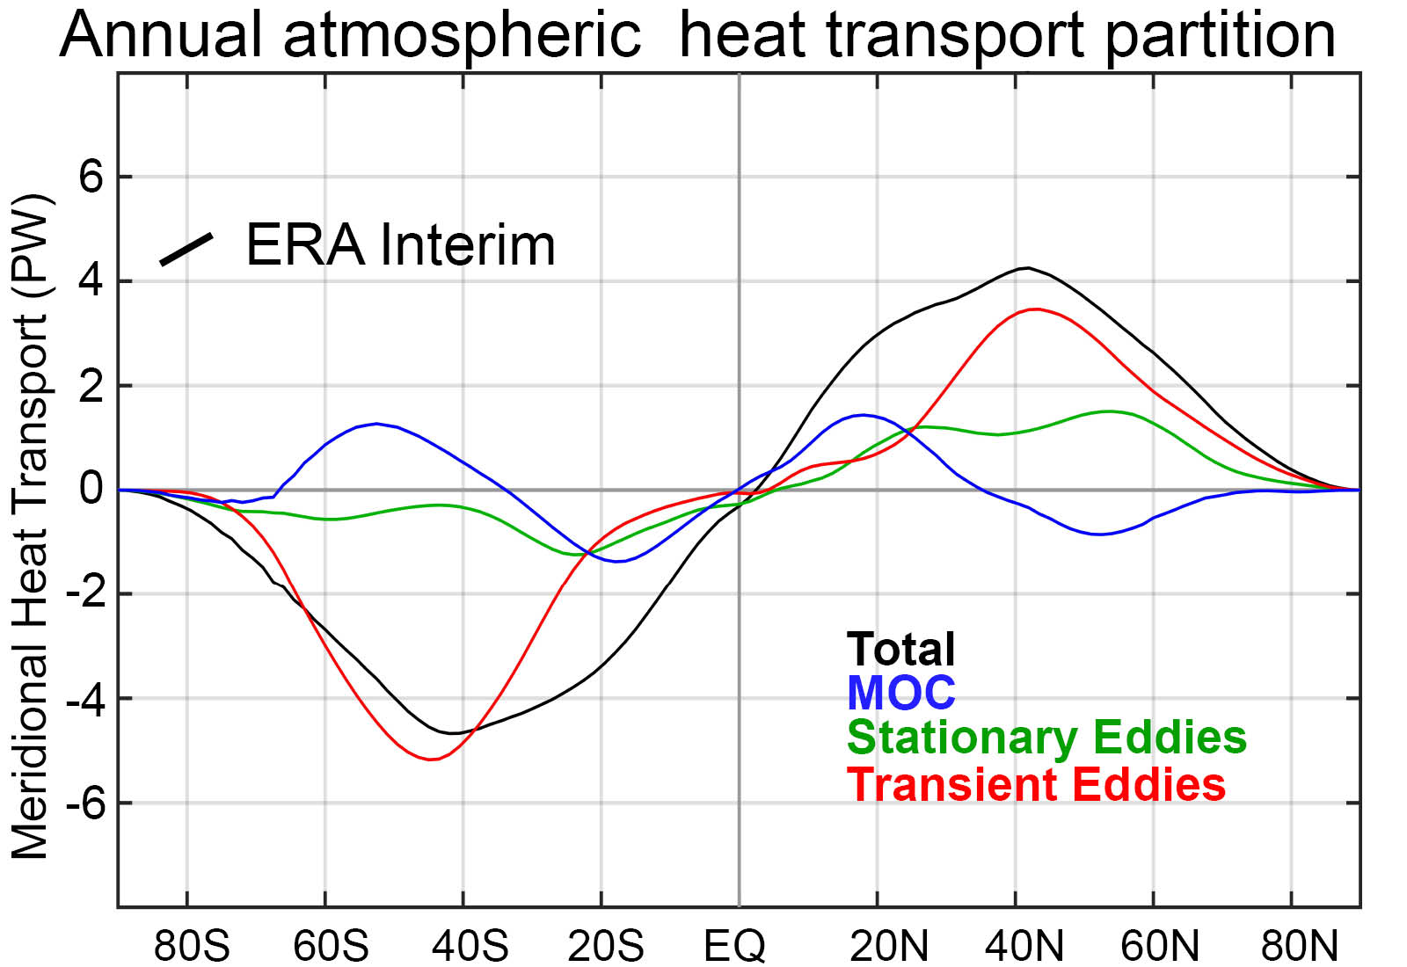
Partitioning of atmospheric energy by circulation type
Stationary
MOC
Overturning
Transient
* = Departure from zonal mean -- [ ]
' = Departure from time mean -- ¯
MSE = moist static energy
= CpT + LQ +gZ
MOC dominates in the deep tropics – Hadley cell
Stationary eddies stronger in NH
Transient eddies dominate the mid-latitudes

Slide 32
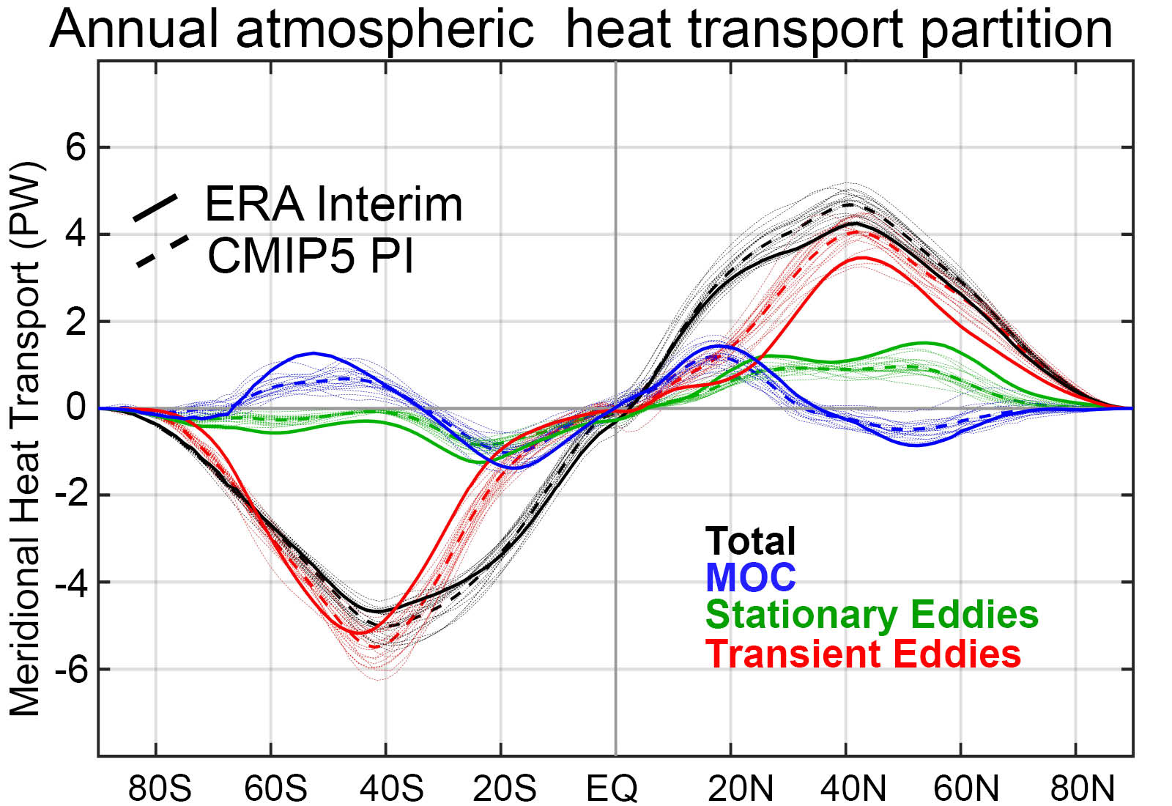
Observation vs. model AHT partitioning

Slide 33

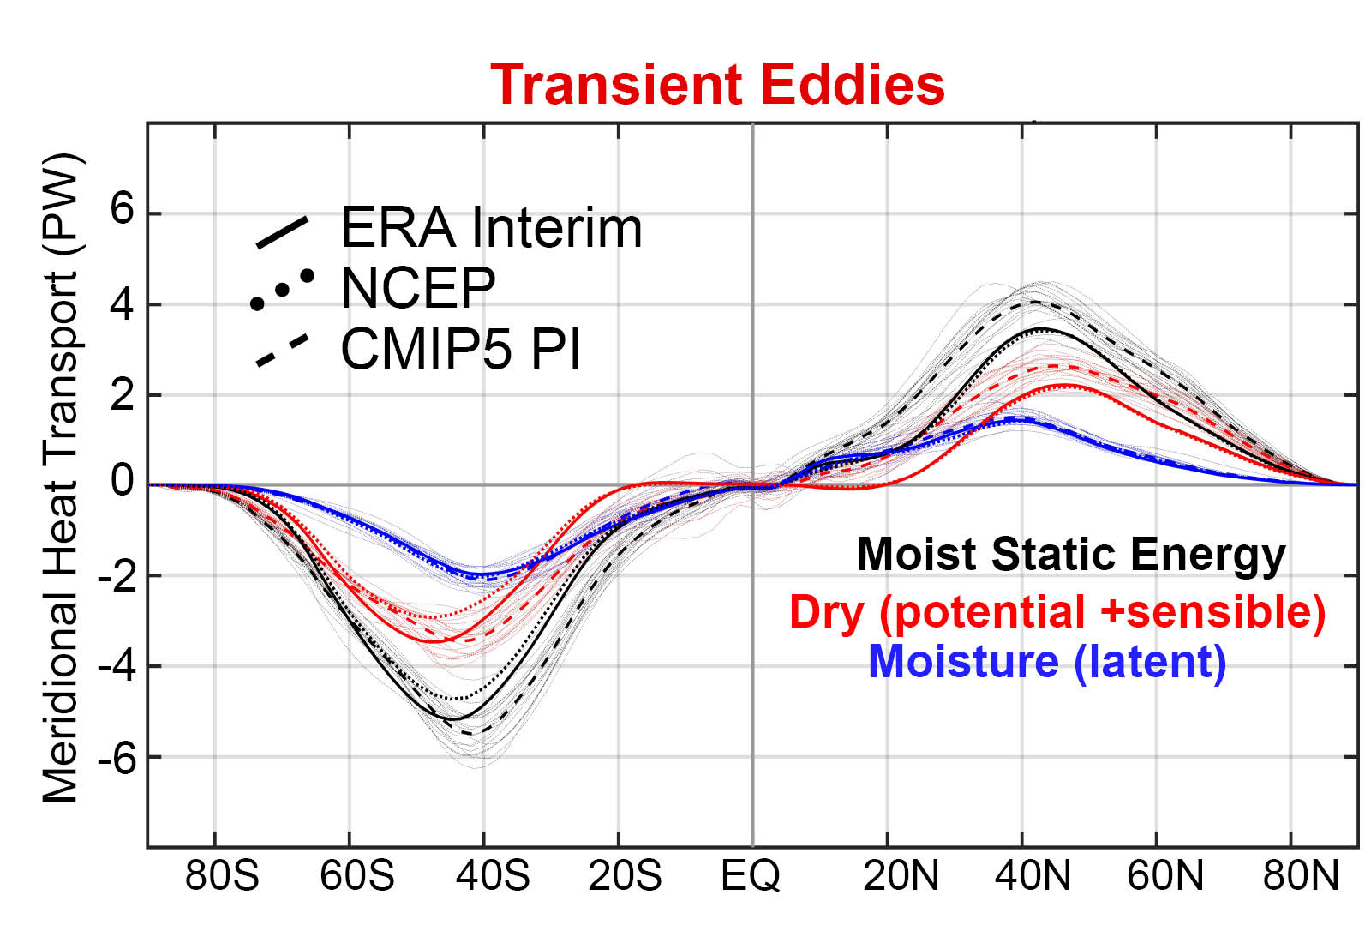
Model bias of enhanced transient eddy heat transport is due to sensible heat transport

Slide 34
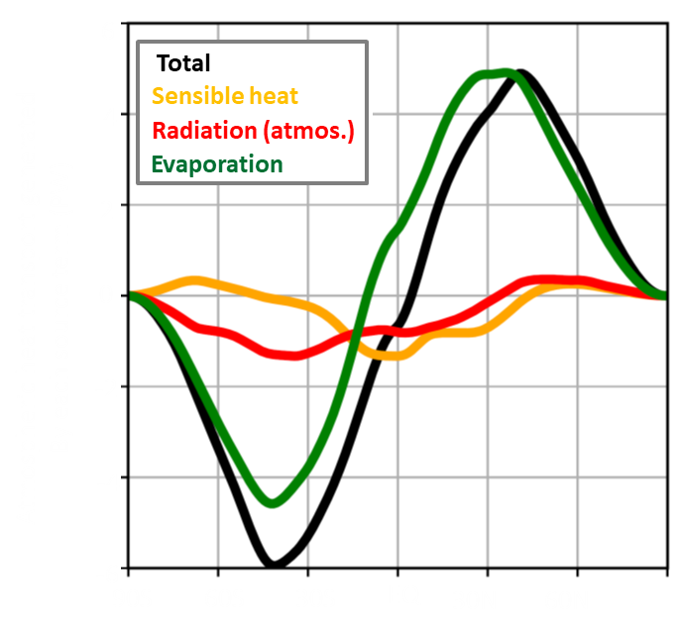
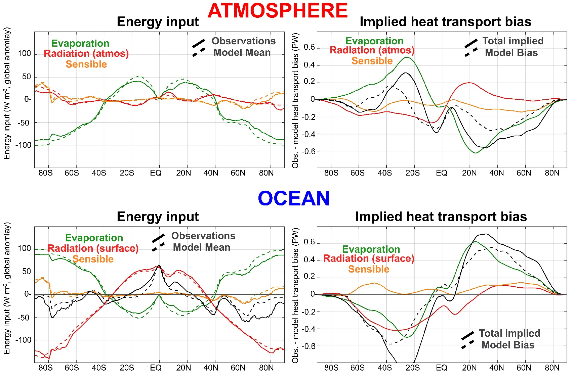
Evaporation biases:
→Result in AHT/OHT tradeoff
→ Are right magnitude to explain AHT/OHT bias

