Slide 1


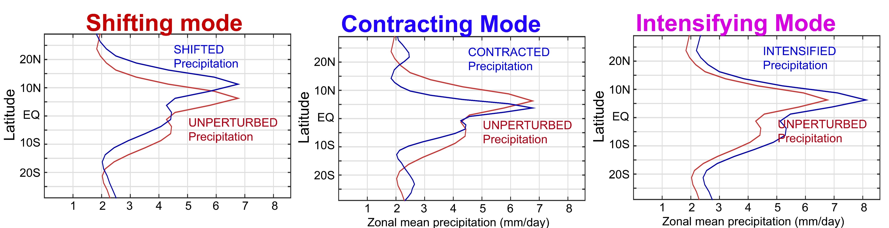
Modes of tropical precipitation changes (variability)
Contraction of the Tropical Precipitation with Global Warming
Aaron Donohoe, Applied Physics Lab
– University of Washington
---Focus on zonal mean here (can apply to zonal inhomogeneities too)
---Apply to simulated response to external forcing in coupled climate models
4XCO₂, Last Glacial Maximum, Mid-Holocene, Freshwater hosing

Slide 2
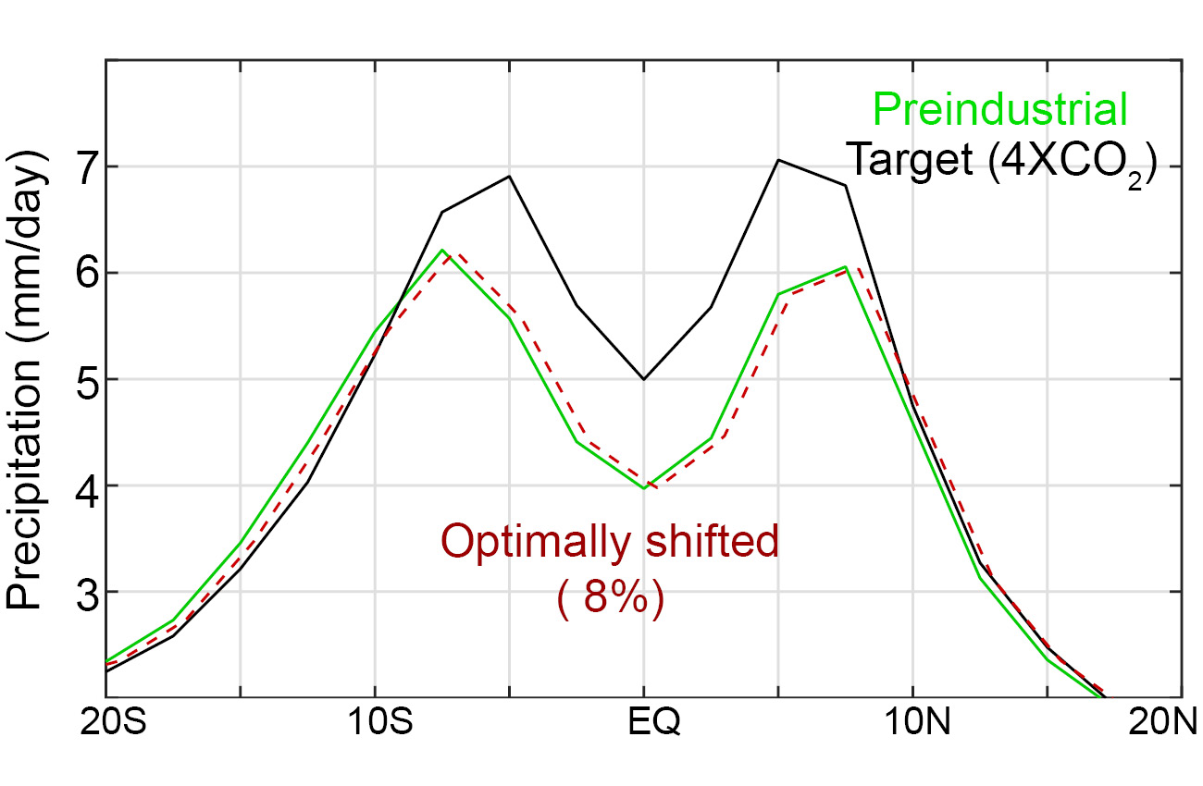
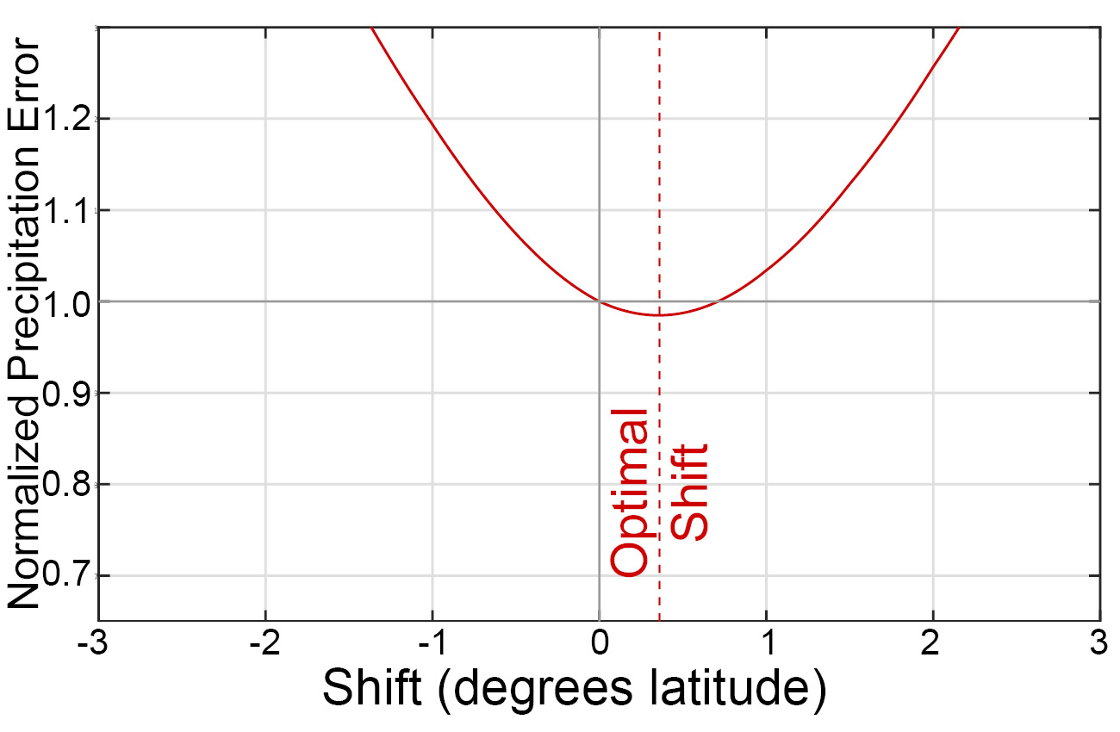
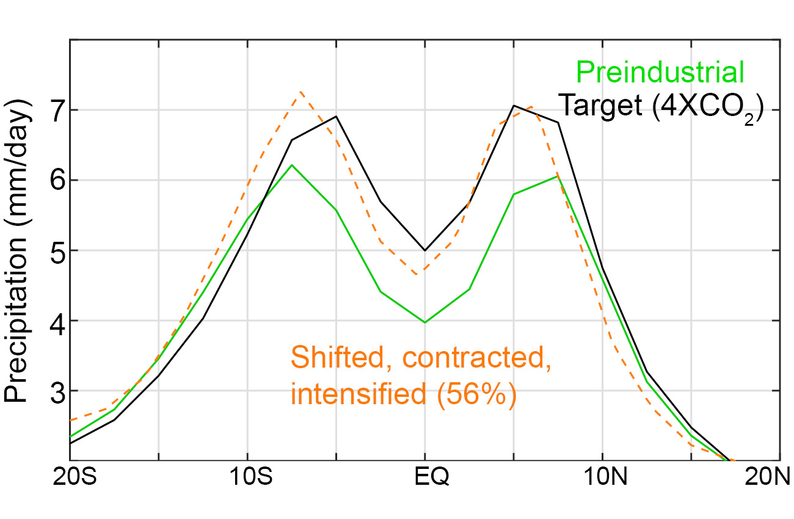
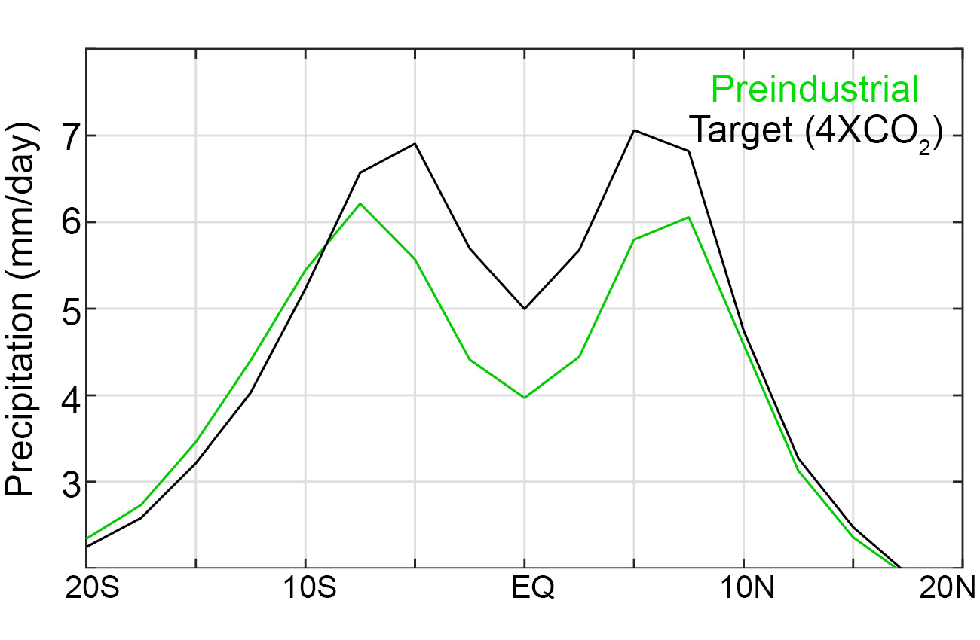
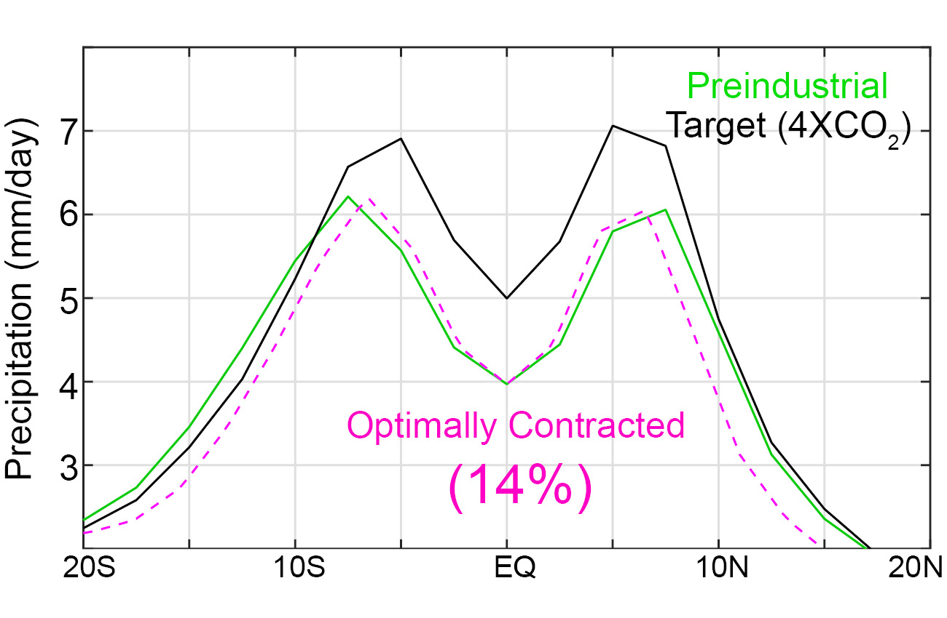
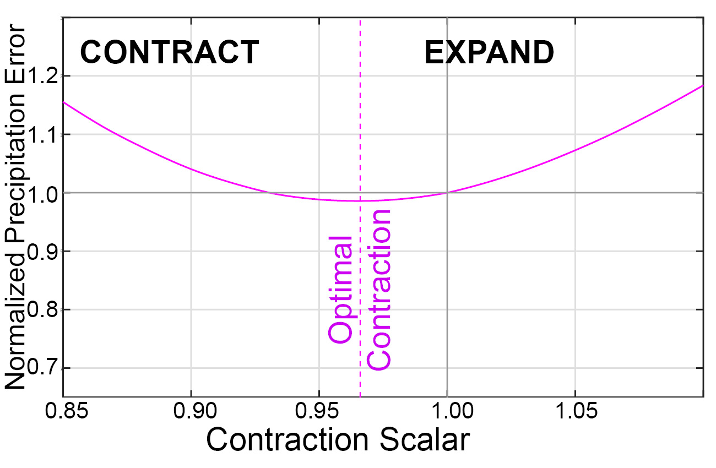
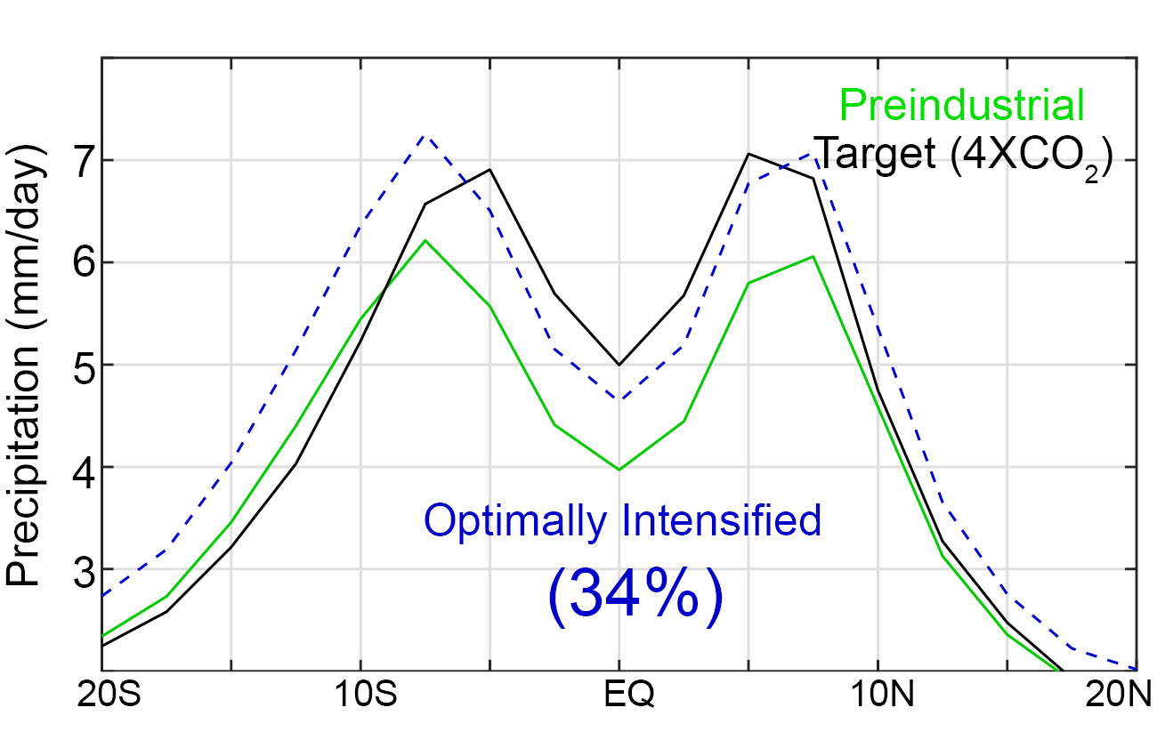
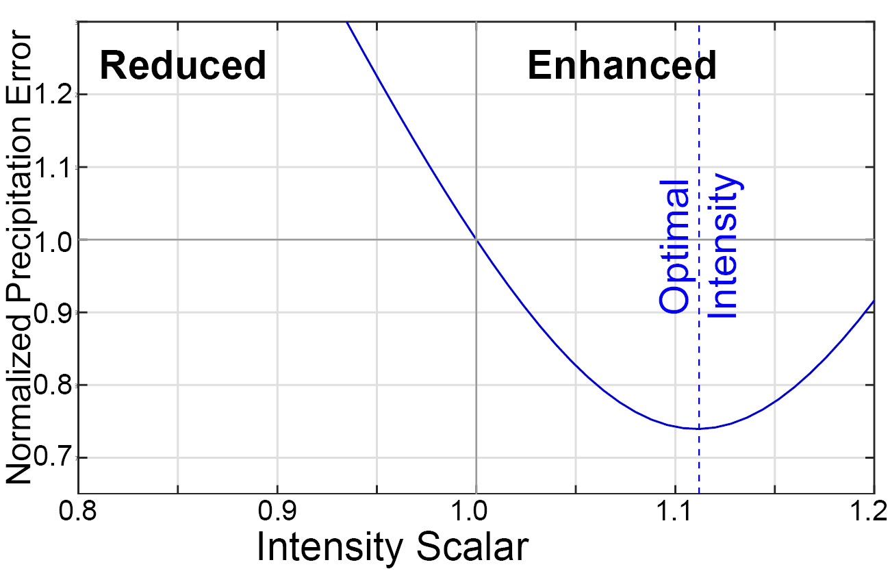
An example : change in precipitation under 4XCO2
SHIFT
Initial and target precip.
with all modes optimized
CONTRACT
INTENSIFIED

Slide 3
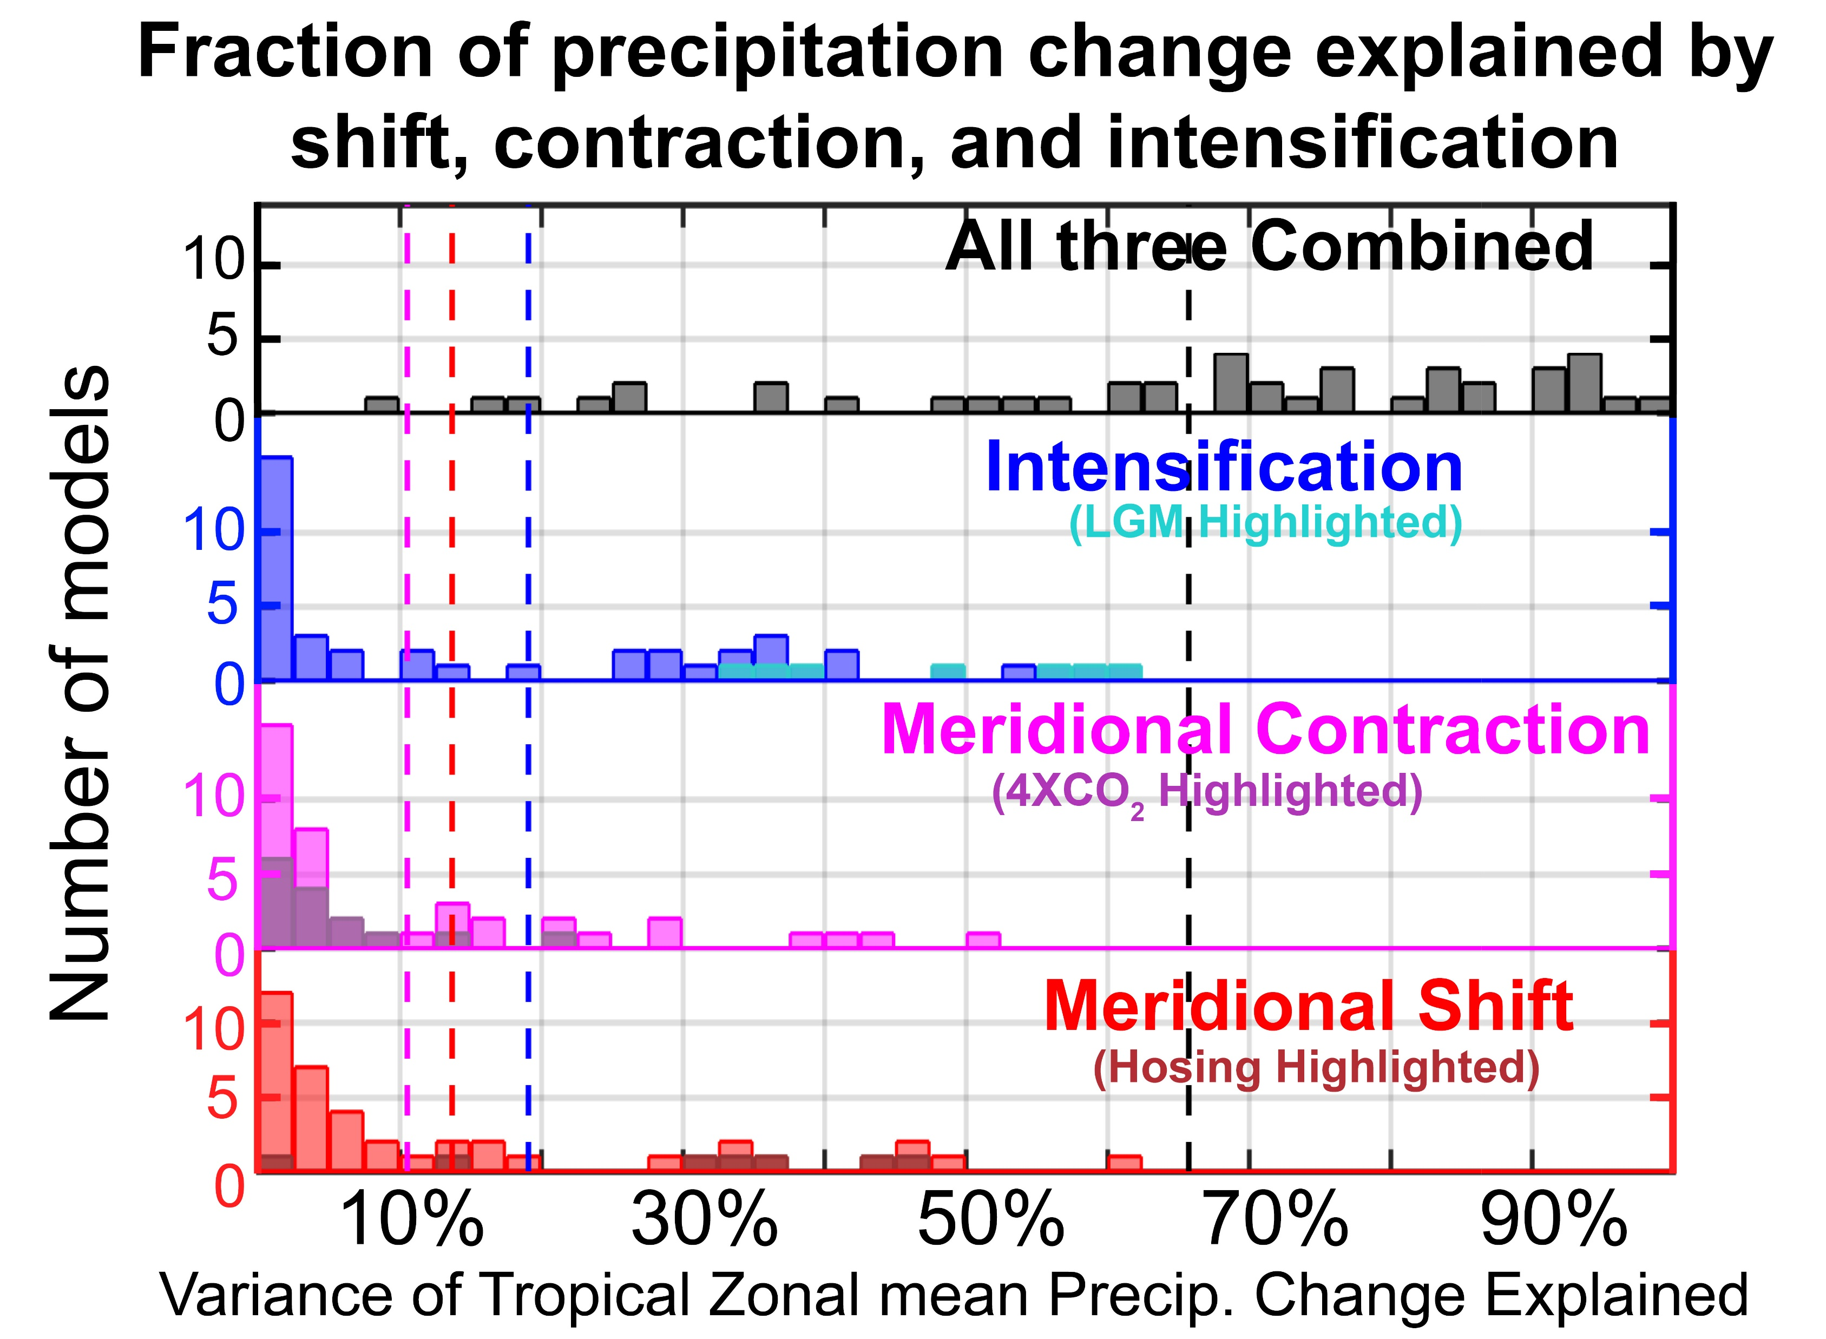
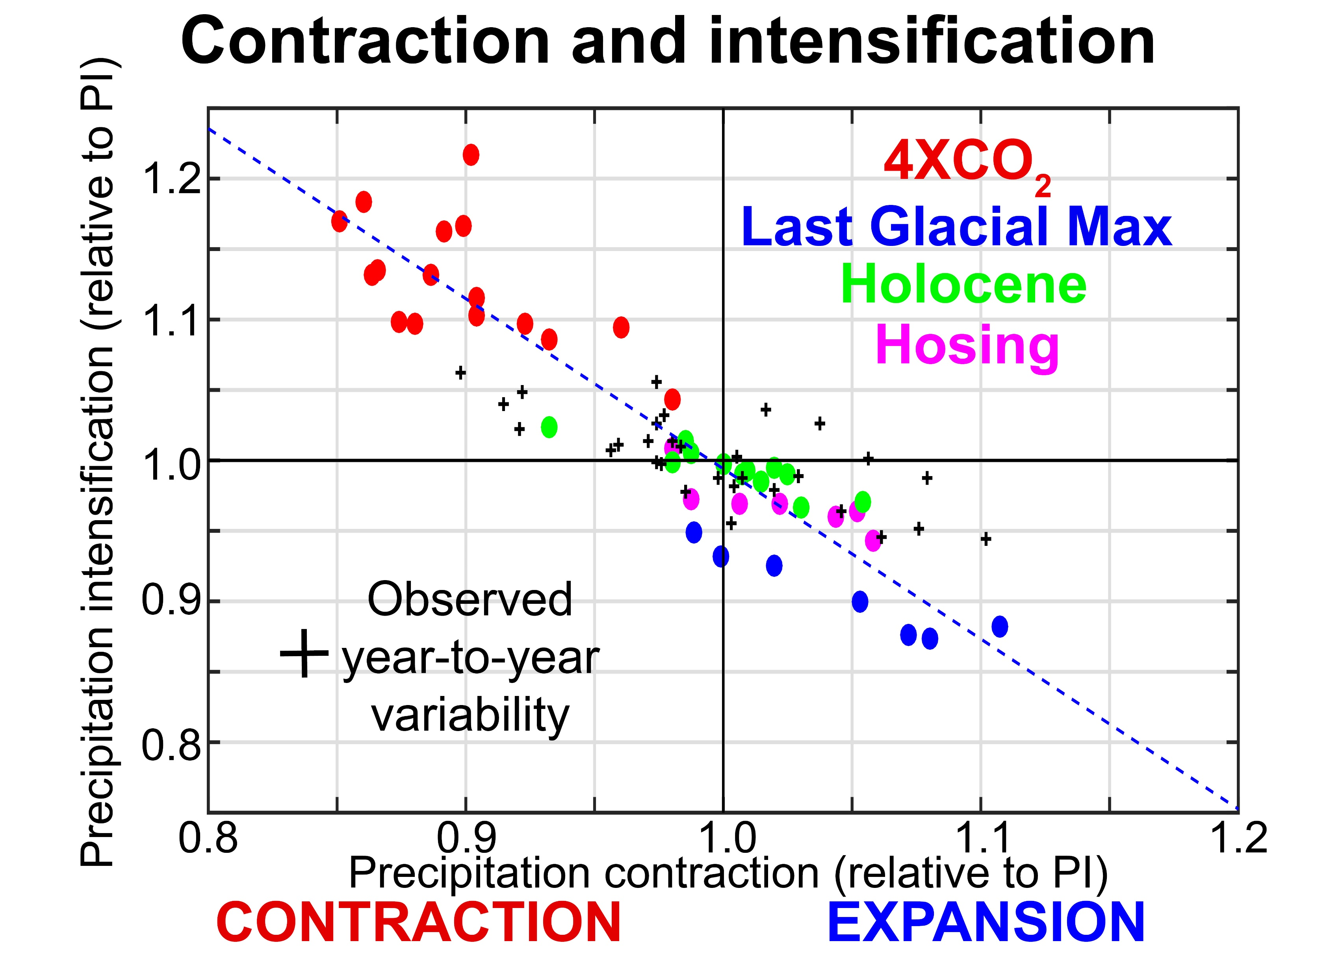
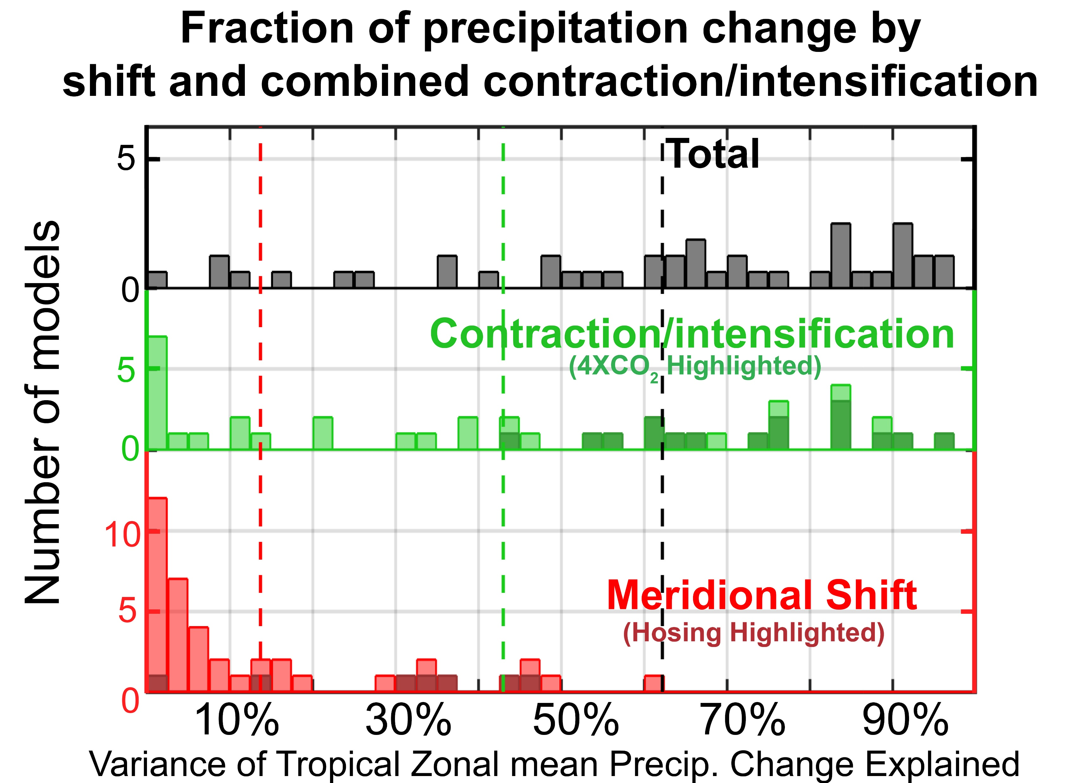
Results: Shifting, contracting and intensifying tropical precip.
ITCZ Shifts explain very little of tropical precipitation changes; contractions and intensification explain more
Contraction and intensification are highly coupled and there is a robust contraction and intensification in a warmer world and expansion reduction in a cooler world – with fixed ratio
Take the contraction and intensifying ratio as empirical. We can then describe the tropical precipitation shift with two modes: shifting and intensifying/contract with little loss of explanatory power
ITCZ Shifts are:
(1) small in magnitude
(2) explain little precip. Change
(3) not robust with climate change

Slide 4
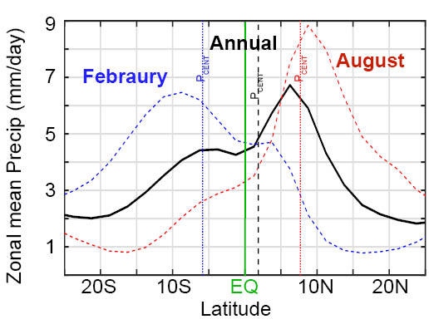
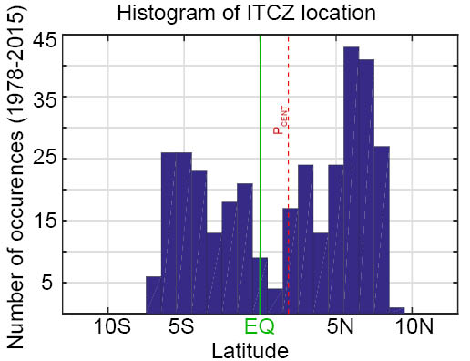
What determines the width of tropical precipitation in the annual mean?
Distribution of tropical precipitation is bimodal
→ Like a sine wave
→ ITCZ is seldom in
annual mean location
Annual mean precipitation is the statistical average of precipitation during solsticial seasons

Slide 5
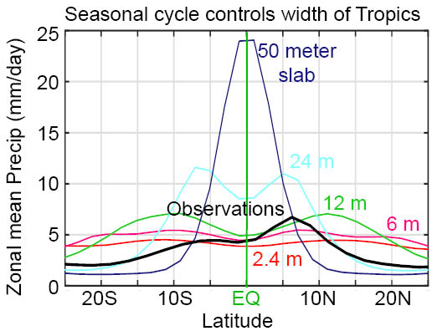
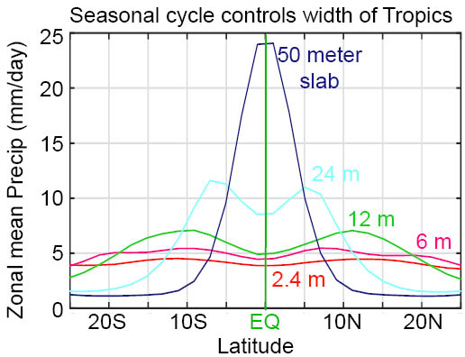
Role of seasonal cycle in stretching out the annual mean precipitation
GFDL aquaplanet with seasonal insolation coupled to slab ocean (Dargan)
Change depth of slab (50m to 2.4 m --globally uniform)
Amplitude of seasonal ITCZ migration off the equator controls the width of the tropics!

Slide 6
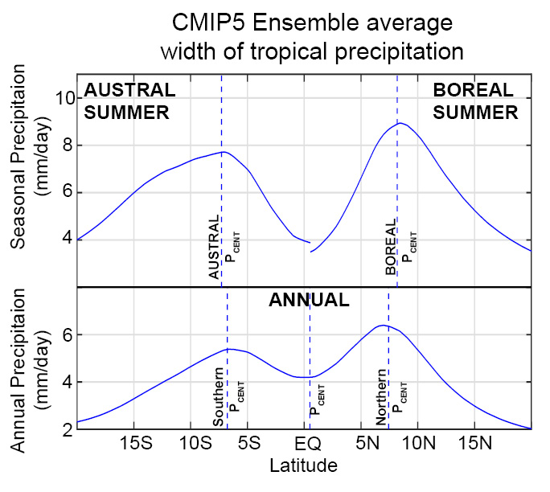
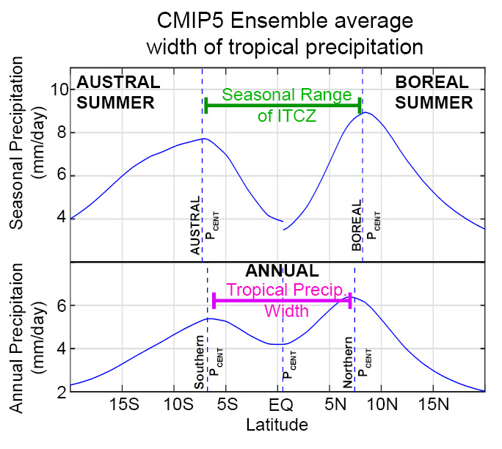
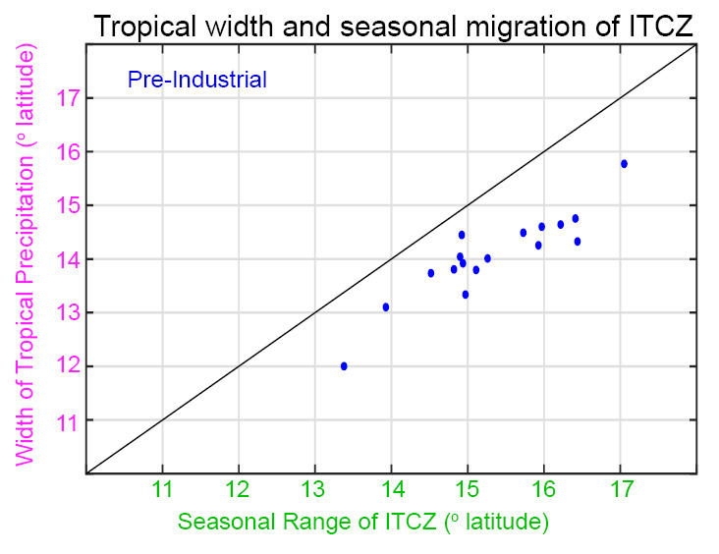
Width of tropical precipitation controlled by seasonal range of ITCZ migration

Slide 7
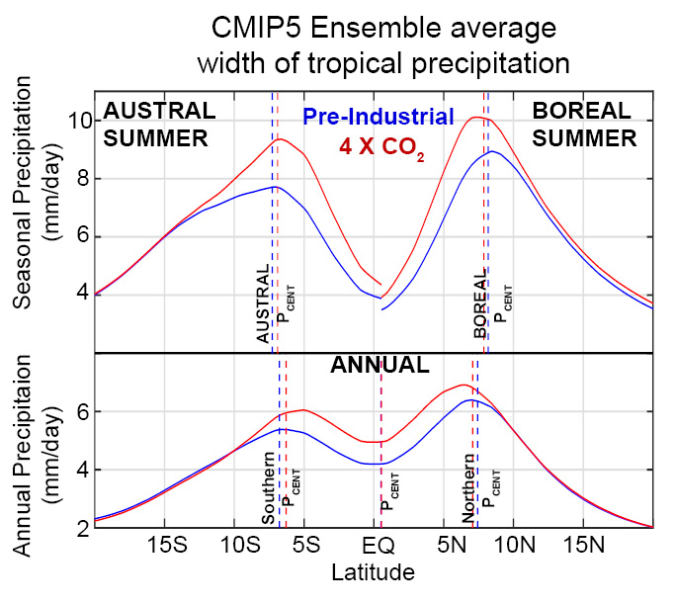
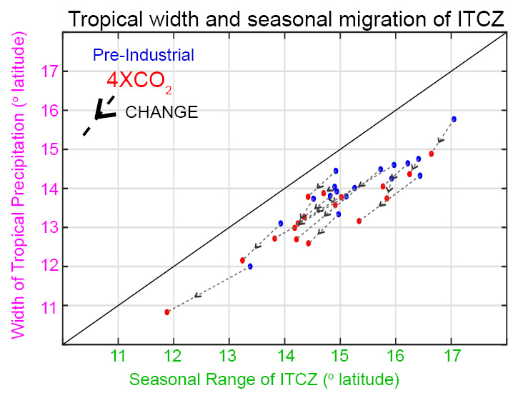
Contraction of tropical precipitation under global warming is equivalent to reduced seasonal migration of ITCZ

Slide 8
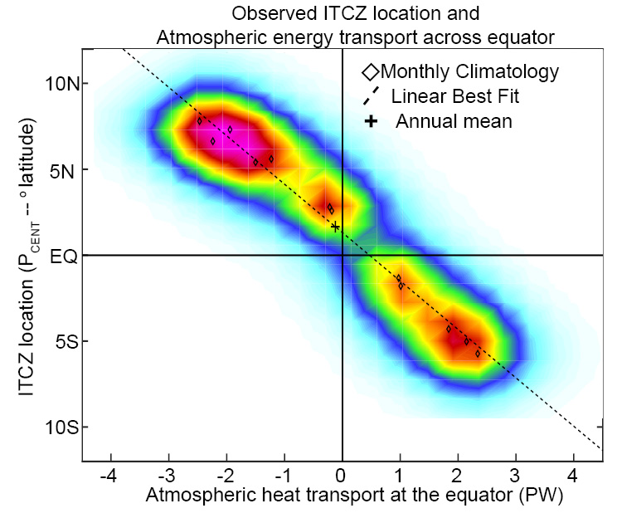
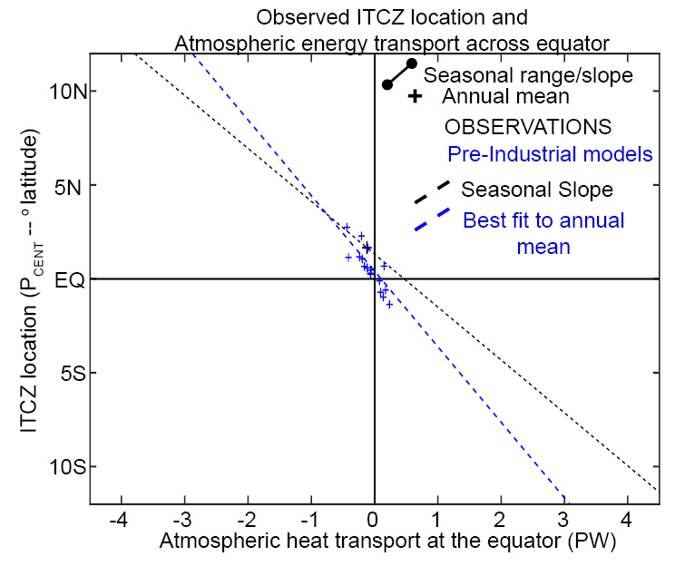
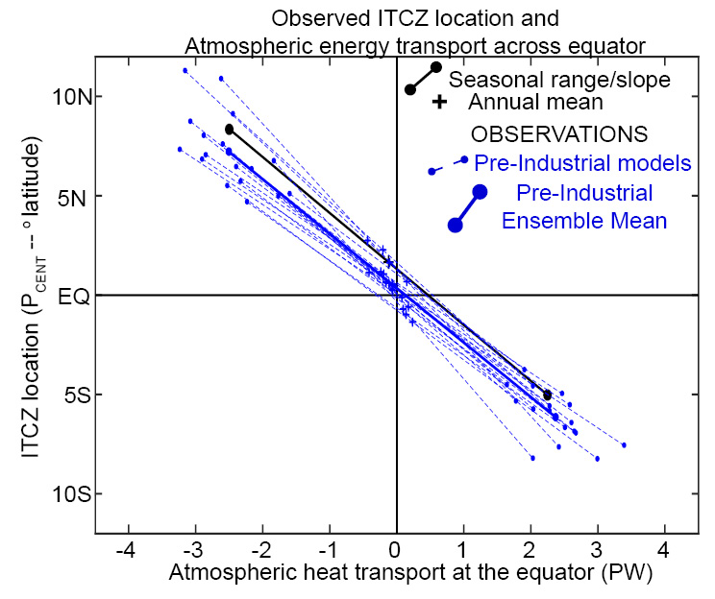
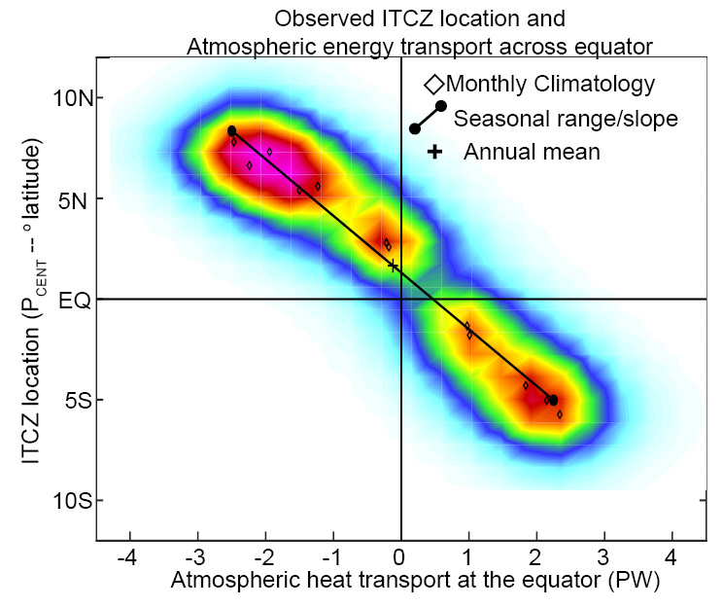
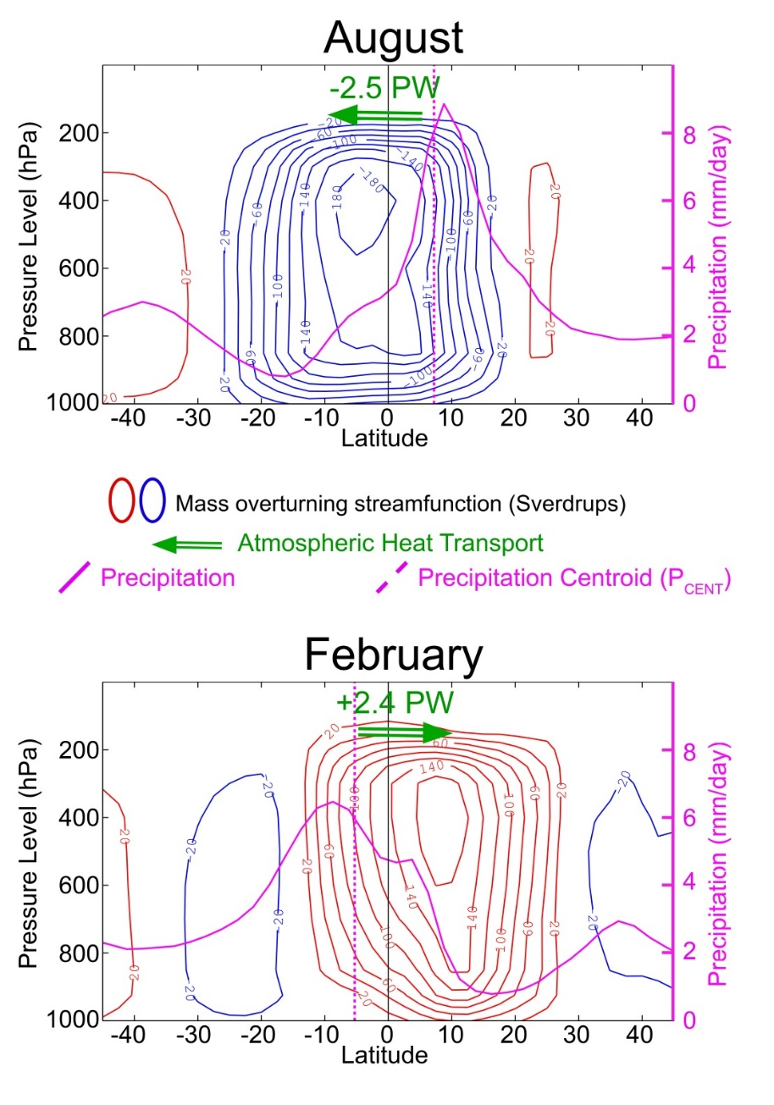
Previous work has demonstrated that annual mean ITCZ location is dictated by annual mean inter-hemispheric heat transport (Frierson Hwang 2012, Donohoe et al. 2013 many others)
CLAIM:
Seasonal amplitude (range) of cross equatorial energy transport dictates seasonal migration of ITCZ off equator → tropical width

Slide 9
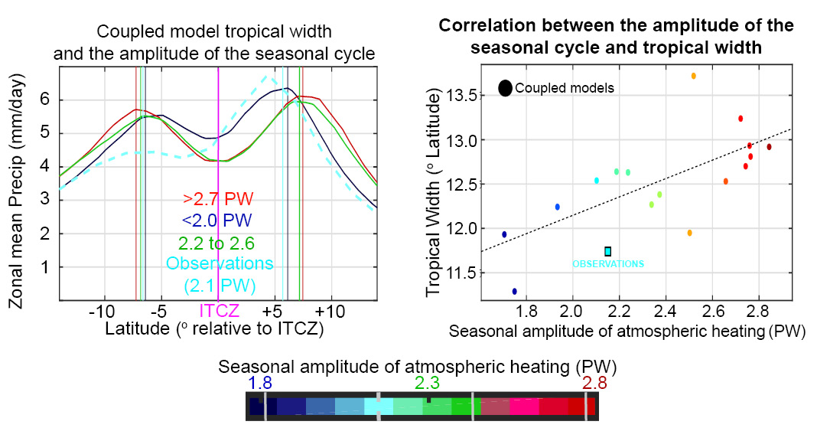

Slide 10
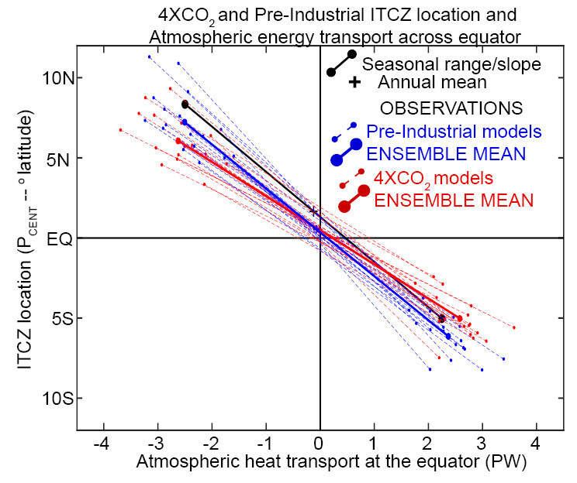
Reduced seasonal migration of the ITCZ (tropical contraction) under global warming:
Is NOT a consequence of reduced seasonality of energy transport across the equator (range on abscissa)
Results from reduction of slope between ITCZ location and energy transport
→ ITCZ (and Hadley cell) migrates less far from the equator to achieve a given energy transport

Slide 11
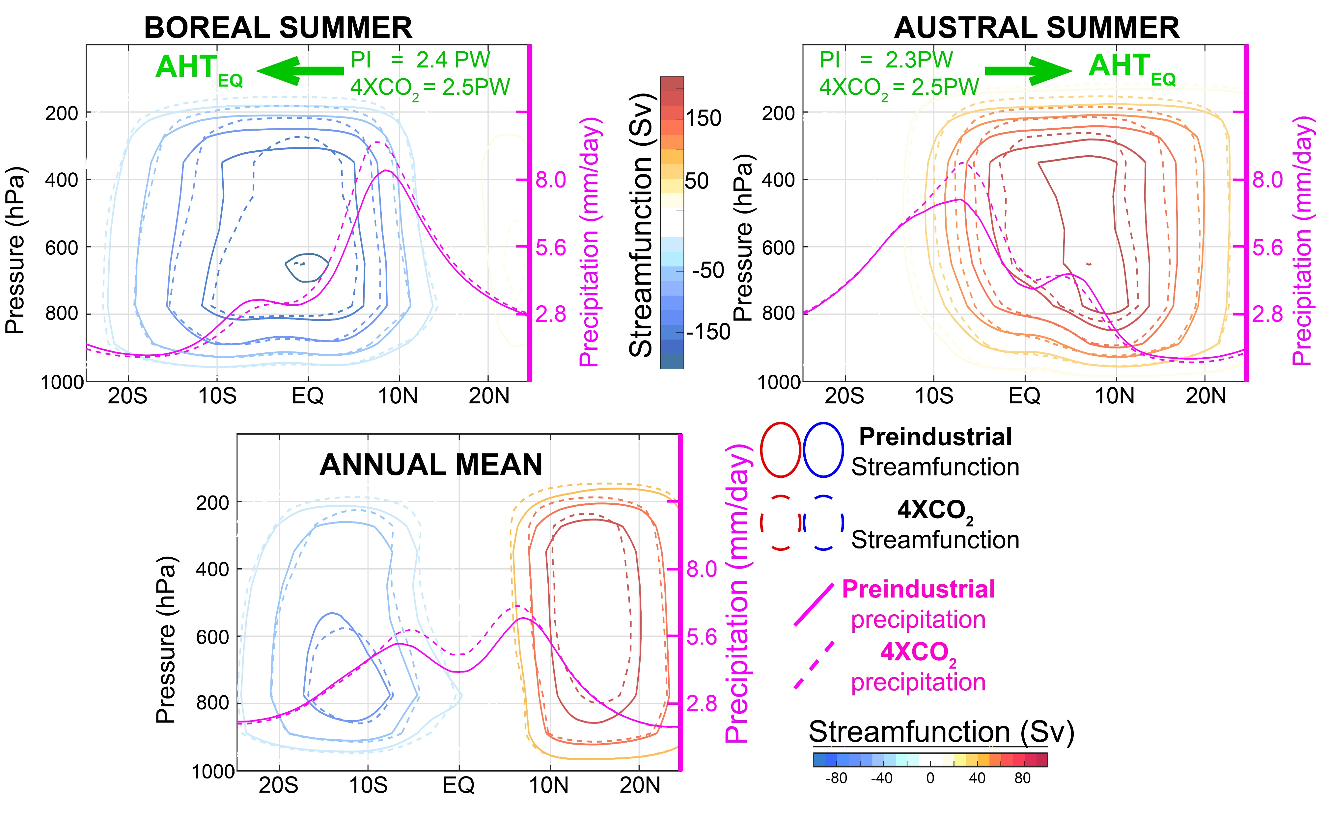

Slide 12

SUMMARY
Tropical precipitation robustly contracts and intensifies in a warmer world and expands and reduces in a colder world
→ dominant mode of tropical precipitation variability and changes under external forcing
Width of tropics set by seasonal migration of ITCZ off the equator
→ Amplitude of seasonal energy input the atmosphere
Speculation: Under global warming tropopause rising and increased gross moist stability of the tropics means the ITCZ (and Hadley cell) don’t have to move as far off the equator to satisfy seasonal energy constraints

