Slide 1

The seasonal cycle of temperature
Aaron Donohoe – Polar Science Center, APL, UW
Eliza Dawson (Stanford)
Lynn McMurdie, David Battisti (UW atmos)
Andy Rhines (Netflix)
Dynamics Seminar, January 30, 2018

Slide 2
Exercise: Timing of the seasons in Seattle
On what calendar date is the climatological temperature minimum in Seattle?
→ Express as days past the winter solstice (Jan. 1 = +10, Dec. 1 = -20)
B. On what calendar date is the climatological temperature maximum in Seattle?
→ Express as days past the summer solstice
C. How asymmetric is the seasonal cycle about the insolation?
→ Answer (B) minus answer (A)

Slide 3
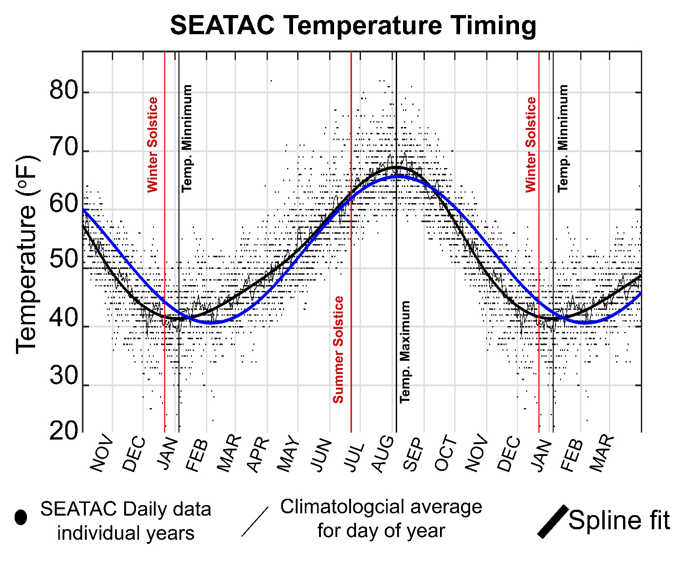
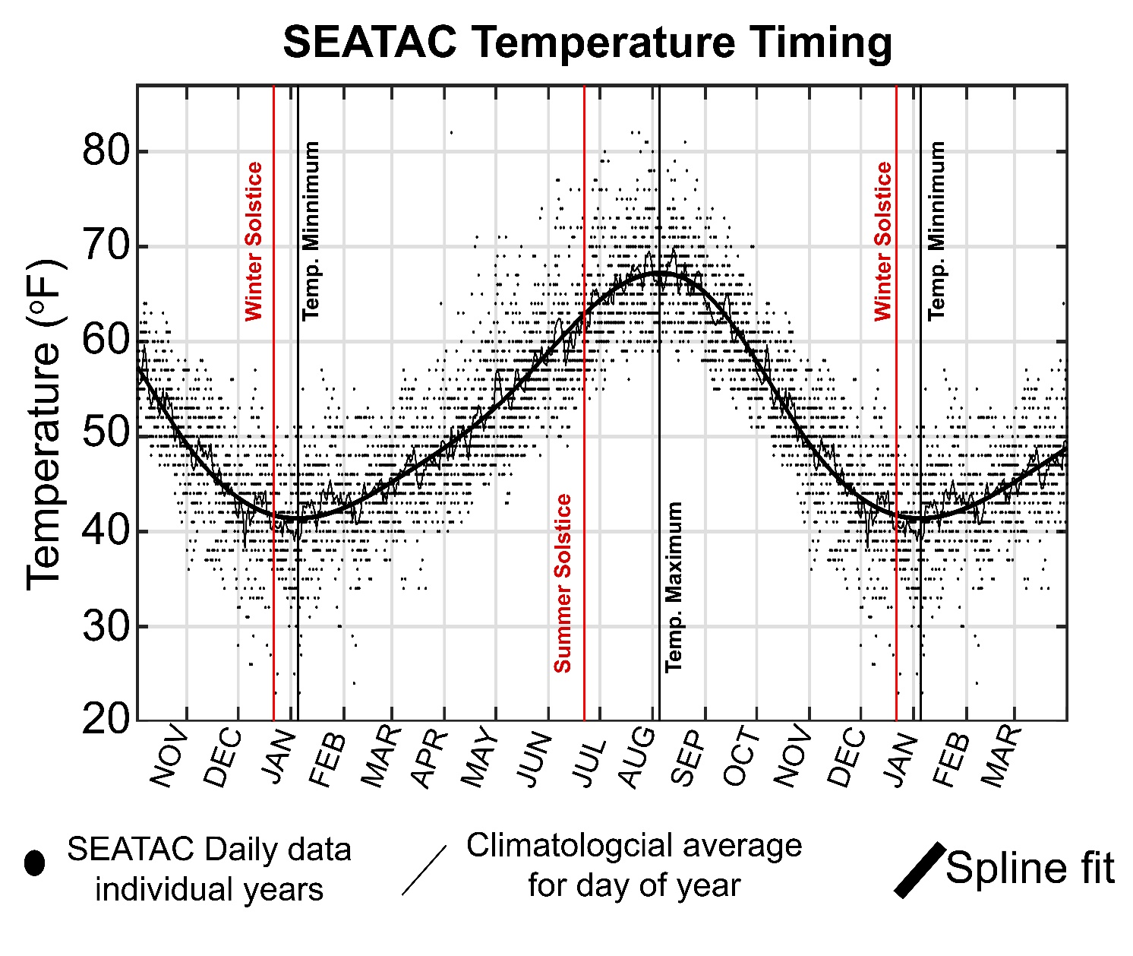
Minimum Temperature:
January 4th (+ 14)
Maximum Temperature:
August 4th (+44)
Seasonal Asymmetry of timing:
44 – 14 =
30 days
Annual Harmonic

Slide 4
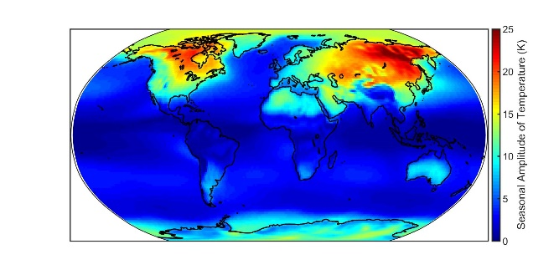
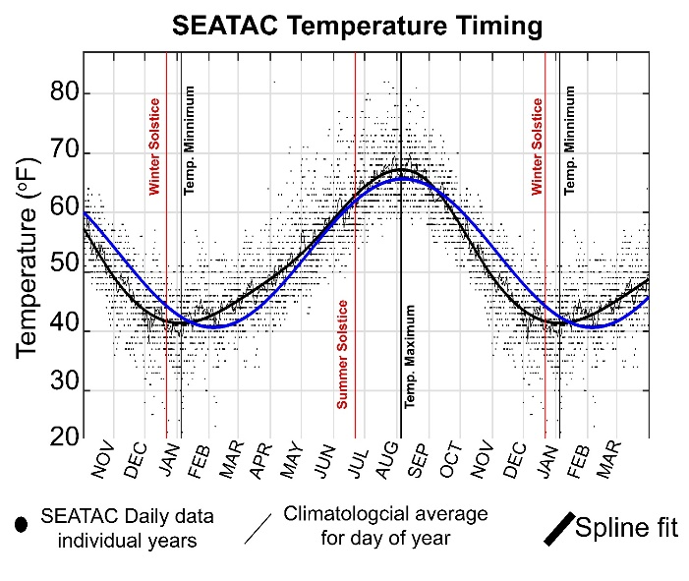
Outline
What determines the amplitude of the seasonal cycle of temperature?
→How does solar radiation at the top of the atmosphere heat the atmospheric column
→ Changes under global warming
2. Seasonal asymmetries in the lag between surface temperature and insolation

Slide 5

Seasonal amplitude (annual harmonic) of surface temperature
Basic idea: seasonal variations in surface solar radiation force the seasonal cycle
Low heat capacity of land surface → large amplitude
High heat capacity of ocean → small amplitude
Mixing of (ocean/land) end members from west to east → Eastern side of continents have largest amplitude

Slide 6
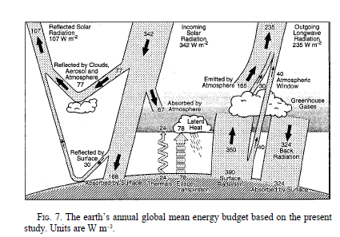
How is the atmosphere heated in the annual average?
How is top of atmosphere solar radiation gets into the atmospheric column: annual mean
30% reflected
20% absorbed atmosphere
50% transmitted
To surface
50% net flux
From surface
To atmosphere
Kiehl and Trenberth 1997

Slide 7
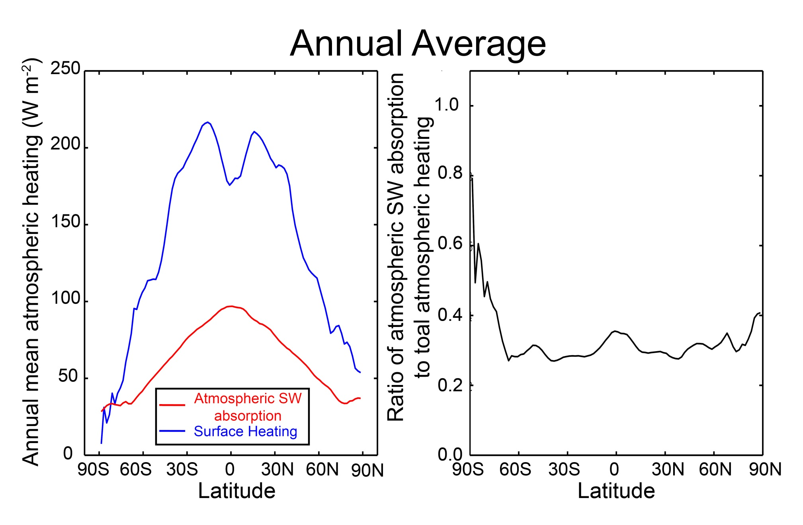
Spatial structure of atmospheric heating
Spatial structure of atmospheric heating
Annual Average

Slide 8
Limiting models of seasonal atmospheric heating
SW flux
Turbulent + LW
Surface flux
Heated from above
Heated from below
SW absorbing
atmosphere
SW transparent
atmosphere
DEEP
OCEAN
Shallow ocean

Slide 9
Atmospheric energy budget
Conventional
This study
Net SW
TOA
OLR
Atmospheric SW absorption (SWABS)
OLR
Net energy flux
Through surface
SW transparent
atmosphere
Surface heat
Flux (SHF)
Surface
Surface
Net energy flux through surface =
Solar + turbulent + LW
SHF = turbulent + LW
=> Energy exchange between surface and atmosphere

Slide 10
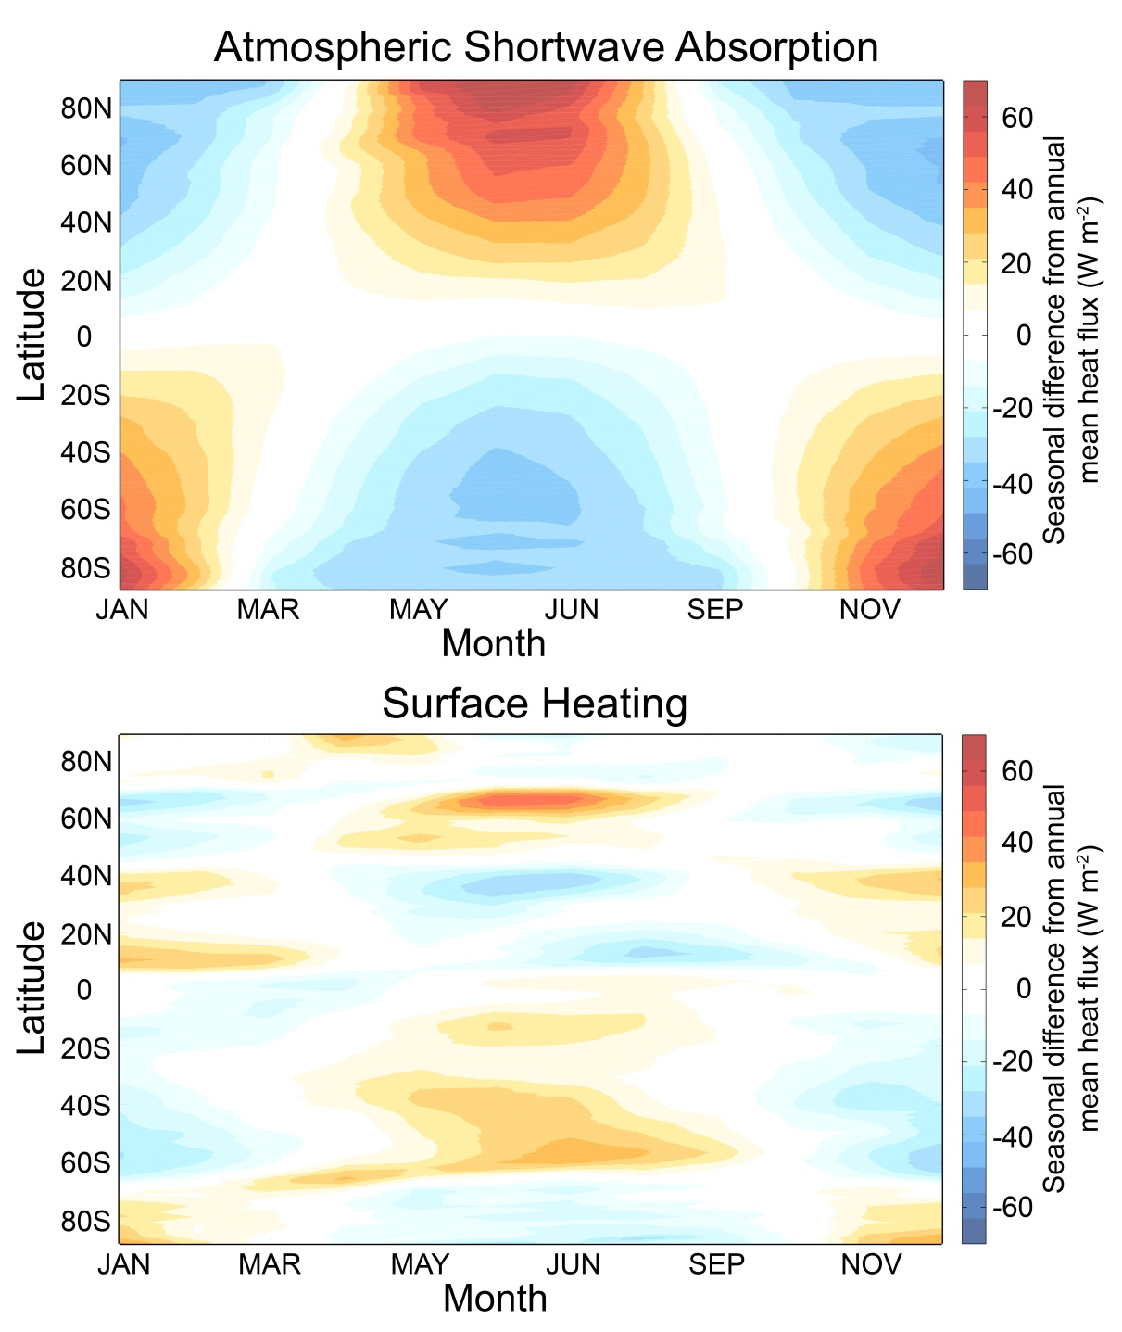
Seasonal Atmospheric Heating
ANNUAL MEAN IS
REMOVED

Slide 11
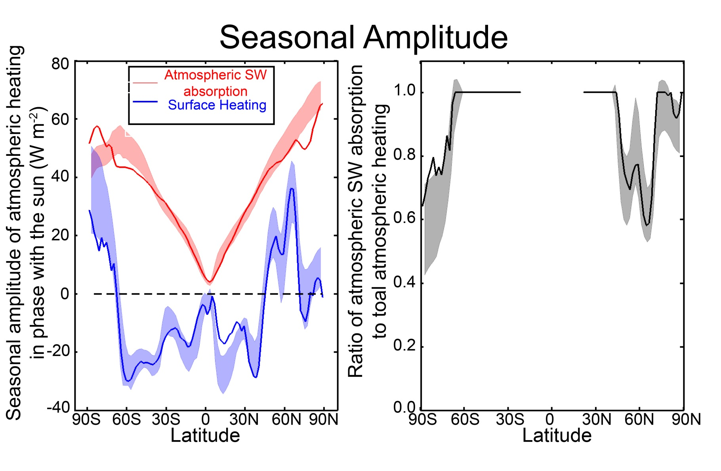
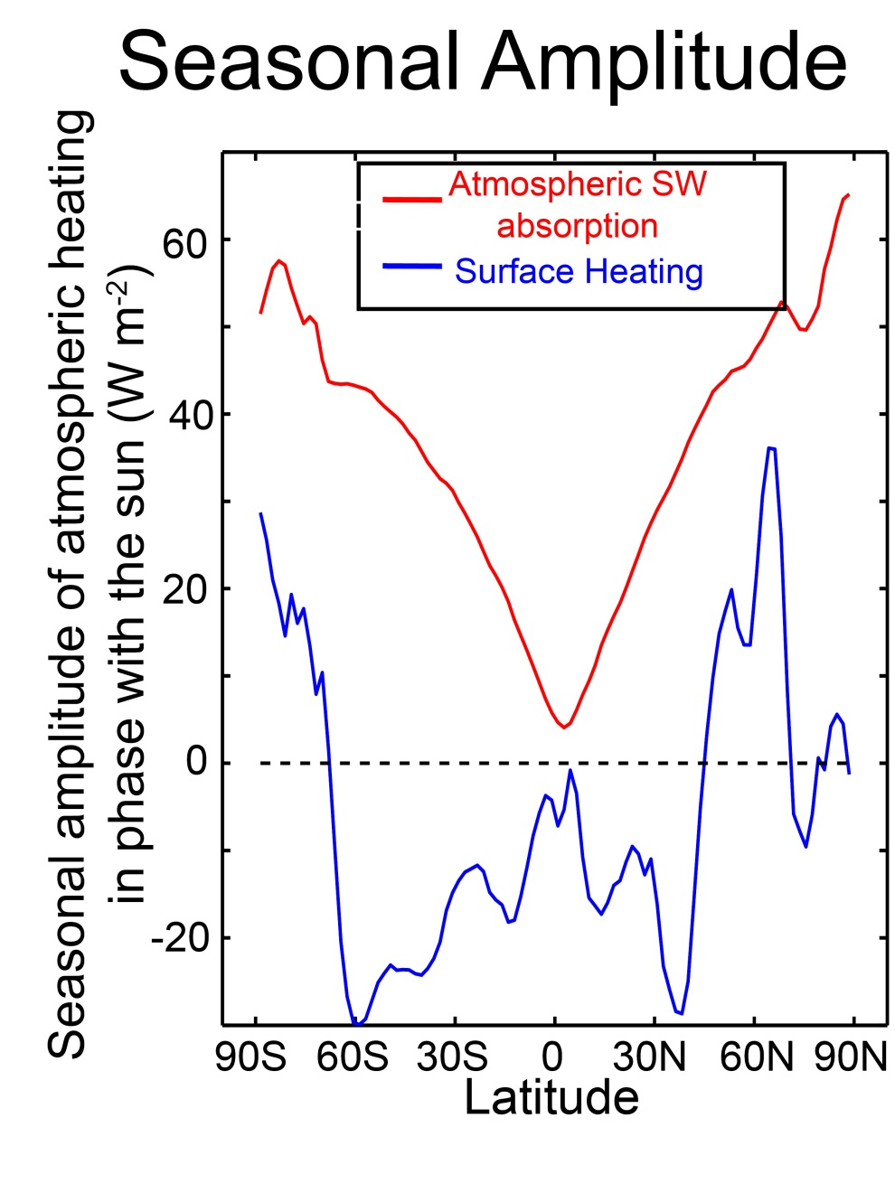
Seasonal Amplitude of heating
Seasonal Amplitude
Annual Mean
Define seasonal amplitude as:
Amplitude of annual harmonic
In phase with the insolation
Takes into account magnitude
and phase
Positive amplifies seasonal cycle
Negative reduces seasonal cycle

Slide 12
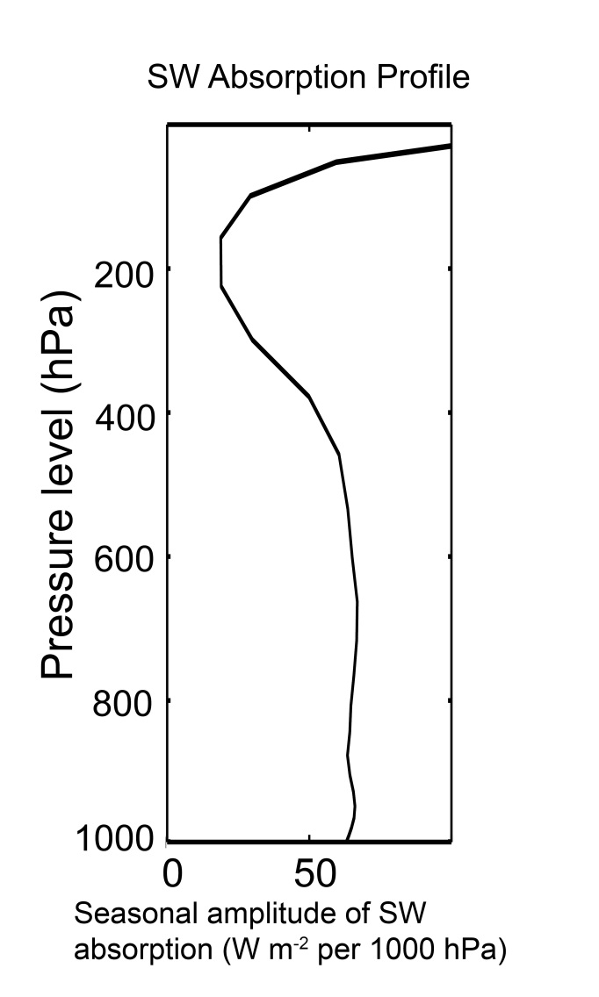

Define a seasonal amplitude
Vertical structure of SW absorption
GFDL Model
Seasonal amplitude
In the extratropics
Ozone
Water
Vapor

Slide 13
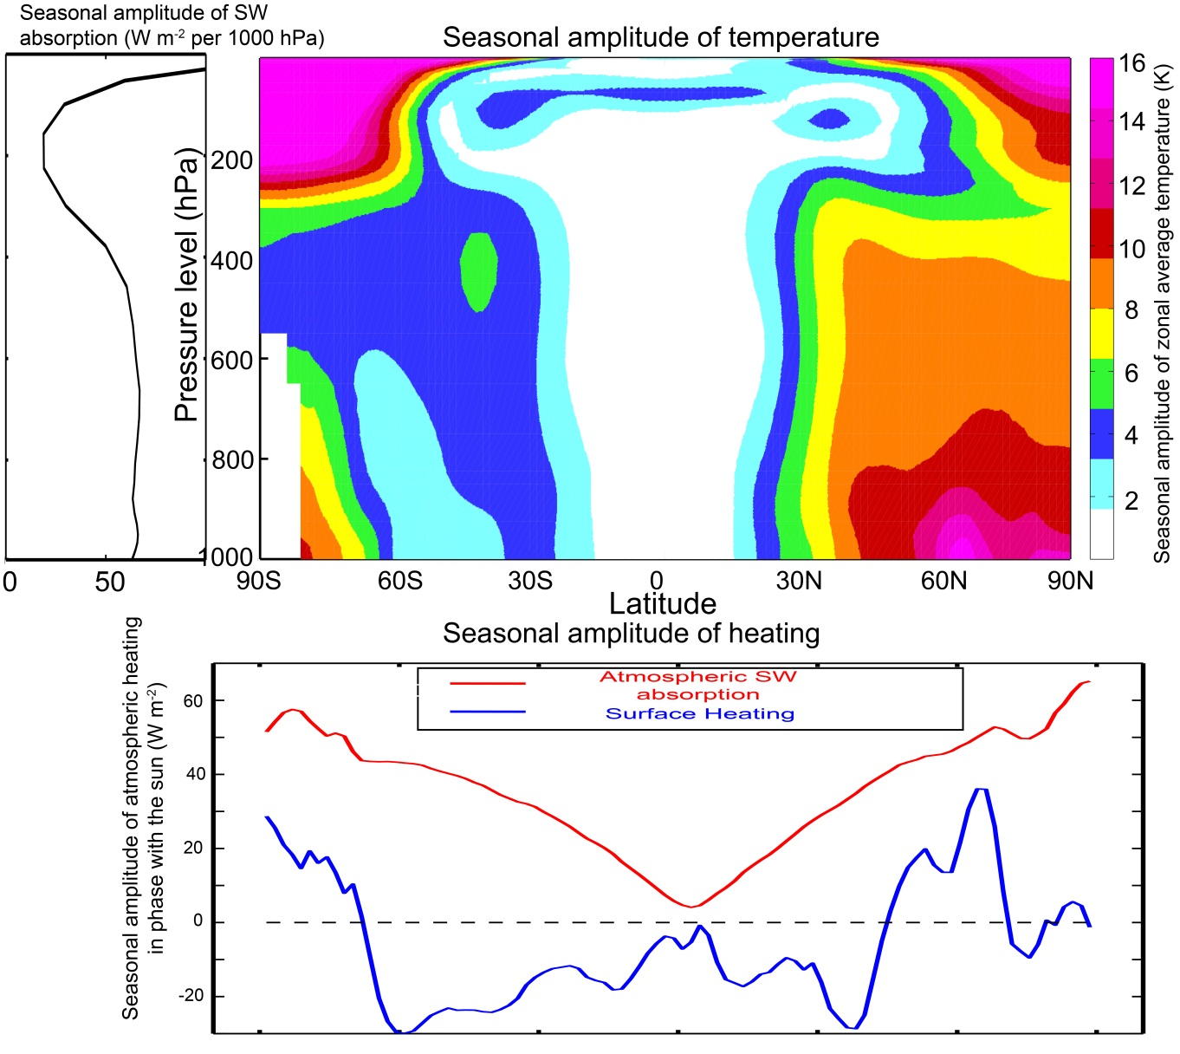
Structure of seasonal amplitude in temperature
Seasonal cycle is surface amplified where the surface heat fluxes contribute to seasonal heating (over land)

Slide 14
Aquaplanet simulations: ocean mixed layer depth and the source of seasonal atmospheric heating
SWABS
SWABS
Surface fluxes
Surface fluxes
50 meters deep
2.4 meters deep

Slide 15
CO₂ doubling expectations
Summer schematic
Surface flux
SWABS
Moistening and melting
Mores seasonal energy input directly into the atmosphere (SWABS)
Less seasonal energy input at the surface (SHF)
Sea ice
Open ocean

Slide 16
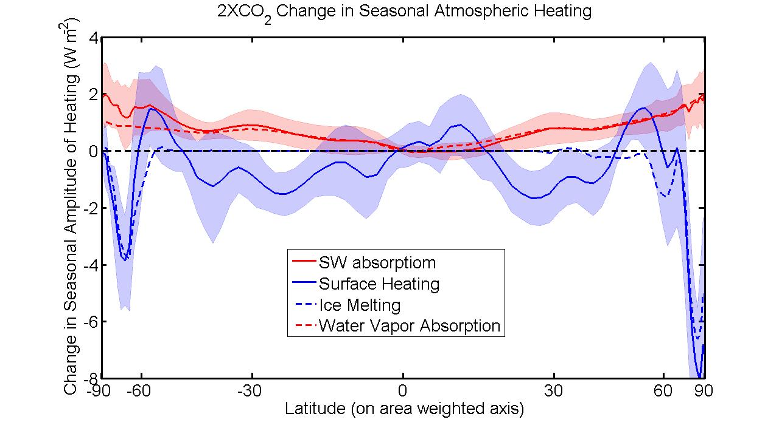

Slide 17
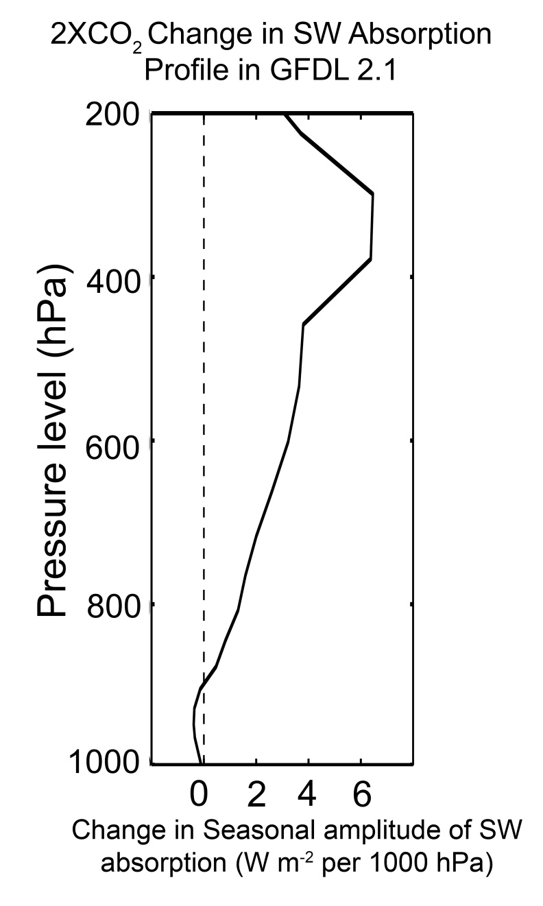
Water Vapor as a SW Absorber
(Figure: Robert Rhode
Global Warming Art Project)

Slide 18
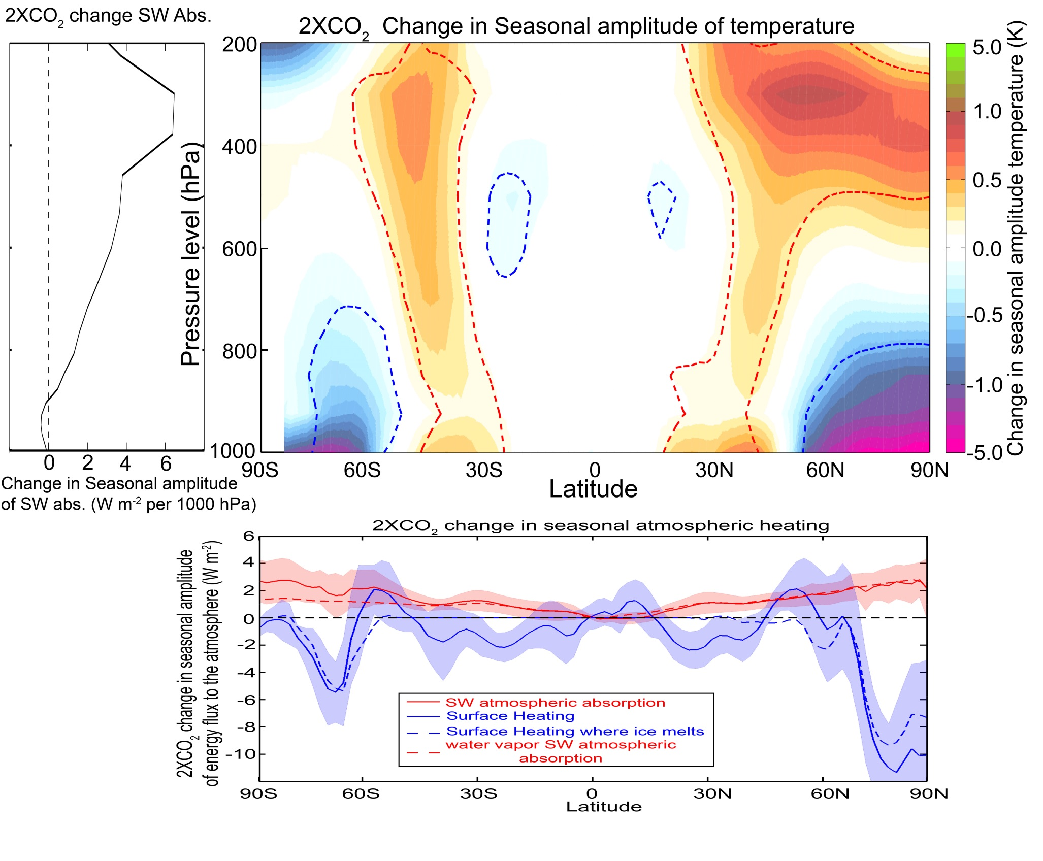
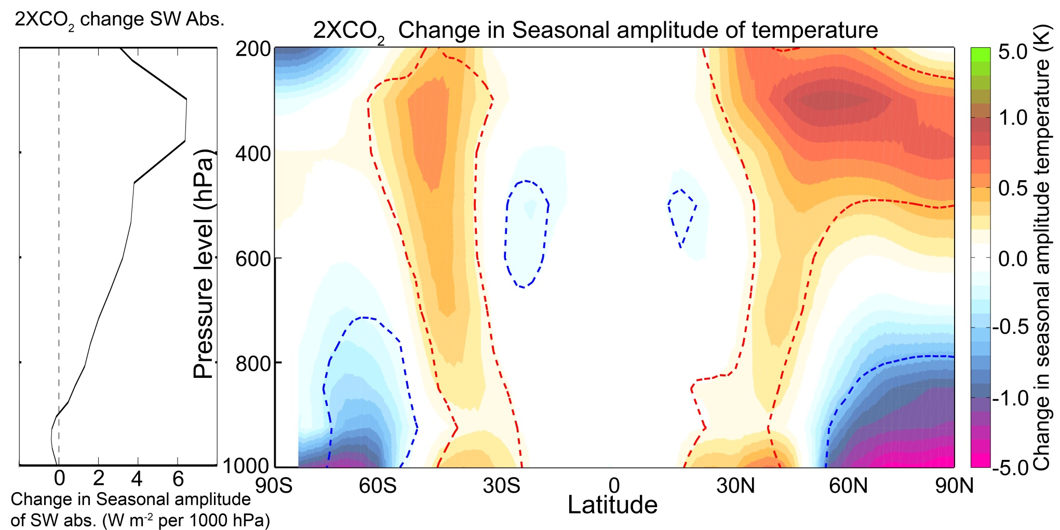
Reflects the combined contributions of:
Melting sea ice
=> reduced seasonal cycle of temperature at the surface
2. Increased SWABS due to atmospheric moistening
=> enhanced seasonal cycle of temperature aloft

Slide 19
What sets the phase of the seasonal cycle?
PHASE
AMPLITUDE
Phase and amplitude of annual harmonic both reflect continentality
Are non-linearly related
Stine et al. 2009

Slide 20
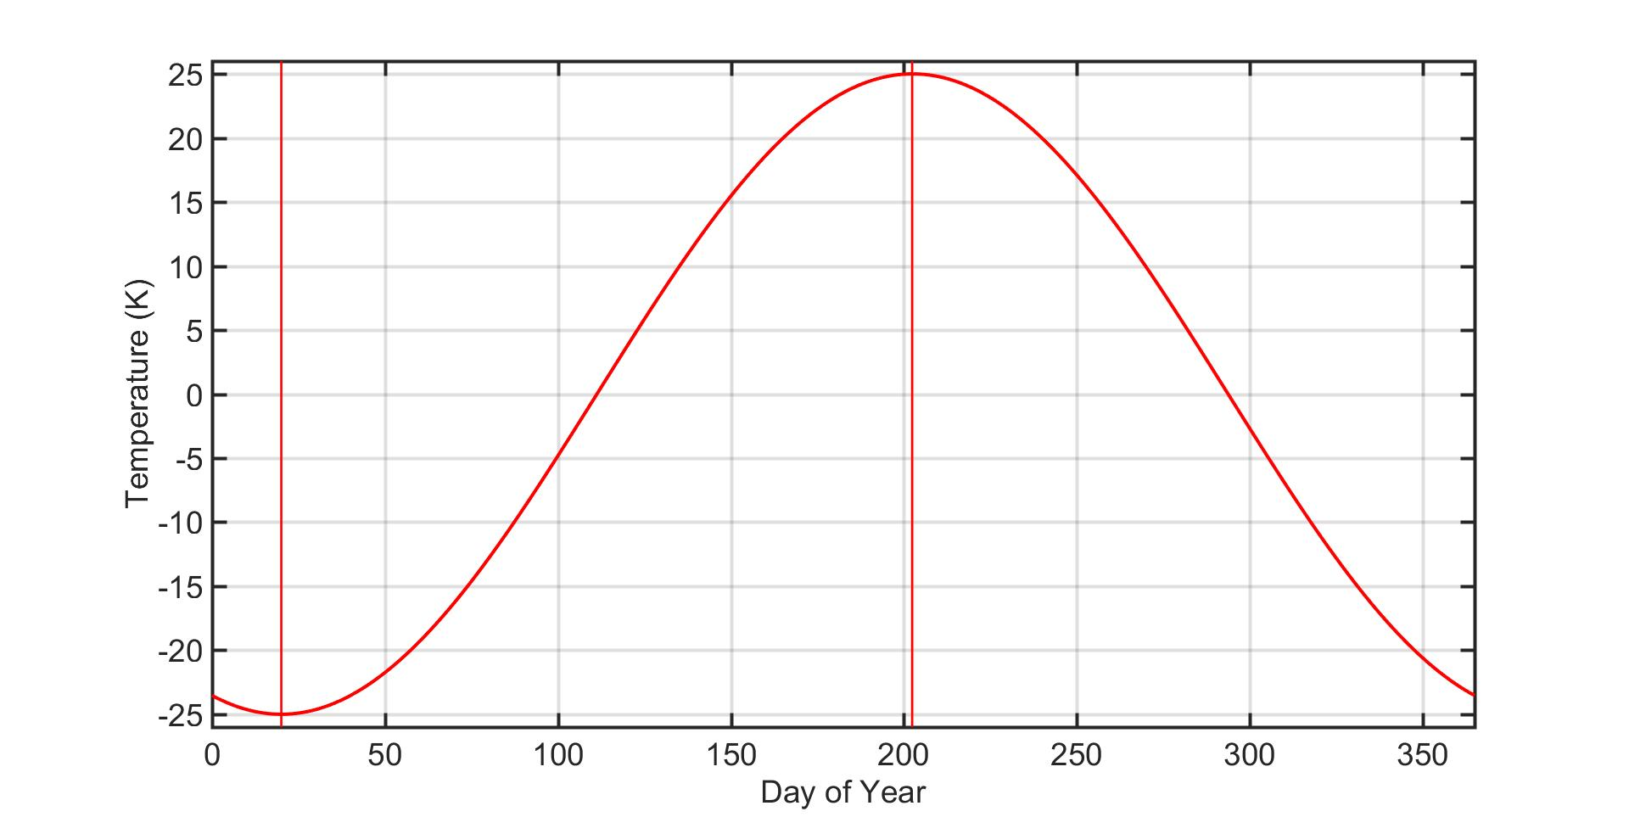
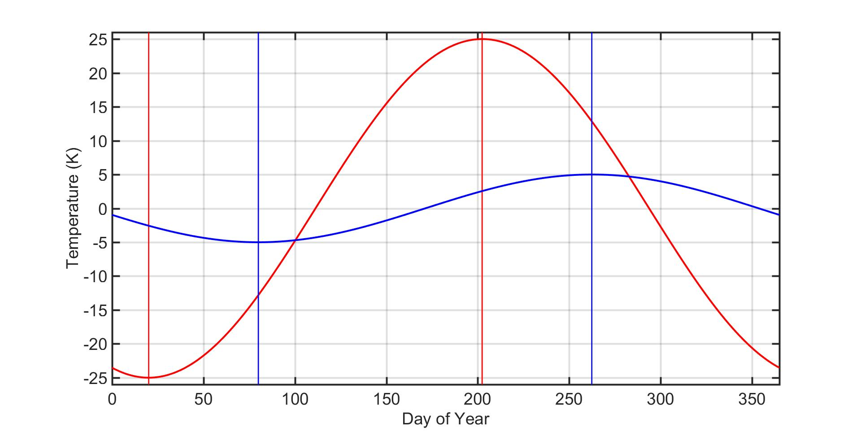
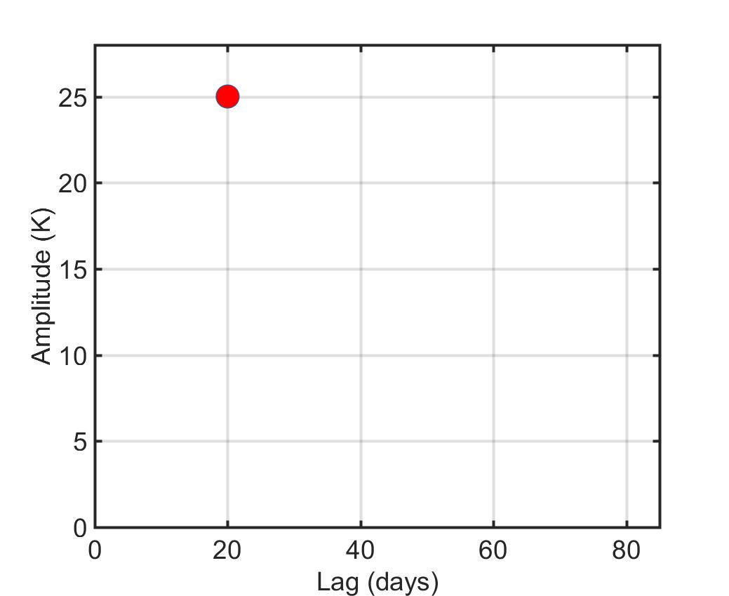
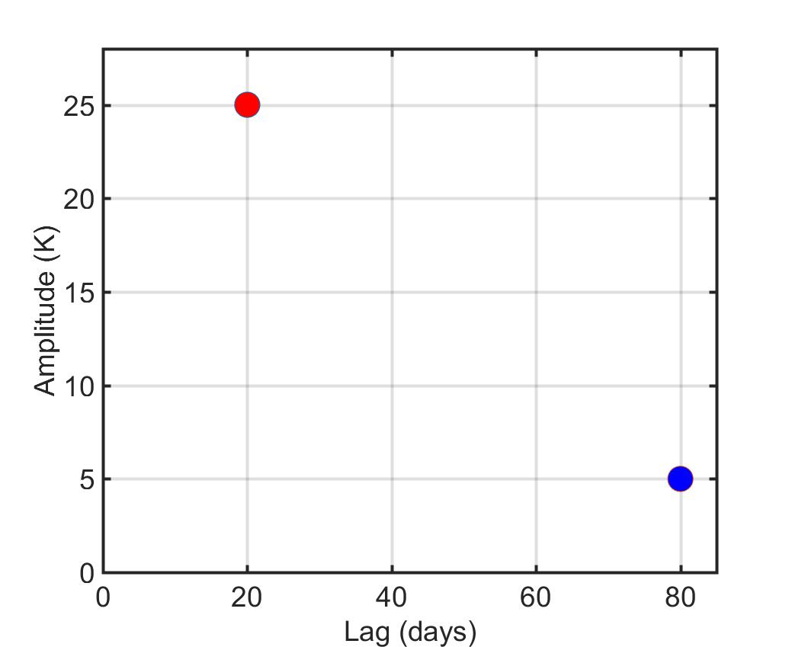
Pure Land
Phase
Pure Ocean
Pure Land
Model the seasonal cycle as the mixing of two end members:
Pure land : Amplitude 25, 20 day phase lag
Pure ocean: Amplitude 5, 80 day phase lag
Pure Ocean

Slide 21
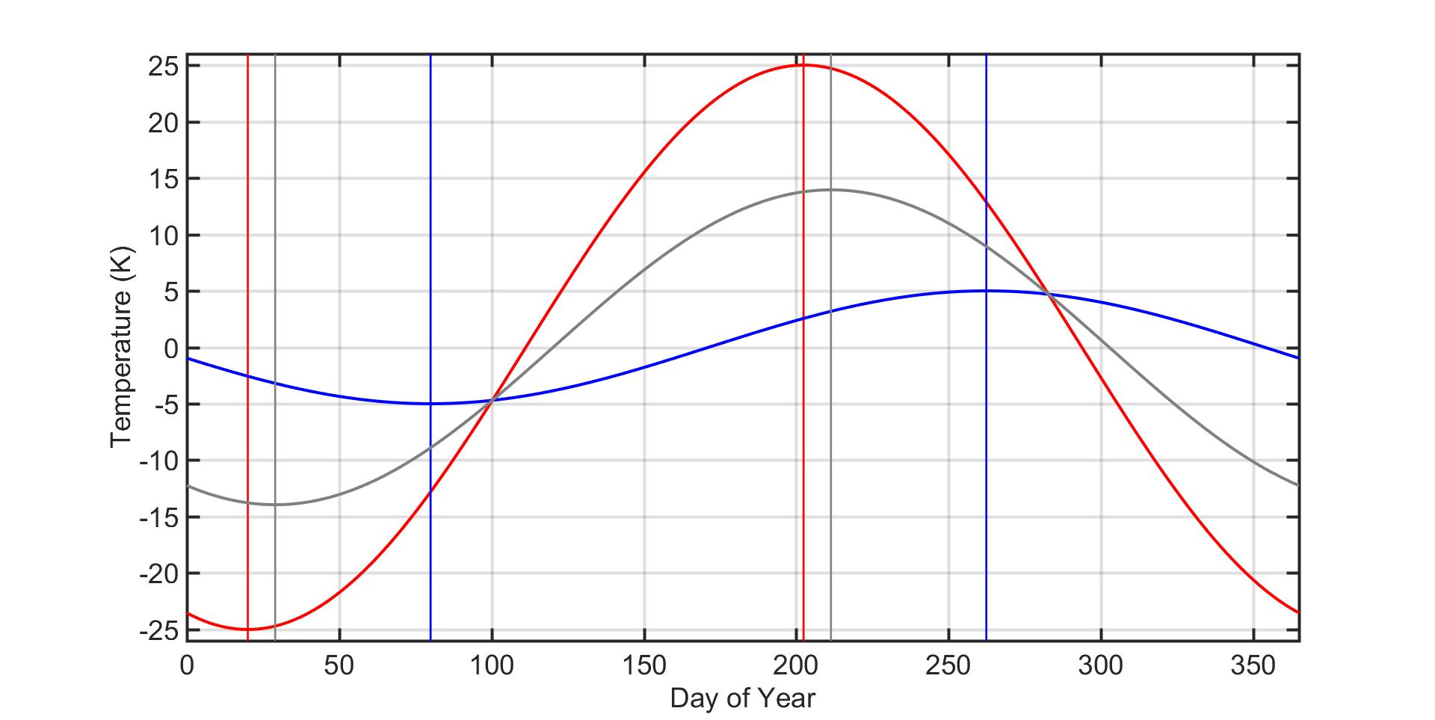
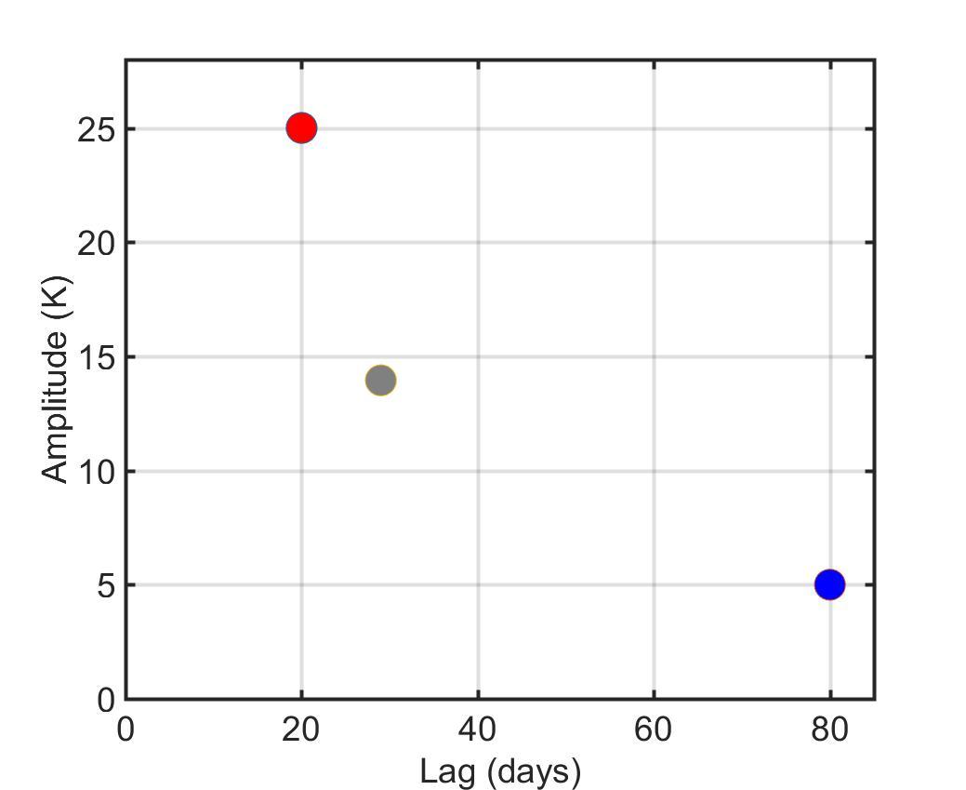
Pure Land
50% ocean , 50% land
Phase
Pure Ocean
Pure Land
Model the seasonal cycle as the mixing of two end members:
Pure land : Amplitude 25, 20 day phase lag
Pure ocean: Amplitude 5, 80 day phase lag
The weighted superposition of these two end members results in a non-linear relationship between phase and amplitude
50% ocean , 50% land
Pure Ocean

Slide 22
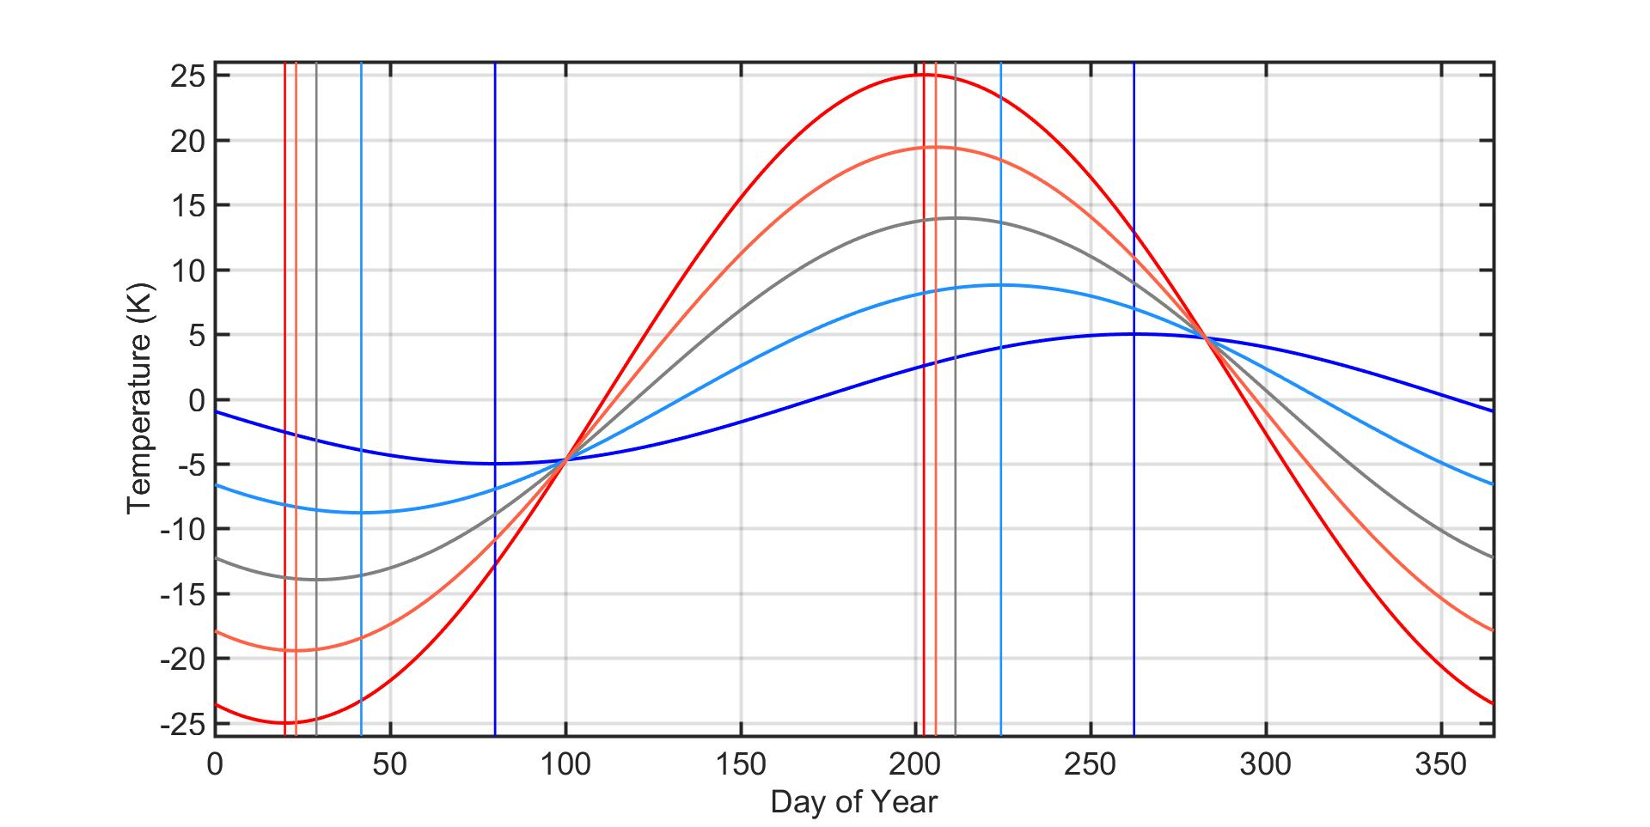
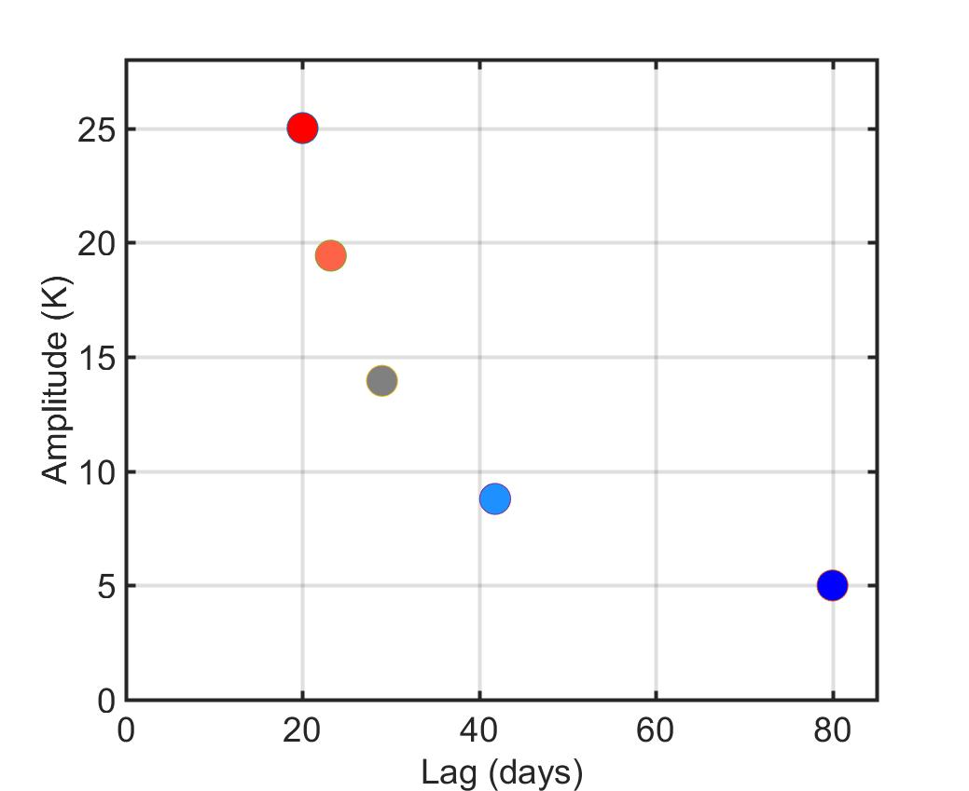
Pure Land
75% land
50% ocean , 50% land
75% ocean
Phase
Pure Ocean
Pure Land
Model the seasonal cycle as the mixing of two end members:
Pure land : Amplitude 25, 20 day phase lag
Pure ocean: Amplitude 5, 80 day phase lag
The weighted superposition of these two end members results in a non-linear relationship between phase and amplitude
75% land
50% ocean , 50% land
75% ocean
Pure Ocean

Slide 23
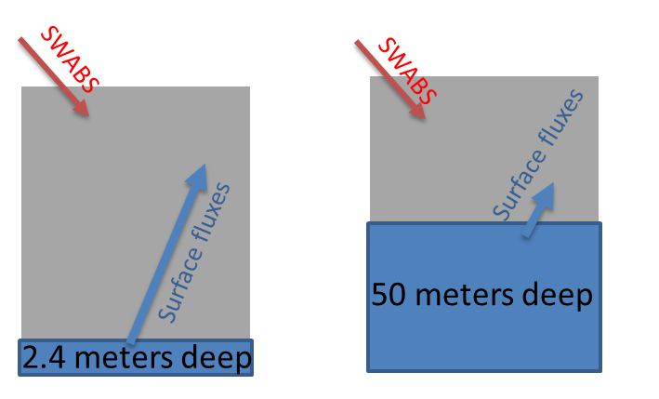
Aquaplanet simulations:
Phase of seasonal cycle is a non-monotonic function of ocean mixed layer depth
Longest phase lag at intermediate depths
Short lags for shallow (expected) and deep (unexpected) ocean depths
Reflects change in the source of seasonal heating
→ Shallow = surface heating
→ Deep = solar heating in phase with insolation
All aquaplanet depths give a longer lag than observed
→ Land domain is fundamental to setting the phase

Slide 24
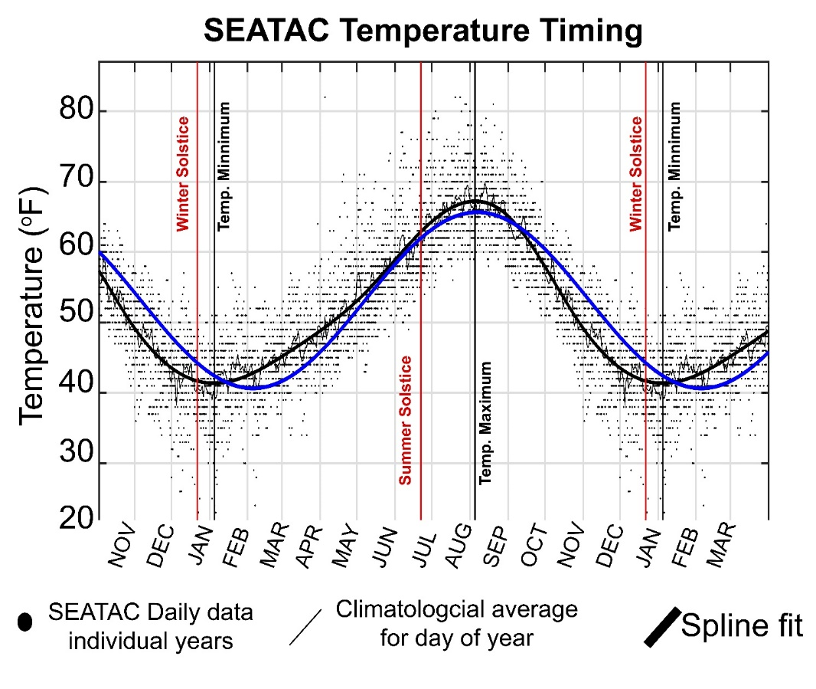
Seasonal asymmetries in the lag between surface temperature and insolation
Smooth seasonal cycle with a periodically padded spline with 6 evenly spaced knots
τ_{MAX} = Time of maximum
(relative to solstice)
τ_{MIN} = Time of minimum
(relative to solstice)
ASYM = τ_{MAX} - τ_{MIN}
DATA
Station data: 2 meter air T_{AVG} temperature from the Global Historical Climatology Network – 3,096 stations after quality control
ERA Interim 1000 hPa temperature (also NCEP 2m air)
Ocean Weather Ship (WWII era)
Mount Rainier (Camp Muir and Paradise) – Thanks Robert Hahn and Dennis D’Amico

Slide 25
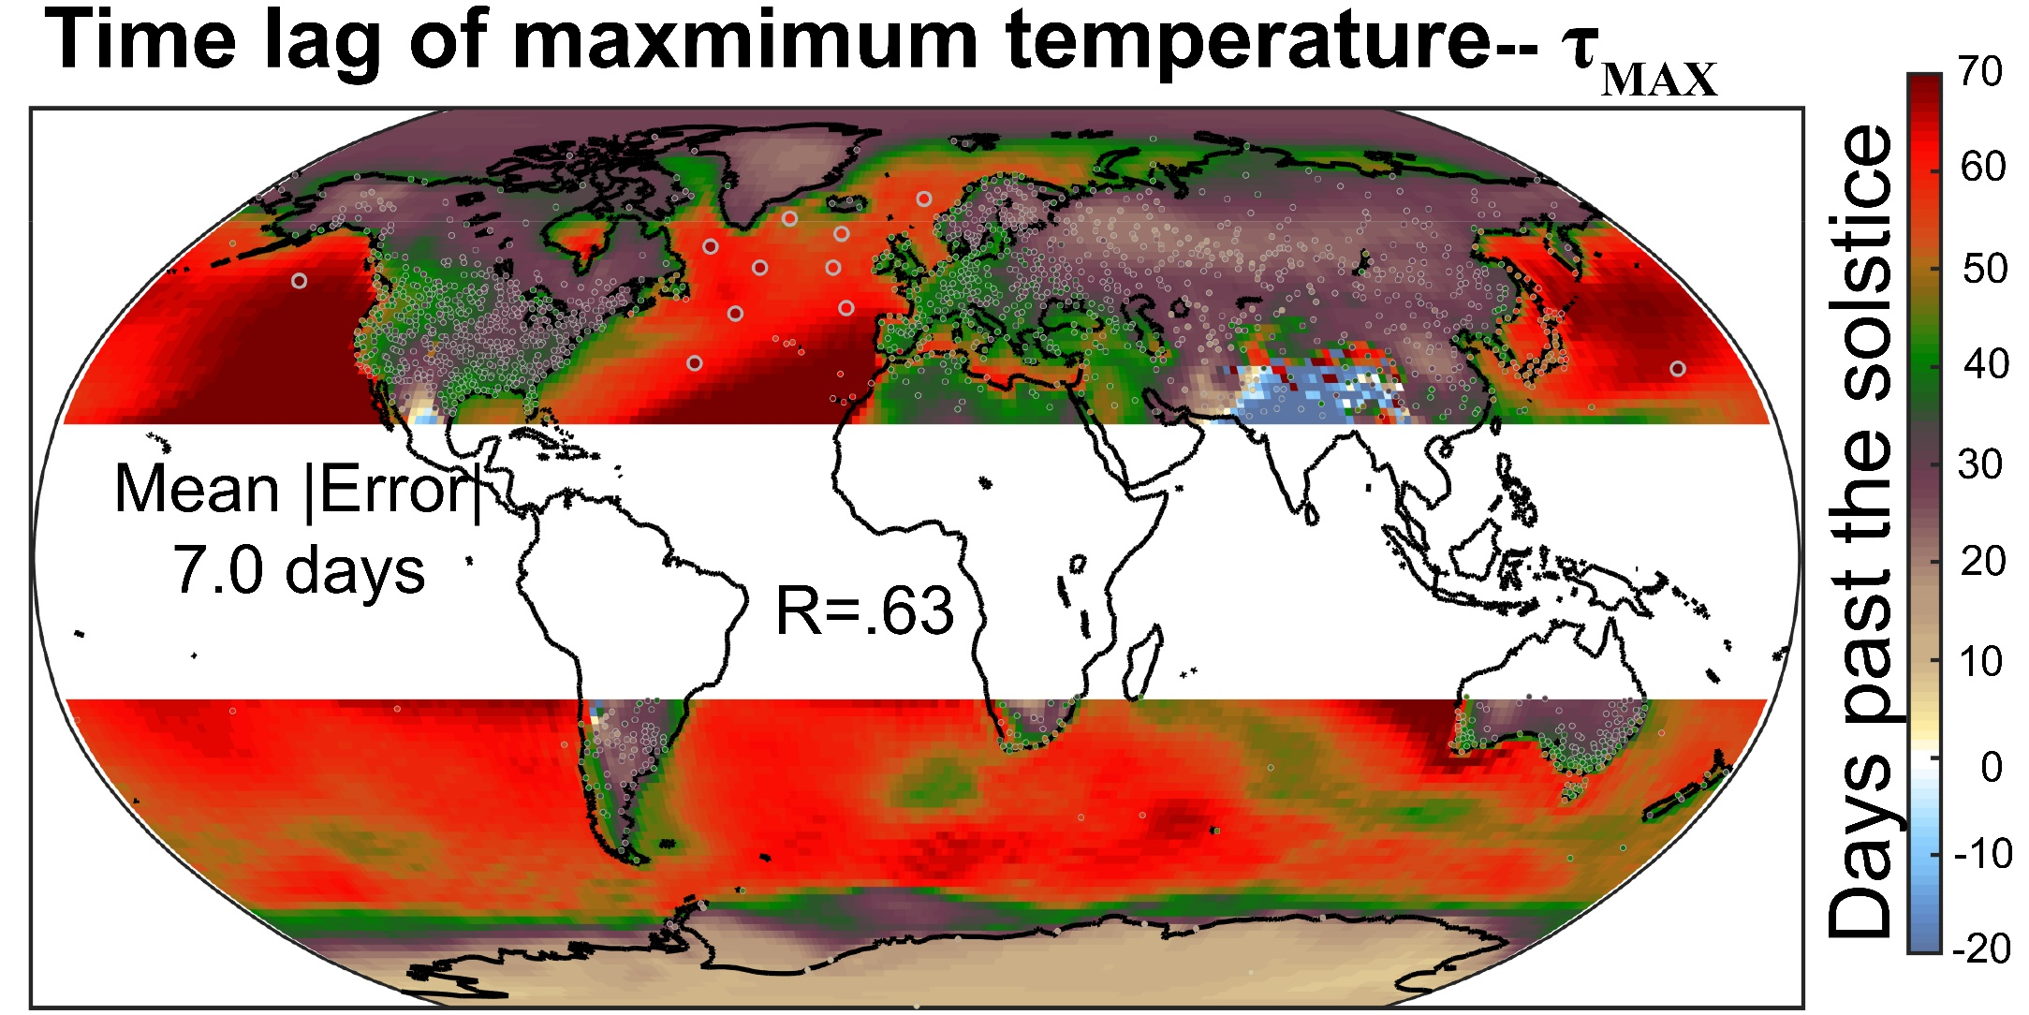
τ_{MAX} varies at the regional (continent and ocean basin) scale in the station data and this pattern is well represented in the reanalysis

Slide 26
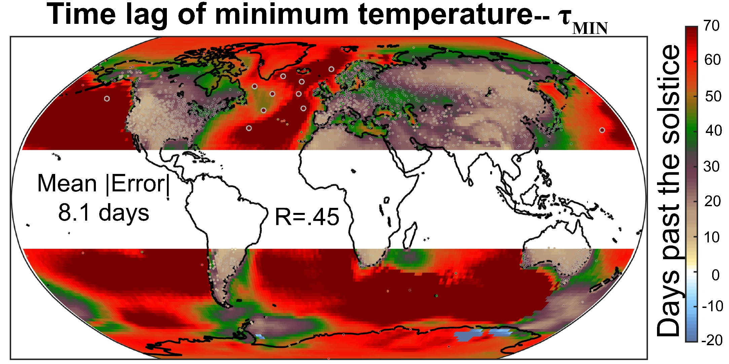
τ_{MIN} has a sharp gradient on the west coast of the US, low values to the west and higher values to the east
-- opposite the expected zonal gradient

Slide 27
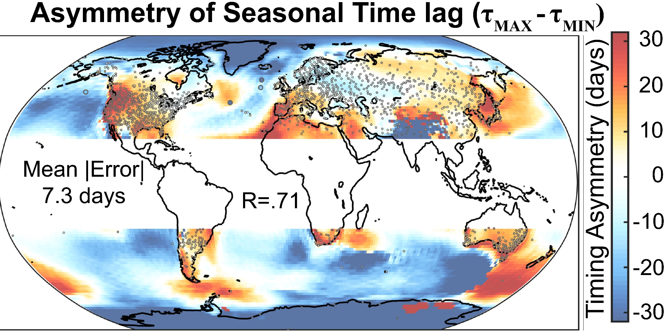
Regional patterns of magnitude 30 days (comparable to SEATAC)
Generally: ASYM is (-) over ocean and (+) over land
Difference between west coast of North America and Europe
High latitudes have (-) ASYM
Monsoon region has (-) values

Slide 28
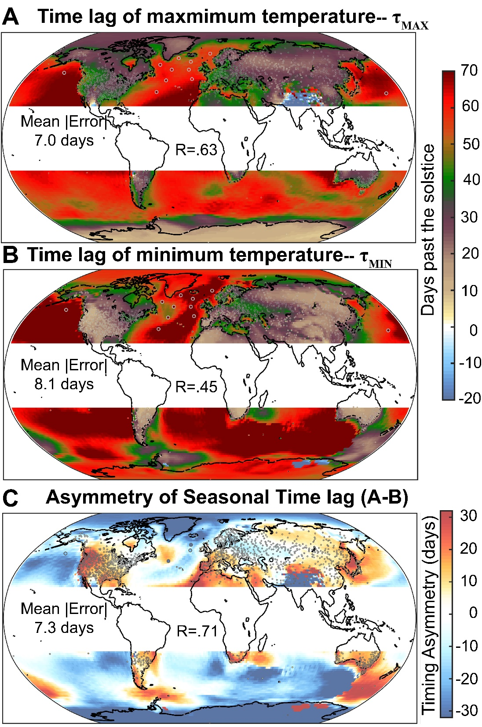
Generally: ASYM is (-) over ocean and (+) over land
Difference between west coast of North America and Europe
Associated with timing of the minnimum
High latitudes have (-) ASYM
minimum temperature is delayed
Monsoon region has (-) values
maximum temperature precedes the solstice

Slide 29
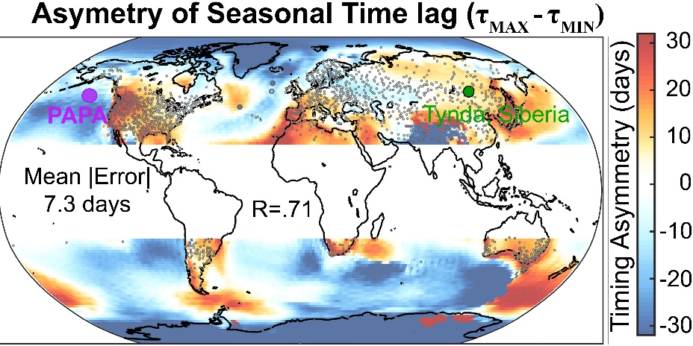
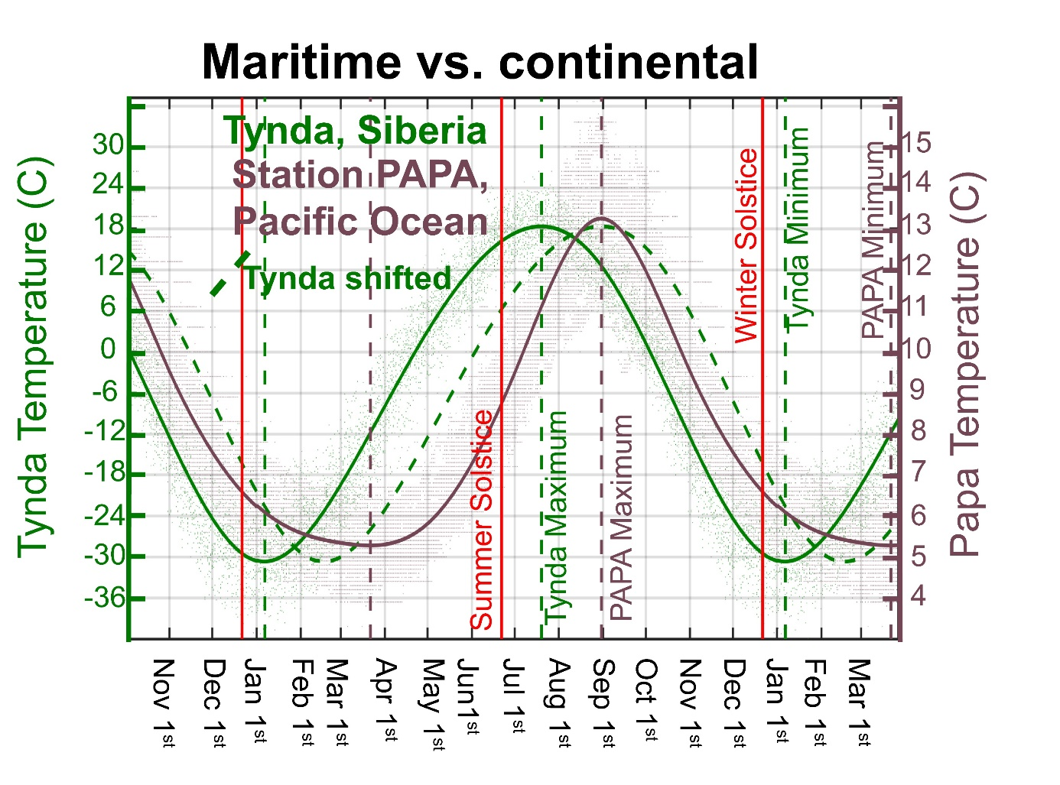
Marine vs. continental
Prolonged cold season over the ocean and sharply peaked warm season
Prolonged warm season over land with sharply peaked cold season
ASYM values:
Tynda = +12 days
Papa = -20 days
Point: These are typical differences in the shape of the seasonal cycle seen over large regions

Slide 30
Boundary layer depth impact on seasonal lags:
Ocean versus atmosphere
OCEAN: Deep mixed layer in winter
Atmosphere
Surface heating over land during summer results in convective mixing throughout the troposphere: damping by ocean
Surface cooling in winter results in shallow atmospheric boundary layer effectively isolating the surface from the influence of upper level advection of marine air
Seasonal evolution of Ocean Temperature (T_{O}) with seasonally varying mixed layer depth (H(t))
→driven by surface solar (S(t)) and damped by turbulent fluxes (λ)
Resultant phase lag
increases with increasing
mixed layer depth
Winter
Summer
Shallow mixed layer
Deep mixed
layer

Slide 31
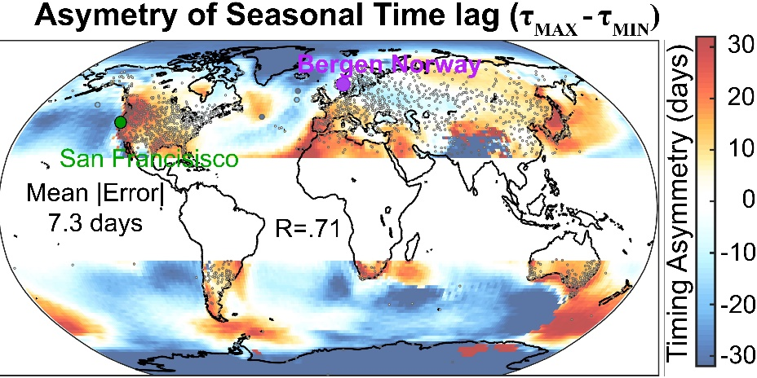
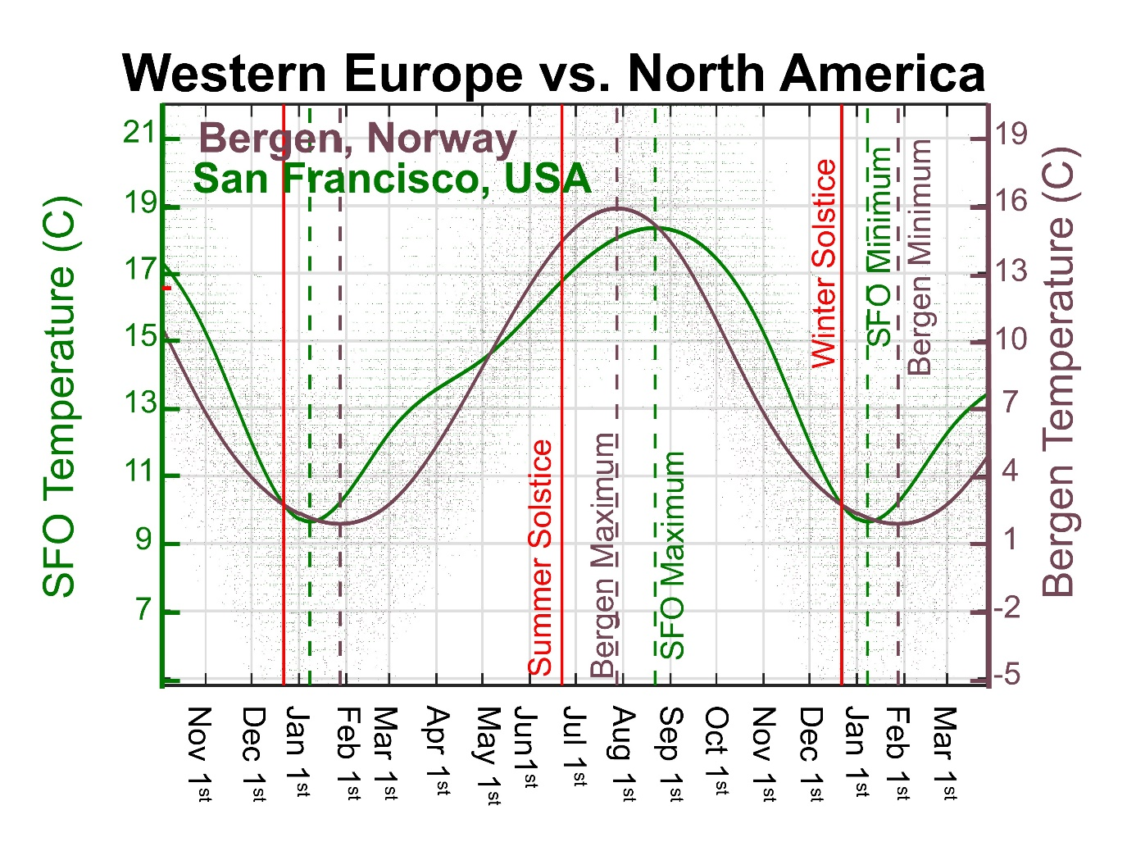
Europe vs.
Merica
Sharply peaked minimum in North America
More sinusoidal in Europe
ASYM values:
San Francisco = +44 days
Bergen = -1 days

Slide 32
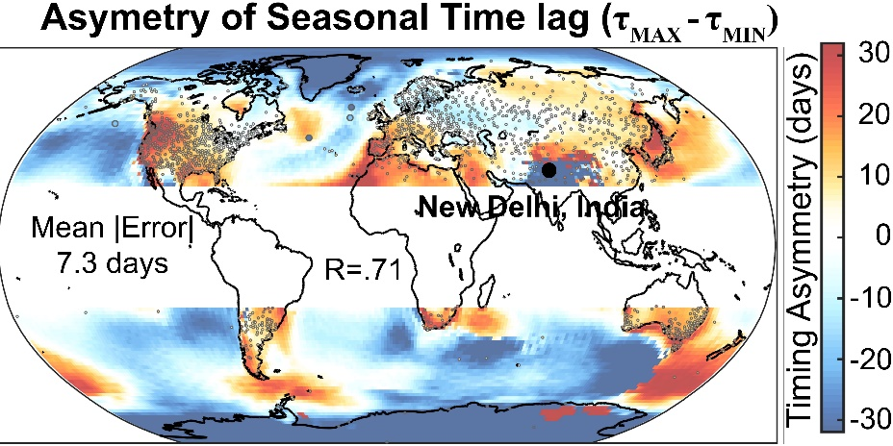
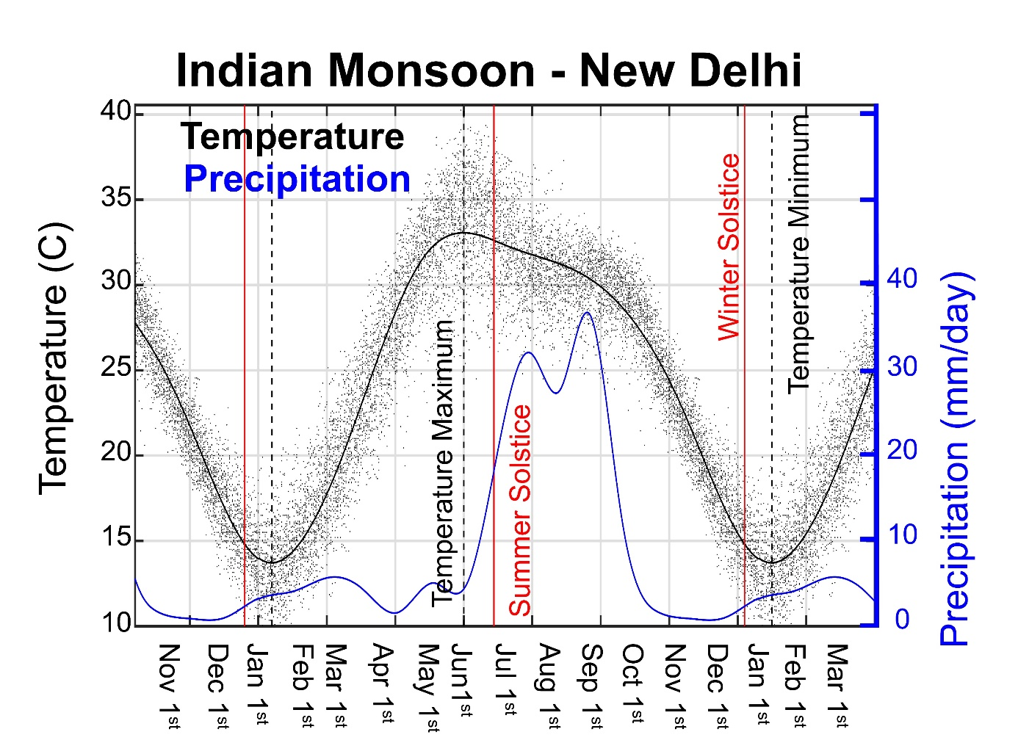
Monsoon region
Temperature drop upon monsoon offset (around the beginning of June)
Temperature maximum precedes the summer solstice

Slide 33
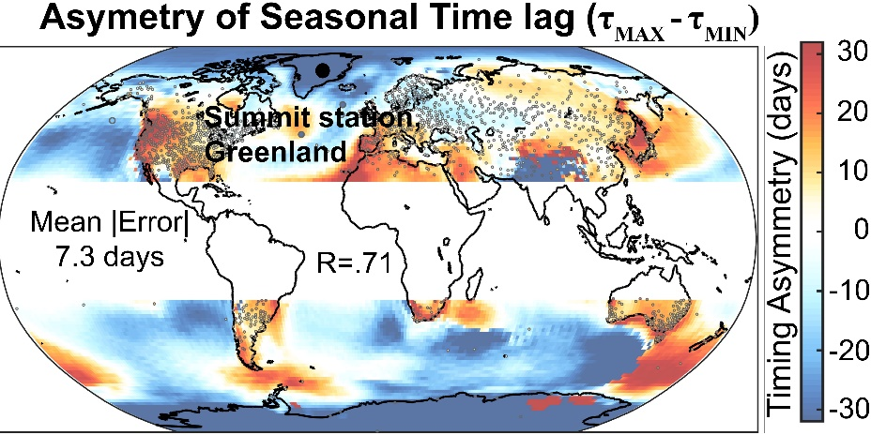
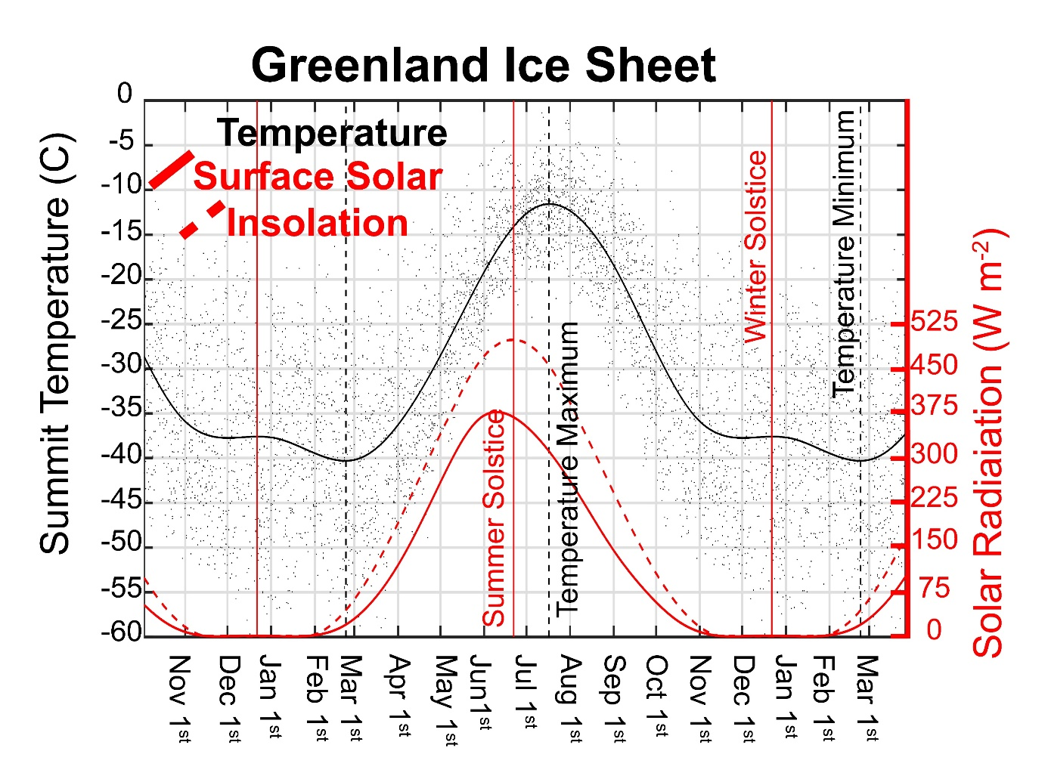
Polar regions
Solar radiation flatlines at zero for the polar night
Minimum temperature occurs just after the sun returns
→Analogous to daily minimum temperature minimum just after sunrise in the diurnal cycle when: longwave cooling = solar heating

Slide 34
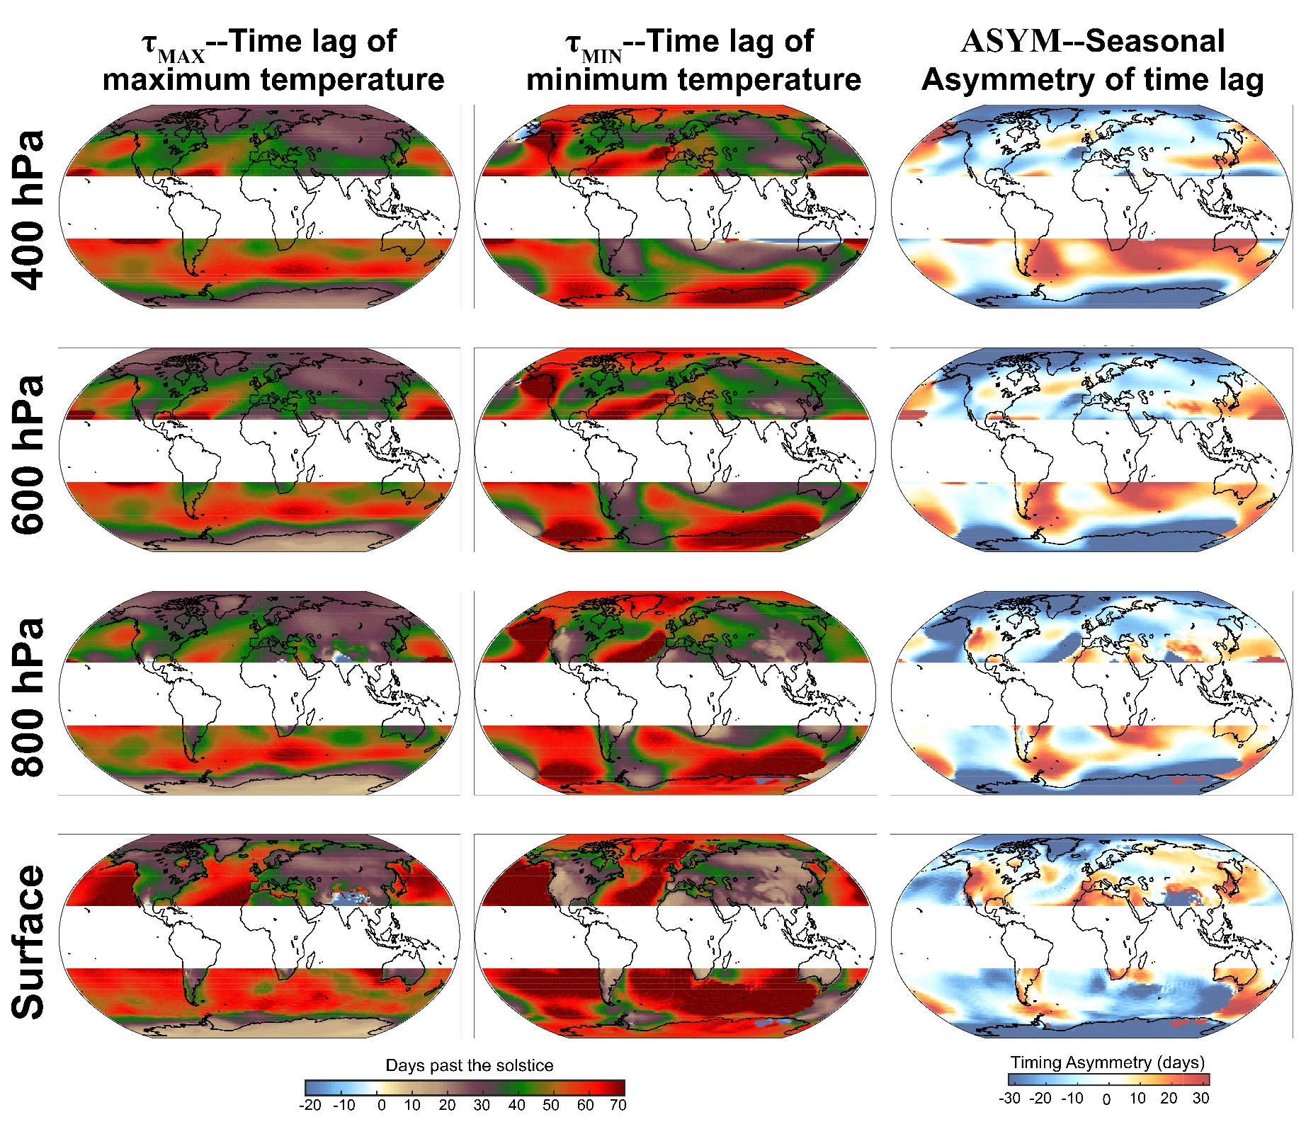
Vertical structure

Slide 35
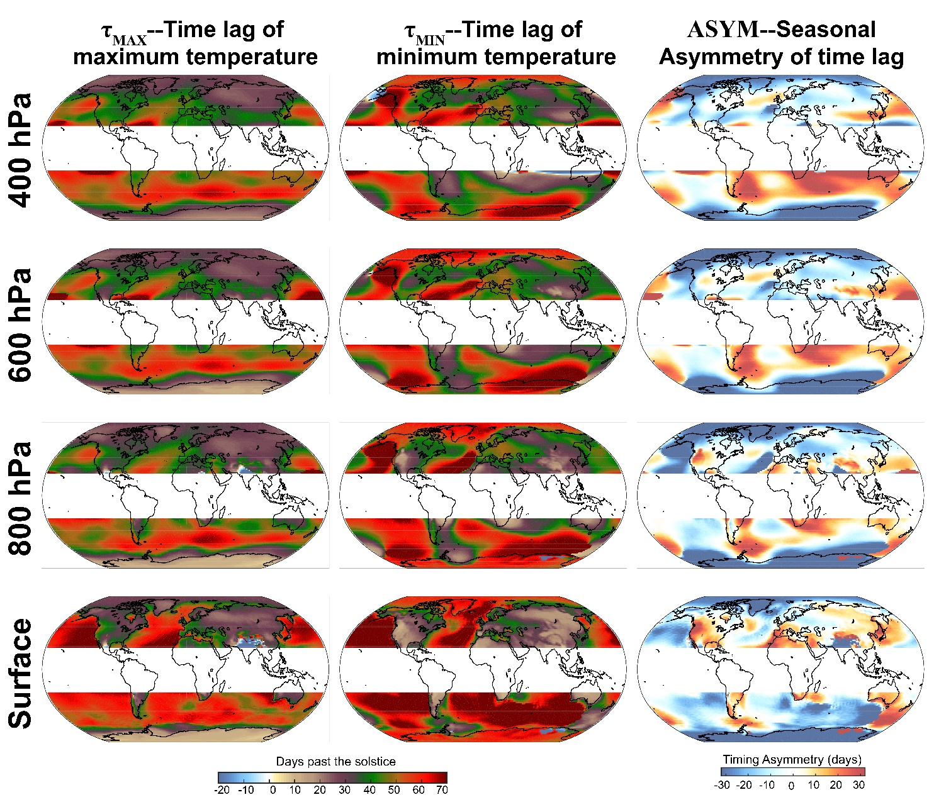
Role of wintertime stationary wave in ASYM
DJF
500 hPa Geopotential Height
DJF stationary wave
→ Delays τ_{MIN} west of the ridge due to predominant southerly warm air advection until the ridge breaks down
→ Accelerates τ_{MIN} east of the ridge by northerly cold air advection

Slide 36
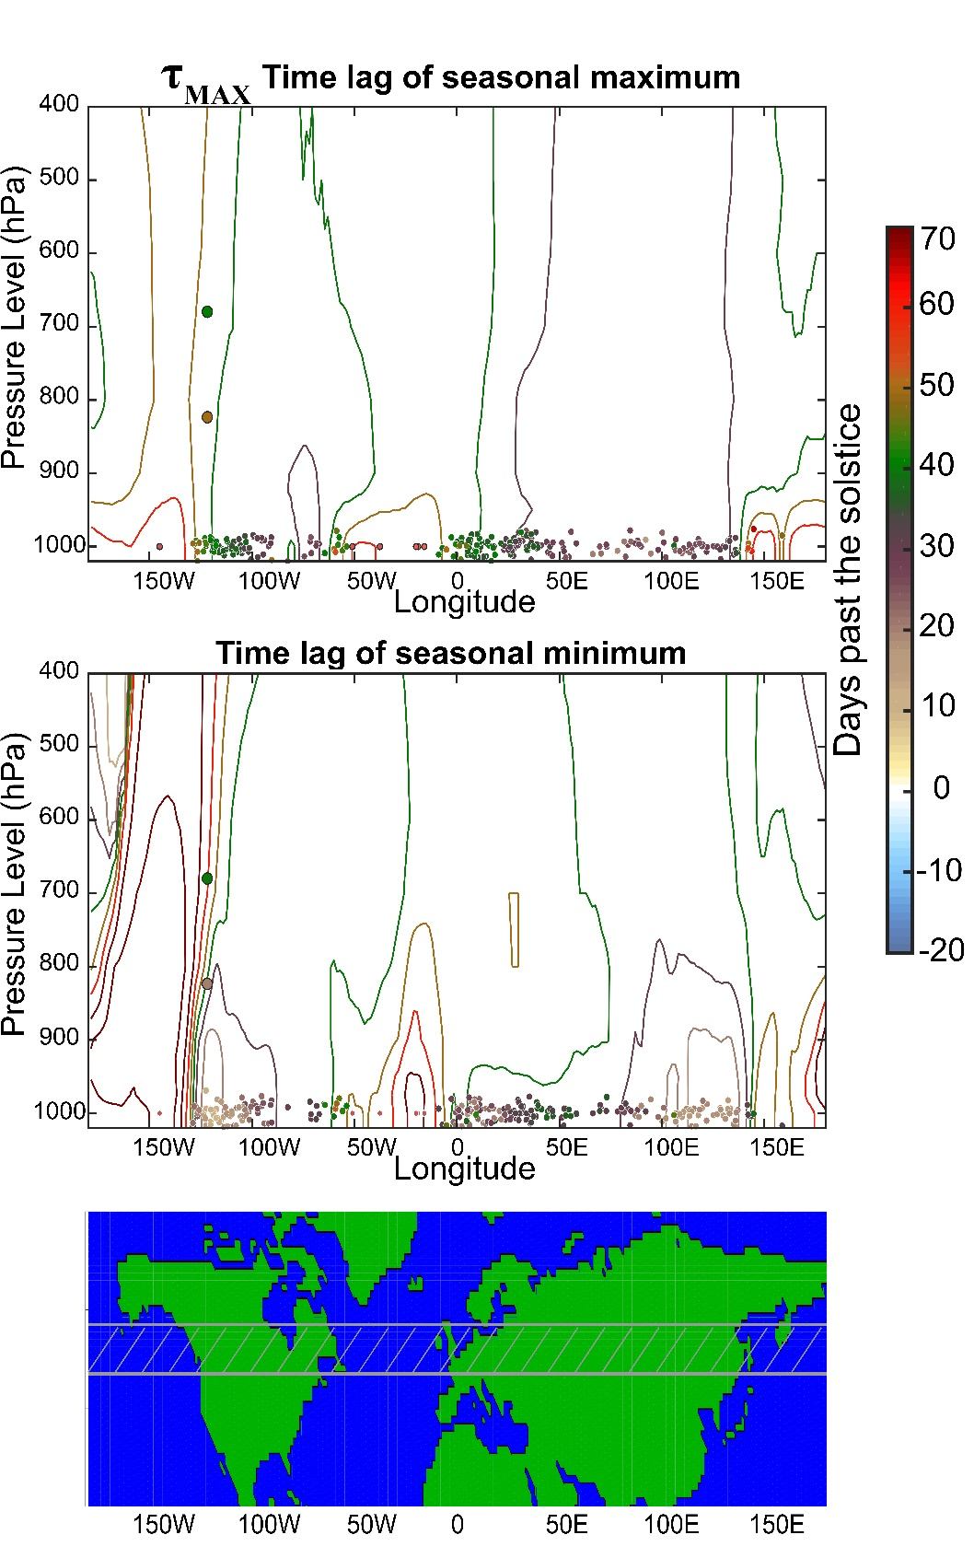
Cross sections across 50N
Phase is more homogenous aloft than at the surface
τ_{MIN} is homogenous from the surface to 800 hPa, above which there is a sharp gradient to more zonally homogenous values in the free troposphere
τ_{MIN} has a barotropic high lag feature jus west of the west coast of the US
→ Feature slants eastward with height
Data from Mt. Rainier (Paradise and Camp Muir) supports this sharp gradient

Slide 37
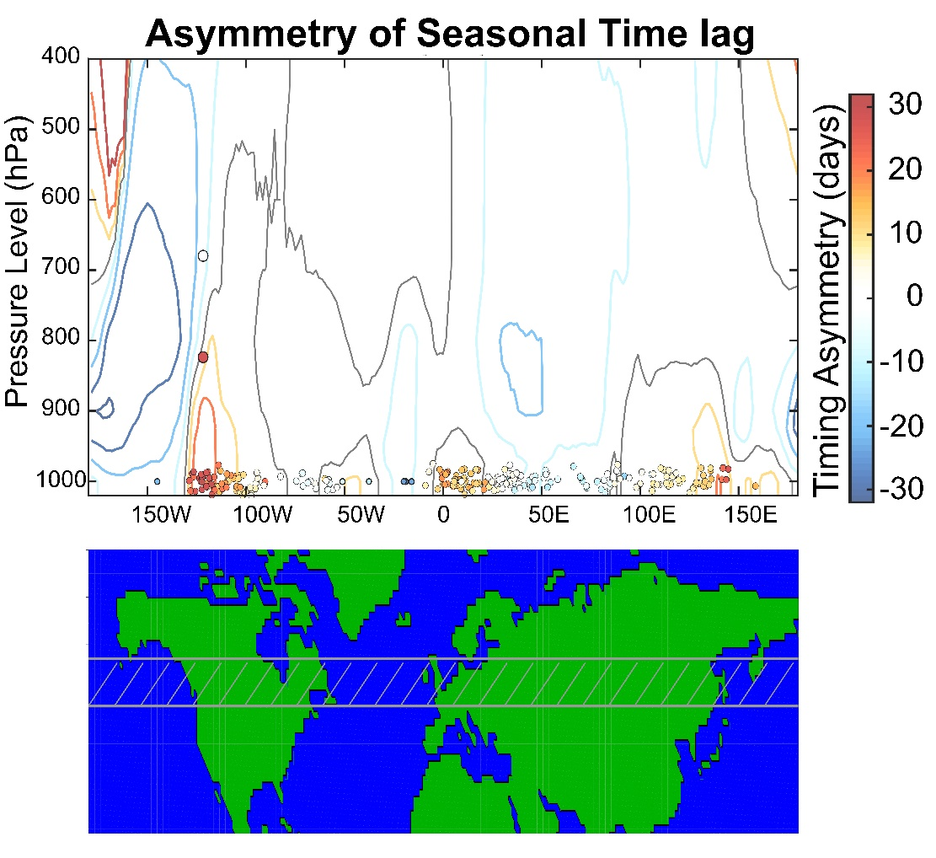
Cross sections across 50N
Phase is more homogenous aloft than at the surface
The dipole in ASYM across the west coast of the US extends farther upward in the atmosphere (mainly reflects τ_{MIN}

Slide 38
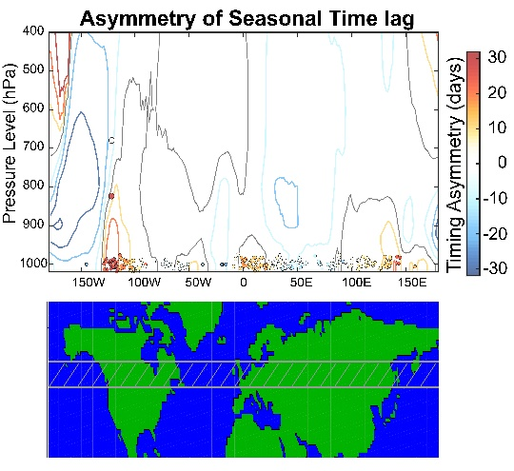
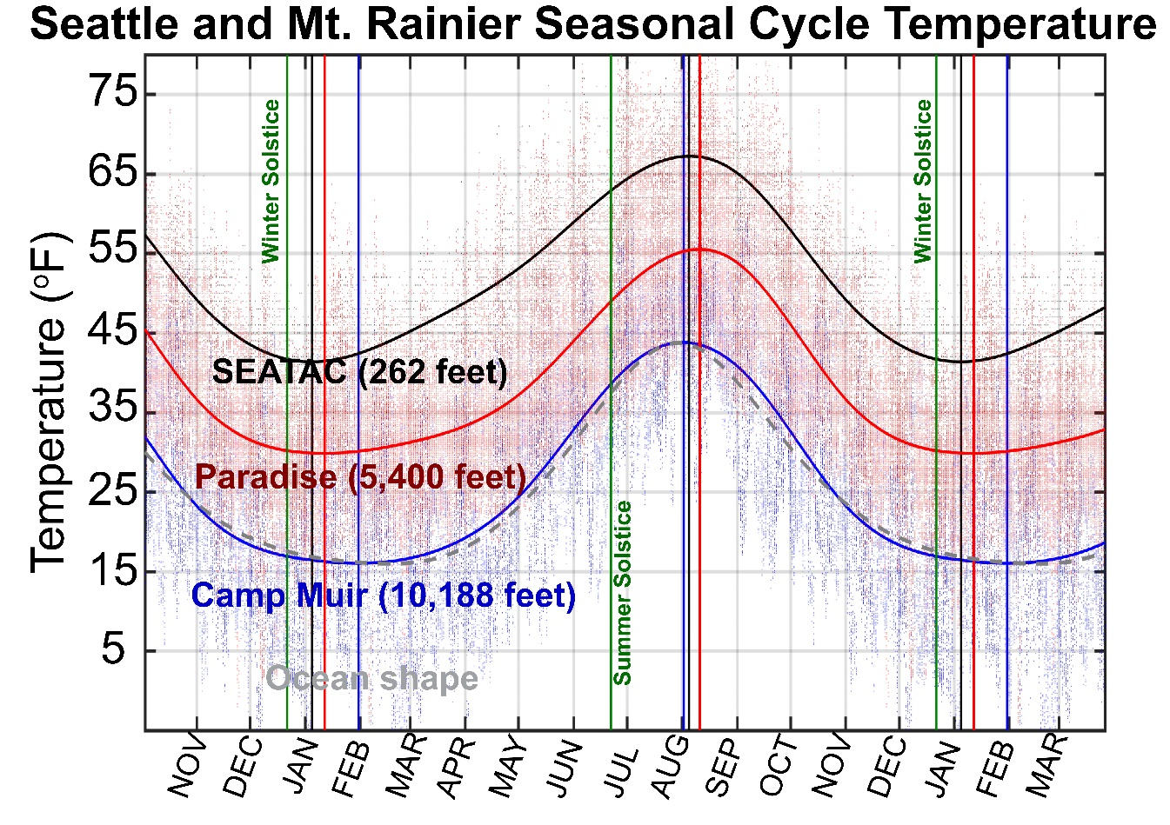
Mt. Rainier data supports the strong vertical gradient in ASYM
Moving upward from SEATAC to Paradise (5,400 feet) to Camp Muir (10,188 feet)
→ The cold season becomes increasing prolonged in duration with a delayed τ_{MIN}
→ Camp Muir seasonal shape resembles that of the ocean domain (dashed gray, shifted and rescaled)

Slide 39
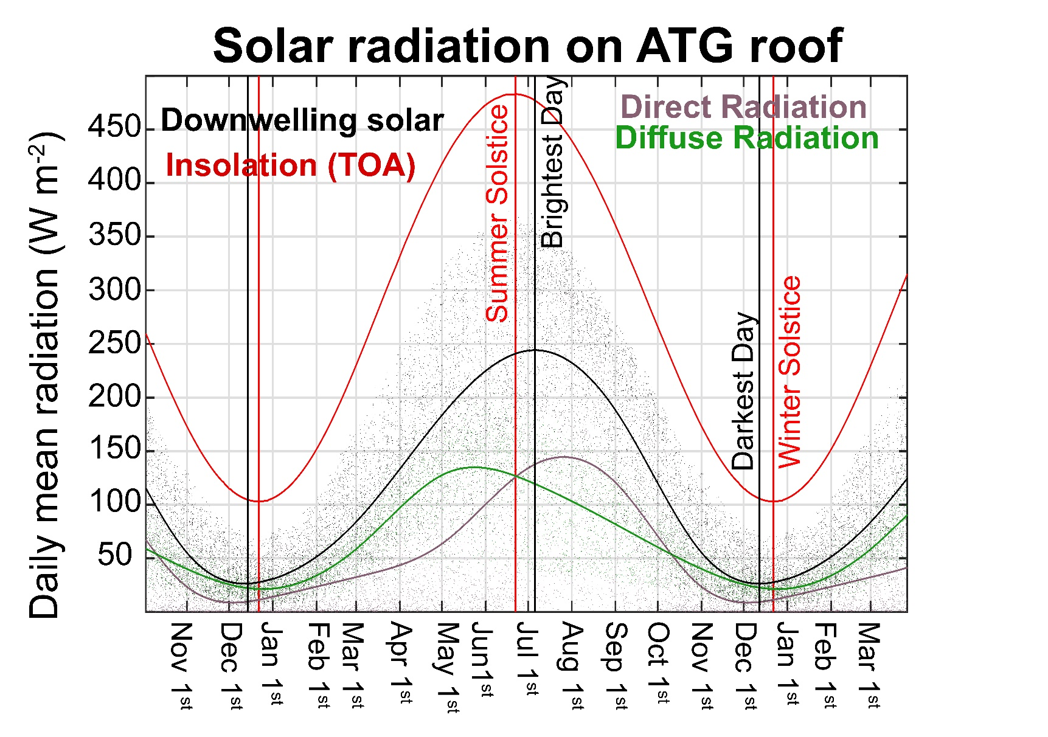
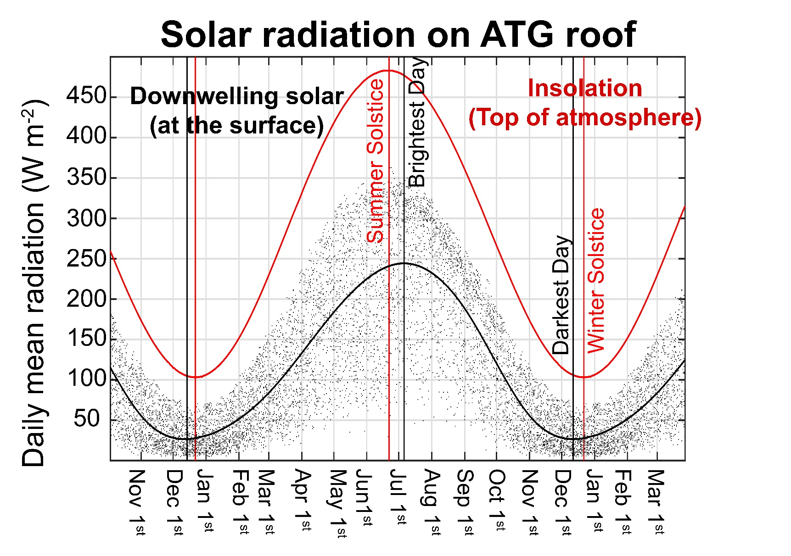
Explanations for ASYM:
1. Timing of surface solar radiation
Date of maximum solar radiation (surface) :
July 6th
+14 days from solstice
Date of minimum solar radiation:
December 11th
= -10 days from solstice
Radiation asymmetry =
+14 – (-) 10 = +24 days
Compare to temperature ASYM of +30 days

Slide 40
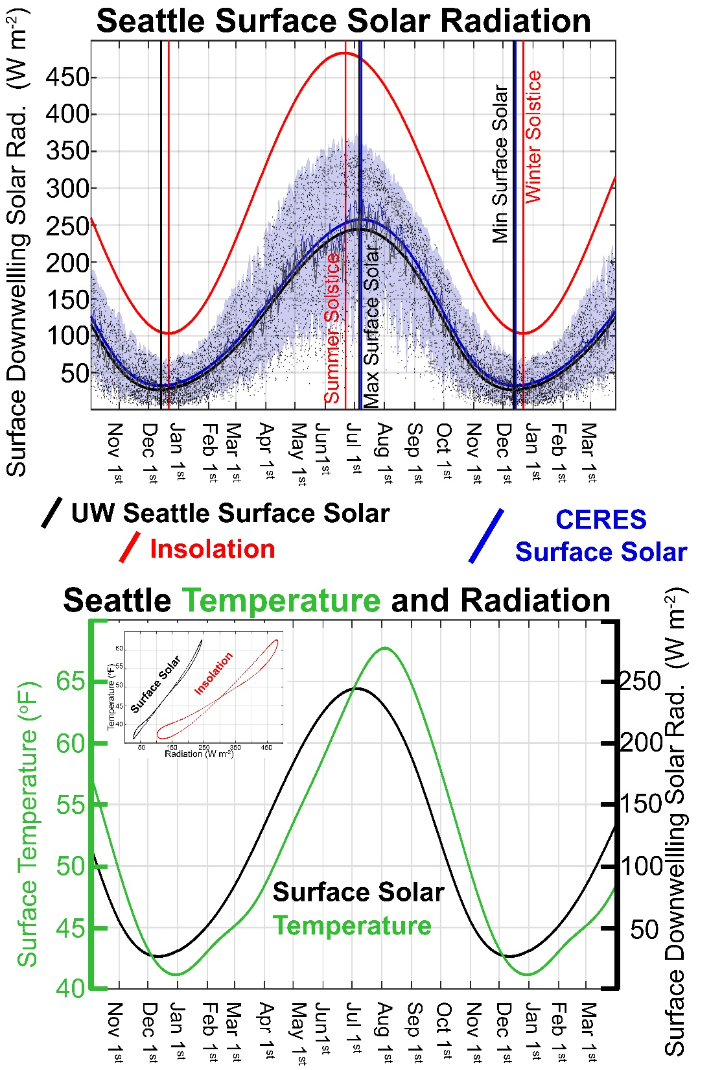
Possible Explanation for ASYM:
Timing of surface solar radiation
Temperature consistently lags downwelling solar at the surface (by 25 days)
Indicated by the straight line fit (black points) between temperature and surface solar (-25 days) on inset
In contrast, temperature versus insolation (red) shows a figure 8 structure indicating different lags over the seasonal cycle

Slide 41
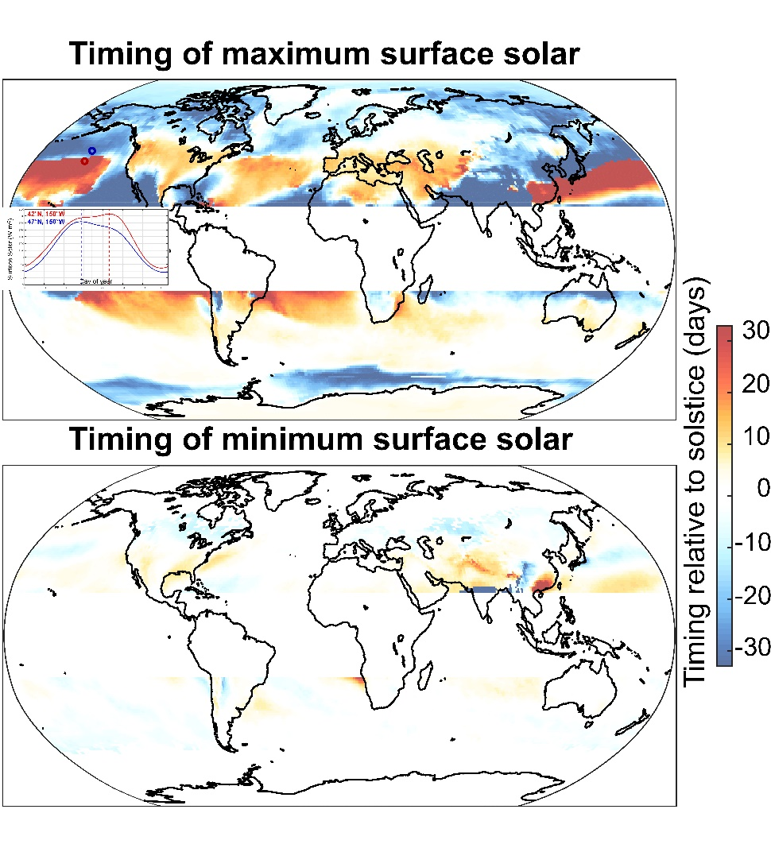
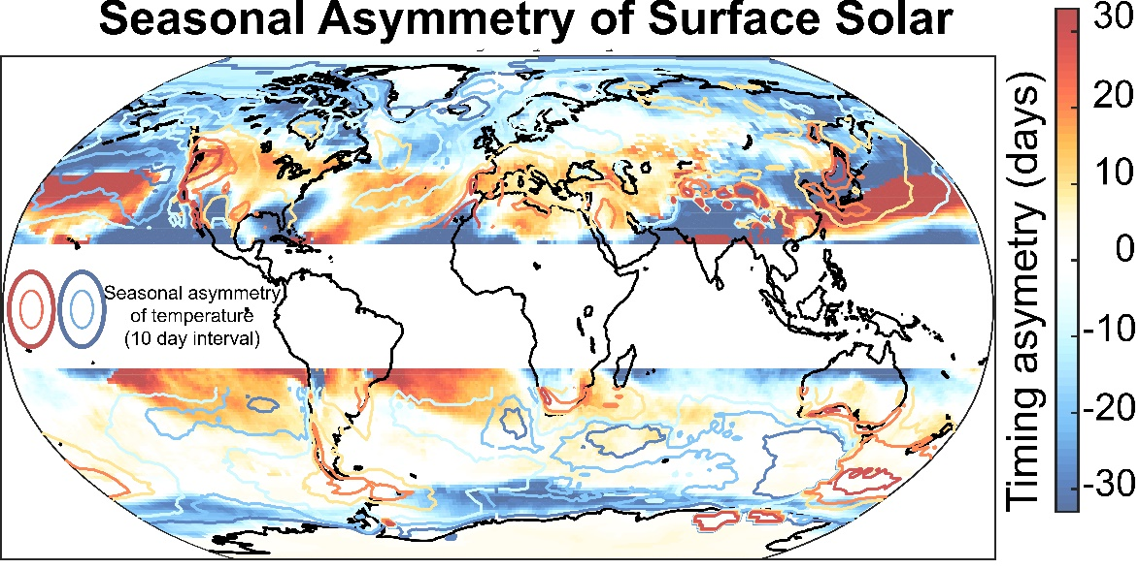
Surface solar timing globally
More structure in timing of maximum than minimum (possible angle of incidence dependence)
→ Storm track shifts, maximum radiation occurs after (before) the poleward shift on the equatorward (poleward) side
Globally, seasonal asymmetry on surface solar is not significantly correlated with that in temperature (ASYM)
→ True over land domain and ocean domain considered seperately

Slide 42

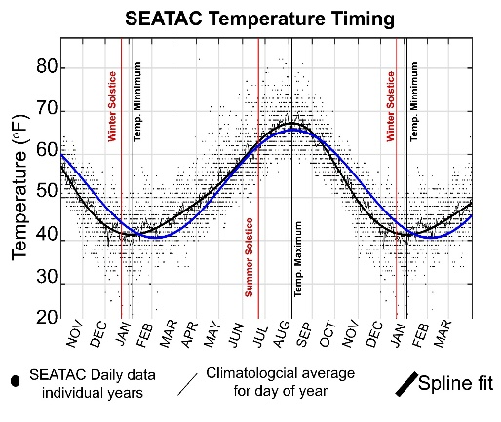
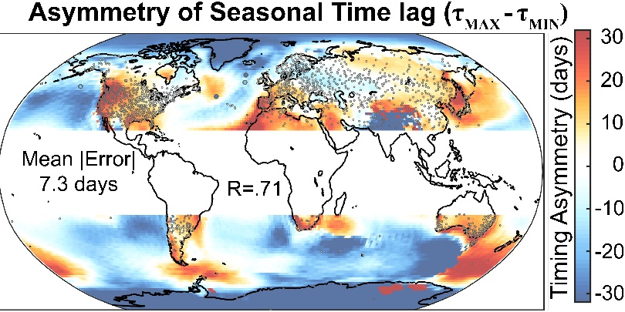
Conclusions
1. The seasonal heating of the atmosphere is due to shortwave heating of the atmosphere and is opposed by surface fluxes
→ Atmospheric moistening will amplify the seasonal cycle aloft and ice melt reduces the seasonal cycle at the surface
2. The seasonal cycle of temperature is asymmetric about the solstices at regional scales with differences between the phasing of the minimum and maximum temperature of order 30 days
→ Possible explanations include boundary depth, phasing of solar radiation modified by cloudiness, seasonality of atmospheric circulation

Slide 43
Extras

Slide 45
Outline
What determines the amplitude of the seasonal cycle of temperature?
→How does solar radiation at the top of the atmosphere heat the atmospheric column
2. The seasonal cycle of energy fluxes in the climate system:
Global mean, inter-hemispheric, equator-to-pole heat transport
Tropics
Extratropics
3. Seasonal asymmetries in the lag between surface temperature and insolation

