Slide 1

Local versus remote controls of high latitude climate
Aaron Donohoe – Polar Science Center, APL, UW
APL Seminar, April 11, 2019

Slide 2


Energy budget of the climate system
5.8 PW
Absorbed Solar
Emitted
(Outgoing Longwave)
Net
Tropics
Extratropics
Notes:
NH = 8.2 - 2.4 = 5.8
SH = 9.0 – 3.2 = 5.8

Slide 3
Energy budget of the climate system
Relative to global mean values
The extratropics have a 8.2 PW deficit in absorbed shortwave radiation
This is partially balanced by reduced (OLR) associated with cold temperature
And primarily balanced by 5.8 PW of poleward energy transport by the atmosphere and ocean
5.8 PW
8.2 PW
2.4 PW
Absorbed Solar
Emitted
(Outgoing Longwave)
Net
5.8 PW
Tropics
Extratropics
Donohoe and Battisti, 2012
Stone, 1978
Notes:
NH = 8.2 - 2.4 = 5.8
SH = 9.0 – 3.2 = 5.8

Slide 4
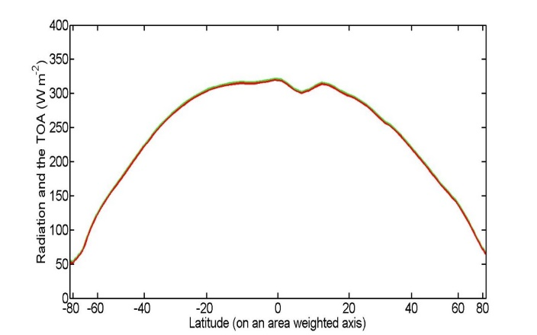
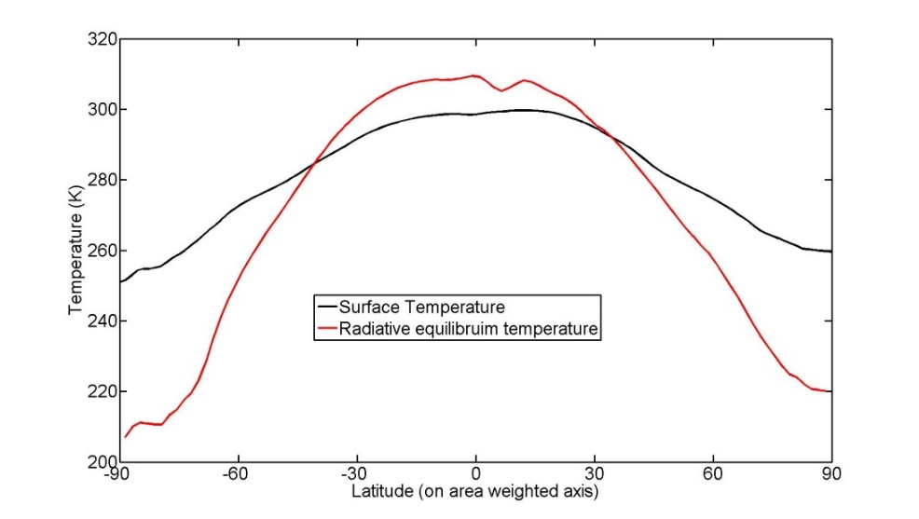

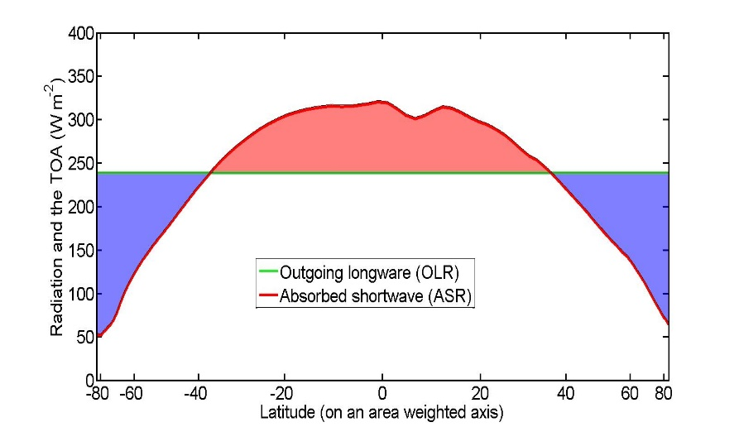
Two extreme cases
Absorbed
Emitted
Net = Heat Transport
No Dynamics
Implied Temperature Gradient
8.2 PW
8.2 PW
0
Local radiative Equilibrium
→ large temperature gradient
Tropics
Extratropics
Efficient dynamics
8.2 PW
8.2 PW
0
8.2 PW
No OLR or temperature
Contrast → the solar contrast moves get transported between the boxes
Tropics
Extratropics

Slide 5

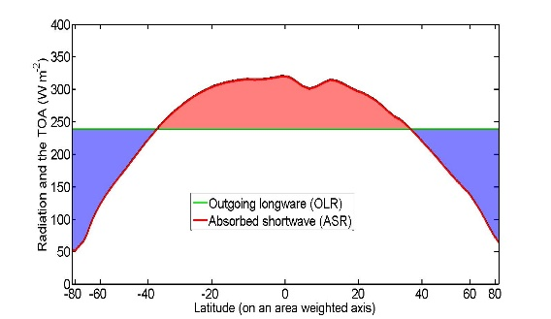
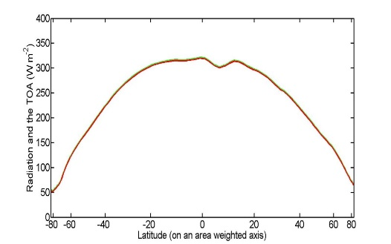
Observed
Observed climate system is 70% of the way toward the dynamic limit (ratio of heat transport to solar gradient)
→ Equator-to-pole temperature gradient is only 30% as strong as required by local radiative equilibrium
Theory suggests that most of the high latitude forcing is balanced by changes in global scale atmospheric and oceanic dynamics as opposed to local radiation
Implication: High latitude climate is efficiently linked to mid-latitudes/tropics and future (past) changes in poleward energy transport may have large impacts in the high-latitudes
5.8 PW
Dynamic Limit
Radiative Limit
8.2 PW
0 PW

Slide 6
Arctic energy (poleward of 70N) from Serreze et al. 2007)
Radiative loss = Energy Import
- (Incident – Reflected) + Emitted = Ocean flux + atmospheric flux
110 W m⁻² = 111 W m⁻²
Incident
Solar
184 W m⁻²
Reflected SW
98 W m⁻²
Emitted LW
196 W m⁻²
atmospheric flux
FWALL
100 W m⁻²
Arctic
oceanic flux (surface flux)
11 W m⁻²

Slide 7
Outline
The impact of sea ice loss on the radiative budget of the high latitudes.
→ Observational estimate of how much ice loss will amplify global warming?
2. How does poleward energy (and moisture) transport change under global warming?
→ Impacts on high latitude temperature and precipitation

Slide 8
What determines the Earth’s planetary albedo? (solar radiation reflected at top of atmosphere)
Reflected by Atmosphere
Solar Incident
Reflected by Surface
Atmosphere
Earth’s Surface

Slide 9

Simplified (isotropic) shortwave radiation model
S = incident
R = cloud
reflection
A = absorption
α = surface
albedo
(UNKNOWNS)
v
v
v

Slide 10
Simplified (isotropic) shortwave radiation model
S = incident
R = cloud
reflection
A = absorption
α = surface
albedo
(UNKNOWNS)
v
v

Slide 11
Simplified (isotropic) shortwave radiation model
S = incident
R = cloud
reflection
A = absorption
α = surface
albedo
(UNKNOWNS)

Slide 12
Simplified (isotropic) shortwave radiation model
S = incident
R = cloud
reflection
A = absorption
α = surface
albedo
(UNKNOWNS)

Slide 13
Simplified (isotropic) shortwave radiation model
S = incident
R = cloud
reflection
A = absorption
α = surface
albedo
(UNKNOWNS)

Slide 14
Simplified (isotropic) shortwave radiation model
Atmospheric
Contribution
To planetary
Albedo
Surface
Contribution
To planetary
Albedo
S = incident
R = cloud
reflection
A = absorption
α = surface
albedo
(UNKNOWNS)

Slide 15
Simplified (isotropic) shortwave radiation model
Atmospheric
Contribution
To planetary
Albedo
Surface
Contribution
To planetary
Albedo
S = incident
R = cloud
reflection
A = absorption
α = surface
albedo
(UNKNOWNS)

Slide 16
Partitioning of planetary albedo into atmospheric and surface components
Reflected by Atmosphere
α_{P} = α_{P,ATMOS} + α_{P,SURF}
Reflected by Surface
α_{P,ATMOS} = (1-A)R
Solar Incident
α_{P,SURF} = α(1-A)(1-R)²
(1-αR)
Atmosphere
Earth’s Surface

Slide 17
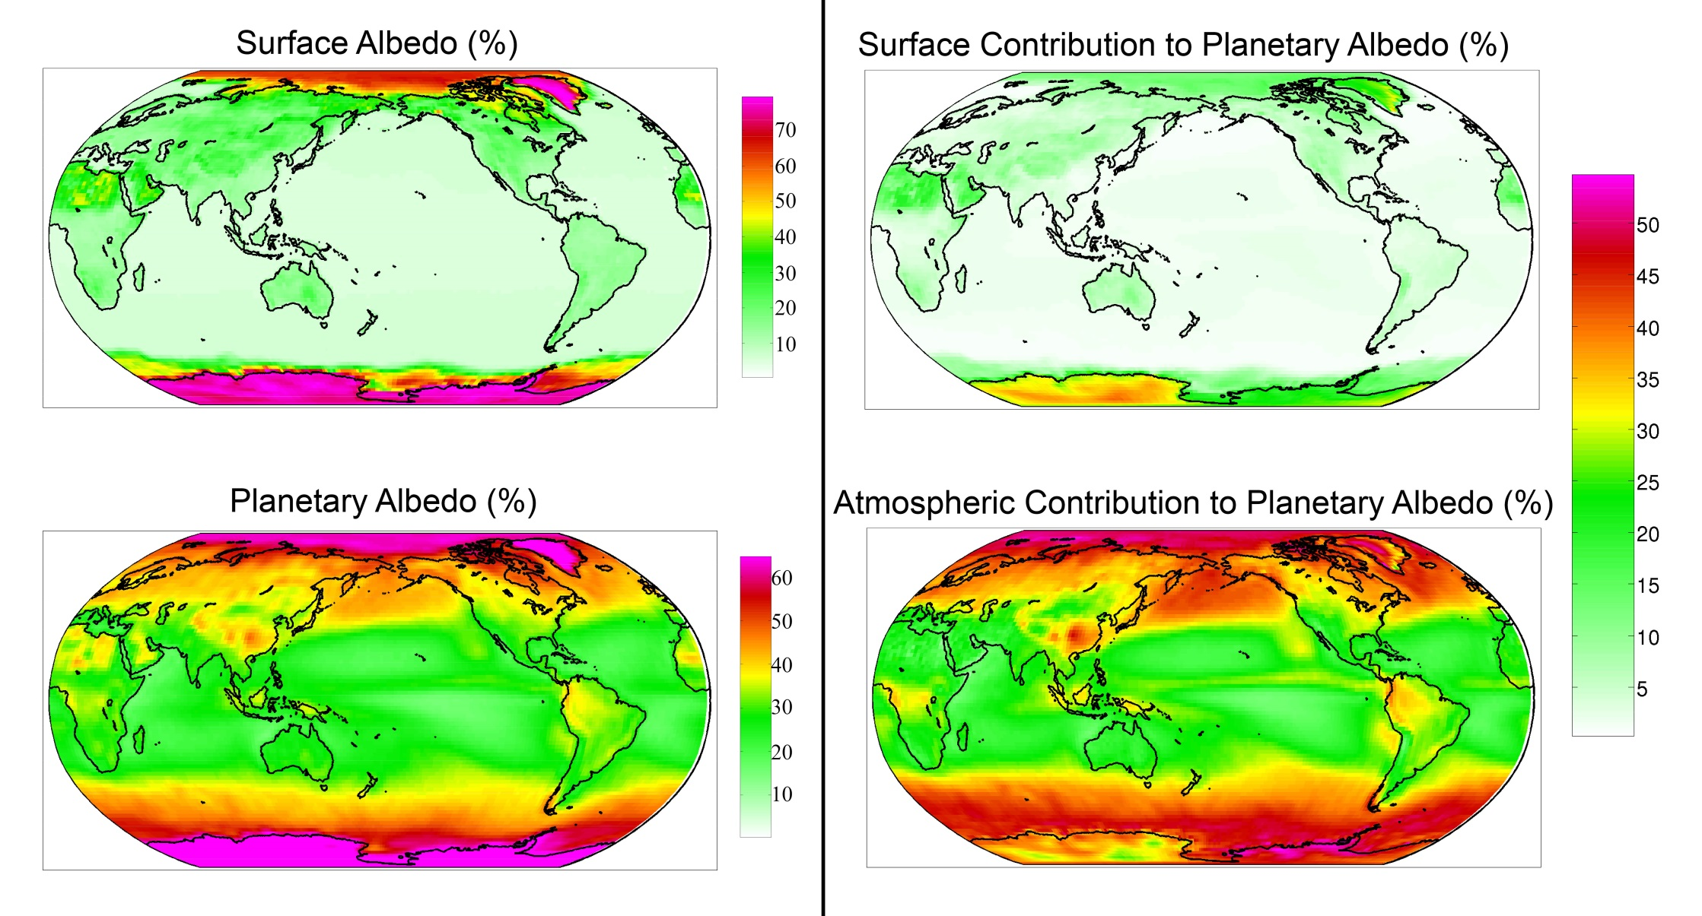
Observed (CERES) surface and atmospheric contribution to planetary albedo
Donohoe and Battisti, 2011

Slide 18
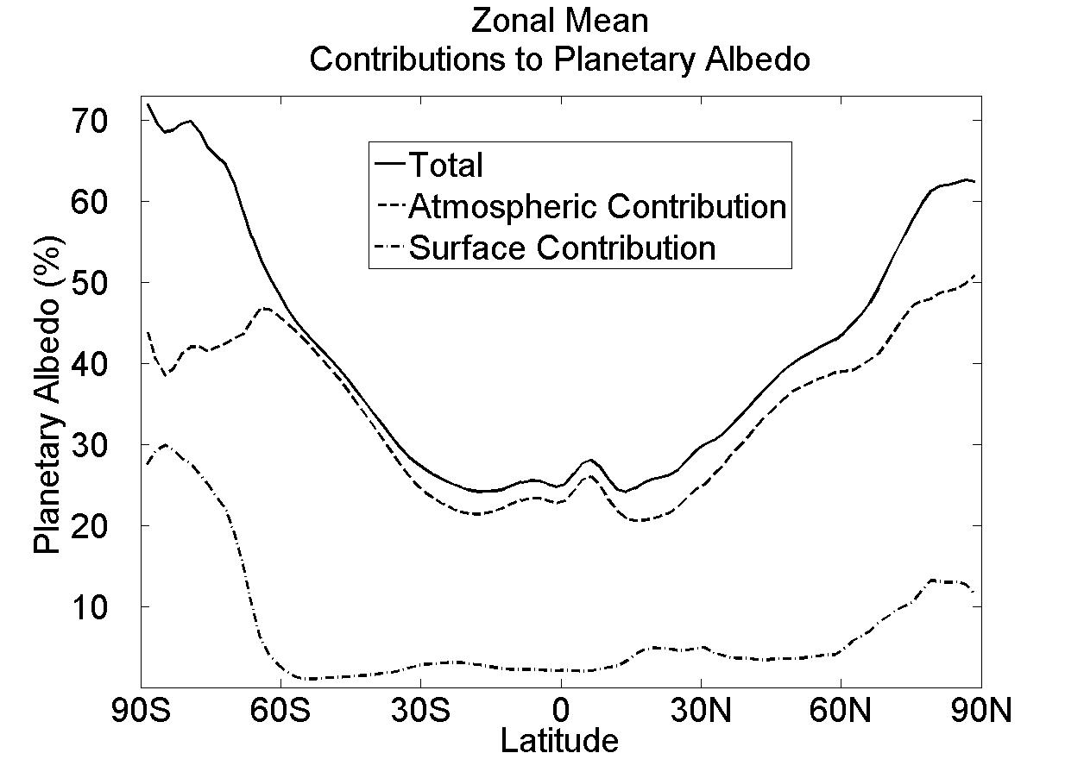
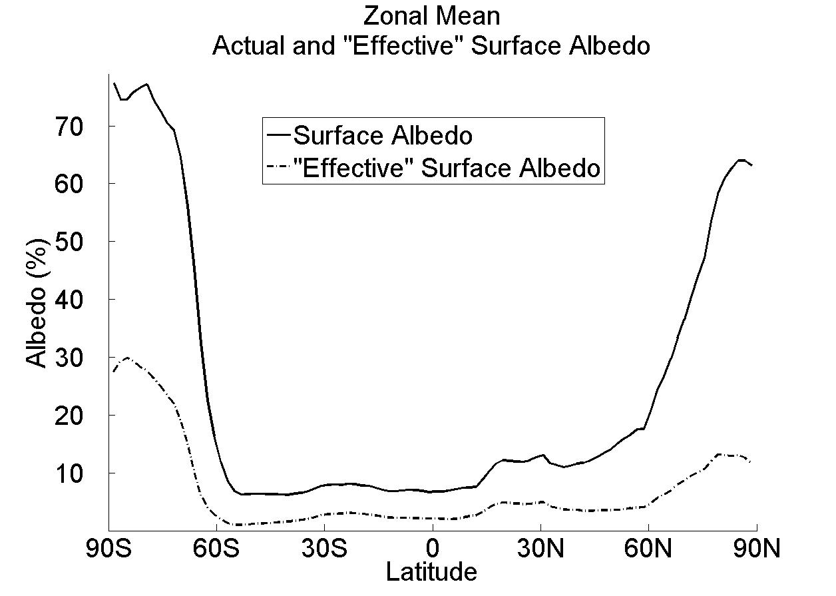
Observed Surface and atmospheric contribution to planetary albedo
Surface albedo and surface contribution to planetary albedo (α and α_{P,SURF})
α (surface albedo)
α_{P,SURF} = α(1-A)(1-R)²
α_{P,SURF}
(1-αR)

Slide 19
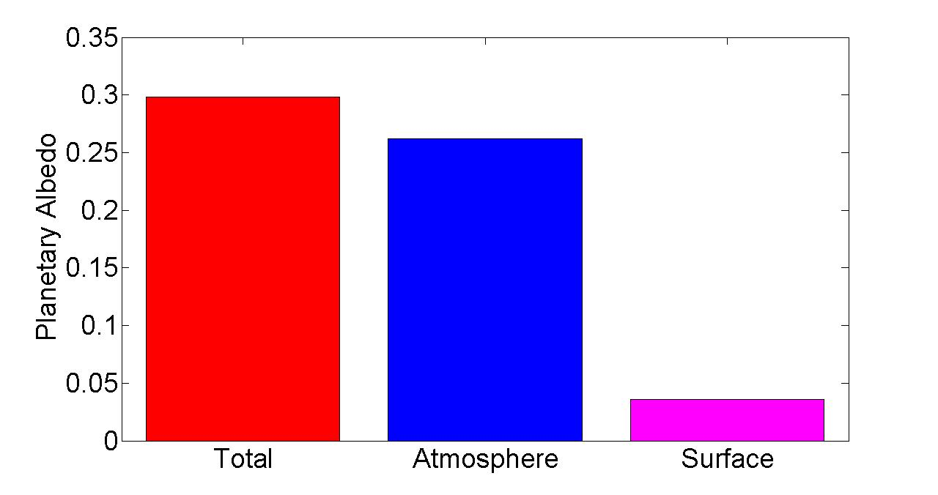
Observed Global Mean Planetary Albedo and it atmospheric/surface Partitioning
Notes:
0.298 = 0.262 + 0.036
100% = 88% + 12%

Slide 20
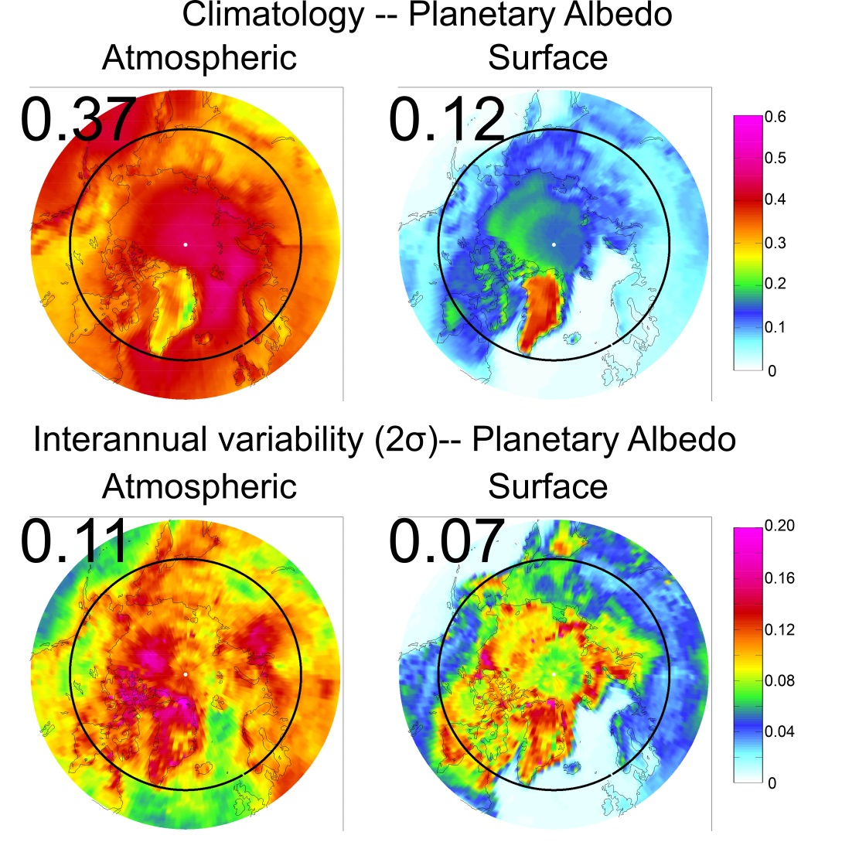
Arctic Planetary Albedo
→Atmosphere contributes more to climatology
Greenland is the exception
→ Bright and not much atmosphere (clouds) above

Slide 21
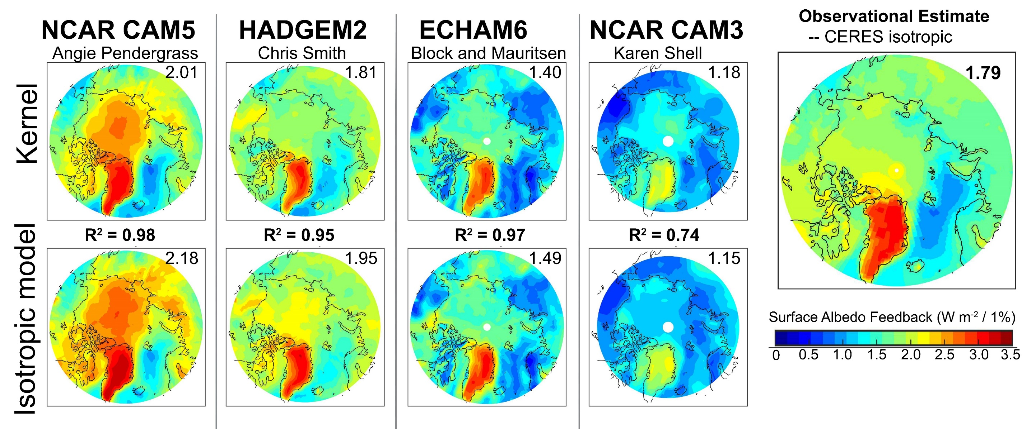
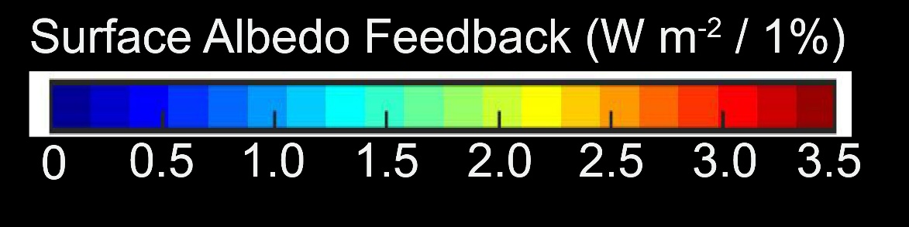
How much additional solar radiation is absorbed in the Arctic as sea ice melts? -- Radiative sensitivity
Averaged over May, June, July and August
Calculated from Radiative kernels – by perturbing surface albedo in each model’s radiative code
Large inter-model differences due to mean state cloudiness
Summer insolation averages 420 W m⁻² → transparent atmosphere expected to have values of 4.2 W m⁻² %⁻¹

Slide 22
Radiative sensitivity in our simplified radiation model
Climatology
Reflected by Atmosphere
α_{P,SURF} = α(1-A)(1-R)²
Reflected by Surface
(1-αR)
Solar Incident
Radiative Sensitivity
Strategy: Calculate radiative sensitivity from the climatological radiative fluxes at the top of atmosphere and surface using the simple model → compare to comprehensive radiative kernel technique
Atmosphere
Earth’s Surface

Slide 23

Radiative sensitivity calculated from kernels versus simple model
In each model (column), radiative kernel calculation (top) is well replicated by simple model – domain average, spatial pattern, inter-model spread
(Donohoe, Blanchard-Wrigglesworth, Schweiger, and Rasch, submitted)

Slide 24

Observational estimate of radiative sensitivity
Simple model relies on climatological radiative fluxes only
Satellite observations provide an estimate of Radiative sensitivity
The model average radiative sensitivity is close to the observational estimate

Slide 25
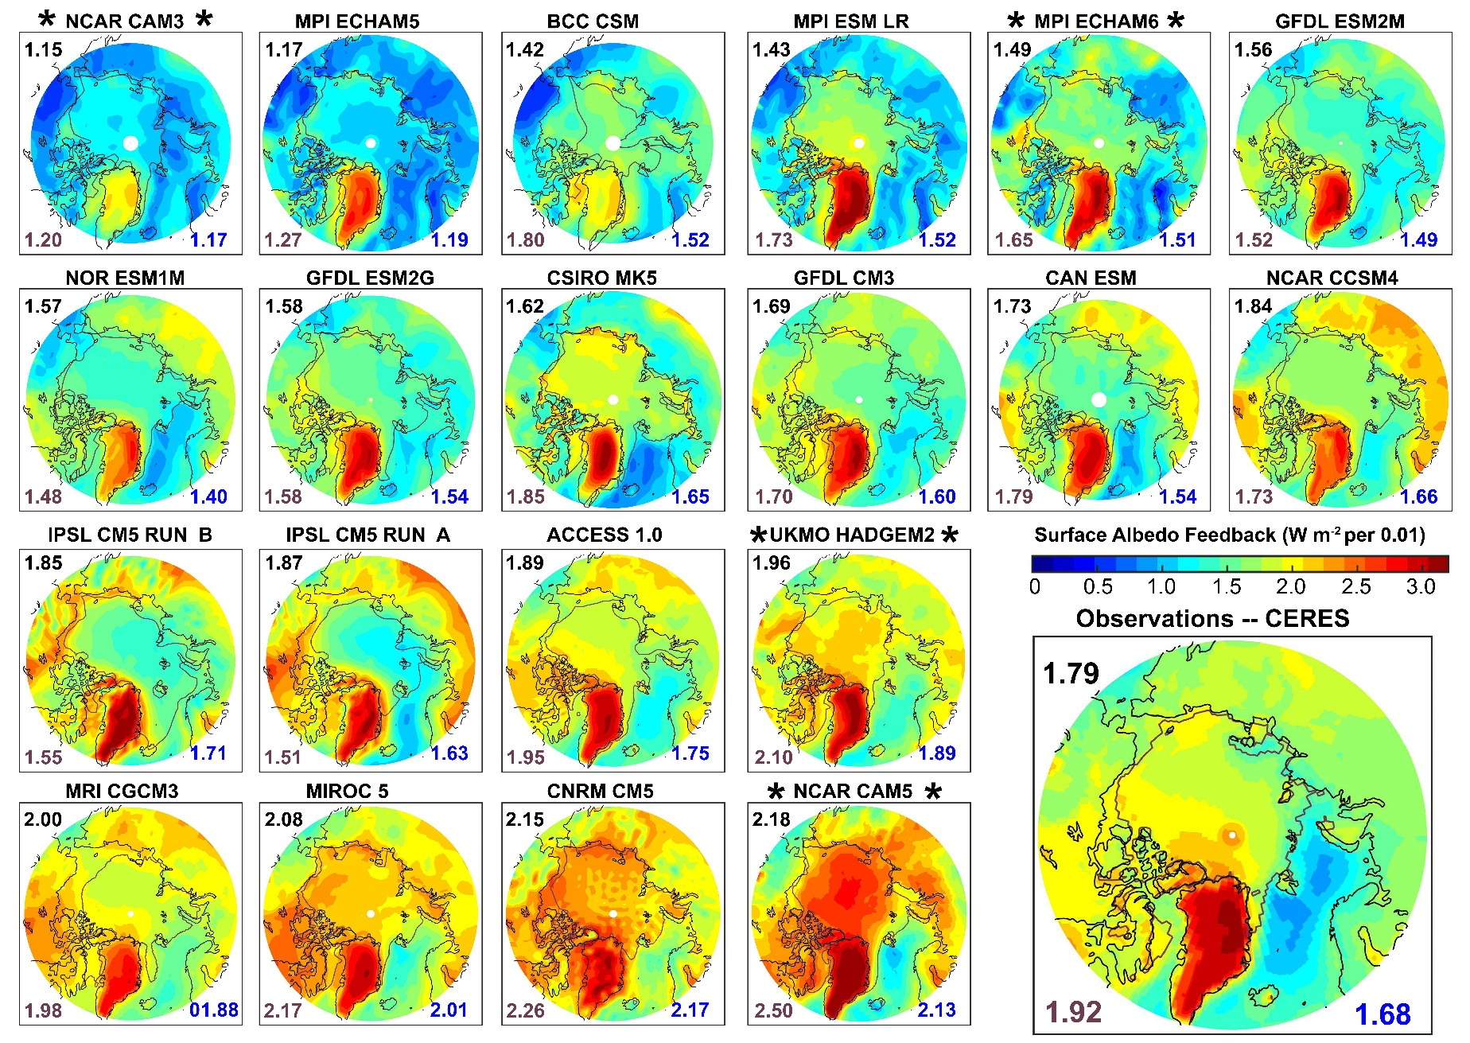
Radiative sensitivity all models
Domain Average
Ice edge
Arctic Ocean Average
Average over sea ice

Slide 26
Recap so far..
Impact of surface albedo changes on absorbed solar radiation differs by a factor of 2 between different models in radiative kernel calculations
These inter-model differences are well replicated using a simple radiation model that relies on only climatological radiative fluxes
This allows an observational estimate of radiative sensitivity and the evaluation in ALL climate models with standard model output
Moving forward…
Global Radiative Feedbacks
The comprehensive evaluation of radiative provides:
Obseravtional estimate of ice albedo feedback
Insight into inter-model spread
albedo feedback
Ice Albedo
Feedback
=
Ice sensitivity
Radiative Sensitivity
IPCC AR5, Soden and Held 2006

Slide 27
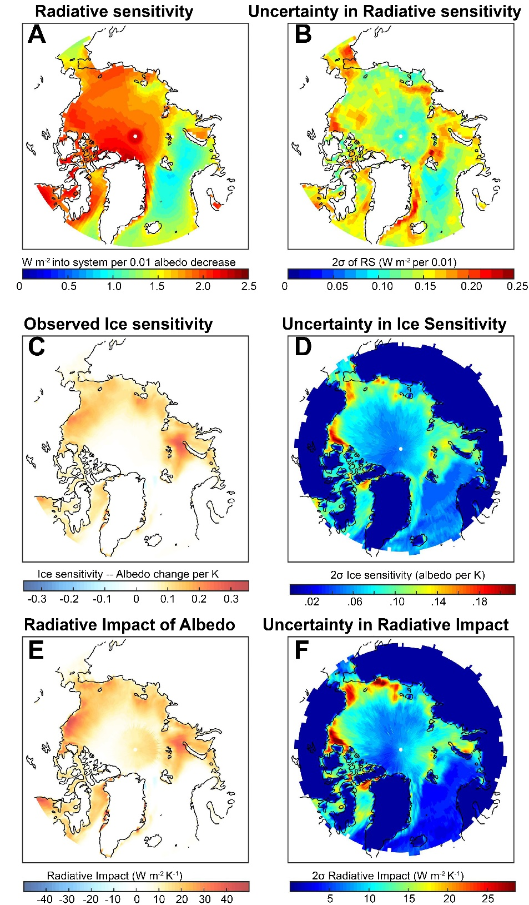
Observational Ice Albedo Feedback (IAF)
Ice Albedo
Feedback
=
Ice sensitivity
Radiative Sensitivity
Surface albedo changes between 1982 and 2017 from 2 sources
NSIDC sea ice change times Δα of 0.54
Polar Pathfinder (APP-X) surface albedo change
Global mean surface temperature change = 0.7 +/- .1 K from 3 sources
HADCRUT (Cowtan and Way)
GISTEMP
NCEP surface temp
Radiative sensitivity from CERES
Global Impact of IAF
= 0.16 ± 0.04 W m⁻² K⁻¹

Slide 28
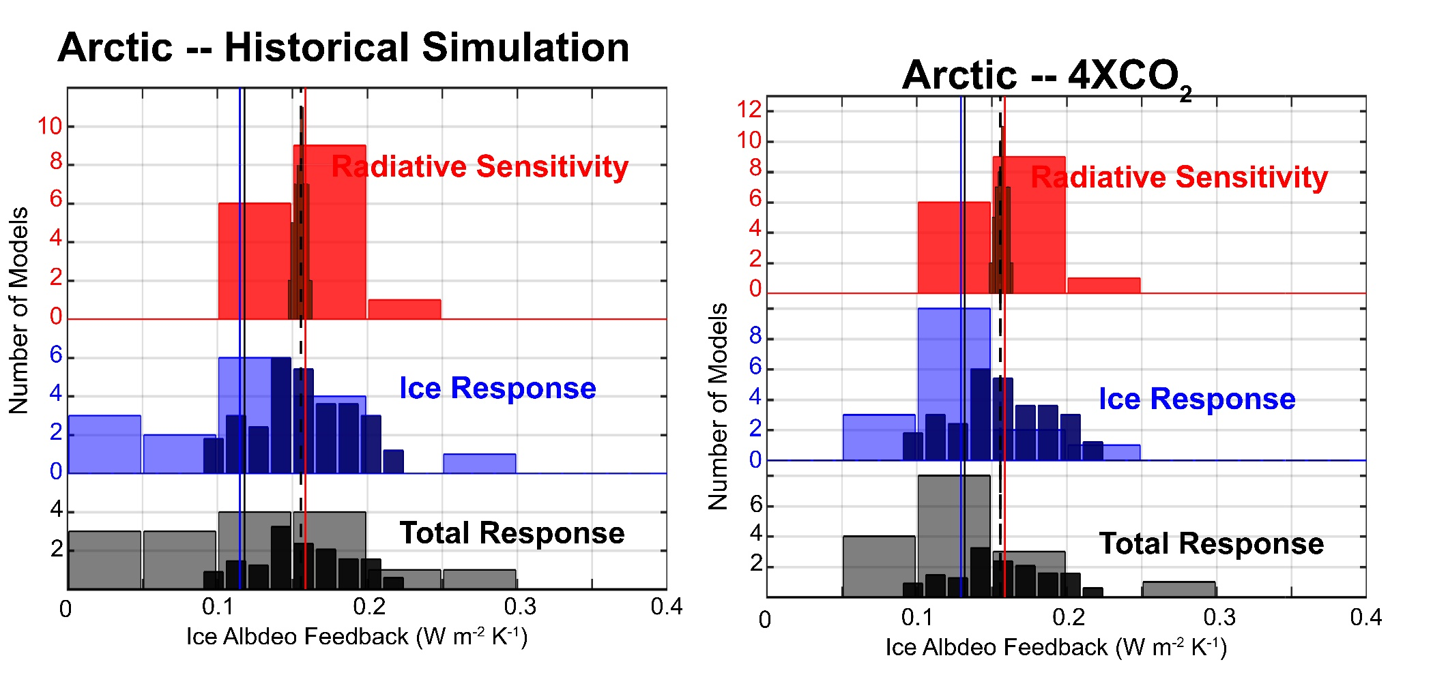
Model Observation comparison of ice albedo feedback
Models
Models
OBS.
OBS.
Observed IAF = 0.16 ± 0.04 W m⁻² K⁻¹
CMIP5 historical simulation IAF = 0.12 ± 0.13 W m⁻² K⁻¹
CMIP5 4XCO2 IAF = 0.13 ± 0.09 W m⁻² K⁻¹
CMIP5 4XCO2 IAF with observational Radiative Sensitivity = 0.13 ± 0.08 W m⁻² K⁻¹
CMIP5 4XCO2 IAF with observational Ice Sensitivity = 0.16 ± 0.04 W m⁻² K⁻¹

Slide 29
Conclusions – Ice albedo feedback
The global Arctic ice albedo feedback estimated to be +0.16 ± 0.04 W m⁻² K⁻¹
For context, the total climate feedback (λ) central estimate is -1.33 W m⁻² K⁻¹
= CO2 forcing / climate sensitivity
IAF Amplifies (feedback Gain) of global warming by 15%
Model average Radiative sensitivity is similar to observational estimate
-- Inter-model differences in RS result in IAF differences of ± 0.04 W m⁻² K⁻¹
Model average Ice sensitivity is slightly smaller than that observed
-- Inter-model differences in RS result in IAF differences of ± 0.08 W m⁻² K⁻¹
Ice Albedo
Feedback
=
Ice sensitivity
Radiative Sensitivity

Slide 30
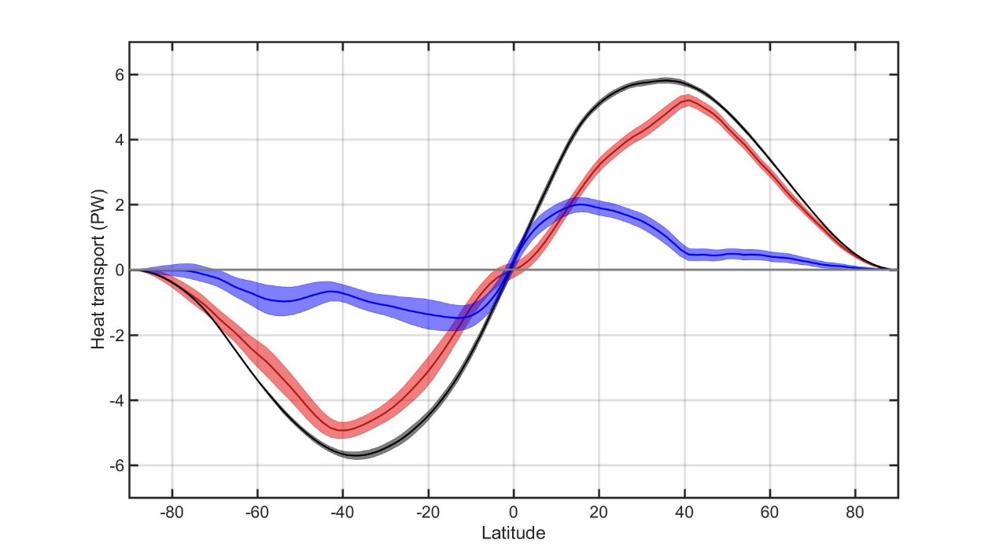
Heat transport in the climate system
5.8 PW
5.8 PW
Total (atmosphere plus ocean) heat transport in the climate system is equal to the spatial integral of net radiative imbalance at TOS
→ 5.8 PW poleward at around 37⁰ in each hemisphere
Atmospheric heat transport is the vertical zonal and time integral of the meridional (moist static = latent + potential ) energy flux from reanalysis
Ocean as a residual
Outside of the tropics, the atmosphere does most of work
TOTAL
Atmosphere
Ocean

Slide 31
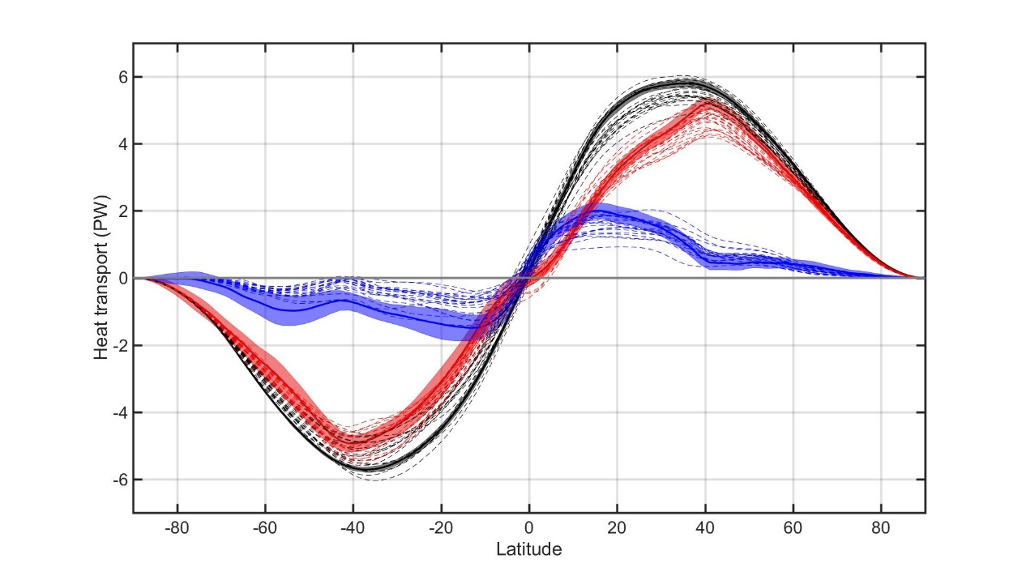
Heat transport in the climate system
5.8 PW
5.8 PW
Total (atmosphere plus ocean) heat transport in the climate system is equal to the spatial integral of net radiative imbalance at TOS
→ 5.8 PW poleward at around 37⁰ in each hemisphere
Atmospheric heat transport is the vertical zonal and time integral of the meridional (moist static = latent + potential ) energy flux from reanalysis
Ocean as a residual
Outside of the tropics, the atmosphere does most of work
TOTAL
Atmosphere
Ocean
OBS.
CMIP5 Models

Slide 32
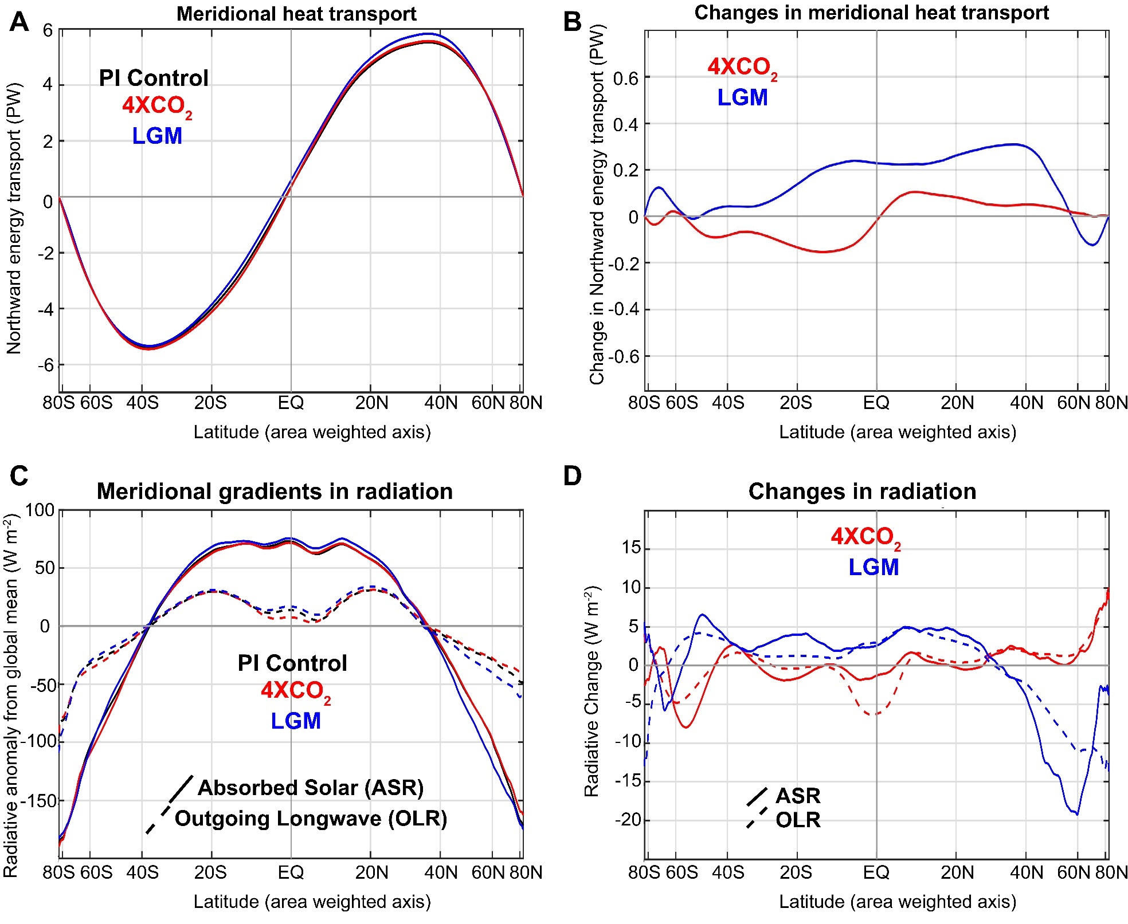
Consider poleward heat transport changes in a multi-model (20 models) of 3 different climates states:
Pre-industrial control (PI)
Last Glacial Maximum (LGM)
Abrupt CO2 quadrupling (4XCO2)
Total heat transport nearly unchanged
The equator-to-pole gradient of net radiation is nearly unchanged because
→ Absorbed solar radiation changes are nearly balanced by outgoing longwave radiation changes (regionally, not necessarily locally)
Donohoe et al. 2019

Slide 33


Understanding heat transport
5.8 PW
ASR*
OLR*
8.2 PW
2.4 PW
-
Heat
Transport
=
Notes:
NH = 8.2 - 2.4 = 5.8
SH = 9.0 – 3.2 = 5.8

Slide 34

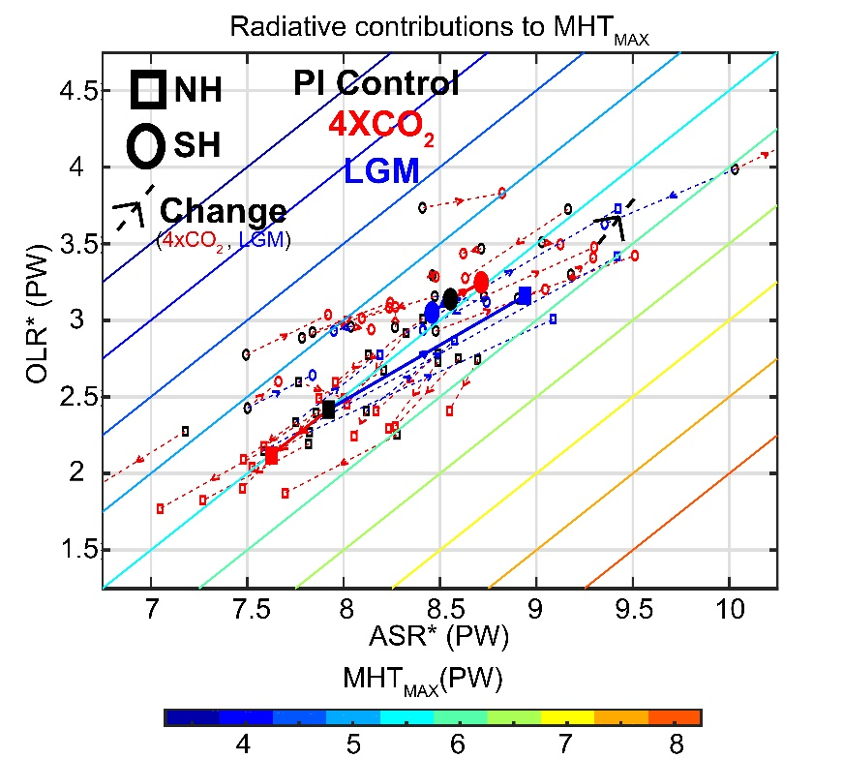
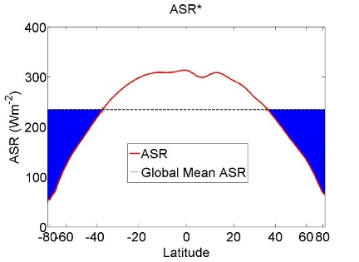

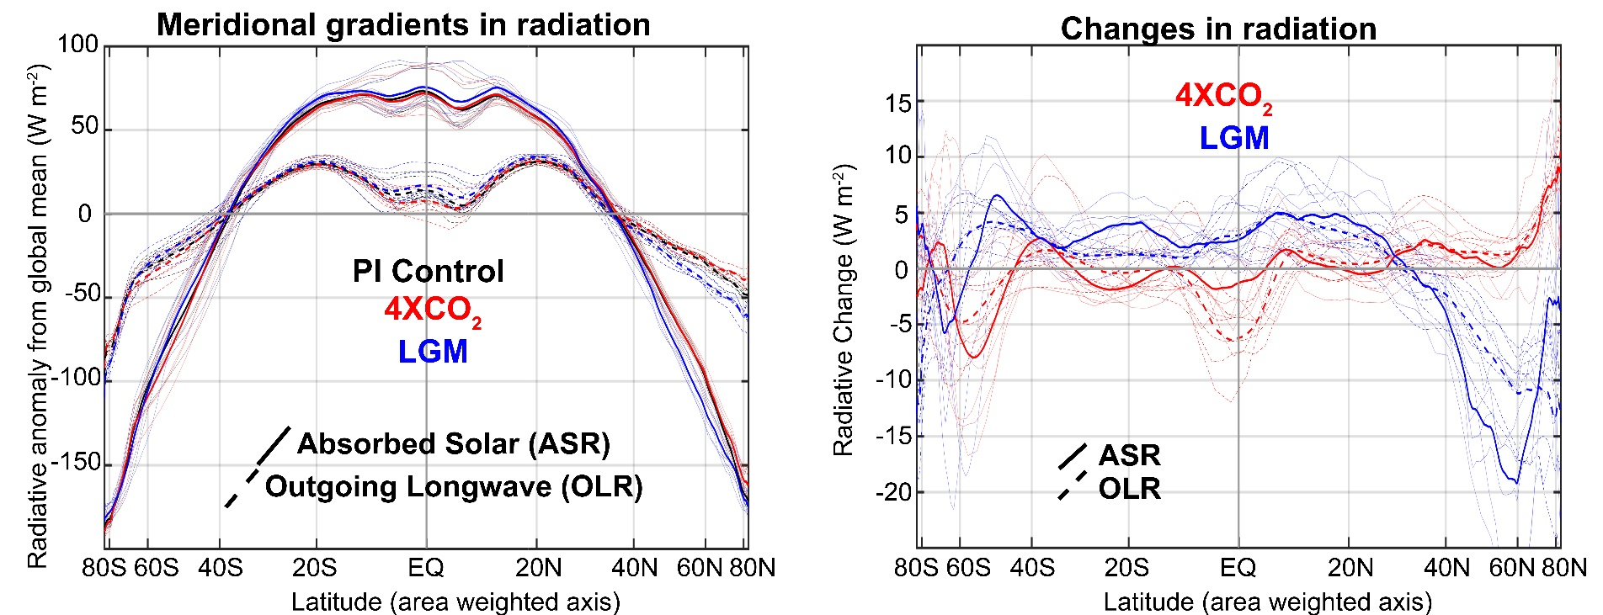
Radiative constraints on poleward energy transport
Poleward heat transport =
-

Slide 35
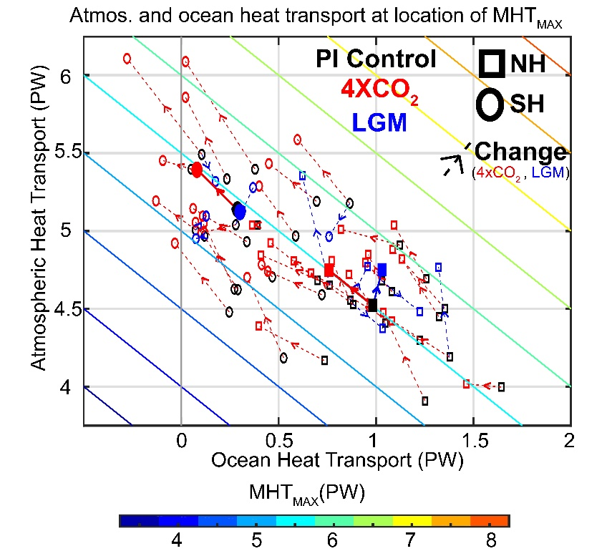
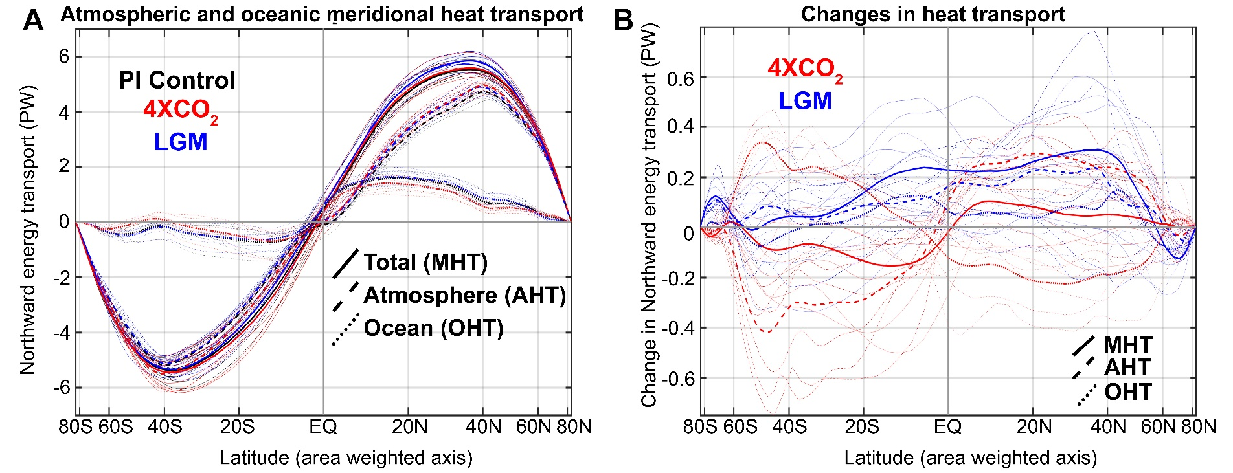
Radiative constraints on poleward energy transport
In general, changes in atmospheric and oceanic energy transport compensate to maintain near invariance of total heat transport
Under 4XCO2, pole AHT increases and IMPLIED OHT decreases due to high latitude ocean heat uptake
In LGM, increase in NH AHT is uncompensated by OHT change

Slide 36




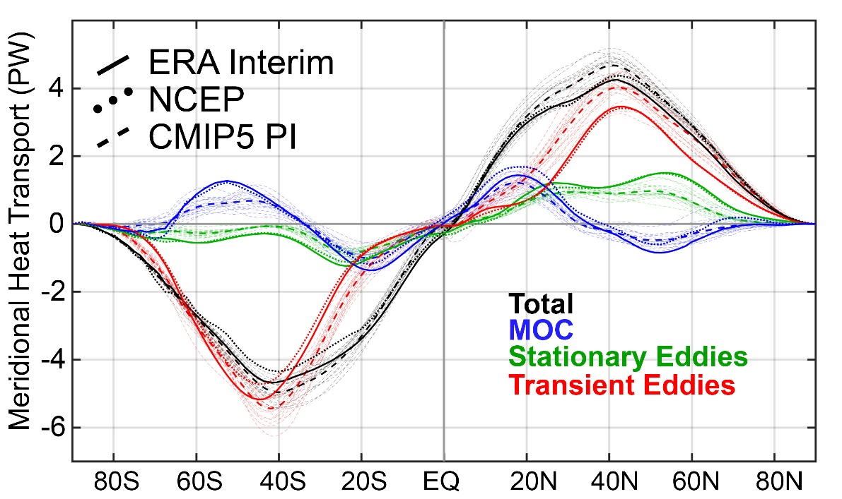
Partitioning of atmospheric energy by circulation type
Stationary
MOC
Overturning
Transient
* = Departure from zonal mean -- [ ]
' = Departure from time mean -- ¯
MSE = moist static energy
= CpT + LQ +gZ
MOC dominates in the deep tropics – Hadley cell
Stationary eddies stronger in NH
Transient eddies dominate the mid-latitudes

Slide 37
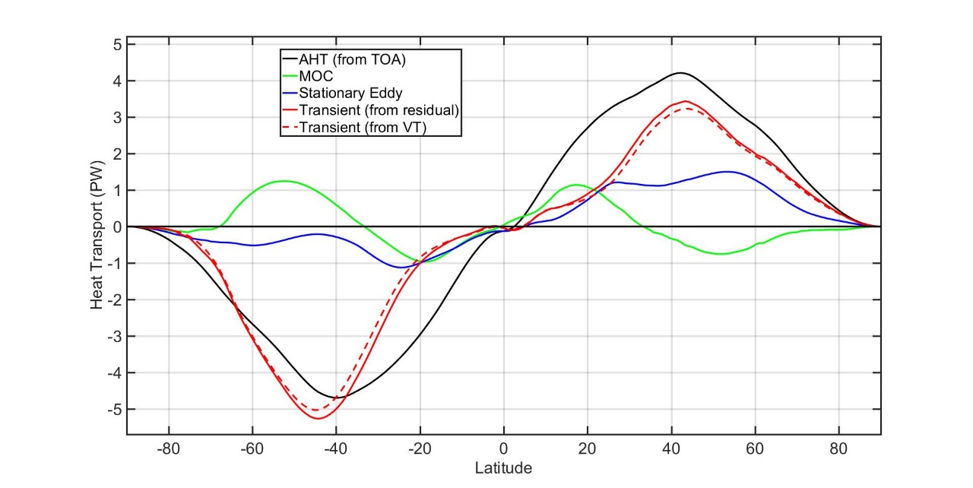
Bragging slide: The partitioning of energy transport in model ensembles is a new result and based on a novel technique
Transient eddy heat transport requires 6 hourly 3d data not commonly available from climate models
Our calculation uses monthly mean standard output to calculate AHT from TOA radiation and surface fluxes and MOC, SE from atmospheric data, transients as a residual (ongoing effort that seems to be working)
Also have seasonal calculation
And moist dry partioning
Draft IPCC AR6 Figure (contributing Author) Model/observation comparison of heat transport portioning:
Chapter 7: The Earth's energy budget, climate feedbacks, and climate sensitivity

Slide 38
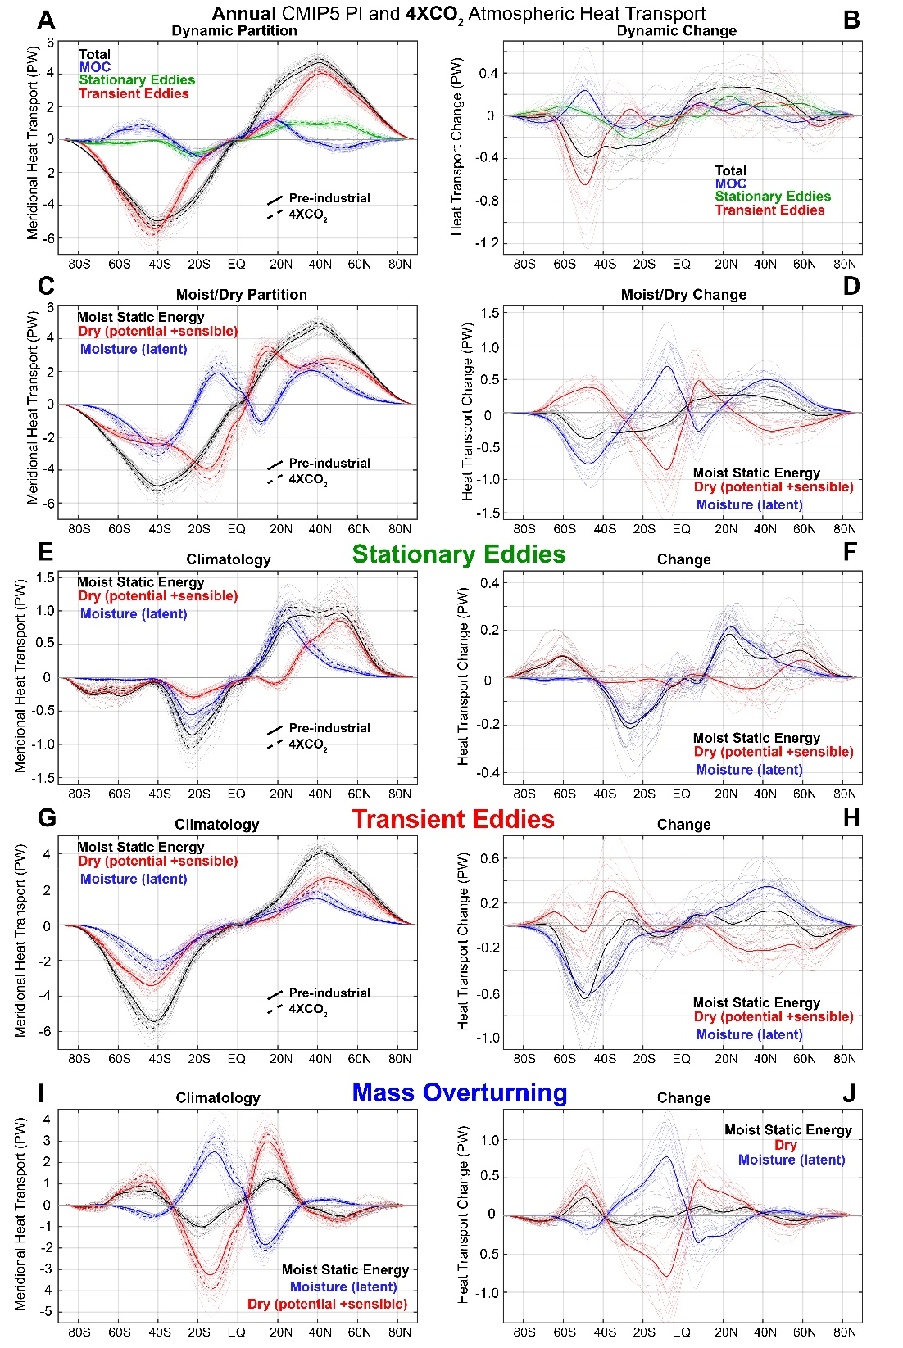
Changes in the partitioning of poleward energy transport under 4XCO2
Moisture transport intensifies in the sense of their climatological direction
→ Compensating decreases in sensible energy transport
Robust increase in stationary eddy moisture transport by monsoons in the subtropics
NH mid-latitude stationary sensible energy transport changes are variable
Transient eddy moisture transport increase, sensible decreases, total increases slightly

Slide 39
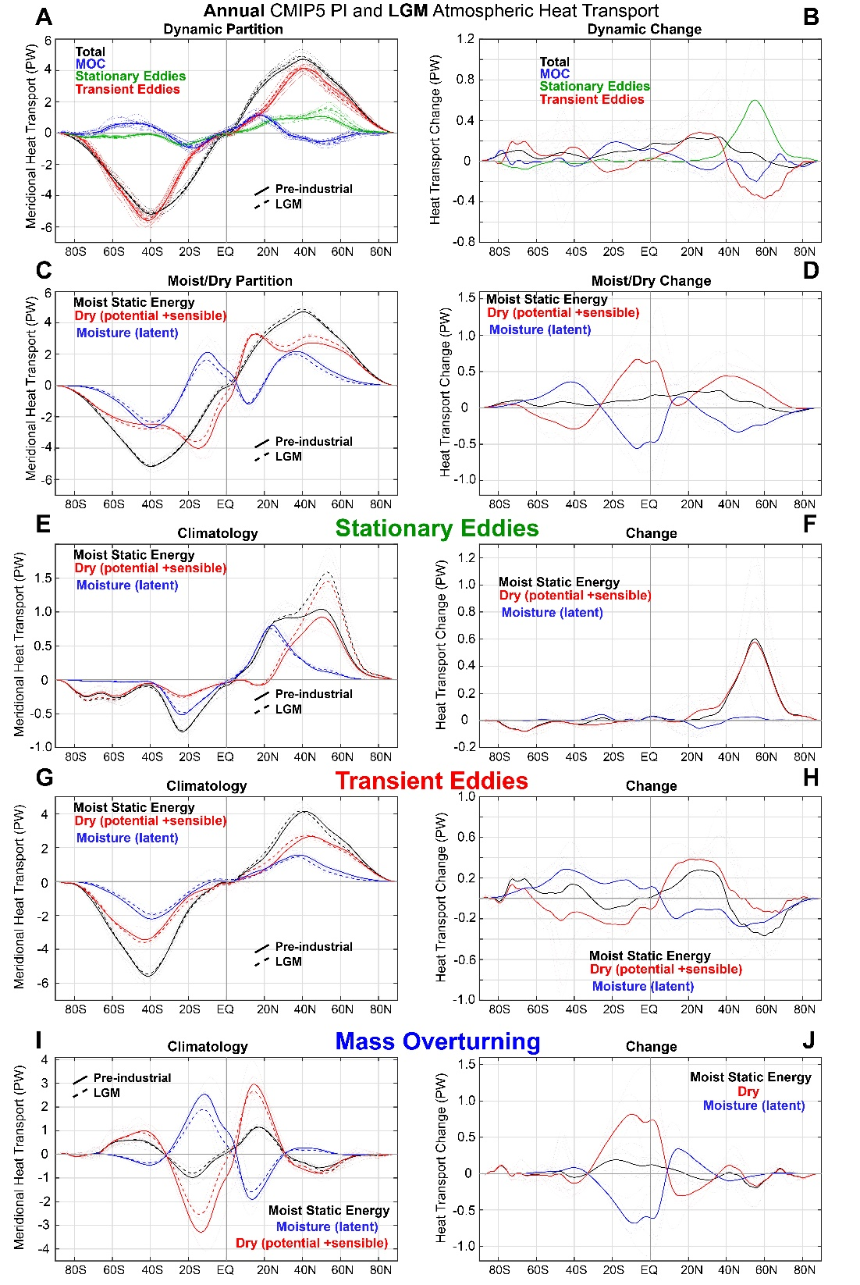
Changes in the partitioning of poleward energy transport during the Last Glacial Maximum
Large increase in NH mid-latitude stationary eddy energy transport associated with Laurentide ice sheet
In some models (PMIP2) there is a compensating decrease in transient eddy energy transport
Zonal Velocity
Transient eddy heat flux
Donohoe et al. 2009

Slide 40
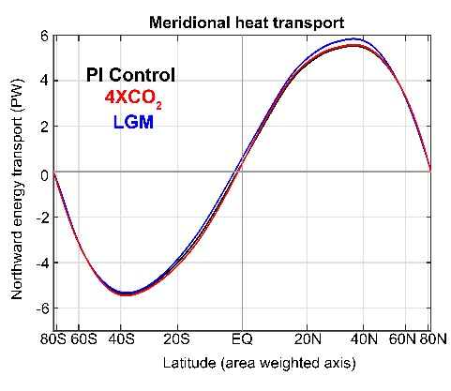


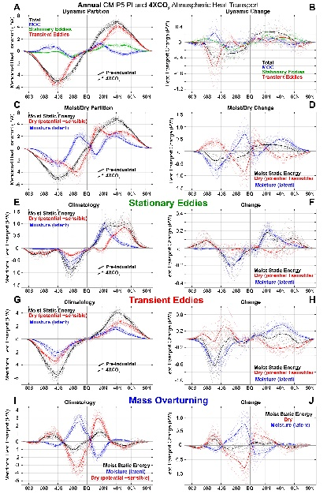
Conclusions: Energy Transport
Total poleward energy transport is nearly invariant from the last glacial maximum to CO2 quadrupling
TOTAL
AHT
OHT
Invariance of total energy transport viewed from radiative and dynamical lenses:
Absorbed solar radiation changes balanced by OLR changes → small net radiation change
Atmosphere and ocean energy transport compensation
Atmospheric energy transport changes moderated by compensating component changes:
Moist/dry
Stationary eddy/transient eddy
MOC adjustment to radiative deficit
Working hypothesis: Transient eddy transport adjusts
to residual diabatic heating from all other processes

Slide 41
Extras

Slide 43
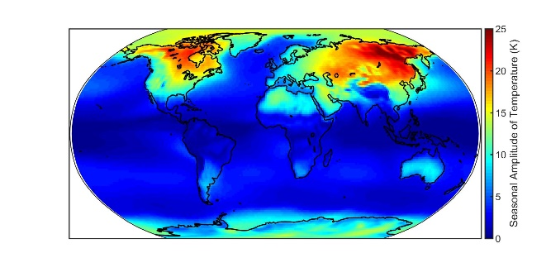
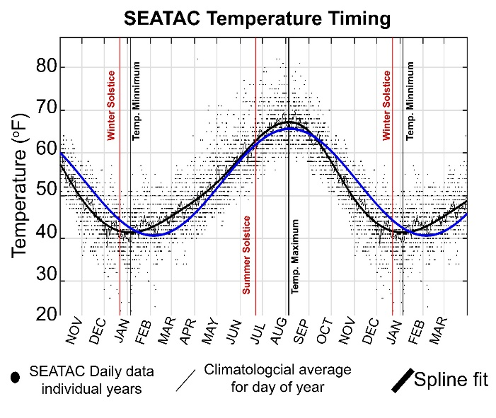
Outline
What determines the amplitude of the seasonal cycle of temperature?
→How does solar radiation at the top of the atmosphere heat the atmospheric column
2. The seasonal cycle of energy fluxes in the climate system:
Global mean, inter-hemispheric, equator-to-pole heat transport
Tropics
Extratropics
3. Seasonal asymmetries in the lag between surface temperature and insolation

Slide 44
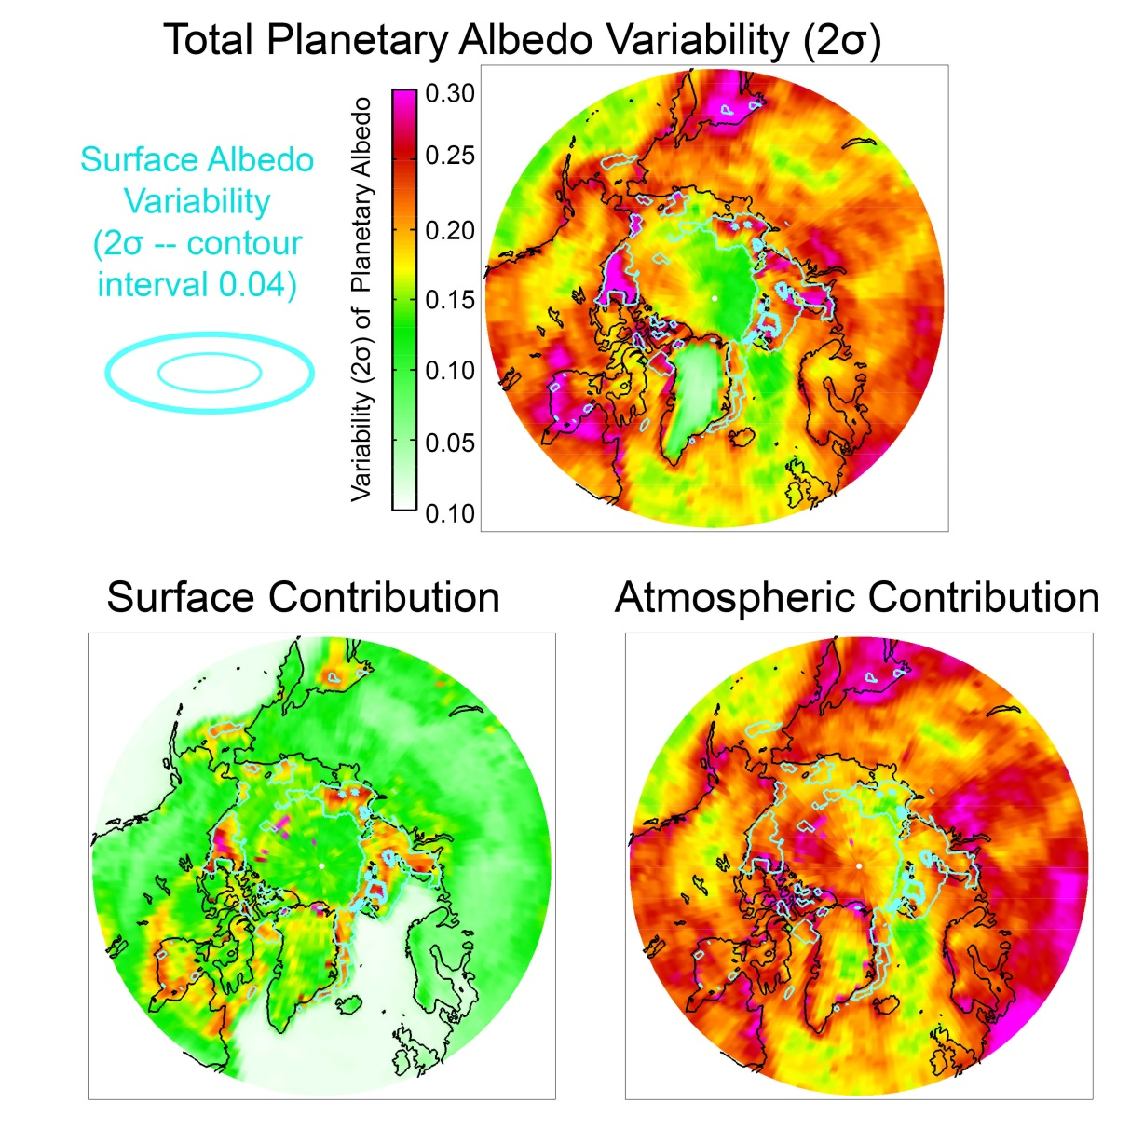
Variability of Arctic Planetary Albedo
→Atmosphere contributes more to variability
→ Exception is on the sea ice edge where there is a lot of surface albedo variability

Slide 45
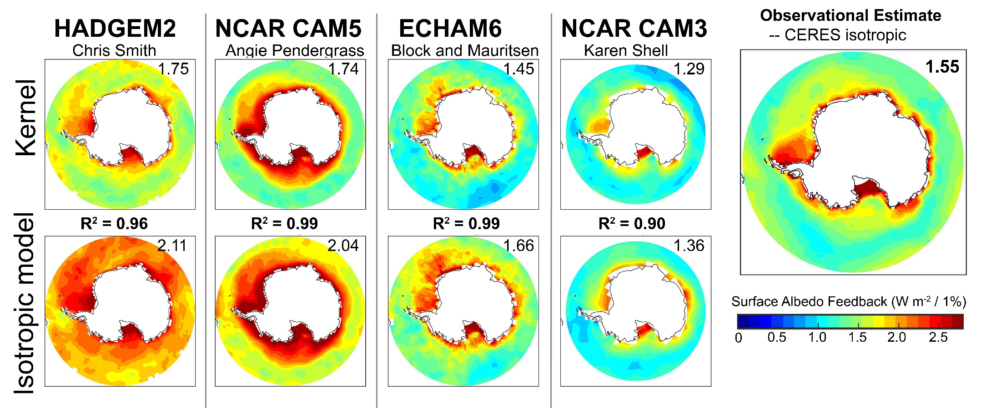
Radiative sensitivity from kernels, simple model and observations in the Southern Ocean
November, December, January and Feb.
Substantial inter-model spread in Radiative sensitivity (though less than Arctic)
Kernel well replicated by simple model
Observations are within the model spread

Slide 46
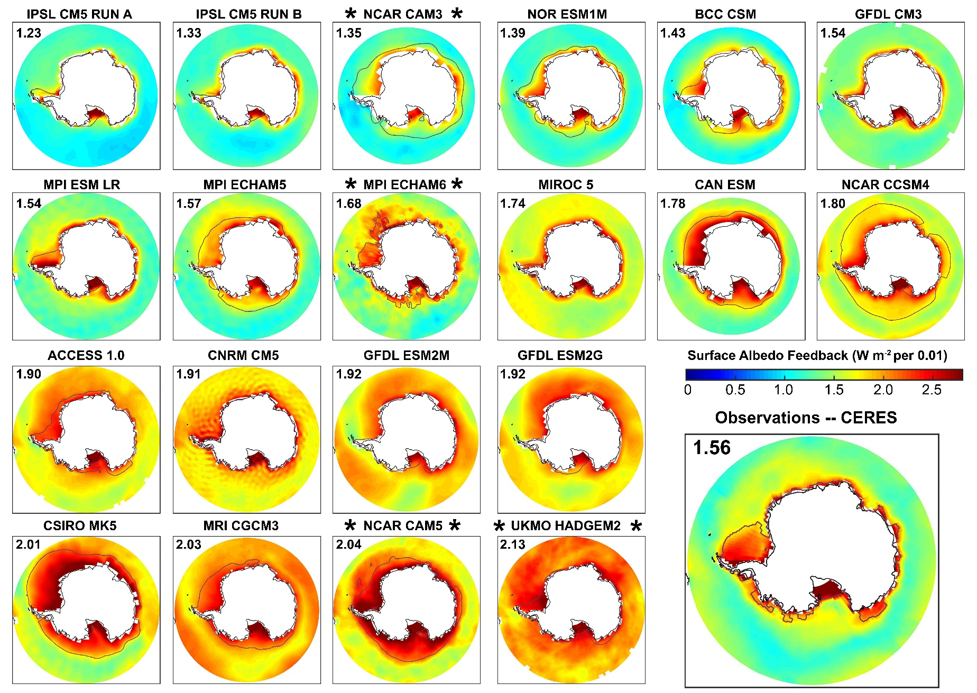
Radiative sensitivity all models
Ocean Domain Average

Slide 47
Two extreme cases
Absorbed
Emitted
Net = Heat Transport
No Dynamics
Local radiative
Equilbrium → large temperature gradient
Tropics
Extratropics
Efficient dynamics
No OLR or temperature
Contrast → the solar contrast moves get transported between the boxes
Tropics
Extratropics

Slide 48
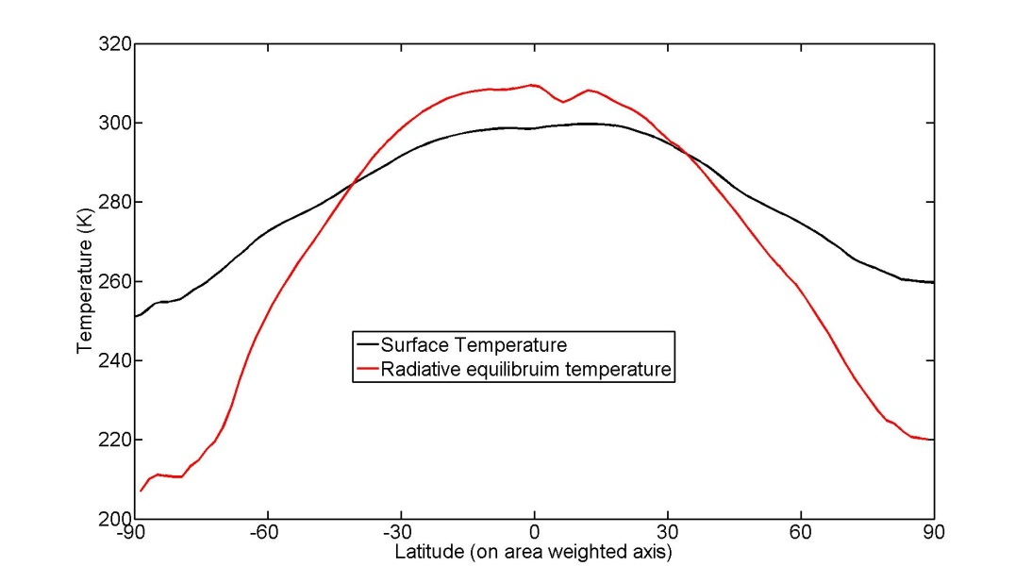
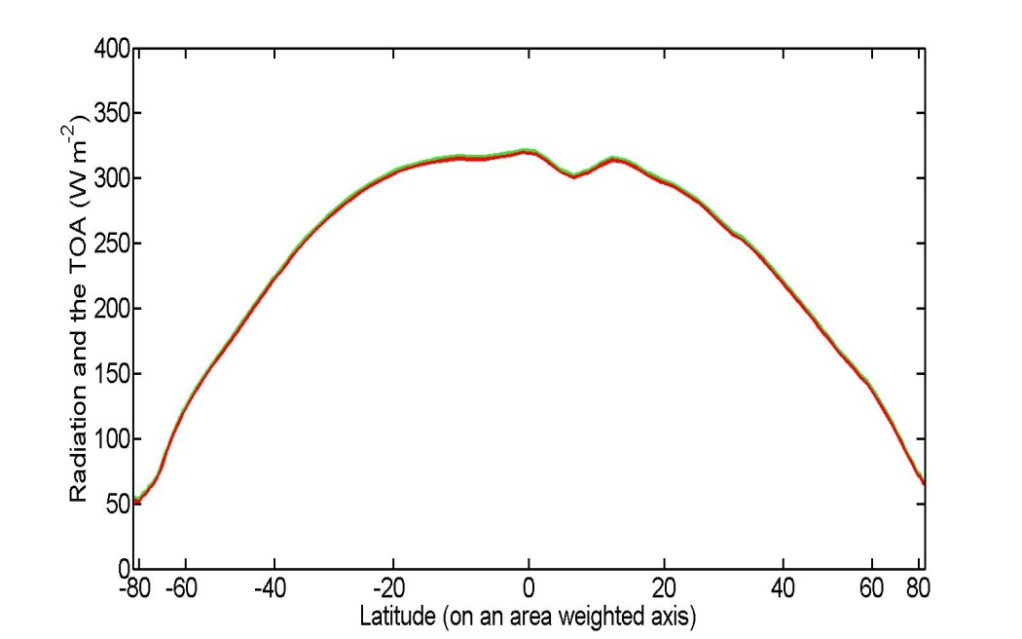
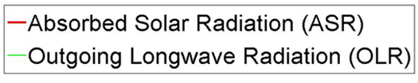
Temperature in the radiative limit
If absorbed shortwave (ASR)
= OLR at each latitude
ASR = σ(T_{S} -30) ⁴
(
ASR
0.25
)
+ 30 K= T_{S}
σ

Slide 49
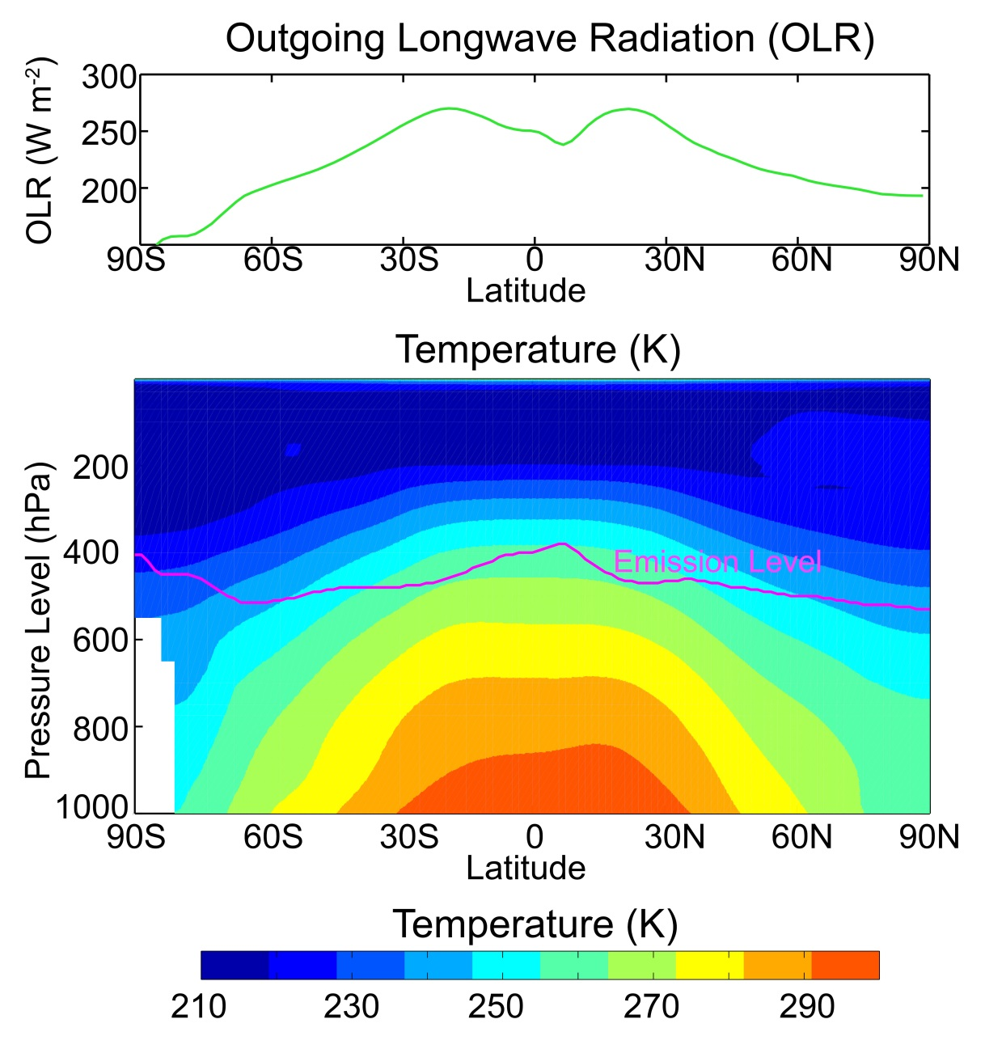
Emission Temperature (T_{E}) Vs. Surface Temperature (T_{S})
Radiation is emitted from the upper troposphere where it is colder
T_{E} = T_{S} - 30 K

Slide 50

Heat Transport in the dynamic limit
8.2 PW
8.2 PW
0
8.2 PW
Tropics
Extratropics
Notes:
NH = 8.2 - 2.4 = 5.8
SH = 9.0 – 3.2 = 5.8

