Slide 1


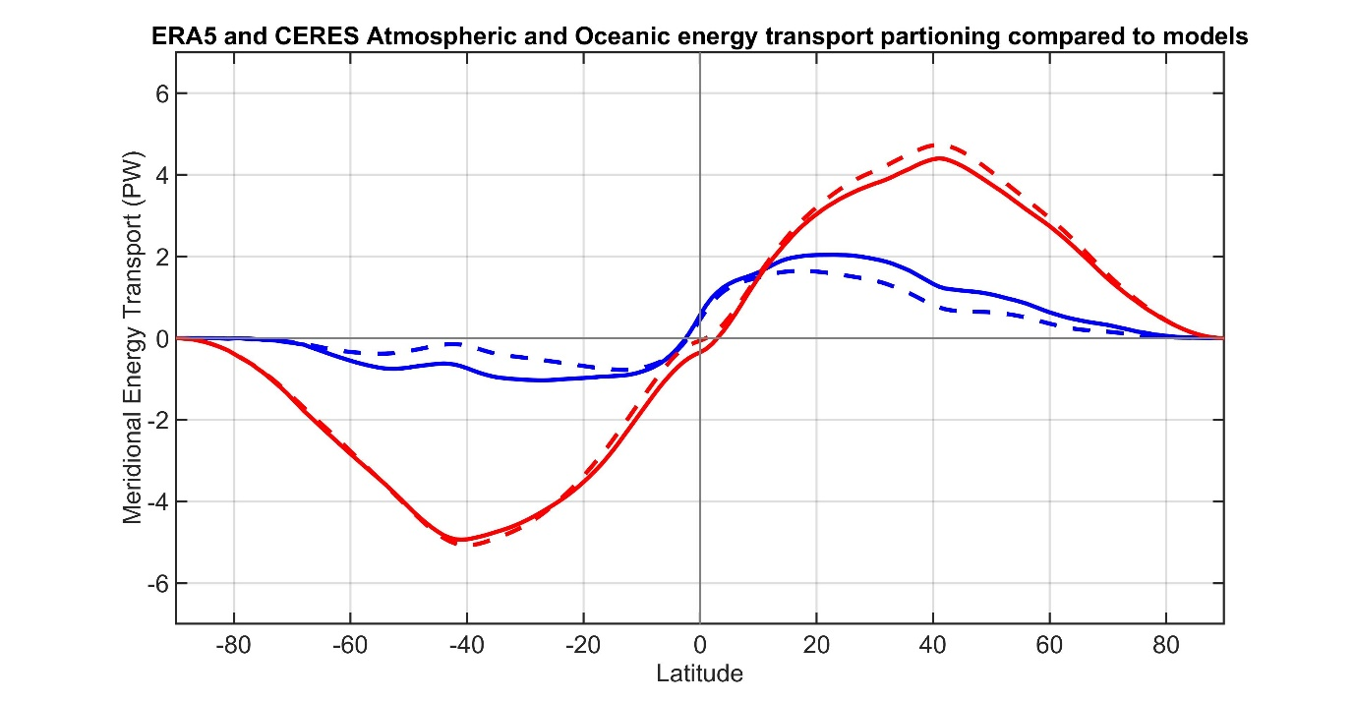






Are climate models biased in the atmosphere-ocean partitioning of poleward energy transport?
ATMOSPHERE
OCEAN
Observations
Model Mean
Robert Fajber – University of Washington
Department of atmospheric science
Aaron Donohoe – Polar Science Center, APL, UW
Kyle Armour – UW Oceanography

Slide 2
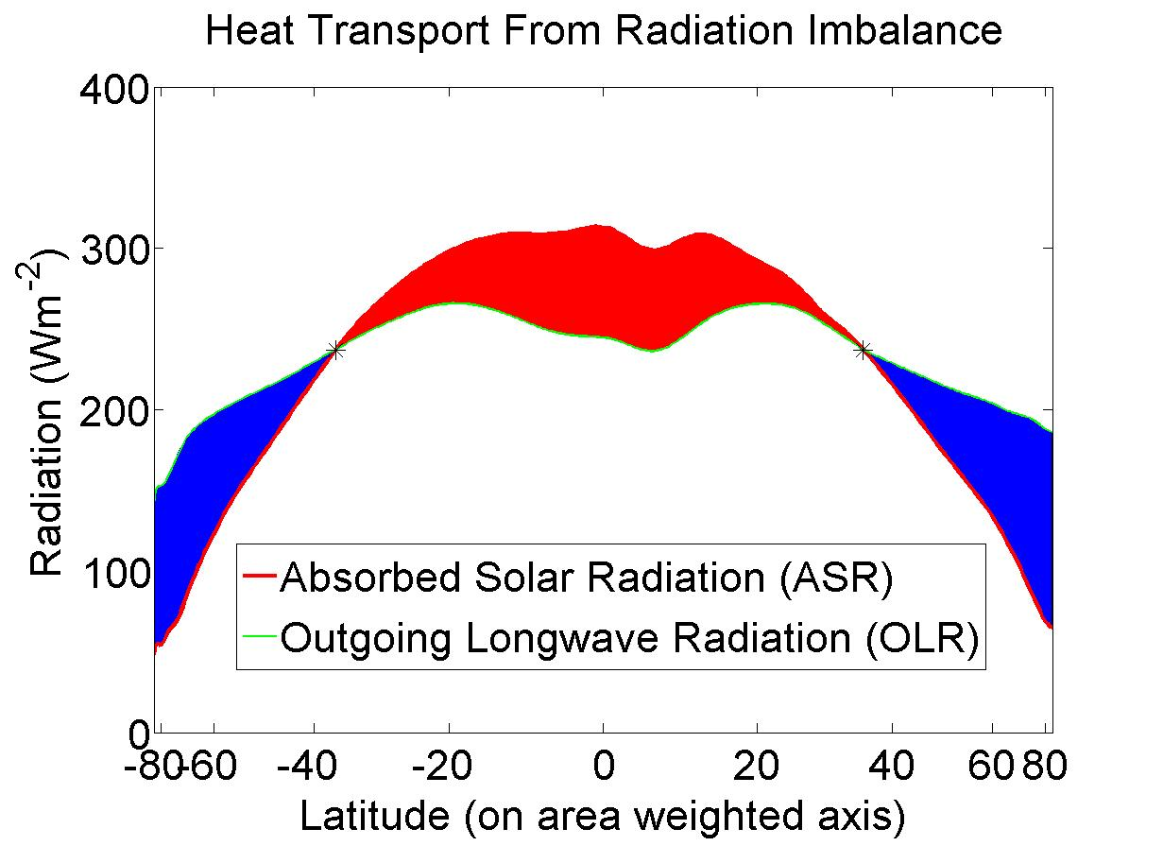
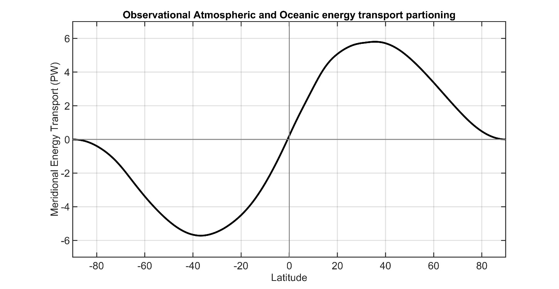
Total (atmosphere plus ocean) energy transport from satellite top of atmosphere (TOA) radiation (CERES EBAF ).
5.8 PW
5.8 PW
Total
Notes:
NH = 8.2 - 2.4 = 5.8
SH = 9.0 – 3.2 = 5.8

Slide 3
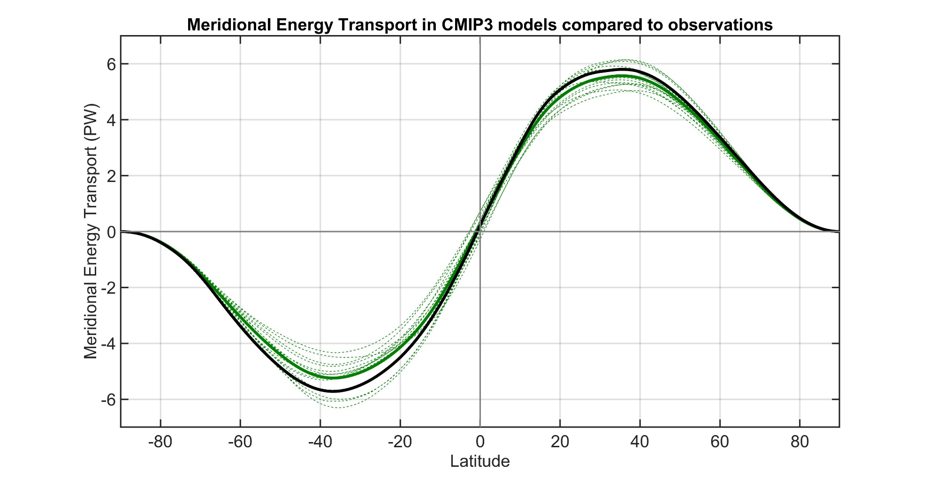
Observations
Individual models
Model Mean
Total (atmosphere plus ocean) meridional heat transport varies by about 20% between models.
→ Also biased low relative to observations especially in the SH
Donohoe and Battisti (2012). What determined meridional heat transport in climate models. J. Climate.

Slide 4
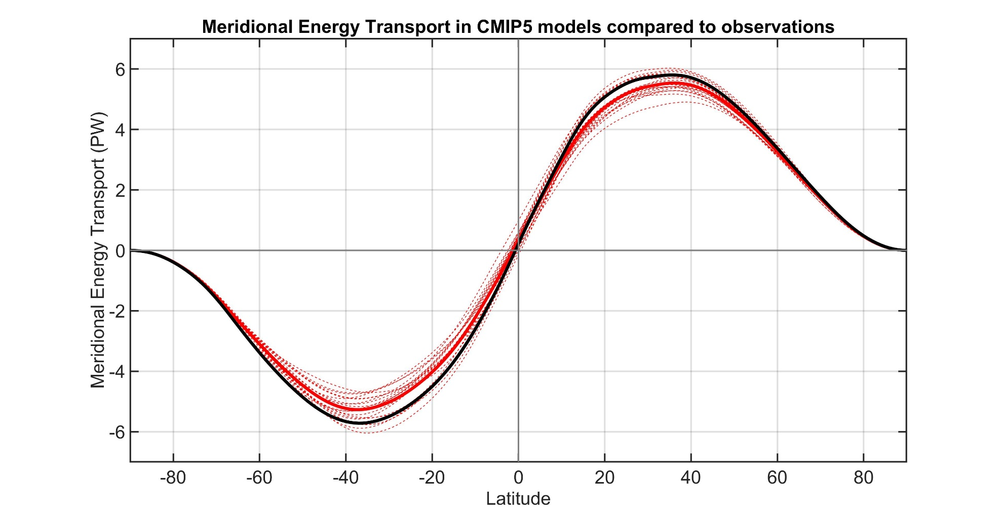
Observations
Individual models
Model Mean

Slide 5
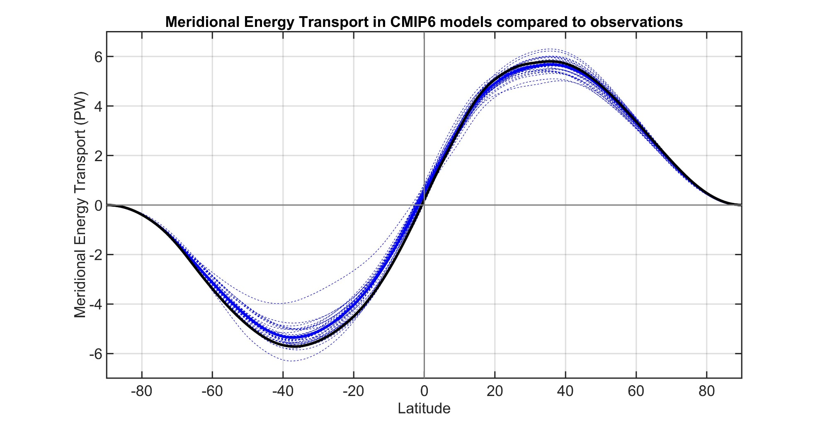
Observations
Individual models
Model Mean

Slide 6
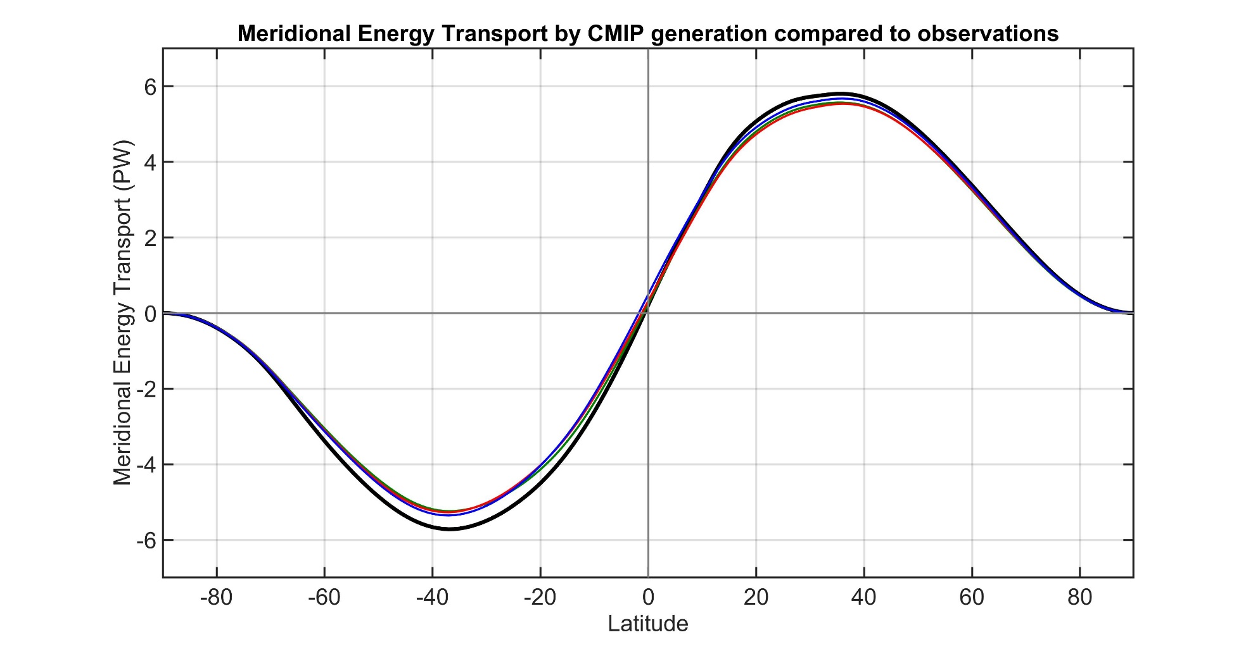
Observations
CMIP3 Mean
CMIP5 Mean
CMIP6 Mean
Inter-model spread and bias in MHT is persistent across generations of CMIP models

Slide 7
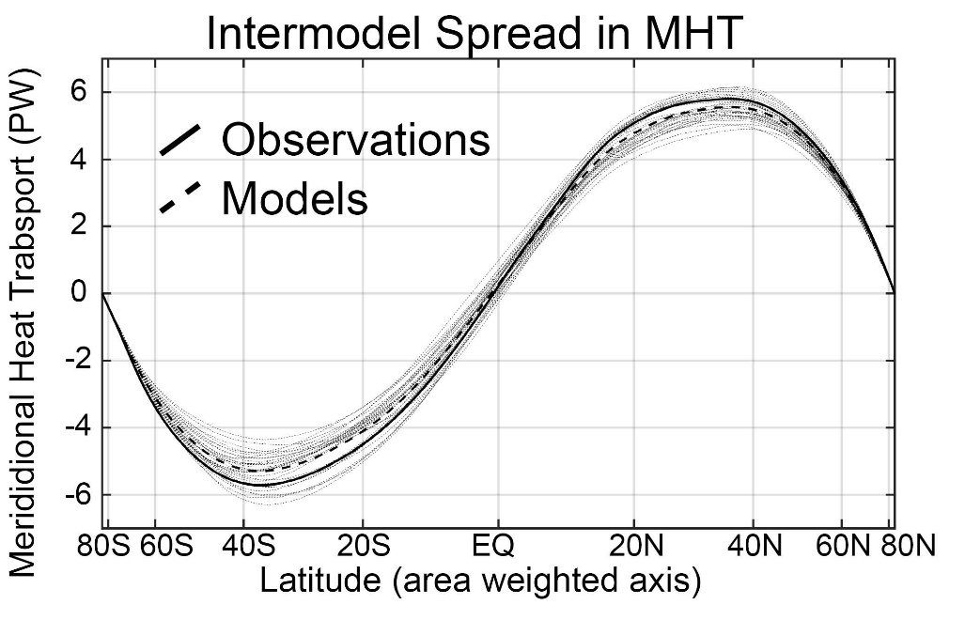
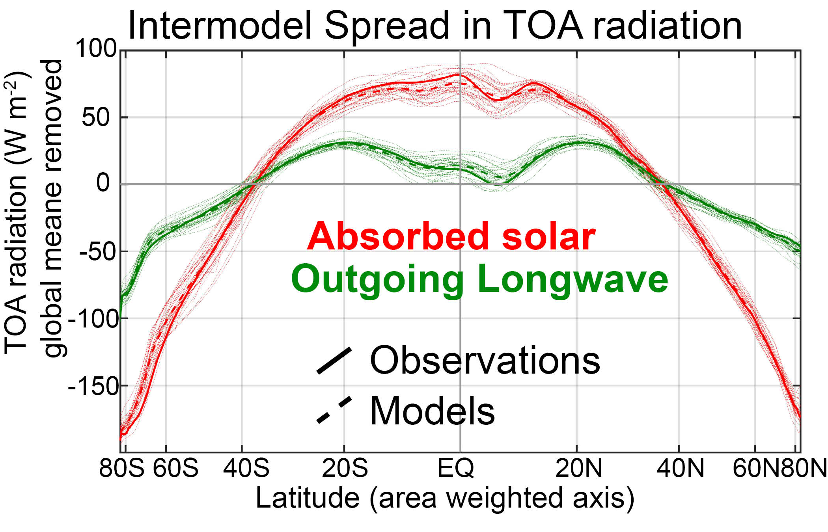

Slide 8

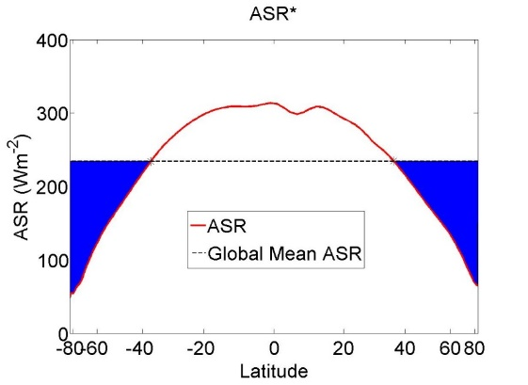
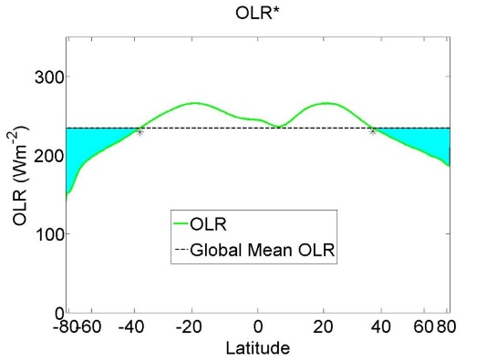

MHT maximum (PW)
MHT = ASR* - OLR*

Slide 9
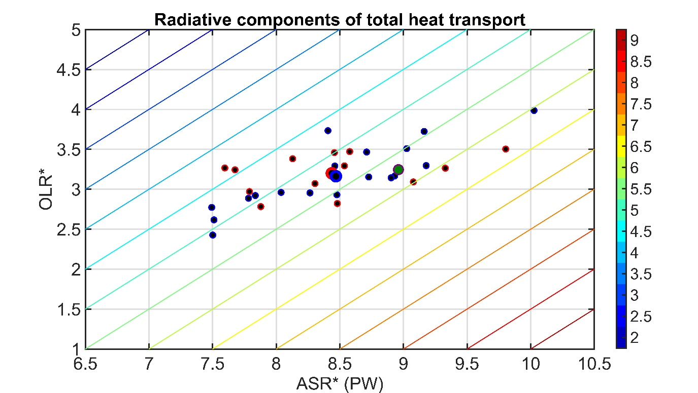
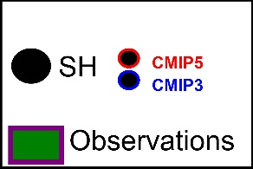
MHT maximum (PW)
MHT = ASR* - OLR*
Southern Hemisphere
Mean state inter-model spread in MHT:
Spread in ASR* exceeds that in OLR
→No compensation between ASR* and OLR*
→ Model mean bias due ASR* -- low planetary albedo of Southern Ocean

Slide 10
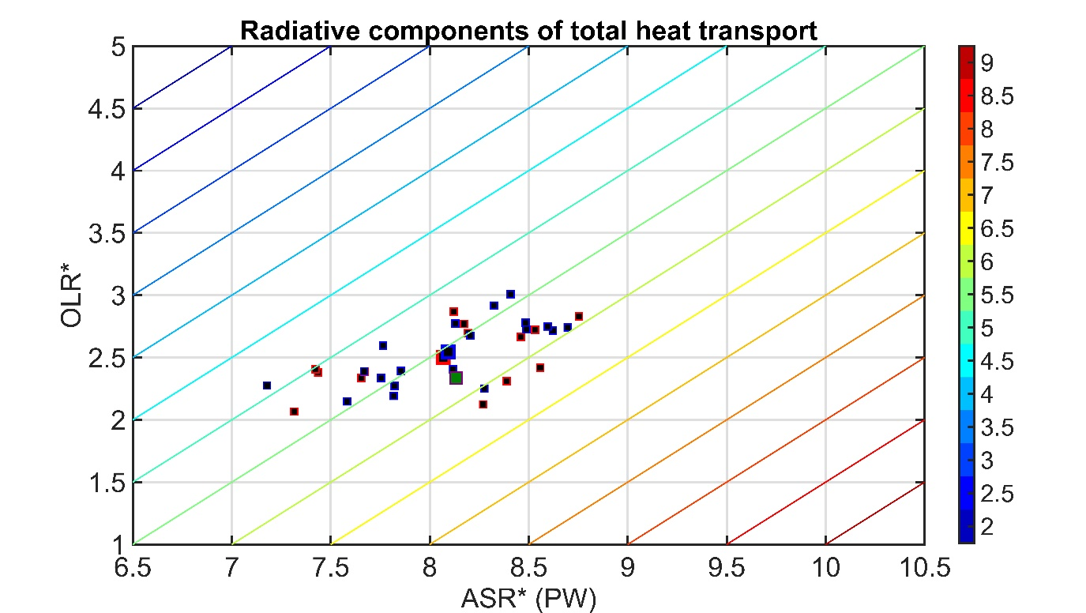
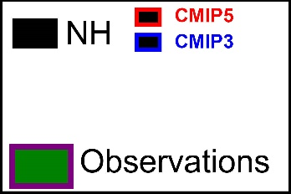
MHT = ASR* - OLR*
MHT maximum (PW)
Northern Hemisphere
Mean state inter-model spread in MHT:
Spread in ASR* exceeds that in OLR
→No compensation between ASR* and OLR*
→ Model mean bias do to too much tropical OLR

Slide 11
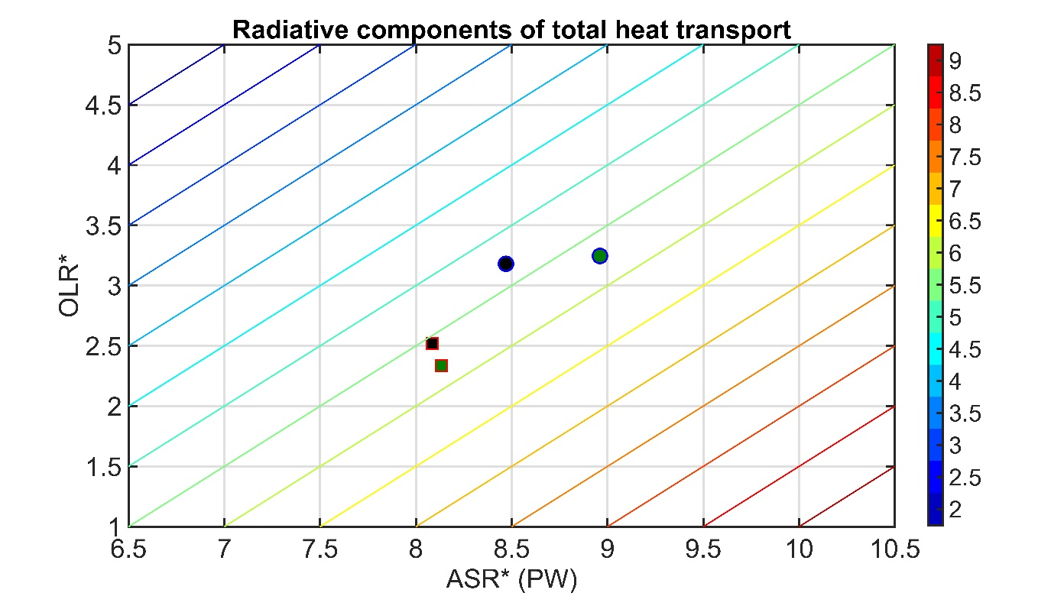
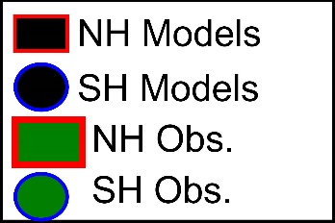
MHT = ASR* - OLR*
MHT maximum (PW)
Northern Hemisphere
Mean state inter-model spread in MHT:
Spread in ASR* exceeds that in OLR
→No compensation between ASR* and OLR*
→ Model mean bias do to too much tropical OLR

Slide 12
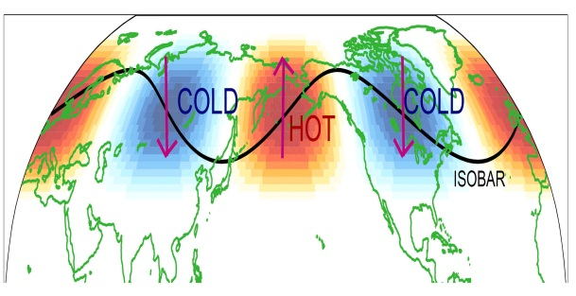
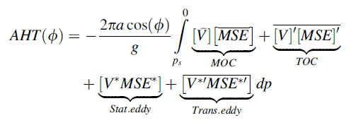
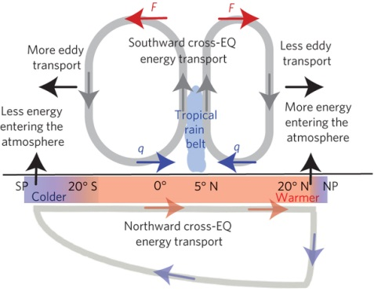
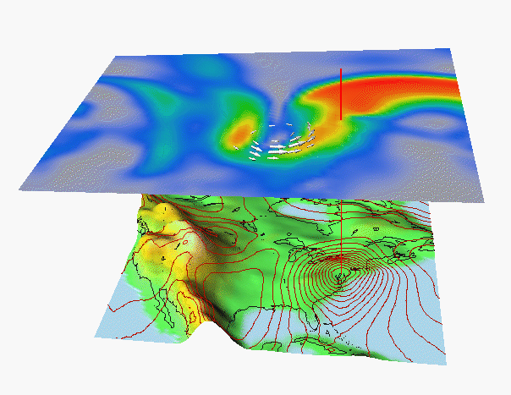
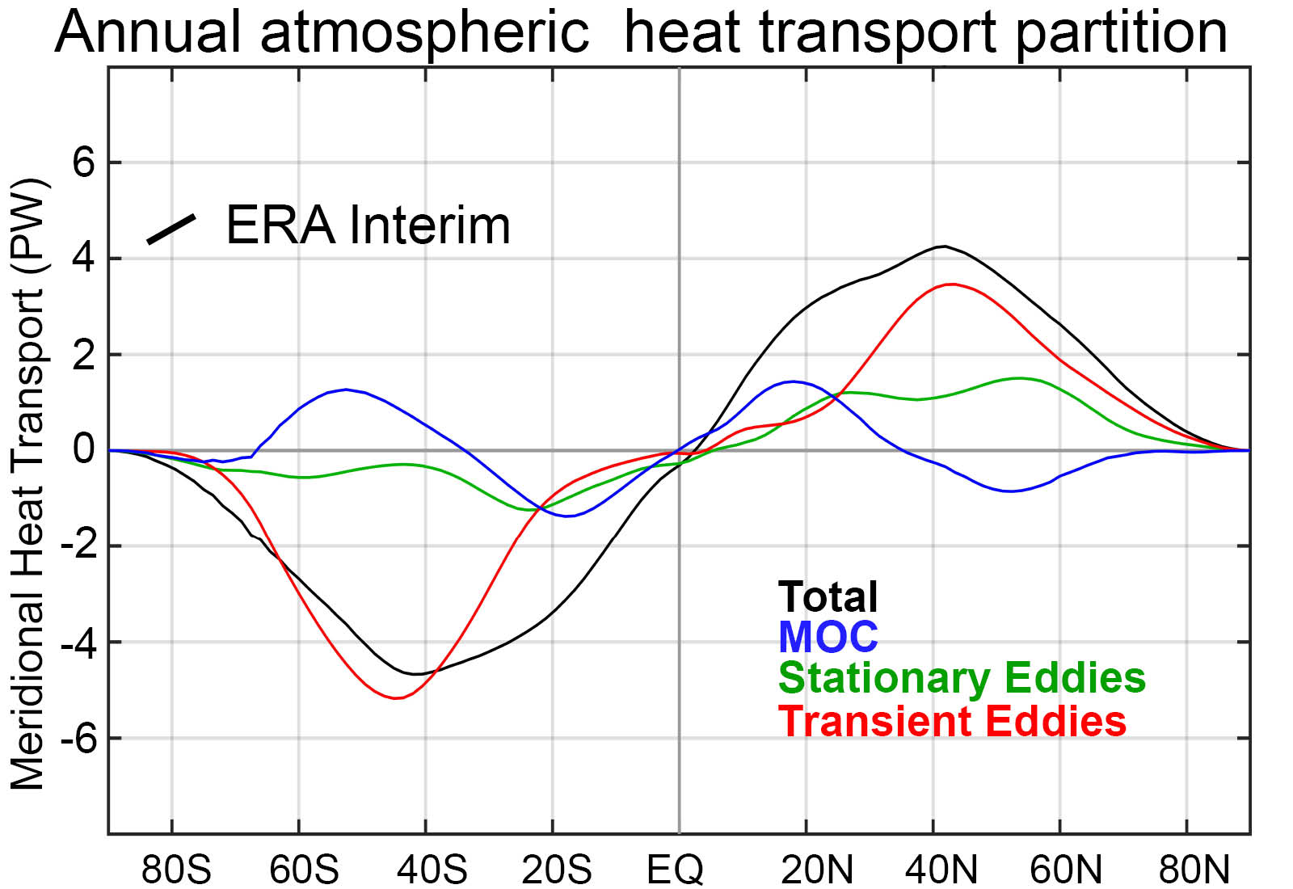
Stationary
Atmospheric energy transport calculated from ERA5 high frequency reanalysis
MOC
Overturning
Transient
* = Departure from zonal mean -- [ ]
' = Departure from time mean -- ¯
MSE = moist static energy
= CpT + LQ +gZ
MOC dominates in the deep tropics – Hadley cell
Stationary eddies stronger in NH
Transient eddies dominate the mid-latitudes

Slide 13
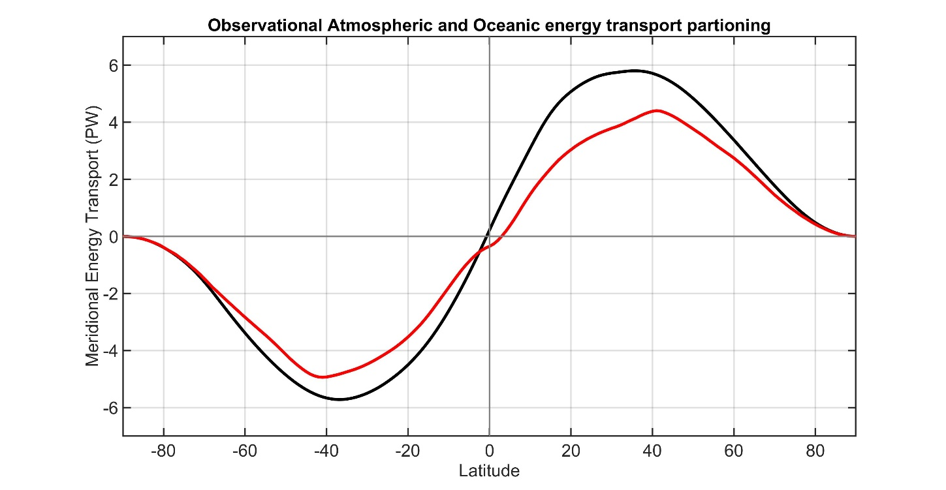
ASR
Total (atmosphere plus ocean) energy transport from TOA radiation (CERES satellite).
NET
OLR
AHT
Atmospheric energy transport from 6 hourly ERA5 reanalysis dynamics calculation
Tropics
Extratropics
Total
Atmosphere
Notes:
NH = 8.2 - 2.4 = 5.8
SH = 9.0 – 3.2 = 5.8

Slide 14
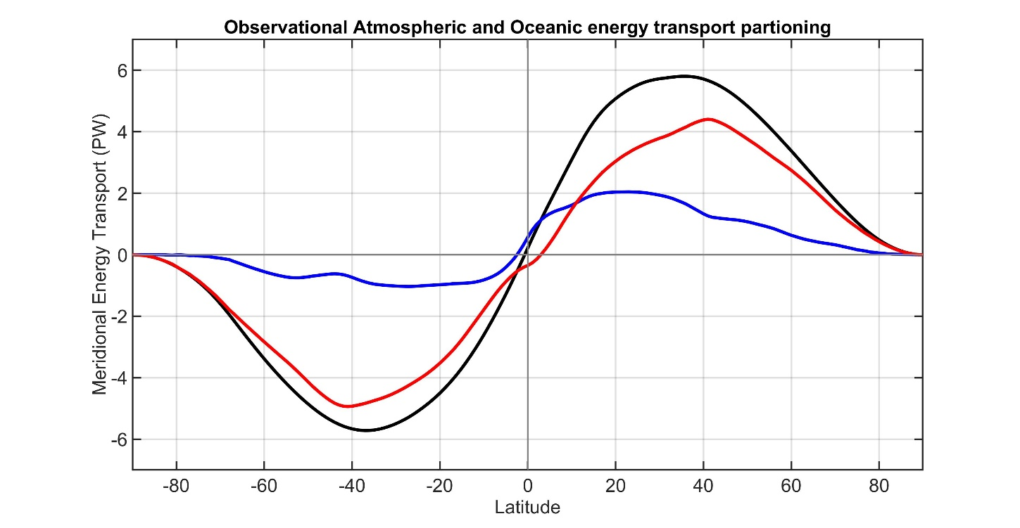
ASR
Total (atmosphere plus ocean) energy transport from TOA radiation (CERES satellite).
NET
OLR
AHT
Atmospheric energy transport from 6 hourly ERA5 reanalysis dynamics calculation
Tropics
Extratropics
Surface flux
Ocean heat transport as the residual = Total - atmos
Total
Total
Atmosphere
Ocean
Notes:
NH = 8.2 - 2.4 = 5.8
SH = 9.0 – 3.2 = 5.8

Slide 15
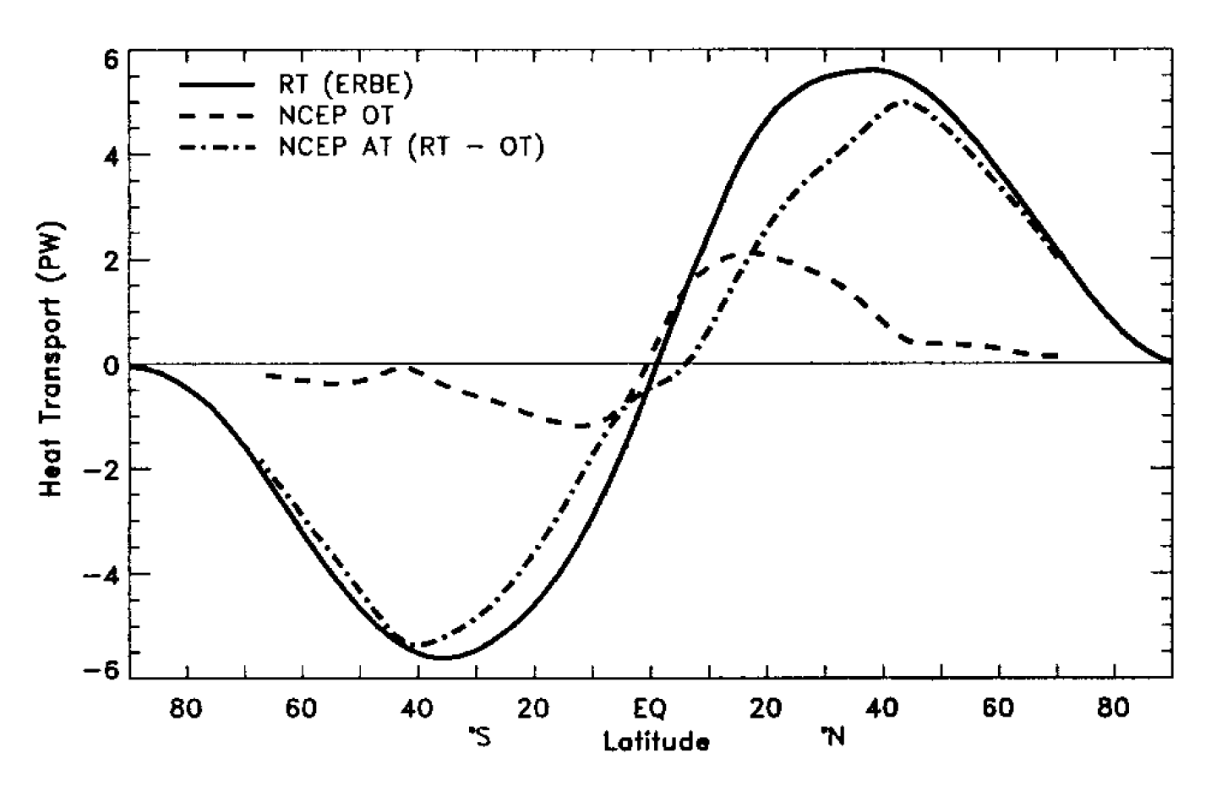
This strategy was pioneered by Trenberth and Caron (2001)
Total
Atmosphere
Ocean
Notes:
NH = 8.2 - 2.4 = 5.8
SH = 9.0 – 3.2 = 5.8

Slide 16
Observational partitioning of AHT/OHT
Total (atmosphere plus ocean) energy transport from TOA radiation (CERES satellite).
Tropics
Atmospheric energy transport from 6 hourly ERA5 reanalysis dynamics calculation
Extratropics
Ocean heat transport as the residual = Total - atmos
Total
Atmosphere
Ocean
Notes:
NH = 8.2 - 2.4 = 5.8
SH = 9.0 – 3.2 = 5.8

Slide 17
Model partitioning of AHT/OHT
MHT from Radiation
Total heat
transport (MHT)
Integral of
TOA radiation
=
Net radiative
Deficit of extratropics
5.8 PW
Integral of
Surface heat
Flux (SHF)
Ocean heat
Transport (OHT)
=
Atmospheric heat transport (AHT)
AHT = MHT – OHT
= Integral (TOA – SHF)
Tropics
Extratropics
Notes:
NH = 8.2 - 2.4 = 5.8
SH = 9.0 – 3.2 = 5.8

Slide 18
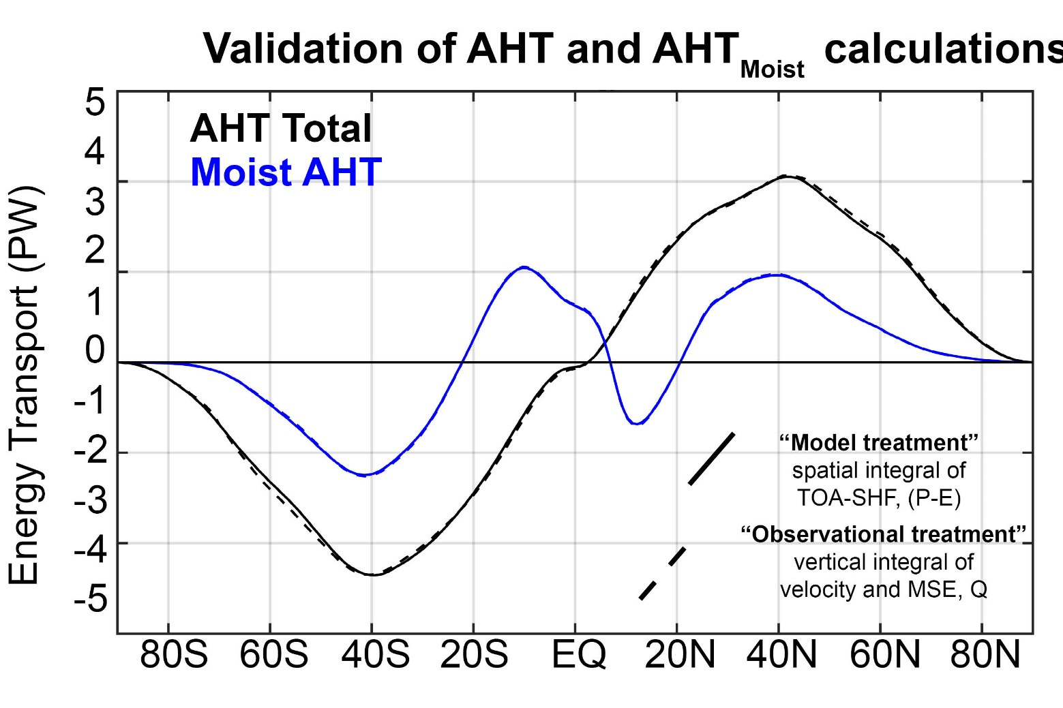
Consistency of “observational” and “model” based MHT calculation in a model simulation

Slide 19

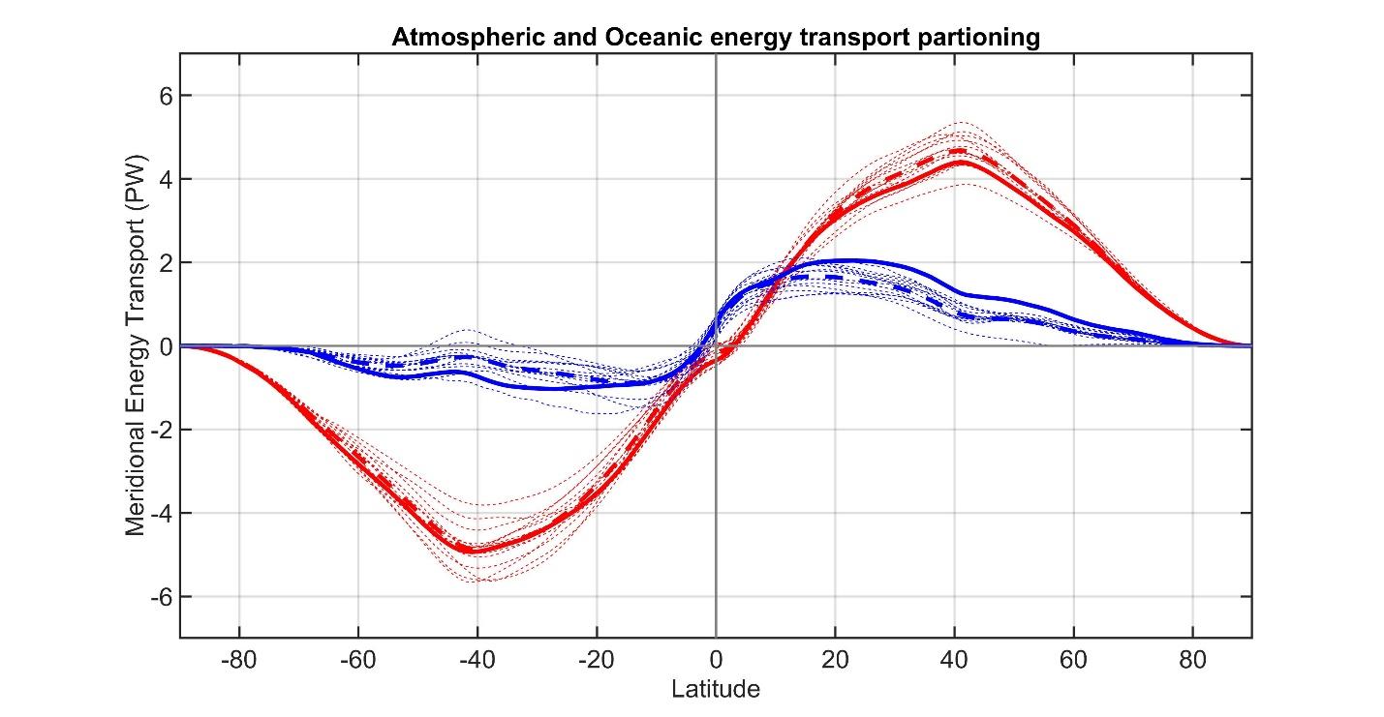
CMIP3 -- Partitioning of MHT 3
Observations
Total energy
transport
Individual models
Model Mean
ATMOSPHERE
Atmosphere ocean partitioning
OCEAN
Observations
Individual models
Model Mean

Slide 20

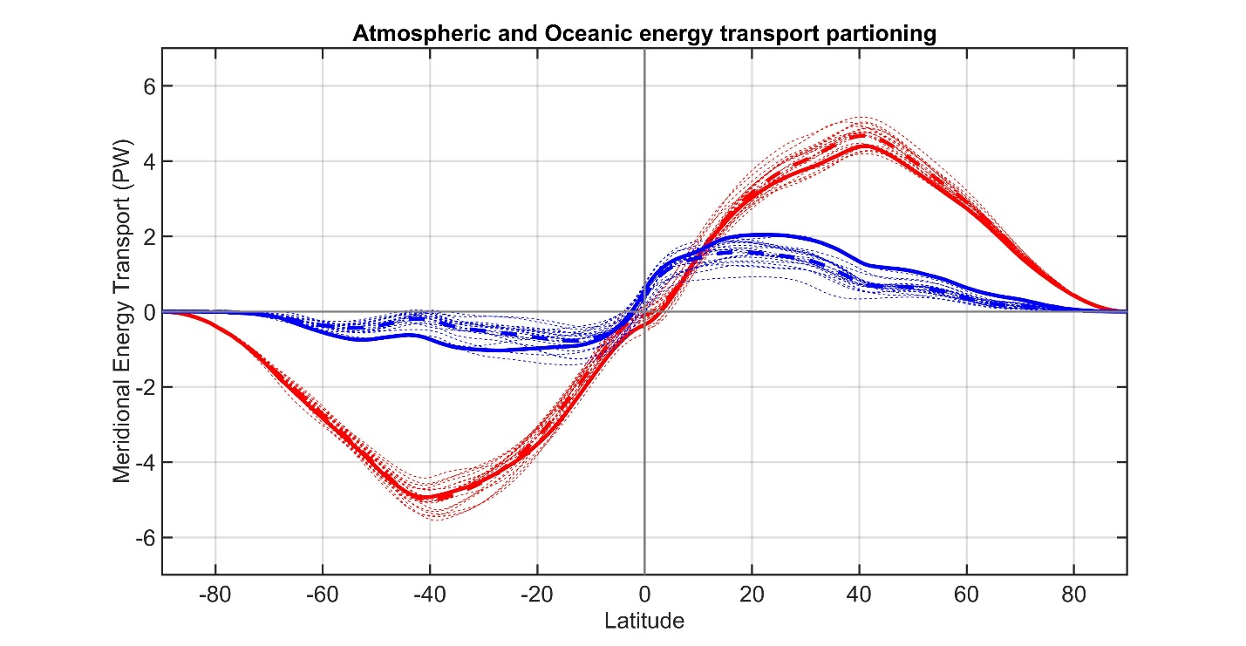
CMIP53
Observations
Total energy
transport
Individual models
Model Mean
ATMOSPHERE
Atmosphere ocean partitioning
OCEAN
Observations
Individual models
Model Mean

Slide 21
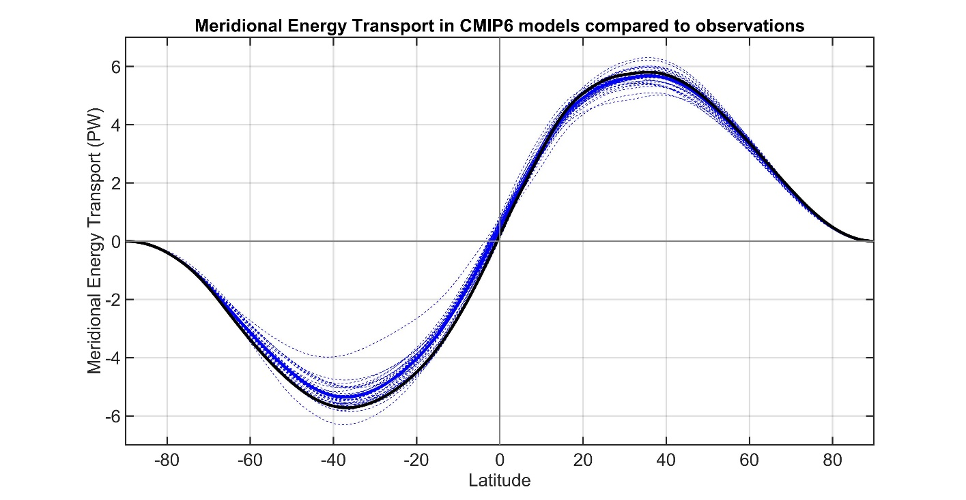
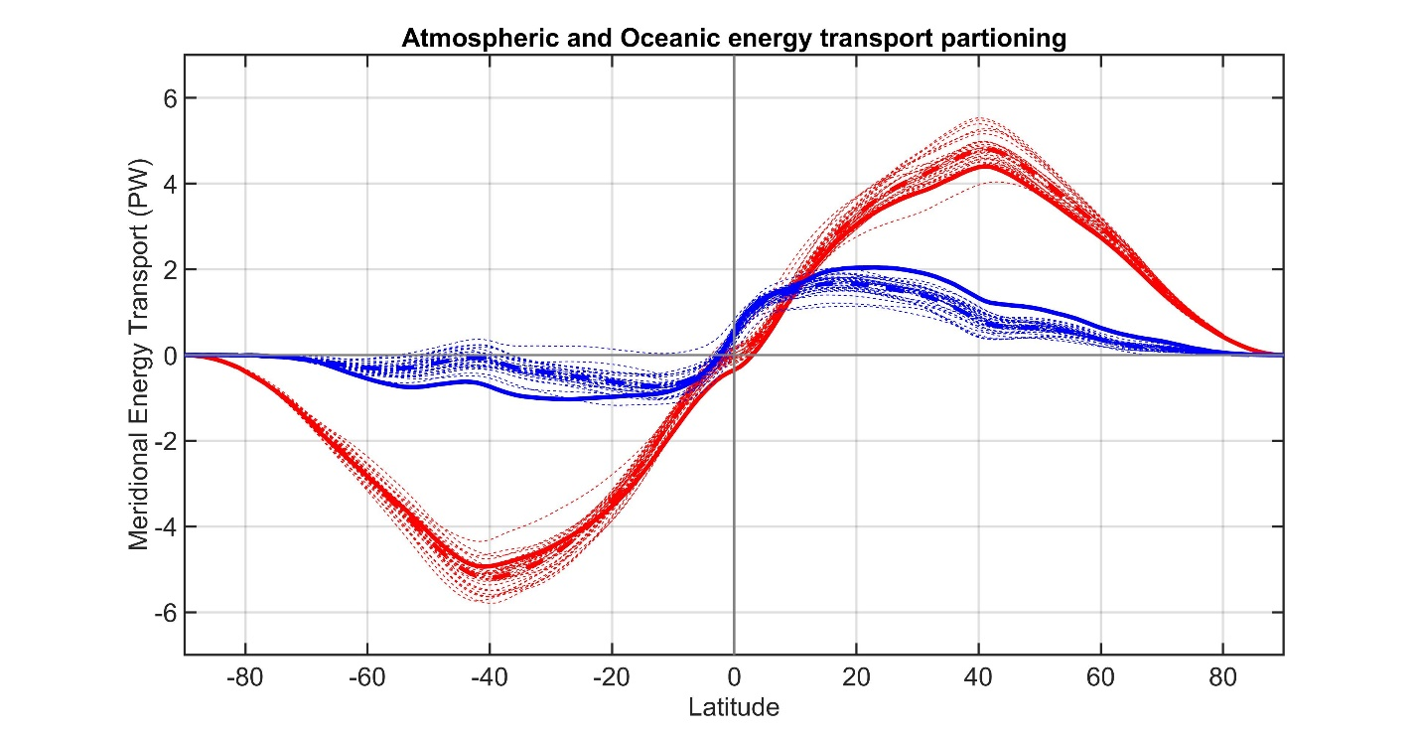
CMIP63
Observations
Total energy
transport
Individual models
Model Mean
ATMOSPHERE
Atmosphere ocean partitioning
OCEAN
Observations
Individual models
Model Mean

Slide 22

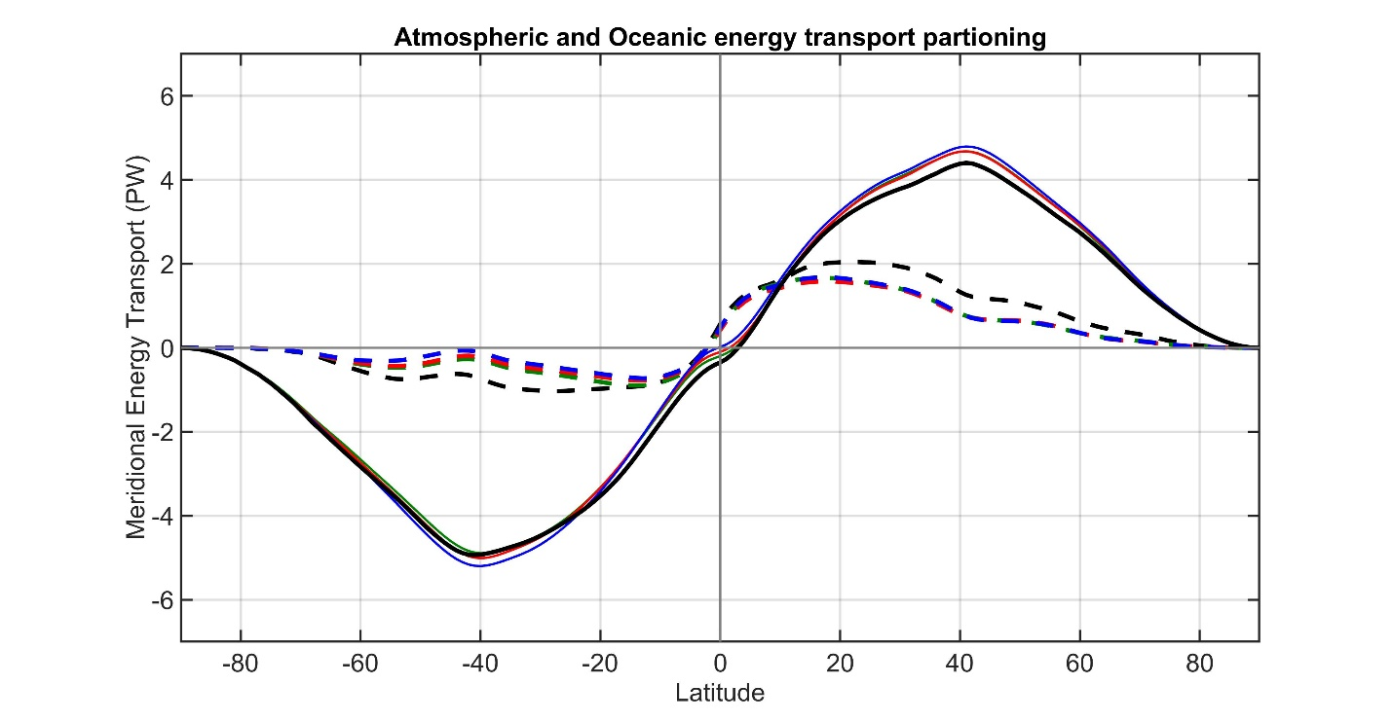
CMIP3 to 6 against observations
Observations
Total energy
transport
CMIP3 Mean
CMIP5 Mean
CMIP6 Mean
ATMOSPHERE
Atmosphere ocean partitioning
OCEAN
Observations
CMIP3 Mean
CMIP5 Mean
CMIP6 Mean

Slide 23
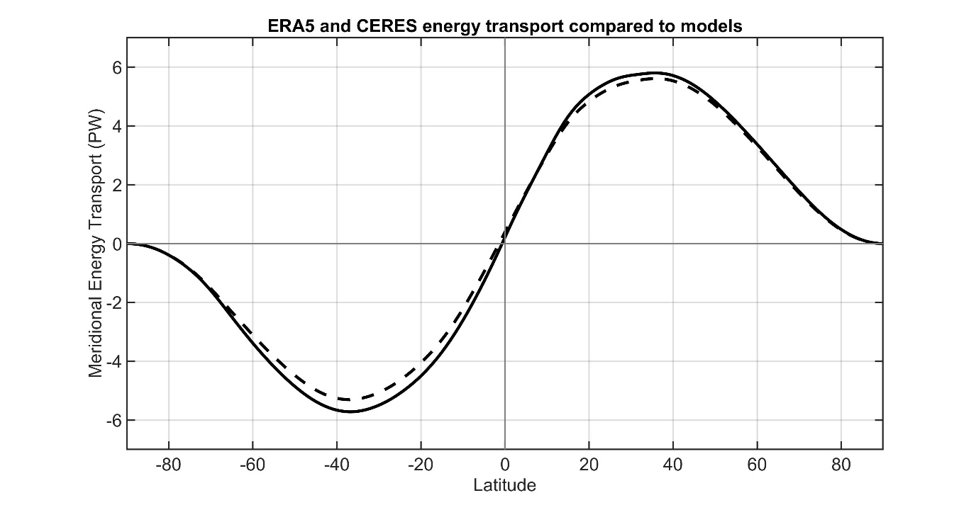
OBSERVATIONS FROM ERA5 and CERES
Observations
CMIP Mean
Total energy
transport
ATMOSPHERE
OCEAN
Observations
Atmosphere ocean partitioning
CMIP Mean

Slide 24
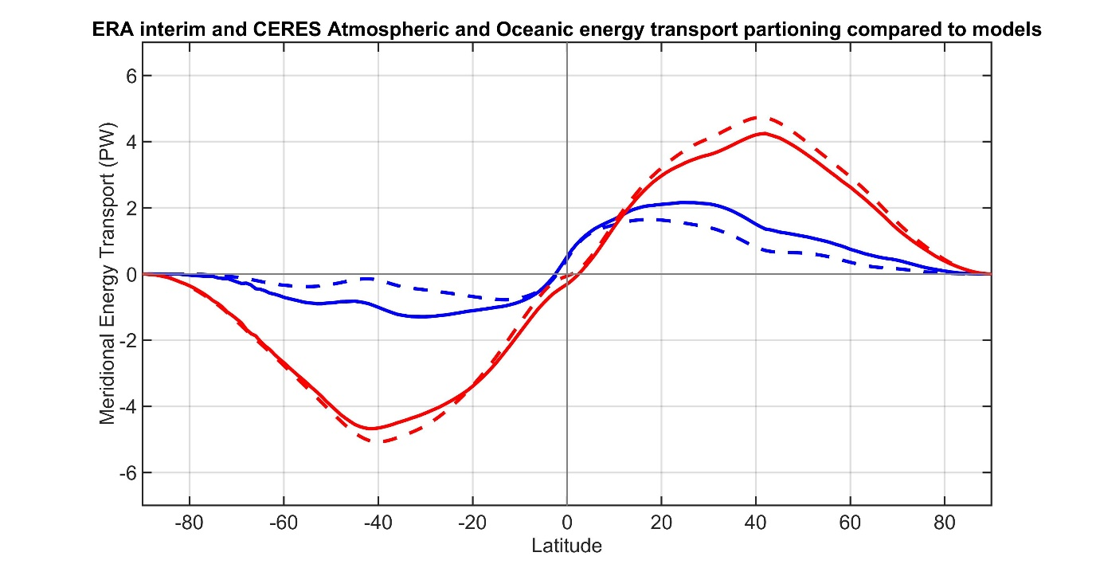
OBSERVATIONS FROM ERA INTERIM and CERES
Observations
CMIP Mean
Total energy
transport
ATMOSPHERE
OCEAN
Observations
Atmosphere ocean partitioning
CMIP Mean

Slide 25
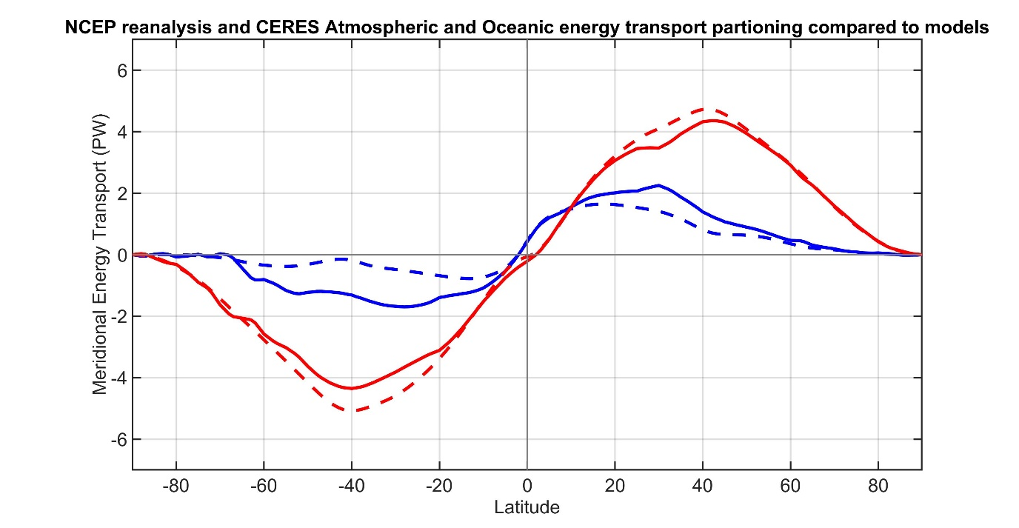
OBSERVATIONS FROM NCEP reanalysis and CERES
Observations
CMIP Mean
Total energy
transport
ATMOSPHERE
OCEAN
Observations
Atmosphere ocean partitioning
CMIP Mean

Slide 26
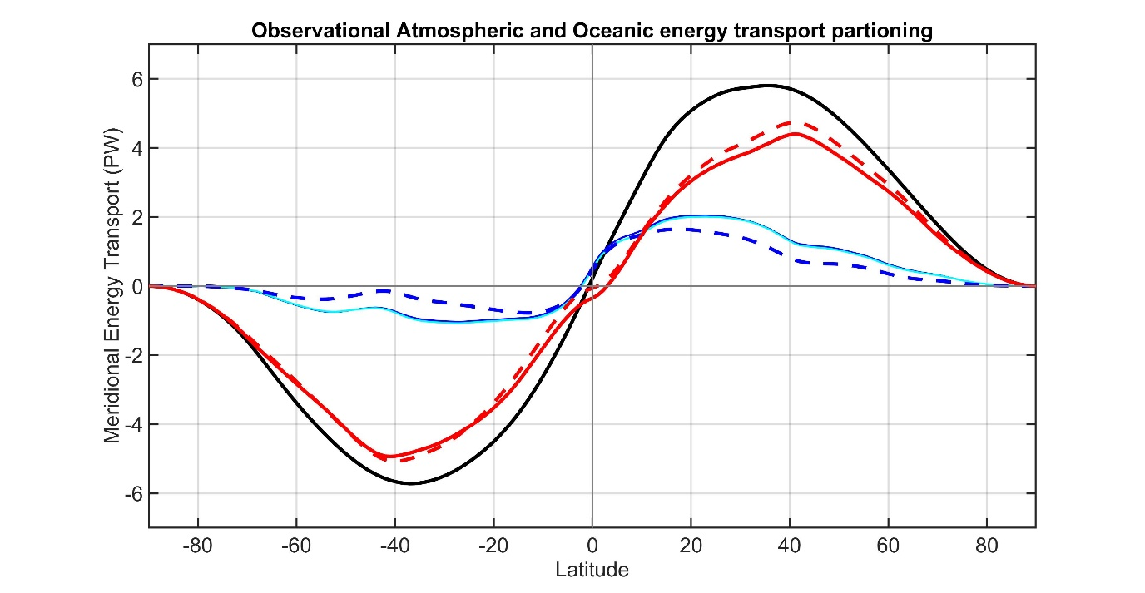
Accounting for ocean heat content changes
Total energy
transport
Observations
CMIP Mean
ATMOSPHERE
Correcting for ocean heat content changes -------------------------
From EN4 ocean reanalysis temperature trends
OCEAN
Observations
CMIP Mean

Slide 27
Partitioning of atmospheric energy by circulation type
Stationary
MOC
Overturning
Transient
* = Departure from zonal mean -- [ ]
' = Departure from time mean -- ¯
MSE = moist static energy
= CpT + LQ +gZ
MOC dominates in the deep tropics – Hadley cell
Stationary eddies stronger in NH
Transient eddies dominate the mid-latitudes

Slide 28
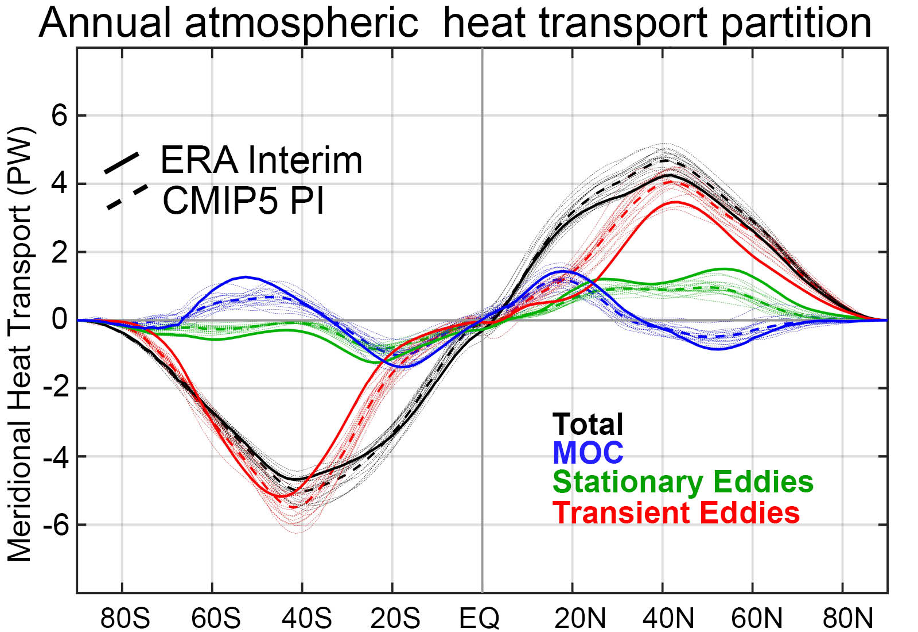
Observation vs. model AHT partitioning

Slide 29

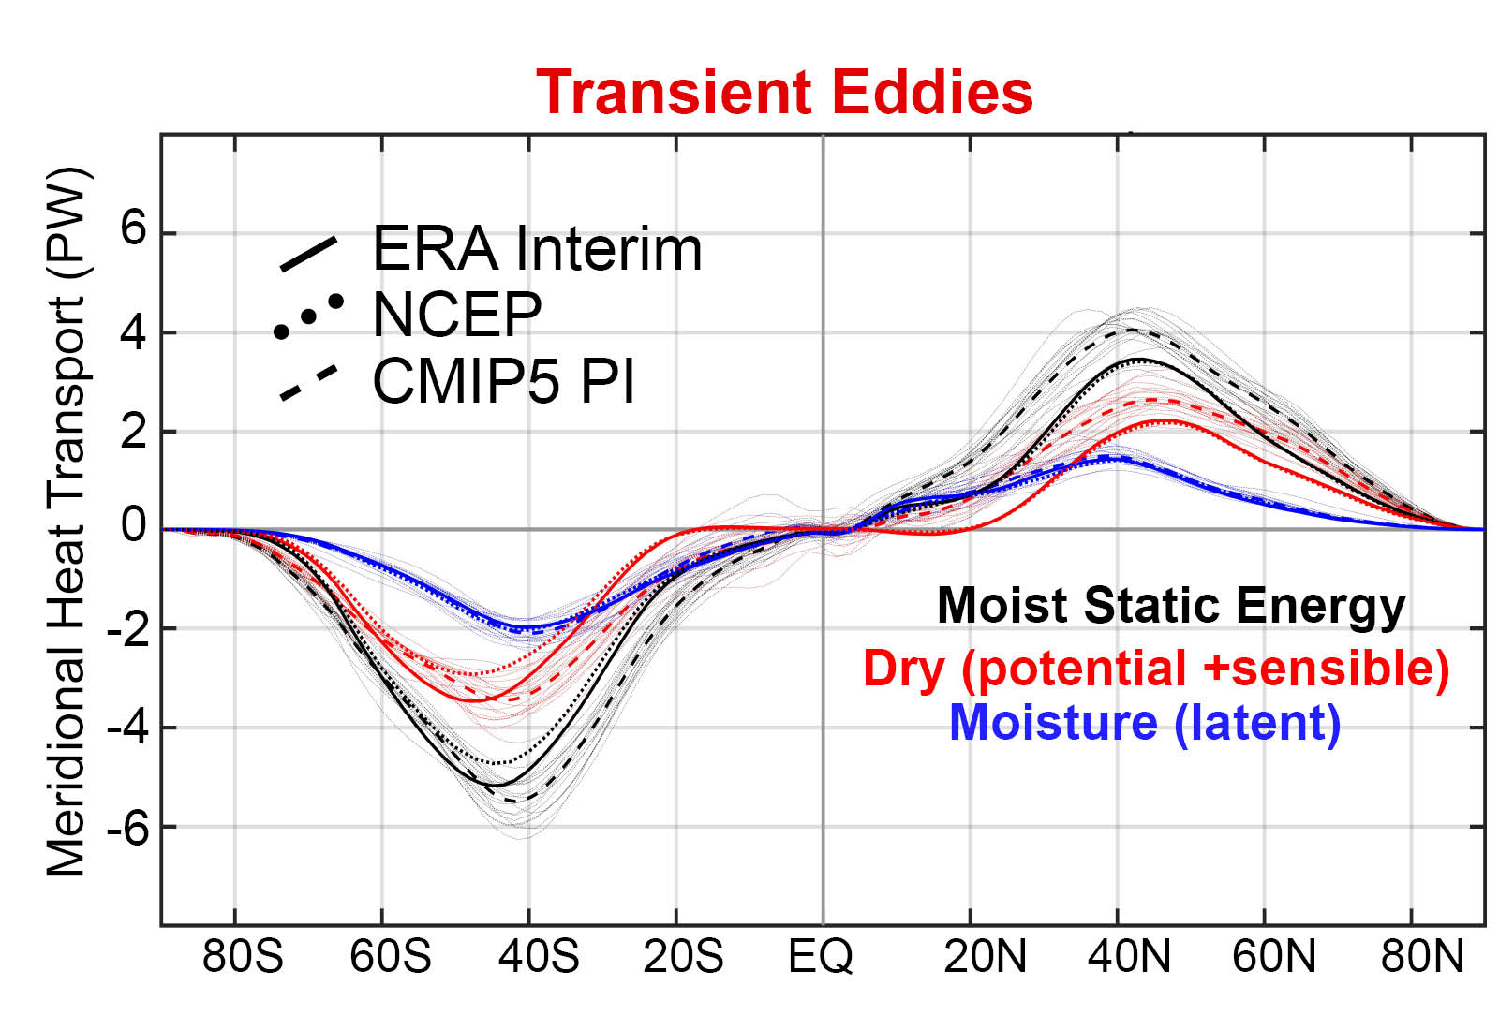
Model bias of enhanced transient eddy heat transport is due to sensible heat transport

Slide 31
