Slide 1
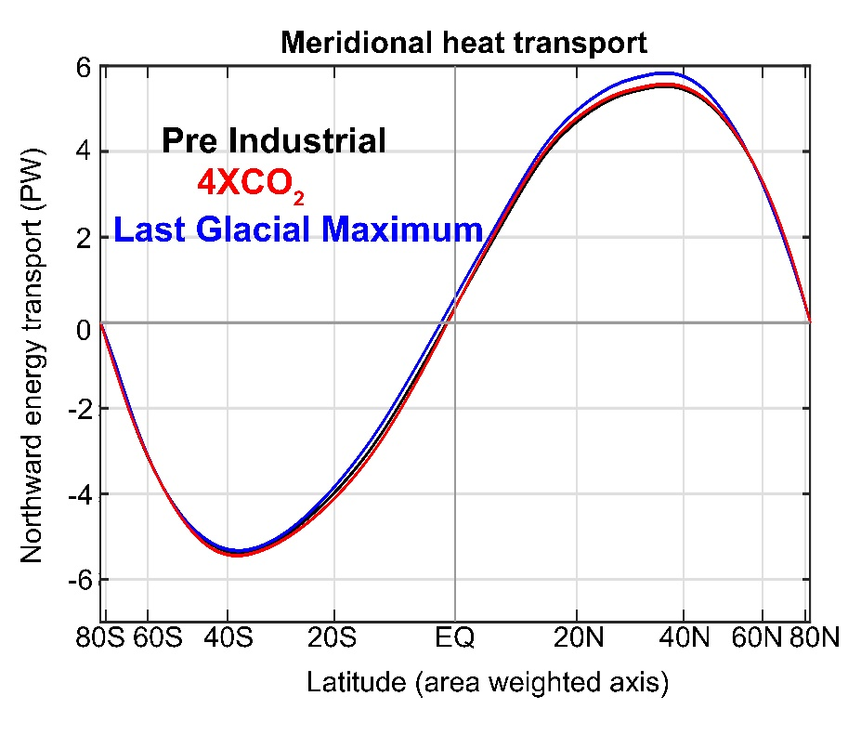








The climate impact of changes in poleward heat transport by atmospheric eddies is damped by the Ferrel cell response
Motivation for work:
Why doesn’t poleward energy transport change with climate state?
Aaron Donohoe – Polar Science Center, APL, UW
Tyler Cox -- UW atmospheric sciences
Robert Fajber – UW atmospheric science
Kyle Armour – UW Oceanography
Gerard Roe – UW Earth and Space Sciences

Slide 2
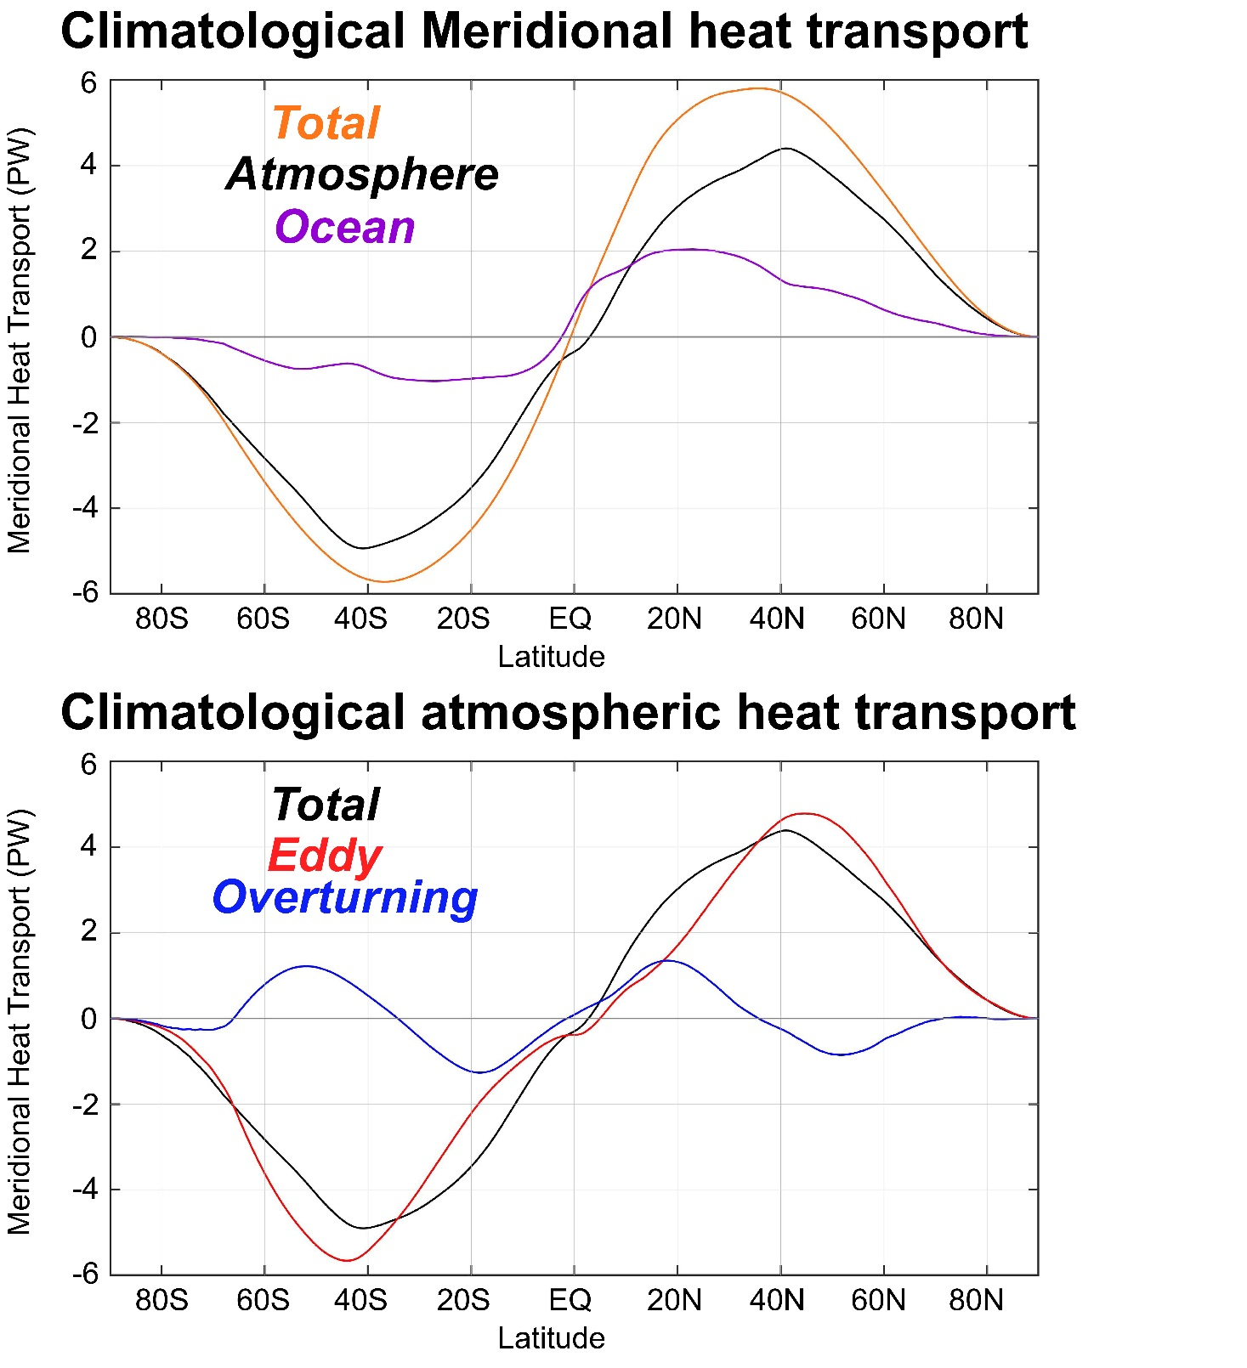
Total
Extratropical heat transport is dominated by the atmosphere
Atmospheric eddies do the majority of heat transport and are opposed by the overturning circulation (in the Ferrel cell)

Slide 3
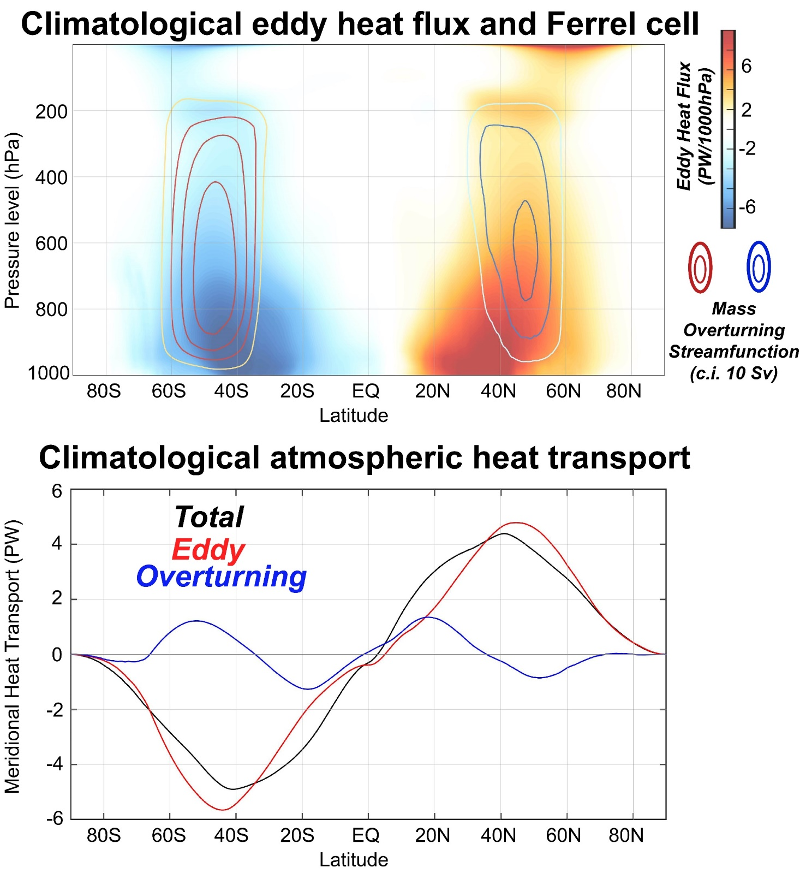
Total
Thermally indirect Ferrel cell is co-located with maximum in vertically integrated eddy heat flux

Slide 4
Total
Thermally indirect Ferrel cell is co-located with maximum in vertically integrated eddy heat flux
Eddy heat flux convergence on the poleward flank of storm track forces ascending branch of Ferrel cell
Thermally indirect Ferrel cell is co-located with maximum in vertically integrated eddy heat flux
Hadley cell
Ferrel cell
Wallace, Battisti, Thompson and Hartmann
The Atmospheric General circulation

Slide 5
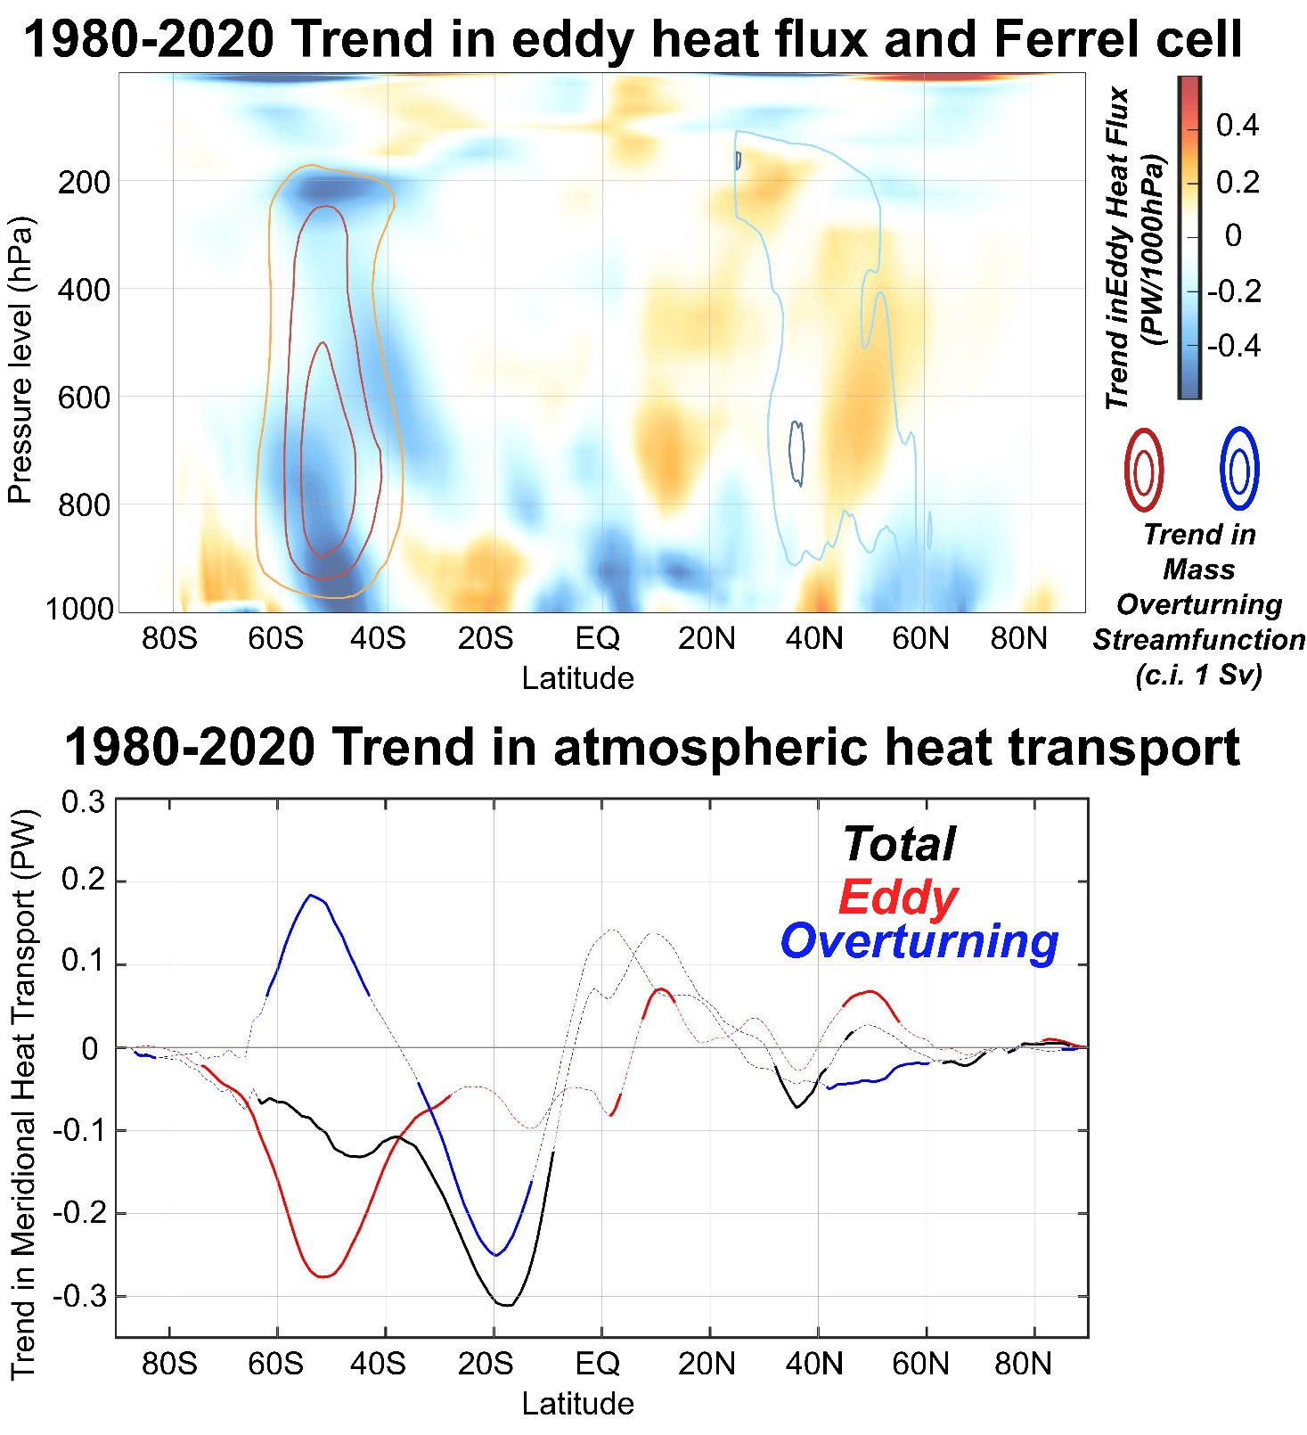
Total
Trends in atmospheric heat transport show robust (consistent between reanalyses) compensating trends in eddy and overturning AHT most notable in the Southern Hemisphere
We don’t trust the tropical trends--see Chemke and Polvani (2019)

Slide 6
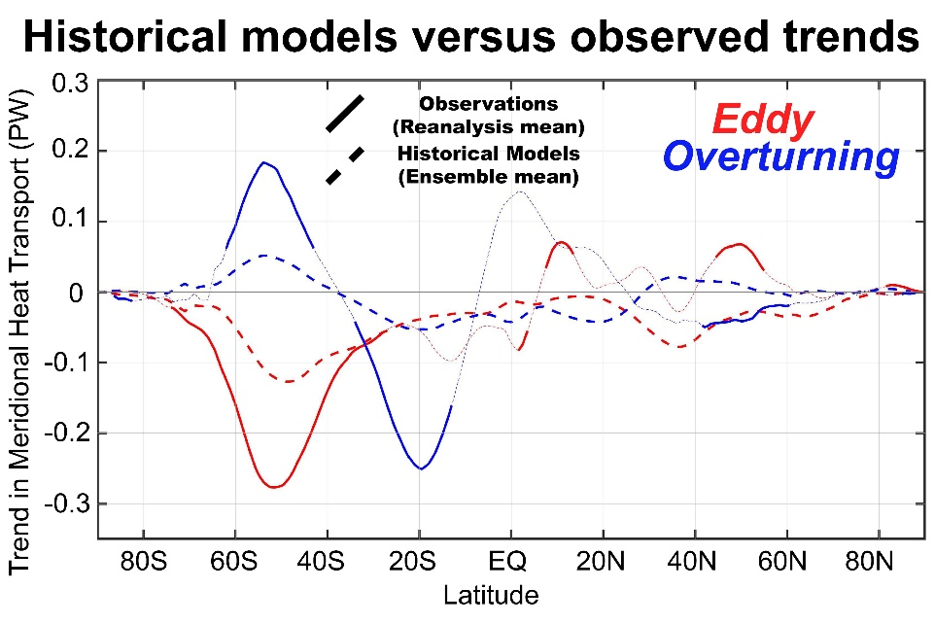
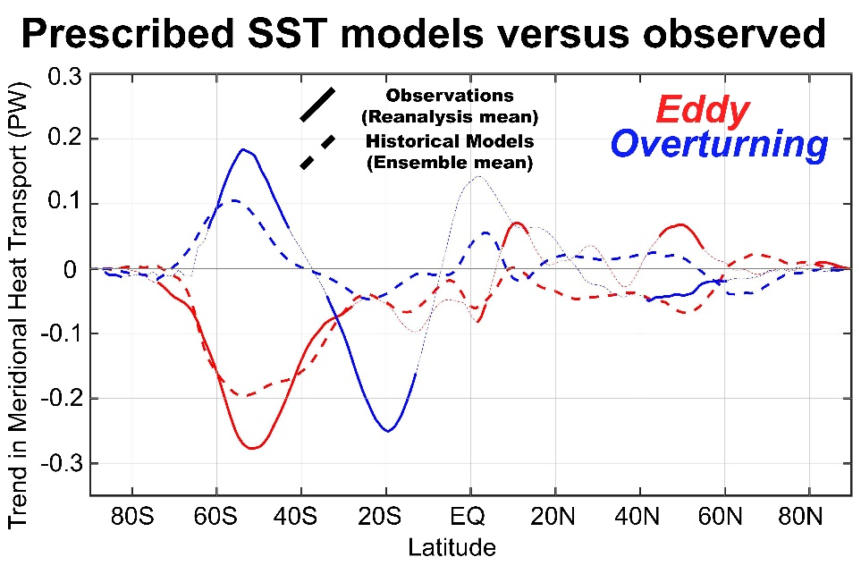
Model ensemble mean
Model simulation with historical forcing and prescribed observed SST show compensating trends in eddy and overturning AHT in the SH
→ Historical trends are smaller than observed
→ Prescribed SST are close to observed trends

Slide 7
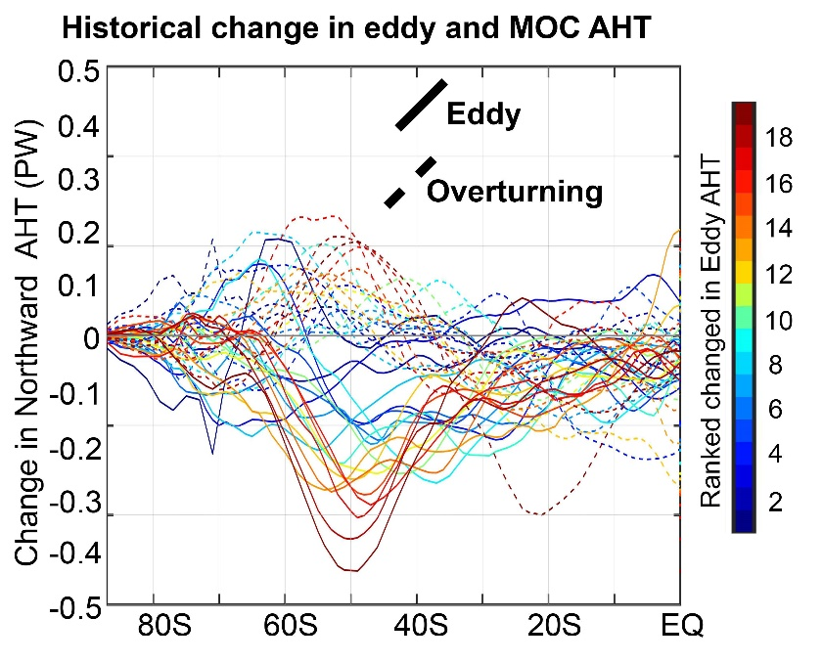
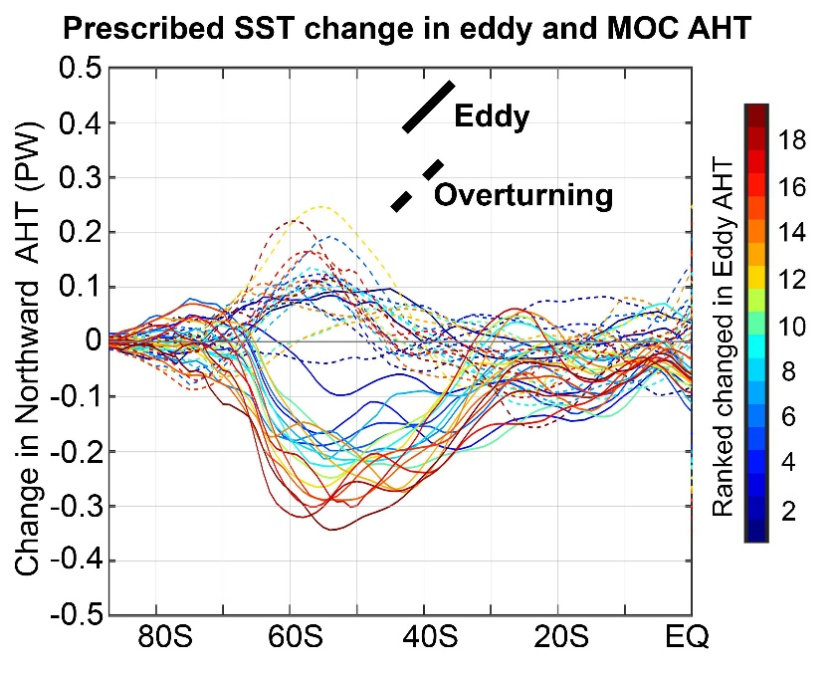
Model ensemble mean
Model spread

Slide 8
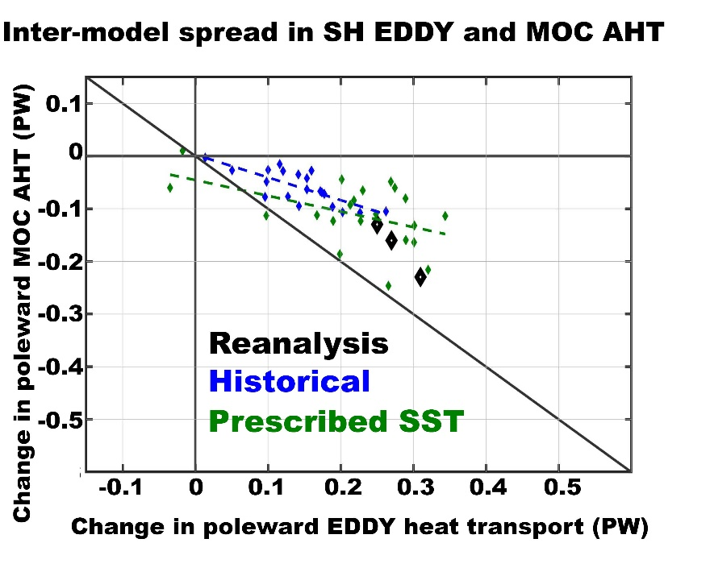
Compensation between eddy and overturning AHT trends in the inter-model spread
→ Models with more eddy AHT change have larger Ferrel cell response
→ Compensation of about 50%
Model spread

Slide 9
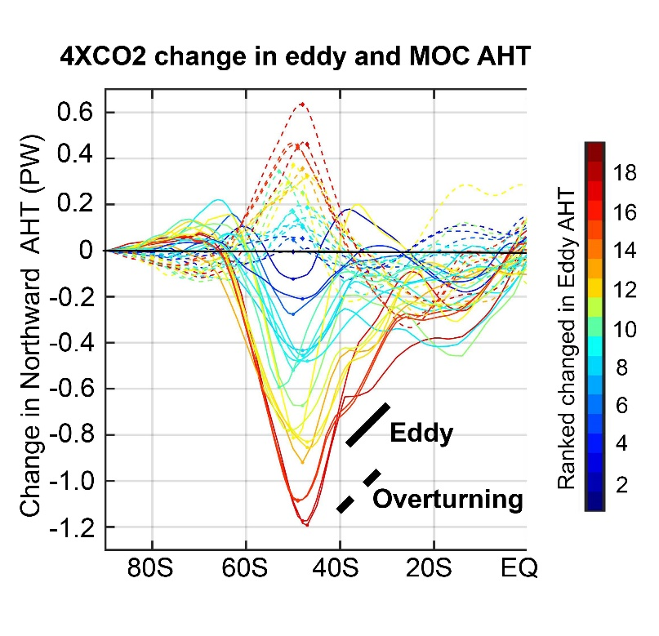
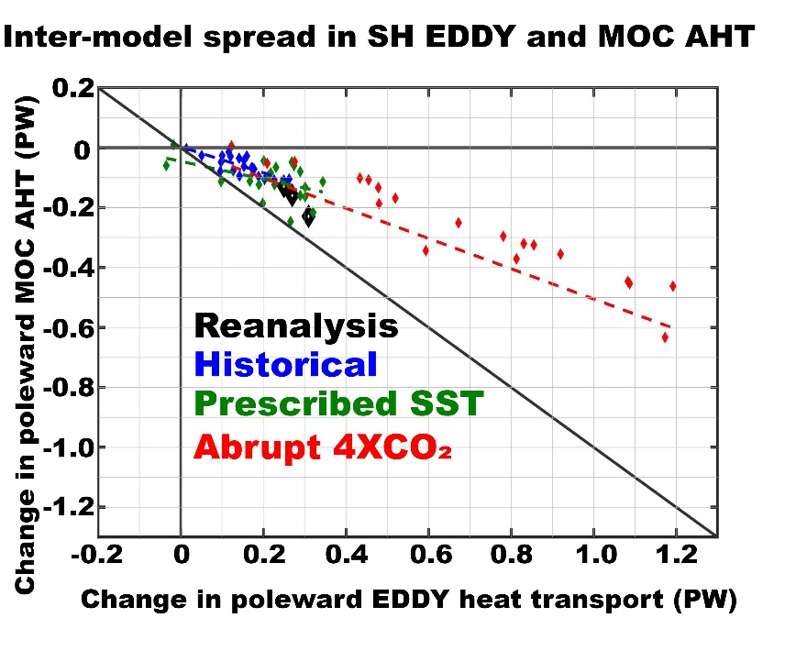

Slide 10
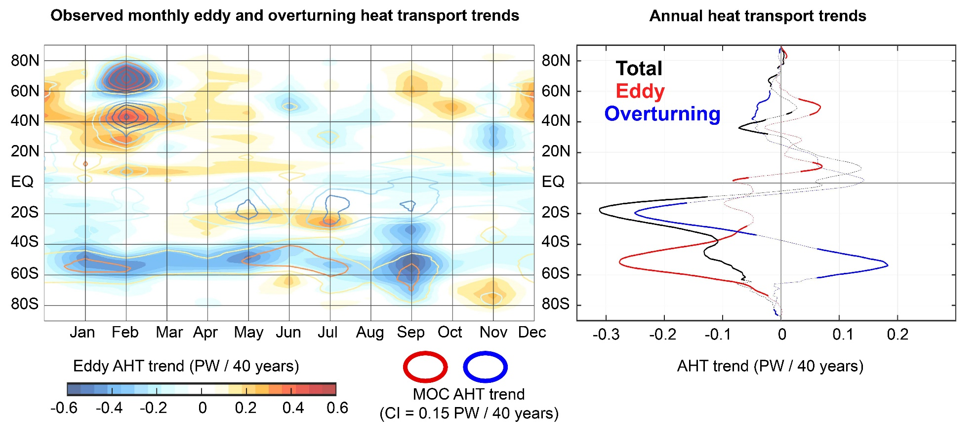
Observed trends in AHT (1980-2018)
ERA5 reanalysis
Eddy and Ferrel cell AHT changes trends are seasonally and spatially co-located with a compensation of 60%

Slide 11
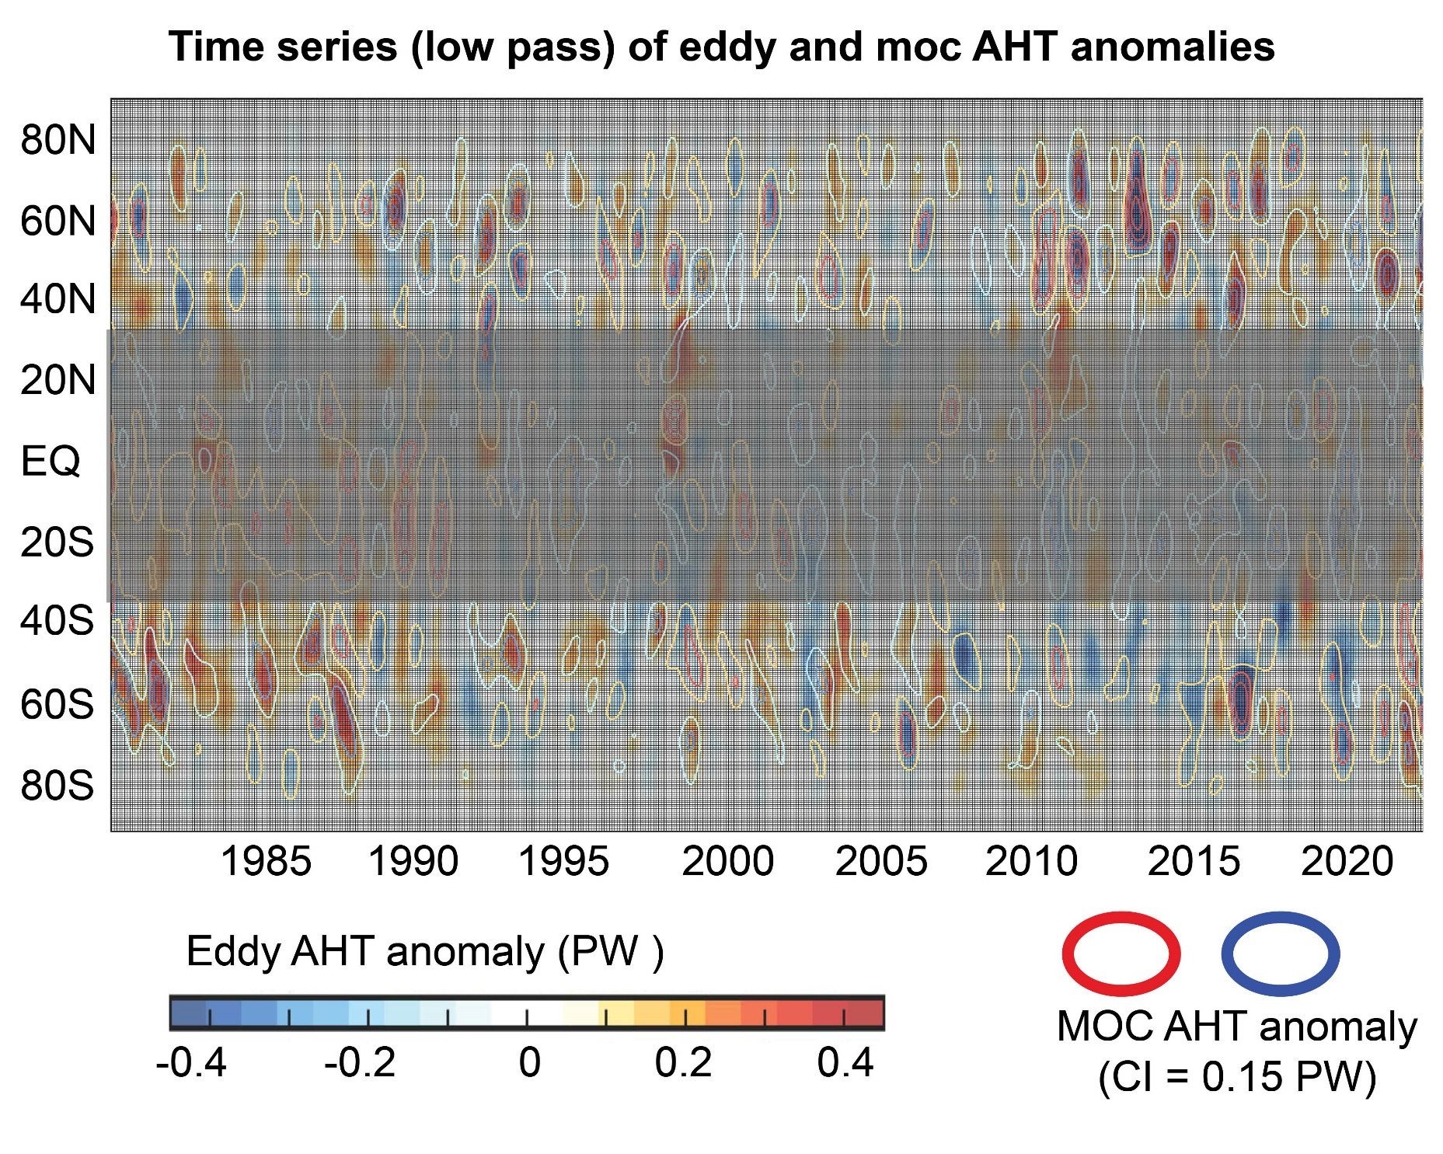

Slide 12
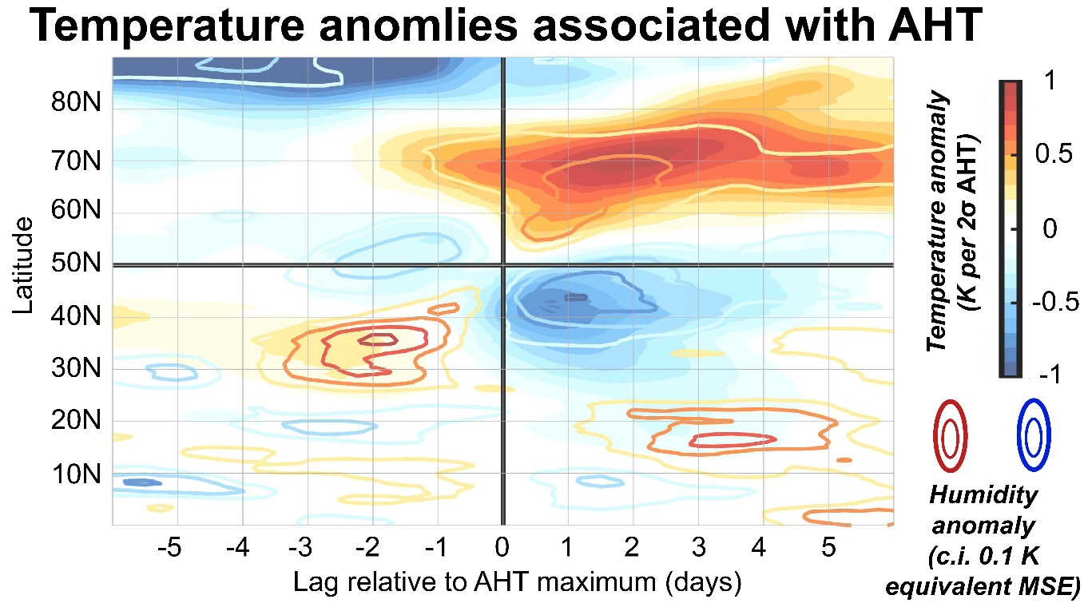
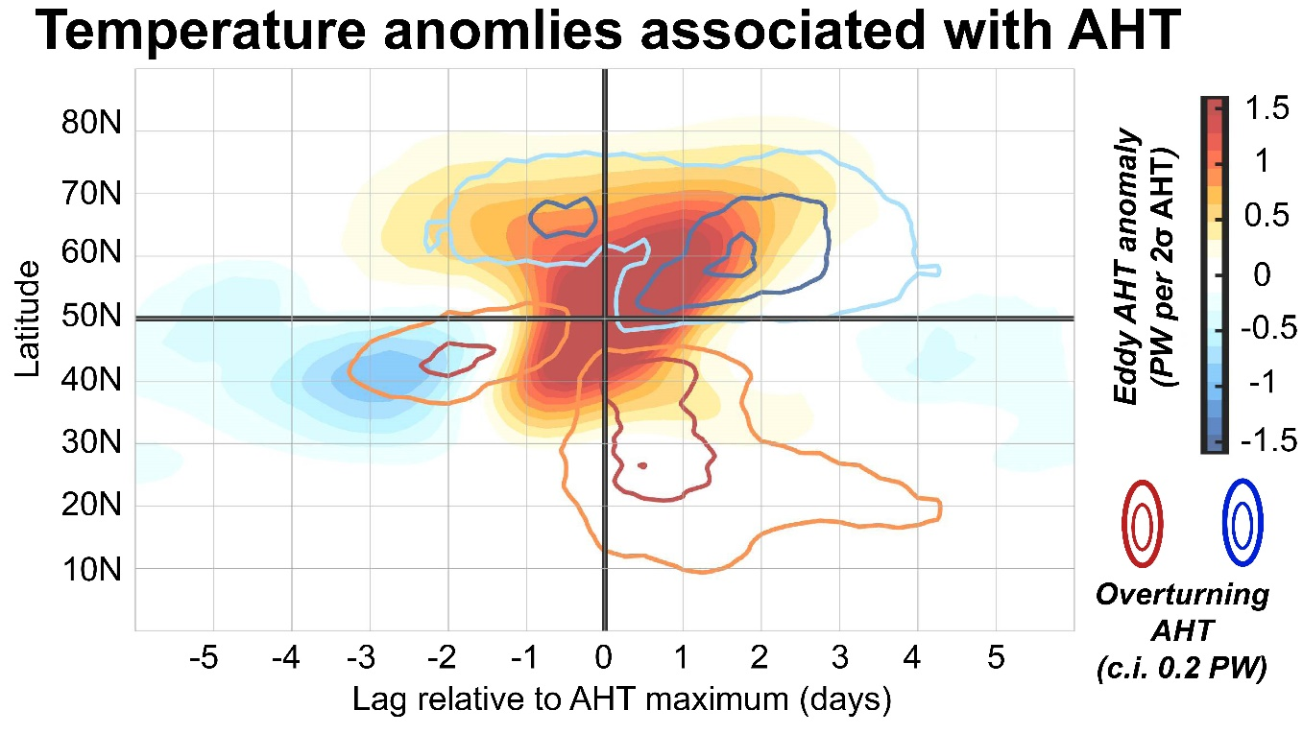
Composites of AHT anomaly at 50N (Wintertime DJF
Atmospheric heat transport is responsible for the majority (80%) of atmospheric heating
Ferrel cell response is nearly synchronous and damps heating by 20%

Slide 13
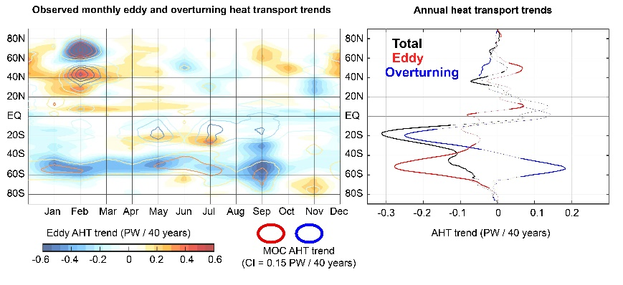
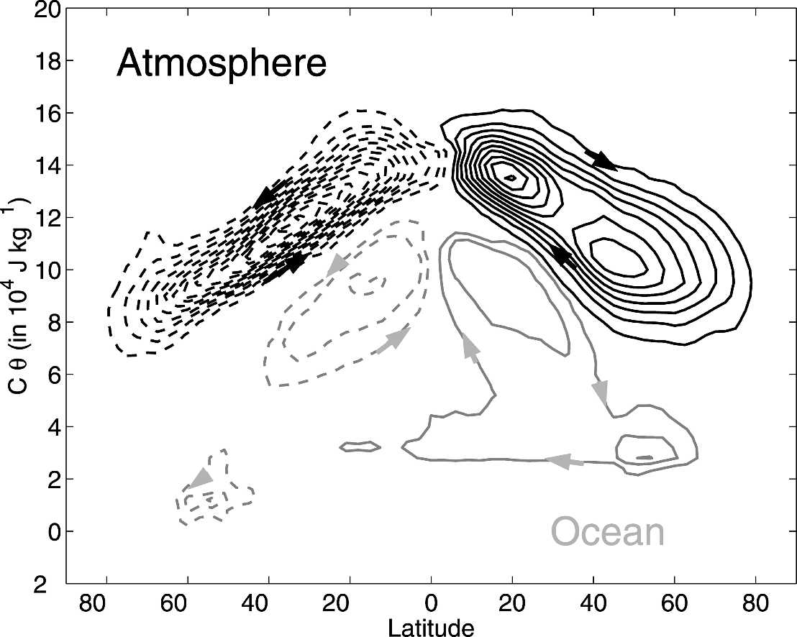
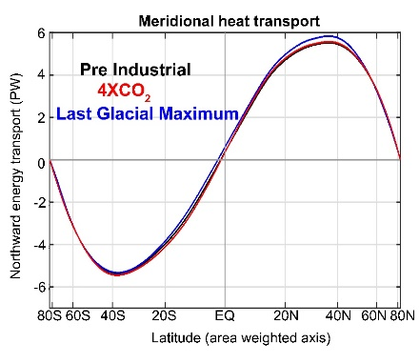
Summary and considerations
→Eddy and overturning compensation occurs across timescales from forced trends, historical trends, monthly, synoptic
** Damps climate impact of eddy AHT changes
→Well known from Transformed Eulerian Mean (or circulation on isentropic coordinates) but does theory predict the degree of compensation (approximately 60%)
**Do models have the right compensation?
** Why is perturbation compensation larger than climatological compensation?
→ Does Ferrel cell response provide the connection between radiative constraints on poleward heat transport invariance and its dynamical realization?
Czaja and Marshall (2006)

Slide 14
Eddy and Ferrel Cell AHT compensation
(Tyler Cox)
Hadley Cell
Ferrel Cell
On the equator flank of the Ferrel cell (point D):
→ Eddy heat flux convergence forces vertical motion (unless it can be radiatively damped)
Vertical mass flux is balanced by thermally indirect Ferrel cell mass transport with and AHT equal to mass flux times static stabiltiy
AHT of the Ferrel cell compensates for eddy heat flux perfectly if there is no radiative damping
Wallace, Battisti, Thompson and Hartmann
The Atmospheric General circulation

Slide 15
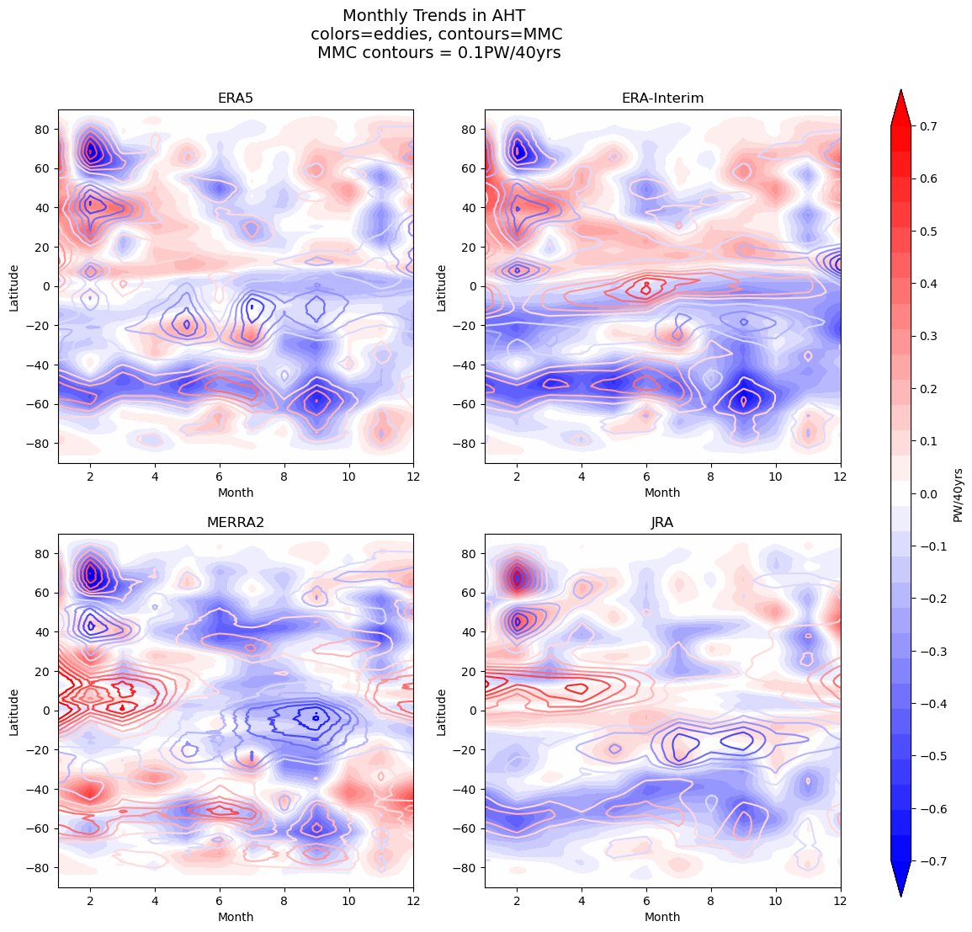
AHT trends and eddy-Ferrel cell compensation is consistent between different reanalyses

