Slide 1
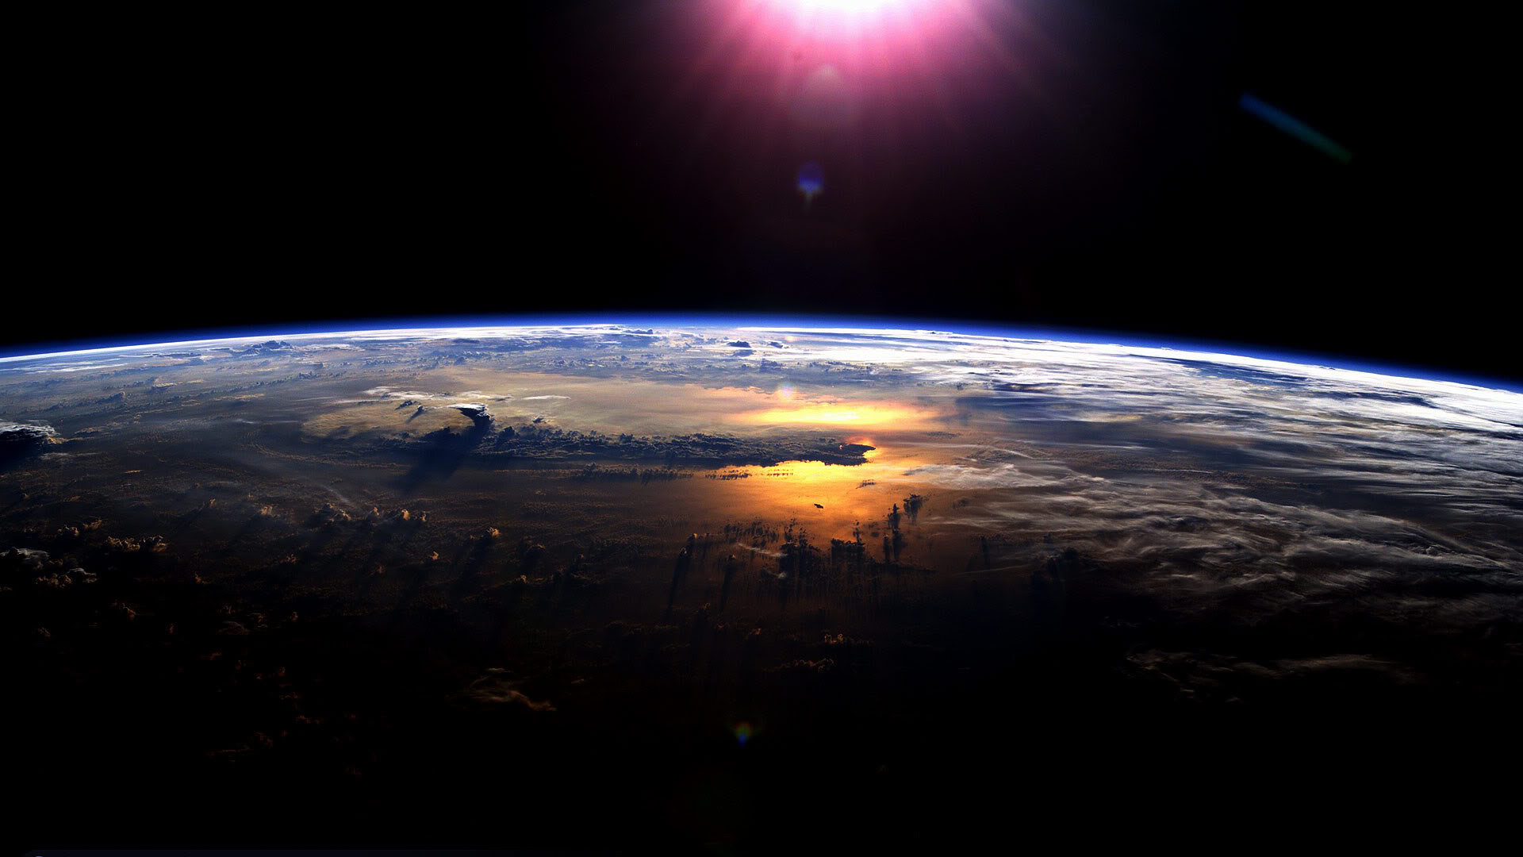
Shortwave and longwave radiative contributions to global warming under increasing CO₂
Aaron Donohoe – Applied Physics Lab, UW
Kyle Armour, David Battisti, Angie Pendergrass
CSU colloquium
12/5/2014

Slide 2
Solar versus longwave forced global warming
Equilibrium
Outgoing Longwave Radiation (OLR)
Absorbed
Shortwave
Radiation
(ASR)
Earth
ASR = OLR

Slide 3
Solar versus longwave forced global warming
Solar perturbation
Equilibrium
Outgoing Longwave Radiation (OLR)
Absorbed
Shortwave
Radiation
(ASR)
ASR > OLR
ASR = OLR
Warming
Greenhouse perturbation
Earth
CO₂
CO₂
ASR = OLR
ASR > OLR
ASR = OLR
Warming

Slide 4
Solar versus longwave forced global warming
Solar perturbation
Equilibrium
Outgoing Longwave Radiation (OLR)
Absorbed
Shortwave
Radiation
(ASR)
ASR = OLR
Warming
Greenhouse perturbation
Earth
CO₂
CO₂
ASR = OLR
ASR = OLR
Warming

Slide 5
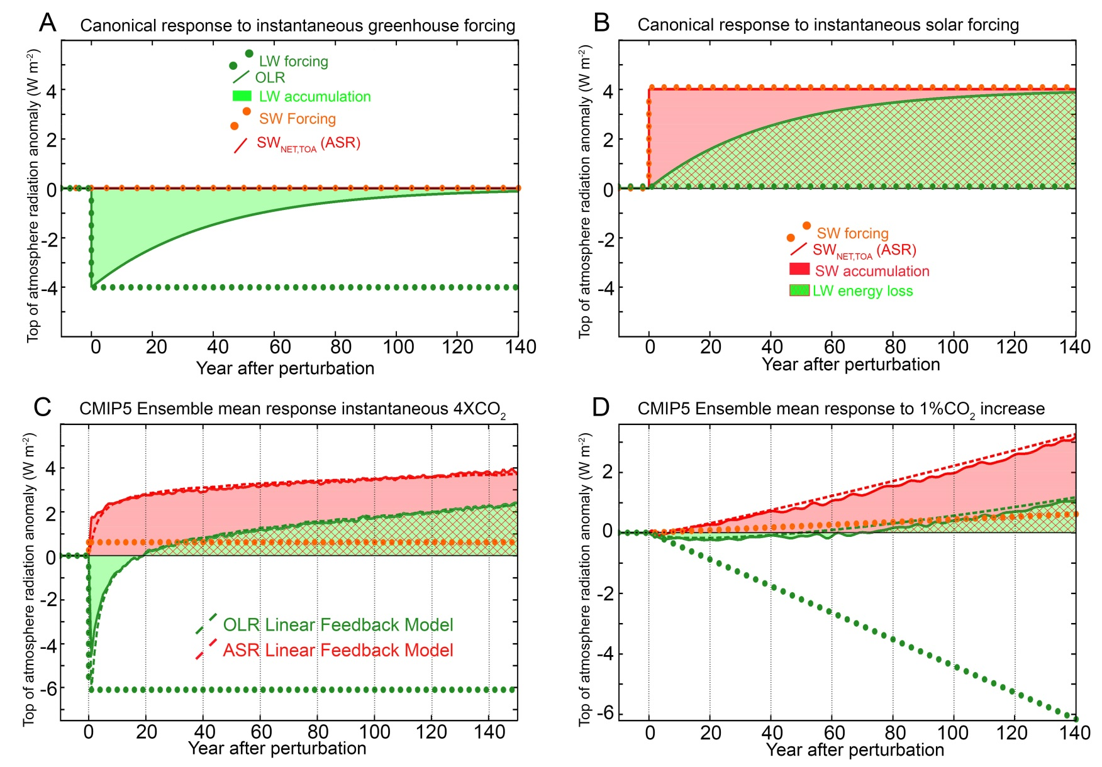
Top of Atmosphere Radiative response to greenhouse and shortwave forcing
OLR returns to unperturbed value in 20 years

Slide 6
How to reconcile this – response to greenhouse forcing with a shortwave feedback
LW feedback only
LW and SW feedback
Greenhouse forcing F_{LW}= 4 W m⁻²
F_{LW}= 4 W m⁻²
λ_{SW} ΔT
= 4 W m⁻²
λ_{LW} ΔT
= 8 W m⁻²
-λ_{LW} ΔT
= 4 W m⁻²
ΔOLR=
-F_{LW} + -λ_{LW} ΔT = ΔASR
ΔOLR
= 0
ΔT= 2K
ΔT= 4K
Forcing = response
Forcing = response
F_{LW} = -(λ_{LW} +λ_{SW} ) ΔT
F_{LW} = -λ_{LW} ΔT
if λ_{SW} = +1 W m ⁻² K ⁻¹
if λ_{LW} = -2 W m ⁻² K ⁻¹
ΔT = F_{LW} /-λ_{LW} = 2 K
ΔT = F_{LW} /-(λ_{LW} + λ_{SW} ) = 4 K

Slide 7
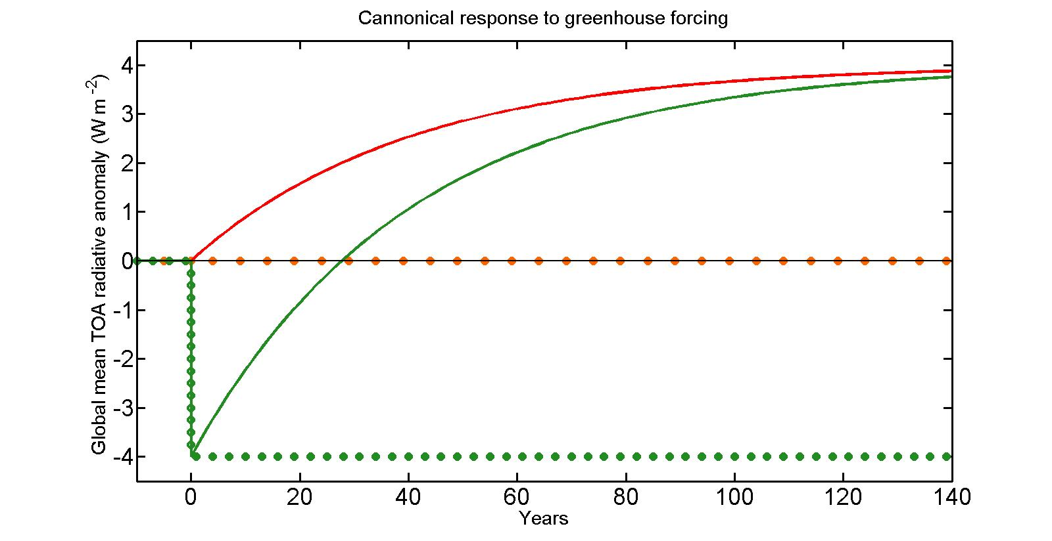
Time evolution of OLR response to greenhouse forcing with SW feedback
OLR must go from –FLW at time 0 to FLW in the equilibrium response
OLR returns to unperturbed value when half of the temperature response occurs
τ_{cross} = τ ln(2)
ASR
OLR
F_{LW}
Where τ is the e-folding timescale of the response
~ 20 years for heat capacity of 150m ocean

Slide 8
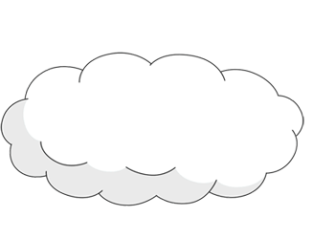
Why are SW feedbacks positive?
Claim: Even in the absence of cloud changes, one should expect a positive SW feedback based on 2 robust physical mechanisms:
1: SW water vapor feedback
2: Surface albedo feedback
incident
Reflected
cloud
absorbed
H₂0
(vapor)
Reflected
surface
transmitted
ice
ocean

Slide 9
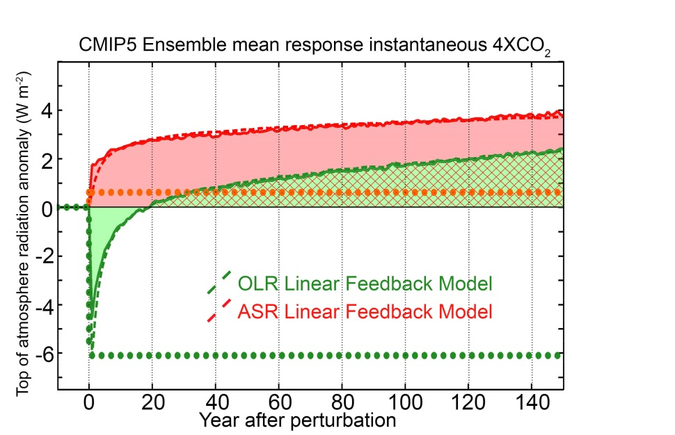
Outline
1. Timescale of OLR recovery from greenhouse forcing (4XCO₂) in GCMs
    Introduce Linear Feedback model
    Physics of Ensemble Average
    Cause of Inter-model spread
2. Observational constraints on OLR recovery timescale

Slide 10
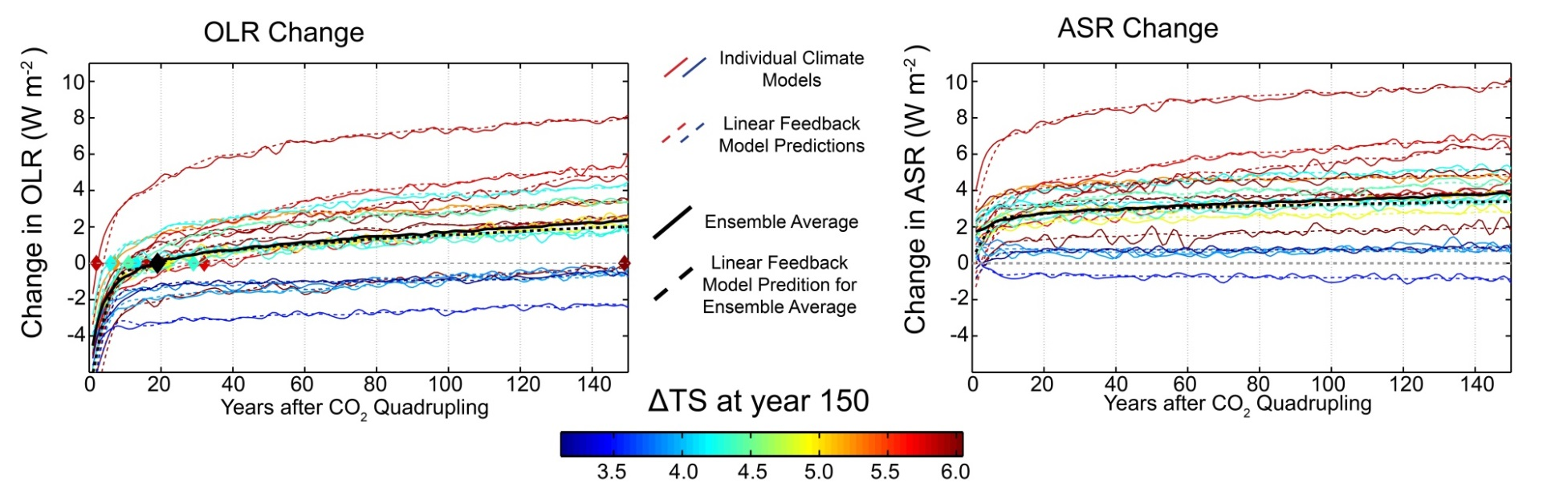
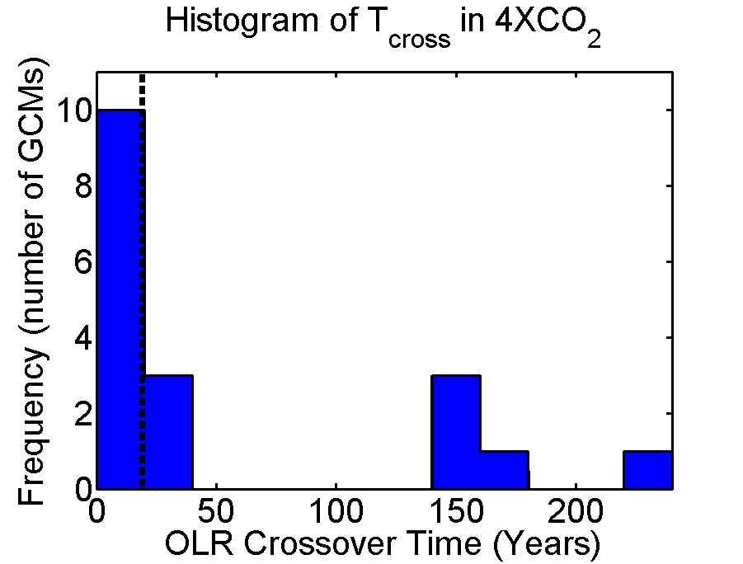
Inter-model spread in TOA response
The TOA response to greenhouse forcing differs a lot between GCMs
OLR returns to unperturbed values (Τ_{CROSS}) within 5 years for some GCMs and not at all for others (bi-modal)
On average, Τ_{CROSS} = 19 years
Ensemble mean

Slide 11

Linear Feedback model
Top of atmosphere (TOA) radiation
Forcing
Feedbacks
Energy Change
C = heat capacity of climate system. Time dependent – meters of ocean
T_{S} = Global mean surface temperature change
F_{SW} and F_{LW} are the SW and LW radiative forcing (including fast cloud response to radiative forcing – W m⁻²)
λ_{LW} and λ_{SW} are the LW and SW feedback parameters. W m⁻² K⁻¹
Given above parameters and T_{S} , we can predict the TOA response
Notes:
7.5 meters per W m^-2 year

Slide 12
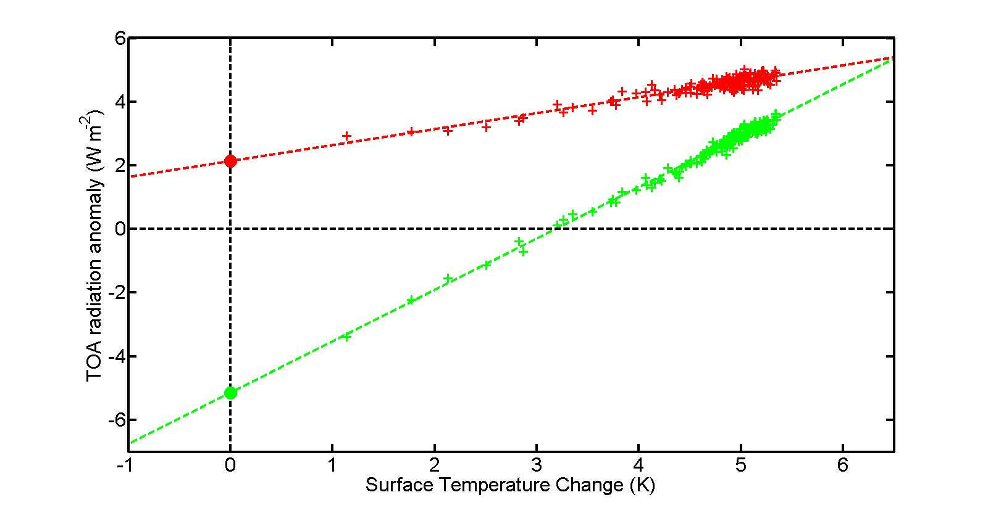
Backing out Forcing and feedbacks from instantaneous 4XCO2 increase runs
CNRM model
ASR change
F_{SW}
OLR change
Slope = - λ_{LW}
-F_{LW}
Feedbacks parameters (λ_{LW} and λ_{SW}) are the slope of –OLR and ASR vs. T_{S} (W m⁻² K⁻¹)
Forcing (F_{SW} and F_{LW}) is the intercept (W m⁻² ) . Includes rapid cloud response to CO₂ (Gregory and Webb)

Slide 13
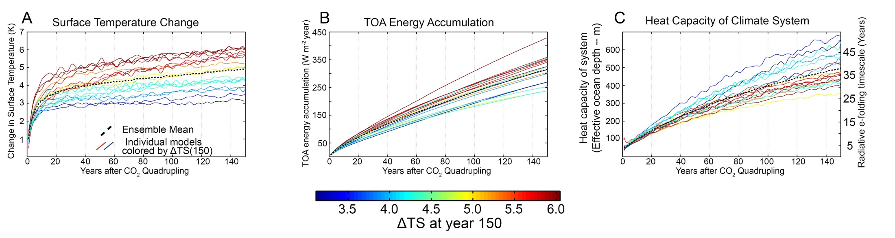
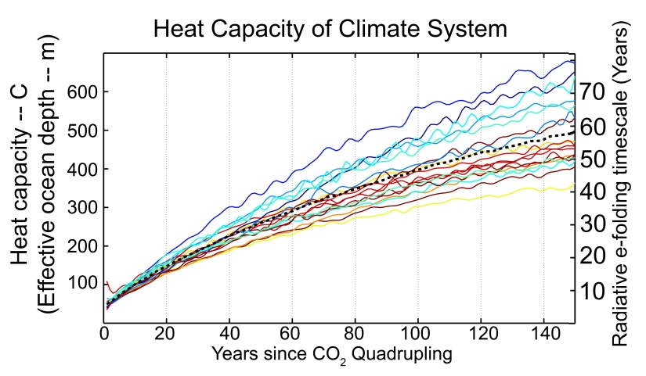
Heat capacity: 4XCO₂
Heat capacity increases with time as energy penetrates into the ocean
In first couple decades, energy is within the first couple 100 m of ocean and system e-folds to radiative equilibrium in about a decade

Slide 14
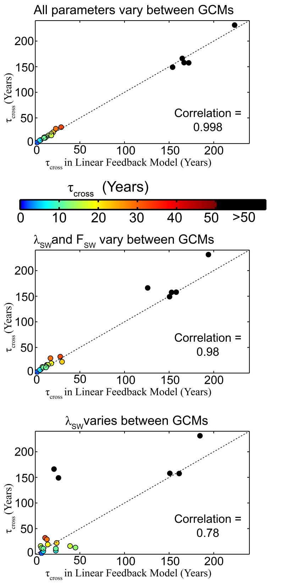
Linear Feedback model works
The TOA response in each model (and ensemble average) – solid lines– is well replicated by the linear feedback model
What parameters (forcing, feedbacks, heat capacity) set the mean radiative response and its variations across models?

Slide 15

Understanding the ensemble average response
Ensemble average forcing and feedbacks
OLR at equilibrium
λ_{LW} = -1.7 W m⁻² K⁻¹
λ_{SW} = +0.6 W m⁻² K⁻¹
F_{LW} = + 6.1 W m⁻²
OLR at time = 0
equilibrium temperature change
T_{EQ}$=\frac{−F}{\text{λ}\text{LW} \text{+ }\text{λ}\text{S}\text{W}} =6K$
ASR in new equilibrium = T_{EQ} λ_{SW} = 4 W m⁻²
To come to equilibrium, OLR must go from - F_{LW} = - 6.1 W m⁻² to T_{EQ} λ_{LW} = +4 W m⁻²
OLR must change by 10 W m⁻² to come to equilibrium
→ OLR crosses zero about 60% of the way the equilibrium

Slide 16
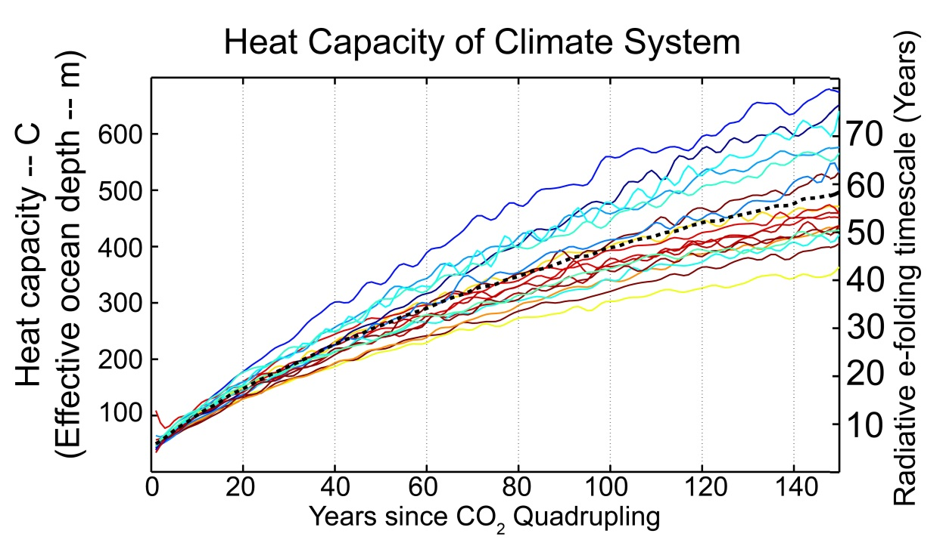



How fast does the system approach equilibrium?
Ensemble average forcing and feedbacks
C = 250 m (30 W m⁻²year K⁻¹)
the ensemble average for first
century after forcing
λ_{LW} = -1.7 W m⁻² K⁻¹
λ_{SW} = +0.6 W m⁻² K⁻¹
The energy imbalance equation:
$$C\frac{dT_{S}}{dt}=F+λT_{S}$$
Has the solution:
T_{S}$\left(t\right)= \frac{−F}{\text{λ}} \left(1−e^{\frac{tλ}{C}} \right)=T_{eq} (1−e^{−\frac{t}{τ}} )$
Key point:
OLR returns to unperturbed value in of order the radiative relaxation timescale of the system → decades
With the characteristic timescale (τ)
τ= $\frac{−C}{λ}$ = $\frac{−C}{λ_{SW}+λ_{LW}}$
= $\frac{30 W m^{−2} {year K}^{−1 }}{1.1 W m^{−2}K^{−1}}$ = 27 years

Slide 17
What parameter controls inter-GCM spread in TOA response?
Using all GCM specific parameters gets the inter-model spread in τ_{cross}
Varying just λ_{SW} and F_{SW} between GCMS captures inter-model spread in τ_{cross}
λ_{LW} , F_{LW} and heat capacity differences between GCMs less important for determining the radiative response
Varying just λ_{SW} gives bi-modal distribution of τ_{cross} with exception of two models (F_{SW} plays a role here)

Slide 18
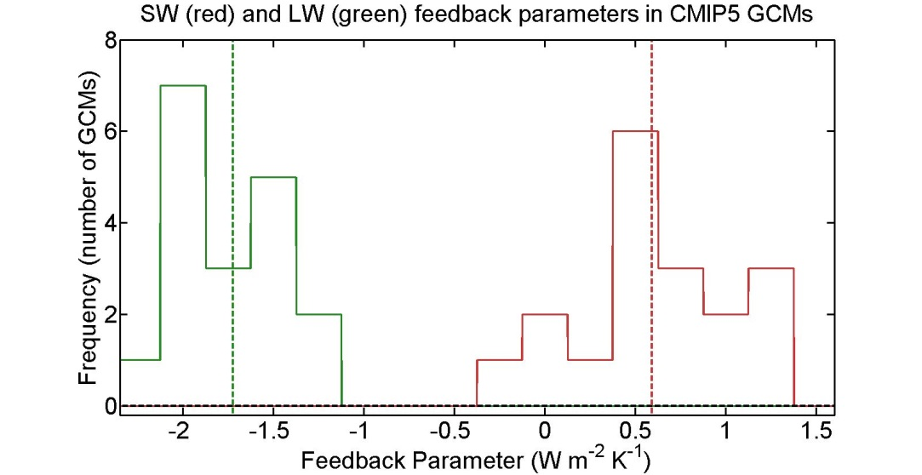






τ_{cross} dependence on feedback parameters
Ensemble average forcing and feedbacks
λ_{LW} = -1.7 W m⁻² K⁻¹
λ_{SW} = +0.6 W m⁻² K⁻¹
F_{LW} = + 6.1 W m⁻²
equilibrium temperature change
T_{EQ}$=\frac{−F}{\text{λ}\text{LW}\text{+}\text{λ}\text{SW}} =6K$
T_{EQ}$=GFEED \frac{−F}{\text{λ}\text{LW}} =1.6 ∗3.7K$
Feedback gain: Amplification of response due to $\text{λ}\text{SW}$
G_{FEED}$=\frac{1}{\text{1+}\text{λ}\text{SW}\text{/}\text{λ}\text{LW}} =1.6$
T_{S}$=GFEED \frac{−F}{\text{λ}\text{LW}} (1−e^{−\frac{t}{τ}} )$
OLR$=F_{LW}(−1+GFEED−GFEEDe^{−\frac{t}{τ}} )$
initial
transition
final
OLR =0 at τ=τ_{cross}
How far from equilibrium OLR =0
$$\text{τ}\text{cross}=−τ \ln\left(1−\frac{1}{GFEED}\right)$$

Slide 19
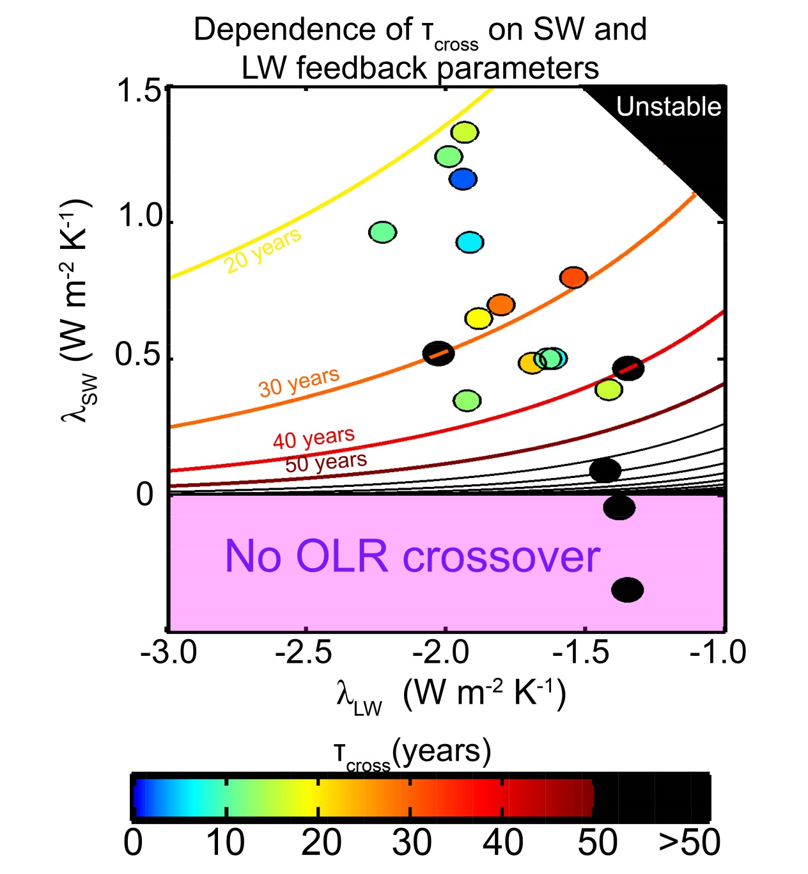

Sensitivity of τ_{CROSS} to feedback parameters
If F_{SW} = 0 (simplification):
τ_{CROSS} = $−τ \ln\left(1−\frac{1}{GFEED}\right)$
= τ ln(-λ _{LW} / λ _{SW} )
Ensemble Average
τ_{cross} is determined by the OLR value demanded in the new equilibrium
Set by relative magnitudes of λ _{LW}
and λ _{SW}
HAS STEEP GRADIENTS IN VICINITY OF λ_{SW}=0

Slide 20
What parameter controls inter-GCM spread in TOA response?
While the relative magnitudes of λ_{SW} and λ_{LW} explain the vast majority of the spread in τ_{cross} there are several model outliers
A more complete analysis includes inter-model differences in F_{SW}
→ F_{SW} includes both direct radiative forcing by CO2 (small) and the rapid response of clouds to the forcing

Slide 21
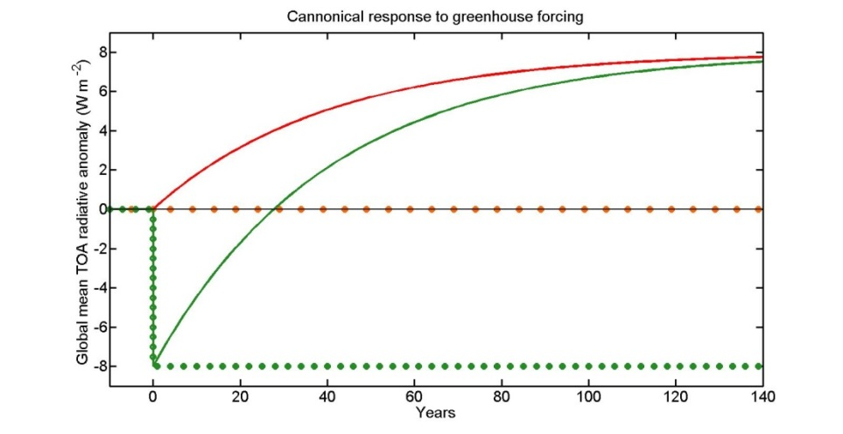
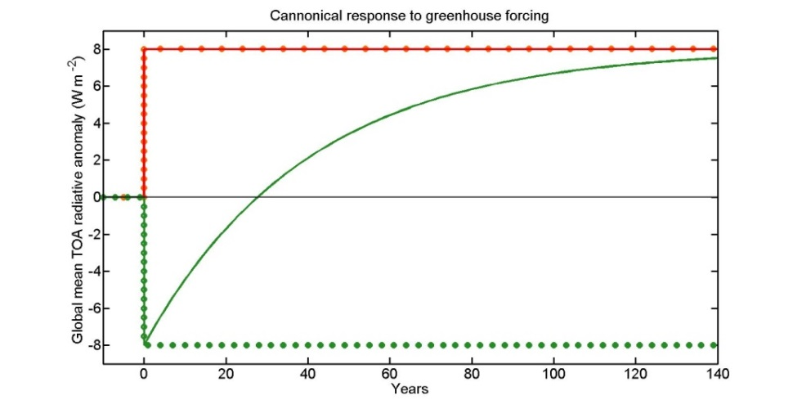



From before, if F_{SW} =0 then::
If F_{SW} ≠ 0 then::
$$\text{τ}\text{cross}=−τ \ln\left(1−\frac{1}{GFEED}\right)$$
$$\text{τ}\text{cross}=−τ \ln\left(1−\frac{1}{GFORCEGFEED}\right)$$
G_{FEED}$=\frac{1}{\text{1+}\text{λ}\text{LW}\text{/}\text{λ}\text{SW}}$
G_{FORCE}$=1+\frac{F_{SW}}{\text{F}\text{LW}}$
Forcing Gain = 2
Feedback Gain = 2
If |λ_{SW}| = ½ |λ_{LW}| → T_{EQ} is doubled
The OLR change to get to equilibrium is:
(2*F_{LW}/ |λ_{LW}|) * |λ_{LW}| = 2F_{LW}
OLR = 0 occurs half way to equilibrium
T_{CROSS} = T ln(2)
If F_{LW} = F_{SW} → T_{EQ} is doubled and OLR asymptotes to +F_{LW}
OLR = 0 occurs half way to equilibrium
T_{CROSS} = T ln(2)

Slide 22
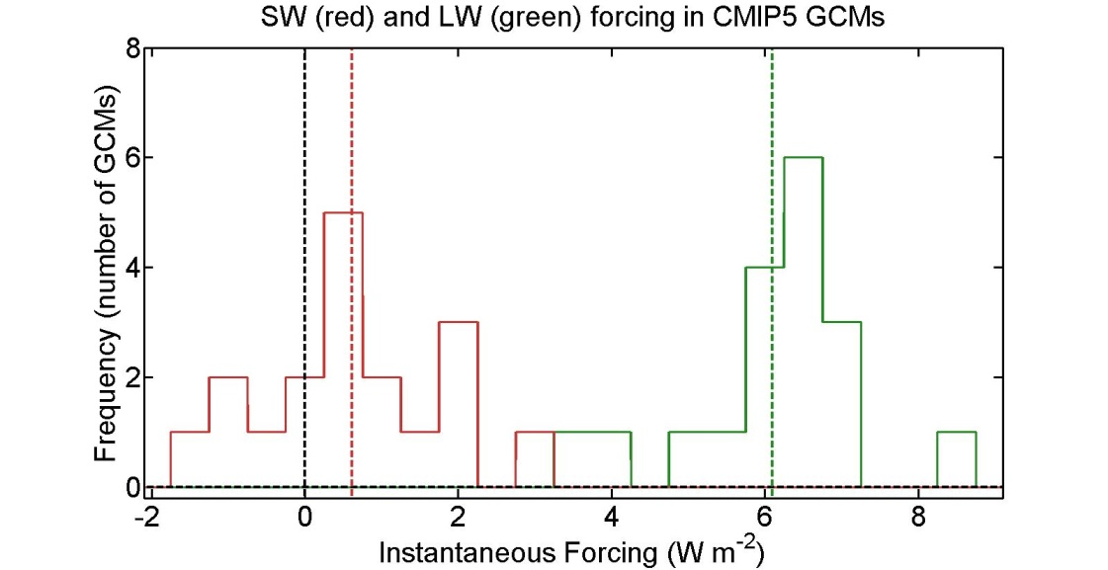
SW and LW Feedbacks and Forcing: 4XCO₂
Feedbacks
LW
SW
Ensemble Average
Forcing
LW feedback is negative (stabilizing) and has small inter-GCM spread
SW feedback is mostly positive and has large inter-GCM spread
Forcing is mostly in LW (greenhouse)
SW forcing has a significant inter-GCM spread

Slide 23
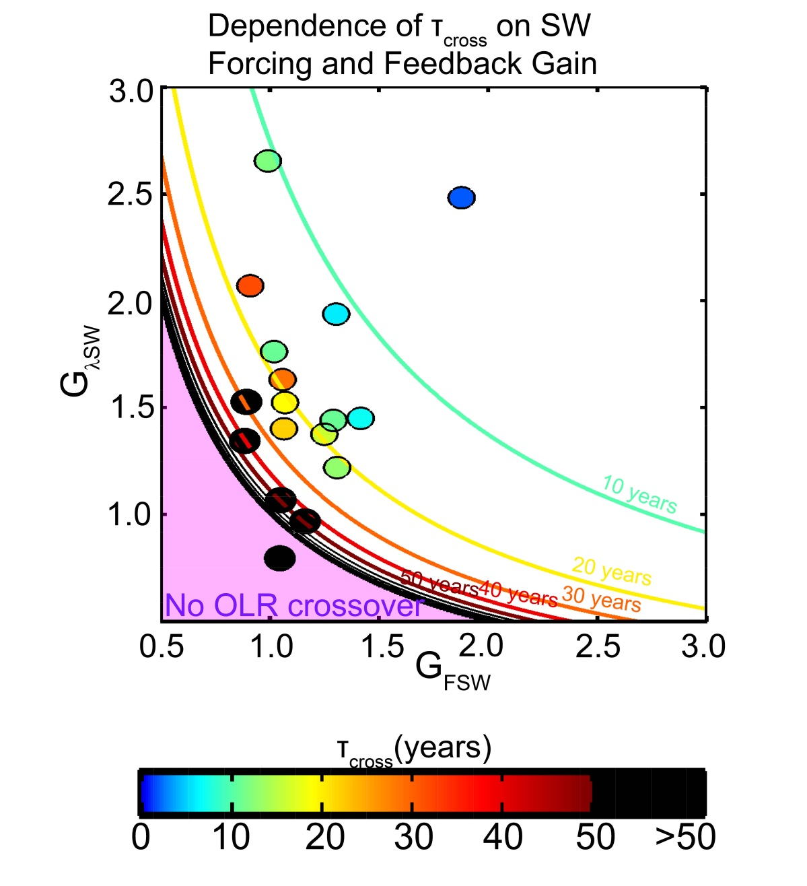

Sensitivity of τ_{CROSS} to feedback parameters
$$\text{τ}\text{cross}=−τ \ln\left(1−\frac{1}{GFORCEGFEED}\right)$$
Positive SW forcing and feedbacks favor a short OLR recovery timescale with a symetric dependence on the “gain” factors
Explains the majority (R= 0.88) of inter- model spread
Assumes a time and model invariant heat capacity (250m ocean depth equivalent)

Slide 24
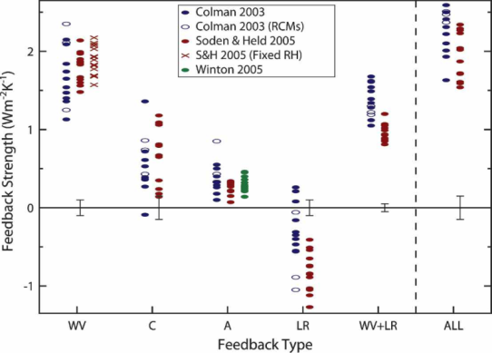
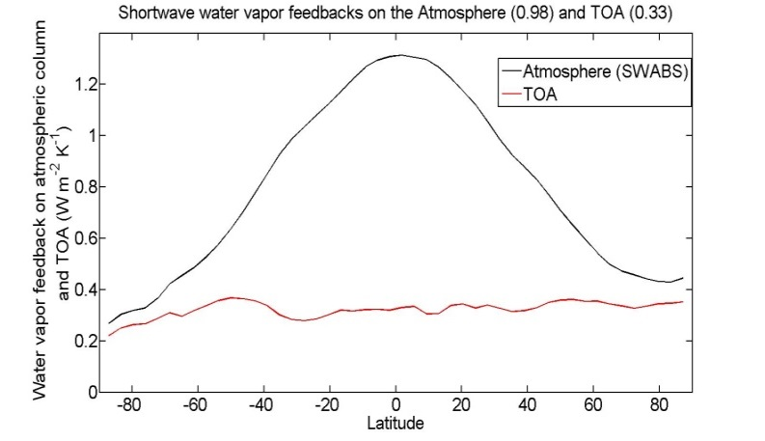
Cause of SW positive feedbacks:
incident
Reflected
cloud
absorbed
H₂0
(vapor)
Reflected
surface
transmitted
ice
ocean
Surface albedo feedback =
+0.26 ±0.08 W m⁻²K⁻¹
Bony et al. (2006)
SW Water vapor feedback
= +0.3±0.1 W m⁻²K⁻¹

Slide 25

Conclusions – so far
CO₂ forcing reduces OLR but the resulting global warming in climate models is due to increased ASR
Result of the relative magnitudes of SW and LW feedbacks and the response time of climate system
In the majority of models, OLR recovers in decades. In a minority of models, OLR recovers in centuries
→ This bi-modal behavior is expected based on the OLR value demanded by the new equilibrium when considering the SW feedbacks (and forcing) -- steep gradients when SW feedback is in the vicinity of 0
Where does the observed climate system sit in this parameter space?

Slide 26


Feedback parameters from observations
Strategy: Use the co-variability of T_{S} and (FORCING ADJUSTED) OLR and ASR anomalies to back out λ_{SW} and λ_{LW} over the satellite observations
$$ASR^{′}\left(t\right)=F_{SW}\left(t\right)+ λ_{SW}T_{S}′(t)$$
OLR’$\left(t\right)={−F}_{LW}\left(t\right)− λ_{LW}T_{S}′(t)$
TOA radiation from CERES EBAF (2000-2014) – monthly anomalies from climatology (N=170)
T_{S} from 3 sources: 1.NCEP Reanalysis, 2. GIS TEMP and 3. HadCRUT4 (Cowtan and Way)
FORCING ADJUSTMENTS
Greenhouse gas forcing (LW+SW) by CO₂, CH₄ and N₂O from NOAA System Research Laboratory
Stratospheric aerosol optical depth (SAGE II, GOMOS, CALIPSO) converted to SW forcing (Solomon et al. 2011)
Solar variability removed from ASR anomalies
Assumes that tropospheric aerosol forcing has not changed over analysis period (Murphy, 2013 [Nat.Geo.], Carslaw, 2013[Nature], Stevens, 2013 [Nature])

Slide 27
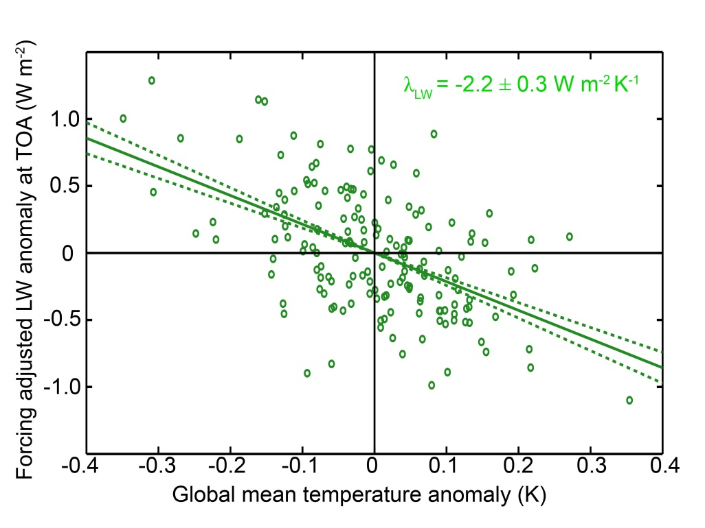

LW Feedback parameter from observations
Surface temperature explains a small fraction of OLR’ variance (R=0.52)
Error bars on regression coefficient (1σ) are small, why?
Weak 1 month auto-correlation in OLR’ – r_{OLR} (1month) = 0.3 → lots of DOF (N*= 113)
Unexplained amplitude
$$σ_{λ_{LW}}=\frac{σ_{OLR}\sqrt{1−{{r^{2}}_{OLR,TS}^{}}_{\begin{aligned} \\ \end{aligned}}^{}}}{σ_{T_{S}}\sqrt{N^{∗}}}$$
Independent
realizations
Even if none of the OLR’ variance was explained, the regression slope is still significant
→ Given the number of realizations, you would seldom realize such a large regression coefficient in a random sample – in the absence of a genuine relationship between T_{S} and OLR

Slide 28
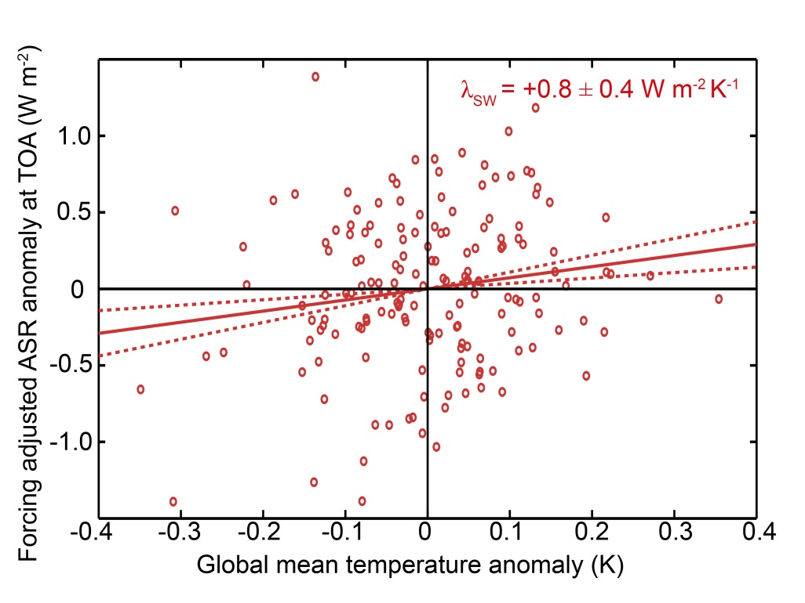

SW Feedback parameter from observations
Very weak correlation (r=0.16)
Almost no memory in ASR’ – r_{OLR} (1month) = 0.1 – mean we have lots of DOF (N*= 143)
$$σ_{λ_{SW}}=\frac{σ_{ASR}\sqrt{1−{{r^{2}}_{ASR,TS}^{}}_{\begin{aligned} \\ \end{aligned}}^{}}}{σ_{T_{S}}\sqrt{N^{∗}}}$$
The significance of the regression slope is not a consequence of the variance explained but, rather, the non-zero of the slope despite the number of realizations
→ The feedback has emerged from the non-feedback radiative processes in the record

Slide 29
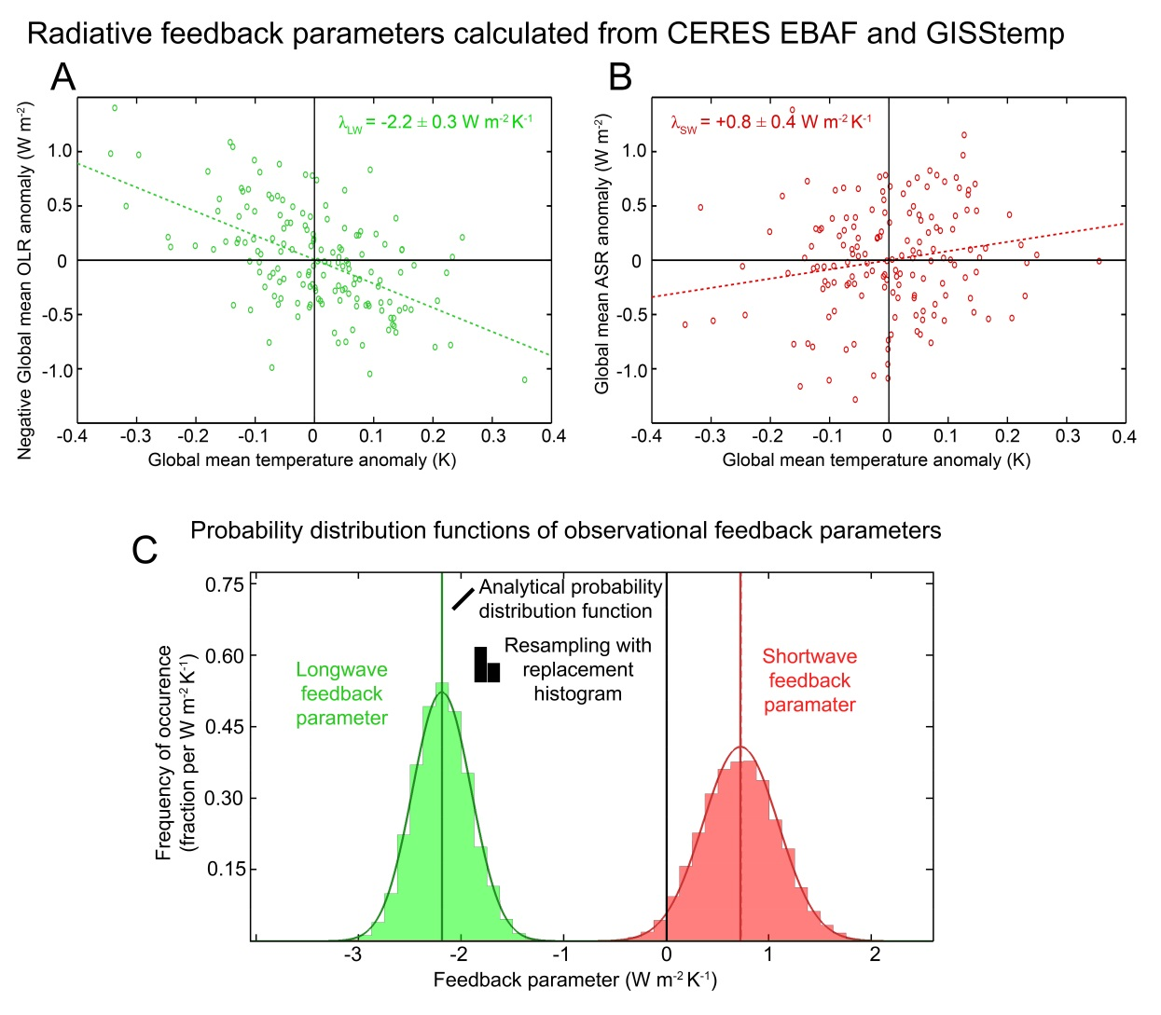
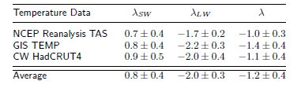
Probability distribution functions of λ _{SW} and λ_{LW} derived from observations– solid lines are from regression uncertainty and boxes are a histogram from bootstrapped Monte-Carlo simulation of resampling with replacement
Good agreement, very small chance that λ _{SW} < 0

Slide 30
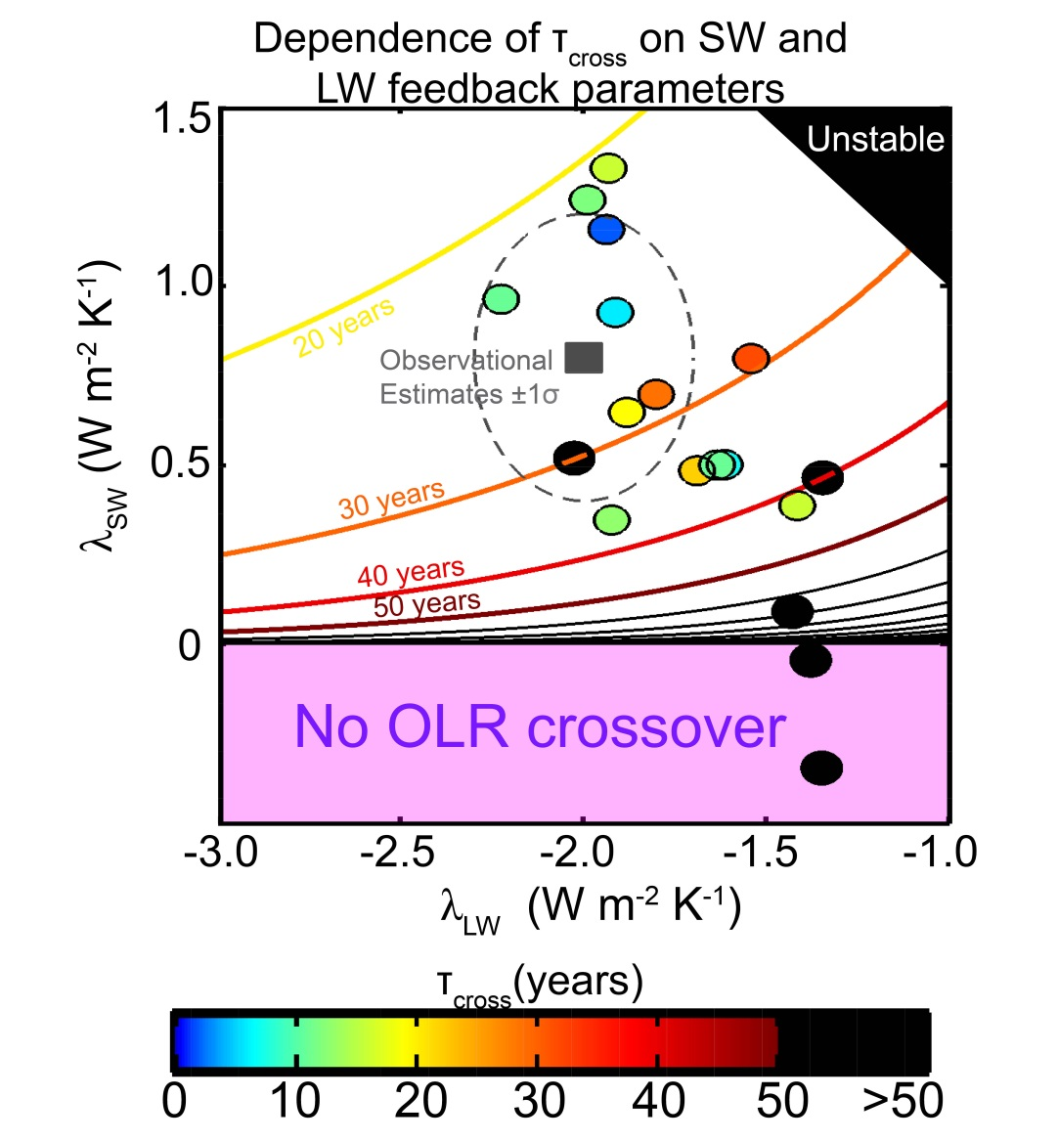

Implications for OLR recovery timescale
Observational constraints suggest that τ_{cross} is of order decades IN RESPONSE TO LW FORCING ONLY
Assumes an (CMIP5 ensemble average) radiative relaxation timescale (τ) of 27 years
τ_{CROSS} = $−τ \ln\left(1−\frac{1}{GFEED}\right)$
= τ ln(-λ _{LW} / λ _{SW} )

Slide 31
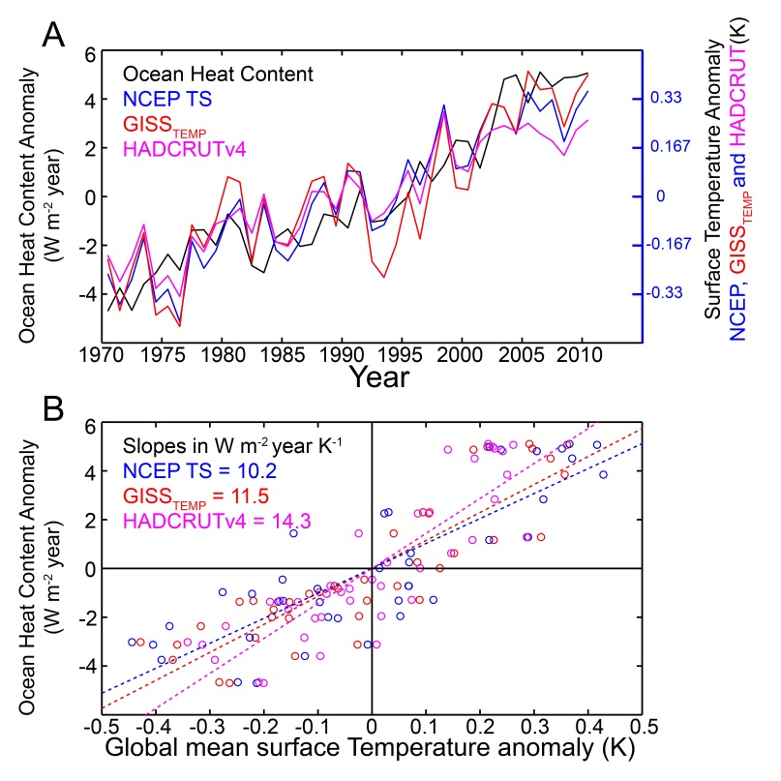
Observational constraints on heat capacity
Assume: Energy imbalance at TOA goes into ocean heat storage.
Then: Co-variability of global mean surface temperature and ocean heat content (Levitus) gives estimates of heat capacity
Equivalent ocean depth of 90±40m
Radiative e-folding time (τ) of 9 years
Estimates of τ_{cross} from previous slide are conservative
→ τ_{cross} likely < 20 years

Slide 32
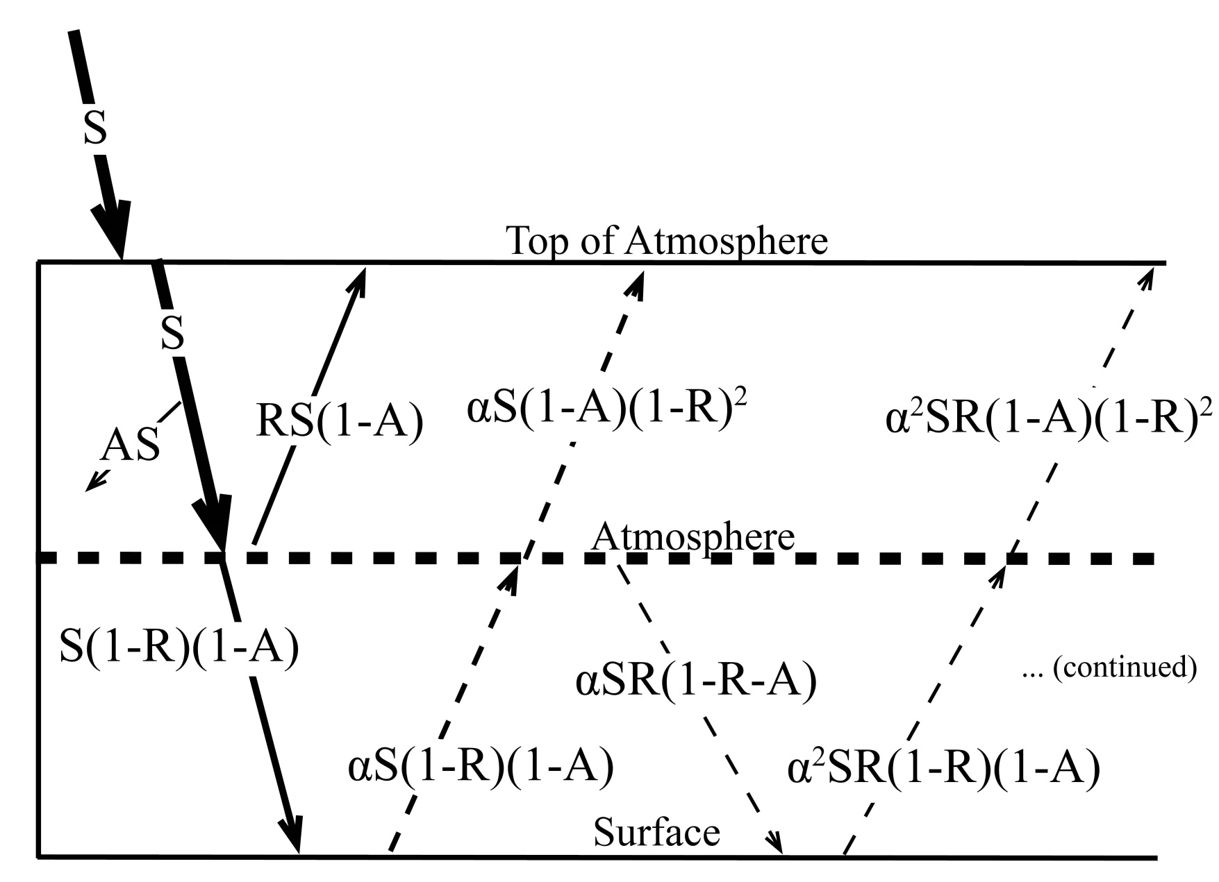
Diagnosing the physics of SW feedbacks in observations
Atmospheric
Contribution
To Reflected SW
Surface
Contribution
To Reflected
SW
S = incident
R = cloud
reflection
A = absorption
α = surface
albedo
(UNKNOWNS)

Slide 33
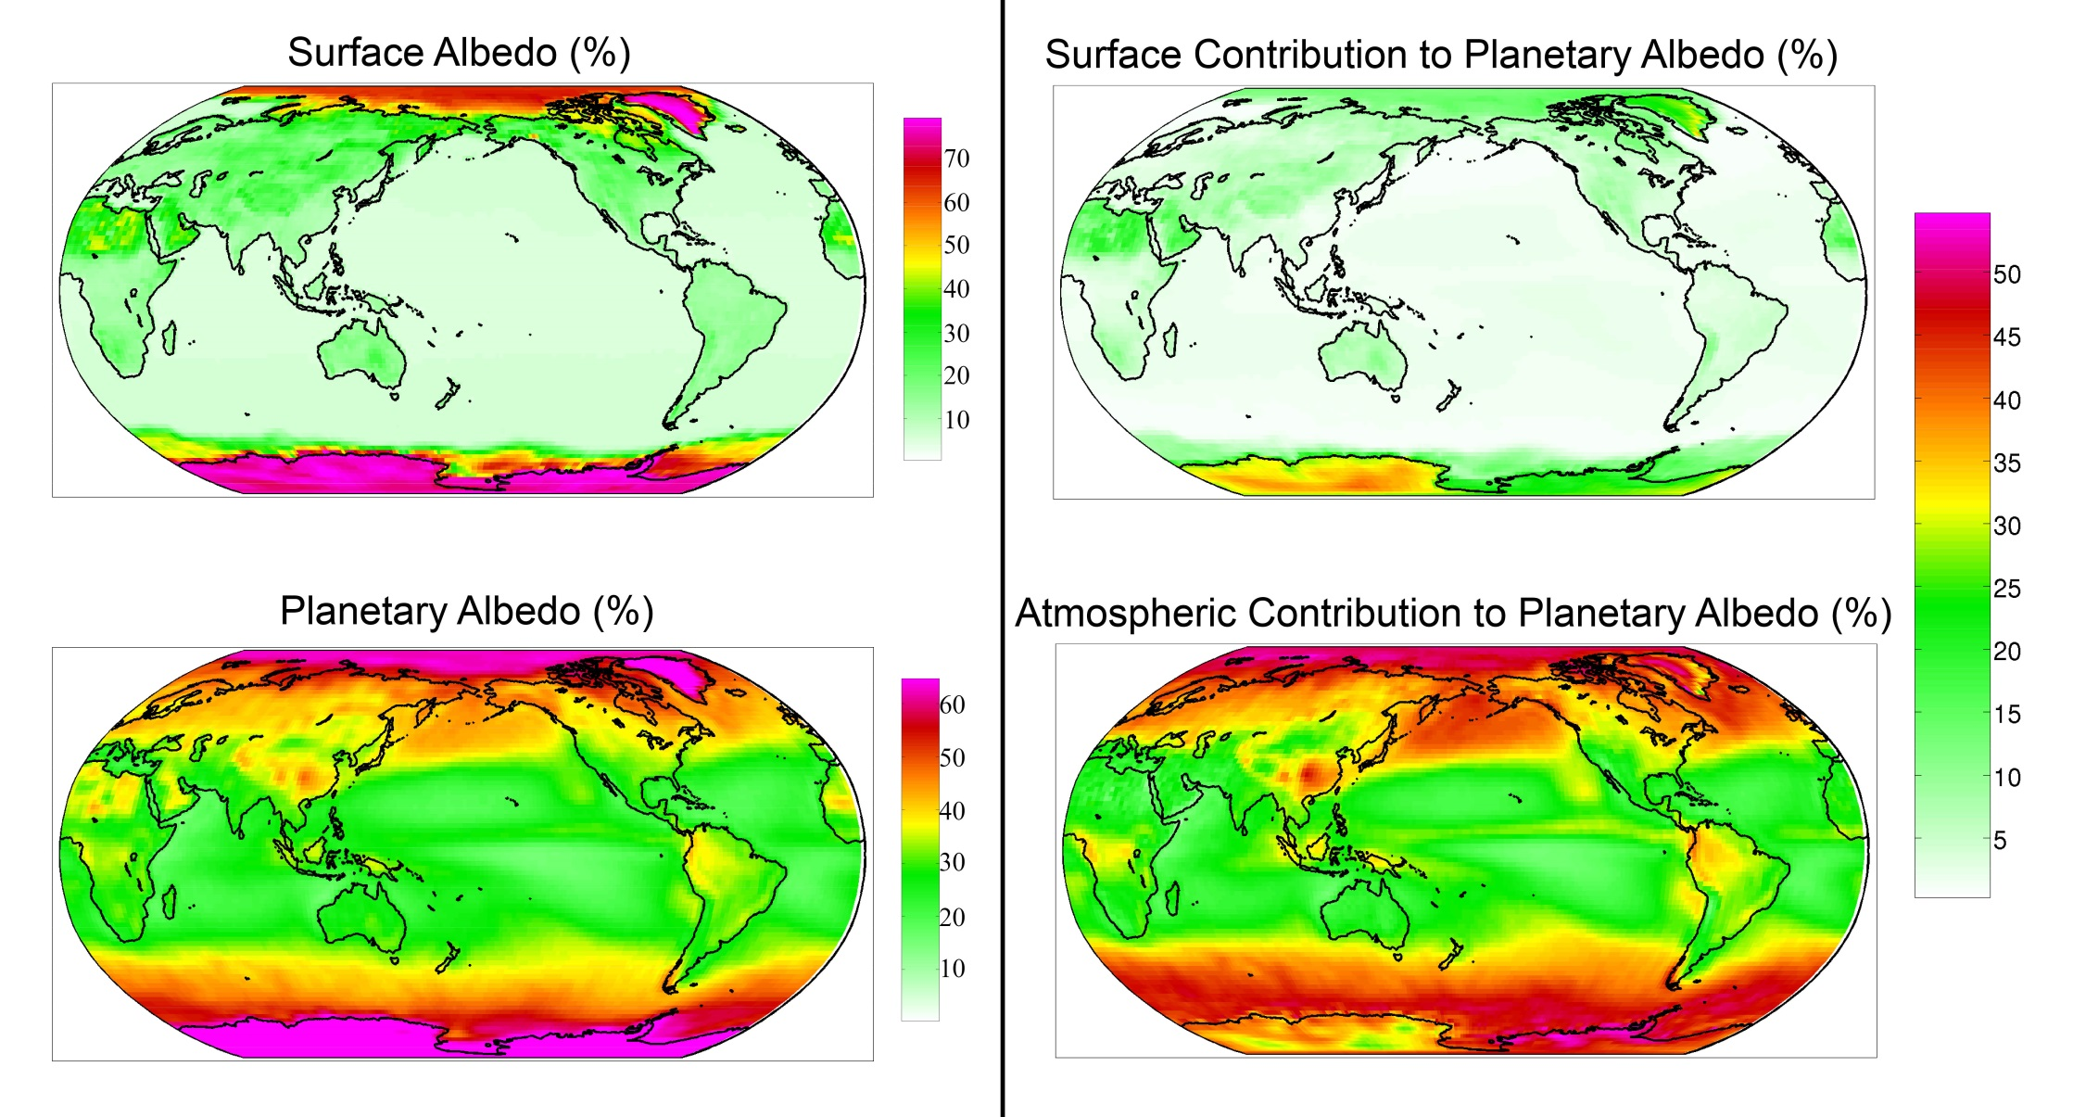
Observed (CERES) surface and atmospheric contribution to planetary albedo

Slide 34
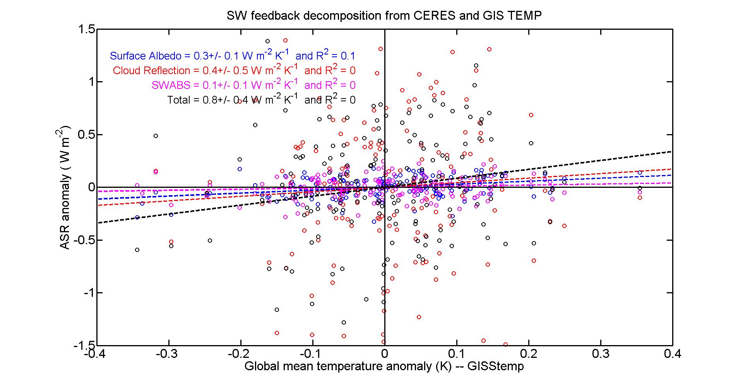
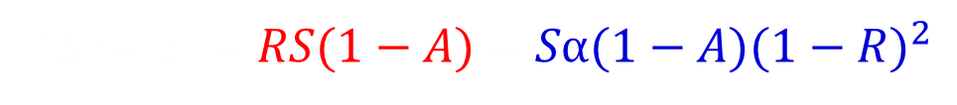

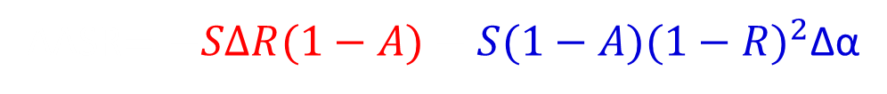
Attribution of observational SW feedbacks
Atmospheric Reflection
Surface Reflection
ASR$=S −RS(1−A)−Sα(1−A){(1−R)}^{2}$
Cloud Change
Surface Albedo Change
ΔASR$=−SΔR(1−A)−S(1−A){(1−R)}^{2}$Δα
$+ SR\left(ΔA\right)+Sα(ΔA){(1−R)}^{2}$
Atmospheric SW Absorption

Slide 35
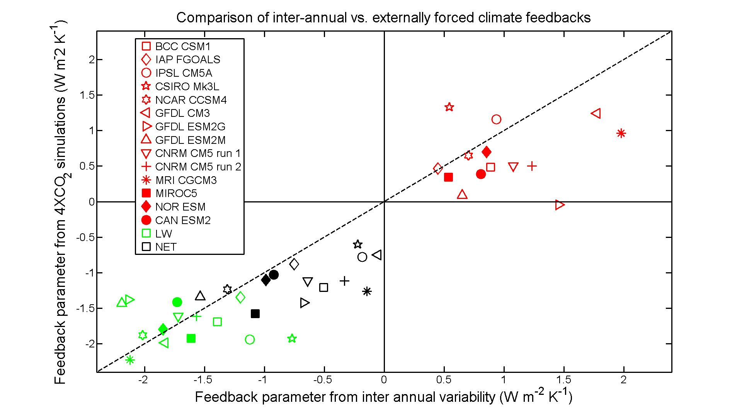
Are the radiative feedbacks that operate on inter-annual timescales equivalent to equilibrium feedbacks?
SW
LW
NET

Slide 36

Conclusions
Radiative response to increasing CO₂ is set in motion by decrease in OLR but energy accumulation is due to enhanced ASR
Result of the relative magnitudes of SW and LW feedbacks and the ASR/OLR demanded by the new equilibrium
Observational constraints suggest that LW forcing will be alleviated within a couple decades and thereafter, global warming driven by enhanced ASR
Consequence of two robust positive SW feedbacks
1. atmospheric absorption by increased water vapor
2. Ice albedo feedback

Slide 37
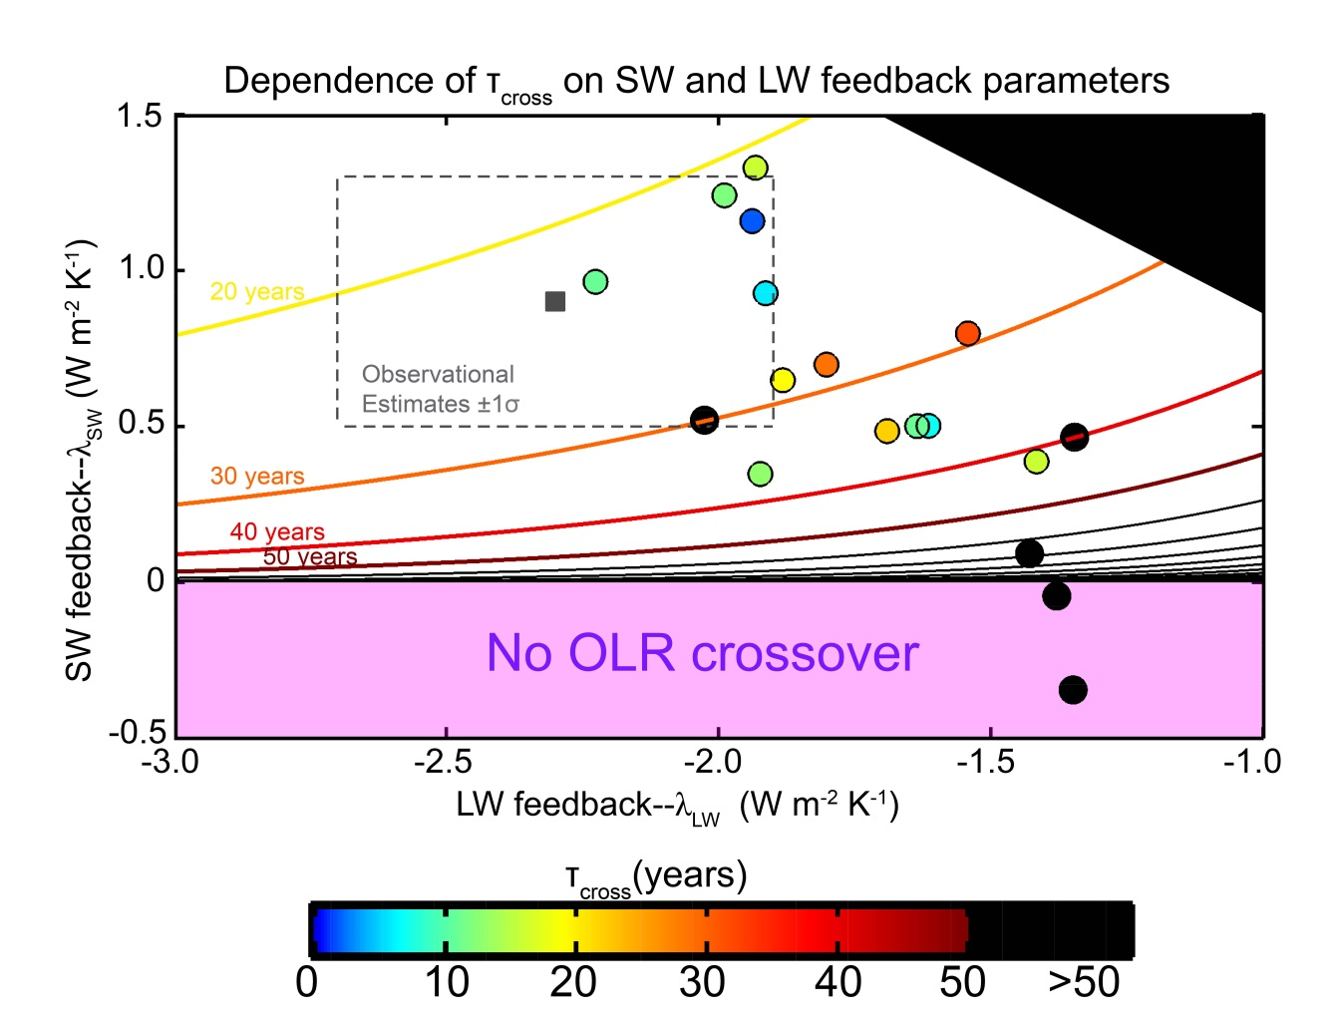
Sensitivity of τ_{CROSS} to feedback parameters
If F_{SW} = 0 (simplification):
τ_{CROSS} = τ ln(-λ _{LW} / λ _{SW} )
Ensemble Average
Observational
Constraints

Slide 38

Conclusions
CO₂ forcing reduces OLR but the resulting global warming in climate models is due to increased ASR
Result of the relative magnitudes of SW and LW feedbacks and the response time of climate system
Observational constraints suggest that LW forcing will be alleviated within a couple decades and thereafter, global warming driven by enhanced ASR
Consequence of two robust positive SW feedbacks
1. atmospheric absorption by increased water vapor
2. Ice albedo feedback

Slide 39
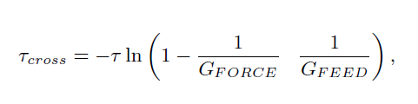
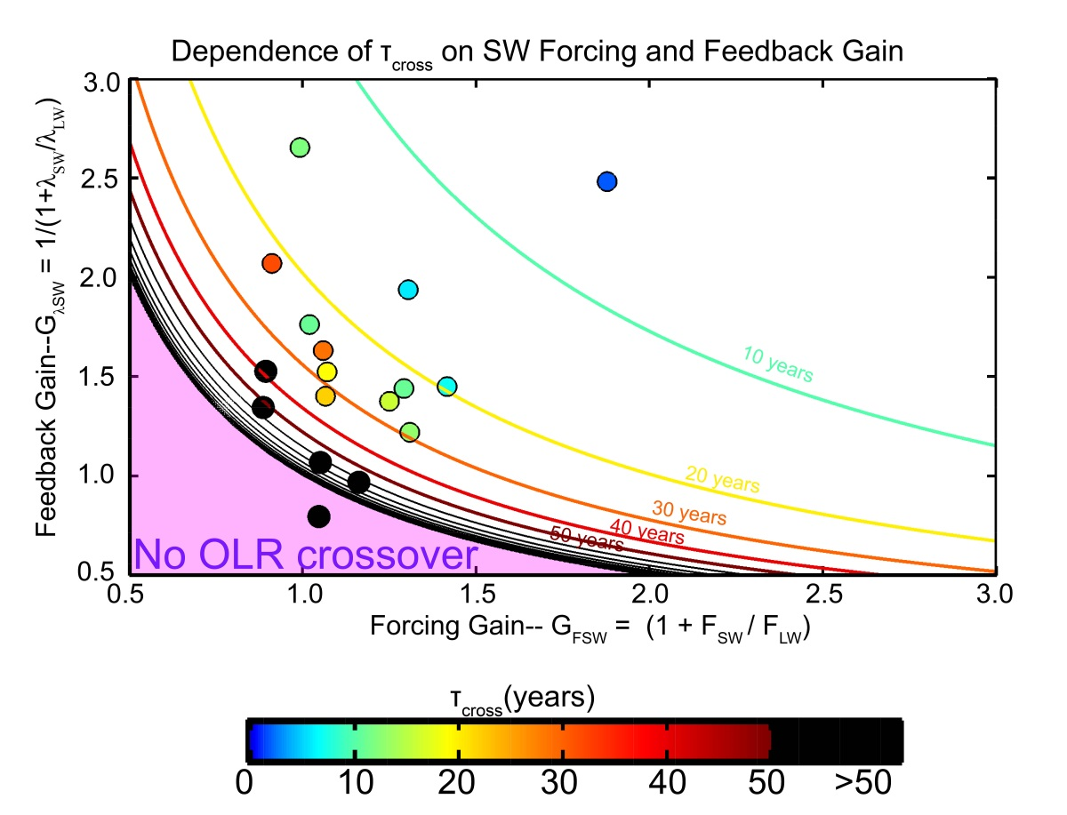
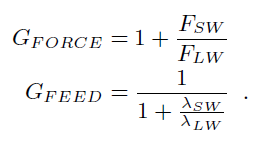
Sensitivity of Τ_{CROSS} to SW forcing and gain
If C (Τ) is time invariant (slight simplification):
Where G_{FORCE} and G_{FEED} are the gain in the temperature response due to the SW forcing and feedbacks (relative to the system with LW forcing and feedbacks only)

Slide 40
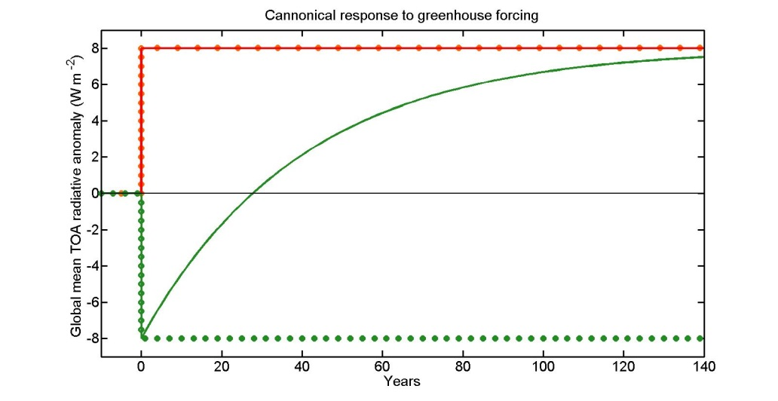

Why SW forcing and gain have the same impact on Τ_{CROSS}
Forcing Gain = 2
If F_{LW} = F_{SW} → T_{EQ} is doubled and OLR asymptotes to +F_{LW}
OLR = 0 occurs half way to equilibrium
T_{CROSS} = T ln(2)
Feedback Gain = 2
If |λ_{SW}| = ½ |λ_{LW}| → T_{EQ} is doubled
The OLR at equilibrium is:
(2*F_{LW}/ |λ_{LW}|) * |λ_{LW}| = 2F_{LW}
OLR = 0 occurs half way to equilibrium
T_{CROSS} = T ln(2)

Slide 41
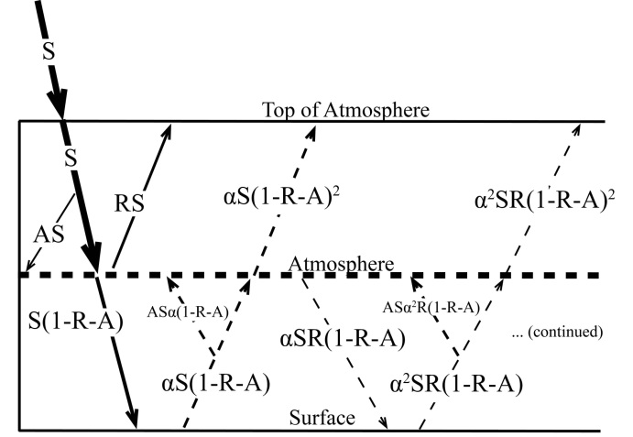
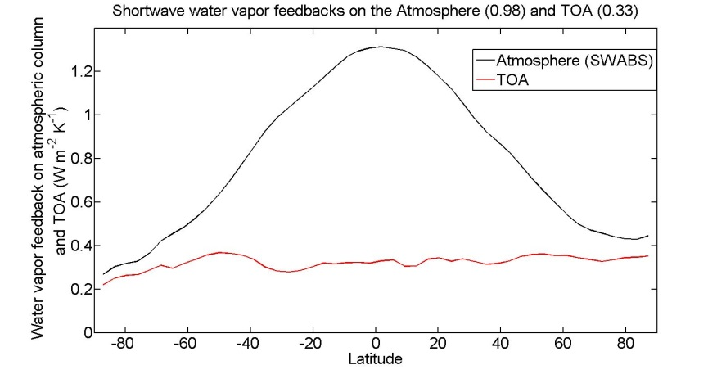
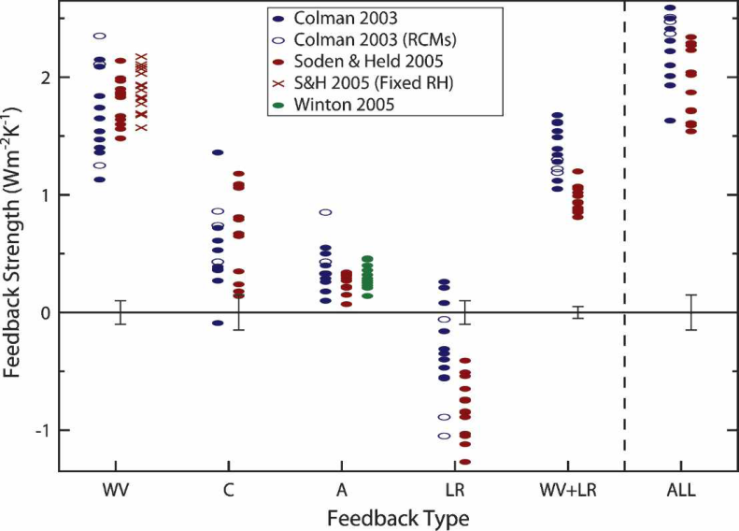
Cause of SW positive feedbacks:
SW Water vapor feedback
(water vapor absorbs SW) = +0.3 W m⁻²K⁻¹
Surface albedo feedback =
+0.26 (+/-)0.08) W m⁻²K⁻¹
Bony et al. (2006)

Slide 42
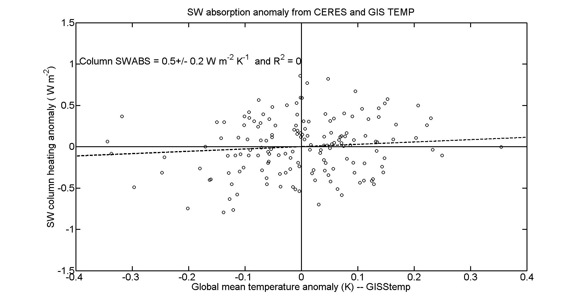
SWABS Feedback

Slide 43
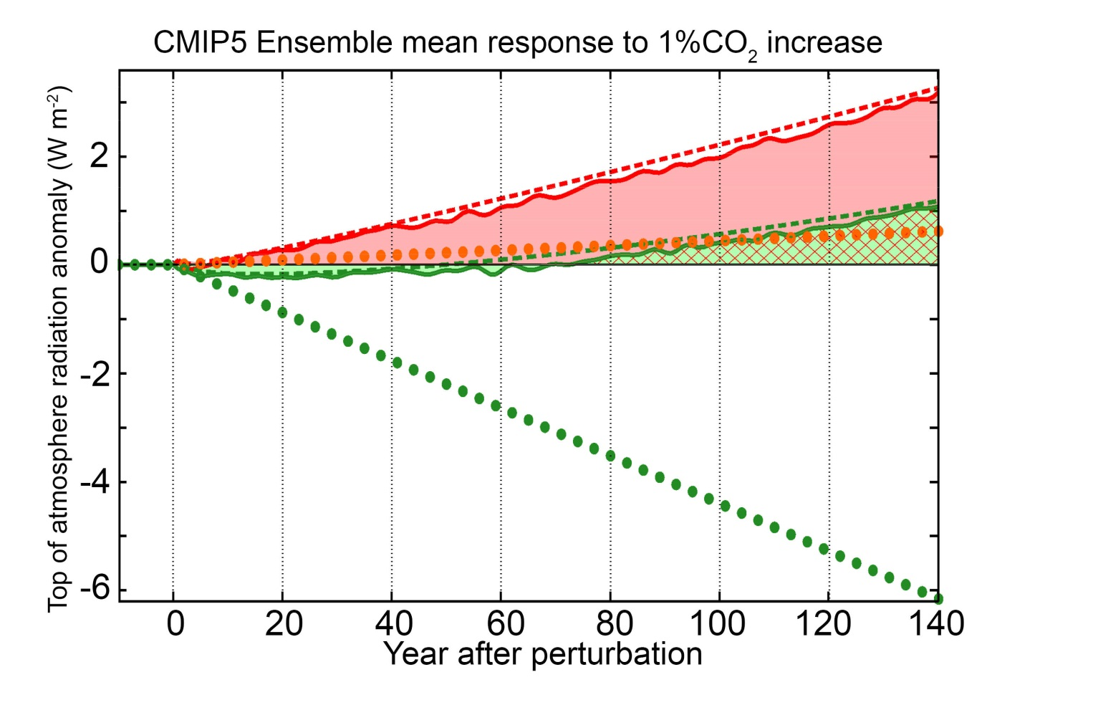

1% per year CO₂ ramp simulations
Quantify the SW and LW contributions to energy accumulation with the ShortWave Energy Accumulation Ratio
= 1.1 on average

Slide 44
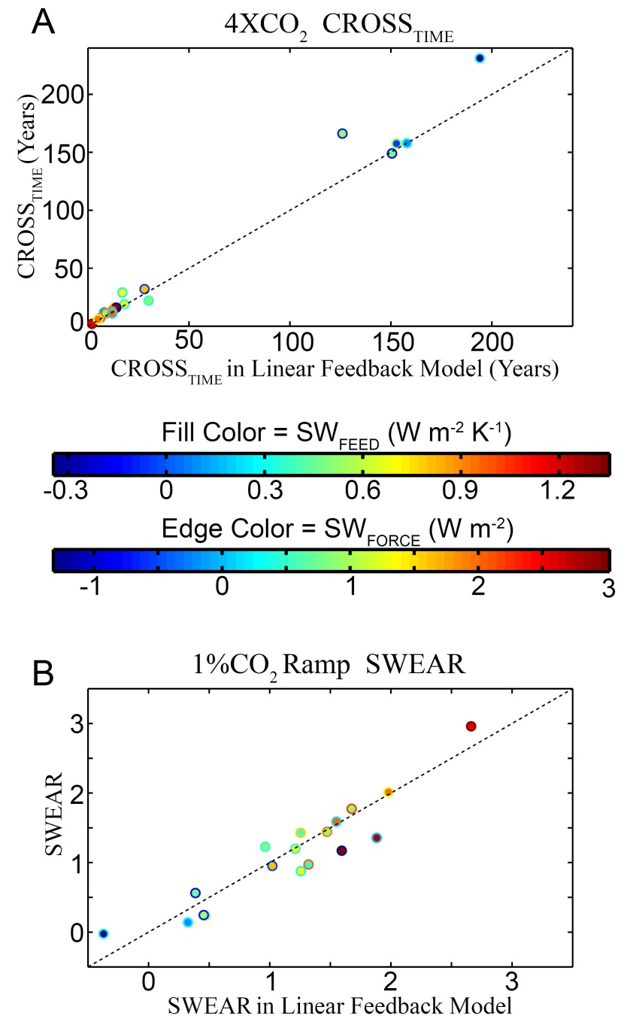
1% per year CO₂ ramp simulations: predicting SWEAR with linear feedback model
Linear feedback model with GCM specific λ_{LW} and F_{SW} TAKEN FROM 4XCO₂ RUNS and ensemble average everything else predicts:
TCROSS in Instantaneous 4XCO₂ runs
SWEAR in 1%per year CO₂ ramp runs

Slide 45
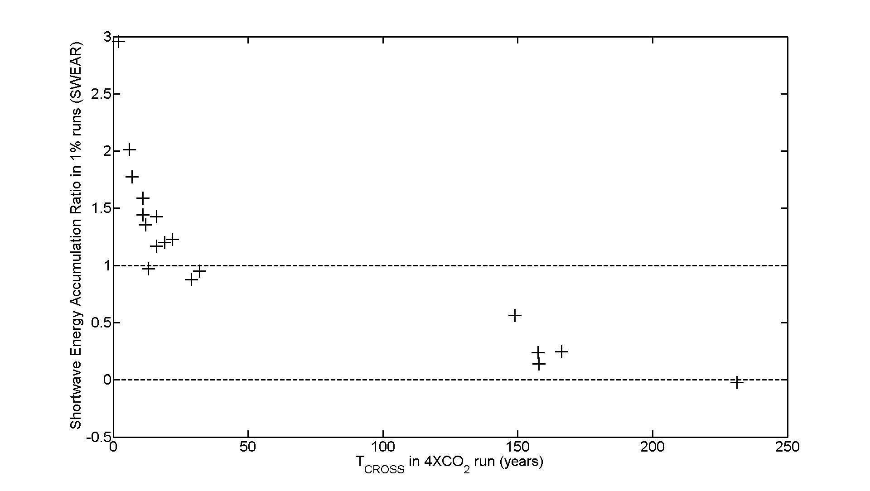
Relating T_{CROSS} and SWEAR
Response to CO₂ ramp can be thought of as a superposition of the response to an instantaneous perturbation, each initiated at a different starting time
T_{CROSS} after the forcing, the LW forcing has been ameliorated by the Planck feedback and thereafter the energy accumulation is only in the shortwave → large SWEAR values

Slide 46
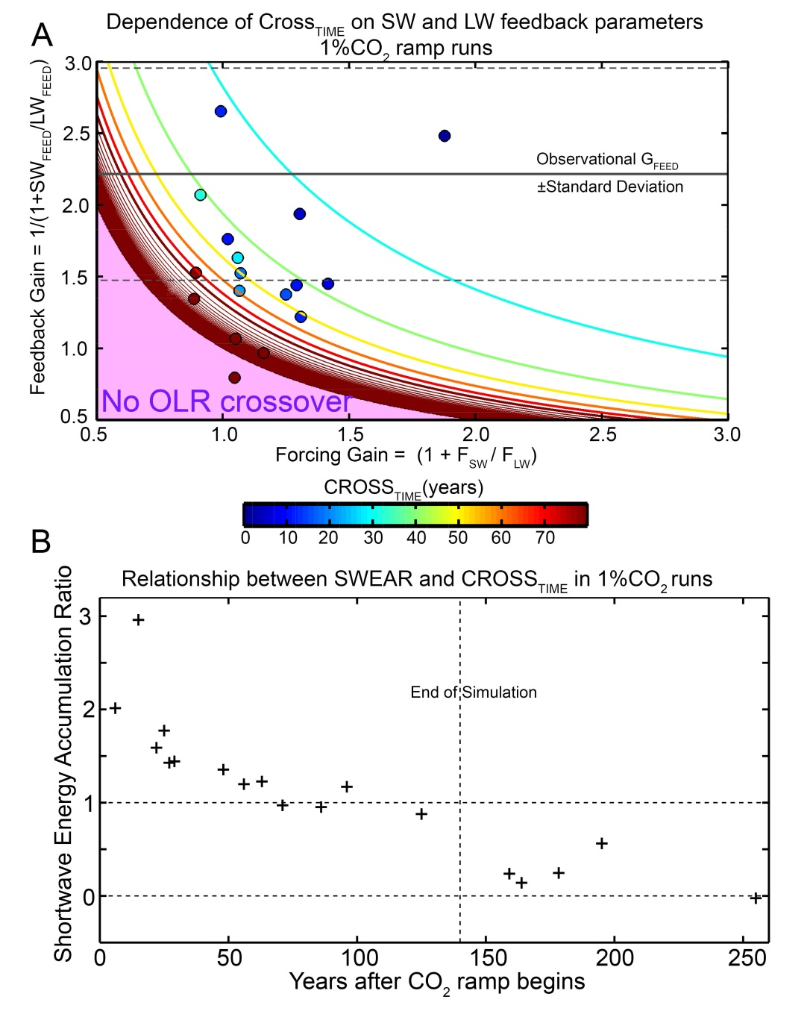

Analytic solutions in 1% run
Approximate analytic solution to T_{CROSS} with ramped forcing
Steep gradient suggests that either OLR returns to unperturbed value in a couple decades or not at all (asymptotically)
WHERE IS THE REAL CLIMATE SYSTEM IN THIS PICTURE

Slide 47
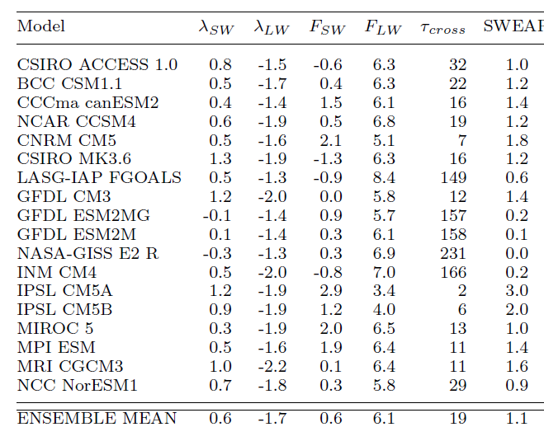
Analytic solutions in 1% run

Slide 48

Time evolution of OLR response to greenhouse forcing with SW feedback
Temperature evolution:
T = ΔT (1- e^{-t/τ})
ASR
OLR
F_{LW}
C = heat capacity of climate system
E-folding timedscale (τ) = 20 years
For C of 150m ocean

