Slide 1

The relationship between the location of the intertropical convergence zone (ITCZ) and atmospheric heat transport across the equator
Aaron Donohoe, John Marshall, David Ferreira, and David McGee
Thanks to: Dargan Frierson and Yen-Ting Hwang

Slide 2
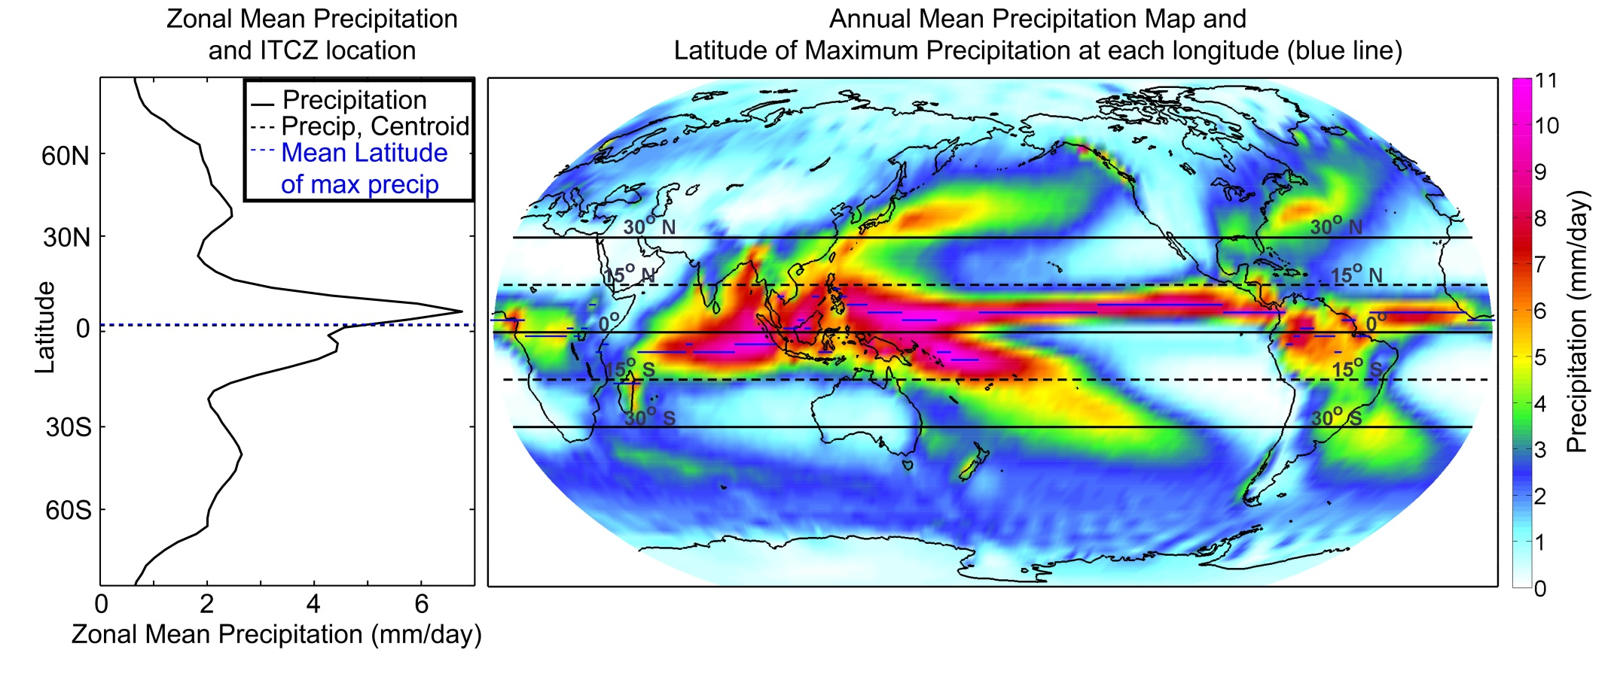
Annual mean precipitation
Noaa CPC merged analysis

Slide 3
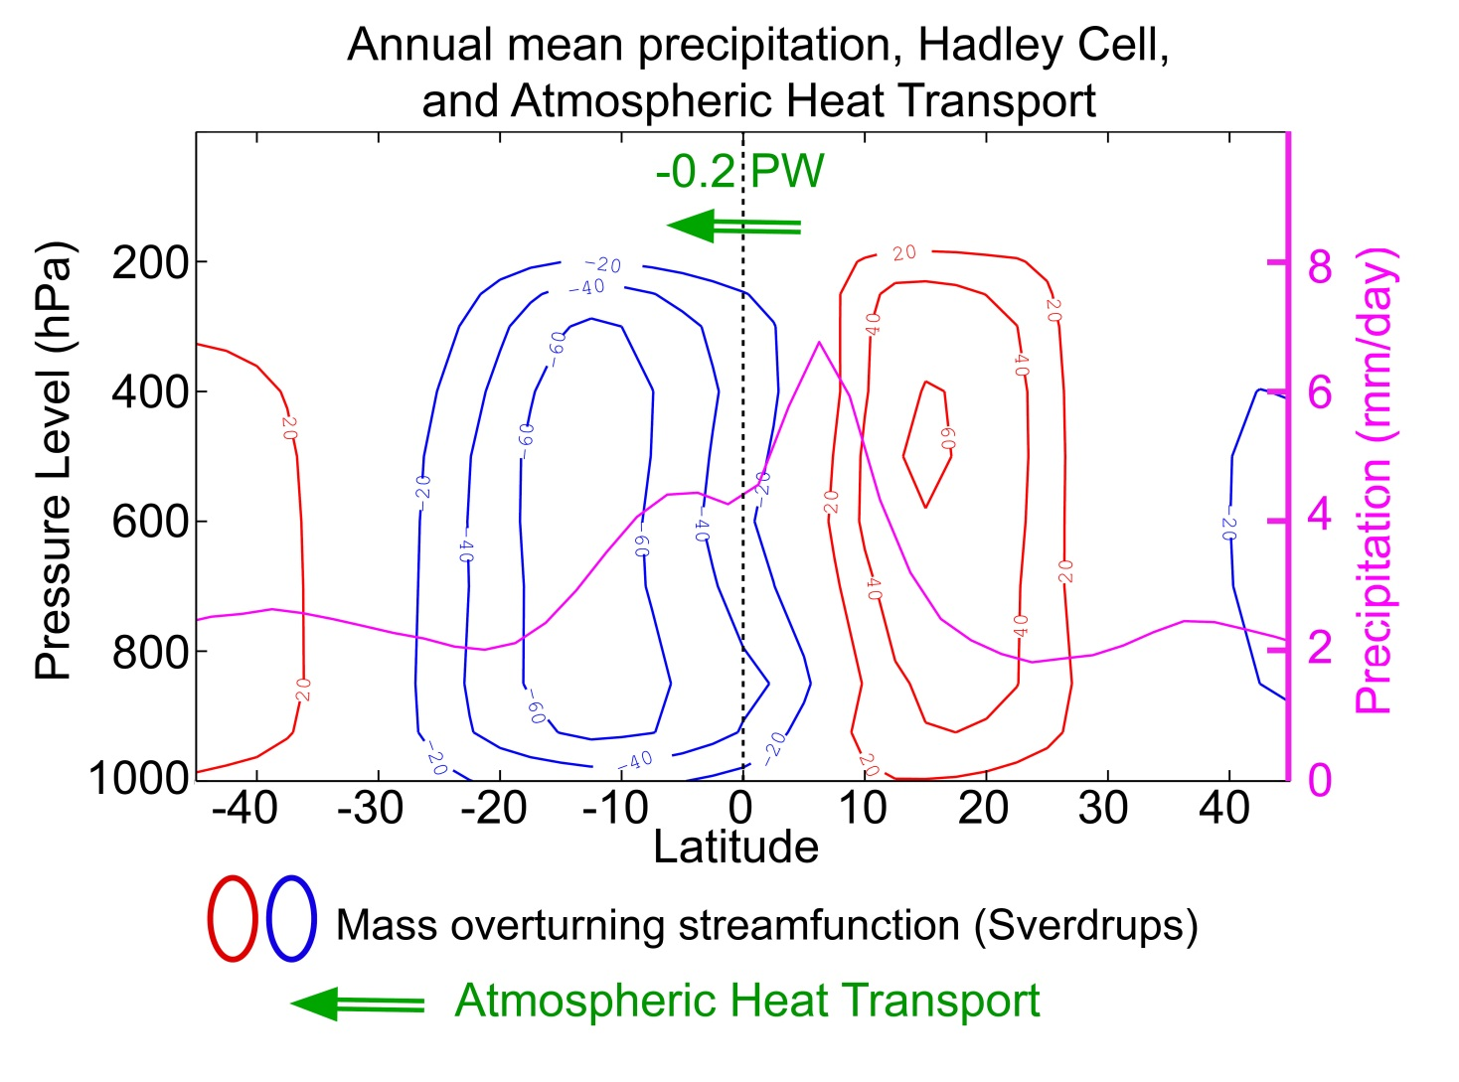
Annual mean Hadley Cell and it’s relationship to precipitation and heat transport
NCEP reanalysis, Noaa CPC merged analysis

Slide 4
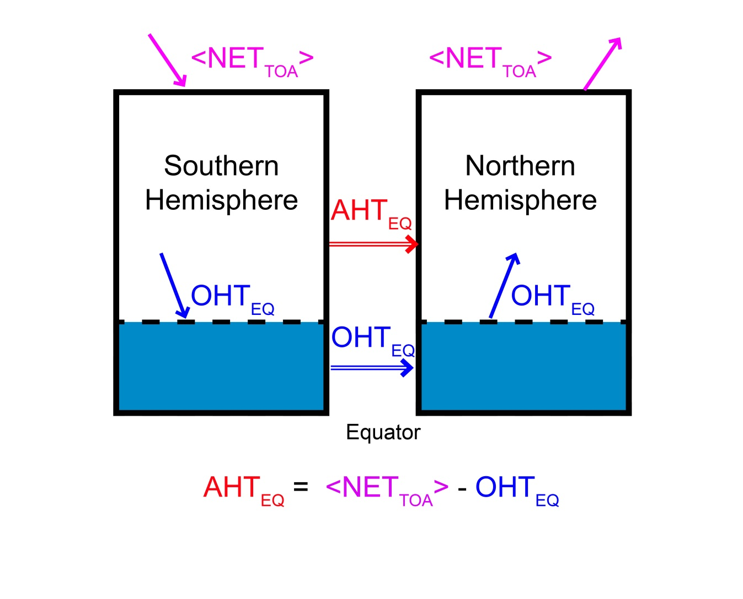
Hemispheric energy budget
AHT_{EQ} = Atmospheric heat transport across the equator
OHT_{EQ} = Ocean heat transport across the equator
<NET_{TOA}> = Net radiative input into the SH at TOA
= Net radiative export from NH at TOA

Slide 5
Outline
Annual mean ITCZ Location
Seasonal cycle of ITCZ location and AHT_{EQ}
- Observations
- Coupled models
- Idealized models
Annual mean ITCZ shifts in climate perturbation experiments
- 2XCO₂ , Last Glacial Maximum, mid Holocene

Slide 6
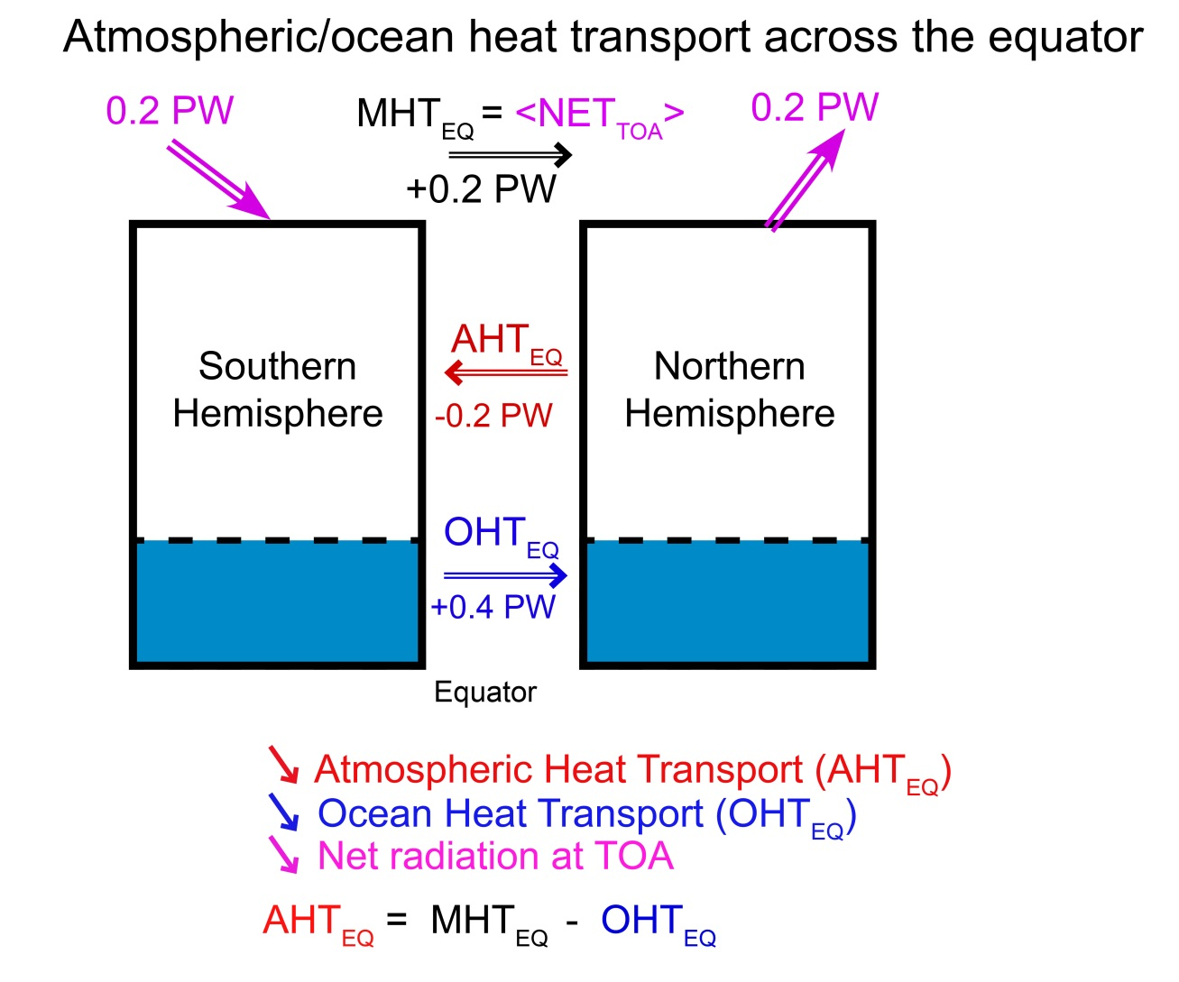
Observed Hemispheric Energy Budget
Marshall, Donohoe, Ferreira, In Prep

Slide 7
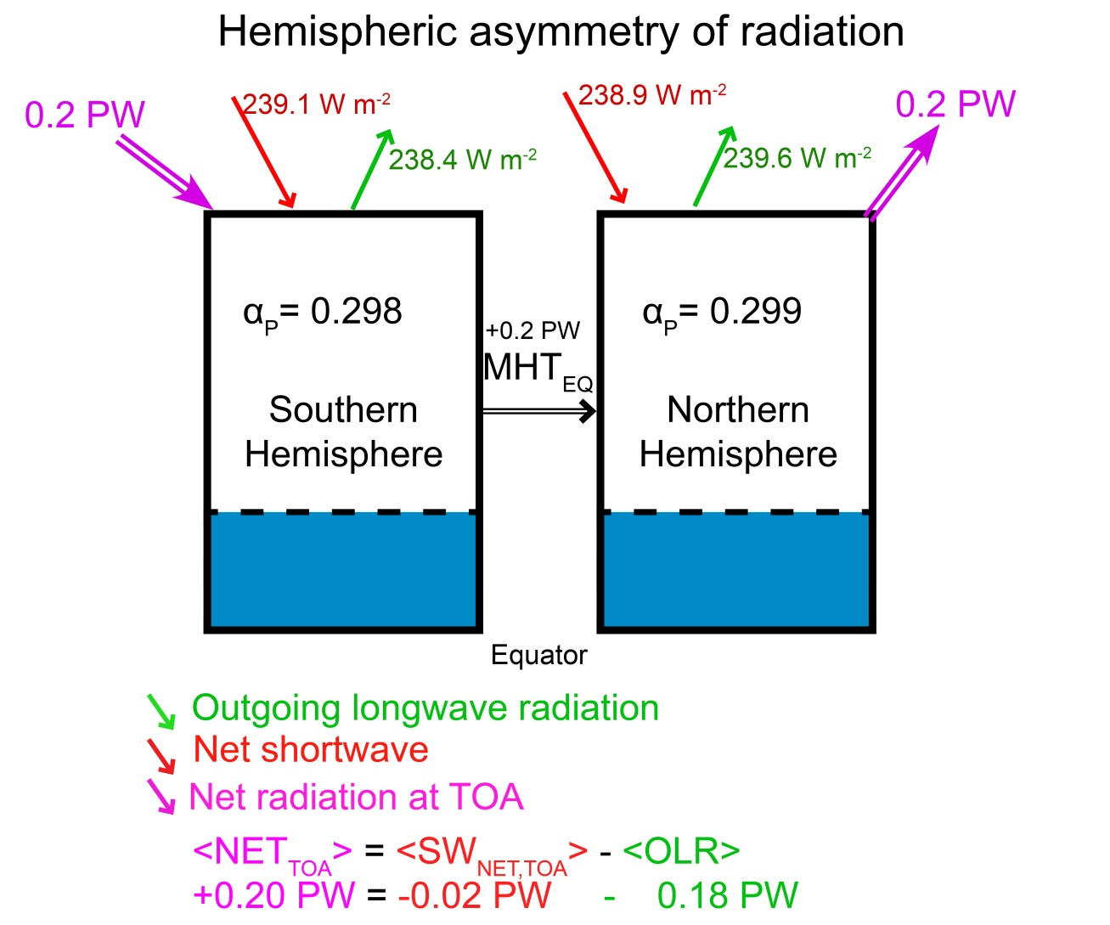
Hemispheric Contrast of TOA radiation
< > s are the anomaly from the global mean integrated over the SH (or negative the integral over the NH)

Slide 8
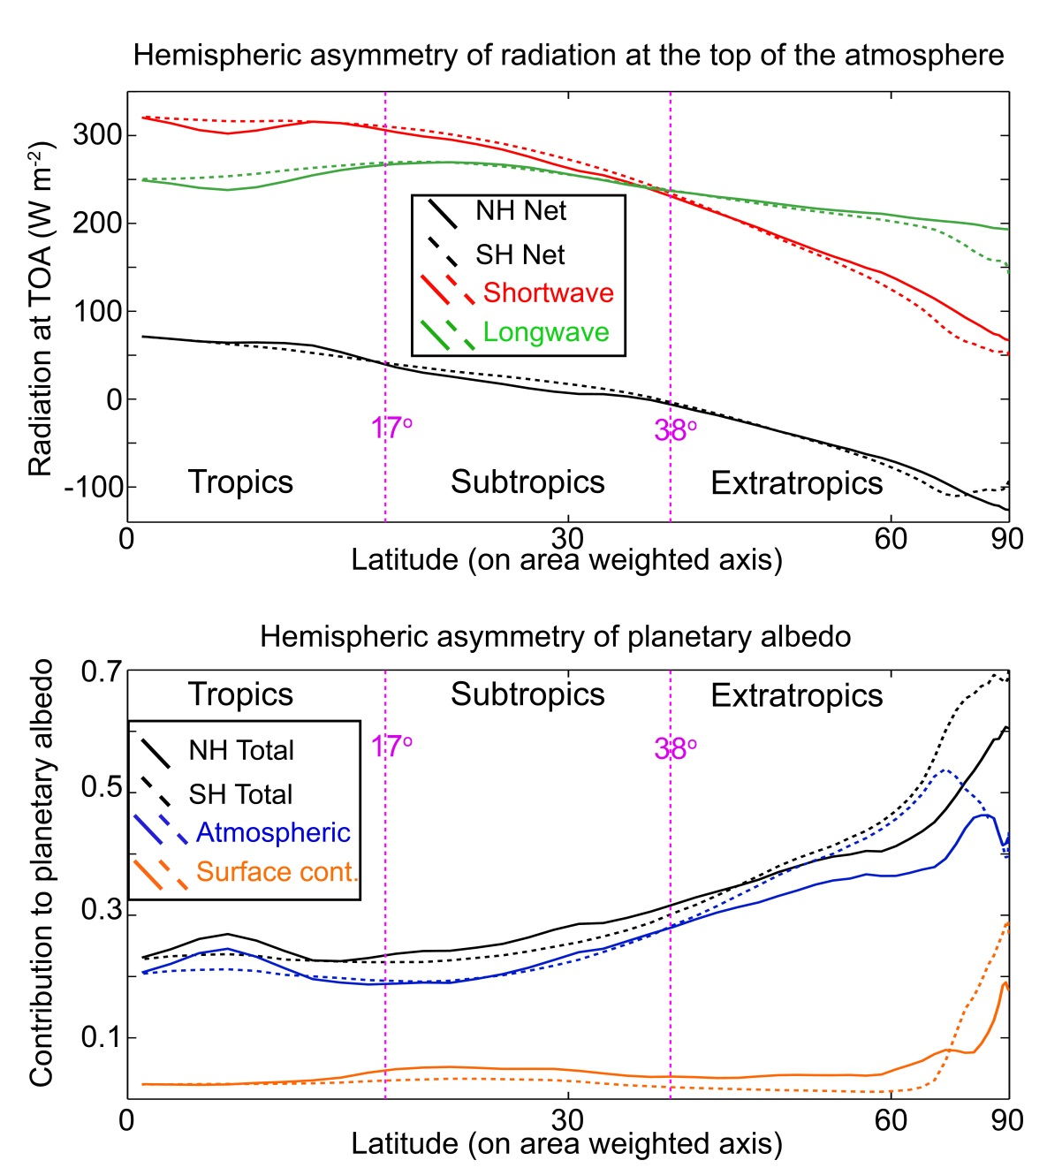
Hemispheric Contrast Of TOA Radiation
NH reflects more SW radiation in the subtropical deserts. SH reflects more SW in the extratropics due to clouds in the Southern Ocean
The NH is warmer (more OLR), especially in the polar latitudes
Planetary albedo is partitioned into cloud and surface contributions via the method of Donohoe and Battisti (2011)

Slide 9
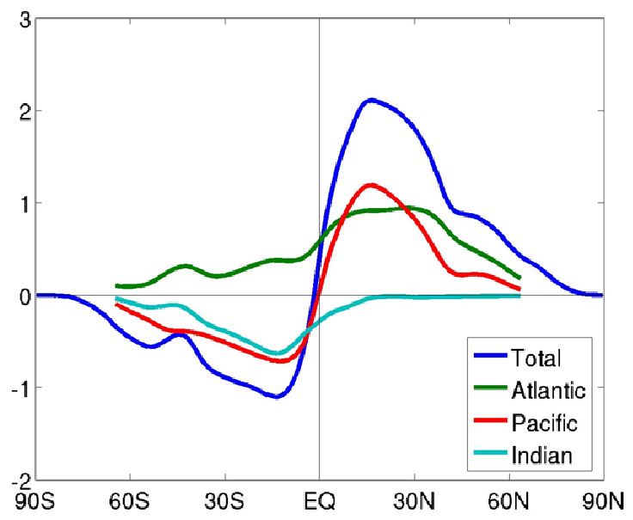
Ocean heat transport across the equator
Atlantic
All basins – indirect (residual)
Energy Transport
Northward Energy Transport (PW)
Ganachaud and Wunsch ,2003
Frierson et al. , Submitted

Slide 10

Conclusions– so far
The annual mean ITCZ is located North of the Equator
The Atmospheric heat transport across the equator is Southward
The above both reflect a mutual connection to a Hadley cell with a rising branch in the NH
The Southward AHT at the equator could not be energetically balanced without Northward ocean heat transport across the equator

Slide 11
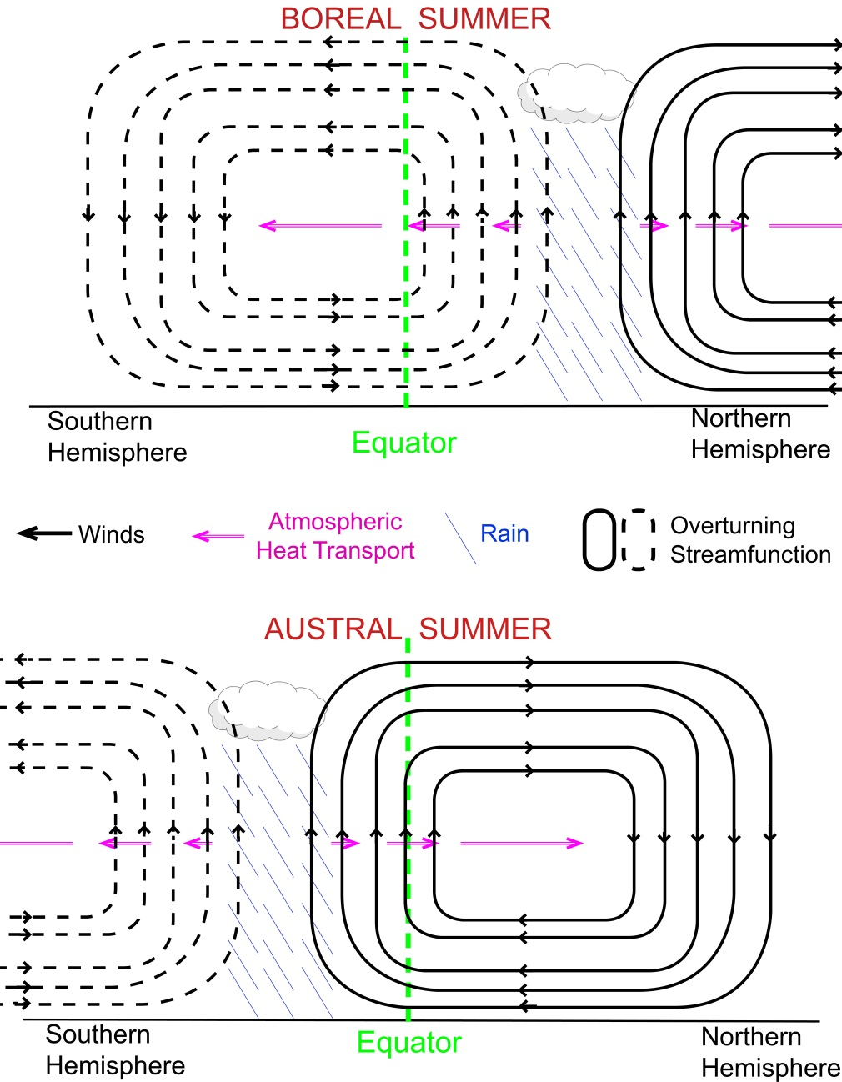
2. The seasonal cycle of ITCZ location and AHT at the equator

Slide 12
Data and methods
AHT_{EQ} is calculated from NCEP reanalysis T62 L17 6 hourly data (winds, temperature, humidity, and geopotential)
The moist static energy flux is calculated in flux form of the equations after mass is balanced via a barotropic wind correction (Trenberth, 97)
Similar results are found using ERA-interim reanalysis fluxes in advective form (Donohoe and Battisti, 2012) and JRA reanalysis (Fasullo and Trenberth 2010)
The ITCZ location is measured as the Precipitation Centroid (P_{CENT}) = the median of zonal mean precipitation equatorward of 20º (Frierson and Hwang, 2010)

Slide 13
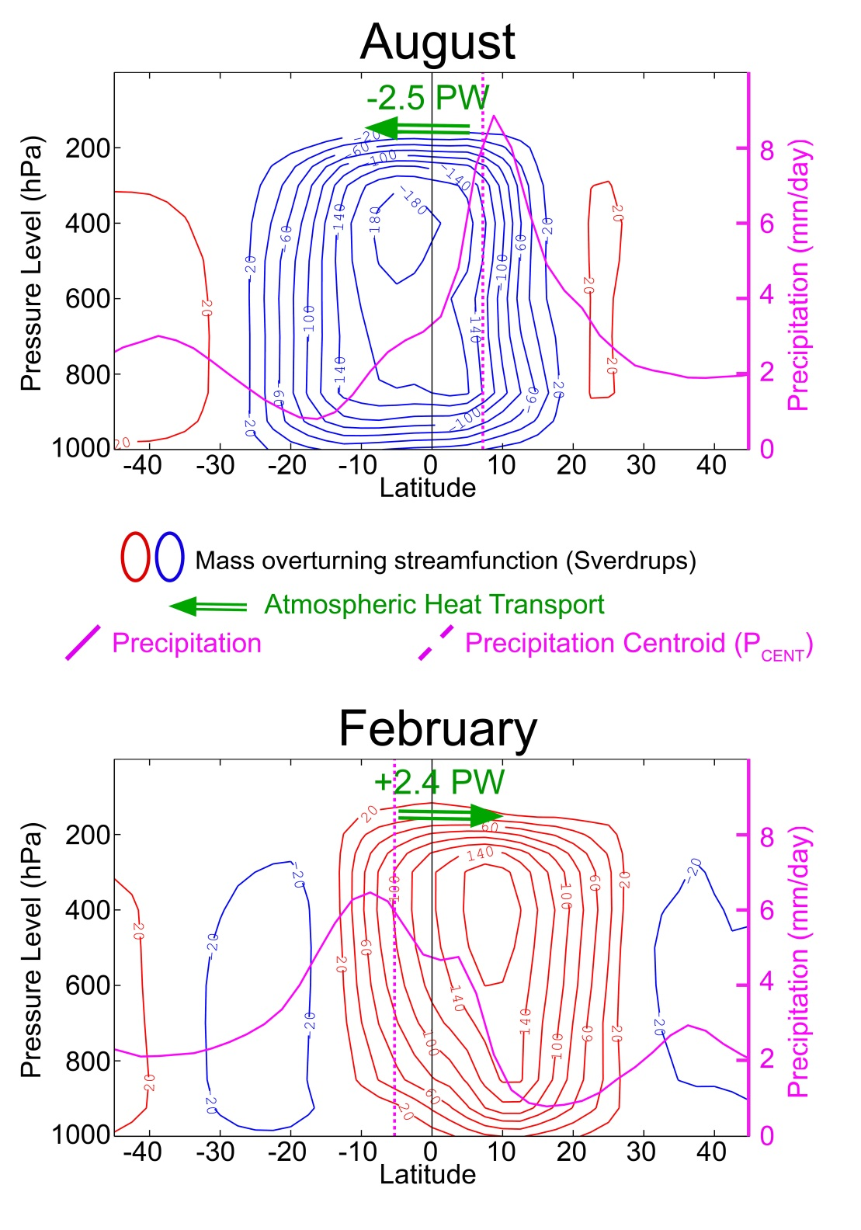
Solstice Seasons
Annual average is
the small residual of
Nearly canceling seasonal
extremes

Slide 14
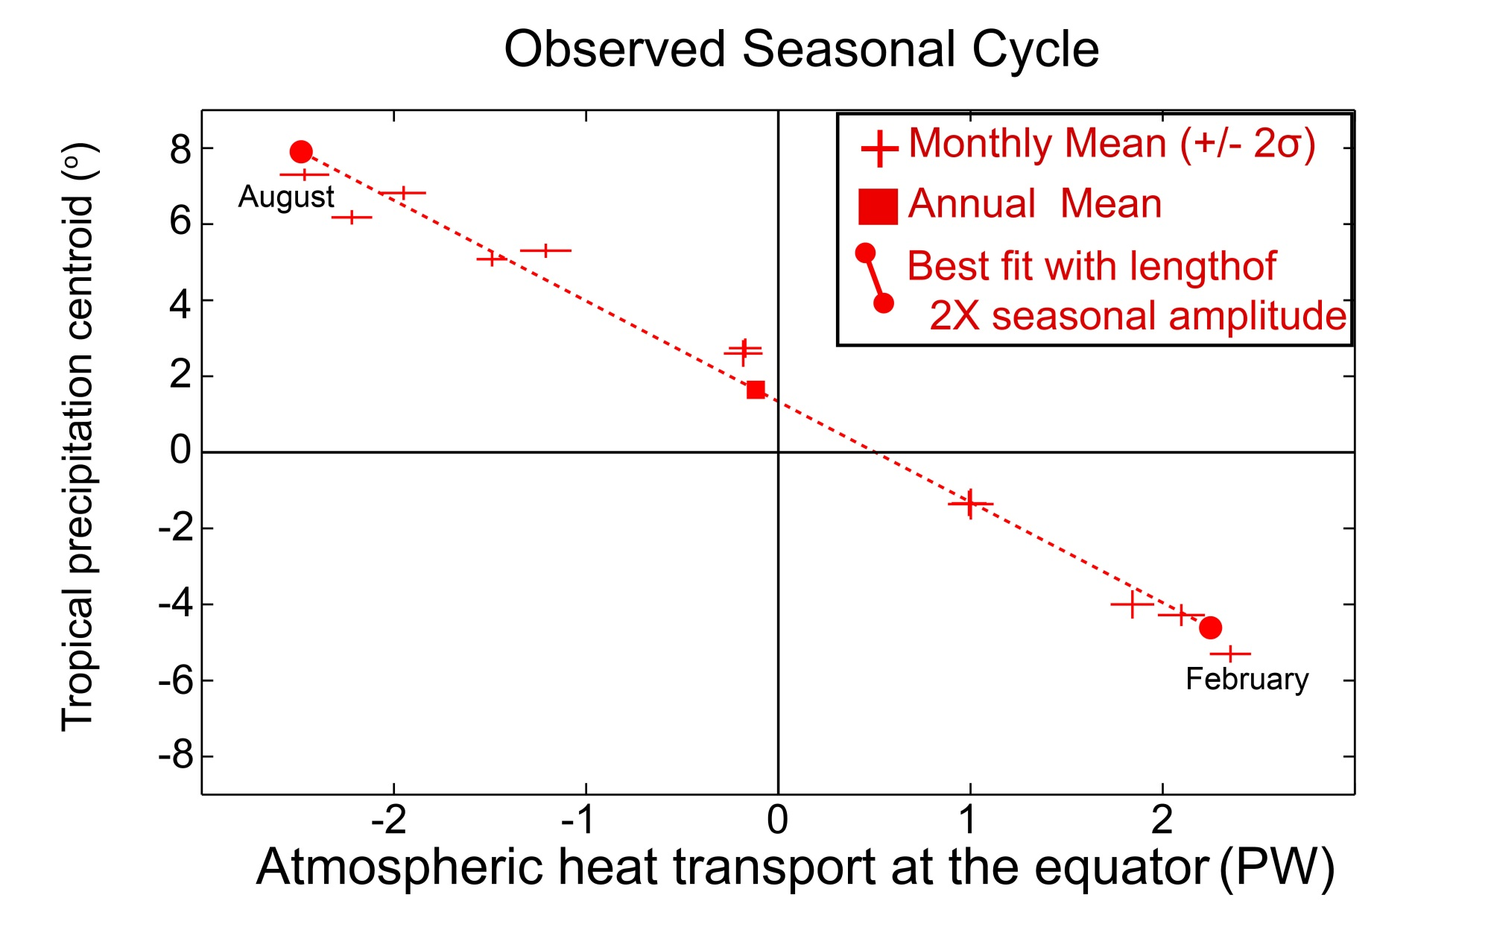
Seasonal cycle of ITCZ location and AHT_{EQ}
Slope is -2.7 +/-0.6 degree latitude per PW

Slide 15
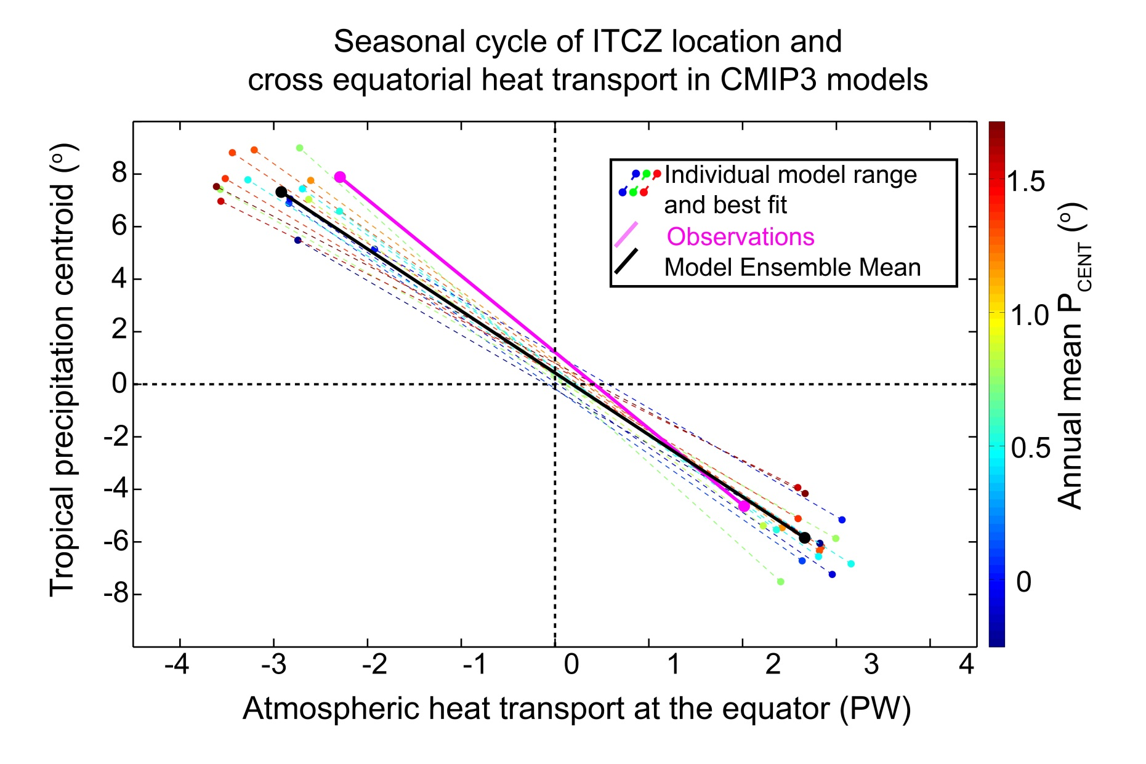
Seasonal cycle in coupled models
Ensemble mean slope -2.5+/-0.4 degree latitude per PW

Slide 16
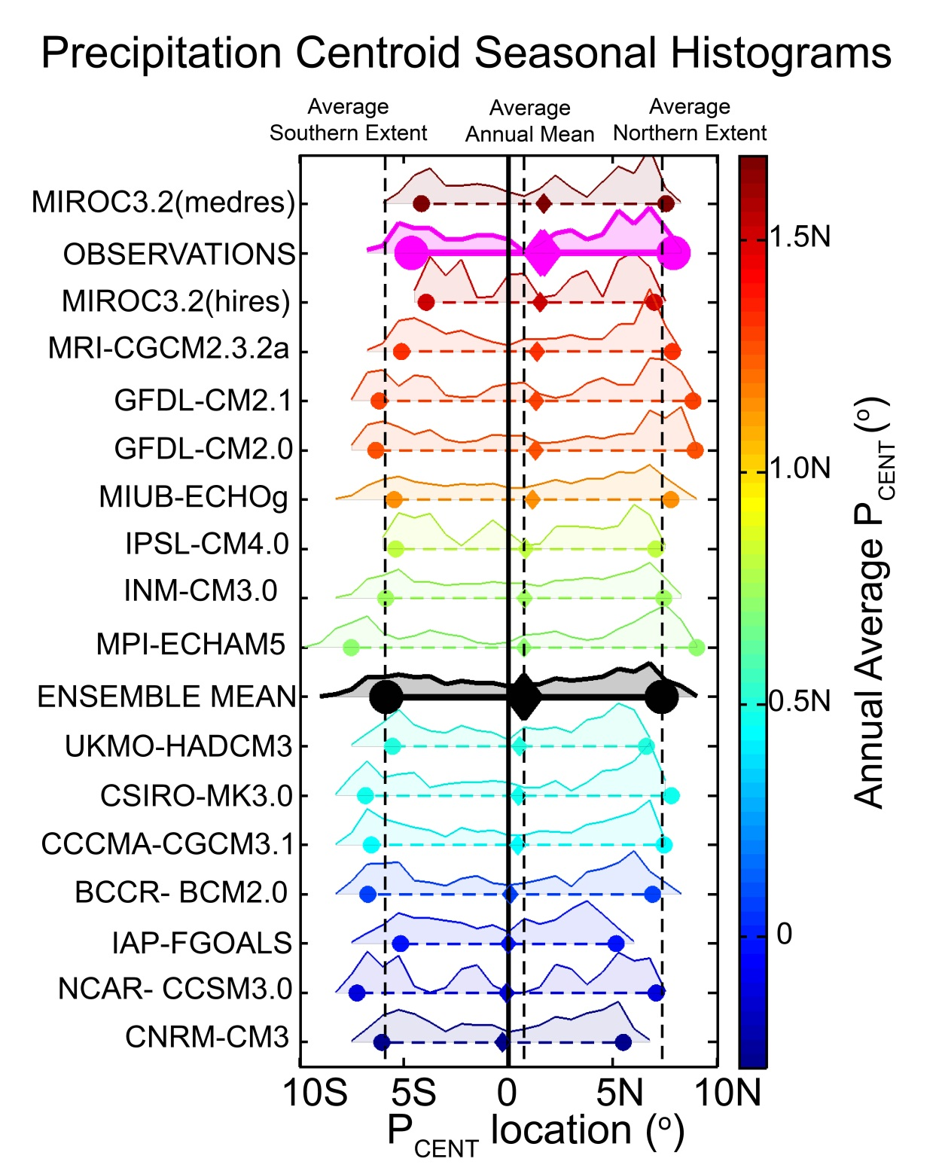
The annual average is seldom realized
Seasonal extremes set the annual average

Slide 17
Atmospheric energy budget
Conventional
This study
Net SW
TOA
OLR
Atmospheric SW absorption (SWABS)
OLR
Heat Transport
Divergence
Net energy flux
Through surface
Heat Transport
Divergence
SW transparent
atmosphere
Surface heat
Flux (SHF)
Storage
Storage
Surface
Surface
Net energy flux through surface =
Solar + turbulent + LW
SHF = turbulent + LW
=> Energy exchange between surface and atmosphere

Slide 18
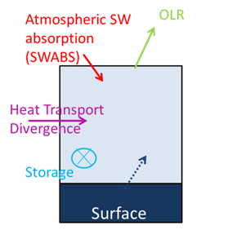
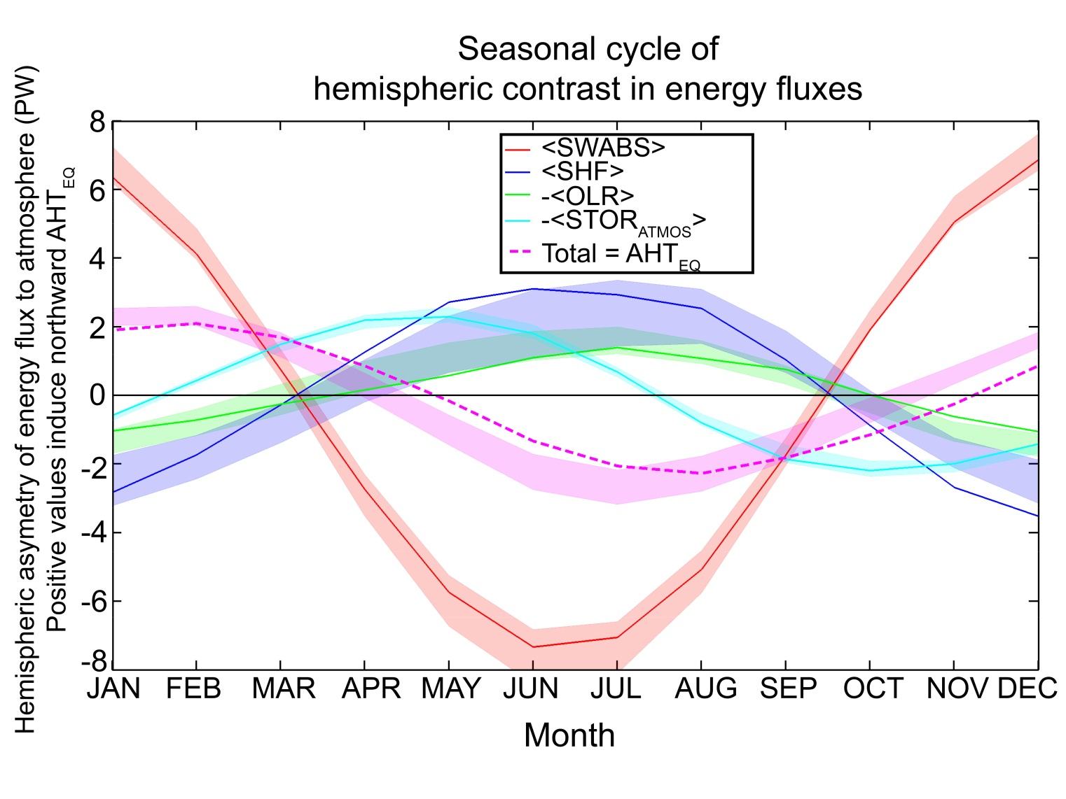
Energy flux into the SH atmosphere by month
Notes:
Amplitudes NET SW TOA = 23 PW, SWABS = 7.1 , SHF = 3.2, OLR =1.1 , stor 2.3 , AHT 2.2

Slide 19
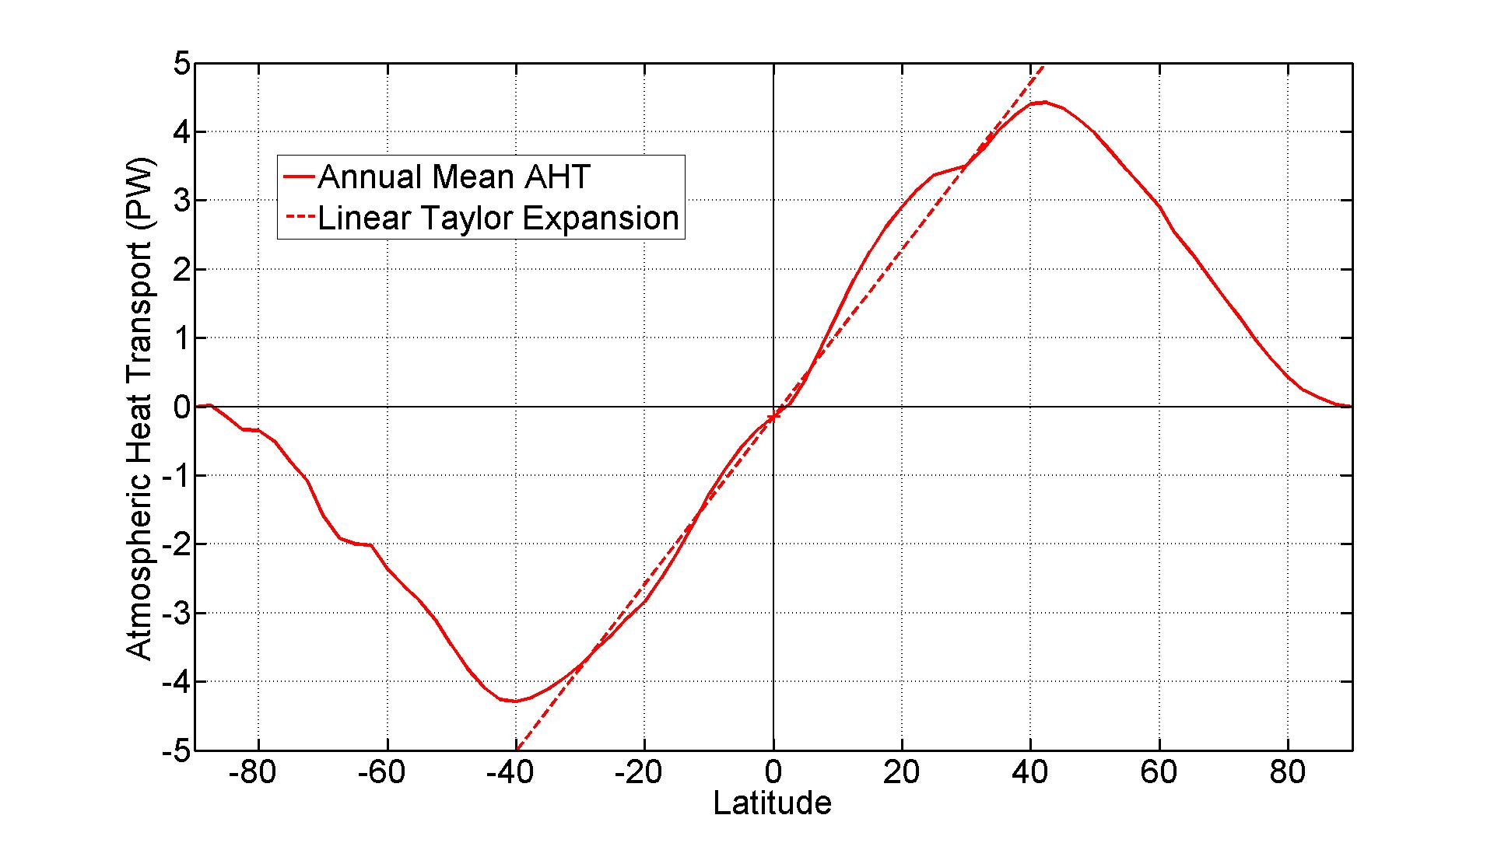
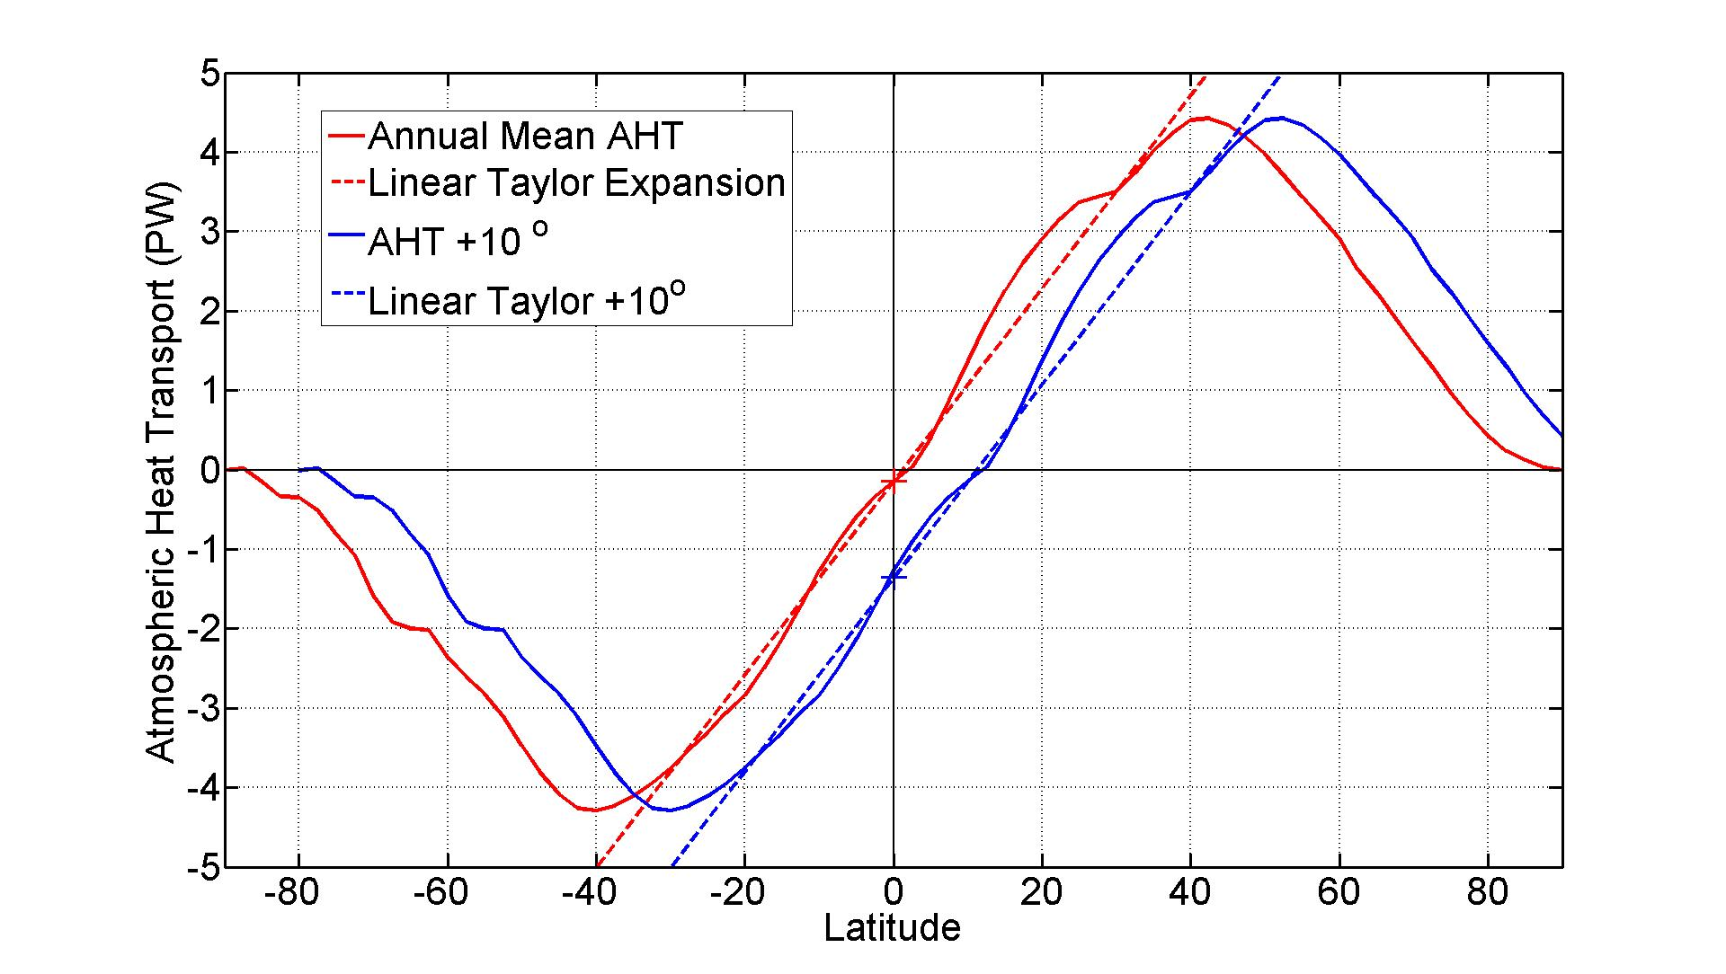
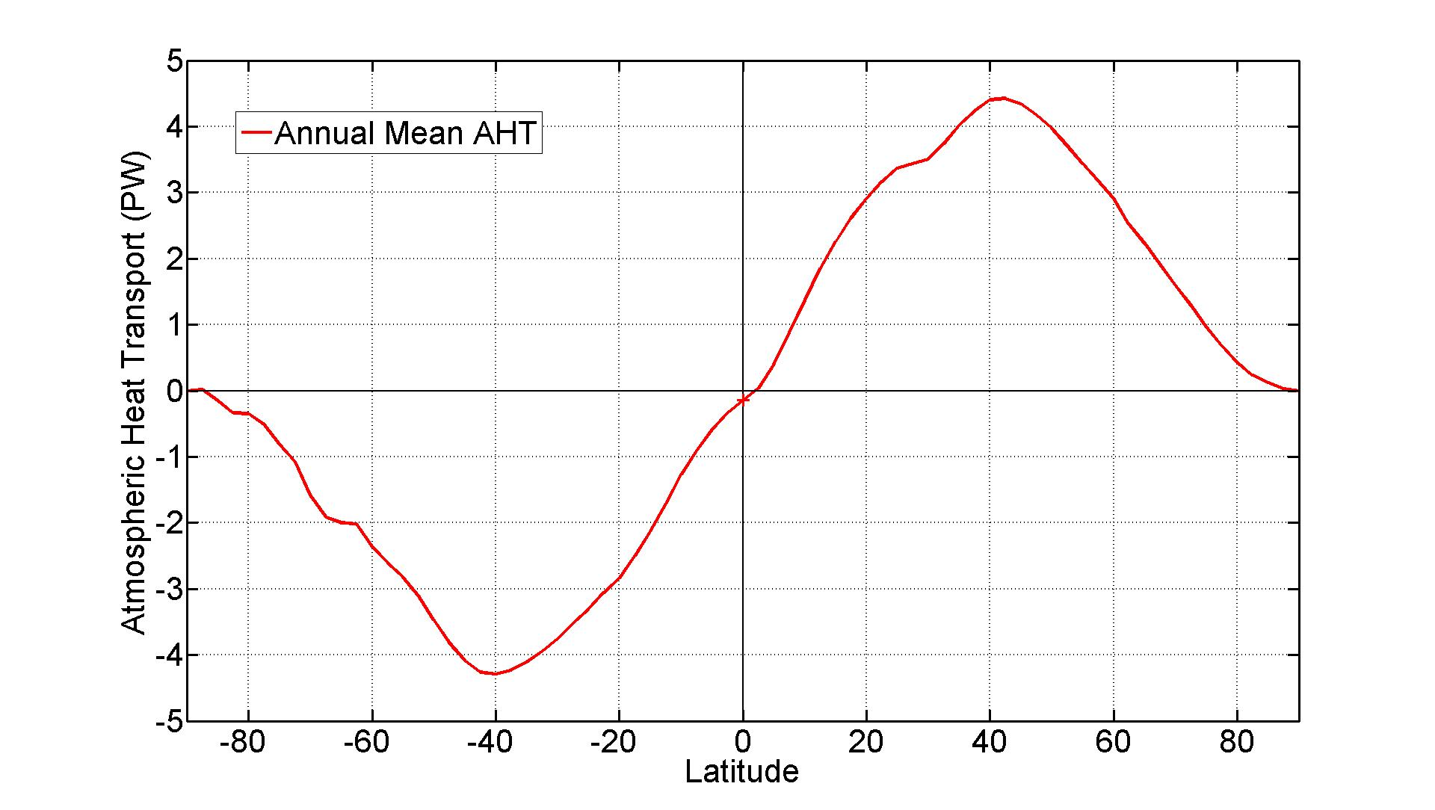
What sets the relationship between ITCZ location and AHT_{EQ}?
Annual Mean Atmospheric Heat Transport

Slide 20
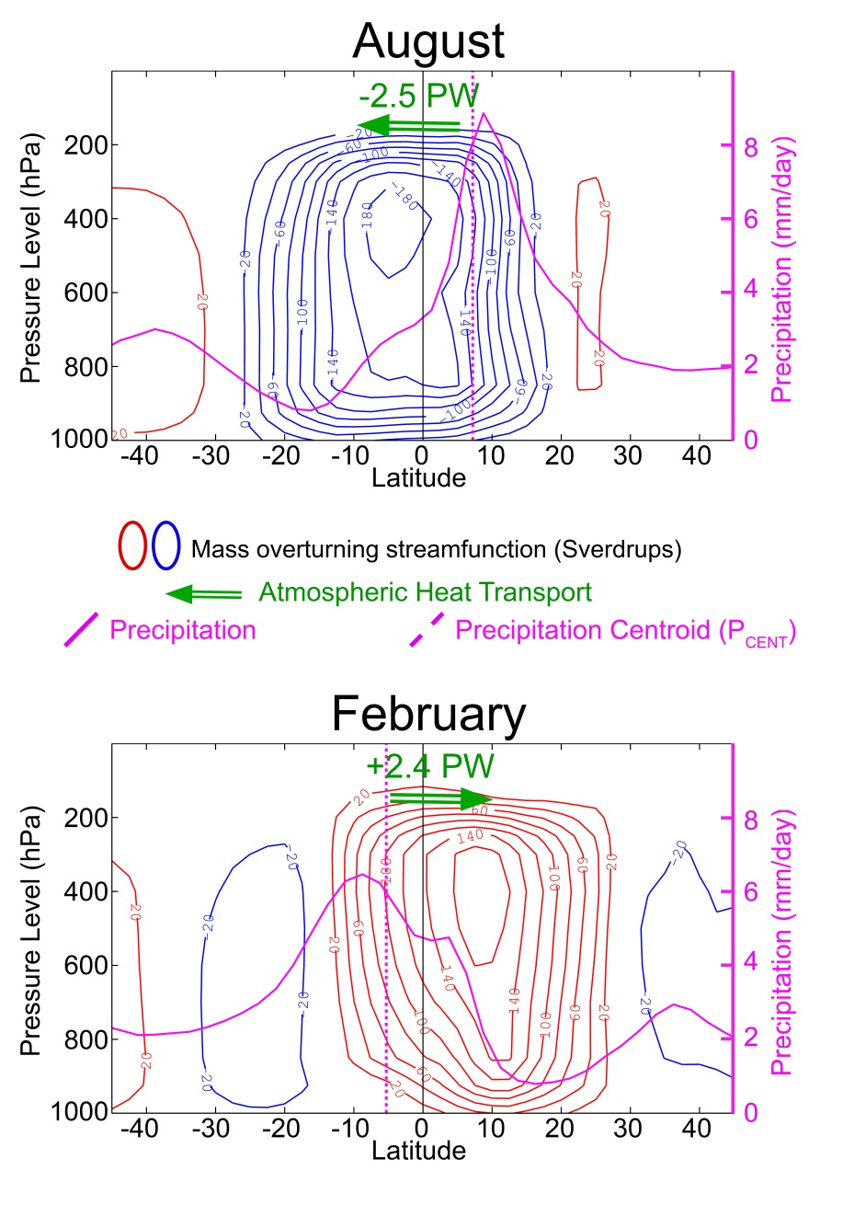
Idealized seasonal cycle
Pure translation
Reality: Intensification of winter cell

Slide 21
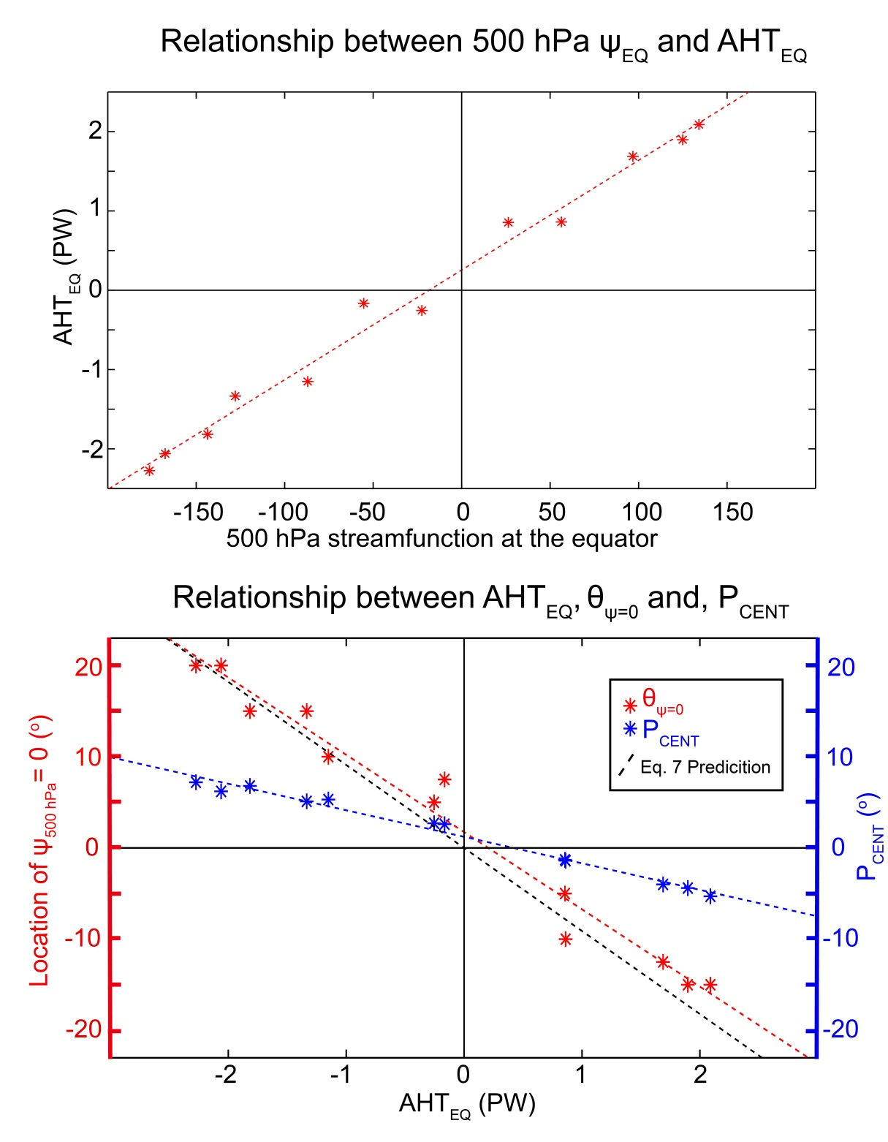
The strength of the overturning cell dictates AHT_{EQ} - the energy contrast between Northward and Southward flowing air is 14K
The location of zero streamfunction (upwelling branch of Hadley cell) moves 9 degrees latitude per PW of AHT_{EQ}
In contrast, P_{CENT} only moves 3 degrees latitude per PW of AHT_{EQ}

Slide 22
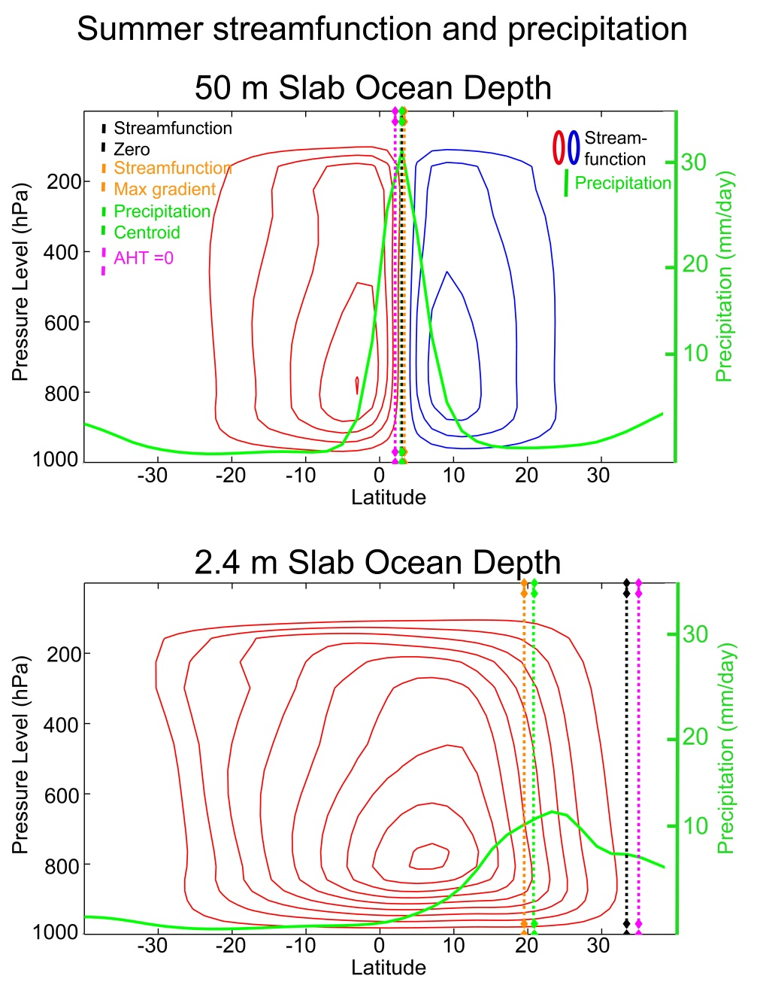
Solstitial ITCZ in slab ocean aquaplanet with varying mixed layer depth
Deep ocean run:
ITCZ stays close to the equator and the winter and summer cells are nearly symmetric -> precipitation maximum is co-located with location of zero streamfunction
Shallow ocean run:
ITCZ moves far off the equator and winter cell intensifies -> precipitation moves to location of maximum streamfunction gradient which is equatorward of location of zero streamfunction

Slide 23
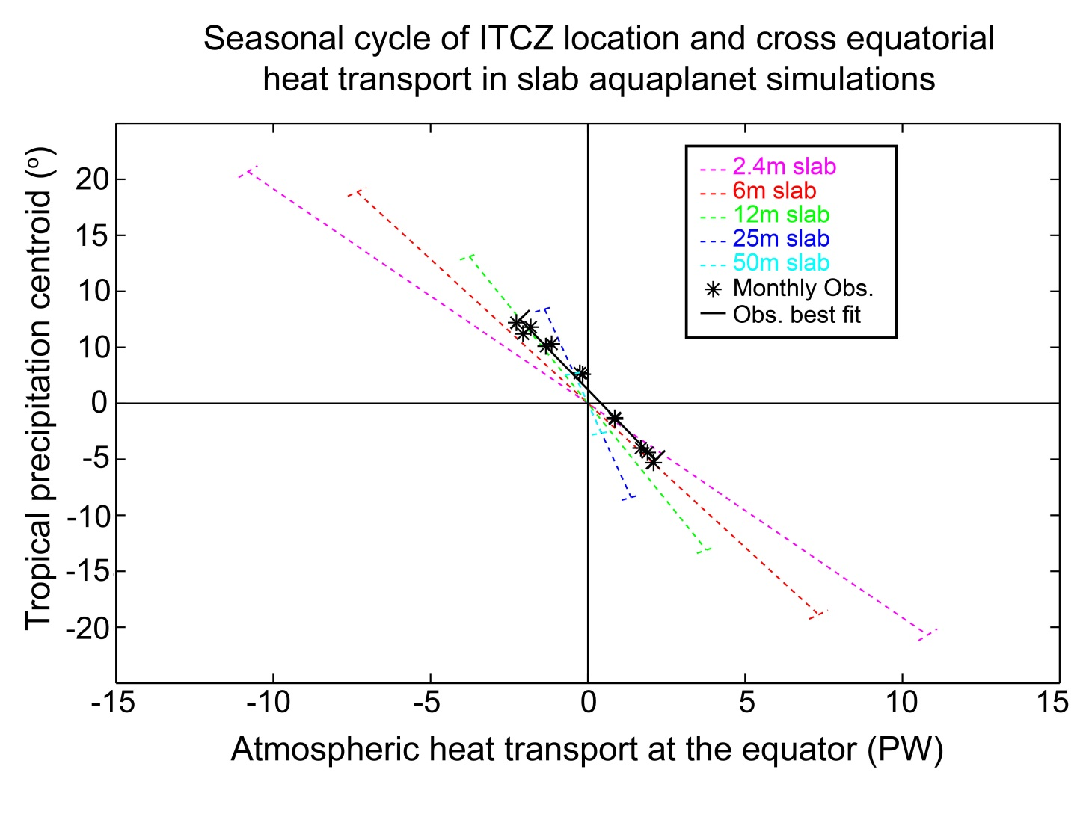
Seasonal relationship between ITCZ and AHT_{EQ} in slab aquaplanet runs

Slide 24
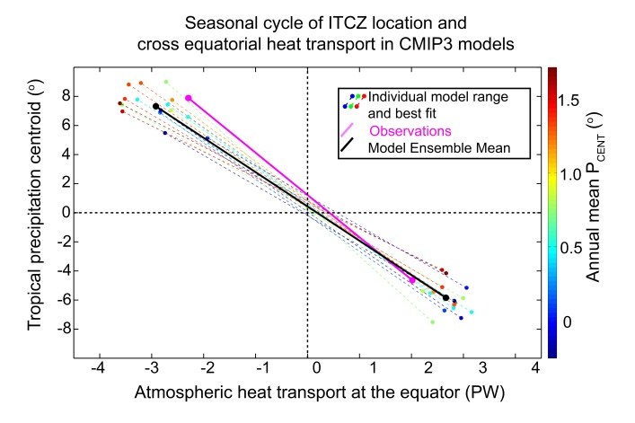
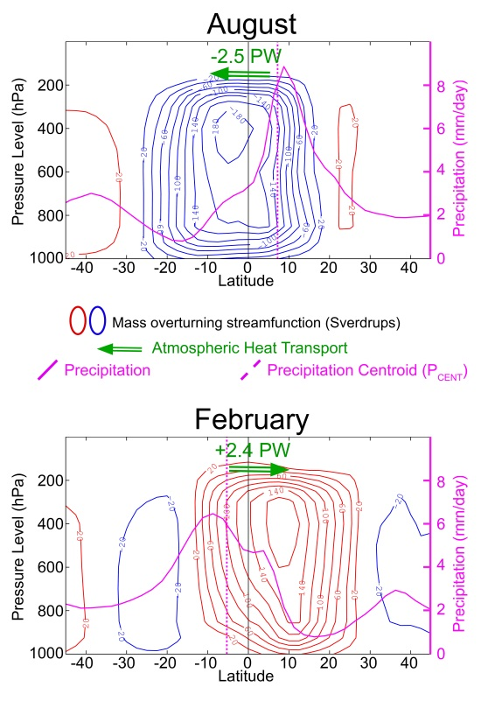
Conclusions this section
ITCZ location and AHT_{EQ} are highly correlated over the seasonal cycle with a relationship of order 3 degrees latitude per PW
The intensification of the winter cell causes the ITCZ to migrate less than the Hadley cell -> more AHT_{EQ} required per unit ITCZ migration

Slide 25
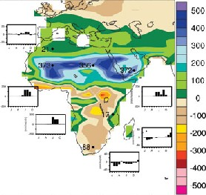
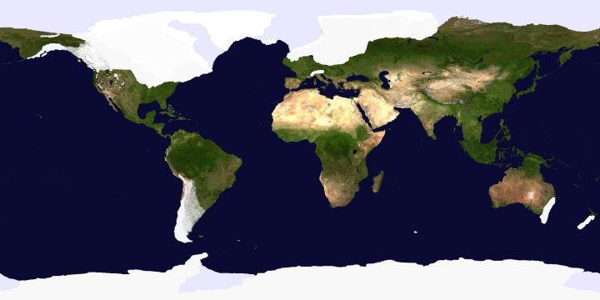
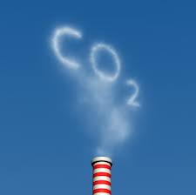
3. Climate Perturbation experiments
Mid Holocene (6Kyear BP)
Last Glacial Maximum (LGM)
Martini and Chesworth
CO₂ Doubling
Credit: Robert Johnson

Slide 26
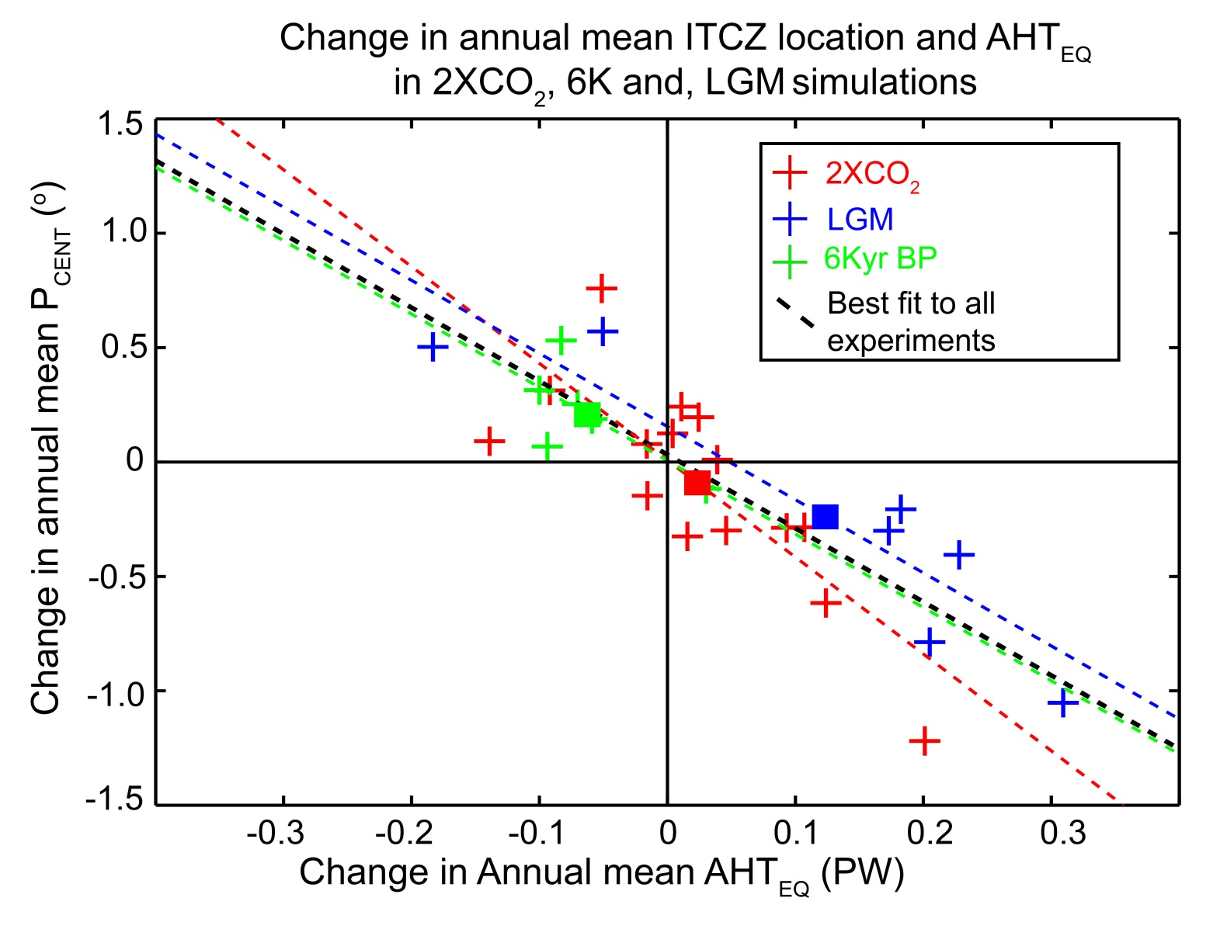
Ensemble mean of each experiment
Slope of -3.2 degrees latitude per PW

Slide 27
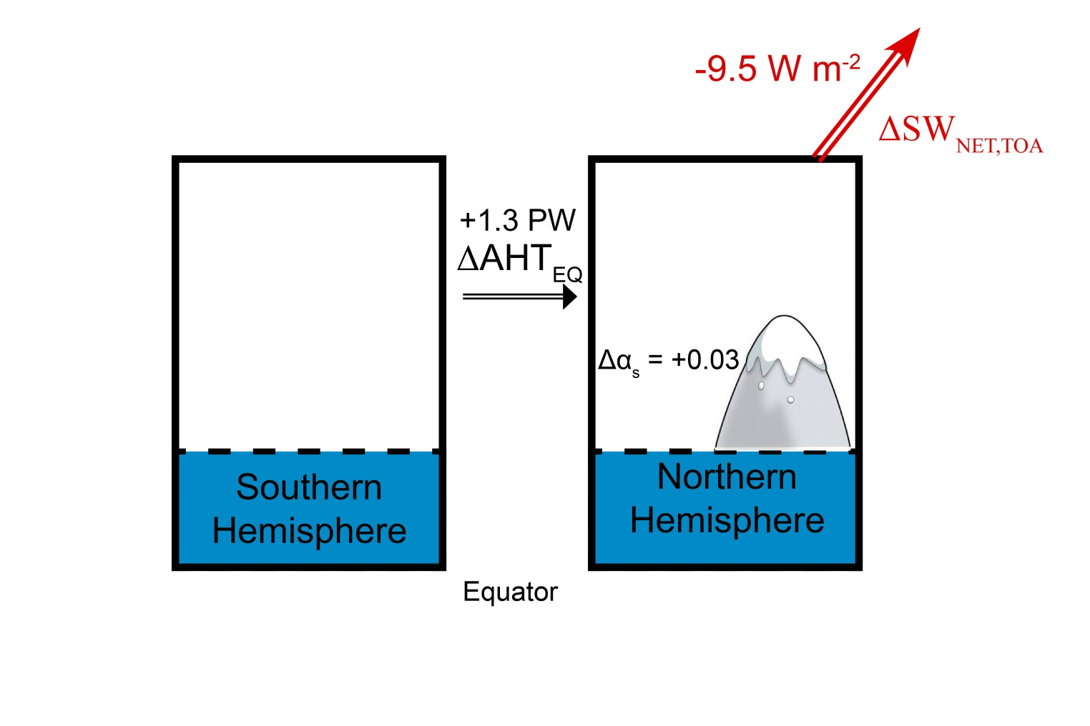
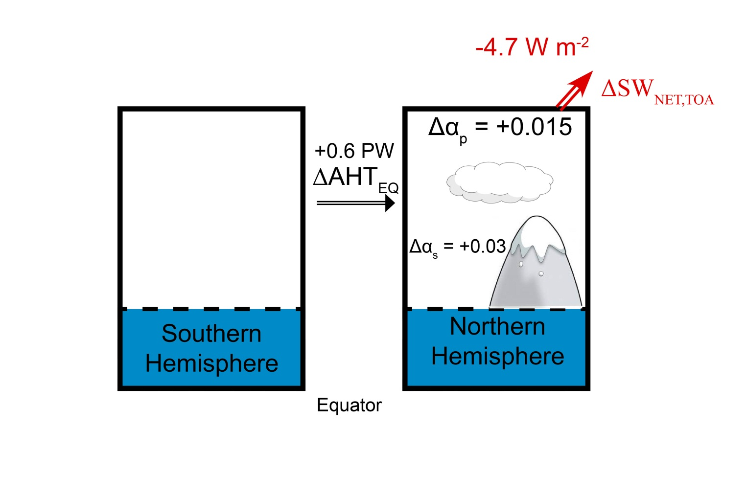



LGM Energetics
AHT_{EQ} change
By processes included :
Surface albedo only:
1.3 PW
Atmospheric SW opacity:
0.6 PW
SW cloud feedback :
0.43 PW
Planck (OLR) Feedback :
0.11 PW
OHT change:
0.12 PW

Slide 28
These are weird!!
Ensemble mean of each experiment
Slope of -3.2 degrees latitude per PW

Slide 29
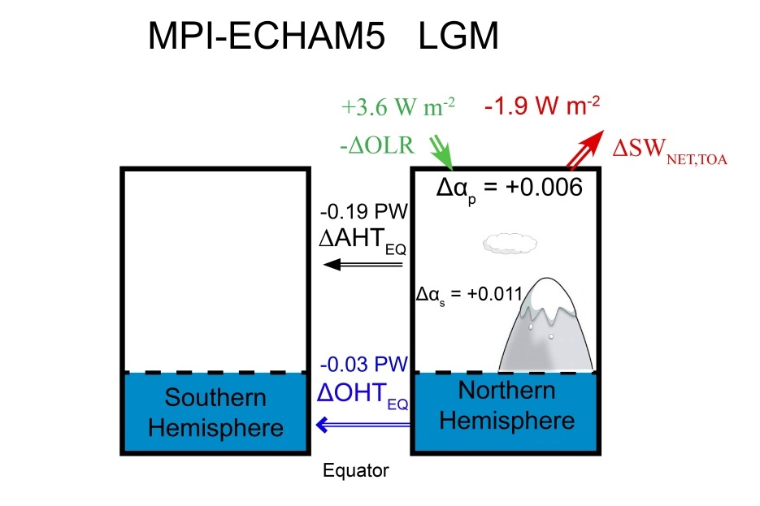


LGM Energetics – Northward ITCZ Shift

Slide 30
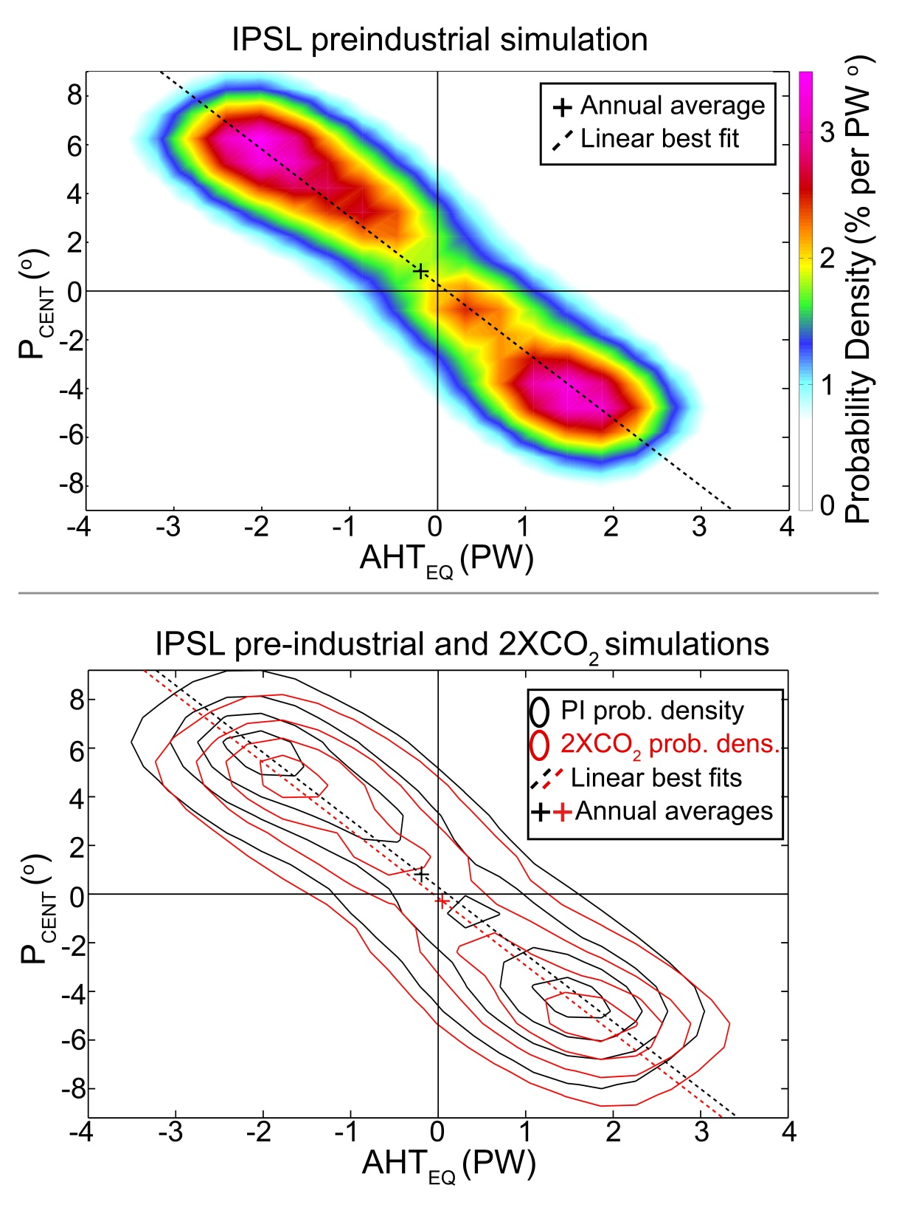
Why is the seasonal relationship between ITCZ location and AHT_{EQ} realized in the (annual mean) perturbation experiments?
Smoothed histograms

Slide 31
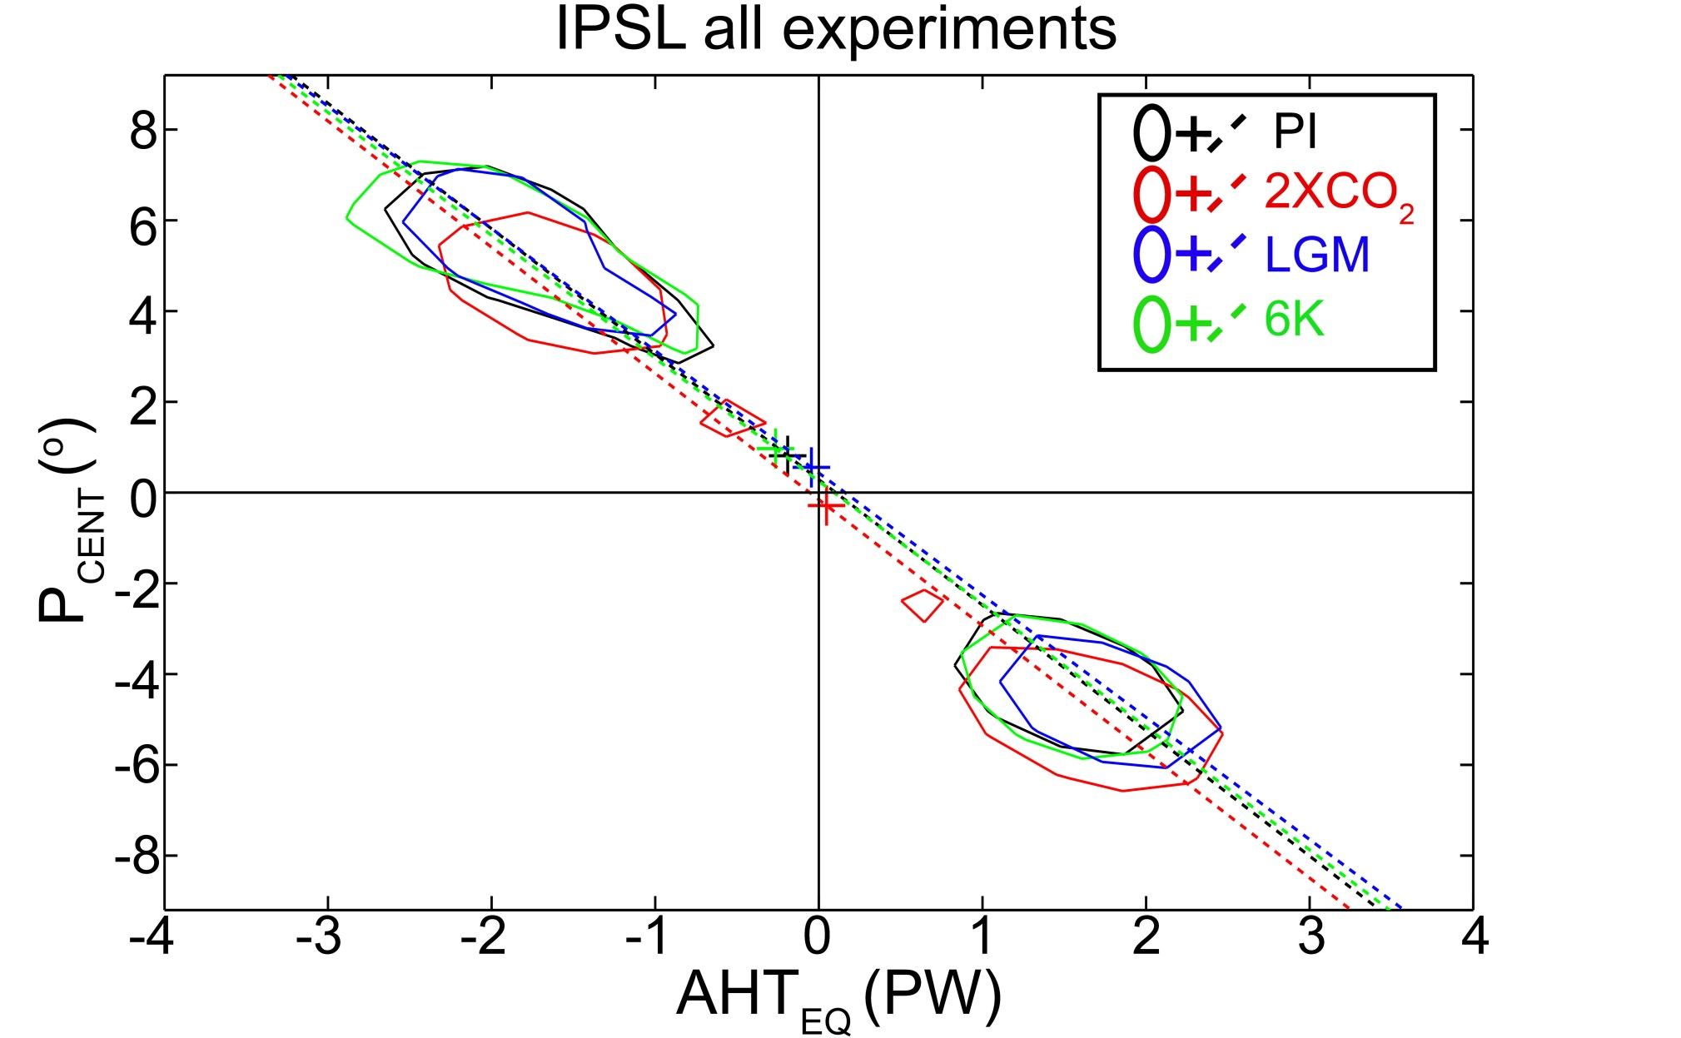
The annual mean lies on the seasonal slope between the solstitial modes
=> The annual mean must shift (is slave to) the seasonal relationship

Slide 32

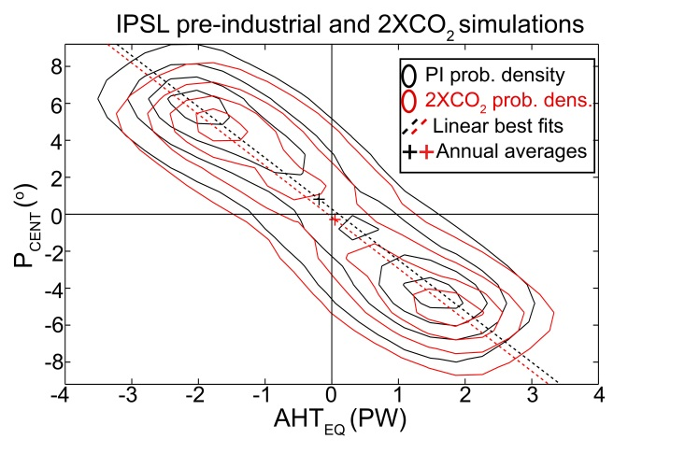
Conclusions
The ITCZ location and AHT_{EQ} have a mutual dependence on the Hadley cell
=> The ITCZ lives in the hemisphere with more energy input into the atmosphere which is a consequence of Ocean heat transport
ITCZ location and AHT_{EQ} are highly correlated over the seasonal cycle with a relationship of order 3 degrees latitude per PW
The same relationship (3 degrees latitude per PW ) applies to the annual mean shift in perturbation experiments because the annual mean shift reflects modest changes in the solstitial modes

Slide 33


Slide 34
