Slide 1
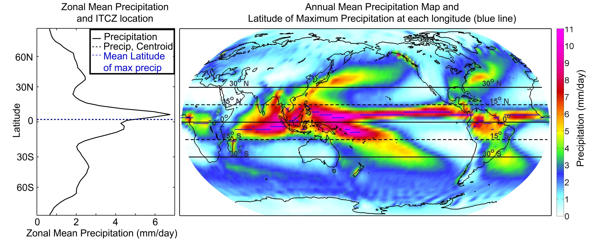
The relationship between the location of the intertropical convergence zone (ITCZ) and atmospheric heat transport across the equator
Aaron Donohoe, John Marshall,
David Ferreira, and David McGee ---- MIT
Noaa CPC merged analysis
Notes:
ITCZ is North of equator

Slide 2
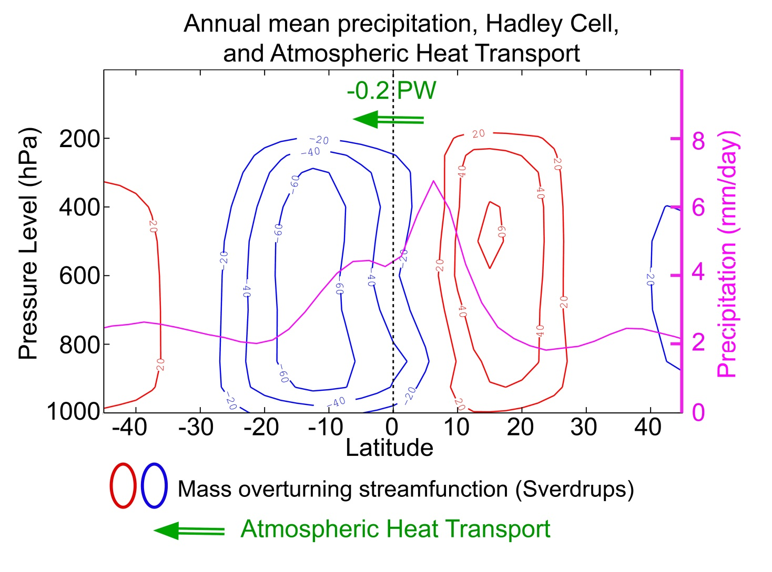
Annual mean Hadley Cell and it’s relationship to precipitation and heat transport
NCEP reanalysis, Noaa CPC merged analysis
Notes:
ITCZ and AHT reflect a mutual connection to Hadley cell.

Slide 3
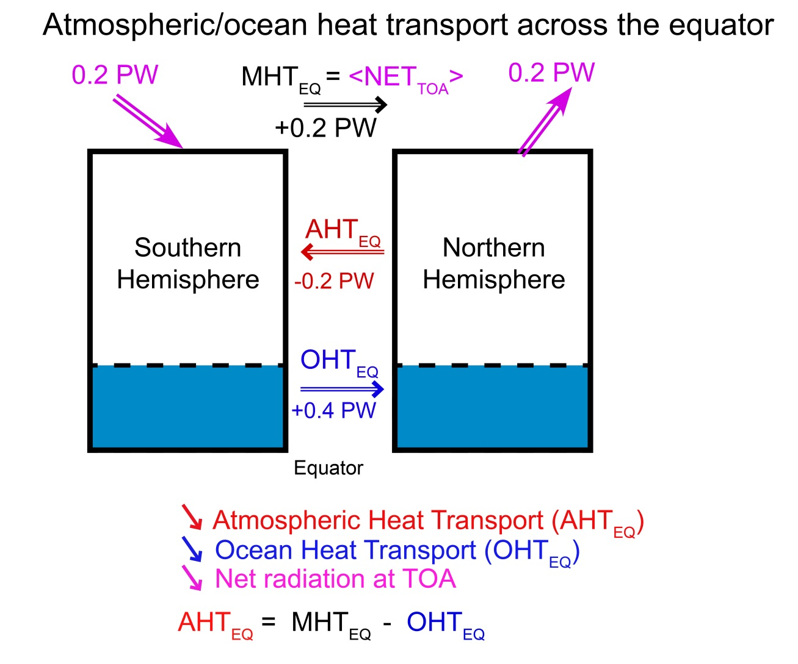
Observed Hemispheric Energy Budget
Marshall, Donohoe, Ferreira, In Prep

Slide 4
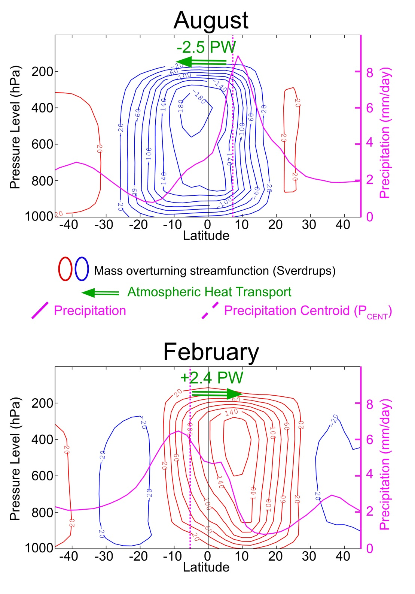
Solstice Seasons
Annual average is
the small residual of
Nearly canceling seasonal
extremes

Slide 5
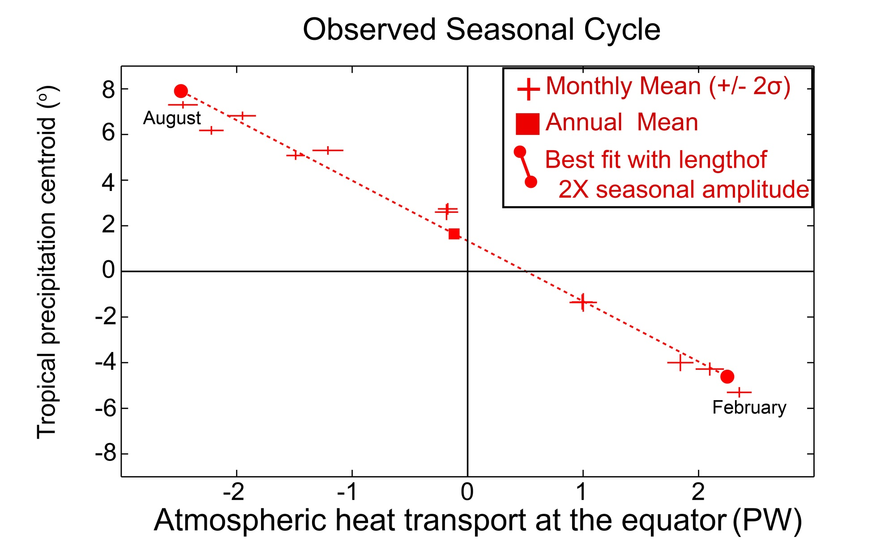
Seasonal cycle of ITCZ location and AHT_{EQ}
Slope is -2.7 +/-0.6 degree latitude per PW

Slide 6
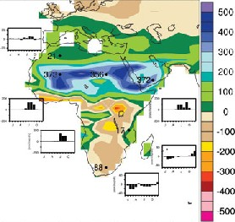
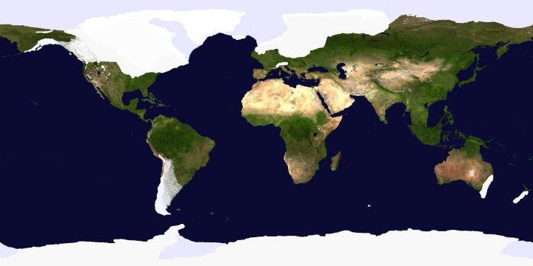
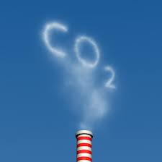
3. Climate Perturbation experiments
Mid Holocene (6Kyear BP)
Last Glacial Maximum (LGM)
Martini and Chesworth
CO₂ Doubling
Credit: Robert Johnson

Slide 7
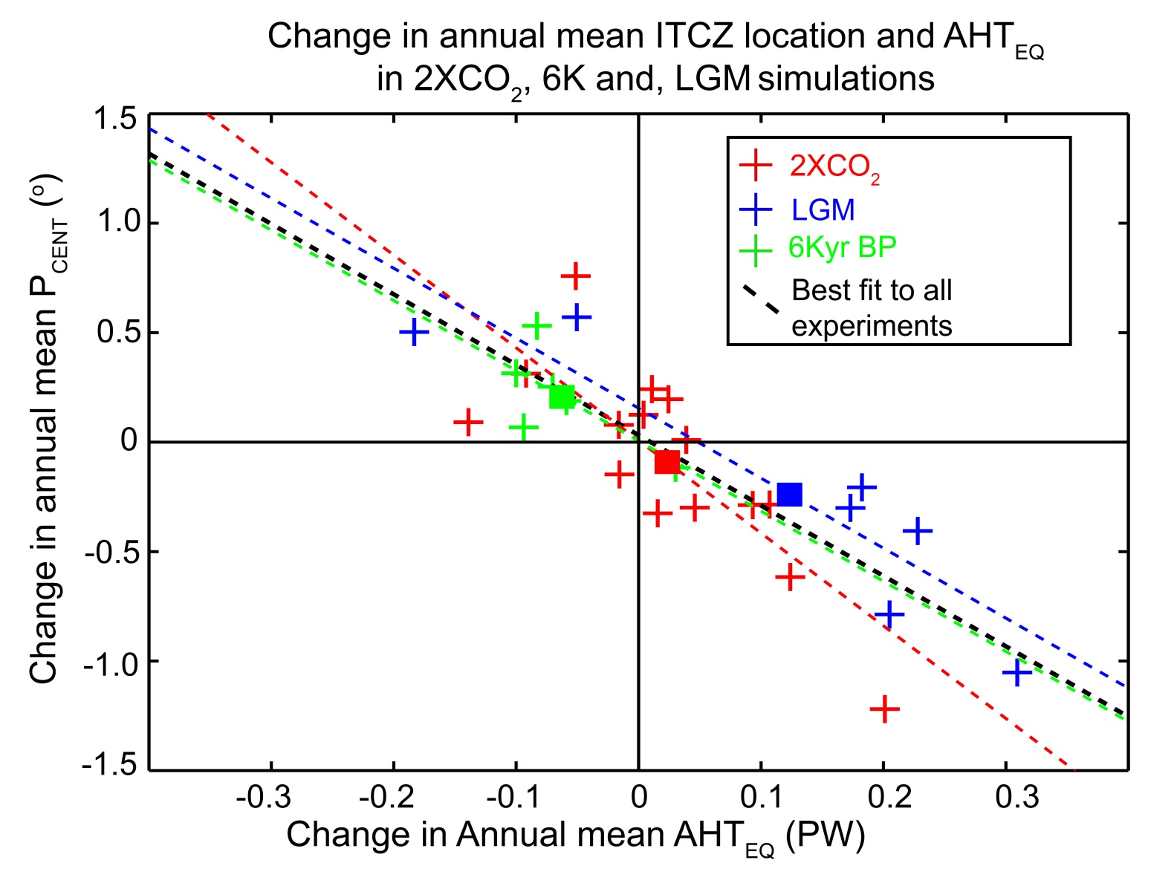
Ensemble mean of each experiment
Slope of -3.2 degrees latitude per PW

Slide 8
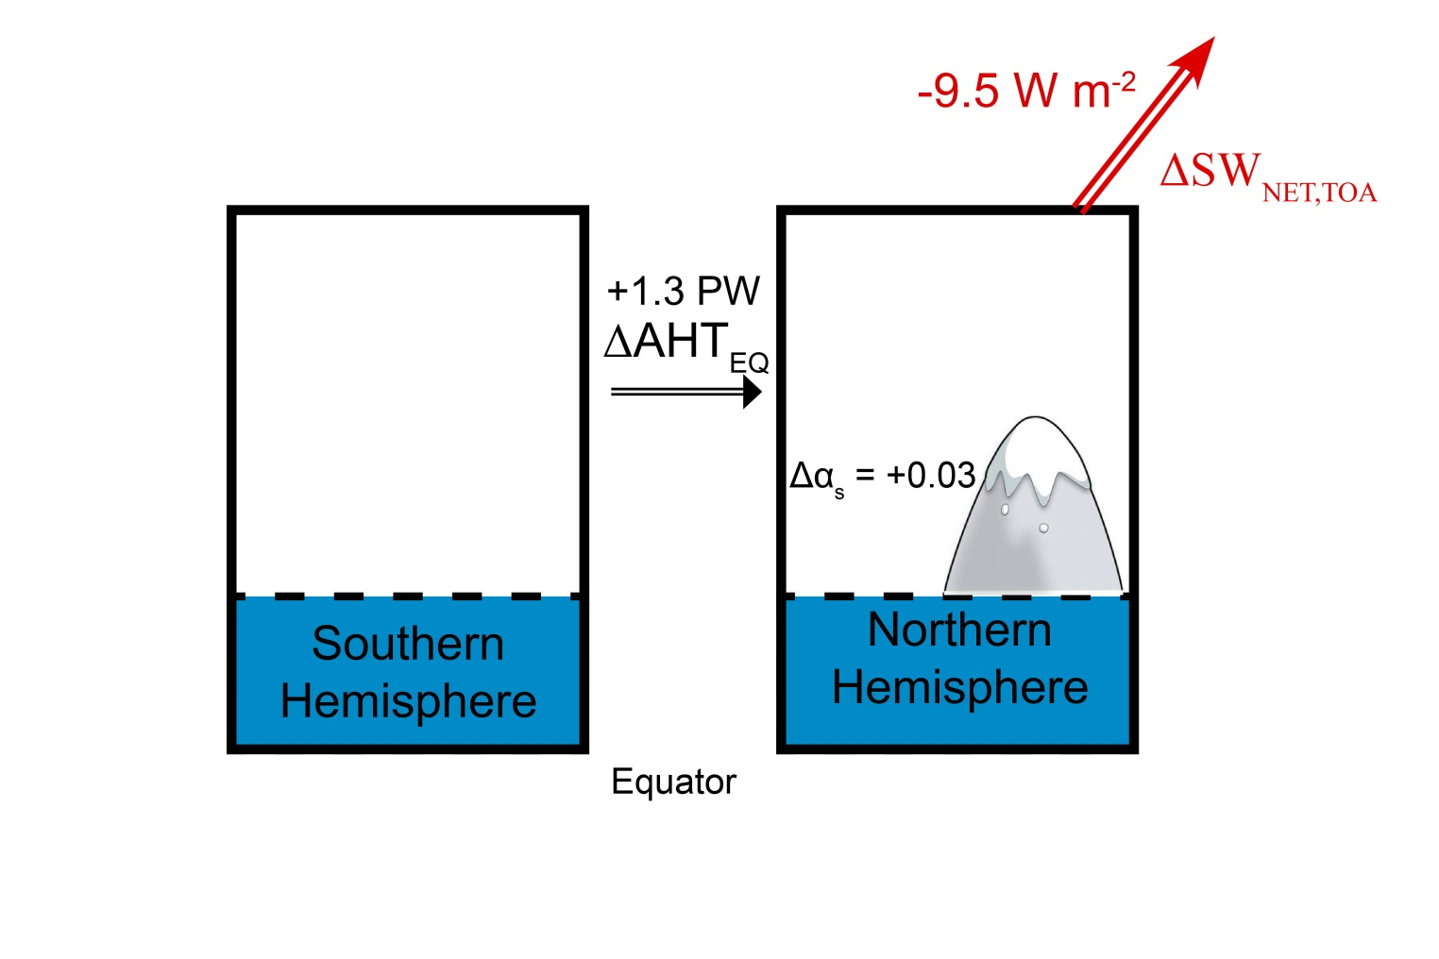
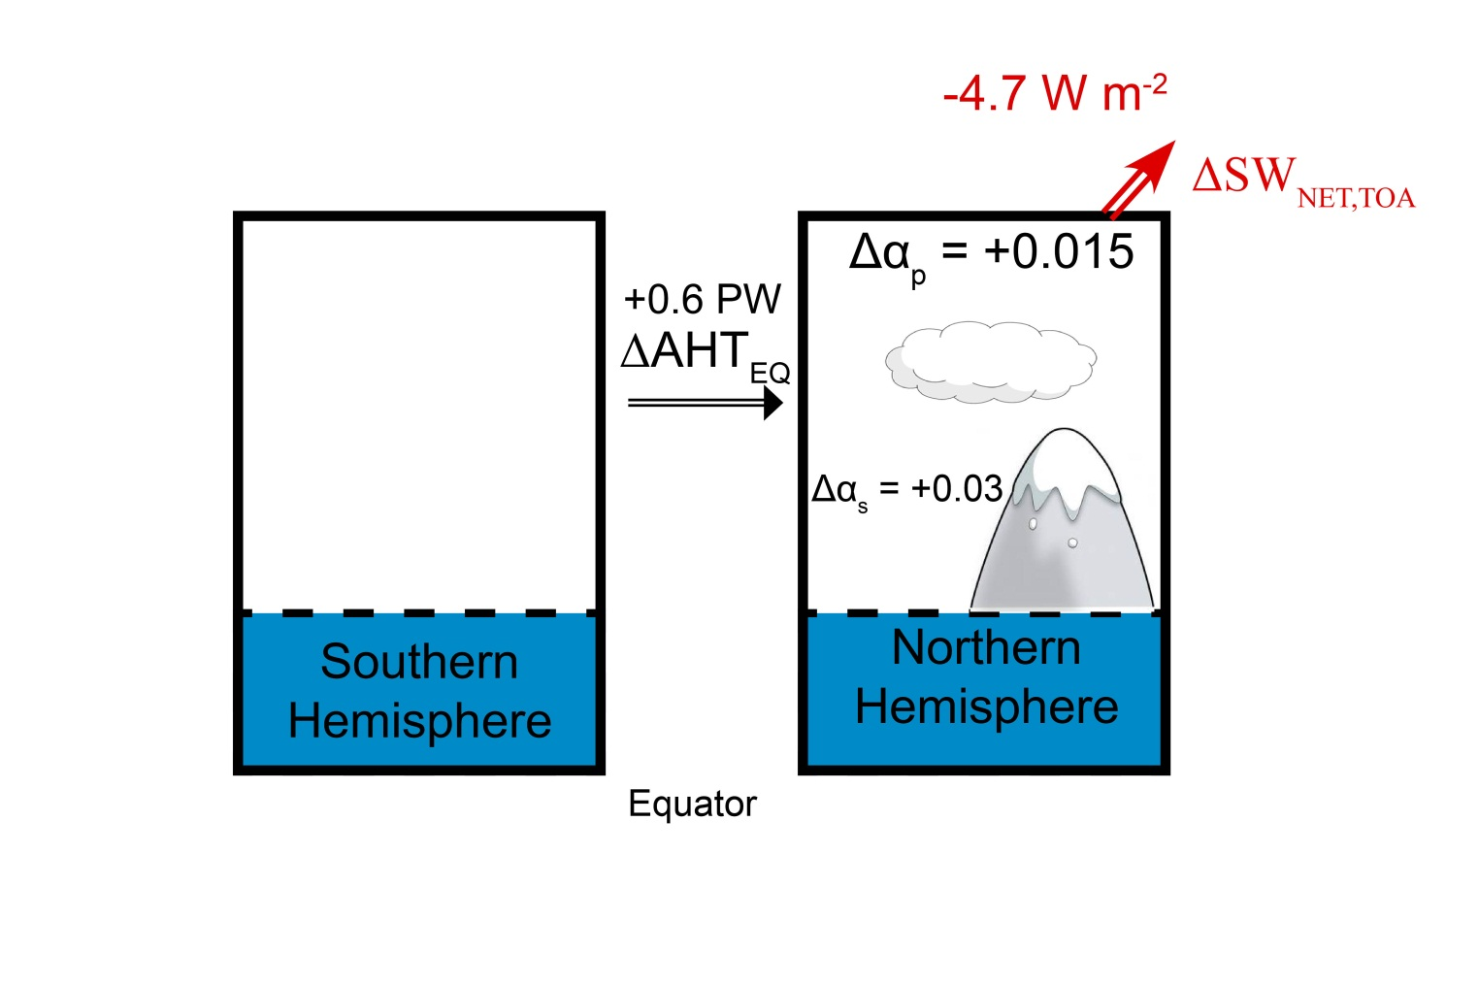



LGM Energetics
AHT_{EQ} change
By processes included :
Surface albedo only:
1.3 PW
Atmospheric SW opacity:
0.6 PW
SW cloud feedback :
0.43 PW
Planck (OLR) Feedback :
0.11 PW
OHT change:
0.12 PW

Slide 9
Conclusions
The ITCZ location and atmospheric heat transport at the equator are highly correlated
Over the seasonal cycle
In the annual mean shift due to climate perturbations
A 3 degree latitude ITCZ shift requires 1 PW of AHT_{EQ}
→ It’s hard to move the ITCZ more than a couple degrees because the required large scale energy flux perturbations are hard to obtain

