Slide 1
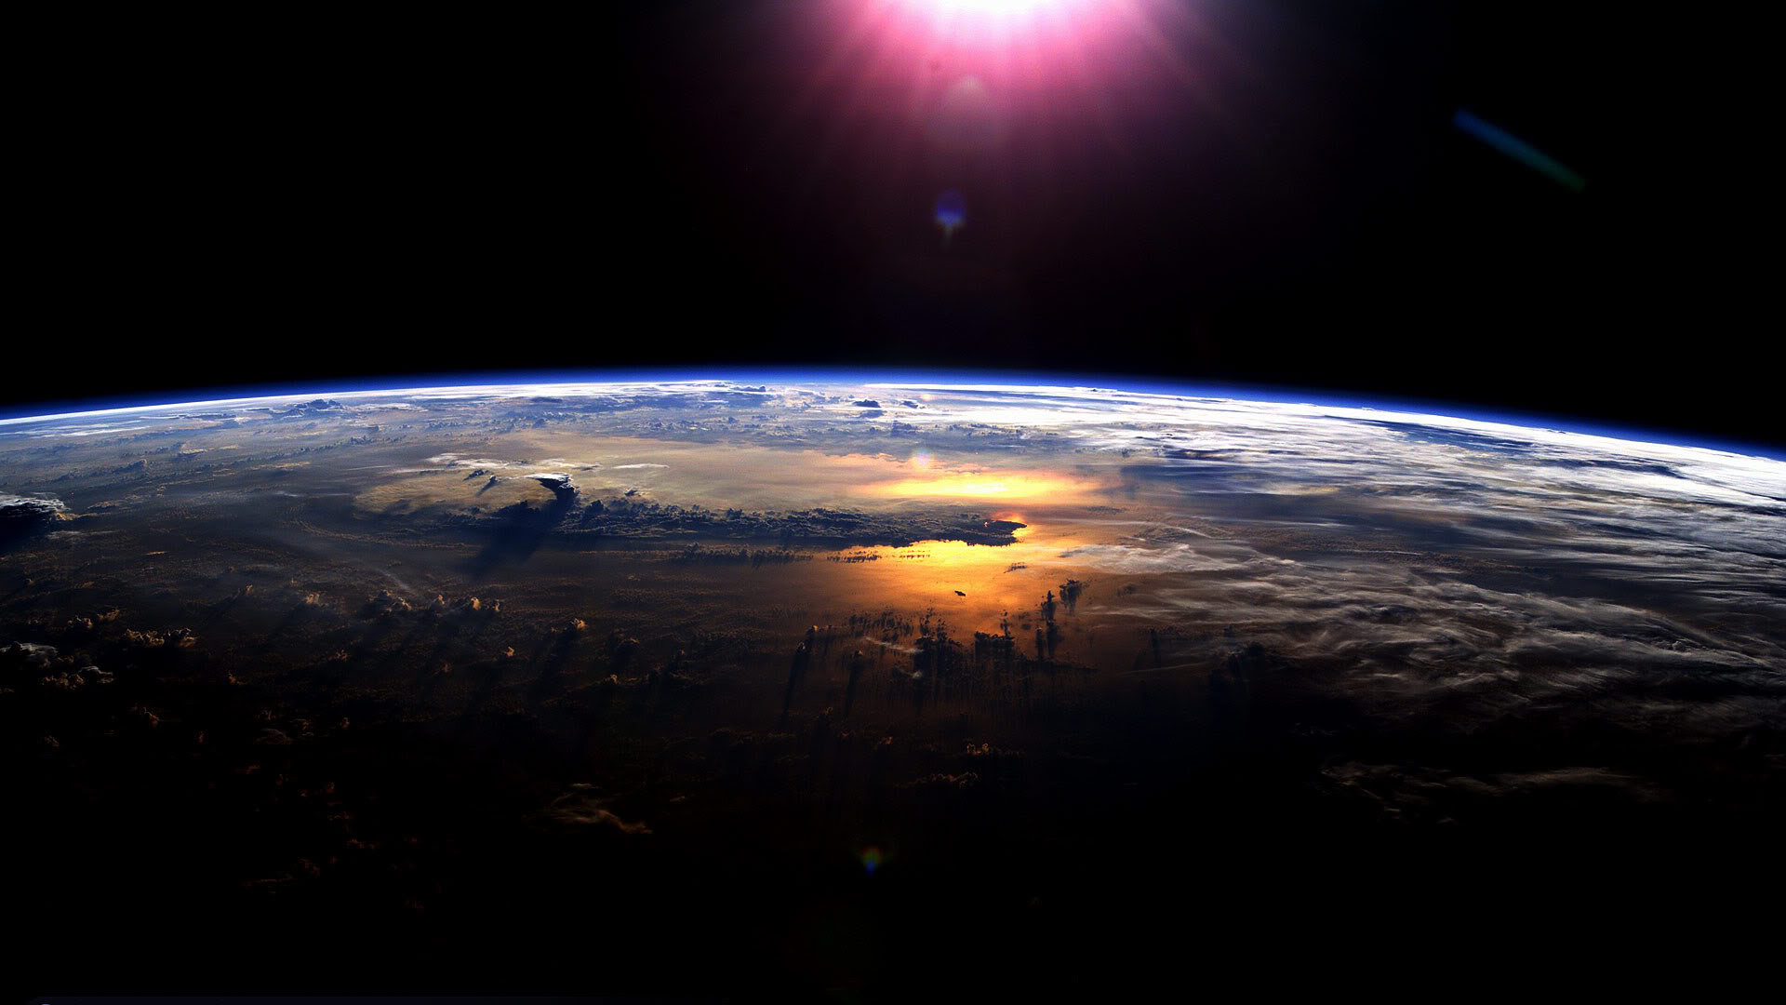
The absorption of solar radiation in the climate system
Aaron Donohoe
Applied Physics Lab – University of Washington
CERES Fall Science Team Meeting
September 2, 2015

Slide 2
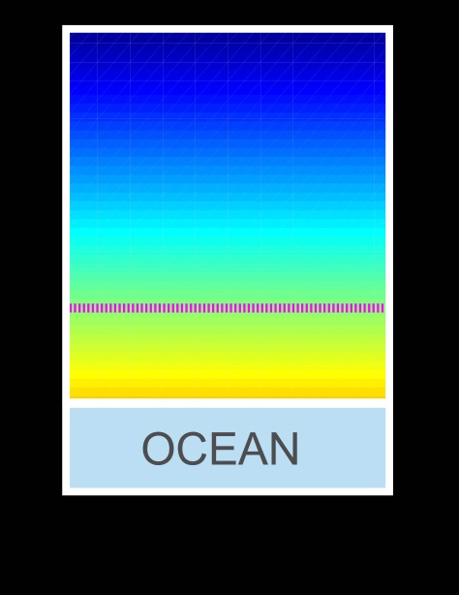
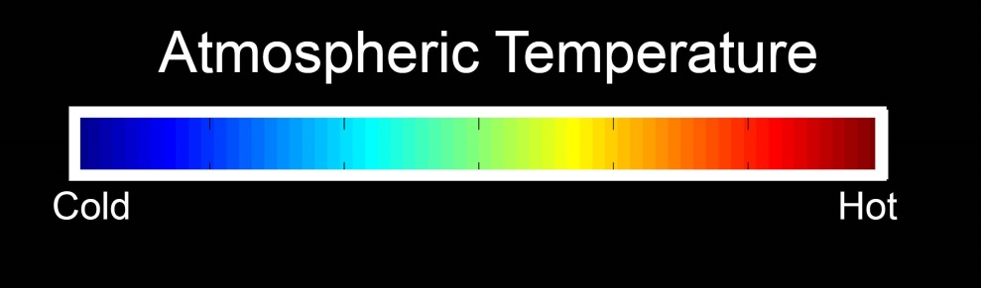
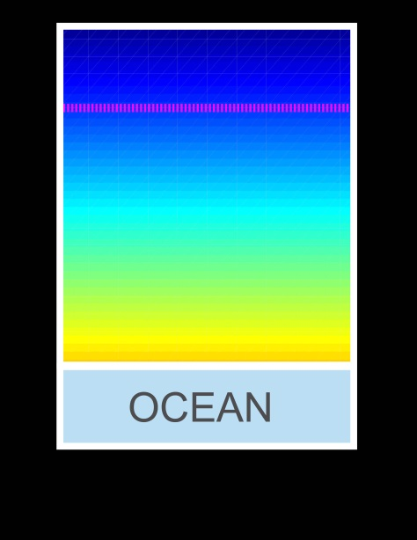
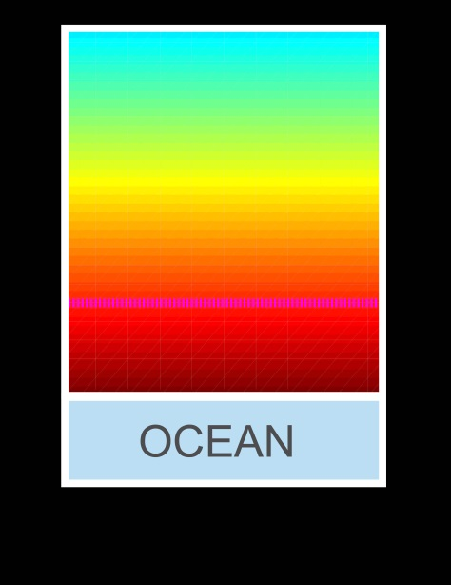

Energy imbalance and temperature change
Unperturbed
ASR = OLR
Atmospheric Emission Level
Solar Perturbation
Greenhouse Perturbation
ASR = OLR
ASR > OLR
CO₂
CO₂
ASR = OLR
ASR > OLR

Slide 3
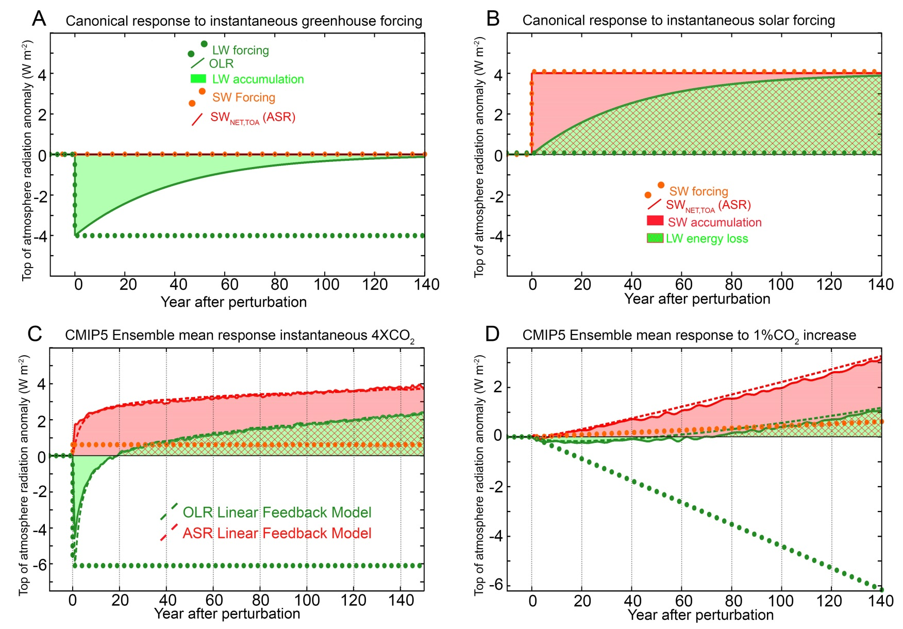
Top of Atmosphere Radiative response to greenhouse and shortwave forcing
OLR returns to unperturbed value in 20 years

Slide 4
How to reconcile this – response to greenhouse forcing with a shortwave feedback
LW feedback only
LW and SW feedback
Greenhouse forcing F_{LW}= 4 W m⁻²
F_{LW}= 4 W m⁻²
λ_{SW} ΔT
= 4 W m⁻²
λ_{LW} ΔT
= 8 W m⁻²
-λ_{LW} ΔT
= 4 W m⁻²
ΔOLR=
-F_{LW} + -λ_{LW} ΔT = ΔASR
ΔOLR
= 0
ΔT= 2K
ΔT= 4K
Forcing = response
Forcing = response
F_{LW} = -(λ_{LW} +λ_{SW} ) ΔT
F_{LW} = -λ_{LW} ΔT
if λ_{SW} = +1 W m ⁻² K ⁻¹
if λ_{LW} = -2 W m ⁻² K ⁻¹
ΔT = F_{LW} /-λ_{LW} = 2 K
ΔT = F_{LW} /-(λ_{LW} + λ_{SW} ) = 4 K

Slide 5
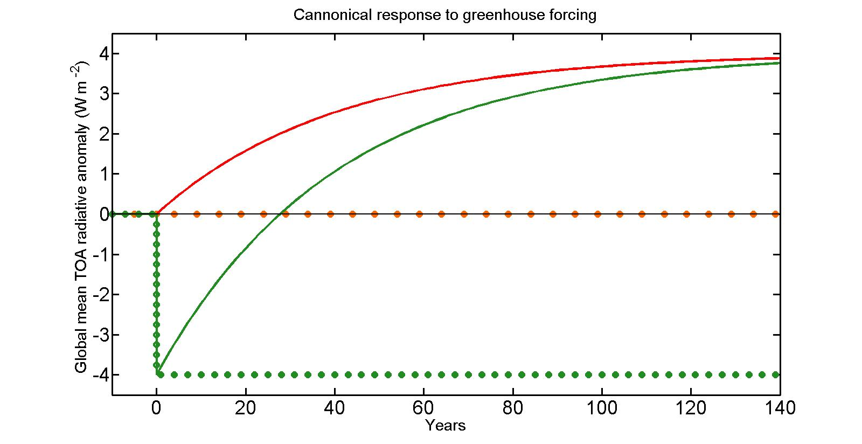



Time evolution of OLR response to greenhouse forcing with SW feedback
OLR must go from –FLW at time 0 to FLW in the equilibrium response
OLR returns to unperturbed value when half of the equilibrium temperature change occurs
ASR
OLR
F_{LW}
The energy imbalance equation:
$$C\frac{dT_{S}}{dt}=F+λT_{S}$$
T_{S}$\left(t\right)= \frac{−F}{\text{λ}} \left(1−e^{\frac{tλ}{C}} \right)=T_{eq} (1−e^{−\frac{t}{τ}} )$
Has the solution:
With the characteristic timescale (τ)
τ= $\frac{−C}{λ}$ = $\frac{−C}{λ_{SW}+λ_{LW}}$ = 30 years (for 150 meter deep ocean)

Slide 6
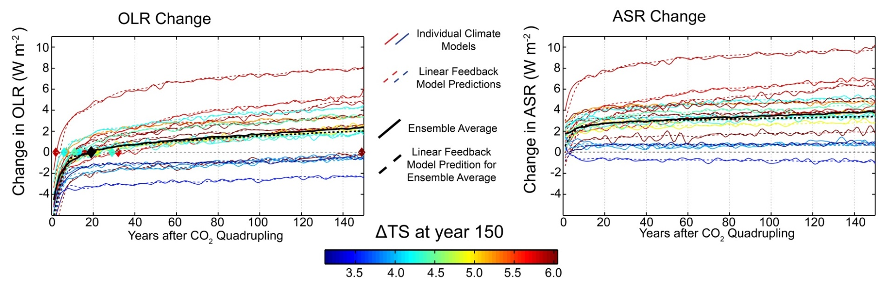
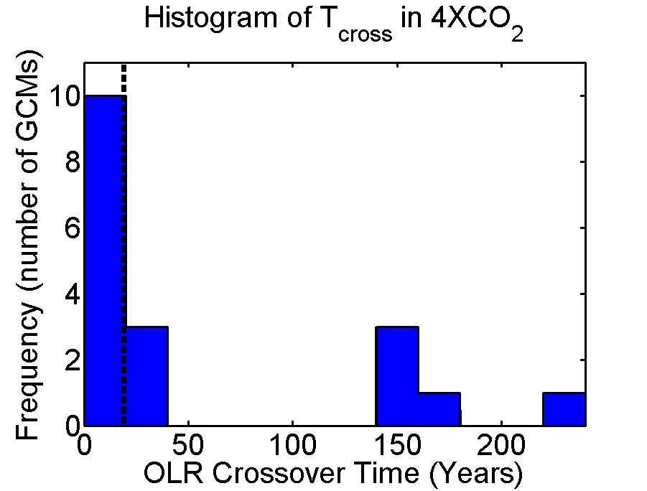
Inter-model spread in TOA response
The TOA response to greenhouse forcing differs a lot between GCMs
OLR returns to unperturbed values (Τ_{CROSS}) within 5 years for some GCMs and not at all for others (bi-modal)
On average, Τ_{CROSS} = 19 years
Ensemble mean

Slide 7

Linear Feedback model
Top of atmosphere (TOA) radiation
Forcing
Feedbacks
Energy Change
C = heat capacity of climate system. Time dependent – meters of ocean
T_{S} = Global mean surface temperature change
F_{SW} and F_{LW} are the SW and LW radiative forcing (including fast cloud response to radiative forcing – W m⁻²)
λ_{LW} and λ_{SW} are the LW and SW feedback parameters. W m⁻² K⁻¹
Given above parameters and T_{S} , we can predict the TOA response
Notes:
7.5 meters per W m^-2 year

Slide 8
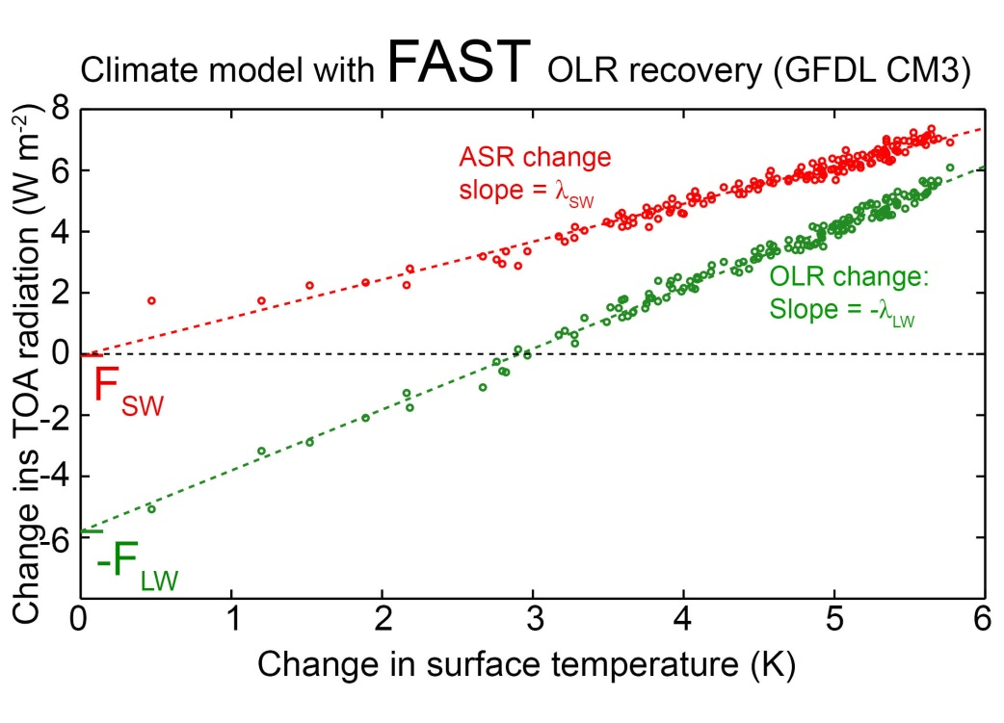
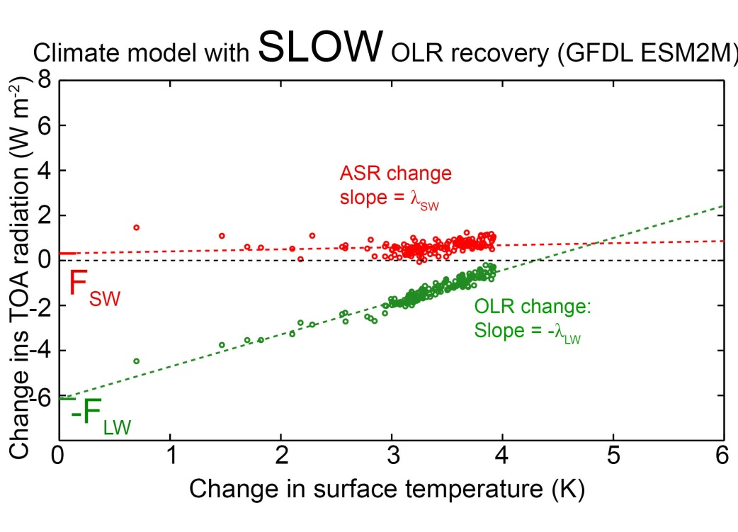
Backing out Forcing and feedbacks from instantaneous 4XCO2 increase runs
CNRM model
Feedbacks parameters (λ_{LW} and λ_{SW}) are the slope of –OLR and ASR vs. T_{S} (W m⁻² K⁻¹)
Forcing (F_{SW} and F_{LW}) is the intercept (W m⁻² ) . Includes rapid cloud response to CO₂ (Gregory and Webb)

Slide 9
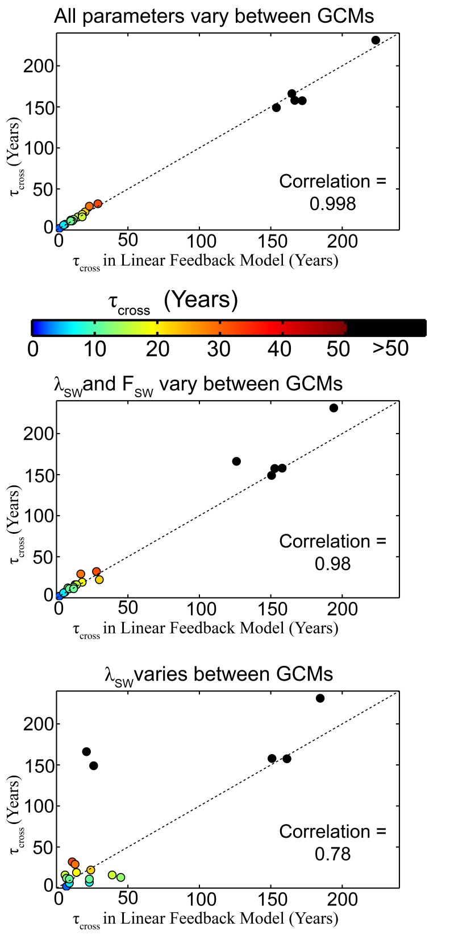
Linear Feedback model works
The TOA response in each model (and ensemble average) – solid lines– is well replicated by the linear feedback model
What parameters (forcing, feedbacks, heat capacity) set the mean radiative response and its variations across models?

Slide 10
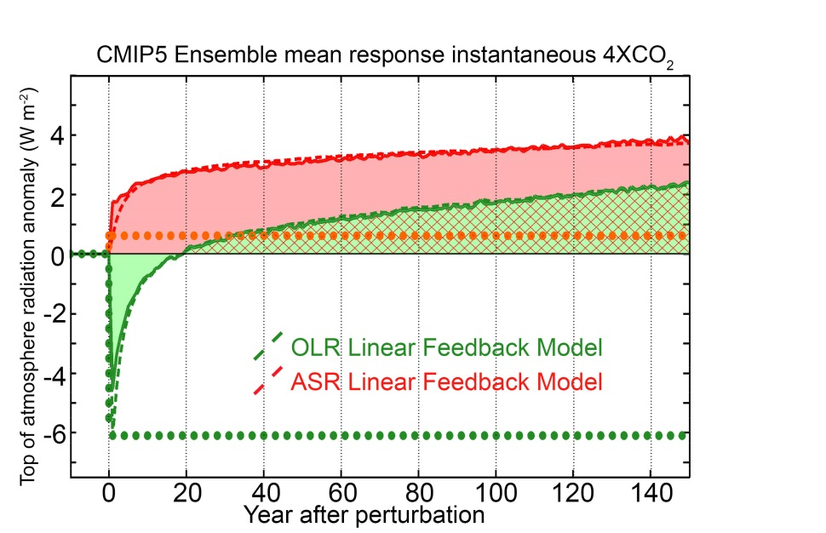

Ensemble average OLR recovery timescale
Ensemble average forcing and feedbacks
OLR at equilibrium
λ_{LW} = -1.7 W m⁻² K⁻¹
λ_{SW} = +0.6 W m⁻² K⁻¹
F_{LW} = + 6.1 W m⁻²
OLR at time = 0
equilibrium temperature change
T_{EQ}$=\frac{−F}{\text{λ}\text{LW} \text{+ }\text{λ}\text{S}\text{W}} =6K$
ASR in new equilibrium = T_{EQ} λ_{SW} = 4 W m⁻²
To come to equilibrium, OLR must go from - F_{LW} = - 6.1 W m⁻² to T_{EQ} λ_{LW} = +4 W m⁻²
OLR must change by 10 W m⁻² to come to equilibrium
→ OLR crosses zero about 60% of the way the equilibrium

Slide 11
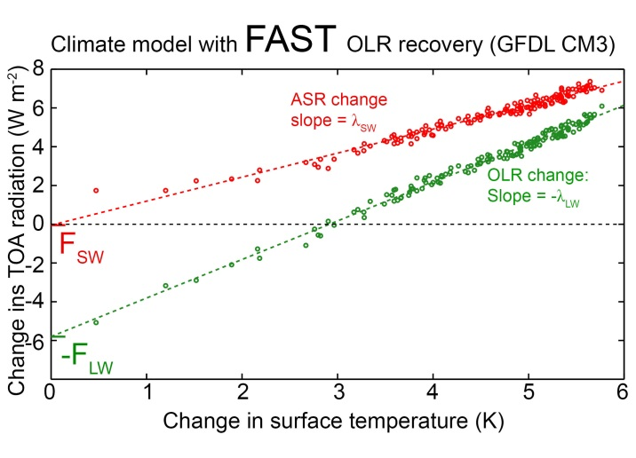

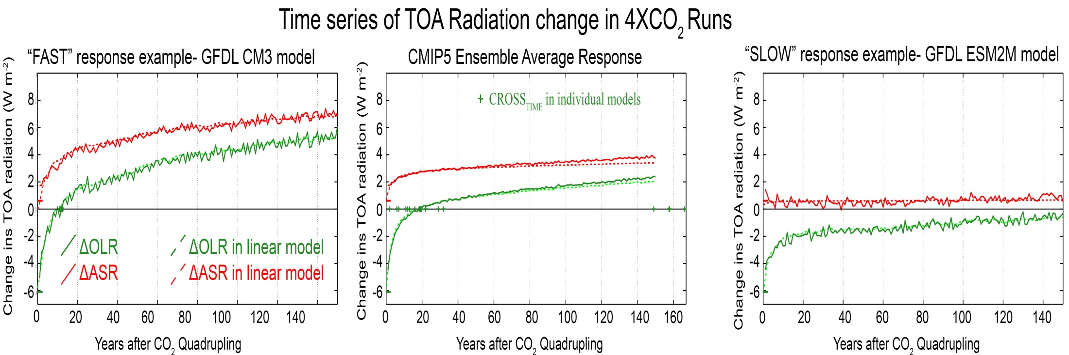
Climate model differences in OLR response time
CNRM model

Slide 12
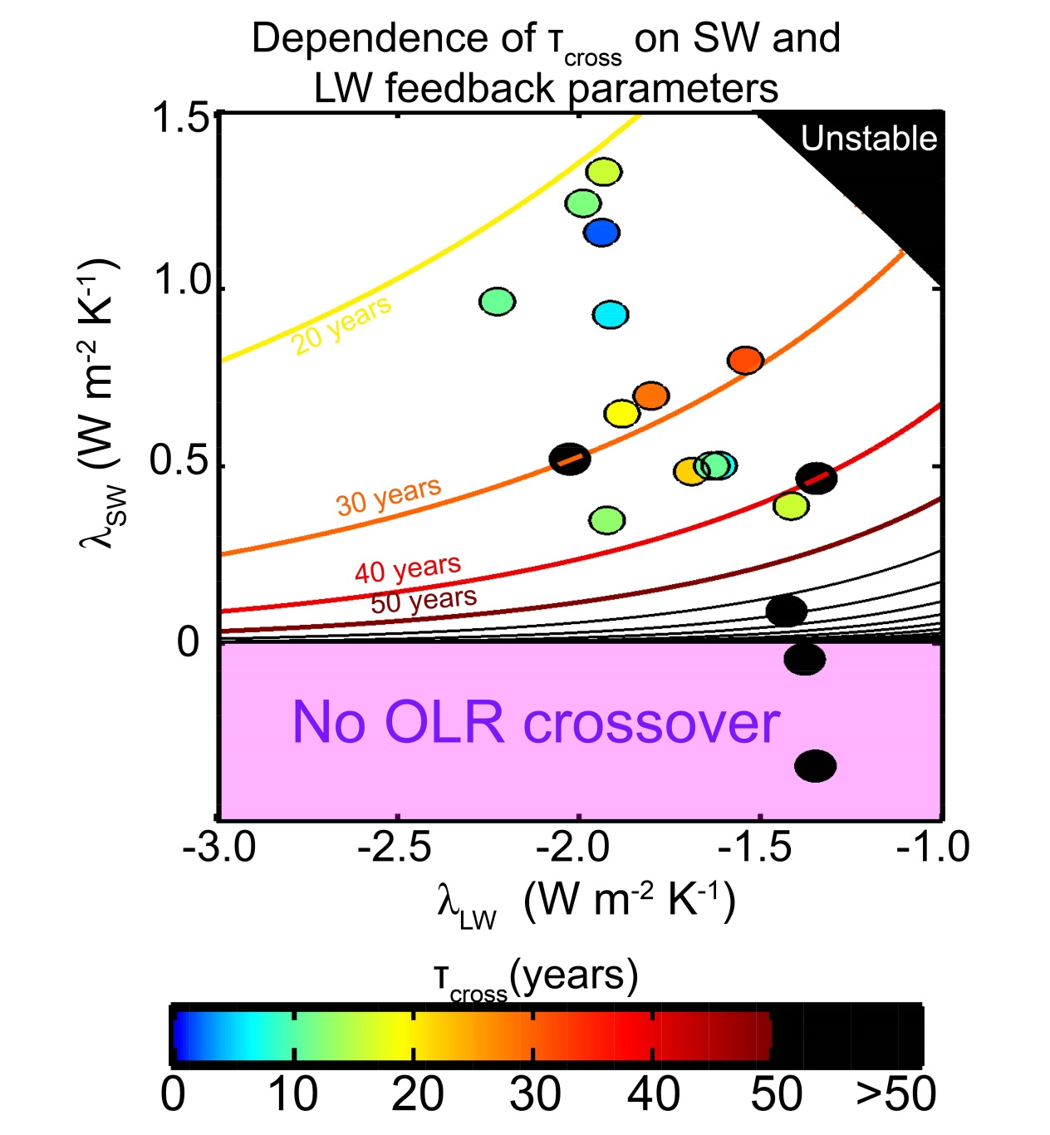
Sensitivity of τ_{CROSS} to feedback parameters
If F_{SW} = 0 (simplification):
τ_{CROSS} = τ ln(-λ _{LW} / λ _{SW} )
Ensemble Average
τ_{cross} is determined by the OLR value demanded in the new equilibrium
Set by relative magnitudes of λ _{LW}
and λ _{SW}
HAS STEEP GRADIENTS IN VICINITY OF λ_{SW}=0

Slide 13
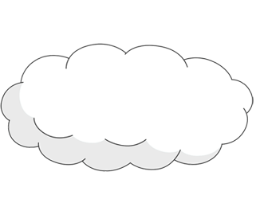
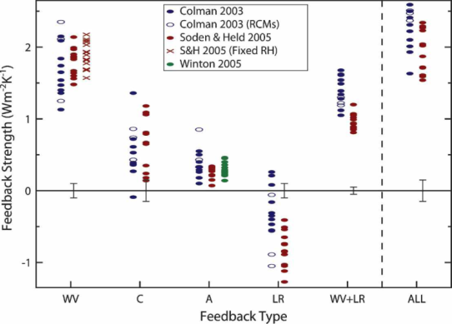
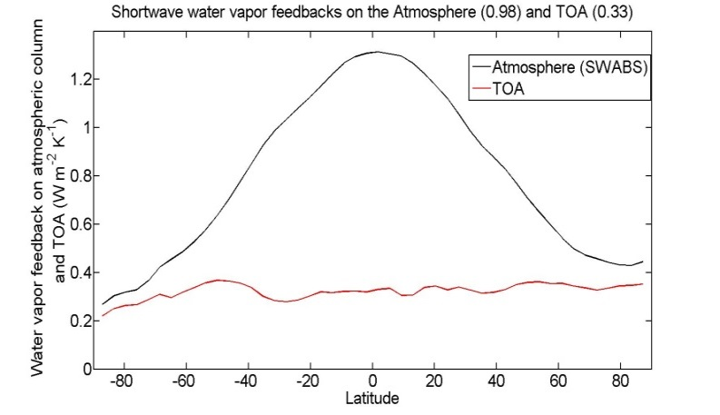
Cause of SW positive feedbacks:
incident
Reflected
cloud
absorbed
H₂0
(vapor)
Reflected
surface
transmitted
ice
ocean
Surface albedo feedback =
+0.26 ±0.08 W m⁻²K⁻¹
Bony et al. (2006)
SW Water vapor feedback
= +0.3±0.1 W m⁻²K⁻¹

Slide 14
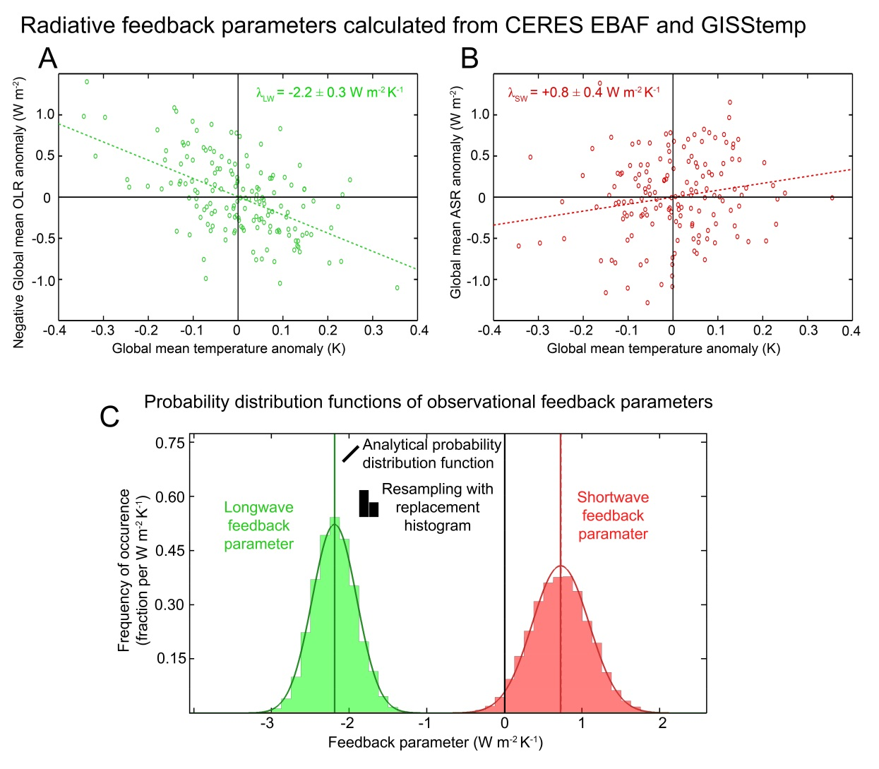
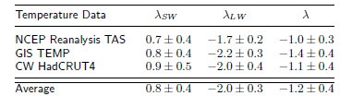
Observations of the co-variability of global mean surface temperature and ASR/OLR give statistically significant estimates of λ_{SW} and λ_{LW}
λ_{SW} = 0.8 ± 0.4 W m⁻² K⁻¹
λ_{LW} = -2.0 ± 0.3 W m⁻² K⁻¹

Slide 15
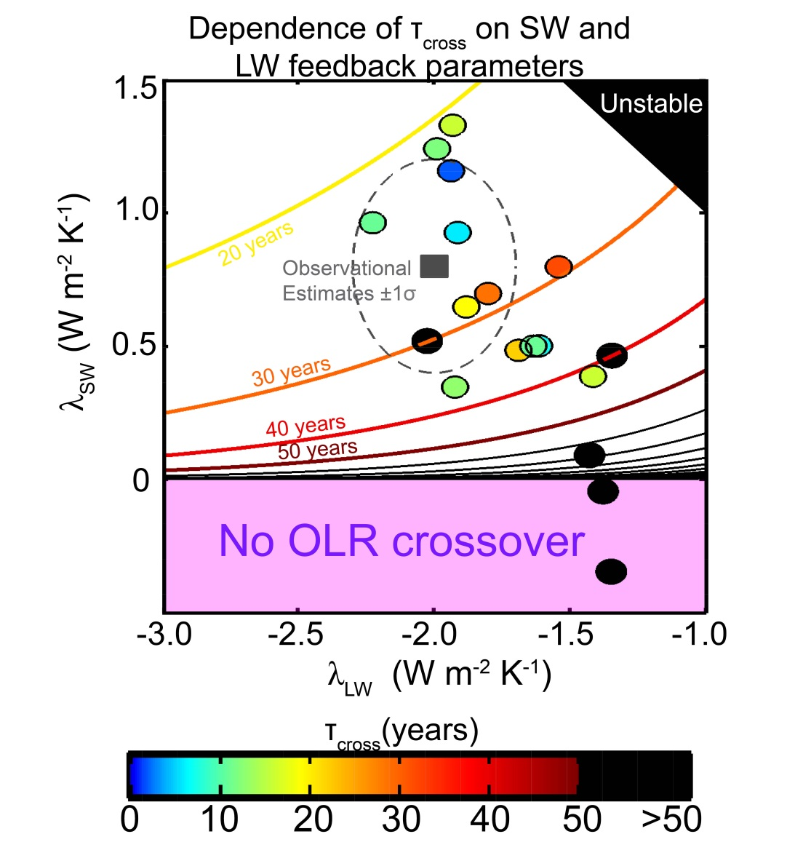
Implications for OLR recovery timescale
Observational constraints suggest that τ_{cross} is of order decades IN RESPONSE TO LW FORCING ONLY
Assumes an (CMIP5 ensemble average) radiative relaxation timescale (τ) of 27 years
τ_{CROSS} = τ ln(-λ _{LW} / λ _{SW} )

Slide 16
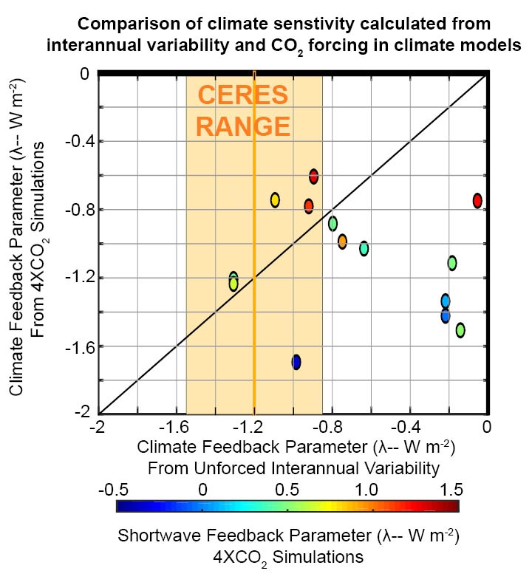
Can we get climate feedbacks from interannual variability of CERES (and surface temperature)?

Slide 17
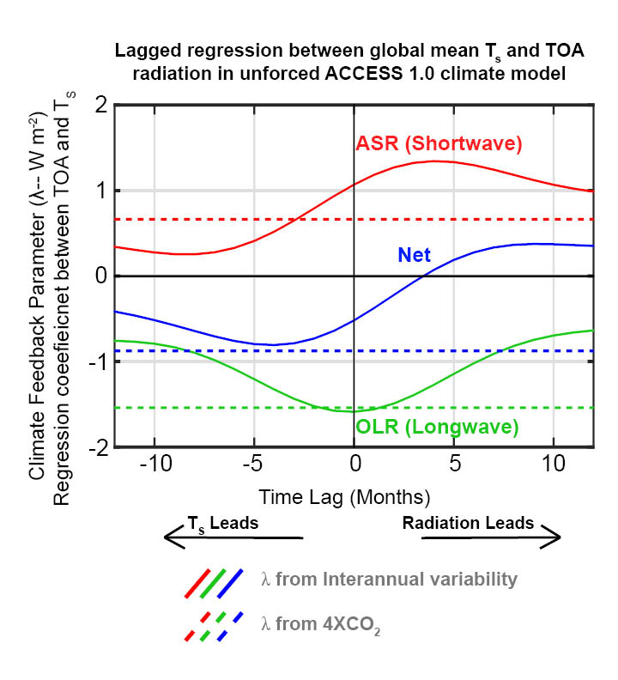
Radiation causes surface temperature anomalies as well as responds to it– potential to confuse the non-feedback forcing with the feedback.

Slide 18
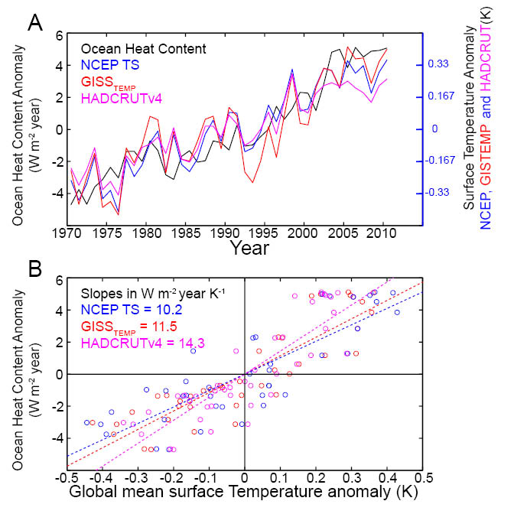

Slide 19
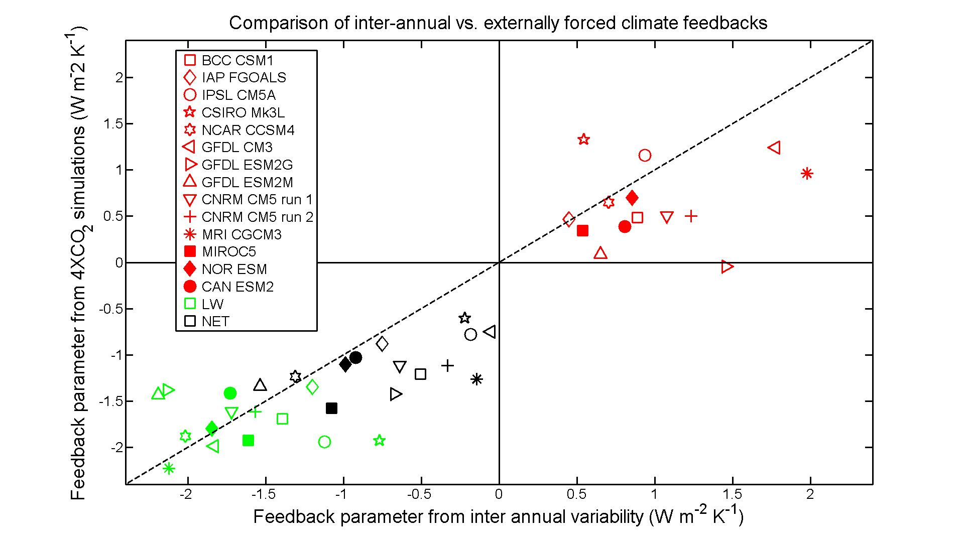
Are the radiative feedbacks that operate on inter-annual timescales equivalent to equilibrium feedbacks?
SW
LW
NET

Slide 20
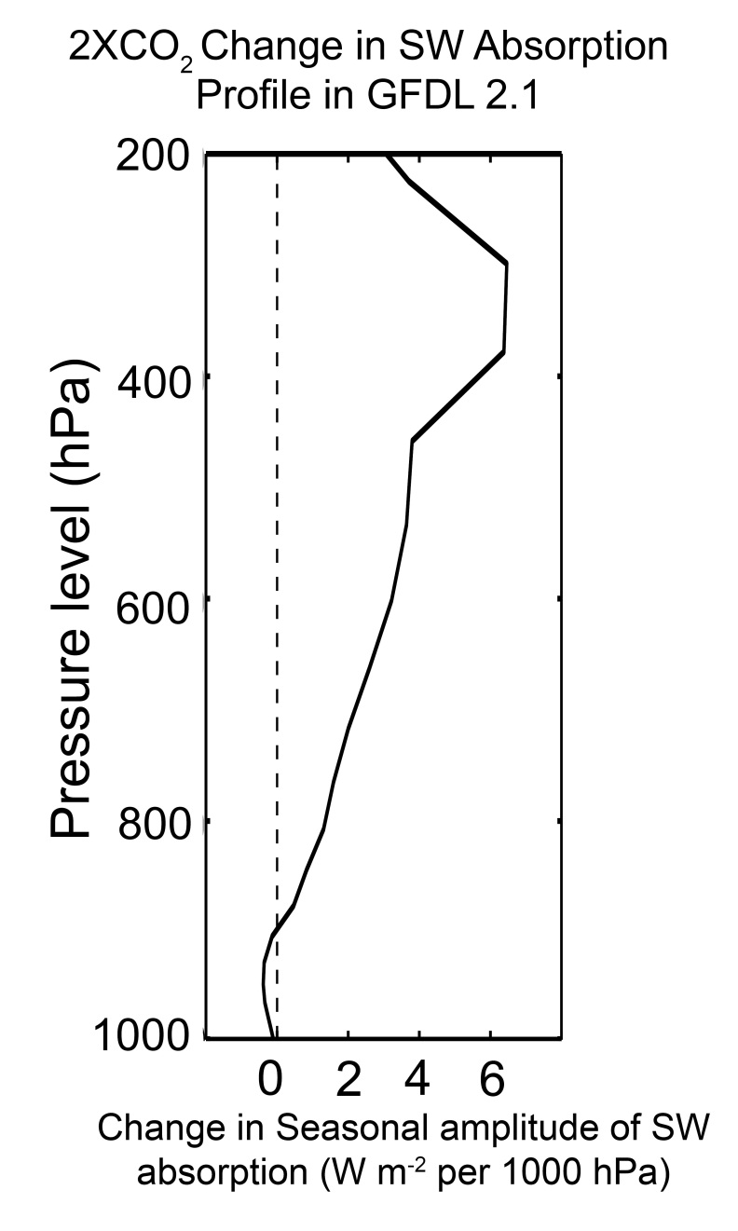
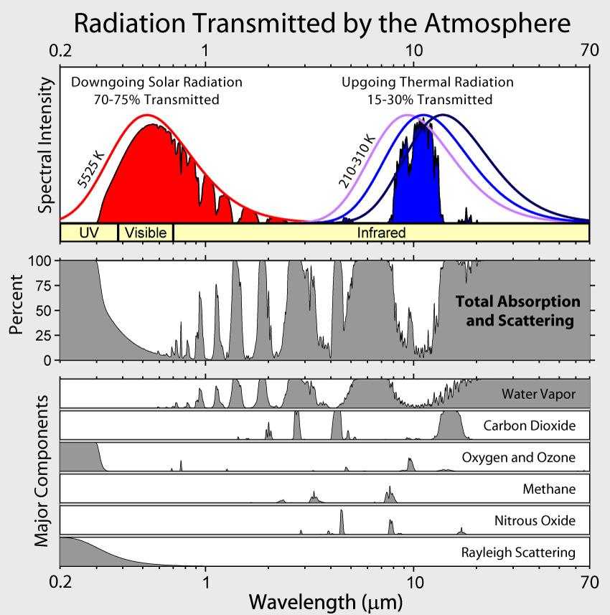
Water Vapor as a SW Absorber
(Figure: Robert Rhode
Global Warming Art Project)

Slide 21
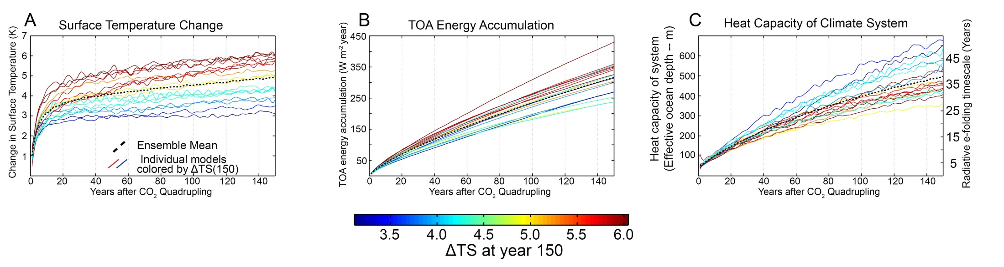
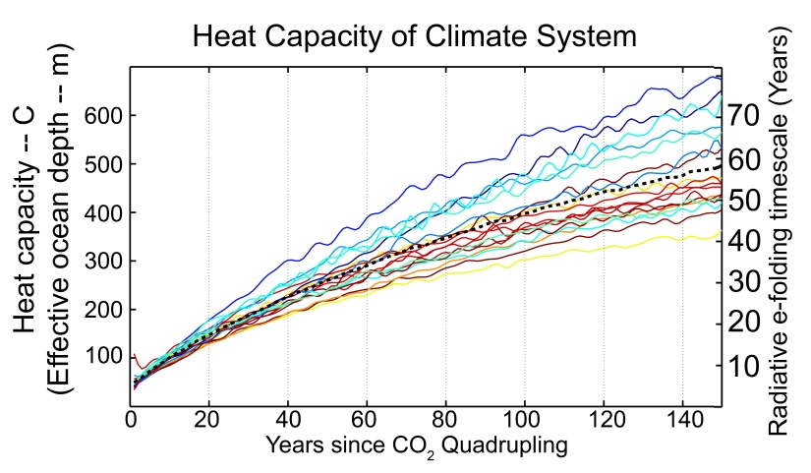
Heat capacity: 4XCO₂
Heat capacity increases with time as energy penetrates into the ocean
In first couple decades, energy is within the first couple 100 m of ocean and system e-folds to radiative equilibrium in about a decade

Slide 22
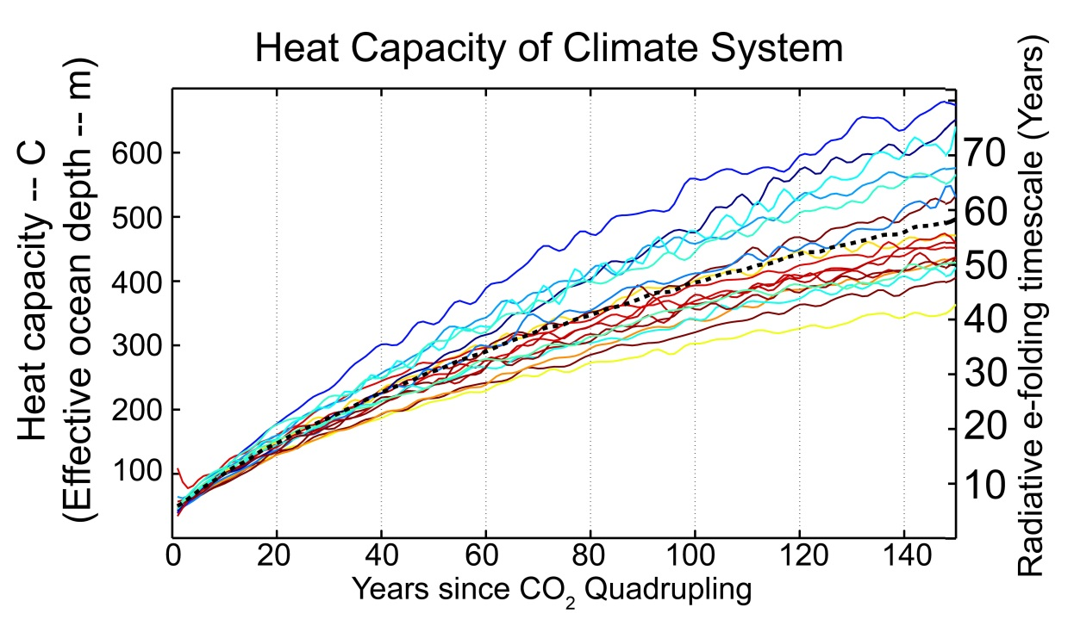


How fast does the system approach equilibrium?
Ensemble average forcing and feedbacks
C = 250 m (30 W m⁻²year K⁻¹)
the ensemble average for first
century after forcing
λ_{LW} = -1.7 W m⁻² K⁻¹
λ_{SW} = +0.6 W m⁻² K⁻¹
The energy imbalance equation:
$$C\frac{dT_{S}}{dt}=F+λT_{S}$$
Has the solution:
T_{S}$\left(t\right)= \frac{−F}{\text{λ}} \left(1−e^{\frac{tλ}{C}} \right)=T_{eq} (1−e^{−\frac{t}{τ}} )$
Key point:
OLR returns to unperturbed value in of order the radiative relaxation timescale of the system → decades
With the characteristic timescale (τ)
τ= $\frac{−C}{λ}$ = $\frac{−C}{λ_{SW}+λ_{LW}}$
= $\frac{30 W m^{−2} {year K}^{−1 }}{1.1 W m^{−2}K^{−1}}$ = 27 years

Slide 23
What parameter controls inter-GCM spread in TOA response?
Using all GCM specific parameters gets the inter-model spread in τ_{cross}
Varying just λ_{SW} and F_{SW} between GCMS captures inter-model spread in τ_{cross}
λ_{LW} , F_{LW} and heat capacity differences between GCMs less important for determining the radiative response
Varying just λ_{SW} gives bi-modal distribution of τ_{cross} with exception of two models (F_{SW} plays a role here)

Slide 24
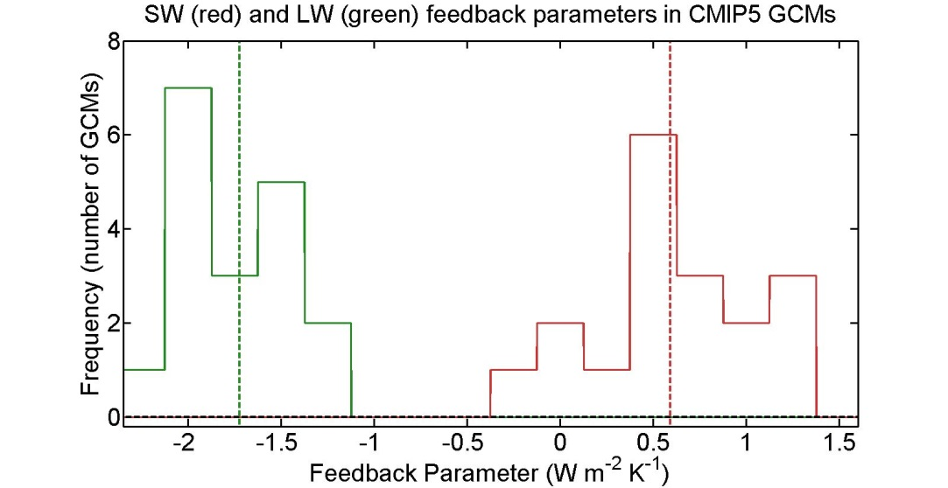




τ_{cross} dependence on feedback parameters
Ensemble average forcing and feedbacks
λ_{LW} = -1.7 W m⁻² K⁻¹
λ_{SW} = +0.6 W m⁻² K⁻¹
F_{LW} = + 6.1 W m⁻²
equilibrium temperature change
T_{EQ}$=\frac{−F}{\text{λ}\text{LW}\text{+}\text{λ}\text{SW}} =6K$
T_{EQ}$=GFEED \frac{−F}{\text{λ}\text{LW}} =1.6 ∗3.7K$
Feedback gain: Amplification of response due to $\text{λ}\text{SW}$
G_{FEED}$=\frac{1}{\text{1+}\text{λ}\text{SW}\text{/}\text{λ}\text{LW}} =1.6$
T_{S}$=GFEED \frac{−F}{\text{λ}\text{LW}} (1−e^{−\frac{t}{τ}} )$
OLR$=F_{LW}(−1+GFEED−GFEEDe^{−\frac{t}{τ}} )$
initial
transition
final
OLR =0 at τ=τ_{cross}
How far from equilibrium OLR =0
$$\text{τ}\text{cross}=−τ \ln\left(1−\frac{1}{GFEED}\right)$$

Slide 25
How fast does the system approach equilibrium?
Ensemble average forcing and feedbacks
C = 250 m (30 W m⁻²year K⁻¹)
the ensemble average for first
century after forcing
λ_{LW} = -1.7 W m⁻² K⁻¹
λ_{SW} = +0.6 W m⁻² K⁻¹
The energy imbalance equation:
$$C\frac{dT_{S}}{dt}=F+λT_{S}$$
Key point:
OLR returns to unperturbed value in of order the radiative relaxation timescale of the system → decades
Has the solution:
T_{S}$\left(t\right)= \frac{−F}{\text{λ}} \left(1−e^{\frac{tλ}{C}} \right)=T_{eq} (1−e^{−\frac{t}{τ}} )$
With the characteristic timescale (τ)
τ= $\frac{−C}{λ}$ = $\frac{−C}{λ_{SW}+λ_{LW}}$
= $\frac{30 W m^{−2} {year K}^{−1 }}{1.1 W m^{−2}K^{−1}}$ = 27 years

Slide 26
What parameter controls inter-GCM spread in TOA response?
Using all GCM specific parameters gets the inter-model spread in τ_{cross}
Varying just λ_{SW} and F_{SW} between GCMS captures inter-model spread in τ_{cross}
λ_{LW} , F_{LW} and heat capacity differences between GCMs less important for determining the radiative response
Varying just λ_{SW} gives bi-modal distribution of τ_{cross} with exception of two models (F_{SW} plays a role here)

Slide 27
τ_{cross} dependence on feedback parameters
Ensemble average forcing and feedbacks
λ_{LW} = -1.7 W m⁻² K⁻¹
λ_{SW} = +0.6 W m⁻² K⁻¹
F_{LW} = + 6.1 W m⁻²
equilibrium temperature change
T_{EQ}$=\frac{−F}{\text{λ}\text{LW}\text{+}\text{λ}\text{SW}} =6K$
T_{EQ}$=GFEED \frac{−F}{\text{λ}\text{LW}} =1.6 ∗3.7K$
Feedback gain: Amplification of response due to $\text{λ}\text{SW}$
G_{FEED}$=\frac{1}{\text{1+}\text{λ}\text{SW}\text{/}\text{λ}\text{LW}} =1.6$
T_{S}$=GFEED \frac{−F}{\text{λ}\text{LW}} (1−e^{−\frac{t}{τ}} )$
OLR$=F_{LW}(−1+GFEED−GFEEDe^{−\frac{t}{τ}} )$
initial
transition
final
OLR =0 at τ=τ_{cross}
How far from equilibrium OLR =0
$$\text{τ}\text{cross}=−τ \ln\left(1−\frac{1}{GFEED}\right)$$

Slide 28

Sensitivity of τ_{CROSS} to feedback parameters
If F_{SW} = 0 (simplification):
τ_{CROSS} = $−τ \ln\left(1−\frac{1}{GFEED}\right)$
= τ ln(-λ _{LW} / λ _{SW} )
Ensemble Average
τ_{cross} is determined by the OLR value demanded in the new equilibrium
Set by relative magnitudes of λ _{LW}
and λ _{SW}
HAS STEEP GRADIENTS IN VICINITY OF λ_{SW}=0

Slide 29
What parameter controls inter-GCM spread in TOA response?
While the relative magnitudes of λ_{SW} and λ_{LW} explain the vast majority of the spread in τ_{cross} there are several model outliers
A more complete analysis includes inter-model differences in F_{SW}
→ F_{SW} includes both direct radiative forcing by CO2 (small) and the rapid response of clouds to the forcing

Slide 30
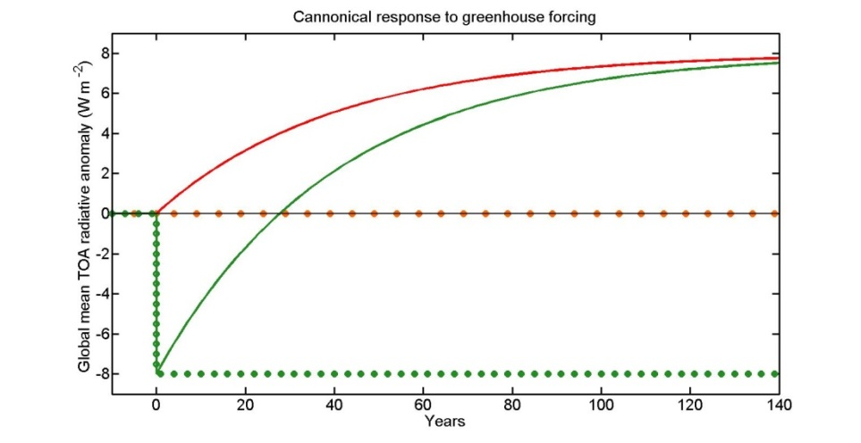
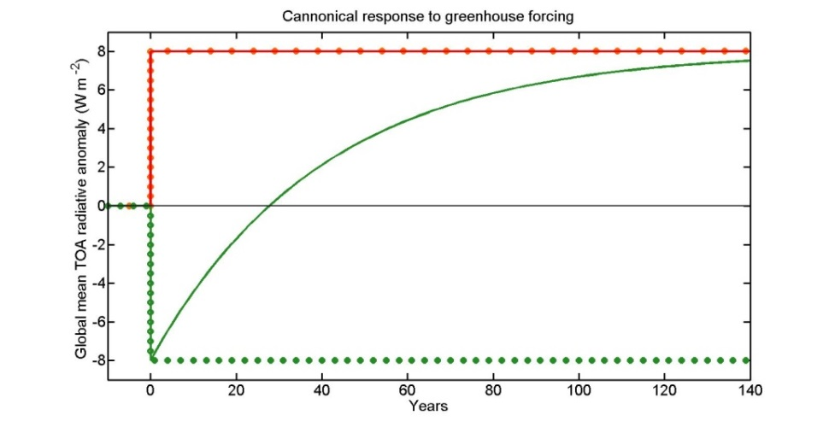



From before, if F_{SW} =0 then::
If F_{SW} ≠ 0 then::
$$\text{τ}\text{cross}=−τ \ln\left(1−\frac{1}{GFEED}\right)$$
$$\text{τ}\text{cross}=−τ \ln\left(1−\frac{1}{GFORCEGFEED}\right)$$
G_{FEED}$=\frac{1}{\text{1+}\text{λ}\text{LW}\text{/}\text{λ}\text{SW}}$
G_{FORCE}$=1+\frac{F_{SW}}{\text{F}\text{LW}}$
Forcing Gain = 2
Feedback Gain = 2
If |λ_{SW}| = ½ |λ_{LW}| → T_{EQ} is doubled
The OLR change to get to equilibrium is:
(2*F_{LW}/ |λ_{LW}|) * |λ_{LW}| = 2F_{LW}
OLR = 0 occurs half way to equilibrium
T_{CROSS} = T ln(2)
If F_{LW} = F_{SW} → T_{EQ} is doubled and OLR asymptotes to +F_{LW}
OLR = 0 occurs half way to equilibrium
T_{CROSS} = T ln(2)

Slide 31
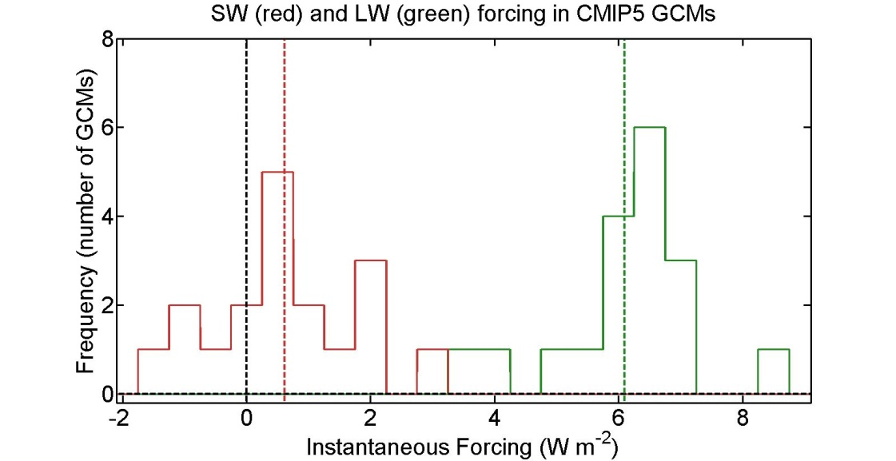
SW and LW Feedbacks and Forcing: 4XCO₂
Feedbacks
LW
SW
Ensemble Average
Forcing
LW feedback is negative (stabilizing) and has small inter-GCM spread
SW feedback is mostly positive and has large inter-GCM spread
Forcing is mostly in LW (greenhouse)
SW forcing has a significant inter-GCM spread

Slide 32
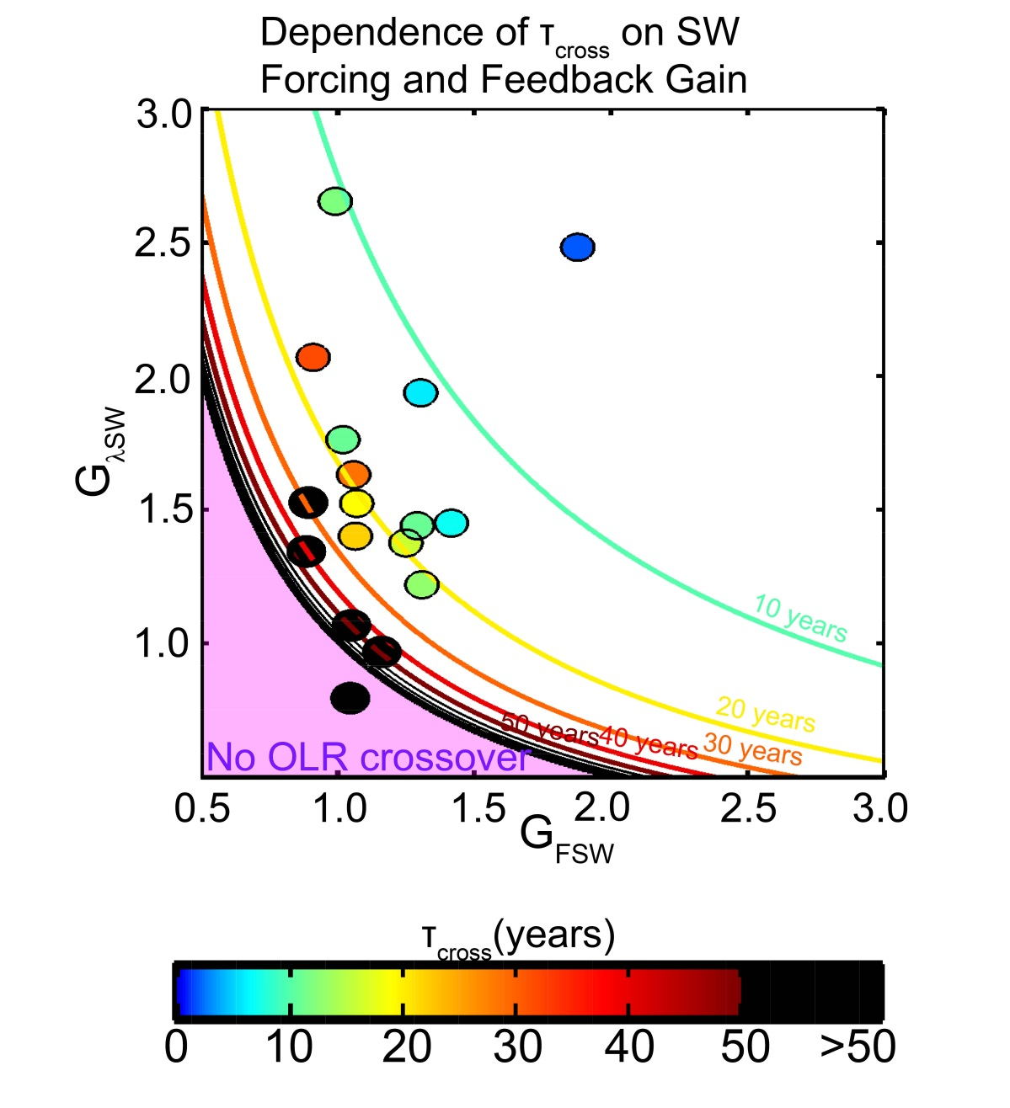

Sensitivity of τ_{CROSS} to feedback parameters
$$\text{τ}\text{cross}=−τ \ln\left(1−\frac{1}{GFORCEGFEED}\right)$$
Positive SW forcing and feedbacks favor a short OLR recovery timescale with a symetric dependence on the “gain” factors
Explains the majority (R= 0.88) of inter- model spread
Assumes a time and model invariant heat capacity (250m ocean depth equivalent)

Slide 33
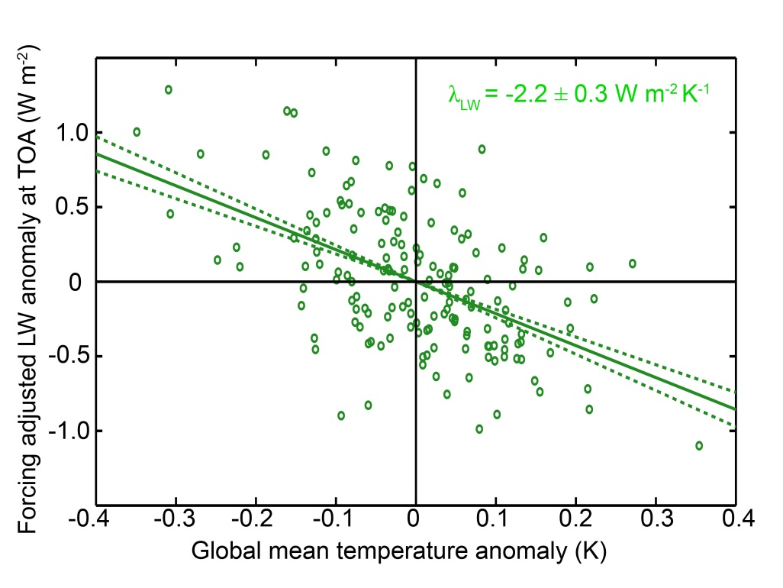

LW Feedback parameter from observations
Surface temperature explains a small fraction of OLR’ variance (R=0.52)
Error bars on regression coefficient (1σ) are small, why?
Weak 1 month auto-correlation in OLR’ – r_{OLR} (1month) = 0.3 → lots of DOF (N*= 113)
Unexplained amplitude
$$σ_{λ_{LW}}=\frac{σ_{OLR}\sqrt{1−{{r^{2}}_{OLR,TS}^{}}_{\begin{aligned} \\ \end{aligned}}^{}}}{σ_{T_{S}}\sqrt{N^{∗}}}$$
Independent
realizations
Even if none of the OLR’ variance was explained, the regression slope is still significant
→ Given the number of realizations, you would seldom realize such a large regression coefficient in a random sample – in the absence of a genuine relationship between T_{S} and OLR

Slide 34
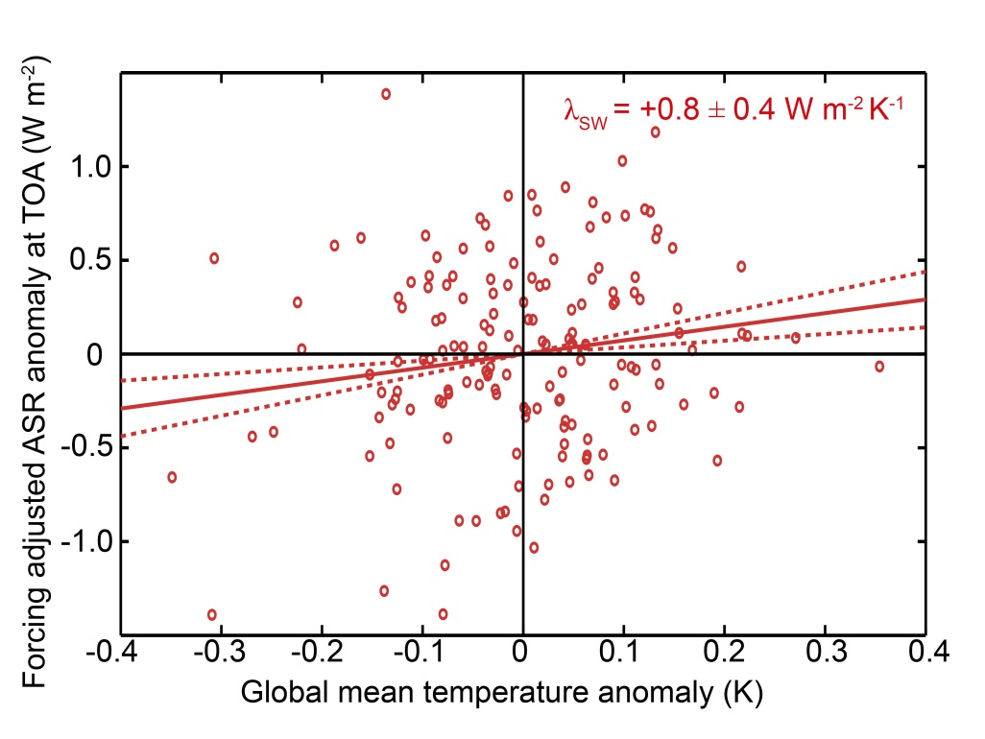

SW Feedback parameter from observations
Very weak correlation (r=0.16)
Almost no memory in ASR’ – r_{OLR} (1month) = 0.1 – mean we have lots of DOF (N*= 143)
$$σ_{λ_{SW}}=\frac{σ_{ASR}\sqrt{1−{{r^{2}}_{ASR,TS}^{}}_{\begin{aligned} \\ \end{aligned}}^{}}}{σ_{T_{S}}\sqrt{N^{∗}}}$$
The significance of the regression slope is not a consequence of the variance explained but, rather, the non-zero of the slope despite the number of realizations
→ The feedback has emerged from the non-feedback radiative processes in the record

