Slide 1


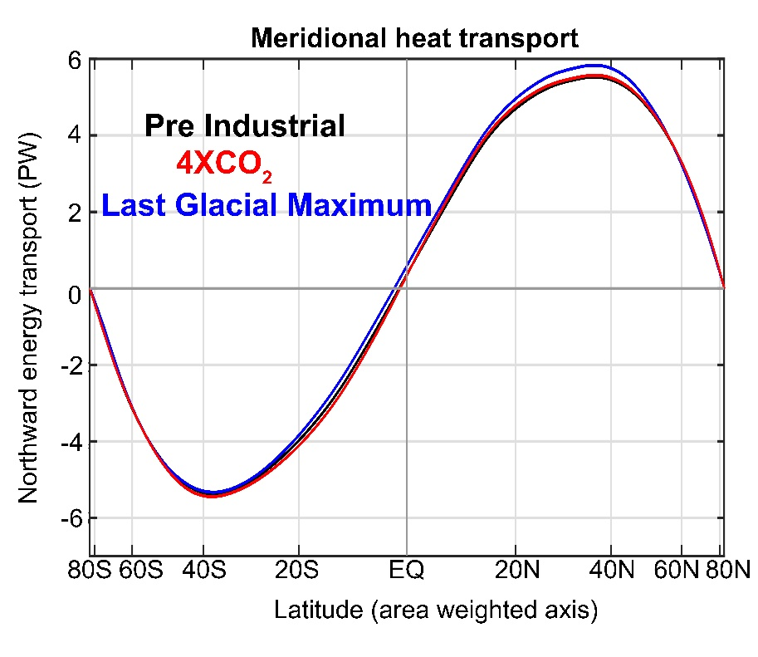






The partitioning of poleward energy transport in the climate system; model biases and the near invariance of total energy transport under climate forcing
Aaron Donohoe – Polar Science Center, APL, UW
Tyler Cox -- UW atmospheric sciences
Robert Fajber – UW atmospheric science
Kyle Armour – UW Oceanography
David Battisti– UW atmospheric sciences
Gerard Roe – UW Earth and Space Sciences
Lily Hahn– UW atmospheric sciences
Dargan Frierson- UW atmospheric sciences

Slide 2




Radiative perspective of energy transport
5.8 PW
ASR*
OLR*
8.2 PW
2.4 PW
-
Heat
Transport
=
Notes:
NH = 8.2 - 2.4 = 5.8
SH = 9.0 – 3.2 = 5.8

Slide 3
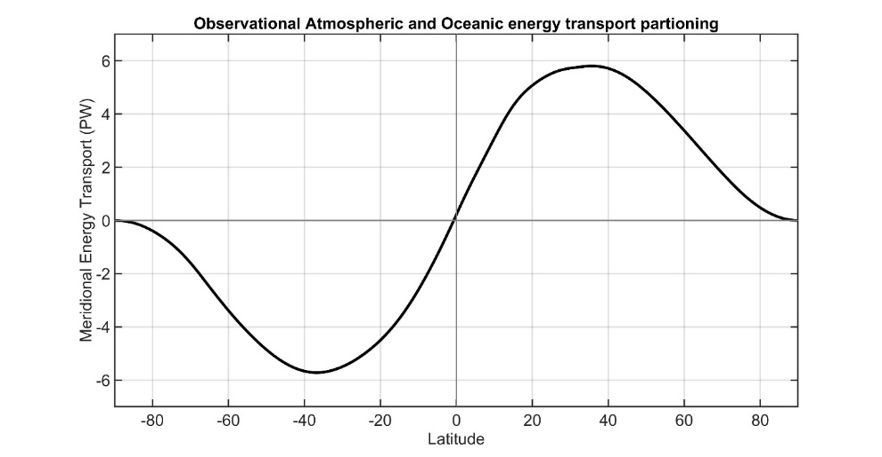
Radiative constraints on poleward heat transport
Observed Poleward Heat transport
From CERE Satellite radiation
5.8 PW
Net radiative
Deficit of extratropics
Notes:
NH = 8.2 - 2.4 = 5.8
SH = 9.0 – 3.2 = 5.8

Slide 4
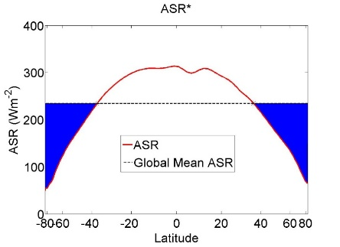

Radiative constraints on poleward heat transport
ASR*
OLR*
5.8 PW
8.2 PW
2.4 PW
2.4 PW
Net radiative
Deficit of extratropics
=
-
OLR*
ASR*
2.4 PW
8.2 PW
5.8 PW
Absorbed Solar
Emitted
(Outgoing Longwave)
Net
Tropics
Extratropics
MHT
Notes:
NH = 8.2 - 2.4 = 5.8
SH = 9.0 – 3.2 = 5.8

Slide 5
ASR*, OLR*, MHT, and the tropical/extratropical energy budget
OLR*
ASR*
2.4 PW
8.2 PW
MHT =
ASR* - OLR*
MHT
Tropics
5.8 PW
To extratropics
All arrows are relative to the global average

Slide 6
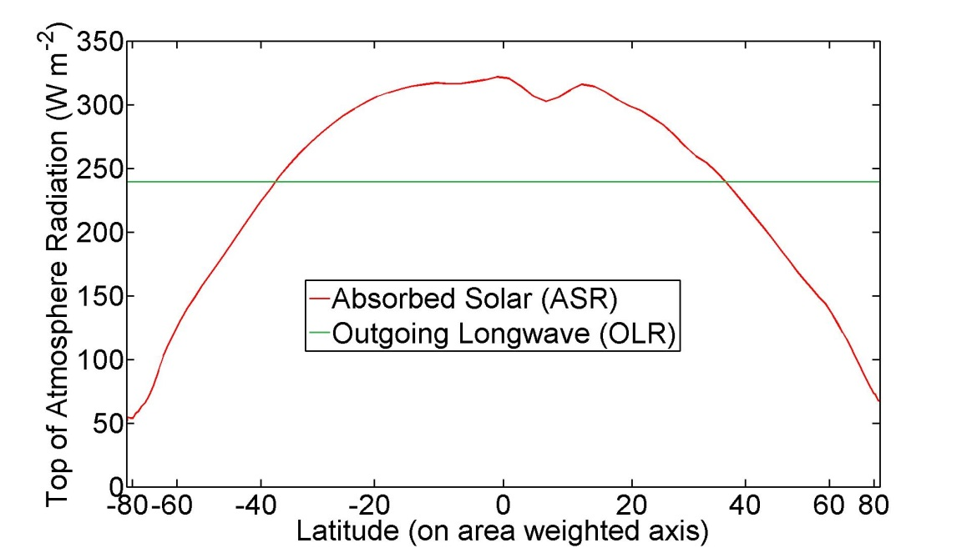

ASR*, OLR*, MHT
Dynamic Limit
MHT = ASR*
OLR* = 0
ASR*
9.0 PW
8.2 PW
8.2 PW
MHT
Tropics
8.2 PW
To extratropics
All arrows are relative to the global average

Slide 7
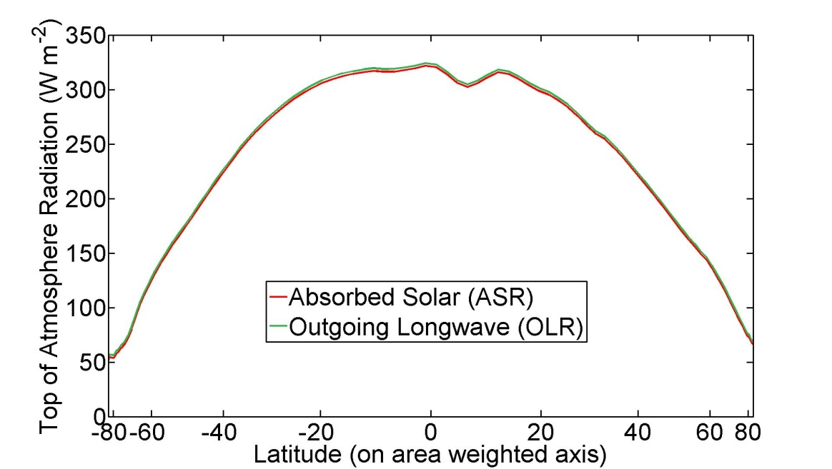
ASR*, OLR*, MHT
Radiative Limit
MHT = 0 ,
ASR* = OLR*
ASR*
8.2 PW
OLR*
8.2 PW
MHT
Tropics
0 PW
To extratropics
All arrows are relative to the global average

Slide 8
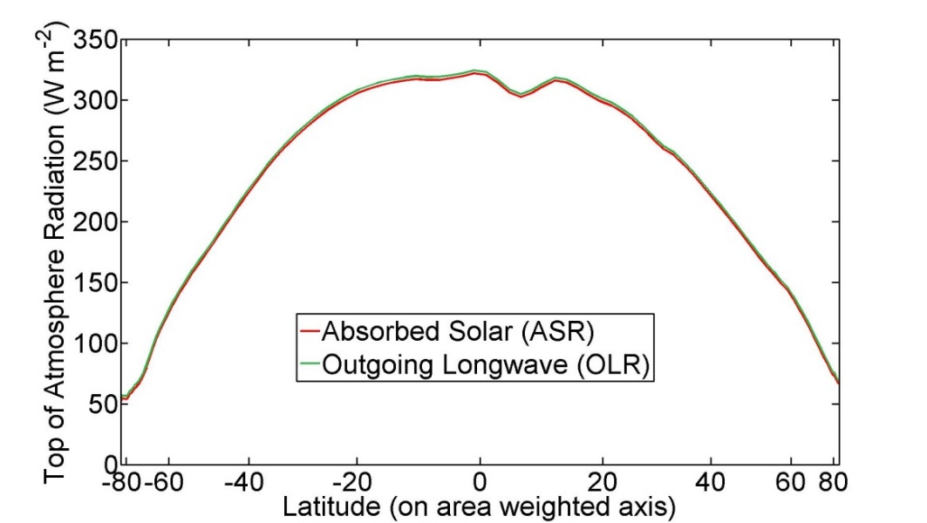
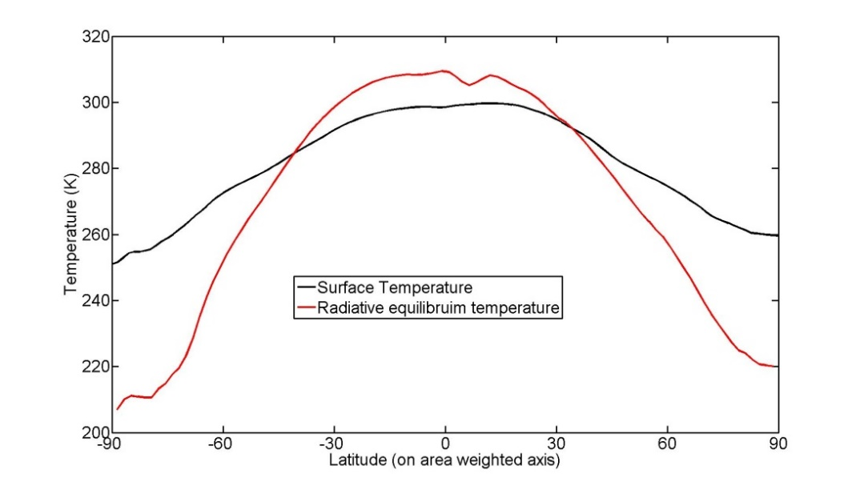
The equator-to-pole temperature gradient in the radiative limit
Equator-to-pole temperature gradient of 100K needed for OLR to balance ASR are each latitude
→Poleward heat transport is responsible for Earth being habitable

Slide 9
In the observed climate system, dynamics are more efficient than radiation at moderating the equator-to-pole temperature gradient
ASR*
OLR*
8.2 PW
2.4 PW
MHT
5.8 PW
To extratropics
Tropics

Slide 10
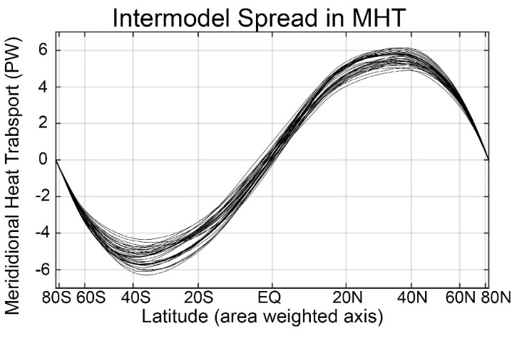
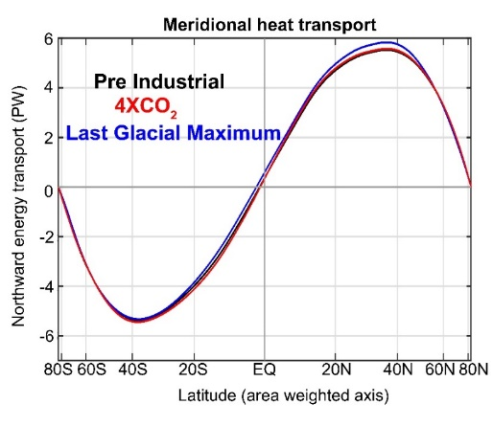
Two main results to understand
Poleward heat transport:
2. Is nearly invariant under past/future forcing
1. Varies (20%) between different climate models and is biased relative to observations
Overview of talk:
1. Radiative constraints on poleward heat transport
2. Atmosphere/ocean partitioning of heat transport
3. Partitioning of atmospheric heat transport (eddies, overturning circulation)

Slide 11
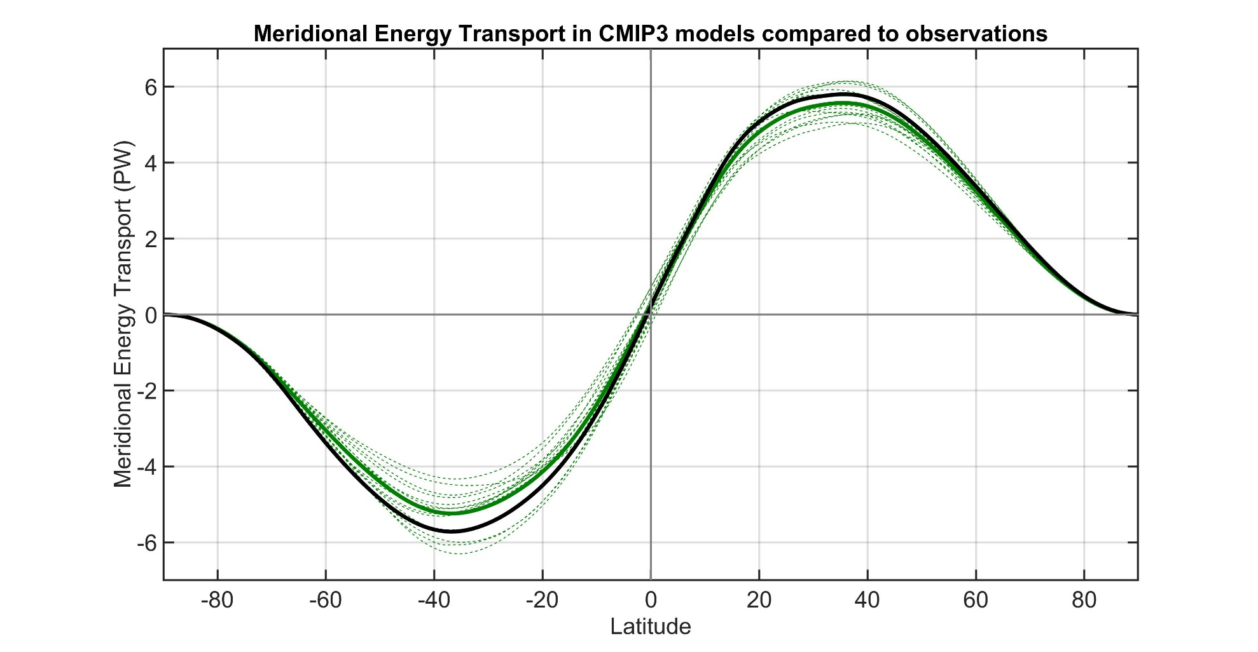
Observations
Individual models
Model Mean
Total (atmosphere plus ocean) meridional heat transport varies by about 20% between models.
→ Also biased low relative to observations especially in the SH
Donohoe and Battisti (2012). What determined meridional heat transport in climate models. J. Climate.

Slide 12
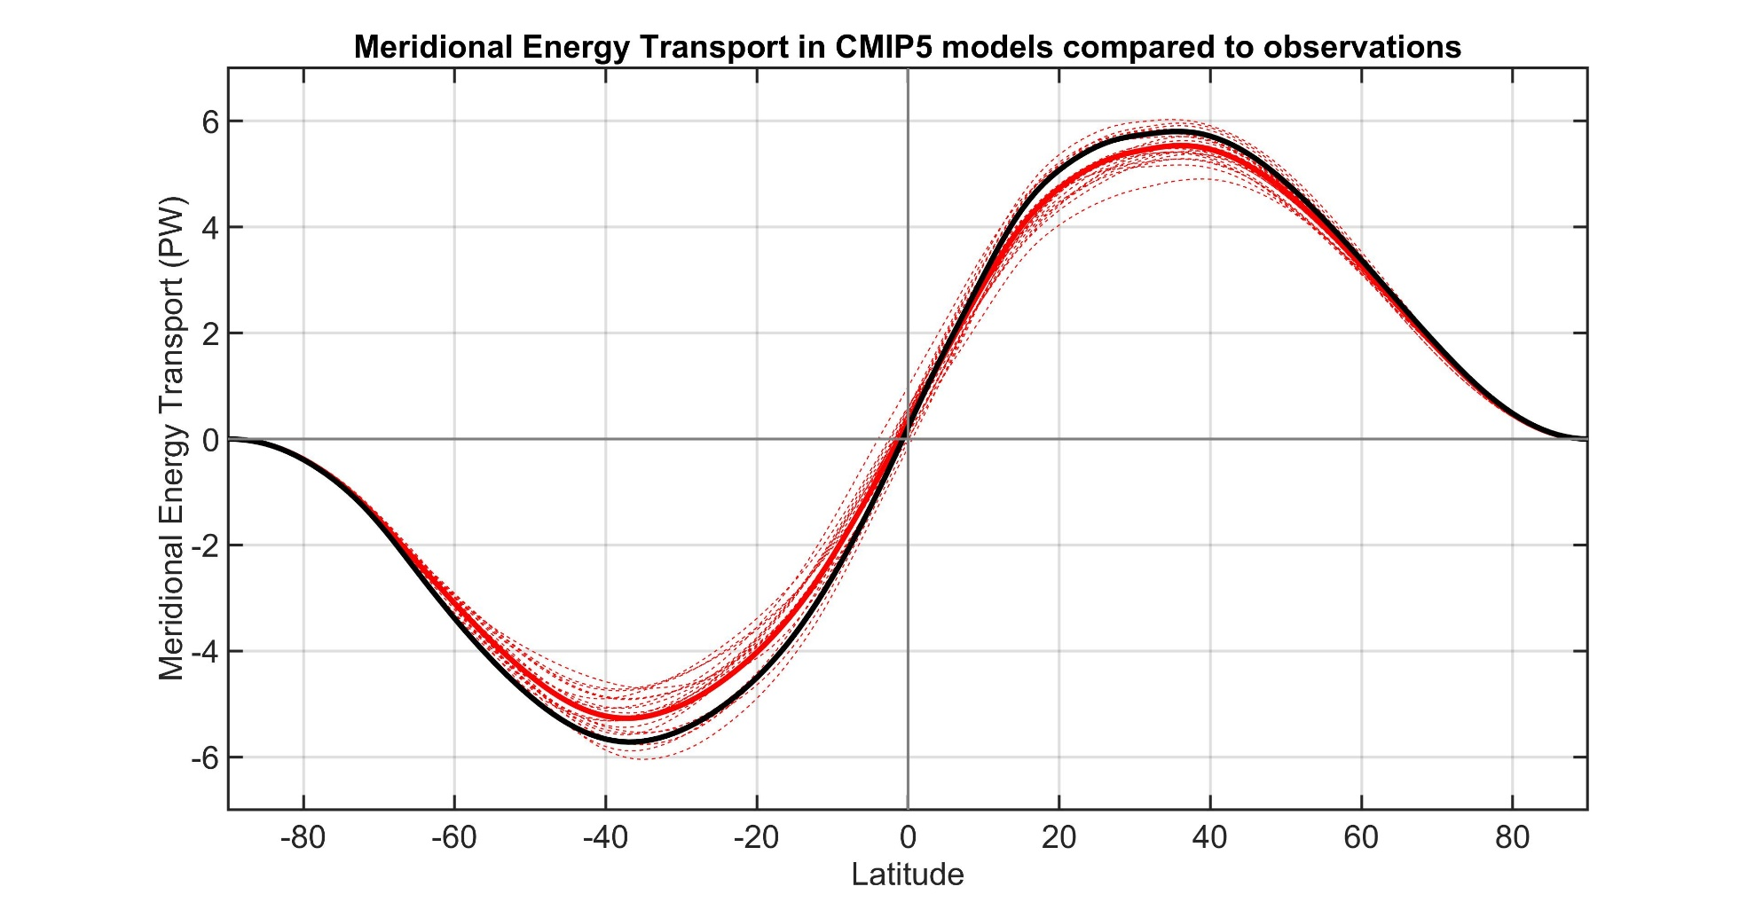
Observations
Individual models
Model Mean

Slide 13
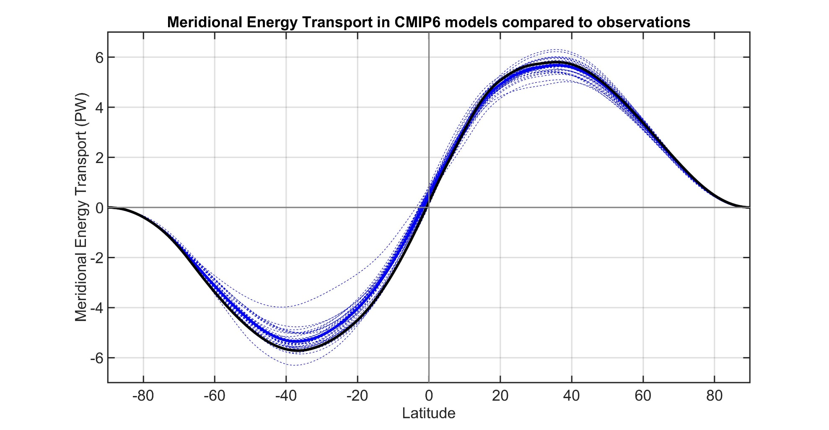
Observations
Individual models
Model Mean

Slide 14
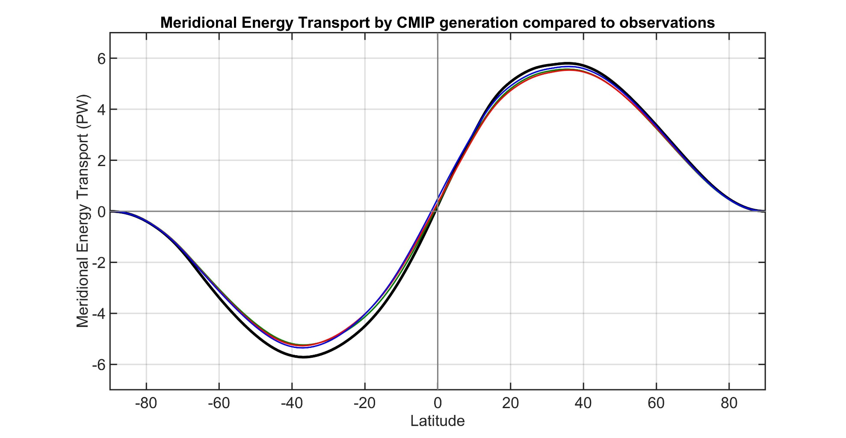
Observations
CMIP3 Mean
CMIP5 Mean
CMIP6 Mean
Inter-model spread and bias in MHT is persistent across generations of CMIP models

Slide 15


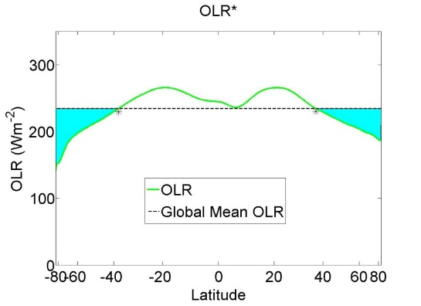
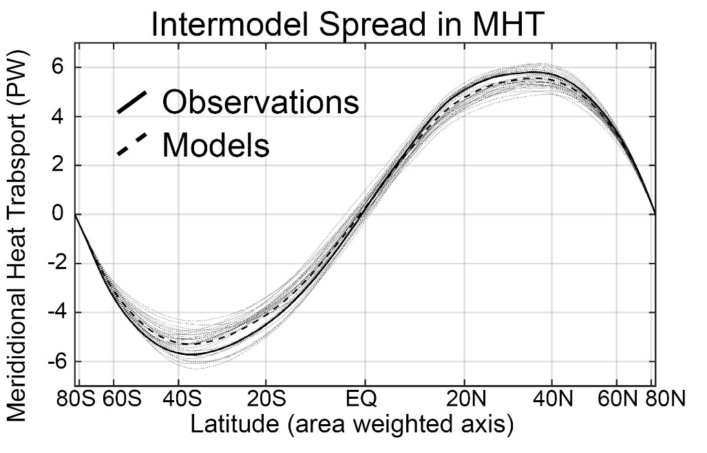
MHT maximum (PW)
MHT = ASR* - OLR*

Slide 16
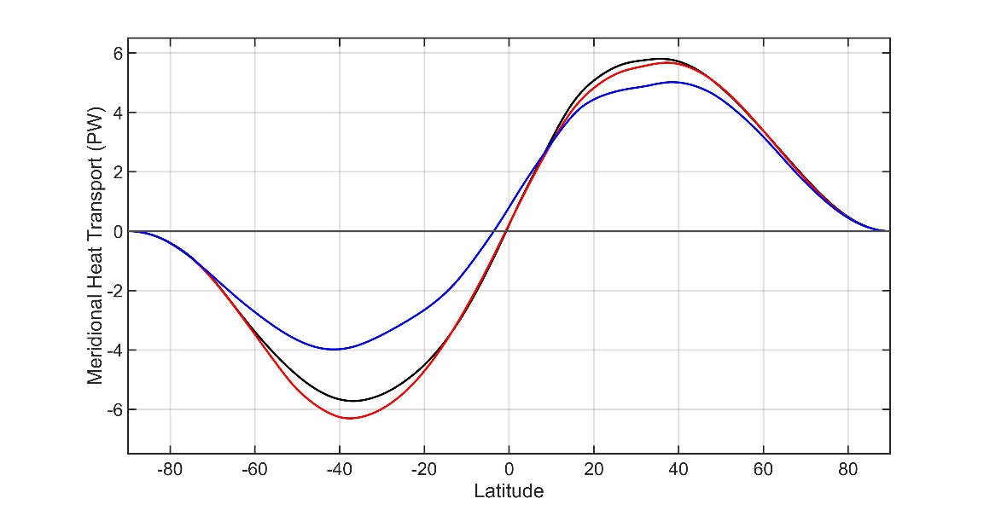
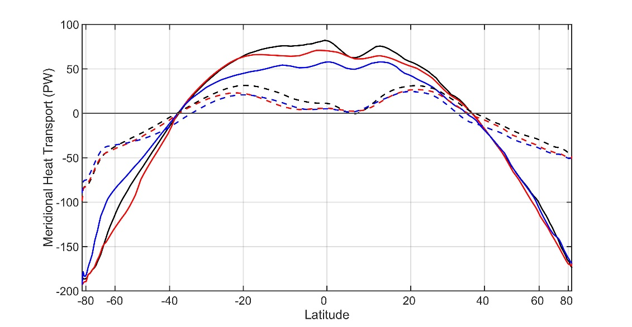
Radiative constraints on inter-model spread in poleward heat transport
Compare model with:
The least MHT in the SH
and
The most MHT in the SH
Model with most MHT
Model with least MHT
Observations
Absorbed
Solar
Outgoing
Longwave

Slide 17
Radiative constraints on inter-model spread in poleward heat transport
Compare model with:
Least MHT
Model with most MHT
ASR*
OLR*
Model with least MHT
6.7 PW
2.7 PW
Observations
4.0 PW
To extratropics
Tropics
MOST MHT
ASR*
OLR*
3.0 PW
9.3 PW
TOA radiation (w m-2)
Global mean removed
Absorbed
Solar
6.3 PW
Outgoing
Longwave
Tropics
To extratropics

Slide 18
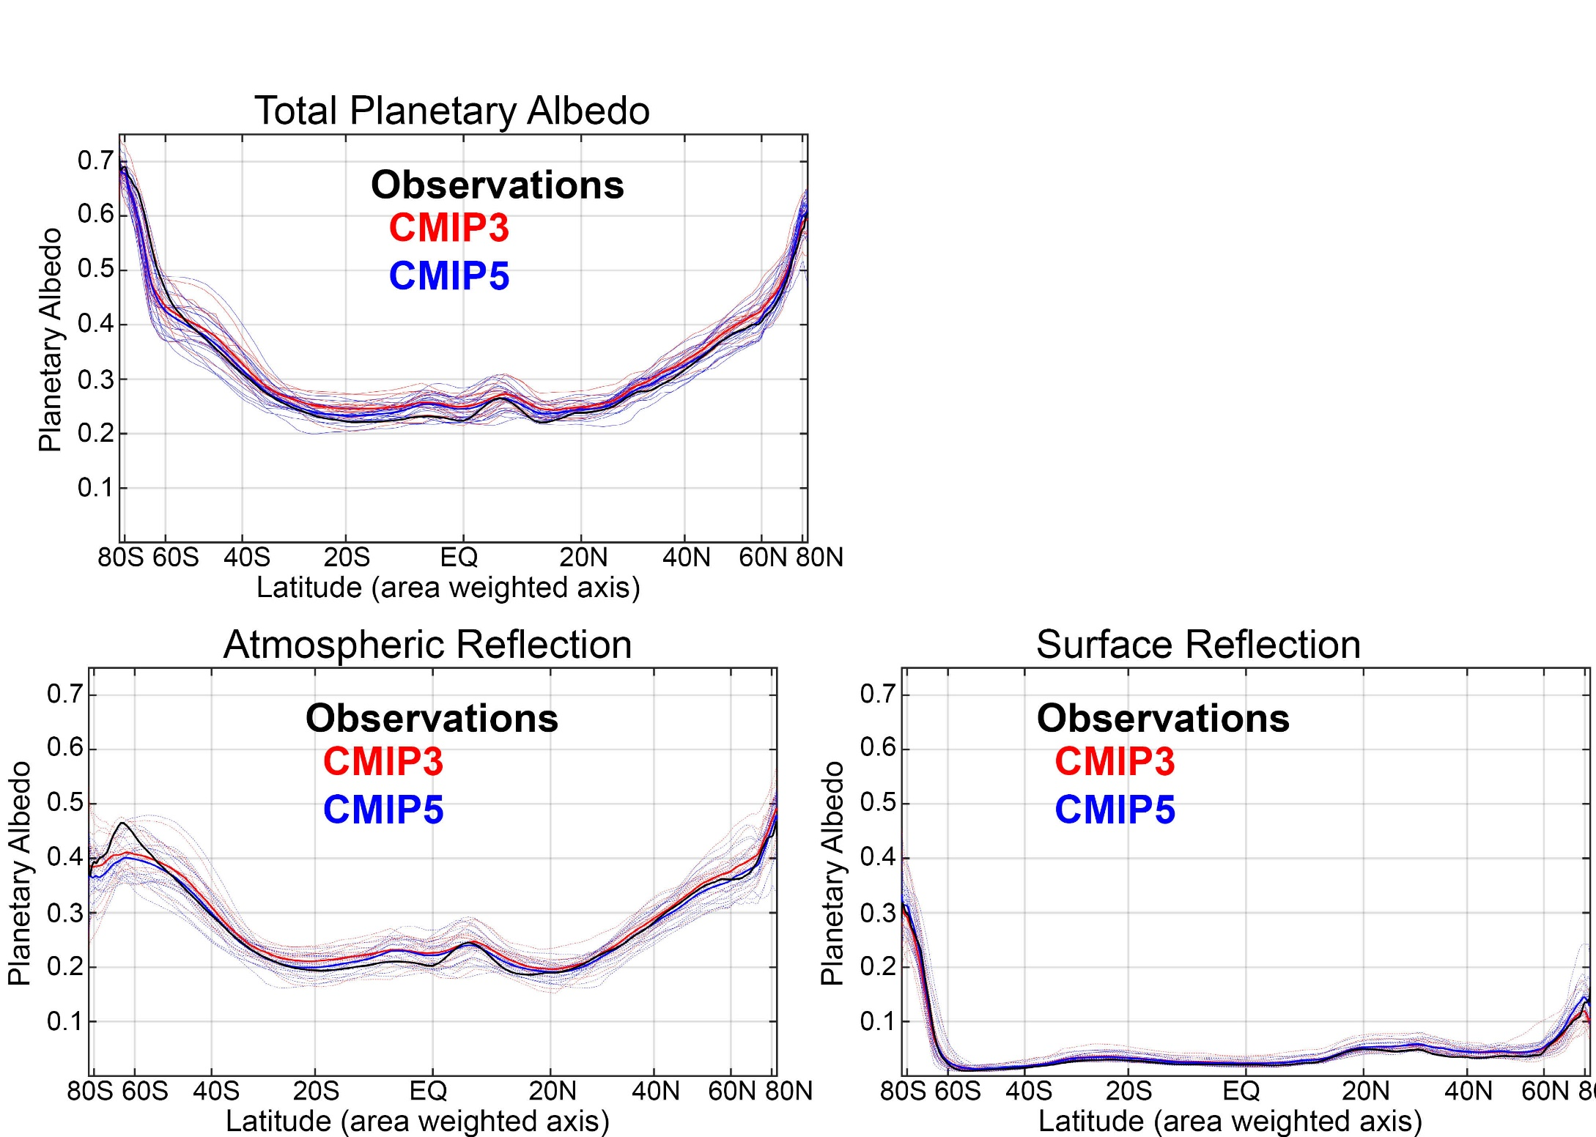
Fraction of solar radiation reflected at TOA (planetary albedo) differs between climate models and is responsible for MHT differences
Due to cloud differences Surface albedo contributes very little to planetary albedo
Donohoe and Battisti (2012). Atmospheric and surface contributions
to planetary albedo J. Climate.

Slide 19
The near invariance of meridional heat transport from the last glacial maximum to CO₂ quadrupling

Slide 20
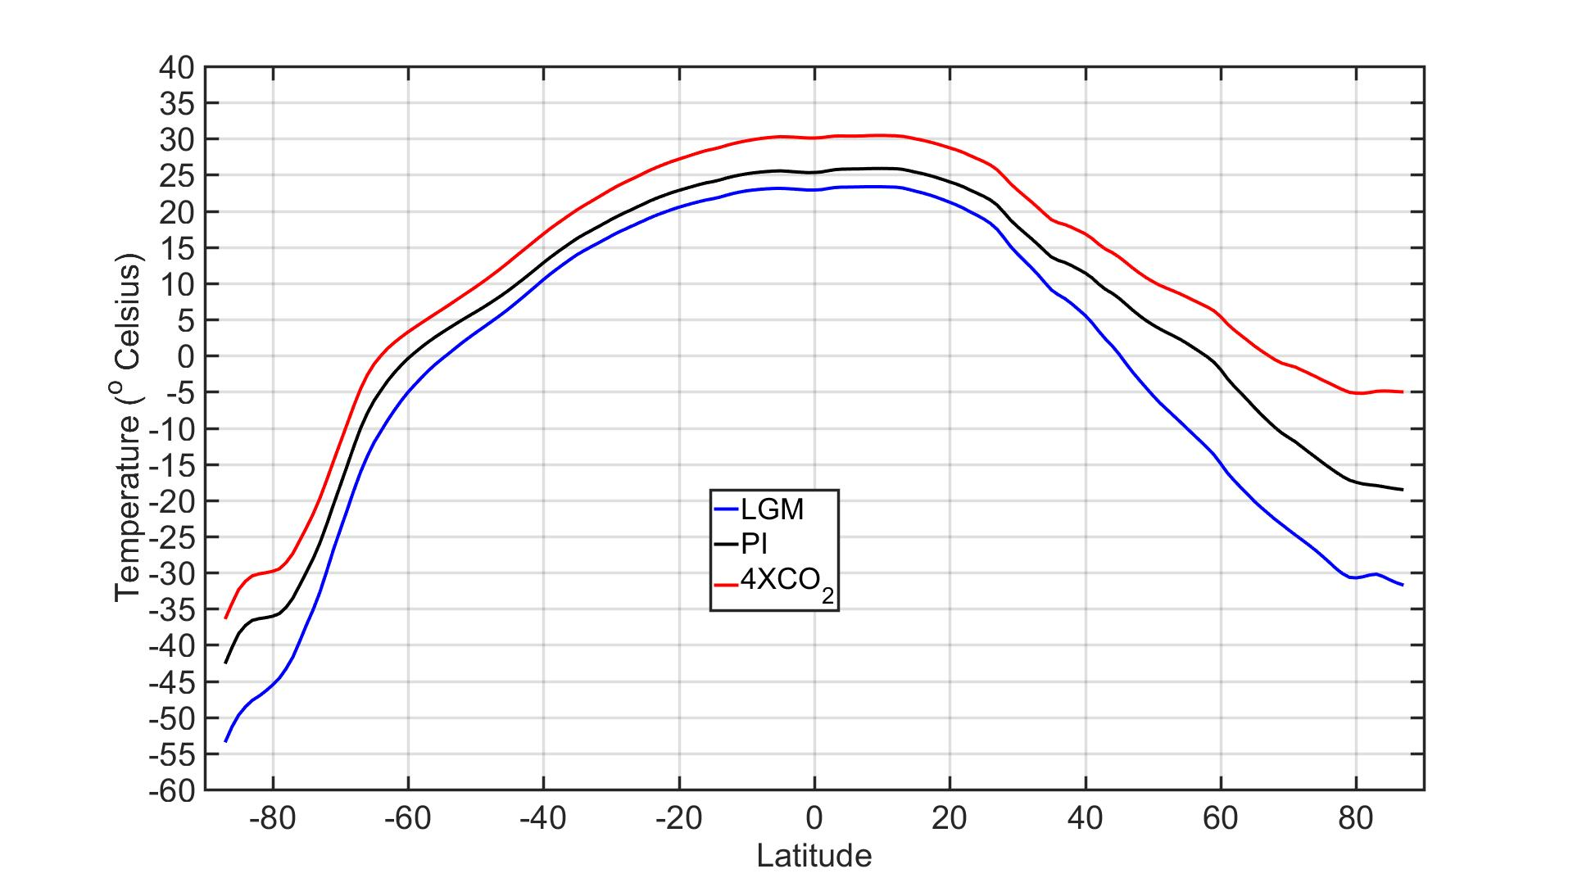
Annual and Zonal mean temperature
LGM to 4XCO₂ : very different climate states
Global mean temperature ranges from 9⁰C to 19⁰C
Equator to pole temperature gradient ranges from 55⁰C to 35⁰C
Laurentide Ice Sheet
4 km of ice over North America
Orbital Parameters
Impact of obliquity on MHT is small but non- trivial
(≈ 0.1 PW increase in LGM MHT )
Li and Battisti (2007)

Slide 21
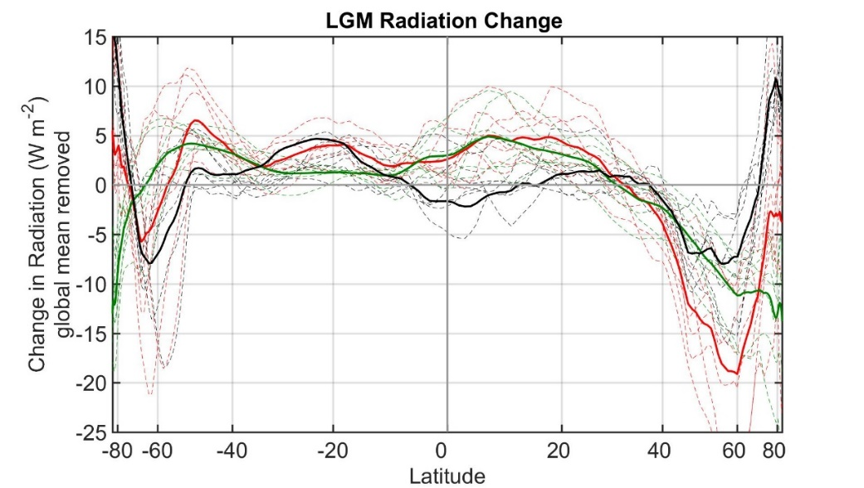
Last Glacial Maximum Northern Hemisphere
Change in energy budget
ASR*
OLR*
1.1 PW
0.8 PW
NET
0.3 PW
ASR
OLR
To extratropics
Tropics

Slide 22
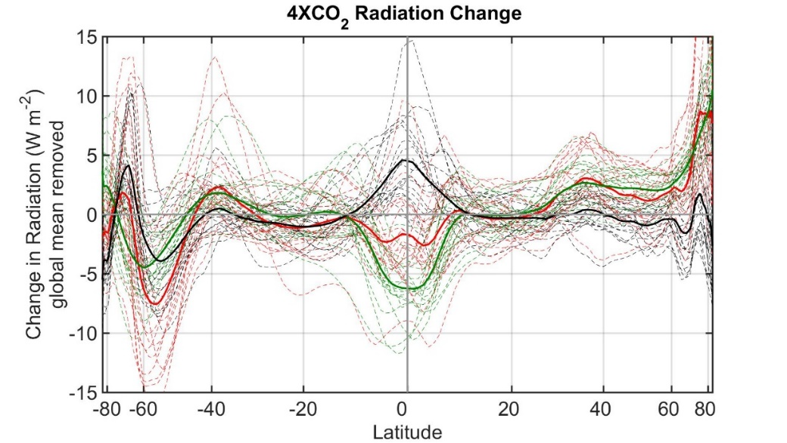
Last Glacial Maximum Northern Hemisphere
Change in energy budget
ASR*
OLR*
1.1 PW
0.8 PW
NET
0.3 PW
ASR
OLR
To extratropics
Tropics
4XCO₂ MHT invariance from radiation
Change in energy budget
ASR*
OLR*
0.4 PW
0.3 PW
0.1 PW
ASR
OLR
NET
To extratropics
Tropics

Slide 23
Summary thus far:
2. MHT does not vary across climate state because changes in shortwave and longwave radiation compensate at the hemispheric scale
1. MHT varies between models because simulated clouds have dipropionate impact on absorbed shortwave and outgoing longwave radiation

Slide 24
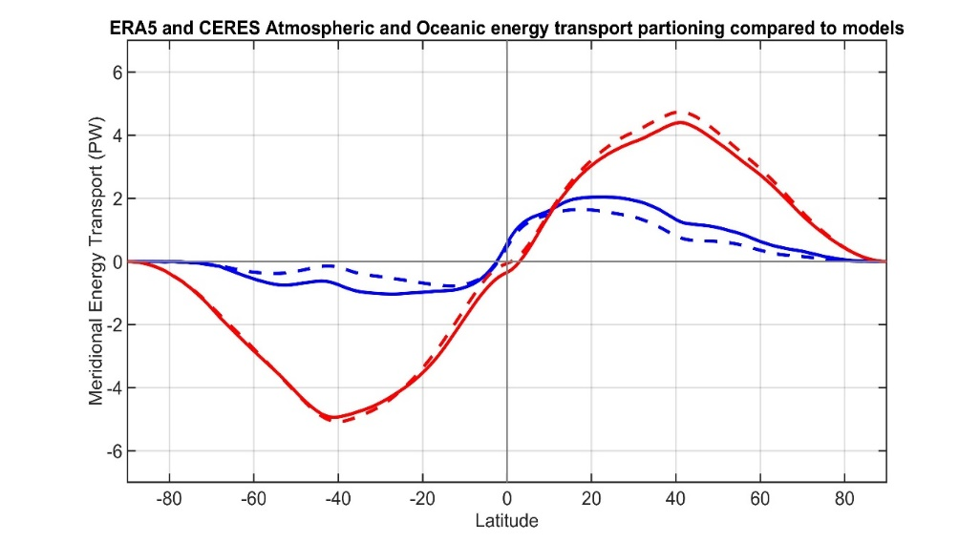
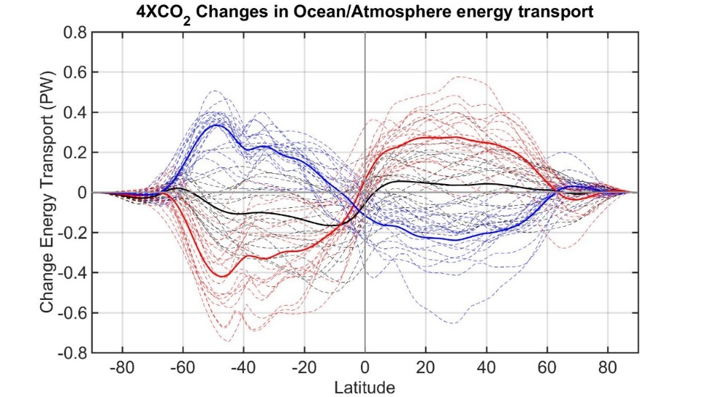
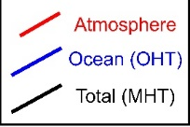
II: Partitioning of poleward heat transport between the atmosphere and ocean
Models move too much energy poleward through the atmosphere and not enough energy through the ocean
Increased poleward atmospheric heat transport is compensated for by decreased poleward implied ocean heat transport under global warming
ATMOSPHERE
OCEAN
Observations
Model Mean

Slide 25
Model partitioning of AHT/OHT
MHT from Radiation
Total heat
transport (MHT)
Integral of
TOA radiation
=
Net radiative
Deficit of extratropics
5.8 PW
Integral of
Surface heat
Flux (SHF)
Ocean heat
Transport (OHT)
=
Atmospheric heat transport (AHT)
AHT = MHT – OHT
= Integral (TOA – SHF)
Tropics
Extratropics
Notes:
NH = 8.2 - 2.4 = 5.8
SH = 9.0 – 3.2 = 5.8

Slide 26

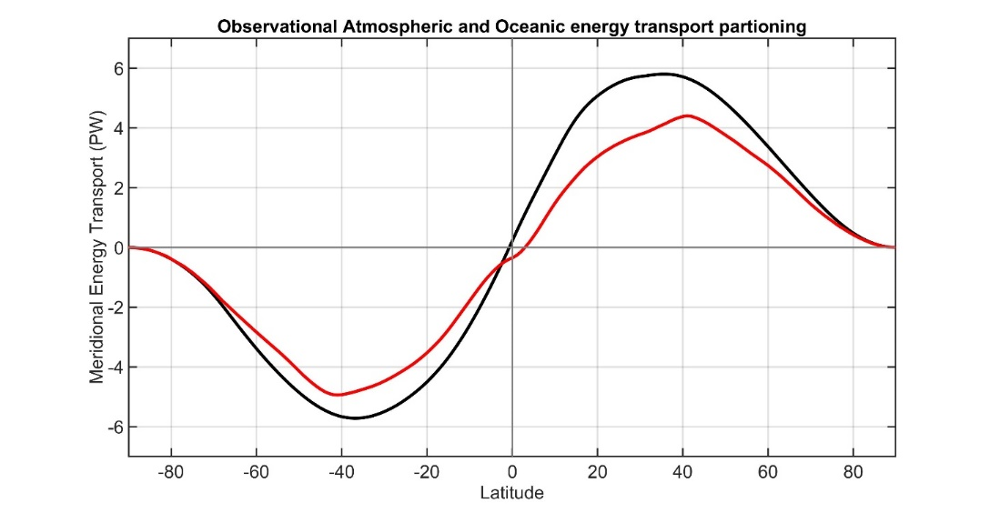
Observational atmosphere/ocean partitioning of poleward heat transport
ASR
Total (atmosphere plus ocean) energy transport from TOA radiation (CERES satellite).
NET
OLR
AHT
Atmospheric energy transport from 6 hourly ERA5 reanalysis dynamics calculation
Tropics
Extratropics
Total
Atmosphere
Notes:
NH = 8.2 - 2.4 = 5.8
SH = 9.0 – 3.2 = 5.8

Slide 27
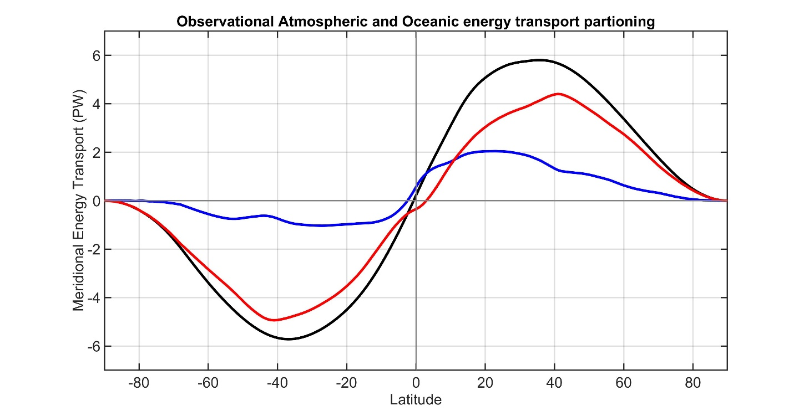
ASR
Total (atmosphere plus ocean) energy transport from TOA radiation (CERES satellite).
NET
OLR
AHT
Atmospheric energy transport from 6 hourly ERA5 reanalysis dynamics calculation
Tropics
Extratropics
Ocean heat transport as the residual = Total - atmos
Total
Atmosphere
Ocean
Notes:
NH = 8.2 - 2.4 = 5.8
SH = 9.0 – 3.2 = 5.8

Slide 28
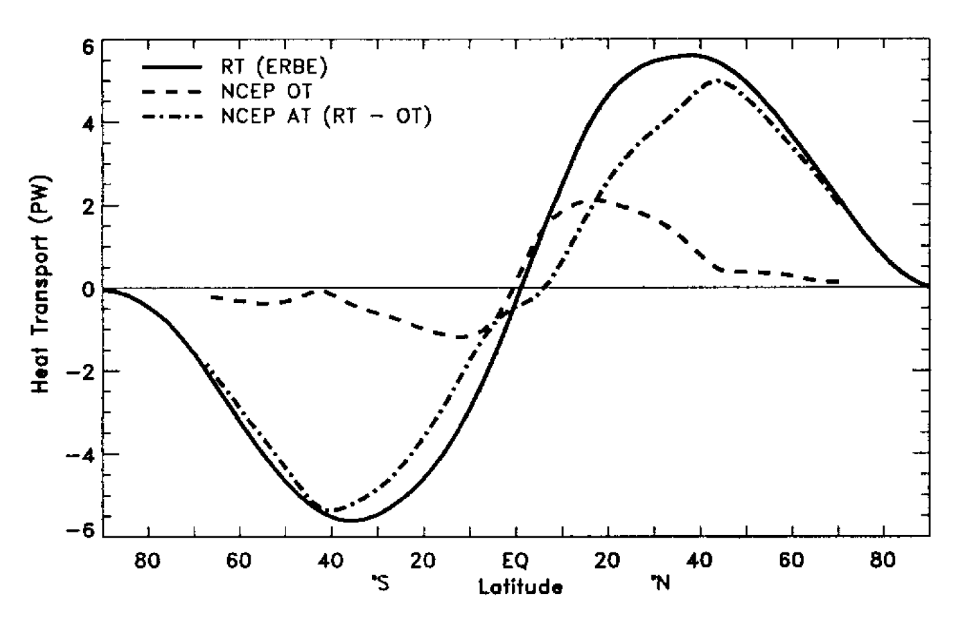
This strategy was pioneered by Trenberth and Caron (2001)
ERBE and NCEP
Total
Atmosphere
Ocean
Our result
CERES and ERA5
Notes:
NH = 8.2 - 2.4 = 5.8
SH = 9.0 – 3.2 = 5.8

Slide 29
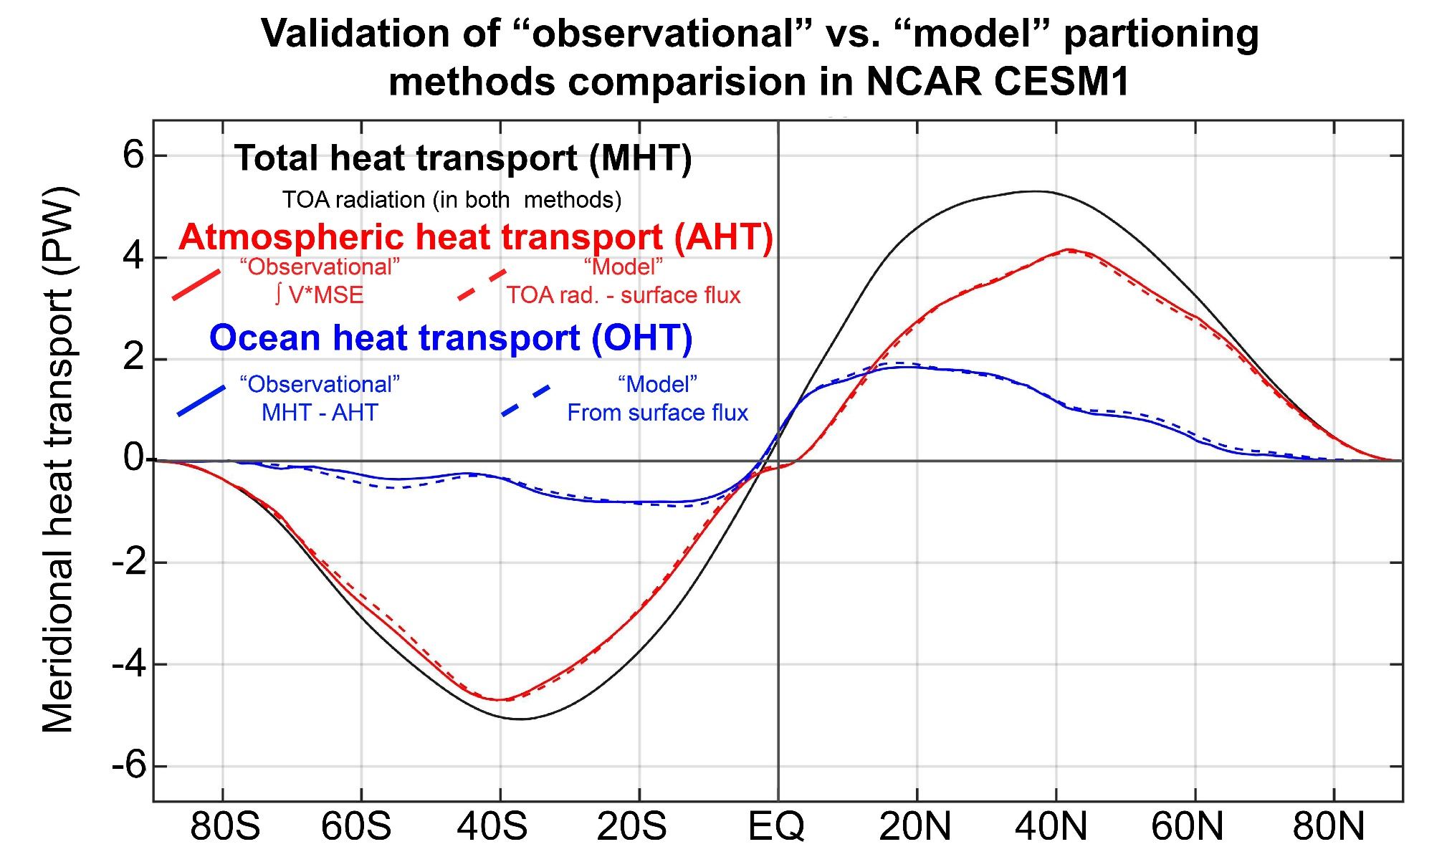

Slide 30

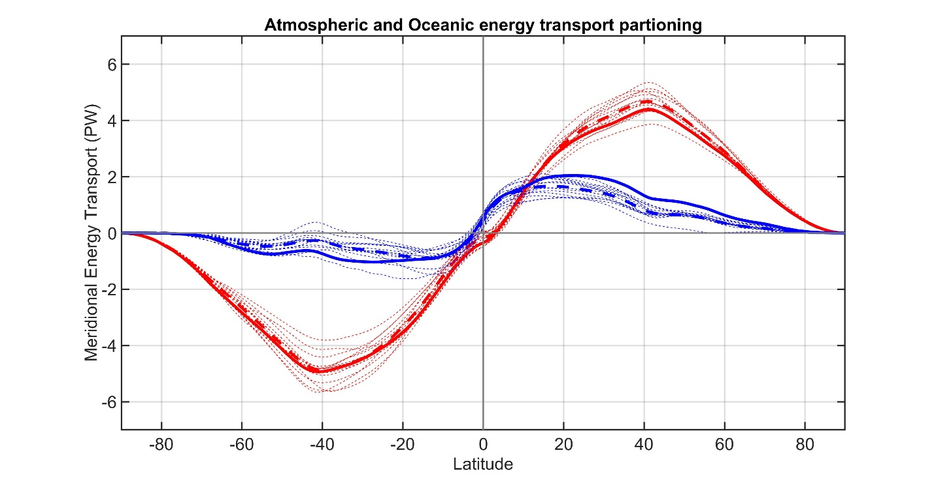
CMIP3 -- Partitioning of MHT 3
Observations
Total energy
transport
Individual models
Model Mean
ATMOSPHERE
Atmosphere ocean partitioning
OCEAN
Observations
Individual models
Model Mean

Slide 31

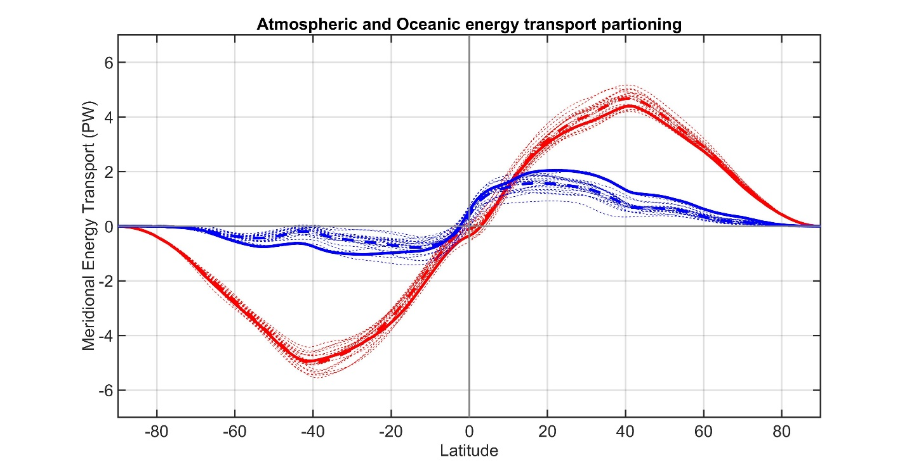
CMIP53
Observations
Total energy
transport
Individual models
Model Mean
ATMOSPHERE
Atmosphere ocean partitioning
OCEAN
Observations
Individual models
Model Mean

Slide 32
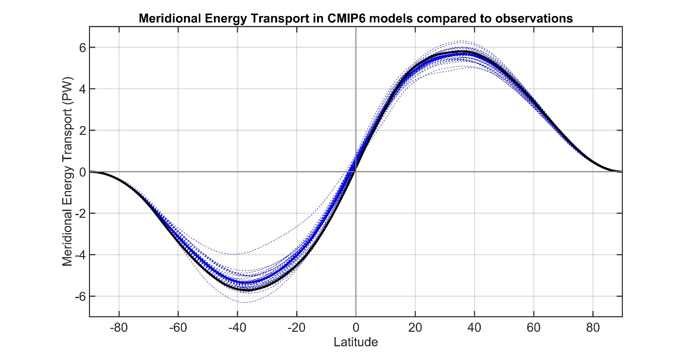
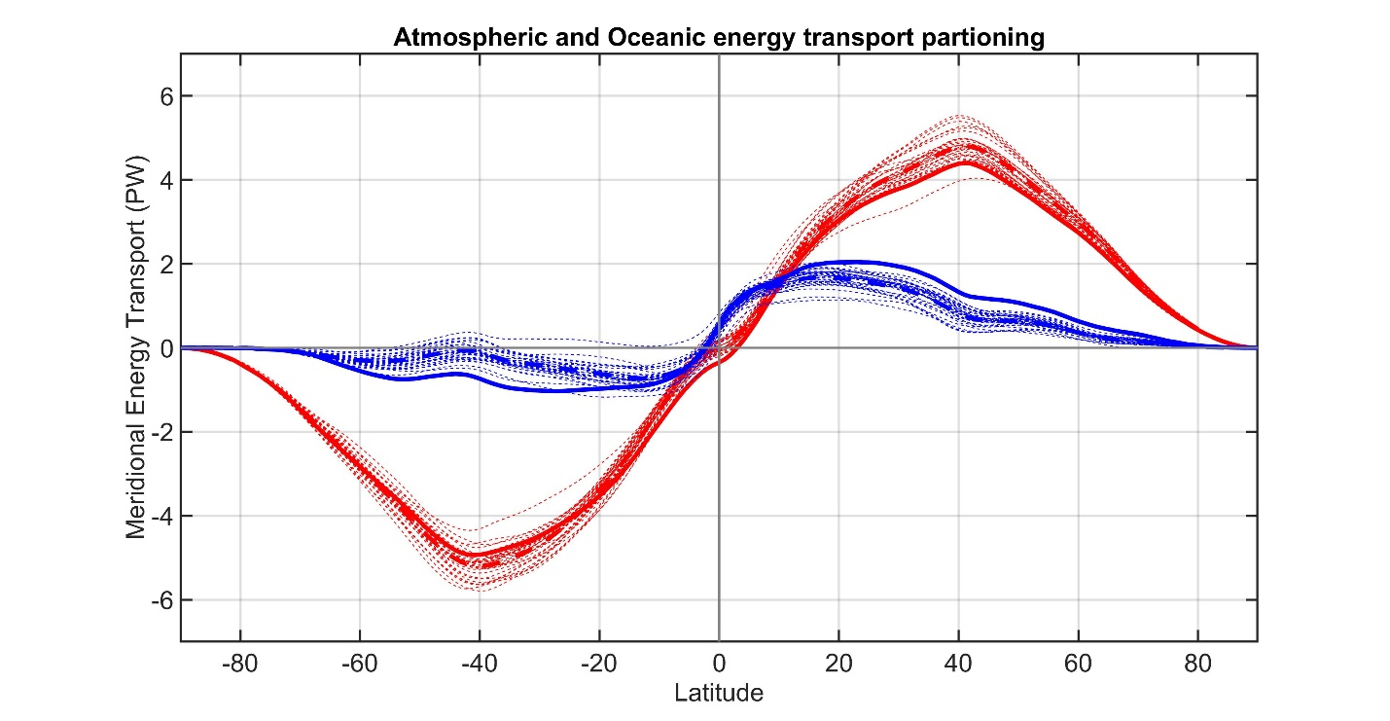
CMIP63
Observations
Total energy
transport
Individual models
Model Mean
ATMOSPHERE
Atmosphere ocean partitioning
OCEAN
Observations
Individual models
Model Mean

Slide 33

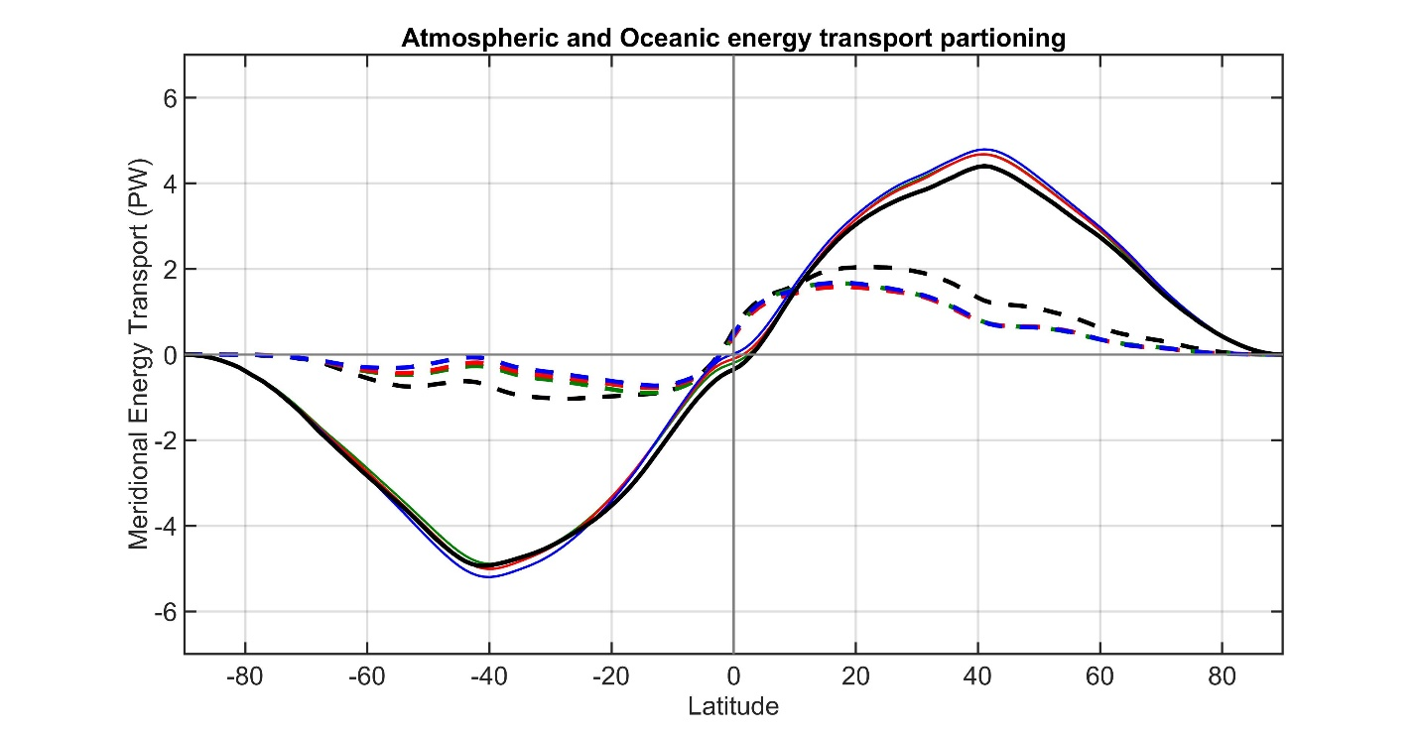
CMIP3 to 6 against observations
Observations
Total energy
transport
CMIP3 Mean
CMIP5 Mean
CMIP6 Mean
ATMOSPHERE
Atmosphere ocean partitioning
OCEAN
Observations
CMIP3 Mean
CMIP5 Mean
CMIP6 Mean

Slide 34
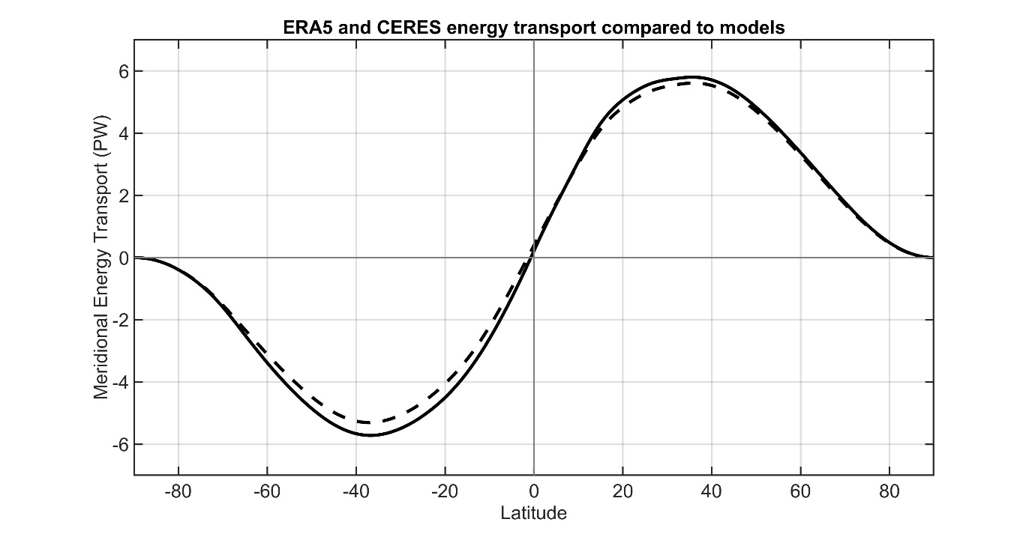
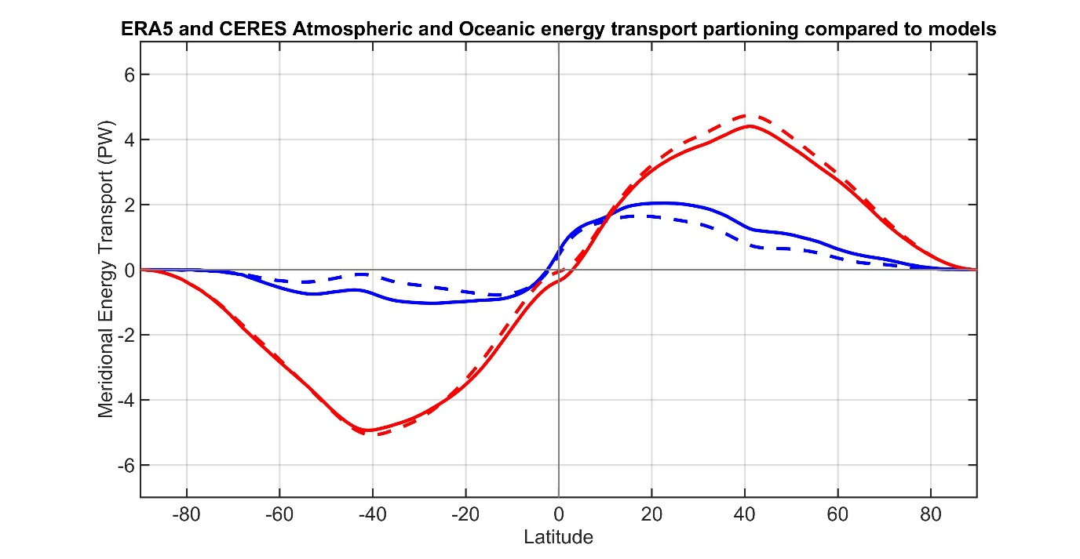
OBSERVATIONS FROM ERA5 and CERES
Observations
CMIP Mean
Total energy
transport
ATMOSPHERE
OCEAN
Observations
Atmosphere ocean partitioning
CMIP Mean

Slide 35
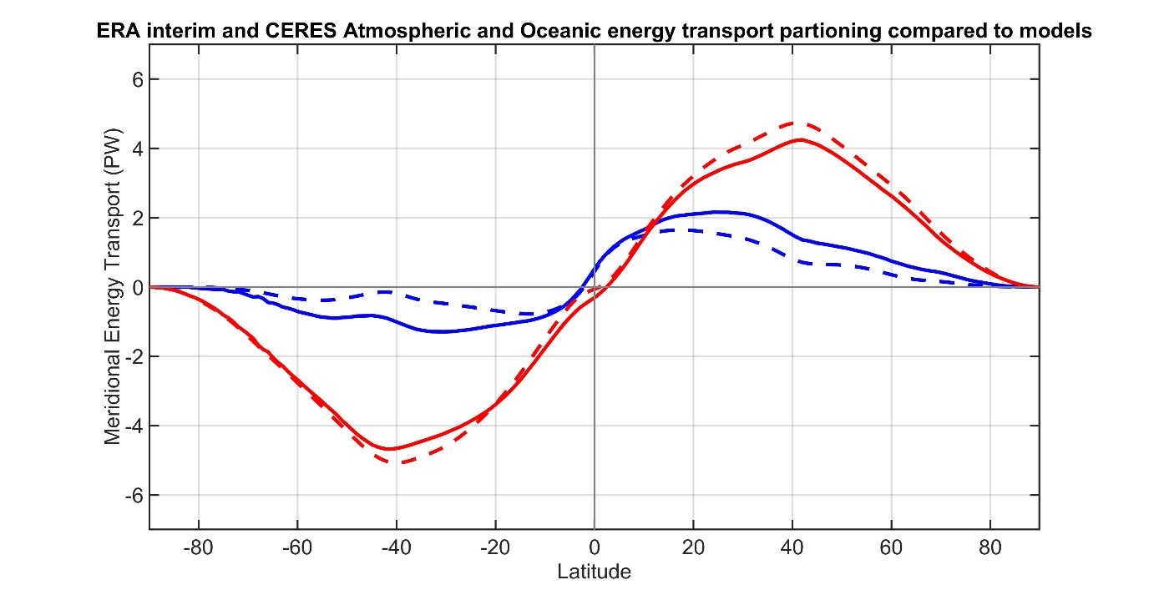
Sensitivity to reanalysis
ERA INTERIM and CERES
Observations
CMIP Mean
Total energy
transport
ATMOSPHERE
OCEAN
Observations
Atmosphere ocean partitioning
CMIP Mean

Slide 36
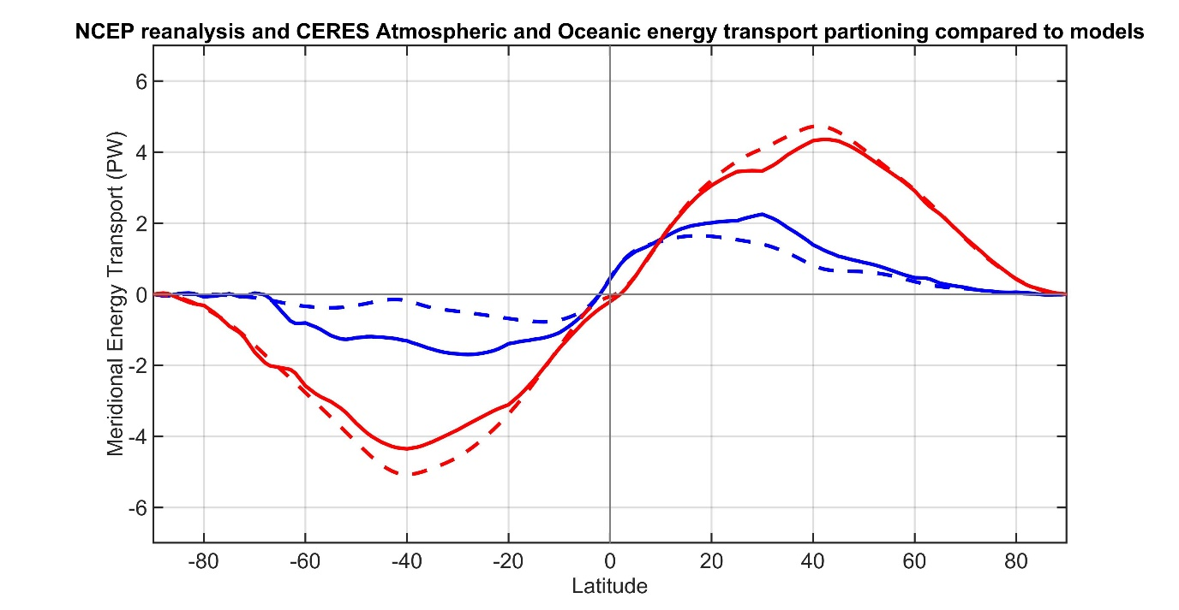
Sensitivity to reanalysis
NCEP reanalysis and CERES
Observations
CMIP Mean
Total energy
transport
ATMOSPHERE
OCEAN
Observations
Atmosphere ocean partitioning
CMIP Mean

Slide 37
Sensitivity to observational radiation
CERES EBAF (energy balanced and filled)
Observations
CMIP Mean
Total energy
transport
ATMOSPHERE
OCEAN
Observations
Atmosphere ocean partitioning
CMIP Mean

Slide 38
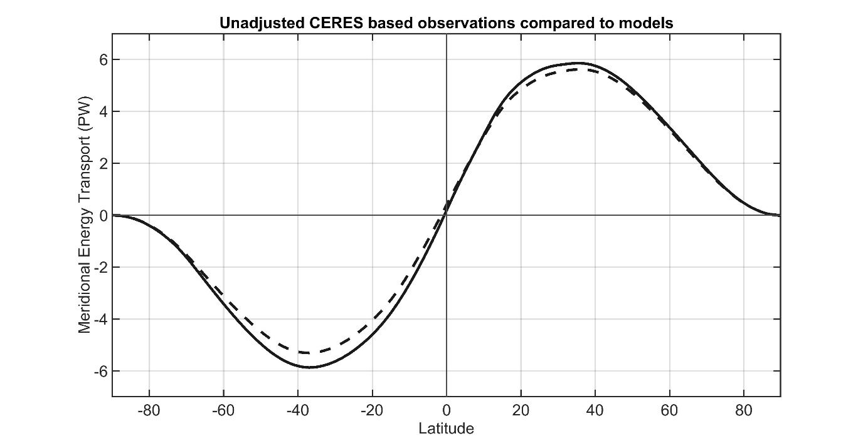
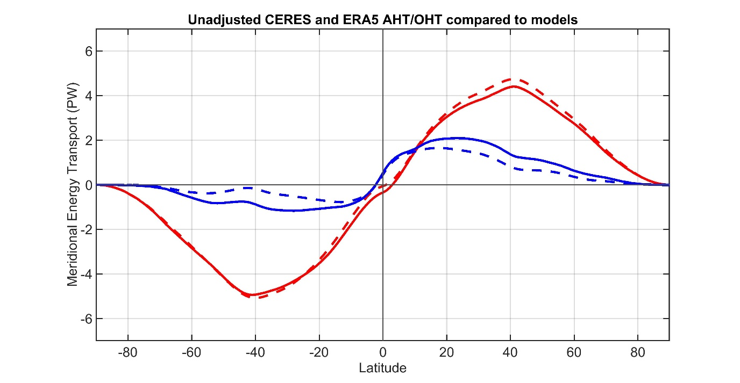
Sensitivity to observational radiation unadjusted CERES (single scanner)
Observations
CMIP Mean
Total energy
transport
ATMOSPHERE
OCEAN
Observations
Atmosphere ocean partitioning
CMIP Mean

Slide 39
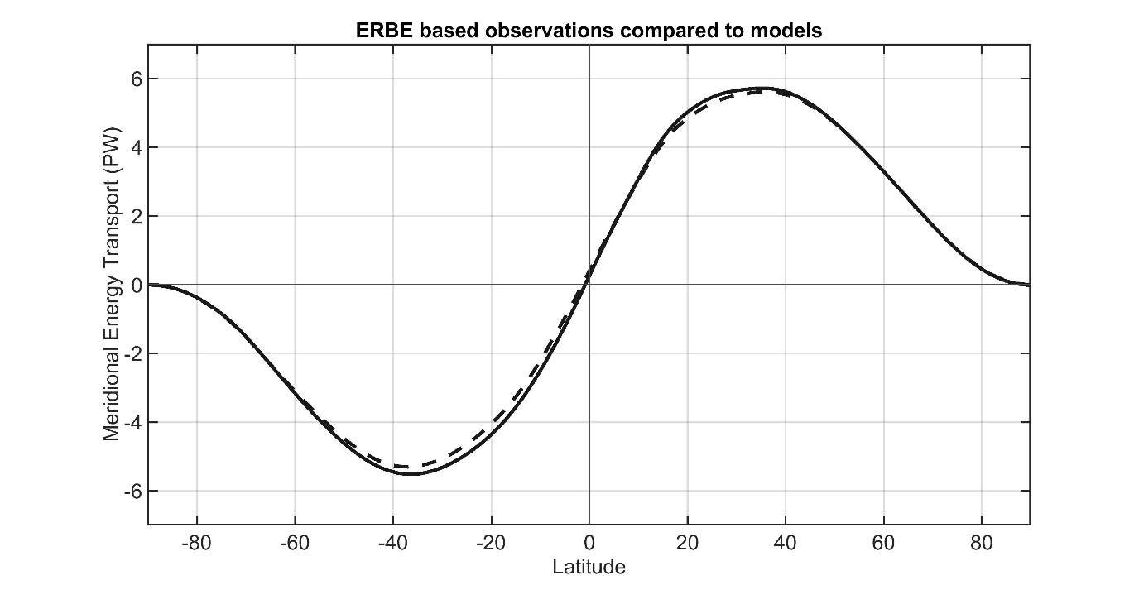
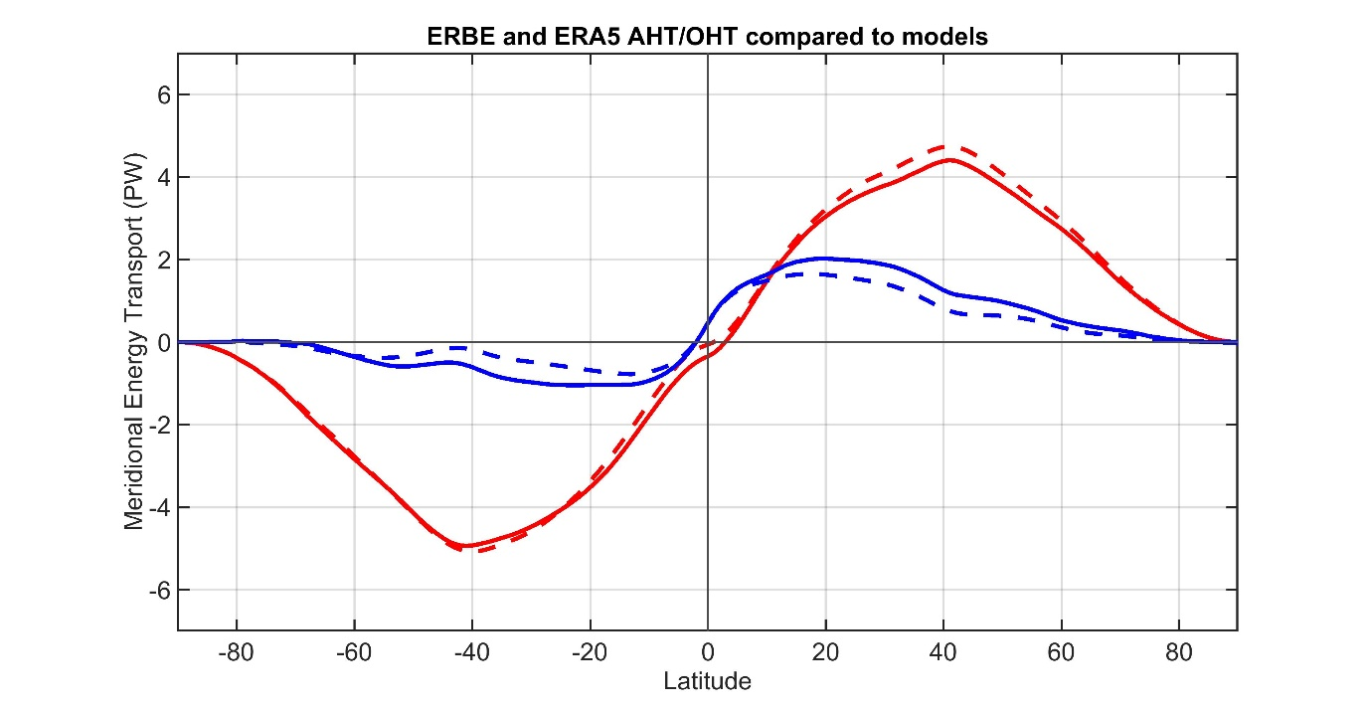
Sensitivity to observational radiation
ERBE (1984-1990)
Observations
CMIP Mean
Total energy
transport
ATMOSPHERE
OCEAN
Observations
Atmosphere ocean partitioning
CMIP Mean

Slide 40
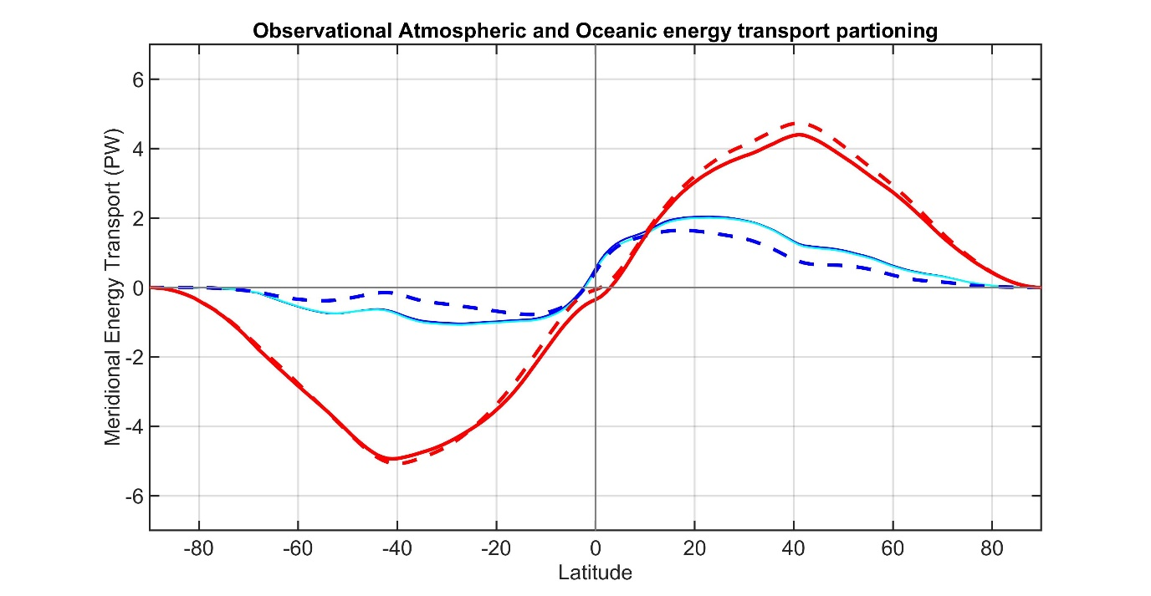
Accounting for ocean heat content changes
Total energy
transport
Observations
CMIP Mean
ATMOSPHERE
Correcting for ocean heat content changes -------------------------
From EN4 ocean reanalysis temperature trends
OCEAN
Observations
CMIP Mean

Slide 41
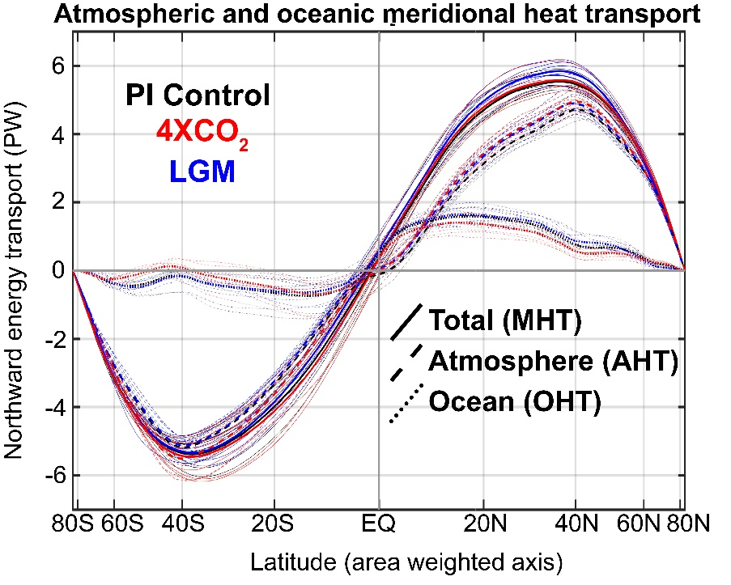

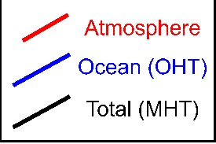
Atmosphere/Ocean partitioning of heat transport under 4XCO₂
MHT maximum (PW)
Observations
Individual models
Model Mean
4XCO₂ change in
AHT/OHT :
High latitude ocean heat uptake (reduced implied OHT) compensated by increased AHT

Slide 42
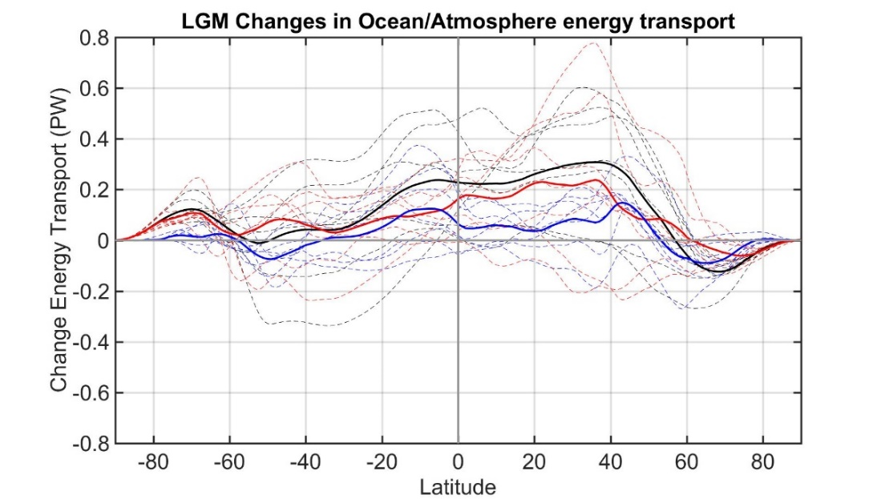
Atmosphere/Ocean in the Last Glacial Maximum
MHT maximum (PW)
Observations
Individual models
Model Mean
Last Glacial Maximum
Changes in ocean heat transport are not very interesting (in models)

Slide 43
What determines the partitioning of heat transport between the atmosphere and ocean (Robert Fajber)
Energy input to the atmosphere
Globally, evaporation adds energy to the atmosphere and
atmospheric radiation removes energy
Local energy imbalances drive atmospheric heat transport
Source of atmospheric energy input (W m⁻² )
Notes:
Left figure shows the sources of energy input to the atmosphere in observations (ERA reanalysis) with the global mean removed. Energy enters the atmosphere in the low latitudes and leaves the atmosphere in the high latitudes (black line). The energy input to the atmosphere is decomposed into three terms; the sensible hear flux from the surface to the atmosphere (orange), the evaporation (green), and the radiative heating of the atmosphere (note this differs from the top of atmosphere radiation and the surface radiation). The evaporation has more spatial structure than the other terms contributing energy into the atmosphere.
The right panel shows the atmospheric heat transport due to each process. This shows that nearly all the poleward heat transport in the atmosphere is derived from evaporation. This result has been confirmed with idealized model studying in which we (Robert Fajber) traces the heating and transport that results from each process by tagging and tracing air parcels (much like one would do with passive tracer transport).
There is one subtlety here. The evaporations drives both the flux of temperature and humidity (dry and moist energy transports in the atmosphere. The evaporation in the tropics can either be balanced by a moisture transport in the atmosphere, or be precipitated out which condesationally heats the atmospheric column to drive the dry atmospheric heat transport.

Slide 44
What determines the partitioning of heat transport between the atmosphere and ocean (Robert Fajber)
150
6
Total
Total
Radiation (atmos)
Radiation (atmos)
100
Sensible heat
4
Sensible heat
Evaporation
Evaporation
50
50
2
Source of atmospheric energy input (W m⁻² )
Global mean removed
Atmospheric heat transport generated
By each source term (PW)
0
0
-50
-2
-100
-4
-150
30N
60N
90N
-6
30N
60N
90N
90S
60S
30S
EQ
90S
60S
30S
EQ
Notes:
Left figure shows the sources of energy input to the atmosphere in observations (ERA reanalysis) with the global mean removed. Energy enters the atmosphere in the low latitudes and leaves the atmosphere in the high latitudes (black line). The energy input to the atmosphere is decomposed into three terms; the sensible hear flux from the surface to the atmosphere (orange), the evaporation (green), and the radiative heating of the atmosphere (note this differs from the top of atmosphere radiation and the surface radiation). The evaporation has more spatial structure than the other terms contributing energy into the atmosphere.
The right panel shows the atmospheric heat transport due to each process. This shows that nearly all the poleward heat transport in the atmosphere is derived from evaporation. This result has been confirmed with idealized model studying in which we (Robert Fajber) traces the heating and transport that results from each process by tagging and tracing air parcels (much like one would do with passive tracer transport).
There is one subtlety here. The evaporations drives both the flux of temperature and humidity (dry and moist energy transports in the atmosphere. The evaporation in the tropics can either be balanced by a moisture transport in the atmosphere, or be precipitated out which condesationally heats the atmospheric column to drive the dry atmospheric heat transport.

Slide 45
Atmospheric heat transport is traditionally subdivided into processes that add moisture versus heat to the atmosphere
Source of atmospheric energy input (W m⁻² )
Global mean removed
Moisture input = evaporation - precipitation
Atmospheric heating = precipitation + stuff
Notes:
Left figure shows the sources of energy input to the atmosphere in observations (ERA reanalysis) with the global mean removed. Energy enters the atmosphere in the low latitudes and leaves the atmosphere in the high latitudes (black line). The energy input to the atmosphere is decomposed into three terms; the sensible hear flux from the surface to the atmosphere (orange), the evaporation (green), and the radiative heating of the atmosphere (note this differs from the top of atmosphere radiation and the surface radiation). The evaporation has more spatial structure than the other terms contributing energy into the atmosphere.
The right panel shows the atmospheric heat transport due to each process. This shows that nearly all the poleward heat transport in the atmosphere is derived from evaporation. This result has been confirmed with idealized model studying in which we (Robert Fajber) traces the heating and transport that results from each process by tagging and tracing air parcels (much like one would do with passive tracer transport).
There is one subtlety here. The evaporations drives both the flux of temperature and humidity (dry and moist energy transports in the atmosphere. The evaporation in the tropics can either be balanced by a moisture transport in the atmosphere, or be precipitated out which condesationally heats the atmospheric column to drive the dry atmospheric heat transport.

Slide 46
Sptail pattern of atmospheric heating (dry static energy input) is dominated by precipitation
Source of atmospheric heating
Precipitation
Radiation
Sensible
Source of atmospheric heating input (W m⁻² )
Global mean removed
Atmospheric heating = precipitation + radiation + sensible
Notes:
Left figure shows the sources of energy input to the atmosphere in observations (ERA reanalysis) with the global mean removed. Energy enters the atmosphere in the low latitudes and leaves the atmosphere in the high latitudes (black line). The energy input to the atmosphere is decomposed into three terms; the sensible hear flux from the surface to the atmosphere (orange), the evaporation (green), and the radiative heating of the atmosphere (note this differs from the top of atmosphere radiation and the surface radiation). The evaporation has more spatial structure than the other terms contributing energy into the atmosphere.
The right panel shows the atmospheric heat transport due to each process. This shows that nearly all the poleward heat transport in the atmosphere is derived from evaporation. This result has been confirmed with idealized model studying in which we (Robert Fajber) traces the heating and transport that results from each process by tagging and tracing air parcels (much like one would do with passive tracer transport).
There is one subtlety here. The evaporations drives both the flux of temperature and humidity (dry and moist energy transports in the atmosphere. The evaporation in the tropics can either be balanced by a moisture transport in the atmosphere, or be precipitated out which condesationally heats the atmospheric column to drive the dry atmospheric heat transport.

Slide 47

Evaporation drives total atmospheric heat transport
Atmospheric energy input = moisture input + heating
evaporation – precipitation + precipitation
evaporation

Slide 48
If AHT is governed by evaporation
Prediction: Reduced evaporation → reduced AHT
Control
Snowball
In Snowball Earth simulation
Evaporation becomes negligible
AHT reduced by 90%
Evaporation
Sensible
Radiation
Model simulation from:
J Horner, A Voigt, C Braun, Snowball earth initiation and the thermodynamics of sea ice. J. Adv. Model. Earth Syst. 14, e2021MS002734 (2022).
Control
½ evap
Simulation with evaporation
Coefficient is cut in half
Evaporation reduced by %20
AHT reduced by similar amount
Change ih AHT (PW)

Slide 49
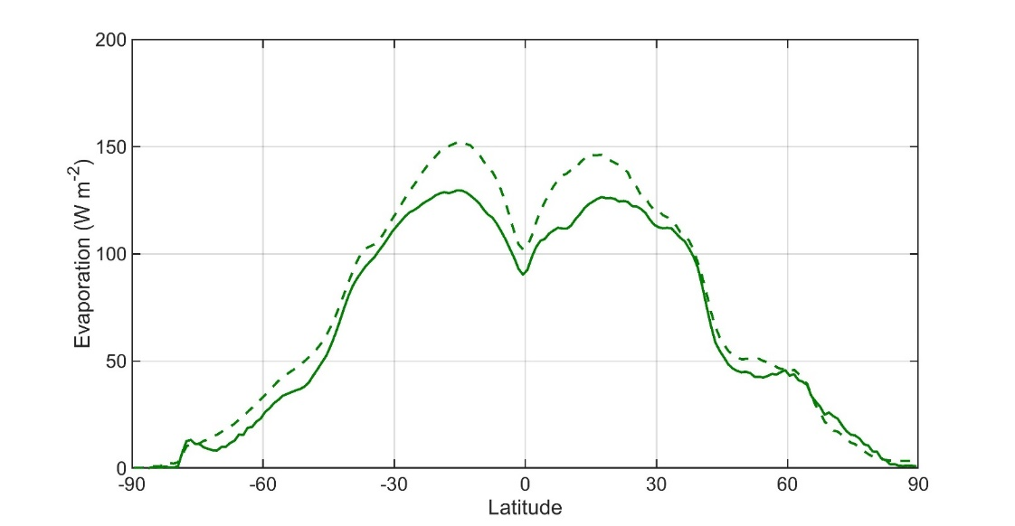
Why are models biased high in AHT
ATMOSPHERE
OCEAN
Observations
Model Mean
Hypothesis: model’s have too much AHT because they have too much evaporation
CMIP Mean
Evaporation
Observations
CMIP Mean
Observations are WHOI OA flux
Both plots are ocean domain only

Slide 50
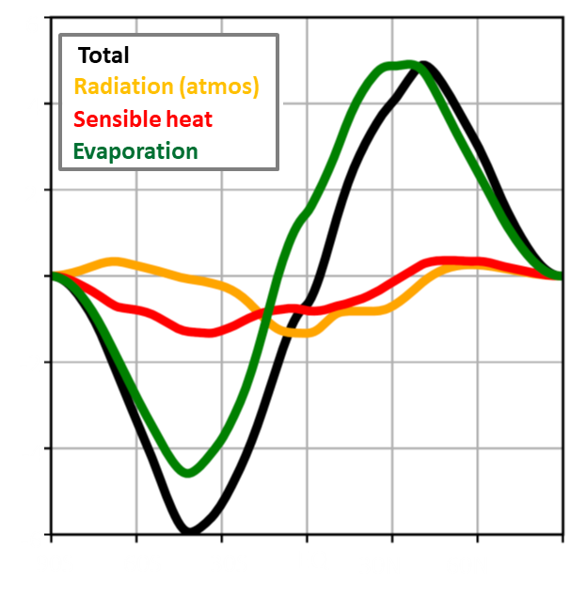
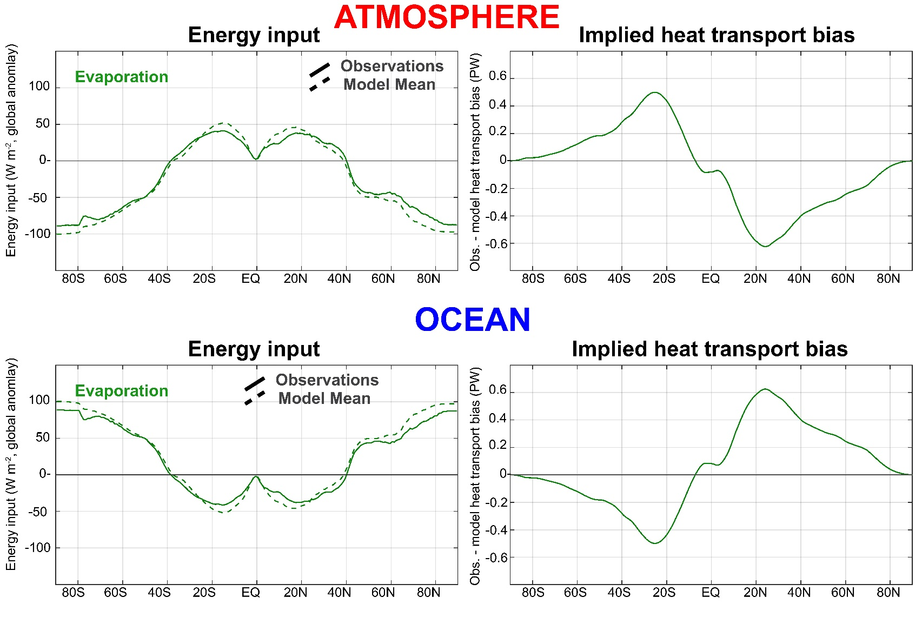
Evaporation biases:
→Result in AHT/OHT tradeoff
→ Are right magnitude to explain AHT/OHT bias

Slide 51
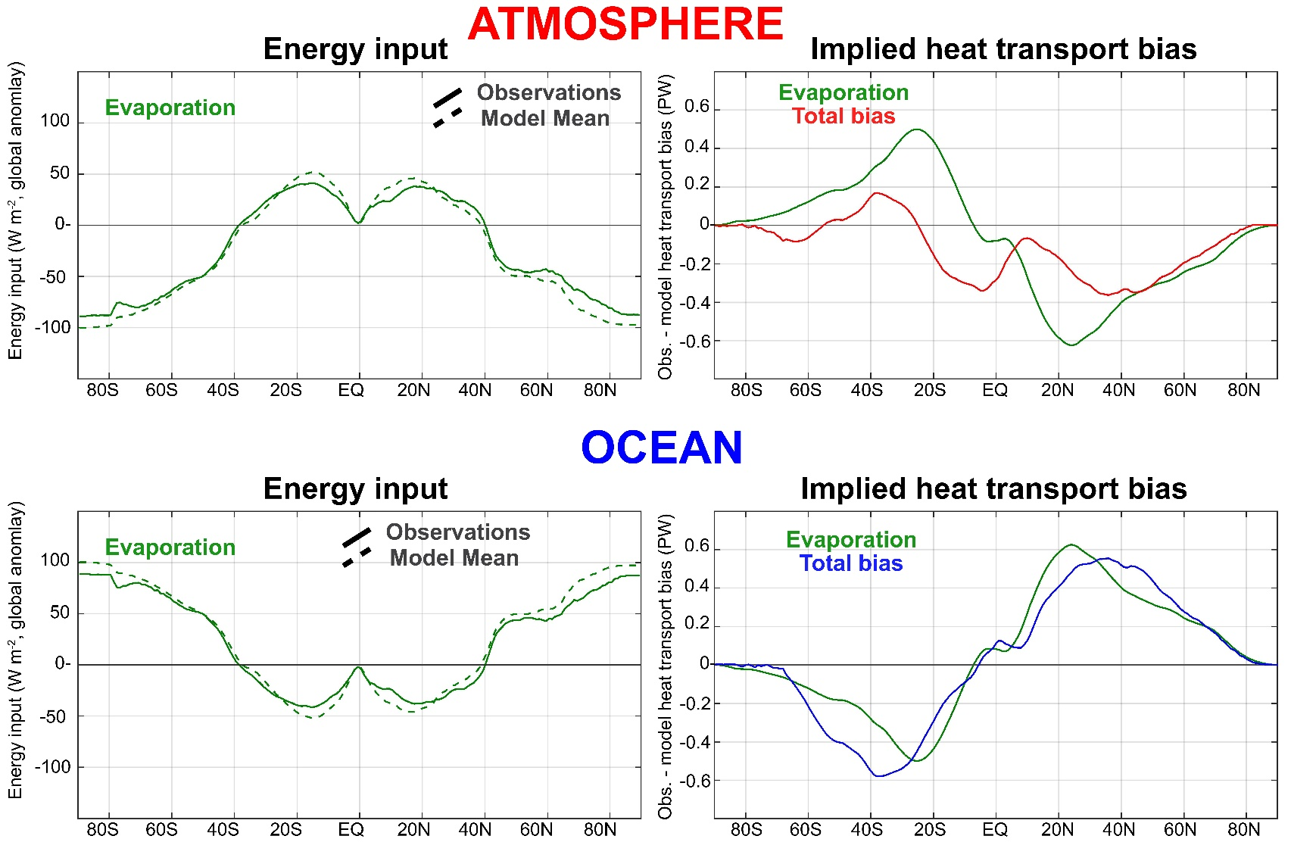
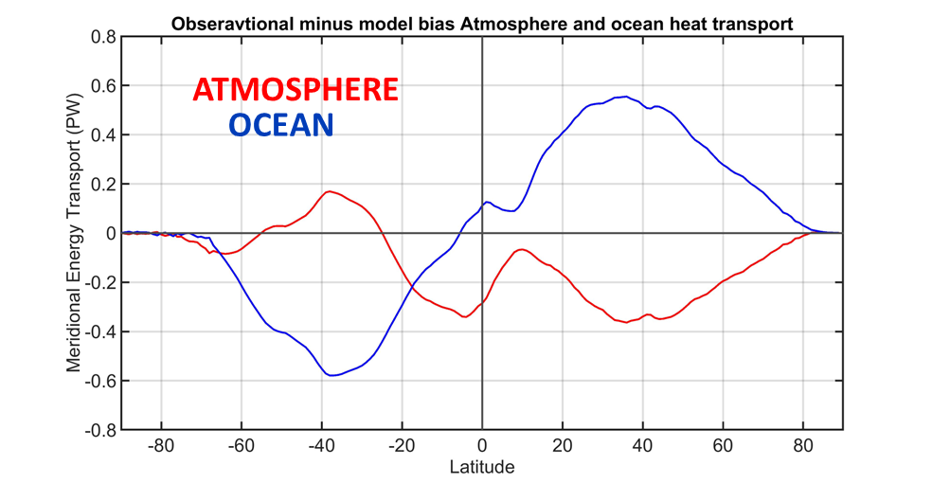
Evaporation biases:
→Result in AHT/OHT tradeoff
→ Are right magnitude to explain AHT/OHT bias

Slide 52




Partitioning of atmospheric energy by circulation type
Stationary
MOC
Overturning
Transient
* = Departure from zonal mean -- [ ]
' = Departure from time mean -- ¯
MSE = moist static energy
= CpT + LQ +gZ
MOC dominates in the deep tropics – Hadley cell
Stationary eddies stronger in NH
Transient eddies dominate the mid-latitudes

Slide 53

LGM changes in the partitioning of atmospheric heat transport:
→Increased stationary eddy heat transport induced by Laurentide ice sheet is nearly compensated by decreased transient eddy heat transport

Slide 54

Climatological partitioning of atmospheric heat transport:
→ Spatial structure of heat transport by mean overturning circulation and eddies sums to meridional smooth MHT mandated by radiative constraints
4XCO₂ changes in the partitioning of atmospheric heat transport:
→ Complicated spatial structure of changes in overturning, stationary eddies and transient eddies sum to spatially smooth AHT demanded by high latitude ocean heat uptake

Slide 55

Stationary and transient AHT compensation under idealized topography (Tyler Cox)
Colors – transient eddy heat flux (anomalies)
Contours = Moist static energy gradient (zonal anomaly)

Slide 56
MHT invariance under idealized topography
Colors – transient eddy heat flux (anomalies)
Contours = Moist static energy gradient (zonal anomaly)
Mountains make stationary waves
Stationary wave AHT reduced meridional gradient in temperature (MSE)
Transient eddies respond to MSE gradient change
AHT is invariant if eddy heat transport is more sensitive to MSE gradients than radiation

Slide 57
Eddy and Ferrel Cell AHT compensation
(Tyler Cox)
Hadley Cell
Ferrel Cell
On the equator flank of the Ferrel cell (point D):
→ Eddy heat flux convergence forces vertical motion (unless it can be radiatively damped)
Vertical mass flux is balanced by thermally indirect Ferrel cell mass transport with and AHT equal to mass flux times static stabiltiy
AHT of the Ferrel cell compensates for eddy heat flux perfectly if there is no radiative damping
Wallace, Battisti, Thompson and Hartmann
The Atmospheric General circulation

Slide 58

Eddy and Ferrel AHT compensation under 4XCO₂
Models with larger poleward eddy AHT changes have larger compensating Ferrel cell changes
→ Compensation of about 50%

Slide 59

Observed trends in AHT (1980-2018)
ERA5 reanalysis
Eddy and Ferrel cell AHT changes trends are seasonally and spatially co-located with a compensation of 60%

Slide 60

AHT trends and eddy-Ferrel cell compensation is consistent between different reanalyses

Slide 61




Conclusions
Total (atmosphere plus ocean) poleward heat transport (MHT):
Varies by 20 between models due to clouds
Is nearly invariant with climate forcing
The partitioning of MHT between the
atmosphere (AHT) and ocean (OHT)
is biased toward too much AHT and too little OHT
→Evaporation sets AHT
→ Models have too much evaporation which increases AHT at the expense of OHT (speculation)
Observations
Model Mean
ATMOSPHERE
OCEAN
AHT changes are muted due to compensation between:
Stationary and transient eddied
Eddy AHT and Ferrel cell AHT

Slide 62
EXTRAS

Slide 63



MHT maximum (PW)
MHT = ASR* - OLR*
Southern Hemisphere
Mean state inter-model spread in MHT:
Spread in ASR* exceeds that in OLR
→No compensation between ASR* and OLR*
→ Model mean bias due ASR* -- low planetary albedo of Southern Ocean

Slide 64


MHT = ASR* - OLR*
MHT maximum (PW)
Northern Hemisphere
Mean state inter-model spread in MHT:
Spread in ASR* exceeds that in OLR
→No compensation between ASR* and OLR*
→ Model mean bias do to too much tropical OLR

Slide 65


MHT = ASR* - OLR*
MHT maximum (PW)
Northern Hemisphere
Mean state inter-model spread in MHT:
Spread in ASR* exceeds that in OLR
→No compensation between ASR* and OLR*
→ Model mean bias do to too much tropical OLR

Slide 66
Aquaplanet rotation rate experiments
Gray radiation model
MHT increases as rotation rate decreases
Cox, Armour, Roe, Donohoe, Frierson (2021)
Radiative and dynamic controls of AHT over different planetary rotation rates

Slide 67
Aquaplanet rotation rate experiments
Gray radiation model
MHT increases as rotation rate decreases
Cox, Armour, Roe, Donohoe, Frierson (2021)
Radiative and dynamic controls of AHT over different planetary rotation rates

Slide 68





AHT partitioning with rotation rate
Overturning dominated
Eddy Dominated

Slide 69
Aquaplanet rotation rate experiments
With fixed radiation
Run an additional suite of simulation with radiation (vertical profile in atmosphere and at surface) fixed to regular rotation rate control experiment
→Temperature and circulation can change
(but radiation doesn’t know about it)
MHT can’t change
How does circulation adjust in radiative feedback enabled versus disabled runs to maintain MHT invariance?

Slide 70
Atmospheric overturning circulation
→Meridional extent of Hadley cell controlled by rotation rate
→Strength of circulation differs by two with and without radiative feedbacks
→ AHT scales as mass circulation (fixed gross moist stability)

Slide 71
→Strength of circulation differs by two with and without radiative feedbacks
Radiative cooling associated with poleward transport in the upper branch results in enhanced subsidence
Suggests Hadley cell strength is radiatively driven and provides a possible connection between radiation and circulation
Radiative heating anomaly

Slide 72

2x rotation eddy regime
Increased rotation rate
Decreased eddy length scale
Reduced eddy diffusivity
Poles initially cool
No radiative
Feedback
With radiative
Feedback
Poles cool
until MHT is restored with enhanced equator-to-pole temperature contrast
Reduced OLR (radiative gain) allows MHT to decrease
Less severe change in equator-to-pole temperature contrast

Slide 73


What determines the inter-model spread in MHT?
Cloud Reflection
Equator to pole contrast of absorbed shortwave
Poleward Energy Transport
Poleward Energy Transport
Equator to pole contrast in clouds
Notes:
R^2 NH \\\ 0.63 SH \\\\ 0.84

Slide 74

Changes in the partitioning of poleward energy transport under 4XCO2
Moisture transport intensifies in the sense of their climatological direction
→ Compensating decreases in sensible energy transport
Robust increase in stationary eddy moisture transport by monsoons in the subtropics
NH mid-latitude stationary sensible energy transport changes are variable
Transient eddy moisture transport increase, sensible decreases, total increases slightly

Slide 75

Changes in the partitioning of poleward energy transport during the Last Glacial Maximum
Large increase in NH mid-latitude stationary eddy energy transport associated with Laurentide ice sheet
In some models (PMIP2) there is a compensating decrease in transient eddy energy transport
Zonal Velocity
Transient eddy heat flux
Donohoe et al. 2009

Slide 76
1 : What determines the Earth’s planetary albedo? (solar radiation reflected at top of atmosphere)
Reflected by Atmosphere
Solar Incident
Reflected by Surface
Atmosphere
Earth’s Surface

Slide 77

Simplified (isotropic) shortwave radiation model
Atmospheric
Contribution
To planetary
Albedo
Surface
Contribution
To planetary
Albedo
S = incident
R = cloud
reflection
A = absorption
α = surface
albedo
(UNKNOWNS)

Slide 78
Partitioning of planetary albedo into atmospheric and surface components
Reflected by Atmosphere
α_{P} = α_{P,ATMOS} + α_{P,SURF}
Reflected by Surface
α_{P,ATMOS} = R
Solar Incident
α_{P,SURF} = α(1-R-A)²
(1-αR)
Atmosphere
Earth’s Surface

